Slide 1



Digital Forensics:
Data Analysis
Thematic CERN School of Computing, 2025
Daniel Kouřil
kouril@cesnet.cz

Slide 2
Analysis of storage images

Slide 3
Analysis aims
The aim is to analyze collected evidence
  Imagine you have a large (GBs) image and need to do its analysis (e.g. access files and recover deleted data)
Clarify the objective before starting the actual analysis
  Recovering deleted data vs. secure evidence about malicious activities

Slide 4
Analysis environment
The analysis does not depend on the system where we got data from
  Artifacts related to MS Windows architecture can be analyzed on Linux-based environment and vice versa
A Linux environment based on CLI will be used thorough the course
  Many tools are common commands or are available from distribution packages
Always keep the primary data intact and work only with its copies

Slide 5
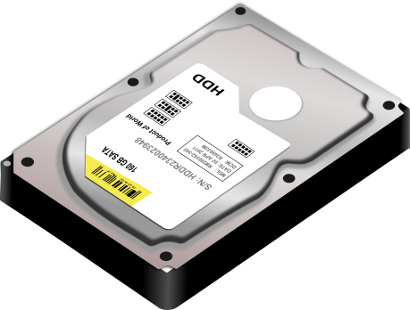
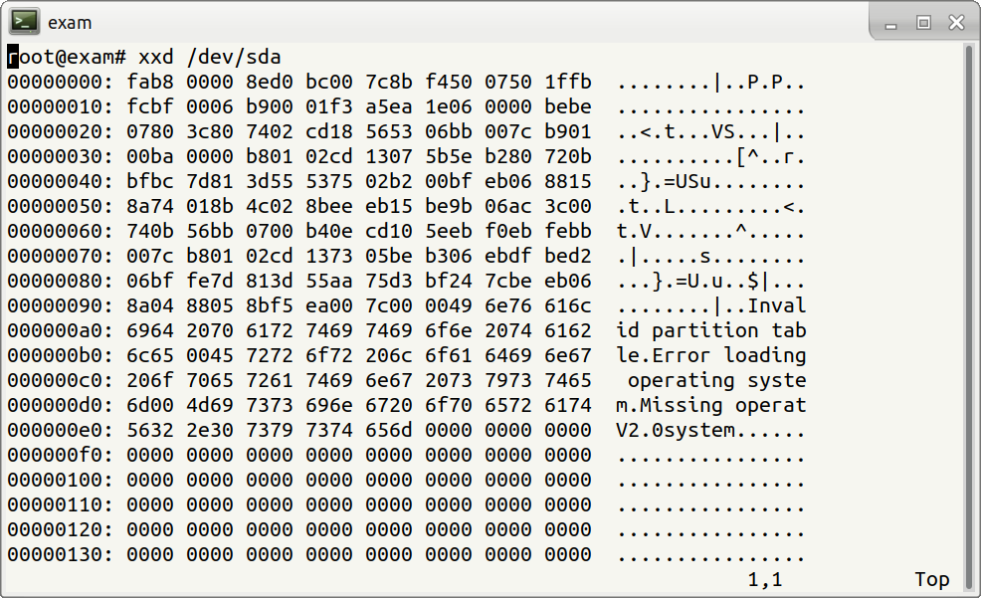
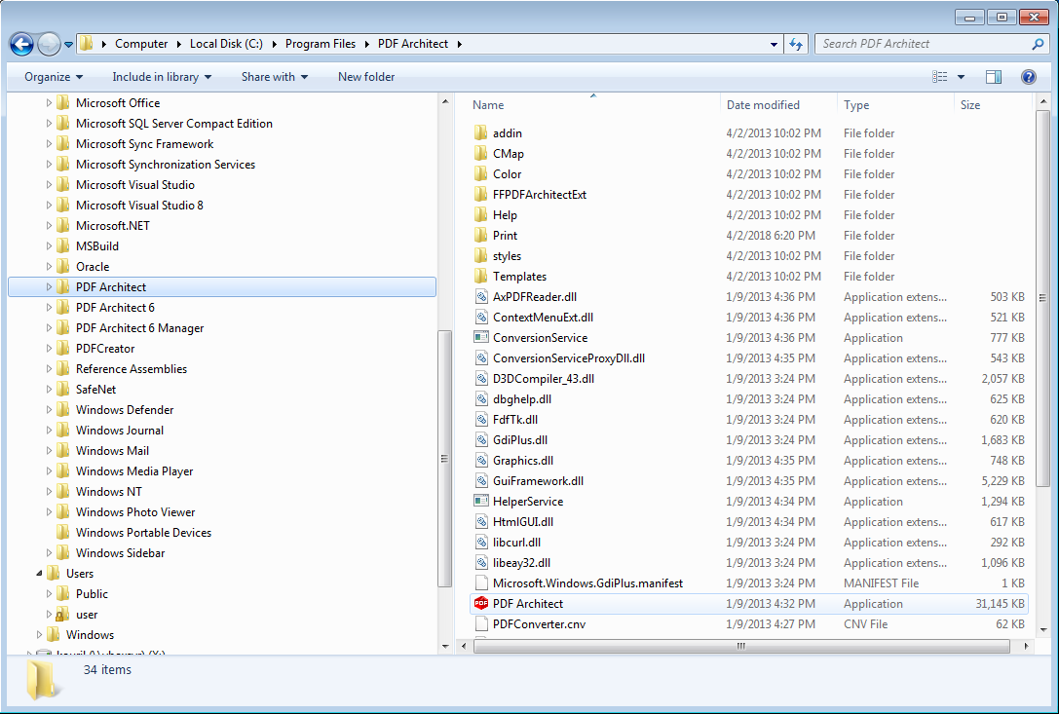

Slide 6
Image analysis
Image is a sequence of bytes (just a file)
  Internal structure needs to be established
File
File system
Volume (partition)
Physical device’s image
Some objects may be embedded
  Files containing other images (VM disks)

Slide 7
Procedure to analyze an image
Take the input image as a single volume
Break down the current volume to additional volumes (if any)
  Detect all visible volumes and their types
  Detect unallocated space
Process identified volumes one by one
  If the volume hosts a file system -> mark for subsequent analysis
  Other (known) volumes (auxiliary) -> check if they contain other volumes (or their parts) and reconstruct them
  Unknown volume type -> ad-hoc analysis
Process file system volumes
  Gather and evaluate information about files stored
  Files can contain volumes also (ie. start again)
Examine unallocated space

Slide 8
File system

Slide 9
File system
Organization of data on storage
Data kept in files
  File content
  File metadata
File systems differ from forensics view
  Different features
  Different support of tools

Slide 10
File Content
File is a logical sequence of bytes
  The type is determined by the content, not by name, location or extension
File analysis is dictated by the objectives
  User data (data content)
  System files (logs, configurations, installed SW)
  Executables

Slide 11
File metadata
Metadata information
  Owner identifier
  Group identifier
  Permissions / ACL
  Addresses of data blocks (content)
  Important timestamps
No need to access content
  Smaller space needed
  Less privacy issues

Slide 12
Analysis using timelines

Slide 13
Timelines
Common analysis technique important for many objectives
Timeline provides a simple overview of events that happened on the system
Can be constructed from any data where timestamps is recorded
  Logs, events (users logins)
  Application data (mail/document manipulations)
  File metadata (file utilizations)

Slide 14
File timestamps
Common types of timestamps (POSIX)
  m-time (modification time) – the last time the content was changed
  a-time (access time) – the time of last access (content)
  c-time (change time) – the last time metadata was changed
Additional timestamps on some file systems
  d-time (deletion time)
  b-time (creation time) (sometimes cr-time)
Timestamps only refer to the very last action performed

Slide 15
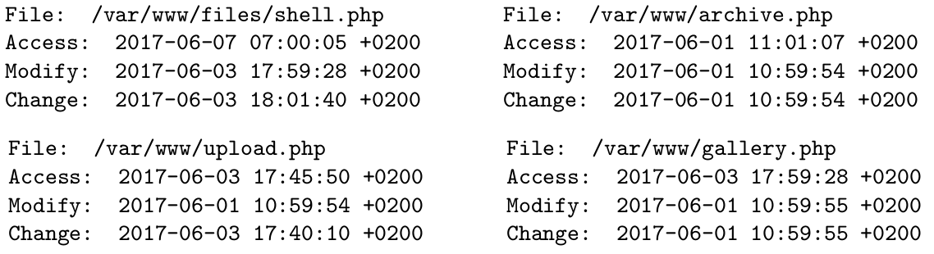
A malicious PHP file (backdoor) shell.php was found on a web server. Examine the time stamps of archive.php, upload.php, gallery.php and determine which file was likely used to store the malicious payload and select timestamp when the backdoor was used for the last time.

Slide 16
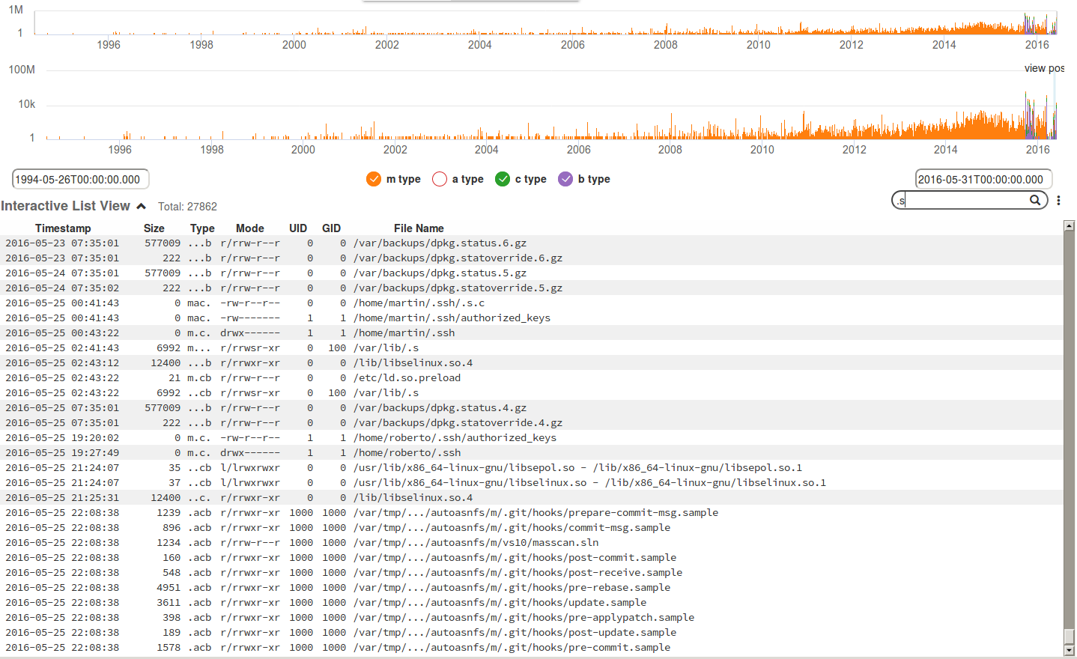
Fimetis by CSIRT-MU (https://github.com/CSIRT-MU/fimetis)

Slide 17
Working with file timestamps
Executing a file changes its Atime
  The precision of a-time depends on configuration
m-time and a-time can be easily changed by file owner
  happens when copying/moving files, or deploying software from packages
c-time can’t be changed easily
Pay attention to time zones and granularity
  FAT uses system time, NTFS uses UTC
  Precision is among days (FAT), secs (ext3), and nanosecs (ext4)

Slide 18
Obtaining metadata
fls and mactime commands (only for supported FS)
Simple ’find’ command (recursive walk through the filesystem)
  find / -xdev -print0 |
    xargs -0 stat -c "%Y %X %Z %A %U %G %n"
  Leif Nixon’s timeline-decorator.py to format
  Be prepared for a lot of data (hundreds thousands of records)

Slide 19
Live Analysis

Slide 20
Live analysis
Access to volatile information kept by OS
Some crucial aspects to consider
  Reliability of the collected data
  Modifications to the system done during the process
The goal is to capture information for off-line analysis, not doing analysis on the host

Slide 21
Areas of Live Analysis
Obtaining volatile information available from kernel and applications
Obtaining content of memory
  A complete host memory or memory of selected processes
Recovering data that would be lost
  Deleted, still open files on Linux

Slide 22
Obtaining OS information
Network status
  Open/established connections, listening/bound processes
  allocated IP (4/6) addresses
  VPN connections, routing tables, neighbors
  Firewall state
Information on the system setup
  Available devices
  Mounted file systems, mapped drives, shares
    Data and “auxiliary” (RAIDs,…)

Slide 23
Obtaining OS information
Information on processes
  List of active processes and their attributes
    The full path of the program, command line parameters, running time
  List of files open by processes
  Information on inter-process communication (shared memory, queues)
Information on the OS
  Loaded kernel modules/drivers, OS messages (dmesg), running OS version
  Configured time-zone, uptime
  Clipboards contents
Auxiliary info (partially available also offline)
  Logged users

Slide 24
Extracting information on processes
Processes may contain important information
  Resources used (e.g. network connections, files being processed, IPC)
  Memory contains pristine information, including sensitive data
    Encryption keys, passwords

Slide 25
Linux specifics

Slide 26
Getting process information
Process may have multiple file-descriptors opened
  Used executable, libraries
  Particular files on file system
  Network sockets
Information on processes can be accessed using standard system commands
  lsof –p PID

Slide 27
/proc filesystem
Linux kernel exposes some internal structures in the /proc virtual file
System commands mostly use data from /proc
/proc can be useful to access data that is not available through commands (or spot anomalies)

Slide 28
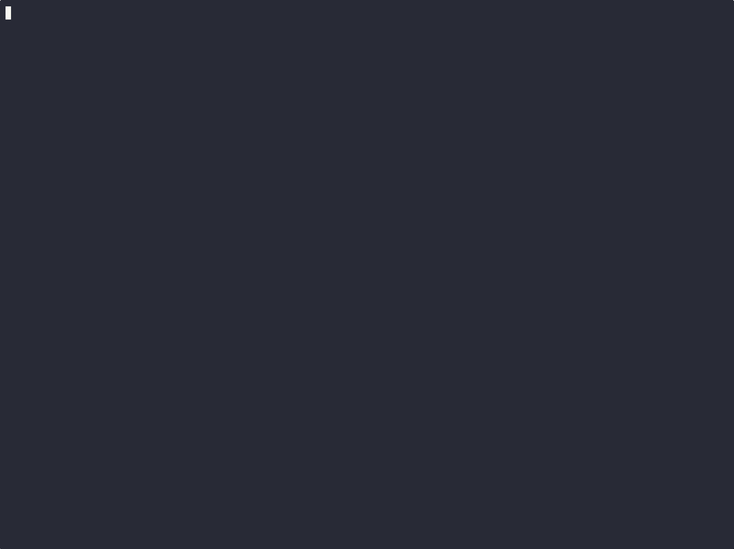

Slide 29
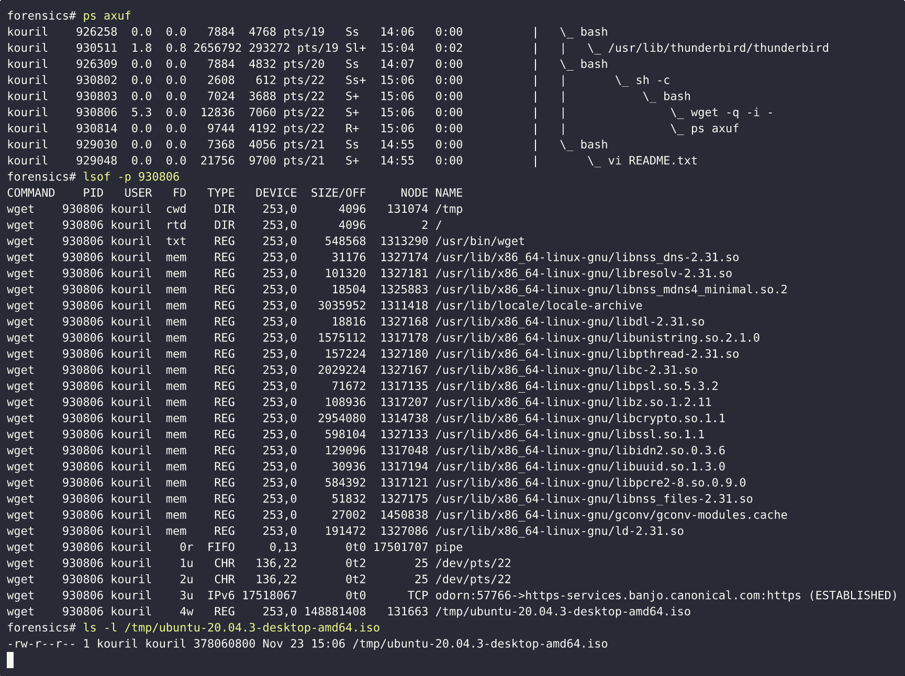

Slide 30
Deleted files
Deleted files are available until they are closed
  If a file is open by a process, it’s removed from the filesystem but its content can still be still accessed
“symbolic links” in /proc can be used to recover the data
  cp /proc/$PID/exe /tmp/exe
  The process must be alive (even stopped)
Holds for both executable and open files (see the fd directory)

Slide 31


Slide 32
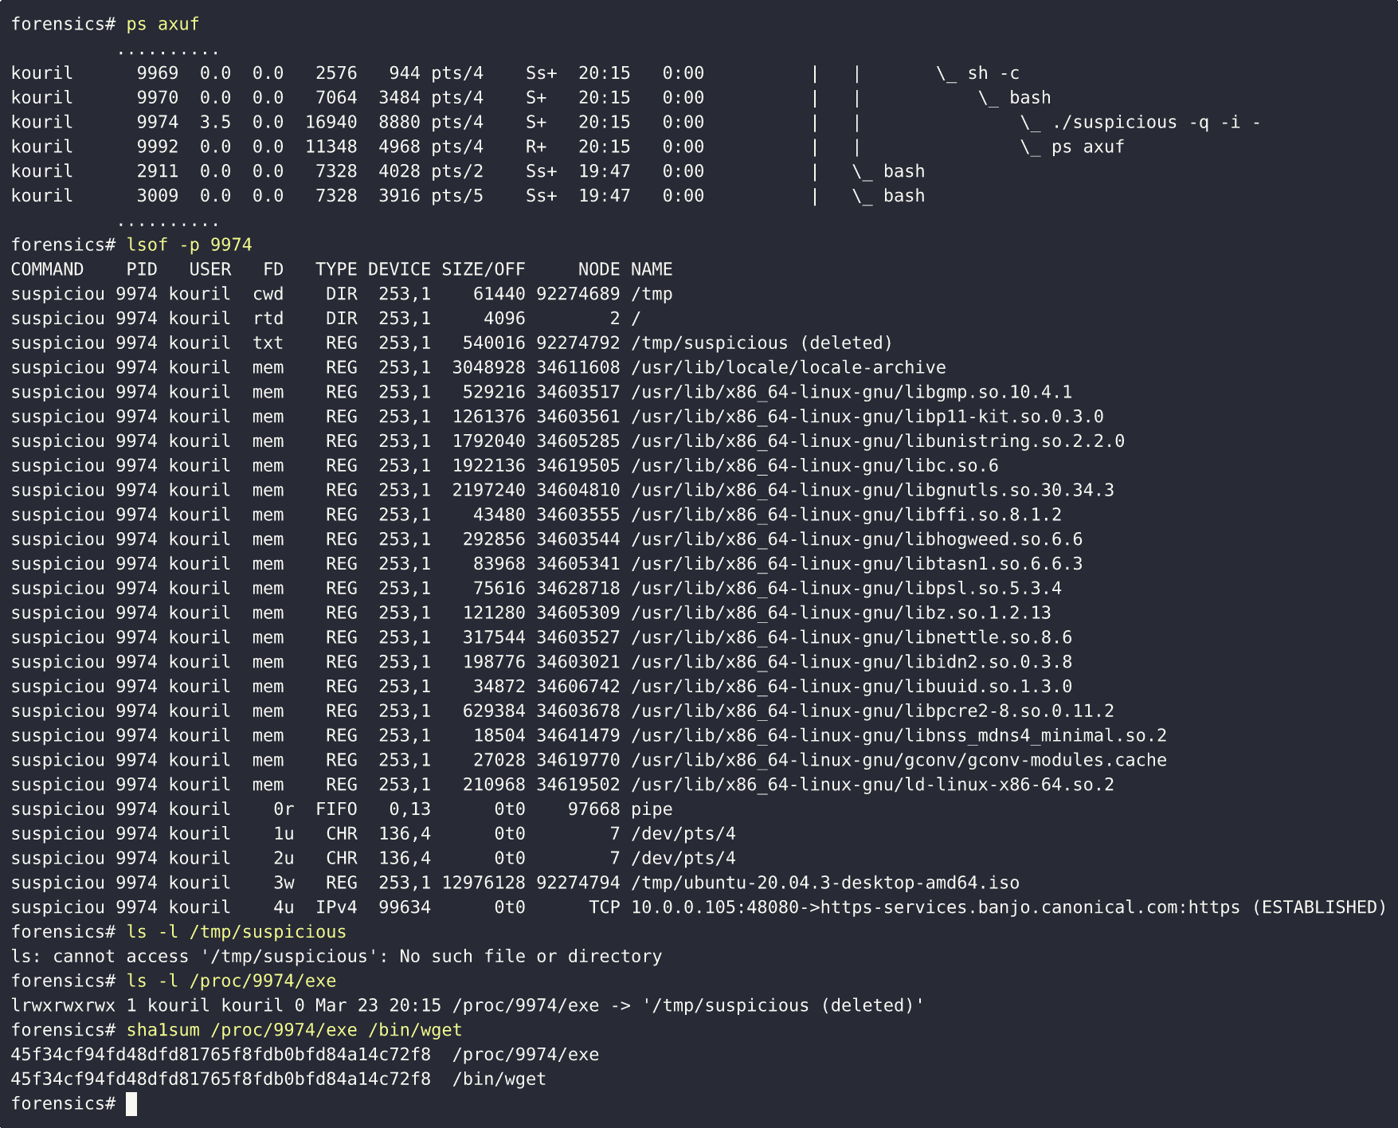

Slide 33
Network
Getting information on network status
  Three different ways:
    netstat -tnp
    ss -tnp
    Check the /proc virtual filesystem
  All should yield the same information (in different formats though)
    If not, some of the commands might be modified
tcpdump might be handy to check live traffic

Slide 34
Open network connections
(netstat –tnp)
Active Internet connections (w/o servers)
Proto Recv-Q Send-Q Local Address Foreign Address State PID/Program name
tcp 0 0 127.0.0.1:9050 127.0.0.1:34902 ESTABLISHED -
tcp 0 0 127.0.0.1:44280 127.0.0.1:8118 ESTABLISHED 31418/wget

Slide 35
Dumping process memory
gcore –o dump
  Part of the GDB package
  Some (soft) errors might be triggered
Outputs an ELF file containing the process memory

Slide 36
Analysis of executable files

Slide 37
Executable files
Scripts
  List of commands, script constructs
  Easily readable by human (if not obfuscated)
Binary executables
  Machine code (produced by compiler)
  byte code (Java)
  ELF, PE formats
Libraries
  Static / dynamic
  Library functions, variables (internal / exported)
  Export interface (ABI/API)

Slide 38
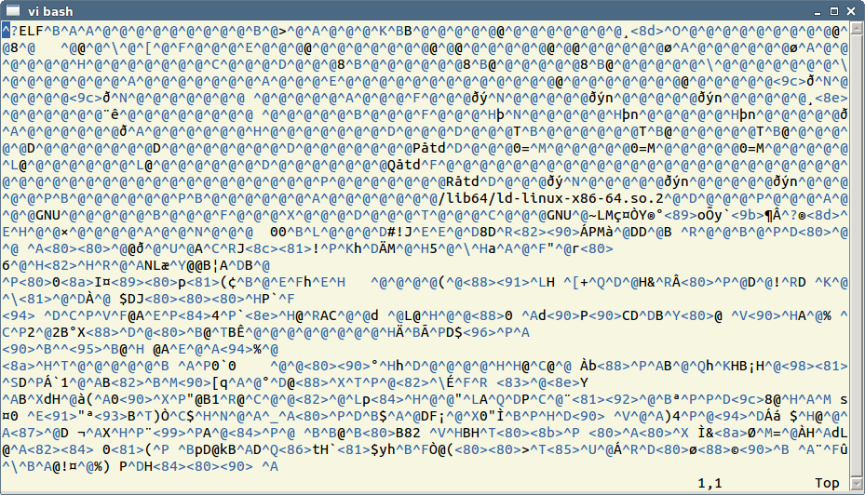
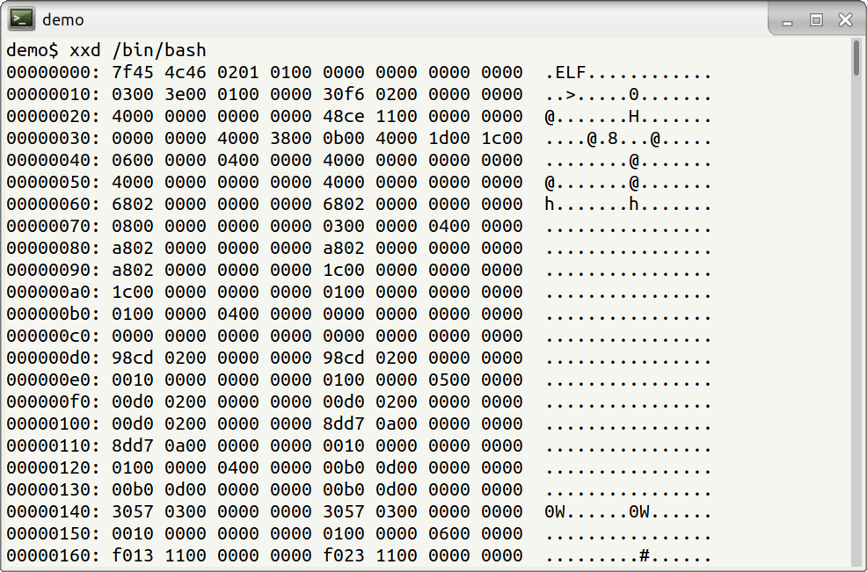
Binary executable files
System specific formats
Dynamic vs. static analysis

Slide 39
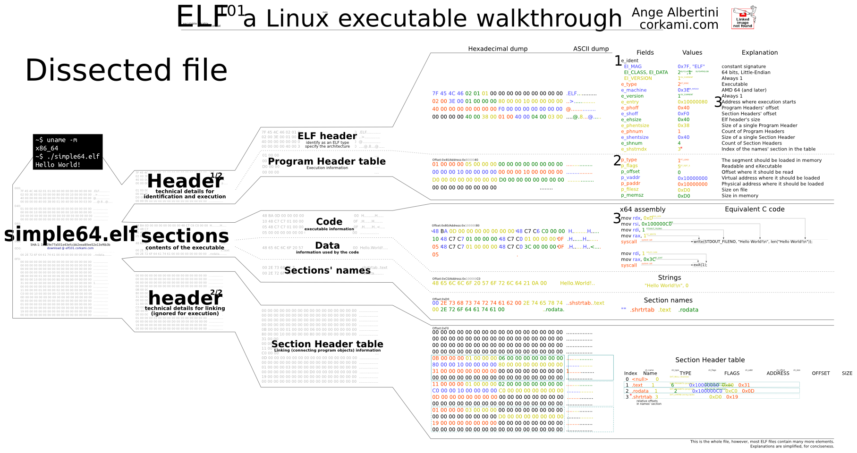
ELF

Slide 40


A quick look inside an ELF executable
https://binvis.io/
Statically vs. dynamically linked binaries
file exe
exe: ELF 64-bit LSB executable, x86-64, version 1 (GNU/Linux), for GNU/Linux 2.6.32, statically linked, stripped
strings –a exe (Reveals human-readable strings)

Slide 41
Quick examination
file exe
exe: ELF 64-bit LSB executable, x86-64, version 1 (GNU/Linux), for GNU/Linux 2.6.32, statically linked, stripped
A number of other tools is available

Slide 42
Useful links
https://confluence.egi.eu/display/EGIBG/Forensics+Howto
https://www.dfn-cert.de/en/Trainings.html#ITForensics

