Slide 1



Container Security
Thematic CERN School of Computing, 2025
Daniel Kouřil
kouril@cesnet.cz

Slide 2

OS-Level virtualization
Container = process isolation + limitation of resources
How is it done?

Slide 3
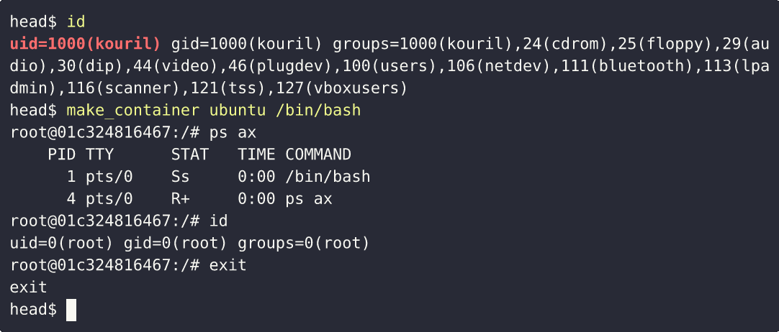
OS-Level virtualization
Container = process isolation + limitation of resources
How is it done?

Slide 4
Linux Containers
Two crucial technologies in Linux kernel
Namespaces
  Containers are contained in “compartments”, can’t see outside
Control groups (cgroups)
  Processes are limited in access to resources (memory, CPU, I/O)
Linux container =
process(es) assigned a set of namespaces + cgroups
  Everything is controlled by the same OS level (kernel) (no host/guest OS)
  The processes have “just” limited view on the whole system (or illusion)

Slide 5
Containment using namespaces
Kernel
System calls/interactions
(e.g. list of processes)
Processes in
“container A”
Processes in
“container B”
Uncontained
processes

Slide 6
Common namespaces
PID namespace
processes isolation
NET namespace
managing/separating network interfaces
IPC namespace
separating inter-process communication
MNT namespace
managing/separating filesystem mount points
UTS namespace
mainly to set the hostname and domain name visible to the process
User ID namespace
privilege isolation

Slide 7
Isolating process IDs
Process ID namespace allows the container to establish separate process trees
host# docker run -it debian bash
root@3146c2faec9b:/# dash
# ps af
PID TTY STAT TIME COMMAND
1 pts/0 Ss 0:00 bash
6 pts/0 S 0:00 dash
7 pts/0 R+ 0:00 \_ ps af
the complete picture is still visible from the host
…….
1029 ? Ssl 7:48 /usr/bin/containerd
28834 ? Sl 0:00 \_ containerd-shim -namespace moby ……...
28851 pts/0 Ss 0:00 \_ bash
28899 pts/0 S+ 0:00 \_ dash
.......

Slide 8
Isolating users and groups
Separated uid/gid allocations, decoupled from real identifiers
A user process in a namespace is assigned a ‘local’ identifier that is recognized only inside the namespace
  a mapping need to be maintained between the namespace and “global” (real) uids/gids
Host (real) id’s
0
1
….
100000
100001
id’s in a user namespace
0
1

Slide 9
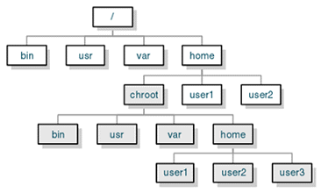
Isolating container filesystem
Complete container filesystem is part of the host filesystem hierarchy
chroot() is used to change the root directory
  /home/chroot
Processes can’t “escape” the chroot’ed directory
  /home/chroot/bin/bash (full/global path to a shell in chroot)
  /bin/bash (path used from within the container
Source: http://www.jmcresearch.com/src/articlehelper.php?action=print&id=3

Slide 10
Linux kernel capabilities
Capabilities turn the binary “root/non-root” dichotomy into a fine-grained access control system
Capabilities can be assigned to a thread to determine whether that thread can perform certain actions.
  CAP_NET_BIND_SERVICE capability is needed for a process to bind to a low-numbered (below 1024) port.
Containers processes can be assigned different capabilities that limit or extend the rights to perform actions

Slide 11
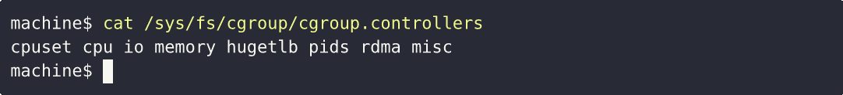
Resource restrictions using cgroups
Linux control groups limit resources processes can use
  CPU, I/O, memory
Processes can see only fraction of all available resources
  A container can’t consume all resources to starve other containers
Cgroups are maintained by the kernel
  Settings mediated via kernel pseudo‐filesystems

Slide 12
Limiting memory using cgroups
# create a specific cgroup:
mkdir /sys/fs/cgroup/memory/memory_eaters
# limit the memory usage to ca. 10MB
echo 10000000 > \ /sys/fs/cgroup/memory/memory_eaters/memory.limit_in_bytes
# enter the new cgroup with the current shell to apply to limit:
echo $$ > /sys/fs/cgroup/memory/memory_eaters/cgroup.procs

Slide 13
Security assessment
Is it secure?
Threat model & landscape
Containers introduced a new eco-system
  Containers
  Images
  New “middleware” components (OS support, services)

Slide 14
Breaking container isolation
May be done deliberately to provide full access to the system
Unwanted container escape compromises the security
Escaping container refers to different possible actions
  data access (according to C.I.A):
    reading (violation of C.)
    modifying (violation of I.)
  executing code outside the container

Slide 15
Potential vectors to break isolation
Misconfiguration
  Depends on the container attributes (capabilities) and setting
  Some not obvious
    allowing mount effectively gives access to uncontained code execution
  inject a “hook” that is invoked by a trusted component in the system
    a crontab rule or a kernel “notifier” running command on certain events
    must run outside the container - APIs (e.g. inotify) won’t help
Vulnerabilities in kernel or container components
  Proper patch management is important
  Updates to kernel requires reboot of the machine

Slide 16
Docker

Slide 17
Docker
Ecosystem to work with containerized applications
  Management of containers
  Support for data management, networking, image management, …
Docker image as an application “package”
  Snapshot of filesystem (usually the application and dependencies)
    Nothing more though – no/limited OS components, specific libraries, etc.
  Images can be made available from repositories (the Docker Hub)
  Can be instantiated to create the container
    The same relation as class – object, program - process
docker run -it ubuntu /bin/bash
  Download the image
  “mount” the image filesystem
  Start the entrypoint contained in a namespace

Slide 18
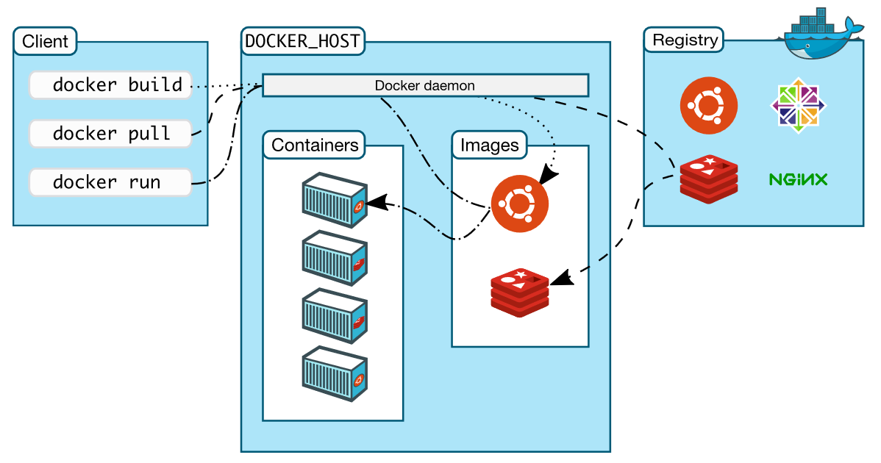
Docker Architecture
https://docs.docker.com/get-started/overview/

Slide 19
File arrangements for Docker
How to structure an image and container
  Is a subdirectory on a filesystem enough?
Applications often share similar needs
  Essential libraries, system configuration (timezone, ..)
How to arrange file system efficiently?

Slide 20
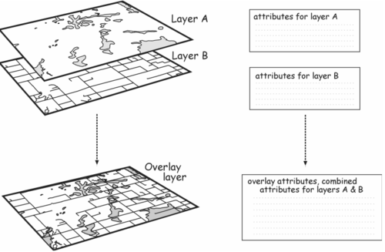
Overlaying
L1: Base OS-level image
  Common libraries, settings
  e.g. Ubuntu 24.04
L2: Deployed application
  e.g. Apache runtime
L3: Application configuration
  e.g. /etc/apache2
Container: combined above layers

Slide 21
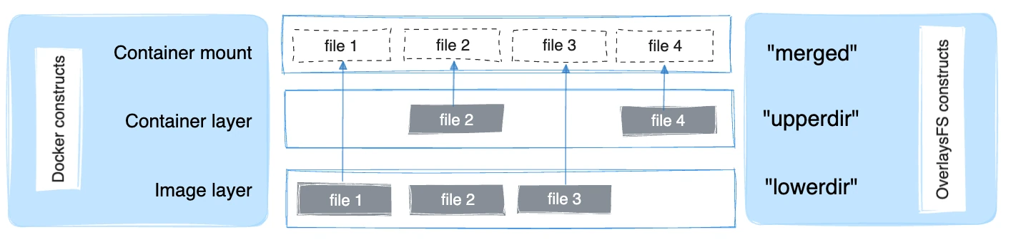
Union file system
Read-only layers
“virtual” file system view
Usually multiple image layers

Slide 22


Slide 23
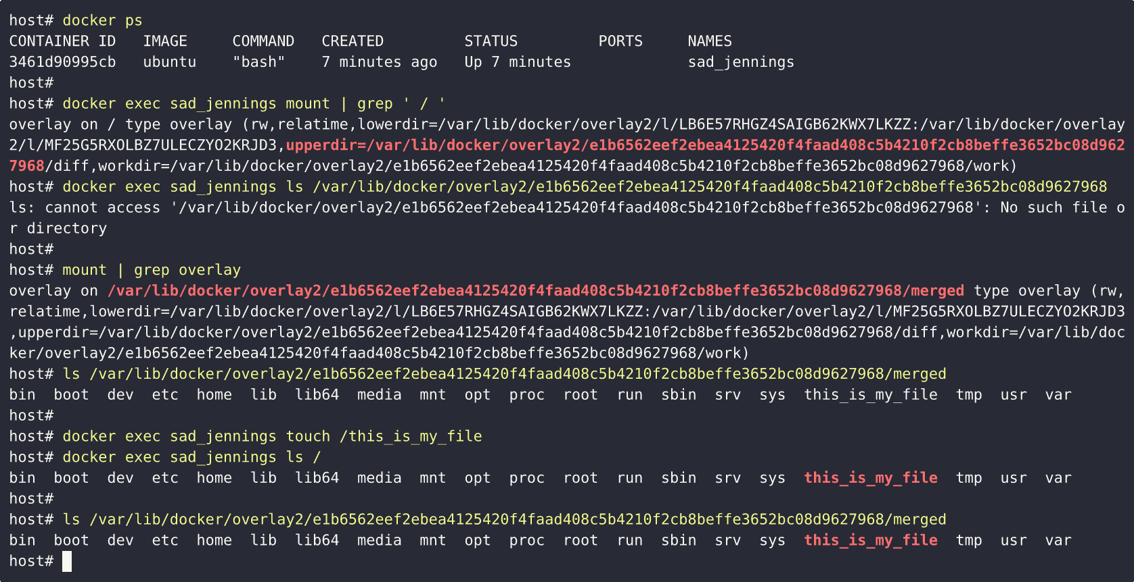

Slide 24
I am the root. Or not?
multiple levels of elevated privileges, from an unprivileged user to full root rights:
  if user namespace is used, the root inside a container has no root privileges outside in the host system
    Not enabled by default in Docker deployments
  the root in a container has some elevated privileges but restricted by a set of capabilities
    The Docker default behavior
  we can explicitly add extra capabilities to a container on start
  with the --privileged flag, we have full root rights granted

Slide 25
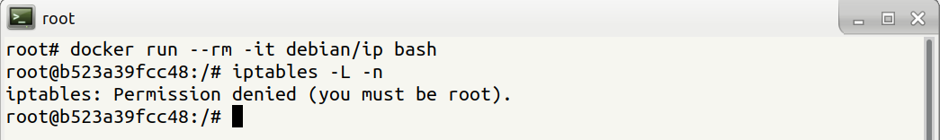
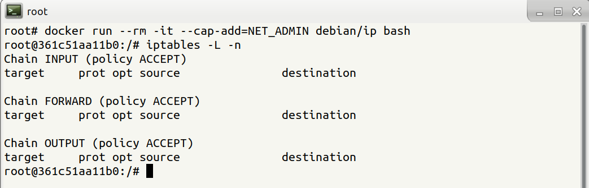
Root may be limited

Slide 26
Root(ful) Docker daemon
Containers and images are maintained by Docker Daemon
Docker daemon needs full access (administrative) to the system
  Containers can be given all features they need, including controlled access to any data on the host filesystem
  Data is easy to share, process can bound arbitrary ports, …
Docker containers can be used to access and/or modify any part of the whole host OS!
  e.g., full access to host files from within the Docker container

Slide 27
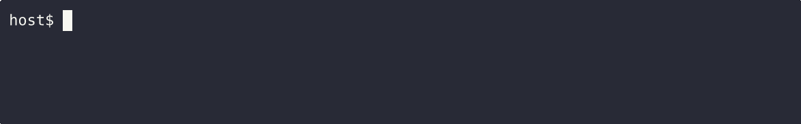
Docker containers are almighty

Slide 28
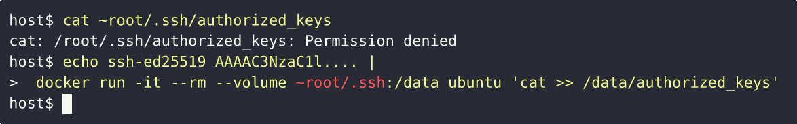
Docker containers are almighty

Slide 29
Docker security
Only trusted users should be allowed to control your Docker daemon
  Docker daemon listens for requests at a unix domain socket created at /var/run/docker.sock
  it is possible to make the Docker Daemon listen on a network interface
Docker runs as privileged daemon
  Proper patch management is crucial

Slide 30
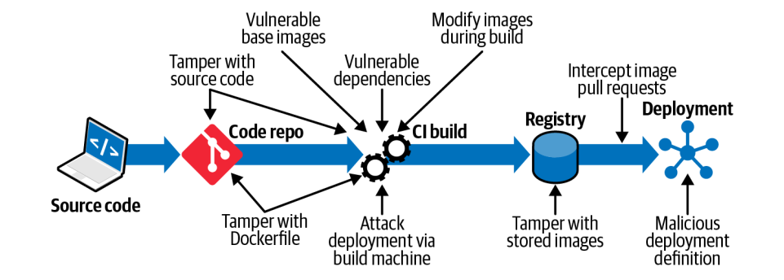
Image threat landscape
Container Security, by Liz Rice, https://www.oreilly.com/library/view/container-security/9781492056690/

Slide 31
Secure container images
Providing authentication and integrity verification
  Digital signatures vs. trusted repository
Image maintenance and development process
  Addressing vulnerabilities in the image
  Controlled code development
Secure environment for building and releasing
Compare to other SW distribution channels

Slide 32
It’s not just Docker
Other technologies provide other ways for containers
  Podman
  LXD
  Systemd, firejail, …
  Flatpak, Snap
  Singularity
  Containerd/runC
Regardless the technology it’s always namespaces + cgroups
  Some technologies add additional specifics

Slide 33
Rootless Containers

Slide 34
Rootless containers
Instantiating contained process without root privileges
  All steps outlined before are performed by the user who is starting the container
Podman
  Leading rootless technology
  Drop-in replacement for Docker
    Very good compatibility with CLI
    alias docker=podman
  No daemon or root-level access is needed though

Slide 35
Rootless containers
Useful for several scenarios
  Easy to deploy on user level
  Usable for multi-user machines (HPC, grids)
Can only do what the user can do, which may be limiting
  Binding to privileged ports (e.g., 80, 443)
  Full access to the host filesystem
  Sharing data with other users

Slide 36
Cheat Sheets

Slide 37
start a new container
docker run IMAGE
docker run --rm IMAGE
start a new container in interactive mode (e.g. with a shell)
docker run -it IMAGE bash
start a new container from an image with a command
docker run IMAGE command
start a new container and map a local directory into the container
docker run -v HOSTDIR:TARGETDIR IMAGE

Slide 38
show a list of running containers
docker ps
show a list of all containers
docker ps -a
delete a container
docker rm CONTAINER
start a shell inside a running container
docker exec -it CONTAINER bash
stop a running container
docker stop CONTAINER
resume a stopped container
docker start CONTAINER
download an image from a repository
docker pull IMAGE
List local images
docker image ls
Delete a local image
docker image rm IMAGE

