Slide 1
CLIC booster linac Proposal
Adnan Kurtulus, Alexej Grudiev

Slide 2
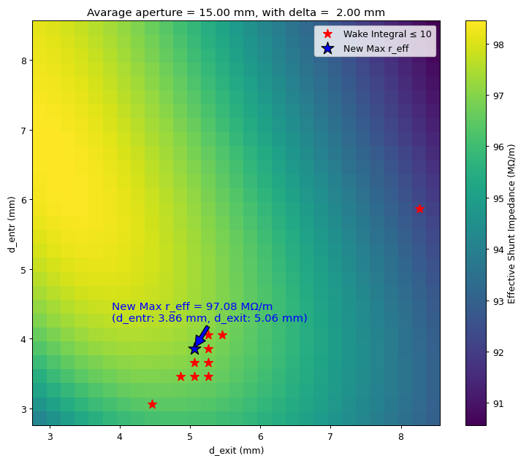
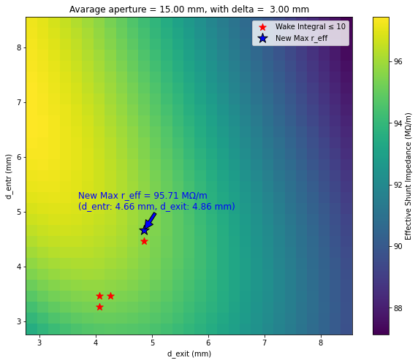
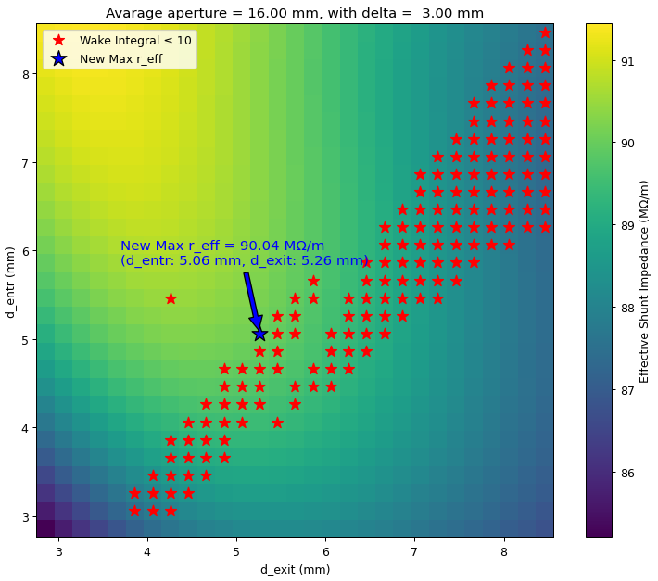
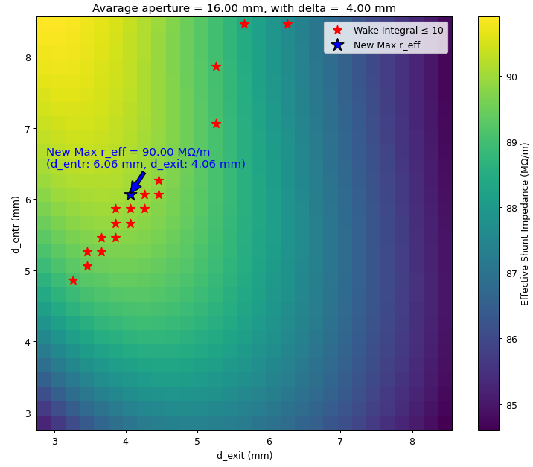
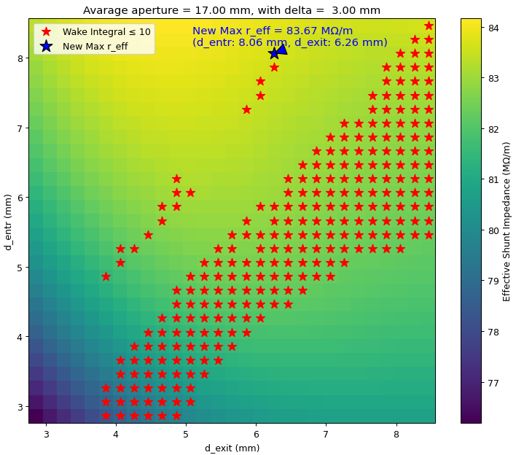
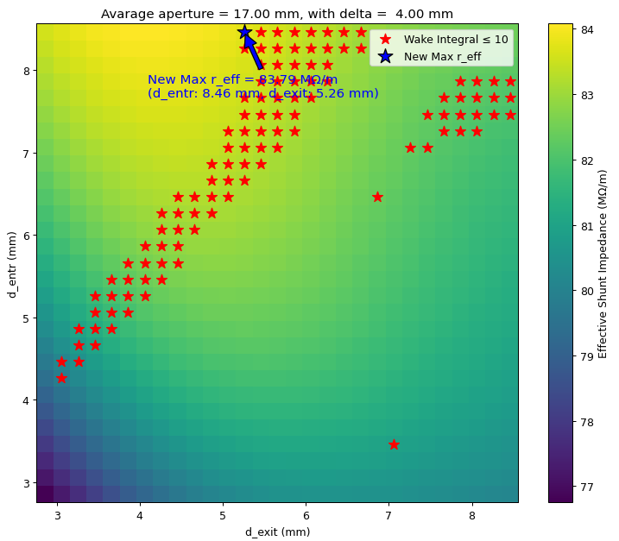
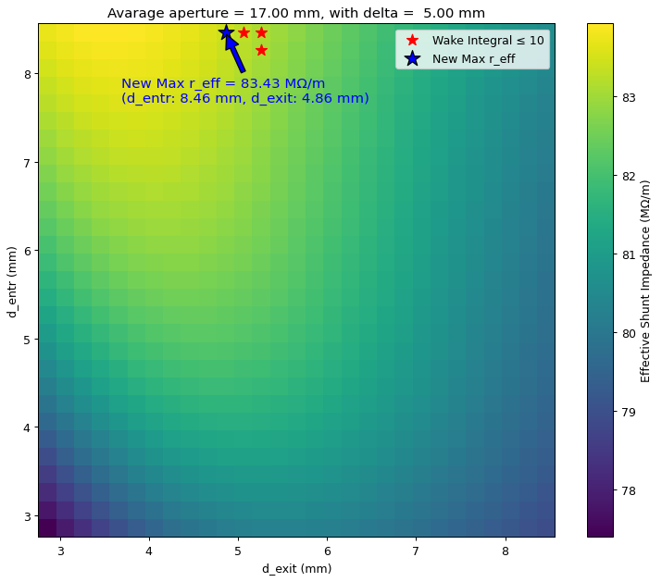
CLIC Booster Linac scans
Scanned from avg. aperture 12 mm to 17 mm.
Avg. Aperture 15 mm and above satisfy the wake conditon.
Parameters for the structure:
f = 2 GHz, Length = 3m, Phase advance = 2π/3, Q_{0,SLED} = 2e5, T_{klystron} = 5 us, $G_{avg}=25 MV/m$.
15 mm
16 mm
17 mm

Slide 3
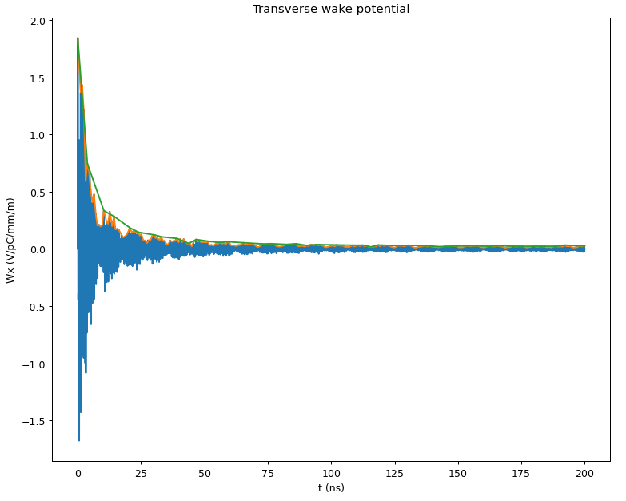
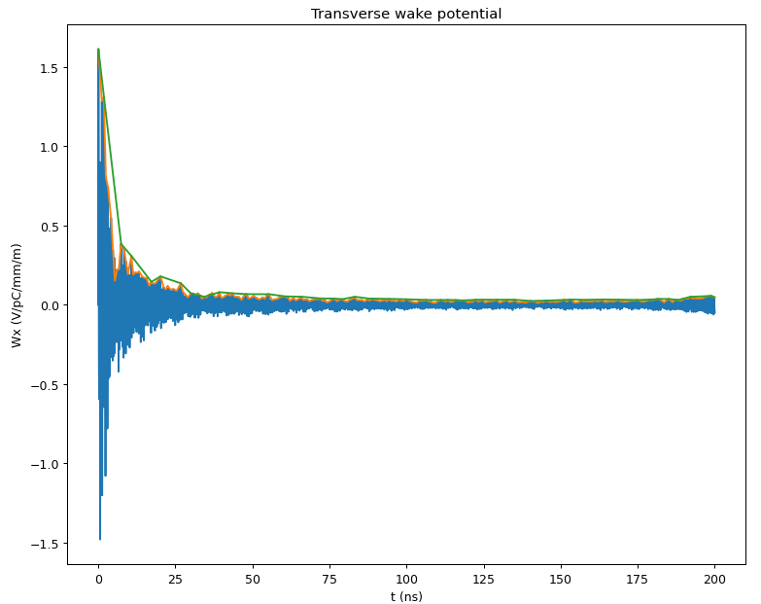
CLIC Booster Linac strcuture wakefields
Parameters for the structure:
f = 2 GHz, Length = 3m, Phase advance = 2π/3, Q_{0,SLED} = 2e5, T_{klystron} = 5 us, $G_{avg}=25 MV/m$.
Avg. Aperture 15 mm with delta = 2mm
Avg. Aperture 16 mm with delta = 3mm
Sum of wakes = 9.83 < 10
between 0.5 ns to 175.5 ns
Sum of wakes = 9.41 < 10
between 0.5 ns to 175.5 ns

Slide 4
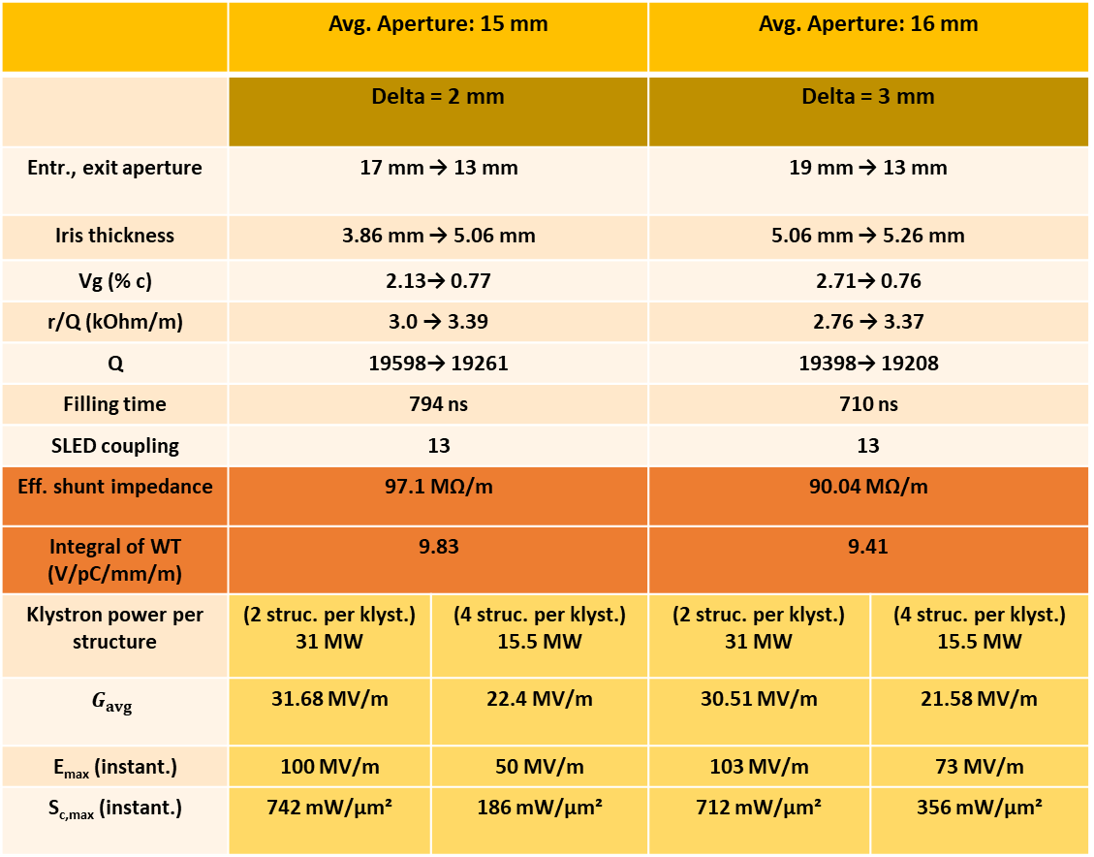
CLIC Booster Linac structure proposals
Parameters for the structure:
f = 2 GHz, Length = 3m, Phase advance = 2π/3, Q_{0,SLED} = 2e5, T_{klystron} = 5 us.
 | Avg. Aperture: 15 mm |  | Avg. Aperture: 16 mm
 | Delta = 2 mm |  | Delta = 3 mm
Entr., exit aperture | 17 mm → 13 mm |  | 19 mm → 13 mm
Iris thickness | 3.86 mm → 5.06 mm |  | 5.06 mm → 5.26 mm
Vg (% c) | 2.13→ 0.77 |  | 2.71→ 0.76
r/Q (kOhm/m) | 3.0 → 3.39 |  | 2.76 → 3.37
Q | 19598→ 19261 |  | 19398→ 19208
Filling time | 794 ns |  | 710 ns
SLED coupling | 13 |  | 13
Eff. shunt impedance | 97.1 MΩ/m |  | 90.04 MΩ/m
Integral of WT (V/pC/mm/m) | 9.83 |  | 9.41
Klystron power per structure | (2 struc. per klyst.) 31 MW | (4 struc. per klyst.) 15.5 MW | (2 struc. per klyst.) 31 MW | (4 struc. per klyst.) 15.5 MW
$$G_{avg}$$ | 31.68 MV/m | 22.4 MV/m | 30.51 MV/m | 21.58 MV/m
E_{max} (instant.) | 100 MV/m | 50 MV/m | 103 MV/m | 73 MV/m
S_{c,max} (instant.) | 742 mW/μm² | 186 mW/μm² | 712 mW/μm² | 356 mW/μm²
Calculations are done considering the same RF power technology of the FCC.

Slide 5
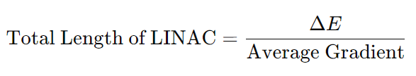
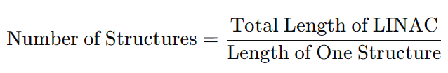
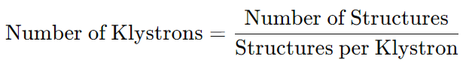
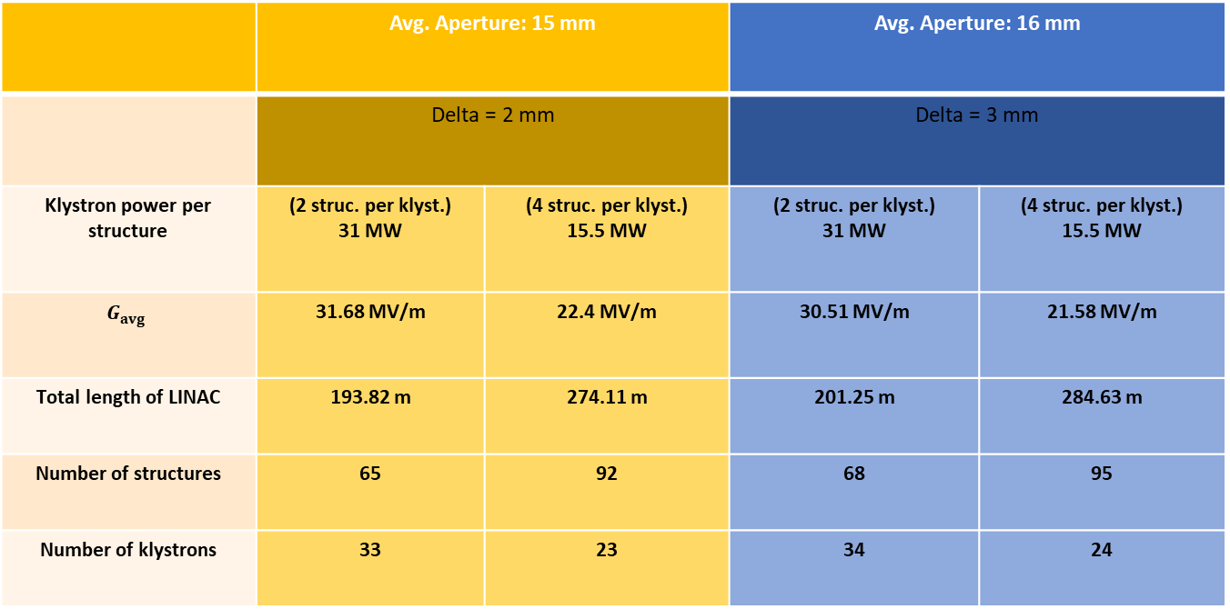
CLIC Booster Linac Design
 | Avg. Aperture: 15 mm |  | Avg. Aperture: 16 mm
 | Delta = 2 mm |  | Delta = 3 mm
Klystron power per structure | (2 struc. per klyst.) 31 MW | (4 struc. per klyst.) 15.5 MW | (2 struc. per klyst.) 31 MW | (4 struc. per klyst.) 15.5 MW
$$G_{avg}$$ | 31.68 MV/m | 22.4 MV/m | 30.51 MV/m | 21.58 MV/m
Total length of LINAC | 193.82 m | 274.11 m | 201.25 m | 284.63 m
Number of structures | 65 | 92 | 68 | 95
Number of klystrons | 33 | 23 | 34 | 24

Slide 6
Energy spread minimization of booster linac

Slide 7
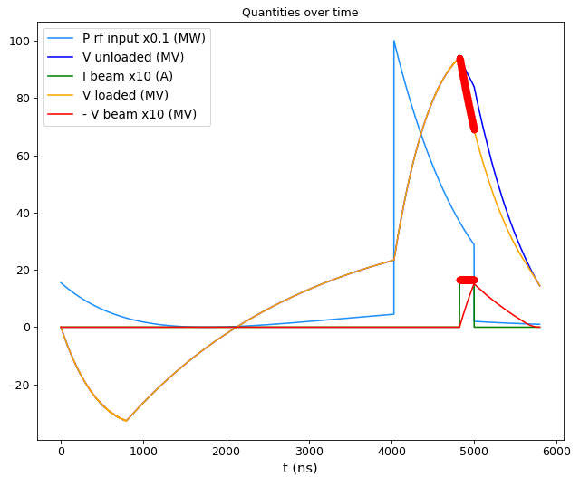
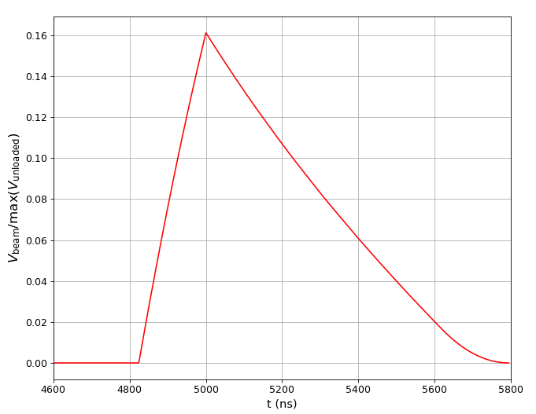
Avg. aperture = 15mm, 2 structure per klyst.

Slide 8
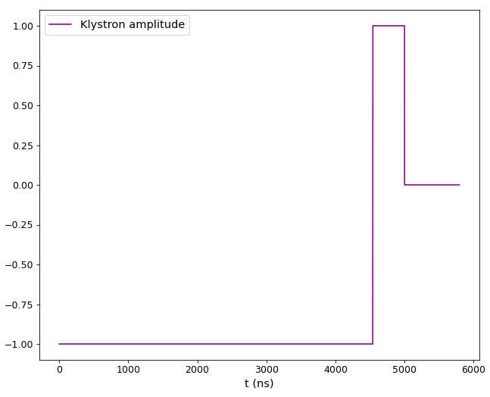
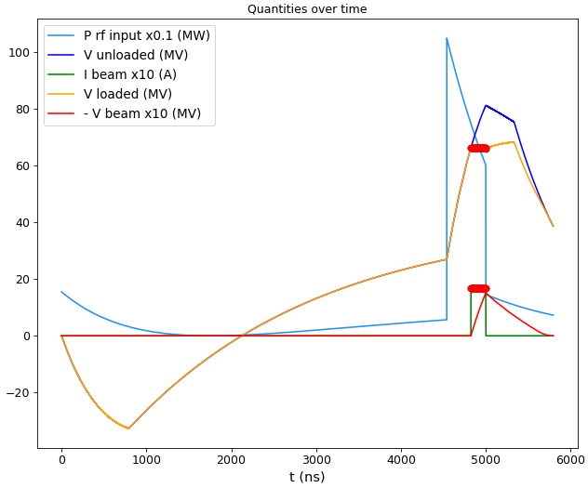
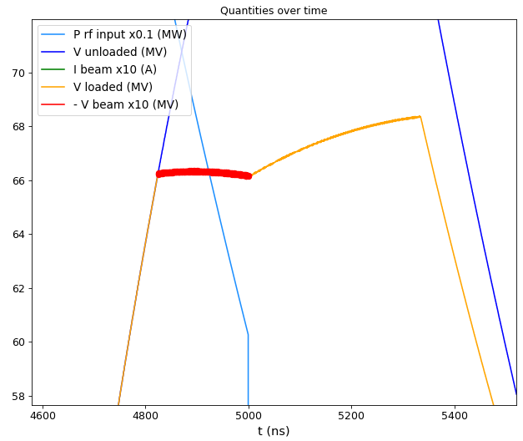
Avg. aperture = 15mm, 2 structure per klyst.
Maximum difference between 352 bunches:
ΔV= 0.2 MV
0.3% energy spread
T_fill = 794 ns
334 ns shorter

Slide 9
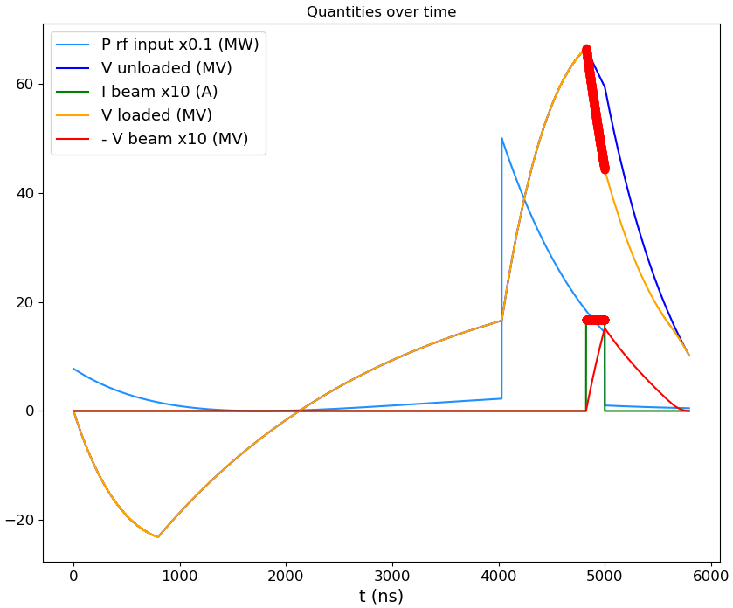
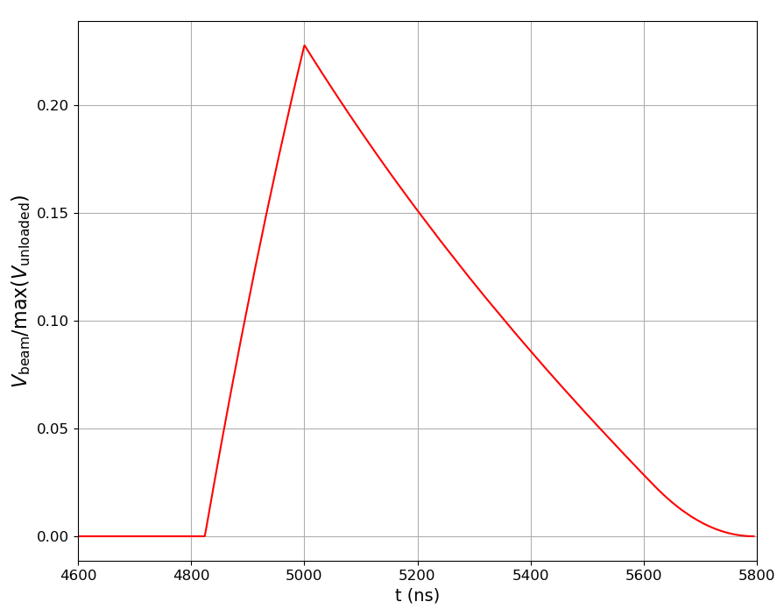
Avg. aperture = 15mm, 4 structure per klyst.

Slide 10
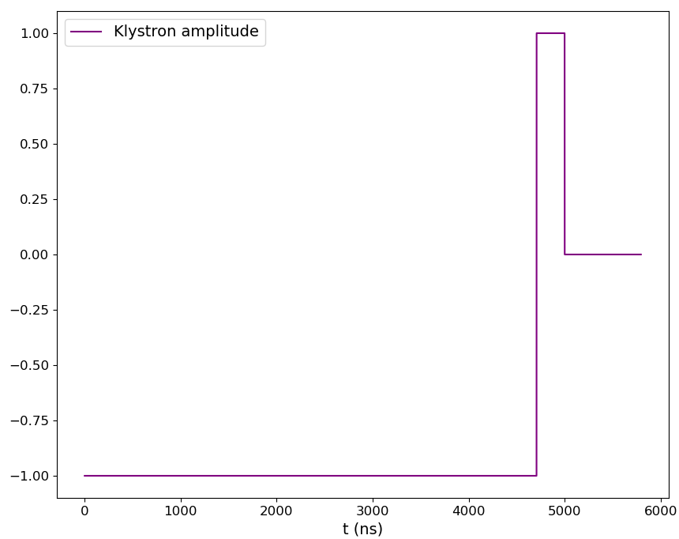
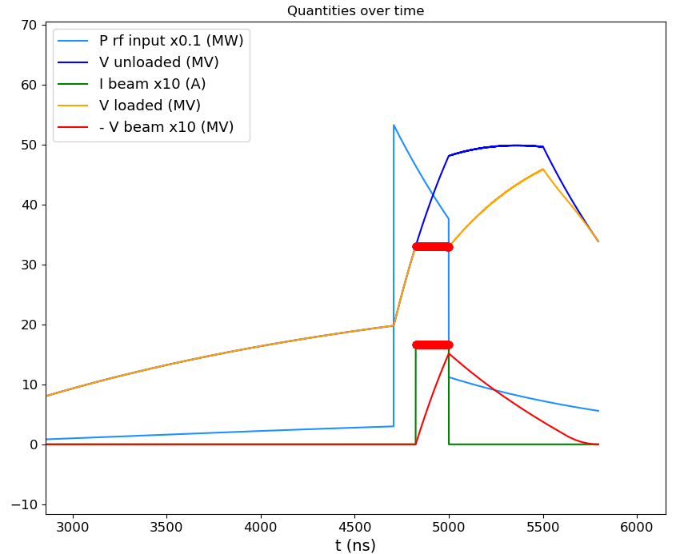
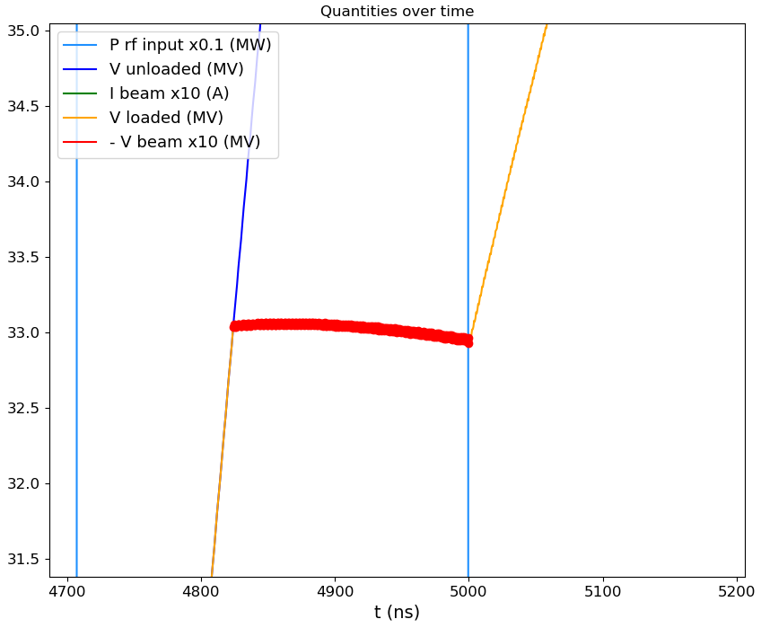
Avg. aperture = 15mm, 4 structure per klyst.
Maximum difference between 352 bunches:
ΔV= 0.1405 MV
0.42% energy spread
T_fill = 794 ns
396 ns shorter

Slide 11
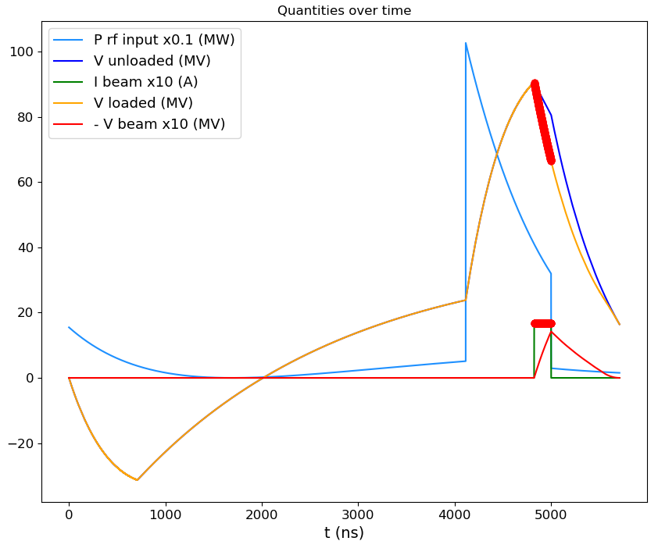
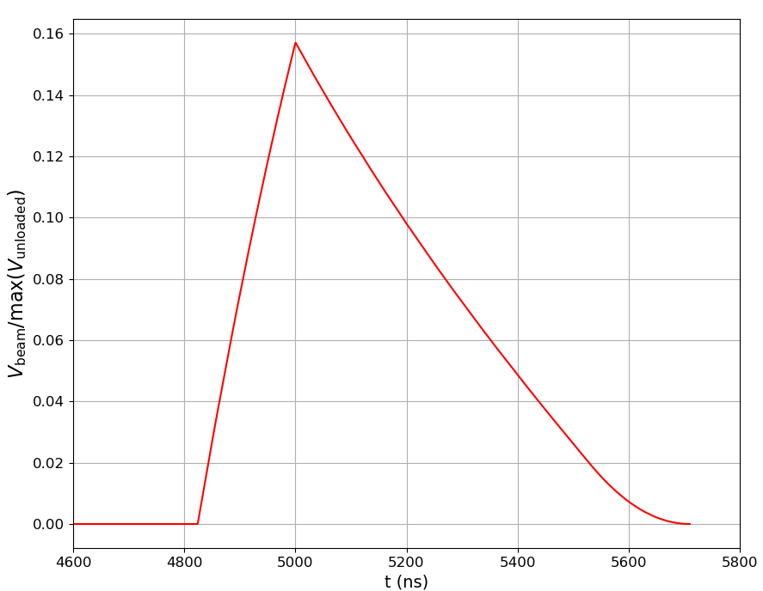
Avg. aperture = 16mm, 2 structure per klyst.

Slide 12
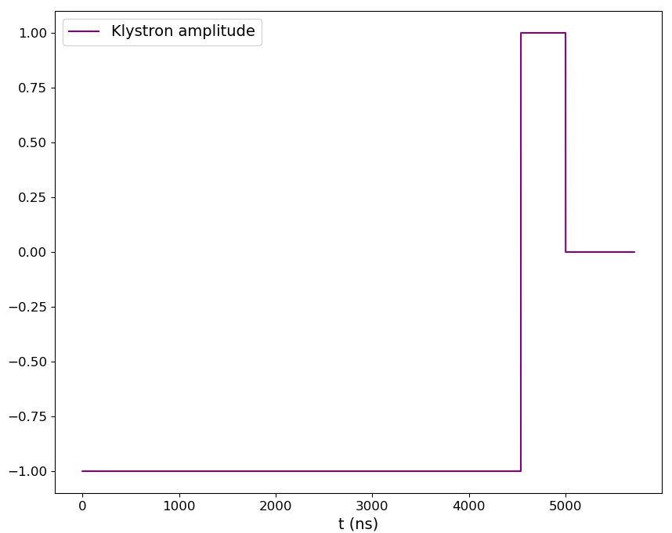
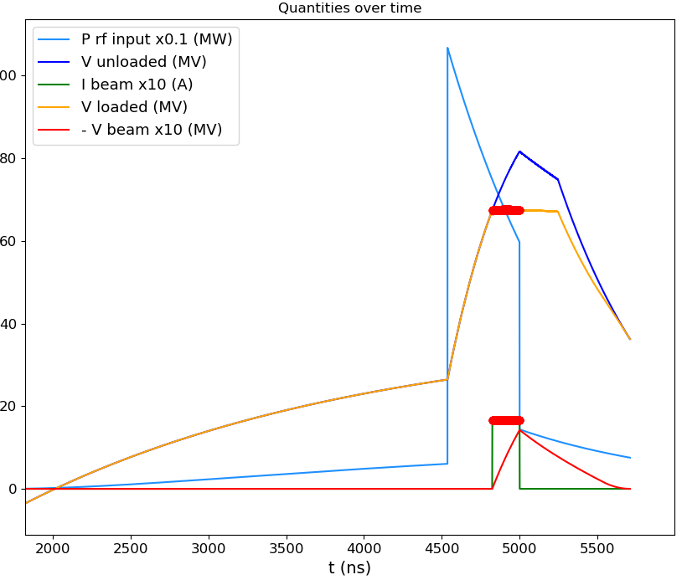
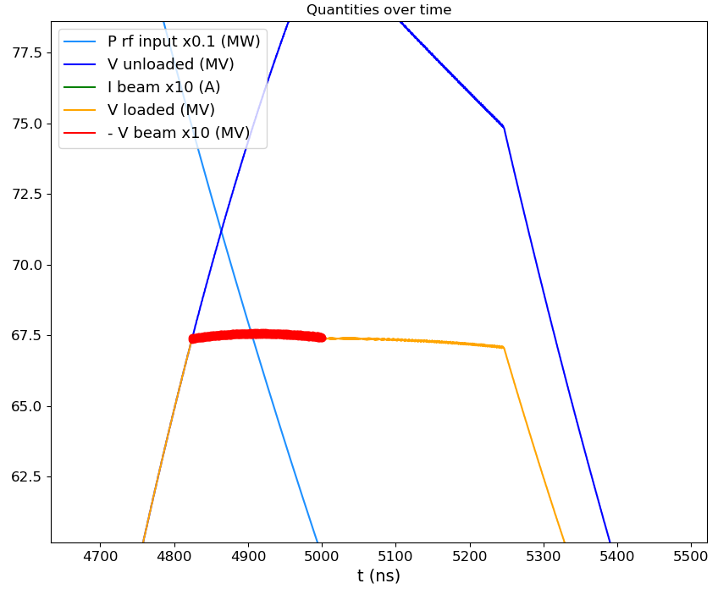
Avg. aperture = 16mm, 2 structure per klyst.
Maximum difference between 352 bunches:
ΔV= 0.22 MV
0.33% energy spread
T_fill = 710 ns
246 ns shorter

Slide 13
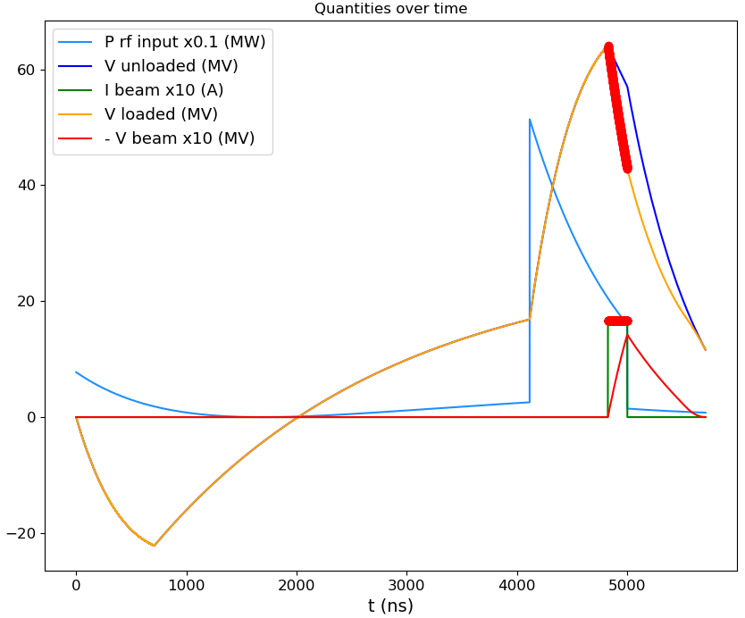
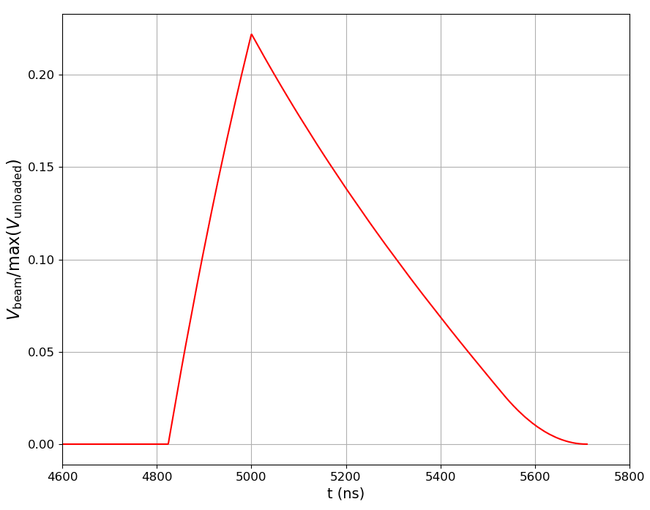
Avg. aperture = 16mm, 4 structure per klyst.

Slide 14
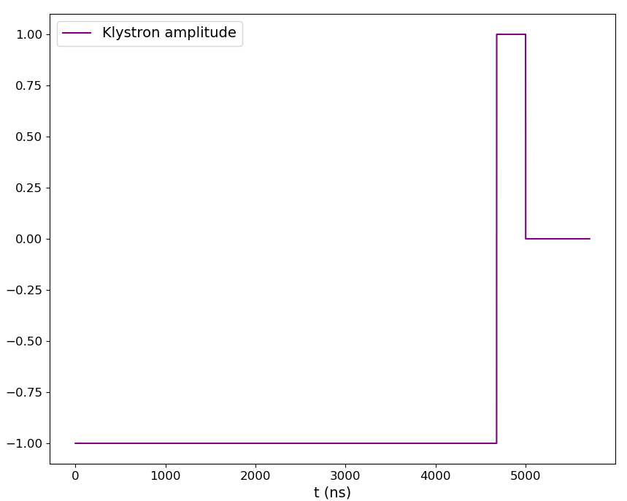
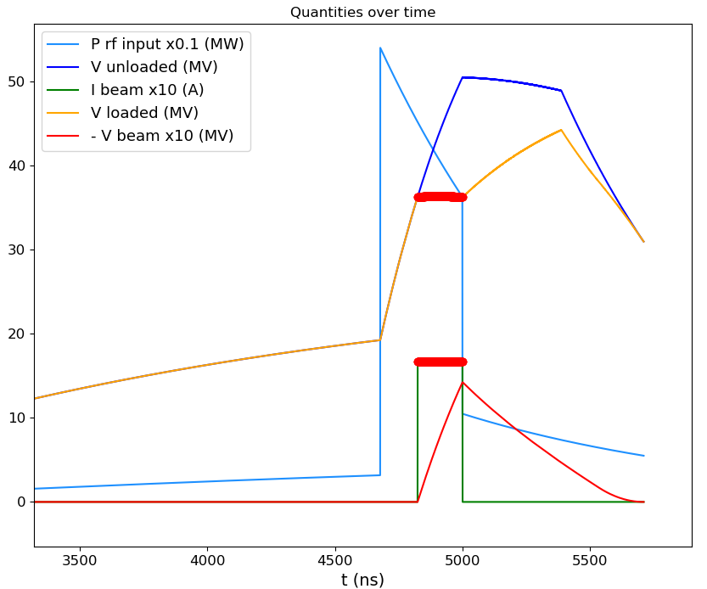
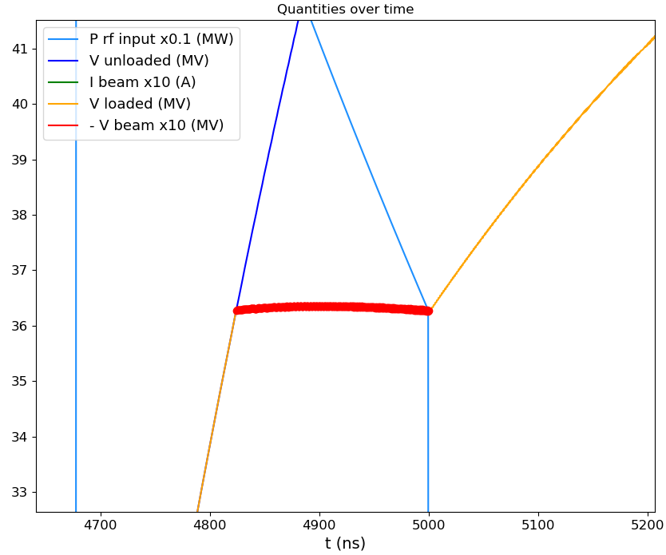
Avg. aperture = 16mm, 4 structure per klyst.
Maximum difference between 352 bunches:
ΔV= 0.1 MV
0.28% energy spread
T_fill = 710 ns
387 ns shorter

Slide 15
15 mm, 2 klyst. per struct. | Loaded V | Rsh
Single Bunch | 94.904 MV | 97 MΩ/m
352 Bunches | ̴66.28 MV | 47.31 MΩ/m
̴51.22 % lower Shunt imp.
15 mm, 4 klyst. per struct. | Loaded V | Rsh
Single Bunch | 67.09 MV | 97 MΩ/m
352 Bunches | ̴33.02 MV | 23.50 MΩ/m
̴75.77 % lower Shunt imp.
16 mm, 2 klyst. per struct. | Loaded V | Rsh
Single Bunch | 91.40 MV | 90.04 MΩ/m
352 Bunches | ̴67.51 MV | 49.12 MΩ/m
̴45.45 % lower Shunt imp.
16 mm, 4 klyst. per struct. | Loaded V | Rsh
Single Bunch | 64.64 MV | 90.04 MΩ/m
352 Bunches | ̴36.32 MV | 28.42 MΩ/m
̴68.43 % lower Shunt imp.

Slide 16
Injector Linac Scans

Slide 17
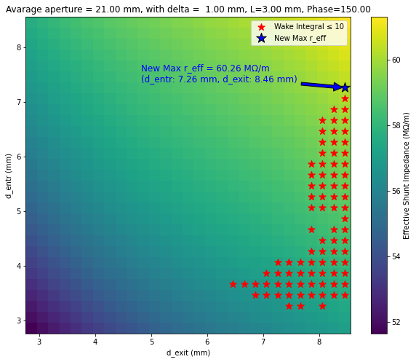
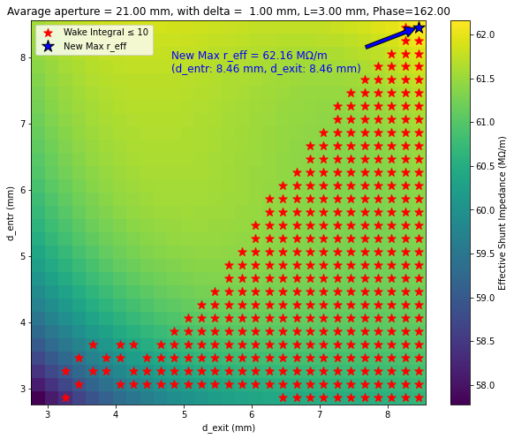
CLIC Injector Linac scans
Parameters for the structure:
f = 2 GHz, Length = 3m, Phase advance = 2π/3, Q_{0,SLED} = 2e5, T_{klystron} = 5 us, $G_{avg}=25 MV/m$.

Slide 18
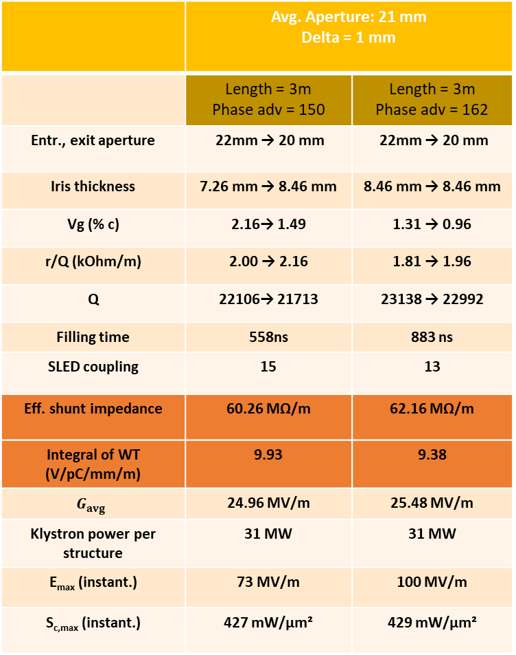
CLIC Injector Linac scans
 | Avg. Aperture: 21 mm Delta = 1 mm
 | Length = 3m Phase adv = 150 | Length = 3m Phase adv = 162
Entr., exit aperture | 22mm → 20 mm | 22mm → 20 mm
Iris thickness | 7.26 mm → 8.46 mm | 8.46 mm → 8.46 mm
Vg (% c) | 2.16→ 1.49 | 1.31 → 0.96
r/Q (kOhm/m) | 2.00 → 2.16 | 1.81 → 1.96
Q | 22106→ 21713 | 23138 → 22992
Filling time | 558ns | 883 ns
SLED coupling | 15 | 13
Eff. shunt impedance | 60.26 MΩ/m | 62.16 MΩ/m
Integral of WT (V/pC/mm/m) | 9.93 | 9.38
$$G_{avg}$$ | 24.96 MV/m | 25.48 MV/m
Klystron power per structure | 31 MW | 31 MW
E_{max} (instant.) | 73 MV/m | 100 MV/m
S_{c,max} (instant.) | 427 mW/μm² | 429 mW/μm²

Slide 19
Backup Slides

Slide 20
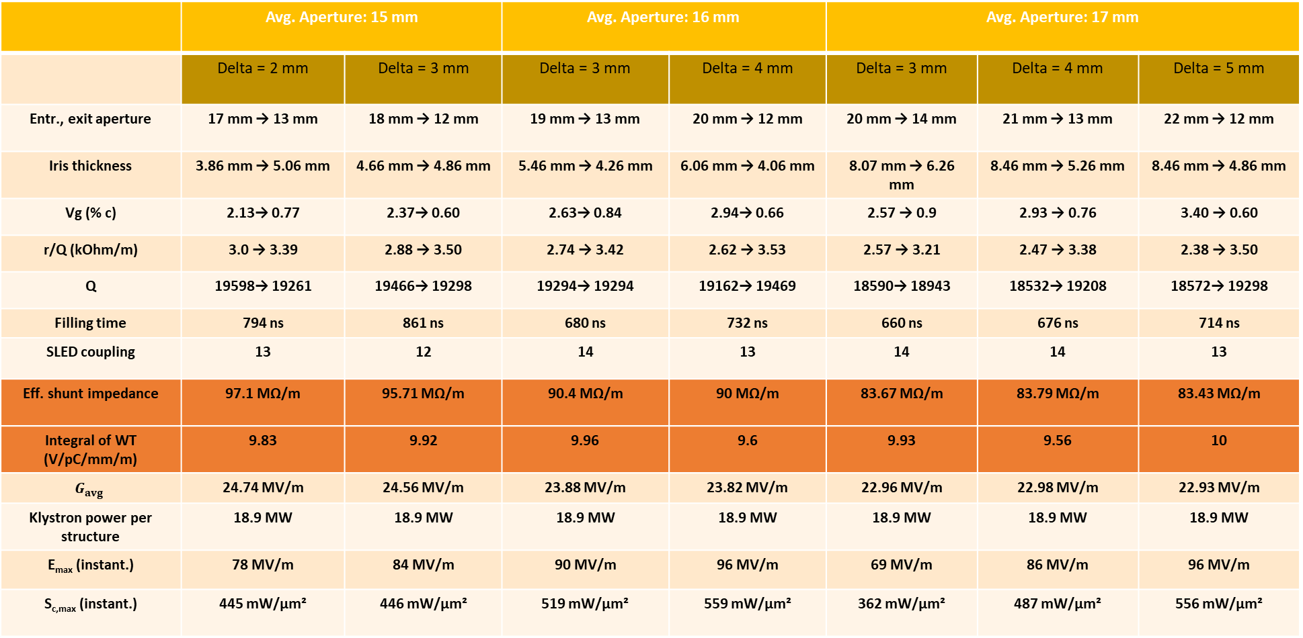
CLIC Booster Linac scans
 | Avg. Aperture: 15 mm |  | Avg. Aperture: 16 mm |  | Avg. Aperture: 17 mm
 | Delta = 2 mm | Delta = 3 mm | Delta = 3 mm | Delta = 4 mm | Delta = 3 mm | Delta = 4 mm | Delta = 5 mm
Entr., exit aperture | 17 mm → 13 mm | 18 mm → 12 mm | 19 mm → 13 mm | 20 mm → 12 mm | 20 mm → 14 mm | 21 mm → 13 mm | 22 mm → 12 mm
Iris thickness | 3.86 mm → 5.06 mm | 4.66 mm → 4.86 mm | 5.46 mm → 4.26 mm | 6.06 mm → 4.06 mm | 8.07 mm → 6.26 mm | 8.46 mm → 5.26 mm | 8.46 mm → 4.86 mm
Vg (% c) | 2.13→ 0.77 | 2.37→ 0.60 | 2.63→ 0.84 | 2.94→ 0.66 | 2.57 → 0.9 | 2.93 → 0.76 | 3.40 → 0.60
r/Q (kOhm/m) | 3.0 → 3.39 | 2.88 → 3.50 | 2.74 → 3.42 | 2.62 → 3.53 | 2.57 → 3.21 | 2.47 → 3.38 | 2.38 → 3.50
Q | 19598→ 19261 | 19466→ 19298 | 19294→ 19294 | 19162→ 19469 | 18590→ 18943 | 18532→ 19208 | 18572→ 19298
Filling time | 794 ns | 861 ns | 680 ns | 732 ns | 660 ns | 676 ns | 714 ns
SLED coupling | 13 | 12 | 14 | 13 | 14 | 14 | 13
Eff. shunt impedance | 97.1 MΩ/m | 95.71 MΩ/m | 90.4 MΩ/m | 90 MΩ/m | 83.67 MΩ/m | 83.79 MΩ/m | 83.43 MΩ/m
Integral of WT (V/pC/mm/m) | 9.83 | 9.92 | 9.96 | 9.6 | 9.93 | 9.56 | 10
$$G_{avg}$$ | 24.74 MV/m | 24.56 MV/m | 23.88 MV/m | 23.82 MV/m | 22.96 MV/m | 22.98 MV/m | 22.93 MV/m
Klystron power per structure | 18.9 MW | 18.9 MW | 18.9 MW | 18.9 MW | 18.9 MW | 18.9 MW | 18.9 MW
E_{max} (instant.) | 78 MV/m | 84 MV/m | 90 MV/m | 96 MV/m | 69 MV/m | 86 MV/m | 96 MV/m
S_{c,max} (instant.) | 445 mW/μm² | 446 mW/μm² | 519 mW/μm² | 559 mW/μm² | 362 mW/μm² | 487 mW/μm² | 556 mW/μm²

Slide 21
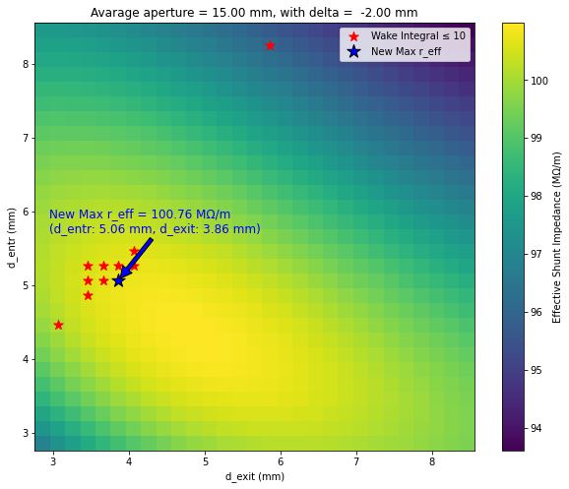
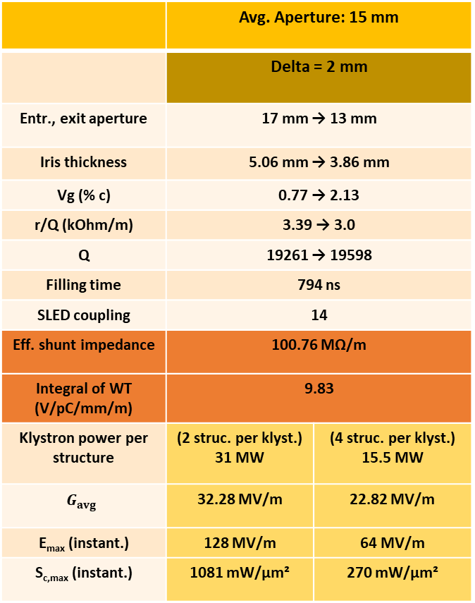
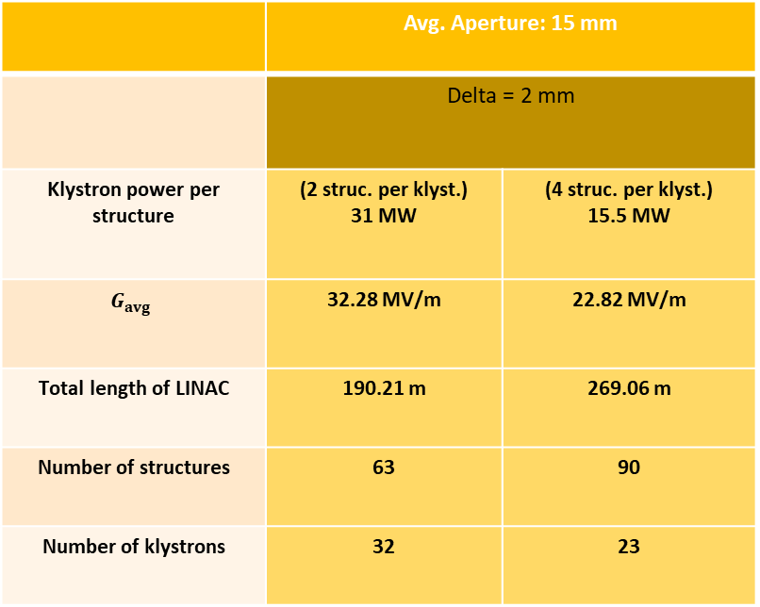
Alternative structure?
 | Avg. Aperture: 15 mm
 | Delta = 2 mm
Entr., exit aperture | 17 mm → 13 mm
Iris thickness | 5.06 mm → 3.86 mm
Vg (% c) | 0.77 → 2.13
r/Q (kOhm/m) | 3.39 → 3.0
Q | 19261 → 19598
Filling time | 794 ns
SLED coupling | 14
Eff. shunt impedance | 100.76 MΩ/m
Integral of WT (V/pC/mm/m) | 9.83
Klystron power per structure | (2 struc. per klyst.) 31 MW | (4 struc. per klyst.) 15.5 MW
$$G_{avg}$$ | 32.28 MV/m | 22.82 MV/m
E_{max} (instant.) | 128 MV/m | 64 MV/m
S_{c,max} (instant.) | 1081 mW/μm² | 270 mW/μm²
 | Avg. Aperture: 15 mm
 | Delta = 2 mm
Klystron power per structure | (2 struc. per klyst.) 31 MW | (4 struc. per klyst.) 15.5 MW
$$G_{avg}$$ | 32.28 MV/m | 22.82 MV/m
Total length of LINAC | 190.21 m | 269.06 m
Number of structures | 63 | 90
Number of klystrons | 32 | 23

Slide 22
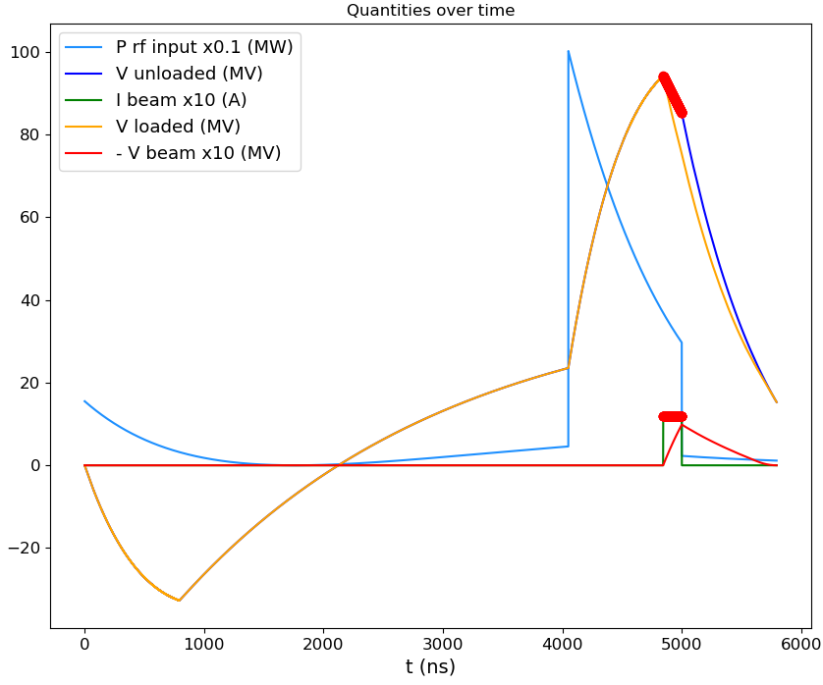
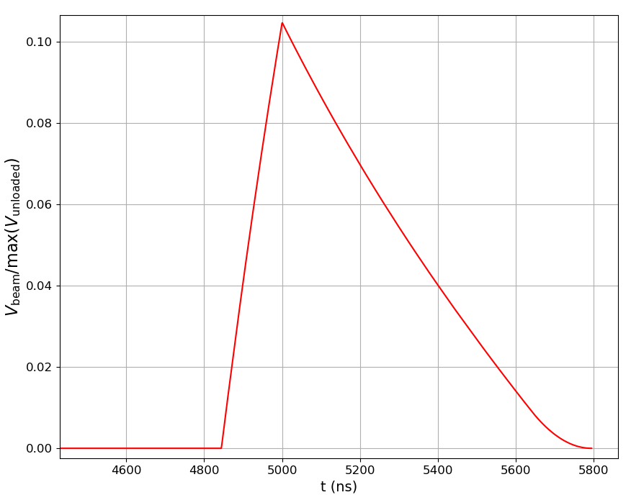
Avg. aperture = 15mm, 2 structure per klyst.

Slide 23
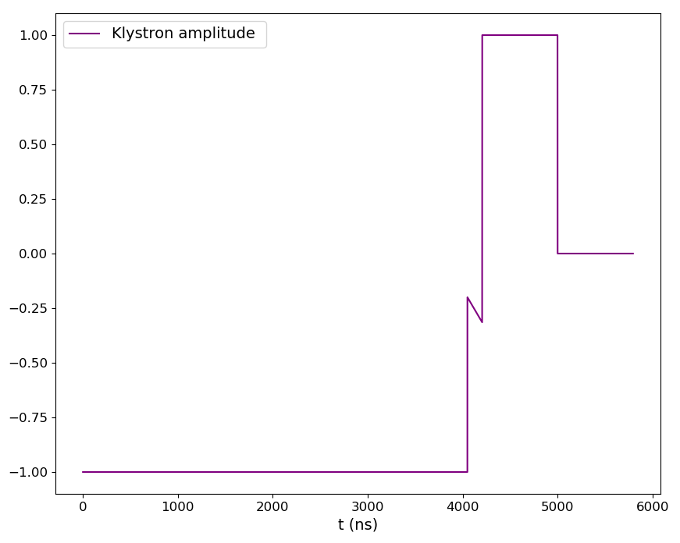
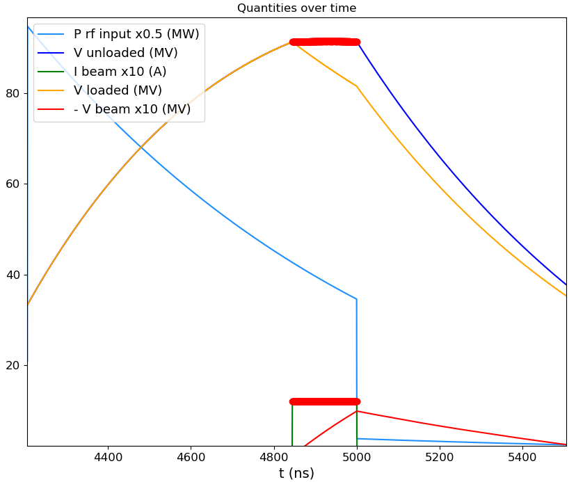
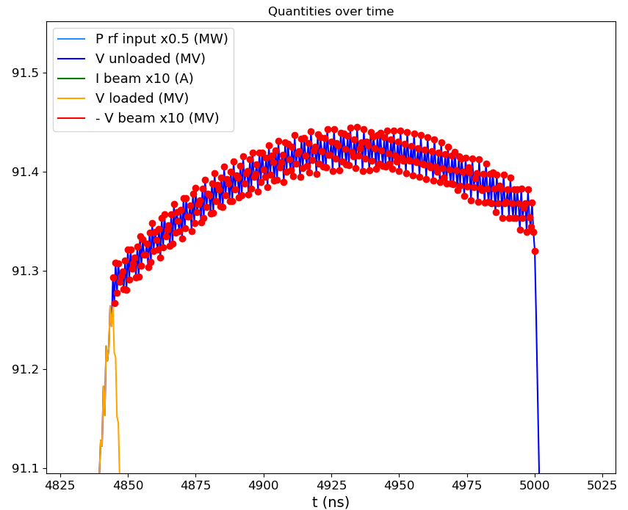
Avg. aperture = 15mm, 2 structure per klyst.
Maximum difference between 312 bunches:
ΔV= 0.18 MV
0.2% energy spread

Slide 24
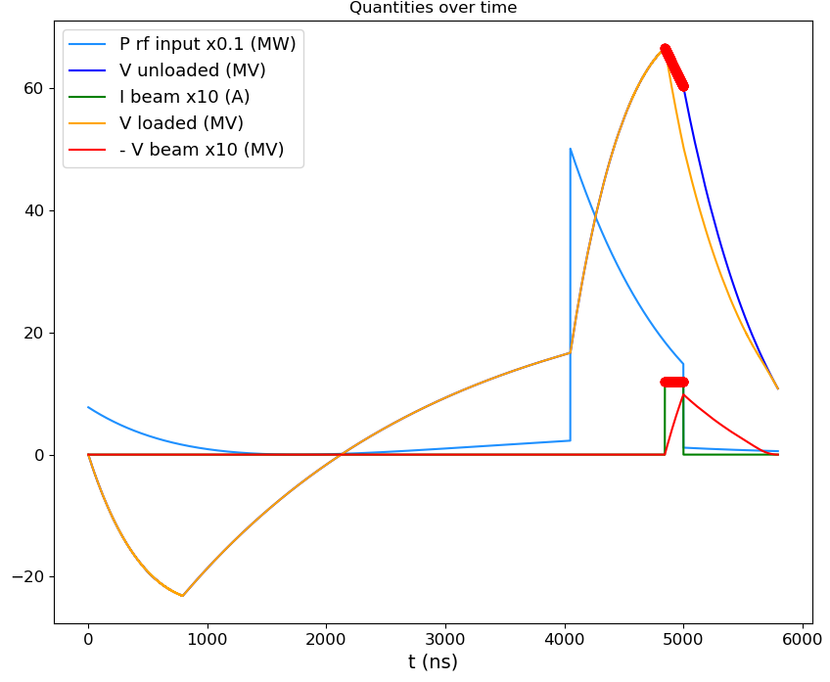
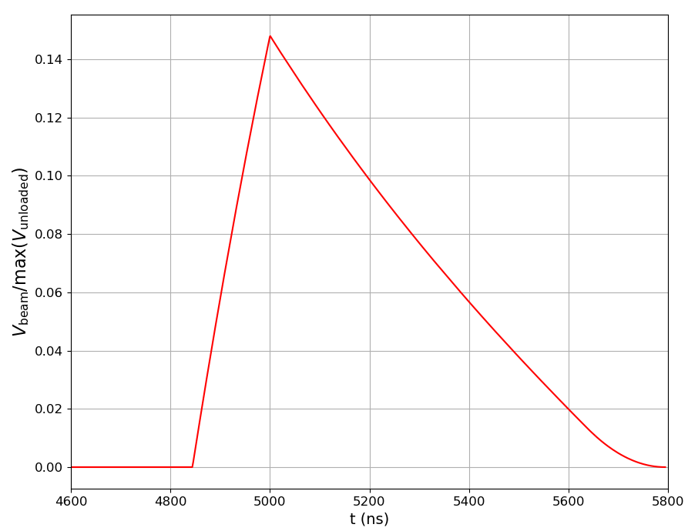
Avg. aperture = 15mm, 4 structure per klyst.

Slide 25
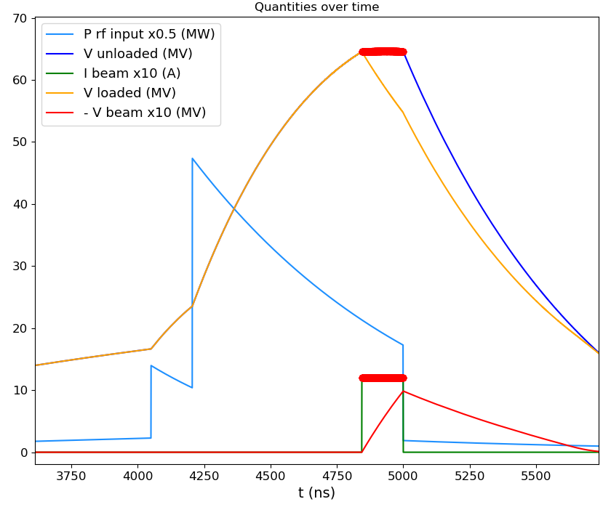
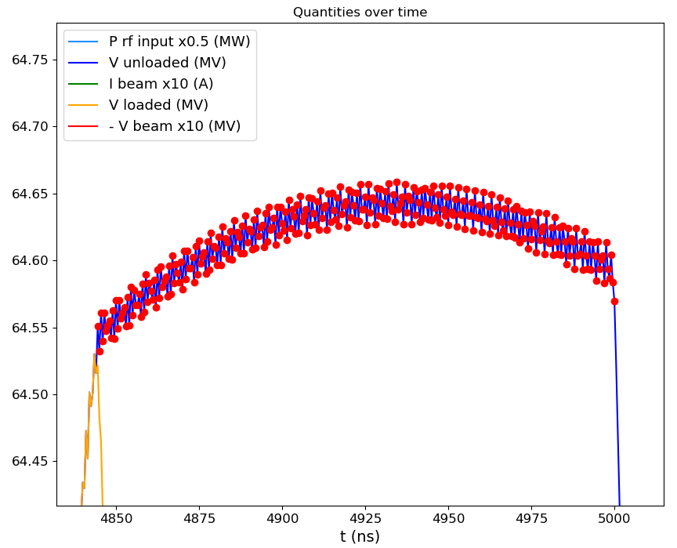
Avg. aperture = 15mm, 4 structure per klyst.
Maximum difference between 312 bunches:
ΔV= 0.13 MV
0.2% energy spread

Slide 26


Avg. aperture = 16mm, 2 structure per klyst.

Slide 27



Avg. aperture = 16mm, 2 structure per klyst.
Maximum difference between 312 bunches:
ΔV= 0.28 MV
0.3% energy spread

Slide 28


Avg. aperture = 16mm, 4 structure per klyst.

Slide 29


Avg. aperture = 16mm, 4 structure per klyst.
Maximum difference between 312 bunches:
ΔV= 0.2 MV
0.3% energy spread

Slide 30
15 mm, 2 klyst. per struct. | Unloaded V | Rsh
Single Bunch | 94.13 MV | 97 MΩ/m
312 Bunches | ̴91.4 MV | 91.45 MΩ/m
̴5.72% lower Shunt imp.
15 mm, 4 klyst. per struct. | Unloaded V | Rsh
Single Bunch | 66.56 MV | 97 MΩ/m
312 Bunches | ̴64.61 MV | 91.39 MΩ/m
̴5.78% lower Shunt imp.
16 mm, 2 klyst. per struct. | Unloaded V | Rsh
Single Bunch | 90.72 MV | 90.04 MΩ/m
312 Bunches | ̴87.8 MV | 84.33 MΩ/m
̴6.34% lower Shunt imp.
16 mm, 2 klyst. per struct. | Unloaded V | Rsh
Single Bunch | 64.14 MV | 90.04 MΩ/m
312 Bunches | ̴62.06 MV | 84.29 MΩ/m
̴6.79% lower Shunt imp.

Slide 31

CLIC Booster Linac Design
 | Avg. Aperture: 15 mm |  | Avg. Aperture: 16 mm
 | Delta = 2 mm |  | Delta = 3 mm
Klystron power per structure | (2 struc. per klyst.) 31 MW | (4 struc. per klyst.) 15.5 MW | (2 struc. per klyst.) 31 MW | (4 struc. per klyst.) 15.5 MW
$$G_{avg}$$ | 30.74 MV/m | 21.73 MV/m | 29.53 MV/m | 20.87 MV/m
Total length of LINAC | 200 m | 282.6 m | 208 m | 294 m
Number of structures | 67 | 94 | 70 | 98
Number of klystrons | 34 | 24 | 35 | 25

