Slide 1



What's new in the
HTCondor Software Suite (HTCSS) ?
What's coming up?
European HTCondor Workshop 2025
Prague
Todd Tannenbaum
Center for High Throughput Computing
University of Wisconsin-Madison

Slide 2


Legend
= “Voila”
= “What’s the
Bad News?”

Slide 3
Release Numbering Scheme
Major.minor.patch, e.g. HTCSS 24.12.2
New Major version in Q3 each year
Major Version number = year of release (23, 24, 25, …)
Two release series for each major version:
  LTS ("Long Term Support") Channel: only bug fixes, please!
  Feature Channel: gimme the latest greatest features!
Most recent TWO major versions are supported
  E.g. security bug patches for two years
  In Sept 2025 Version 25.x will be released. Support for v24.x and v25.x; support for 23.x will end.

Slide 4
Since last year…
New releases monthly containing a total of
+ 130 documented features
+ 193 documented bugfixes

Slide 5
Highlights on the web, details in the Manual
Highlights:
https://htcondor.org/htcondor/release-highlights/
Details:
https://htcondor.readthedocs.io/en/latest/version-history/index.html
Documented all the new features / mechanisms that have been added at each version
Notes about "gotchas" when upgrading from version X to Y
condor_upgrade_check tool assists administrators upgrading an HTCondor instillation between major version (i.e. V24 -> V25)
  Intended for use by those running LTS release of HTCondor.
  Checks current installation and setup for well known incompatibilities and informs administrator of actions to take to resolve said issues.

Slide 6
Using Container Images
Users can have their job run inside a Docker container image via
container_image = docker://repo:tag

Slide 7
Using Container Images
Users can have their job run inside a Docker container image via
container_image = docker://repo:tag
Bad News: Rate Limits!
Unauthenticated user limits at Docker Hub
  Max of 100 image pulls per 6-hour window
    per IPv4 address or
    per IPv6 /64 subnet
Authenticated users have higher limits
Users with a Docker subscription have no limits

Slide 8
New Authenticated Docker Support
On the AP, first do:
docker login
When placing your job, use submit command:
docker_send_credentials = true
Get matched to a root EP
Voila!
Q: How does this work?

Slide 9


New Authenticated Docker Support
On the AP, first do:
docker login
When placing your job, use submit command:
docker_send_credentials = true
Get matched to a root EP
Voila!
Q: How does this work?
  A: Tokens!

Slide 10
New Authenticated Docker Support, cont.
Q: Does this mean I can use a private Docker repository?

Slide 11


New Authenticated Docker Support
Q: Does this mean I can use a private Docker repository?
A: It depends!
Can pull private images,
but Docker’s cache has
no access control to
images it caches at the EP!
Who can run the Docker CLI on the EP? Do you trust them?

Slide 12
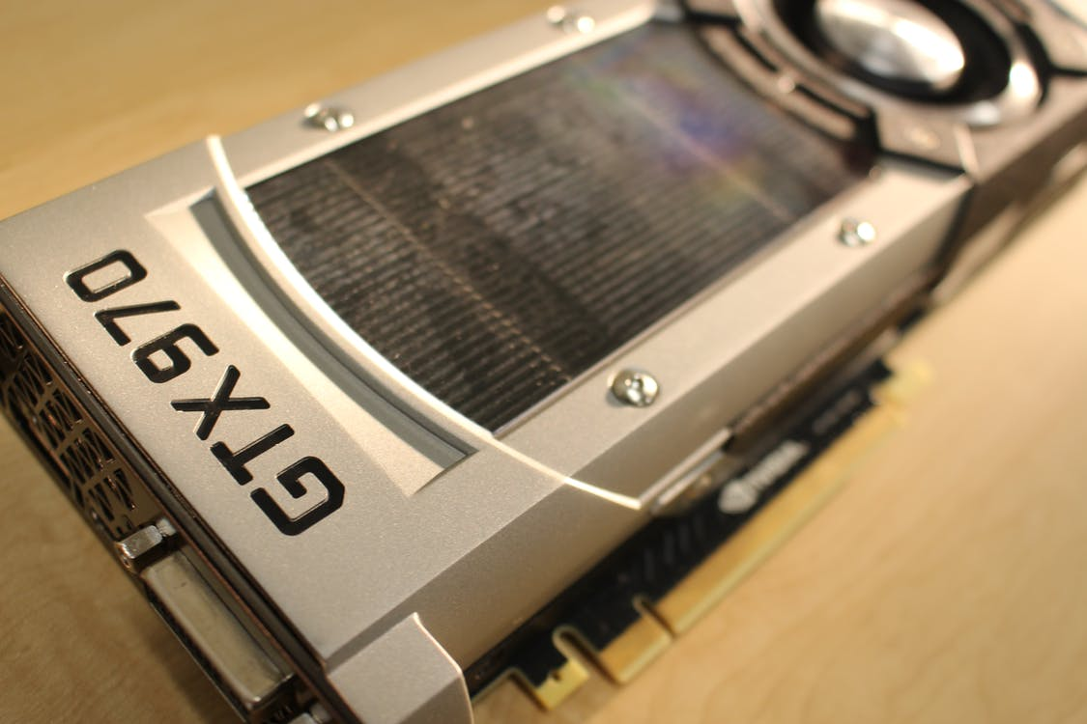
GPU Scheduling Activities
HTCondor has long been able to
  - detect GPU devices and schedule GPU jobs
  - monitor/report job GPU utilization
New: Support for heterogenous GPUs in one server
  - E.g. a server with two different models of GPU cards
  - NVIDIA Multi-Instance GPU (MIG) partitioning
New: Jobs can only see the GPU devices
assigned by the EP by using cgroup
device namespaces
New: Support for AMD ROCm
More first-class keywords in submit file
Submit File Example:
Executable = foo.exe
RequestGPUs = 1
gpus_minimum_capability = 7.0
gpus_minimum_memory = 16GB
Queue

Slide 13
First-class Backfill pslots
Motivating Scenario: I want my GPU rich server to give priority to GPU jobs, but backfill with CPU-only jobs
A p-slot provisioned from a shadow set of resources that tracks contention with the primary set of resources
  SLOT_TYPE_<N>_BACKFILL = TRUE
BACKFILL slots have special attributes
  BackfillSlot = true
  ResourceConflict = "Memory, GPUs, GPU-aabbccdd"
ResourceConflict given the names of the resources that contend with an active primary slot

Slide 14
Ex: Backfill the CPUs on a GPU node
# make a TYPE_1 primary P-slot and give it all of the resources
#
use FEATURE : GPUs
use FEATURE : PartitionableSlot(1, 100%)
SLOT_TYPE_1_START = TARGET.RequestGpus > 0
# make a TYPE_2 backfill P-slot with 90% of the shadow resources and no GPUs
#
SLOT_TYPE_2_BACKFILL = true
use FEATURE : PartitionableSlot(2, 90%, GPUs=0)
SLOT_TYPE_2_PREEMPT = size(ResourceConflict?:"") > 0
# The backfill slot should only run jobs that opt in as BackfillJob
SLOT_TYPE_2_START = TARGET.BackfillJob

Slide 15
Pelican Local Cache on the EP
Object Store
Cache files coming from OSDF (Pelican) on the EP
use feature:PelicanCache(size of cache)
Works with a glidein EP as well. Voila!!
Origin
Cache
HTCSS EP
+
EP Pelican Cache

Slide 16
Pelican Local Cache on the EP
Object Store
Cache files coming from OSDF (Pelican) on the EP
use feature:PelicanCache(size of cache)
Works with a glidein EP as well. Voila!!
Origin
Cache
What’s the Bad News?
  Admin must fragment EP Disk Space
  What about data transferred without Pelican?
    Files from the AP (HTCondor File Transfer / CEDAR)
    Files from Web Server URLs / HTTP
  Data Stored twice! Need double the EP disk space
    One copy in EP Pelican Cache, then copied to job scratch dir
  AP knowledge not captured
HTCSS EP
+
EP Pelican Cache

Slide 17
Share Common Files
You can try it out as of HTCSS 24.9!
  Shares explicitly-listed common files between jobs in the same job list (cluster) running at the same time.
    Transfers them only once.
    Makes only one copy on-disk.
    Controlled by the AP.
    Details in talk Fri @ 9:20am by Brian Bockelman
Execution Point
Slot 1 → Job 55.0
Access Point

Slide 18
Share Input Common Files
You can try it out as of HTCSS 24.9!
  Shares explicitly-listed common files between jobs in the same job list (cluster) running at the same time.
    Transfers them only once.
    Makes only one copy on-disk.
    Controlled by the AP.
    Details in talk Fri @ 9:20am by Brian Bockelman
Execution Point
Slot 1 → Job 55.0
Slot 2 → Job 55.1
Access Point
Hard-link
Common
input files

Slide 19
Speaking of giving control to the AP…
We want the AP to get complete information from the EP, but no decisions.
Let the AP draw its own conclusions, and then tell the EP what to do.

Slide 20
New Job Attribute:
VacateReason[Code]
Set whenever execution attempt is interrupted (in job ad and and evict event)
VacateReason
  Human-readable string
VacateReasonCode
  By convention:
  1-999: There was a problem with the job
  1000+: Interruption not the job’s fault

Slide 21
Job Cool Down
SYSTEM_ON_VACATE_COOL_DOWN
ClassAd expression evaluated at the AP in the context of a job that is leaving Running state (for Idle or Held)
At vacate, if >0
  Ignore EP’s request to hold job
  Don’t run job for given number of seconds
JobCoolDownExpiration
  Time when most recent cool-down ends
NumJobCoolDowns
  Count of cool-downs for this job

Slide 22
STARTER_NESTED_SCRATCH
Today
execute_dir
dir_xxxx
Job
files
condor
files

Slide 23
STARTER_NESTED_SCRATCH
execute_dir
?
dir_xxxx
htcondor
scratch
condor
files
Job
files

Slide 24

EP Disk Reservation and Enforcement
Allows HTCondor to utilize the Linux Logical Volume Manager to provide isolated work environments and strong disk usage enforcement for jobs executing on EP’s.
  No LVM ? EP will create a loopback filesystem on the fly!
  Introduced in v23.5.2
  Requires an HTCondor EP running on Linux as root
  Details Friday @ 10am
Look in the Manual for config knob STARTD_ENFORCE_DISK_LIMITS

Slide 25
No Job Networking
EP admin can set
NO_JOB_NETWORKING = true
Job will only have loopback, no other network
But condor daemons will have network
Advertises HasJobNetworking for matchmaking

Slide 26
Cgroup Management w/o root
If the base system grants permission, a glidein EP can create cgroups w/o root!
Off by default, ENABLE_CGROUP_WITHOUT_ROOT enables, will be default soon
HTCondor creates writeable cgroups by default
Can also launch an EP via Docker and create writeable cgroups

Slide 27
At long last, Enterprise Linux 9 support in HTCSS is happy!

Slide 28
At long last, Enterprise Linux 9 support in HTCSS is happy!
But it took a long time

Slide 29
At long last, Enterprise Linux 9 support in HTCSS is happy!
But it took a long time
And several sites ran into problems along the way
  (mainly with memory tracking due to cgroups -> cgroup 2)

Slide 30
At long last, Enterprise Linux 9 support in HTCSS is happy!
But it took a long time
And several sites ran into problems along the way
  (mainly with memory tracking due to cgroups -> cgroup 2)
And couple months ago, Enterprise Linux 10 was released!

Slide 31
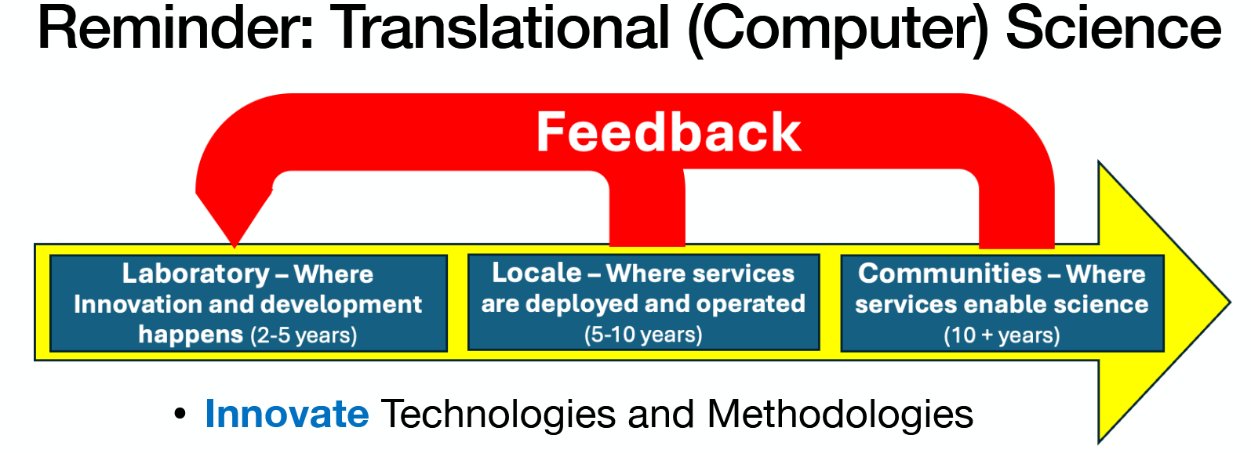
What went wrong?
How can we do better with EL 10?

Slide 32

What went wrong?
How can we do better with EL 10?

Slide 33
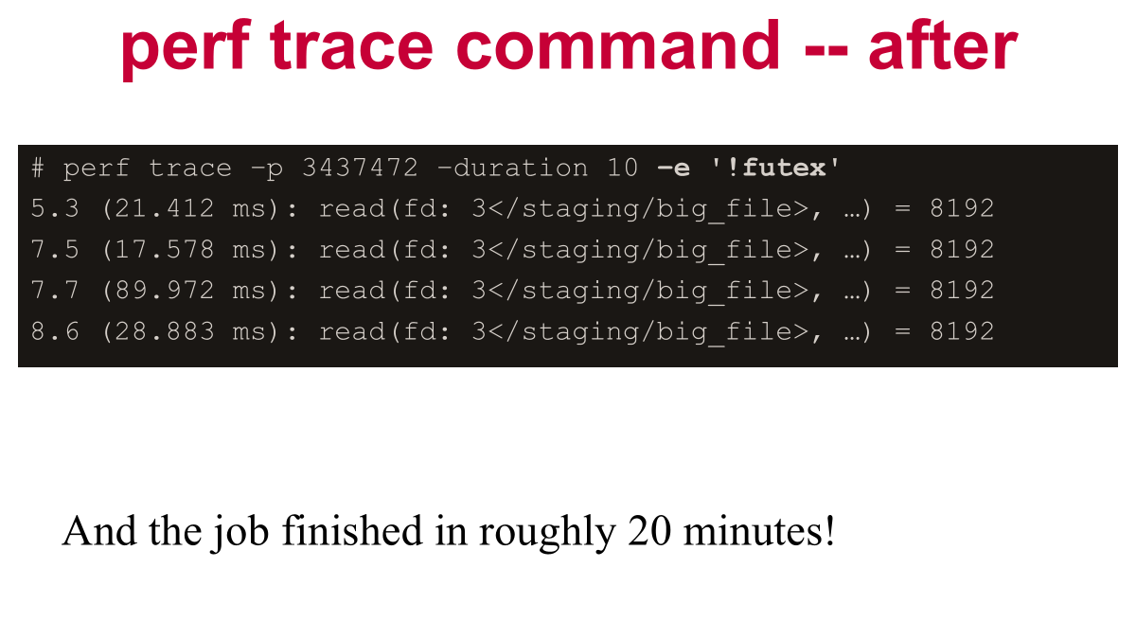
Tracing and its results…
Couple years ago talk about tracing..
We found schedd blocking writing to pipe..
(and fixed it)

Slide 34
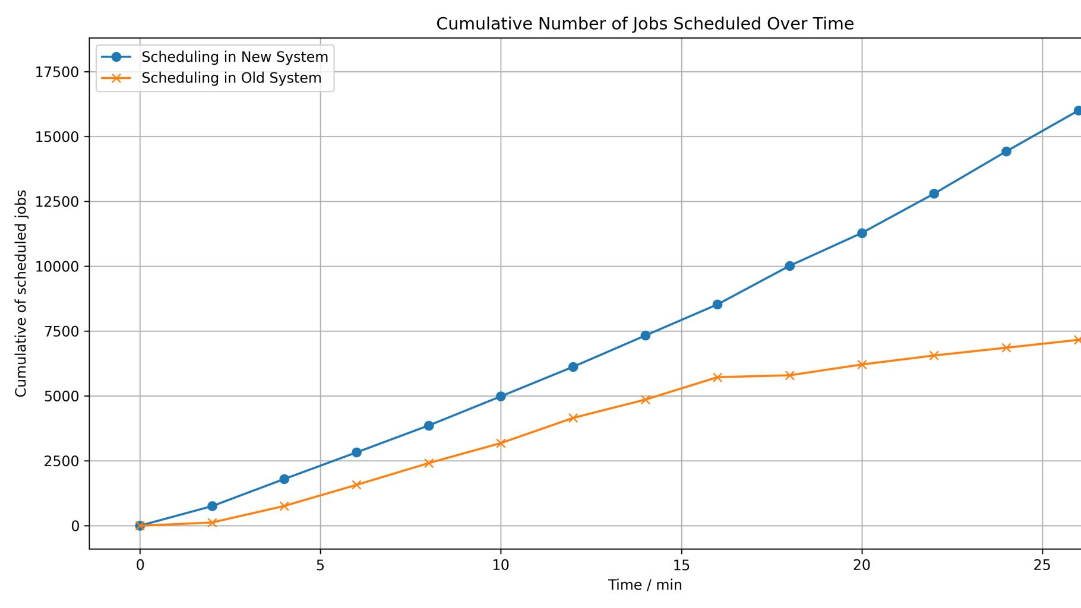

Slide 35
DAG Checker Tool: condor_dag_checker
Good for checking the validity of a DAG file and getting some statistics back without having to place the DAG and dig through the DAGMan debug log file.
  Check DAG file for various failures such as invalid DAG command syntax, referencing undefined nodes, cyclic dependencies.
  Get statistics about a DAG such as the count of nodes and arcs in a given DAG.

Slide 36
From command-line…
Before…
$ MY_DIR=dir my_command one two three > out 2> err

Slide 37
From command-line… to submit file
Executable = my_command
Arguments = one two three
Output = out
Error = err
Environment= MY_DIR=dir
queue

Slide 38
New “Shell” submit command
With shell…
$ MY_DIR=dir my_command one two three > out 2> err

Slide 39
New “Shell” submit command
shell = MY_DIR=dir my_command one two three > out 2> err
queue

Slide 40
Dealing with Job Memory
Current default behavior: Hold jobs that use more memory than requested.

Slide 41
Dealing with Job Memory
New first class way for users to retry with more memory.
Examples:
Ex 1
RequestMemory = 1 GB
RetryRequestMemory = 4 GB
Ex 2
RequestMemory = 1 GB
RetryRequestMemory = 4 GB, 16 GB
Ex 3
RequestMemory = 1 GB
RetryRequestMemoryIncrease = RequestMemory * 4
RetryRequestMemoryMax = 16 GB

Slide 42
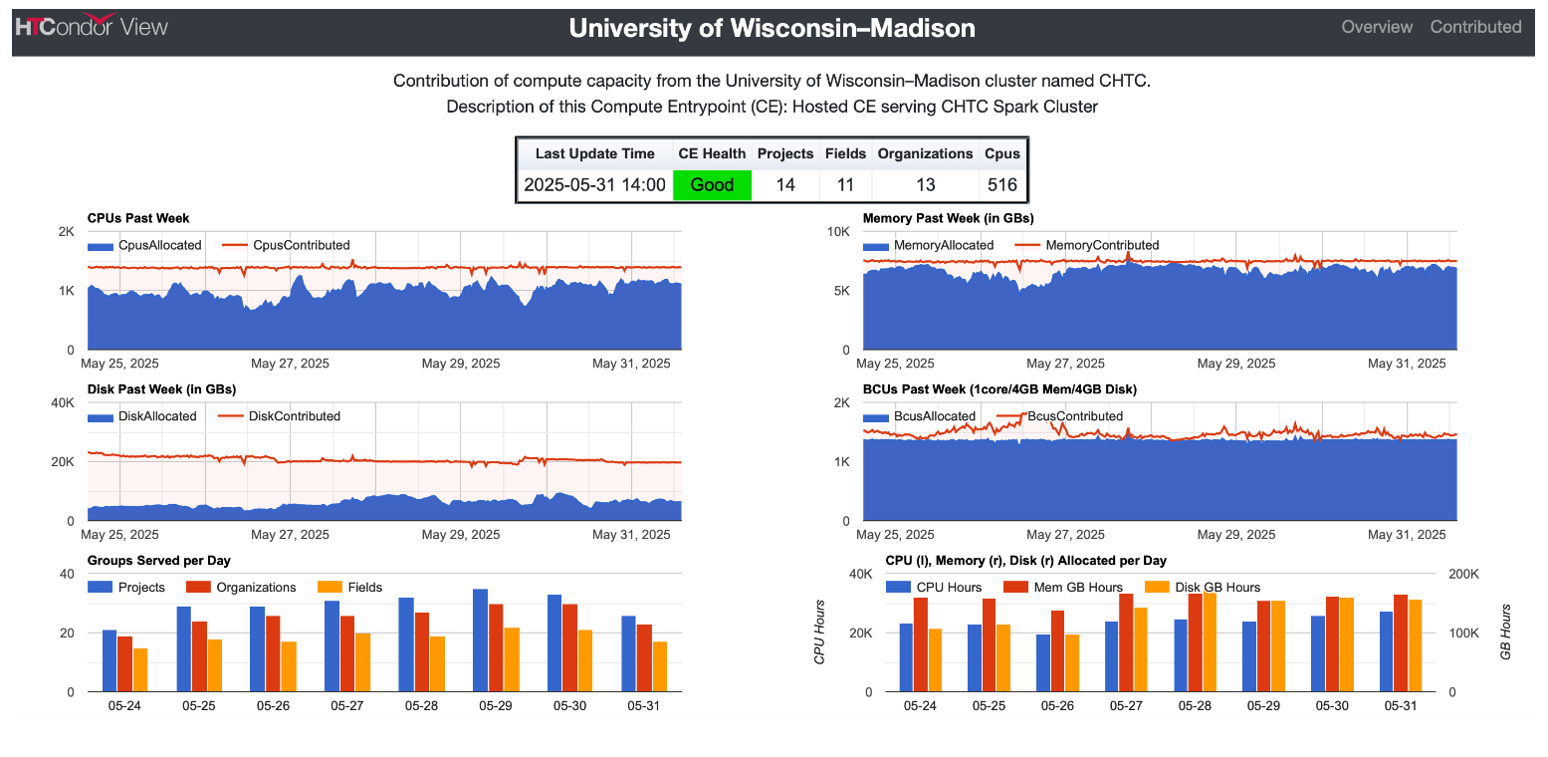
CE Dashboard

Slide 43

CE Dashboard to
CM Dashboard to
Prometheus Exporter

Slide 44
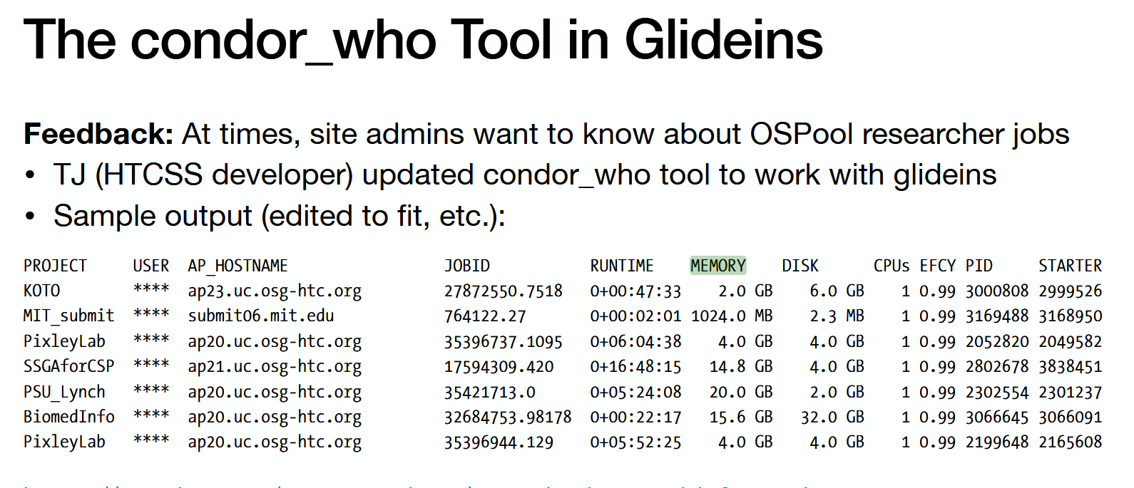

Slide 45
New defaults coming up might be surprising
Python API (bindings) v1 being dropped -> long live v2 ! Question:
import htcondor
import htcondor2 as htcondor

Slide 46
New defaults coming up might be surprising
Python API (bindings) v1 being dropped -> long live v2 ! Question:
import htcondor
import htcondor2 as htcondor
HTCondor CE Routes must use “new” syntax
System Swap space (virtual memory) will not be used for jobs on the EP by default
Dropping support for multiple queue statements in a single submit file
(Use queue foreach, etc.)
Partitionable Slots enabled by default (instead of static partitioning)
The job’s executable will no longer be renamed to ‘condor_exec.exe’
GPU discovery is enabled on all Execution Points by default

Slide 47
Last but not least…
A public service announcement…

Slide 48
Y 2038 Problem!
January 19th 2038

Slide 49
Y 2038 Problem!
Pre 24.x, daemons hung staring > Y 2038
Classad date functions fixed:
In 23.x
$ classad_eval '[]' 'formatTime(int(abstime("2025-01-01")) + (13 * 365 * 24 * 3600))'
"Tue Dec 29 00:00:00 2037"
$ classad_eval '[]' 'formatTime(int(abstime("2025-01-01")) + (14 * 365 * 24 * 3600))'
"Sat Nov 22 17:31:44 1902"

Slide 50
Y 2038 Problem!
Pre 24.x, daemons hung starting > Y 2038
Classad date functions fixed:
In 24.x
$ classad_eval '[]' 'formatTime(int(abstime("2025-01-01")) + (13 * 365 * 24 * 3600))'
"Tue Dec 29 00:00:00 2037"
$ classad_eval '[]' 'formatTime(int(abstime("2025-01-01")) + (14 * 365 * 24 * 3600))
"Wed Dec 29 00:00:00 2038"

Slide 51
Why do you care?
Need to work on future dates now
Software: Financial, scientific, security…
Firmware: Problem with embedded systems,
  Card reader
  Physical security systems
  Etc, etc, etc.
Let's fix these now via RFP process

Slide 52
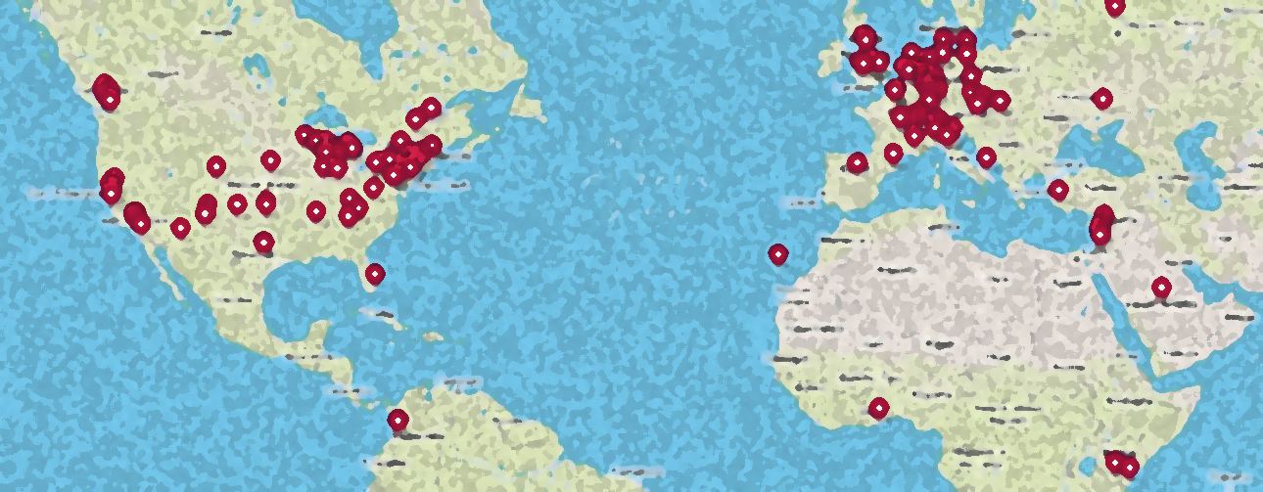
Thank You!
Please add your institution
to our world map of HTCondor Users at:
https://htcondor.org/user-map
and click "Add Your Institution" on upper right
This work is supported by NSF under Cooperative Agreement OAC-2030508 as part of the PATh Project. Any opinions, findings, and conclusions or recommendations expressed in this material are those of the author(s) and do not necessarily reflect the views of the NSF.

Slide 53
Evolving new command line user interface
htcondor <noun> <verb>
  "htcondor job submit", "htcondor job status", …
  "htcondor dag submit", "htcondor dag status", …
  "htcondor jobset submit", "htcondor jobset status", …
  "htcondor annex create", "htcondor annex status", …
  "htcondor eventlog read"
Legacy tools (condor_q, condor_submit, condor_history, …) not going anywhere…
Notes:
htcondor job status gives information about a single job given a job id

Slide 54
condor_q - looking at one running job
$ condor_q 123.45
-- Schedd: login04.osgconnect.net : <192.170.231.217:9618?... @ 07/12/23 21:43:13
OWNER BATCH_NAME SUBMITTED DONE RUN IDLE TOTAL JOB_IDS
toddt ID: 123 7/12 21:37 _ 1 _ 10000 123.45
Total for query: 1 jobs; 0 completed, 0 removed, 0 idle, 1 running, 0 held, 0 suspended
Notes:
Using the legacy tool "condor_q", this is what the output looks like when given a single job id

Slide 55
condor_q - looking at the details
$ condor_q –l 123.45
AccountingGroup = "group_opportunistic.EvolSims.toddt"
AcctGroup = "EvolSims"
AcctGroupUser = "anushd"
AllowedExecuteDuration = 72000
Args = "44"
AutoClusterId = 3232
BytesRecvd = 0.0
BytesSent = 0.0
ClusterId = 36371245
Cmd = "/home/anushd/cluster_code/cwrapper.sh"
CommittedSlotTime = 0
CommittedSuspensionTime = 0
CommittedTime = 0
CondorPlatform = "$CondorPlatform: X86_64-CentOS_7.9 $"
CondorVersion = "$CondorVersion: 10.6.0 2023-06-26 PackageID: 10.6.0-0.656423 RC $"
CoreSize = 0
CpusProvisioned = 1
…
Notes:
If you want to see more information, most users resort to using the "-long" option which display all 150+ attributes about a job. But which ones do most users care about? What are they named? What units are the values (KBs, MBs, GBs, …) ?

Slide 56
New Job Status
$ htcondor job status 123.45
Job 123.45 is currently running on host exec221.chtc.wisc.edu.
It started running again 2.1 hours ago.
It was submitted 3.6 hours ago.
Its current memory usage is 2.5 GB out of 4.0 GB requested.
Its current disk usage is 3.8 GB out of 5.5 GB requested.
It has restarted 2 times.
Goodput is 80% (0.5 hours badput, 2.1 hours goodput).
Notes:
Here is the output using the new command-line tool. The most common desired information is displayed in plain English.

Slide 57
What about a DAGMan workflow?
$ htcondor dag status 223
DAGMan Job 223.0 [simple.dag] has been running for 52 days 04:12:46.
DAG has submitted 382 individual job(s), of which:
45 are running.
10 are idle.
0 are held.
162 have completed successfully
DAG has failed nodes but will continue until all possible work is finished: 5 nodes failed.
10 nodes waiting to begin.
24 nodes running.
[###########=======----------------] 34% complete.
Notes:
Sample output from "htcondor dag status", to see status about a DAGMan job….

Slide 58
HTCondor Python Bindings Version 2
The version 1 bindings depend on an unsupported library (boost.python), so we needed to do something to make sure the bindings would remain available.
Bindings are intended to be generally compatible; import htcondor2 as htcondor should mostly just work.
  However: We removed some of the things marked as deprecated in the version 1 bindings, and will be deprecating a few other APIs that are not widely used
Win for users: Compared to version 1, the new version 2 bindings will be much less picky about the specific version of Python interpreter being used ☺

Slide 59
Simpler User Experience for jobs w/ Tokens:
Let the AP fetch tokens from issuers on behalf of the user

