Slide 1
Managing Trust with
Tokens and Capabilities
Miron Livny
UW-Madison Vilas Research Professor
John P. Morgridge Professor of Computer Science
PATh Principal Investigator

Slide 2
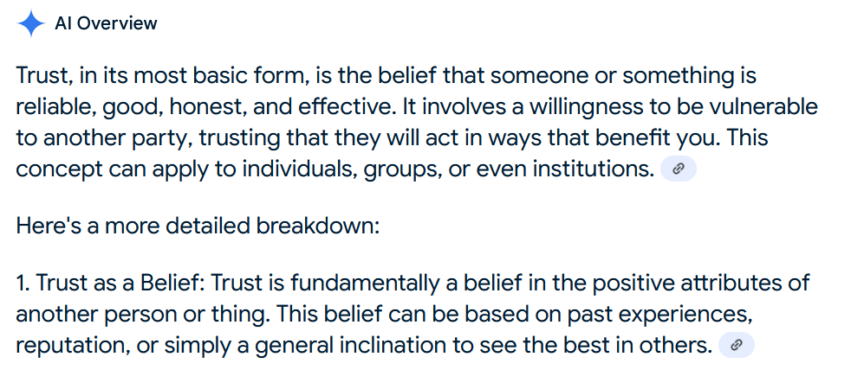

Slide 3
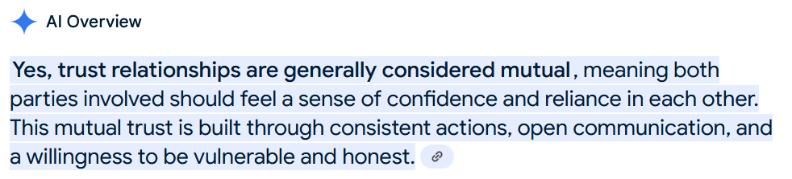
Is Trust a mutual relationship?

Slide 4
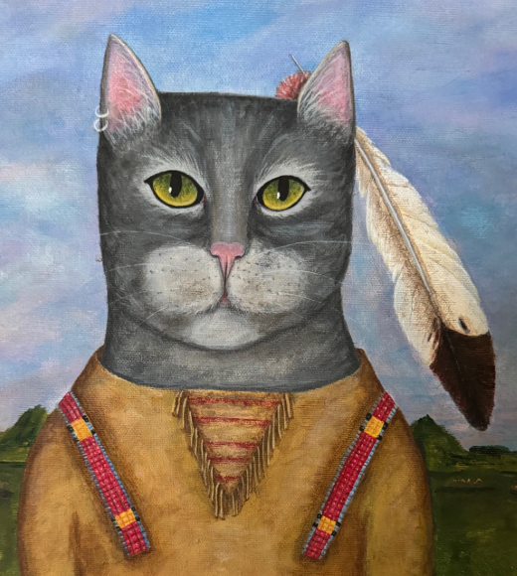
I am a Cat
My Passport #
is 17
Autherization Entity
Identifier Entity
Server
Client
My name is Roo
My name is Soo

Slide 5
Server receives a request “send file Foo back to the requesting client”
How does the server trust the request?
Request presents an “Identifier”
Request presents an “Identifier Token”
Request presents a “Access Token”
Request presents a “Secrete”

Slide 6
I am a Cat
My Passport #
is 17
Autherization Entity
Identifier Entity
Server
Client
Copy of Foo
Give Me Foo
My name is Roo
My name is Soo

Slide 7
For #1 server needs:
  A proof from a trusted identifier entity that whoever (software) issued the request is associated with the provided Identifier
  An Access Control List (ACL) from a trusted authorization entity
  Understand the schema of the ACL
For #1 Client needs:
  Get an Identifier and a Secret (password) from the trusted identifier entity
  Register Identifier with trusted authorization entity

Slide 8
For #2 server needs:
  To trust the Identifier and the Identifier entity that issued the identifier token.
  An Access Control List (ACL) from a trusted authorization entity
  Understand the schema of the ACL
For #2 Client needs:
  Register Identifier and obtain Identifier Token from trusted Identifier entity
  Register Identifier with authorization entity

Slide 9
For #3 server needs:
  Trust that the token was issued by an authorization entity identified by the token
  Trust the authorization entity that issued the token
  Understand the schema of the token
For #3 Client needs:
  Obtain a token from the trusted authorization entity with the desired access permissions

Slide 10
For #4 server needs:
  To obtain from a trusted authorization entity a list of secrets and associated permissions
  Understand the schema of the list
For #4 Client needs:
  To obtain a Secrete from trusted authorization entity

Slide 11
When a Researcher places a job that reads Foo at the Access Point (AP) it entrusts the flie copy with the AP – namely the AP has full control over the copy of Foo and can hand it over to any client
The AP is the client (via the EP) that requests the copy of Foo from the server
The server entrusts Foo with the AP – namely, must trust the AP as an authorization entity for Foo who can hand Foo over to any client

Slide 12
How does a researcher establish trust with the AP?
How does the AP associate a Job with a Researcher?
How does the Server establish trust with the AP?

Slide 13
Prototyping
Placement Tokens

Slide 14
To place a JobList at an AP the researcher needs to register with the AP
  If authorized, researcher is assigned an AP identifier.
  AP registration does not mean an OS account on the server hosting the AP
To place a JobList at an AP the researcher needs a PlacementTokent for the AP
  If authorized, researcher is given an PlacementToken (capability, cookie)

Slide 15
AP
Identifier Entity
I am a Cat
My Passport #
is 17
Autherization Entity
Goo = F(Foo)
Server
Client
Copy of Foo
Give Me Foo
My AP Identifier is Boo
My name is Roo
My name is Soo
Placement Token

Slide 16
We are working on a prototype for the Placement Dameon (DP)
  Prototype includes a Web Server
  Uses (external) campus Identifier Entity for “Passport # identifiers”
  Uses an Access Control List provided by a Research Computing Facilitator
  SchedD supports AP Identifiers for placement control and “Owner” identifiers

