Slide 1


FCC-ee positron linac design
Y. Zhao, A. Latina, CERN
FCC-ee WP1 meeting
27 Sep 2024

Slide 2
Test 1.0
“Old version” of Capture Linac

Slide 3
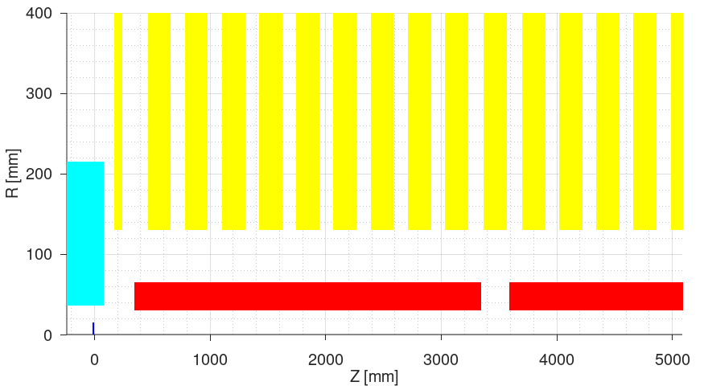
Capture section
Electrons
E = 2.86 GeV. σ_{x,y} = 1 mm
Target
Conventional shape. R = 15 mm
W = 15 mm. z₁ = 40 mm (w.r.t HTS B₀)
AMD
HTS solenoid. B₀ ~ 15 T.
Matching solenoid
L = 72 mm. B₀ ~ 0.25 T (doubled of design). z_{c} = 244 mm (w.r.t HTS B₀).
Capture linac (CL)
RF structures: L = 3 m. a₀ = 30 mm. N = 7, G = 14 MV/m, φ = [239 235 234 231 249 271 260]° (Parameters provided by WP3)
Regular solenoids: L = 200 mm. B₀ ~ 0.31 T. N = 9 (per structure)

Slide 4
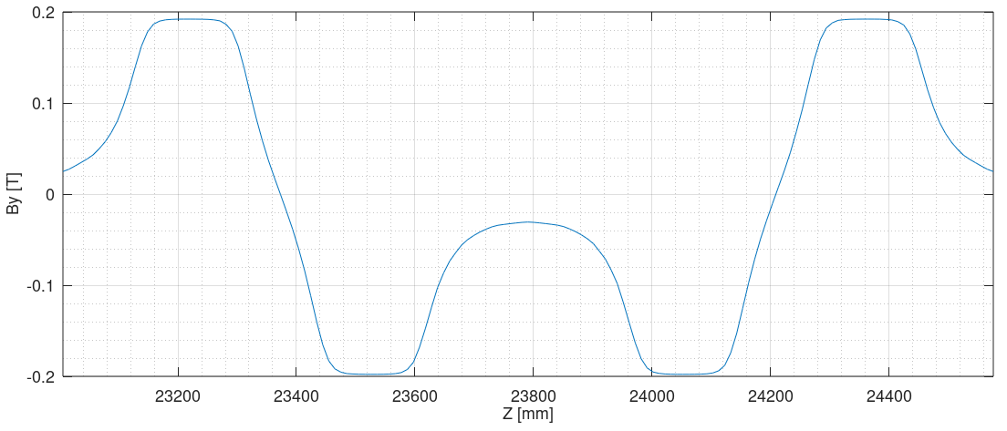
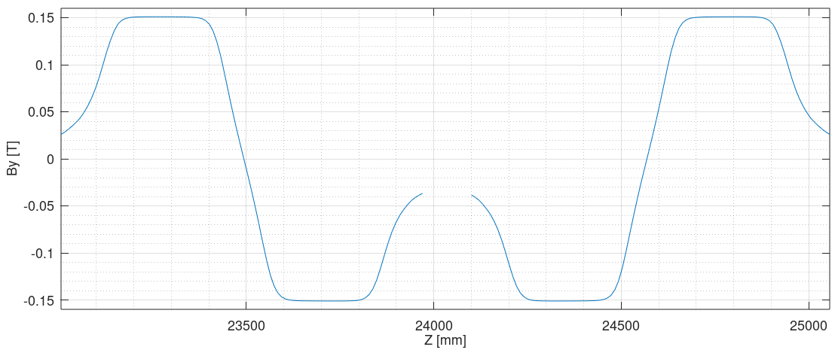
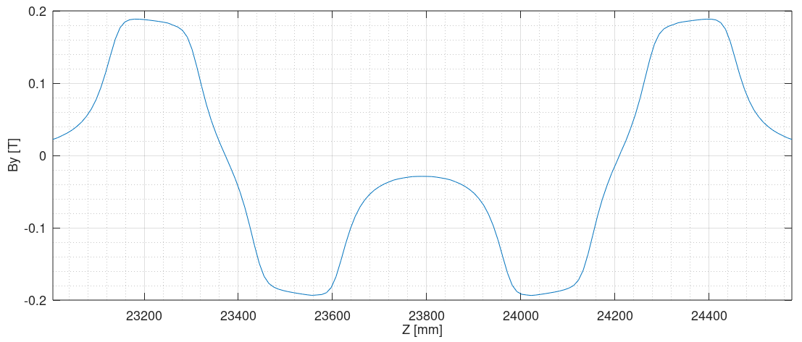
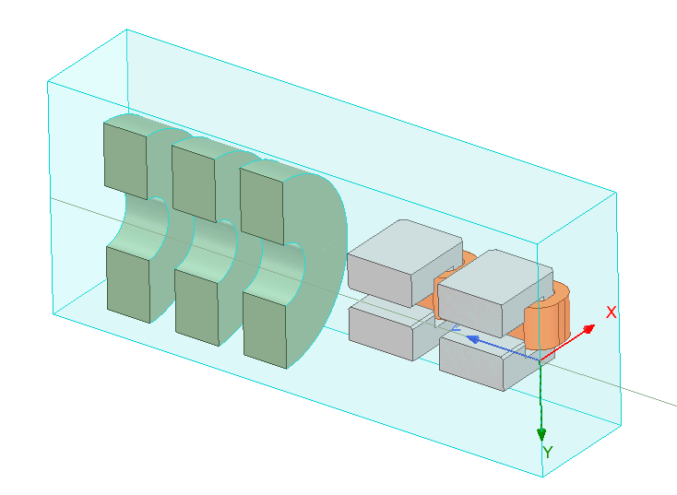
Chicane
Designed by Riccardo
“V0”: Being used. Designed before FCC week for 1.54 GeV DR baseline. Dipole yoke is 180 mm long. Vertical aperture is 60 mm diameter (40 mm diameter for beam pipe). Being used now. As the total field of 4 dipoles with dispersion closed is available. Superposition of 4 single dipole simulation fields is different and is not suggested to be used
“V1”: Not used. Redesigned after FCC week to increase aperture. Yoke is 300 mm long. Vertical aperture is 80 mm diameter (70 mm diameter for beam pipe). Performance is worse than “V0”, maybe due to that dispersion is not closed for the total field of 4 dipoles. Besides, dipole is too long and integrated field is also too strong. This version is suggested to be obsoleted
“V2”: In progress
“V0” (full chicane simulation)
“V1” (full chicane simualtion)
“V0” (single dipole simulation)
“V2” (full chicane with 6 solenoids simulation)

Slide 5
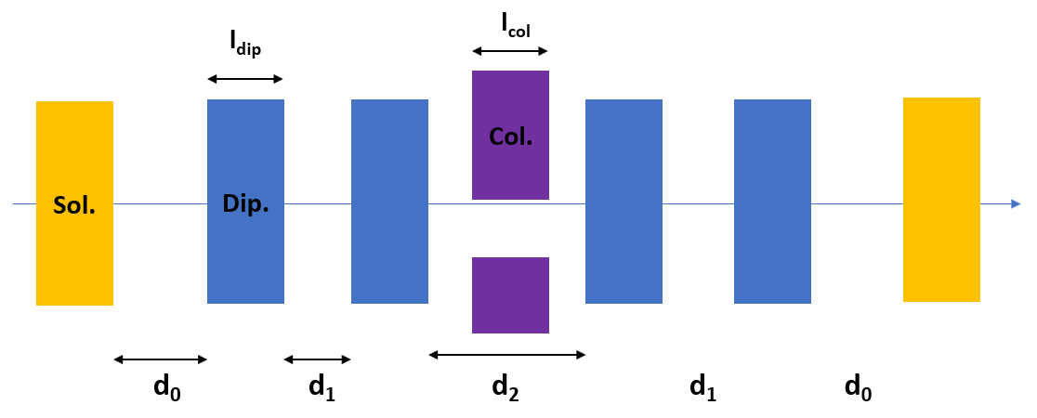
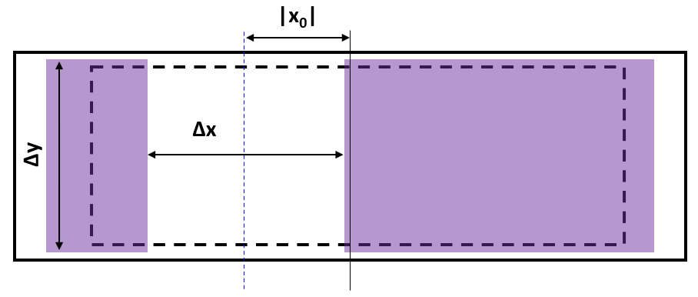
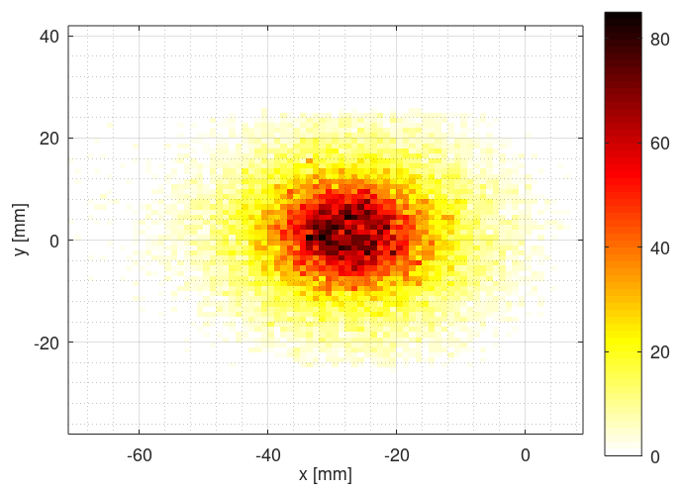
Chicane
Chicane parameters (“V0”)
Dipole yoke length (fixed by design): l_{dip} = 180 mm
Apertures of beam pipe (fixed by design): Δx = 150 mm, Δy = 50 mm (By design, the aperture for yoke is 60 mm, for beam pipe is 40 mm as it is also in the fieldmap. But it’s assumed to 50 mm in tracking, as we anyway will design a larger aperture chicane)
Distances (fixed by design) between dipole yokes: d1 = 125 mm, d2 = 350 mm
Distance (optimised parameter in simulation) between solenoid and dipole yoke: d0 = 125 mm
Collimator parameters
Length: l_{col} = 120 mm
Apertures: Δx = 60 mm, Δy = 60 mm
X offset: x₀ = -30 mm

Slide 6
Positron linac power consumption
Power consumption and cost comparison in PL (based on discussion with Jean-Yves)
Elements in CL and matching sections are the same and therefore not included
Parameter | G20 option | G14 option | G20+G14 option
Average gradients in S1, S2, S3 [MV/m] | ~20 | ~14 | ~[20, 14, 14]
Number of structures per RF module | 2 | 4 | [2, 4, 4]
Number of structures in S1, S2, S3 | [10, 12, 24] | [16, 16, 36] | [10, 16, 36]
Expected initial energy S1, S2, S3 [MeV] | ~[200, 780, 1475] | ~[200, 830, 1460] | ~[200, 780, 1425]
Total number of RF modules | 5+6+12+1 = 24 | 4+4+9+1 = 18 | 5+4+9+1 = 19
Total number of solenoids | 10*10 = 100 | 16*10 = 160 | 10*10 = 100
Total number of quadrupoles | 12+12+1 = 25 | 16+18+2 = 36 | 16+18+2 = 36
RF power consumption [MW] | 24*0.19 = 4.56 | 18*0.19 = 3.42 | 19*0.19 = 3.61
Solenoid power consumption [MW] | 100*0.016 = 1.60 | 160*0.016 = 2.56 | 100*0.016 = 1.60
Quadrupole power consumption [MW] | neglected | neglected | neglected
Total power consumption [MW] | 6.16 | 5.98 | 5.21
Study will be focused on the “G20+G14” option, which is best choice, with power consumptions reduced by 15%

Slide 7
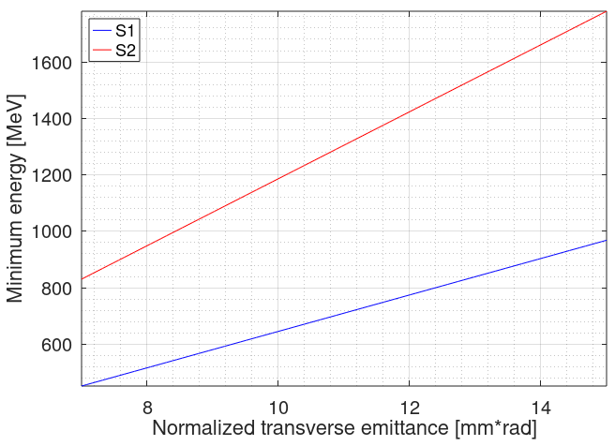
Positron linac design
Minimum energies at linac entrance
Currently assuming 12 mm*rad emittance
Parameters assumed:
Structure iris radius: 30 mm
Structure length: 3 m
FODO phase advance: 90 deg
Quadrupole length: 0.4 m
Quadrupole-Structure distance: 0.15 m
Structure-Structure distance: 0.1 m
1424 MeV
775 MeV

Slide 8
Positron linac results
Parameters and results
Parameter | Value
FODO phase advance [°] | 90
Quadrupole spacings in S2, S3 [m] | 3.3, 6.4
Number of structures in S1, S2, S3 | 10, 16, 36
Average gradient [MV/m] (w/o SRWF) | 20, 14, 13.271
Average gradient [MV/m] (w/ SRWF) | 20, 14, 13.595
RF phases off-crest in S1, S2, S3 [°] | -10, 5, 5
Expected maximum emittance to transport [mm*rad] | ~12.0
Average energy (around peak) at entrance of S1, S2, S3 [MeV] (w/o SRWF) | 203, 777, 1444
Average energy (around peak) at entrance of S1, S2, S3 [MeV] (w/ SRWF) | 203, 767, 1424
Bunch length (around peak) at S3 exit [mm] | 3.0
Energy spread (around peak) at S3 exit [%] | 1.0
Positron yield at S3 exit (all positrons) | 3.34
Normalised X, Y emittances at S3 exit (all positrons) [mm*rad] | 12.7, 12.2
Expected DR accepted yield with 2% energy acceptance | 2.91
Expected DR accepted yield with 4% energy acceptance | 3.07

Slide 9
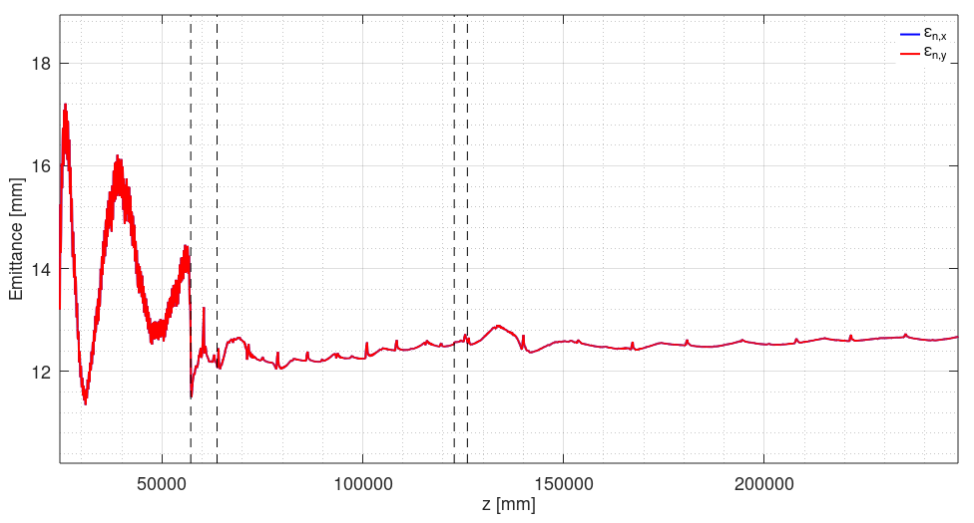
Positron linac design
Emittance evolution in S1, S2, S3

Slide 10
Test 2.0
“New version” of Capture Linac

Slide 11
Capture section
Electrons
E = 2.86 GeV. σ_{x,y} = 1 mm
Target
Conventional shape. R = 15 mm
W = 15 mm. z₁ = 40 mm (w.r.t HTS B₀)
AMD
HTS solenoid. B₀ ~ 15 T.
Matching solenoid
L = 72 mm. B₀ ~ 0.25 T (doubled of design). z_{c} = 244 mm (w.r.t HTS B₀).
Capture linac (CL)
RF structures: L = 3 m. a₀ = 30 mm. N = 6, G = 14 MV/m, φ = [236 234 232 265 276 249]° (Parameters provided by WP3)
Regular solenoids: L = 200 mm. B₀ ~ 0.31 T. N = 9 (per structure)
Otherwise, all same as Test 1.0

Slide 12
Positron linac results
Parameters and results
Parameter | Value
FODO phase advance [°] | 90
Quadrupole spacings in S2, S3 [m] | 3.3, 6.4
Number of structures in S1, S2, S3 | 10, 16, 36
Average gradient [MV/m] (w/o SRWF)
Average gradient [MV/m] (w/ SRWF) | 20, 14, 13.756
RF phases off-crest in S1, S2, S3 [°] | -10, 5, 5
Expected maximum emittance to transport [mm*rad] | ~12.0
Average energy (around peak) at entrance of S1, S2, S3 [MeV] (w/o SRWF)
Average energy (around peak) at entrance of S1, S2, S3 [MeV] (w/ SRWF) | 185, 756, 1407
Bunch length (around peak) at S3 exit [mm] | 2.8
Energy spread (around peak) at S3 exit [%] | 0.9
Positron yield at S3 exit (all positrons) | 3.27
Normalised X, Y emittances at S3 exit (all positrons) [mm*rad] | 12.7, 12.0
Expected DR accepted yield with 2% energy acceptance | 2.85
Expected DR accepted yield with 4% energy acceptance | 2.98

Slide 13
Comparison
Test 1.0: 7 structures in CL
Test 2.0: 6 structures in CL. Compared with using 7 structures:
Positron yield is comparable
Total positron yield is 2% lower: 3.34 → 3.27
DR accepted yield (if 2% energy acceptance) is 2% lower: 2.91 → 2.85
DR accepted yield (if 4% energy acceptance) is 3% lower: 3.07 → 2.98
Bunch length is 7% shorter: 3.0 mm → 2.8 mm
Energy spread is 10% smaller: 1.0% → 0.9%
Normalized emittances are same: 13 mm*rad in X, 12 mm*rad in Y

Slide 14
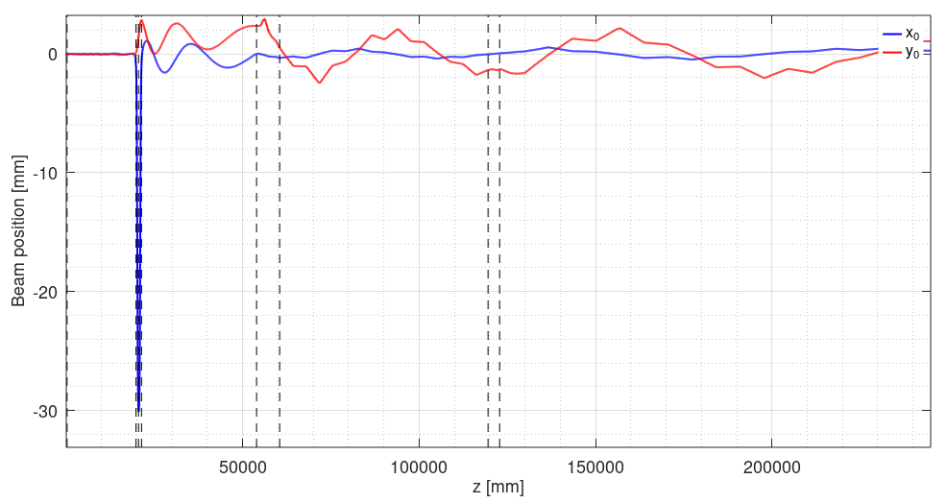
Transport table plotting (indicative only)
The transport table is from Volume in RF-Track using Bunch6dT, estimated from all particles in full space in time evolution, which might be not as precise as the final results, since particles that will not be accepted are also accounted

Slide 15
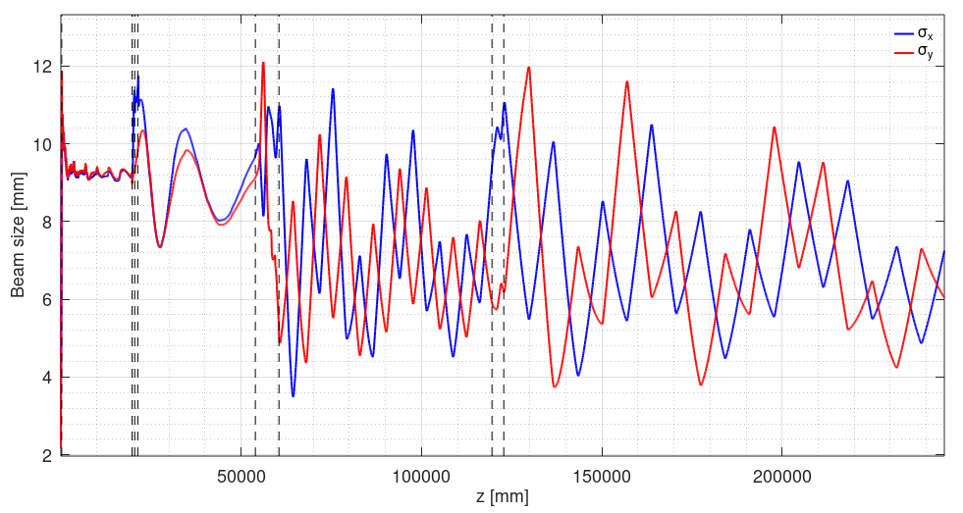
Transport table plotting (indicative only)
The transport table is from Volume in RF-Track using Bunch6dT, estimated from all particles in full space in time evolution, which might be not as precise as the final results, since particles that will not be accepted are also accounted

Slide 16
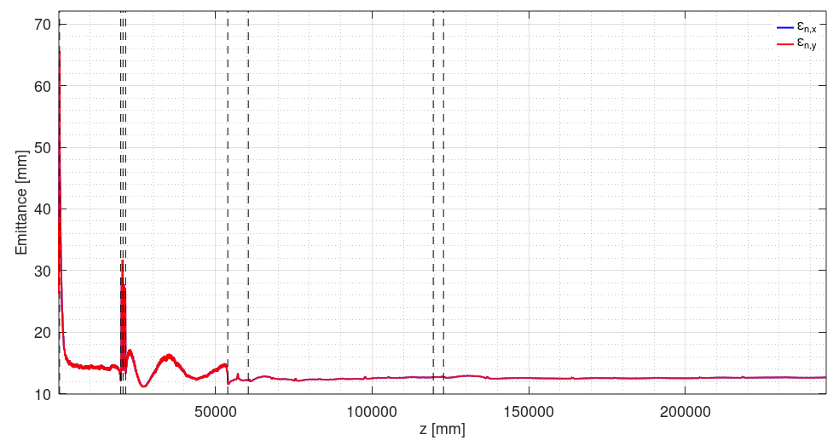
Transport table plotting (indicative only)
The transport table is from Volume in RF-Track using Bunch6dT, estimated from all particles in full space in time evolution, which might be not as precise as the final results, since particles that will not be accepted are also accounted

Slide 17
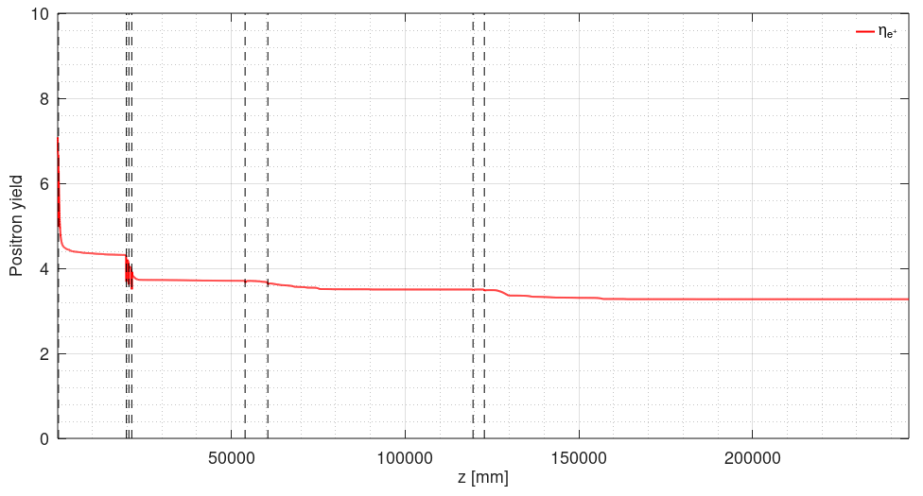
Transport table plotting (indicative only)
The transport table is from Volume in RF-Track using Bunch6dT, estimated from all particles in full space in time evolution, which might be not as precise as the final results, since particles that will not be accepted are also accounted
Losses in CL & Chicane & S1 & S2 & S3: ~36%, 7%, 7%, 5%, 6%. To be optimised

Slide 18
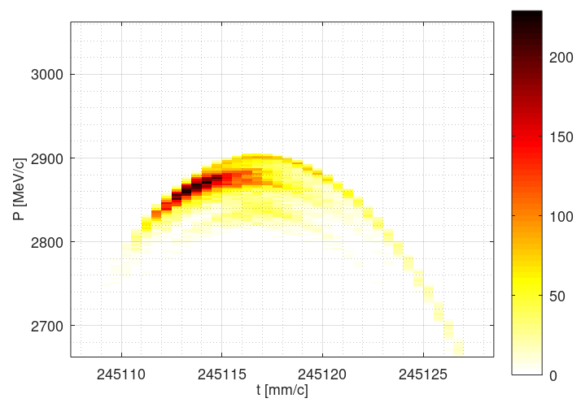
Final performance
At S3 exit (without DR acceptance cuts)
Positron yield: 3.27

Slide 19
Test 2.1
“New design” of chicane

Slide 20
New chicane design
Chicane version: “V2.0”
Parameters (quite similar as “V0”)
Dipole yoke length (fixed by design): l_{dip} = 180 mm
Apertures of beam pipe (fixed by design): Δx = 150 mm, Δy = 50 mm (60 mm for yoke)
Distances (fixed by design) between dipole yokes: d1 = 125 mm, d2 = 350 mm
Distance between solenoid and dipole yoke: d0 = 125 mm (preliminary)
Collimator parameters
Length: l_{col} = 120 mm
Apertures: Δx = 60 mm, Δy = 60 mm
X offset: x₀ = -30 mm

Slide 21
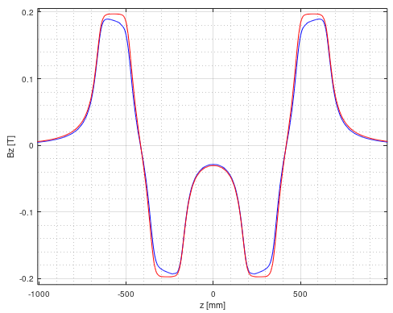
New chicane design
We already know that the full chicane simulation has quite different field from single dipole simulation, due to interactions between dipoles.
The question is, do we need to consider similar effect between chicane and solenoids, or it’s negligible
Blue: “V0” single dipole simulation
Red: “V0” full chicane simulation

Slide 22
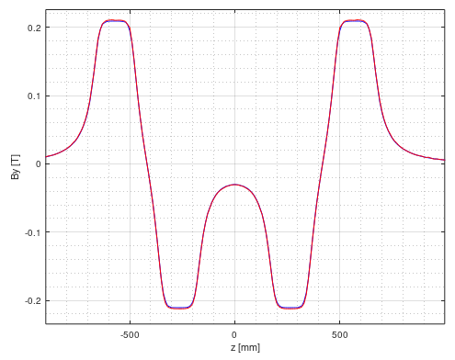
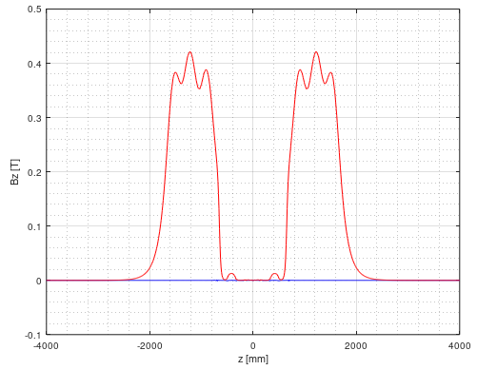
New chicane design
To know this, we compare two models:
“V2.0.0”: full chicane simulation
“V2.0.1”: full chicane + 6 neighbouring solenoids simulation
Comparison of original fieldmaps after mirroring (octant to full space)
Designed by R. Zennaro
Compare only two models

Slide 23
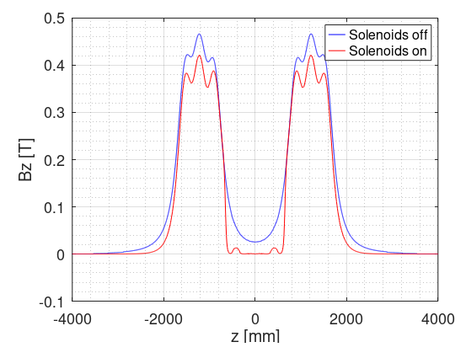
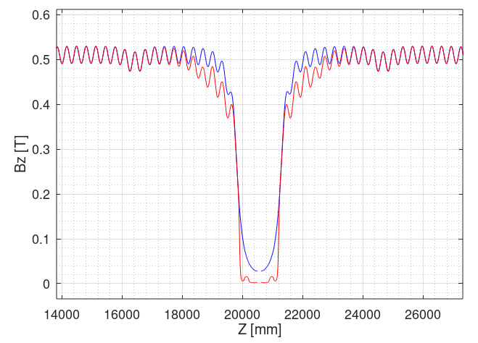

New chicane design
Comparison of fields
Blue: “V2.0.0”
Red: “V2.0.1”
RF-Track
Original (consider only 6 solenoids)

Slide 24
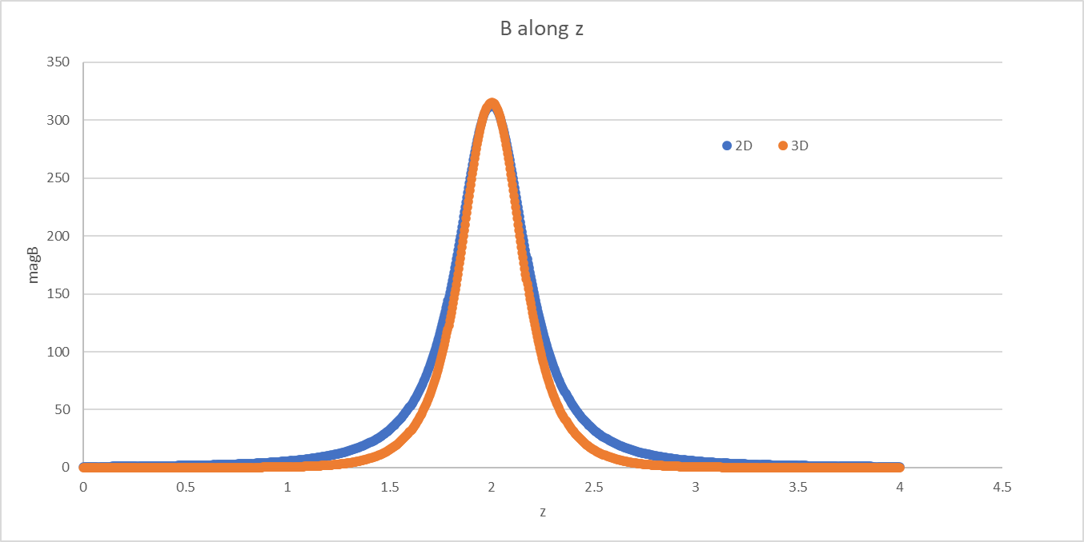
New chicane design
Comparison of 2D and 3D solenoid simulations
(Plotted by Riccardo)
2D simulation is more robust
Difference in 3D mainly due to volume size. Very large volume is required for 3D simulation
New 3D simulation received yesterday. Didn’t have time to look at it

Slide 25
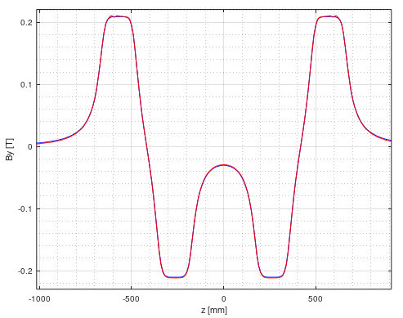
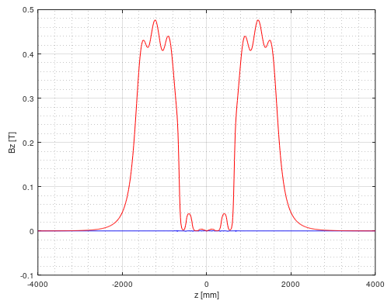
New chicane design
Comparison of fields
Blue: “V2.0.0”
Red: “V2.0.1” (with larger volume size)
Compare only two models

Slide 26
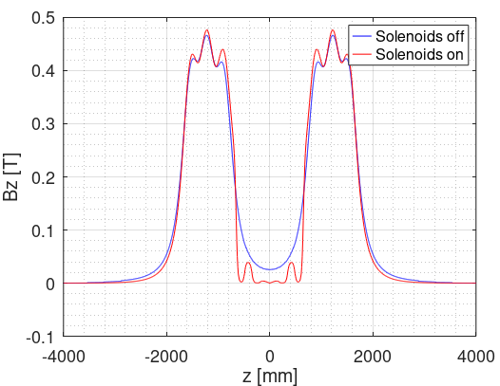
New chicane design
Comparison of fields
Blue: “V2.0.0”
Red: “V2.0.1” (with larger volume size)
In progress!
RF-Track
Original (consider only 6 solenoids)

Slide 27
New chicane design
Tracking results comparison
In progress!

Slide 28
Conclusions
Combination of using 20 MV/m and 14 MV/m has the lowest power consumption, and was studied
Positron linac redesigned based on old (7 structures) & new (6 structures) Capture Linac configurations and new requirements in Positron Linac
Promising results
Yields for 7 structures and 6 structures in CL are comparable
Total positron yield ~3.3, bunch length ~3 mm, energy spread ~1%, transverse normalized emittance ~12−13 mm*rad at Positron Linac exit
Expected DR accepted positron yield ~2.9−3.0 (depending on energy acceptance)
Losses to be further optimised
New chicane design and tests are in progress

Slide 29
Backup

