Slide 1
WP1 Meeting
Physics design of the positron target and capture system
I. Chaikovska on behalf of the WP3 team
27 September 2024

Slide 2
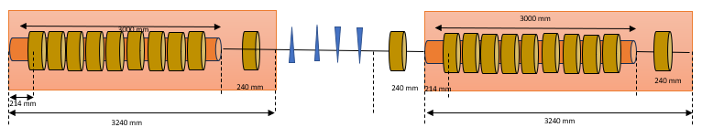
Physics design: towards end of FCC FS
List of available layouts:
Version 0
Version 1
Version 2 => 7 RF structures
Version 3 ➞ current baseline
HTS solenoid MD + 6 structures + Chicane + 2 structures + analytical formulae or full e+ linac simulation
Capture system -version 3
72 mm
3000 mm
200 mm
3000 mm
200 mm
168 mm
240 mm
240 mm
236 mm
214 mm
346 mm
214 mm
23026 mm + 1530 mm

Slide 3
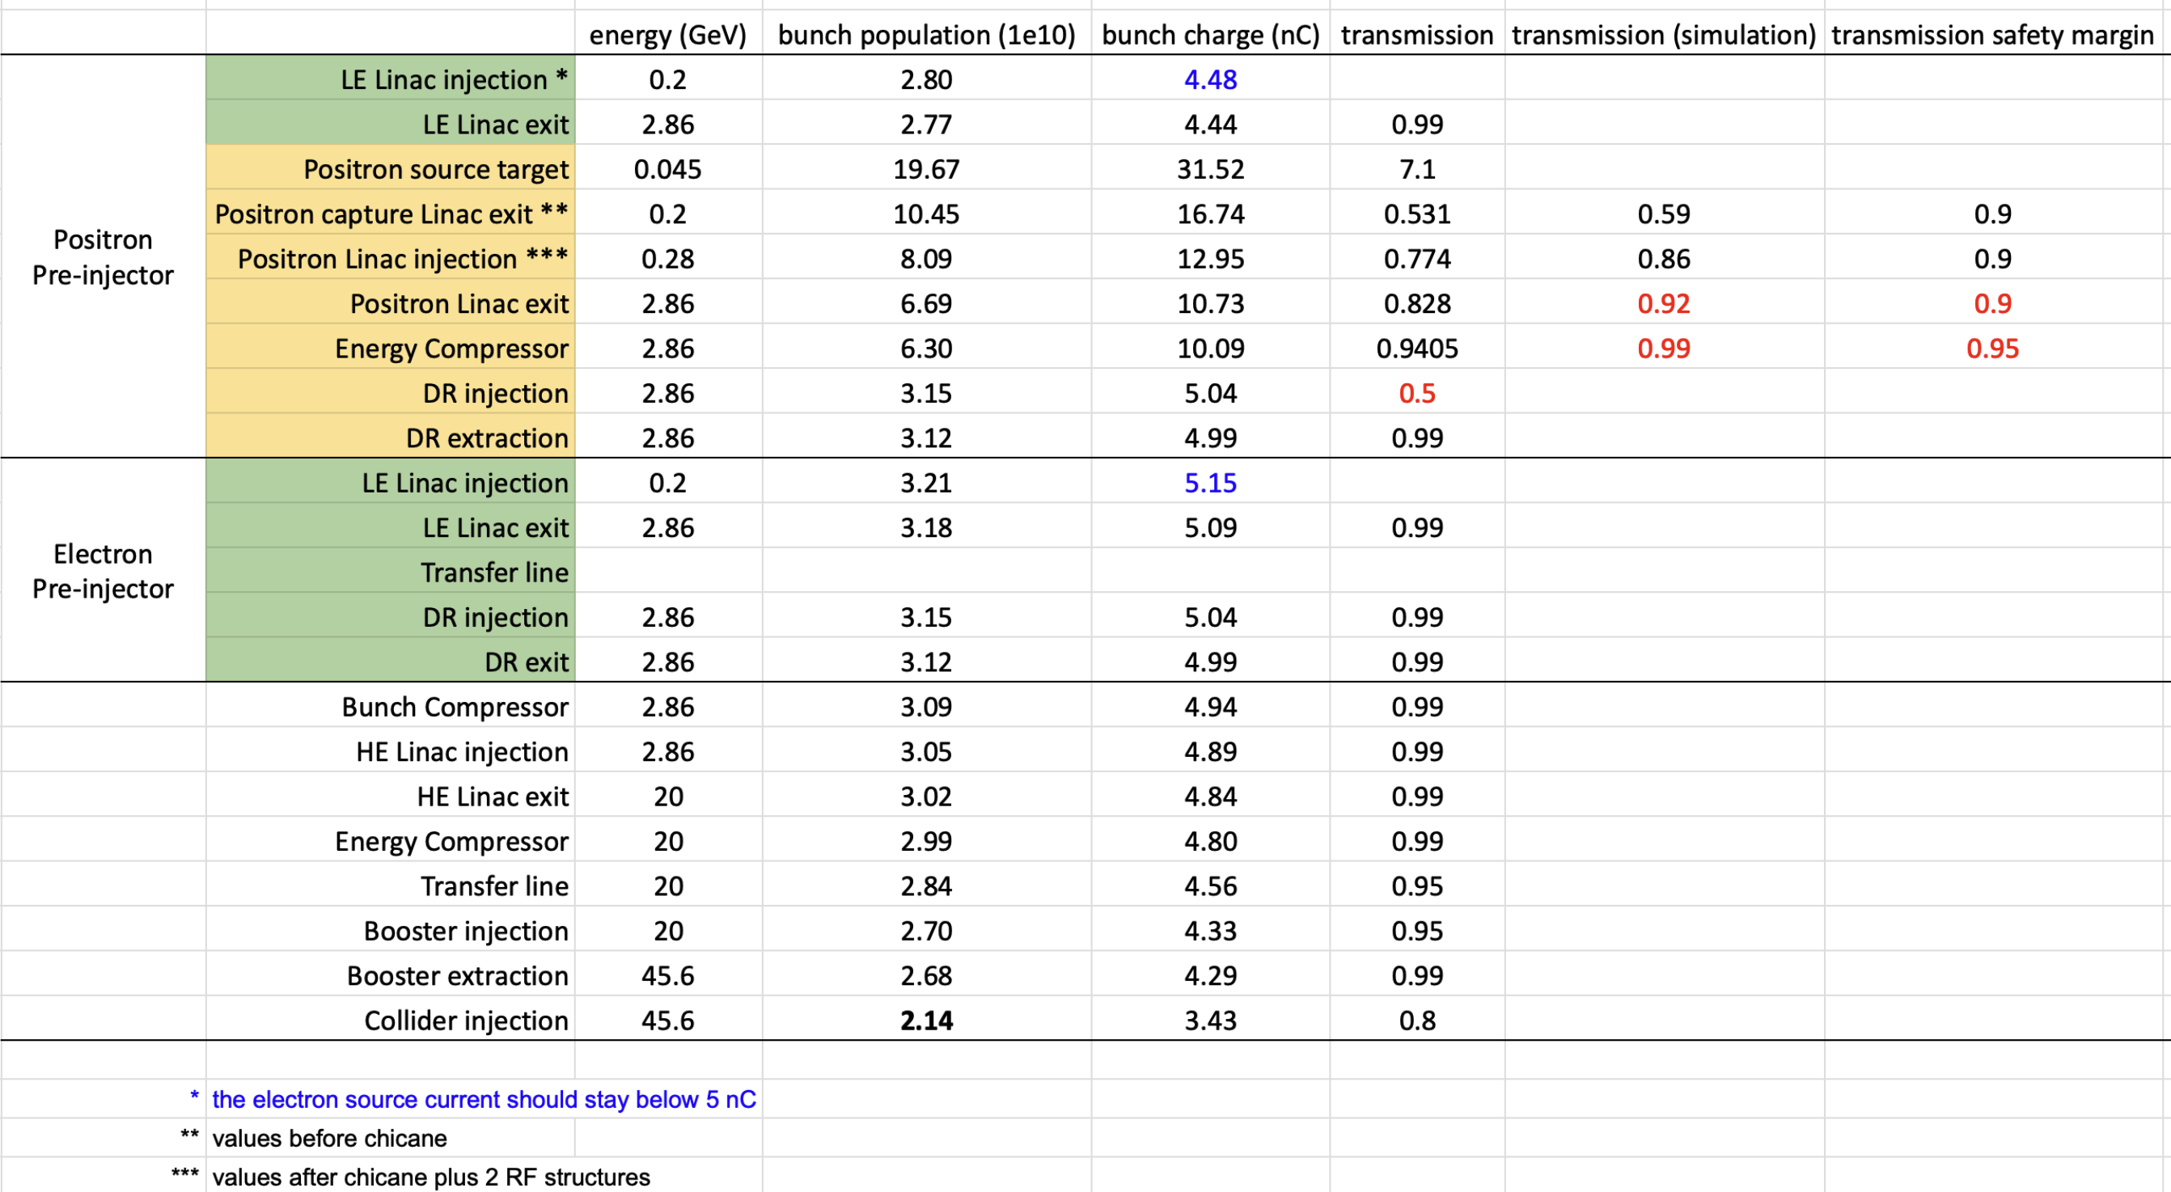
Safety Margin up to pLinac exit:
1/(0.9*0.9*0.9) ~1.4
(based on simultions)
Including ESC and DR:
1/(0.9*0.9*0.9*0.95*0.5) ~2.9
(Assumptions, to be updated with simulation results)

Slide 4
Physics design: towards end of FS (by Dec. 2024)
Consolidation of the baseline design of the e+ injector: production, capture, primary acceleration (2.86 GeV) and injection into the DR
All studies on Capture System –v3 ?
Solenoid power consumption. Is it acceptable or should be revised?
  CS (before chicane): 6 x 10 x 0.016 = 0.96 ~ 1 MW
  pLinac (after chicane): 10 x 10 x 0.016 = 1.6 MW
  If not ➞ choice between solenoidal vs. quadrupole focusing after chicane (and at which energy) ?
In case of solenoid focusing, more realistic magnetic fieldmap (solenoid-chicane) is needed for more reliable results. Ongoing.
Start-to-end simulations and optimization (e- beam distribution from linac studies?)
Misalignment/error studies (jitters)
The first assessment of the performance with 3 GHz RF structures (need to know the starting parameters: exact frequency, mode, aperture, gradient).

Slide 5
Starting from next year (CHART3)
Studies on a new layout with smaller aperture 3 GHz RF structures and higher field SC solenoid in CL.
The baseline design:
HTS solenoid matching device, solenoidal focusing with Bz = 0.5 T, 6 RF structures (2 GHz) with 14 MeV/m and aperture of ∅60 mm, the SKEKB type chicane.
  ➞ Ne⁺/Ne⁻ @PL (ΔE: 2%, Δt: 20 mm/c) is 2.85 (3.3 full bucket). e- drive beam charge: ~4.5 nC
Alternative layouts of the positron capture linac:
  HTS solenoid MD, RF structures (3 GHz), mode, aperture and gradient TBD, NC vs. SC solenoidal focusing ➞ it seems that SC solenoid should be adopted to fulfill the requirements. HTS technology for tuning solenoid (as maximum simulated dose per year is not compatible with Nb₃Sn )?
  HTS solenoid MD, RF structures (3 GHz), mode, aperture and gradient TBD, quadrupole focusing. (becomes more like to SuperKEKB)

Slide 6
e- drive beam parameter for e+ production
From Simona
Normalized e- beam emittance = 3-5 μm rad
We are currently using 15 μm rad ➞ to be changed to 5 μm rad
For the presented jitter studies we have used 5 μm rad
Beam position jitter effect
e- beam position jitter before the target: from 170 μm up to the extreme case of 1 mm
Simulation results: in current layout, with x and y position jitter of 1 mm (max values), the accepted e+ yield decreased by ~ 10%, while the emittance stays within +/- 4%

Slide 7
e- drive beam parameters (Geant4)
15mm
Energy = 2.86 GeV
Beam size (x, y) rms = 1 mm
Beam position (x, y) = 0 mm
Bunch length rms = 1 mm/c
Energy spread rms = 1e-3 => 5e-3
Divergence (xp, yp) = 0.893 μrad, (px, py) = 2.556 KeV/c.
Normalized emittance (x, y) = 5 μm rad.
Statistics= 50k – 10k
Simulation performed w/o mesh.
10mm
e- source
Target
Beam matching section upstream the target (flexibility in beam size @Target)

Slide 8
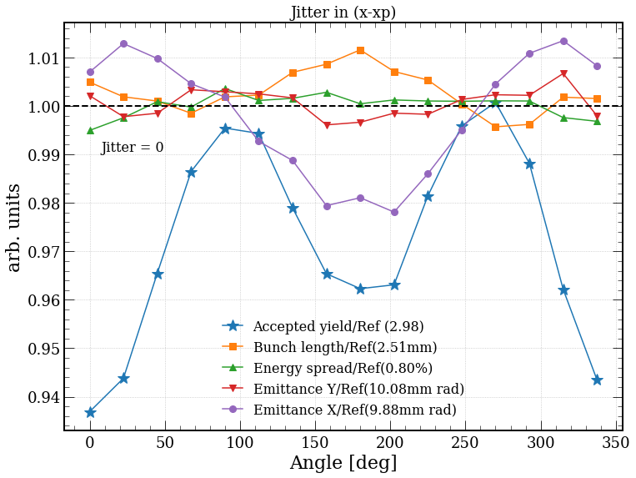
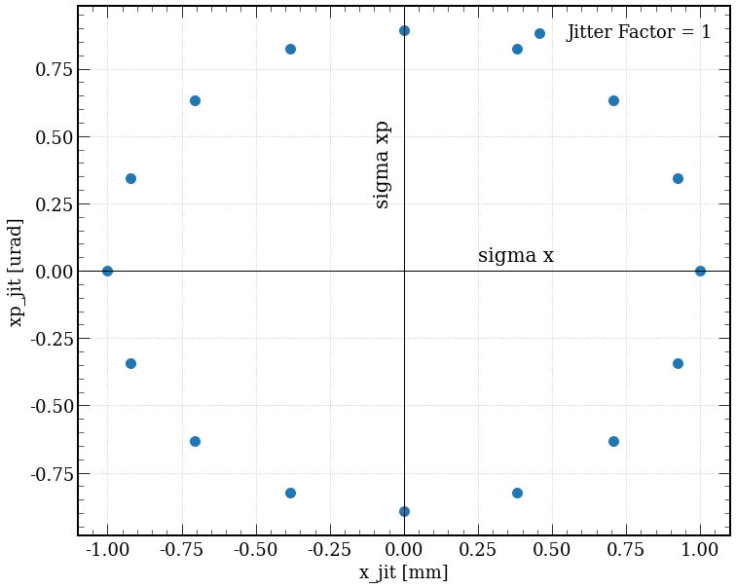
F. Alharthi
X-XP jitter (100% of σ_{pos} and σ_{angl})
Each “angle” corresponds to a jitter configuration (in X and XP).
The results are normalized to the ideal simulation w/o jitter
At the worst case the accepted yield drops by ~7%

Slide 9
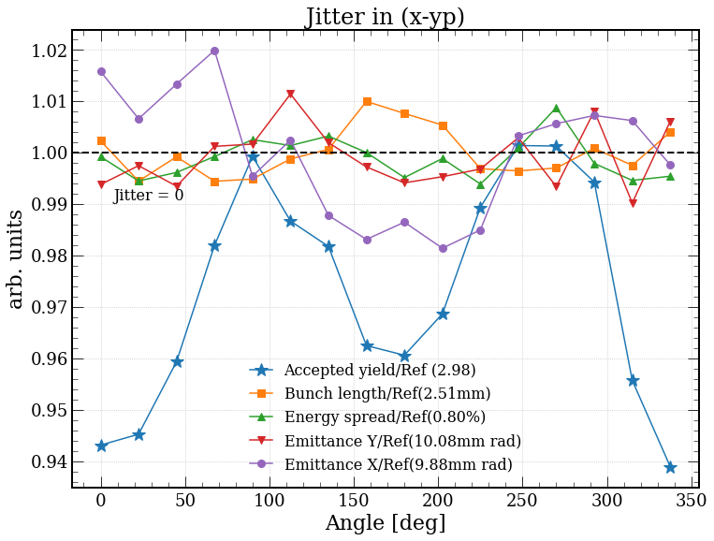
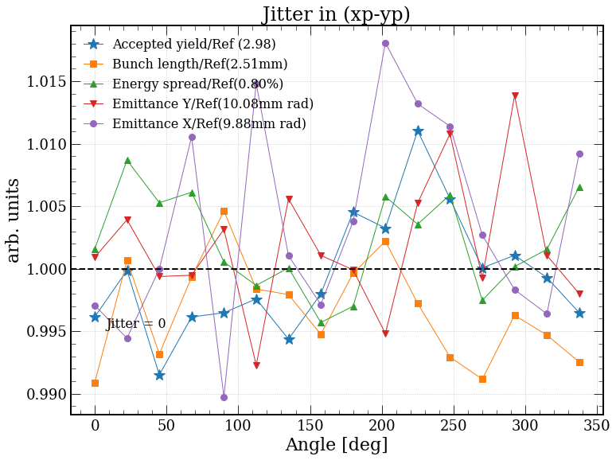
F. Alharthi
X-YP and XP-YP jitter (100% of σ_{pos} and σ_{angl})

Slide 10
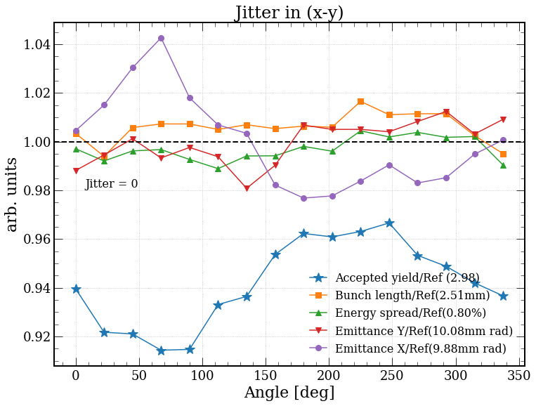
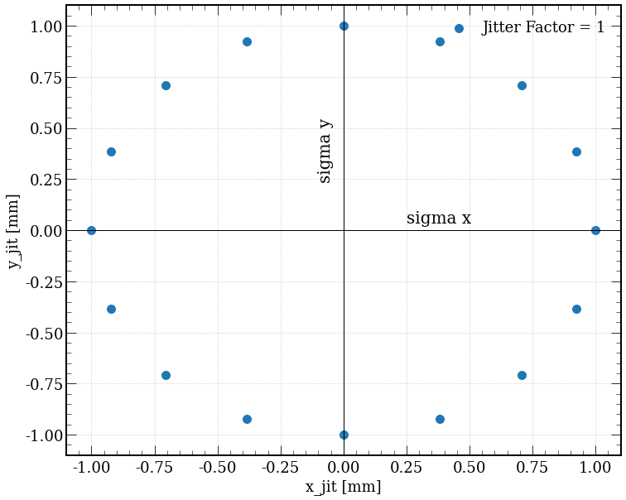
F. Alharthi
X-Y jitter (100% of σ_{pos} and σ_{angl})
The jitter introduced to both positions (X/Y) no jitter in XP or YP
Jitter in position (x and y) results in ~10% lower accepted yield (the largest deviation in the current study)
Emittance values: fluctuate between +/- 4%

Slide 12
Latest simulation results
 | Baseline HTS-Sol. | SuperKEKB (with BC) - FC
Aperture of matching device | 2r = 30~60 mm | 2r = 7~52 mm
Positron yield @ target | 7.09 | 7.09
Beam size x/y (mm) @ s1 | 7.49/7.41 | 5.70/5.67
Average total energy (MeV) @ s1 | 262.16 | 277.17
Energy spread (MeV) @ s1 | 35.05 | 26.12
Positron yield @ s1 | 3.61 | 1.69
Bunch length (mm) @ s1 (Accepted by cut window) | 3.04 | 5.43
Positron yield @ PL (ΔE: 2%, Δt: 20 mm/c) | 2.85(3.27) | 1.48(1.59)
Primary bunch charge (nC) | 4.74 | 9.12
Target deposited power (kW) | 1.24 | 2.39
PEDD (J/g) | 7.08 | 13.64
Emittance x/Emittance y (Normalized) (mm.rad) @ PL | 13/12 | 7.24/7.54
Energy spread (%) @ PL | 0.9 | 0.6

Slide 13
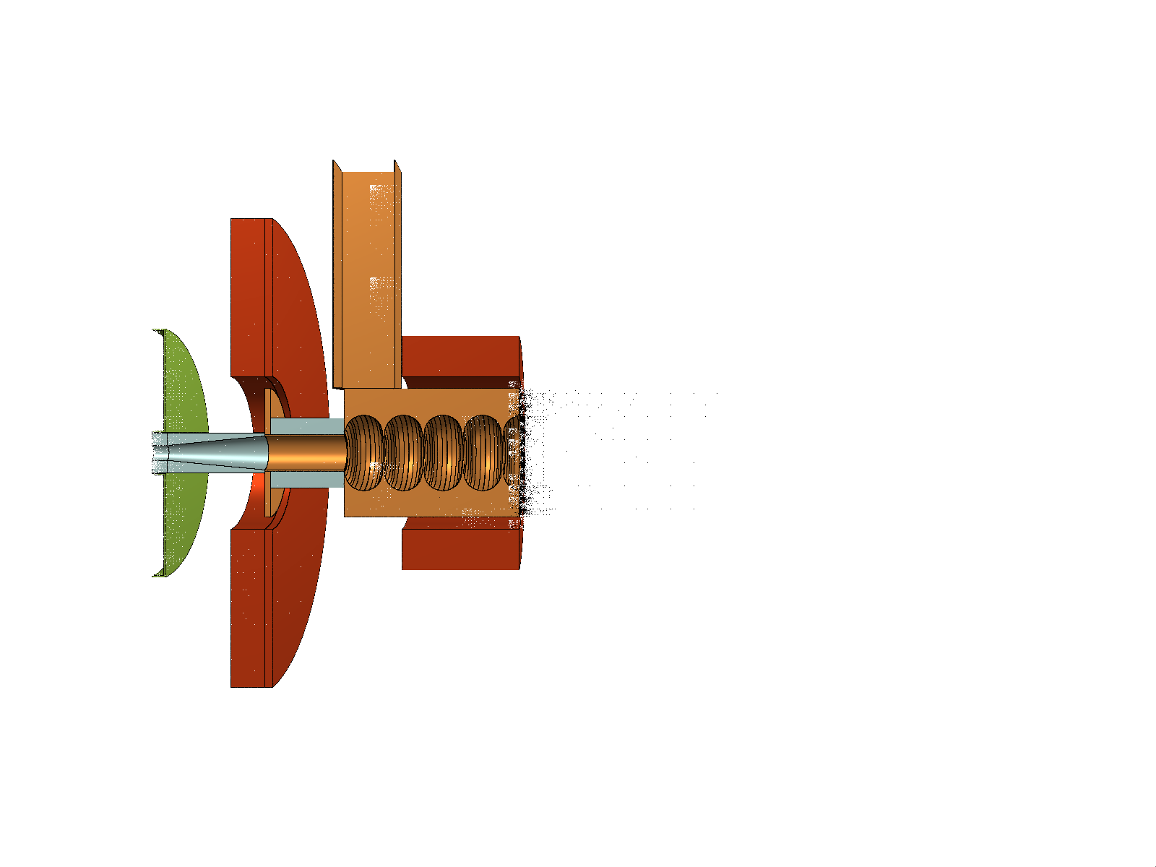
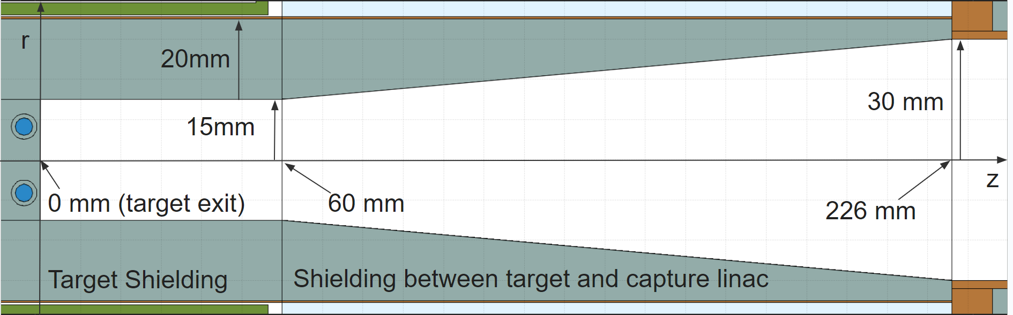
Setup: positron target and capture linac
Based on FLUKA simulations, the optimal shielding geometry involves placing shielding upstream of the tuning solenoid.
From beam dynamics simulations in the capture system, the best performance can be achieved by optimizing the phases of the capture linac.
Solenoid z [mm]: 168 to 240
Shielding z[mm]: 236 to 361

