Slide 1

Update meeting n.19
^{19th} meeting
27-09-2024
Simona Bettoni¹, Andrea Latina², Alexej Grudiev², Riccardo Zennaro¹
¹ Paul Scherrer Institut, Villigen (Switzerland)
² CERN, Meyrin (Switzerland)

Slide 2
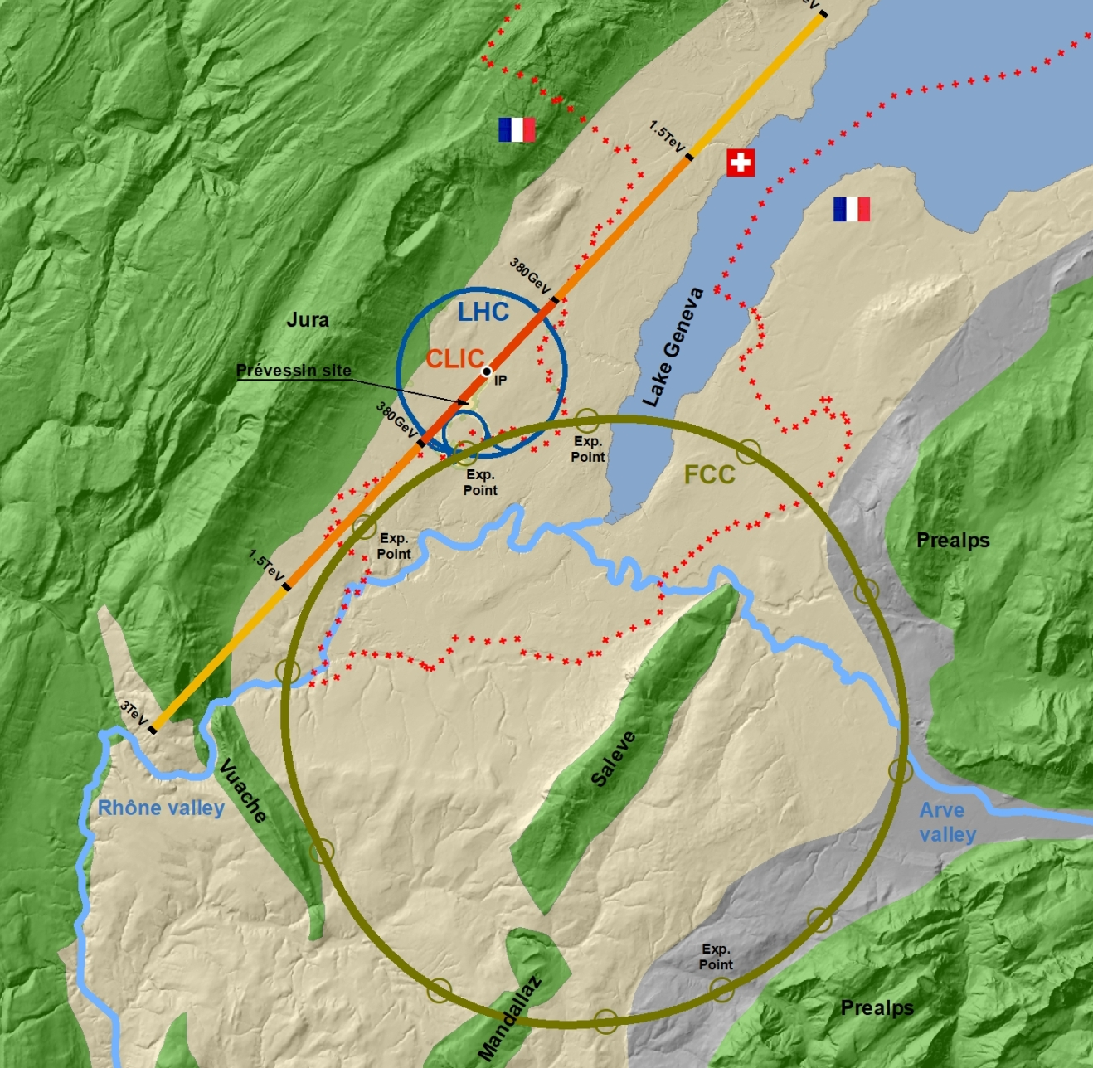
Outlook
Answers from the previous meeting
JA and Q
  Check the impact of the different charges (requested by Alexej)
Energy compressor: work in progress
  “Standard” mode
  Using the BC downstream of DR
  Varying the bunch length
  Comparison with the case without using EC
Conclusions

Slide 3
Answers from the previous meeting

Slide 4
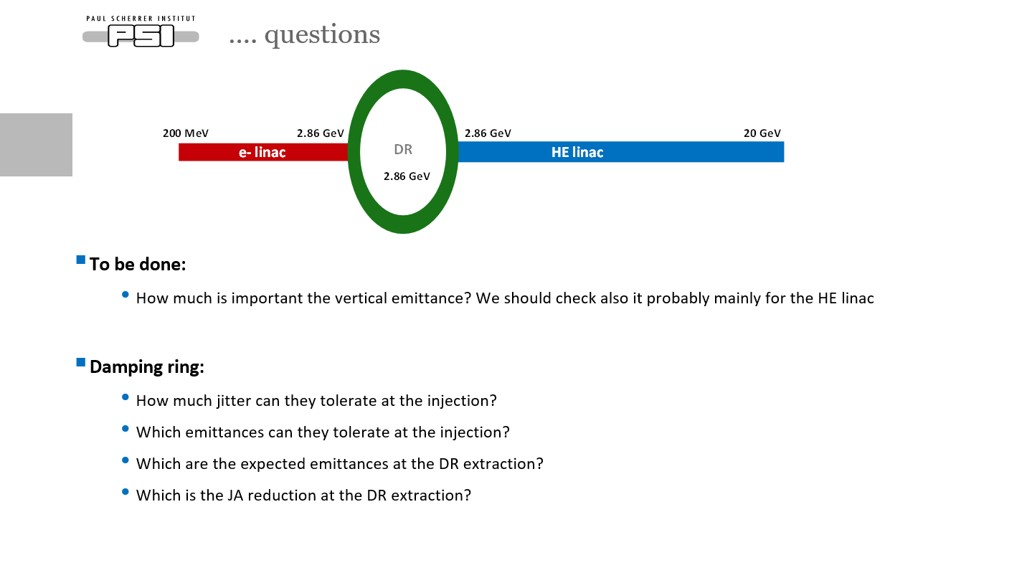
Some assumptions/answers
DR:
To be checked with Catia (?she asked), but probably is tolerable (possible to inject very large emittance positron beam)
Emittance seems to be ok, if acceptance is ok for e+ bunches
Let’s assume 1 mm.mrad in x and 10 mm.mrad in y
Let’s assume that JA is so that everything coming from the e- linac is canceled. The jitter we will have is given by the extraction kicker. How much? We have a lot of margin at the moment

Slide 5
JA vs Q

Slide 6
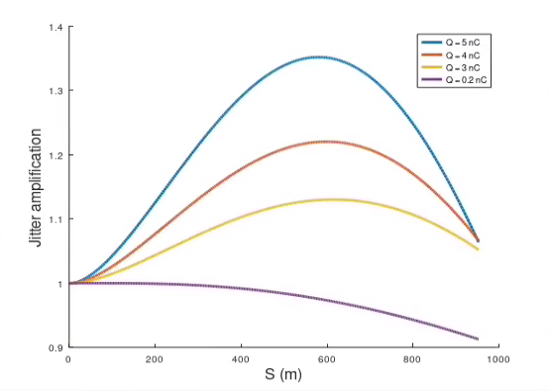
HE linac, single bunch
Compute the JA scanning the charge of the beam
a/λ = 0.12
G = 22.5 MV/m

Slide 7
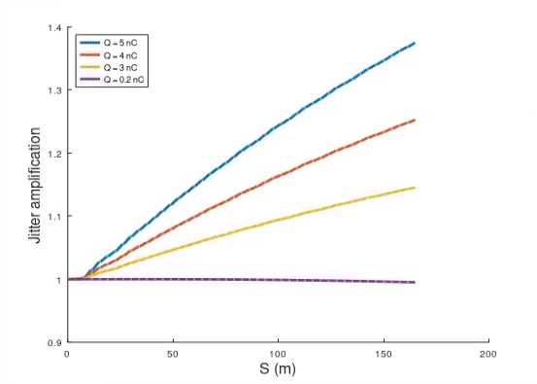
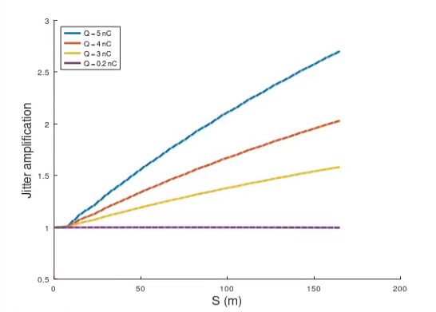
e- linac, single bunch
Compute the JA scanning the charge of the beam
a/λ = 0.15
G = 20.5 MV/m
Compute the JA scanning the charge of the beam
a/λ = 0.12
G = 20.5 MV/m
Quite substantial increase of the JA in the case of a/l = 0.12

Slide 8
e- bunch for positron production

Slide 9
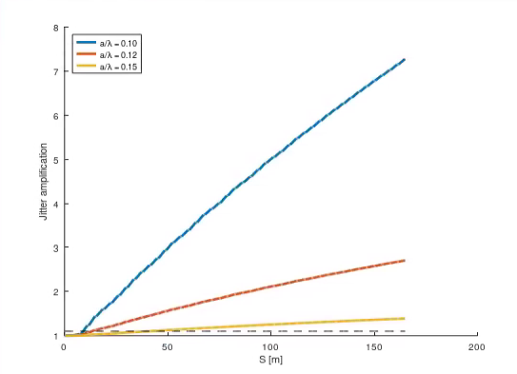
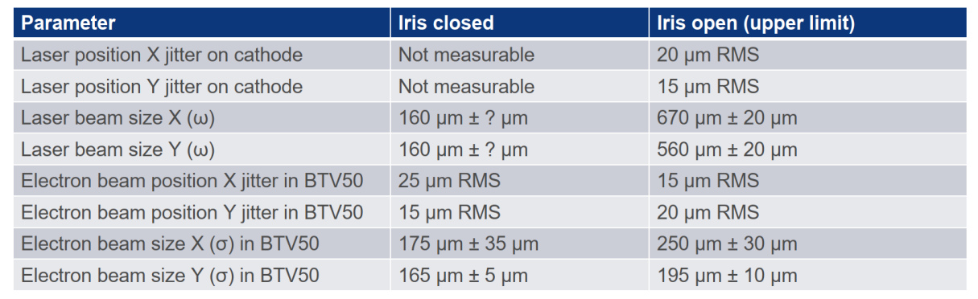
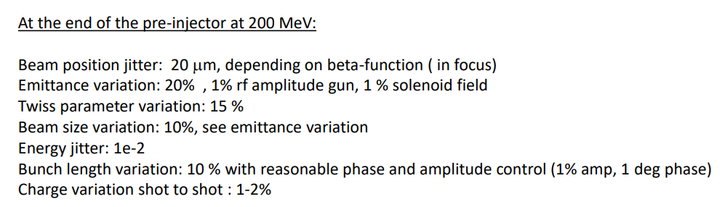
Mail to Iryna (02/09/2024)
We calculate it as:
Final_jitter = Initial_jitter*jitter_amplification
Initial_jitter = 0.12*sigma. This number comes from Awake’s measurements (Steffen Doebert)
Jitter_amplification = 2.73 for a/l = 0.12 and 1.40 for a/l = 0.15. These numbers are computed from tracking simulations. Here the correct numbers:
Normalized emittance = 4.4 mm.mrad, jitter ~ 0.33*sigma, where sigma is the rms beam size (a/l = 0.12 RF aperture)
Normalized emittance = 3.5 mm.mrad, jitter ~ 0.17*sigma (a/l = 0.15 RF aperture)
Initial jitter = 0.12*sigma
https://indico.cern.ch/event/1421083/contributions/5976115/attachments/2867972/5020447/Jitterexpectations.pdf
Steffen
Fahad will present the results
 | L = 3 m | L = 4 m
a/l = 0.10 | 7.25 | 13.40
a/l = 0.12 | 2.73 | 4.15
a/l = 0.15 | 1.40 | 1.75

Slide 10
Energy compressor: single and multi-bunch

Slide 11
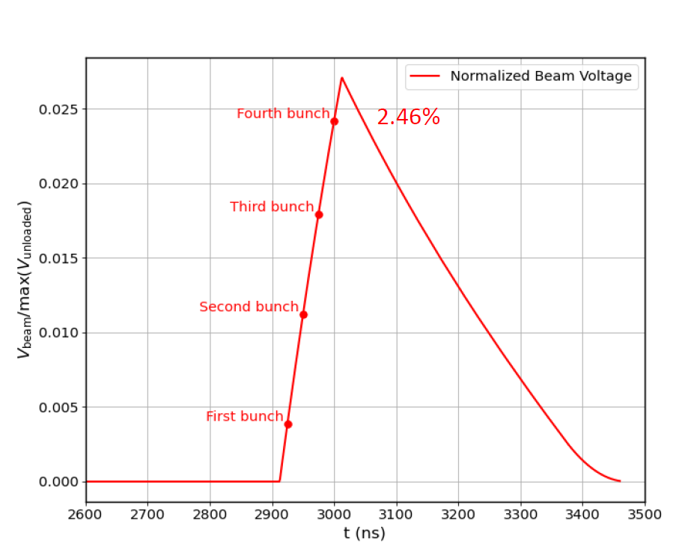
Energy gain versus bunch number
Number of bunches = 4 each one separated by 25 ns
The 4 bunches separated by 25 ns experience different accelerating gradient due to the RF pulse shape
Request from the collider ring: vary arbitrarily the single bunch charge from “0 nC ” up to 5 nC
Possible to compensate this to few permille level for a fixed charge using a complicated LLRF scheme
Looking for alternative solutions
-2%

Slide 12
Change of the goal of the EC
The EC was thought to adjust the single bunch. Now we want to use it for the multi-bunch in case that we do not want/can compensate it using the LLRF. This is how the slides were prepared.
The voltage to balance the multi-bunch effect is not by definition the same that it is necessary for the single bunch adjustment → booster people do not want a too small DE/E
We optimize the voltage for the energy centroids (minimum difference), and after we adjust the incoming chirp (linac phase or chirp from BC downstream of the DR), if necessary, to obtain the target single bunch properties.

Slide 13
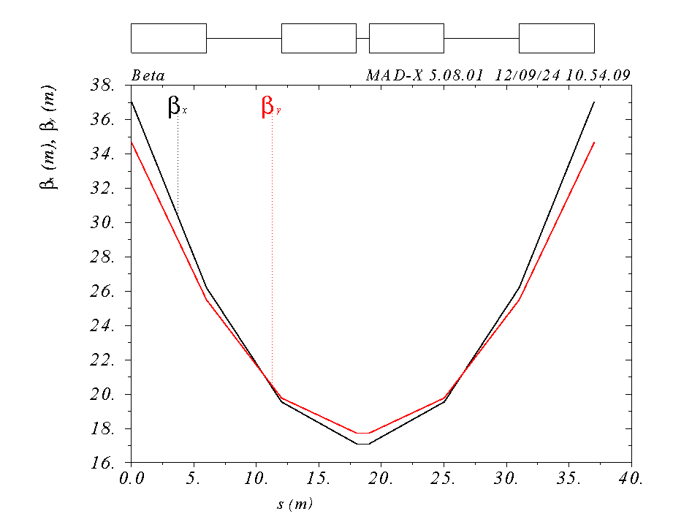
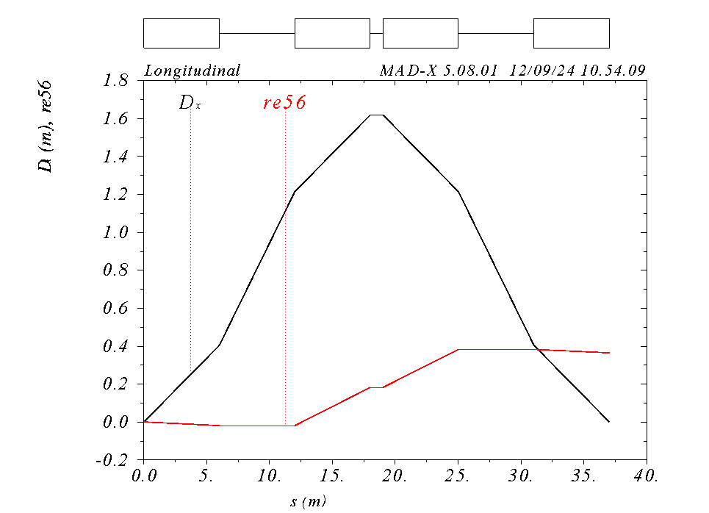
R56 = 0.4 m, Normal Conducting (NC), S-Band
//Parameters
L1_drift = 6;
L2_drift = 1;
L_bend := 5*1.2;
Angle_bend := 0.1124*1.2;
I vary the initial Twiss parameters to have a good optics along and at the exit of the chicane → section matching needed
To be seen if I can match to the final conditions to go to the booster line optics.
I consider 5 m per matching section.

Slide 14
Multi-bunch: S-band
In the case that we assume DE/E = 2%. If we have almost 0% from the DR -> 2%*17 GeV/20 GeV = 1.7% → ±0.85%
I consider the case of the downstream cavity S-band and C-band
Do not consider the single bunch extra time separation

Slide 15
Multi-bunch: C-band
In the case that we assume DE/E = 2%. If we have almost 0% from the DR -> 2%*17 GeV/20 GeV = 1.7% → ±0.85%
I consider the case of the downstream cavity S-band and C-band
Do not consider the single bunch extra time separation

Slide 16
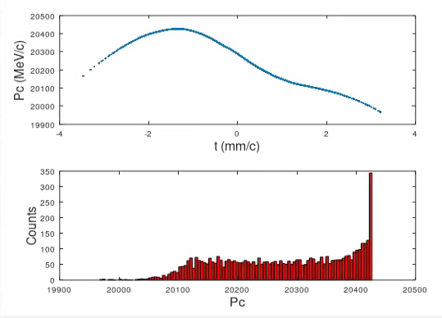
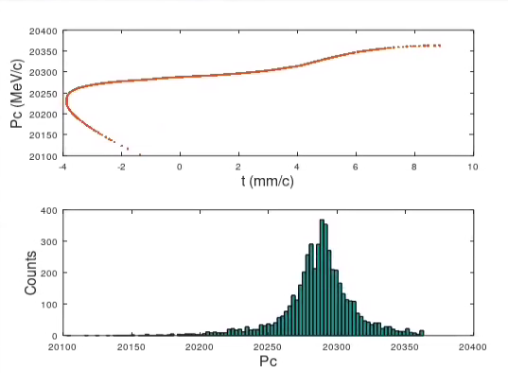
“RF-Tracking” single bunch, S-band
Excluded single bunch wake for the structure of the EC (to be added the matching section)
I use the same settings determined for the multi-bunch case, and I obtain this for the single bunch
Upstream of the EC
Downstream of the EC
rms bunch length = 1.0029 mm
rms dp/p = 0.53087%
Initial dp/p < 0.75 % (different linac length)
rms bunch length = 2.8178 mm
rms dp/p = 0.13399%
The final parameters may be tuned using a small adjustments of the upstream linac phases, if necessary

Slide 17
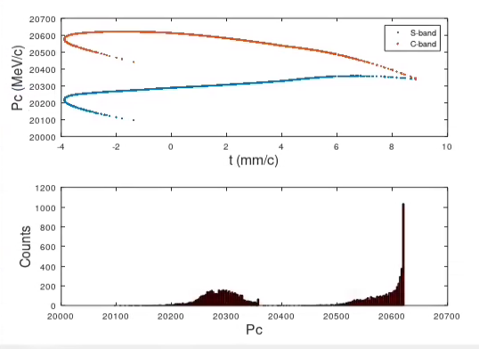
“RF-Tracking” single bunch, C-band
Excluded single bunch wake for the structure of the EC (to be added the matching section)
I use the same settings determined for the multi-bunch case, and I obtain this for the single bunch
Downstream of the EC
C-band
S-band
rms bunch length = 2.8179 mm
rms dp/p = 0.18019%
The final parameters may be tuned using a small adjustments of the upstream linac phases, if necessary

Slide 18
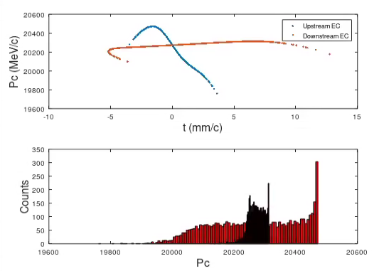
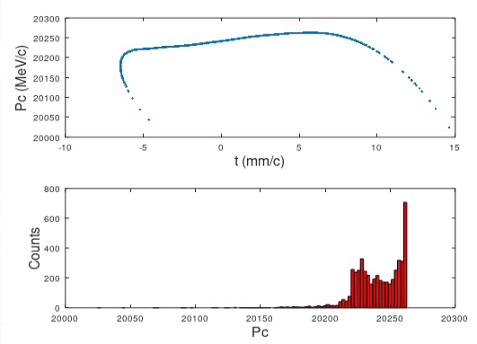
“RF-Tracking” single bunch, C-band
Excluded single bunch wake for the structure of the EC (to be added the matching section)
I go +2 deg off-crest in the HE linac → 6e-4 energy loss → (1-sind(88))*17e9 = 10.35 MeV
Downstream of the EC
+2 deg
+4 deg
rms bunch length = 3.4214 mm
rms dp/p = 0.13472%
rms bunch length = 4.046 mm
rms dp/p = 0.097795%
The final parameters may be tuned using a small adjustments of the upstream linac phases, if necessary.
Here assumed that the chirp residual from the compression is canceled.

Slide 19
Option NC: summary
HE LINAC
MATCHING SECTION
CHICANE
RF STRUCTURES
HE linac phase (deg) | On-crest | +2 | +4
Matching section L (m) | 5 | 5 | 5
Chicane (L) | 40 | 40 | 40
Dipole L (m) | 6 | 6 | 6
Dipole field (T) | 1.5 | 1.5 | 1.5
R56 (m) | ~0.4
R56 to have 4 mm (m) | 0.57 | 0.47 | 0.40
Extra distance bunches (per bunch) | 8 | 8 | 8
RF f (GHz) | 3 | 6 | 6
RF voltage (MV) | 803.5 | 415 | 415
RF length (m)-G = 22.5 MV/m | 35.71 | 18.44 | 18.44
DE/E (%) | 0.134 | 0.135 | 0.098
Bunch length (mm) | 2.82 | 3.42 | 4.05
All done assuming that the chirp residual from the BC is compensated
We may use it → wakes “dechirping” the chirp coming from the compression
Distance among the bunches = 8 mm, f_800 MHz → period ~ 37.5 cm
Bunch length and energy spread of the single bunch to be tuned with the RF phase of the upstream linac or USING the chirp from the BC downstream of the DR (see later)

Slide 20
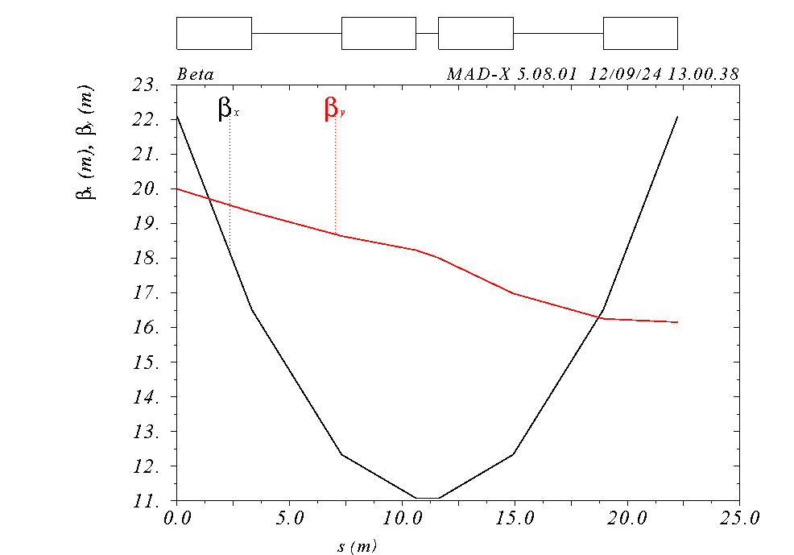
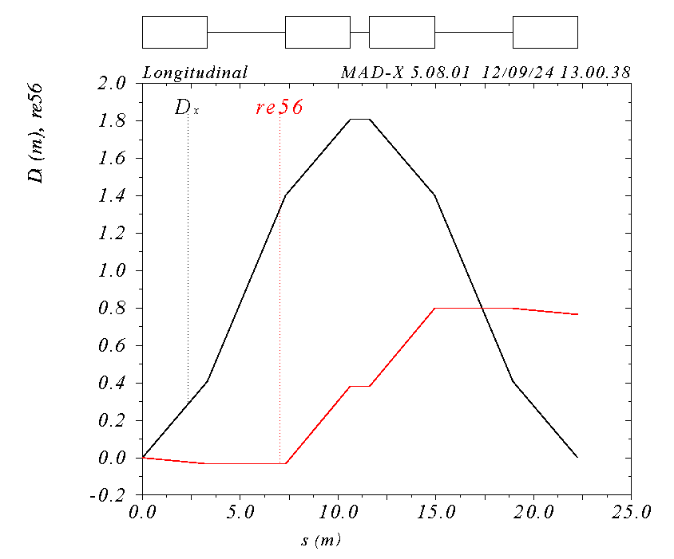
Chicane superconductive
We can assess R56 = 0.8 m

Slide 21
Multi-bunch: S-band
In the case that we assume DE/E = 2%. If we have almost 0% from the DR -> 2%*17 GeV/20 GeV = 1.7% → ±0.85%
I consider the case of the downstream cavity S-band and C-band
Do not consider the single bunch extra time separation

Slide 22
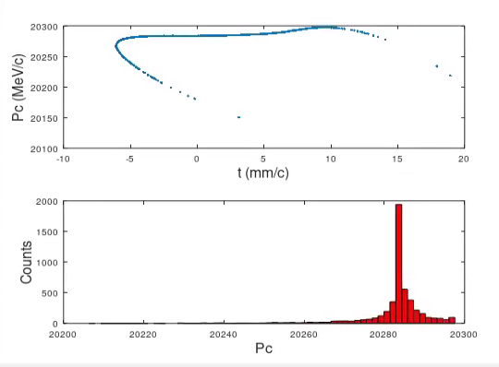
Single bunch, S-band
Excluded single bunch wake for the structure of the EC (to be added the matching section)
I use the same settings determined for the multi-bunch case, and I obtain this for the single bunch
Upstream of the EC
Downstream of the EC
rms bunch length = 1.0029 mm
rms dp/p = 0.53087%
rms bunch length = 4.4599 mm
rms dp/p = 0.048011%
Here assumed that the chirp residual from the compression is canceled

Slide 23
Multi-bunch: C-band
Do not consider the single bunch extra time separation

Slide 24
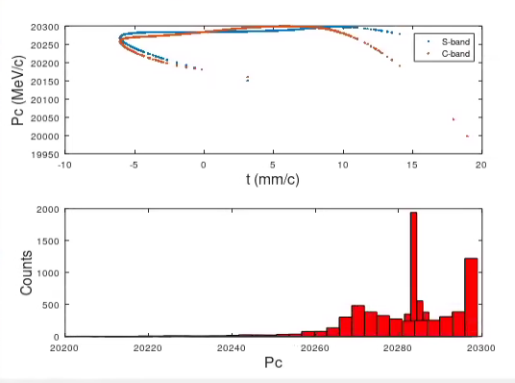
Single bunch, C-band
Excluded single bunch wake for the structure of the EC (to be added the matching section)
I use the same settings determined for the multi-bunch case, and I obtain this for the single bunch
Upstream of the EC
Downstream of the EC
rms bunch length = 1.0029 mm
rms dp/p = 0.53087%
rms bunch length = 4.4623 mm
rms dp/p = 0.083119%

Slide 25
Option SC/NC: summary
Normal conductive chicane
Superconductive chicane
HE linac phase (deg) | On-crest | +2 | +4
Matching section L (m) | 5 | 5 | 5
Chicane (L) | 40 | 40 | 40
Dipole L (m) | 6 | 6 | 6
Dipole field (T) | 1.5 | 1.5 | 1.5
R56 (m) | ~0.4
Extra distance bunches (per bunch) | 8 | 8 | 8
RF f (GHz) | 3 | 6 | 6
RF voltage (MV) | 803.5 | 415 | 415
RF length (m)-G = 22.5 MV/m | 35.71 | 18.44 | 18.44
DE/E (%) | 0.134 | 0.135 | 0.098
Bunch length (mm) | 2.82 | 3.42 | 4.05
HE linac phase (deg) | On-crest
Matching section L (m) | 5
Chicane (L) | 23
Dipole L (m) | 3.3
Dipole field (T) | 5
R56 (m) | 0.8
Extra distance bunches (per bunch) | 16
RF f (GHz) | 3 | 6
RF voltage (MV) | 415 | 237
RF length (m)-G = 22.5 MV/m | 18.44 | 10.53
DE/E (%) | 0.048 | 0.083
Bunch length (mm) | 4.46 | 4.46
DE/E<0.15% in all the cases, and adjustable with a moderate variation of the phase of the upstream HE linac
A better way would be to tune the chirp from BC → there are RF cavities run at the 0 crossing. We may decide the voltage to compensate for the chirp in HE linac to reach the target value IF THE SIGN IS THE DESIRED ONE
Bunch length in the range of 2.8-4.5 mm
Bunch extra delay to be seen in the following slides

Slide 26
Dimensioning
Assuming 20% fillling (Q:0.25*0.1+S:0.1+S: 0.15+S:0.1+S:0.1) more length to put quads and BPMs in between the structures
HE LINAC
MATCHING SECTION
CHICANE
RF STRUCTURES
MATCHING SECTION
NC, S-band → L_TOT = 5+40+35.71*1.2+5 = 92.9 m
NC, C-band (+2 deg) → L_TOT = 5+40+18.44*1.2+5 = 72.1 m
SC, S-band → L_TOT = 5+23+35.71*1.2+5 = 75.9 m
SC, C-band → L_TOT = 5+23+10.53*1.2+5 = 45.6 m
Chicane | RF cavities | HE linac phase (deg) | Total length (m)
NC | S-band | 0 | 92.9
NC | C-band | 2 | 72.1
SC | S-band | 0 | 75.9
SC | C-band | 0 | 45.6
HE linac phase (deg) | On-crest | +2 | +4
Matching section L (m) | 5 | 5 | 5
Chicane (L) | 40 | 40 | 40
Dipole L (m) | 6 | 6 | 6
Dipole field (T) | 1.5 | 1.5 | 1.5
R56 (m) | ~0.4
Extra distance bunches (per bunch) | 8 | 8 | 8
RF f (GHz) | 3 | 6 | 6
RF voltage (MV) | 803.5 | 415 | 415
RF length (m)-G = 22.5 MV/m | 35.71 | 18.44 | 18.44
DE/E (%) | 0.134 | 0.135 | 0.098
Bunch length (mm) | 2.82 | 3.42 | 4.05
HE linac phase (deg) | On-crest
Matching section L (m) | 5
Chicane (L) | 23
Dipole L (m) | 3.3
Dipole field (T) | 5
R56 (m) | 0.8
Extra distance bunches (per bunch) | 16
RF f (GHz) | 3 | 6
RF voltage (MV) | 415 | 237
RF length (m)-G = 22.5 MV/m | 18.44 | 10.53
DE/E (%) | 0.048 | 0.083
Bunch length (mm) | 4.46 | 4.46

Slide 27
Use the transfer line R56 = 2.4 m, S-band
In this case we do not need to build a chicane or equivalent and we can reduce dp/p coming from the transfer line, BUT we need to bring RF to the underground, space?
Extra separation depends on the ratio of the R56 → for 2.4 m the extra separation = 6*separation @ R56 = 0.4 m
Bunch becomes too long to stay in the linear part of the RF, bunch length becomes long (to be reduced the chirp), and bunch separation becomes large

Slide 28
Use the transfer line R56 = 2.4 m, f = 1.5 GHz
Tried to reduce the f to avoid issues with the RF curvature and experienced RF phase
The solution is to lower the frequency

Slide 29
Use the transfer line R56 = 2.4 m, lower f (800 MHz)
This seems to allow to bring DE/E to very small values
Even better, even if I guess that I must have a sub-multiple of the main f → 1 GHz or 500 MHz for example
Long bunch length and gradient is very low!

Slide 30
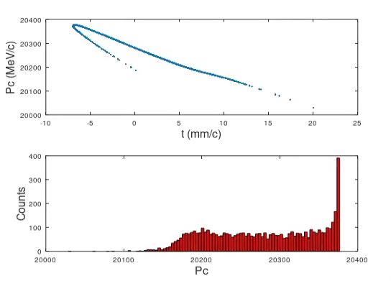
Use the transfer line R56 = 2.4 m, lower f (800 MHz)
Excluded single bunch wake for the structure of the EC (to be added the matching section)
Downstream of the EC
rms bunch length = 4.9627 mm
rms dp/p = 0.33912%
We need to run off-crest the HE linac probably by several degrees (no!) → if we use the BC chirp we should be ok also with the sign

Slide 31
The solution would be
If we go to 0.05% (we may tune the BC downstream of the DR) energy spread using the BC chirp we can use the trasfer line R56, and pass through it with a very small DE/E
We have to use R56 multiple so that the bunch distance is a multiple of the periods of the RF structures downstream of the chicane
Basically 0 energy spread
Smaller gradient, but we need less voltage
Extremely small energy spread in the transfer line
Very small energy spread at the end

Slide 32
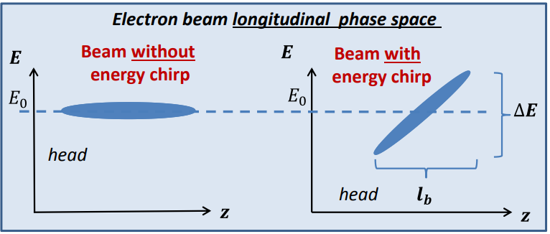
Use the BC chirp
We end naturally from the chicane with the head with less energy than the tail (undercompression-I guess tbc by Simone)
Wakefield will lower the energy of the tail with respect to the head
From the compression of the bunch downstream of the DR → chirp
When we reach the 20 GeV that chirp becomes: chirp_2.86GeV*2.86/20
I spoke with Simone, and he is assuming to compensate the chirp, but he could provide something like 1.1%

Slide 33
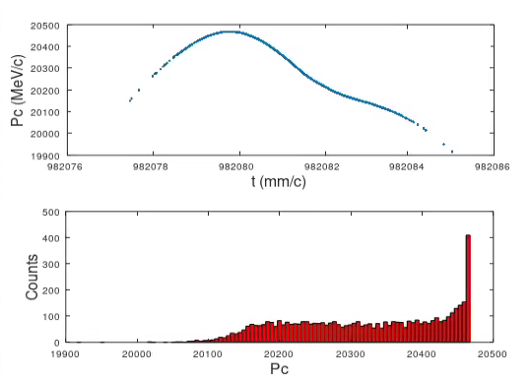
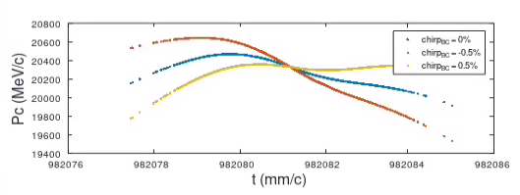
Sign convention
Starting bunch, no EC, no chirp_BC
Head
Head
Tail
Best here:
rms bunch length = 1.0129 mm
rms dp/p = 0.18754%
Tail
Residual chirp corresponds to lower the energy of the head and increases that of the tail → positive sign in the code conventions
From the optimization I would like to have more negative chirp → more wakefield. To be considered the C-band or smaller aperture?
Now we can kind of neglecting the section upstream of the DR
For the compression natural R56 chicane in under-compression mode

Slide 34
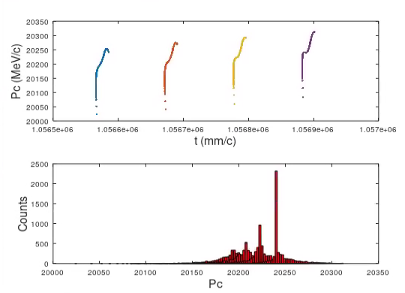
Optimizing params, NC, S-band
chirp_BC = -3; % rms permille
dt_BC = 1; %rms mm/c
dE_single = 4.250; % permille difference energy centroid
Grad_EC = 22.5; %MV/m
freq_EC = 2.8; % GHz
Lstr_EC = 35.711*1.05; % m
MODEL
RESULTS
Final bunches n. 1
rms bunch length = 3.8536 mm
rms dp/p = 0.11893%
Final bunches n. 2
rms bunch length = 3.8196 mm
rms dp/p = 0.11054%
Dt = -1.4915 mm/c
Dp = 14.2939 MeV/c
Final bunches n. 3
rms bunch length = 3.7862 mm
rms dp/p = 0.097074%
Dt = -1.474 mm/c
Dp = 15.56 MeV/c
Final bunches n. 4
rms bunch length = 3.7532 mm
rms dp/p = 0.080109%
Dt = -1.4567 mm/c
Dp = 17.3188 MeV/c
Comments
DE/E centroids compensated at 8.5e-4 (0.25% full “train” compared to 2%) to be better tuned the voltage, if necessary
Extra time separation around 1.5 mm bunch-to-bunch
I need negative sign chirp → overcompression in BC, or swapped R56 sign in the DR BC or in our case
More wakefield would be beneficial → consider to shorten the bunch (reduce tranvserse) and reduce the RF aperture
Bunch length~4 mm, DE/E~0.08-0.11%

Slide 35
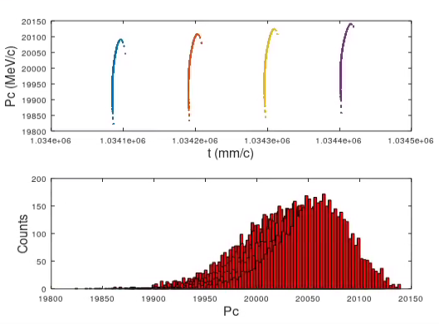
Q = 500 pC, same as in the previous slide
I run HE linac and BC with Q = 0.5 nC without touching any parameter
Final bunches n. 1
rms bunch length = 2.3415 mm
rms dp/p = 0.20196%
Final bunches n. 2
rms bunch length = 2.325 mm
rms dp/p = 0.19972%
Final bunches n. 3
rms bunch length = 2.3088 mm
rms dp/p = 0.19353%
Final bunches n. 4
rms bunch length = 2.2928 mm
rms dp/p = 0.18362%
For low value of the charge are the target parameters the same as for higher Q? Are 0.2% and 2.3 mm bunch length ok for low Q?
We can give what we get and ask if the booster people can check.

Slide 36
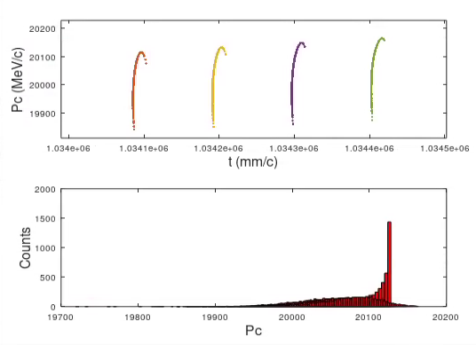
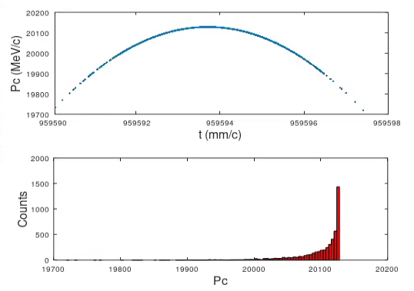
Q = 5 pC
I run HE linac and BC with Q = 5 pC without touching any parameter
Upstream of BC
Downstream of BC
Final bunches n. 1
rms bunch length = 2.2119 mm
rms dp/p = 0.20922%
Final bunches n. 2
rms bunch length = 2.1969 mm
rms dp/p = 0.20782%
Dt = -1.5179 mm/c
Final bunches n. 3
rms bunch length = 2.182 mm
rms dp/p = 0.20276%
Dt = -1.5001 mm/c
Final bunches n. 4
rms bunch length = 2.1674 mm
rms dp/p = 0.19424%
Dt = -1.4825 mm/c
rms bunch length = 0.99876 mm
rms dp/p = 0.20885%
For low value of the charge are the target parameters the same as for higher Q? Are 0.2% and 2.3 mm bunch length ok for low Q?
We can give what we get and ask if the booster people can check.

Slide 37
Proposed design
Q = 5 pC
σ_{z0} = 2.2 mm
DE/E = 0.2%
DE_{cen} = 0.085% tbd
R₅₆ = 0.4 m (SC or NC)
f2 = 2.8 GHz
V = 844 MV
f1 = 2.8 GHz
Chirp_BC = -3
HE linac
RF EC
σ_{z0} ~ 1 mm
σ_{z0} = 1 mm
DE/E = 0.53%
DE_{cen} = 0.43%
σ_{z0} = 3.8 mm
DE/E = 0.53%
DE_{cen} = 0.25% tbd
Q = 5 nC
σ_{z0} = 3.8 mm
DE/E = 0.1%
DE_{cen} = 0.085% tbd
Final bunches n. 1
rms bunch length = 3.8932 mm
rms dp/p = 0.12253%
Final bunches n. 2
rms bunch length = 3.859 mm
rms dp/p = 0.11447%
Dt = -1.4916 mm/c
Final bunches n. 3
rms bunch length = 3.8253 mm
rms dp/p = 0.10122%
Dt = -1.474 mm/c
Final bunches n. 4
rms bunch length = 3.7921 mm
rms dp/p = 0.08424%
Dt = -1.4567 mm/c
Final bunches n. 1
rms bunch length = 2.2119 mm
rms dp/p = 0.20922%
Final bunches n. 2
rms bunch length = 2.1969 mm
rms dp/p = 0.20782%
Dt = -1.5179 mm/c
Final bunches n. 3
rms bunch length = 2.182 mm
rms dp/p = 0.20276%
Dt = -1.5001 mm/c
Final bunches n. 4
rms bunch length = 2.1674 mm
rms dp/p = 0.19424%
Dt = -1.4825 mm/c
This solution allows having:
The target bunch-to-bunch energy shift
The target bunch length
The target energy spread
To be verified if the parameters are ok for the low charge (less instabilities?)
Chirp opposite to that from BC chirp, i.e. the same of the wakefield → they must be included in the EC structures

Slide 38
Included wakefield in EC structures
With SRWF EC structures
Chirp_BC = -3
Final bunches n. 1
rms bunch length = 3.8977 mm
rms dp/p = 0.11417%
Final bunches n. 2
rms bunch length = 3.8634 mm
rms dp/p = 0.10669%
Dt = -1.4916 mm/c
Dp = 14.3024 MeV/c
Final bunches n. 3
rms bunch length = 3.8297 mm
rms dp/p = 0.094386%
Dt = -1.474 mm/c
Dp = 15.5511 MeV/c
Final bunches n. 4
rms bunch length = 3.7966 mm
rms dp/p = 0.079106%
Dt = -1.4566 mm/c
Dp = 17.2929 MeV/c
With SRWF EC structures
Chirp_BC = 0
Final bunches n. 1
rms bunch length = 2.8405 mm
rms dp/p = 0.16554%
Final bunches n. 2
rms bunch length = 2.8186 mm
rms dp/p = 0.16044%
Dt = -1.4913 mm/c
Dp = 13.4384 MeV/c
Final bunches n. 3
rms bunch length = 2.7971 mm
rms dp/p = 0.1511%
Dt = -1.4737 mm/c
Dp = 14.742 MeV/c
Final bunches n. 4
rms bunch length = 2.7759 mm
rms dp/p = 0.13811%
Dt = -1.4564 mm/c
Dp = 16.5418 MeV/c
No SRWF EC structures
Chirp_BC = -3
Final bunches n. 1
rms bunch length = 3.8932 mm
rms dp/p = 0.12253%
Final bunches n. 2
rms bunch length = 3.859 mm
rms dp/p = 0.11447%
Dt = -1.4916 mm/c
Final bunches n. 3
rms bunch length = 3.8253 mm
rms dp/p = 0.10122%
Dt = -1.474 mm/c
Final bunches n. 4
rms bunch length = 3.7921 mm
rms dp/p = 0.08424%
Dt = -1.4567 mm/c
Not a big impact

Slide 39
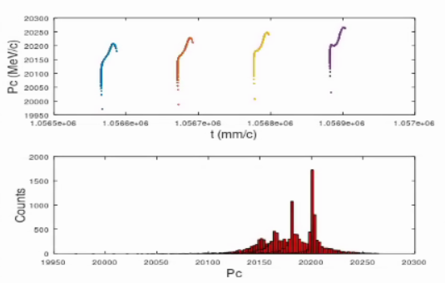
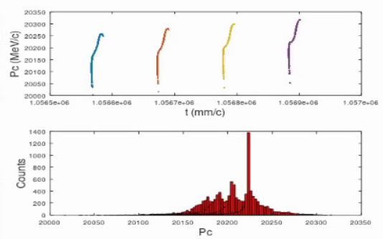
NC, S-band, off-crest in HE linac
+2 deg, chirp_BC = 0
+4 deg, chirp_BC = 0
Bunch at the end of HE linac
rms bunch length = 0.99084 mm
rms dp/p = 0.6994%
Bunch at the end of HE linac
rms bunch length = 1.0037 mm
rms dp/p = 0.87423%
Final bunches n. 1
rms bunch length = 3.4399 mm
rms dp/p = 0.14026%
Final bunches n. 2
rms bunch length = 3.4107 mm
rms dp/p = 0.13285%
Dt = -1.4914 mm/c
Dp = 13.8914 MeV/c
Final bunches n. 3
rms bunch length = 3.382 mm
rms dp/p = 0.12052%
Dt = -1.4739 mm/c
Dp = 15.2099 MeV/c
Final bunches n. 4
rms bunch length = 3.3538 mm
rms dp/p = 0.10422%
Dt = -1.4566 mm/c
Dp = 17.021 MeV/c
Final bunches n. 1
rms bunch length = 4.0815 mm
rms dp/p = 0.11142%
Final bunches n. 2
rms bunch length = 4.045 mm
rms dp/p = 0.10266%
Dt = -1.4916 mm/c
Dp = 14.3294 MeV/c
Final bunches n. 3
rms bunch length = 4.0091 mm
rms dp/p = 0.088724%
Dt = -1.474 mm/c
Dp = 15.5676 MeV/c
Final bunches n. 4
rms bunch length = 3.9736 mm
rms dp/p = 0.071583%
Dt = -1.4567 mm/c
Dp = 17.2982 MeV/c
+4 deg seems to be the good solution
Are the parameters of +2 deg ok?

Slide 40
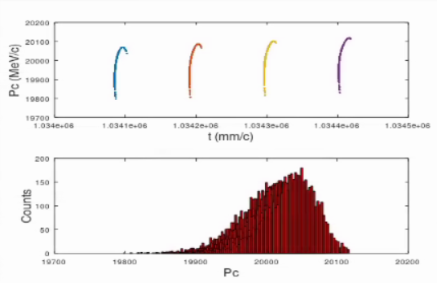
Q = 5 pC
Bunch at the end of HE linac
rms bunch length = 0.99194 mm
rms dp/p = 0.39608%
Final bunches n. 1
rms bunch length = 2.3423 mm
rms dp/p = 0.20343%
Final bunches n. 2
rms bunch length = 2.3257 mm
rms dp/p = 0.20141%
Dt = -1.5179 mm/c
Dp = 10.8736 MeV/c
Final bunches n. 3
rms bunch length = 2.3094 mm
rms dp/p = 0.19549%
Dt = -1.5 mm/c
Dp = 12.1096 MeV/c
Final bunches n. 4
rms bunch length = 2.2934 mm
rms dp/p = 0.18586%
Dt = -1.4825 mm/c
Dp = 13.8762 MeV/c
Same settings as before (+4 deg), but with a much smaller charge
Similar results as the case using chirp_BC

Slide 41
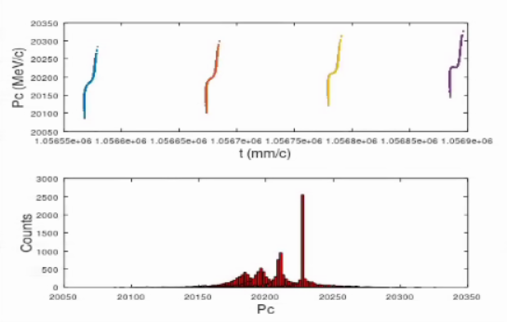
Shortening the bunch, NC, S-band
I go to 0.75 mm rms bunch length in HE linac, I stay on-crest, I put at 0 the chirp_BC
rms bunch length = 0.74703 mm
rms dp/p = 0.58478%
Final bunches n. 1
rms bunch length = 2.788 mm
rms dp/p = 0.10218%
Final bunches n. 2
rms bunch length = 2.7638 mm
rms dp/p = 0.095074%
Dt = -1.4921 mm/c
Dp = 13.3867 MeV/c
Final bunches n. 3
rms bunch length = 2.7398 mm
rms dp/p = 0.084329%
Dt = -1.4745 mm/c
Dp = 14.7557 MeV/c
Final bunches n. 4
rms bunch length = 2.7163 mm
rms dp/p = 0.071242%
Dt = -1.4572 mm/c
Dp = 16.6193 MeV/c

Slide 42
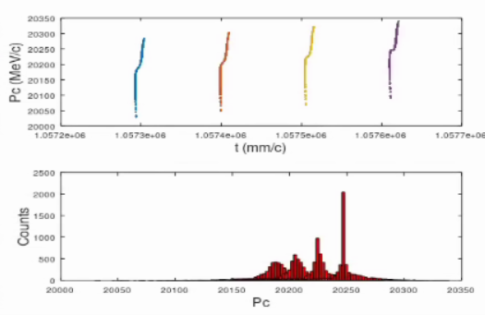
Shortening the bunch, NC, S-band
I go to 0.85 mm rms bunch length in HE linac, I stay on-crest, I put at 0 the chirp_BC
Bunch at the end of HE linac
rms bunch length = 0.85919 mm
rms dp/p = 0.55489%
Final bunches n. 1
rms bunch length = 2.5691 mm
rms dp/p = 0.11657%
Final bunches n. 2
rms bunch length = 2.5486 mm
rms dp/p = 0.11097%
Dt = -1.3217 mm/c
Dp = 18.2404 MeV/c
Final bunches n. 3
rms bunch length = 2.5284 mm
rms dp/p = 0.10253%
Dt = -1.3061 mm/c
Dp = 19.416 MeV/c
Final bunches n. 4
rms bunch length = 2.5085 mm
rms dp/p = 0.09191%
Dt = -1.2906 mm/c
Dp = 20.9518 MeV/c
%NC:
angle_d = 0.1124*1.2*0.95 = 0.1124*1.14;
L_dip = 5*1.2*0.95 = 5*1.14;
L_dr1 = 6;
%NC
Lstr_EC = 35.711*1.05*1.05 %18.44; %35.711; % m

Slide 43
Without EC
Let’s assume that the LLRF can compensate the multi-bunch energy centroid difference, try without EC to match the booster requirements solely using the chirp_BC
Expected necessary chirp to have 0.1% → 2.8%
Expected necessary chirp to have the minimum → 3.5%
chirp_2p86GeV = [0:0.1:2.5];
chirp_20GeV = chirp_2p86GeV*2.86/20;

Slide 44
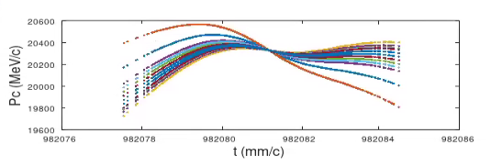
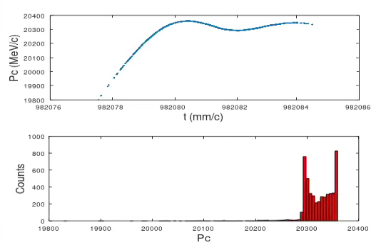
Changing the BC chirp, Q = 5 nC
Longitudinal phase space at the HE linac exit using the chirp_BC to modify the (t,p) space
In this case I use the positive chirp BUT→ >1% → >>1% at BC
The best one I obtained so far
Final bunches n. 1
rms bunch length = 0.99697 mm
rms dp/p = 0.18949%
How do we change the bunch length if we do not have the EC and we reduce by a factor 5 the DE/E?
  We can use the trasfer line:
    R56 = 2.4 m
    DE/E = 0.1% but not correlated
When I change the Q I expect a lot of difference

Slide 45
Conclusions
Multi-bunch energy centroid difference compensated by the LLRF:
    At the exit of the HE linac single bunch DE/E = 0.53%, bunch length = 1 mm
    Acting on the BC residual chirp: DE/E = 0.19%, bunch length = 1 mm
Multi-bunch energy centroid difference compensated by the EC:
    Using the residual chirp from BC:
      The sign is the opposite of that of the compression → we need to increase the chirp
      Optimal = -0.3% corresponding to about 2% at BC. Possible?
      Can we increase the R56 of BC or go to over-compression?
      At the EC exit: DE/E =0.1% and bunch length = 3.8 mm
      When we go to 5 pC: DE/E =0.2% and bunch length = 2.2 mm. Acceptable?
    Using off-crest operation of the HE linac:
      +4 deg at the EC exit DE/E =0.1% and bunch length = 4 mm
      Same as before expected for the low charge mode
    Shortening the bunch length to 0.75 mm at the exit of BC:
      On-crest at the EC exit DE/E =0.1% and bunch length = 2.8 mm. I guess that fine tuning is possible with also EC R56
    In general, to be kept in mind:
      We need to limit the R56 of EC, because of the extra time delay among the bunches (seen different phases), especially for long bunches
      Shorter bunches reduce the impact of the RF curvature of EC, and give us the extra chirp we want
      The residual chirp from BC like it is has the opposite sign of that we need → more wakefields would beneficial

Slide 46
Summary table
Configuration | DE/E (%) | DE centroid (full) % | Time delay (max) mm/c | Bunch length rms (mm)
LLRF for multi-bunch | 0.19 | 0 | 0 | 1
Chirp_BC (opposite sign) | 0.1 | 8.5e-4*3 | 1.45 (R56 =0.4 m) | 3.8
HE linac off-crest 4 deg | 0.1 | 8.5e-4*3 |  | 4
HE linac off-crest 2 deg | 0.13 | 8.5e-4*3 |  | 3.4
Short bunch 0.75 mm rms | 0.1 | 8.5e-4*3 |  | 2.7
Short bunch 0.85 mm rms | 0.1 | 1e-3*3 |  | 2.5
Fine tuning possible, but to be kept in mind that the delay among the bunches will scale linearly with R56. This has an impact on the single bunch longitudinal phase space and the booster dynamics
In case that we use EC we have margin to go even lower or higher in DE/E in case that is needed
In case that we use EC we have 0.2% single bunch energy spread, about 2 mm bunch length without touching any parameter

Slide 47
How to continue
Moderate variation of the bunch length in HE linac: now we have BC
    Smaller transverse wakefield and increase of the chirp (lower E at the head).
    We will lose a bit in loading → margin for the structures? Only in modules?
    Determine a working point in this case w/o EC
Solution with EC:
    Possible to swap the sign of the BC chirp? Up to which value we can aim in this case?
    If not possible, it must be fully compensated, like Simone was doing
    Optimal R56 seems to be around 0.4-0.5 m to avoid too large bunch-to-bunch separation.
    An alternative would be to go to very large R56 (similar to that of the transfer line)
    at a multiple of the EC RF period and use low f cavities. Realistic gradient? Can we use transfer
    line (RF below the ground)?
    See table in the previous slide for the possible options that we have until now
    At the moment take +4 deg in HE linac as the baseline solution

Slide 49
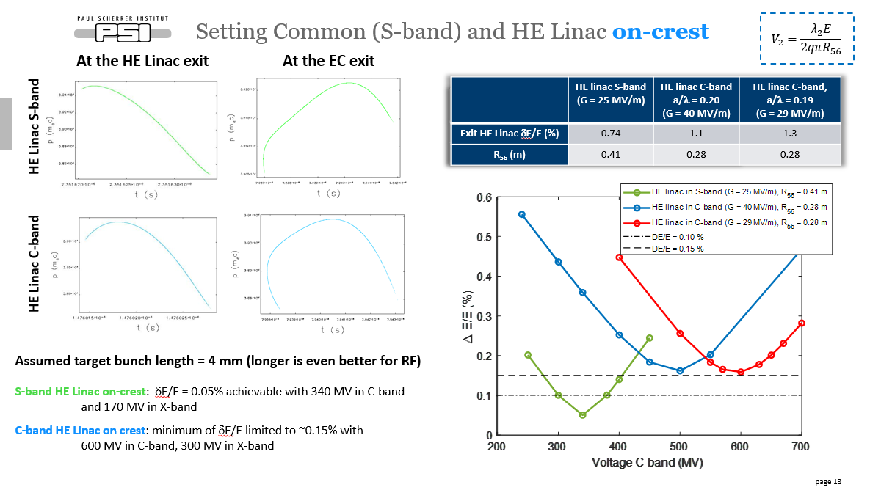
Xlsx file and Elegant
FCC Week London
Xlsx file
Initial distribution almost chirp, so xlsx file quite accurate to estimate the parameters

Slide 50

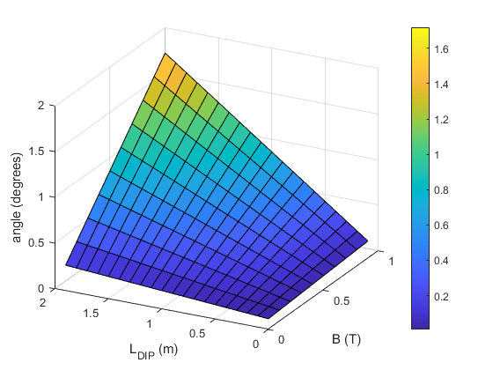
Dipole
B*rho = 3.3356*20 = 66.7120 T*m
Angle = 1/(B*rho)*integral(B*ds) = 1/66.7120*B*L_dipole
Each color represents a B
Each color represents dipole length

Slide 51
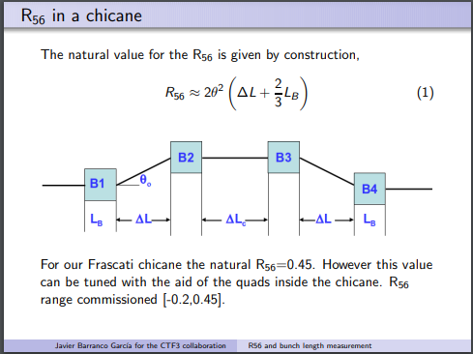
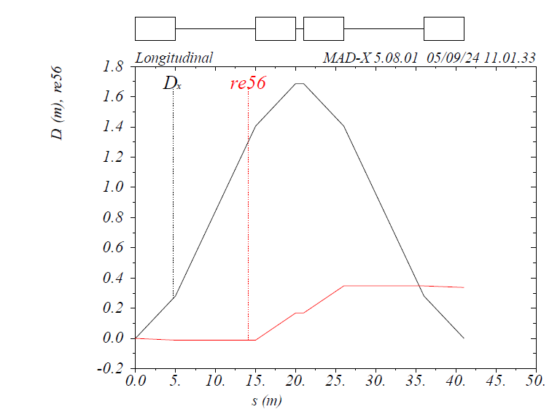
R56 computation: formula(s) vs MAD-X
R56 = -(alpha[deg]*pi/180)^2 * (2*L12 + 4/3*LB)
alpha[deg] = sqrt(-r56/(2*L12 + 4/3*LB))*180/pi
MAD-X
Matlab
B = 1.5
L_dip = 5
Delta_L = 10;
R56 = 0.3370

Slide 52
Config with smaller R56: R56 = 0.4 m, S-band

Slide 53
Config with smaller R56: R56 = 0.4 m, C-band
With +1% and -1%, I remove the off-energy at the end

Slide 54
Options
Swap the slope of the RF pulse (even + and odd -) to compensate the voltage variation along the pulse: possible?
Install the cavities of the EnCompr inside the transfer line at the opportune value of R56
  Too large value does not seem to work at f of the GHz order
Install the EnCompr upstream in the linac, and set it to pre-compensate the energy offset due to the RF pulse slope.
  In this case we do not compensate for the energy jitter for the last section of the linac
  We perfectly compensate for the RF slope and the upstream jitter
  The bunch length probably becomes too long (booster reuirements)
We use a low f cavity. At the moment used a replica of the booster cavity. In this case we can use the R56 of the transfer line
  We need to go off-crest in the upstream linac, because the transfer line wants a smaller DE/E (0.25% → probably < 8 deg at a/l = 0.12)
Modify R56 with quadrupoles:
  Nightmare to run, chromaticity, …

Slide 55
4. Use the transfer line-low RF cavity
In case that I want to use the R56 of the transfer line (2.4 m-not much tunable), I cannot stay with the f of the order of few GHz, because I have a big tail of the DE/E distribution and a very large distance among the bunches
I tried to use a cavity of the booster
Basically 0 (it is in %)
In this case we need to run the linac off-crest to have less energy spread already at the entrance of the transfer line (probably 3-4 deg would be enough)

Slide 56
4. What do I get with DE/E initial = 0.25%
I run the linac to have max 0.25 DE/E, EC with the same settings as the previous slide

Slide 57
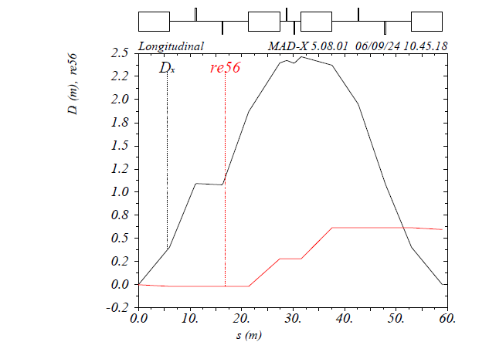
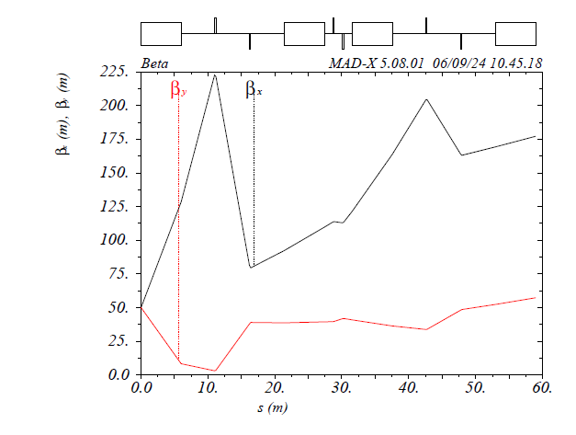
5. Modify the R56 with quadrupoles
//Parameters
L1_drift = 20;
L2_drift = 5;
L_bend := 5*1.2;
Angle_bend := 0.1124*1.2;

Slide 58
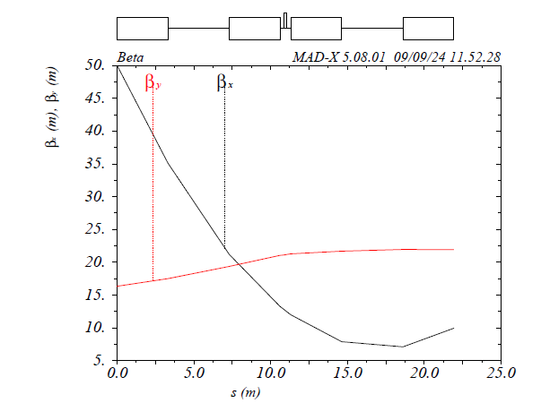
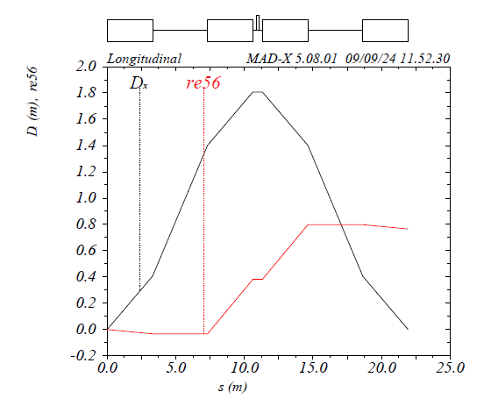
Superconducting dipoles
Thanks to Ciro Calzolaio (PSI) for the field estimation
L_bend := 3*1.1;
Angle_bend := 0.2248*1.1; // NC: 0.1124;
Small betax
R56 ~ 0.8 m

Slide 59
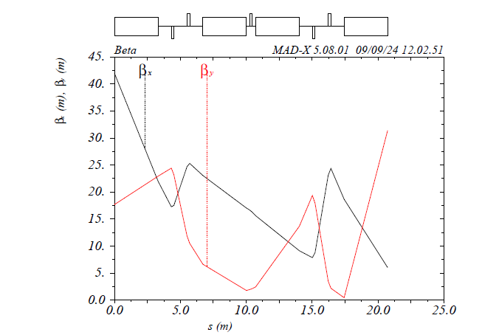
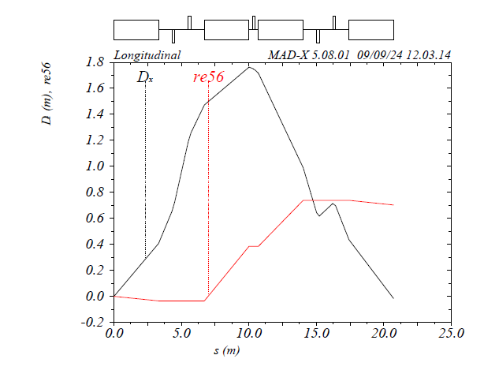
Superconducting dipoles + quads
Small betax
R56 ~ 0.8 m

Slide 60
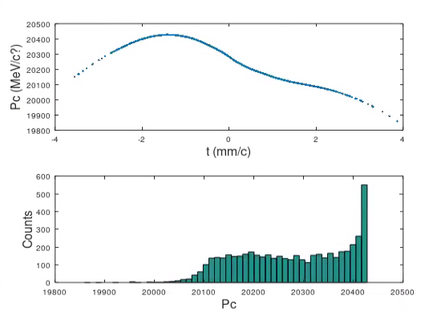
From RF-Track, a/l = 0.12, G = 22.5 MV/m
Assumed that we do not have any contribution coming from after the DR. Is that true? In case that in the DR the equilibrium is reached, yes (probably-a feedback from the experts would be appreciated).
std(p_out)/mean(p_out)*1e2
Dp/p = 0.5332%

Slide 61
Assuming single bunch DE/E = 0.5%

Slide 62
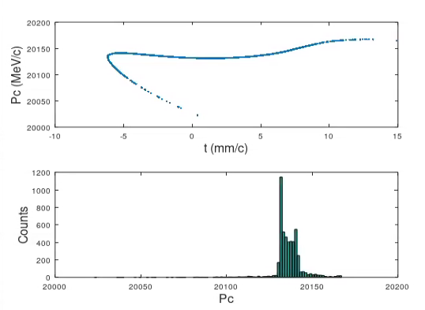
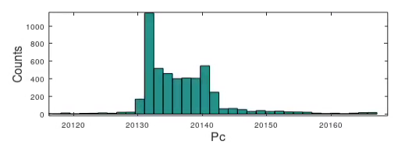
Energy compressor in RF-Track
W/O energy compressor
angle_d = 0.2248*1.1;
L_dip = 3*1.1;
L_dr1 = 4;
L_dr2 = 1;
Corresponding to the superconductive dipoles
Final
rms bunch length = 4.4525 mm
rms dp/p = 0.051613%
/data/user/bettoni_s/RFTrack_sim/Layout_DR_3GeV/EnCompr

Slide 64
Option 2: reduce R56 to reduce voltage, time delay, and bunch length

Slide 65
DE/E = 2.5%, R56 = 0.8 m

Slide 66
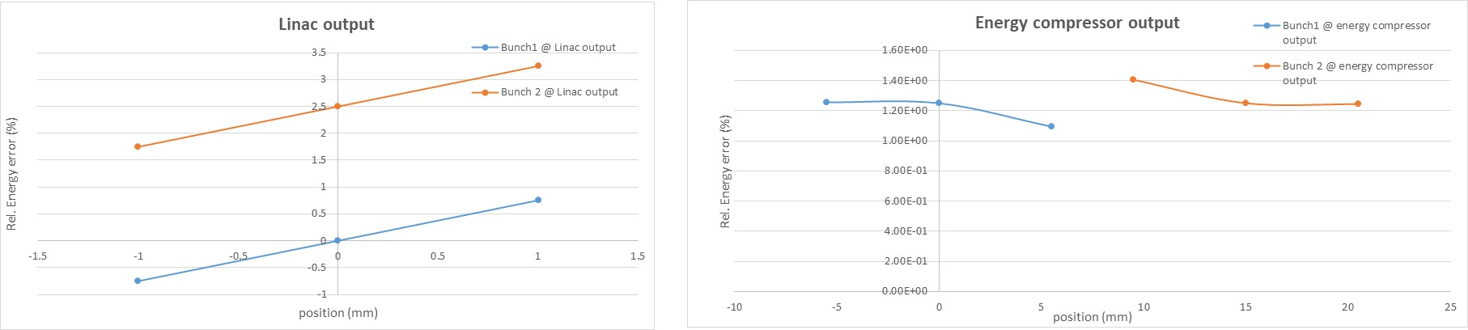
DE/E = 2.5%, R56 = 0.6 m

Slide 67
DE/E = 0.5%

Slide 69
DE/E = 2.5%, bunch length = 0.5 mm

Slide 70
Single bunch EC, S-band, sigma_z = 0.5 mm

Slide 72
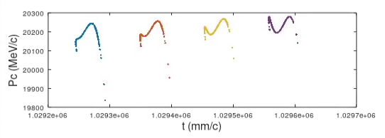
Difference for large R56
SC
R56 = 0.8 m
S-band
Chirp_BC = -6
Final bunches n. 1
rms bunch length = 8.4594 mm
rms dp/p = 0.15429%
Final bunches n. 2
rms bunch length = 8.3931 mm
rms dp/p = 0.13792%
Dt = -2.8177 mm/c
Final bunches n. 3
rms bunch length = 8.3274 mm
rms dp/p = 0.11918%
Dt = -2.7926 mm/c
Final bunches n. 4
rms bunch length = 8.2623 mm
rms dp/p = 0.12941%
Dt = -2.7679 mm/c
Bunch length too long in general and in the structure and distance among the bunches give difference among them in the (t,p) induced by the RF→ we do not go below

Slide 73

Multi-bunch RF-Track
SKIP
NC, S-band, no chirp from BC, no DE/E among single bunches
Final bunches n. 1
rms bunch length = 2.8121 mm
rms dp/p = 0.13309%
Final bunches n. 2
rms bunch length = 2.8121 mm
rms dp/p = 0.13309%
Final bunches n. 3
rms bunch length = 2.8121 mm
rms dp/p = 0.13309%
Final bunches n. 4
rms bunch length = 2.8121 mm
rms dp/p = 0.13309%

Slide 74

DE/E among the single bunches
SKIP
NC, S-band, no chirp from BC, WITH DE/E among single bunches (0.5% per bunch). In reality it should be 0.5*17/20 = 0.4250% among the single bunches (I ignore the effect in the first ~3 GeV)
Final bunches n. 1
rms bunch length = 2.838 mm
rms dp/p = 0.13861%
Final bunches n. 2
rms bunch length = 2.8121 mm
rms dp/p = 0.13211%
Final bunches n. 3
rms bunch length = 2.7867 mm
rms dp/p = 0.12038%
Final bunches n. 4
rms bunch length = 2.7618 mm
rms dp/p = 0.10465%

Slide 75

DE/E among the single bunches and BC residual chirp
NC, S-band, WITH chirp from BC, WITH DE/E among single bunches (0.5% per bunch). Chirp from BC = 0.5%
SKIP
Final bunches n. 1
rms bunch length = 1.181 mm
rms dp/p = 0.23347%
Final bunches n. 2
rms bunch length = 1.1763 mm
rms dp/p = 0.23274%
Final bunches n. 3
rms bunch length = 1.1717 mm
rms dp/p = 0.22995%
Final bunches n. 4
rms bunch length = 1.1673 mm
rms dp/p = 0.22528%
I tune to have the chirp residual from BC

Slide 76

DE/E among the single bunches and BC residual chirp
SKIP
NC, S-band, WITH chirp from BC, WITH DE/E among single bunches (0.5% per bunch).
Final bunches n. 1
rms bunch length = 4.2348 mm
rms dp/p = 0.054197%
Final bunches n. 2
rms bunch length = 4.1897 mm
rms dp/p = 0.045921%
Final bunches n. 3
rms bunch length = 4.1454 mm
rms dp/p = 0.040191%
Final bunches n. 4
rms bunch length = 4.1019 mm
rms dp/p = 0.050508%
I tune to have the chirp residual from BC to see a kind of minimum

Slide 77

DE/E among the single bunches and BC residual chirp
NC, S-band, WITH chirp from BC, WITH DE/E among single bunches (0.5% per bunch→0.5*17/20 = 0.4250%). Chirp from BC = -4
SKIP
Final bunches n. 1
rms bunch length = 4.2279 mm
rms dp/p = 0.053117%
Final bunches n. 2
rms bunch length = 4.1897 mm
rms dp/p = 0.046332%
Final bunches n. 3
rms bunch length = 4.152 mm
rms dp/p = 0.040371%
Final bunches n. 4
rms bunch length = 4.1149 mm
rms dp/p = 0.04342%
Fine tuning can be done. Good enough to continue.

Slide 78
Range using the chirp from BC
SKIP
We keep the voltage constant, and we vary the chirp from BC to see which DE/E we can have
Chirp = 0
Chirp = -2
Chirp = -3
Chirp = -4
Final bunches n. 1
rms bunch length = 2.8341 mm
rms dp/p = 0.13777%
Final bunches n. 2
rms bunch length = 2.8121 mm
rms dp/p = 0.13263%
Final bunches n. 3
rms bunch length = 2.7905 mm
rms dp/p = 0.12364%
Final bunches n. 4
rms bunch length = 2.7692 mm
rms dp/p = 0.11147%
Final bunches n. 1
rms bunch length = 3.5284 mm
rms dp/p = 0.096079%
Final bunches n. 2
rms bunch length = 3.4983 mm
rms dp/p = 0.08947%
Final bunches n. 3
rms bunch length = 3.4687 mm
rms dp/p = 0.078993%
Final bunches n. 4
rms bunch length = 3.4396 mm
rms dp/p = 0.066515%
Final bunches n. 1
rms bunch length = 3.8777 mm
rms dp/p = 0.074508%
Final bunches n. 2
rms bunch length = 3.8435 mm
rms dp/p = 0.067471%
Final bunches n. 3
rms bunch length = 3.8099 mm
rms dp/p = 0.057617%
Final bunches n. 4
rms bunch length = 3.7767 mm
rms dp/p = 0.049056%
Final bunches n. 1
rms bunch length = 4.2279 mm
rms dp/p = 0.053117%
Final bunches n. 2
rms bunch length = 4.1897 mm
rms dp/p = 0.046332%
Final bunches n. 3
rms bunch length = 4.152 mm
rms dp/p = 0.040371%
Final bunches n. 4
rms bunch length = 4.1149 mm
rms dp/p = 0.04342%
Negative extra chirp increases the chirp from BC

Slide 80
Extra time difference among the bunches
SKIP
The bunches will have a distance due to the R56. In the NC case (R56 = 0.4 m) the distance removed the lambda_Sband would be:
The bunches will have a distance due to the R56. In the NC case (R56 = 0.4 m) the distance would be without removing the lambda:
Final bunches n. 1
rms bunch length = 3.8698 mm
rms dp/p = 0.1194%
Final bunches n. 2
rms bunch length = 3.8357 mm
rms dp/p = 0.11141%
Dt = -1.4916 mm/c
Final bunches n. 3
rms bunch length = 3.8021 mm
rms dp/p = 0.098391%
Dt = -1.474 mm/c
Final bunches n. 4
rms bunch length = 3.7691 mm
rms dp/p = 0.081957%
Dt = -1.4567 mm/c
Final bunches n. 1
rms bunch length = 3.8698 mm
rms dp/p = 0.1194%
Mean time = 1056572.0384 mm/c
Final bunches n. 2
rms bunch length = 3.8357 mm
rms dp/p = 0.11141%
Dt = 105.5772 mm/c
Final bunches n. 3
rms bunch length = 3.8021 mm
rms dp/p = 0.098391%
Dt = 105.5947 mm/c
Final bunches n. 4
rms bunch length = 3.7691 mm
rms dp/p = 0.081957%
Dt = 105.612 mm/c
This should correspoond to about 5 deg in S-band, but the f downstream of EC is 800 MHz → 1.4 deg
This for R56 = 0.4 m. In case of R56 = 0.8 m, these numbers will be doubled

Slide 81

Fine tuning multi-bunch
SKIP
chirp_BC = -5; I NEED MORE WAKEFIELD CHIRP → NEGATIVE SIGN
TO BE EVALUATED THE DECHIRP OF THE STRUCTURES DOWNSTREAM THE EC CHICANE
angle_d = 0.1124*1.1;
L_dip = 5*1.1;
Lstr_EC = 35.711*1.25
Final bunches n. 1
rms bunch length = 3.9336 mm
rms dp/p = 0.11035%
Final bunches n. 2
rms bunch length = 3.8985 mm
rms dp/p = 0.10111%
Dt = -1.2156 mm/c
Dp = 16.4279 MeV/c
Final bunches n. 3
rms bunch length = 3.864 mm
rms dp/p = 0.088302%
Dt = -1.2011 mm/c
Dp = 17.4975 MeV/c
Final bunches n. 4
rms bunch length = 3.83 mm
rms dp/p = 0.073426%
Dt = -1.1869 mm/c
Dp = 18.8822 MeV/c
Bunch to bunch compensated at: 17.5/20000 = 8.7500e-04
Bunch delays ~1.2 mm
Dp/p single bunch ~0.1%

