Slide 1
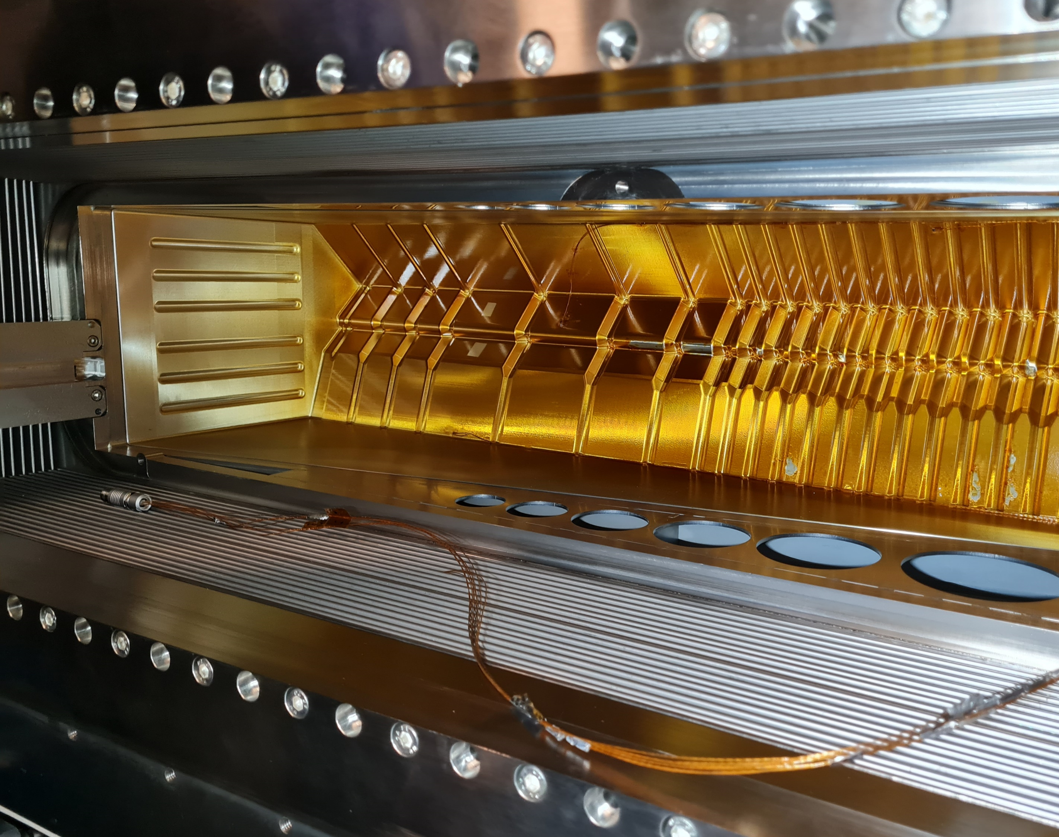
LHCb VELO U2
Mechanical concept

Slide 2
Introduction
Investigating several aspects of the U2 VELO mechanical concept
  Motion system compatible with "iris" RF-shield (linear motion version...)
  Vacuum interface and feedthrough
  Possible approach for the separation of "clean" and "outgassing" part of the module
  Possible approach for "VELO separation from beam pipe"
Some of the assumptions:
  VELO acceptance down to low eta but "LHCb acceptance" up to 270mrad
==> primary vacuum tank can have a radius as low as 21cm @ 800mm
  Try to use "off the shelf" components for the vacuum interface (bellows, feedthrough)
  Try to keep motion and flexes out of the primary vacuum
In the following the base hypothesis is a 4 flange "iris" system:
  Vacuum interface similar for a 2-halves system (while U1 motion can be reused)
  Based on square modules but compatible with module tiling a la "concentric layout

Slide 3
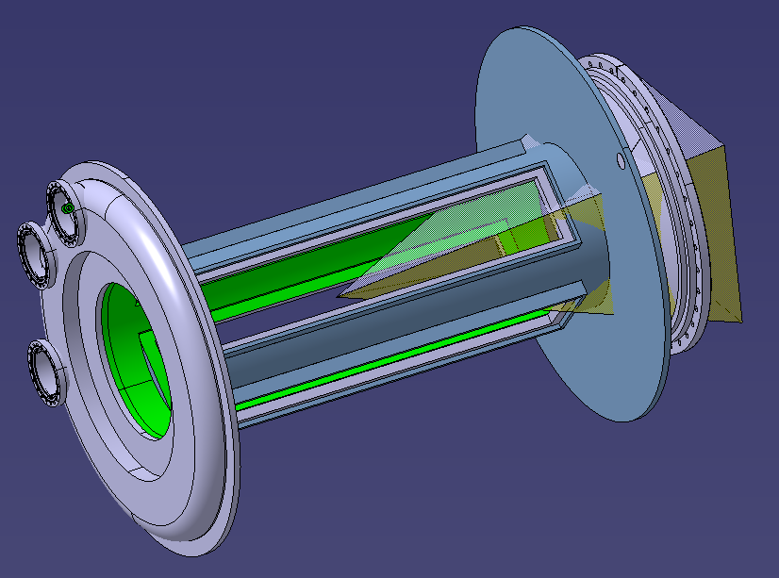
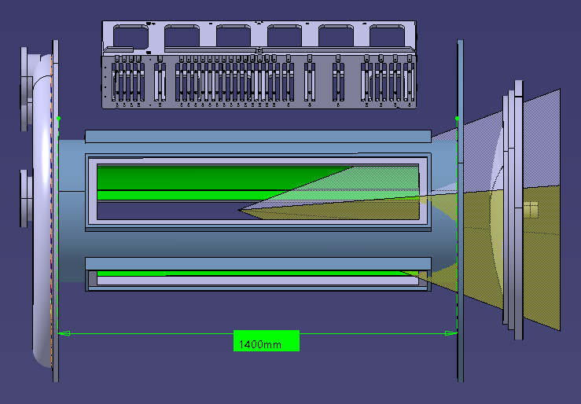
The vessel
Primary vacuum
Diameter 500mm
Insulation vacuum volume
Outer Diameter 1200mm

Slide 4
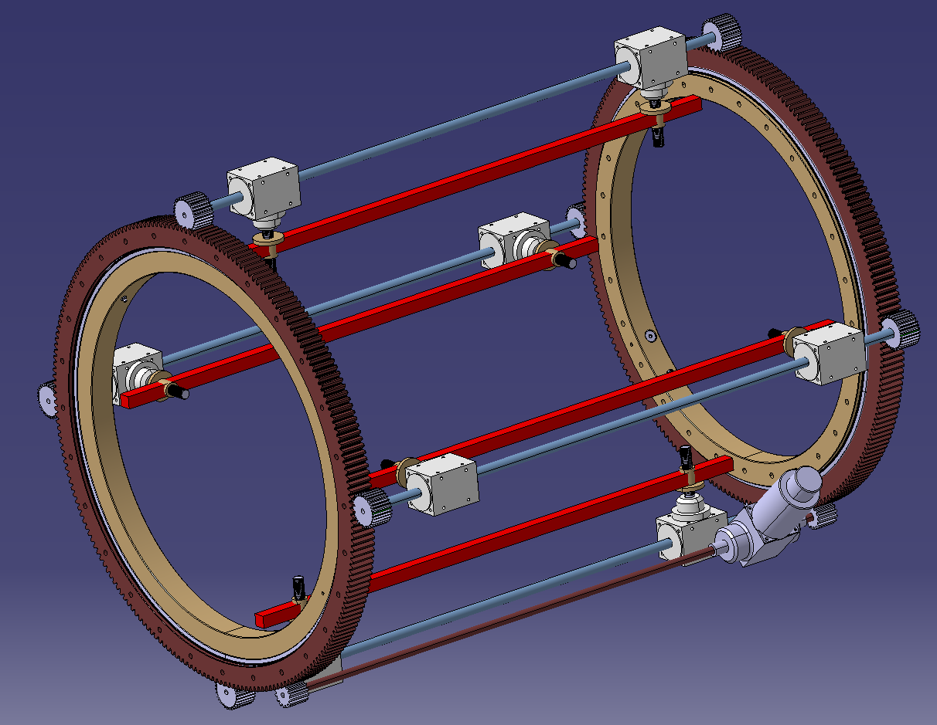

Rotation of the slewing ring bearing generates a linear movement
Mechanical drive system
Bevel gearbox coupled
to a balls screw
SKF Kaydon’s KH precision
slewing ring bearing
Applications:
Radar Antennas
Machine tool tables
Medical devices
Motor

Slide 5
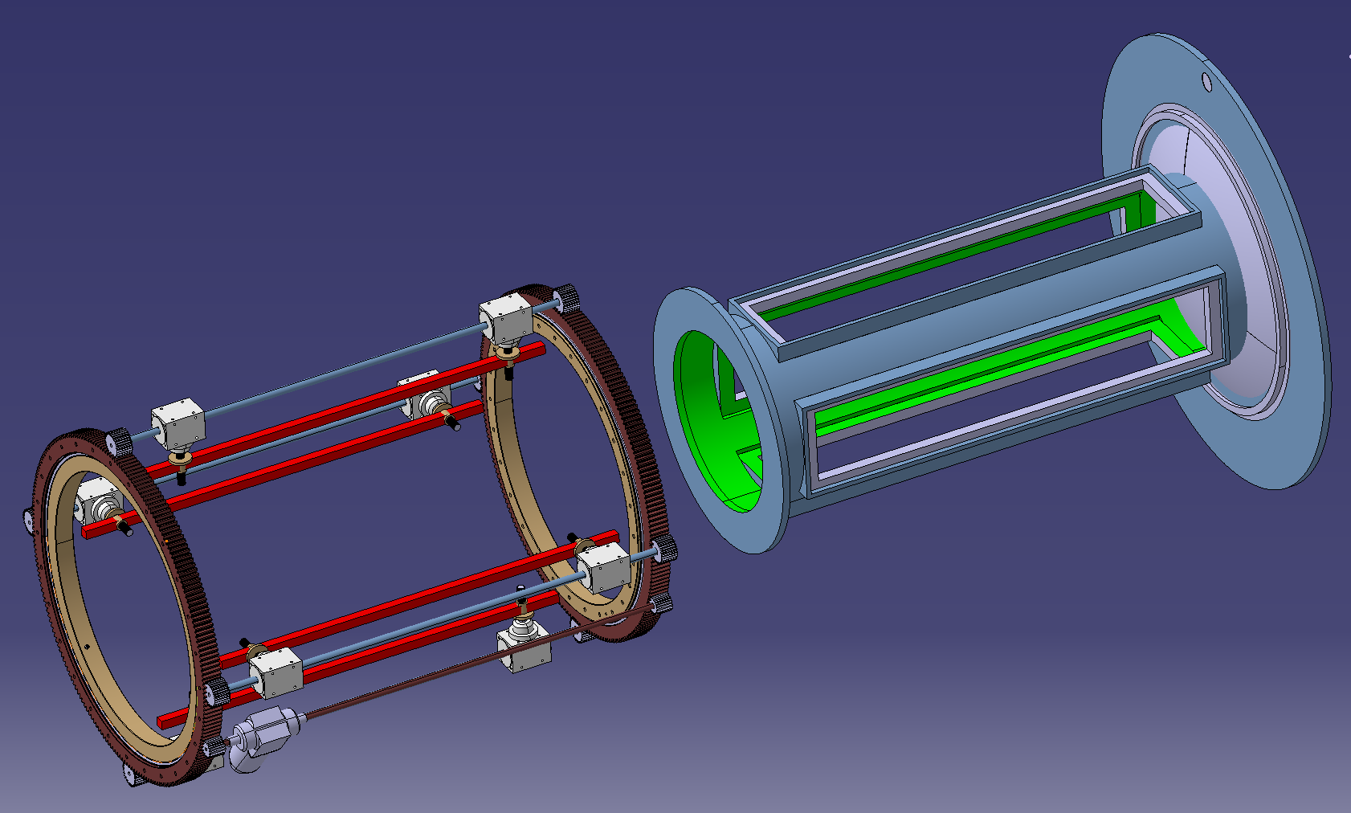
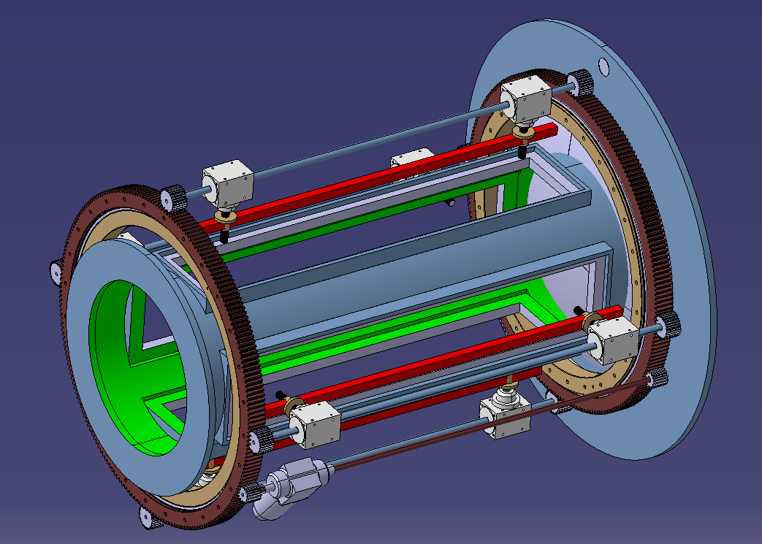
Mechanical drive system

Slide 6
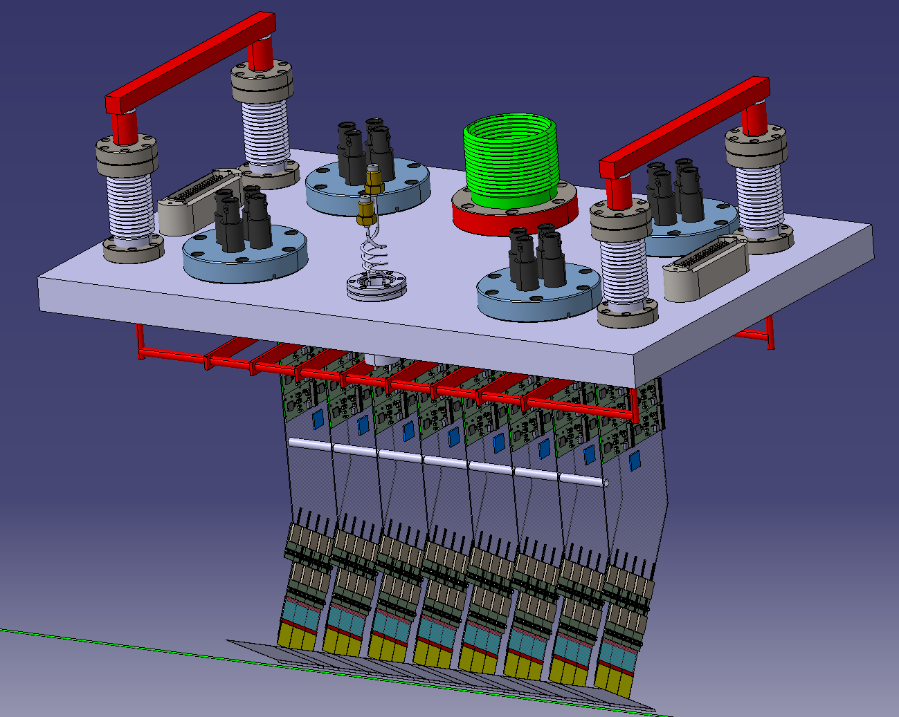
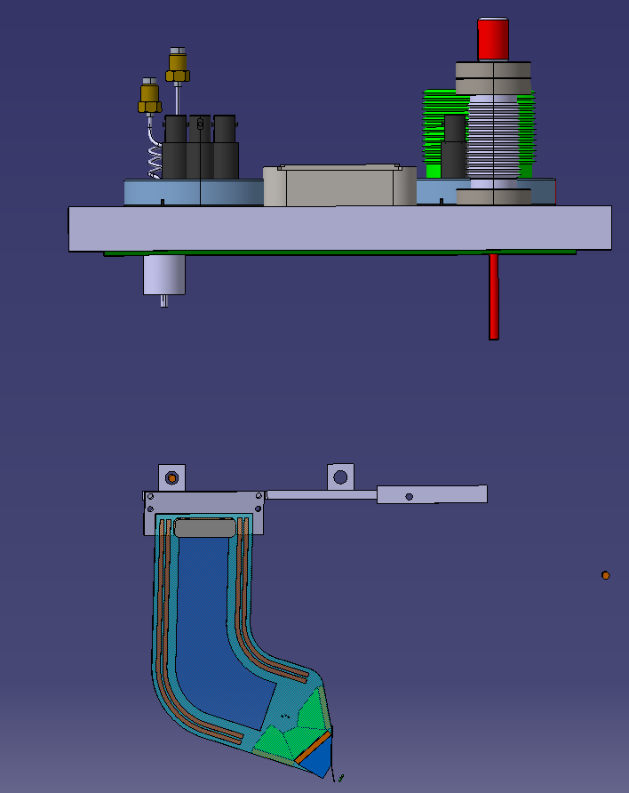
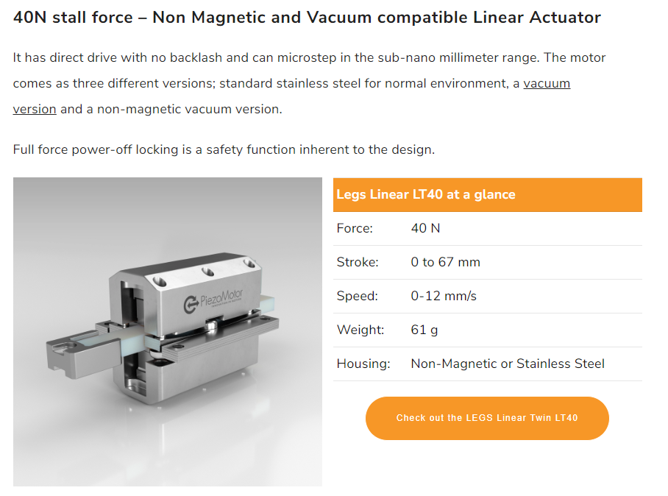
Mechanical drive system
Module flange feedthrough (number of modules per flange can be optimised).
"iris" with linear motion
“Iris” with rotation may also work
CF15 Bellow
Motion transmission in the primary vacuum
Vacuum load on flange ~ 2 Kg
Piezo legs linear actuators
Fine alignment devices

Slide 7
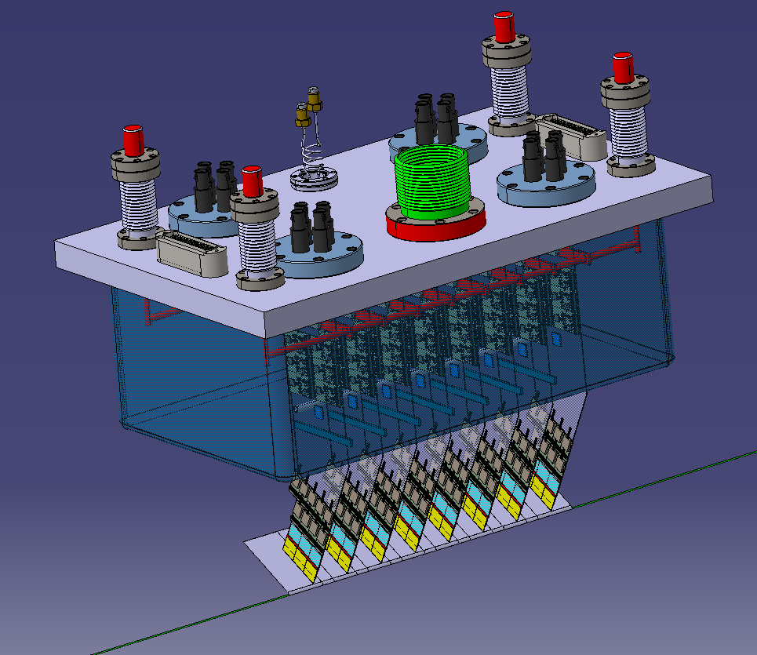
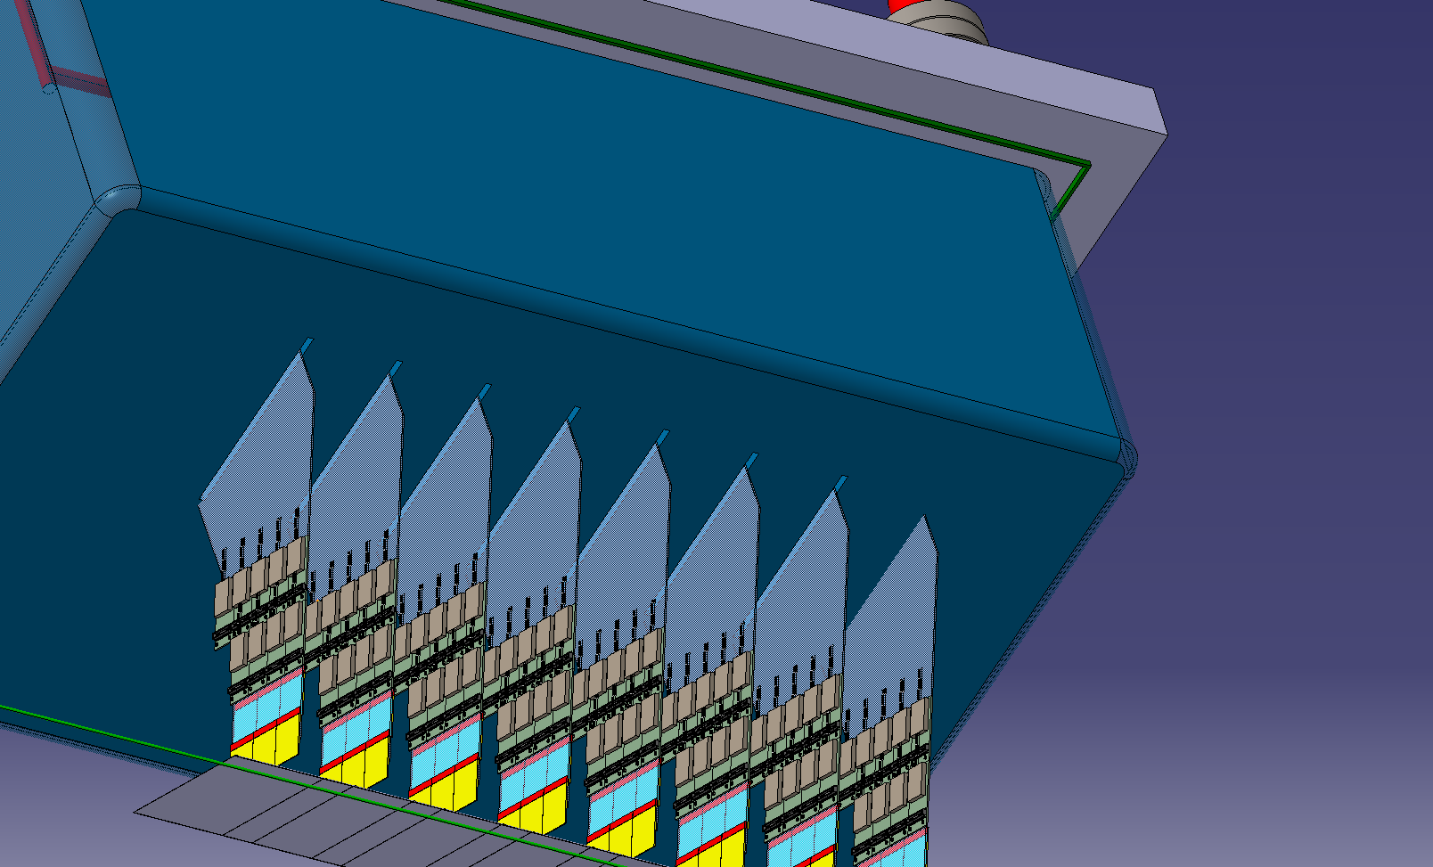
Module outgazing
Screen covering the outgazing parts ?
Pumping orifice, “dirty primary vacuum”
Small slit, cold substrate doesn’t touch

Slide 8
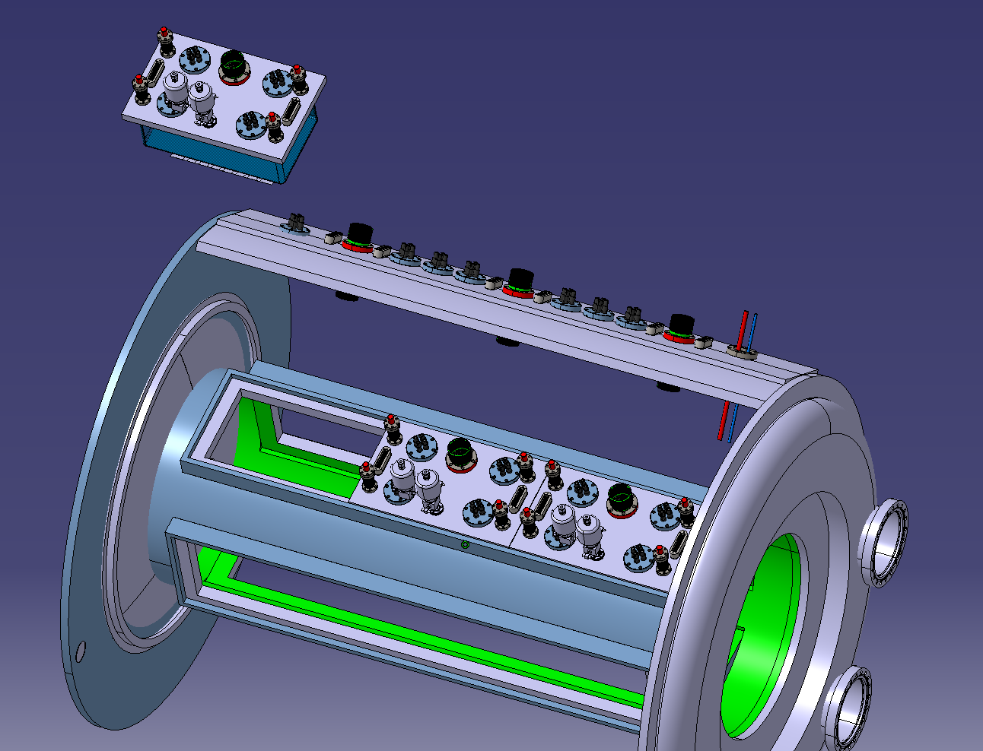
Services feedthrough
Modules flanges primary vacuum
. All feedthroughs must be UHV CF type (copper joint)
. Optimisation of the number of outlets to reduce the risk of leakage
)
Flanges services insulation vacuum.
. HV, LV, optical, CO2, Vacuum ….
(Can be with O-rings)
Pumping orifice, “dirty primary vacuum”

Slide 9
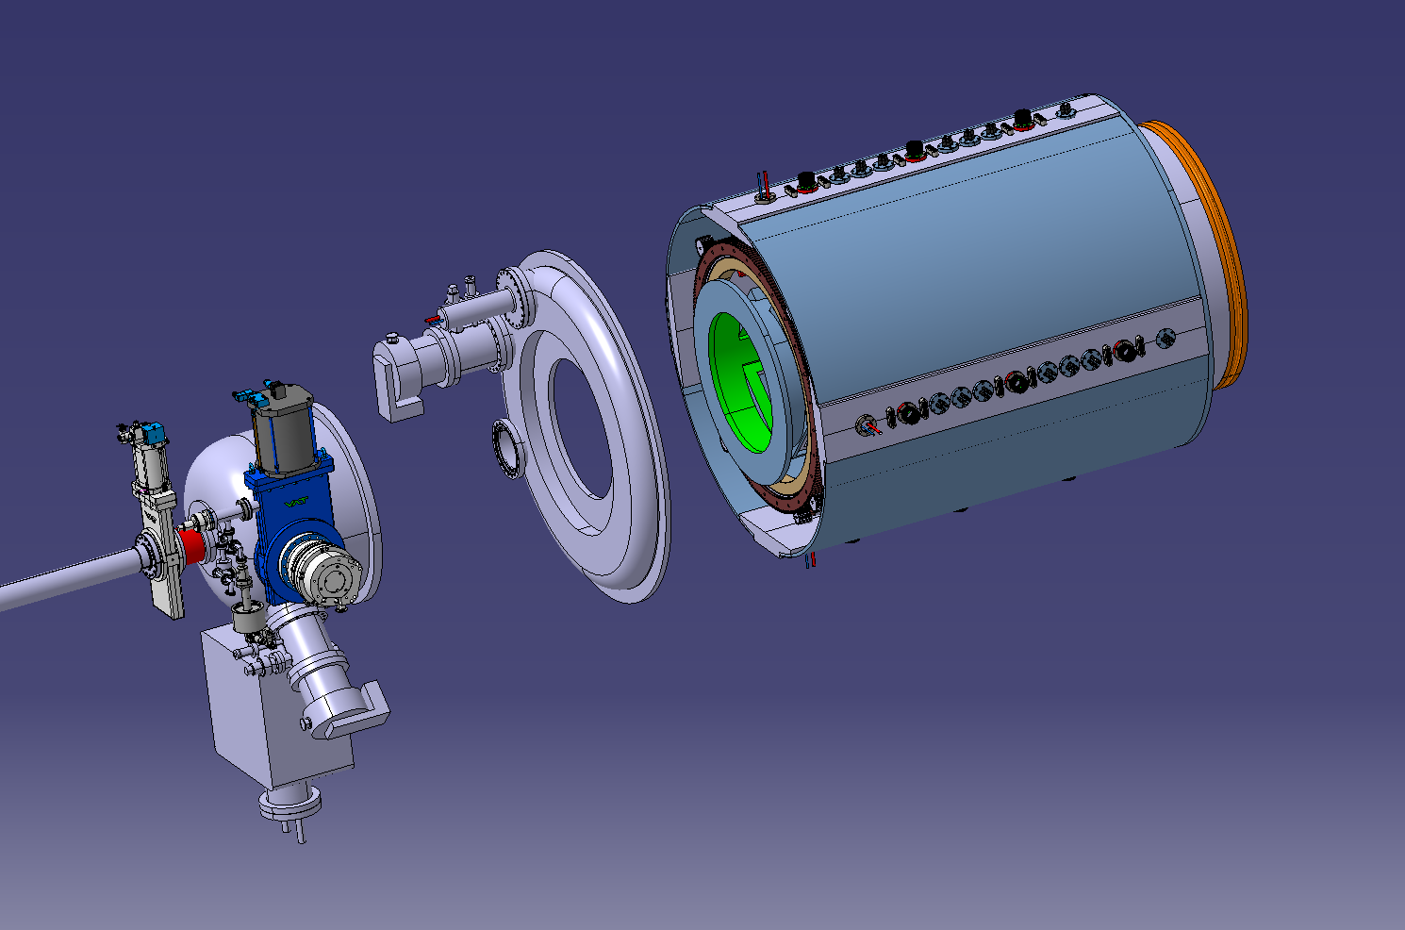
Vacuum layout
Insulation door
Insulation vacuum flange
Primary vacuum Head (SMOG3?)

Slide 10
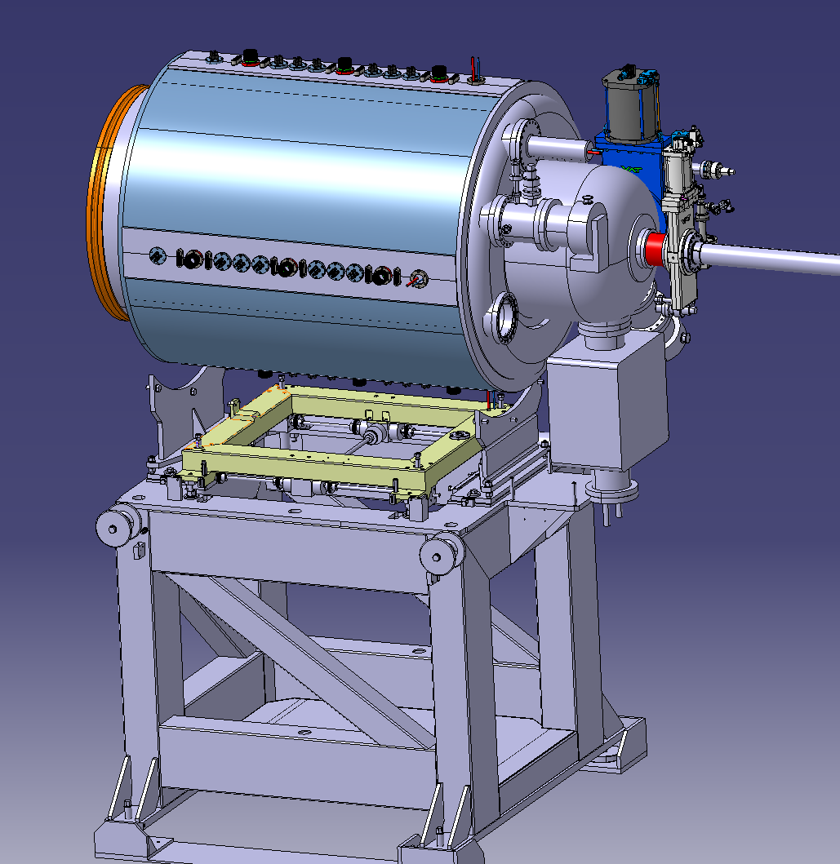
VELO X and Y motion
Bellows placed at the extremity
will absorb a tiny movement +/-5mm
X
X motion should be added to the VELO support frame
Y

Slide 11
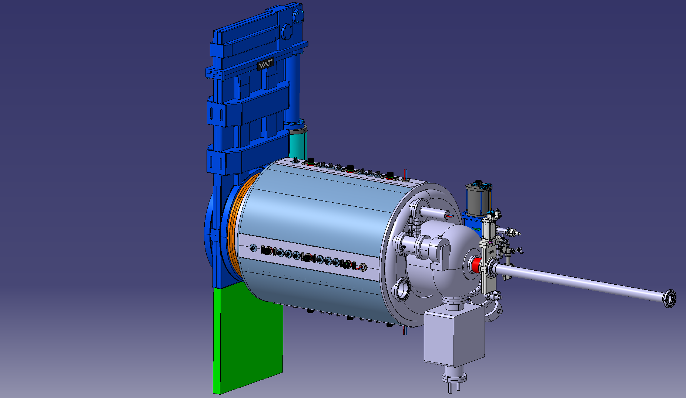
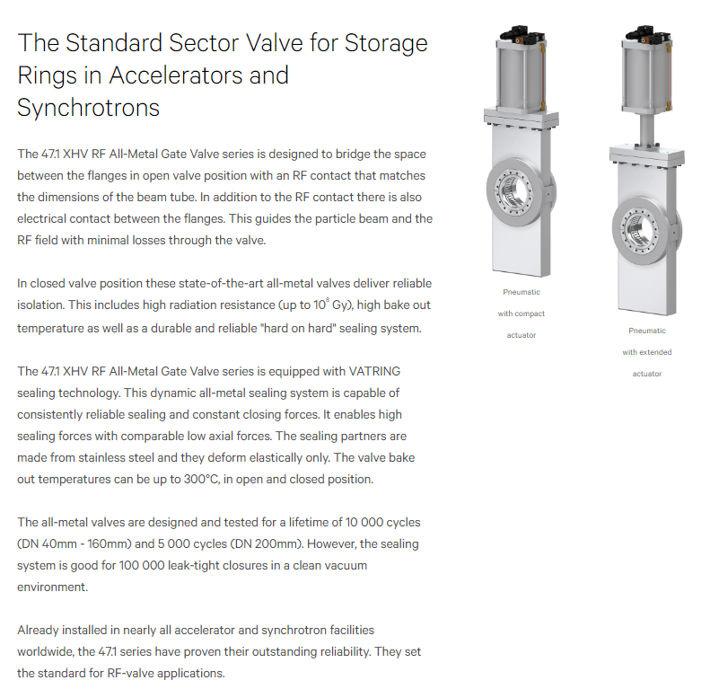
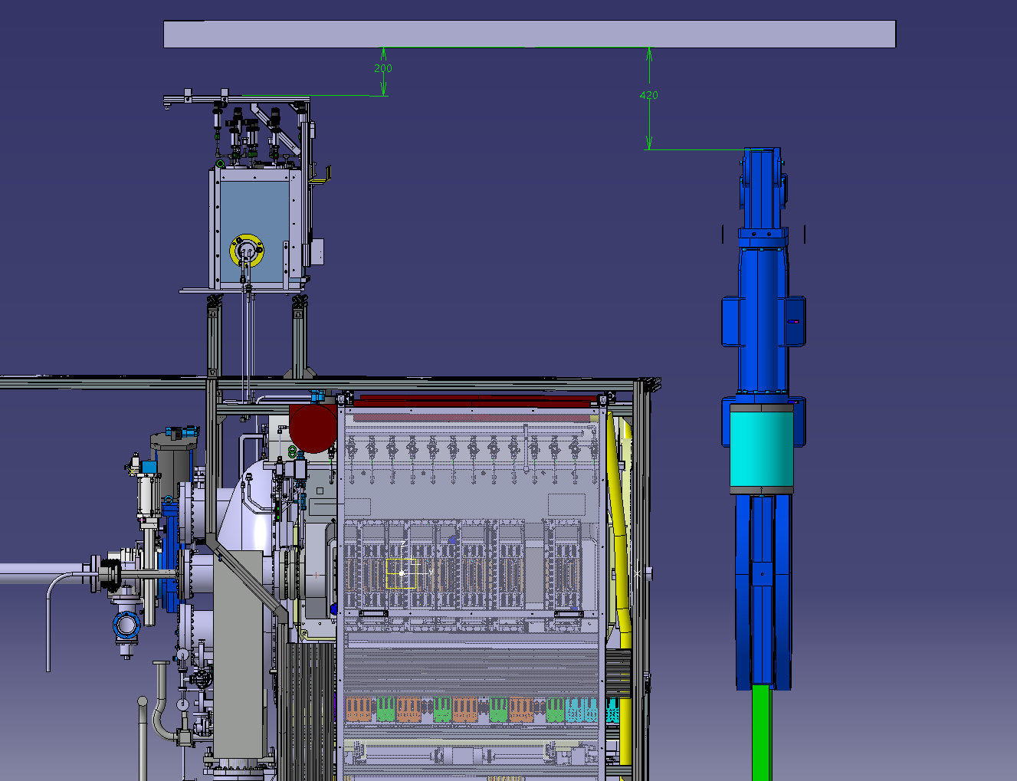
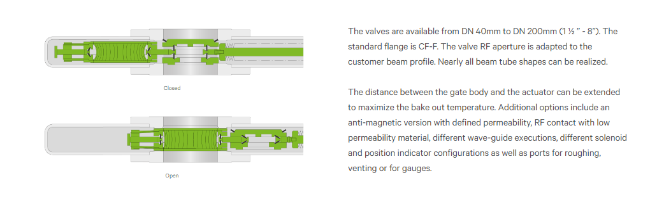
Isolate the VELO primary Vacuum
A challenge for the RF/Vacuum group and the VAT company
RF all metal gate valve: needed for the bake out.
DN 800
Light RF contact mechanism

Slide 12
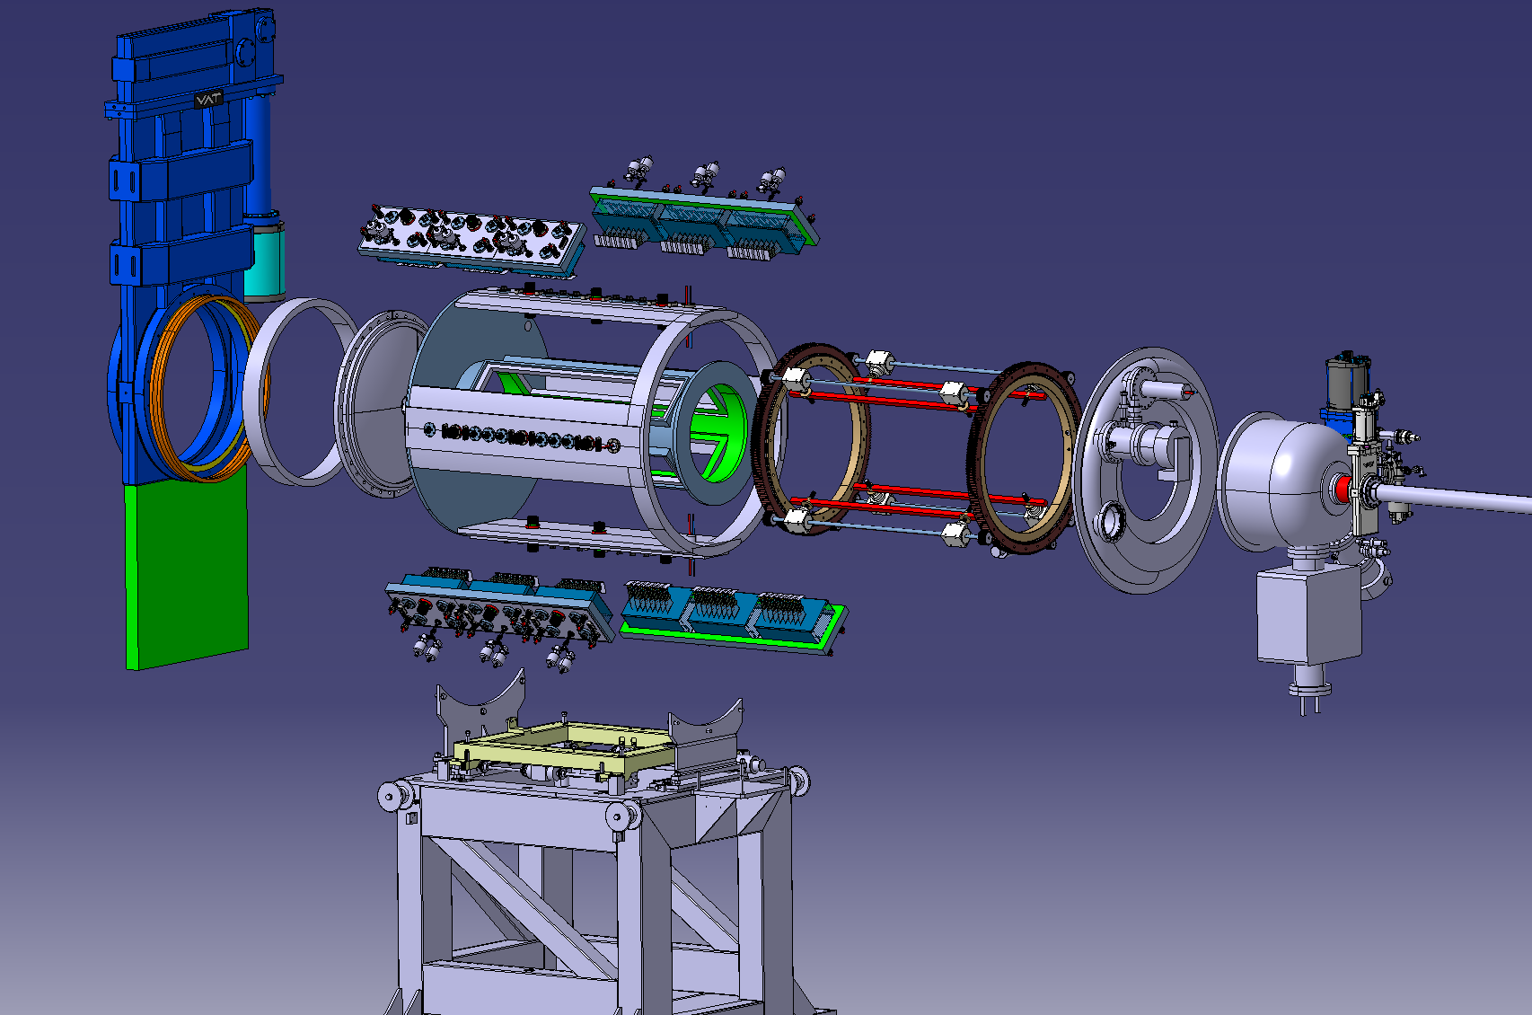
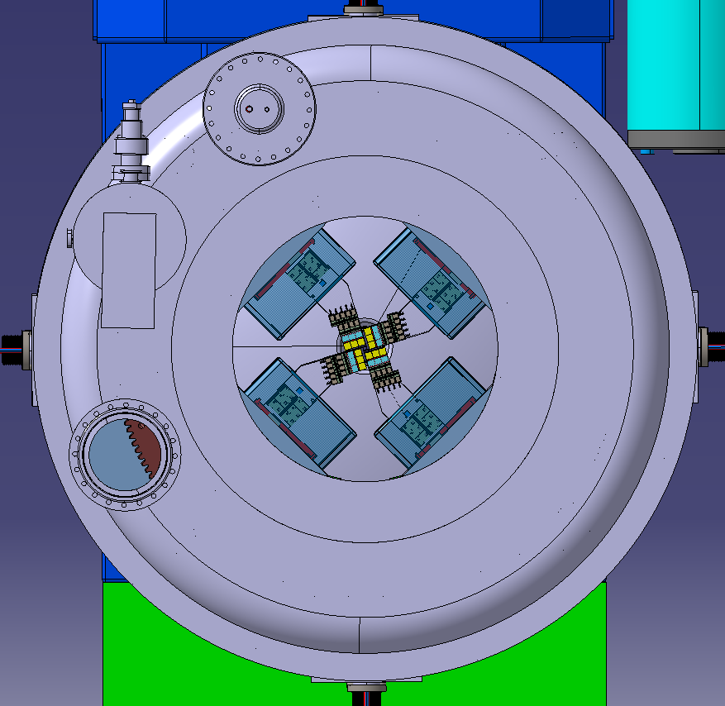

Slide 14
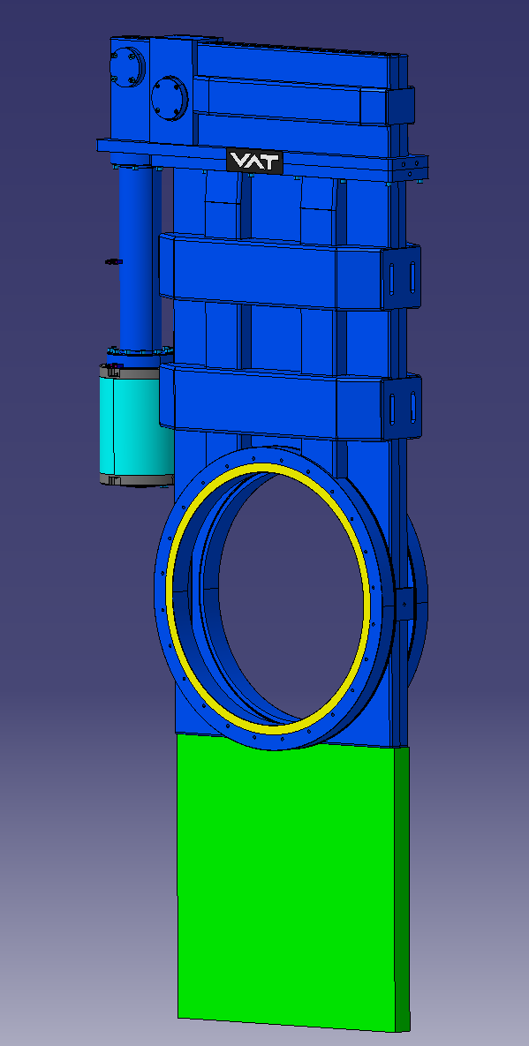
Can this technology be adapted to a large valve,
With low material budget ?
DN 800
VAT 47.1 Extreme High Vacuum RF All-Metal Gate Valve. - VAT Valves

Slide 15
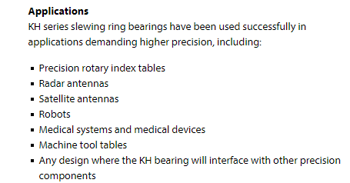
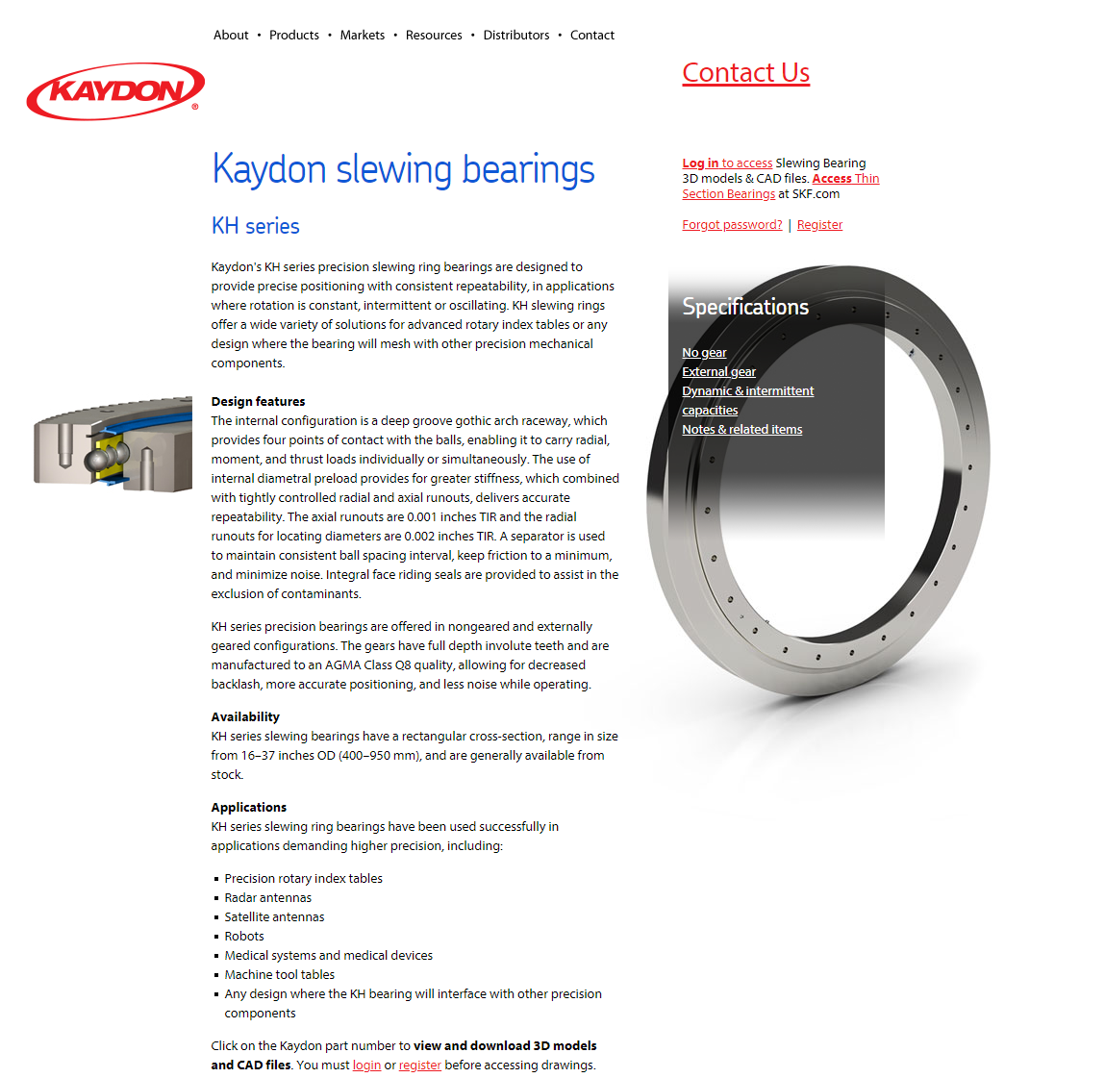
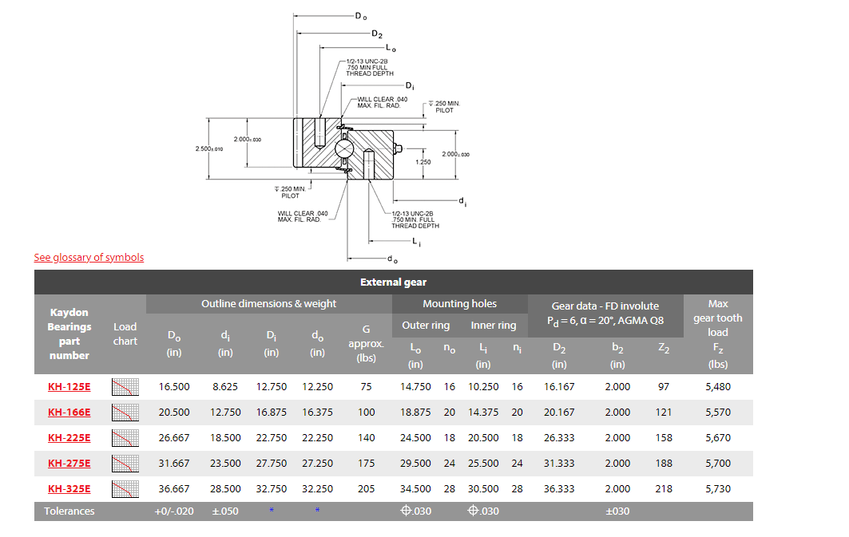
Motion bearing standard SKF production

Slide 16
