Slide 1
LOW SEY COATINGS
Pedro Costa Pinto and Mauro Taborelli
TE-VSC-SCC
Velo workshop 28.11.2024

Slide 2
The secondary electron yield
Low SEY with Non Evaporable Getter coatings
Low SEY with amorphous carbon coatings

Slide 3
The secondary electron yield: SEY
number of emitted electrons (secondary)
SEY=
number of impinging electrons (primary)
N
2.5
Primary e-
2.3
Copper as rec.
2.1
δmax
1.9
secondaries
1.7
SEY
1.5
1.3
1.1
Emax
0.9
0.7
N.Hilleret
0.5
0 500 1000 1500 2000 2500 3000
Primary Energy [eV]
δ_{max} or SEYmax = maximum value as a function of primary energy
E_{max} = primary energy of the maximum
The electrons in that energy range escape from less than 20 nm: SEY depends on surface properties

Slide 4
Non Evaporable Getters (NEG) for accelerator applications
The NEG TiZrV can act as a pump, but when activated it has also a low SEY
Operation of the getter:
Once saturated, or exposed to air the gettering activity ceases and no more gas is pumped.
A Non Evaporable Getter (NEG) can be regenerated by heating to its activation temperature during a certain time.
Activation temperature
(T_{activation})
Room temperature
(RT)
Getter
Notes:
Appropriate situation with the CERN logotype
Mixture of different logotypes
All of them are circulating
All CERN clubs were also very creatives

Slide 5
Non Evaporable Getters (NEG) for accelerator applications
The NEG TiZrV can act as a pump, but when activated it has also a low SEY
Operation of the getter:
Once saturated, or exposed to air the gettering activity ceases and no more gas is pumped.
A Non Evaporable Getter (NEG) can be regenerated by heating to its activation temperature during a certain time.
Activation temperature
(T_{activation})
Room temperature
(RT)
NEGetter
Back to room temperature (RT) the NEG recovers its pumping capabilities.
Notes:
Appropriate situation with the CERN logotype
Mixture of different logotypes
All of them are circulating
All CERN clubs were also very creatives

Slide 6
SEY of Non Evaporable Getter (NEG) coatings
TiZrV NEG can provide a surface with sufficiently low δmax :
activation
at 200C 2h
Henrist et al.
Appl.Surf.Sci,
2001
-Thermal activation is necessary: 2h at 200C or 24h at 180C

Slide 7
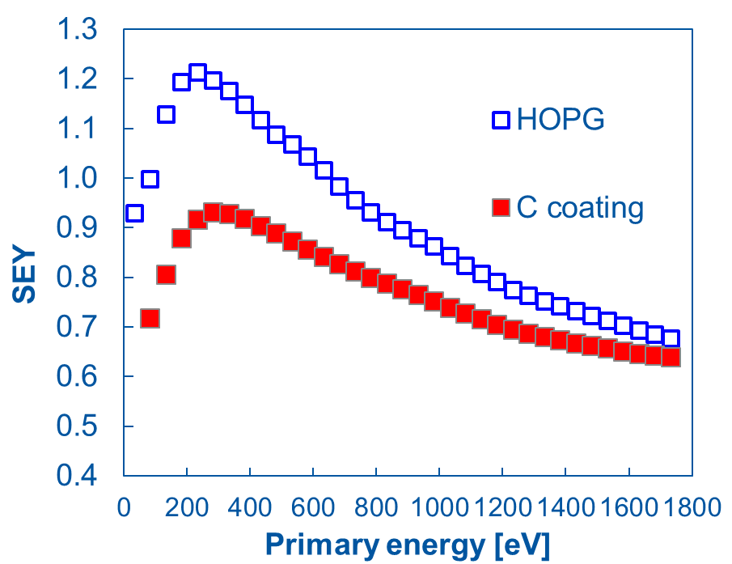
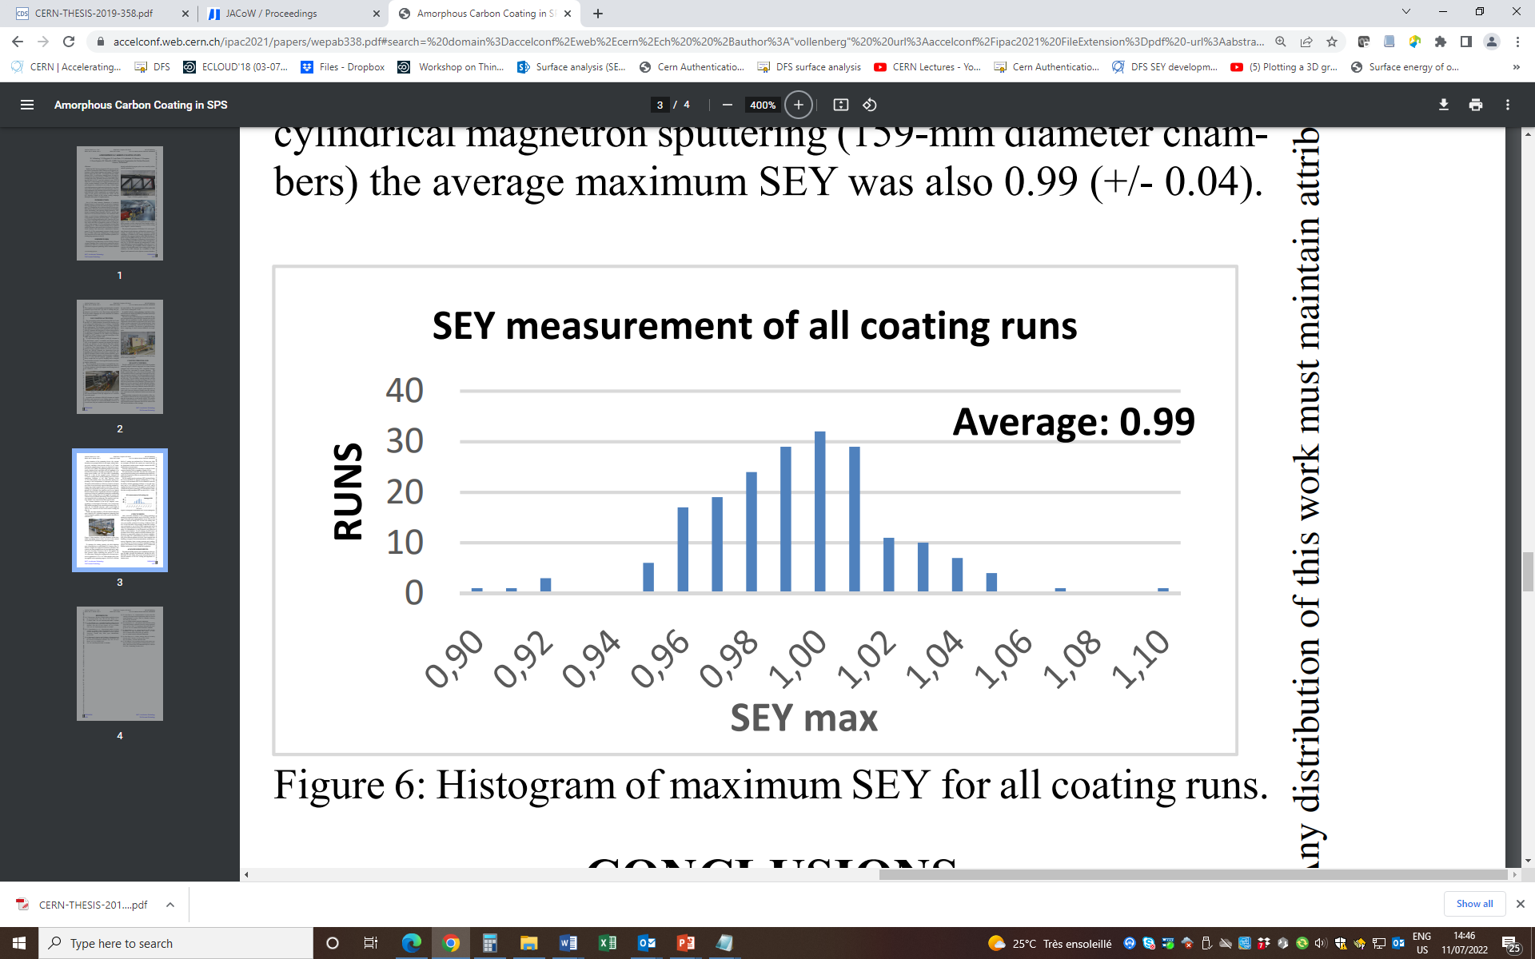
Low SEY without thermal activation: a-C coating
Thin film amorphous carbon coatings with SEY∼1
40
30
20
10
0
runs
After air exposure
after air exposure, without any bake-out; robust for 1 year (clean) air exposure
Low SEY for thickness above 50 nm (on a smooth surface)
sp² character (XPS), nanocrystalline graphite to amorphous (Raman)
NO PUMPING EFFECT

Slide 8
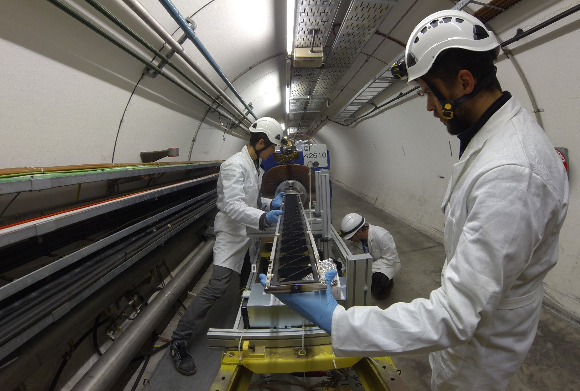
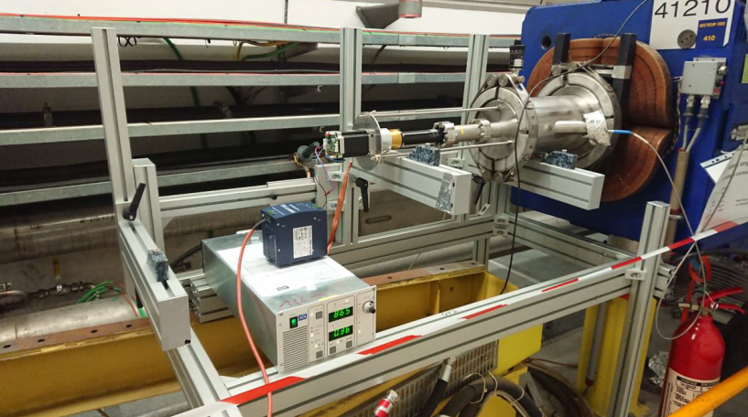
Scaling up to a series: e-cloud mitigation in SPS
Up to 2018: coated 20 dipoles + 15 quadrupoles. Showed no issue in operation.
Long Shutdown 2 (2019-20): all 90 focussing quadrupoles and adjacent short straight sections by June 2020. In operation, suppresses e-cloud
At present: Applied preventively on spare dipoles, since the dynamic pressure recovery after emergency replacements is faster

Slide 9
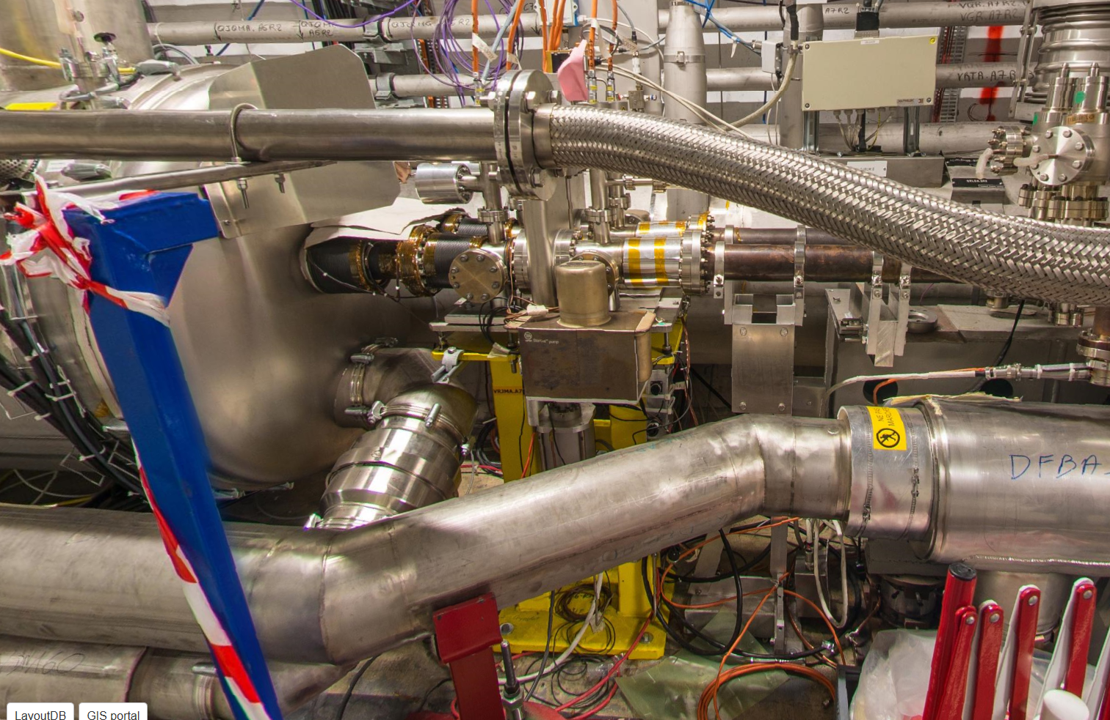
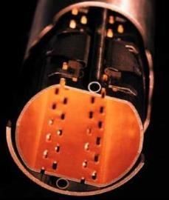
LHC standalone magnet: coating in-situ
Treatment in the tunnel
only 150 mm for access
Beamscreen
20K
Cold bore
1.9K
coating
~ O 50 mm

Slide 10

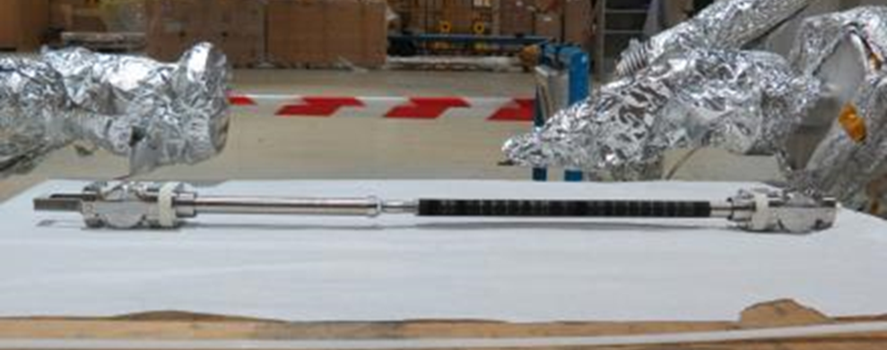
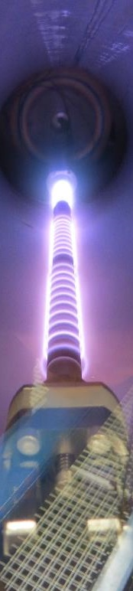
Development of adapted coating method
Develop a “modular sputtering source” that can be inserted and pulled by cables all along a magnet
Reduce outgassing during coating, H₂ is crucial (especially with the double wall of beamscreen and cold bore)
Ti and C cathodes to reduce outgassing and increase adhesion
Graphite target
Titanium target
pump hydrogen
enhance adhesion
direction
C
100
mm

Slide 11
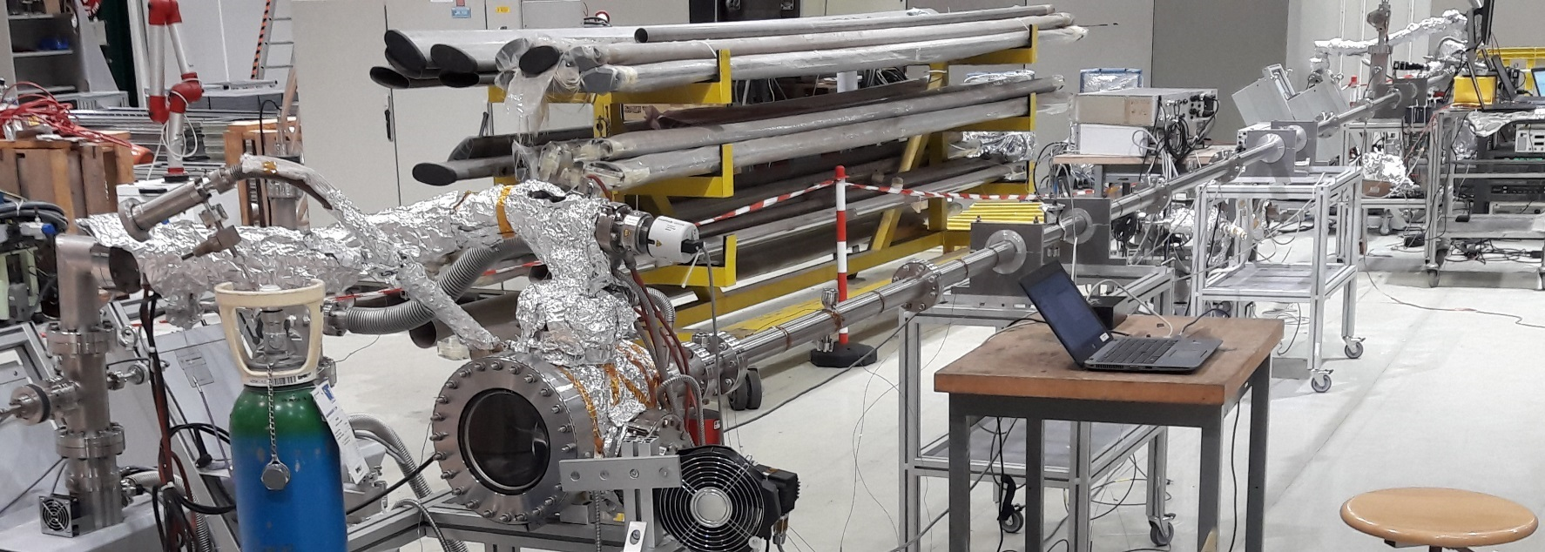
Development of adapted coating method: 10 m travel
10 meters
Successfully applied to Q5L8 quadrupole in situ in 2021, to be applied to Pt2 and Pt8 triplet magnets in LS3
Threshold HL-LHC

Slide 12
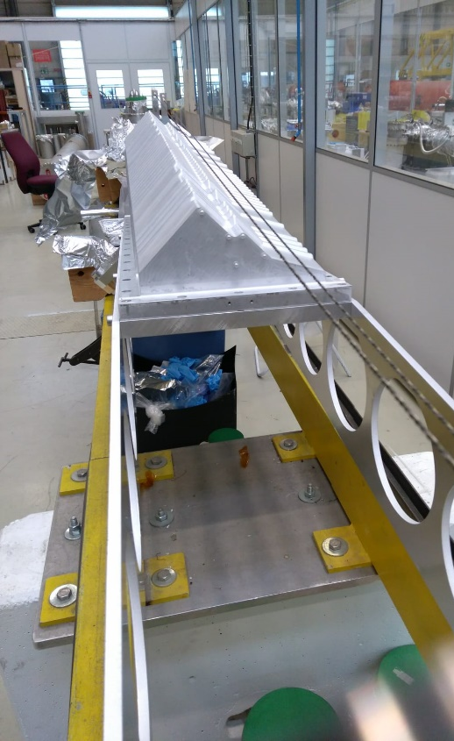
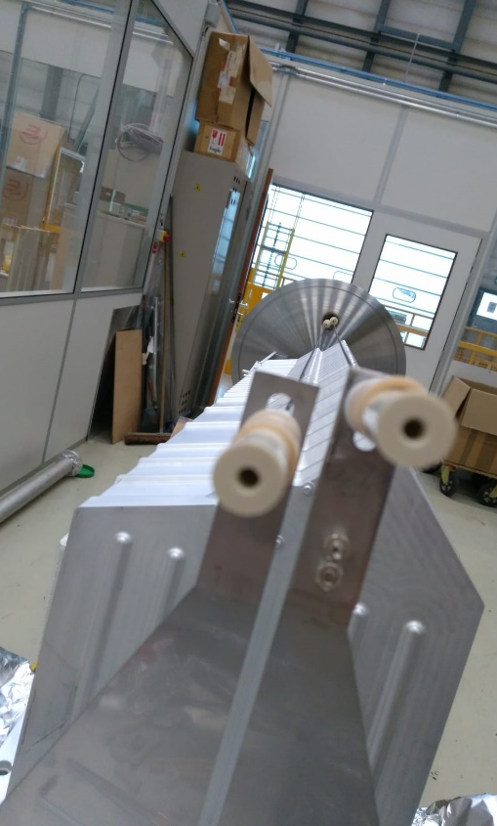
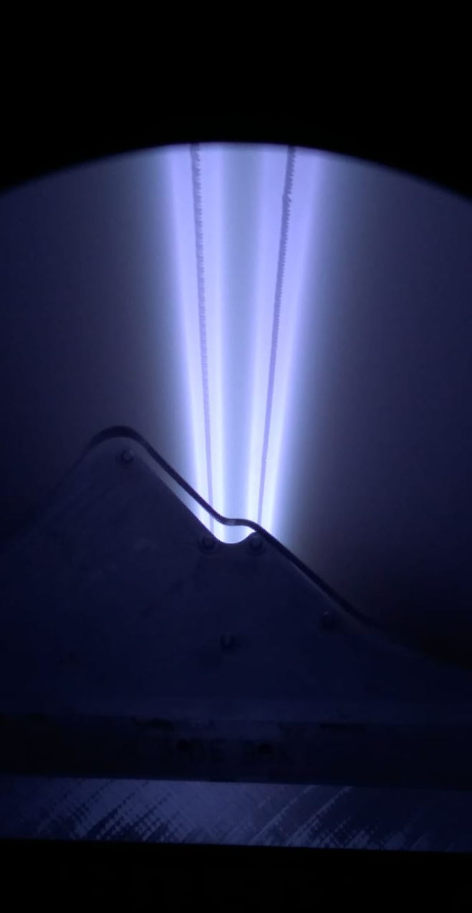
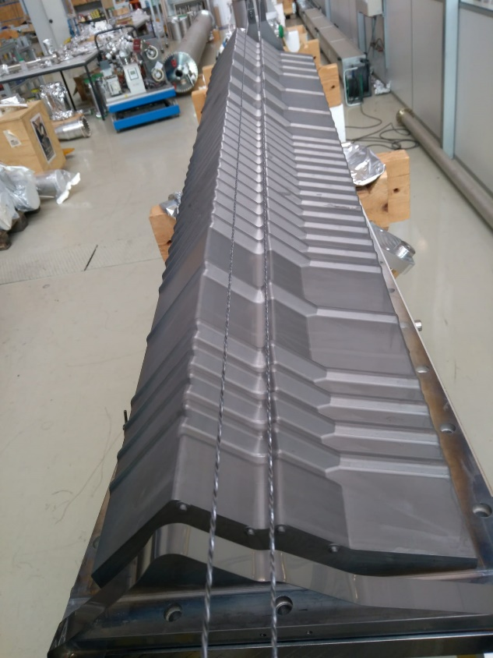
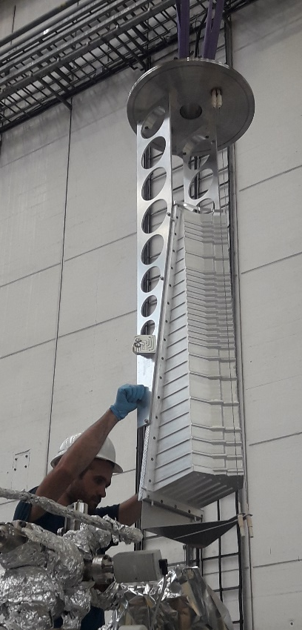
Implementation of coatings in a project
Adapted coating system.

Slide 13
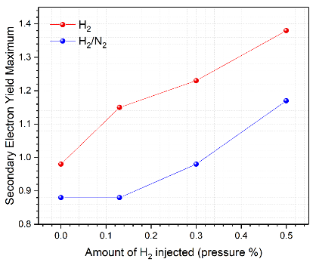
Implementation of coatings in a project
Adapted coating system.
Low SEY: limit impurities in the films (oxygen in NEG, hydrogen in carbon). Ex: by bakeout before coating, add sublayers, doping, discharge parameters

Slide 14
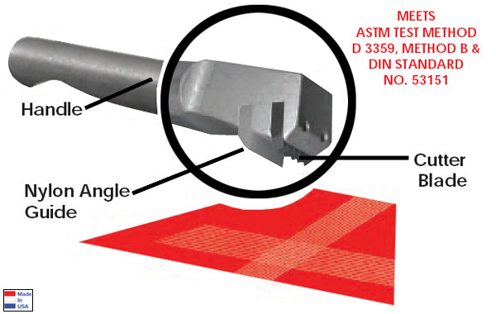
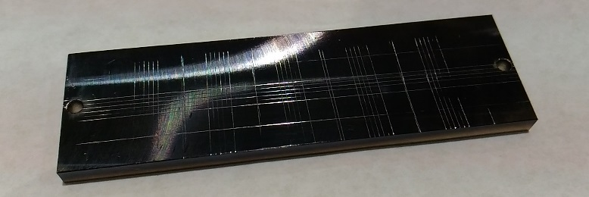
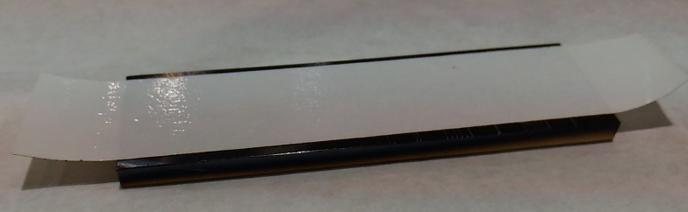
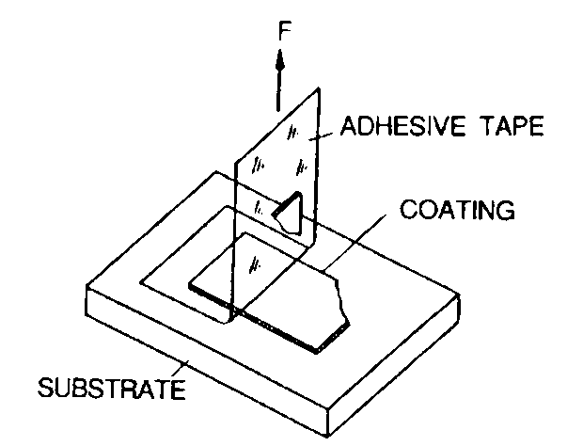
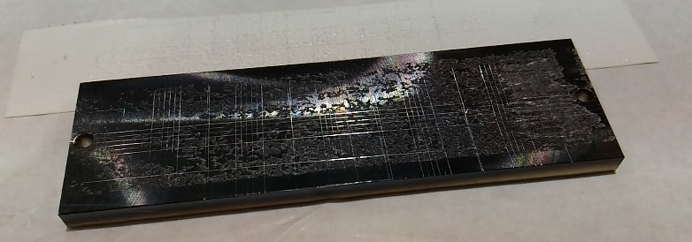
Implementation of coatings in a project
Adapted coating system.
Low SEY: limit impurities in the films (oxygen in NEG, hydrogen in carbon). Ex: by bakeout before coating, add sublayers, doping, discharge parameters
Adhesion: surface preparation is crucial (wet chemistry, plasma treatments, sublayers). Preliminary test on representative surfaces and conditions.

Slide 15
Implementation of coatings in a project
Adapted coating system.
Low SEY: limit impurities in the films (oxygen in NEG, hydrogen in carbon). Ex: by bakeout before coating, add sublayers, doping, discharge parameters
Adhesion: surface preparation is crucial (wet chemistry, plasma treatments, sublayers). Preliminary test on representative surfaces and conditions.
Include the coating constrains from
early stages of the design.

Slide 16
THANK YOU FOR YOUR ATTENTION

Slide 17
Electron cloud or why slow electrons matter
e-cloud
+
+
+
+
Proton bunch (charge +)
Gas molecule
Electron (charge -)
The beam is perturbed by the electron multiplication: emittance growth, beam instability
Cryogenic parts of the accelerator are submitted to heat load
The pressure rises due to electron stimulated desorption and provokes noise in the experiments
E-cloud is more pronounced for high beam currents and short bunch spacing
E-cloud is suppressed by a sufficiently low secondary electron yield of the walls (typically below 1.1-1.3)

Slide 18
Pumping action of TiZrV NEG: sticking probability of H₂ and CO upon thermal activation
The sticking probability is the ratio between sticking and impinging molecules. It shows the pumping efficiency
The sticking probability increases when the NEG is activated (all measurements made at the same T, after thermal activation)
The NEG pumps H₂, CO, CO₂, N₂…. It does not pump CH₄ and noble gases which do react with the surface

Slide 19
e-cloud
Measurement of TEY on materials in the lab
electron gun
electron gun
Gun is closer to sample:
better adapted for low Ep
The two currents are not measured simultaneously
I_{p}
A
I_{p}
I_{c}
I_{c}
I_{c}
Sample
Sample
Faraday cup
I_{p} = I_{s} + I_{c}
δ = I_{c} / (I_{s} + I_{c})
I_{p} = I_{s} with Faraday cup
δ = 1-I_{s}/I_{p}
I_{s}
A
I_{s}
A
Measurements done at low dose (below 10⁻⁶ C/mm²) to avoid conditioning of the surface

Slide 20
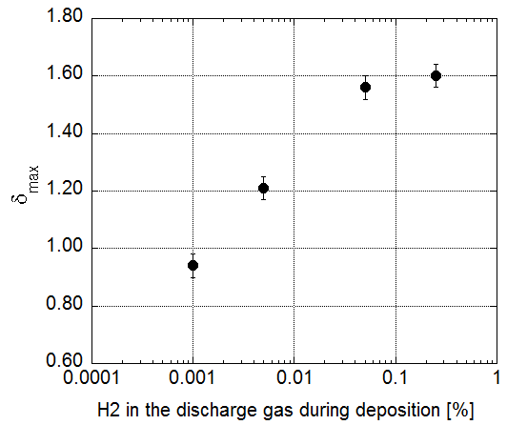
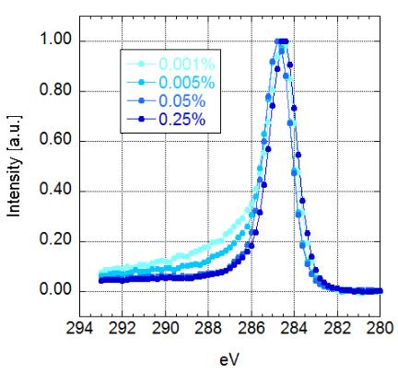
Thin films
δmax is influenced by the hydrogen in the discharge gas
XPS C1s
δ_{max}
SEY max
The intensity at high BE decreases with H₂, but we don’t know the mechanism
Reduce and control H₂ outgassing during the coating process
20

Slide 21
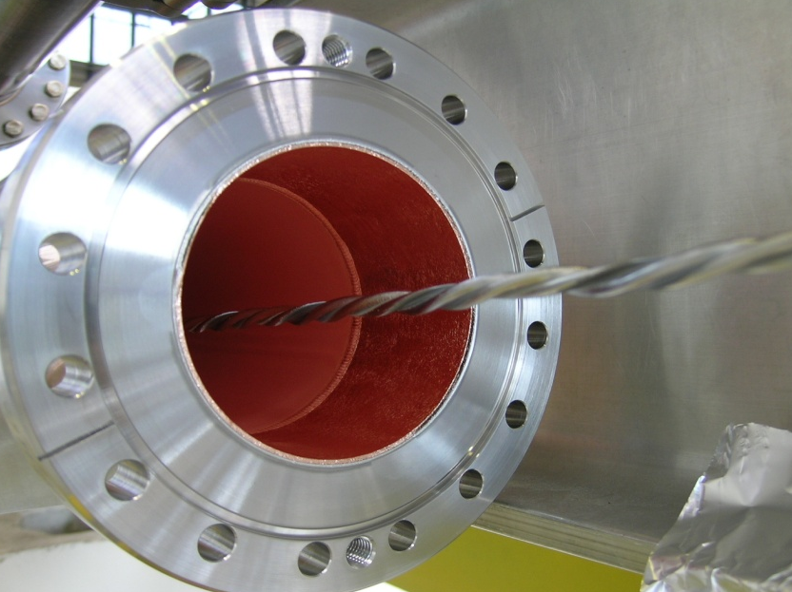
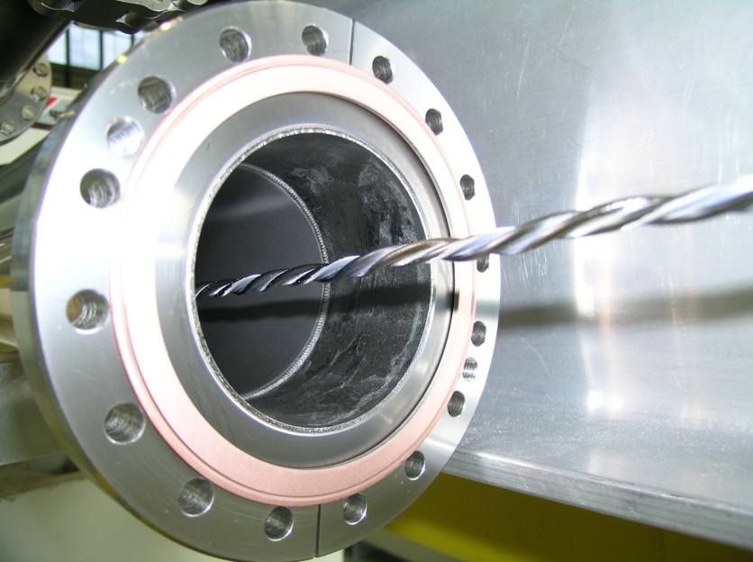
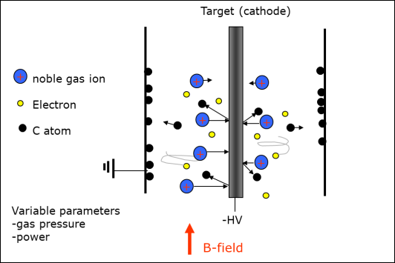
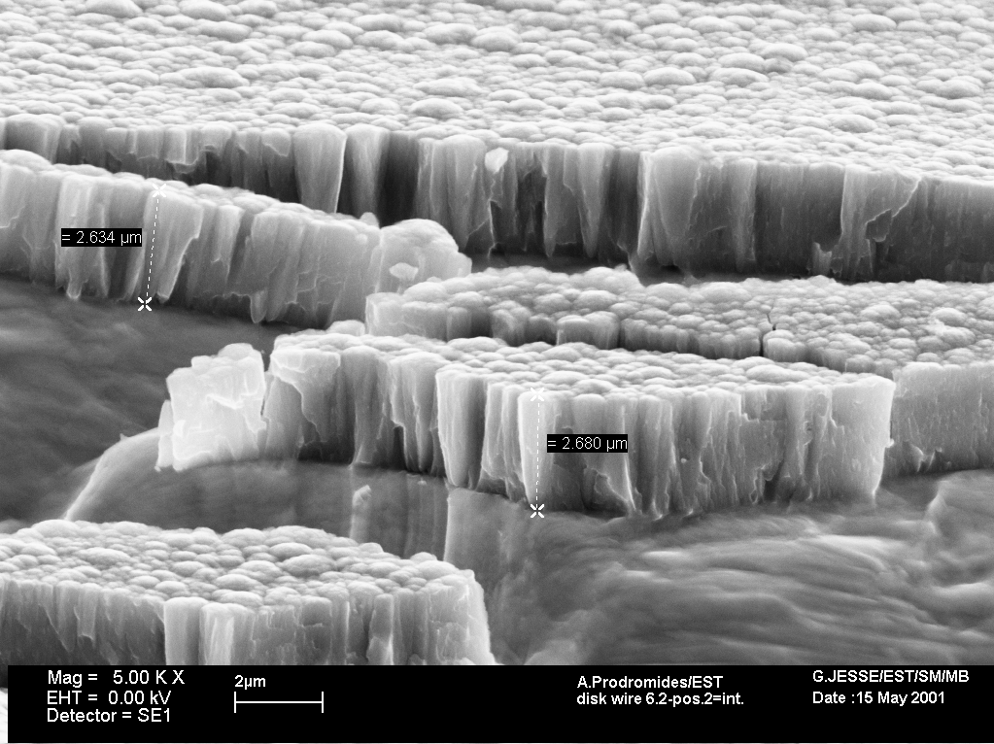
Skip?
Coating method for vacuum pipes
TiZrV alloy is deposited by DC-magnetron sputtering with a single target made of intertwisted wires of titanium, zirconium and vanadium
Before coating
after coating
coil
Vacuum chamber
B-field
typically < 300G
Coating after pumping and bake out
Notes:
Appropriate situation with the CERN logotype
Mixture of different logotypes
All of them are circulating
All CERN clubs were also very creatives

Slide 22

No dust and particles: test in optical particle counter
coated with carbon
2 StSt tubes
measured in
clean-room (REF 1,2)
both measured again in clean-room
left in the lab. with covers
3 µm < Size < 5 µm
3µm < D <5µm
-No difference in particles between coated and uncoated tube
-No increase after shaking and gentle hammering of the chamber
-No increase for a chamber left in air for months
-Same result for size above 5 µm
In addition:scotch-tape test for adhesion
REF1
Tube no coating
REF2
Tube after coating
N particles
intake cycles
Cycles

