Slide 1


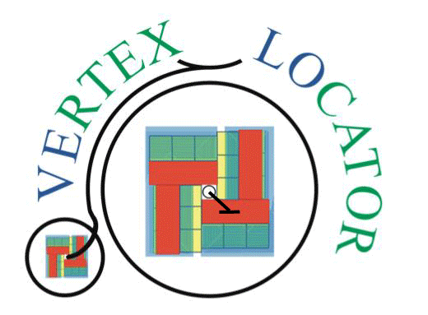
VELO U2 cooling substrates
Oscar Augusto on behalf of the VELO Upgrade 2 group

Slide 2

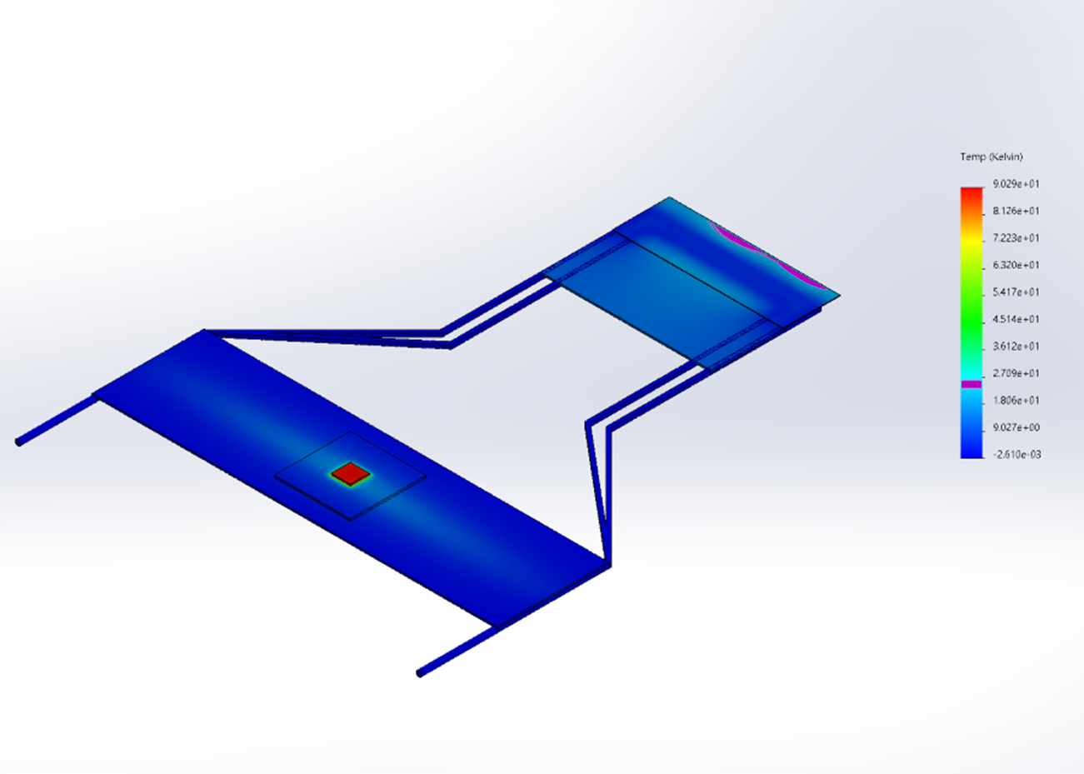
3D metal
Exploration phase
Considering evaporative $CO_{2}$ as baseline solution
Considering evaporative CO_2 as baseline solution
Power dissipation of up to $2W/cm^{2}$
Power dissipation of up to 2W/cm^2
Largest variation of temperature on the sensor part around $25℃$ (with respect to the inner side wall)
Largest variation of temperature on the sensor part around 25℃ (with respect to the inner side wall)
Alternative strategy to cooldown off-chip electronics would have to be improved (cooling routing lines)
U-like design
Different designs submitted to the Royce Institute (Sheffield) and Additure
More aggressive designs (larger $ΔT$) would require lower operating temperature (Krypton?) to keep the max. sensor temperature $<−20℃$
More aggressive designs (larger ΔT) would require lower operating temperature (Krypton?) to keep the max. sensor temperature <−20℃
At the moment, considering different designs which could lead to a material budget reduction compared to plan-Z
U-like design

Slide 3
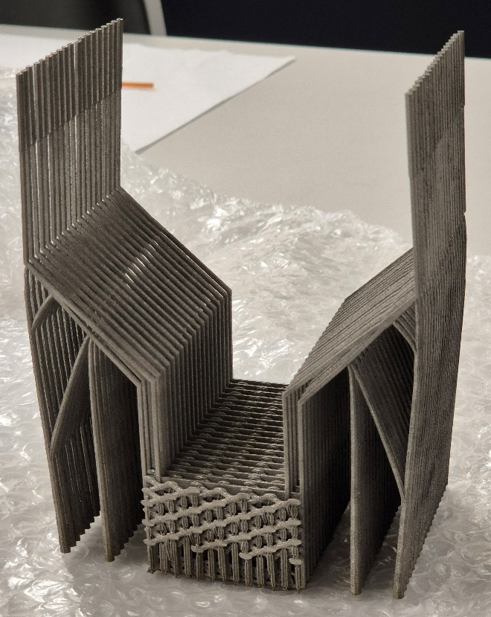
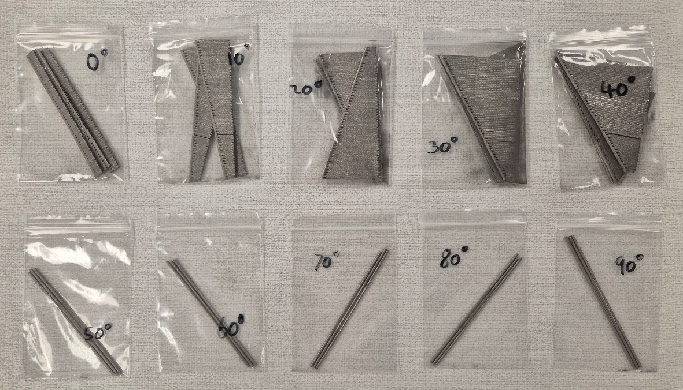
3D metal: LHCb VELO
New samples received in the last weeks
Additure:
Simple straight samples printed at different angles (0-${90}^{∘})$
Simple straight samples printed at different angles (0-90^∘)
Samples from >${30}^{∘}$ are more likely to be open (no blockage)
Samples from >30^∘ are more likely to be open (no blockage)
Basics up approach
Sheffield:
U-loop samples
Visually improved with respect to the previous design
Input and output visually open
Next steps: flow, high pressure, …
Next steps: high pressure test, flow, …
Sheffield
Additure

Slide 4
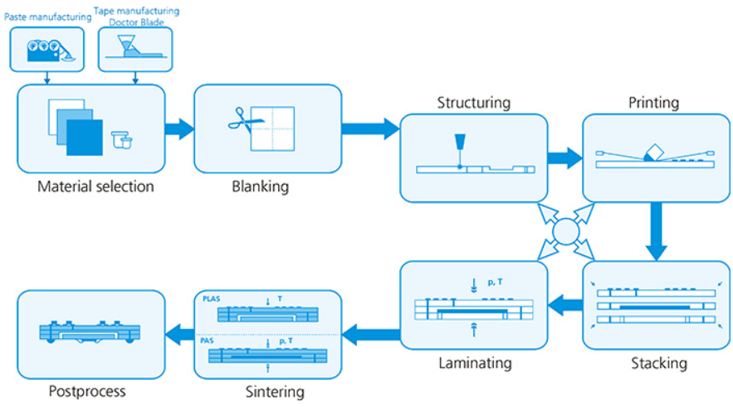
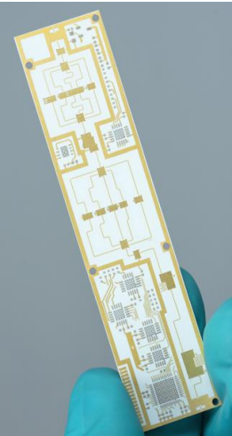
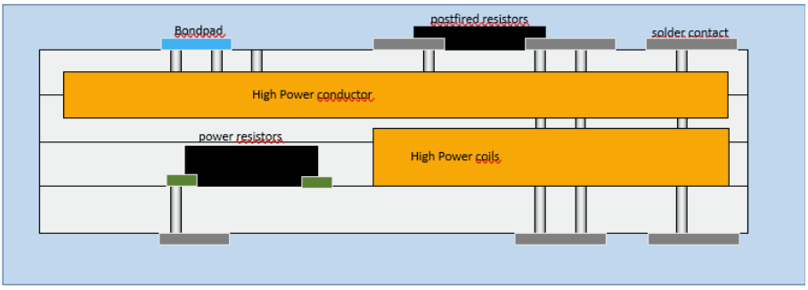
Ceramics
Why?
Robustness, reliability, stability in ultra-high-vacuum
Manufacturing at IKTS Fraunhofer (Germany)
Possible to embed conductive layers in between ceramics layers and metalize the surface
Potential to integrate electronics or high conductivity elements
Mechanically robust and compatible with high ultra vacuum
Different base materials: YSZ, $Al_{2}O_{3}$, … including SiC and AlN
Different base materials: YSZ, Al_2 O_3, … including SiC and AlN
Manufacturing based on several layers
©Fraunhofer IKTS

Slide 5
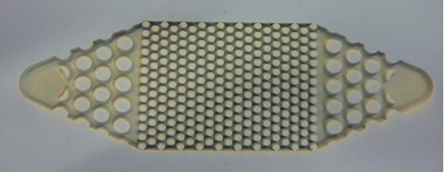
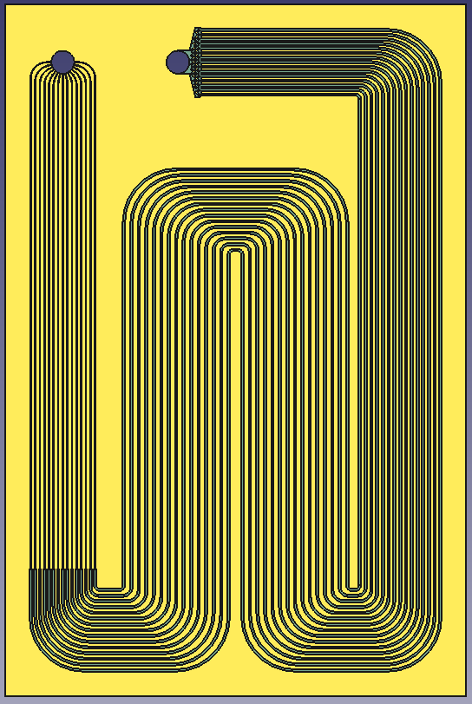
Ceramics
Experience with fluidic applications
First prototype based on the early VELO Upgrade I CERN design
Initial channel with $70μm$ width (restrictions)
Initial channel with 70μm width (restrictions)
Channels height $100μm$
Channels height 100𝜇𝑚
Overall dimensions: $40×60mm^{2}$
Overall dimensions: 40×60mm^2
Based on LTCC
$Al_{2}O_{3}/Glass$ $\sim 1:1$
Al_2 O_3/Glass ~1:1
HTCC at a later stage ($Al_{2}O_{3}$ $\sim 96\%$)
HTCC at a later stage (Al_2 O_3 ~96%)
©Fraunhofer IKTS
Restrictions
Input
Output
40 mm
Main
channels
60 mm

Slide 6
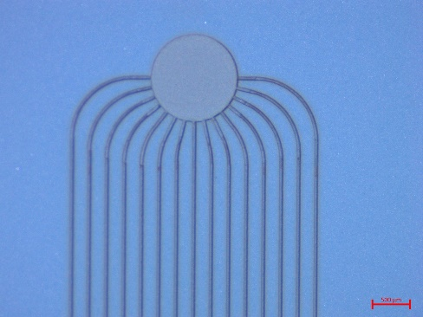
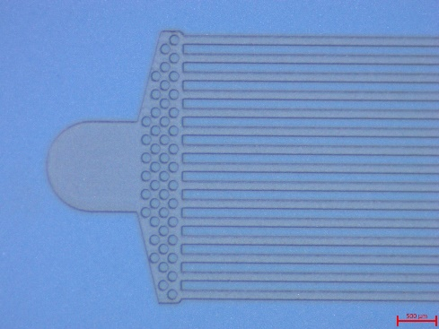
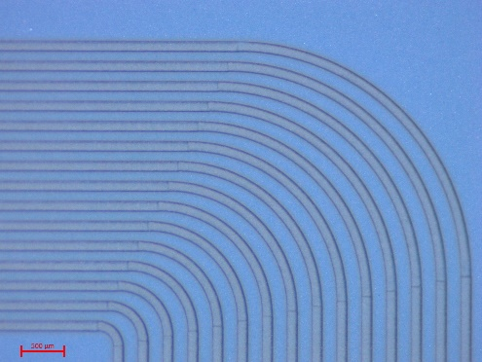
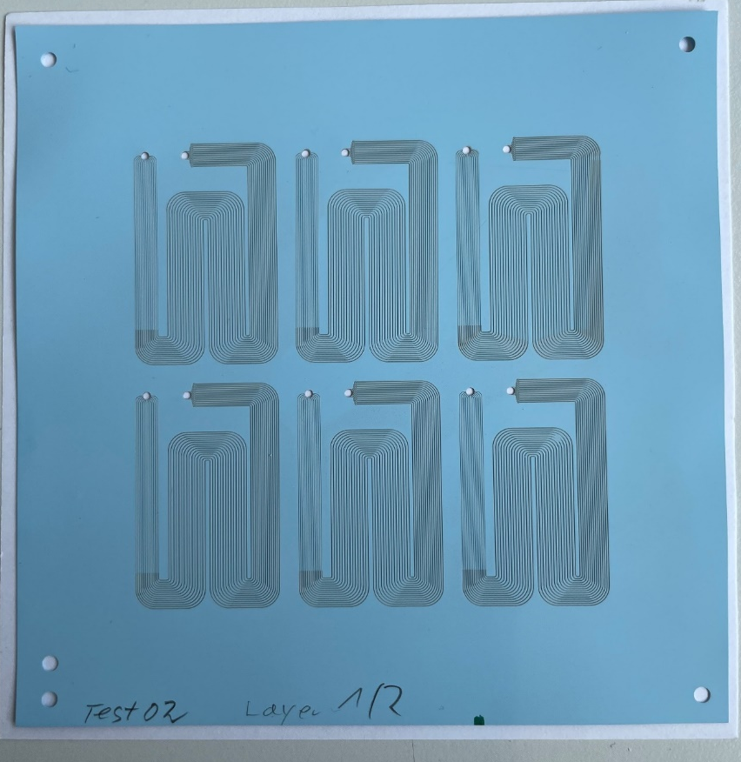
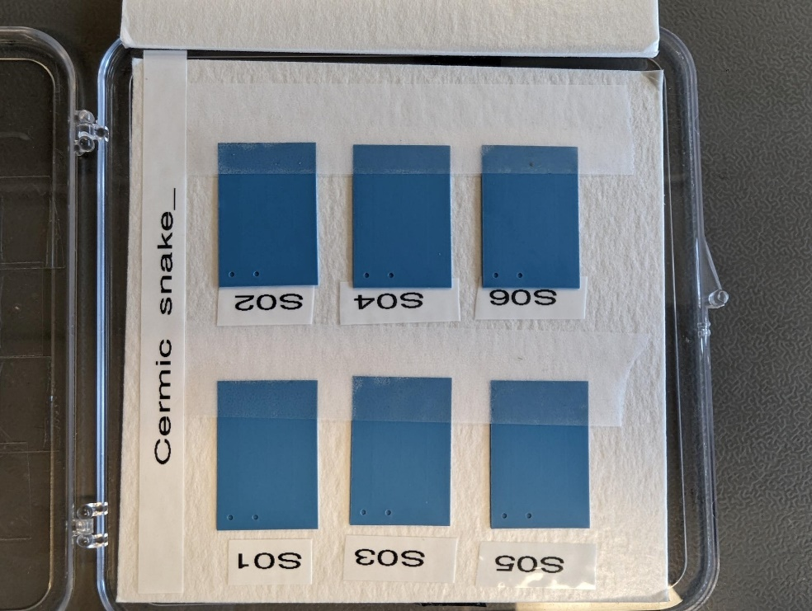
Ceramics: Goal and status
Goal:
Manufacture first samples (IKTS)
Nominal samples received
Validate initial prototypes to high pressure, leak tightness and cooling performance
Benchmark: LHCb VELO Upgrade 2 requirements (High pressure 186 bar, leak tight (vacuum operation) and excellent thermal performance
Miniaturized version (2x smaller in-plane)
Expected 35um and 100um width restrictions and main channels respectively!
IKTS Fraunhoffer ©
IKTS Fraunhoffer ©
IKTS Fraunhoffer ©
Fraunhoffer ©

Slide 7
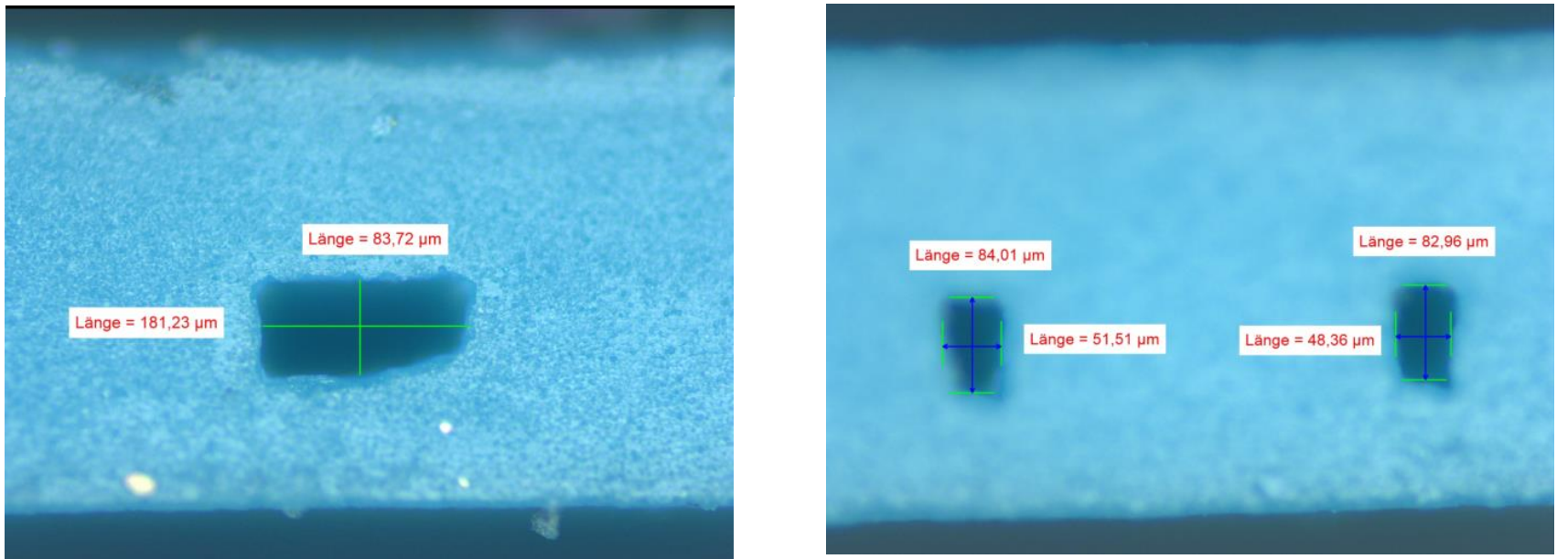
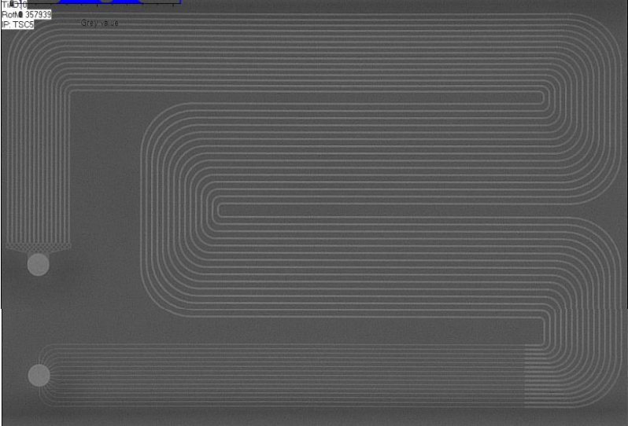
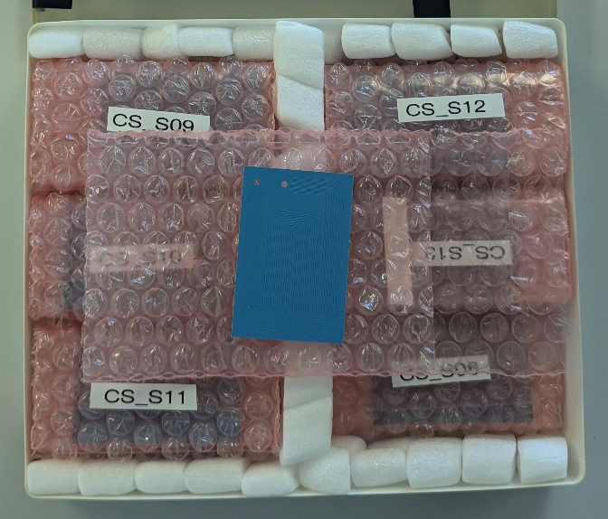
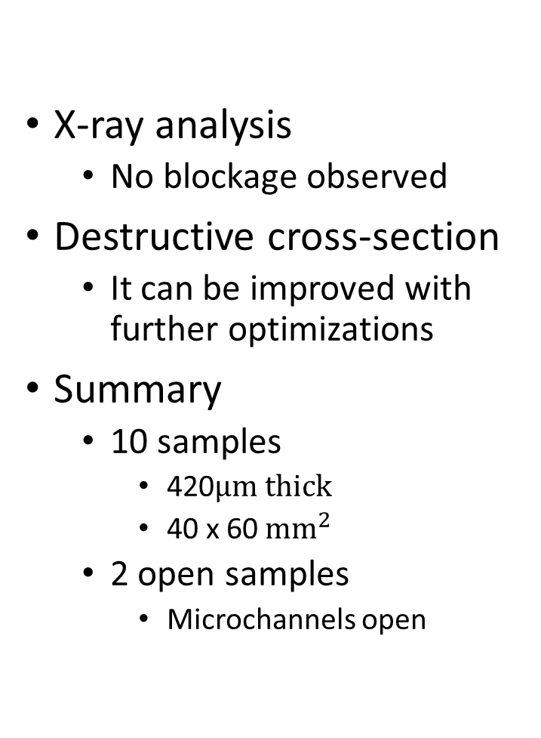
Nominal samples
Sample destructive cross section measurement
X-ray analysis
  No blockage observed
Destructive cross-section
  It can be improved with further optimizations
Summary
  10 samples
    420$μm thick$
    40 x 60 $mm^{2}$
  2 open samples
    Microchannels open
X-ray analysis
Samples at UoM

Slide 8
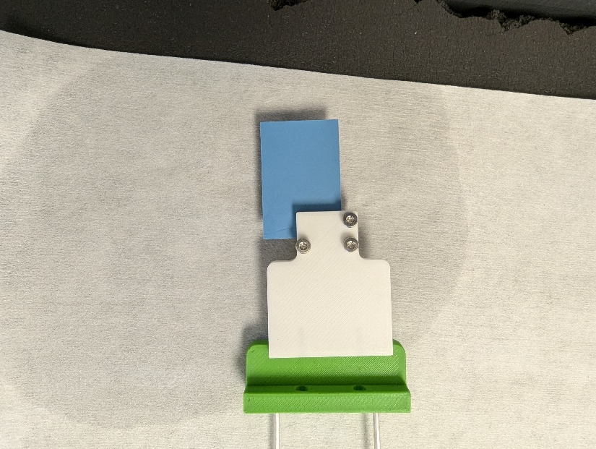
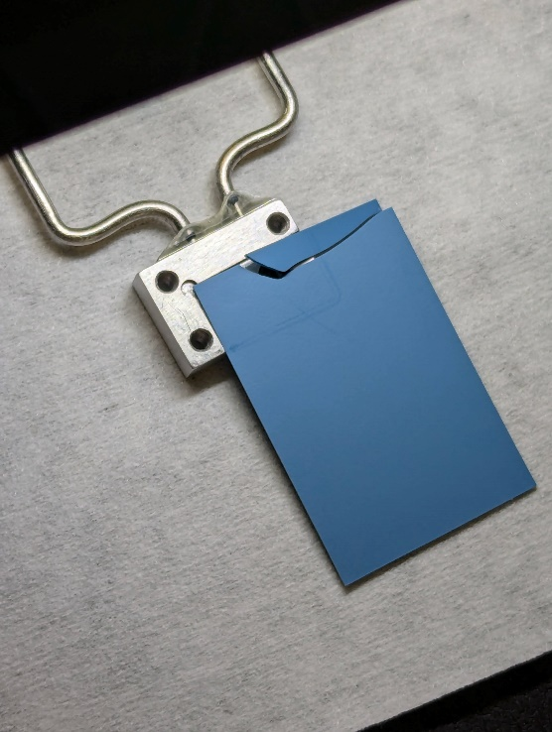
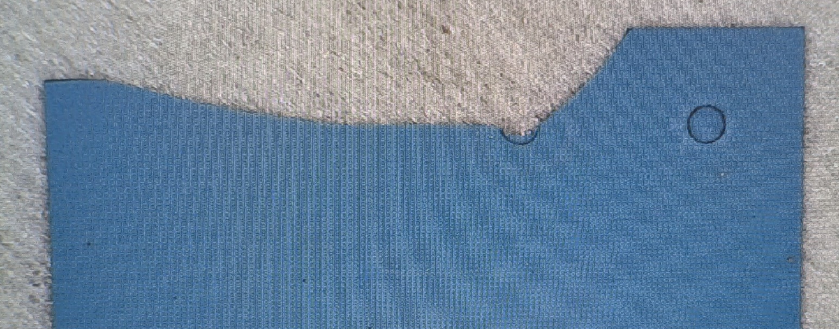
High pressure
Lot0 S4 sample
Miniaturized version of R. Dumps design
  Thank you very much for sharing the design! ☺
A small summary:
  Lot0S06 – broke at 70 bar
  Torque screwdriver + additional cleaning
  Lot0S4 – broke at 120 bar
  Kapton layer on the back of the sample
  Lot0S5 – broke at 110 bar
All sample showed cracking crossing one of the openings
Leak detected
Connector
clamping?

Slide 9
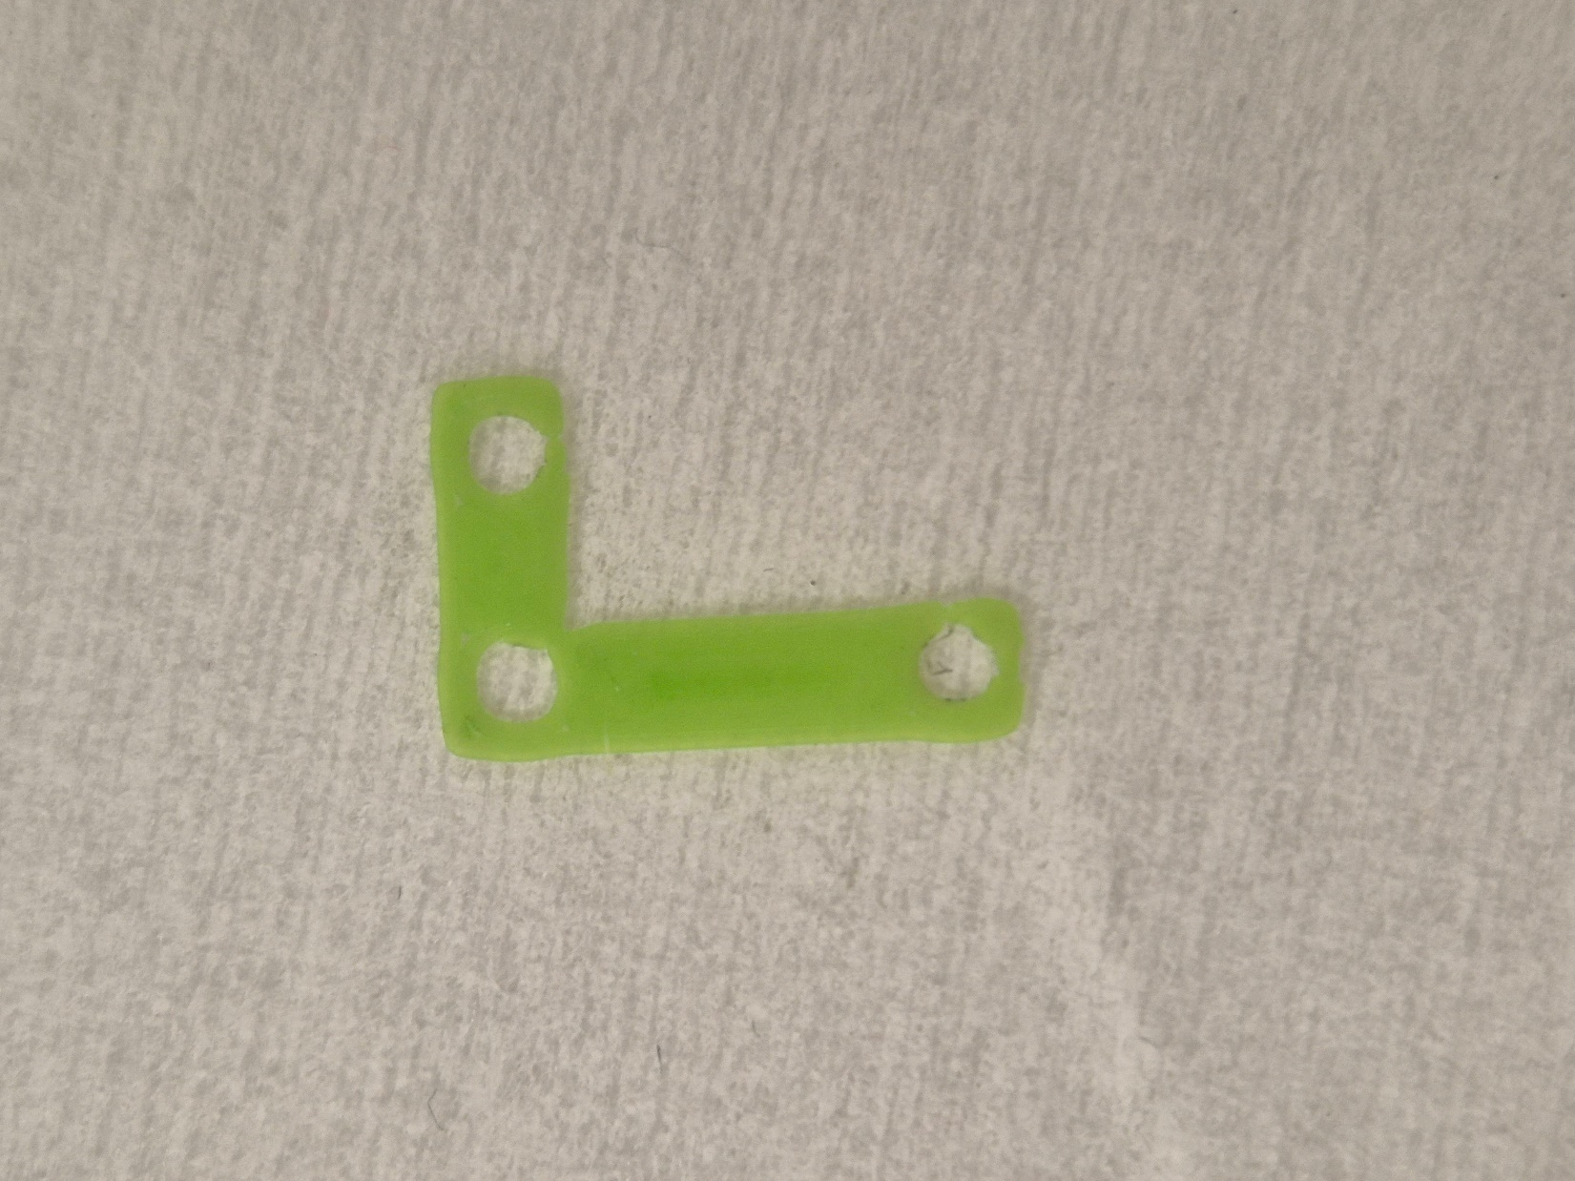
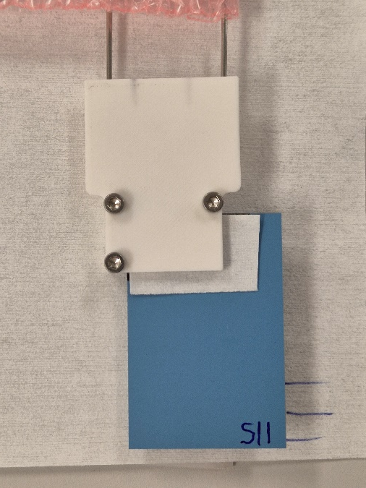
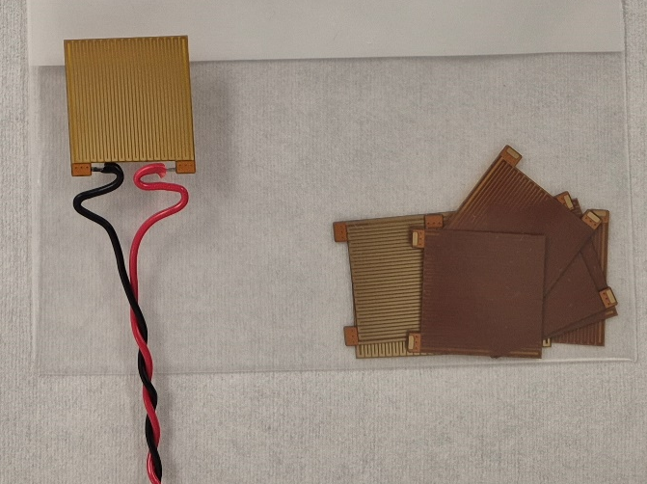
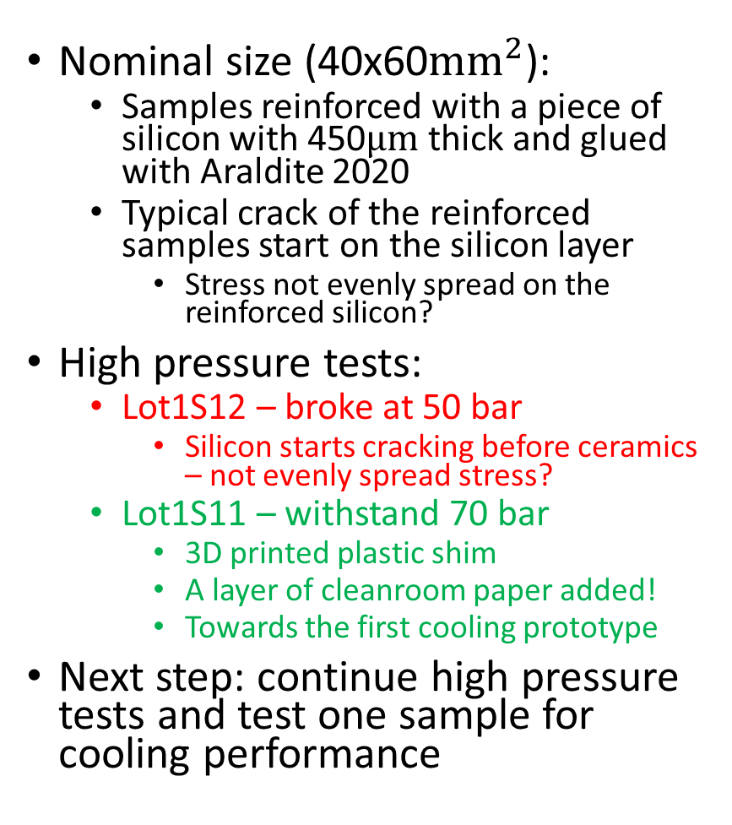

High pressure and next steps
3
Lot1 S11
Nominal size (40x60$mm^{2}$):
  Samples reinforced with a piece of silicon with 450$μm$ thick and glued with Araldite 2020
  Typical crack of the reinforced samples start on the silicon layer
    Stress not evenly spread on the reinforced silicon?
High pressure tests:
  Lot1S12 – broke at 50 bar
    Silicon starts cracking before ceramics – not evenly spread stress?
  Lot1S11 – withstand 70 bar
    3D printed plastic shim
    A layer of cleanroom paper added!
    Towards the first cooling prototype
Next step: continue high pressure tests and test one sample for cooling performance
3D printed plastic shim
Custom-made heater for cooling tests
kapton
copper
glue
Si (200$μm$)

Slide 10
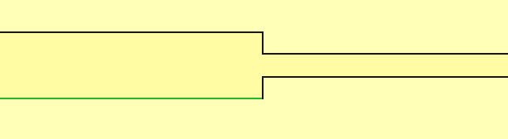
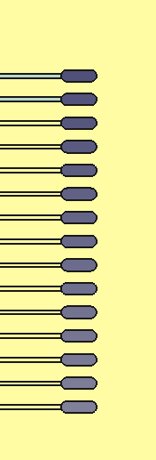

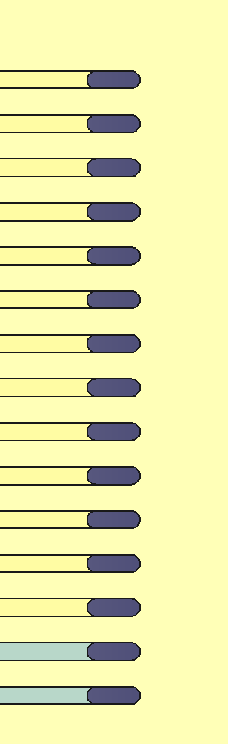

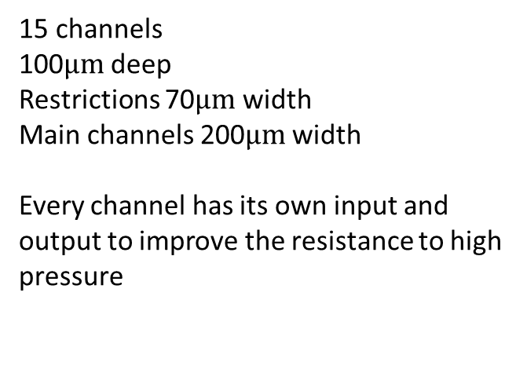


New design for the ceramics
600 x 200$μm^{2}$
70$μm$
200$μm$
Inputs
15 channels
100$μm$deep
Restrictions 70$μm$ width
Main channels 200$μm$ width
Every channel has its own input and output to improve the resistance to high pressure
40mm
Outputs
60mm

Slide 11
New samples
Test of differential pairs and/or resonators
Additional high pressure resistant samples
Reinforcement just in the back of the inputs/outputs
Test structures
Ground
50 um?
200 um
200 um
200 um
microchannels
200 um
microchannels
200 um

Slide 12
Summary
3D metal printing
New manufacturer (Additure) with faster turnarounds
Straight tube structures printed and received
Ceramics
First nominal size structure (40x60$mm^{2}$) to withstand 70 bar
First nominal size structure (40x60mm^2) to withstand 70 bar
Recommissioning the $CO_{2}$ blow-system towards cooling tests
Recommissioning the CO_2 blow-system towards cooling tests
More structures will be reinforced and tested for high pressure
More U-loops structure received from Sheffield (visually better than the first round)
TBT for flow, high pressure, …
TBT for high pressure, cooling, …
New design for improved resistance to pressure (independent inputs/outputs) and first electronics features
Thank you for your attention

Slide 13
Backup slides

Slide 14
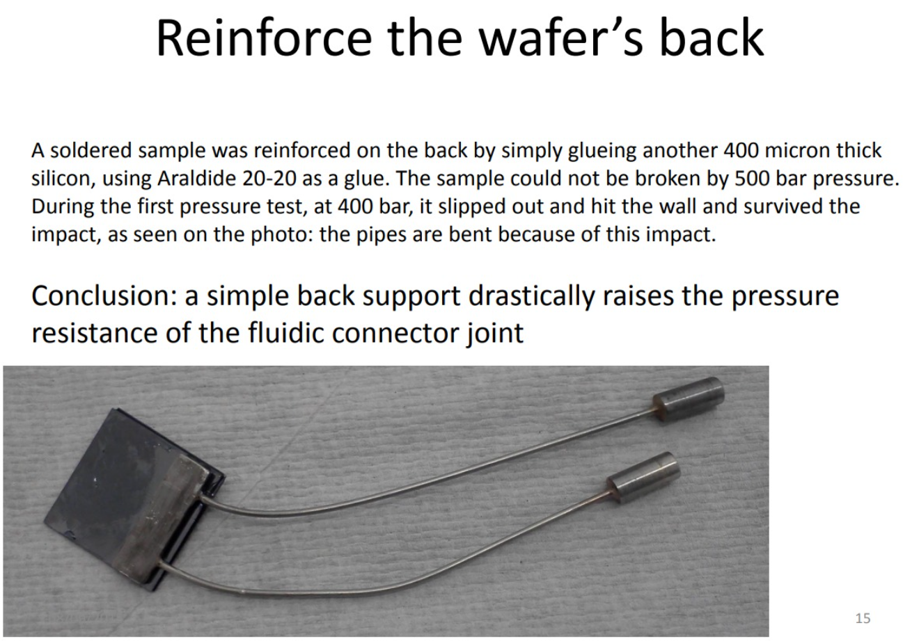
Slide from Pawel Jalocha

Slide 15
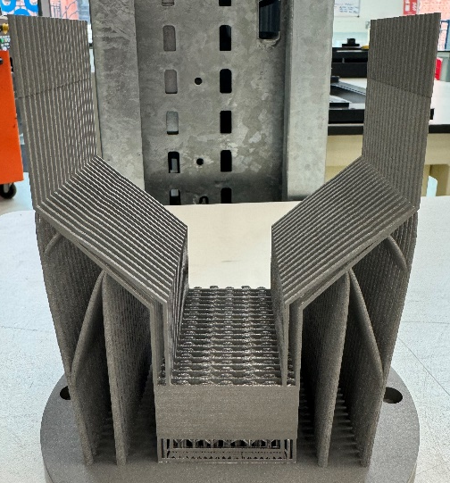
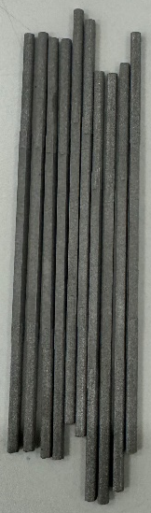

3D metal: LHCb VELO
Different designs
Squared tube and connector prototypes
X-ray tomography via NXCT
U-shaped design
X-ray 2D tomography (one projection)
Printing distortion and blockage
New round of printing (August):
Filling factor and distortions being improved
Different printing parameters to improve distortions and fill factor
Half of the samples will be electro-polished (easier integration?)
Samples are being post-processed
0.5mm
Fill factor
1.0mm

Slide 16
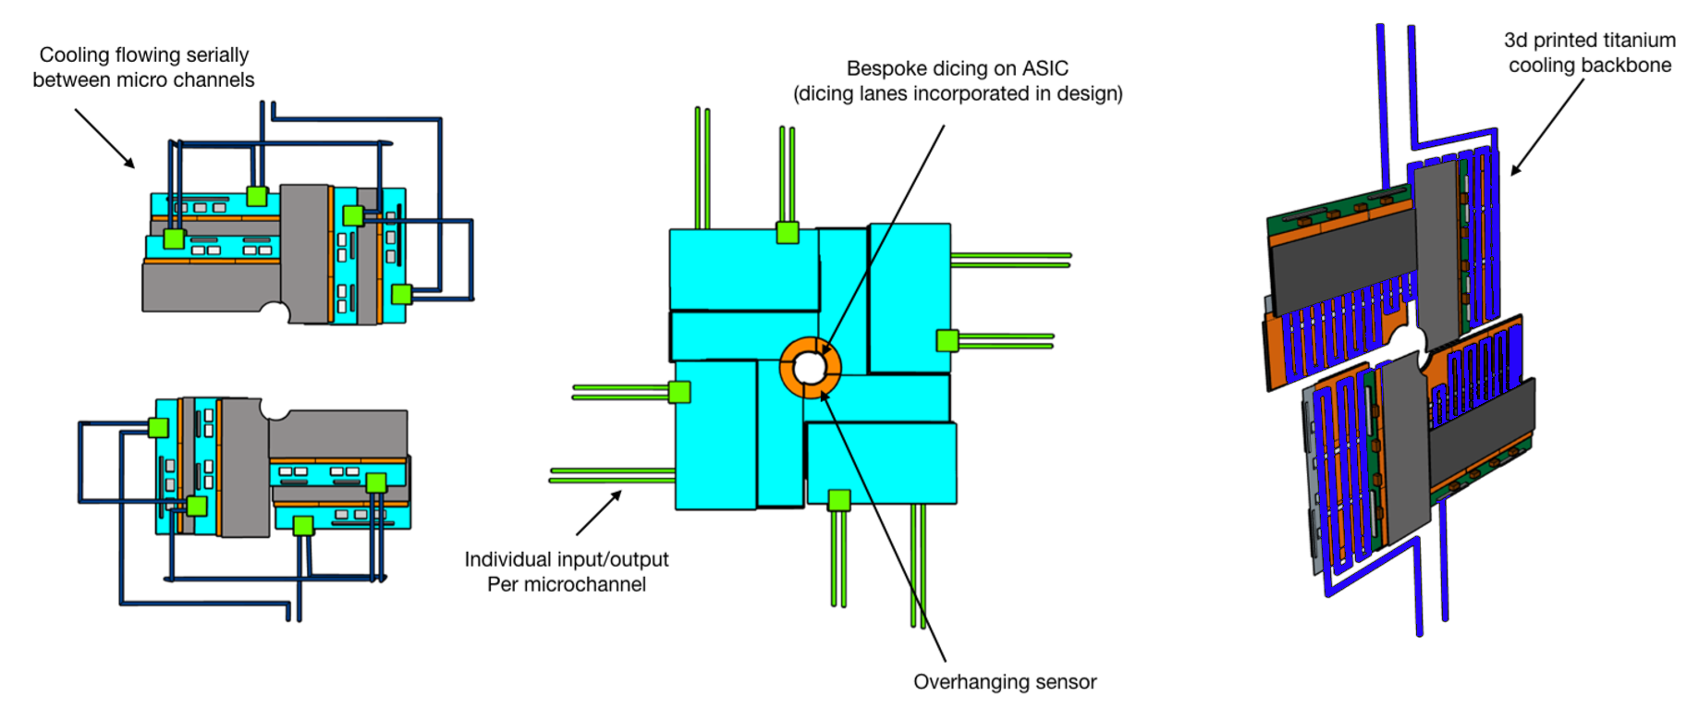
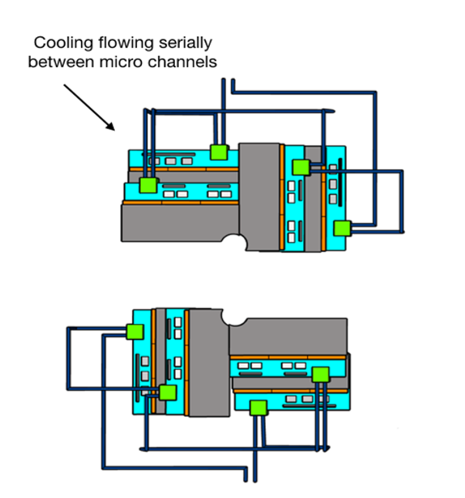
VELO Module/Cooling concepts (FTDR)
Smaller microchannel coolers to reduce the overall cost
More challenging to integrate (interface between pipes and coolers)
Cooling structure could be potentially re-used (NA62 talk)
Better cooling performance
Cheaper and more flexible design
Easier to integrate (cooling plant)

Slide 17
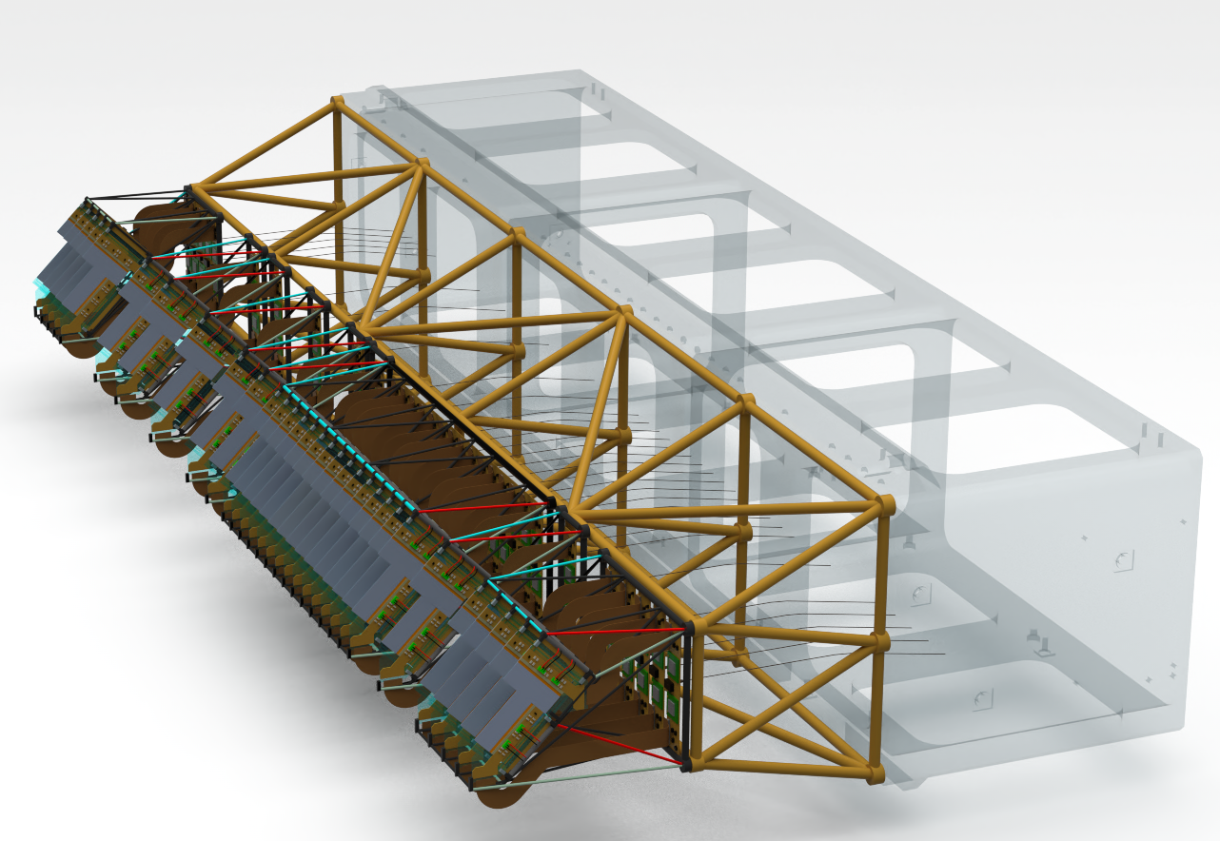
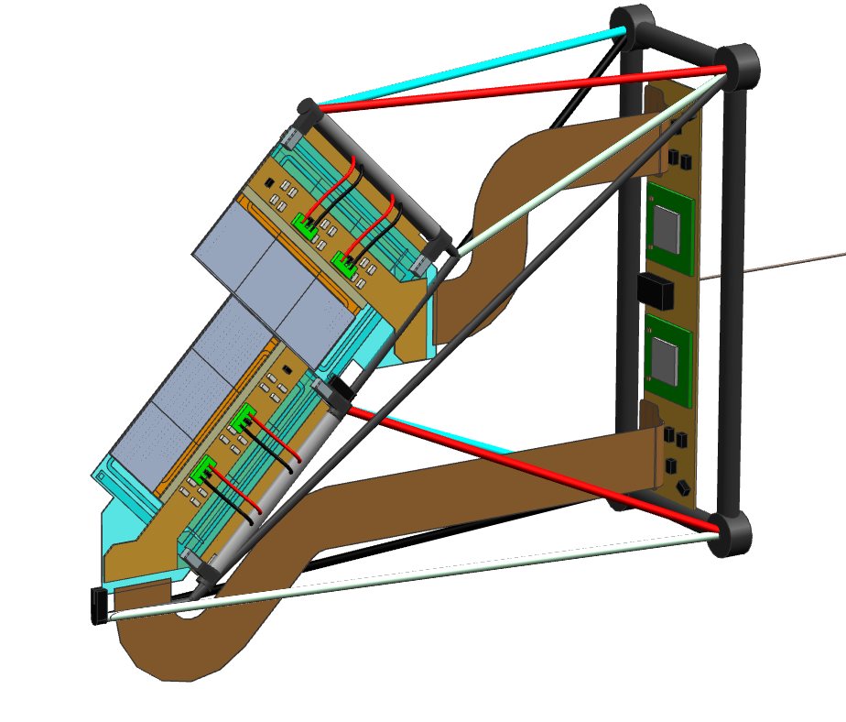
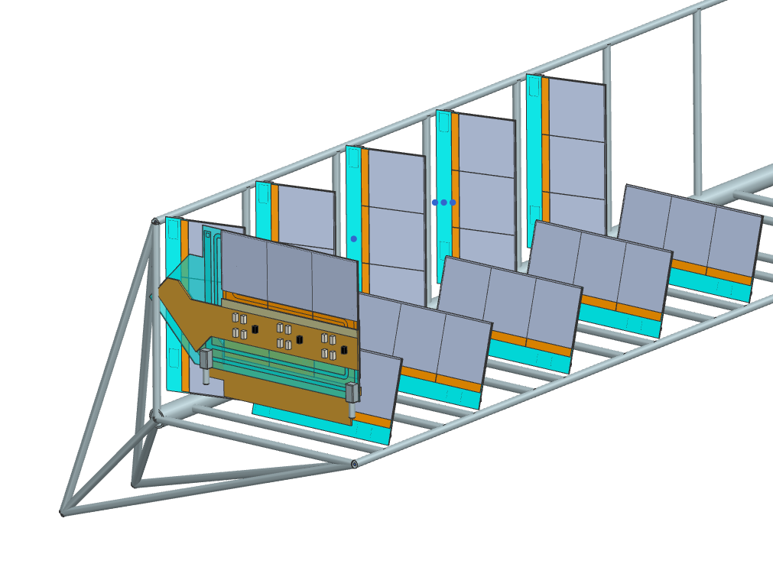
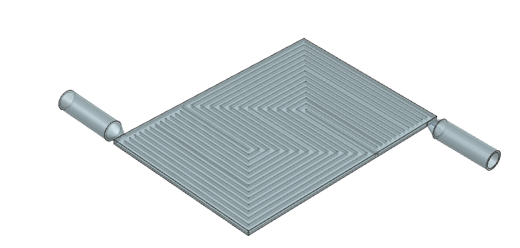

Module development at Nikhef – Status update
Concept [presented JUN 2024]:
  L-shaped station on a carbon fiber frame
Explorative studies:
  Additional sensor ring of triples
  Each tile at angle in theta and phi
  Need simulations.
Current work:
  Feasibility study of cooling substrates produced by 3d printed ceramics (Silicon Carbide, Aluminum Nitride) or aluminum
  Low material interconnects
  Brazing onto ceramics
Results…
  Next meeting, maybe.
Single station with integrated cooling & LV power on a carbon fiber subframe
Conceptual study of detector quarter with modules (2x3 and 1x3) at different angles in theta and phi
Cooling substrate – test piece

Slide 18

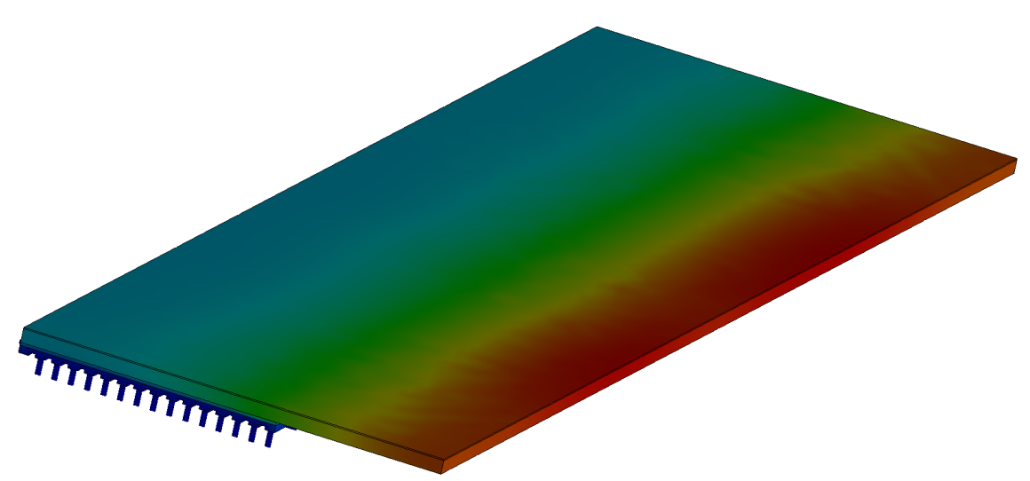
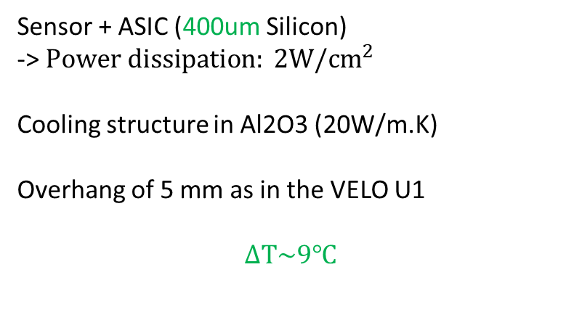

Simplified FEA
$$ΔT(℃)$$
Sensor + ASIC (400um Silicon)
-> $Power dissipation: 2W/cm^{2}$
Cooling structure in Al2O3 (20W/m.K)
Overhang of 5 mm as in the VELO U1
$$ΔT\sim 9℃$$

Slide 19
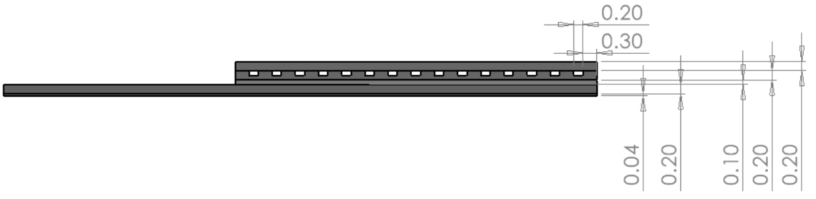
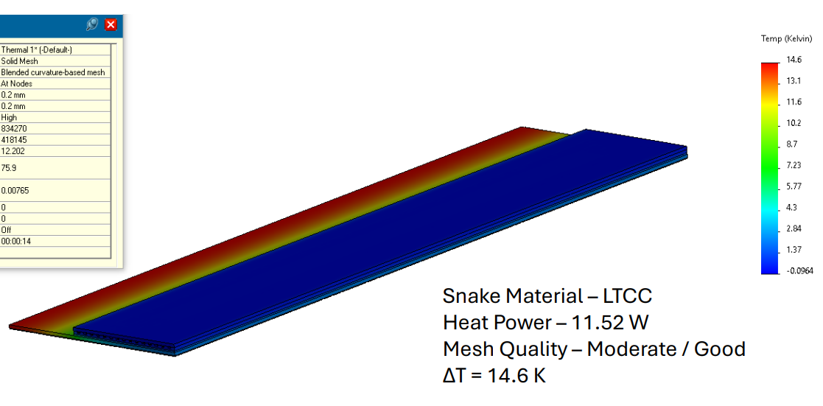

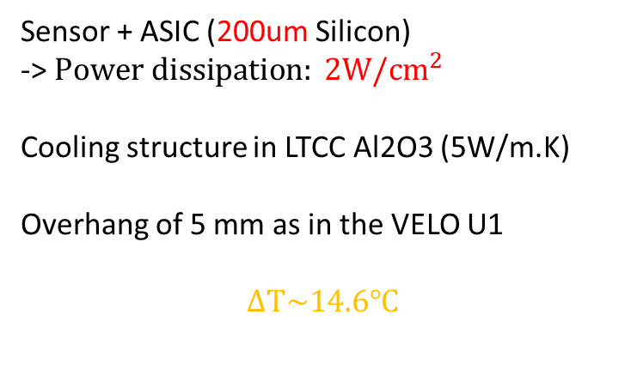
FEA (Alumina LTCC)
Sensor + ASIC (200um Silicon)
-> $Power dissipation: 2W/cm^{2}$
Cooling structure in LTCC Al2O3 (5W/m.K)
Overhang of 5 mm as in the VELO U1
$$ΔT\sim 14.6℃$$
$$ΔT(℃)$$

Slide 20
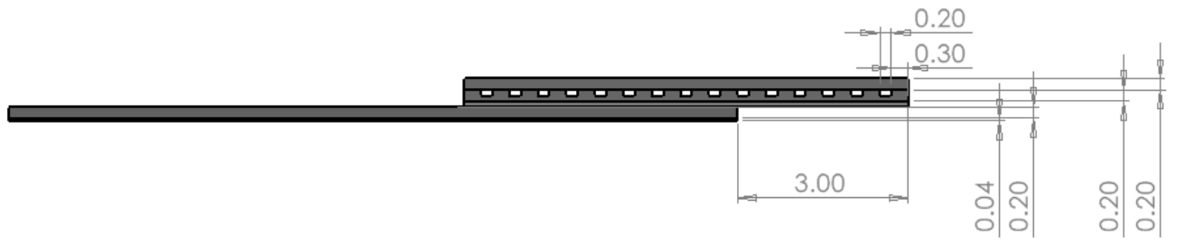
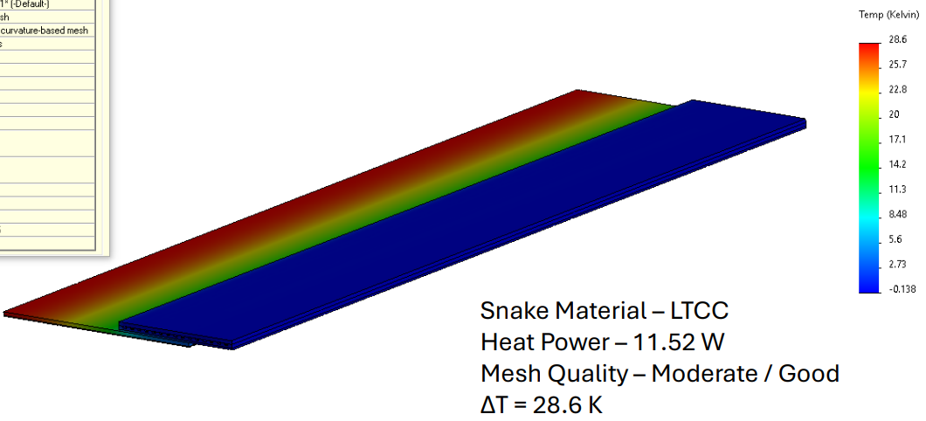

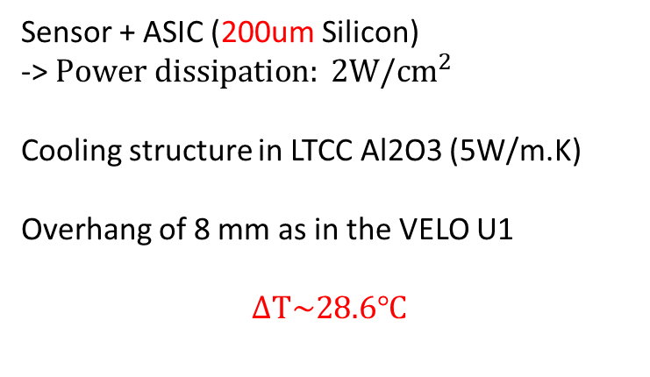
FEA (Alumina LTCC)
Sensor + ASIC (200um Silicon)
-> $Power dissipation: 2W/cm^{2}$
Cooling structure in LTCC Al2O3 (5W/m.K)
Overhang of 8 mm as in the VELO U1
$$ΔT\sim 28.6℃$$
$$ΔT(℃)$$

