Slide 1
LHCb VELO U2 Workshop
Antonio Pellegrino
On behalf of the Nikhef group working on the FELIX project
Backend developments at Nikhef
29 November 2024

Slide 2
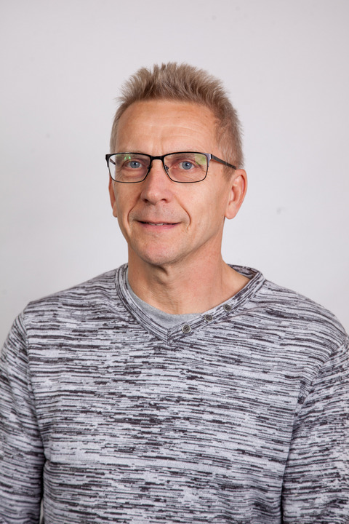

The Nikhef Group working on the ATLAS FELIX Readout
Jos Vermeulen (physicist)
Nayib Boukadida (engineer)
Firmware (e.g. Interlaken)
Henk Boterenbrood(engineer)
Software (e.g. low-level tools)
Frans Schreuder (engineer)
Firmware coordinator
Antonio Pellegrino (physicist)
Melvin Leguijt (engineer)
Firmware (e.g. Timing distribution)
Britt Reijnders(engineer)
Software (e.g. low-level tools)

Slide 3
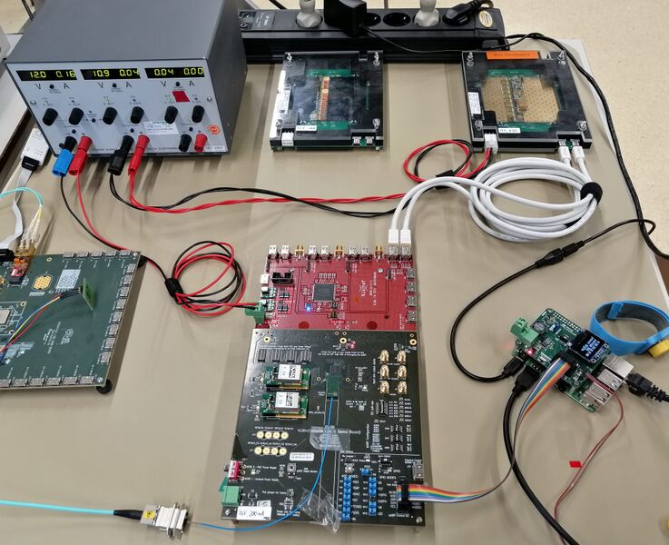
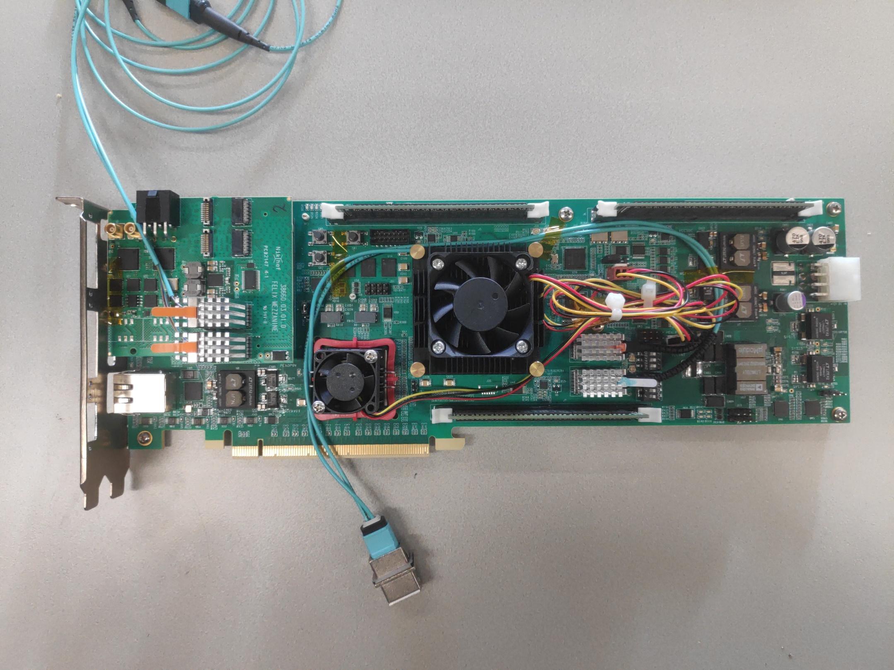

Our role in the ATLAS FELIX project
As you could deduce from the previous slide, we mostly work on the development of firmware and software…
… with some occasional “excursion” on hardware, e.g.
FELIX development: FMC mezzanine supporting 2×12 (Rx/Tx) Fireflies up to 25 Gbps
(Bas van der Heijden)
Detector support: VLDB+ adapter board for ITk strips
(Mesfin Gebyehu)
Fair to say we work in close collaboration with the hardware developers at

Slide 4
Back-End Card “FLX-182”
Interface to FE: 2×12 Tx + 2×12 Rx links of up to 25 Gbps
      Samtec FireFly transceivers
Interface to Timing and Trigger: 4 Rx + 4 Tx dedicated to the Local Trigger Interface
      Samtec FireFly transceiver
Interface to PCIe: 16-lanes Gen4 (240 Gbps usable)
      Bifurcated 2×8 lanes
Work Horse: FPGA of the AMD Versal Adaptive System-on-Chip family
      Versal Prime Series “XCVM1802-VSVA2197-1MP-E-S”
      26G NRZ “GTY” transceivers are used for connectivity
      Dual-core ARM Cortex A72 processor running PetaLinux is used
        to update the card firmware
        for card temperature and voltage monitoring
        to run a built-in self-test
ATLAS already produced the cards needed for testing/development related to Phase 2
      Unit Price: 12,900 USD

Slide 5
FLX-182 ↔ Host Server in ATLAS Testlab
Card currently hosted in server with:
      CPU: AMD Epyc 9004 (“Genoa”)
      2×200 Gbps Ethernet on PCIe Gen5
      96 GB DDR5
FELIX Card
DDR4
ARM Cortex A72
Network-on-Chip (NoC)
Host PC
MicroSD
CPU
SPI
AXI4
Virtual Network IP
FIFO
FIFO
Access Arm Processor through a virtual network connection over PCIe:
      Create in PetaLinux a virtual network device, to allow SSH, HTTP, etc.
      Use in-chip network (NoC) to connect it to the firmware via AXI4
      Expose this to the host PC on one of the two card PCIe devices
BAR3
PCIe
Wupper
Wupper
DMA interface
DMA interface
8 lanes
8 lanes

Slide 6
How FELIX is used in the ATLAS Readout and Control System
Detector Control System (DCS)
“slow control”
Monitoring
Multi-gigabit network
Configure
Data Handler
FE links (e.g. lpGBT)
PON or P2P links
Local Trigger Interf. (LTI)
The firmware on the FELIX card and the software on the FELIX server:
Handle data, slow control and trigger and fast commands
They do that in a “configurable” way (see next slide) to support detector-specific electronics

Slide 7
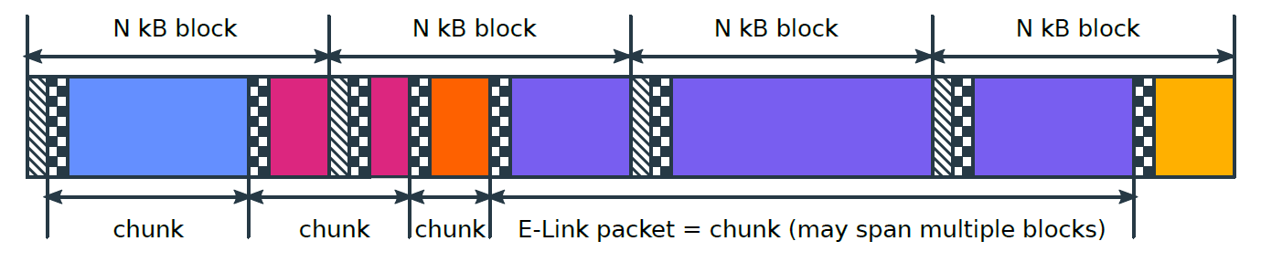
FELIX Firmware in ATLAS
supported protocols for logical links (“e-links”)
“split” data per e-link and identify begin/end of event fragments or other types of data ("chunks“)
(8b10b)
1kB blocks used, continuously transferred under DMA control
Each of up to 10 DMA output streams contains a mixture of 1 kB blocks of different E-Links, eventually associated with different physical links
Supported link protocols

Slide 8
Intermezzo on Timing Distribution
FELIX has to “relay” to all Front-End’s the main LHC clock encoded in the “LTI” logical link
      Some detectors (High Granularity Timing Detector – HGTD) demand unprecedented stability in this process
      At Nikhef we are working on establishing a way to obtain this stability on the FELIX card
We are working on an idea based on the GTY capability to make an eye-pattern
The idea: does the phase difference in the left plot “correlate” to the open eye area?
The Versal GTY transceivers are incredibly good in “recovering” clock…
Our first tests show that indeed it does!?
Currently working on (also in DRD7b.2):
  Check that this is generally valid
  Implementing a fast automatic procedure to “select” the same phase
… but if you want to improve “clock determinism” beyond what shown above, some ingenuity is required

Slide 9
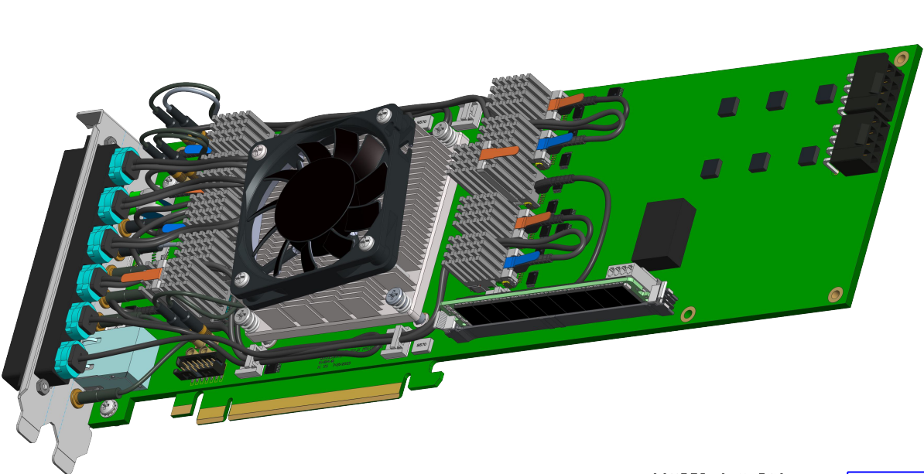
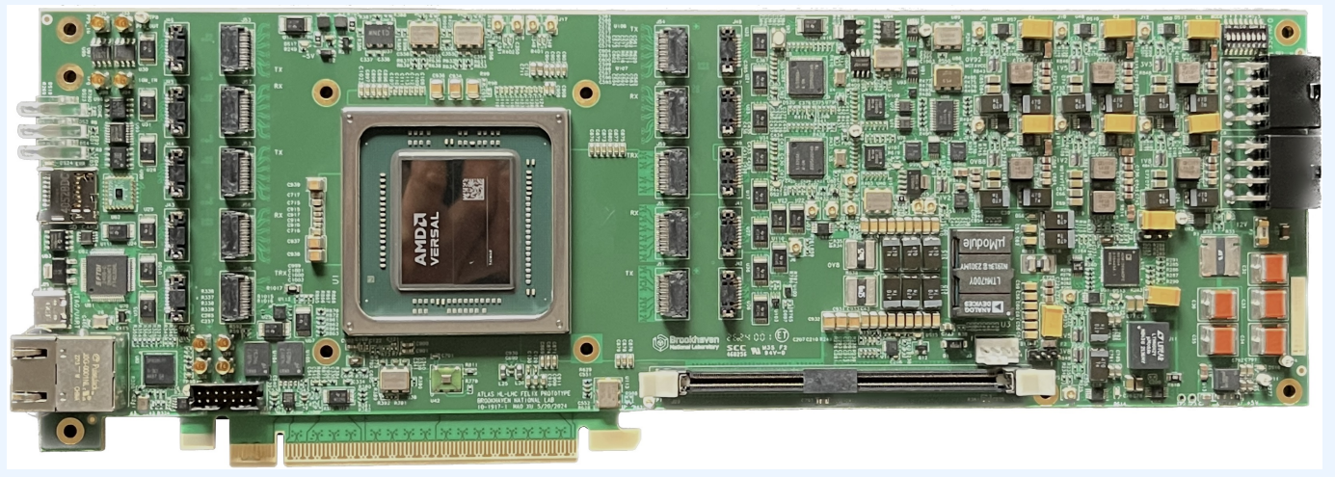
FELIX Card FLX-155
Interface to FE: 4×12 Tx + 4×12 Rx links of up to 25 Gbps
      Samtec FireFly transceivers
Interface to Timing and Trigger: 4 Tx + 4 Rx links of up to 25 Gbps
      Samtec FireFly transceivers
Optional Interface to 100GbE : 4 Tx + 4 Rx links of up to 25 Gbps
      Samtec FireFly transceivers
Interface to PCIe: 16-lanes Gen5 (480 Gbps usable)
      Bifurcated 2×8 lanes
Optional Interface to White Rabbit
      Footprint for oscillators and DAC
Work Horse: FPGA of the AMD Versal Adaptive System-on-Chip family
      Versal Premium Series “XCVP1552-2MSEVSVA3340”
      32G NRZ “GTYP” transceivers are used for connectivity
      Dual-core ARM Cortex A72 processor running PetaLinux will be used
        RAM on DDR4, file system on MicroSD (PetaLinux + Firmware), USB-JTAG/USB-UART
        Update firmware
        Card temperature and voltage monitoring
        Built-in self-test
First Card produced, 2nd one underway
      Price estimate: ⪅ FLX-182 (mainly due to larger Qy)

Slide 10
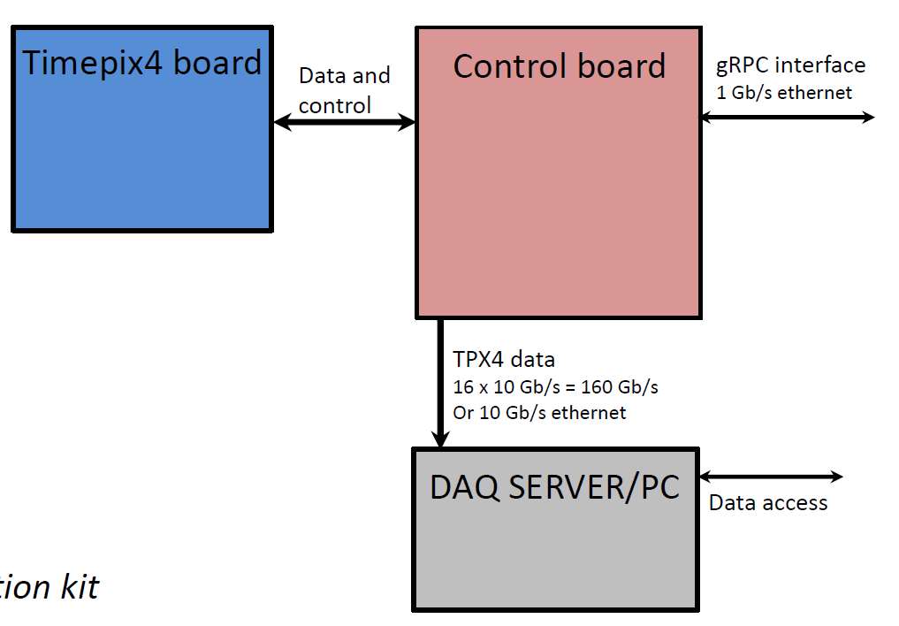
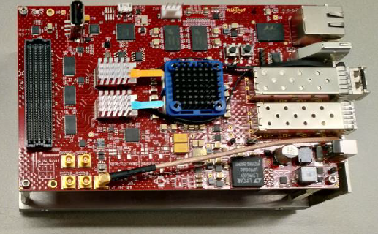
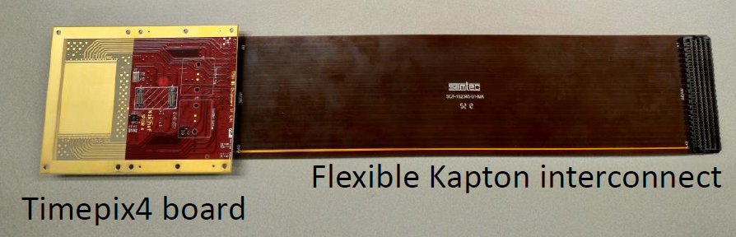
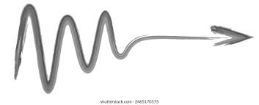
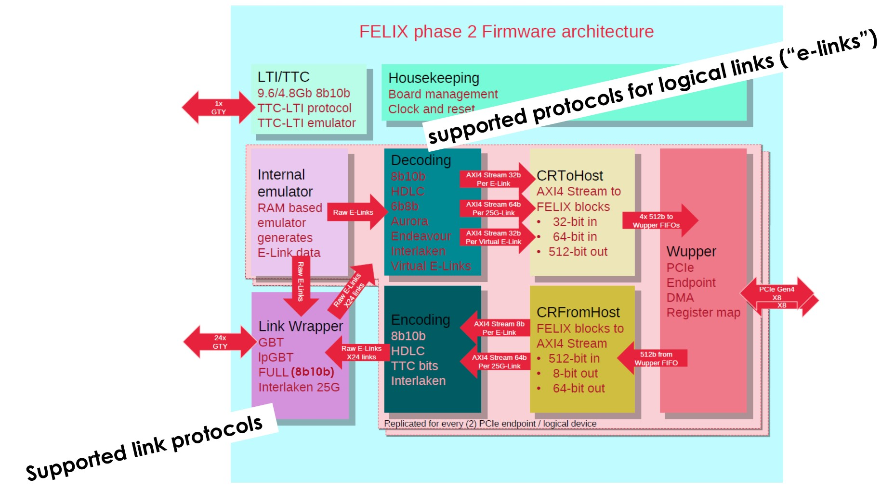
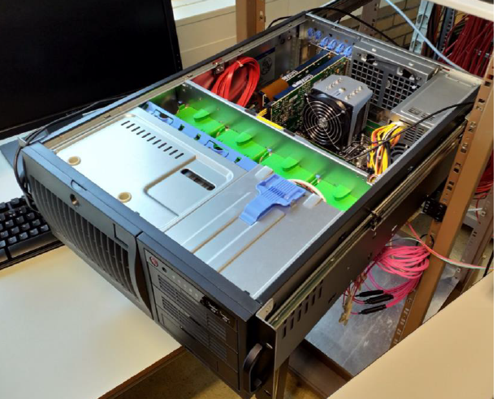
Gedankenexperiment
Chip Board
4 × “Full-mode” Data Link 25 Gbps
Control E-links Up (320/640/1280 Mbps)
Picopix ASIC
lpGBT
Control E-links Down (80/160/320 Mbps)
Control
Timing
Timing E-links (80/160/320 Mbps)
AMD Zynq XC7Z030/35 with ARM Cortex A9 running PetaLinux
Usable PCIe bandwidth: 480 Gbps
In terms of firmware, some work would have to go into
Wupper DMA Interf.
FELIX Software Low-Level Tools (developed at Nikhef and analogous to SPIDR tools) would give a head-start in control & readout in early test phase, before dedicated software is produced

