Slide 1
PicoPix Status
Xavier Llopart
On behalf of the LA-PicoPix design team

Slide 2
The LA-Picopix project
LA-PicoPix is a large scale hybrid pixel detector with the aim of fulfilling all known requirements for the LHCb VELO upgrade:
Large area → 256x256 pixel array
Timing → <50 ps_{rms} per Hybrid (ASIC + Sensor)
Rate → Worst ASIC in Scenario A ~75 events/BxiD (3 ∙10⁹ clusters ∙ s ^{–1})
Radiation hardness → <500 Mrad with full TMR logic design
Spatial resolution → pixel size <55 μm
Design Approach:
Built from gained experienced from previous hybrid pixel detectors tracking detectors:
  Timepix (2007) → Timepix3 (2013) → Velopix1 (2016) → Timepix4 (2020)
  CERN and Nikhef design team
Directly profiting from EP-RD program:
  WP5.3: Intelligence on detector, WP5.2: IP blocks, 3EP5.5: 3D interconnects
  WP6: High Speed links

Slide 3
The Picopix design
The first prototype targets directly the final architecture
  facing at the early stages all the complexity of a full-scale design
Pixel matrix design :
Timing performances
Analog front-end
TDC resolution
Clustering functions
Data reduction
Pixel readout
Architecture and IPs :
Data readout
Control and monitoring
Clock distribution
High-speed links
On-chip biasing
Technology and power:
Power density
(one of the main challenges)
SEE robustness
TID robust design
TSMC 28nm HPC+
Verification environment:
Full UVM verification environment
Formal verification
SEE verification

Slide 4
The Picopix design → LA-Picopix
Why Large Area?
Precise timing (<50ps) in a large array introduces several additional challenges that need to be faced at the early stage → needs silicon prove on a full-size chip
⬥ Clock jitter ⬥ power distribution ⬥ IR-drop induced jitter ⬥ Data readout ⬥ Time corrections ⬥ etc.…
Wafers available → simplifies bumping and sensor development
A large-area prototype submission requires an engineering run >1.2 M$ but:
An approach similar to the Medipix and RD53 Collaborations → An ASIC for multiple users
3 main potential users:
    VELO LHCb
    SY-BI Beam instrumentation
    Medipix collaboration

Slide 5
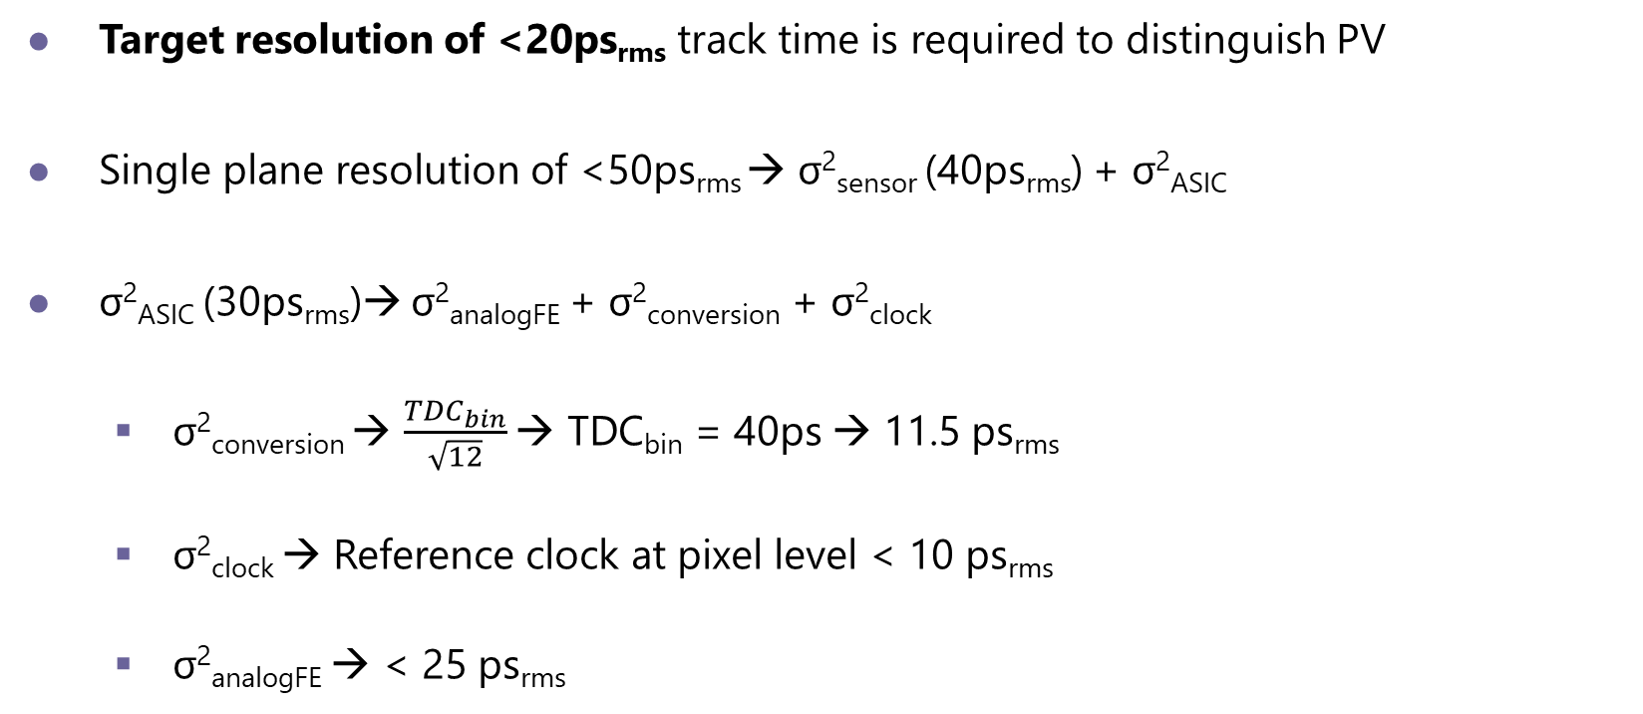
Timing
Target resolution of <20ps_{rms} track time is required to distinguish PV
Single plane resolution of <50ps_{rms} → σ²_{sensor} (40ps_{rms}) + σ²_{ASIC}
σ²_{ASIC} (30ps_{rms})→ σ²_{analogFE} + σ²_{conversion} + σ²_{clock}
  σ²_{conversion} → $\frac{{TDC}_{bin}}{\sqrt{12}}$ → TDC_{bin} = 40ps → 11.5 ps_{rms}
  σ²_{clock} → Reference clock at pixel level < 10 ps_{rms}
  σ²_{analogFE} → < 25 ps_{rms}

Slide 6
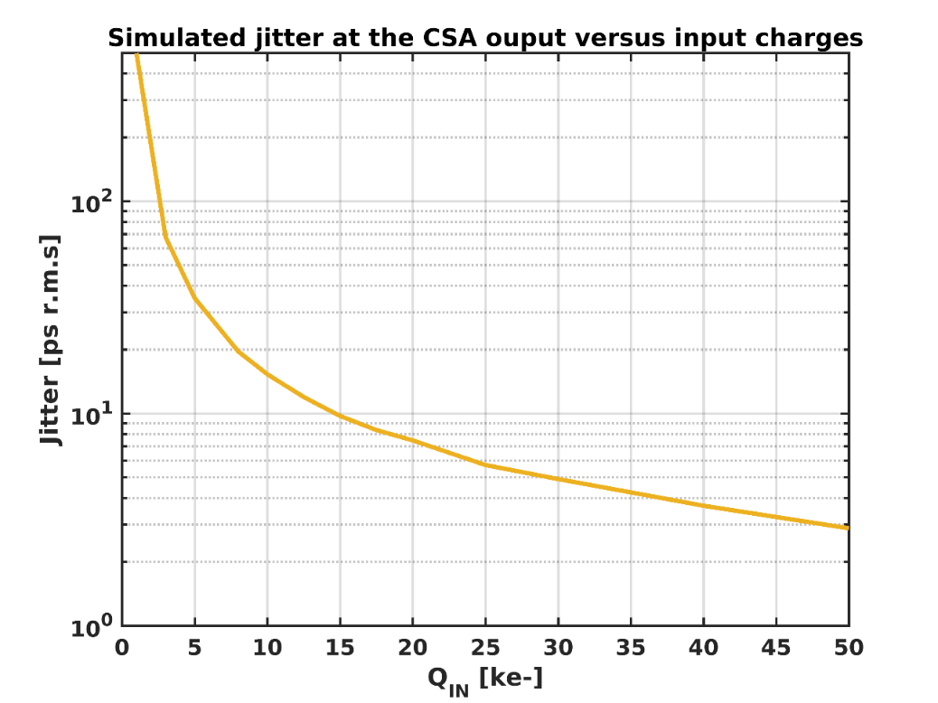
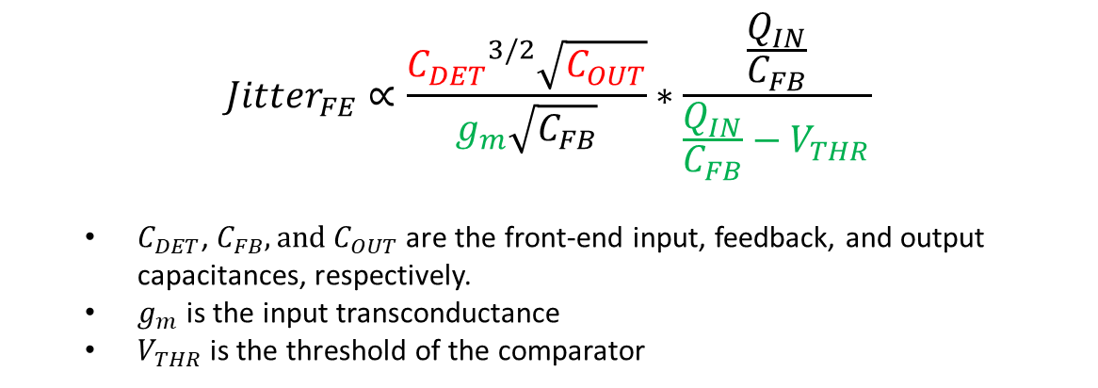
Fundamental limits to time resolution in analog front-end
$${Jitter}_{FE}∝\frac{{C_{DET}}^{3/2}\sqrt{C_{OUT}}}{g_{m}\sqrt{C_{FB}}}∗\frac{\frac{Q_{IN}}{C_{FB}}}{\frac{Q_{IN}}{C_{FB}}−V_{THR}}$$
  $C_{DET}$, $C_{FB}, and{ C}_{OUT}$ are the front-end input, feedback, and output capacitances, respectively.
  $g_{m}$ is the input transconductance
  $V_{THR}$ is the threshold of the comparator
→ Minimize the front-end output capacitance.
→ Maximize the input charge and decrease the threshold.
→ Increase the analog pixel power consumption, but a large power drop over the ASIC worsens the timing performances!
→ The front-end input capacitance must be minimized, which depends on the choice of the sensor, pixel pitch…
R.Ballabriga, The Timepix4 analog front-end design: Lessons learnt on fundamental limits to noise and time resolution in highly segmented hybrid pixel detectors https://doi.org/10.1016/j.nima.2022.167489

Slide 7
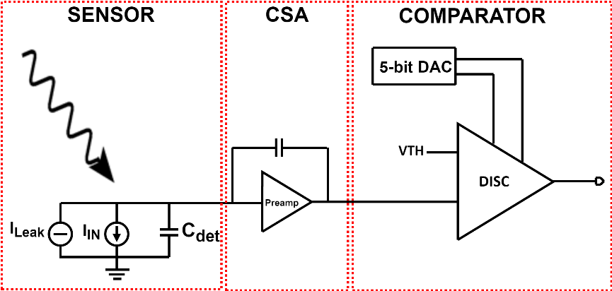
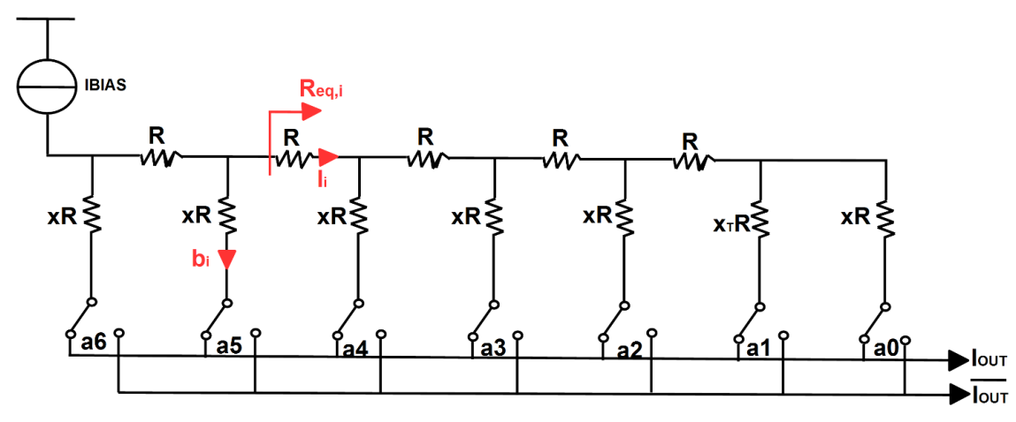
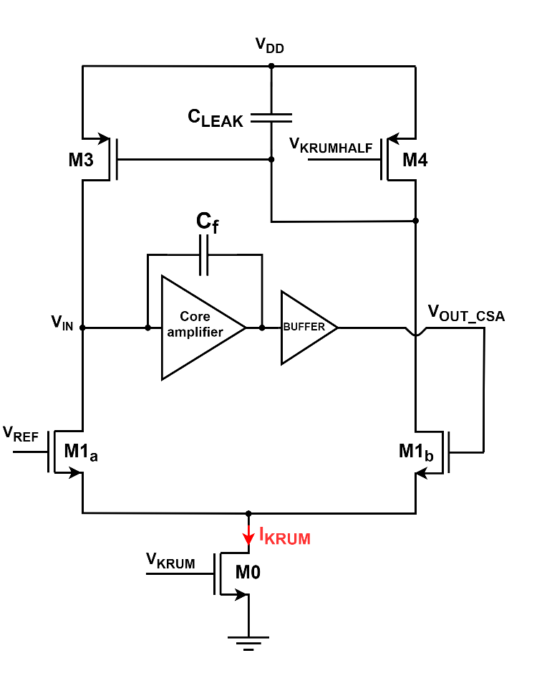
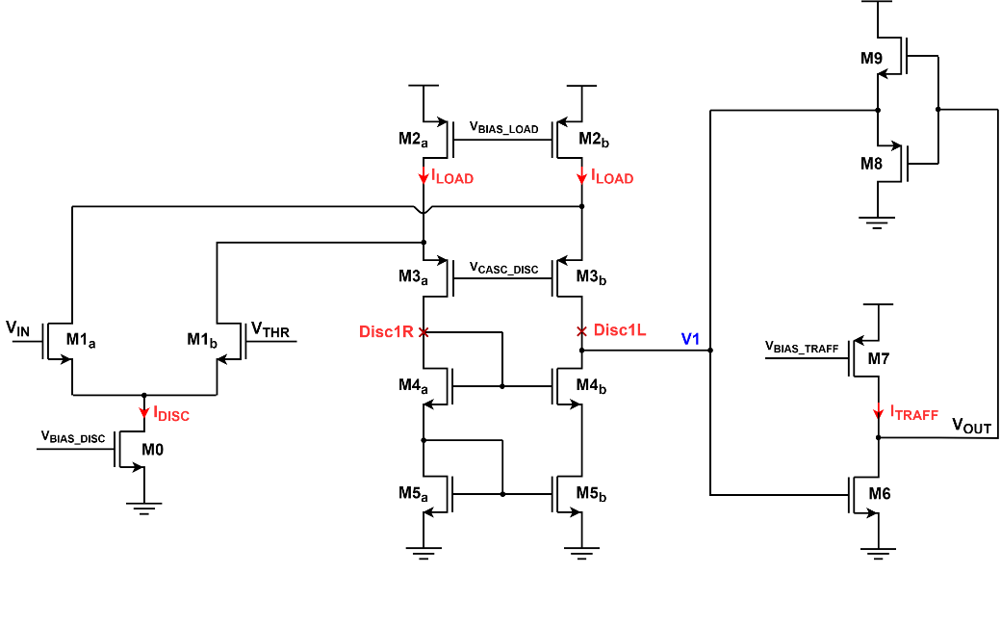
Analog front-end pixel for PicoPix
Conventional tuning DACs use binary structure:
  Consumes large silicon area → sub-binary radix DAC
Study of four different topologies by S. Emiliani (WP5):
Current comparator provides the best performances in jitter and matching.

Slide 8
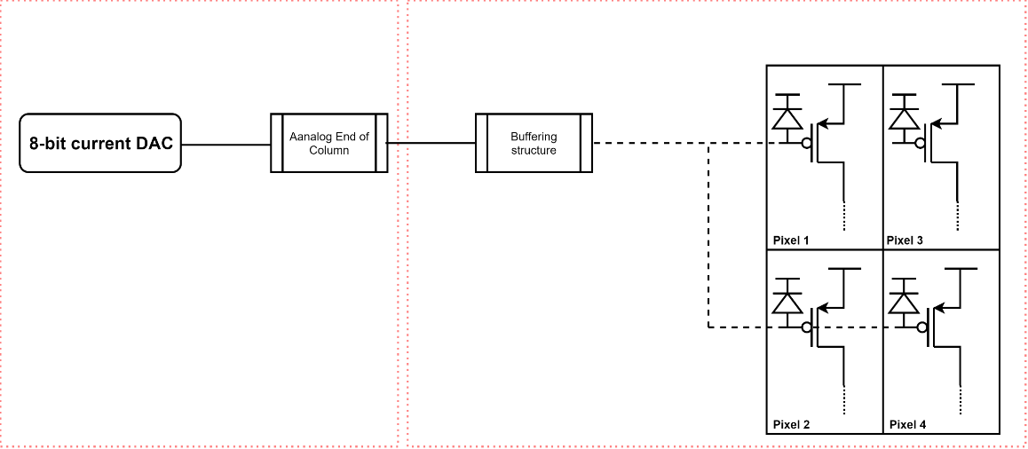
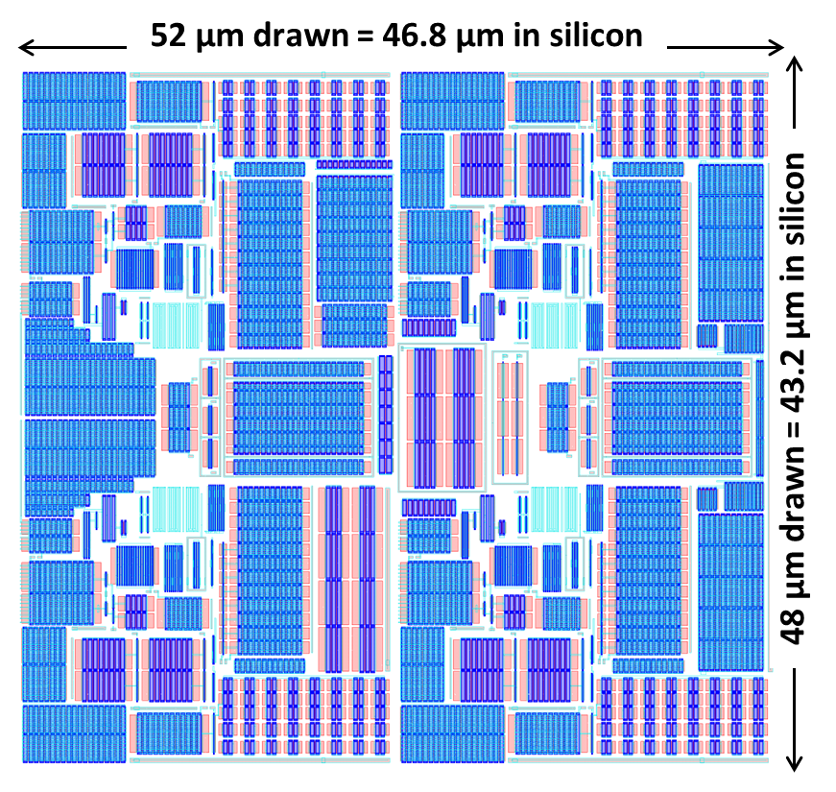
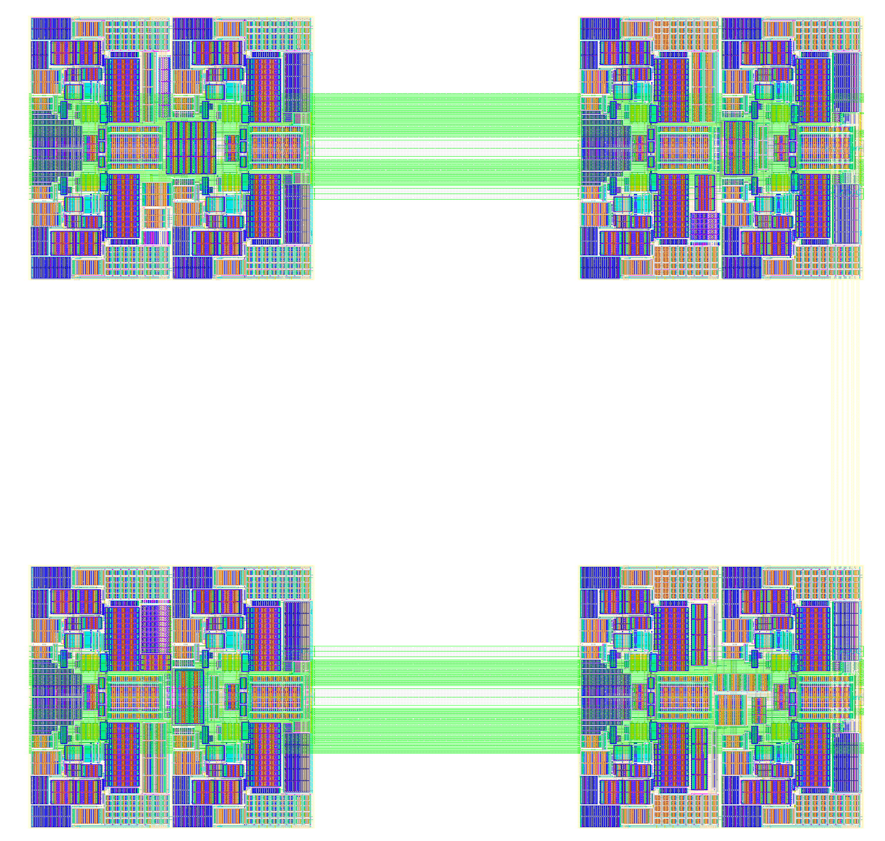
The Analog island cluster
1 cluster is 2x2 Analog Islands (2x2) → 4x4 pixels
  ~30 µW/pixel and Qin-thr>~4ke- → <25 ps_{RMS}
  Optimized for negative input charges (e-)
  7-bit threshold DAC → sub-binary radix DAC
  Novel on-pixel biasing power drop compensation
ANALOG PIXEL ISLAND
Buffering structure
Digital
  2x2 pixels analog island: 52 x 48µm² :
    ~20% area in a 49.5 µm pitch
Analog EOC
PERIPHERY
8-bit DACs

Slide 9
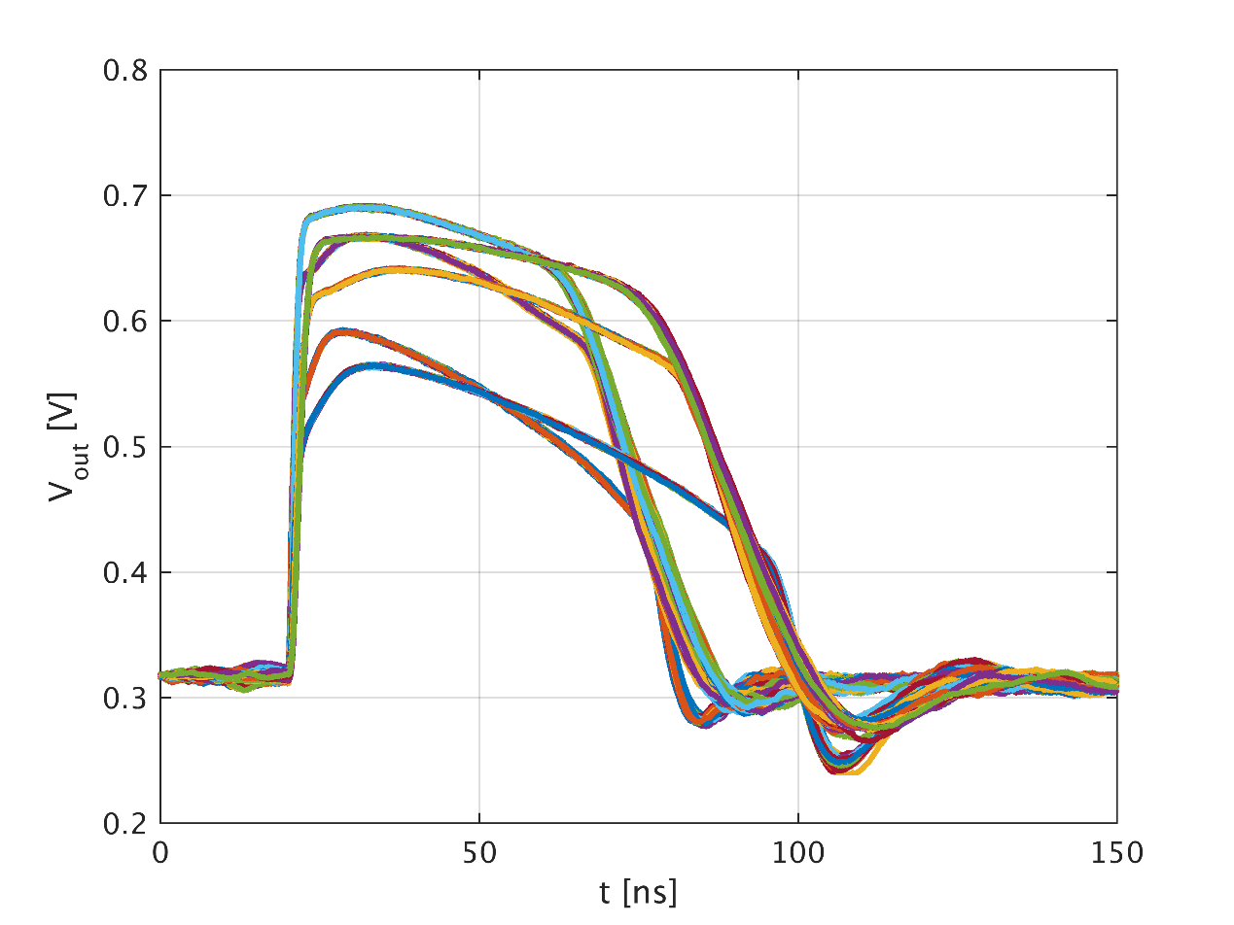
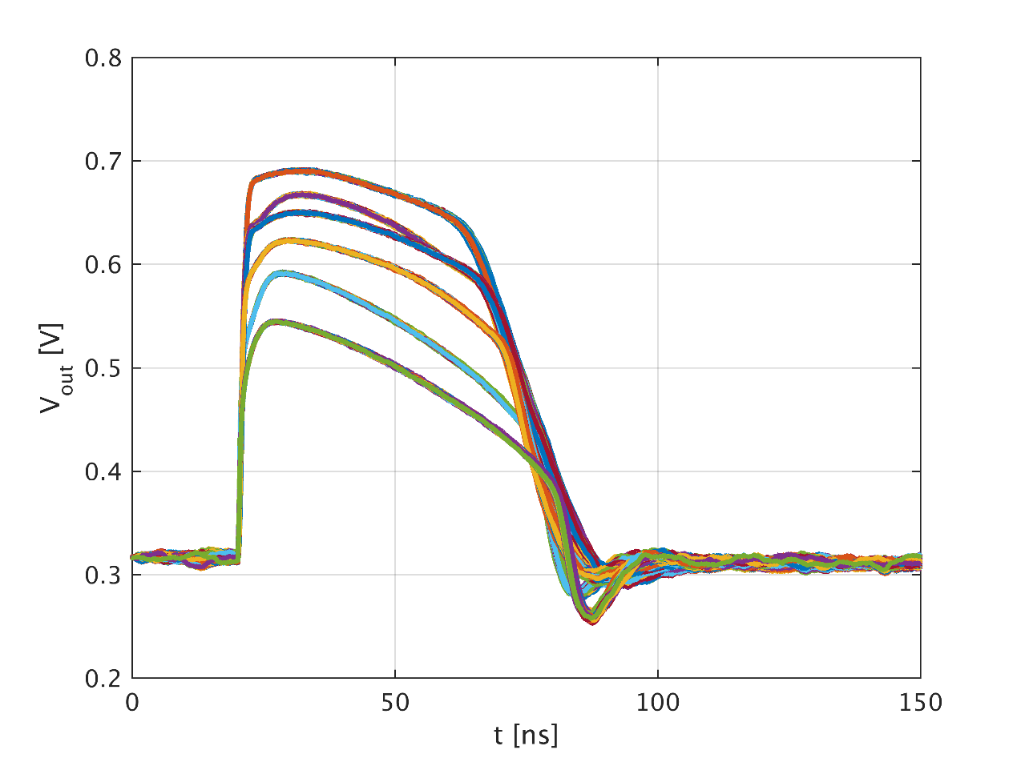
On-pixel power compensation for better timing performances
CSA transient response for 20ke⁻ input charge at T={-40 , 25, and 60 °C} without power drop compensation
CSA transient response for 20ke⁻ input charge at T={-40 , 25, and 60 °C} with on-pixel power drop compensation
Temperature | Pixel close to periphery | Pixel close to beam
-40 ͦC | 14 ps | 25 ps
27 ͦC | 14.5 ps | 29 ps
60 ͦC | 17 ps | 34 ps
Temperature | Pixel close to periphery | Pixel close to beam
-40 ͦC | 14 ps | 13.5 ps
27 ͦC | 14.5 ps | 13 ps
60 ͦC | 17 ps | 16 ps

Slide 10
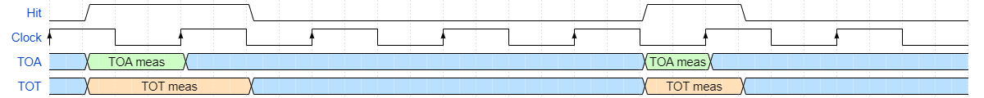
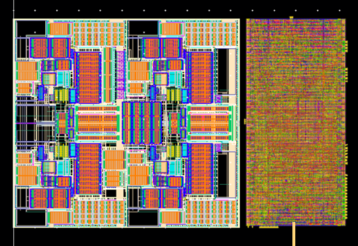
The Picopix TDC
Time-over-Threshold (ToT)
  Proportional to energy measure
  Used internally for ToA time-walk correction
  Can be transmitted within the packet in Tracking-ToT mode (and in raw-data mode)
Time of arrival (TOA)
  Coarse TOA → BxID
  Fine TOA → with 3.125ns resolution
  Ultra-Fine TOA → ~40ps bins (10 bits)
    Auto-calibrated TDC (each measurement)
    P, V, T, Rad and On-chip variations on a
    large-scale chip are critical for this resolution
Reference clock distribution is very critical!
  Pixel to pixel skew (static)
    TOA is corrected without requiring a calibration per channel outside of the chip!
  Clock jitter (dynamic)
    Simulation methodology for establishing IR-drop induced clock jitter [Gianmario Bergamin]
Design status: RTL and Physical design completed
  careful physical design, manual placement
  and routing to match timing
  post-layout extracted simulation

Slide 11
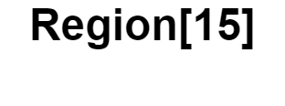


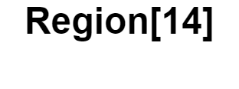


















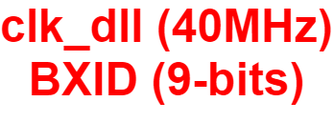
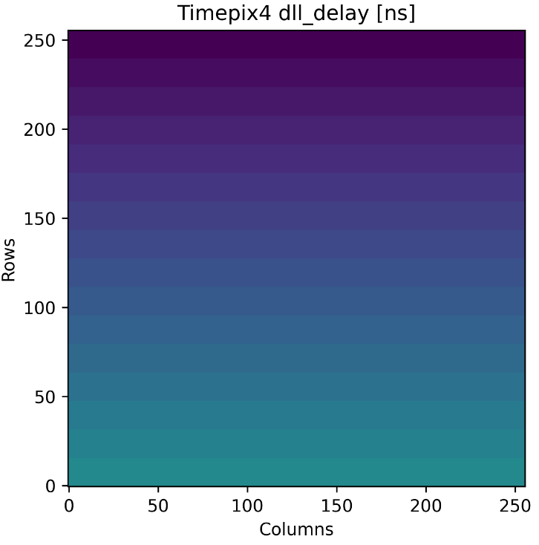
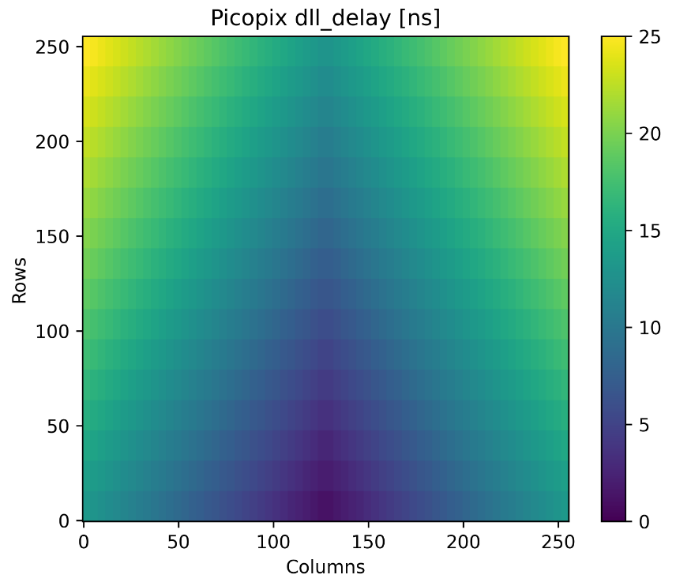
Clock distribution
Full-chip DLL clock distribution
Unique clock source and full PVT controlled
Skewing clock allows quasi-static power consumption and strong IR-drop reduction
Allows control of clock phase with 3-5ps skew
Design status: RTL Complete – blocks implemented
S0
0
S0
0
1
1
0
1
0
1
S0
S0

Slide 12
Particle Rate
The design approach is to compress/filter data inside the ASIC:
  @expected worst rate (3 ∙10⁹ clusters ∙ s ^{–1}) a Timepix4 like readout would require ~400 Gbps !!!
Rate reduction mechanisms:
  Pixel level:
    Clustering → Master selection + HITMAP
    Removing large clusters → > 3x3 → 20%
    Filter TOT < 0, 1, 2 or 3 totclk (as in Velopix1)
  Periphery:
    Packet processor: event-by-event time correction (time-walk, calibration,…)
    Packet processor: event-by-event filtering (TOT range, BxID range, Hitmap shape,…)
    Packet sorting: Header (BxID) + 28b, 36b or 72b data packets
  Output Data:
    High speed serializers: 4x 25Gbps (optical) or 4x12.5Gbps (electrical)
24-bit mode Sorted → 3.84 ∙10⁹ clusters ∙ s ^{–1}
36-bit mode Sorted → 2.56 ∙10⁹ clusters ∙ s ^{–1}

Slide 13
On pixel event processing ➞ Data reduction
Data filtered already at the level of the pixel-array
  Bandwidth reduction towards the periphery
  Significant power and IR-drop reduction
Further reduction and compression in the periphery
Arbitration Logic
 | 1 | 1 | 0
 | 1 |  | 0
 | 0 | 0 | 0
Arbitration logic
  Transmit only Master pixel packet (can be disabled)
  ToA on master provide the highest resolution
  Design status: RTL complete
Hit-Map:
  Hit-Map of all the pixels around the master
  Or Hit-Map of the super-pixels around the master (when transmitting all ToT)
  Design status: RTL complete
Advanced on-pixel data filtering:
  Digital filtering according ToT
  Possible to add filtering according ToA, Hit-Map shape, and others features extraction.
  Design status: To be done
M

Slide 14
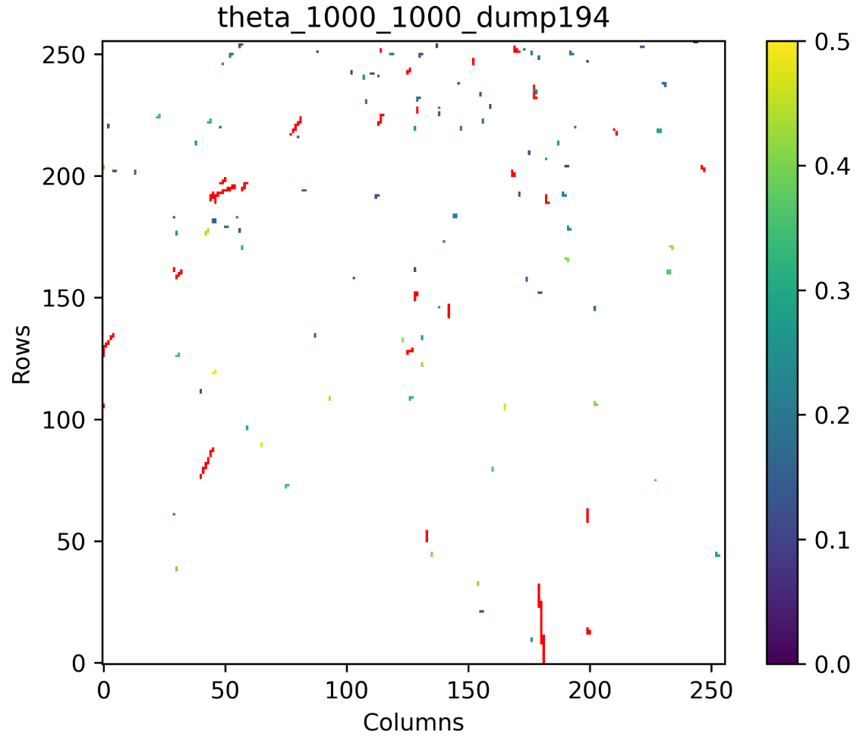
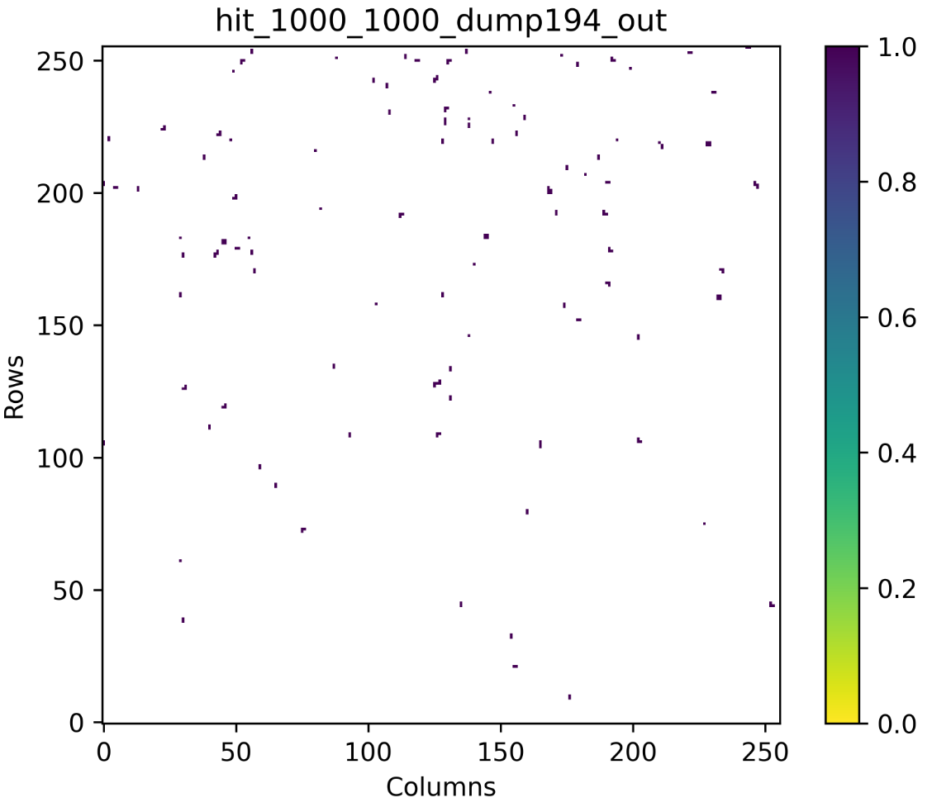
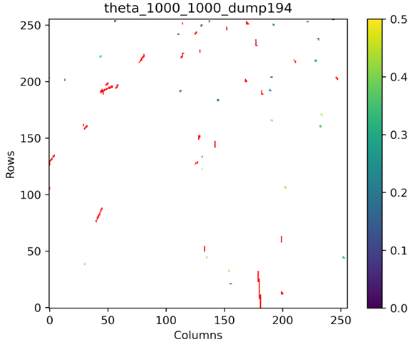
On pixel event processing ➞ Data reduction
Data filtered already at the level of the pixel-array
  Bandwidth reduction towards the periphery
  Significant power and IR-drop reduction
Further reduction and compression in the periphery
Clustering and filtering
Filtering disable
Filtering large clusters
Filtering small clusters
  Design Status: RTL complete

Slide 15
The Picopix ASIC organization
64 columns of 16 regions
64 columns of 16 regions
PIXEL REGION
PIXEL REGION
SUPER-PIXEL
SUPER-PIXEL
PIXEL
PIXEL
PIXEL
Region
PIXEL
Region
Region
Region
Region
Region
Region
Region
•••
•••
PIXEL
PIXEL
PIXEL
PIXEL
•••
•••
•••
•••
•••
•••
•••
•••
•••
•••
•••
•••
Region
Region
Region
Region
Region
Region
Region
Region
TDC
•••
TDC
•••
ARBITRATION
ARBITRATION
SHARED LOGIC
Region
SHARED LOGIC
Region
Region
Region
Region
Region
Region
Region
•••
•••
Data manager
EoC
Data manager
EoC
EoC
EoC
EoC
EoC
EoC
EoC
Slow-control
Slow-control
Control
Control
Peri logic
Packet processor
Peri logic
Packet processor
Clock distribution logic
Clock distribution logic
Event sorter and builder
Event sorter and builder
Hierarchical units
digital PLL
digital PLL
Flat implementation
High speed links
High speed links

Slide 16
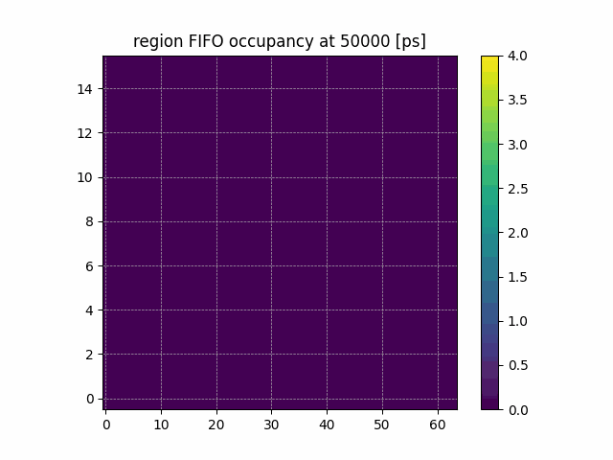
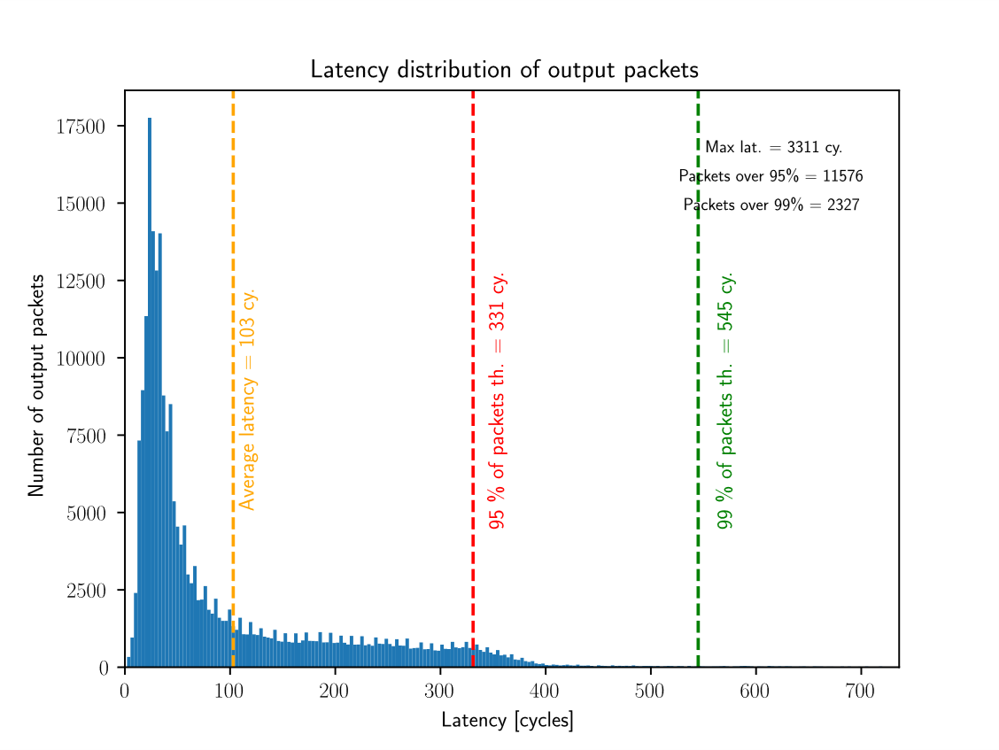
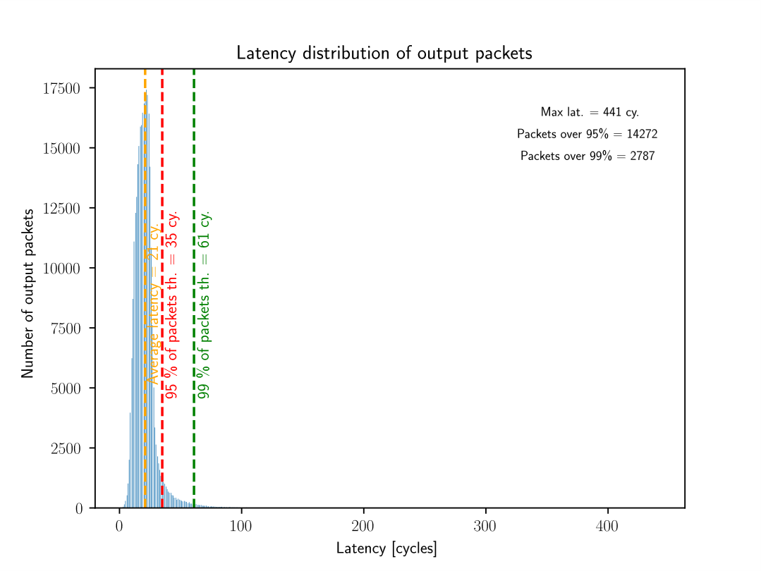
PixESL – Picopix studies
CERN EP R&D WP5
Pixel matrix bandwidth
128 events/BxID

Slide 17
Pixel-matrix data-path
  Pixel array readout by column
  Each super-pixel transmits to the next
  Columns of Super-pixels are organised
  in regions allowing reducing latency.
  Arbitration mechanisms for handling data transfer priorities
  Design Status: RTL almost complete
PIXEL REGION:
PIXEL COLUMN:
TDC PACKET
TDC PACKET
SUPER-PIXEL
SUPER-PIXEL
REGION
● ● ●
● ● ●
SUPER-PIXEL
SUPER-PIXEL
ARBITRATION
ARBITRATION
SUPER-PIXEL
SUPER-PIXEL
SUPER-PIXEL
SUPER-PIXEL
● ● ●
● ● ●
TDC PACKET
TDC PACKET
ARBITRATION
ARBITRATION
ARBITRATION
8 x 2
SUPER-PIXELS
REGION
16
REGIONS
SUPER-PIXEL
SUPER-PIXEL
TDC PACKET
TDC PACKET
● ● ●
● ● ●
SUPER-PIXEL
SUPER-PIXEL
SUPER-PIXEL
SUPER-PIXEL
SUPER-PIXEL
SUPER-PIXEL
ARBITRATION
ARBITRATION
TDC PACKET
TDC PACKET
ARBITRATION
● ● ●
ARBITRATION
ARBITRATION

Slide 18
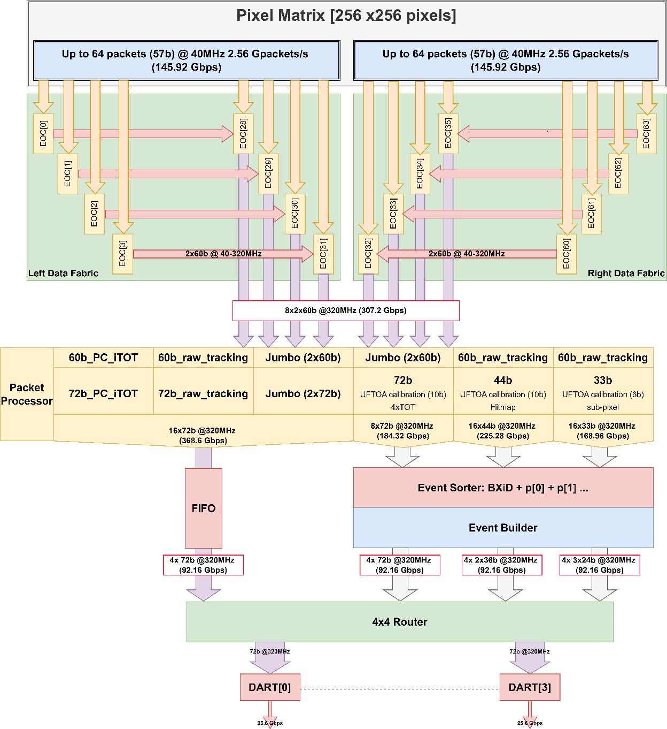
Periphery data-path
PACKET PROCESSOR
Full Time calibration:
  DLL clock skew calibration (Row and Column)
  Unique time-walk correction (programable LUT 32x32)
  TOA event calibration (24.4ps bin)
  10b or 6b fine-time output
  Digital T0Sync shift adjustment (24.4ps bin and 100ns range)
  Built-in TOA extender up to 32-bits(@40MHz)
Event Filtering:
  Configurable TOT range
  Configurable TOA range
  Hitmap shape (single pixels, L shape, + shape,…)
On-chip XY decoding
Single packet formatting:
  To Sorter: 24-bit, 36-bit, 72-bit
  To FIFO: 72b_PC_iTOT, 72b_raw and Jumbo
Design Status: RTL ongoing
81b

Slide 19
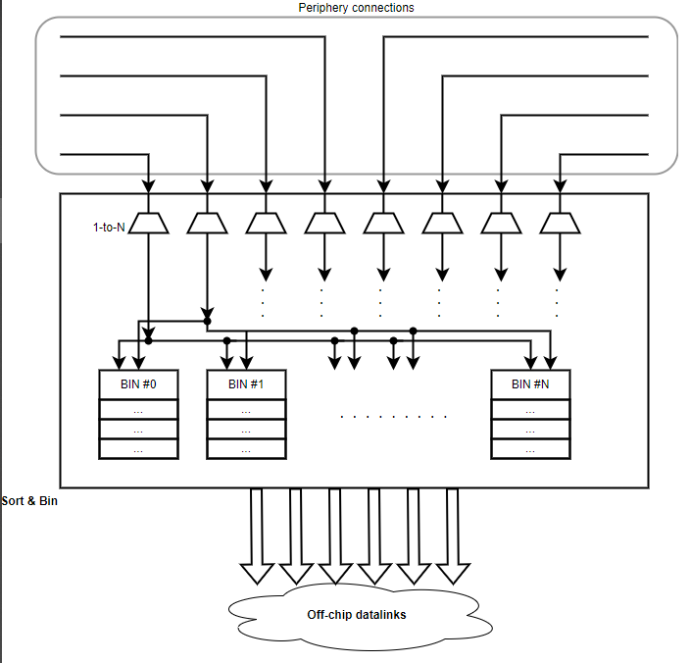
Periphery data-path
EVENT SORTER
Sort packets per BxID
  Cumulates packets over time and groups them in bins based on event tag
  Sorted data readout
Design Status: RTL ongoing
81b
EVENT BUILDER
Creates output packets Header + N*Packets
Design Status: RTL ongoing

Slide 20
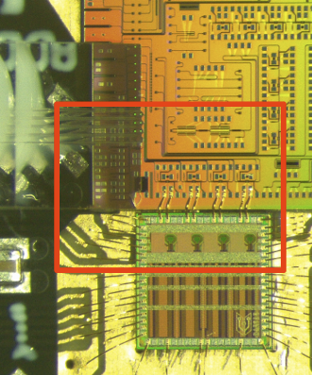
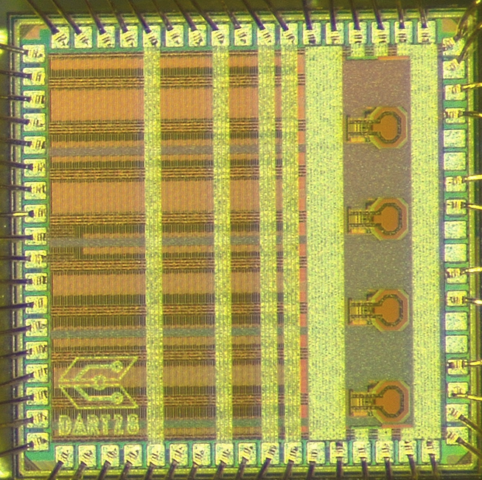
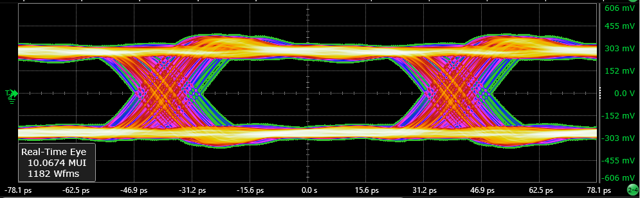
Periphery data-path
HIGH-SPEED TRANSMITTER
Designed by the CERN EP R&D WP6 team
Design Status: First Silicon Prototype Available (DART28)
WP6 design roadmap is aligned with PicoPix project.
FEC – correct up to 30 consecutive bit errors
Effective data rate:
  With silicon photonics: 4 x 23.04 Gb/s = 92.16 Gb/s
  With electrical links: 4 x 11.52 Gb/s = 46.08
81b

Slide 21
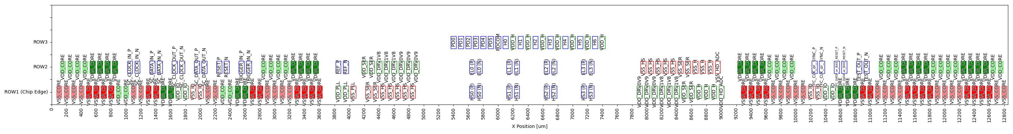
IO + DART pads distribution 256x256 ~50um pixels [preliminary]
VDDA_CORE | 27
VSSA_CORE | 26
VDD_CORE | 25
VSS_CORE | 27
DART Hybrid (electrical)
DART Hybrid (optical)
PIC
~2.4 mm

Slide 22
Picopix operating modes
Main data-driven readout modes implemented:
TRACKING MODE
Tracking mode | The packet includes: ▪ MASTER ADDRESS ▪ ULTRA-FINE TOA ▪ HIT-MAP
Tracking + ToT | The packet includes: ▪ MASTER ADDRESS ▪ ULTRA-FINE TOA ▪ HIT-MAP ▪ TOT OF ALL THE PIXELS
CLUSTER FILTERING
Filter large clusters | Clusters large than 3x3 around master
Filter small clusters | Clusters smaller than 3x3
No filtering | Transmits all clusters
MASTER EXTRACTION | Tracking mode | Tracking mode + ToT
Send cluster master | Full 3x3 Hit-Map around master pixel | Full 3x3 Hit-Map around the super-pixel simplifying the off-chip re-clustering
Send all super-pixels | Local 2x2 Hit-Map within super-pixel
EVENT PACKET | Tracking mode |  | Tracking mode + ToT
 | Packet size | Max N of packets | Packet size | Max N of packets
Raw data format | 72 bits out-of-order | 1.28 GEVENTS s⁻¹ (32 Bx⁻¹) | 144 bits out-of-order | 640 MEVENTS s⁻¹ (16 Bx⁻¹)
Standard format | 36 bits SORTED | 2.56 GEVENTS s⁻¹ (64 Bx⁻¹) | 72 bits SORTED | 1.28 GEVENTS s⁻¹ (32 Bx⁻¹)
Reduced- format | 24 bits SORTED | 3.84 GEVENTS s⁻¹ (96 Bx⁻¹)

Slide 23
Picopix operating modes
Main frame-based readout modes implemented:
FRAME-BASED MODE
 |  | Packet size | Max output rate
Particle counting | Integrate number of particle hits per pixel during the shutter-open period. Zero suppressed readout | 72 bits | 2.56 ∙ 10⁹ Counters s⁻¹ (64 counters / Bx)
Integral ToT | Integrate the Time-over-Threshold per pixel during the shutter-open period. Zero suppressed readout | 72 bits | 2.56 ∙ 10⁹ pixels-TOT s⁻¹ (64 pixels-TOT / Bx)

Slide 24
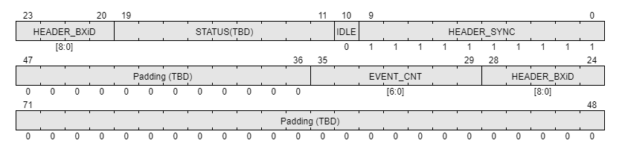
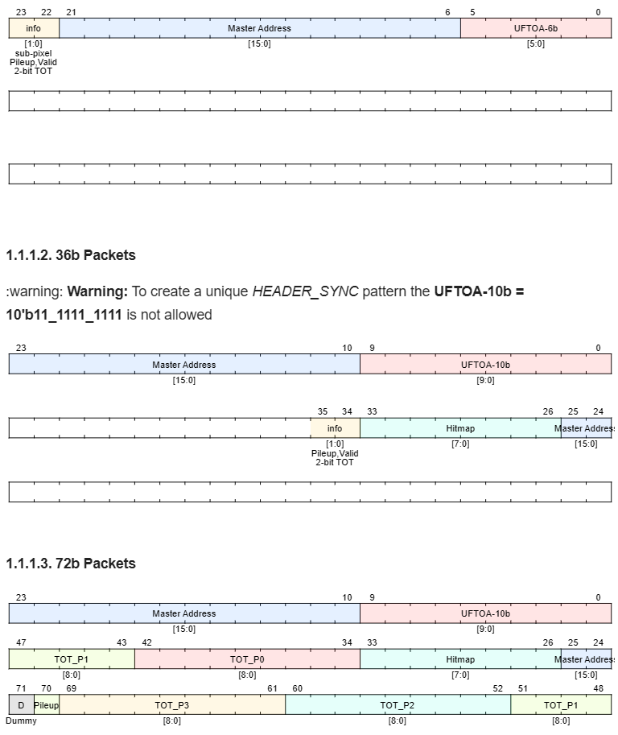
Sorted Data Packets by BxiD (TOA)
Header
BxiD (TOA): @40MHz
STATUS: Readout mode, link config,…
Event Counter: Num of packets will follow
Other: TBD
3x 24-bit data
UFTOA-6b: configurable bin size (24.4 to 396ps)
Master Address: 16-bit pixel address
2-bit info:
  Sub-pixel: 2-bits calculated from Hitmap
  Pileup and on-time TOT Valid
  2-bit TOT
2x 36-bit data
UFTOA-10b: bin size 24.4ps covers 25ns
Master Address: 16-bit pixel address
Hitmap: 8-bit around master pixel
2-bit info:
  Pileup and on-time TOT Valid
  2-bit TOT
1x 72-bit data
UFTOA-10b: bin size 24.4ps covers 25ns
Master Address: 16-bit pixel address
Hitmap: 8-bit around master pixel or super-pixel
TOT_P0, P1, P2 and P3 in super-pixel: 9-bit TOT @320MHz
Pile-up: 1-bit pileup indicator

Slide 25
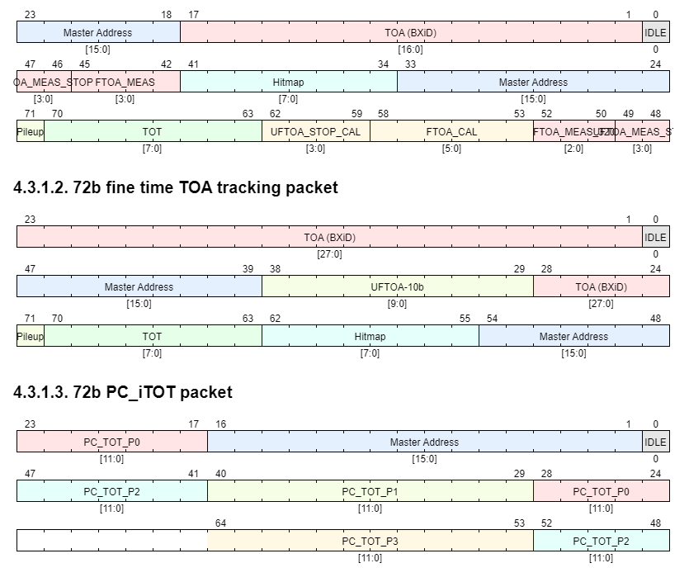
72-bit Non-Sorted Data Packets
72-bit RAW tracking (Data-Driven):
BxiD (TOA): 17-bit
UFTOA-10b RAW: bin size 24.4ps covers 25ns
Master Address: 16-bit pixel address
Hitmap: 8-bit around master pixel
TOA and TOT Raw data
1-bit pileup indicator
72-bit fine time TOA tracking (Data-Driven):
BxiD (TOA): 28-bit
UFTOA-10b: bin size 24.4ps covers 25ns
Master Address: 16-bit pixel address
Hitmap: 8-bit around master pixel
Master TOT: 8-bit
1-bit pileup indicator
72-bit PC or iTOT (Frame Based, zero-suppressed)
Master Address: 16-bit pixel address
PC_iTOT_P0: 12-bit
PC_iTOT_P1: 12-bit
PC_iTOT_P2: 12-bit
PC_iTOT_P3: 12-bit

Slide 26
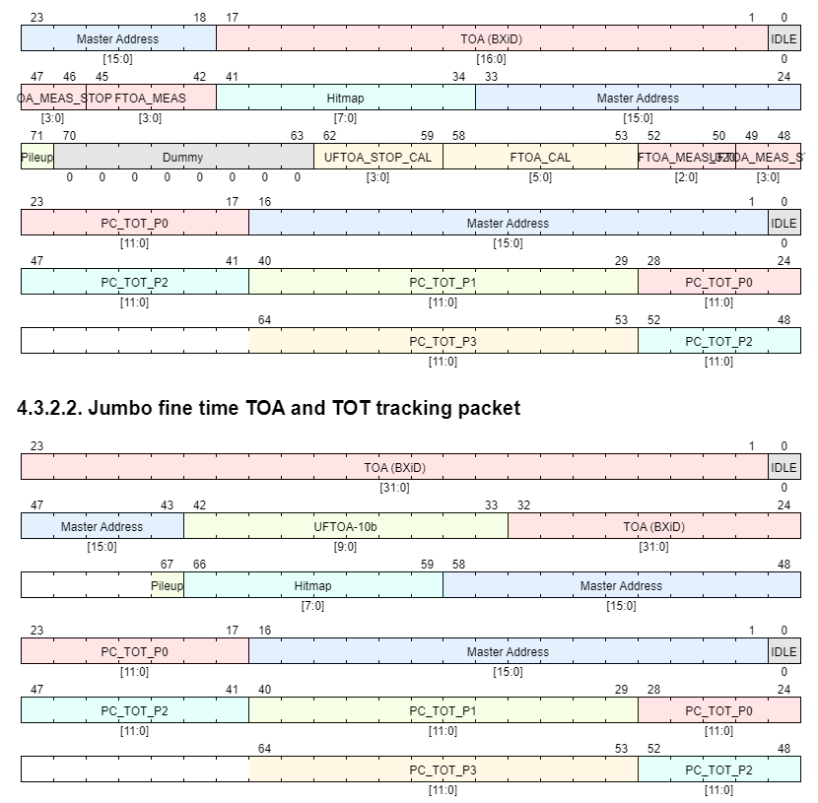
Jumbo (2x72-bit) Non-Sorted Data Packets
Jumbo raw tracking (Data-Driven):
  72-bit RAW packet:
  BxiD (TOA): 17-bit
  UFTOA-10b RAW: bin size 24.4ps covers 25ns
  Master Address: 16-bit pixel address
  Hitmap: 8-bit around master pixel
  TOA and TOT Raw data
  1-bit pileup indicator
72-bit TOT:
Master Address: 16-bit pixel address
TOT_P0: 12-bit
TOT_P1: 12-bit
TOT_P2: 12-bit
TOT_P3: 12-bit
Jumbo fine time TOA and TOT tracking (Data-Driven):
72-bit fine time TOA:
BxiD (TOA): 32-bit
UFTOA-10b: bin size 24.4ps covers 25ns
Master Address: 16-bit pixel address
Hitmap: 8-bit around superpixel
72-bit TOT:
Master Address: 16-bit pixel address
TOT_P0: 12-bit
TOT_P1: 12-bit
TOT_P2: 12-bit
TOT_P3: 12-bit

Slide 27
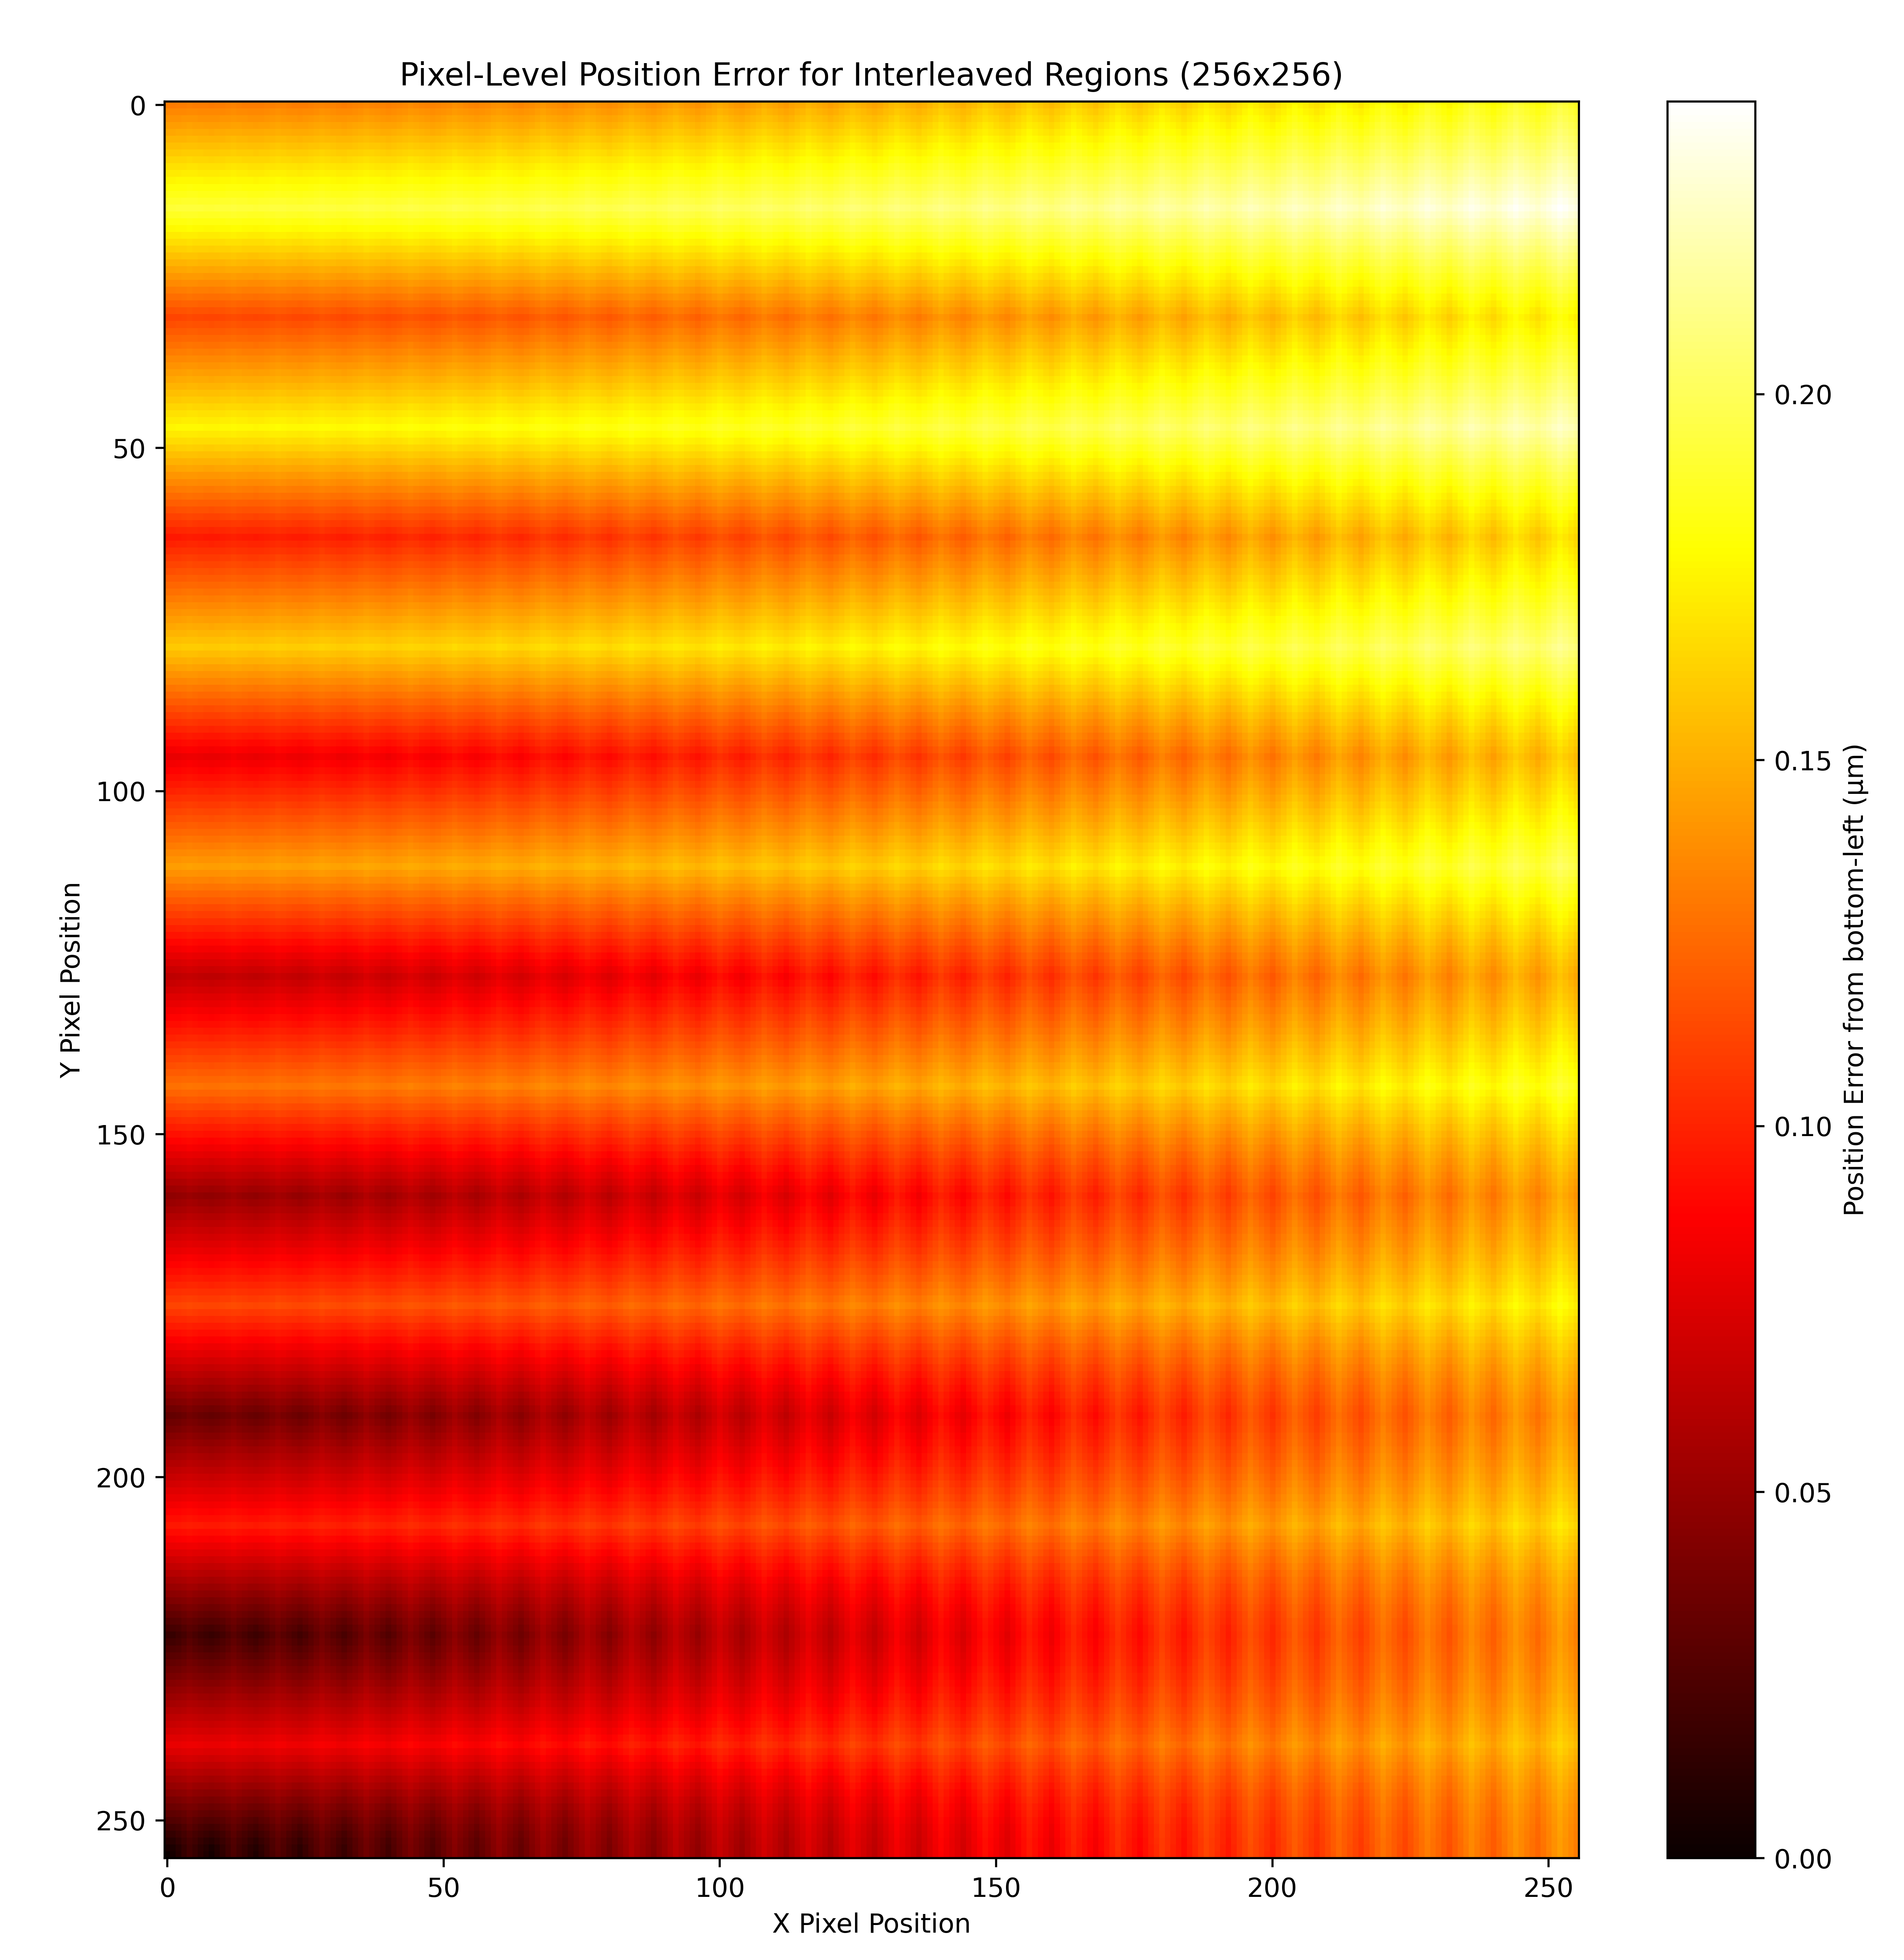
On the pixel size…
From the design power drop simulations and logic area required we need a pixel ~50 μm
TSMC 28nm process has a shrink factor of 0.9:
  A 50 μm pixels requires that we draw 55.555555… μm pixels
If Pixel is drawn as 55 μm (x 0.9) → 49.5 μm
But, it makes more practical sense to fix it to 50 μm:
  Regions of 55.55* μm x 16 → 799.92 μm
  Regions of 55.56* μm x 16 → 800.064 μm
  Total accumulated error < 0.25 μm (ok?)
  *(The minimum grid pitch is 10nm)

Slide 28
Simulated TOA Resolution vs pixel TOT mismatch
Qin=1.8ke- (0.28fC)
Qin=6.2ke- (1fC)
FE model with 100e-rms ENC
Clk_DLL and clk_320 with 5psrms jitter
32 pixels tested simultaneously
Randomized time injection
Data @output of packet processor after full time calibration

Slide 29
Full simulation output example → View to DAQ
Qin=1.8ke- (0.28fC)
Qin=6.2ke- (1fC)
X | Y | BxiD | UFTOA 10b | Hitmap | TOA resolution [psrms]
1 | 1 | 78 | 738 | 11000001 | 0
1 | 16 | 78 | 745 | 111 | 120.843
1 | 33 | 78 | 738 | 11000001 | 98.668
1 | 8 | 78 | 738 | 111 | 85.449
0 | 48 | 78 | 747 | 11100 | 108.361
1 | 24 | 78 | 749 | 111 | 124.248
0 | 65 | 78 | 740 | 1110000 | 115.745
1 | 41 | 78 | 736 | 11000001 | 119.559
0 | 56 | 78 | 753 | 11100 | 146.484
1 | 80 | 78 | 748 | 111 | 144.114
0 | 97 | 78 | 738 | 1110000 | 141.976
1 | 73 | 78 | 740 | 11000001 | 136.727
0 | 88 | 78 | 749 | 11100 | 138.107
0 | 113 | 78 | 746 | 1110000 | 134.125
1 | 129 | 78 | 737 | 11000001 | 135.052
1 | 105 | 78 | 739 | 11000001 | 132.518
0 | 120 | 78 | 749 | 11100 | 133.852
1 | 145 | 78 | 745 | 11000001 | 130.395
1 | 160 | 78 | 738 | 111 | 129.846
1 | 136 | 78 | 737 | 111 | 130.275
1 | 153 | 78 | 748 | 11000001 | 130.314
1 | 177 | 78 | 745 | 11000001 | 127.706
0 | 192 | 78 | 737 | 11100 | 128.29
1 | 168 | 78 | 742 | 111 | 125.507
1 | 184 | 78 | 750 | 111 | 128.09
0 | 209 | 78 | 749 | 1110000 | 128.878
1 | 225 | 78 | 735 | 11000001 | 132.002
1 | 201 | 78 | 741 | 11000001 | 129.805
1 | 216 | 78 | 745 | 111 | 127.874
0 | 241 | 78 | 749 | 1110000 | 128.626
0 | 232 | 78 | 741 | 11100 | 126.778
1 | 249 | 78 | 746 | 11000001 | 125.401
X | Y | BxiD | UFTOA | Hitmap 10b | TOA resolution [psrms]
1 | 0 | 185 | 85 | 111 | 0
0 | 16 | 185 | 85 | 11100 | 0
0 | 33 | 185 | 86 | 1110000 | 14.095
0 | 8 | 185 | 85 | 11100 | 12.207
1 | 24 | 185 | 85 | 111 | 10.918
0 | 48 | 185 | 85 | 11100 | 9.967
0 | 64 | 185 | 85 | 11100 | 9.228
1 | 40 | 185 | 86 | 111 | 11.302
0 | 57 | 185 | 85 | 1110000 | 10.766
1 | 80 | 185 | 85 | 111 | 10.294
1 | 97 | 185 | 86 | 11000001 | 11.404
1 | 73 | 185 | 85 | 11000001 | 11.042
1 | 113 | 185 | 86 | 11000001 | 11.728
1 | 89 | 185 | 84 | 11000001 | 14.134
1 | 129 | 185 | 86 | 11000001 | 14.493
0 | 104 | 185 | 85 | 11100 | 14.095
0 | 120 | 185 | 84 | 11100 | 15.526
0 | 144 | 185 | 85 | 11100 | 15.096
1 | 160 | 185 | 84 | 111 | 16.06
0 | 136 | 185 | 86 | 11100 | 16.377
1 | 152 | 185 | 85 | 111 | 15.983
1 | 177 | 185 | 84 | 11000001 | 16.693
0 | 192 | 185 | 85 | 11100 | 16.316
1 | 168 | 185 | 84 | 111 | 16.852
1 | 185 | 185 | 84 | 11000001 | 17.263
0 | 208 | 185 | 85 | 11100 | 16.915
0 | 224 | 185 | 86 | 11100 | 17.239
1 | 200 | 185 | 85 | 111 | 16.917
1 | 216 | 185 | 85 | 111 | 16.613
1 | 240 | 185 | 85 | 111 | 16.325
0 | 233 | 185 | 86 | 1110000 | 16.601
0 | 248 | 185 | 85 | 11100 | 16.333

Slide 30
Status of design and manpower
Analog Design → Dormant since February due to departure of V. Sriskaran but well advanced at pixel level
  Progress:
    Two analog engineers recently resumed work (J. Kaplon and G. Wegrzyn)
    Focus areas:
      Review Viros’s previous work
      Develop analog peripherals (AEOC, Biasing DACs, BandGap, IO pads)
dPLL → V. Gromov and L.Timmermans
DAC and ADC → C. Ogun
Digital Desgin → 2 active designers (A. Caratelli and X. Llopart)
  Progress:
    RTL development is well advanced but requires the triplication step (TMRG):
      Pixel to output of packet sorter is ~90%
      Slow and Fast control (TFC) is available
Functional Verification → 1 verification engineer (M. Lupi)
  Git repository maintenance and basic verification support
Additional Manpower Status:
  Currently allocated to other LS3 projects → MOSAIX, FastRICH, lpGBT, HGCAL, etc.
  To join the design team in February

Slide 31
Module level consideration
Power distribution at module level is challenging:
  Analog core power (static): Proposed FE requires ~30 μA/pixel → ~1.08W/cm² (~2A) @50 μm pixels
  Digital core power (dynamic): Difficult to predict → <1W
  Serializer power (dynamic): ~200mW / link @25.6 Gbps → 800mW
  A chip requires ~4W how to distribute this?
High speed links @25.6 Gbps require optical fiber (PIC)
Slow control protocol proposed as in Timepix4/Medipix4
LA-Picopix design not relying in TSV processing (cost, material, risk,… )

Slide 32
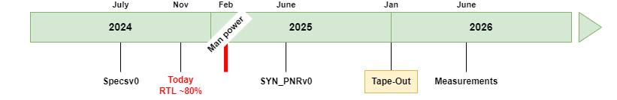
Conclusions
LA-Picopix is a large-area Particle Tracking detector ASIC with < 30 ps_{RMS} timing resolution, on-chip clustering support, data-driven readout up to 3.9 ∙10⁹ cluster ∙ s ^{–1:}
  Targets all known LHCb VELO upgrade requirements
  Other partners (Medipix and CERN-SY) to contribute on the financing of the engineering submission.
  Potential applications:
    ▪ LHCb velo (main specifications) ▪ beam gas monitoring ▪ radiation monitoring ▪ X-Ray imaging ▪ 4D STEM
    ▪ X-ray photon correlation spectroscopy ▪ Mass spectrometry ▪ Medical applications (SPECT/PET) ▪ etc..
LA-Picopix builds up from the experience of the design team in previous large area tracking hybrid pixel detectors and CERN EP-RD programs
Target submission by end of 2025

Slide 33
BACKUP MATERIAL

Slide 34
Summary of specifications
Technology |  |  | 28nm – 10 metal
Pixel Size |  |  | 49.5µm (tbc)
Pixel arrangement |  |  | 3-side buttable 256 x 256
Sensitive area |  |  | 1.606 cm² (tbc)
Data driven (Tracking) | Mode |  | TOT and TOA on Master only
 | Event Packet | Sorted | 24-bit, 34-bit or 72-bit
 |  | Unsorted | 72-bit RAW, 72-bit fine time, Jumbo RAW, Jumbo fine time
 | Max rate @ pixel matrix |  | 5.12x10⁹ events/chip
 | Max average pixel rate |  | <78 KHz
 | Max single pixel rate |  | <20 MHz/pixel
Pixel clustering mode (can be turned off) | On-pixel clustering |  | Master + surrounding 8-bit hitmap for 3x3 events
 | On-pixel large cluster filter |  | Asynchronous filtering for events larger 3x3
 | On-pixel sub-pixel resolution |  | 256x256 → 512x512
 | On-pixel TDC |  | Shared for 4 pixels. TOA + TOT of Master only DCO autocalibration on-chip →~40ps bin(~11.5ps_{rms})
 | Periphery cluster sorting and framing |  | YES
 | SuperPixel Counter |  | 4x12-bit counters → TOT on all pixels or photon counting
 | Periphery absolute on-chip time calibration |  | YES
Frame-based |  |  | YES zero-suppressed. 12-bit pixel counters (PC or iTOT) 72-bit PC or iTOT
Readout bandwidth |  |  | Up to 4x @12.8 or 25.6 Gbps (tbd)
Radiation tolerance |  |  | YES. TMR design

Slide 35
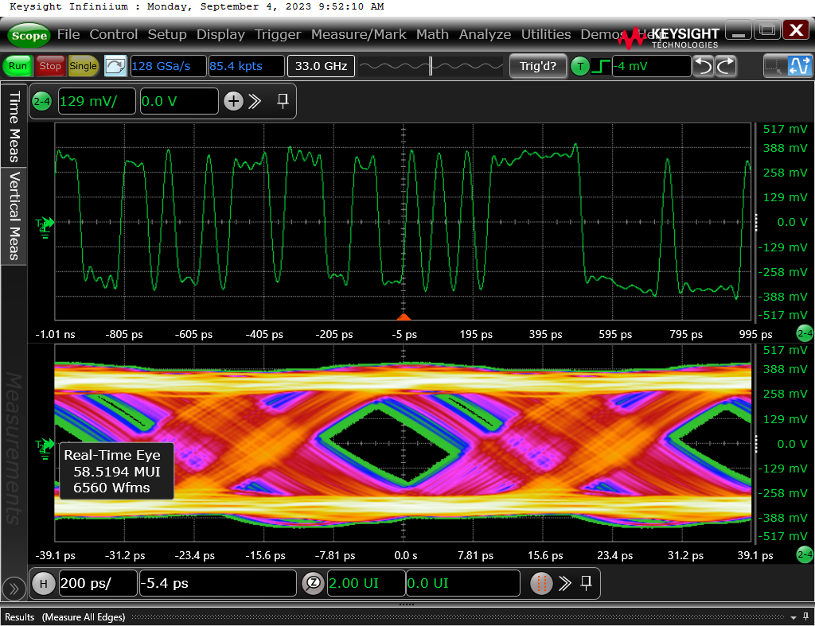
High Speed Transmitter
Designed within EP R&D WP6
Design Status: First Silicon Prototype Available (DART28 Chip)
  All included blocks are fully functional.
  Excellent PLL jitter performance demonstrated (random jitter <300 fs rms).
  TID X-ray test showed no significant eye quality degradation up to 2 Grad at nominal power supply.
  The SEE heavy ion test campaign validated the TDC-based SEE recovery mechanism, preventing PLL unlocks.
  Successful integration and data transmission with silicon photonics demonstrated.
  Data transmission performance degraded at 25.6 Gbps (data-dependent jitter) due to Power Delivery Network limitations.
    Issue understood. Addressing it will require close collaboration between the ASIC design team and the module design team.
Next Steps:
  Increase modulation voltage (3.6V?) for micro ring modulator.
  Add temperature control unit for wavelength stabilization.
  Improve on-chip Power Delivery Network (PDN).
  Adapt data path and configuration interfaces to align with PicoPix project requirements.
WP6 ASIC design roadmap is aligned with PicoPix project.
25.6 Gbps Line Driver (PRBS7)
12.8 Gbps Line Driver (PRBS7)

Slide 36
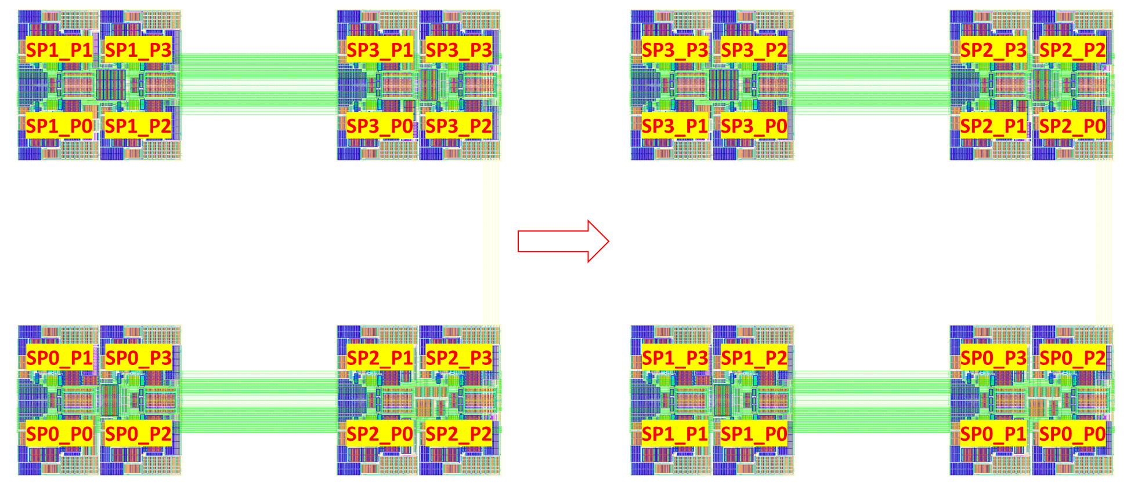
Analog FE in PicoPix by Viros Sriskaran
Analog Islands (2x2):
  ~30 µW/pixel and Qin-thr>~4ke- → <25 ps_{RMS}
  Optimized for negative input charges (e-)
  7-bit threshold DAC
  Novel on-pixel biasing power drop compensation

Slide 37
The Analog Front-end
ANALOG PIXEL ISLAND
Buffering structure
Digital
Analog EOC
PERIPHERY
8-bit DACs

Slide 38
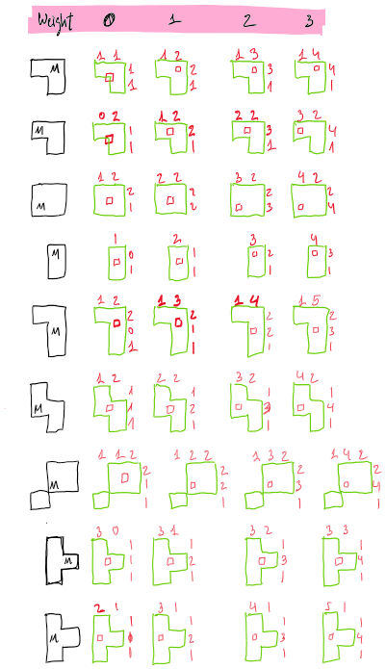
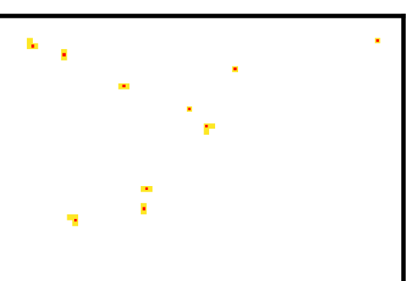
Sub-pixel resolution
Built in combinatorial algorithm to calculate center of gravity based on Master + hitmap
Selectable weight of Master allows to tune algorithm
For a 256x256 array → 512x512 array
  16-bit + 8-bit → 18-bit address
M[x-1][y+1]
M[x][y+1]
M[x+1][y+1]
M[x][y]
+
hitmap
M[x-1][y]
M[x][y]
M[x+1][y]
M[x-1][y-1]
M[x][y-1]
M[x+1][y-1]

Slide 39
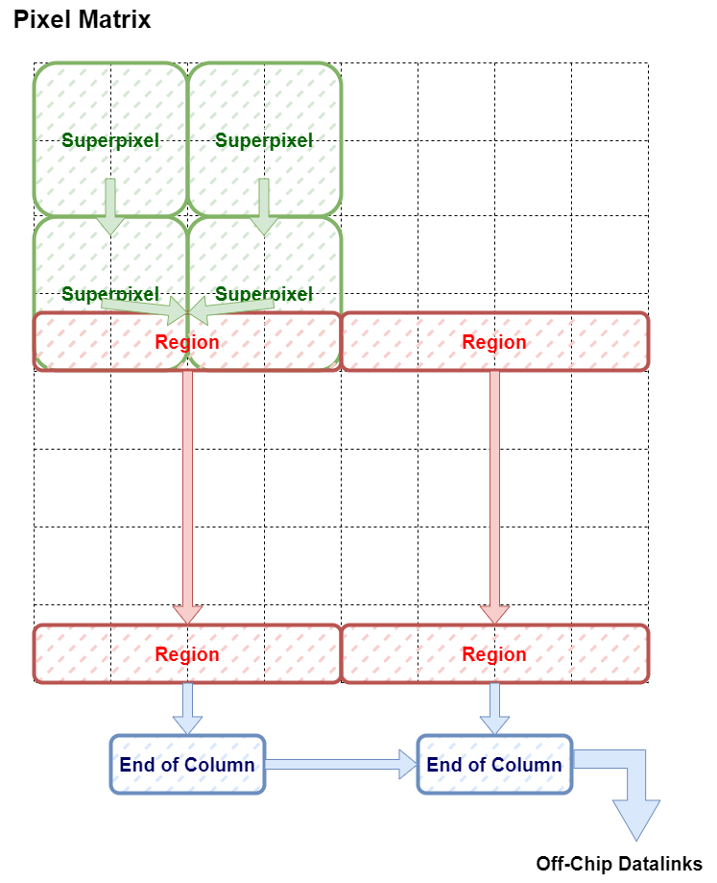
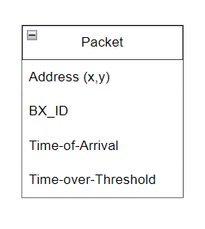
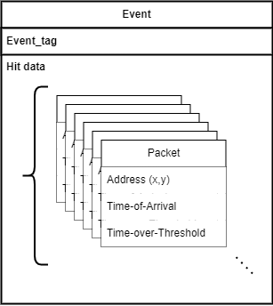
Event sorting
Problem: Data-driven readout provides out-of-order packets
Proposed solution: Design an on-chip Event sorter module that accumulates hit packets over time and groups them in bins based on event tag
Goals:
  Ordered packet readout
  Fixed latency
  Data reduction
Proposed solution
Off-Chip
Datalinks
Event
Sorter
Event frame of hit packets
Out-of-order hit packets

Slide 40
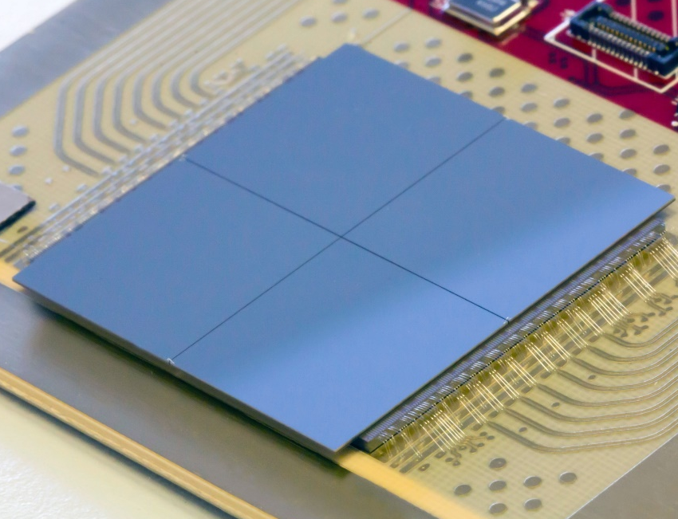
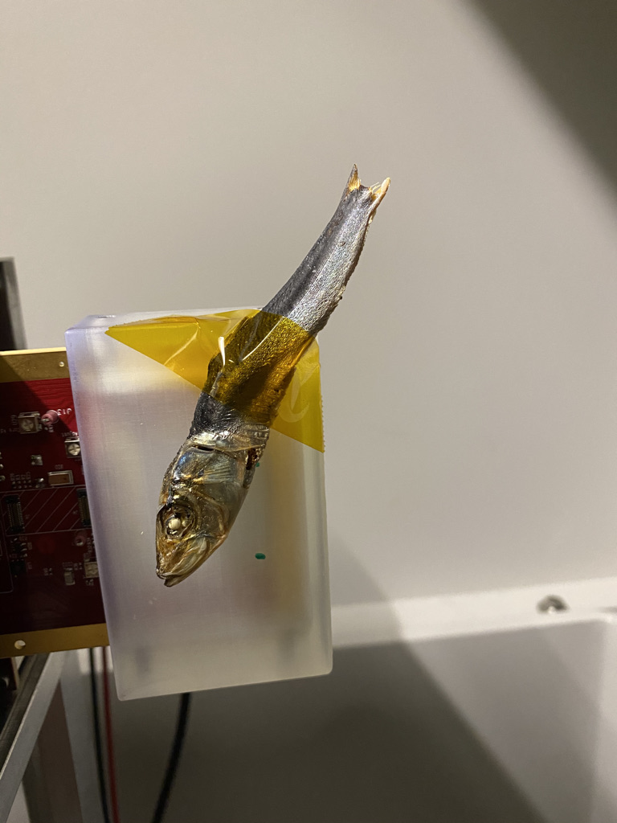
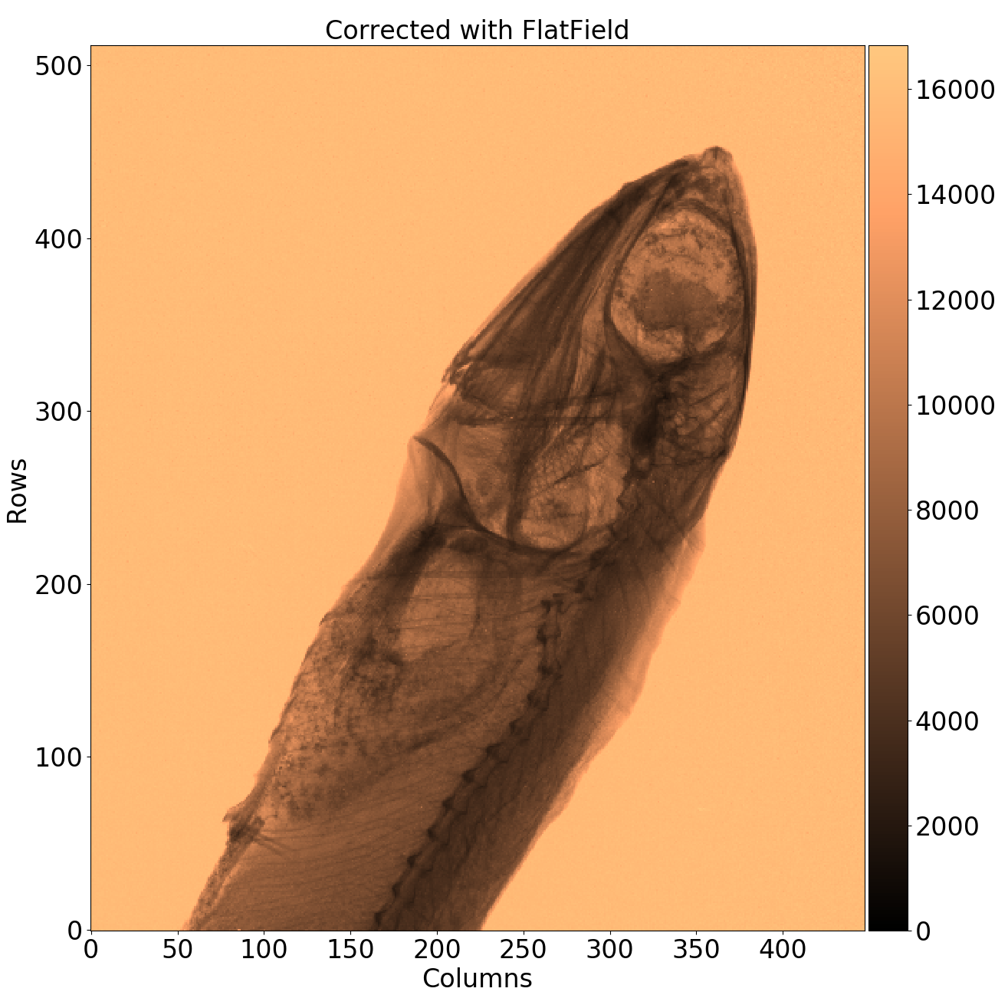
The design can inherit several of the functionalities implemented in the TIMEPIX4 chip
Technology |  |  | 65nm – 10 metal
Pixel Size |  |  | 55 x 55 µm
Pixel arrangement |  |  | 4-side buttable 512 x 448
Sensitive area |  |  | 6.94 cm²
Readout Modes | Data driven (Tracking) | Mode | TOT and TOA
 |  | Event Packet | 64-bit
 |  | Max rate | 3.58x10⁶ hits/mm²/s
 |  | Max Pix rate | 10.8 KHz/pixel
 | Frame based (Imaging) | Mode | CRW: PC (8 or 16-bit)
 |  | Frame | Not-zero-suppressed
 |  | Max count rate | ~5 x 10⁹ hits/mm²/s
TOT energy resolution |  |  | < 1Kev
Time resolution |  |  | 195ps bin → ~60 ps_{rms}
Readout bandwidth |  |  | 16x @10.24 Gbps
Minimum threshold |  |  | <500 e⁻
Radiation tolerance |  |  | NO

Slide 41
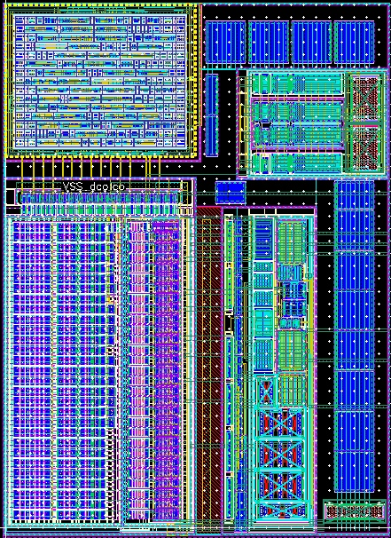
The digital PLL
Design by: Vladimir Gromov, Arseniy Vitkovskiy (NIKHEF)
One digital-PLL per pixel-region
Generates 320MHz clock used for TDC
Required output jitter = 4 ps_{RMS}
Suppression of the time jitter of the column clock
  Efficiently suppresses fast (HF) phase noise present of the reference clock high-freq. input jitter.
  Good immunity to power supply ripples and noise
Design status : Prototyped in September 2023
  In the AMTest28 – Test chip prepared by the CERN ASIC Support Service for testing multiple 28nm IP designs
  Diced dies and test-bench available
  First test results are promising
LAYOUT OF THE dPLL

Slide 42
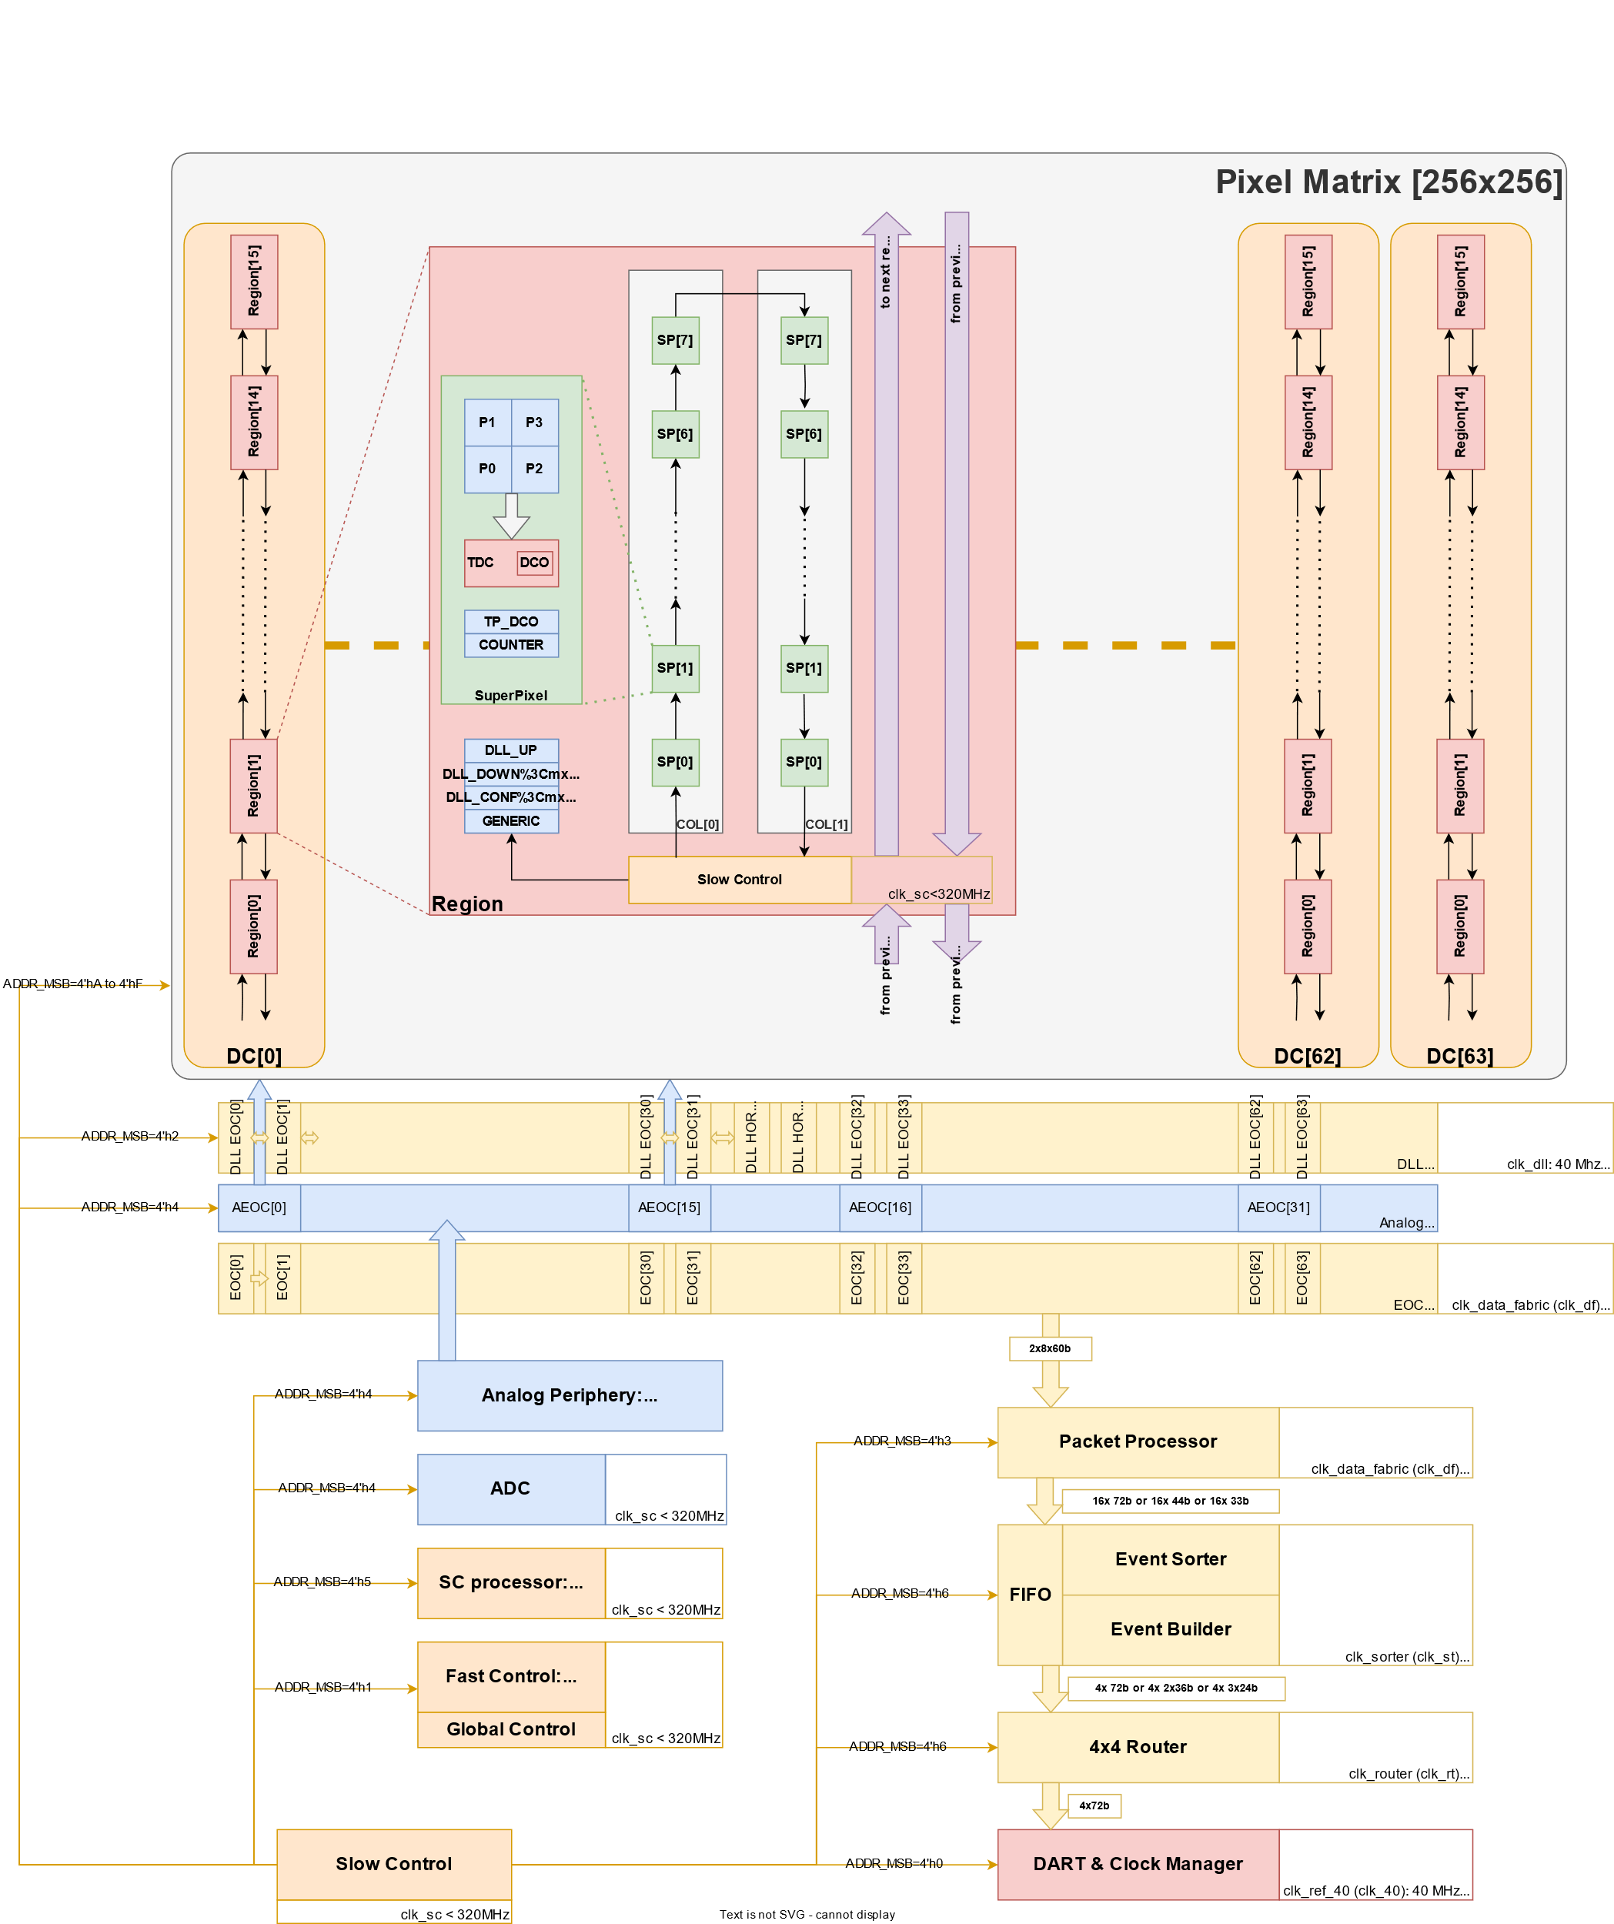
Slow-control
Custom serial control protocol
  Write packet:
  Read packet:
Allow control of periphery slaves and pixel-matrix
Scripted generation of configuration registers
  Instantiate and route registers in RTL
  Generate documentation
Design Status:
  RTL ready
  Verification and CI ready

Slide 43
On-chip processor in Picopix
Take over low-computational task from the back-end (slow-control)
Automatize recurrent monitoring operations as bias monitoring, etc.
Calibration, threshold trimming, clock distribution calibration for precise data correction, etc.
Provide commands instead writing/reading registers
Possibility to reprogram it in any moment, making it very flexible for new applications
SOCRATES - SoC RAdiation Tolerant Eco-System
Toolkit for generating highly-customizable systems that can be integrated in radiation-tolerant ASICs
automates SoC assembly and verification
provides a radiation-tolerant verified IPs library
supports fault-tolerant extensions for redundancy and error correction.
hardware, verification and software toolchain support
CERN EP R&D WP5

Slide 44
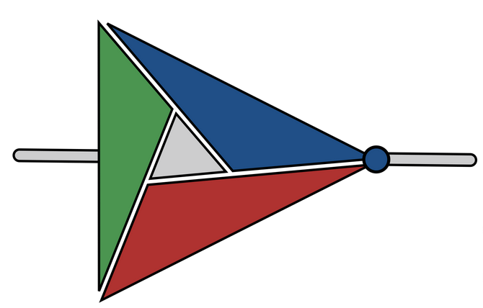






The SOCRATES platform
DEVELOPMENT STAGE:
Advanced stage
Early stage
Ideas for the future
SoCMake
Build System
Pre-verified
IP-blocks library
Radiation Hardening
Hardware composition
Software generation
Verification
Implementation
Generate the top-level SoC
Integrate IP blocks
Infer interconnects
(crossbars, adapters)
Invoke RISC-V toolchain
Generate hardware abstraction layer (HAL)
Generate linker scripts
Functional testing environment
SystemC-UVM environment
FPGA prototyping
Run synthesis and physical implementation flow on targets
Generate constraints
Fault injection framework
Formal verification for TMR
Constraints for fault tolerance
Fault tolerant interconnects
radiation-hardened blocks
Software fault tolerance
  CERN EP R&D WP5 – Marco Andorno , Alessandro Caratelli , Davide Ceresa , Benoit Denkinger , Kostas Kloukinas , Anvesh Nookala

Slide 45


The TriglaV prototype
Fully generated with the SOCRATES toolkit
Architecture Risc-V embedded controller for pixel readout ASICs
Radiation tolerant design:
  CPU and peripherals fully triplicated
Design submitted for 28nm MPW the 27th November 2024
Risc-V Ibex CPU
fully triplicated
180μm x 400μm
Resonant DCDC converted
TRIGLAV SoC
Interconnect crossbar
Memories encoded with scrabbing
Peripherals and test structures

Slide 46





SoCMake: a HW/SW Build System
CMake based HW/SW build system for SoCs
Input configuration in SystemRDL
  Register Description Language
  extended for supporting SoC description
  Used as top-level architecture description
Rapid prototyping of SoCs:
  Quick composition of IP blocks into full systems
  Quickly build different architectures with different IP blocks, hardware accelerators or different CPUs
Open-source
  Toolkit: https://gitlab.cern.ch/socrates
IP blocks and hardware accelerators (*.sv)
SIMULATE
Verilator
Xcelium
VCS
*.sv
Software application
*.cpp
IMPLEMENT
Cadence
...
Top level HDL (*.v)
*.rdl
Register file and Interconnections (*.v)
FPGA EMULATE
Vivado
Hardware abstraction layer
RDL toolchain
Linker scripts generation
Software application
UVM testbench (SystemC)
and SEE injection utilities
Config files for synthesis and implementation (*.yaml, *.tcl)
Documentation - website
(*.html, *.md)

Slide 47
A an almost-fully generated SoC: TriglaV prototype
Goals:
Demonstrate (and develop) SOCRATES capabilities
Validate the toolkit and demonstrate the feasibility of using programmable logic inside front-end ASICs.
Test-drive the HEP 28nm Common Design Platform
Test the radiation performance and validate the design choices
Design strategy:
Fully generated with the SOCRATES toolkit
Target architecture: embedded controller for pixel readout ASICs
Radiation tolerant design
Implemented in 28nm bulk CMOS
focus on introducing observability and testability features to evaluate the radiation tolerance of the design under irradiation testing
Design submission:
MPW run in 28nm reserved for the 30th November 2024

Slide 48
A an almost-fully generated SoC: TriglaV prototype
CPU choice: IBEX (Zero-risky) [1]
Fully triplicated in TriglaV – TMR formal verification and fault-injection
In parallel studies for selective protect CPU components and handle faults [2]
APB-RT interconnect
encoded data and address – triplicated control
error correction double-error handling in software
SOC
control
Debug unit
JTAG
RISC-V IBEX
CPU
TIMERs
GPIO
iPOL2v3
On-chip resonant
DCDC converter
EP R&D WP5.2
PLIC
UART
OBI TMR crossbar
APB-RT interconnect
Bootloader
MSPU
MSPU
ASIC-specific peripherals
SRAM
SRAM
SRAM
SRAM
Memory Scrubbing and Protection Unit
Dual-port commercial SRAM
Bit interleaving, ECC (Hamming encoded 13-8)
Periodic scrubbing
Design Status: MPW run in 28nm reserved for the 30th October 2024

Slide 49
A fully generated SoC in Picopix
End-Of-Column slow-control units
Handles access to pixel-matric configuration registers
Serial protocol
SOC
control
Debug unit
JTAG
RISC-V IBEX
CPU
TIMERs
EoC 1
EoC 1
EoC N
PLIC
EoC 0
EoC 0
…
OBI TMR crossbar
APB-RT interconnect
Bootloader
MSPU
MSPU
Periphery
control
Access to packet-processor
SRAM
SRAM
SRAM
SRAM
Periphery control
Control clock calibration
Access periphery slow-control
Bias monitoring
Access data buffer for analysis
For decisions based on data
Design Status: Not started yet

Slide 50






PixESL a virtual prototyping framework
CERN EP R&D WP5 D. Ceresa, F. Brambilla, J. Dhaliwal
Time-consuming
Fast
guidelines
Specifications
guidelines
guidelines
Specifications
Hardware design
PixESL framework
Hardware design
limitations
limitations
limitations
Validation
Verification
Physics simulation
Physics simulation
Virtual prototype
Verification
Verification
ASIC limits
NO structured feedback
ref. model
Reference model
for verification and physical simulation

