Slide 1
Asset Management of the Fibre Optics Installation with NETGEO
ENTM – Jorge Rodriguez Fernandez – EN-EL-FO
2024-10-08
Indico: 1460563

Slide 2
AGENDA
Introduction
Impact of OFMS on the EN-EL-FO working method
Impact of OFMS on CERN Users
OFMS evolution
Conclusions

Slide 3
Introduction

Slide 4
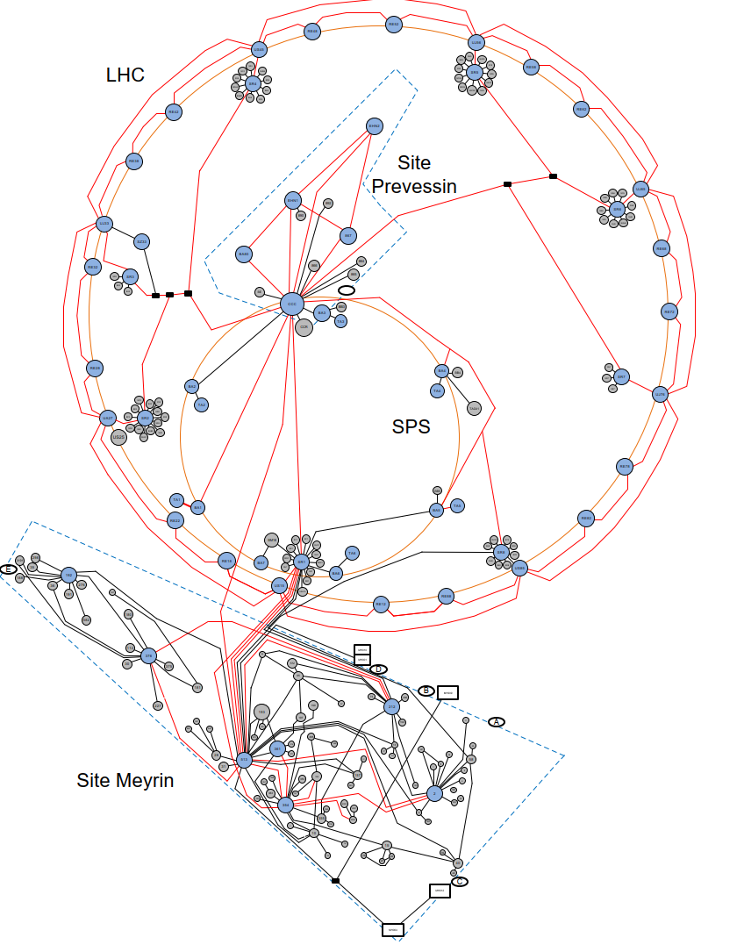
Intro: Overview of CERN FO infrastructure
OFI deployed all over CERN:
    Machine Buildings
      SPS
      LHC
      PS Complex
      …
    Experiments
      NACONS
      LHC EXPERIMENTS
      LINACs
      …
    Tertiary buildings
Used by many users and systems:
    IT-CS
      Technical Network (TN), General Purpose Network (GPN), GSM network, …
    EN-AA
      Access control, Fire Detection, CSAM, …
    BE-CEM
      White Rabbit, Timing, …
    SY-EPC
      Beam Interlock System (BIS), …
    TE-MPE
      Safe Machine Parameter (SMP), Warm magnet Interlock Controller (WIC), …
  …
There are currently 113181 fibres spanning over 34000km.

Slide 5
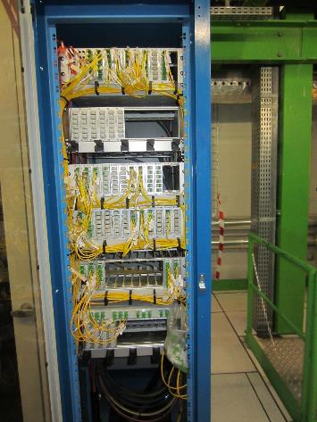
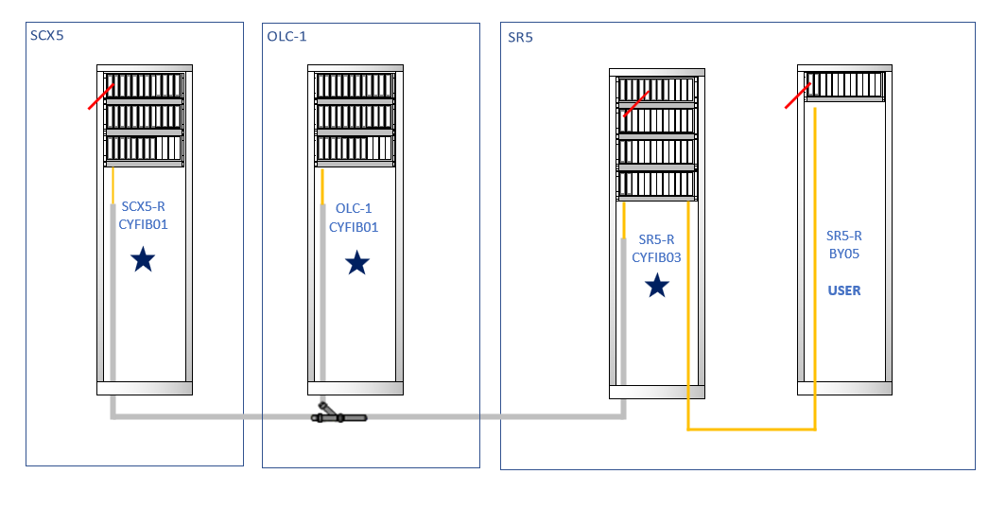
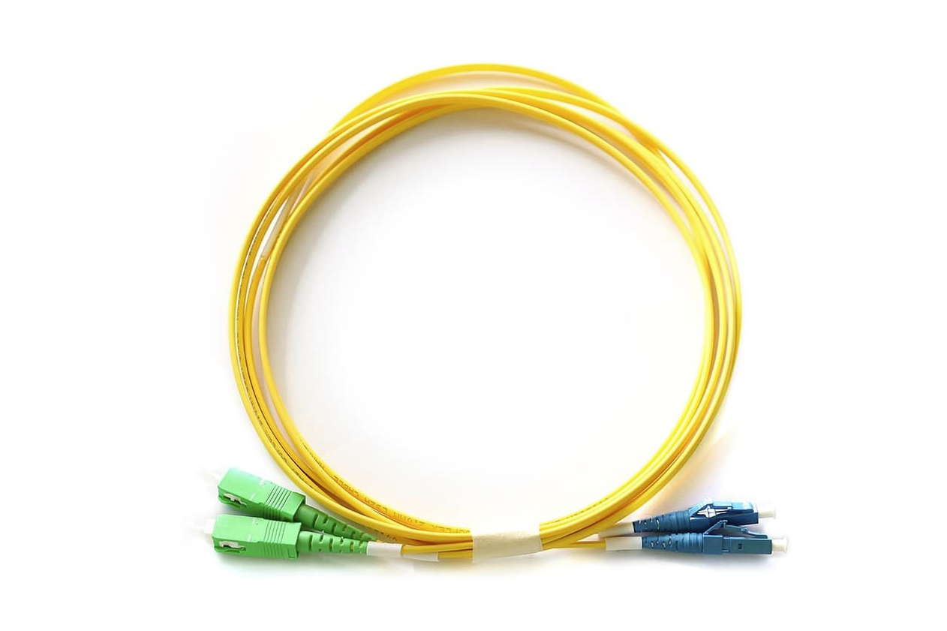
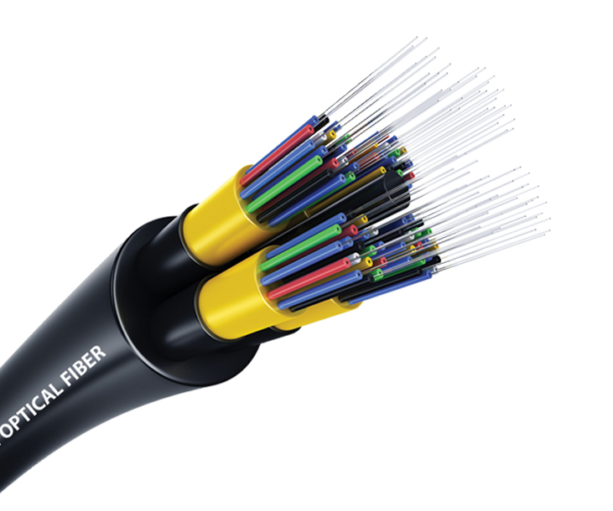
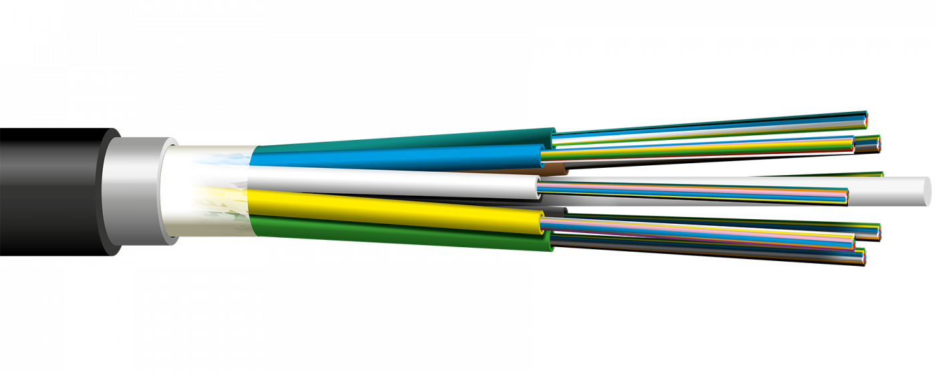
Intro: Overview of CERN FO infrastructure
Rack
Patchcord
Cable
Fibre
Derivation
Duct & Microducts
Route

Slide 6
Optical Fibre Management System (OFMS)
OFMS objectives:
    Database of all existing CERN’s optical fibre infrastructure.
    Conception and preparation of new projects and installation works.
    Management, maintenance and consolidation of the Optical Fibre Infrastructure (OFI).
    Share and synchronize fibre information with CERN users.
    In 2015 a study was performed in collaboration with IT-CS and EN-EL-CBS that concluded that no existing CERN tool was suitable for managing the FO infrastructure.

Slide 7
Asset Management Software

Slide 8



OFMS – NETGEO Software
Why NETGEO:
    Based on CERN existing graphical interface (ArcGIS).
    Based on IT Database (ORACLE architecture).
    Powerful API for additional developments.
    Monitoring alarms.
    User friendly graphical interface.

Slide 9
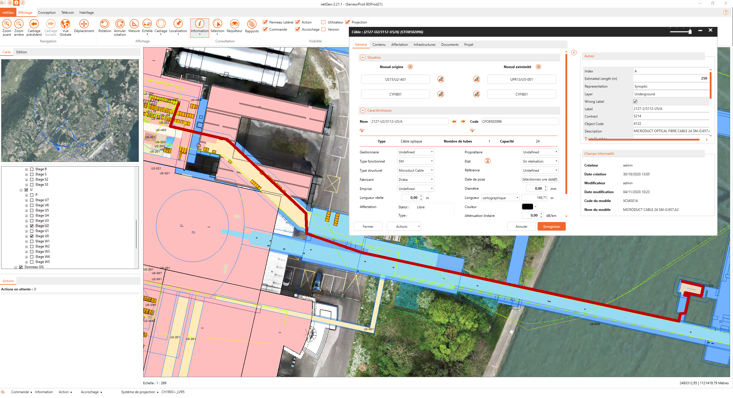
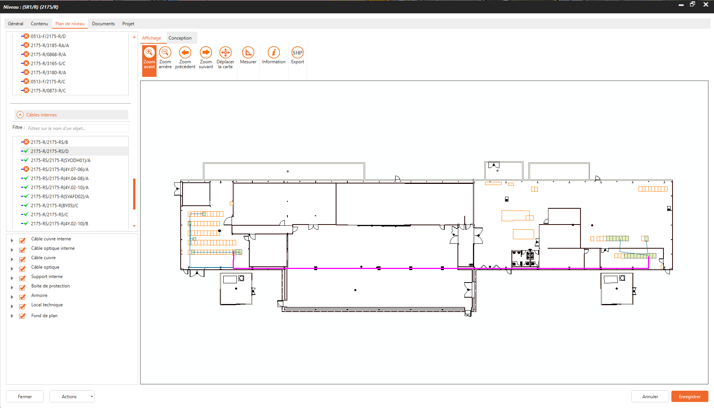
NETGEO – Software graphical interface
Intuitive graphical interface:
    Cables and ducts are drawn directly in the cartographical system.
NETGEO interface

Slide 10
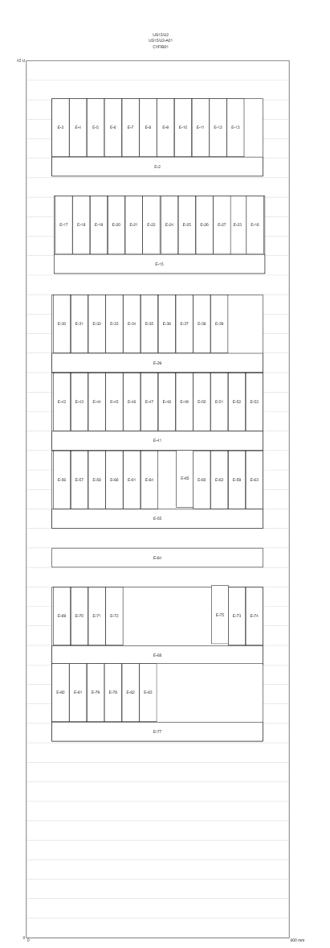
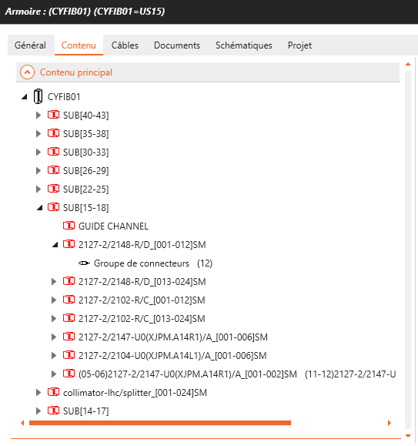
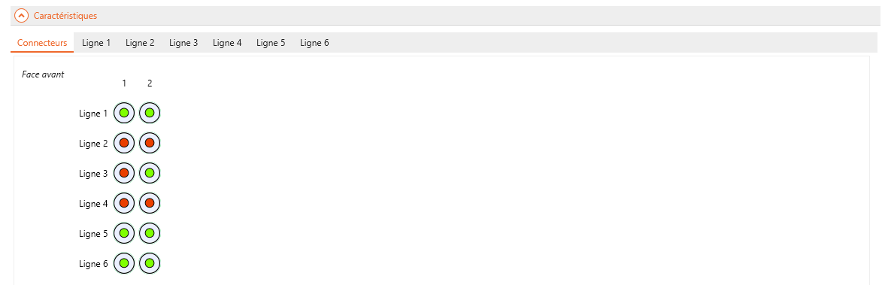
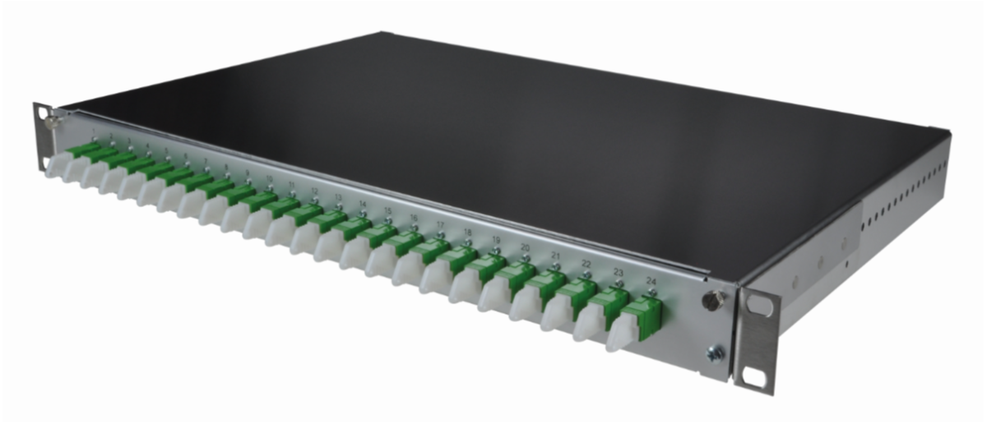
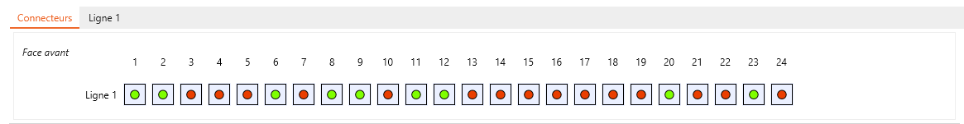
NETGEO – Equipment Components
Rack/Equipment
Rack, equipment model integration:
    Able to register size, type, position, connector.
Terminal equipment

Slide 11
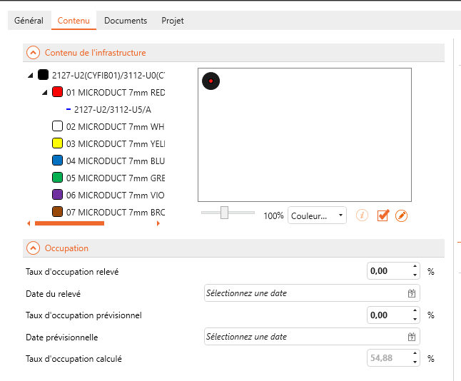
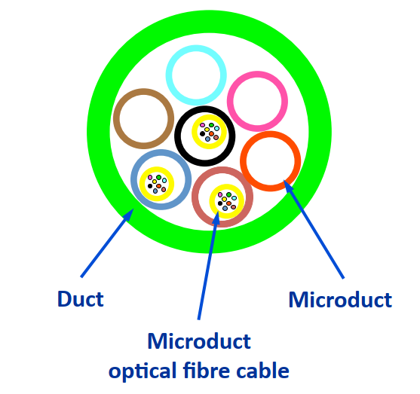
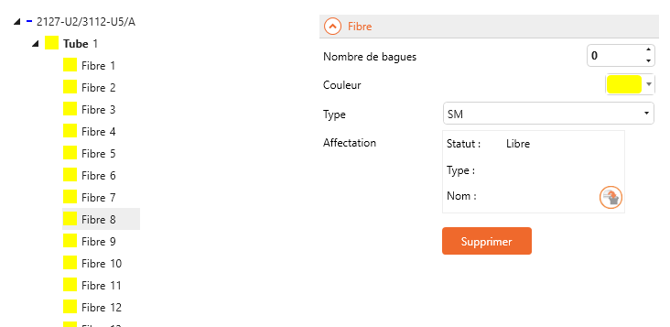
NETGEO – Linear Components
Duct/ Microduct
Management of duct infrastructure:
    Number of available microducts in a duct.
    Association between duct and cables.
Information about availability of fibres and route:
    Status (Free, Used, Reserved, Broken…).
    User (EN-EL, SY-BI, IT-CS…).
    Sub-system (DOFRS, White Rabbit, IT-TN…).
Fibre/Route

Slide 12
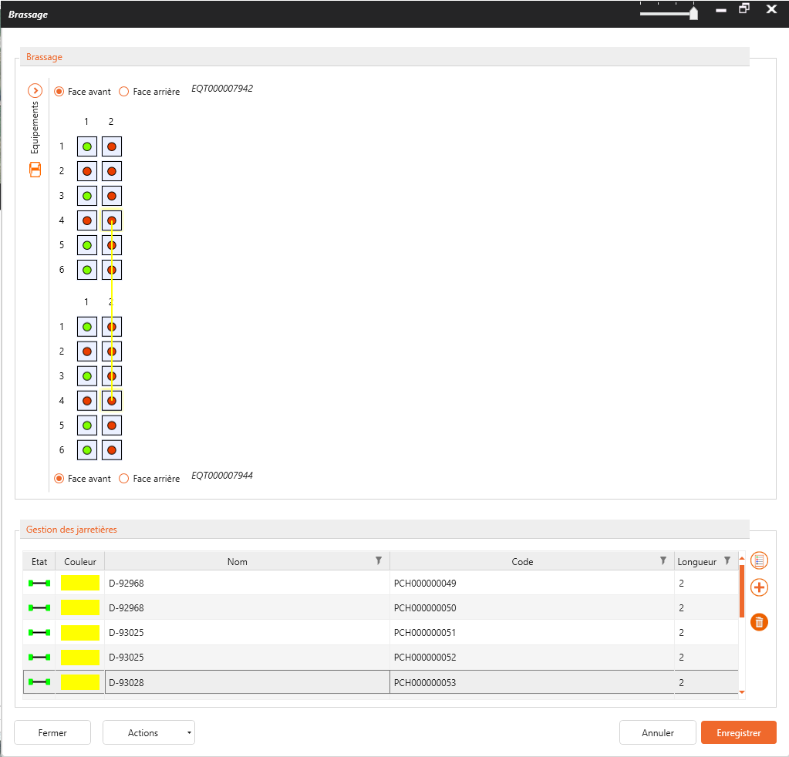
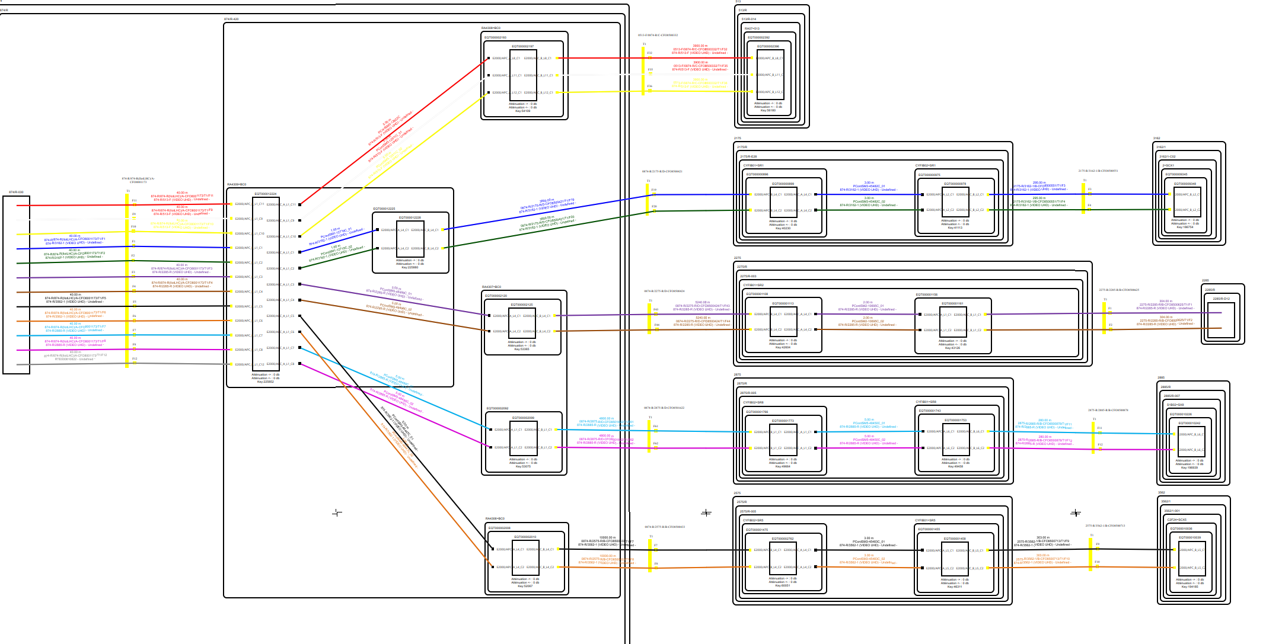
NETGEO – Interconnection
Patching interface
Interconnection of optical fibre components:
    Interactive patchcord registration:
      Type of connector.
      Fibre availability and status.
      Pcord representation.
    Automatic creation of routes.
    Automatic extraction of patching schemas.
Patching Schema

Slide 13
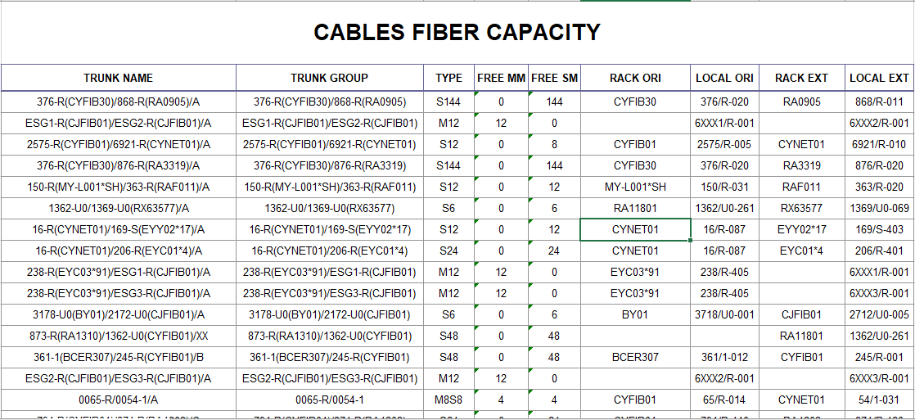
NETGEO – Reports
Extraction of reports from NetGEO:
    Reports are fully customizable.
    Data can be exported in multiple formats (PDF, .xlsx,…).
    Usable by every NetGEO user.

Slide 14
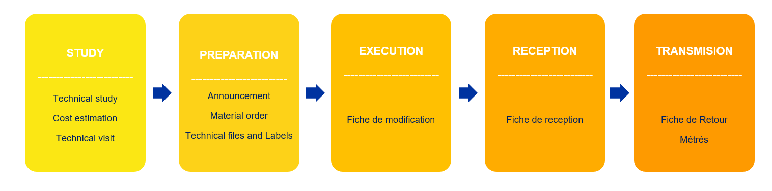
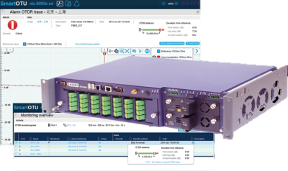
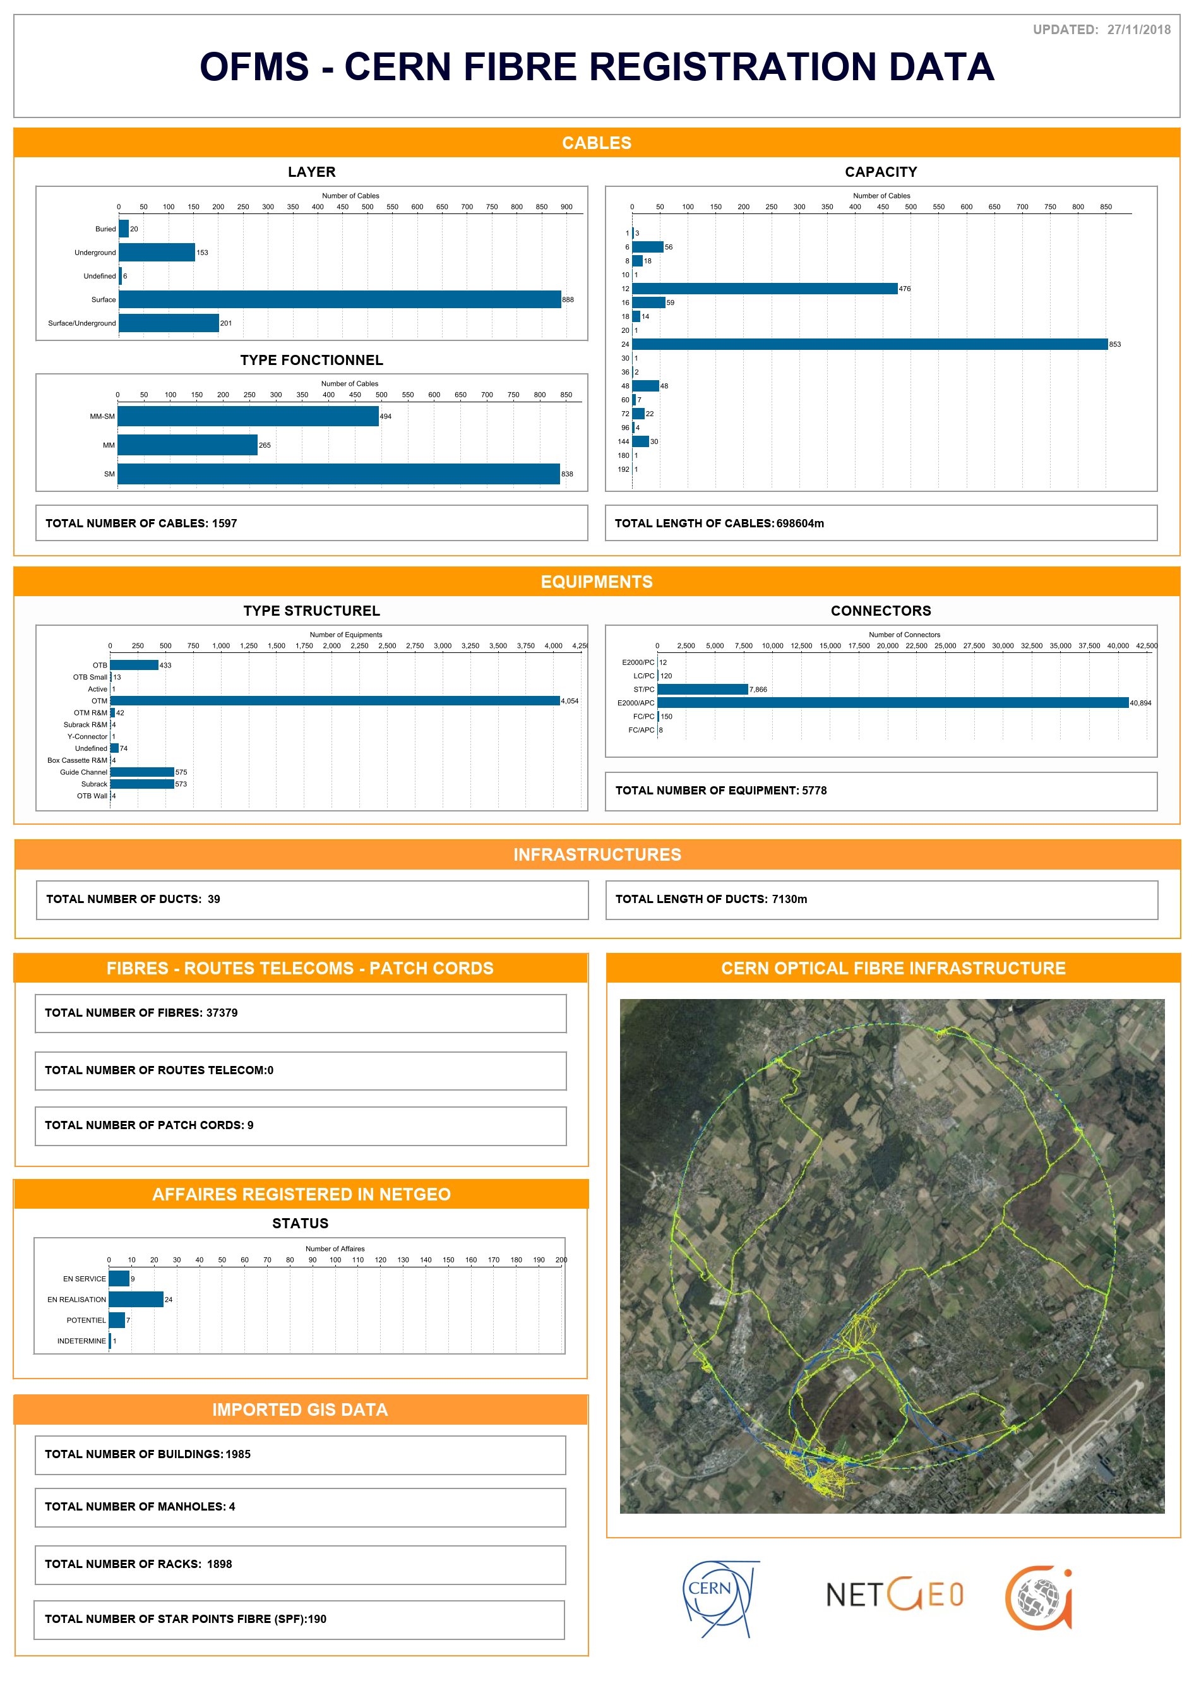
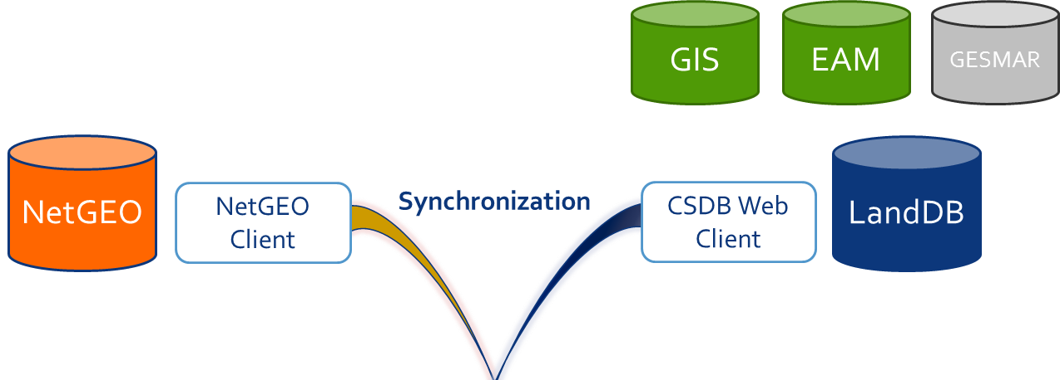
OFMS – Functions Overview
Project managers FO
CERN Users
Management
Simplified and standardized working method
Database synchronizations
Monitoring
Reports

Slide 15
OFMS – Components Registration
Cables
Distribution
(OFSP-OFSP)
User
(At least one extremity is a User Rack)
Racks
OFSP
User
Equipment
User
Ducts/µDucts
Distribution
User
Patchcords
Distribution
User
Distribution
Components
KPI for the OFMS:
    Database content vs. Reference quantity (Installed base of OFI elements in the field).
  Registration status:
    On track with racks, cables, and equipment.
    Ongoing Duct registration.
    Patchcord registration success.
Legend:
Registered
Partially Registered
Not registered
KPI registration
KPI-Data | Target | KPI 2024 | Created by users | From registration
Racks | 2855 | 3279 | - | 3279
Ducts | 2396 | 1072 | 917 | 155
Cables | 2547 | 3392 | 1600 | 1792
Equipment | 7262 | 13333 | 5559 | 7774
Patchcords | 25691 | 29373 | 858 | 28518

Slide 16
Impact of OFMS on
FO Installation

Slide 17
Optical Fibre Installation Phases
STUDY
--------------------------
Technical study
Cost estimation
Technical visit
PREPARATION
--------------------------Announcement
Material order
Technical folder and Labels
EXECUTION
--------------------------
Fiche de modification
RECEPTION
--------------------------
Reception Sheet
TRANSMISION
--------------------------
As-Built Document.
Métrés
OFMS and NETGEO are crucial parts of every step.

Slide 18
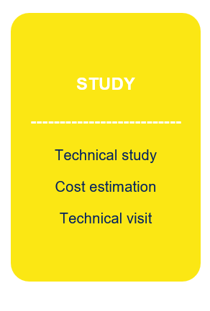

OF Installation – Study Phase
E.g.: Rack availability
E.g.: Rack availability
Reliable information in the database:
  Allows to analyze remotely the status of the OFI:
    Checking the information directly in NetGEO.
    Using database extractions (Reports).
        Simplifies study process.
        Reduces number of technical visits.
        More accurate cost estimations.

Slide 19
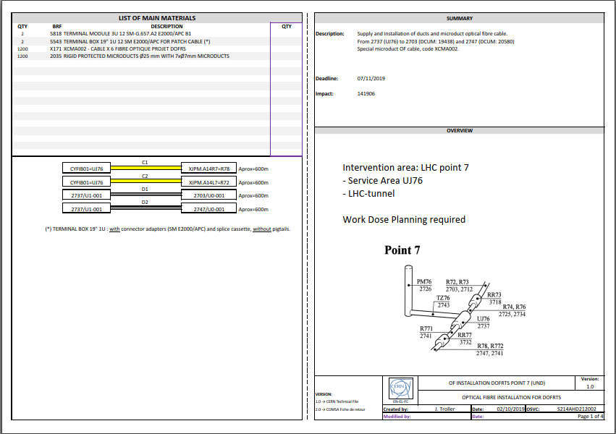
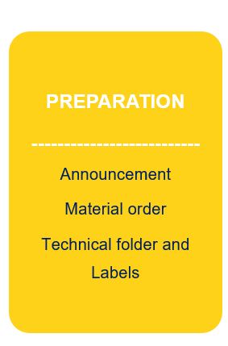
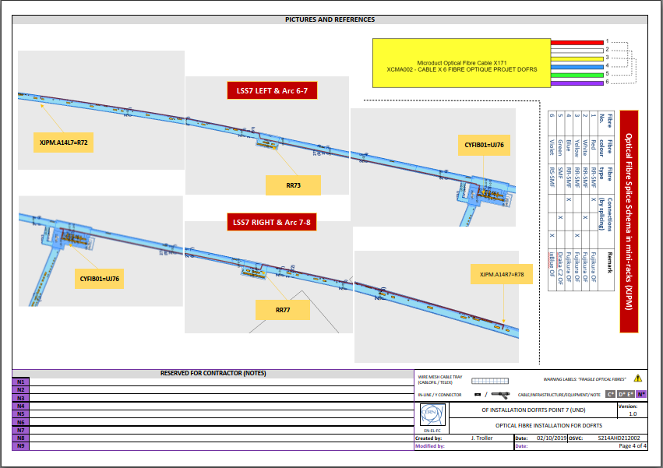


OF Installation – Preparation Phase
E.g.: Technical Folder
Standardized templates and procedures:
  Creation of components in NetGEO.
  Assignation of components (ducts, cables, equipment) to jobs.
  Automatic extraction of Announcement and Technical Folder.
      OFI elements pre-registered in database.
      Quicker preparation of Technical Folder.
      Homogenization of Technical Folder.
      Automatic extraction and standardization of labels.
E.g.: Labels

Slide 20
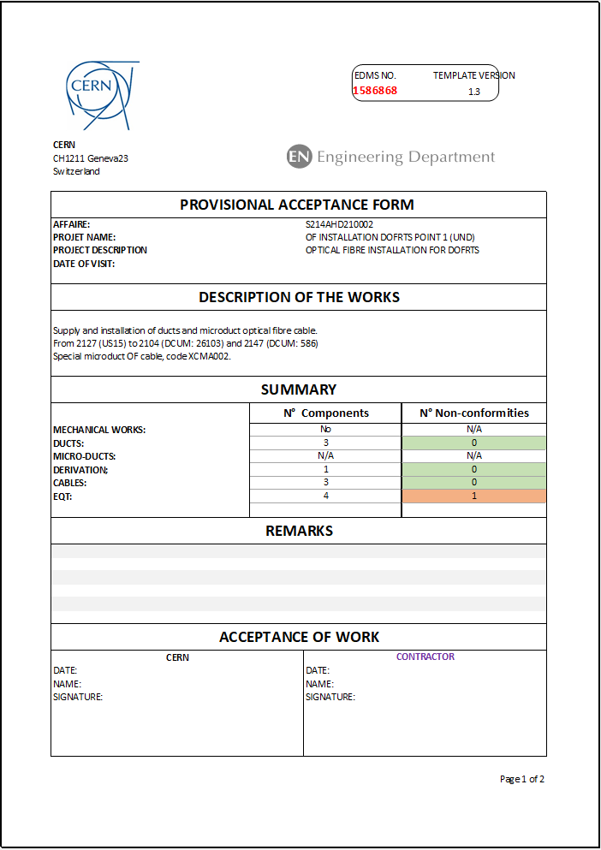

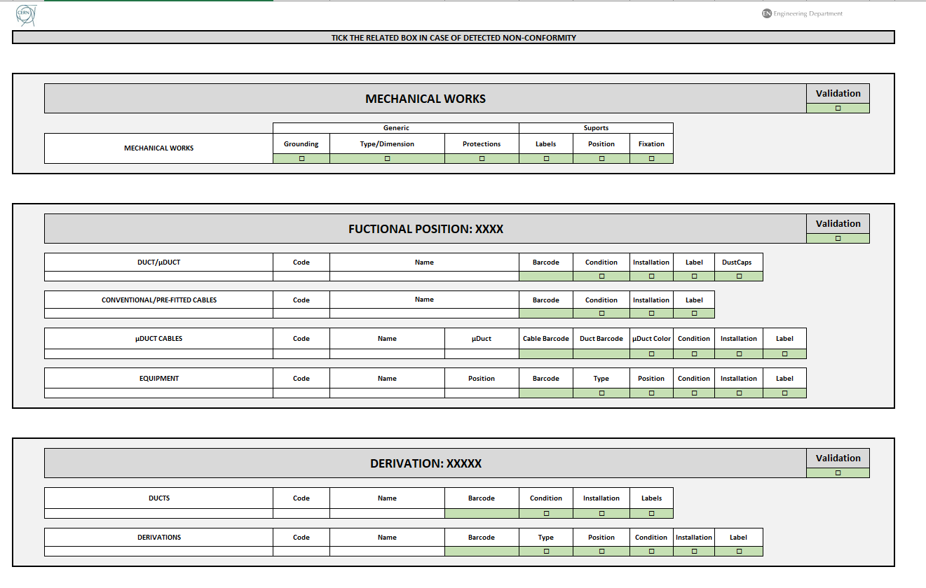
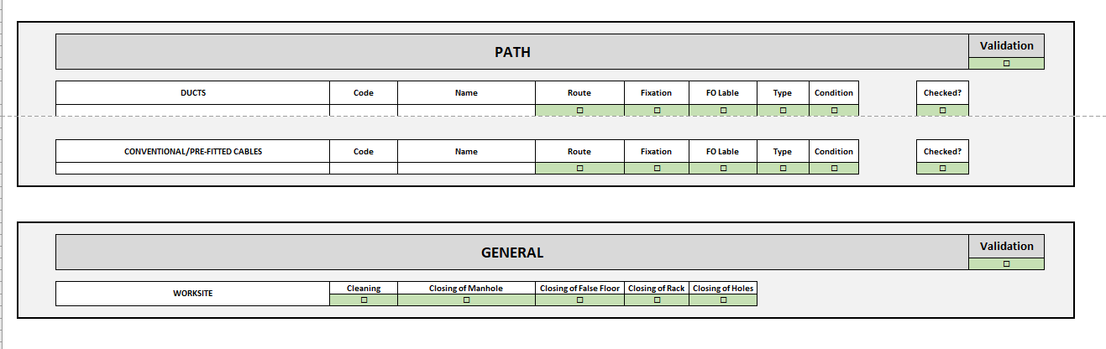
OF Installation – Reception Phase
E.g.: Reception Sheet
Automatic extraction of Reception Sheet:
  Standardized template and procedure:
    Optimized for laptops and tablets.
    Electronic signature.
    Designed to ensure every element of the installation is checked.

Slide 21
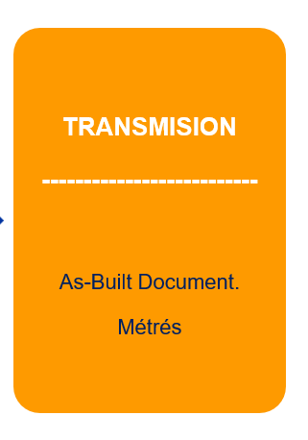
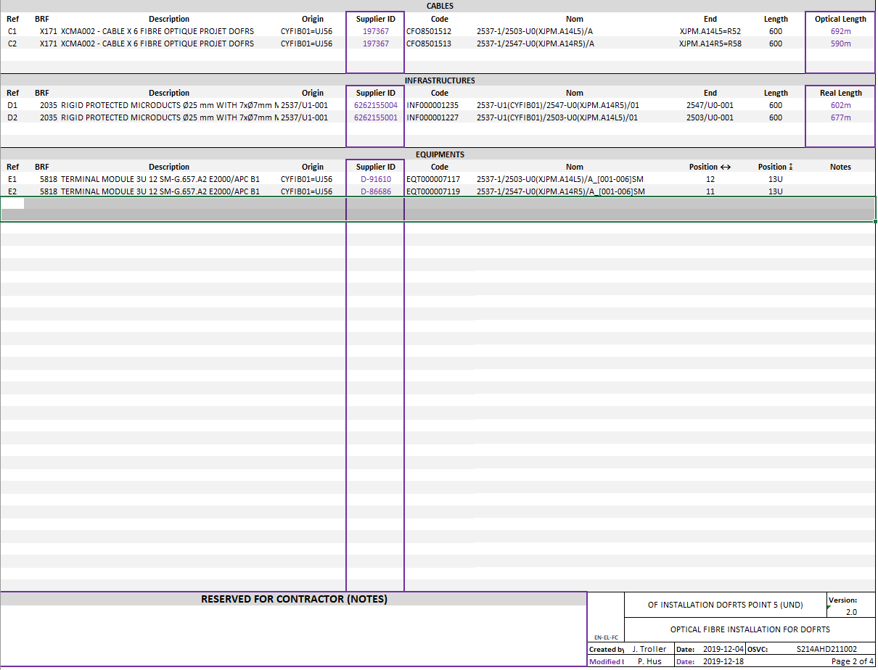
OF Installation – Transmission Phase
As-built document registered in NETGEO:
  Based on Technical Folder.
  Register very important information for future traceability:
    Cables:
      Optical Length.
      Manufacturer ID.
    Ducts:
      Final Length.
      Manufacturer ID.
    Equipement:
      Manufacturer ID.
    Pcords:
      Manufacturer ID.
E.g.: As-Built Document

Slide 22
Impact of OFMS on
CERN Users

Slide 23
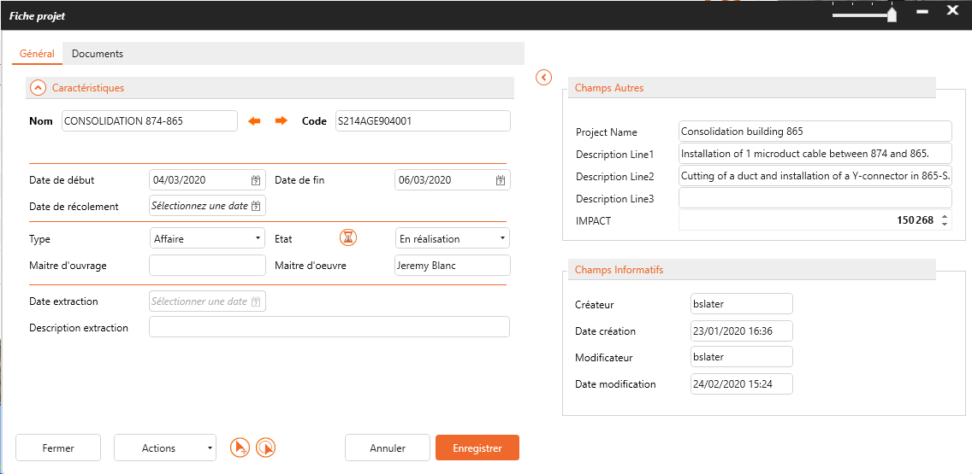
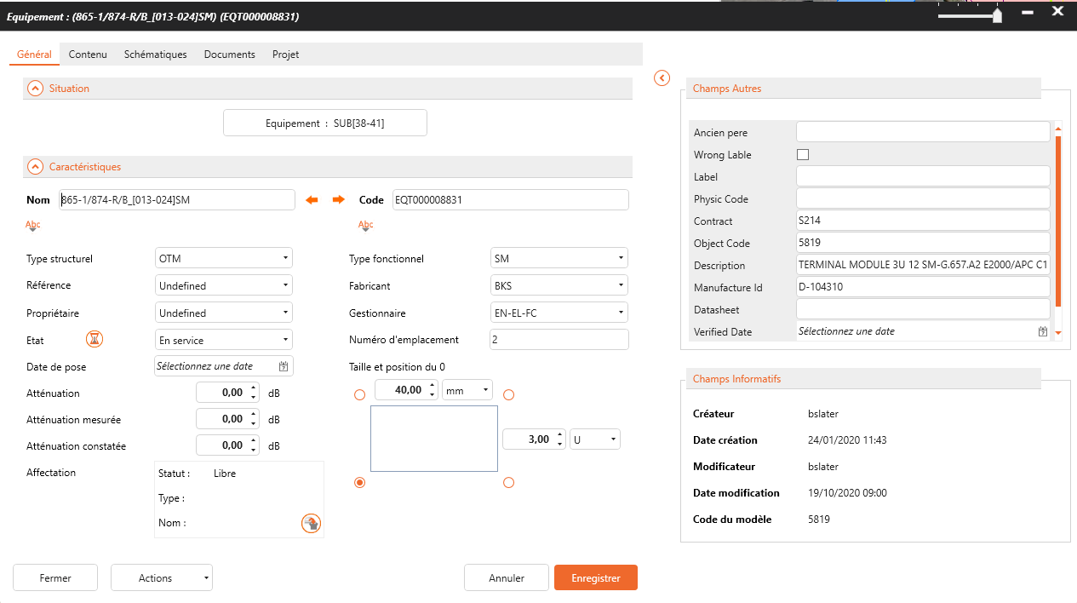
CERN Users – Component Information
E.g.: Job fiche
Improved traceability of the data:
  Installation order (OSVC).
  Components labelled with unique identifier.
  Manufacturer ID.
  Installation date.
  Location.
Reduce waiting time in case of intervention:
    Quick identification of component to replace.
    Faster identification of the location of the problem.
    Identification of other possible failure points in case of manufacturing problem.
    Quicker preparation in case of future consolidation.
E.g.: Equipement fiche

Slide 24
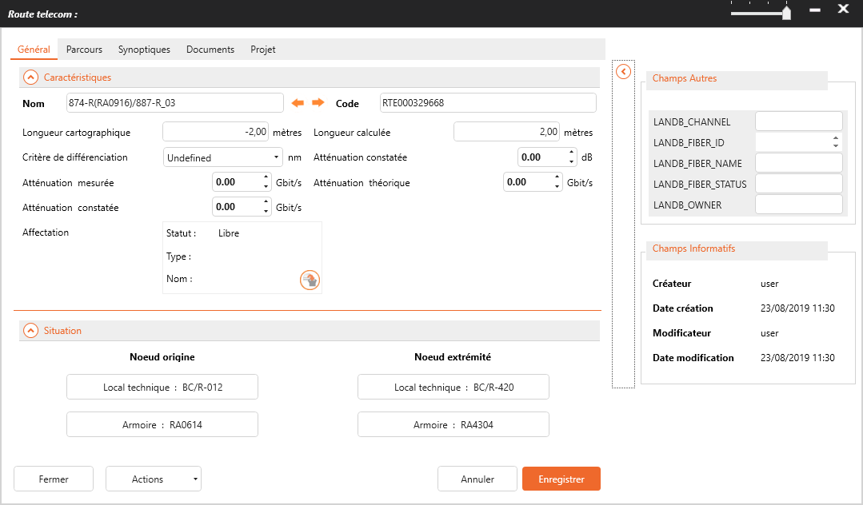
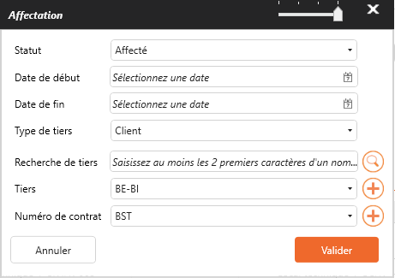
CERN Users – Fibre Use
E.g.: Route Assignation
Each link in NetGEO must be associated to:
  Machine system (e.g Fire Detection, Beam Instrumentation).
  Owner group (e.g EN-AA, SY-BI).
Allows to treat data based on user:
    Quickly identify users in specific link.
    Extract schemas of user infrastructure.
    Prepare specific reports.
    Maintain CERN databases all synchronized.

Slide 25
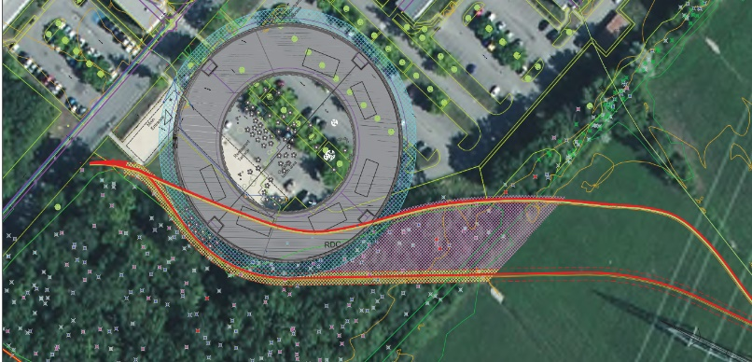
CERN Users – Example for Civil Engineering Work
E.g.: Building 777 network displacement
Importance of data traceability:
    E.g.: Building 777 built over existing optical fibre Network:
      CCC-BA4 (288 fibres cable).
      BA3-BA4 (144 fibres cable).
      CCC-SR8 (288 fibres cable).
OFMS was crucial to identify affected cables, fibres and users and organizing cable displacement.
Users | # Fibres
IT-CS (TETRA, MMC, TN, GPN, Redphone) | >139f
SY-BI (BPM, BLM, TTC/BST) | >47f
EN-AA (Access, SMSI, CSAM) | >28f
SY-RF (Synchronisation) | >10f
EN-EL (66kV protection) | >8f

Slide 26
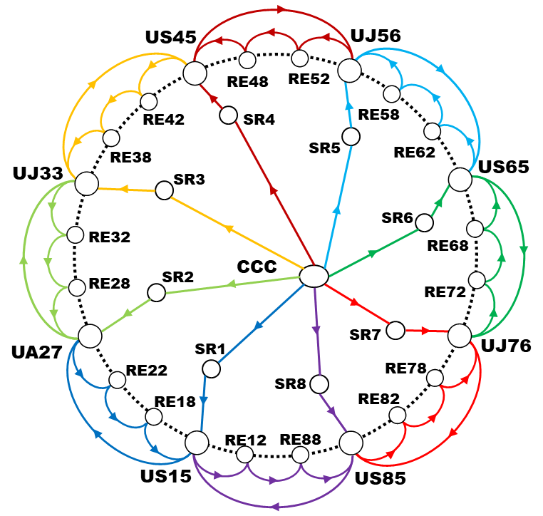
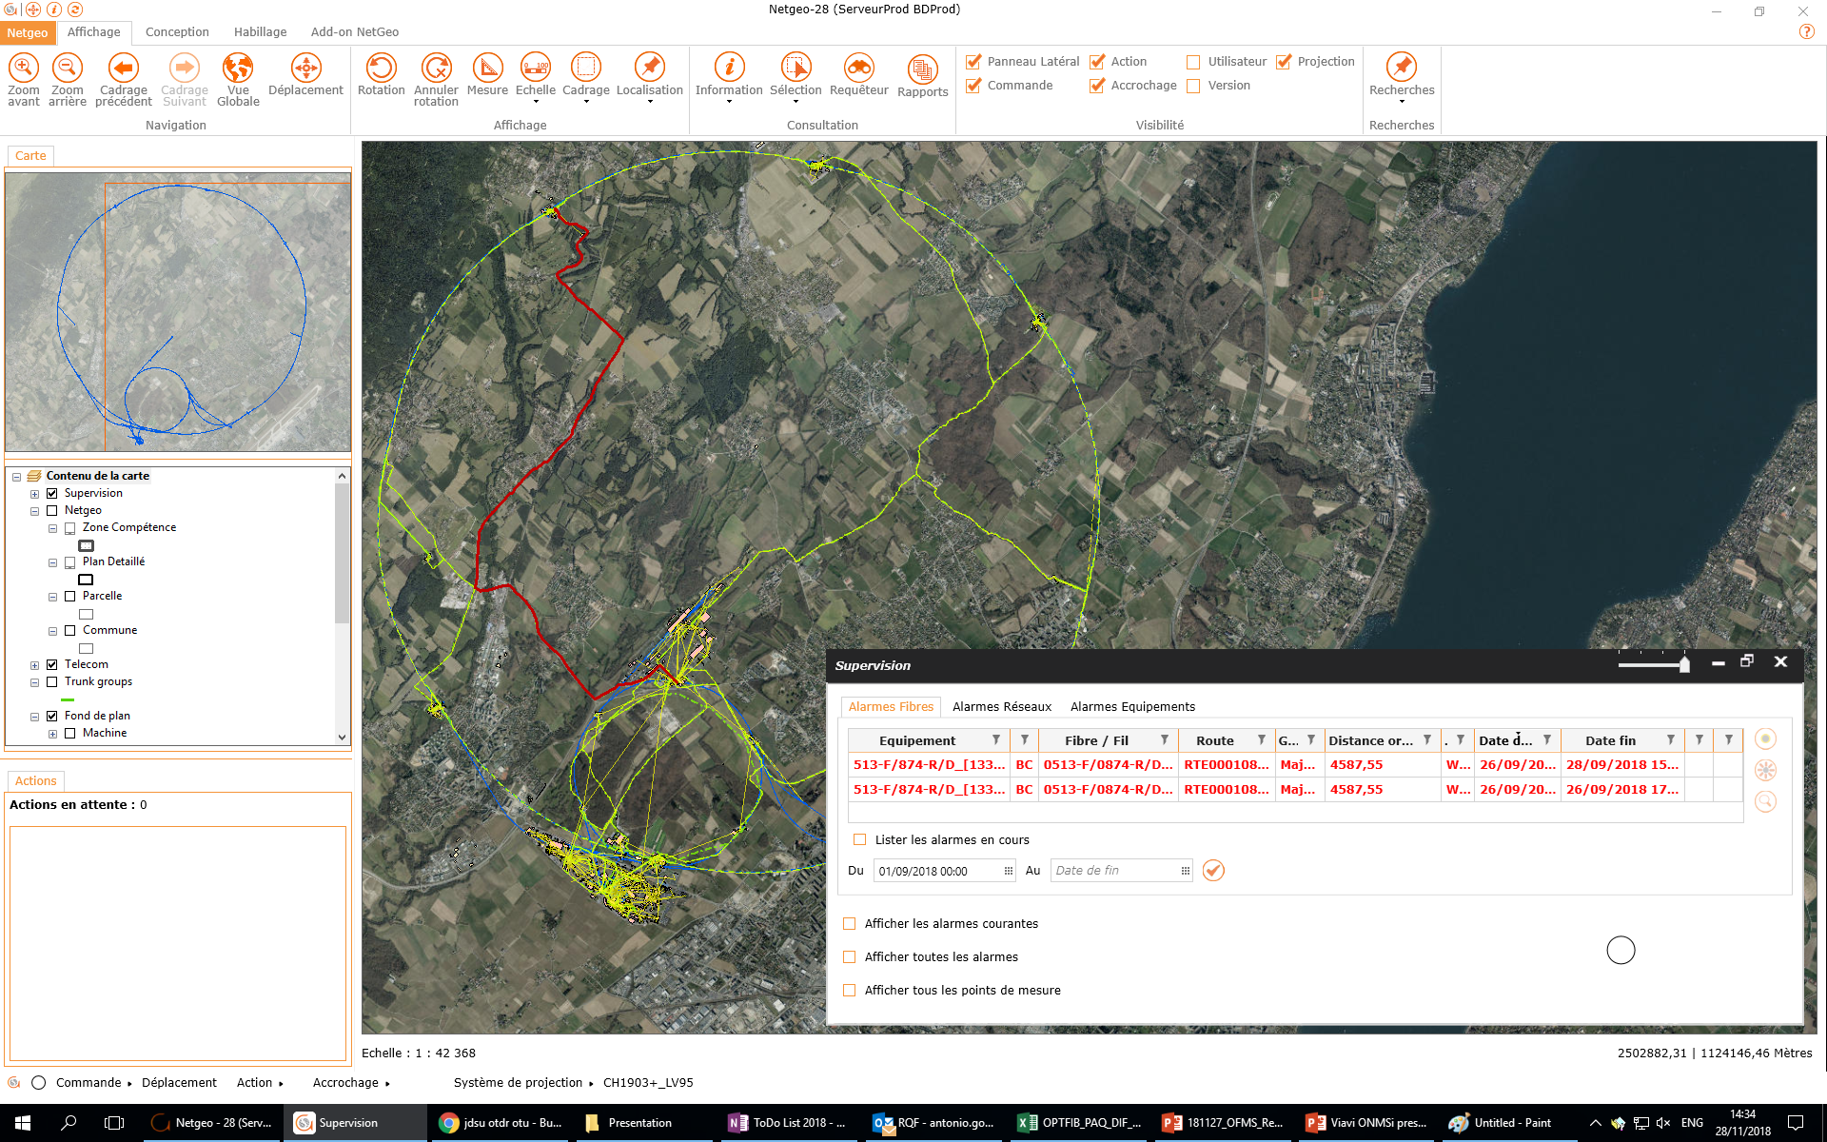
CERN Users – Fibre Monitoring
Fibre Monitoring tool:
  Live measurement of specific optical fibre links:
    Monitoring of radiation damage (RIA).
    Alerts if broken optical link (with location of the problem).
Important tool that allows:
    Better understanding of status of the main links.
    Impact of the radiation by area.
    Calculation of power budget of new links.
E.g.: Monitoring interface

Slide 27
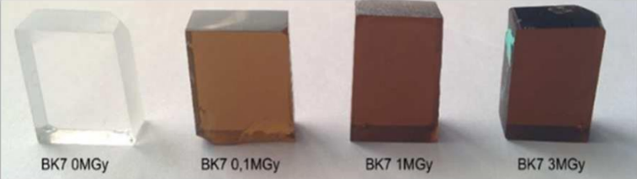
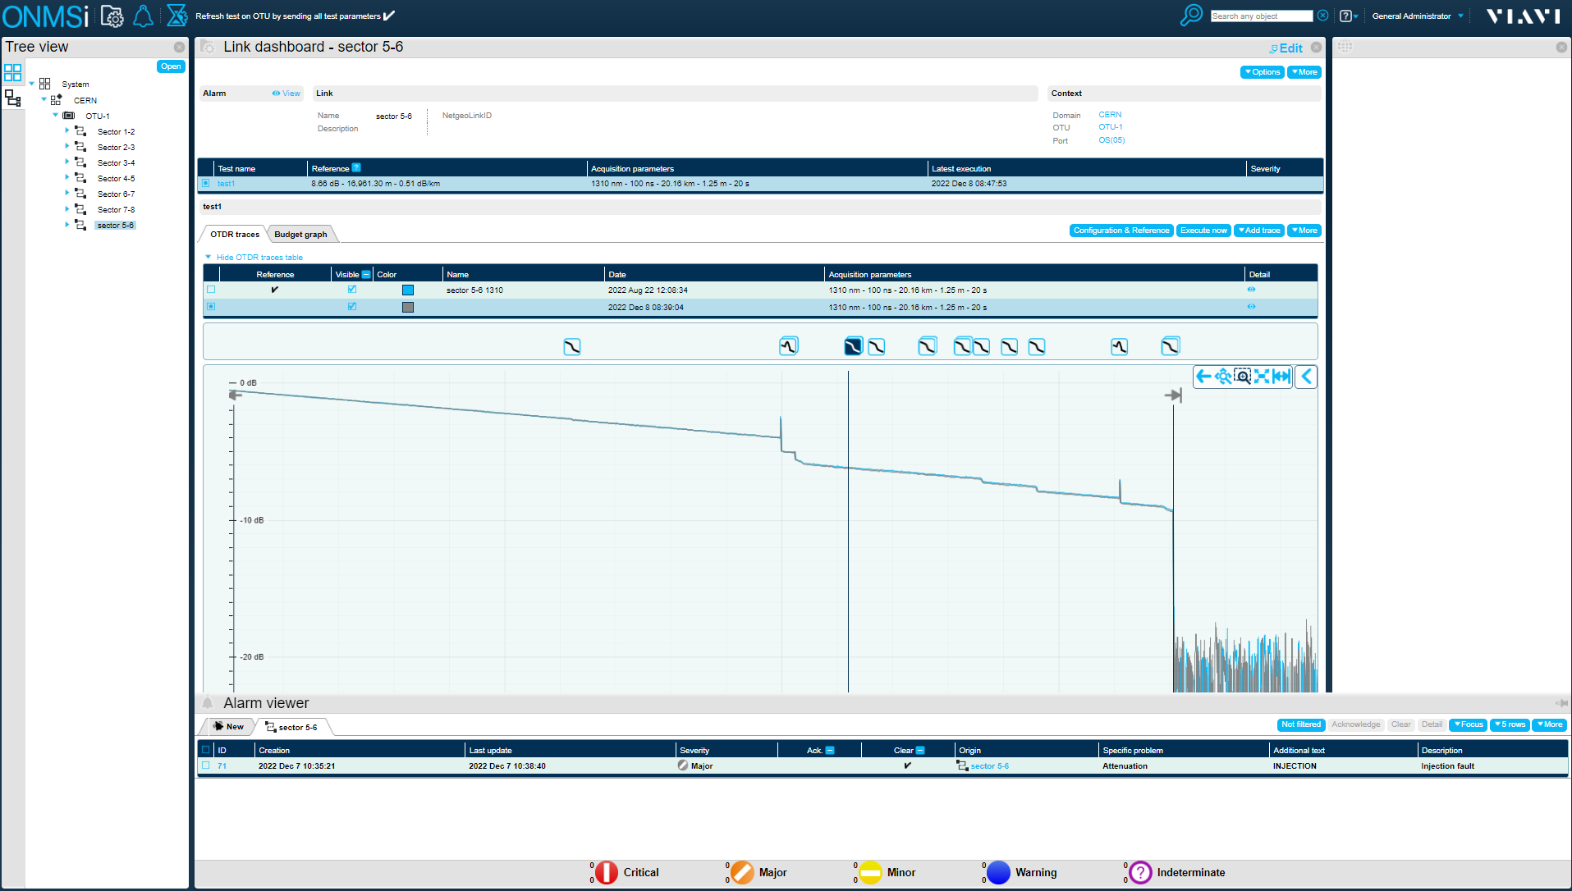
CERN Users – Example of RIA monitoring
Importance of fibre monitoring:
    Radiation Induced Attenuation (RIA)
OFMS monitoring is crucial to identify and locate RIA in existing links and to anticipate equipment transmission failure.
E.g.: OF link trace
T. Allanche, “Effect of high radiation doses (MGy) on light Emitting Diodes and optical glasses”, PhD thesis, 2020.

Slide 28
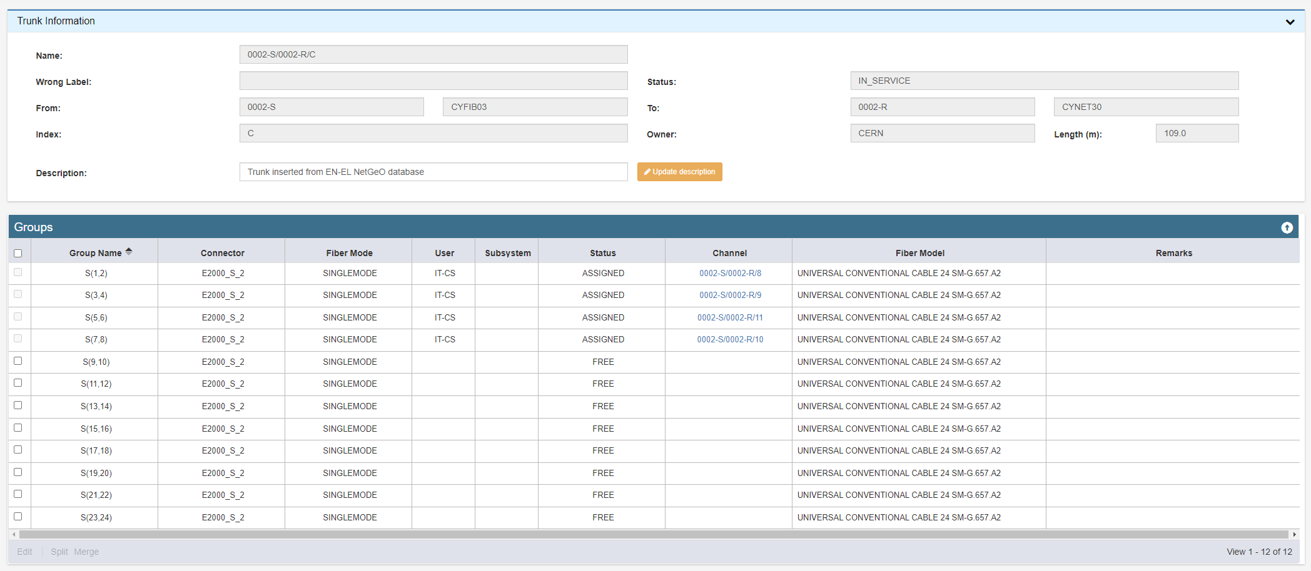
CERN Users – Database Synchronization
Data synchronization with IT-CS:
    Allows to share a common cable infrastructure.
    Data is coherent in both databases and up to date.
    Data is complemental and redundant.
    Simplifies preparation of deployment projects.
To ensure data quality, strict rules have been implemented in the synchronization process:
  E.g.: The creation of cable and fibre data is permitted exclusively in NETGEO.
E.g.: Cable CSDB propagated from NETGEO

Slide 29
OFMS Evolution

Slide 30
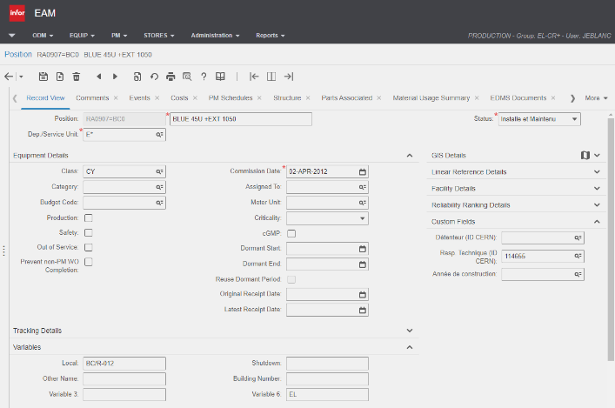
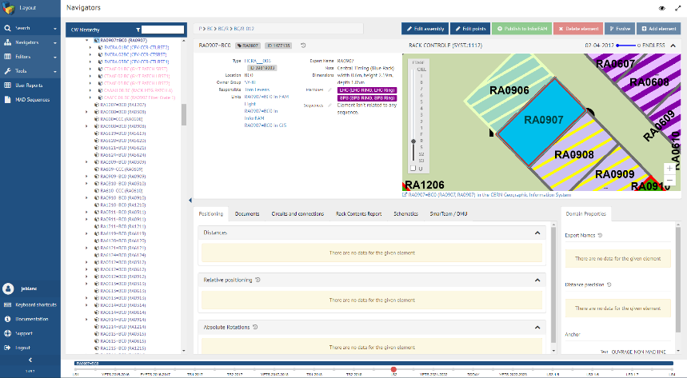
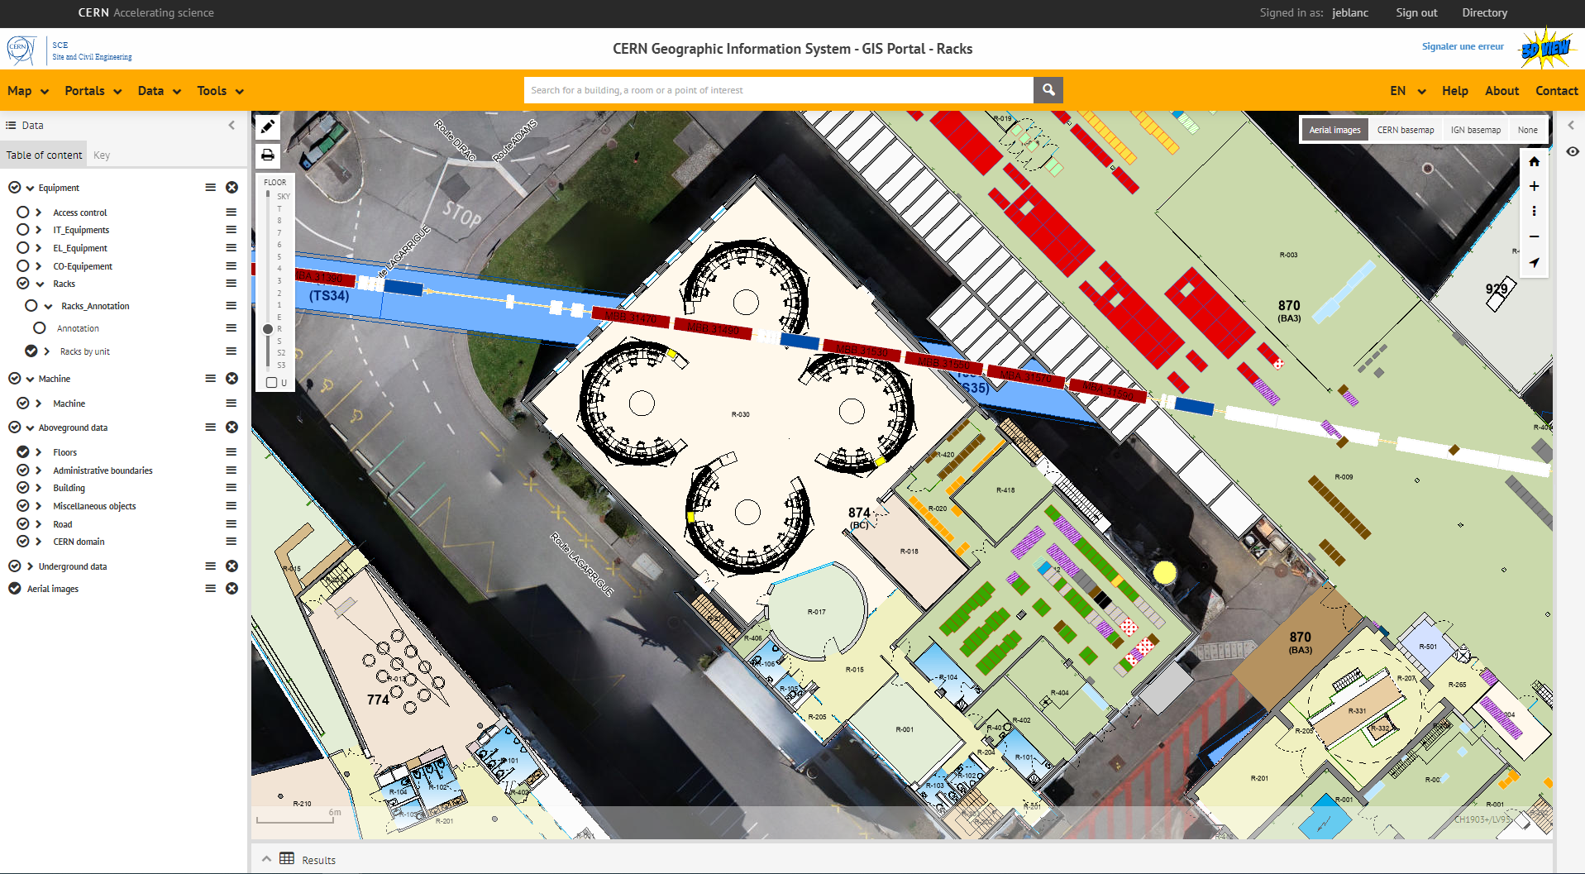
OFMS Evolution – Improve Integration at CERN
EAM
Some users are registering their optical fibre components in different databases (EAM, LayoutDB, GIS, …):
  Redundant information.
  Not necessarily accurate information.
  Misuse of resources.
Possible improvement: synchronisation with OFMS database:
    Information can be automatically shared after registration in NETGEO.
    Modifications can be automatically propagated to all databases.
  A study on how to synchronize OFMS and other CERN databases is on-going.
LayoutDB
GIS

Slide 31
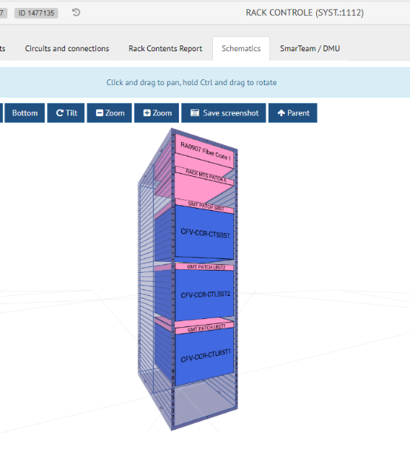
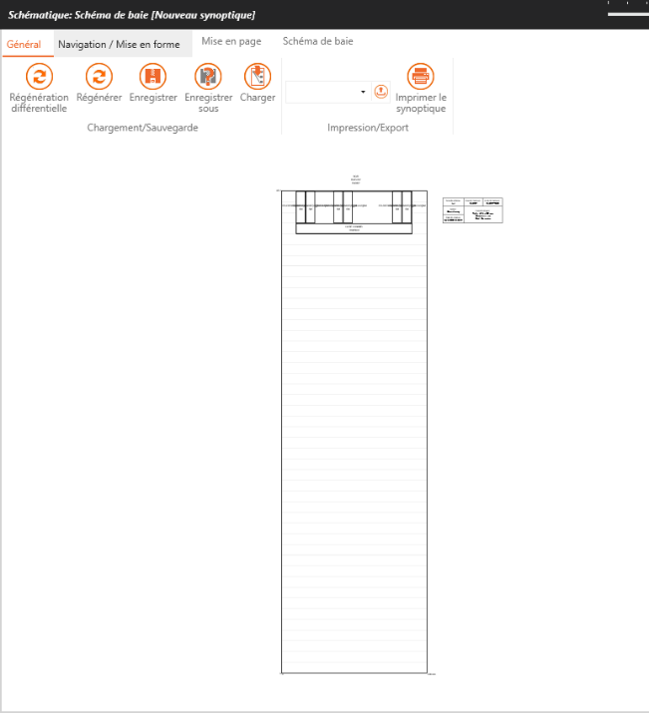
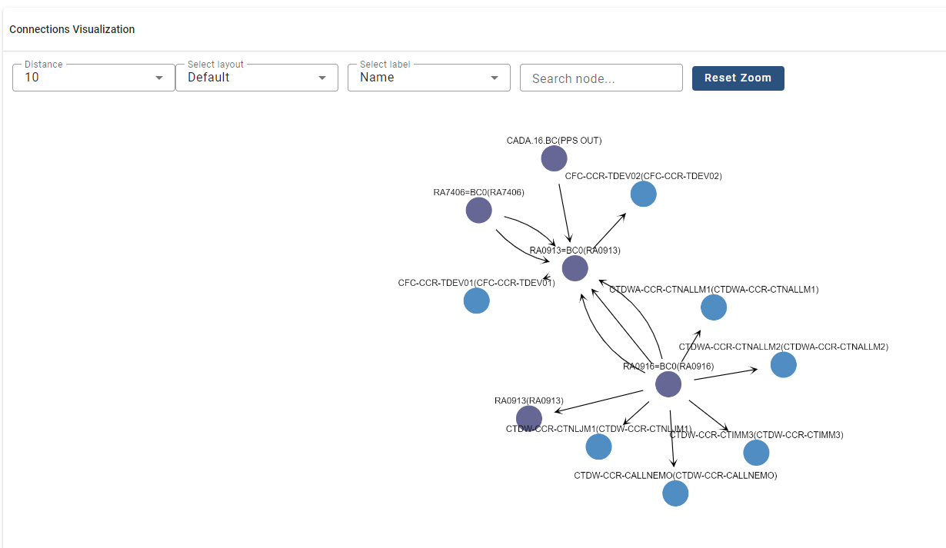
OFMS Evolution – Improve Integration at CERN
LayoutDB
Equipment and optical links being created in LayoutDB.
Possible improvement: synchronisation with OFMS database
    Optical links automatically available in LayoutDB after implementation.
    Sharing of information regarding system/user.
NETGEO
LayoutDB link representation

Slide 32
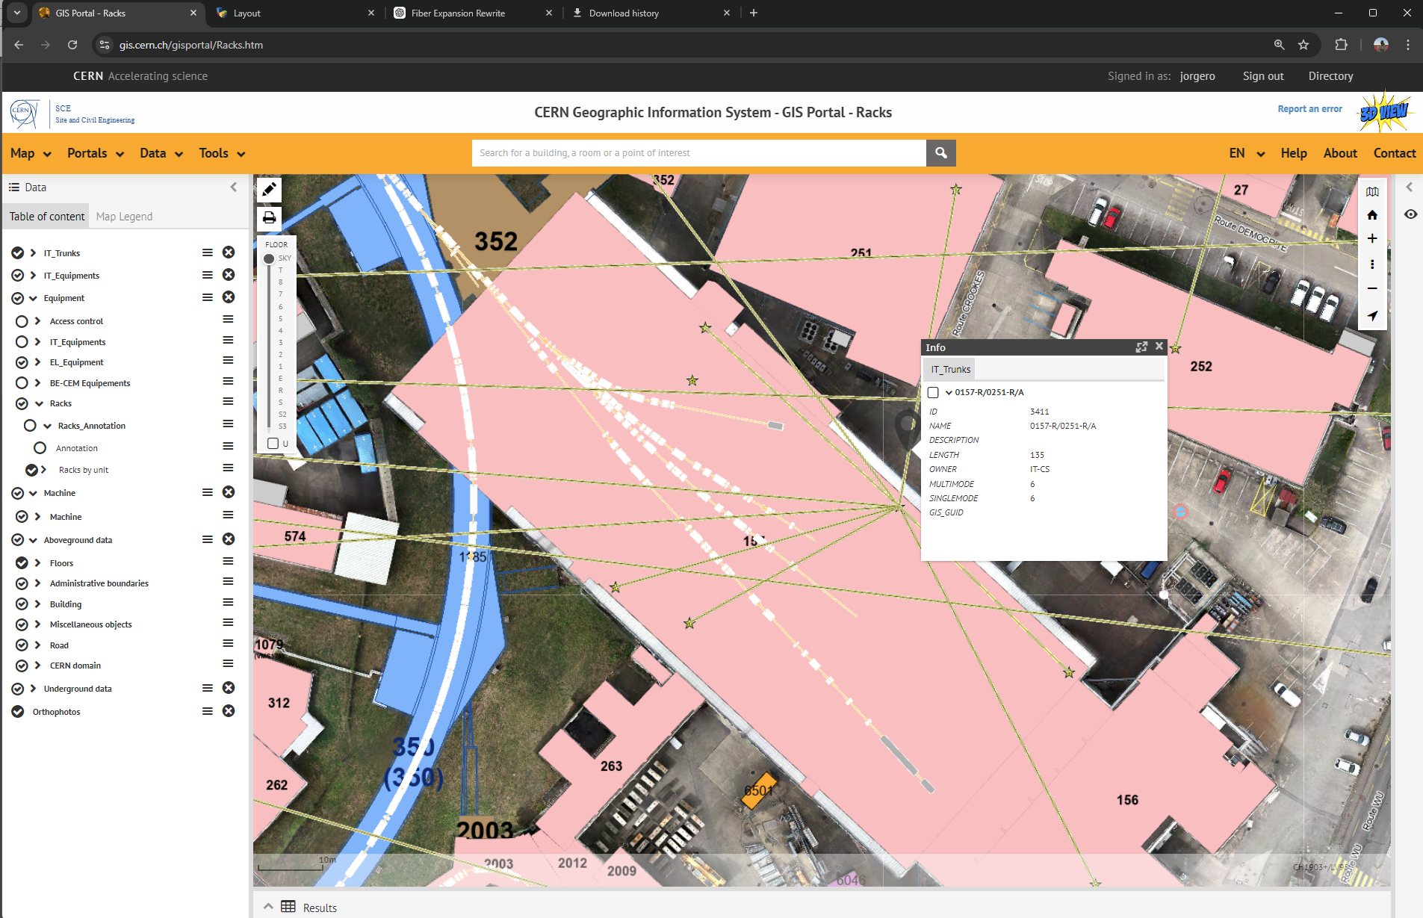
OFMS Evolution – Improve Integration at CERN
GIS cable representation
Existing GIS layer showing IT trunks:
  Only part of FO infrastructure (only cables used by IT and connected to IT Star Point).
  Information not reliable (obsolete cables included).
  Possible improvement: change source of information for OFMS database.
    Cables connected to any type of rack*.
    Extra data can be added to the information layer.
      *As long as rack registered in GIS.

Slide 33
Conclusions

Slide 34
Conclusions
The Optical Fibre Management System (OFMS) has proven to be a critical tool for efficiently managing CERN's extensive fibre optics infrastructure:
  It has significantly enhanced the EN-EL-FO working method by streamlining the processes of installation, maintenance, and consolidation, all while improving communication with contractors and CERN users.
The system's key contributions include:
    Centralization and Standardization: OFMS consolidates all fibre optics information into a single database, providing a standardized approach to managing installations and updates.
    Enhanced Traceability and Monitoring: CERN users now enjoy improved traceability of their fibre optic links, allowing for quicker installation preparation, fault diagnosis and replacement of components. This reduces downtime and ensures faster problem resolution.
    Integration with CERN Databases: Ongoing synchronization with other CERN systems, such as CSDB, further increases data accuracy and reduces registration redundancy.
    Future Developments: Open it to broader CERN user groups will make the system more accessible, providing even greater integration across CERN’s systems.

Slide 36
IT server implementation
IT technical infrastructure
TEST
DEV
PROD
Oracle CERN
Database Server
Oracle CERN
Database Server
Oracle CERN
Database Server
3 NETGEO DATABASES
NETGEO TEST Web Server
NETGEO DEV Web Server
Online Client
NETGEO PROD Web Server
NETGEO Online Web Server
WEB APPLICATION
4 NETGEO SERVERS
Local client
NETGEO2 Application server
PC APPLICATION
1 MAIN ACCESS SERVER
1 LICENSE SERVER
NETGEO2 Licence Server

Slide 37
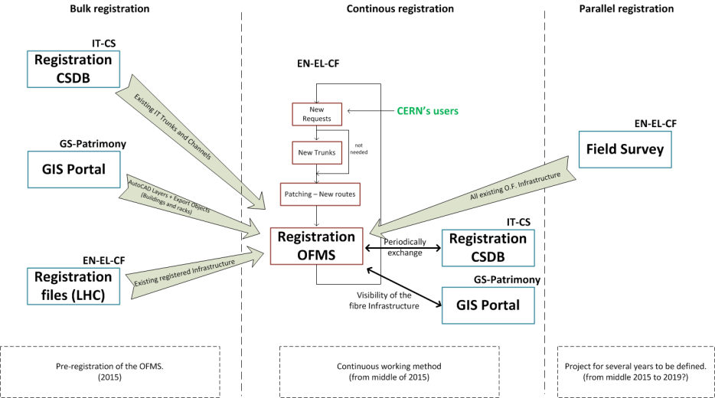
Data and registration

Slide 38





Increase integration with CERN databases
EAM
MTF
EDMS
GESMAR
LayoutDB
GIS
LANDB
NetGEO
DONE
PRIORITY
TO BE CONSIDERED

Slide 39

Future: SMARTGEO
NETGEO → SMARTGEO
  NetGEO to be fully redeveloped as a web-based application:
    Software accessible from any web browser in a bigger range of devices (phone, tables,…)
    Simplified deployment in user terminals.
    Compatibility with GEO Solutions (potentially interesting CERN user).
    Personalization of user interface and data access based on user type.

Slide 40
Intro: Overview of CERN FO infra

Slide 41

OFI Management
Links configuration, operation, consolidation, maintenance…
Full Management solution:
    Overview of the OFI.
    Fibre monitoring.
    Planning.
        All OFI information is centralized in one system.
        Allows greater level of analysis and granularity.

Slide 42

Management: Overview of the OFI
Data analysis based on OFMS:
    Allows better understanding of the volume of installations done/pending.
    Perform analysis based on areas, type of installation,…
    Link OFMS with other tools used in the section (Technical Panels,…).

Slide 43

Management: Consolidation Overview
OFMS implemented tools allow:
    Quick identification of links that require consolidation.
    Advance analysis of the Network.
    Consolidation data up to date.

