Slide 1

SuperKEKB RF Gun System and Operation Status
Rui Zhang (KEK ACCL-5, Injector Group)
2024.12.02. @CERN

Slide 2
Contents
Introduction of KEK, SuperKEKB & Linac injector
SuperKEKB RF gun system
  RF gun cavity
  Photocathode
  Laser system of RF gun
Recent achievements and 2024ab commissioning status
Summary and outlook

Slide 3



Self Introduction
Ph. D course: 2010.04-2013.12, Department of Physics and Astronomy, Shanghai Jiao Tong University (SJTU)
  Novel thermal management in solid-state laser
  Multi-function nonlinear laser
  Micro-nano optics
Post doctoral researcher: 2014.04-2016.03, Injector Group, ACCL Division V, KEK
  Development of combination technology for Yb:YAG thin disk laser
  Improvement of RF gun thin disk laser system for SuperKEKB
  Cryogenic laser experiment
Assistant professor: 2016.04-now, Injector Group, ACCL Division V, KEK
  Nd/Yb hybrid laser system for SuperKEKB RF gun
  Synchrotron radiation monitor
  Spatial and temporal reshaping for laser beam
  Improvement of photocathode quantum efficiency
  Fast laser abort system
Hobbies: Badminton, Volleyball, Travel, Origami, Anime, Bonsai, Horticulture…
Mt. Tsukuba
03-34

Slide 4


Location of KEK
Mt. Tsukuba
KEK Tokai Campus
KEK Tsukuba Campus
Ibaraki Prefecture
Tokyo
04-34

Slide 5

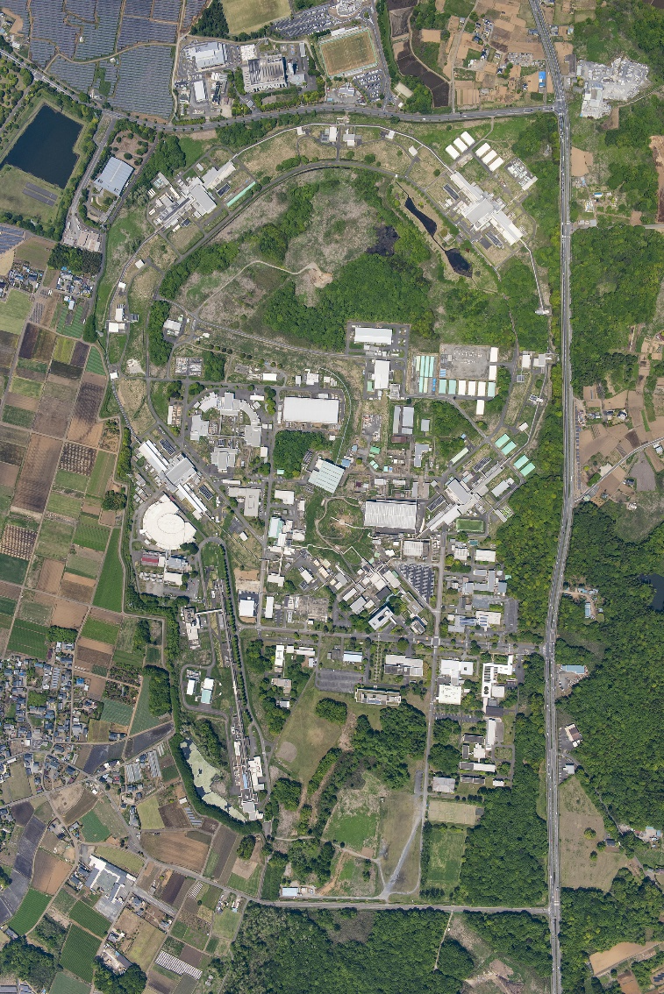
Tsukuba Campus of KEK
Nikko Hall
Tsukuba Hall
Mt. Tsukuba
PF-AR
Fuji Hall
PF
Oho Hall
DR
KEK Tsukuba Campus
Linac
J-arc
05-34

Slide 6
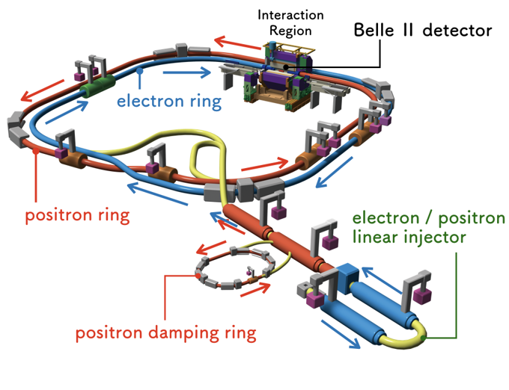
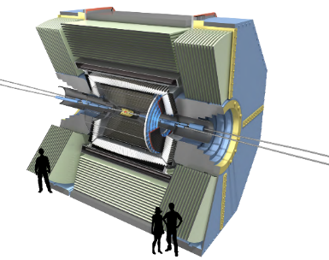
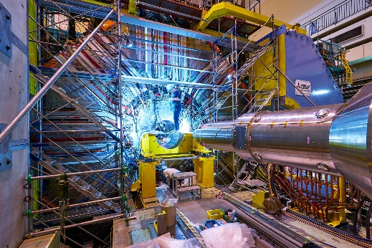
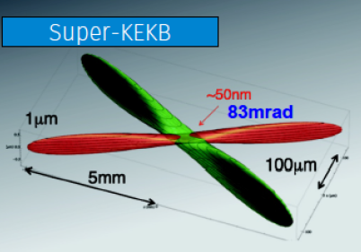
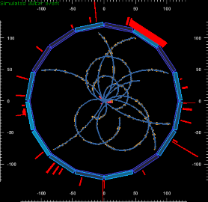

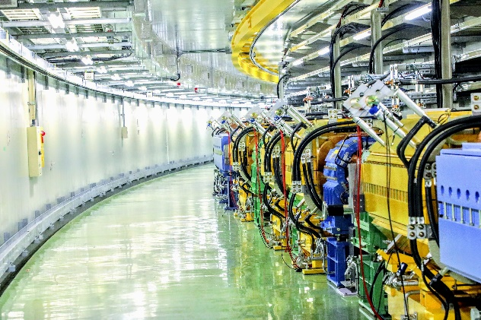
SuperKEKB Project
Upgrade of KEKB B-factory
High-luminosity electron-positron collider
Asymmetric-energy electron-positron double-ring collider
Main ring is composed of
  Low Energy Ring (LER)
  4.0 GeV Positron 3.6 A
  High Energy Ring (HER)
  7.0 GeV Electron 2.6 A
Positron damping ring
Design Luminosity: 8.0x10³⁵ cm⁻²s⁻¹
  40 times maximum luminosity of KEKB
  Twice beam current of KEKB
  Squeezed β_{y}* with nano-beam collision
Y. Funakoshi, IPAC2022, Bangkok, 2022.06
06-34

Slide 7
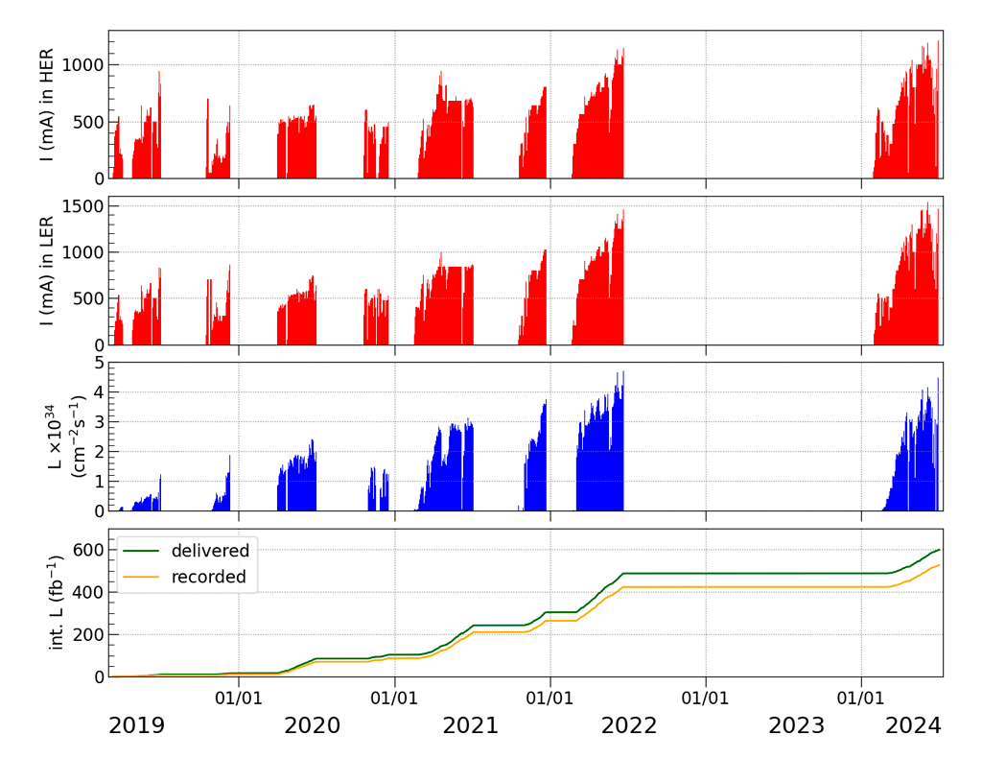
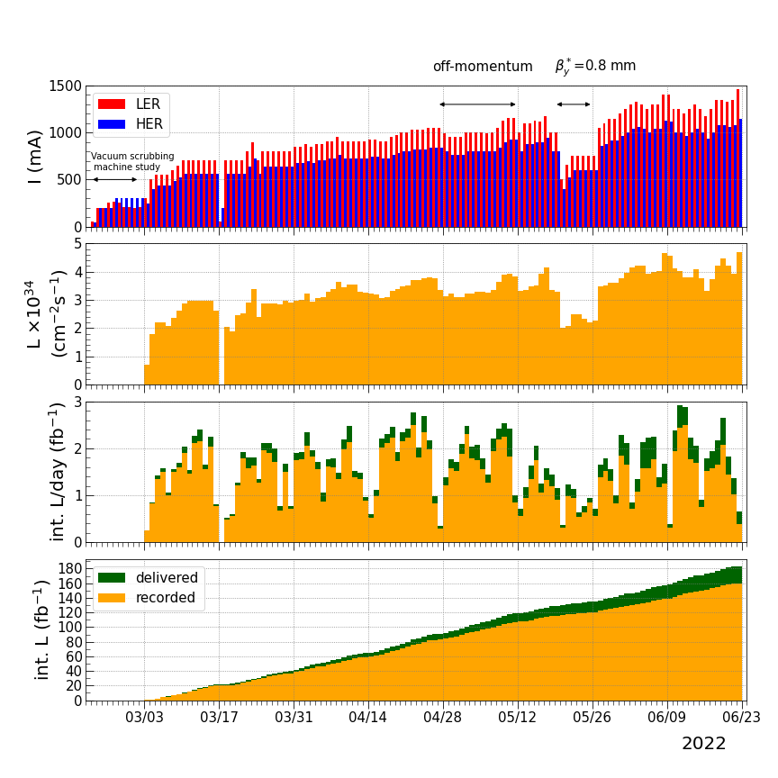
SuperKEKB Project
New luminosity world record in 2022: 4.71 x 10³⁴ (cm⁻²s⁻¹)
Tsukuba Hall
07-34

Slide 8

SuperKEKB Project
 | KEKB achieved |  | SuperKEKB 2022 June 22nd |  | SuperKEKB design
 | LER | HER | LER | HER | LER | HER
I_{beam} [A] | 1.637 | 1.188 | 1.363 | 1.118 | 3.6 | 2.6
Bunches Number | 1585 |  | 2249 |  | 2500
I_{bunch} [mA] | 1.033 | 0.7495 | 0.606 | 0.497 | 1.440 | 1.040
βy* [mm] | 5.9 | 5.9 | 1.0 | 1.0 | 0.27 | 0.30
ξy | 0.129 | 0.090 | 0.0398 | 0.0278 | 0.0881 | 0.0807
Luminosity [10³⁴cm⁻²s⁻¹] | 2.11 |  | 4.71 |  | 80
Integrated Luminosity [ab⁻¹] | 1.04 |  | 0.40 |  | 50
08-34

Slide 9
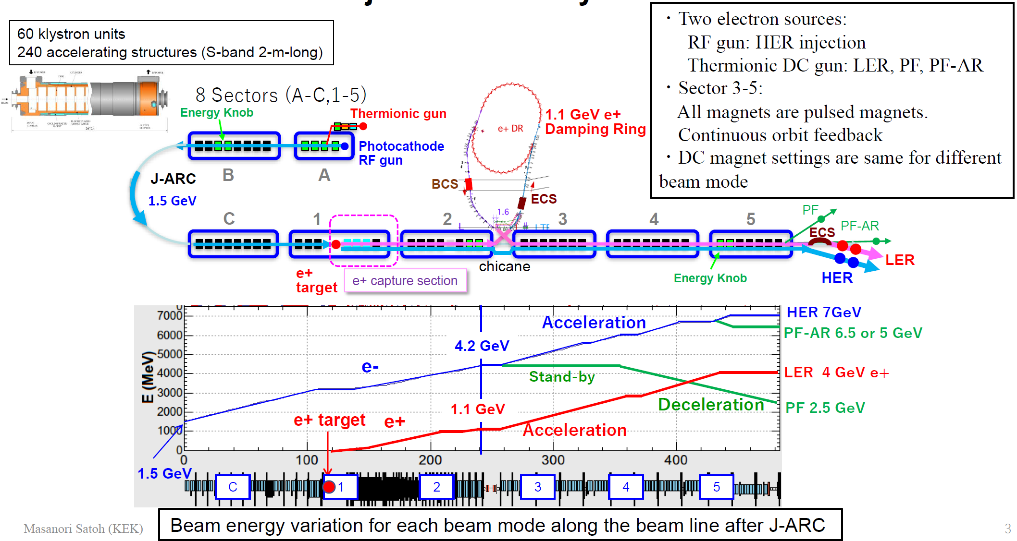
General Layout of SuperKEKB Linac
M. Satoh, the 26th KEKB Accelerator Review Committee, 2022.12.16
09-34

Slide 10
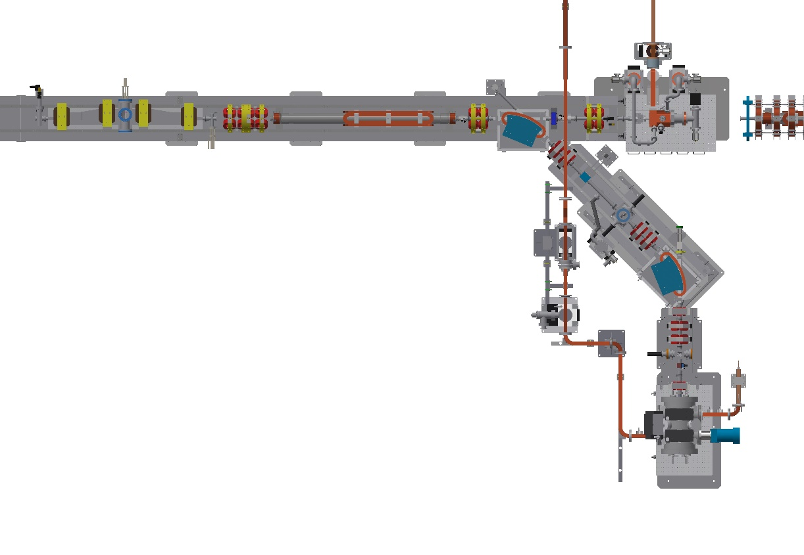
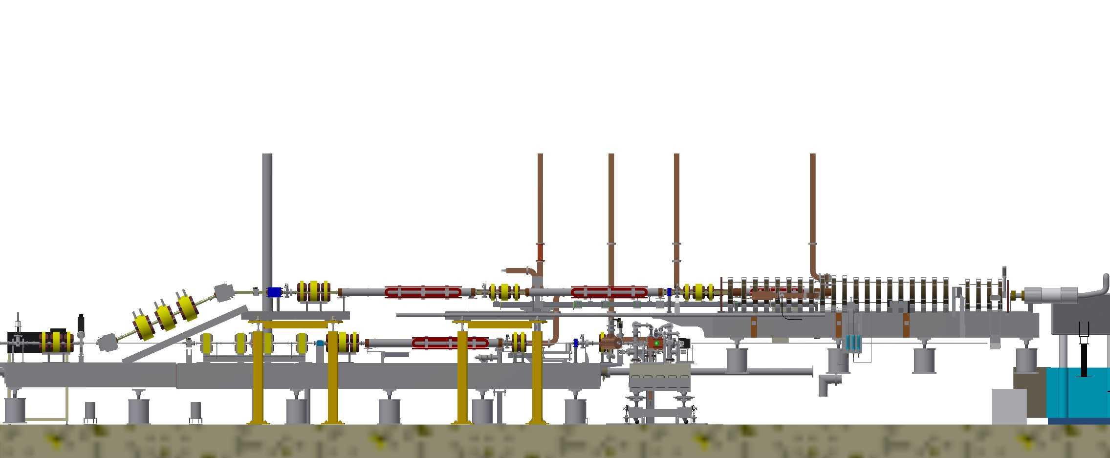
Electron Source Part of Linac
RF gun (GR_A1)
e⁻ : 0.1 - 5 nC (KBE for HER injection)
Primary RF gun
Top view
Thermionic DC e⁻ gun (GU_AT)
e⁻ beam for e⁺ production: 13 nC (KBP for positron generation)
e⁻ beam study: 1 nC (JBE)
PF injection: 0.1 - 0.3 nC (QFE)
PF-AR injection: 0.1 - 0.3 nC (ARE)
Pulse bends in 24º line
Pulse to pulse beam switching for RF e⁻ gun/thermionic e⁻ gun
RF gun (GR_AS)
Backup for HER injection (Under studying)
Side view
R. Zhang, the 120th B Factory Project Committee, 2021.10
10-34

Slide 11
SuperKEKB Requirements
 | Electron HER 7 GeV | Positron LER 4 GeV
Normalized Emittance | 40 / 20 [μm] | 100 / 15 [μm]
Energy Spread | 0.07% | 0.16%
Bunch Charge | 4.0 nC | 4.0 nC
A stable electron beam with high charge and low emittance is essential for SuperKEKB
11-34

Slide 12
SuperKEKB RF Gun
Requirements
4 nC electron charge generation capability
10 μm emittance preservation
Long term continuous operation
4 nC Beam Operation
Less space charge effect
  Longer pulse: 10 - 20 ps
Essential strong focusing field
  Preserves the low emittance from the RF gun
Stable long-time operation
  Lower electric field: < 100 MV/m
Side coupler or cut disk gun cavity structure is preferred
R. Zhang, the 23rd KEKB Accelerator Review Committee, 2019.07
12-34

Slide 13
S-band RF Gun System for SuperKEKB
RF gun cavity: strong focusing electric field & high acceleration efficiency
Quasi travelling wave side coupler (QTWSC): A1 primary RF gun
Cut disk travelling wave structure (CDTWS): A1 secondary RF gun
Photocathode: long lifetime & comparable high QE
Medium QE with long lifetime: 10⁻⁴ - 10⁻³ @266nm > 1 year
Metal composite: Ir₂Ce or Ir₇Ce₂
Laser: simple, stable, spatial & temporal reshaping
Laser active material pumped by laser diode directly
  Yb-fiber & Neodymium (Nd) doped crystal (Nd:YAG): A1 ground laser hut
  Yb-fiber & Ytterbium (Yb) doped crystal (Yb:YAG): A1 underground laser hut
Temporal and spatial reshaping for minimum energy spread and emittance
R. Zhang, the 23rd KEKB Accelerator Review Committee, 2019.07
13-34

Slide 14
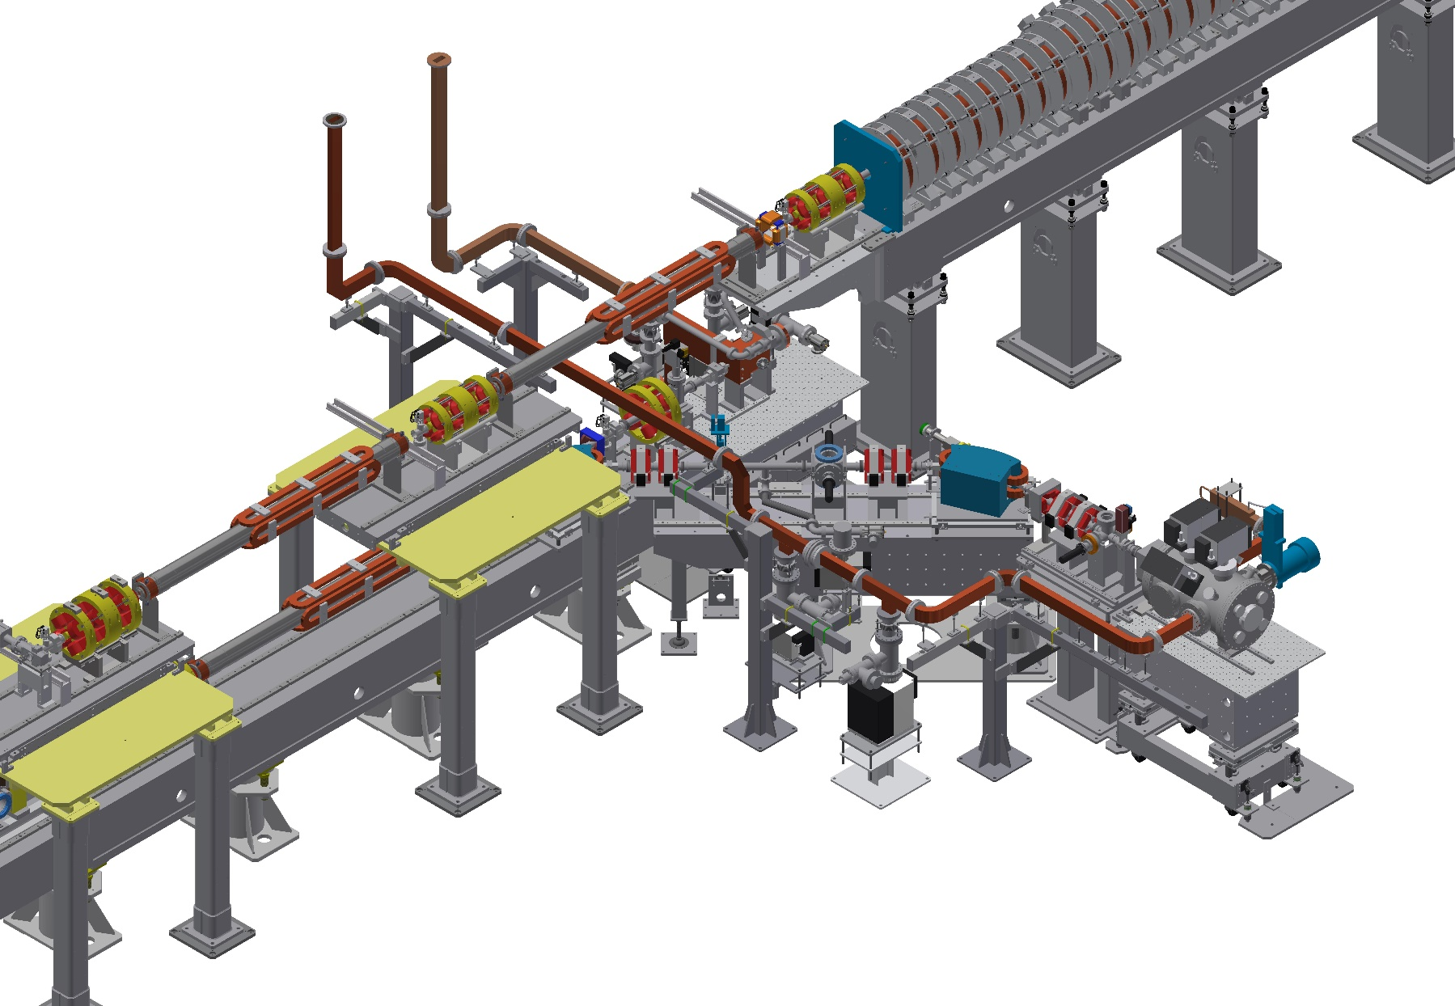
RF Gun in Linac A1 Section
14-34

Slide 15
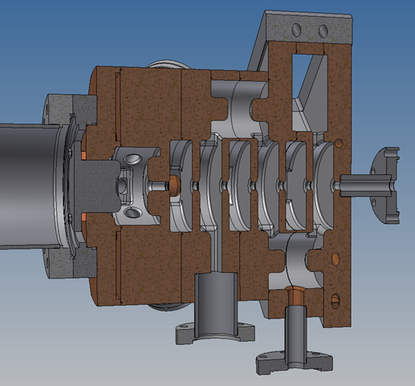
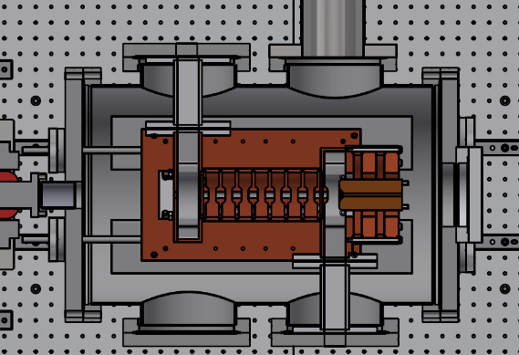
The 120th B Factory Project Committee
RF Gun in Linac A1 Section
A1 primary RF gun
QTWSC
In beam line
A1 primary RF gun
A1 secondary RF gun
A1 secondary RF gun
CDSTW
Perpendicular to the beam line
Under studying
M. Yoshida, LCG Meeting, 2021.10
15-34

Slide 16
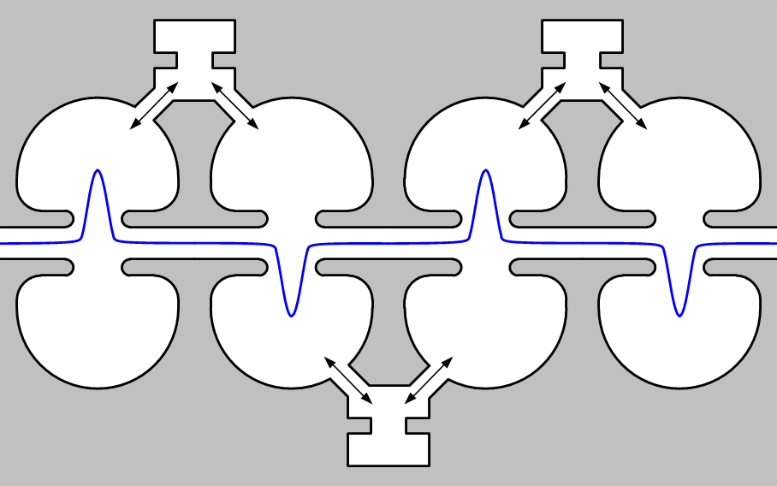
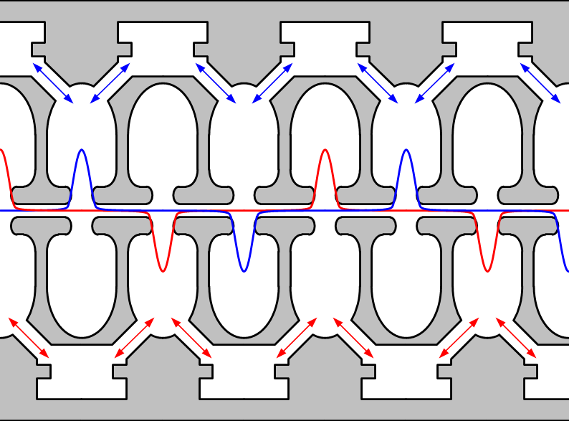
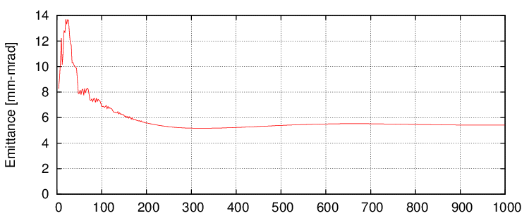
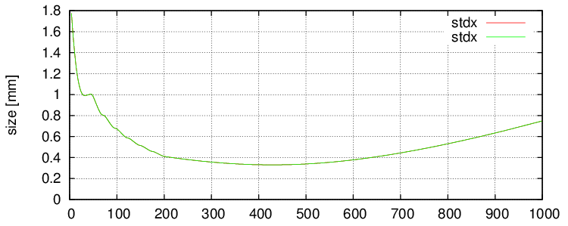
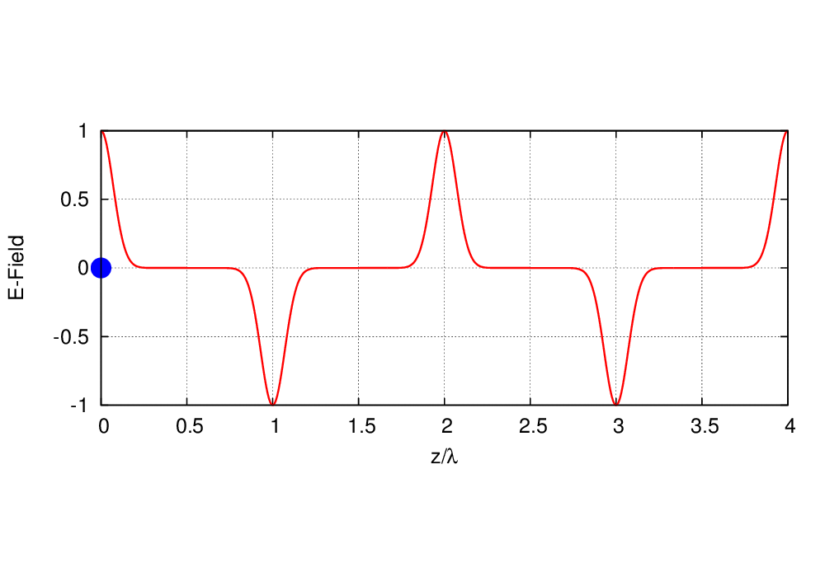
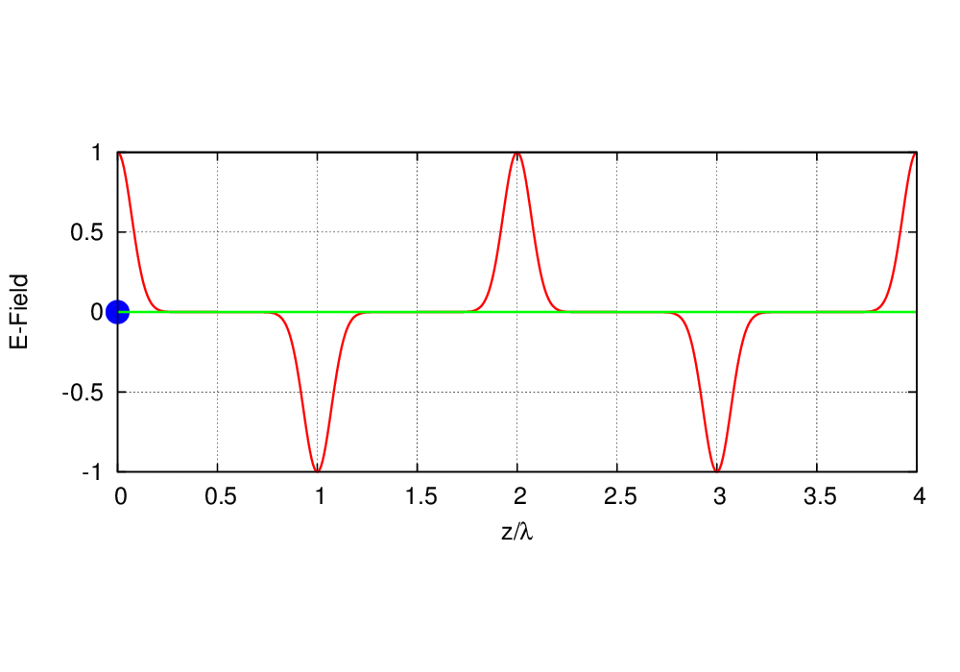
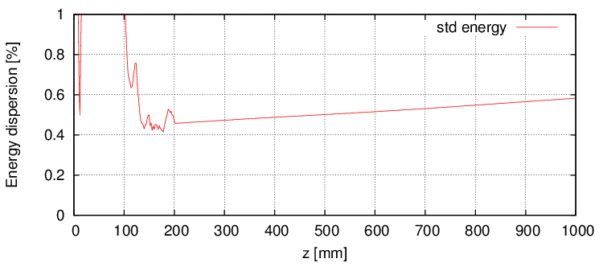
QTWSC RF Gun Design
Common SC RF Gun
QTWSC RF Gun
Properties of QTWSC (5 nC case)
Gun exit
M. Yoshida, the 26th KEKB Accelerator Review Committee, 2022.12
16-34

Slide 17
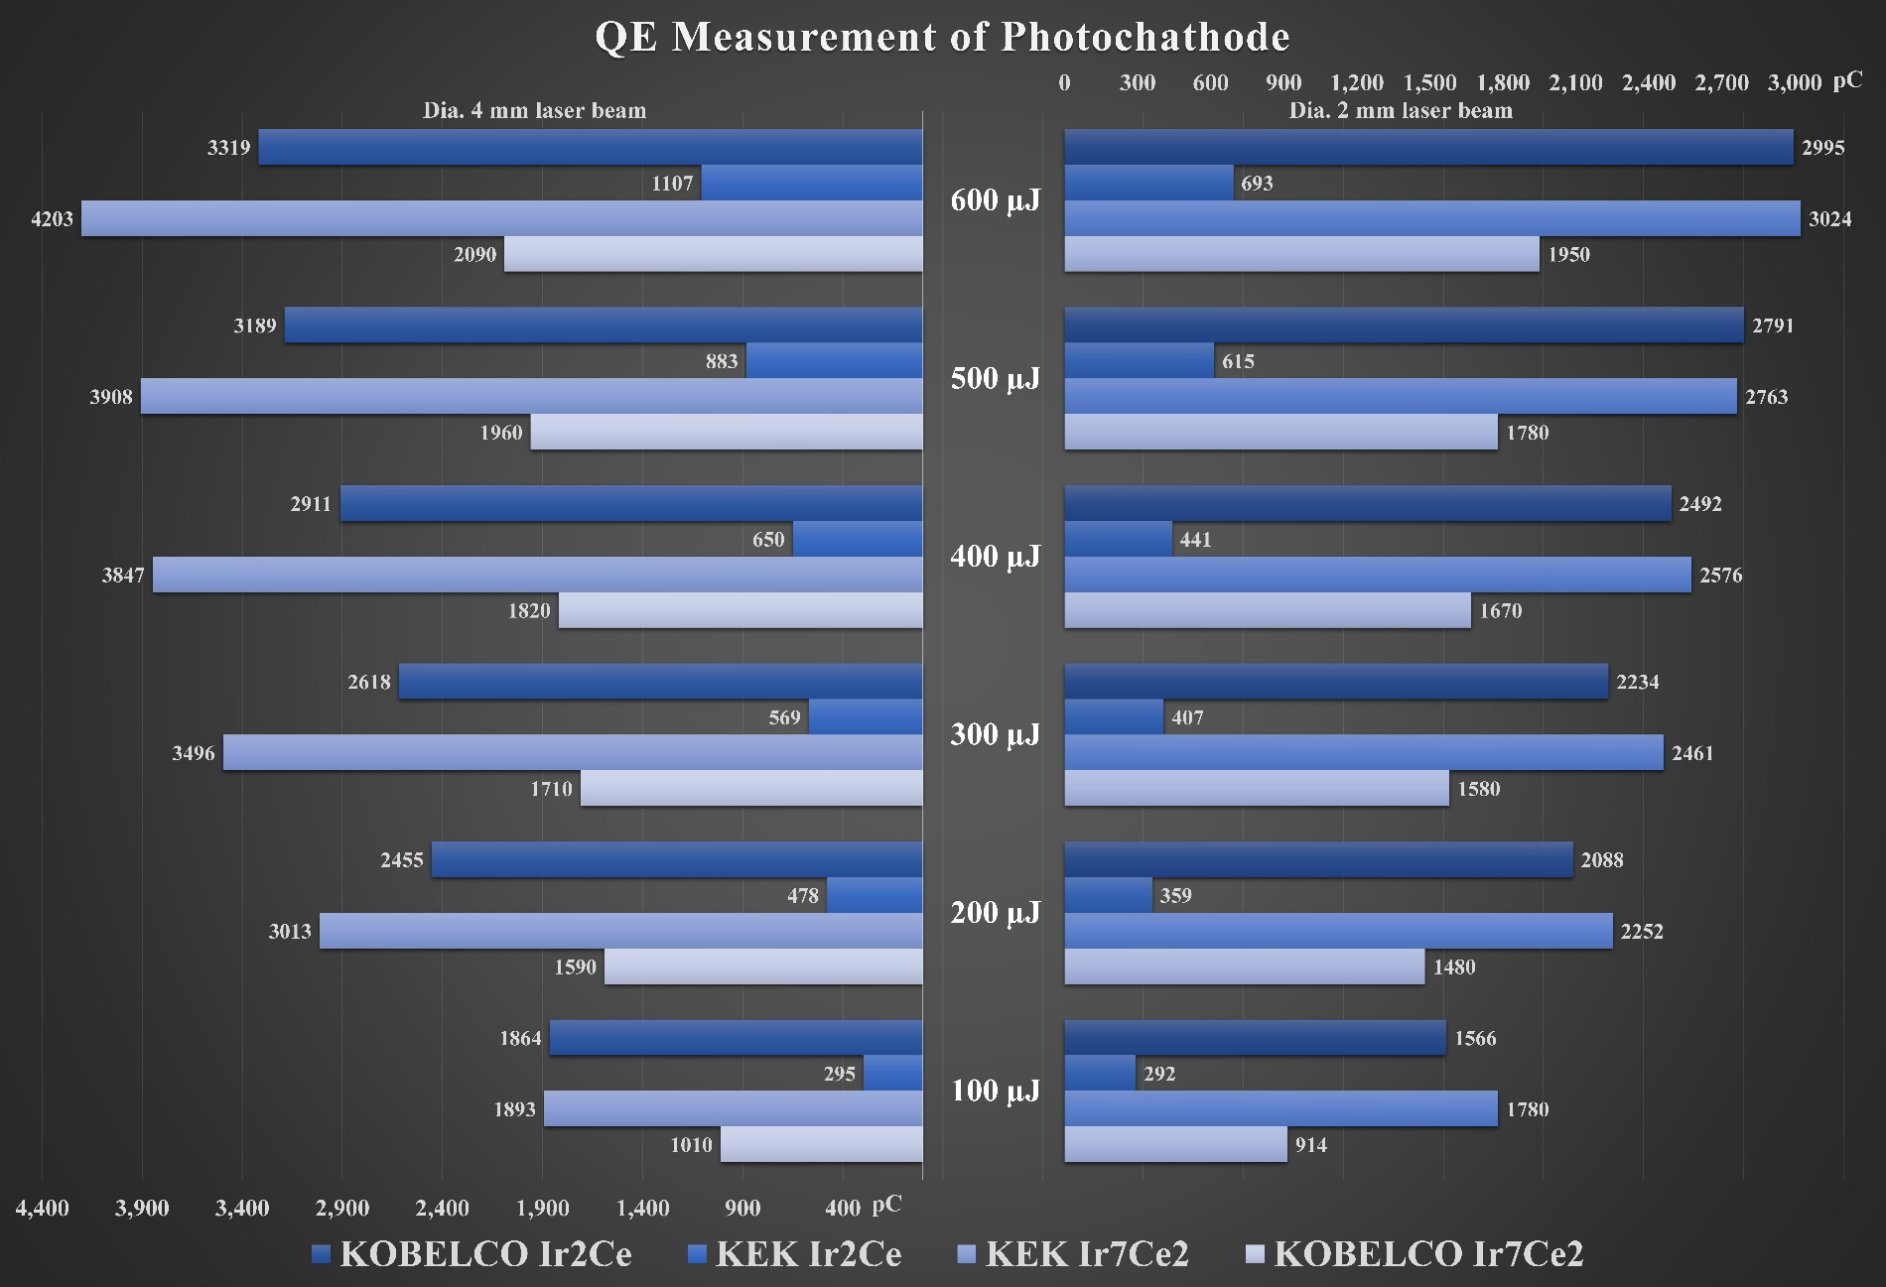
Photocathode for RF Gun
Iridium Cerium Alloy Photocathode
R. Zhang, Linac Meeting, 2021.01
17-34

Slide 18
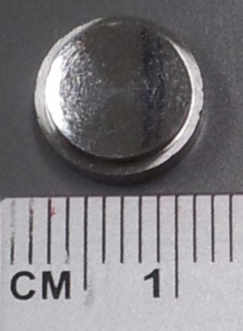
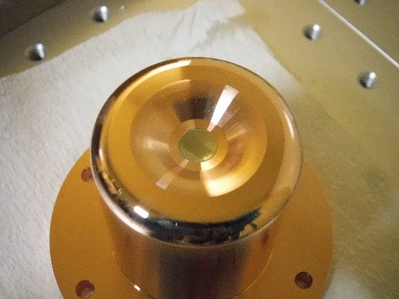
Photocathode for RF Gun
Iridium Cerium Alloy Photocathode
Characteristics of photocathodes
Quantum efficiency ranking:
KEK Ir₇Ce₂ > KOBELCO Ir₂Ce >
KOBELCO Ir₇Ce₂ > KEK Ir₂Ce
Sparking probability:
KEK Ir₇Ce₂ < KOBELCO Ir₂Ce
The adoption of KEK Ir₇Ce₂ began with the 2021ab commissioning phase
Achievable bigger size (>12 mm)
R. Zhang, Linac Meeting, 2021.01
18-34

Slide 19
Laser System for RF Gun
Yb-Fiber and Nd:YAG Hybrid Laser System
Fiber
Oscillators (114 MHz)
Menlo Orange 1 (1030 &1064 nm)
MEMS Switch
3 In 1 Out
Menlo Orange 2 (1030 & 1064 nm)
→
Upstream
Home made ANDi type 1064 nm
Fiber
Amplifiers (10 MHz)
Yb Single Mode Fiber
Amplifier 1
Semiconductor Optics Amplifier (SOA)
114 MHz → 10 MHz
Yb Single Mode Fiber
Amplifier 2
Yb Single Mode Fiber
Amplifier 3
→
→
→
Nd:YAG Rod Laser
Amplifiers (1-25 Hz)
EO Pulse Picker
10 MHz → 1- 50 Hz
Double bunch
Beam splitter 50:50
→
1st Nd:YAG Laser Line with 5 Stages Rod Amplifiers (High power 5th stage)
→
2nd Nd:YAG Laser Line with 5 Stages Rod Amplifiers (High power 5th stage) with delay line
Wavelength Conversion & Spatial Reshaping
YCOB in 1st Laser Line 1064 nm → 532 nm
BBO in 2nd Laser Line 1064 nm → 532 nm
Beam Polarizer
Combination for Two Laser Lines
Beam Polarizer
Division for Two Laser lines
BBO in 1st Laser Line 532 nm → 266 nm → DOE
BBO in 2nd Laser Line 532 nm → 266 nm → DOE
→
→
Downstream
→
→
Transporting Line for
Two Lasers (11 m long)
Ground Laser Hut
→ Tunnel RF Gun Box
→
RF Gun
Injection From Two Windows
19-34
R. Zhang, the 23rd KEKB Accelerator Review Committee, 2019.07

Slide 20
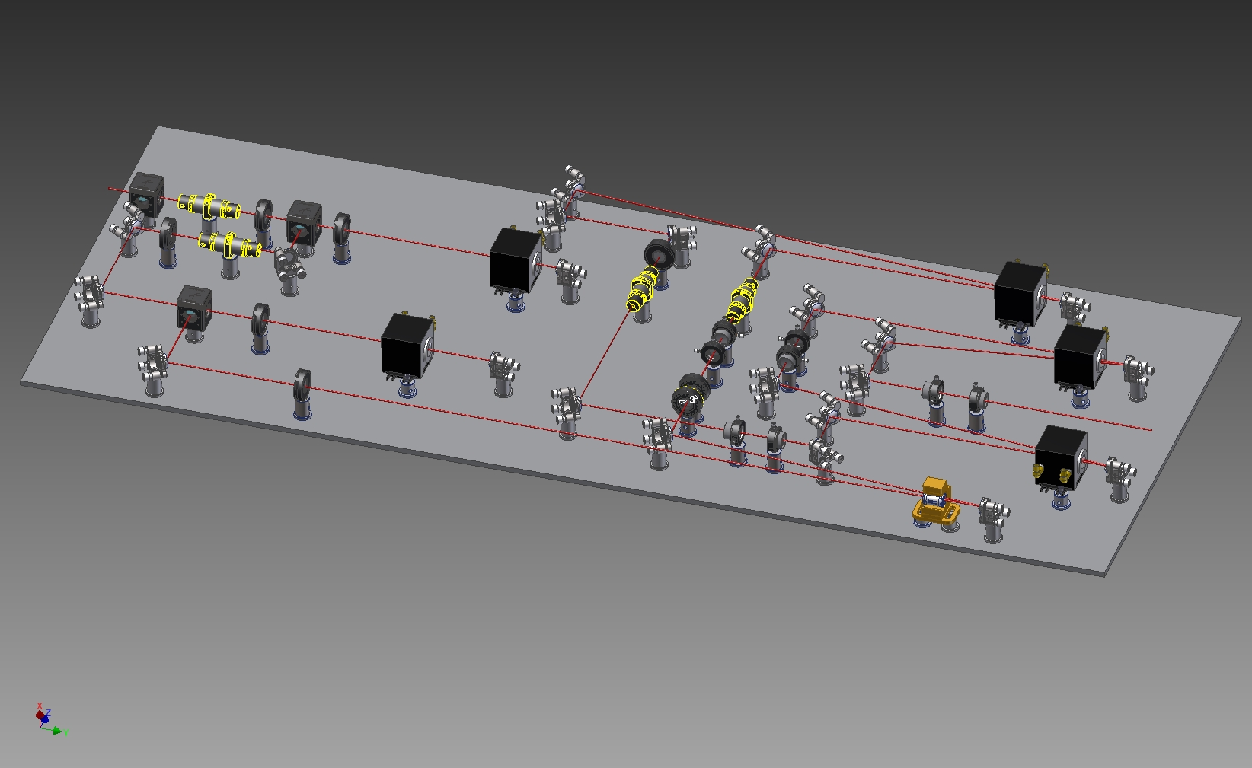
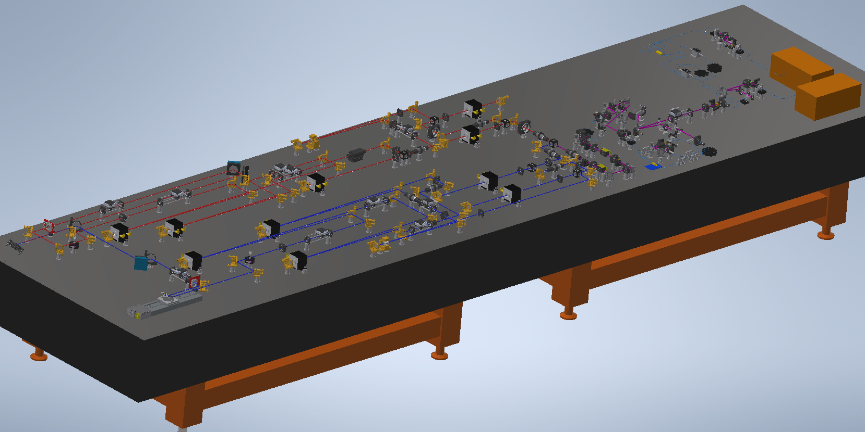
Laser System for RF Gun
Yb-Fiber and Nd:YAG Hybrid Laser System
Laser from fiber stage
1st Nd:YAG rod amplifier stage
3rd stage
①
2nd stage
③
5th stage
②
⑤
Pockels cell
④
To BBO for green laser
4th stage
R. Zhang, the 23rd KEKB Accelerator Review Committee, 2019.07
20-34

Slide 21
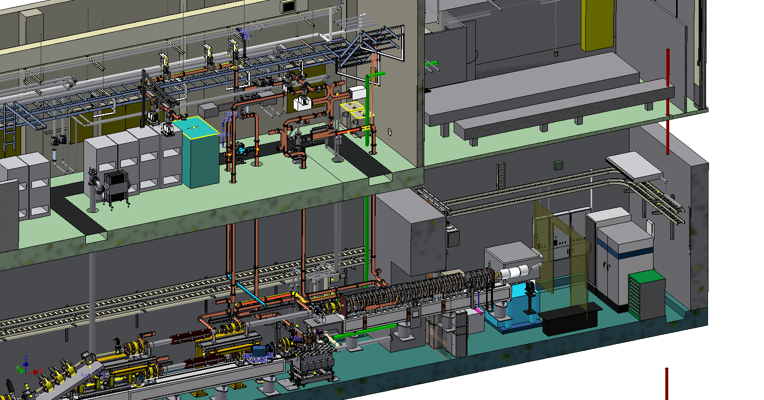
Laser System for RF Gun
Yb-Fiber and Nd:YAG Hybrid Laser System
Laser Transporting Line (LT)
A1 Ground Laser Hut
Green Lasers
Klystron A1 Gallery
1st Laser Line
2nd Laser Line
GS_A1 Room
LT
Thermionic Gun
Tunnel A1 Part
24º Line
0º RF Gun
A1 Chicane
R. Zhang, the 9th SuperKEKB Long-term Operation Plan Meeting, 2021.10
21-34

Slide 22
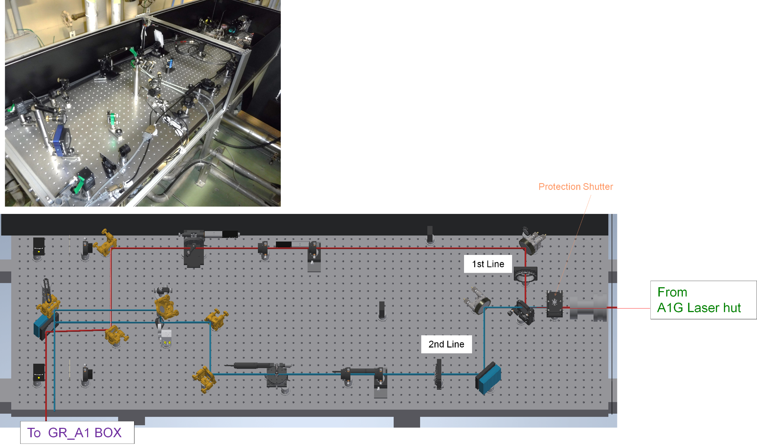
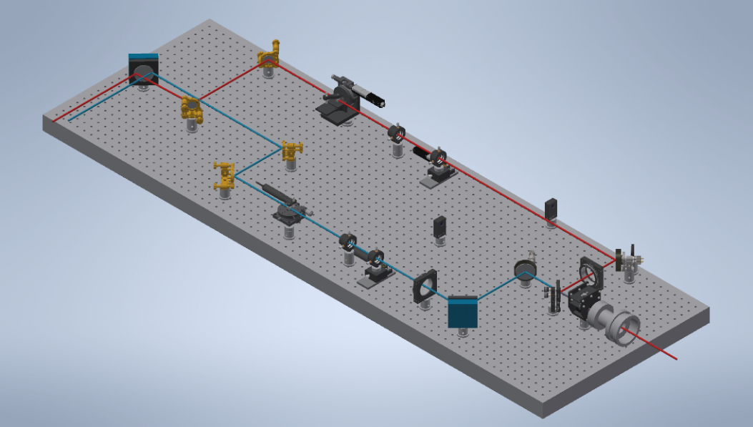
Laser System for RF Gun
Yb-Fiber and Nd:YAG Hybrid Laser System
Position sensor
Piezo mirror mount
FHG
Piezo mirror mount
Position sensor
Injection shutter
FHG
R. Zhang, the 9th SuperKEKB Long-term Operation Plan Meeting, 2021.10
22-34

Slide 23
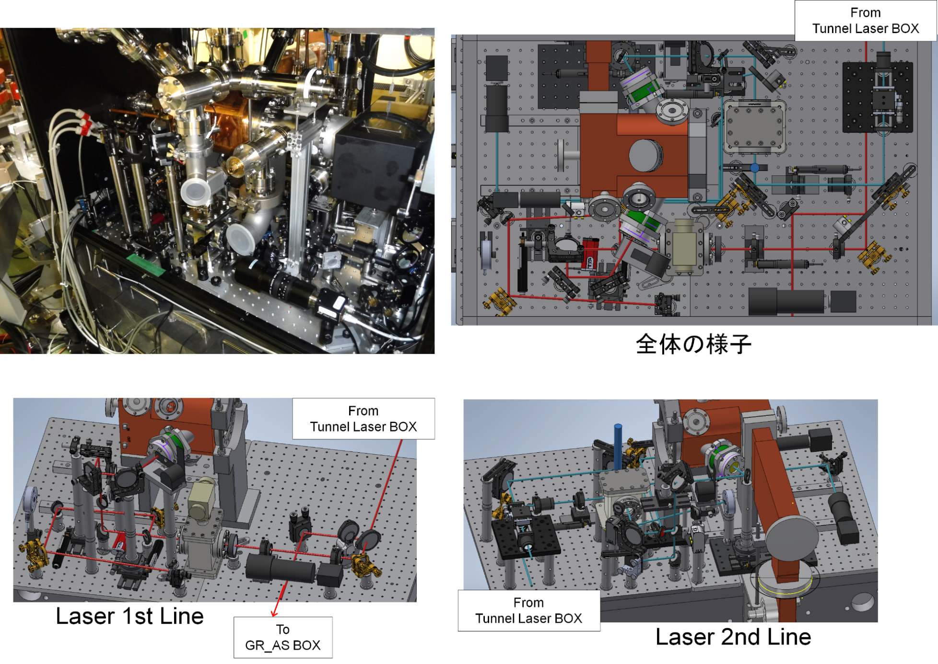
Laser System for RF Gun
Yb-Fiber and Nd:YAG Hybrid Laser System
R. Zhang, the 9th SuperKEKB Long-term Operation Plan Meeting, 2021.10
23-34

Slide 24
Laser System for RF Gun
Two Laser Beams Incidence Mode for Better Beam Quality
Simple illustration for 2 lasers incidence (out of ratio)
A1 ground laser hut
Tunnel optics table
90º RF gun
2nd line
BBO
60º injection
Delay line
Flip mirror
e⁻ beam
HWP
BBO
0º RF gun
1st line
Polarizer
11 m long transporting line
60º injection
HWP
HWP
Polarizer
BBO
Laser with vertical polarization, laser with horizontal polarization, HWP: half wave plate
R. Zhang, the 23rd KEKB Accelerator Review Committee, 2019.07
24-34

Slide 25
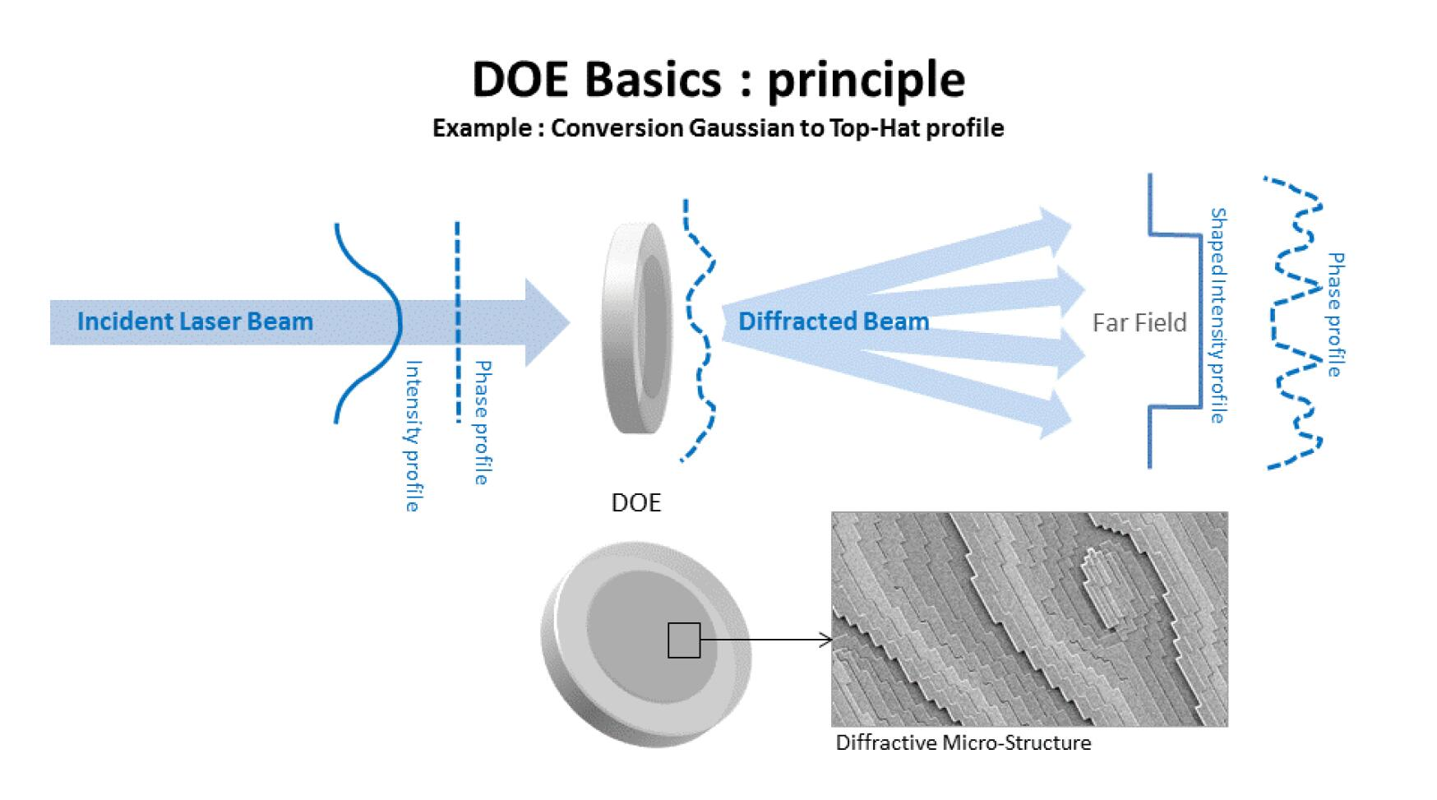
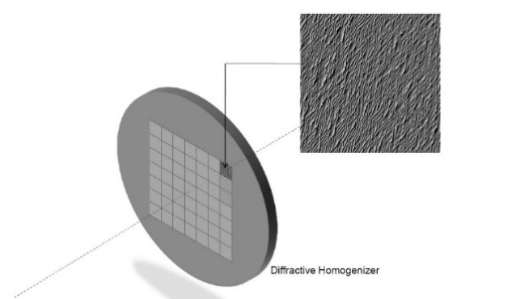
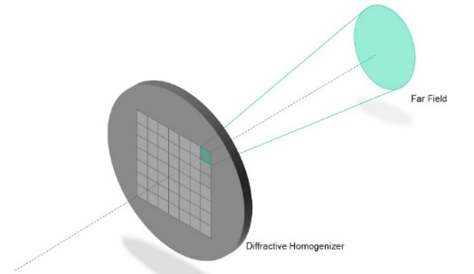
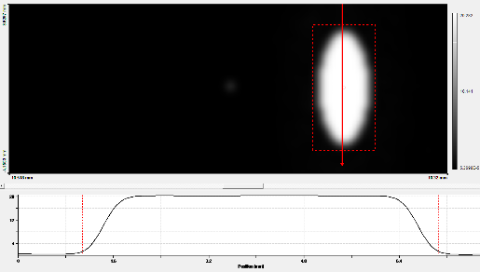
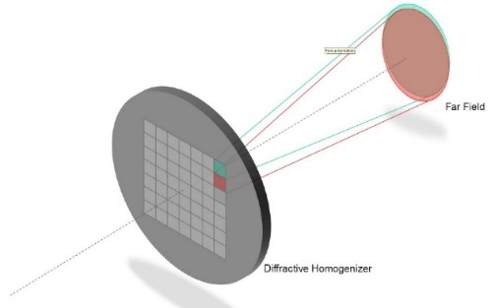
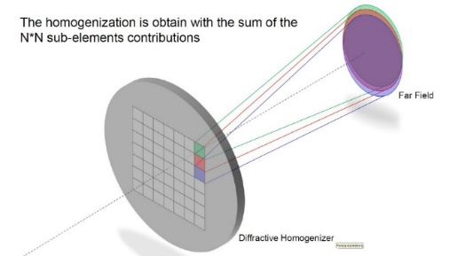
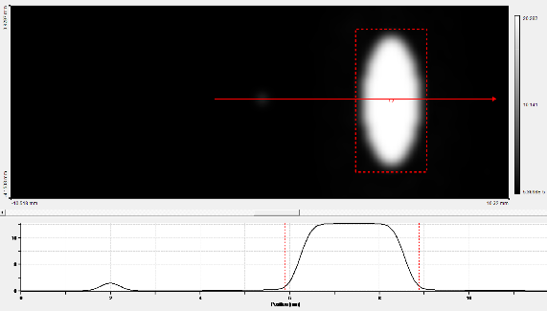
Laser System for RF Gun
Spatial Reshaping for Lower Emittance
Diffractive Optical Element for producing high-quality electron beams
Principle: Diffraction optics by lens and micro-configuration
Desired intensity distribution can be realized (phase coding)
World’s first application of a DOE in the UV laser section
6mm
3mm
R. Zhang, the 9th SuperKEKB Long-term Operation Plan Meeting, 2021.10
25-34

Slide 26
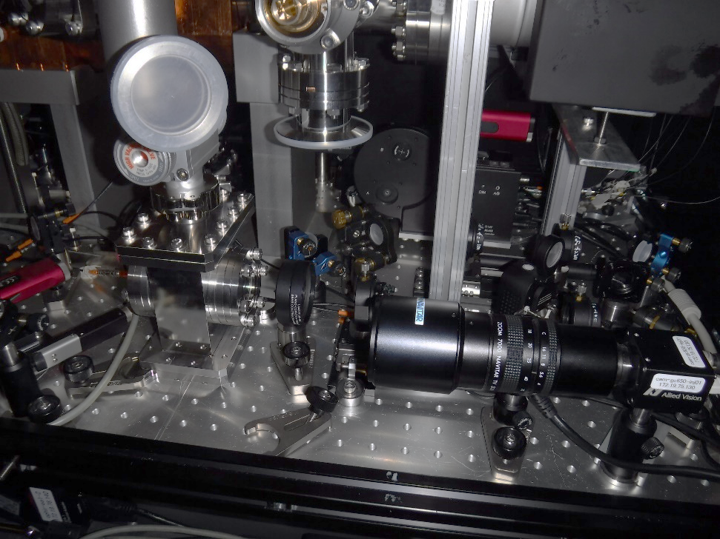
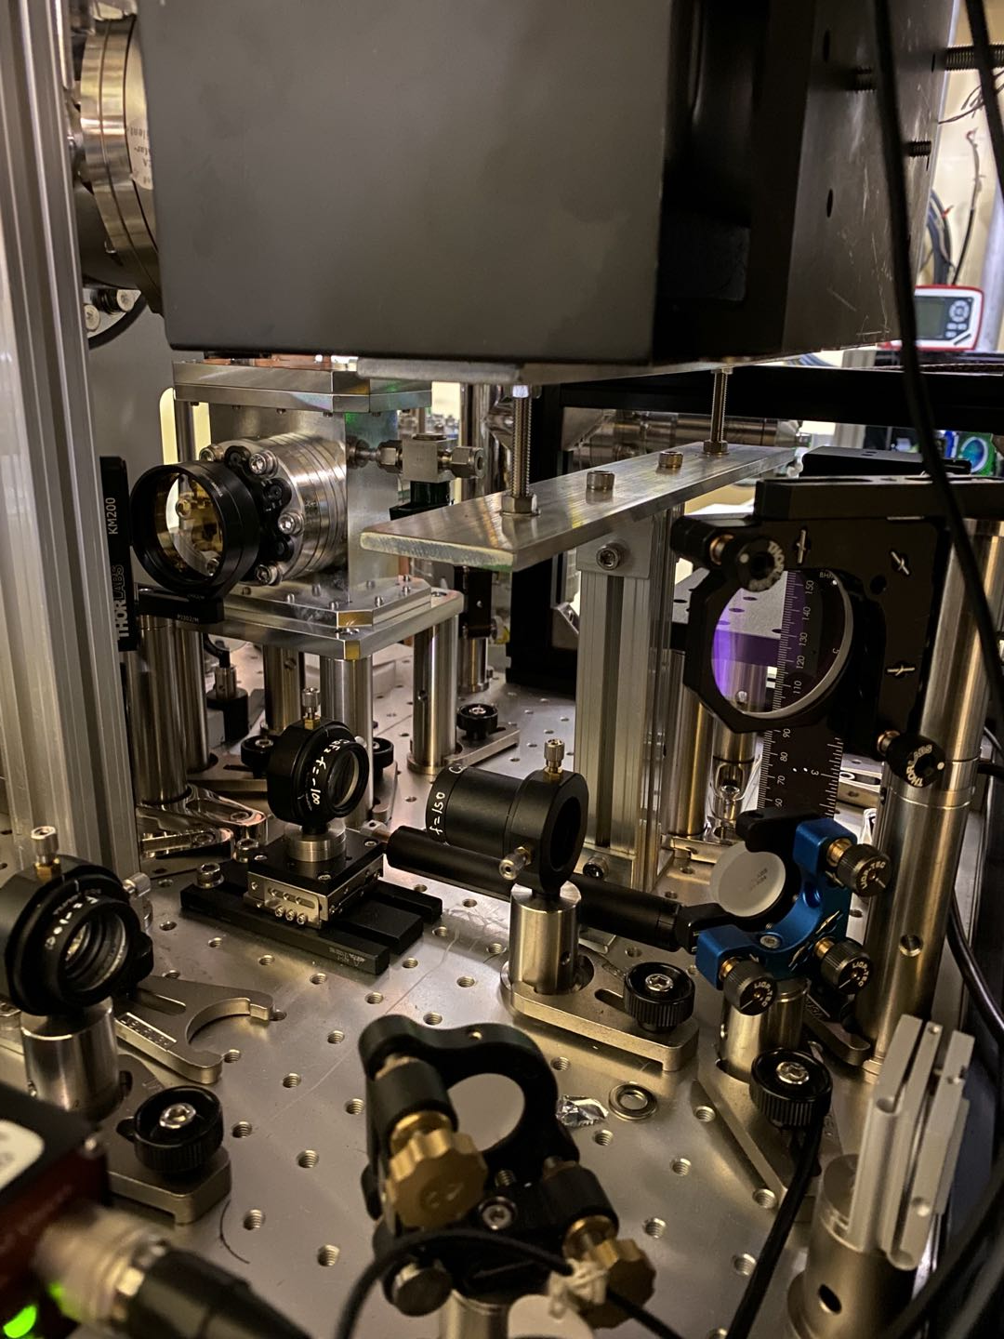
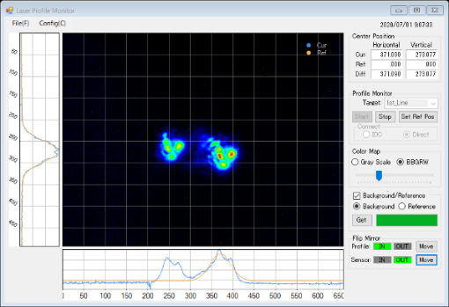
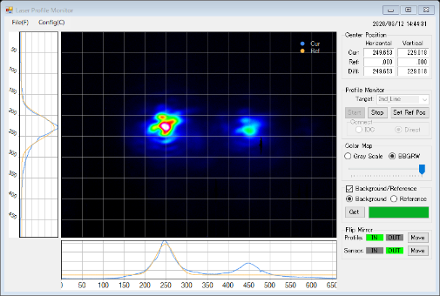
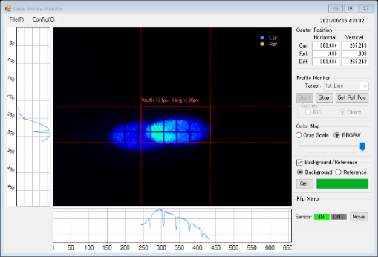
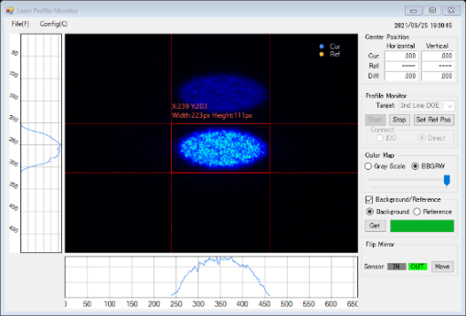
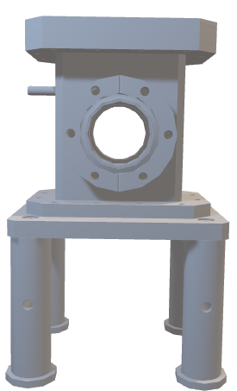
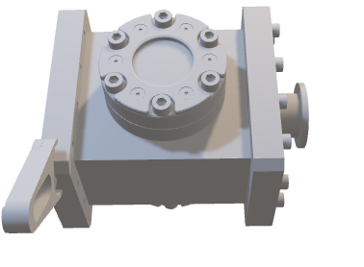
Laser System for RF Gun
Spatial Reshaping for Lower Emittance
Application of DOE in the 1st laser line since 2020c and in the 2nd laser line since 2021c
Elliptical flat-top spatial distribution on the photocathode surface (LA: 6 mm, SA: 3 mm) for generating low-emittance electrons and preventing RF gun discharge
1st laser before DOE
2nd laser before DOE
1st laser after DOE
2nd laser after DOE
R. Zhang, the 9th SuperKEKB Long-term Operation Plan Meeting, 2021.10
R. Zhang, IPAC2022 Bangkok, 2022.06
26-34

Slide 27
2021c Operation Status & Achievements
Laser Pointing Stability
R. Zhang, N. Toyotomi (Mitsubishi SC), the 120th B Factory Project Committee, 2021.10
27-34

Slide 28
2021c Operation Status & Achievements
Laser Pointing Stability
A1 Ground Laser Hut
Tunnel Optics Table
Piezo mirror mount
Position sensor
Position sensor
R. Zhang, N. Toyotomi (Mitsubishi SC), the 120th B Factory Project Committee, 2021.10
28-34

Slide 29
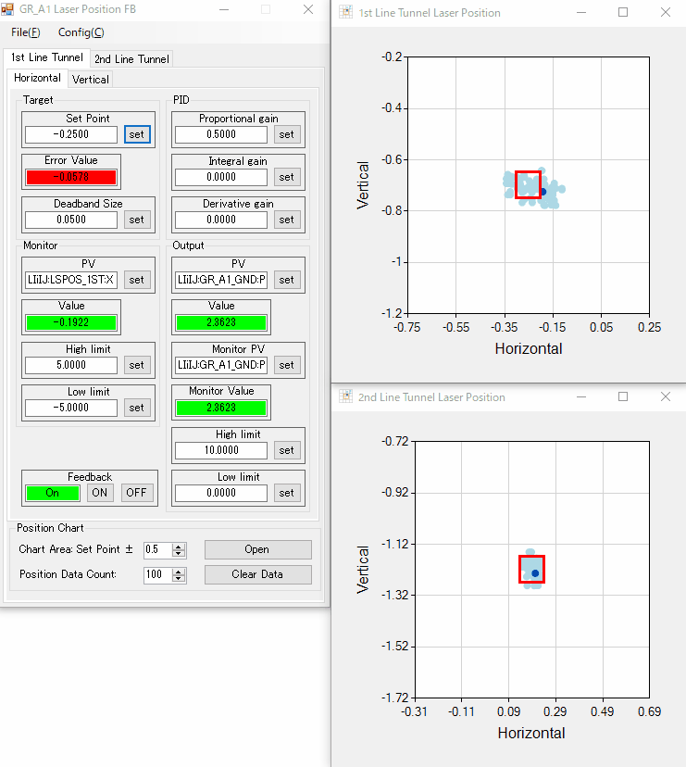
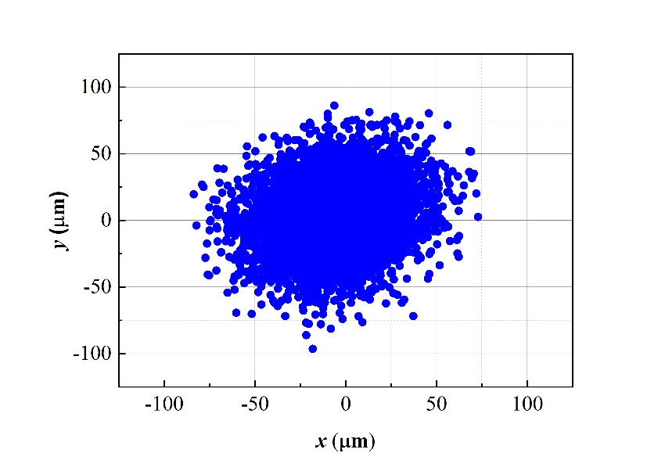
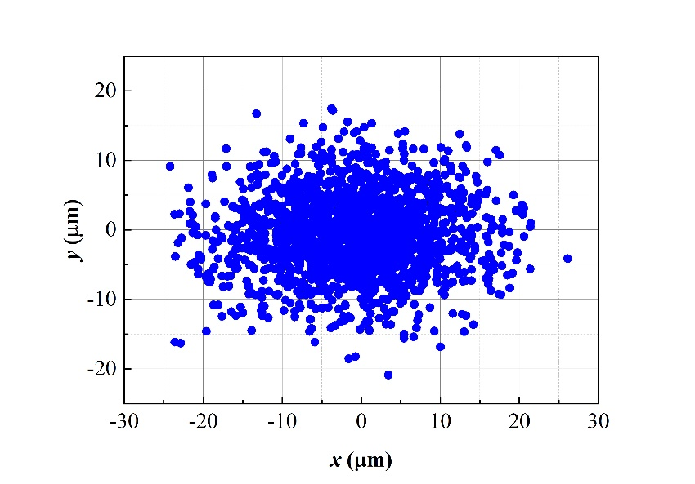
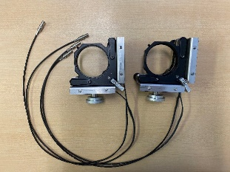


2021c Operation Status & Achievements
Better Laser Pointing Stability
Laser position feedback system
Laser pointing stability at virtual photocathode
Measured in 2019.06 without DOE & laser position feedback
H 2σ: 48.04±0.51 μm
V 2σ: 46.08±0.69 μm
Measured in 2021.06 with DOE & laser position feedback
H 2σ: 24.30±3.06 μm V 2σ: 10.08±0.46 μm
R. Zhang, N. Toyotomi (Mitsubishi SC), the 120th B Factory Project Committee, 2021.10; IPAC2022 Bangkok, 2022.06
29-34

Slide 30







2022ab Operation Status & Achievements
Best Emittance Record for the SuperKEKB Commissioning
Wire scanner @ B-sector
Wire scanner @ B-sector
Two lasers incidence mode
2 nC from the RF gun
${γε}_{x}=8.574±1.131 mm∙mrad$
${γε}_{y}=8.890±1.215 mm∙mrad$
The best record so far
Wire scanner @ BT
Wire scanner @ BT
${γε}_{x}=14.672±7.795 mm∙mrad$
${γε}_{y}=12.027±1.934 mm∙mrad$
Best record
30-34

Slide 31

2024c Operation Status & Achievements
Stable and Continuous RF-gun Injection for HER
HER e⁻ beam injection
Stable and continuous e⁻ beam operation for injection
  2 nC 25 Hz double bunch
Comparable higher injection efficiency in 2024c commissioning
No trend of photocathode QE degradation
Reliable laser system and feedback system
  Position feedback
  Laser pulse energy feedback
  RF phase feedback
Stable 4-ring simultaneous injection
Electron beam current
HER injection efficiency
Electron charge @ injection point
HER injection background
31-34

Slide 32

2024c Operation Status & Achievements
Stable and Continuous RF-gun Injection for HER
HER e⁻ beam injection
Stable and continuous e⁻ beam operation for injection
  2 nC 25 Hz double bunch
Comparable higher injection efficiency in 2024c commissioning
No trend of photocathode QE degradation
Reliable laser system and feedback system
  Position feedback
  Laser pulse energy feedback
  RF phase feedback
Stable 4-ring simultaneous injection
32-34

Slide 33


Future Operation Study
3 nC and 4 nC Electron Beam Study for Future Commissioning
3 nC 2-Bunch Beam
Emittance Status at B-sector*
 | 3 nC | 3 nC (2-bunch) |  | 4 nC
εx (μm) | 23.196 ± 4.325 | 32.454 ± 4.285 | 17.191± 2.875 | 39.816 ± 5.749
εy (μm) | 16.068 ± 2.431 | 30.914 ± 5.290 | 29.902 ± 5.711 | 25.983 ± 7.894
* B sector wire scanner is the nearest one after the RF-gun
New RF gun cavity will be installed in July 2025
  Better vacuum level
  Lower emittance for 3 nC and 4 nC beam
Yb:YAG laser system with temporal reshaping for electron beams with lower emittance and energy spread
New injection pattern investigation for higher charge HER injection (7 bunch injection)
4 nC Beam
33-34

Slide 34
Summary & Outlook
The SuperKEKB RF-gun system is performing well in the current commissioning
An upgraded laser system is being used to generate a 4 nC electron beam for the upcoming commissioning
A new laser system with temporal reshaping will be implemented to generate a high-charge electron beam with superior quality
A new injection pattern is currently under investigation
THANKS
34-34

Slide 37





LONG-TERM OPERATION PLAN of LASER SYSTEM for RF GUN
Yb:YAG Disk Laser and Nd:YAG Rod Laser
Yb:YAG thin disk laser
Nd:YAG rod laser
Yb:YAG disk laser head
Nd:YAG rod length: 80~95 mm
Nd:YAG rod laser amplifier module
Yb:YAG disk thickness: 1 mm
Good thermal management and modern laser design
Necessary multi-pass for amplification
Used in Phase I
Poor stability and complex adjustment
Not suitable for accelerator long term operation
Mediocre thermal management
Single or double-pass for efficient amplification
Used in Phase II and III
Good stability
Simple adjustment and fast recovery during trouble case
12-27

Slide 38

Partial Reflection Mirror
S2: AR@260nm R<0.2%
Rear surface reflected laser → ghost beam
Partially reflected laser for monitoring
Transmitted UV laser
Input UV laser
Transmitted UV laser
S1: PR@260nm R=5%

Slide 39



Gaussian Beam v.s. Flat-top Beam
Intensity (a.u)
Beam Size
Beam Size

Slide 40


LONG-TERM OPERATION PLAN of LASER SYSTEM for RF GUN
Route B: New Ytterbium-doped YAG (Yb:YAG) laser system
Yb:YAG thin disk laser
Design layout of Yb:YAG rod laser system
Good thermal management
Needs several pass for amplification
Used in Phase I
Poor stability
Complex adjustment
Not suitable for accelerator operation
thickness: 1 mm
Nd:YAG rod laser
Mediocre thermal management
One or two pass for efficient amplification
Used in Phase II and III
Good stability
Simple adjustment and fast recovery
length: 80~95 mm
length: 20 mm
28-32

Slide 41

LONG-TERM OPERATION PLAN of LASER SYSTEM for RF GUN
Route B: New Ytterbium-doped YAG (Yb:YAG) laser system
Current fiber oscillator is available to both Nd:YAG and Yb:YAG laser
Low thermal effect of Yb:YAG laser due to low quantum defect
Available pulse stacking technology for low energy spread electron beam generation
I
I
t
t
Fiber Oscillator
Nd:YAG Laser
Yb:YAG Laser
27-32

Slide 42


Slide 43



Streak Camera Test Data by 2 Lasers
2 lasers mode
1st laser
2nd laser

Slide 44




For High Quality e⁻
Laser Spatial Reshaping
Laser Temporal Reshaping
I
x’
Emittance
I
t₁
t₂
x’
t₁
t₂
x
x
Linearity
r
t
Laser spatial distribution
Phase space
Laser spatial distribution
Phase space
I
I
t
t
Nd:YAG laser
Yb:YAG laser
Laser beam shaper for flat-top
For Nd and Yb laser
Under purchasing
Pulse stacking by birefringent crystals
Demonstrated in Nd laser
Will be used in Yb:YAG laser for real flat
24-26

Slide 45




Updates in 2020
Temporal reshape: Pulse stacking for low energy spread
Input laser pulse with temporal Gaussian shape (FWHM~10 ps)
Pulse stacking setup made by a crystal array
(birefringent effect of crystal)
Output laser pulse with temporal rectangular shape (FWHM~40 ps)
Two stages stacking system made by YVO4 crystals
Input Nd:YLF mode lock laser pulse with 9.4 ps FWHM width
Achieved laser pulse by stacking
* Supported by Dr. Yosuke Honda
17-20

Slide 46
RF-Gun for 5 nC
Space charge is dominant.
  Longer pulse length : 20 - 30 ps
Stable operation is required.
  Lower electric field : < 100MV/m
Focusing field must be required.
  Solenoid focus causes the emittance growth.
  Electric field focus preserve the emittance.
Total
Space charge
RF
Epaxial coupled cavity : BNL
Annular coupled cavity : Disk and washer / Side couple

Slide 47
Energy spread reduction using temporal manipulation
Energy spread of 0.1% is required for SuperKEKB synchrotron injection.
15nC
t
20nC
5nC
10nC
Gaussian
t
Square
5nC
10nC
15nC
20nC
5nC electron
15nC
Primary beam for positron production

Slide 48
Required laser pulse energy
Current laser energy(500μJ)
Charge( C )
Ce₂Te
QE=10⁻⁴
QE=10⁻³
Offline measurement
S-polarization
Offline measurement
P-polarization
QE=10⁻⁵
5nC
ATF
Inclined injection
Normal injection (old 3-2)
Laser power ( J )

Slide 49

Pill-box cavity
Annular coupled cavity with nose
Accelerating field
Accelerating field
Beam
Beam
=> 集束力
Field
Field
Focusing field
Accelerating field
Focusing field
Accelerating field
Accelerating field
Given force
Accelerating field
Given force
Focusing
field
Focusing field

Slide 50



INJECTOR GROUP STATUS
Achievements and Issues in 2021ab
Arisen issues in 2021ab
Serous discharge → Uniform laser intensity distribution and smooth RF conditioning
Performance deterioration of RF-gun window → Component analysis of deposits
Unavailable 2-bunch injection → Sufficient RF conditioning and adjust the RF pulse width, improve the emittance of the 2nd bunch beam
Not achieved charge at BT end > 2 nC → Next page
Photocathode used in 2021ab
Gun window used in 2021ab
M. Yoshida, Linac Technology Meeting, 2021.08
R. Zhang, 2021.08

Slide 52

YCOB CRYSTAL at LINAC
From Prof. YQ Zheng’s Slide, the 1st KEK and SICCAS nonlinear optics forum, Tsukuba, May 28, 2018

