Slide 1
The Challenges for Survey and Alignment in CERN Experiments
Jean-Christophe Gayde
02 December 2024

Slide 2
Contents
The GM-ESA section
Experiment configuration and survey
The geodetic networks for experiments
A precise geometry at all stages
Working in the Experiment environment …
Integrated Alignment and Monitoring Systems
Conclusion

Slide 3
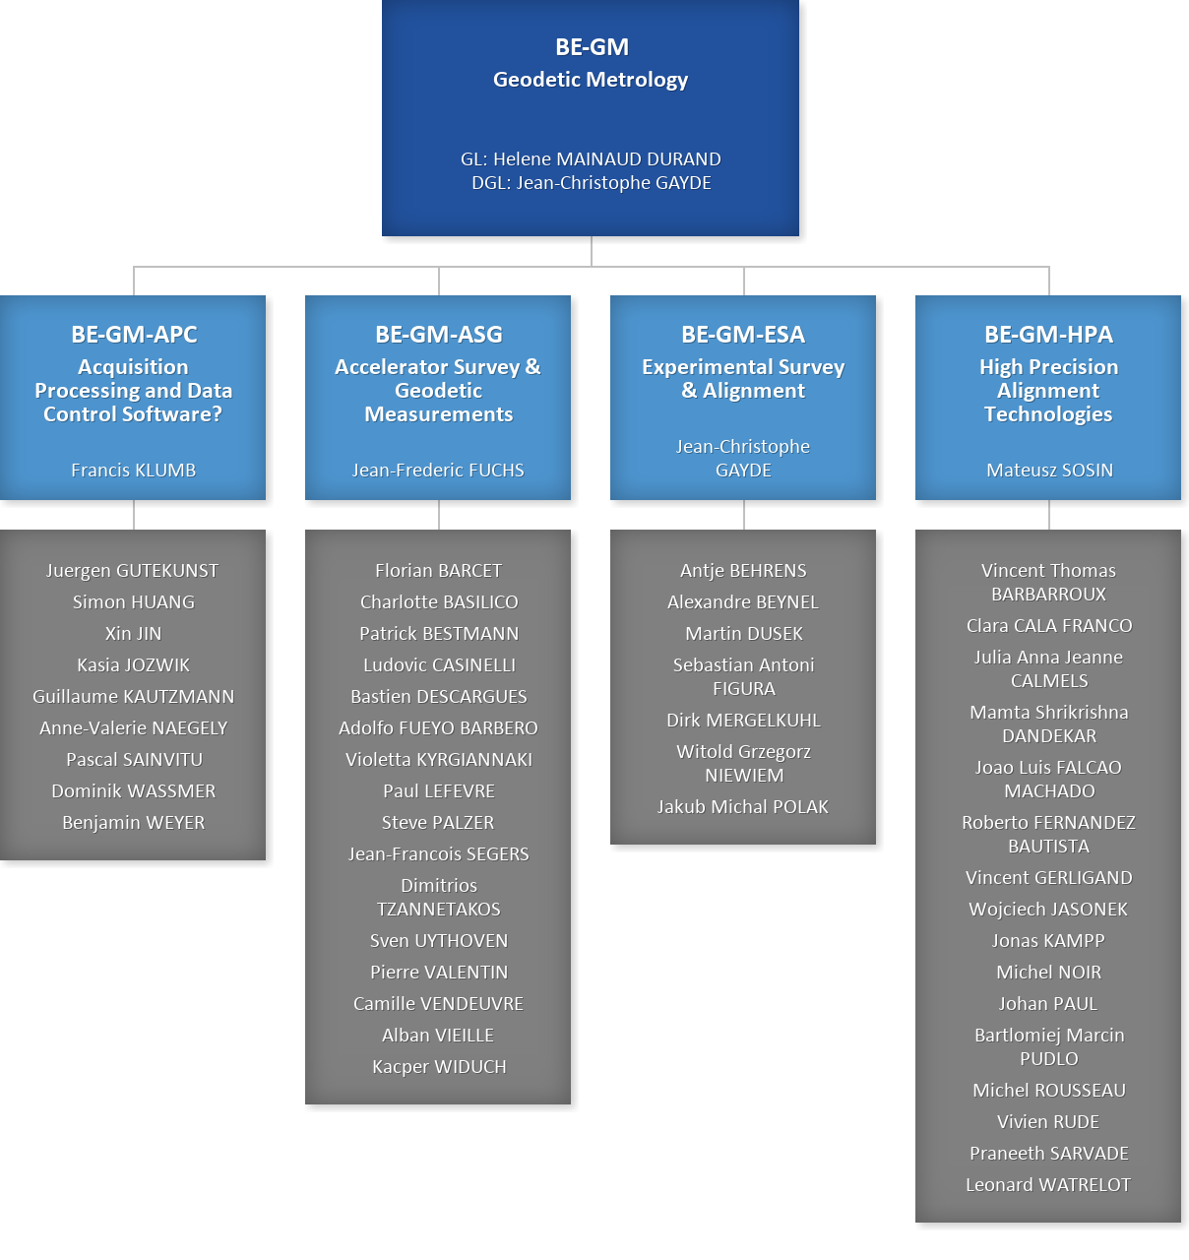

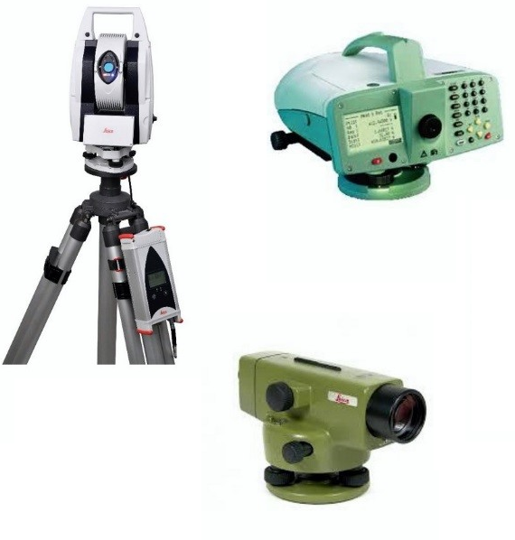

GAO:
E. Keller
C. Nederman
ESA
Section
Surveying, Physics, Mechanics
Solomon KAMUGASA
Pascal Weiss (TEMP)
Noemi BENI
Vitali BATUSOV
Andrei PLUZHNIKOV
Nikolay AZARYAN

Slide 4
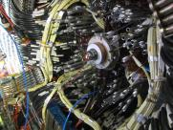
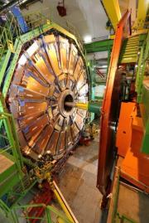
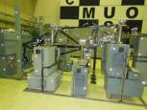
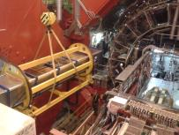
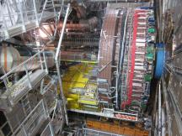
GM-ESA
Provides:
  The geometrical infrastructure for the detector installation
  The detector metrology
  The assembly geometrical follow-up
  The alignment on the beam lines
  The as-built measurements
  R&D as for monitoring systems
Knowing that:
  Detector size varies from some cm to tens of meters
  From very light structures (composite) to quite heavy ones (1000 of tons)
  Often unique and complex objects made of many pieces
  Experiment Collaboration -> Detectors usually not fully designed at CERN

Slide 5
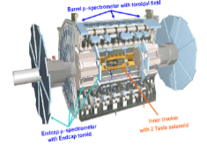
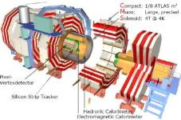
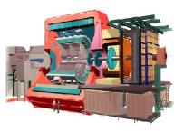
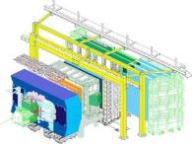
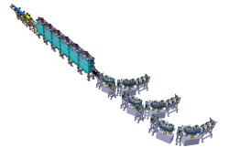
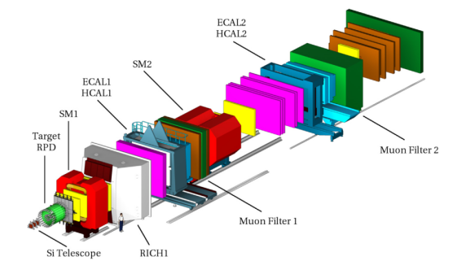
Where is GM-ESA involved?
Survey for all the Experiments at CERN + ISOLDE and HIE-ISOLDE
ATLAS
LHC Experiments
ALICE
ATLAS
CMS
LHCb
and Non-LHC
AMBER
ET pilot
SHINE
NA62
Isolde
HIE-Isolde
SHiP
All experiments of North and East Areas
etc.
CMS
LHCb
ALICE
AMBER
HIE-ISOLDE
And …

Slide 6
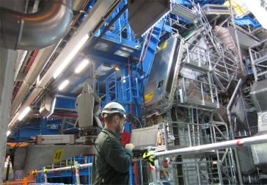
When is GM-ESA involved?
At all phases of the projects:
  At very early stage at the design phase
  Prototyping and tests
  Manufacturing
  Pre-assembly
  Assembly phases of detectors
  Experiment construction
  Alignment and positioning phases in the caverns or experimental areas during construction, Technical Stops, Shutdowns, Machine Developments
Usual measurement precision (at 1 sigma level)
  Detector control at manufacturing before assembly 0.01-0.2 mm
  Deformation of detectors under special conditions 0.02-0.10 mm
  Relative position of detectors wrt other detectors < 0.30 mm
  Absolute position of detectors wrt accelerator geometry < 0.75 mm

Slide 7
Why an involvement at very early stage?
Survey work must start at early stage of the project
Discussion with coordinators / project leaders / physicists / engineers / designers
  Define precisely the needs and find reasonable solutions
  Define all stages when survey will be needed
  Include alignment to the design (references, integration work)
  Define local coordinate systems
  Estimation of the resources needs
  => BUT it is not always the case - last minute (test beams …)
  => GM-ESA has also to be flexible, react very fast and propose solutions
This is very important
Without this survey could be impossible
Standards exist / suitable solutions can be discussed

Slide 8
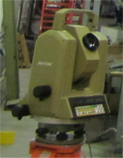
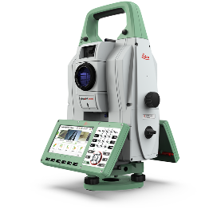


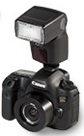
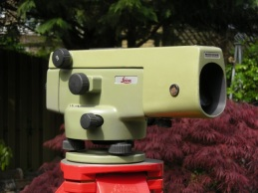
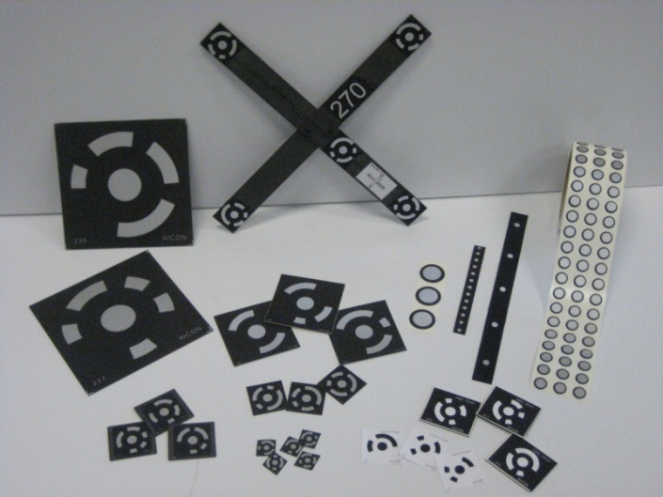
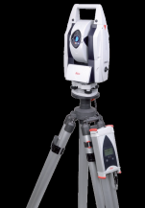
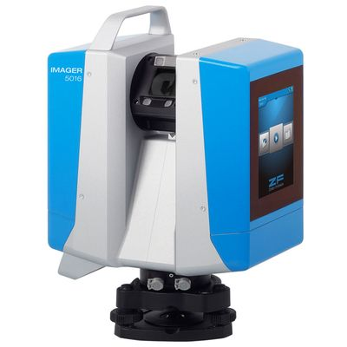


Survey Toolbox
Total stations TS60/TC2002
SU software
Photogrammetry
TOOLBOX
Experiment metrology
Optical levels
NA2/N3
Commercial software
Laser scanner
Z+F IMAGER® 5016
Laser Trackers
AT401/402/403
➔ Line of sight between instrument and object required!

Slide 9
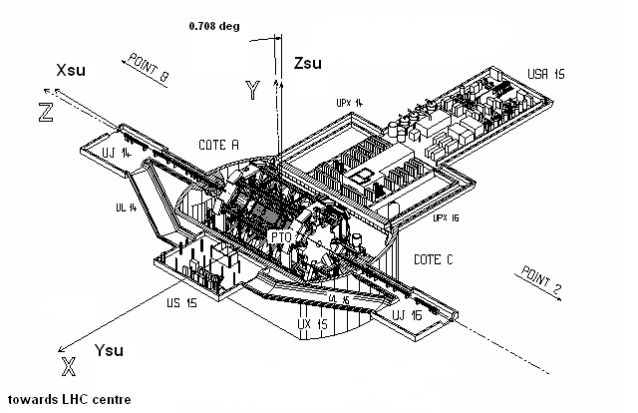
The geodetic networks
A Geodetic Network for each Experiment
Geometrical Link Machine / Experiment
Link to the CCS (CERN Coordinate System)
Materialize the Nominal Beam Line
Coordinated work of all Sections of the GM Group
Allows
The positioning of the detectors on the Nominal Beam Line (NBL)
The geometrical connection between measurements from the different parts of the cavern

Slide 10
Example: The ATLAS network measurement
Geodetic network includes survey galleries
System datum in survey gallery
Measurements: AT40x laser tracker
Network dimensions:
  126 m long, 30 m large, 22 m high
  30 m
  126 m
Summary of results:
New points ~228
Stations ~ 71
Observations ~2317
Unknowns ~767
Sigma a post < 0.075 mm
Results:
  HZ (1σ): 1.7 cc
  VZ (1σ): 2.5 cc
  distance (1σ): 0.03 mm
Problematic factors:
Limited line of sights due to detector
Walls radial movements ( USA wall: 1 mm/year)
Floor heave
Height of 20 m => temperature gradient, steep vertical sighting angles
Refraction in narrow survey galleries
Precision at level of mechanical adapters
  22 m

Slide 11
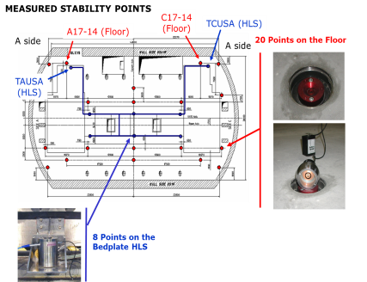
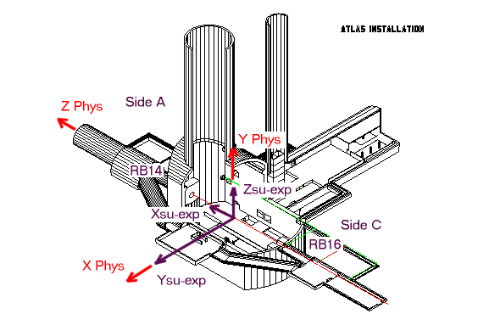
ATLAS Vertical Stability
Predictions:
-5.5 mm sag, due to weight of ATLAS
-2.0 mm sag, concrete contraction (short term)
+1.0 mm per year heave, hydrostatic pressure
very limited adjustment possibilities for ATLAS
predictions have been taken into account for detector placement (assembly TILE-LArg-Solenoid)
C
SKETCH OF FLOOR VERTICAL STABILITY CONTROL PATH
Optical levelling
Tunnel Levelling
Link with cavern floor
Measurements :
~30 epochs, Aug 2003 – Jan 2024
Linked to deep references
Mean heave 0.18 mm/year in center
Max. heave < 4.5 mm in 20 years
New values considered for different upgrades
Deep Reference Points (anchored in bedrock)

Slide 12

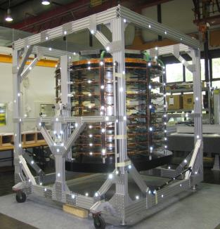
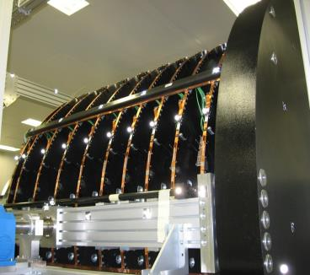
During prototyping, tests and construction
Ex: CMS TEC +/- (Tracker End Caps)
Several photogrammetric measurements at RWTH Aachen during construction phase
TEC = 9 support disks for detector elements + 1 Back Disc
Each with 4 reference points on circumference
Assembly control in vertical position
Deformation control in horizontal position

Slide 13
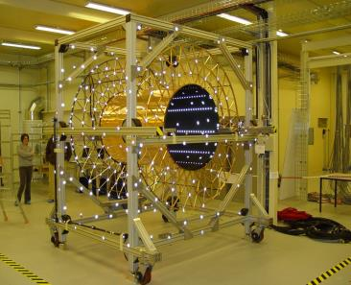
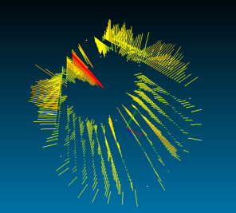
Envelope measurements
Ex. ATLAS TRT Barrel – photogrammetric measurement of inner cylinder
16 lines of target tape with 31 targets each
Only signalized points
450 Images, 1700 object points, 124000 observations in bundle adjustment
Precision 0.06mm in X-, Y- and Z-direction
Cylindricity
Comparison to measurement with Romer measuring arm by EP/DT
Difference to best fit cylinder

Slide 14
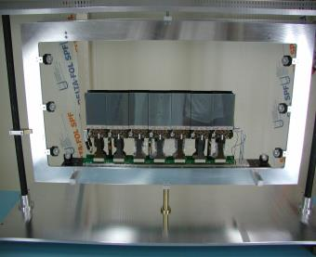
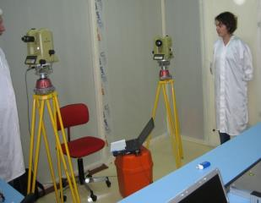
Fiducialisation
LHCb / Fiducialisation of the 12 IT (Inner Tracker) modules
Link between sensitive part and outer references before box closing
Measurement in clean room by microtriangulation
Angular observations of sensor fiducials
Calibrated scale bars
White cross on black background of 0.3 mm x 0.3 mm
Illumination by cold light, no optical disturbance
Transfer to outer references visible during insertion of all elements in IT box
Precision in X-, Y- and Z-direction 0.05 mm (1 sigma)
Sensor fiducials
Outer references

Slide 15
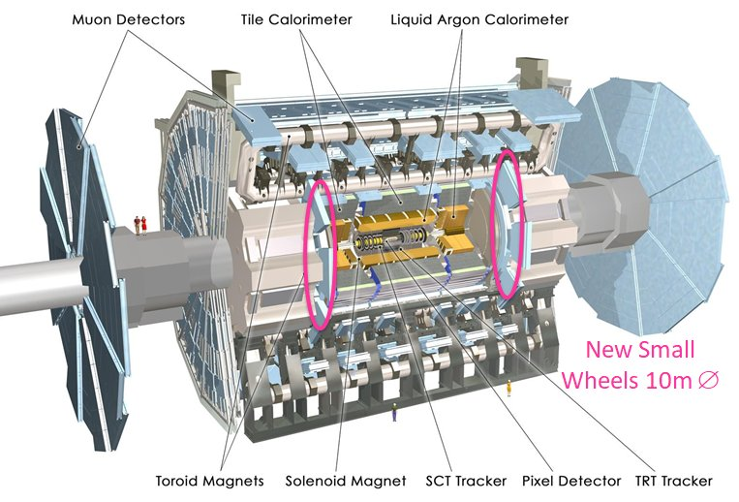
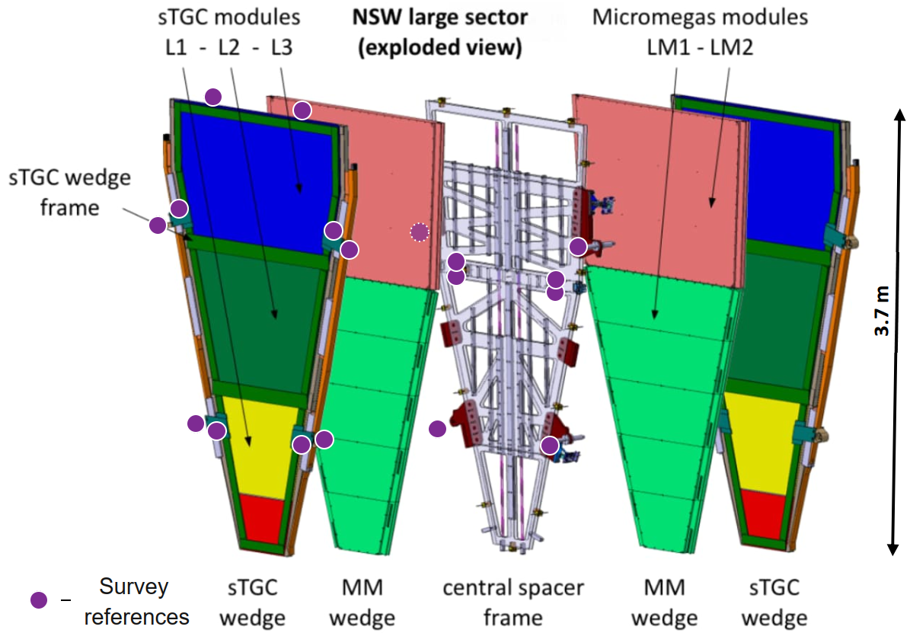
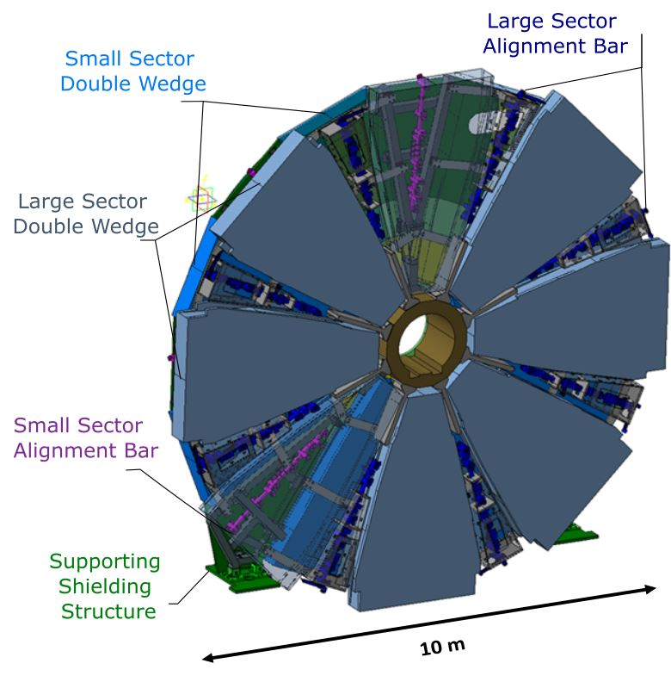
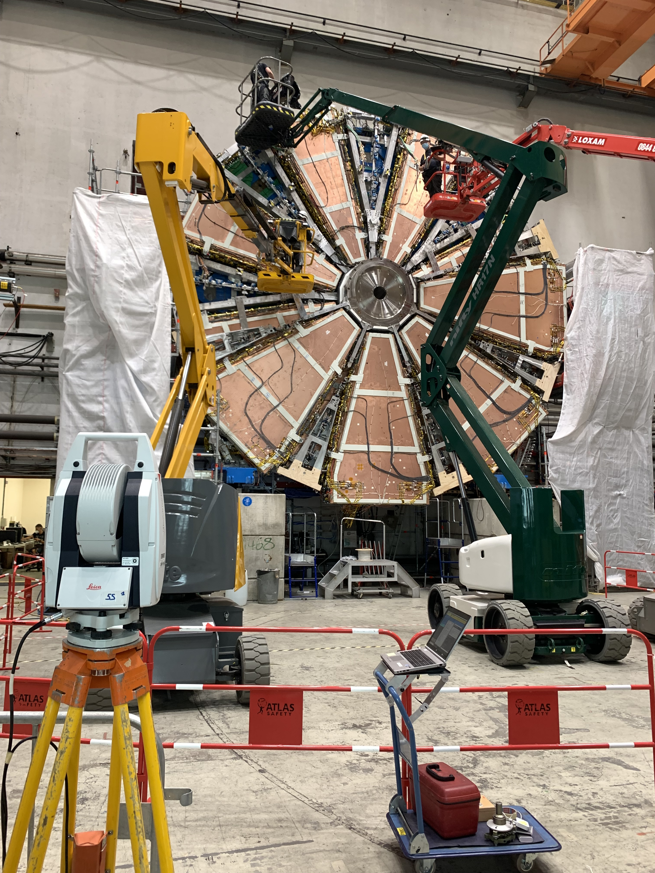
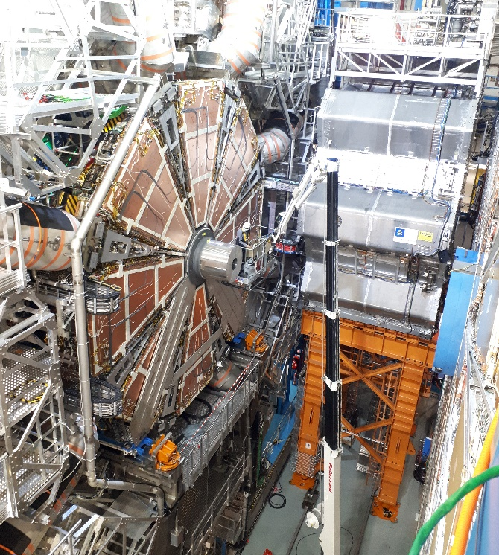
From surface to the cavern
Ex. Assembly and alignment for ATLAS New Small Wheel
Shielding structure with ist Hub and extension
Adjustment of sTGC on completed double wedge
Fiducialisation of spacer frames
Alignment of assembly tooling for wedge construction
Typical relative precision 0.1 mm (mainly laser tracker)
Positioning in the UX15 cavern

Slide 16
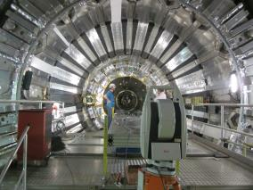
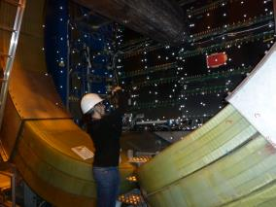
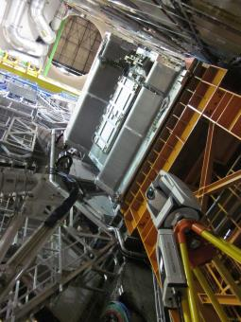
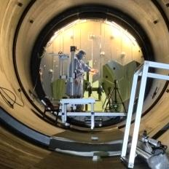
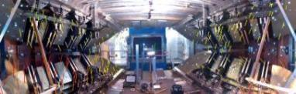
In the cavern
CMS Tracker Rails
Detector assemblies
Detector supports
Opening, closing
Extractions (Beam pipes …)
Insertions
Installation of new parts
Adjustments
Deformation (Loading, movements, B field…)
Positioning on the NBL
Envelope
Cavern stability
Etc.
Alice Muons
ATLAS Network
NA62 RICH
LHCb Magnet

Slide 17
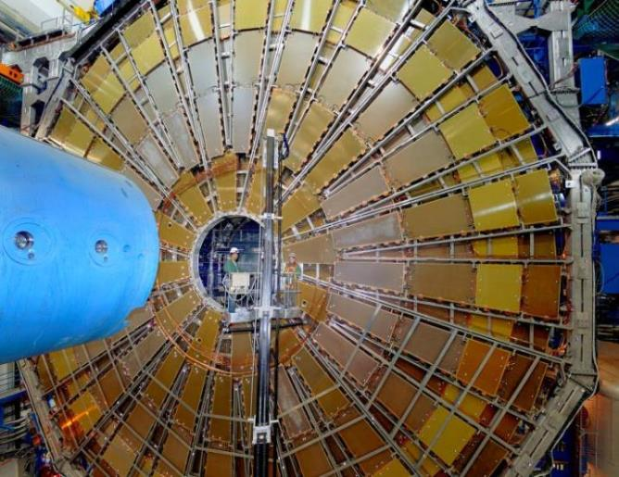
Example of a large detector survey in the cavern
ATLAS TGC Wheels
Summary for TGC3-C
    Object diameter ~25 m
    Distance to object 5-6 m
    Number of photos ~960
    Number of observations ~ 90000
    Number of unknowns ~9400
    Number of points ~1200
    Controls by theodolite
    Data volume ~ 1.9 GB (jpg)
    Measurement time in field ~ 1 day
Precision ~0.5 mm

Slide 18
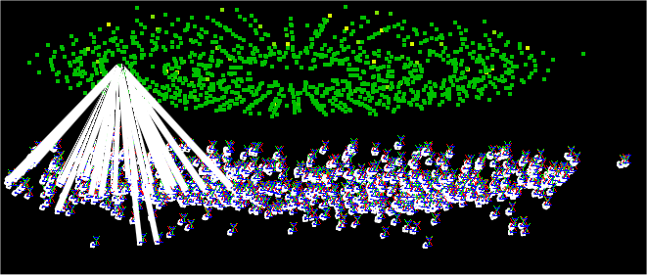
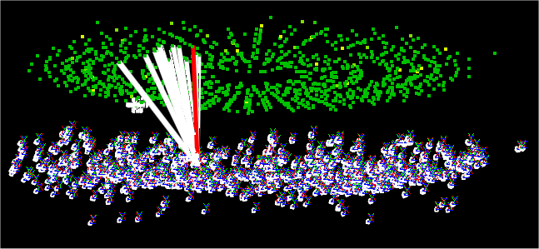
Example of a large detector survey inside the cavern
ATLAS TGC Wheels
3D view of object (left)
  Object points
  Camera stations
  Geometry for single point
3D view of object (right)
  Object points
  Camera stations
  Geometry for single camera

Slide 19
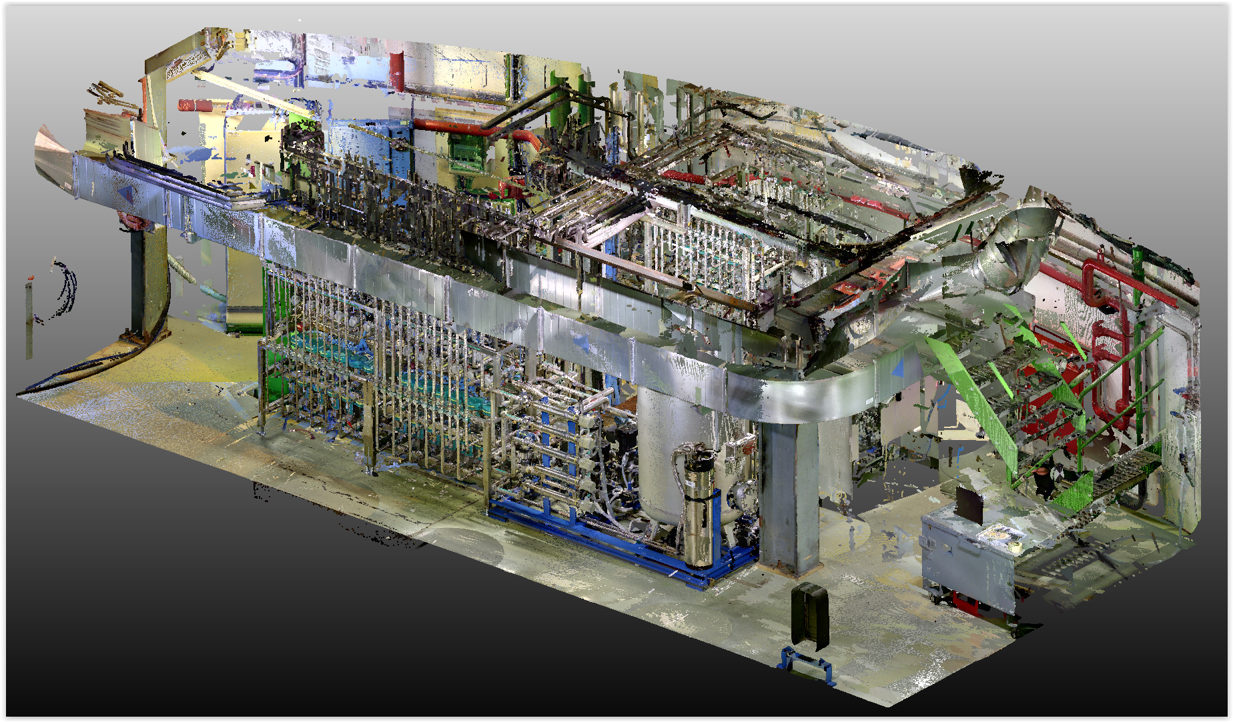
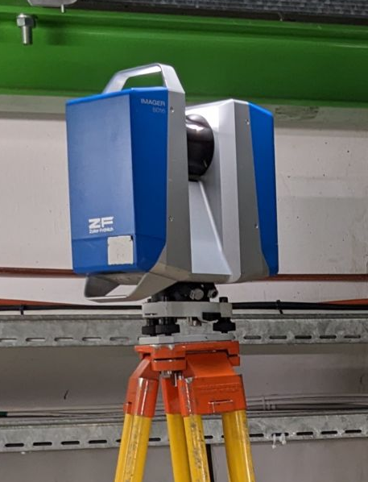
Laser Scanner Z+F 5016 imager®
Up to 1 100 000 points/sec
Point accuracy at 10m = +-2 mm
Spot size = 5.0mm @ 10m
Field of view: 360° x 320°
Colour texture by HDR photos
Textured point cloud as result
  3D Scanning of the new cooling plant inside the Alice Cavern (Measurement and processing)

Slide 20
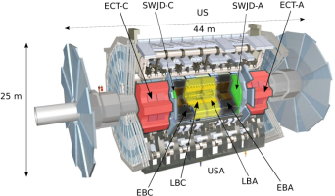
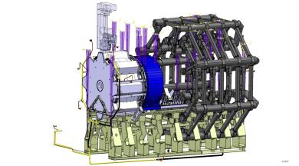
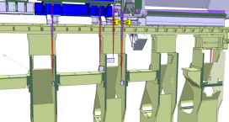
ADEPO (Atlas DEtector POsitioning)
Collaboration between
ATLAS Tech. Coord
and BE/GM-ESA
Demand
Monitor and speed up closure
Gain in precision for re-positioning
  Relative repositioning at 0.3 mm (1 sigma)
  Movement follow-up at 0.1 mm
Cover 6 DOF per moving detector
Cycle < 30 sec.
Resist to 1 Tesla magnetic field
Radiation dose of 2 kGy for lifetime
Status:
Algorithms definition done
“Near” scale one tests performed
Tracing, installation and alignment done
Commissioning on going
First use: closure at end of LS1
System is based on
28 BCAMs on feet/rails system
44 passive targets (prisms)

Slide 21
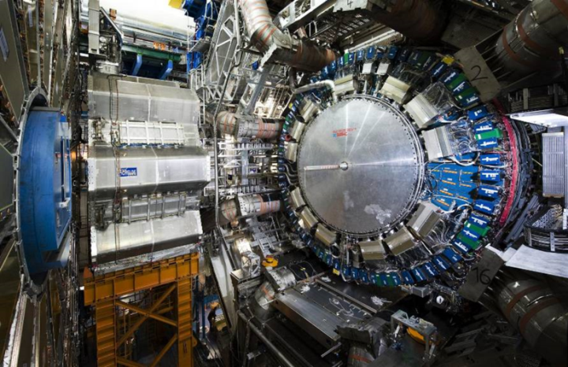
A better idea of the size of the pieces to follow within 0.3 mm
ADEPO (Atlas DEtector POsitioning)
Somebody is there …

Slide 22
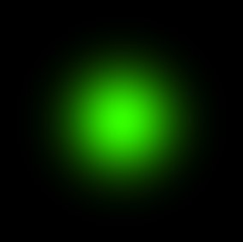






Research and Development - SLB
  Gaussian Beam (GB)
    Structured Laser Beam (SLB)
Notes:
We believe and we have the mandate to create impact outside of HEP

Slide 23





Research and Development - Layer beams
Real photo
Simulated transversal profiles
2 m
140 m
Notes:
We believe and we have the mandate to create impact outside of HEP

Slide 24
CONCLUSION
GM-ESA is present:
  During construction, Technical Stops, Shutdowns, Machine Developments
  During the run periods for preparatory work, tests, assemblies…
Working in experiments requires the integration of aspects such as:
  The knowledge of the experiments and their complexity
  The planning, the sequences of assembly and of opening/closing
The survey expert in charge of each Experiment must be capable of
    Flexibility, creativity, autonomy, fast analysis and decision taking
It is important to work with well trained persons and direct contacts with responsibles
Future will be busy: Technical-Stops, preparatory work for LS3 and LS3 period

