Slide 1
APC – Acquisition, Processing and Data Control
Francis KLUMB, 2 December 2024

Slide 2
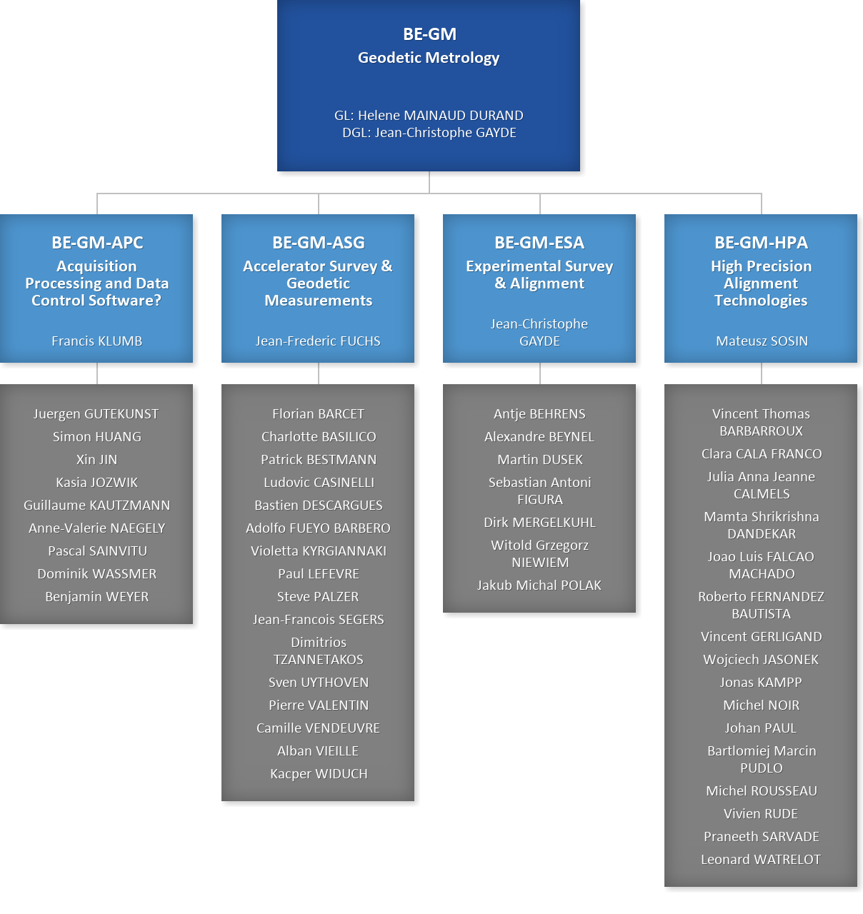


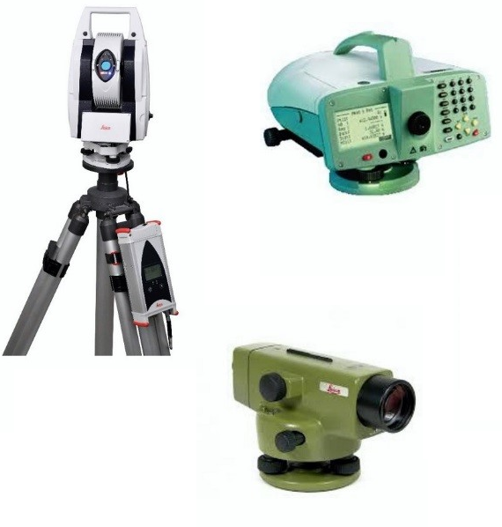
APC
Section
GAO:
E. Keller
C. Nederman
~ 10-12 persons
Surveying engineers, IT developers, mathematician.
Pascal Weiss (TEMP)

Slide 3

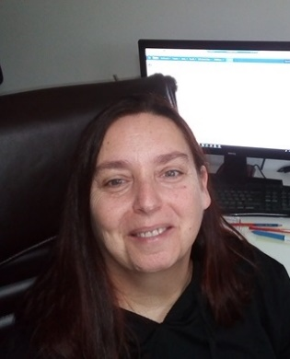

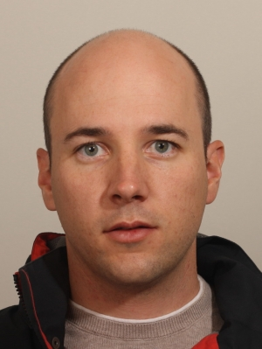


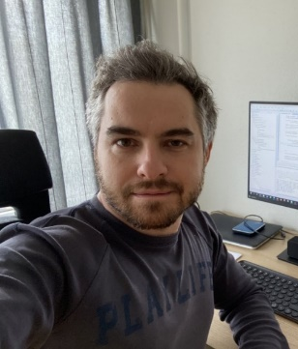

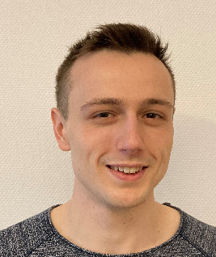



Software Development Team (Oct. 2024)
Team made up of surveying engineers, IT developers and a mathematician
Database
Data Processing & Interfaces
Data Acquisition
Anne-Valérie
Guillaume
Jürgen
Benjamin
Pascal S.
Francis
Iliyan
Katarzyna
Dominik
Simon
Pascal W.
Xin
Section Leader

Slide 4
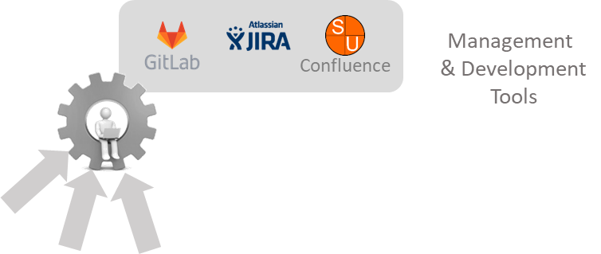
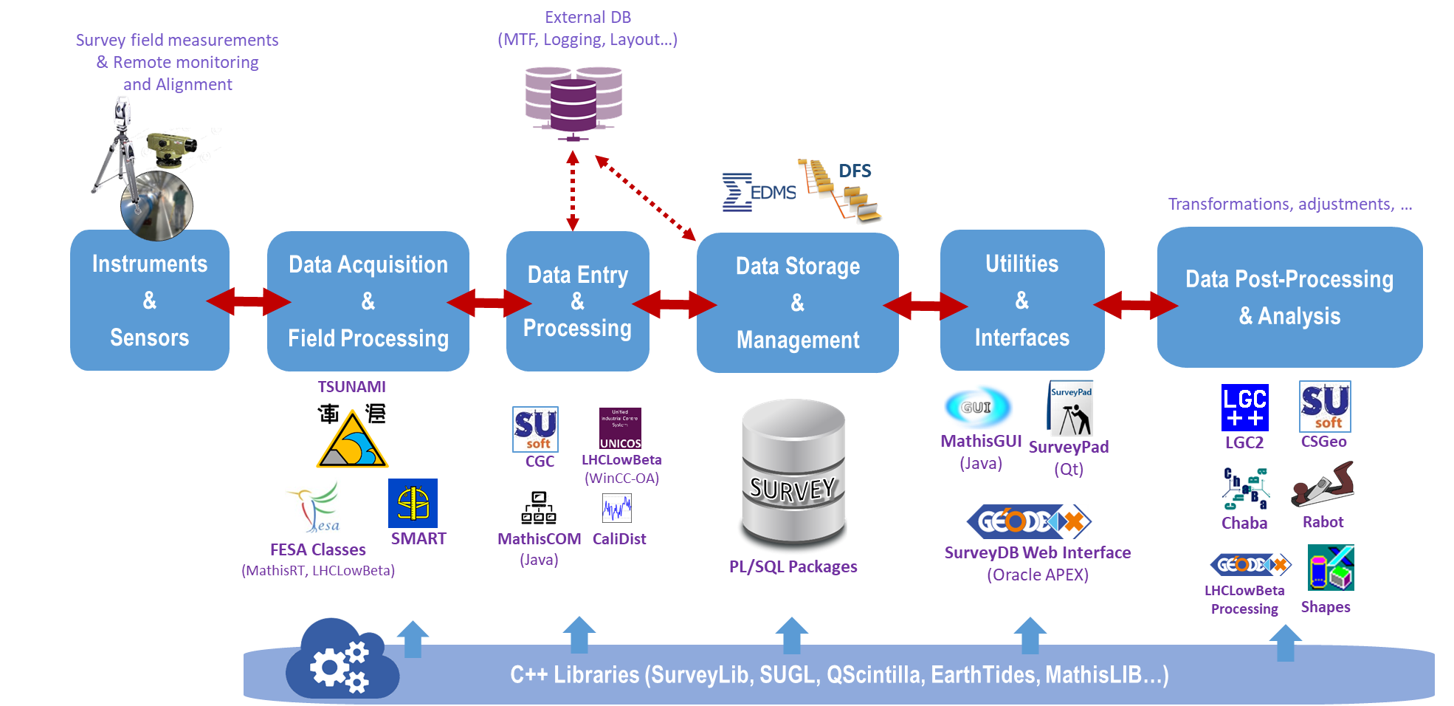

Survey software development & support
Maintenance of the Survey DB, data acquisition and processing tools

Slide 5
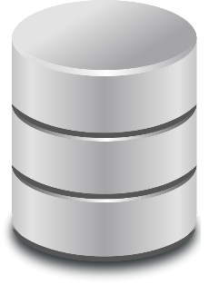
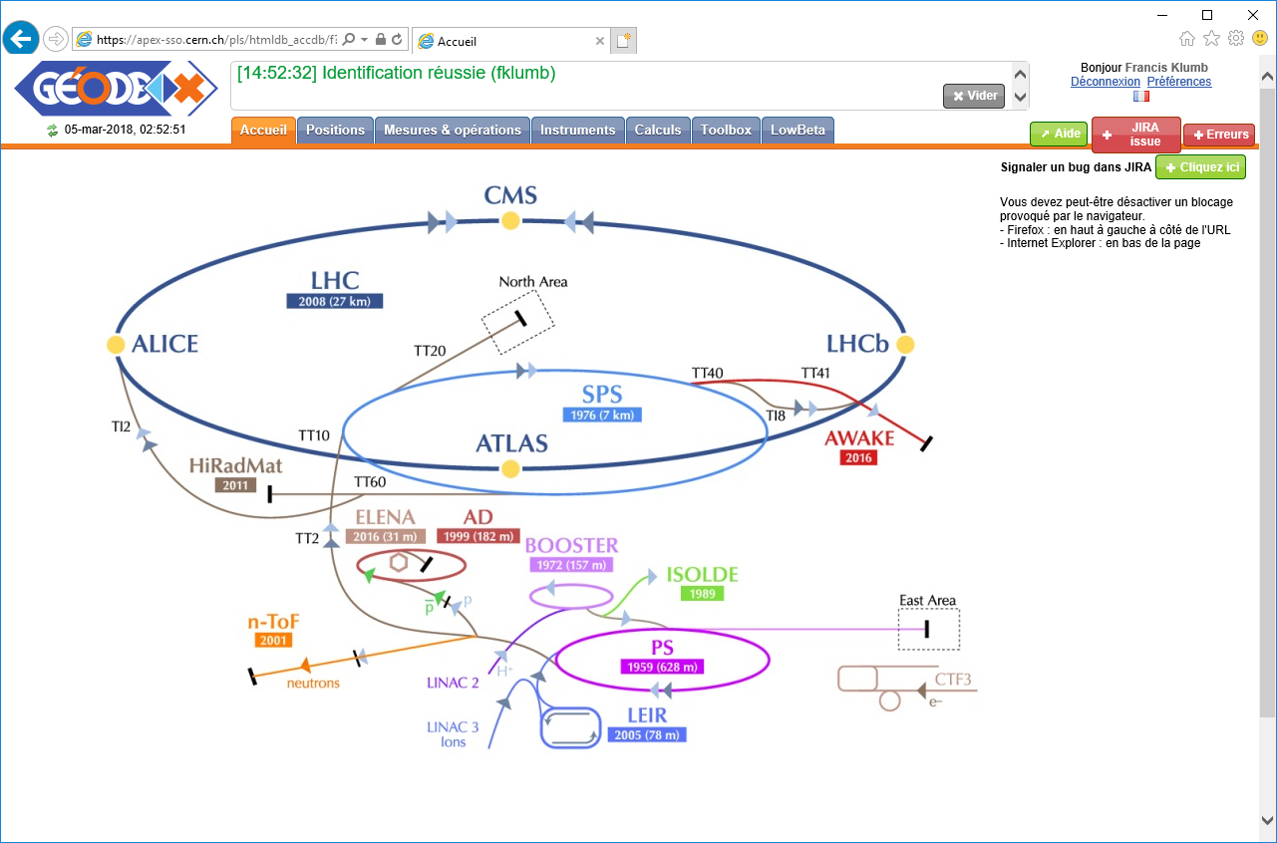
Survey Software – Database and Geode
  Survey DB is a crucial part of the Survey activities workflow,
  and all maintenance and development fully done within the section
  Theoretical positions of all beams at CERN in CCS (CERN Coordinate System),
SURVEY
GEODE
  Real positions of the networks geodetic points in CCS,
  Deviations of all aligned components from their theoretical position,
  Measurements related to the installation and alignment of accelerators components,
  Instruments data necessary for those measurements.
Notes:
Comme vous le savez, nous avons aussi la charge de la base de données Survey et de son interface GEODE, qui constituent un axe central de nos activités Survey. Comme vous le voyez sur le graphe, GEODE a connu de multiples évolutions depuis sa création au milieu des années 80, suivant les versions successives des produits Oracle, comme Oracle Forms puis APEX. Une longue histoire donc de plus de 35 ans! Ce qui, sur l’échelle de temps informatique est une « éternité », et qui nous poussera dans les années à venir à nous poser et prendre un moment pour étudier les futurs choix technologiques.
A ce propos, le projet MAlT au CERN, qui nous incite de plus en plus à nous affranchir des licences imposées par les grandes sociétés commerciales (dont Oracle fait partie!), et à nous tourner vers des solutions open-source (donc sans licence commerciale), nous demandera de réfléchir de manière plus générale au choix des futures technologies informatiques utilisées par la section.

Slide 6
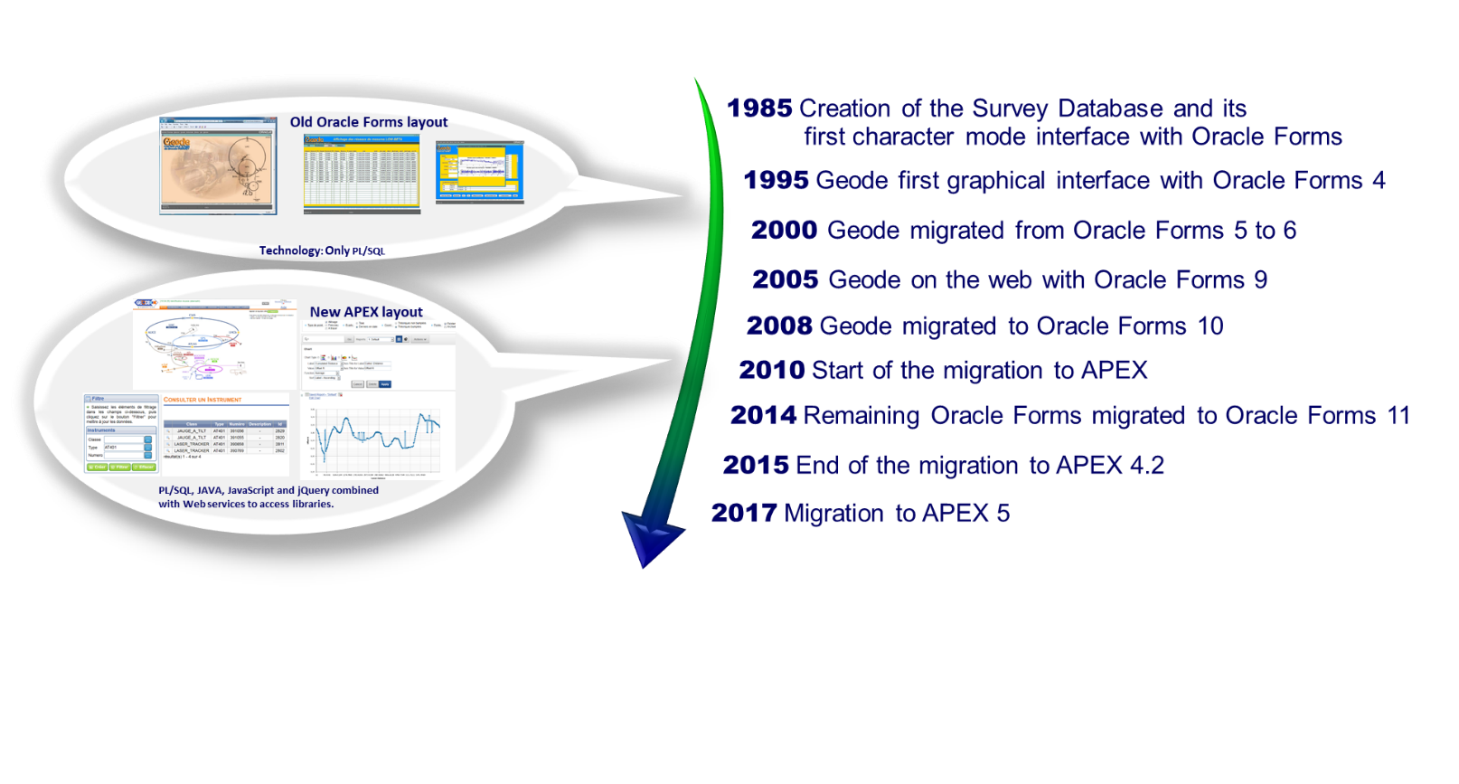
Survey Software : Database and user interface
History of the Survey Database and its interface GEODE
… A long story !
Studies for its renovation (DB and interface) launched this year
Notes:
Comme vous le savez, nous avons aussi la charge de la base de données Survey et de son interface GEODE, qui constituent un axe central de nos activités Survey. Comme vous le voyez sur le graphe, GEODE a connu de multiples évolutions depuis sa création au milieu des années 80, suivant les versions successives des produits Oracle, comme Oracle Forms puis APEX. Une longue histoire donc de plus de 35 ans! Ce qui, sur l’échelle de temps informatique est une « éternité », et qui nous poussera dans les années à venir à nous poser et prendre un moment pour étudier les futurs choix technologiques.
A ce propos, le projet MAlT au CERN, qui nous incite de plus en plus à nous affranchir des licences imposées par les grandes sociétés commerciales (dont Oracle fait partie!), et à nous tourner vers des solutions open-source (donc sans licence commerciale), nous demandera de réfléchir de manière plus générale au choix des futures technologies informatiques utilisées par la section.

Slide 7

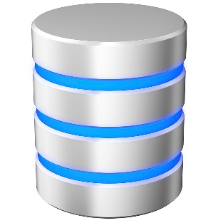
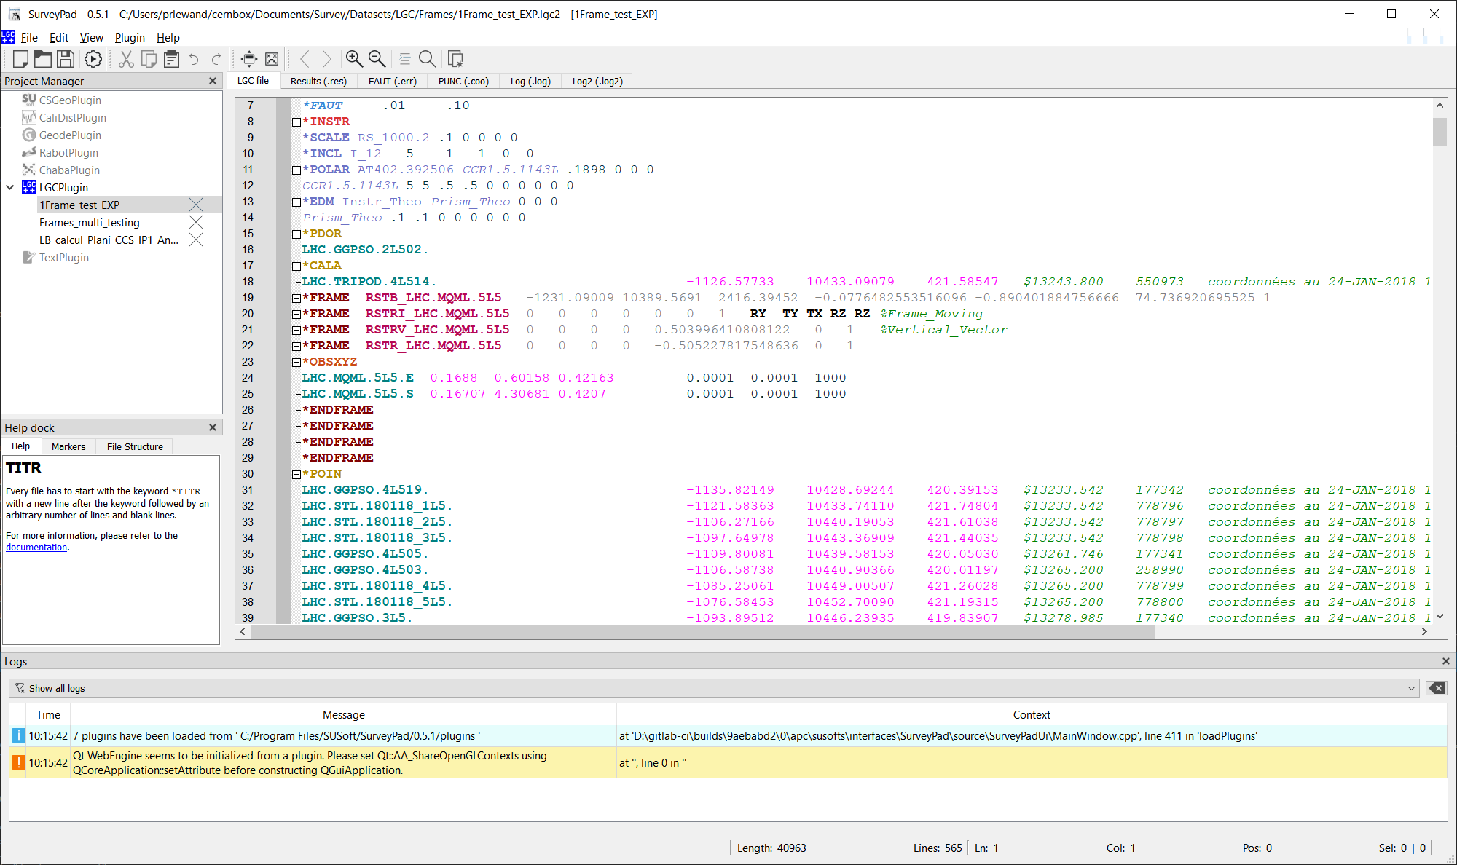
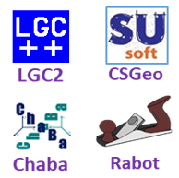
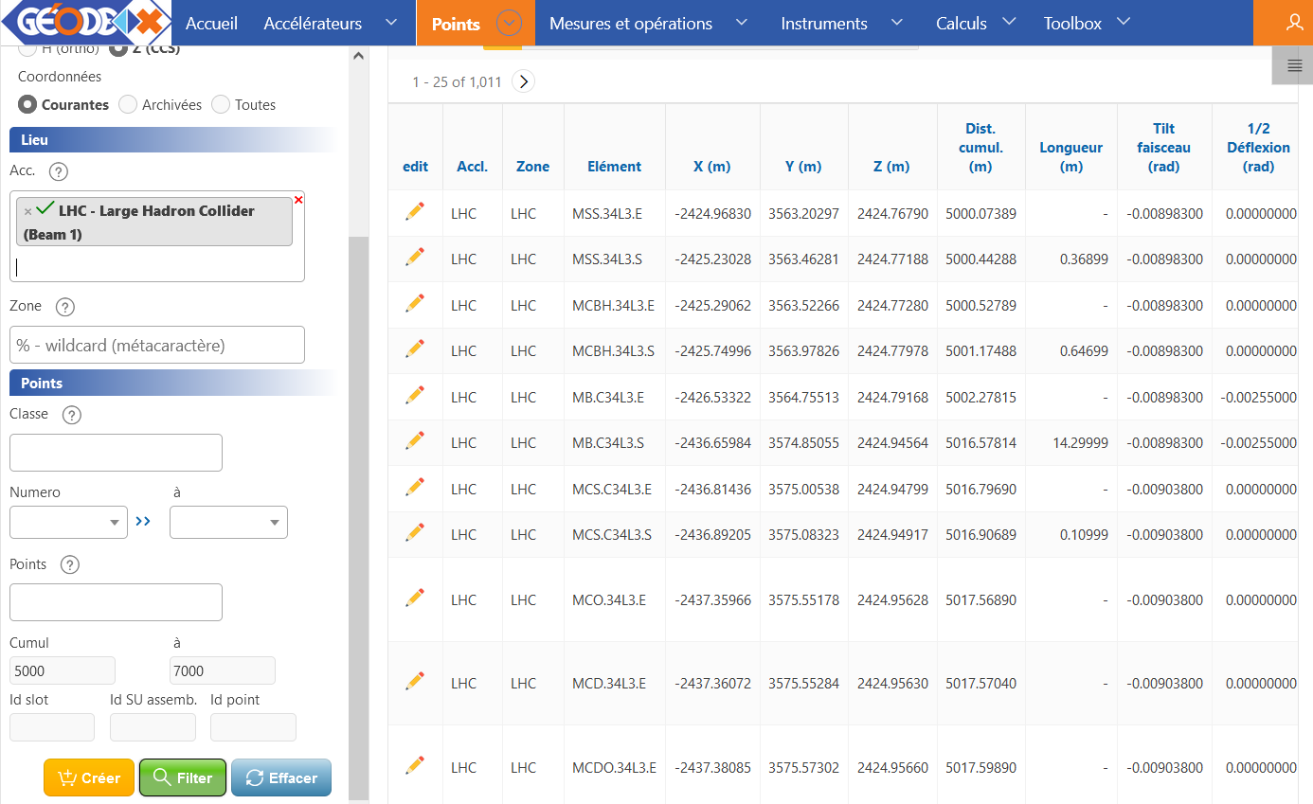


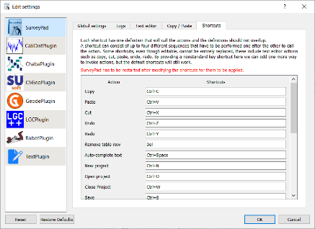

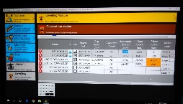
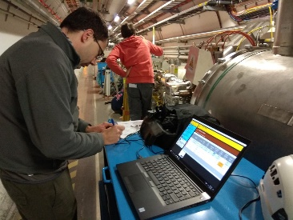
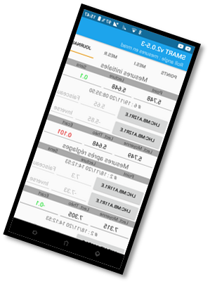
Unified interface for Data Processing tools
SurveyPad
Advanced Data Editor
and processing launcher
Data Processing Tools
7 Plugins today
Survey
GEODE
Web API
Data files
Data files
Input data files
(formatted texts)
…
Acquisition Software

Slide 8

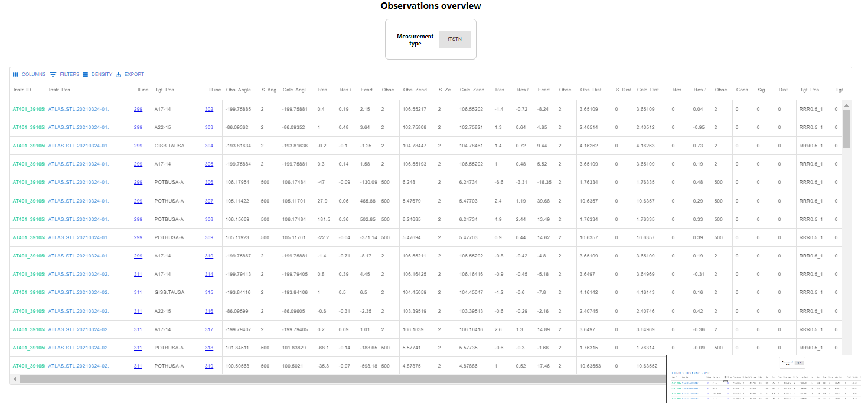
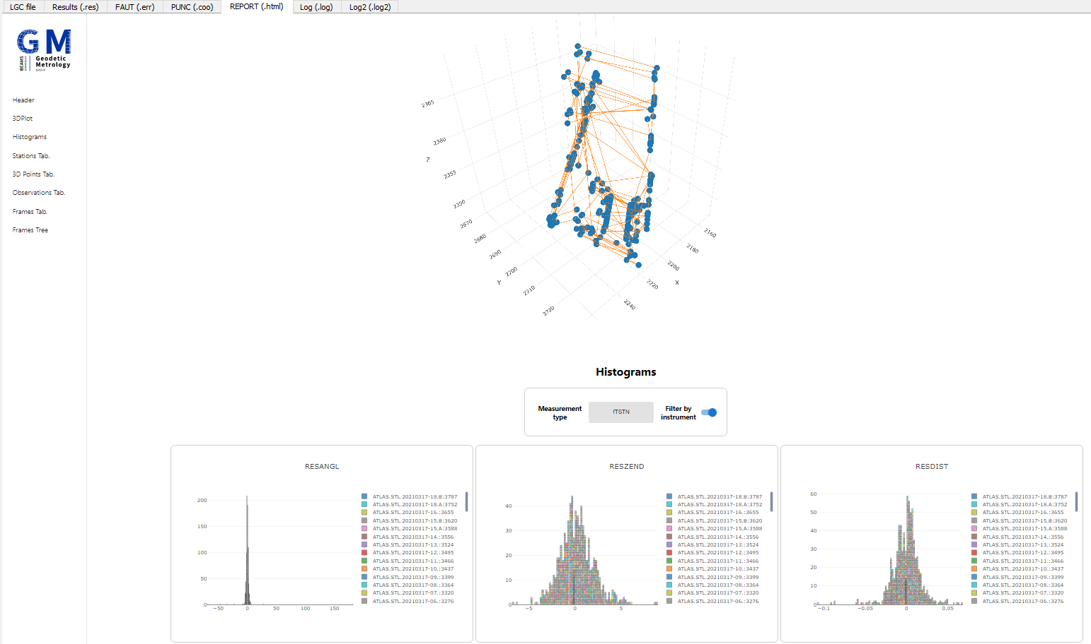
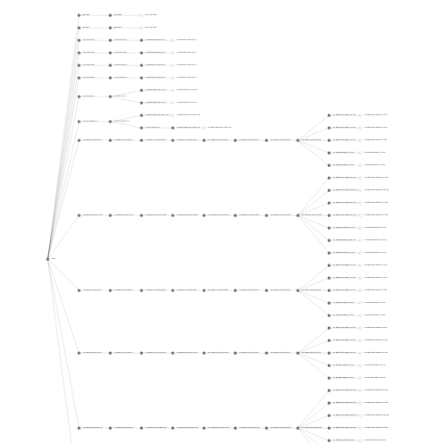
Unified interface for Data Processing tools
SurveyPad
  From text to structured reports (HTML)
Sortable tables
for observations
Simple 3D View
Histograms
Tree View of FRAMEs
8

Slide 9
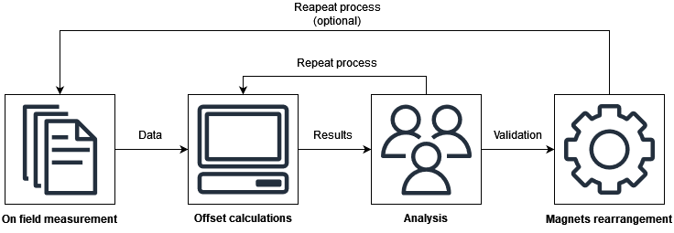
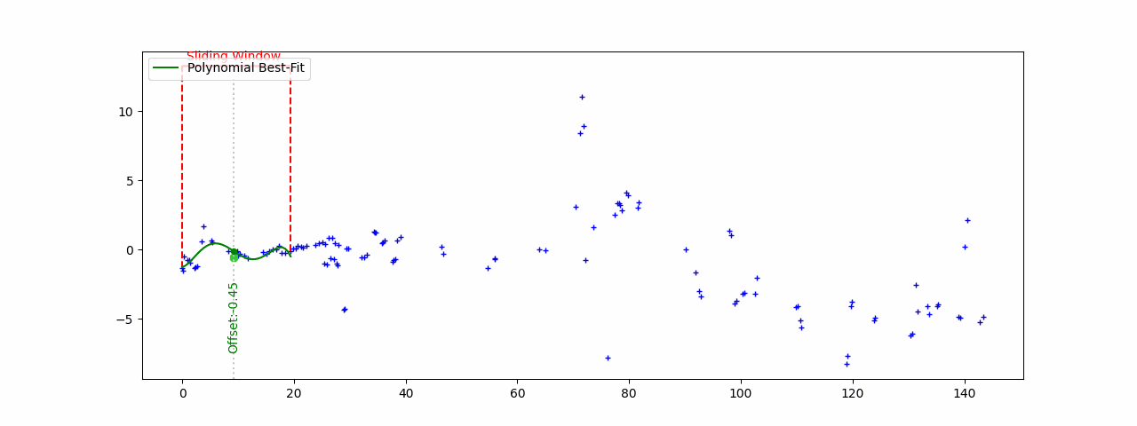

Data processing software
Example of full rework of old, undocumented software
PyRabot: v1.0 first release (Nov.2022)
Reverse Engineering Process in 2022
Smoothing algorithms validated by beam physicists last year….
Sliding window with successive polynomial regressions

Slide 10

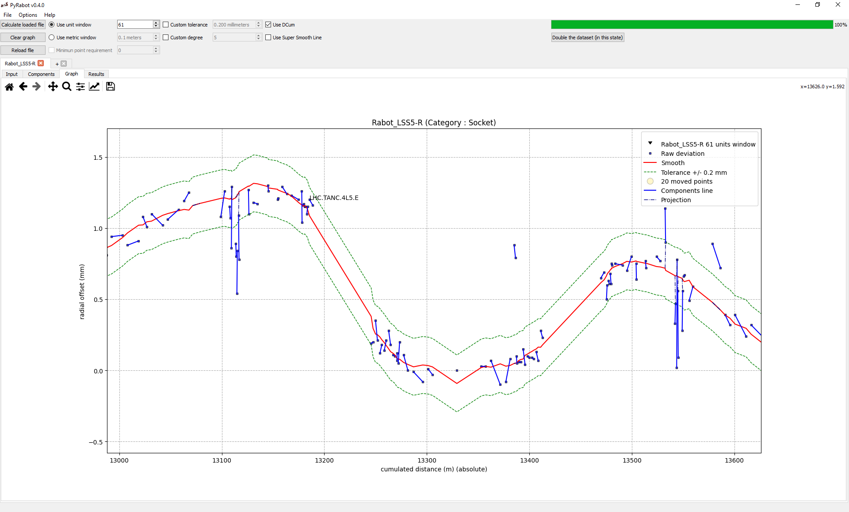
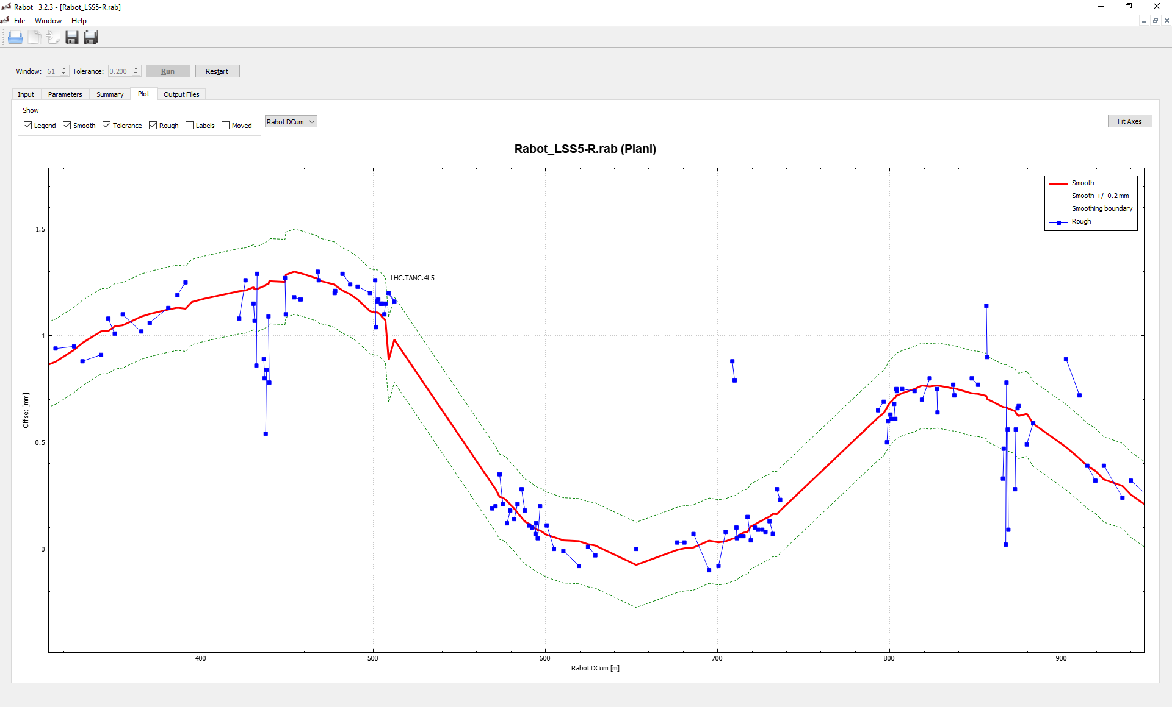

Data processing software
From C++…
30.000 lines of code
Lack of documentation
Unnecessarily complex
No longer maintainable
… to Python
2000 well documented lines of code
Easier and more human readable syntax
New functionalities
Scalable with user’s feedback & needs
Better performance achieved by optimizing algorithms.

Slide 11
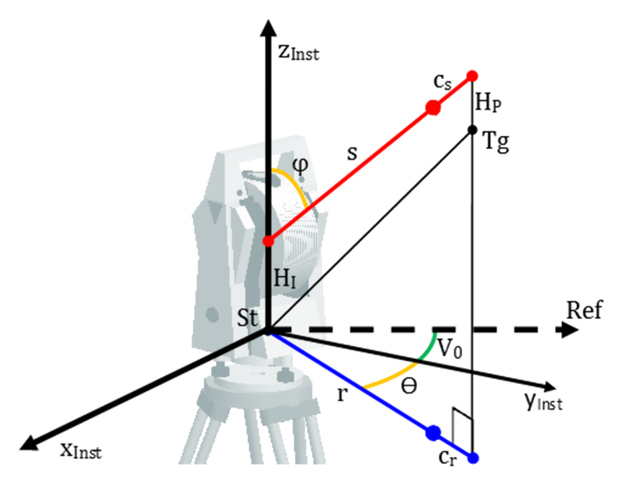


LGC: Our main adjustment software
“Logiciel Genéral de Compensation” (“General Adjustment Software”)
What does LGC do?
Evaluates the position of points / objects and determines associated precisions based on geometrical observations (distances, angles, etc..) through an iterative least square process.
What are the main principles ?
Observation model (parametric):
$${observation = f}_{parametric}\left(unknows\right)$$
Mathematical model defining possible constraints:
$$f_{constraint}\left(unknows\right)=0$$
Stochastic model: precision (or weight) assigned to each observation
Weighted Least Square:

Slide 12
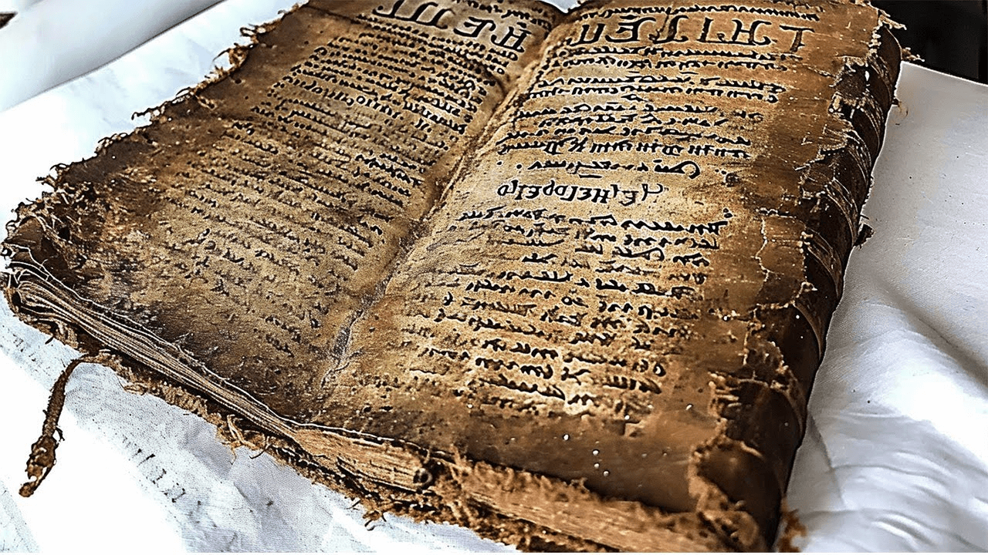

LGC : A bit of history…
First Fortran version developed in the 80’s
LGC v1: C++ version in the 2000’s
… and new related library (SurveyLib) shareable with other projects.
LGC v2 in 2015 : refactoring and introduction of the concept of FRAME
First use in HIE-ISOLDE monitoring system (MATHIS application)
Important progress since 2-3 years:
    v2.5 (October 2022): data consistency check, HLS observations, speed enhancement.
    v2.6 (June 2023): output data serialization (JSON), WPS observations.
    v2.7 (May 2024): full rework of the free adjustment (LIBR option).
    v2.8 (Nov.2024): “libre-ajusté” (free adjustment with variances-covariances applied on chosen points).

Slide 13
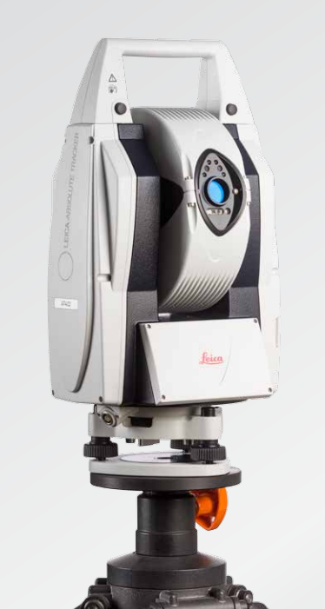
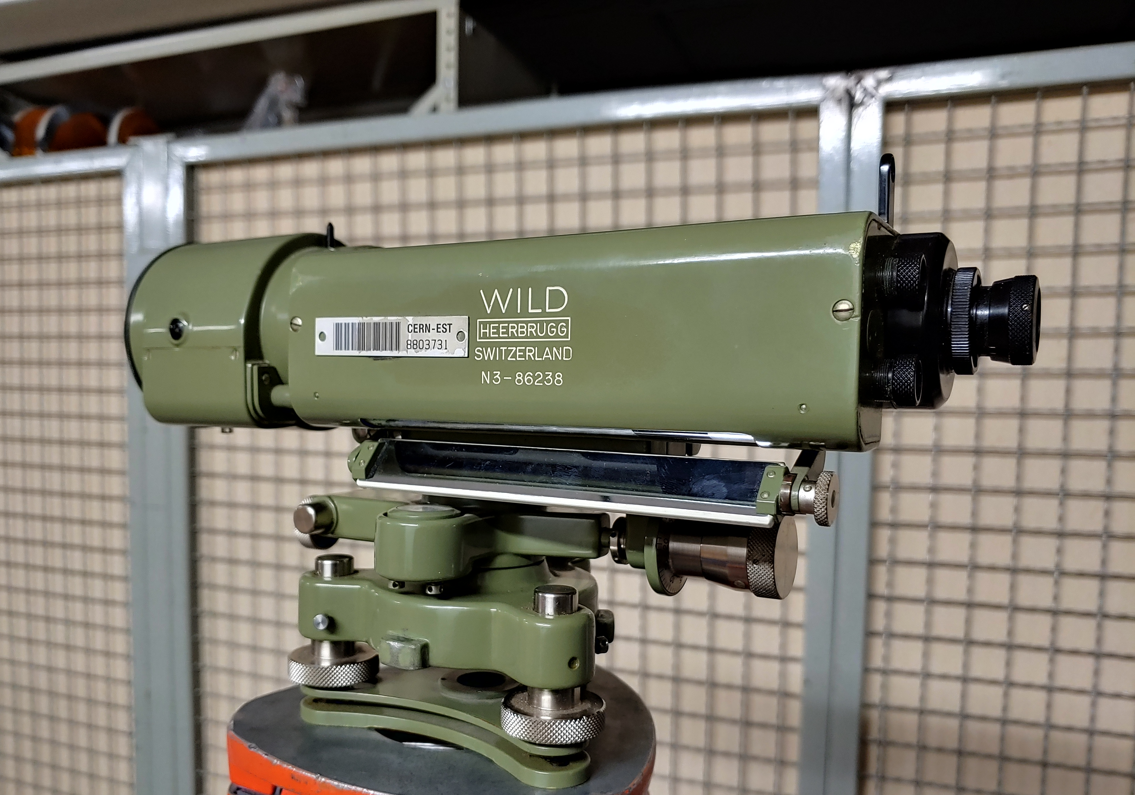
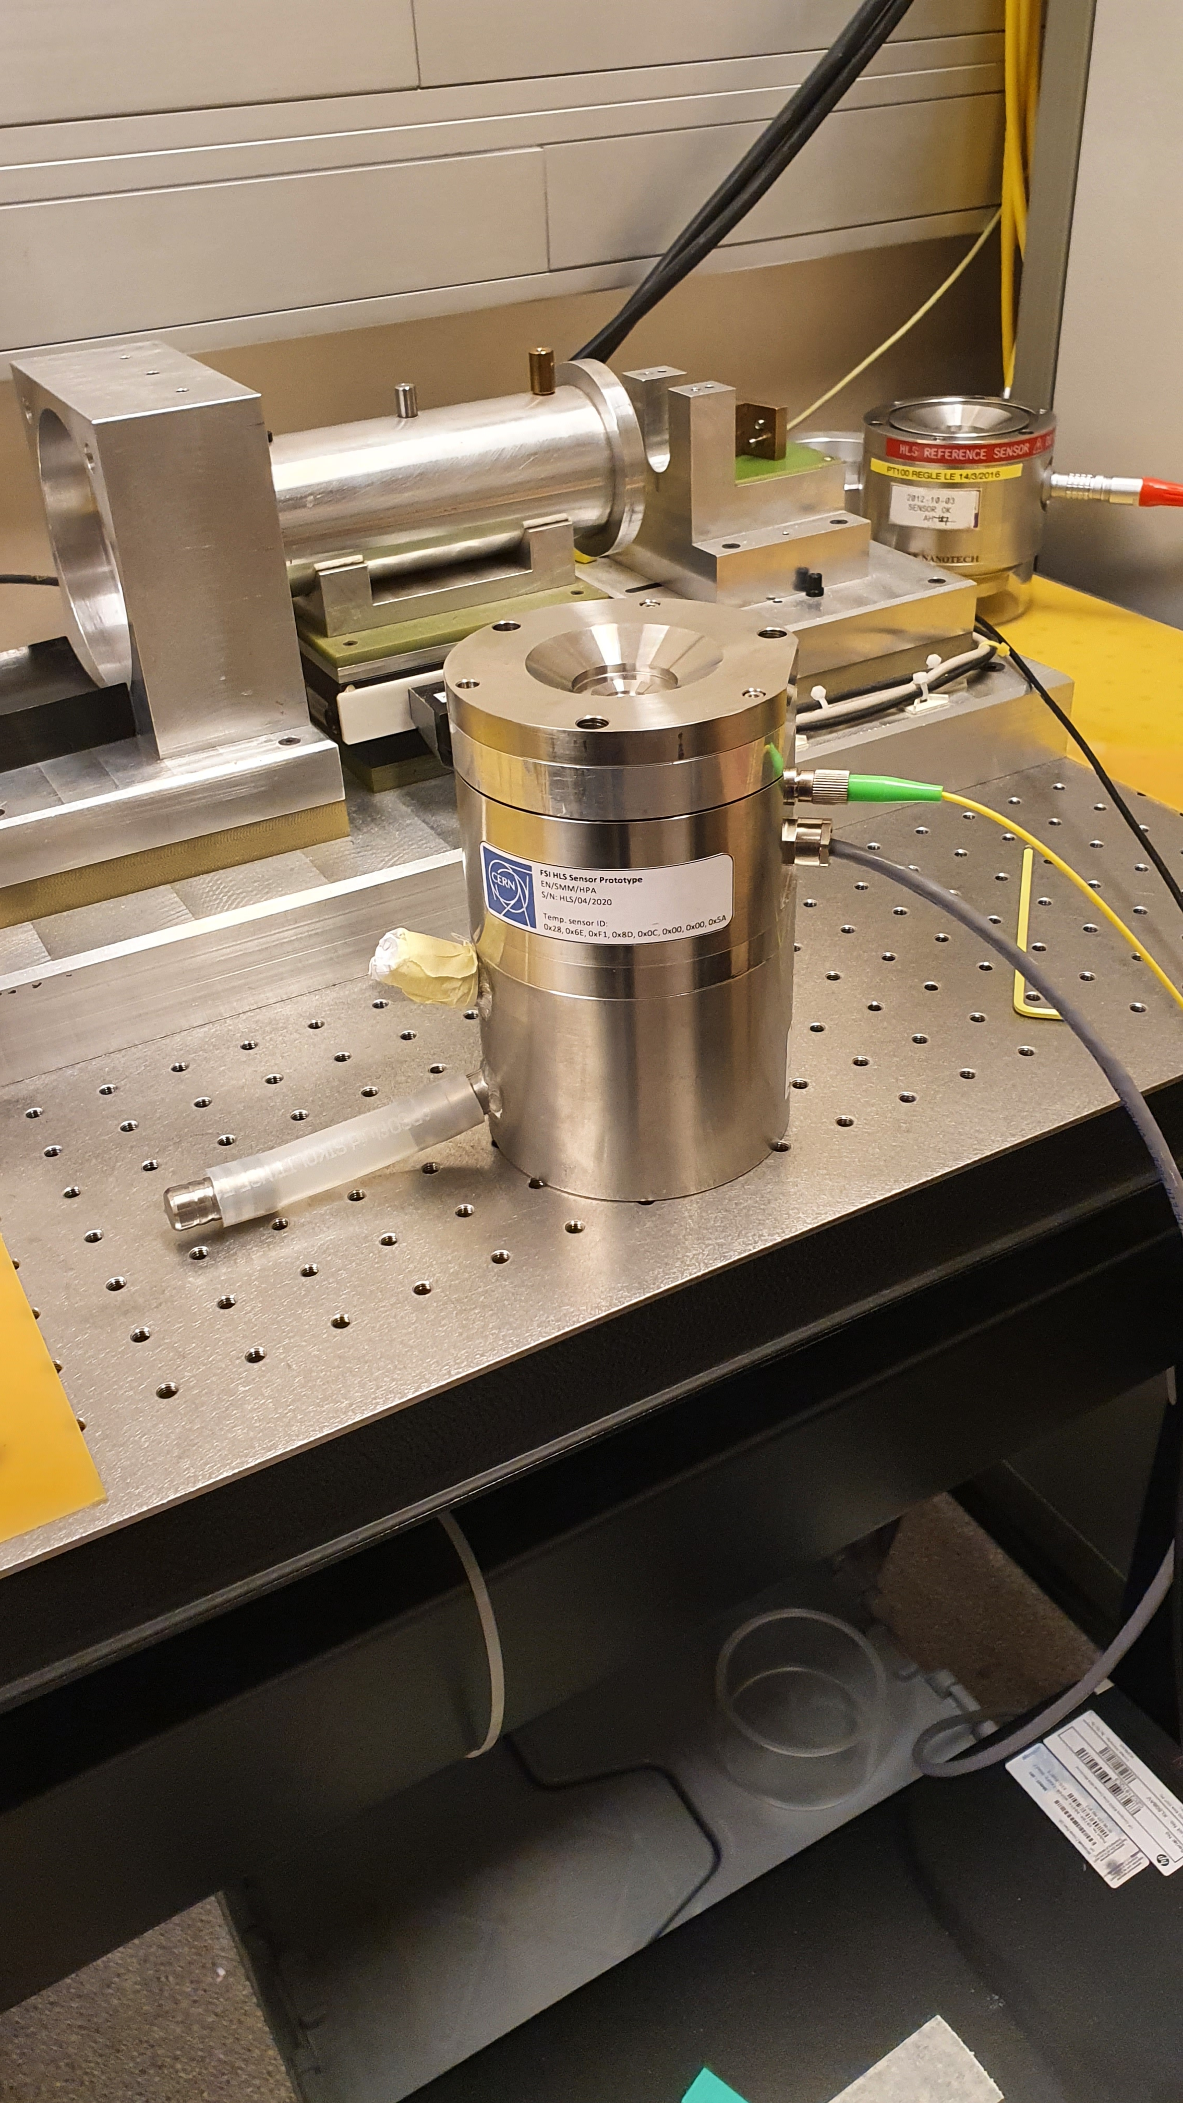
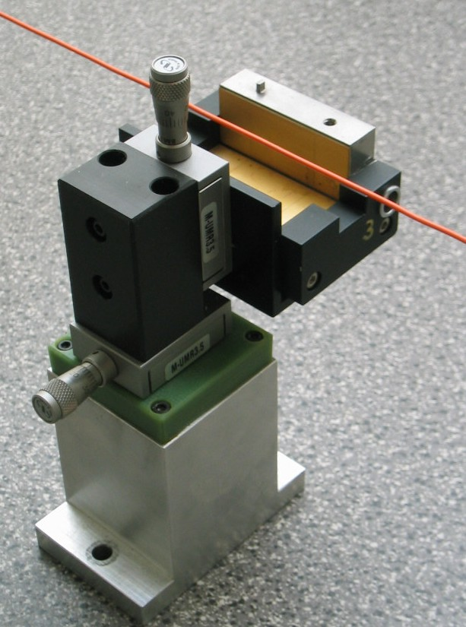
21 observation models implemented today:
LGC : Processing of measurements
  Total Station / Laser Tracker
  Levels
  Distance measurement
  “Ecartomètre”
  BCAM
  Basic Coordinate Measurement Machine
  Inclinometers
  Gyroscope
  HLS
  WPS
  …

Slide 14
LGC Developments
LGC2 Main Software and test protocols:
~31’000 lines of C++ code
SurveyLib Library
~48’000 lines of C++ code
LGC 2
SurveyLIB Library
Geodetic transformations
Least Square Models
Mathematical objects & operations
…
Two major releases per year
  Last release V2.8 (November 2024)

Slide 15


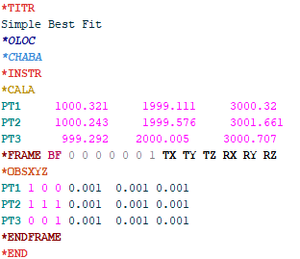
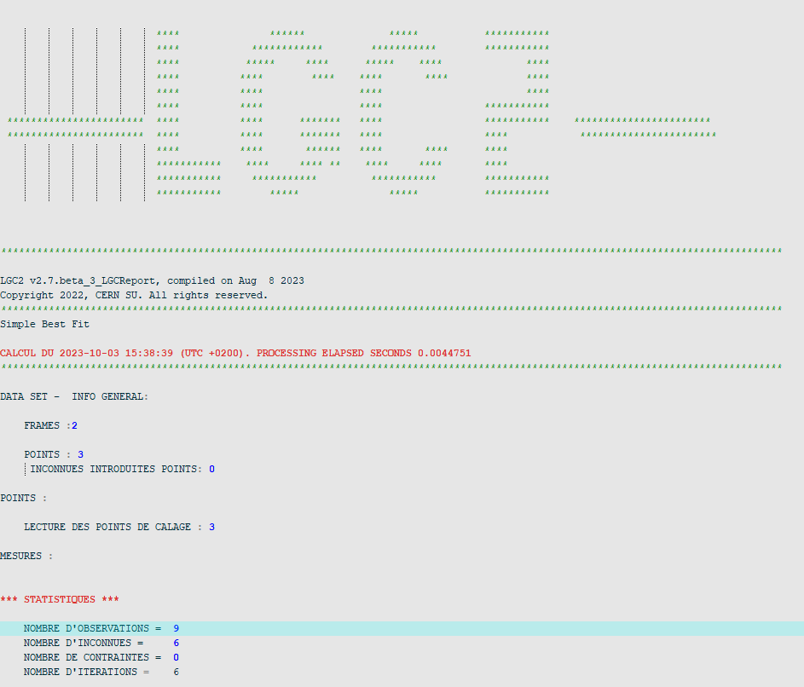
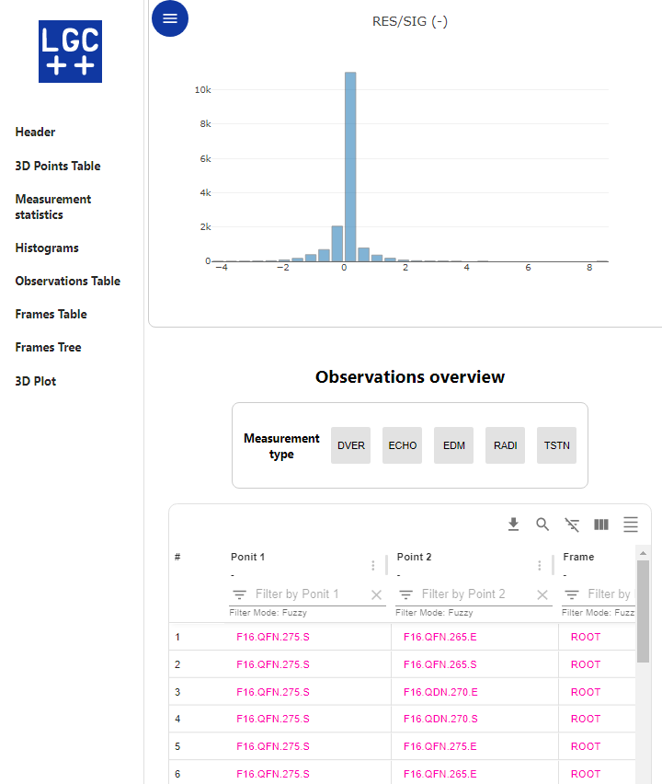
Interacting with LGC today
SurveyPad Interface
(v1.0 official release on October 2023 )
Command line mode
lgc.exe –i inputPath
Input file
Result files
API
Fileless mode
myLGC.updateMeas(id, new_measurement);
status = myLGC.adjust();
myLGC.getPointEstimatePrec(pointName, "ROOT");
myLGC.getSigma0();
Other APP
(ex.: Monitoring)

Slide 16
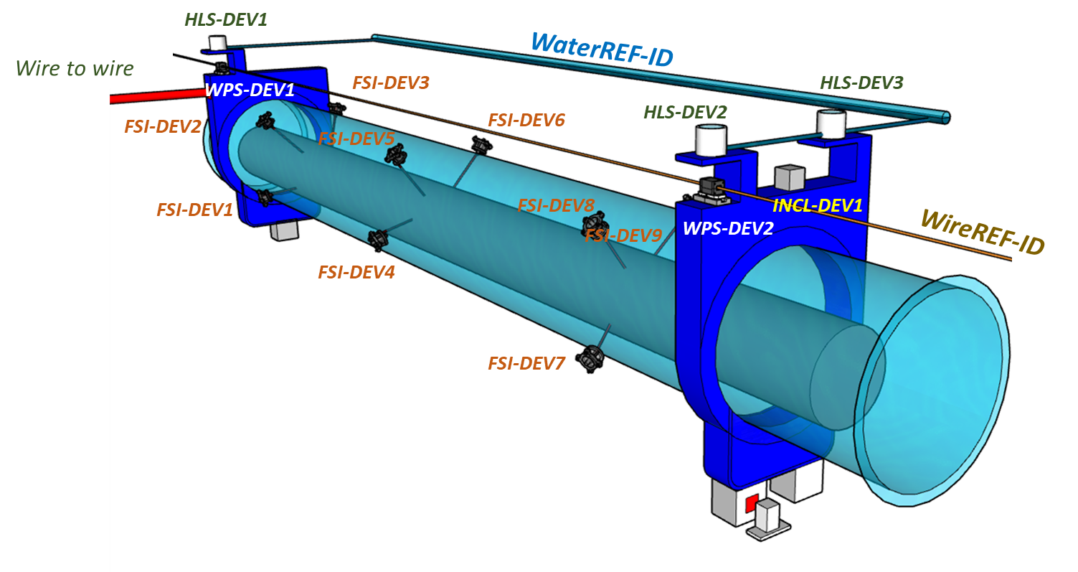
LGC Software and Monitoring Systems
Software has been adapted to monitoring system needs (ex.: FRAS Project)
  Calculation speed
  Robustness: data consistency check
  Structured output data (serialization)
  Library (API) with public methods

Slide 17


LGC and the outside world…

Slide 18

LGC Open Source: main motivations
  Allow other particle physics institutes and academic partners to use and contribute to it.
  Potentially have a bigger LGC community to get contributions, code review, bug reporting, improvement ideas, etc. → more use cases and mutual aids!
  Contribute to develop an ecosystem of post- and pre-processing tools (ex.: Python scripts) shareable within the community.
  Overall increase LGC quality and transparency

Slide 19
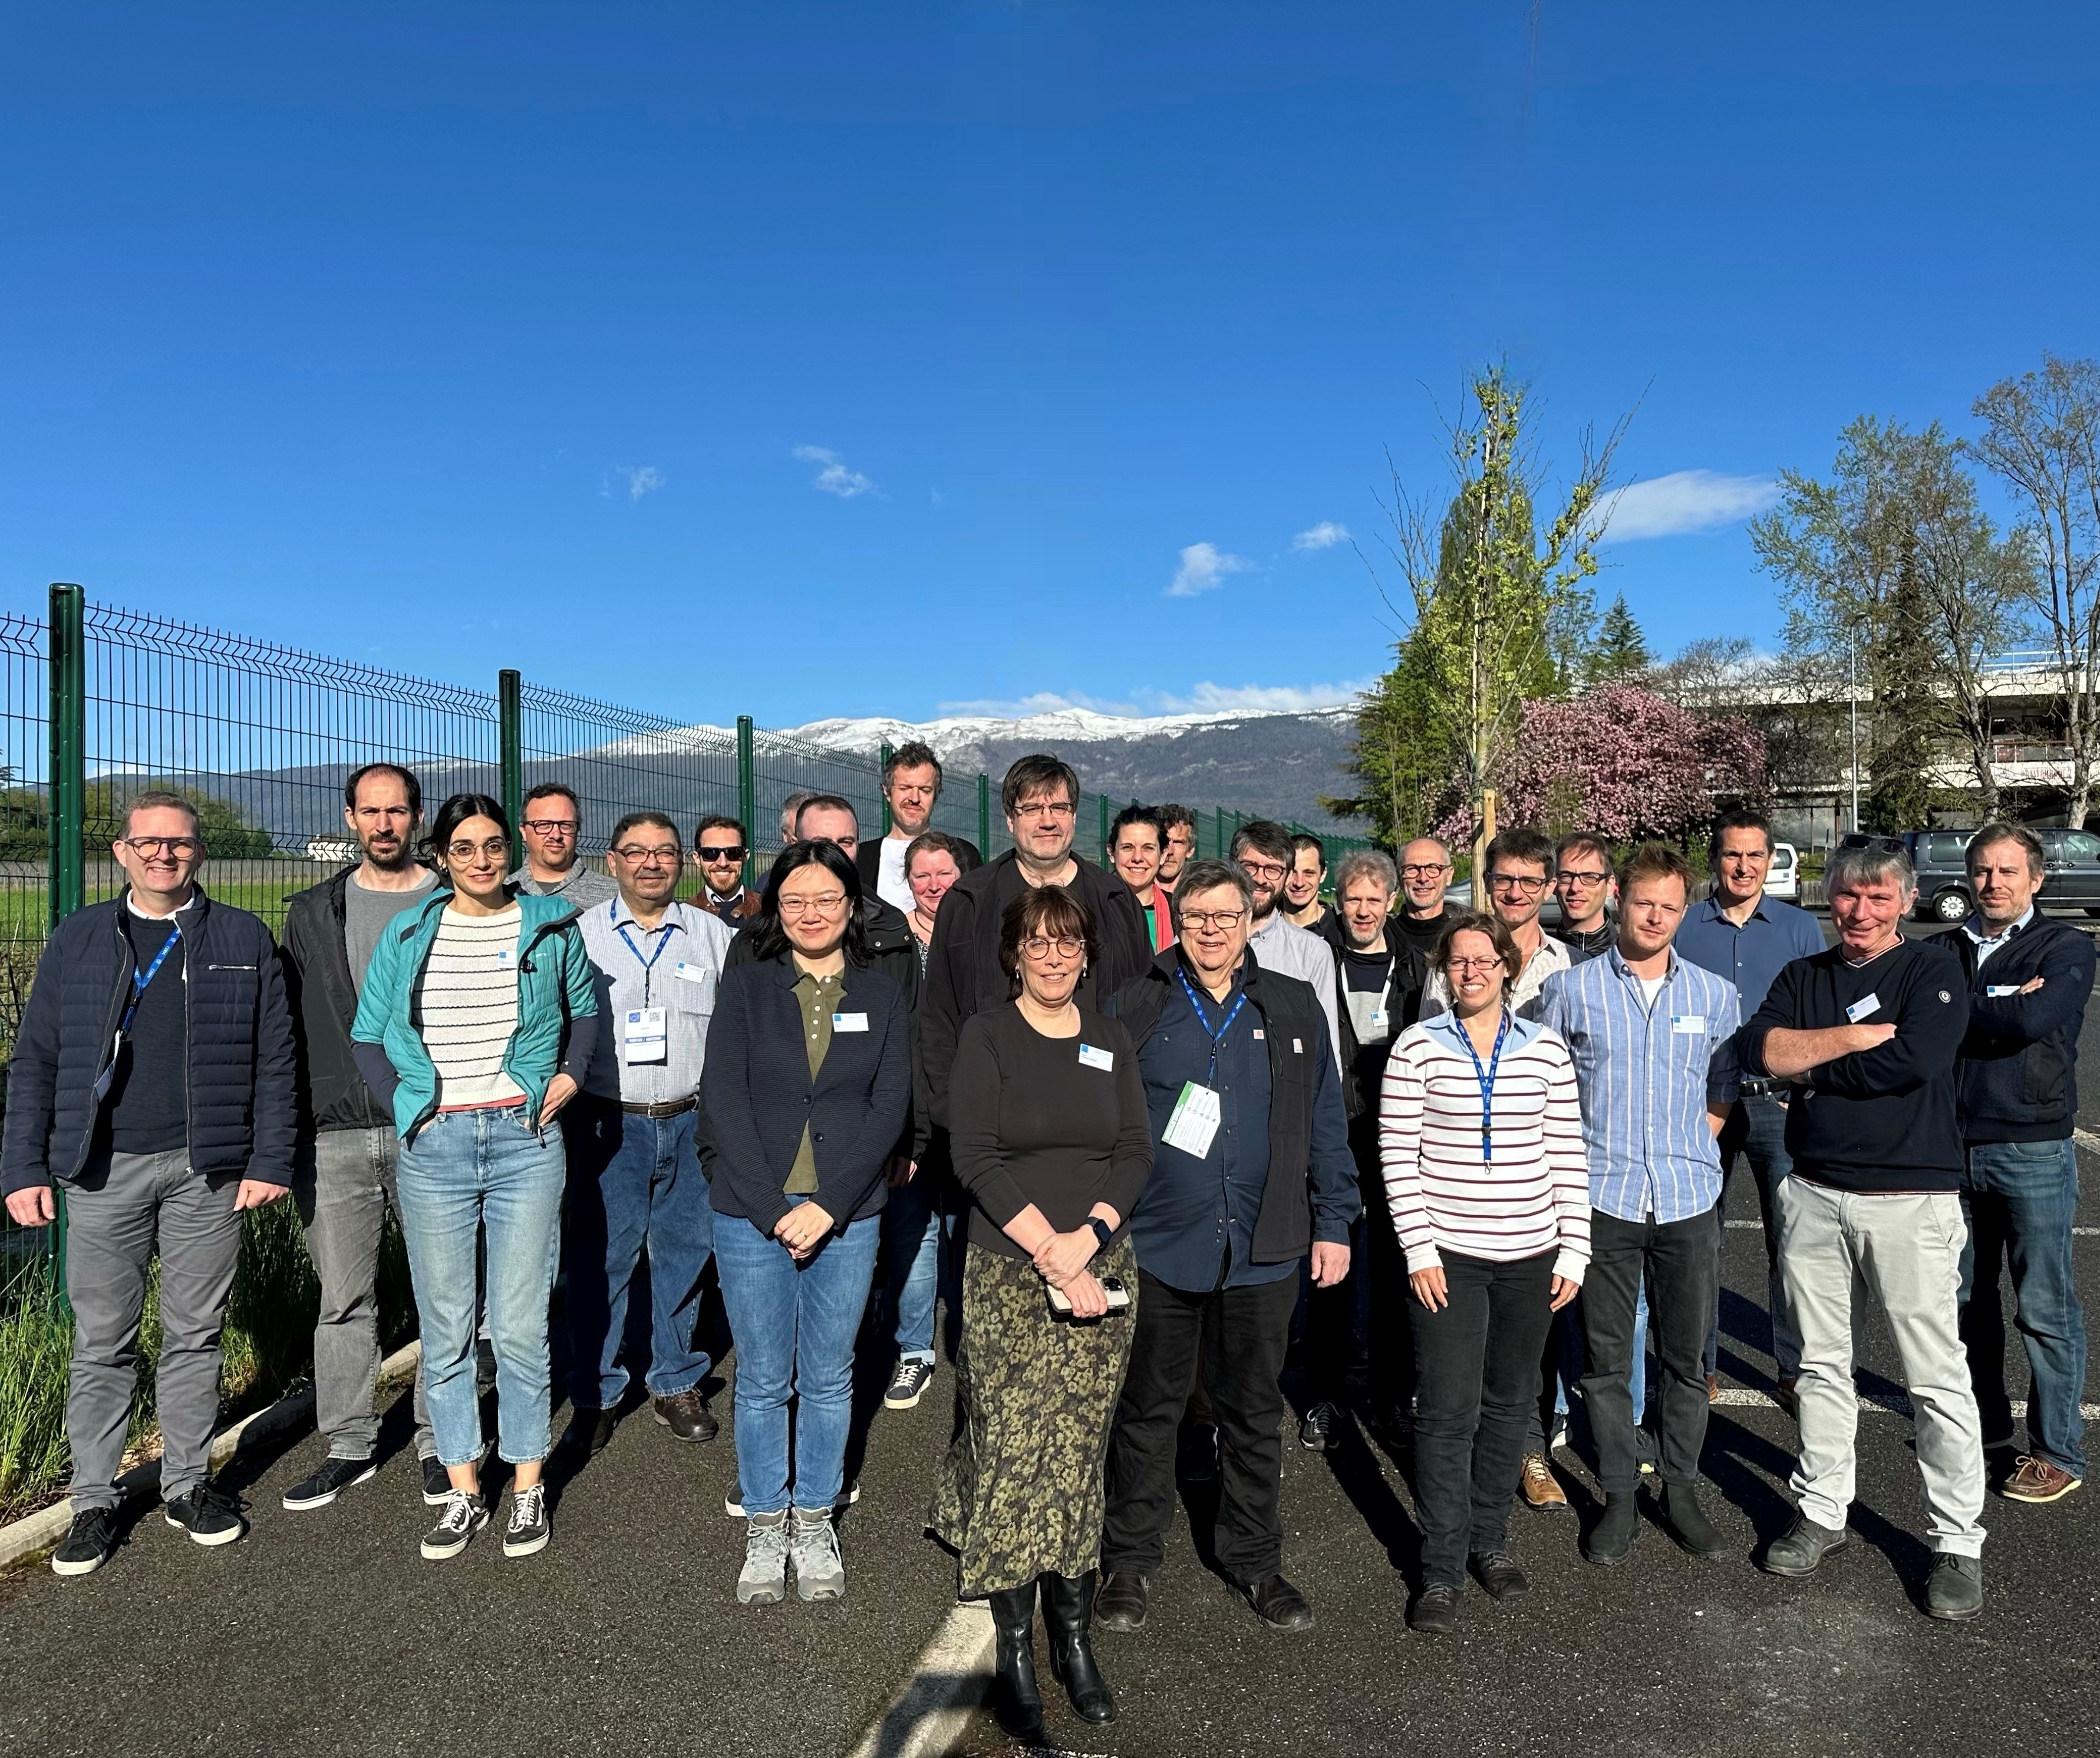
LGC Open Source Project @ CERN
Historically, some exchanges in the past with CERN KT (Knowledge Transfer) for ESGT and IGN collaboration agreements (no open-source objectives).
Project started with the new CERN Open Source Program Office (OSPO, inaugurated in Nov. 2023)
Kick-off meeting in January with BE representatives, followed by other meetings and the writing of detailed documentations.
LGC has become a pilot project for their program.
Code analysis: no roadblock on LGC / SurveyLib and potentially SurveyPad (ongoing analysis).
Workload still to be evaluated and planned.
CERN Alignment Seminar 2024 (9-11 April) was an important milestone:
Participants (ESRF, ALBA, SOLEIL, GANIL, GSI, DIAMOND, MAX IV, DESY) expressed their wish to use and contribute to a common adjustment software based on transparent/documented algorithms: they approved our project !

Slide 20
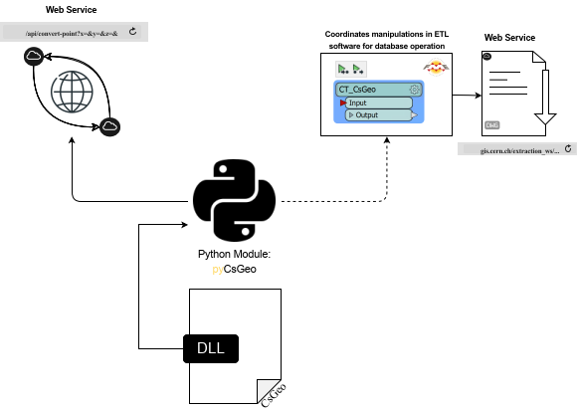
Geodesy: Transformation Software
New geodetic transformations based on French and Swiss national systems
New APIs to transform coordinates from any reference system to another:
Web Service
Geographic Information System (GIS)
Integrated into GIS software at CERN (via Python wrapper)
Deployed through Web Services (REST API)
Web Service
Python Wrapper

Slide 21
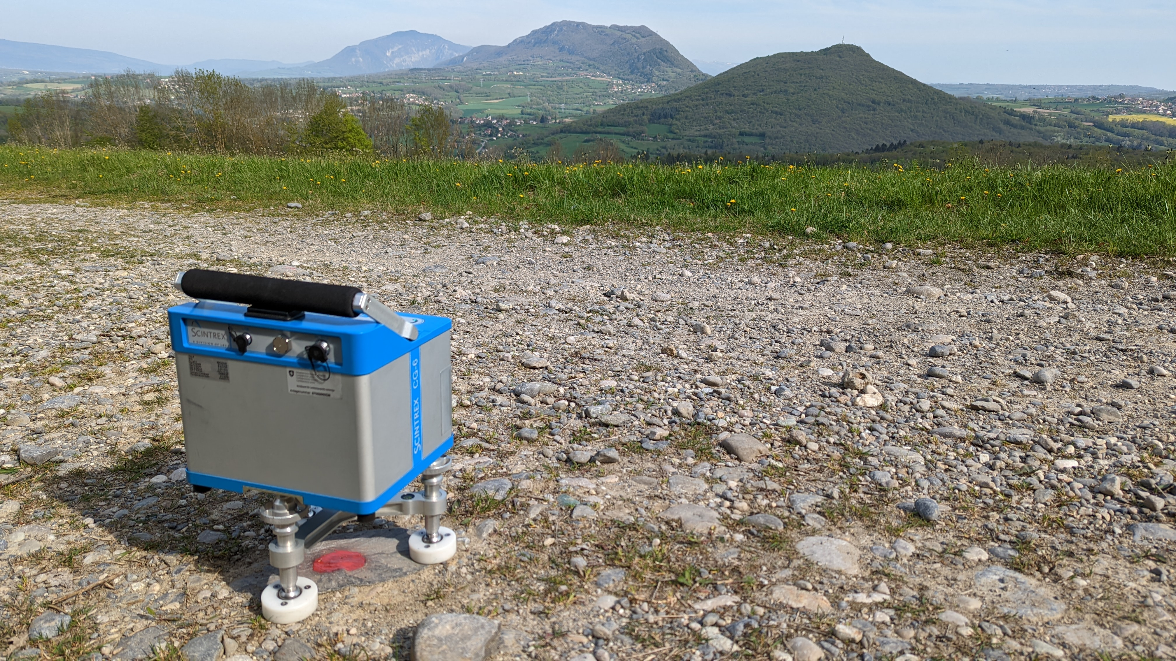
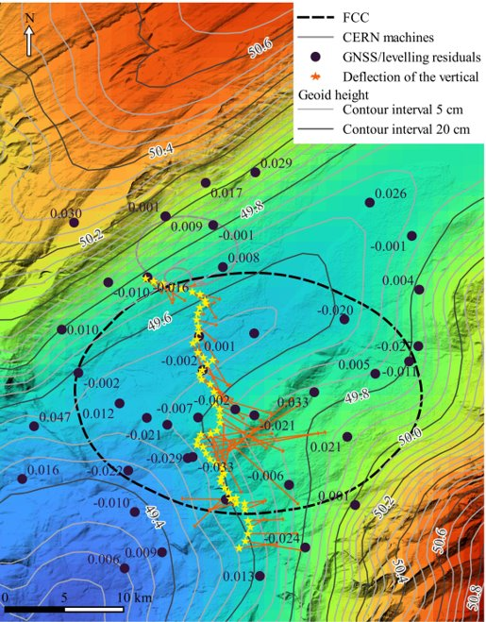
Geodesy: Contribution to FCC Project
Collaboration between CERN, ETH Zürich, HEIG-Vd, Swisstopo and IGN
Desk study and software development:
  Definition of new coordinate reference systems
  Design of primary surface geodetic network
  Improvement of CSGeo Software
Data acquisition:
  Relative gravity observations (densification of existing observations)
Data processing:
  Computation of geodetic-control profile (processing of GNSS, levelling and astro-zenithal observations)
  Computation of a first solution of local geoid model
Gravity observation
Local gravimetric geoid model

Slide 22
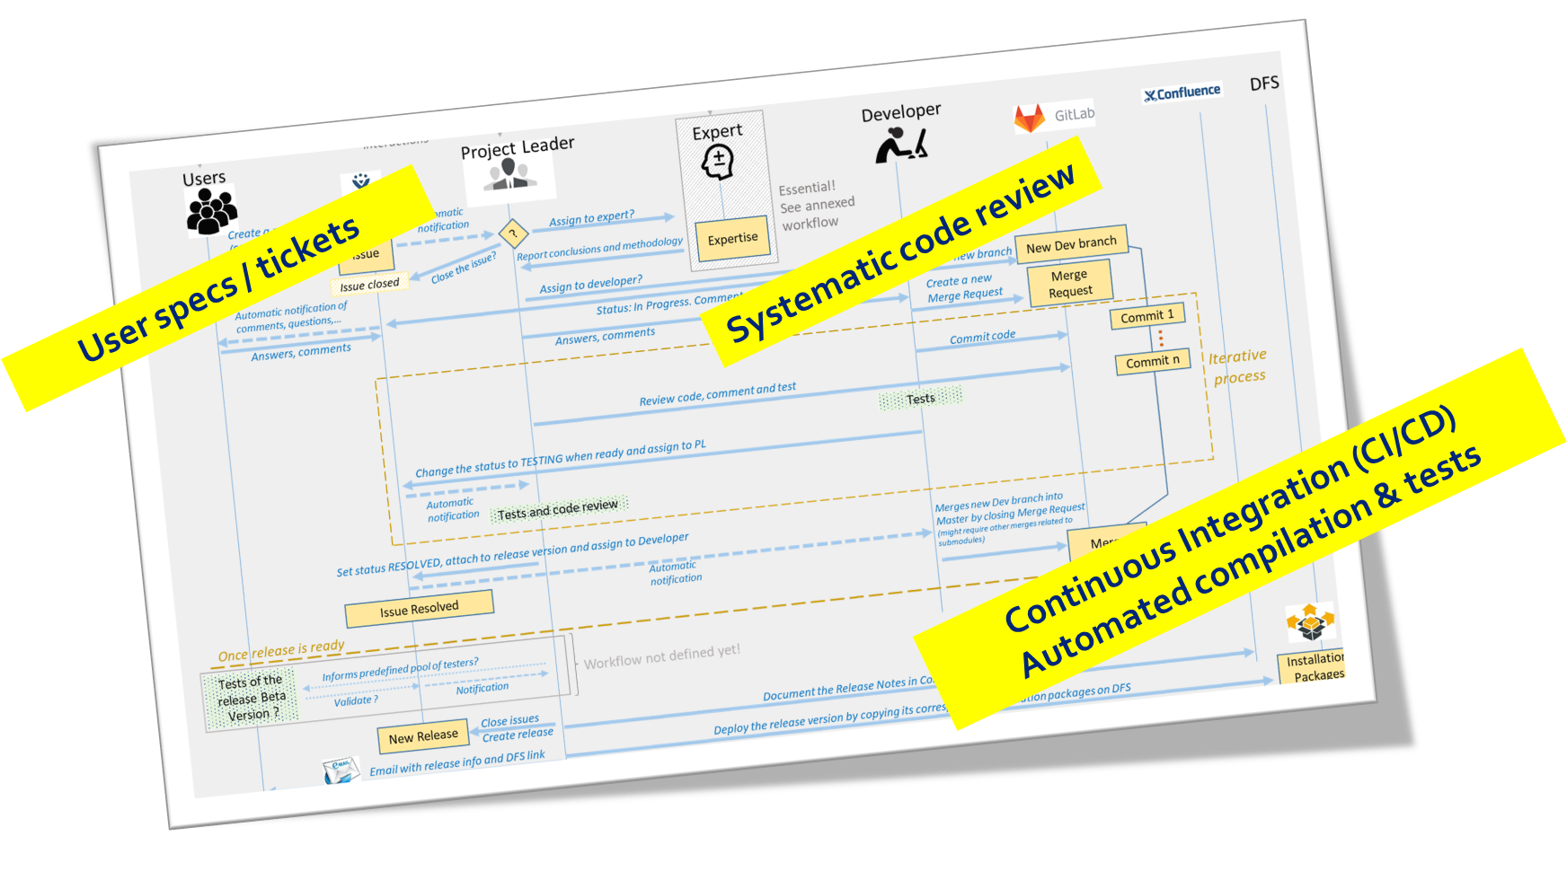


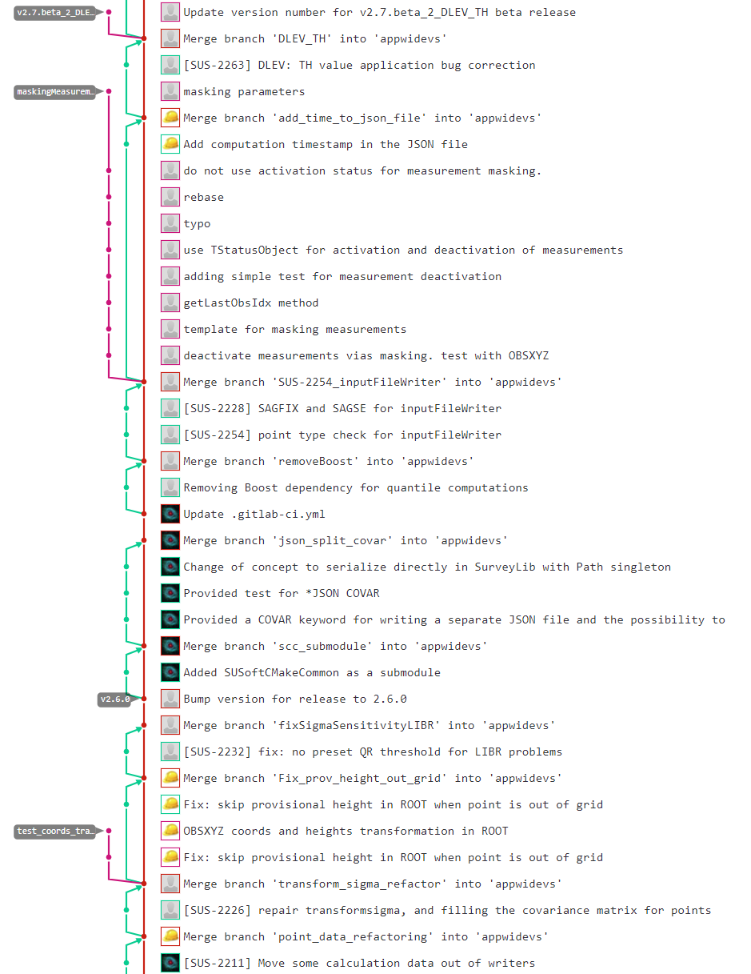
General development workflow
and Quality Assurance
Code Management
For several years, Quality Assurance applied to team developments,
with shared rules, guidelines and documentation

Slide 23
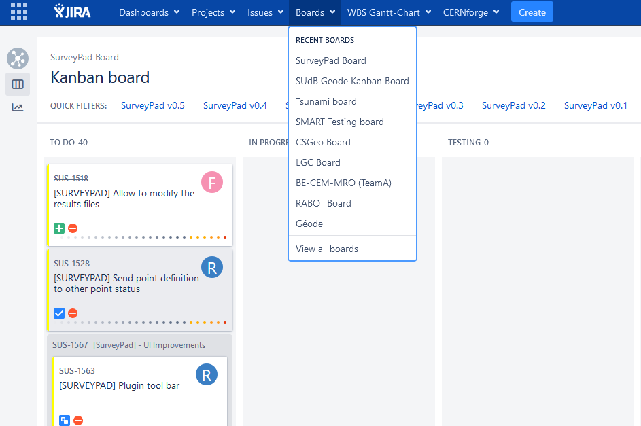
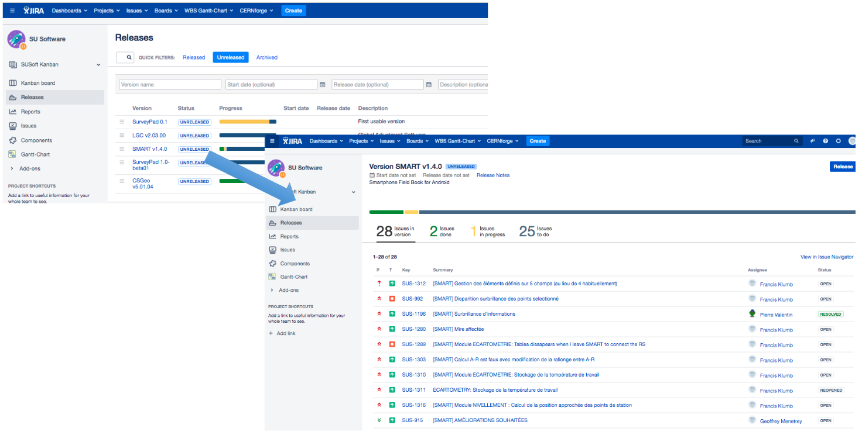
Survey Software - Intensive use of JIRA
Users have become familiar with JIRA tools during LS2: greatly facilitate our communication!
Help to manage our software releases & Project management
Follow the progress of our development & support activities (1 Kanban board per project + scrum-based management for specific consolidation projects)

Slide 24


