Slide 1

Structured laser beam – presentation for KEK visitors
Martin Dušek – BE/GM/ESA
12.3. 2024

Slide 2
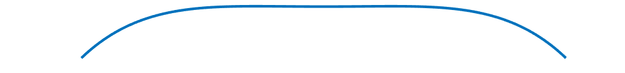
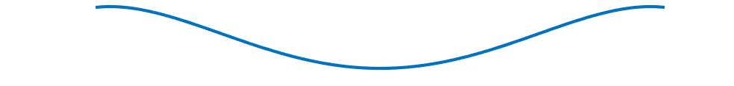
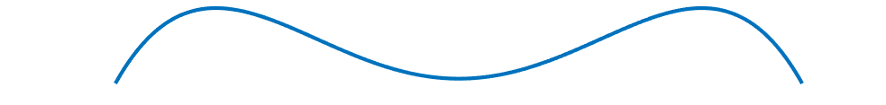
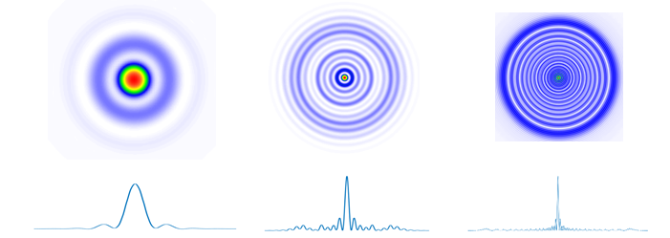
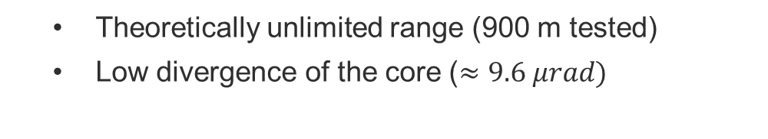
Structured Laser Beam (SLB)
  Pseudo-non-diffractive beam
  Generated by symmetrical optical aberrations
  Adjustable core size
Generated wavefronts
Plano-convex Lens
Plane wave
Ball lens
Wavefront measurement plane
  Theoretically unlimited range (900 m tested)
  Low divergence of the core ($≈9.6 μrad)$
Zero-Phase gradient ring

Slide 3
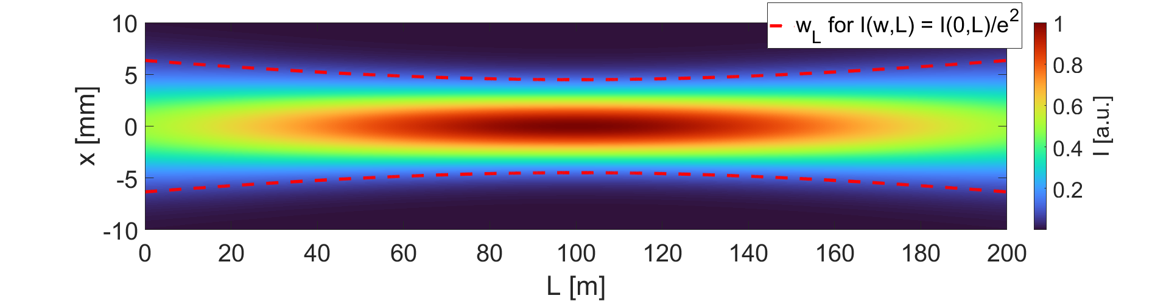
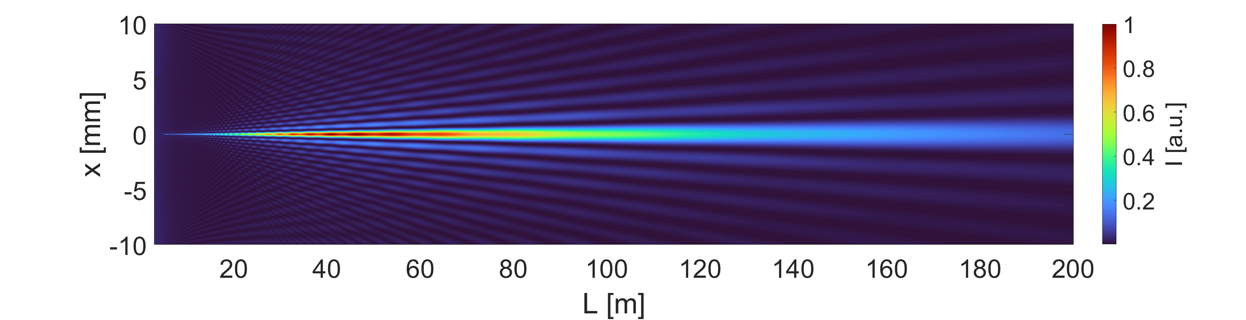
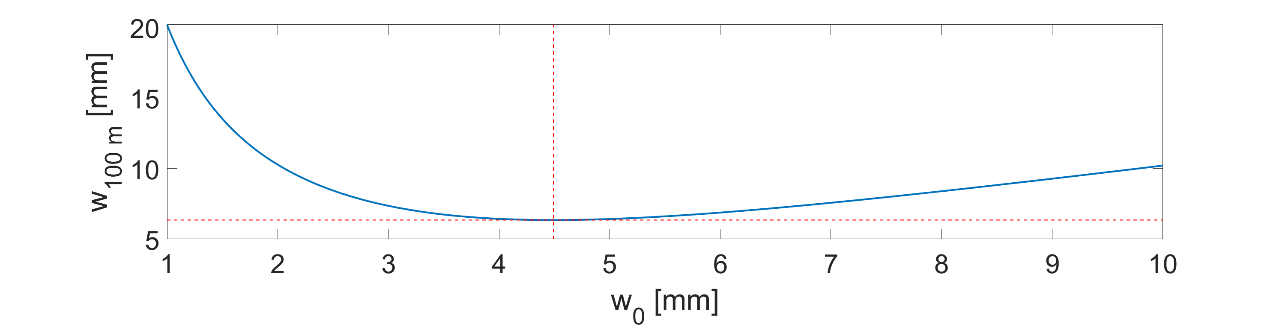
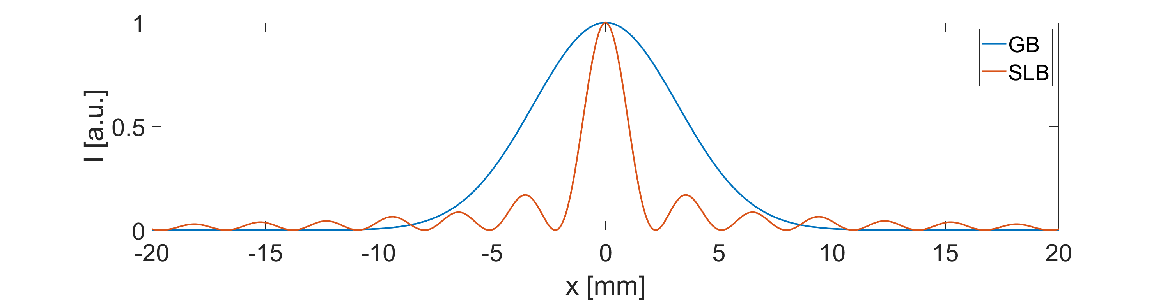
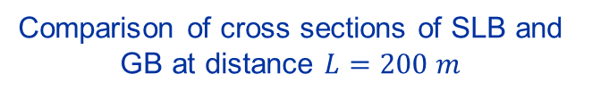
Comparison of the SLB and the GB
Longitudinal profile of the GB
Longitudinal profile of the SLB
Waist optimized for L = 100 m
Comparison of cross sections of SLB and GB at distance $L=200 m$
GB optimization

Slide 4
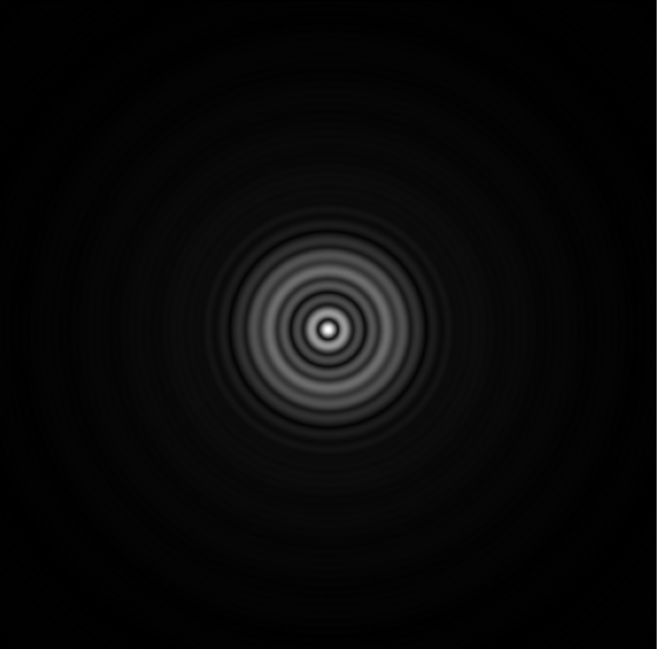
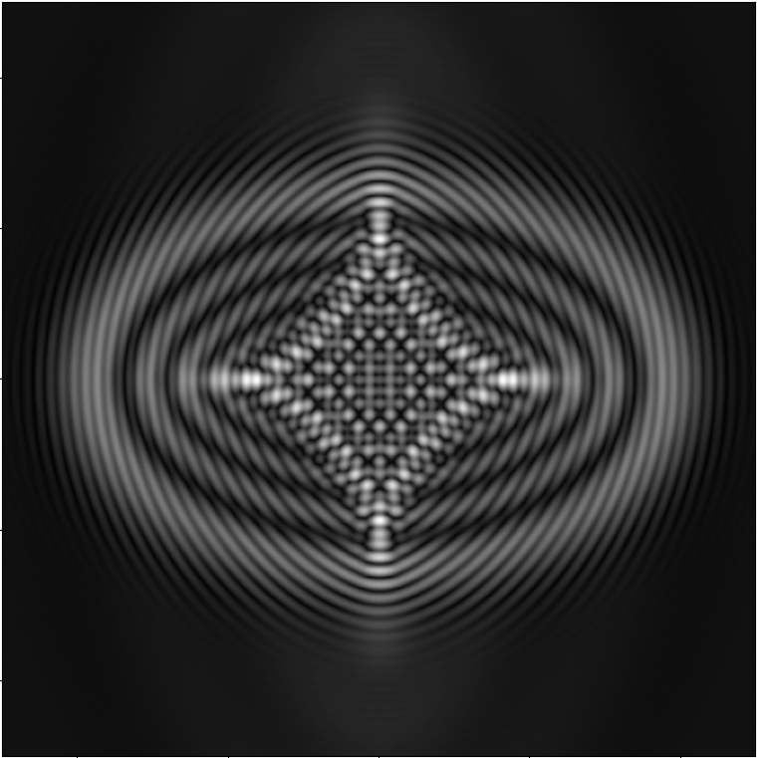
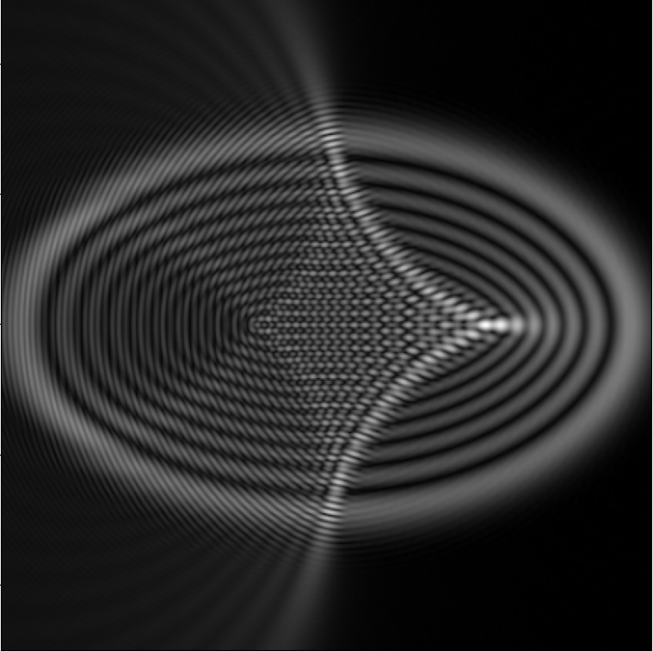
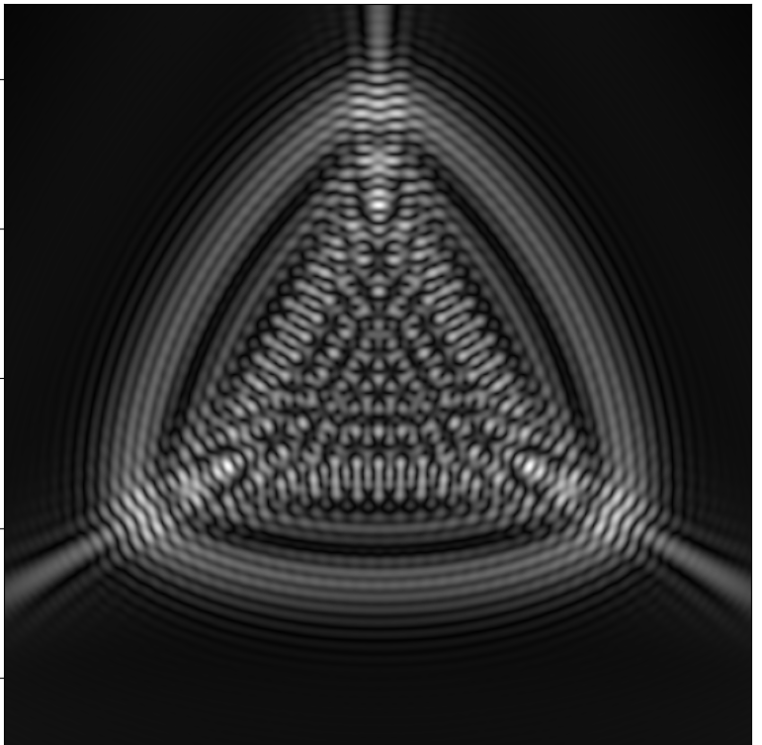
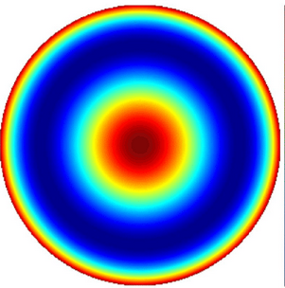
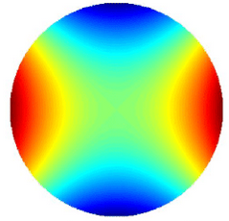
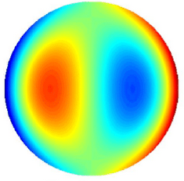
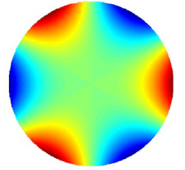
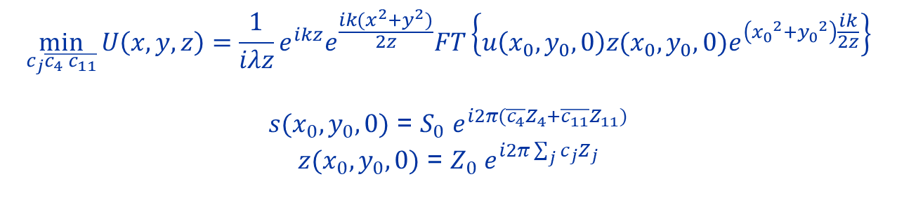
Least-squares fitting
$$\min_{c_{j}\overline{c_{4} }\overline{c_{11}}}{U\left(x,y,z\right)}=\frac{1}{iλz}e^{ikz}e^{\frac{ik(x^{2}+y^{2})}{2z}}FT\left\{{u\left(x_{0},y_{0},0\right)z(x_{0},y_{0},0)e}^{\left({x_{0}}^{2}+{y_{0}}^{2}\right)\frac{ik}{2z}}\right\}$$
$s(x_{0},y_{0},0)$ = $S_{0}$ $e^{i2π(\overline{c_{4}}Z_{4}+\overline{c_{11}}Z_{11})}$
$z(x_{0},y_{0},0)$ = $Z_{0}$ $e^{i2π\sum_{j}{c_{j}Z_{j}}}$
Defocus + Spherical aberration
Astigmatism
Coma
Trefoil
+

Slide 5
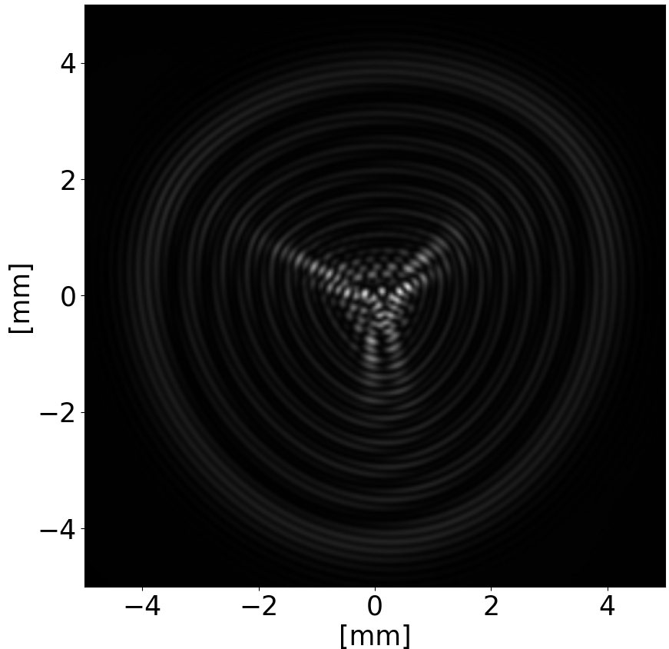
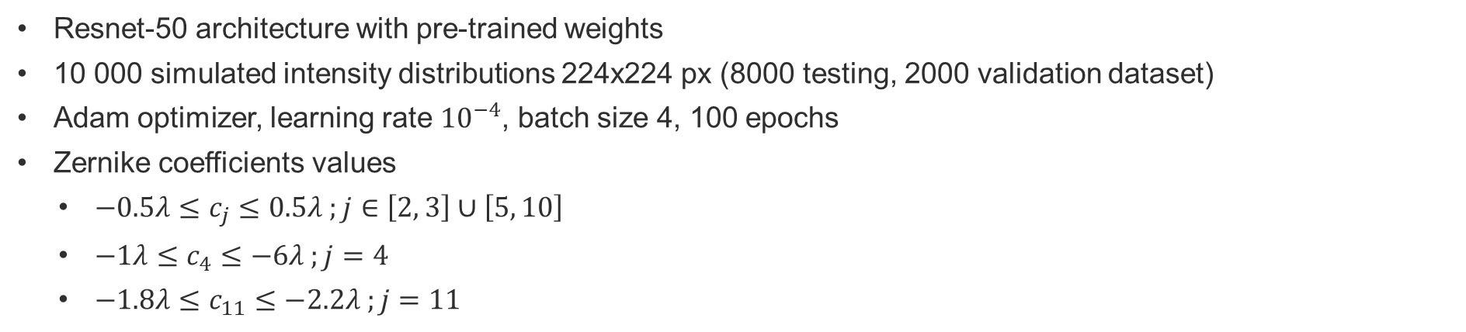
Convolutional Neural Network (CNN)
Resnet-50 architecture with pre-trained weights
10 000 simulated intensity distributions 224x224 px (8000 testing, 2000 validation dataset)
Adam optimizer, learning rate ${10}^{−4}$, batch size 4, 100 epochs
Zernike coefficients values
  $−0.5λ≤c_{j}≤0.5λ ;j∈\left[2, 3\right]∪\left[5, 10\right]$
  $−1λ≤c_{4}≤−6λ ;j=4$
  $−1.8λ≤c_{11}≤−2.2λ ;j=11$
CNN
Estimated
Zernike coefficients
Fitting
Refined
Zernike
coefficients
Measurement in a known distance

Slide 6
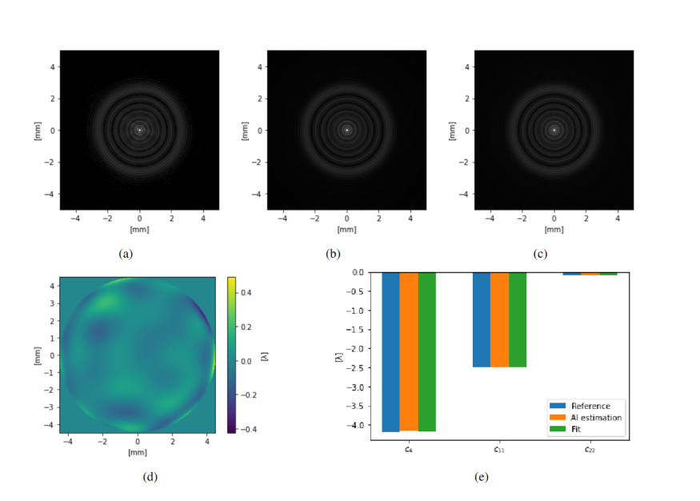
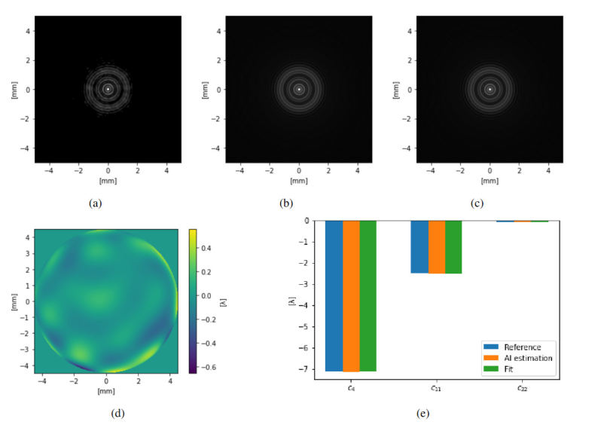
Wavefront detection without aberrations

Slide 7
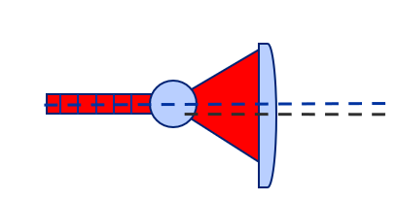
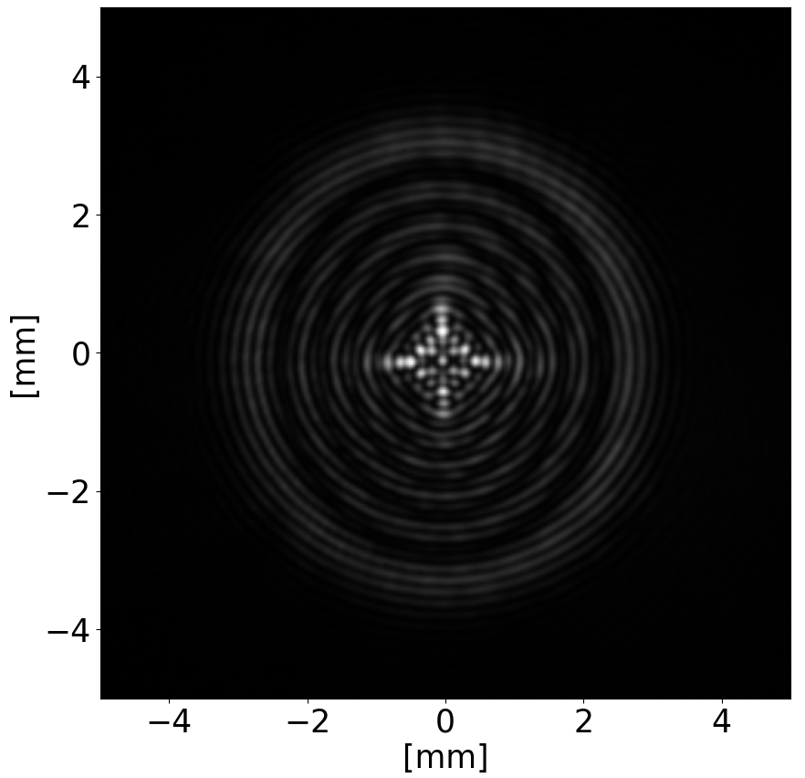
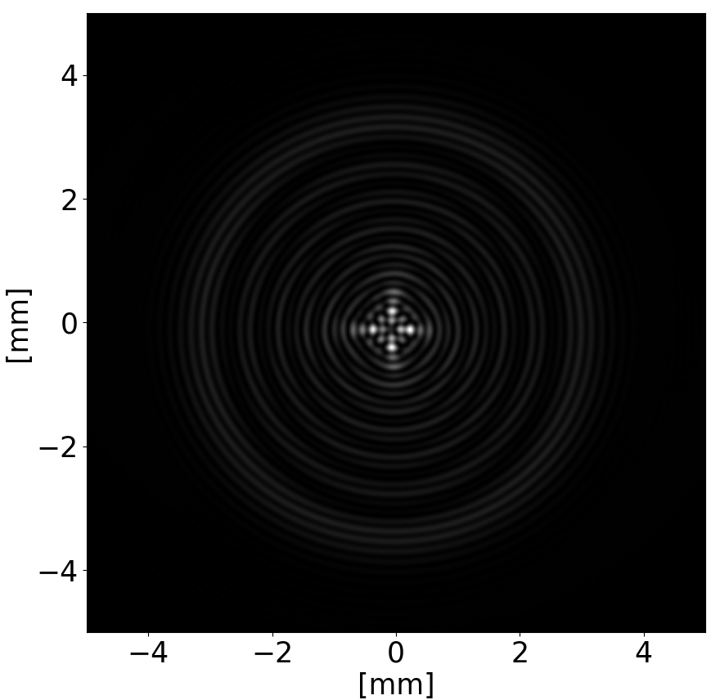
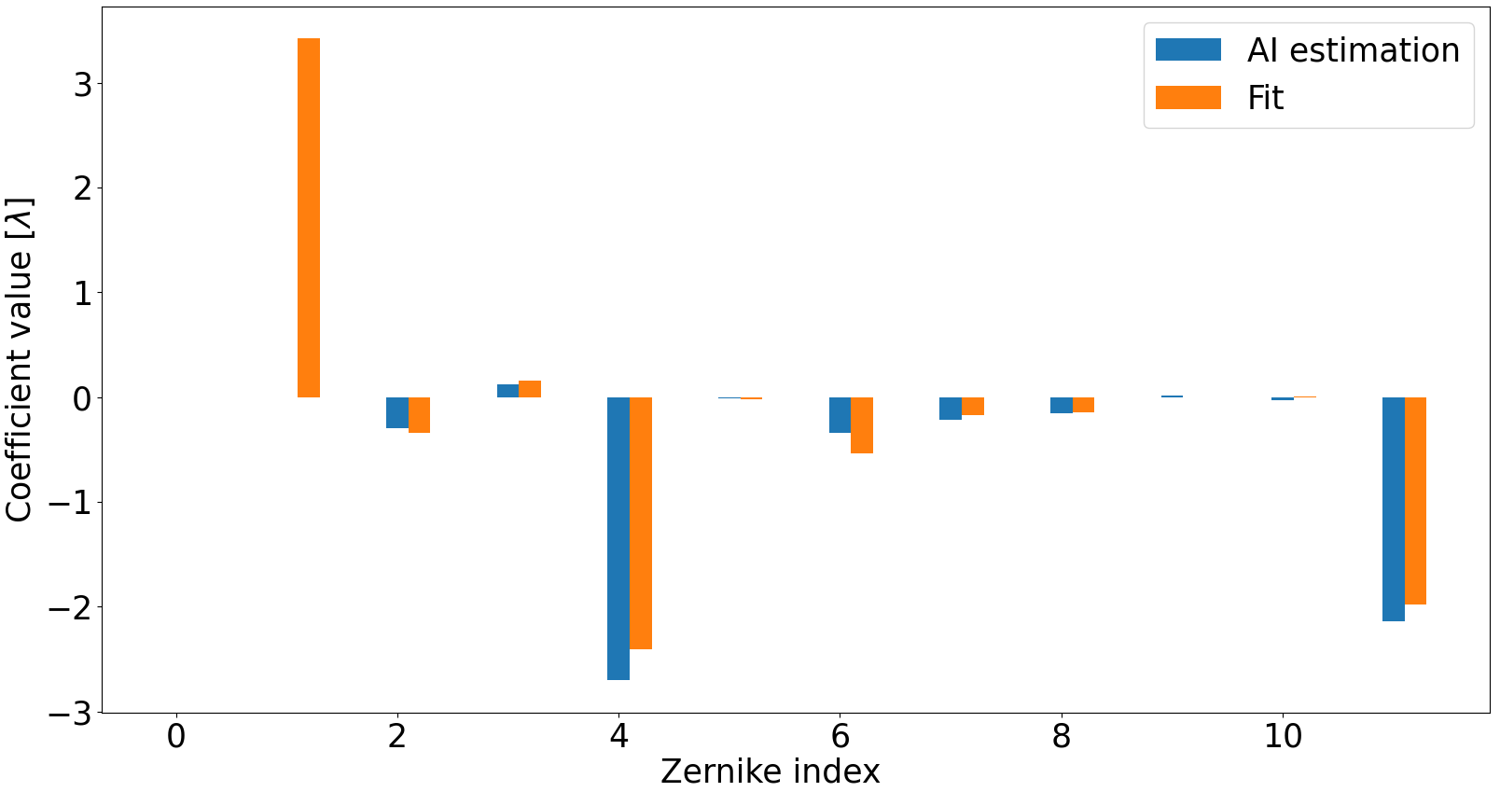
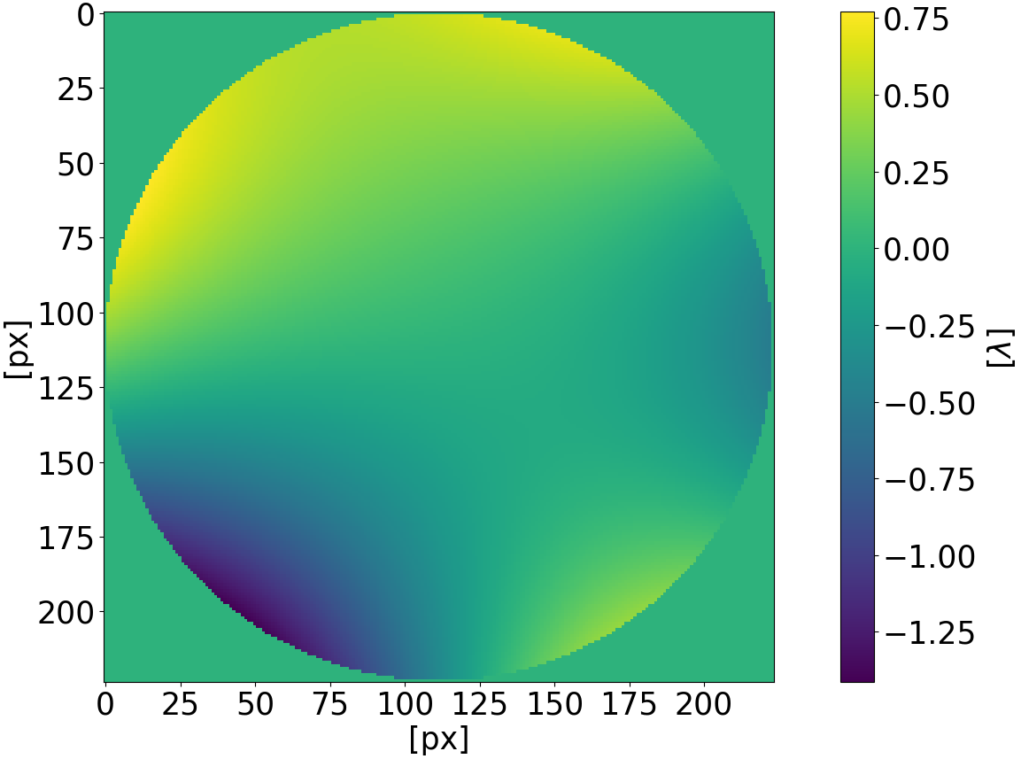
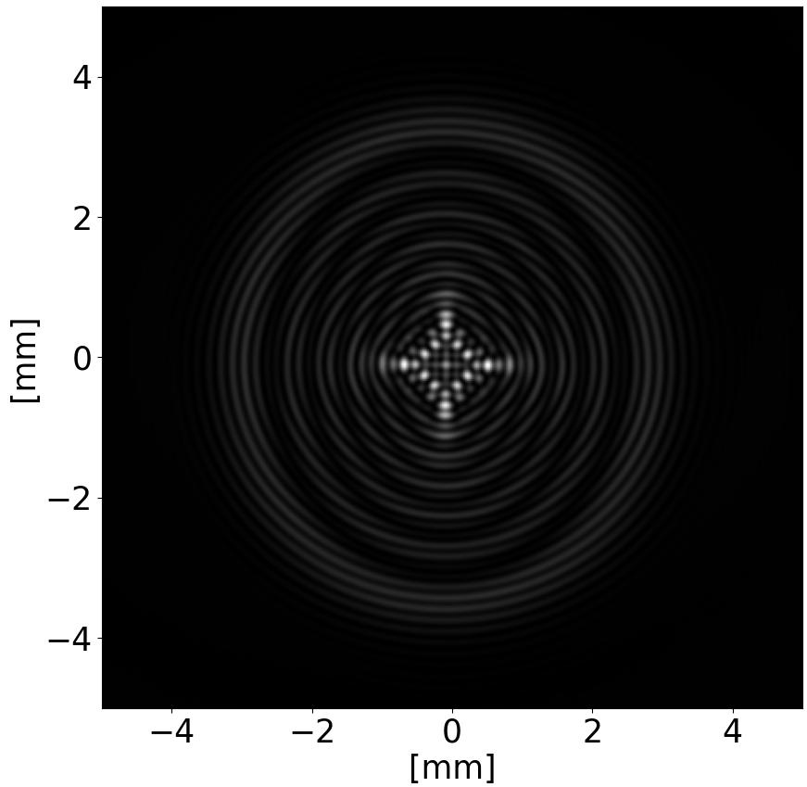
Misaligned projection lens
Measured image
CNN estimation
RMSe = 0.36𝜆 (AI – Fitting)
Peak-to-Valley = 2.1𝜆
Zernike coefficients
Astigmatism
Coma
Trefoil
Wavefront residual (CNN – Fit)
Fitting
Defocus
Spherical

Slide 8

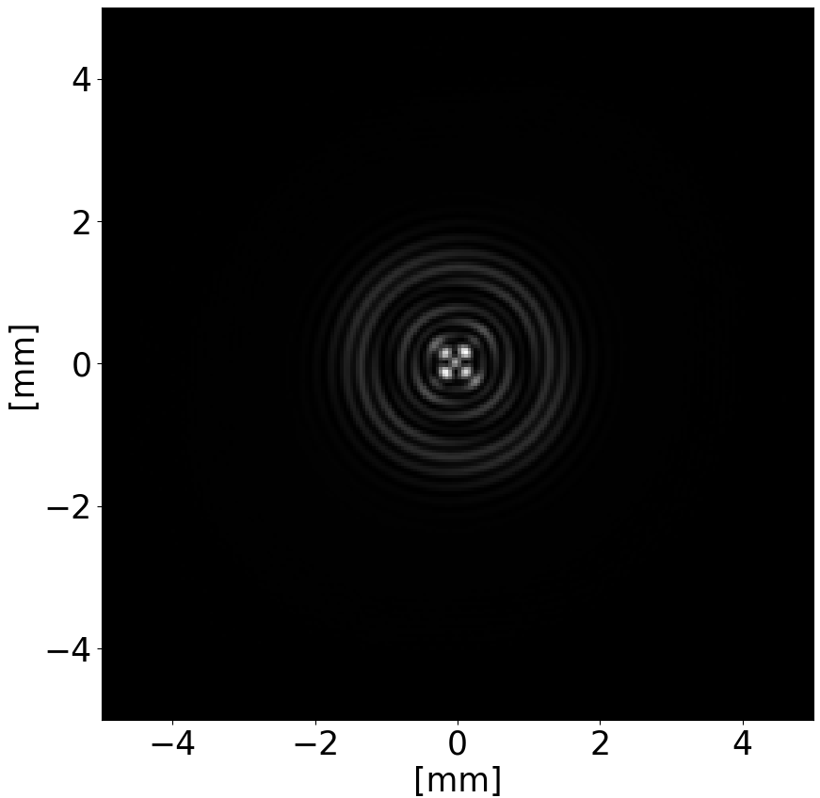
Measurement of the SLB wavefront
Wavefront
Wavefront measurement plane
Zero-phase gradient ring
Non-aberrated SLB
Reference axis
Projection lens axis
Aberrated SLB

Slide 9


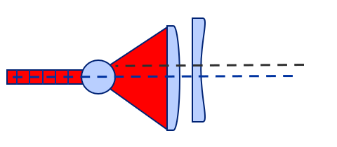
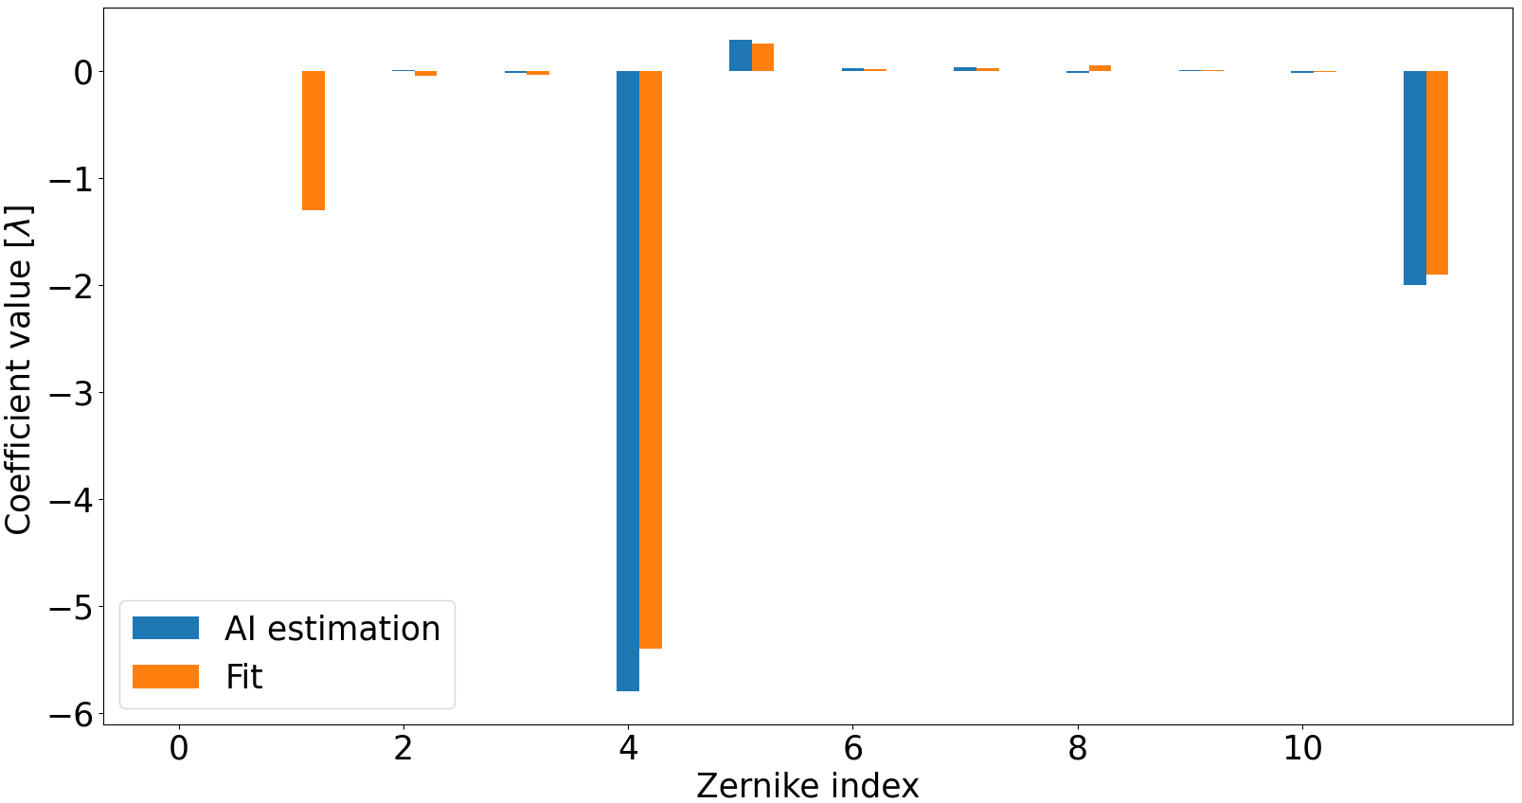
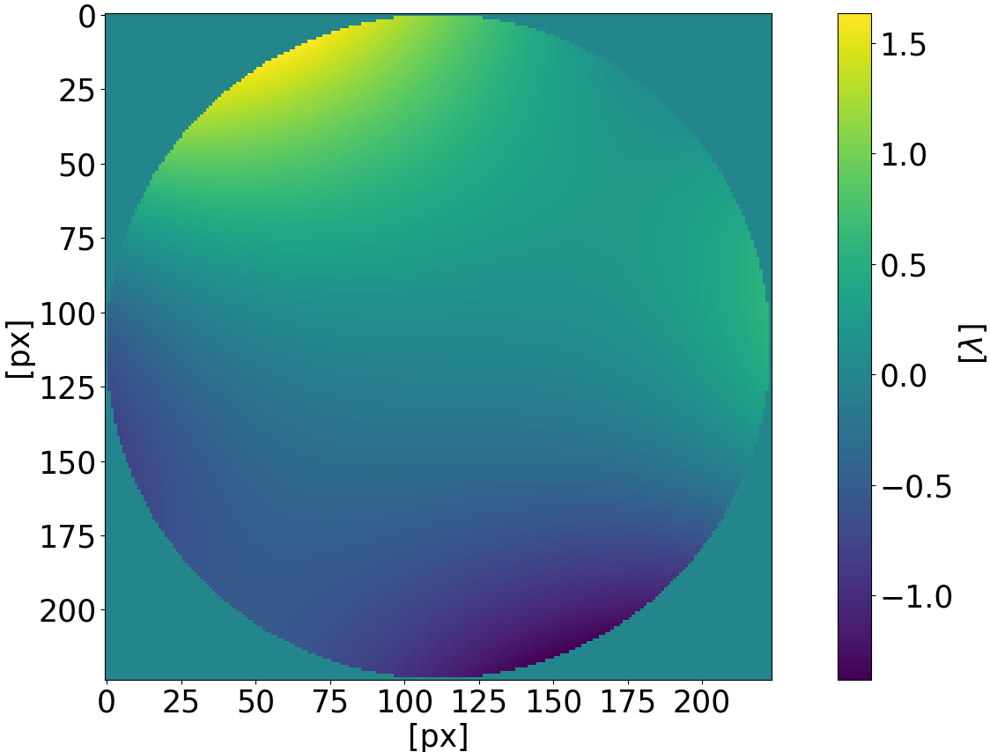
Alignment of a plano-concave lens
Measured image
CNN estimation
RMSe = 0.51𝜆 (AI – Fitting)
Peak-to-Valley = 2.85𝜆
Zernike coefficients
Astigmatism
Coma
Trefoil
Wavefront residual (CNN – Fit)
Fitting
Spherical
Defocus

Slide 10


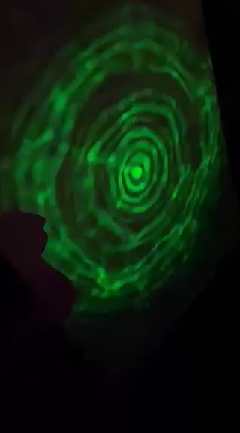
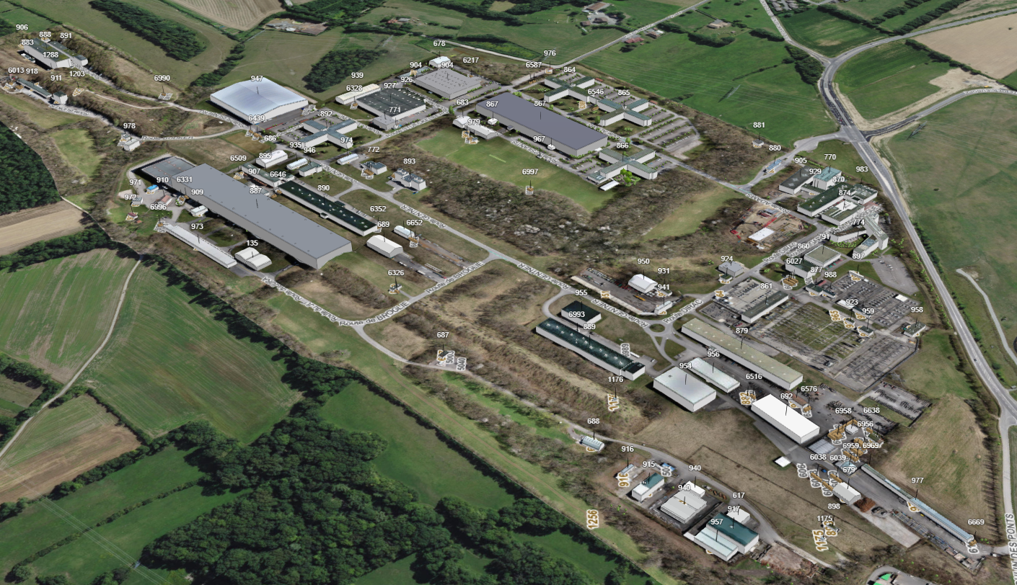
Stability of the SLB
900 m
CERN – France, Prevessin
Beam oscillations after propagating 900 meters in the atmosphere

Slide 11
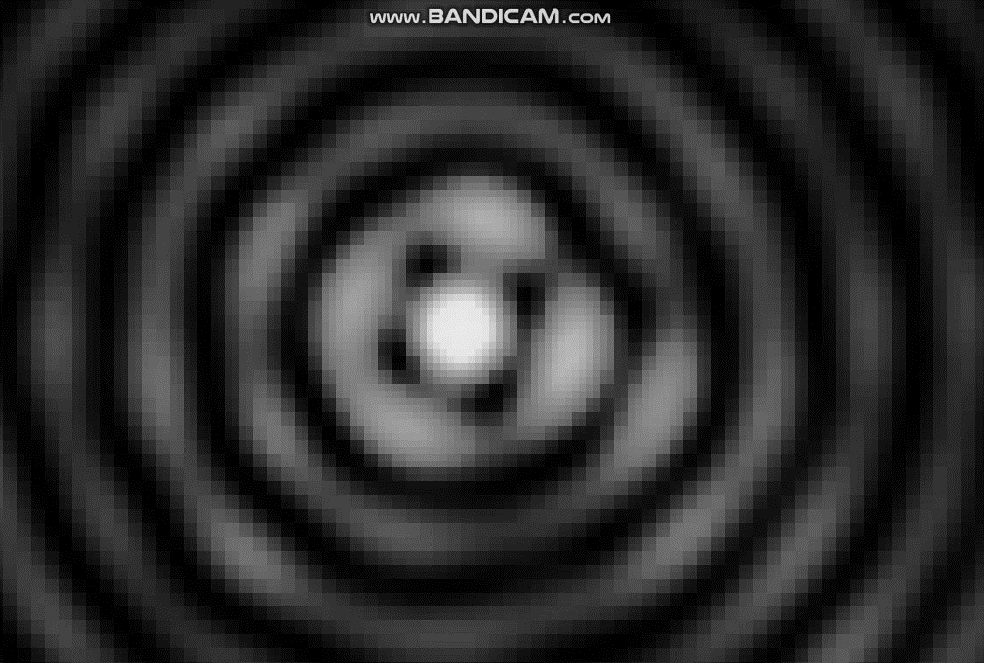
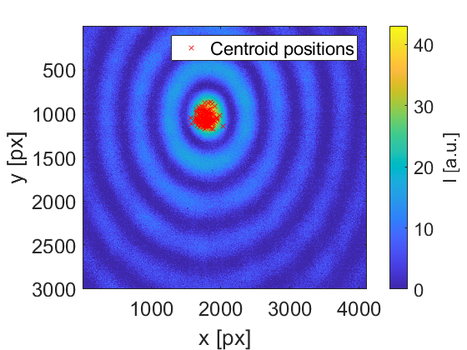
Stability of the SLB
Beam is oscillating due to the air fluctuations of the atmosphere
In the short term, without huge temperature spikes, the beam is oscillating around one point
  Possibility to average data in time
1 mm
Oscillations of a SLB
2 m away from a generator
Real image of a SLB –
120 m away from a generator. Projected on a CMOS chip
14x10 mm² without any imaging optics.
Centroid positions measured for
1 hour. Pixel size 3.45 μm.

Slide 12
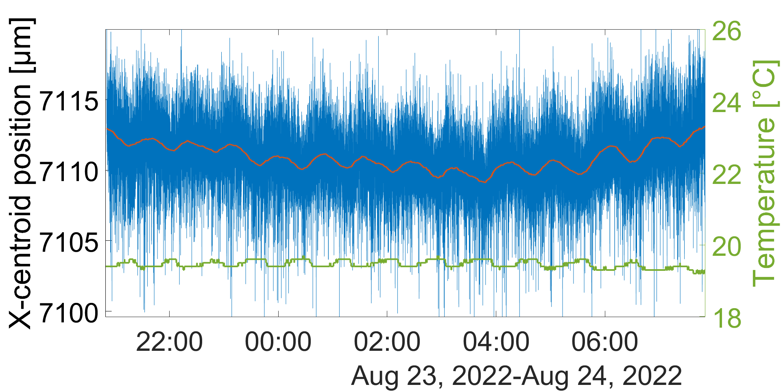
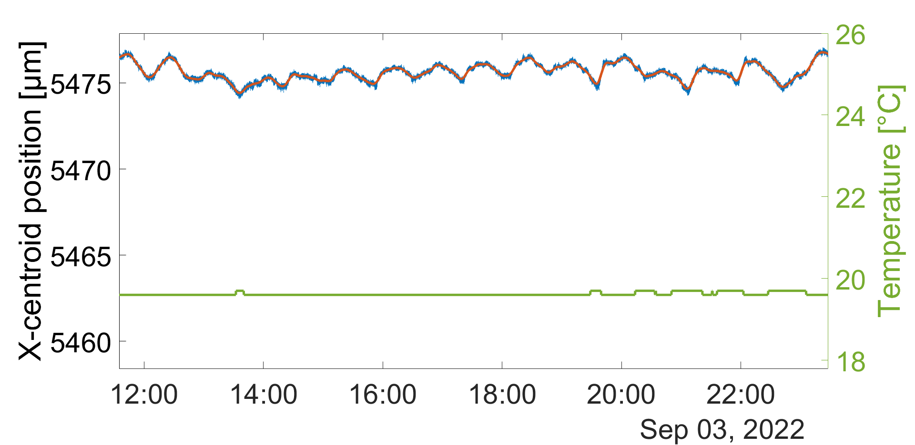
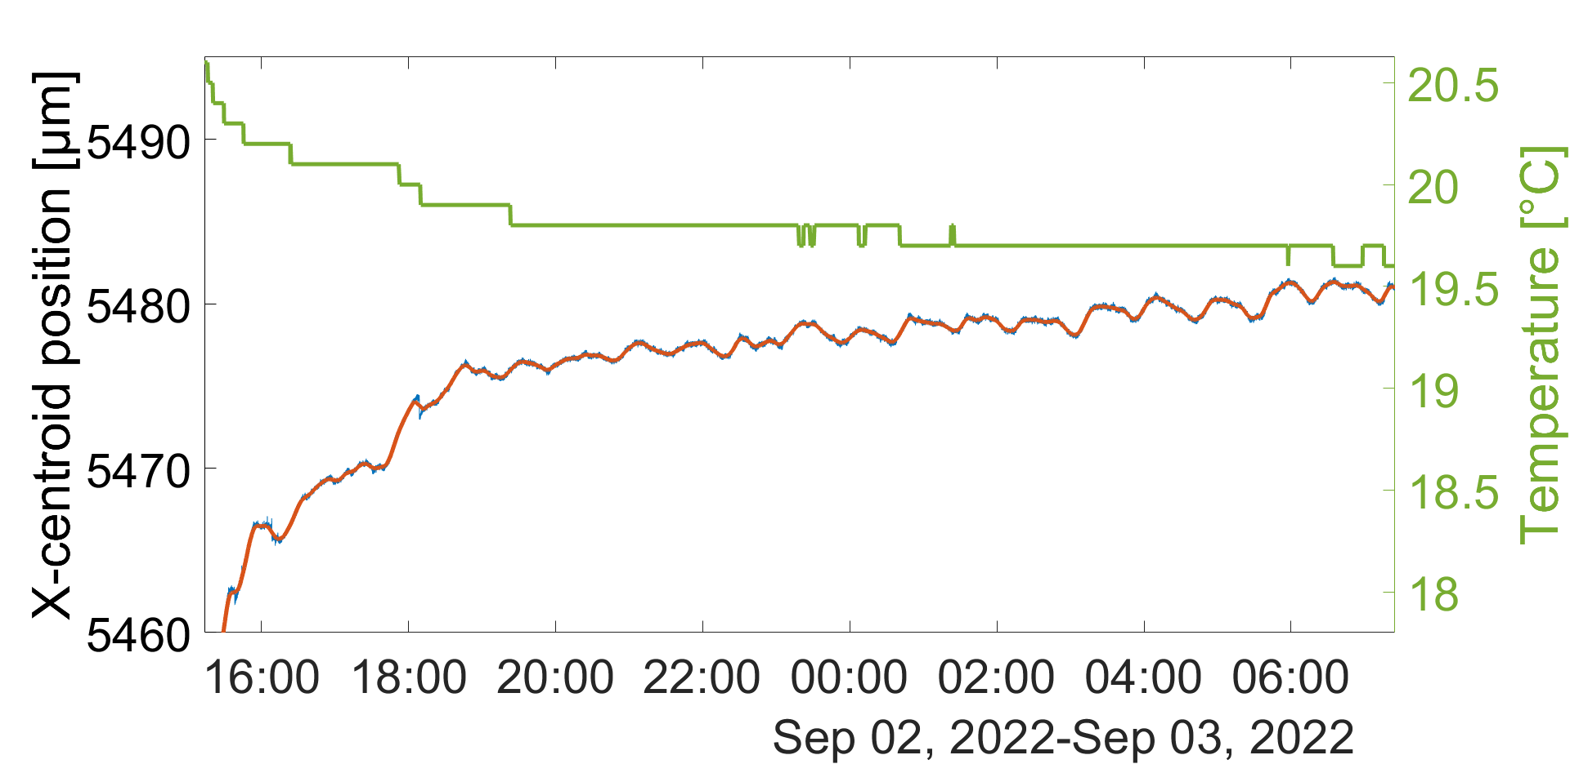
Stability of the SLB
Free-space propagation
Setup aligned using laser tracker
Correlation with temperature
Dependence of the oscillation on the tube gap position
Temperature probe
Movable tube gap
Glass window
Insulated tube propagation
2 m
SLB generator inside the tube
CMOS chip
Results from the laboratory | STD X [μm] | STD Y [μm]
Free-space | 1.53 | 1.3
Tube with a gap in front of the laser | 0.65 | 0.66
Tube with a gap in front of the camera | 0.28 | 0.27
Tube closed by window | 0.11 | 0.11
Tube closed and thermally insulated | 0.06 | 0.07

Slide 13
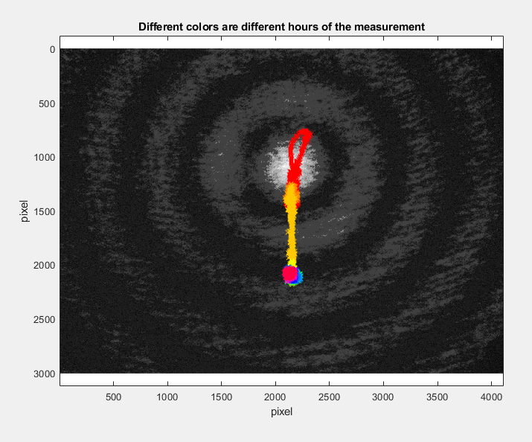
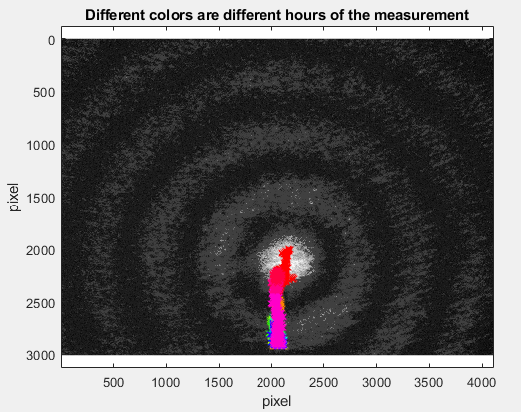
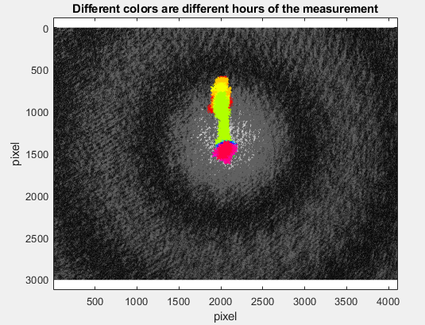
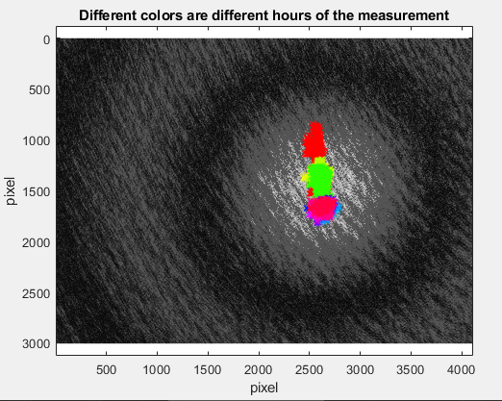
Influence of temperature while other people work in TT1
We assume this is caused by heat comming out of the PC monitor

Slide 14
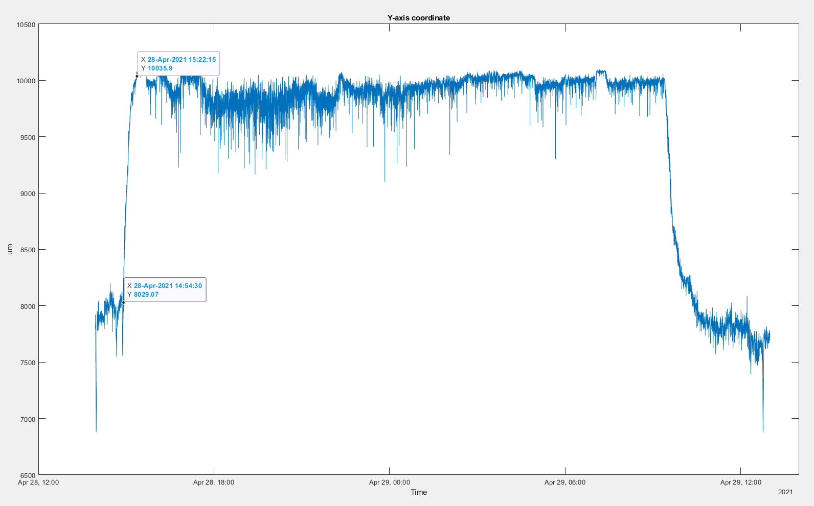
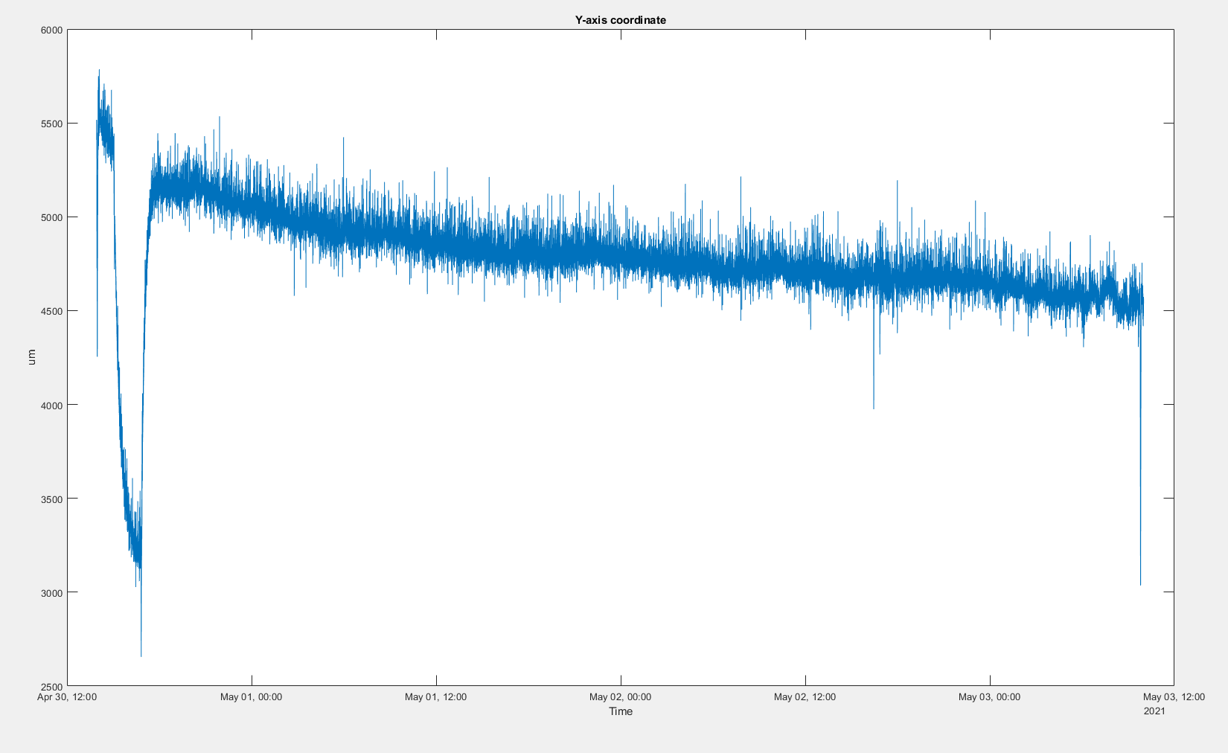
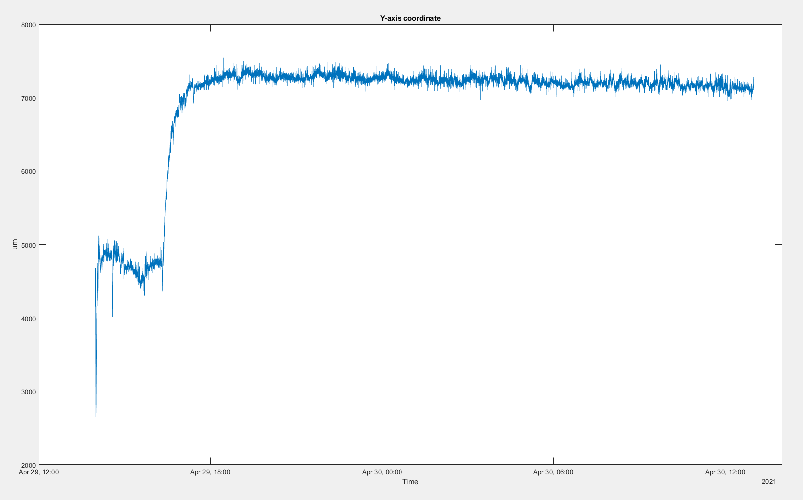
Influence of temperature caused by activity of colleagues in TT1
We assume this is caused by heat comming out of the PC monitor
In the weekend there are no transient effects (0.5 – 1 h duration)
Friday
Weekend

