Slide 1

Structured Laser Beam in prospect of particle acceleration
Martin Dušek – BE/GM/ESA
Date

Slide 2



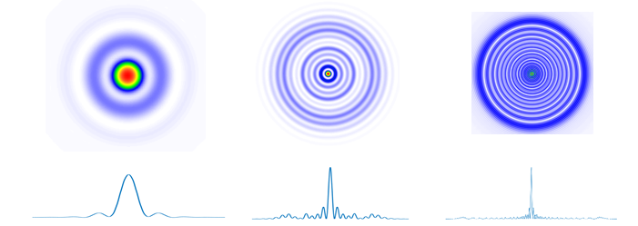
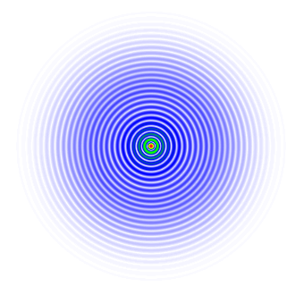
Pseudo non-diffracting beams
Structured laser beam (SLB)
Generated wavefronts
Plano-convex Lens
Axicon
Ball lens
Bessel beam (BB)
Wavefront plane
Zero-phase gradient ring

Slide 3
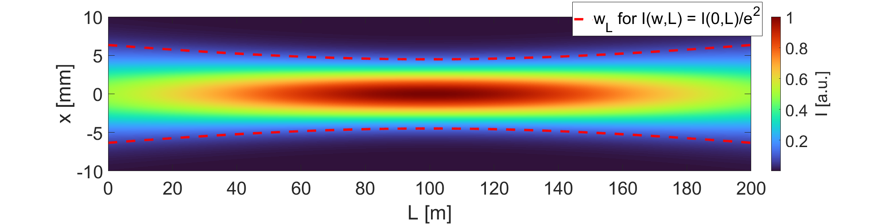
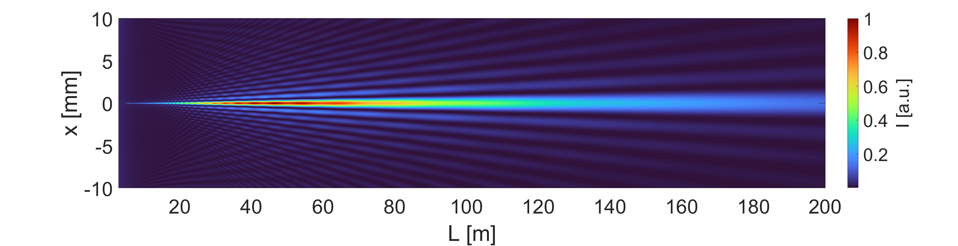
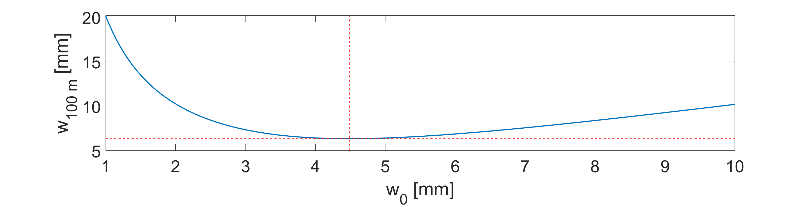
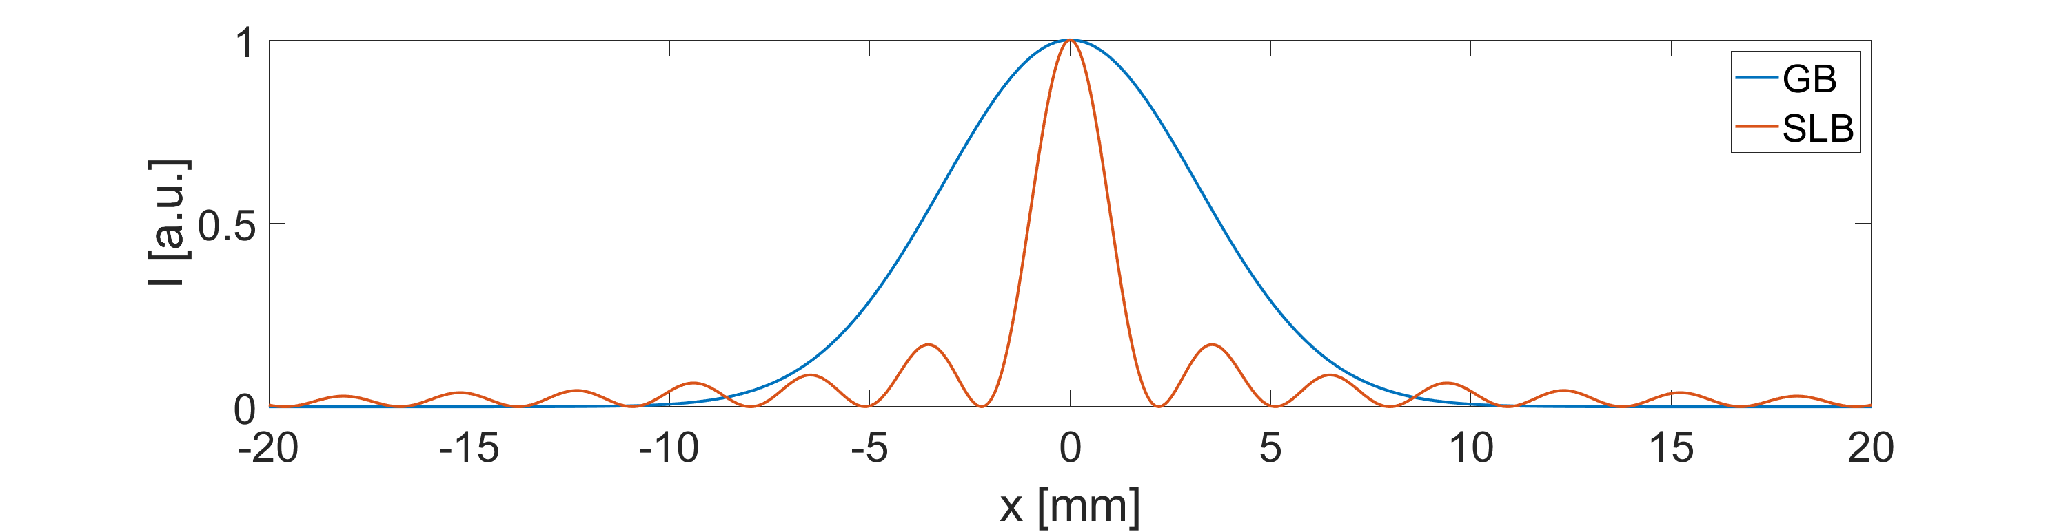
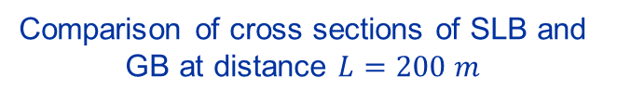
Comparison of an SLB and a Gaussian beam
Longitudinal profile of the GB
Longitudinal profile of the SLB
Waist optimized for L = 100 m
Comparison of cross sections of SLB and GB at distance $L=200 m$
GB optimization

Slide 4
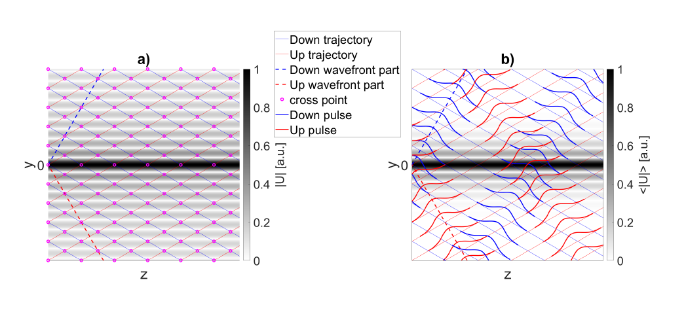
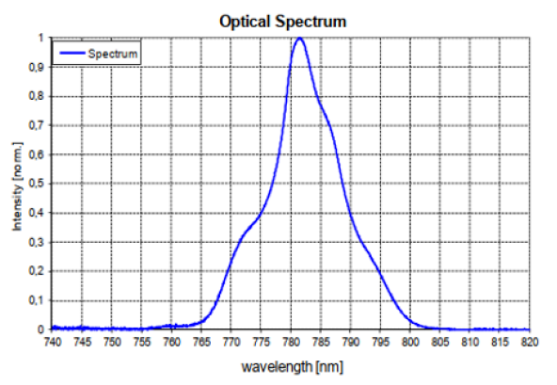
BB generated using fs pulses
Wavefront generated by a plane wave and an axicon

Slide 5
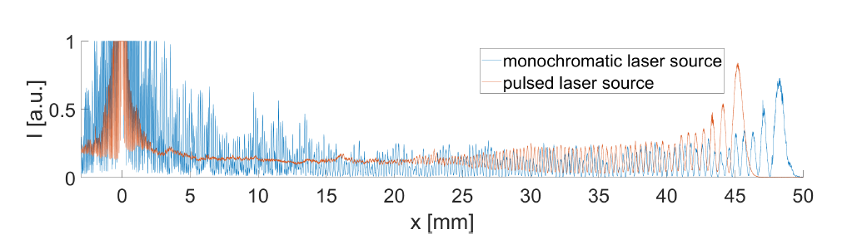
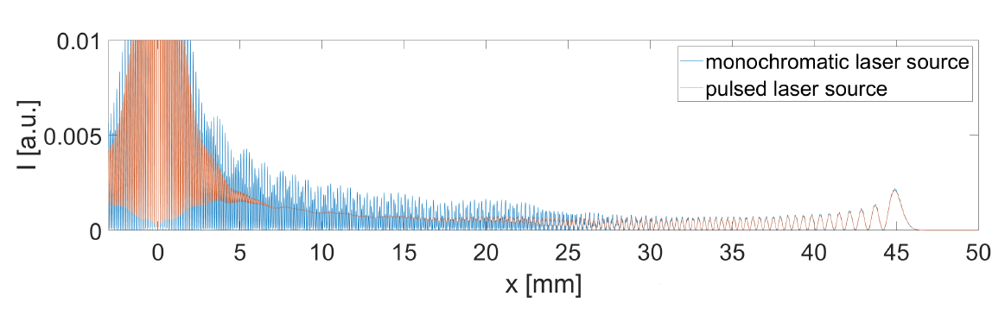
SLB generated using fs pulses
Measurement
Simulation

Slide 6
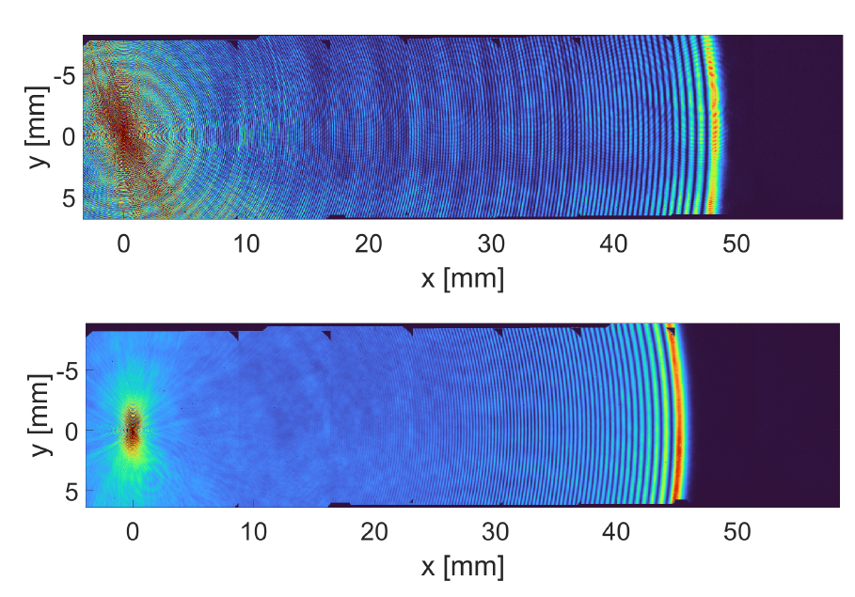
SLB generated using fs pulses
Continuous laser
Pulsed laser

Slide 7
SLB optimization for the plasma cell
Gaussian beam ~ 1.5 mm
Propagation over 10 m
Aperture 10 mm
DEMETER, G., et al. Generation of 10-m-lengthscale plasma columns by resonant and off-resonant laser pulses. Optics & Laser Technology, 2024, 168: 109921.
DEMETER, G., et al. Long-range propagation of ultrafast ionizing laser pulses in a resonant nonlinear medium. Physical Review A, 2021, 104.3: 033506.

Slide 8
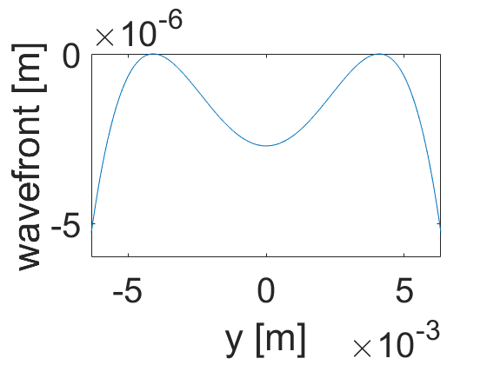
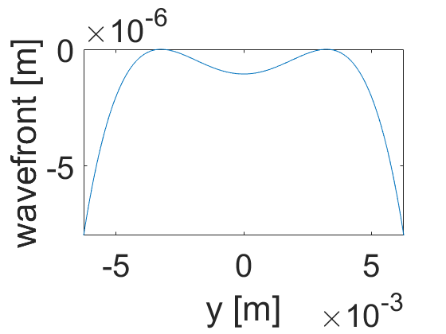
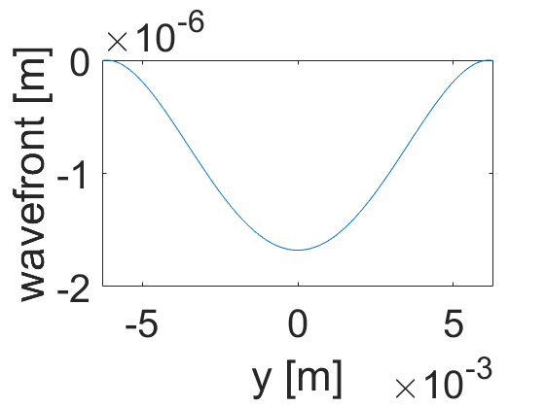
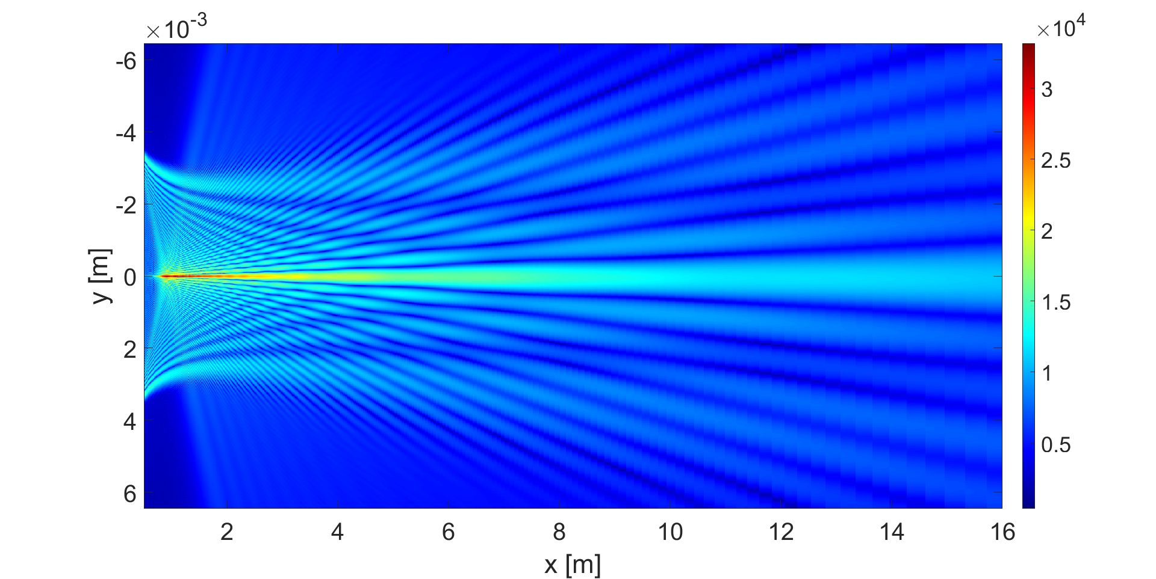
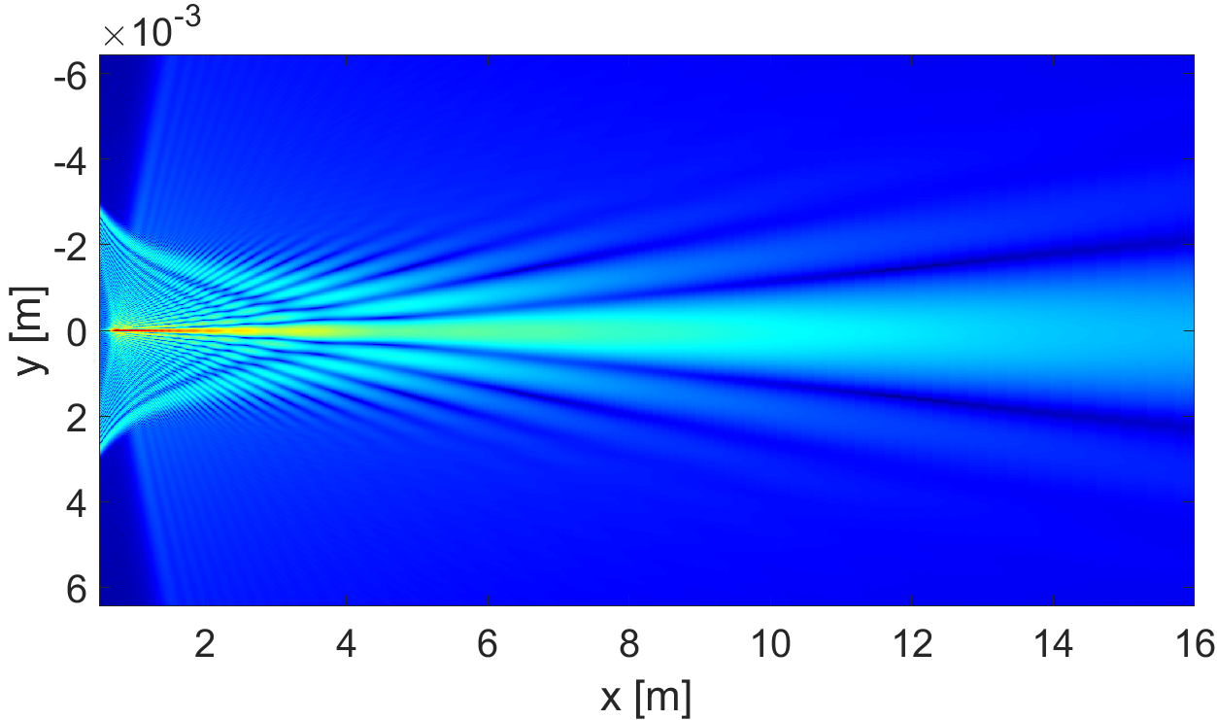
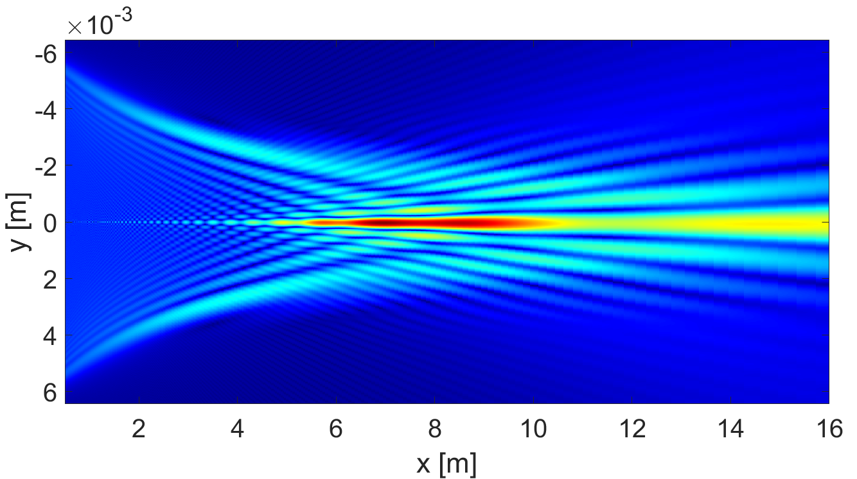
SLB optimization for the plasma cell

Slide 9
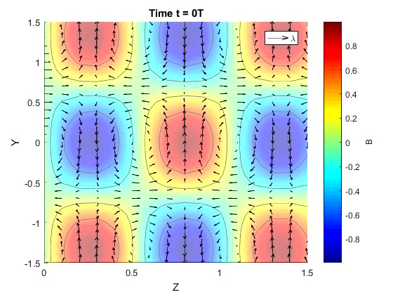
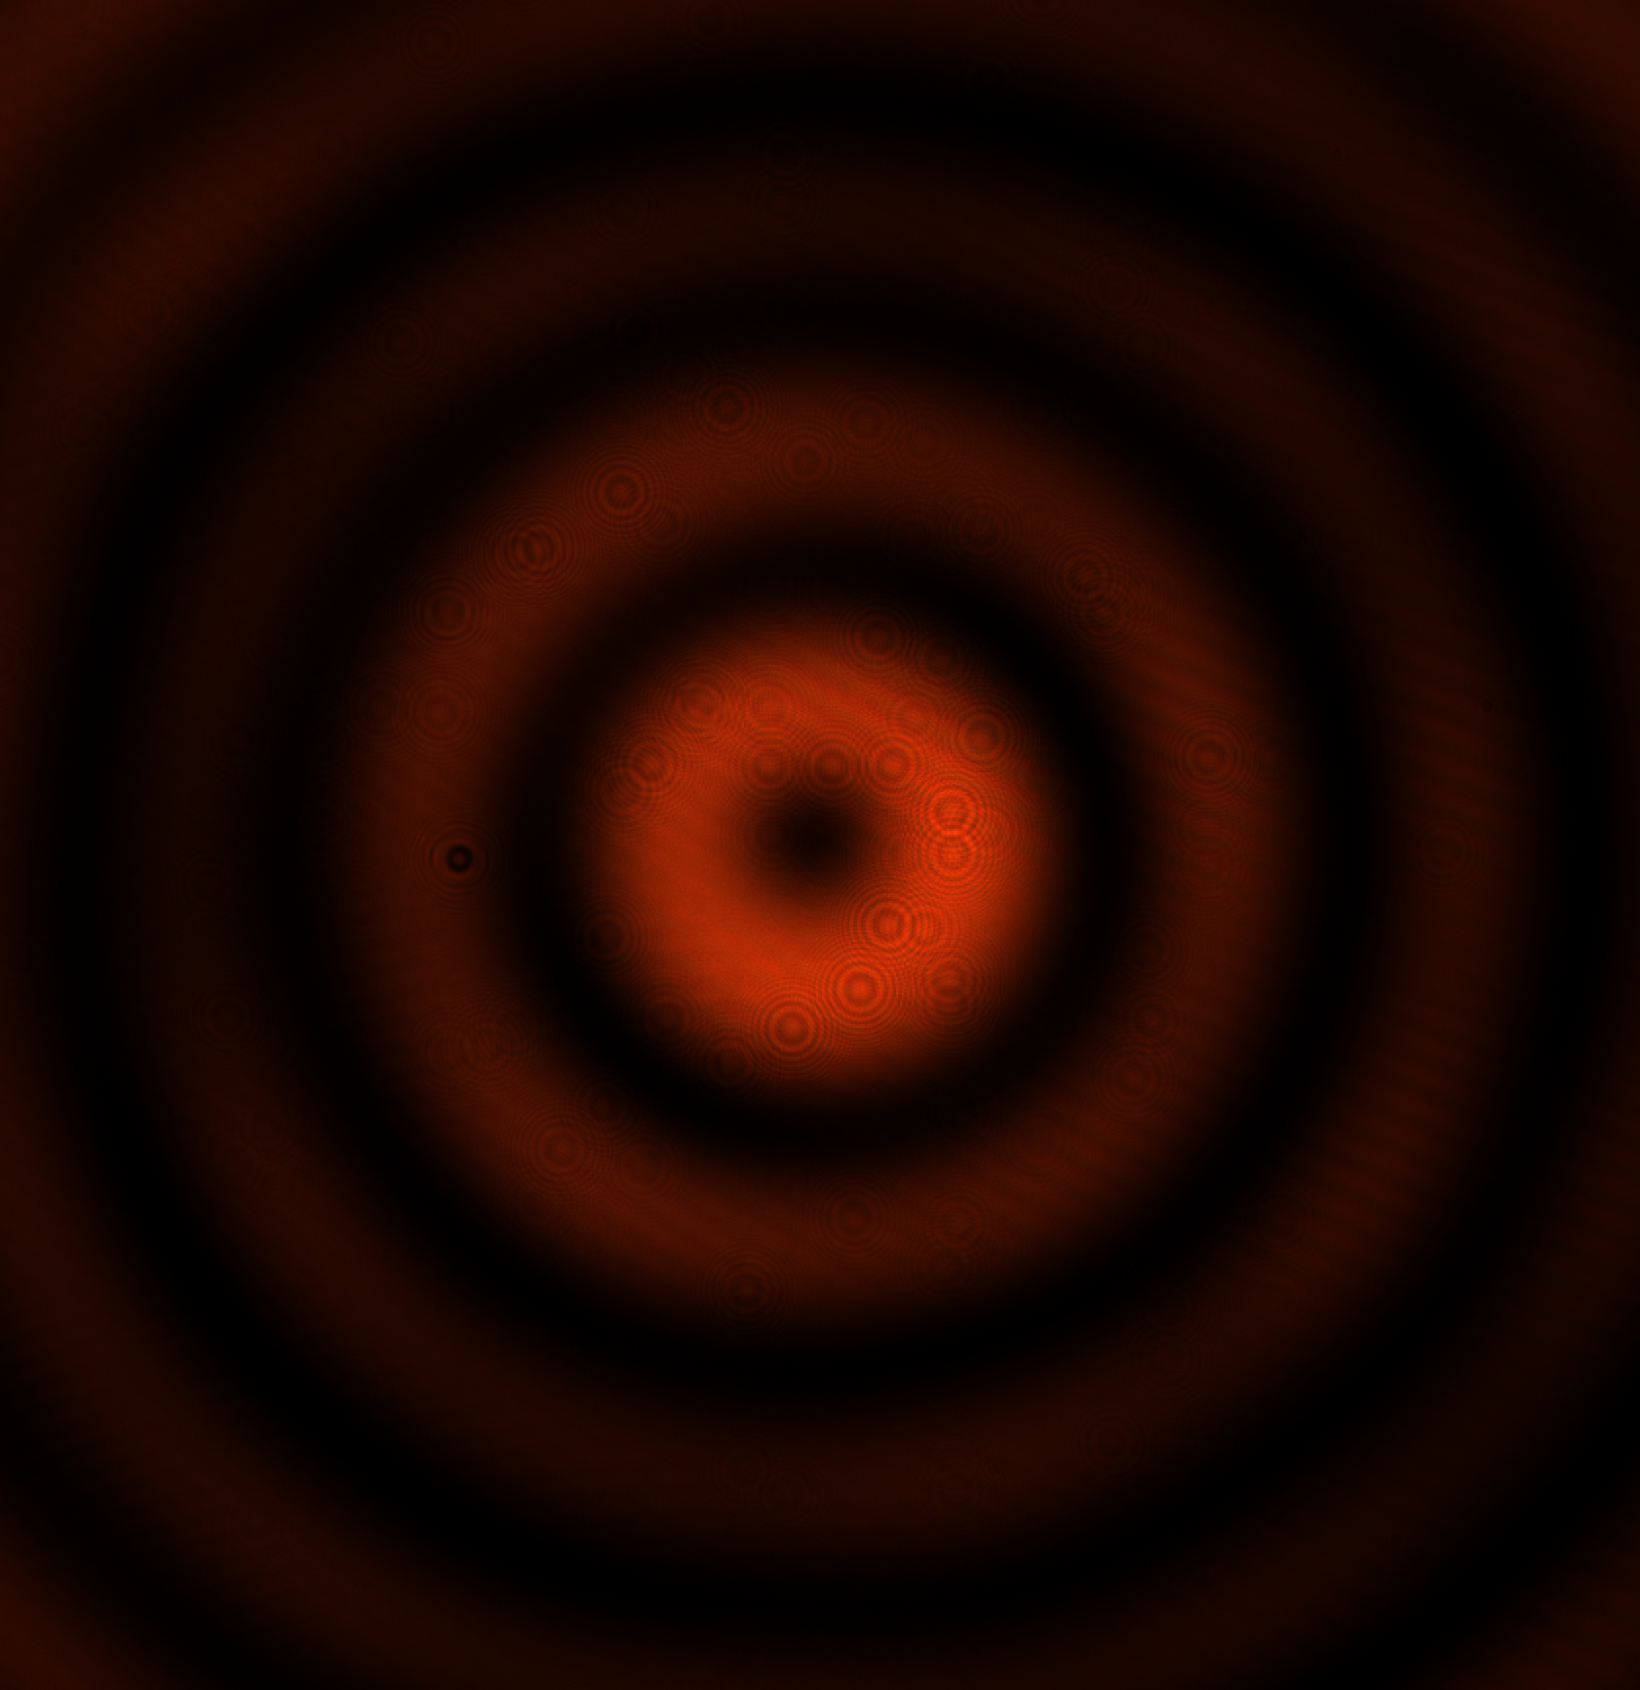
Hollow structured laser beam
1.0
0.5
0
-0.5
-1.0

Slide 10
Utilization of longitudinal polarization for acceleration
y
Linear polarization
Radial polarization
x
Powell, J., et al. "Relativistic Electrons from Vacuum Laser Acceleration Using Tightly Focused Radially Polarized Beams." Physical Review Letters, vol. 133, no. 15, 2024, p. 155001.
  Ti:Sapphire + Optical Parametric Amplifier - λ = 1.4 μm
  Pulse 13 fs
  Repetition rate 100 Hz
  P_{peak} = 98 GW
  Focused by a high NA (0.94) parabolic mirror I = 10¹⁹ W/cm²
  Electron energy 1.43 MeV
E₁
E₁
E₁ ₊ E₂
k₁
k₁
E₁ ₊ E₂
E₂
k₂
k₂
x
E₂
z

Slide 11
Plasma wakefield acceleration – utilization of Bessel beams
GESSNER, Spencer, et al. Demonstration of a positron beam-driven hollow channel plasma wakefield accelerator. Nature communications, 2016, 7.1: 11785.
ARINIELLO, Robert. Emittance preservation in a plasma wakefield accelerator. 2022. PhD Thesis. University of Colorado at Boulder.
  Use of high order Bessel beams for generating accelerating plasma channel
Raciukaitis, G., et al. "Laser wakefield acceleration of electrons using Bessel–Gauss doughnut beams for accelerating beam guiding." Journal of Plasma Physics 89 (2023): 905890209.
  Use of Bessel beams for ionization of plasma to guide accelearting Gaussian beam which remains more focused and keeps the intensity over long distnace

Slide 13
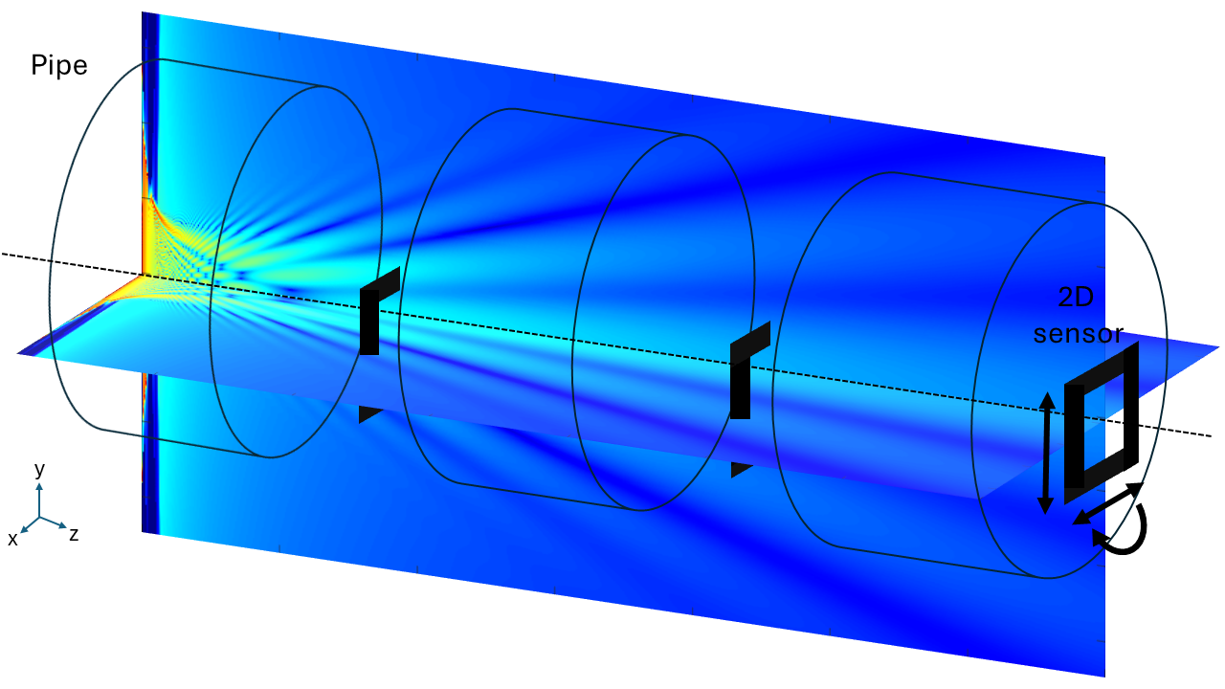
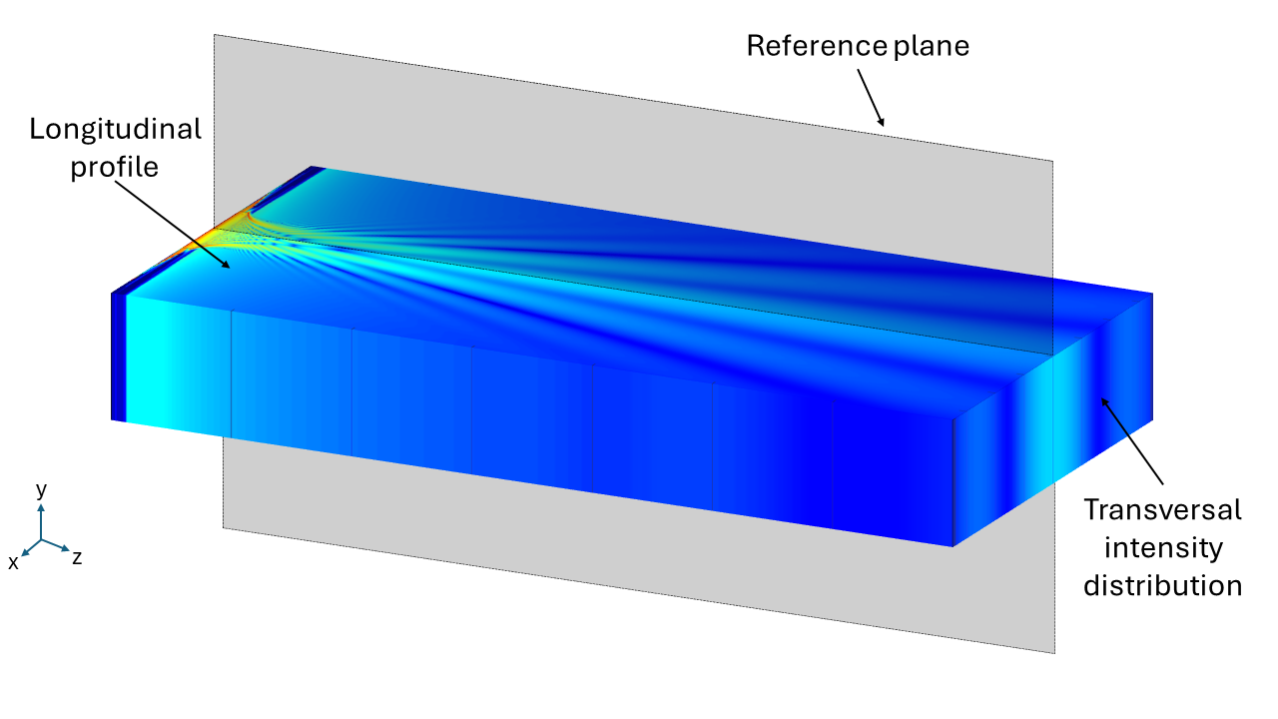
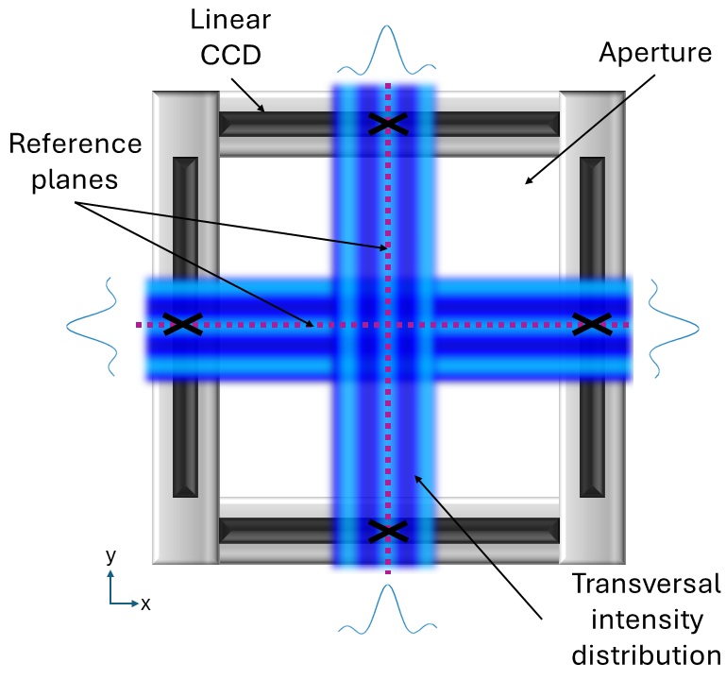
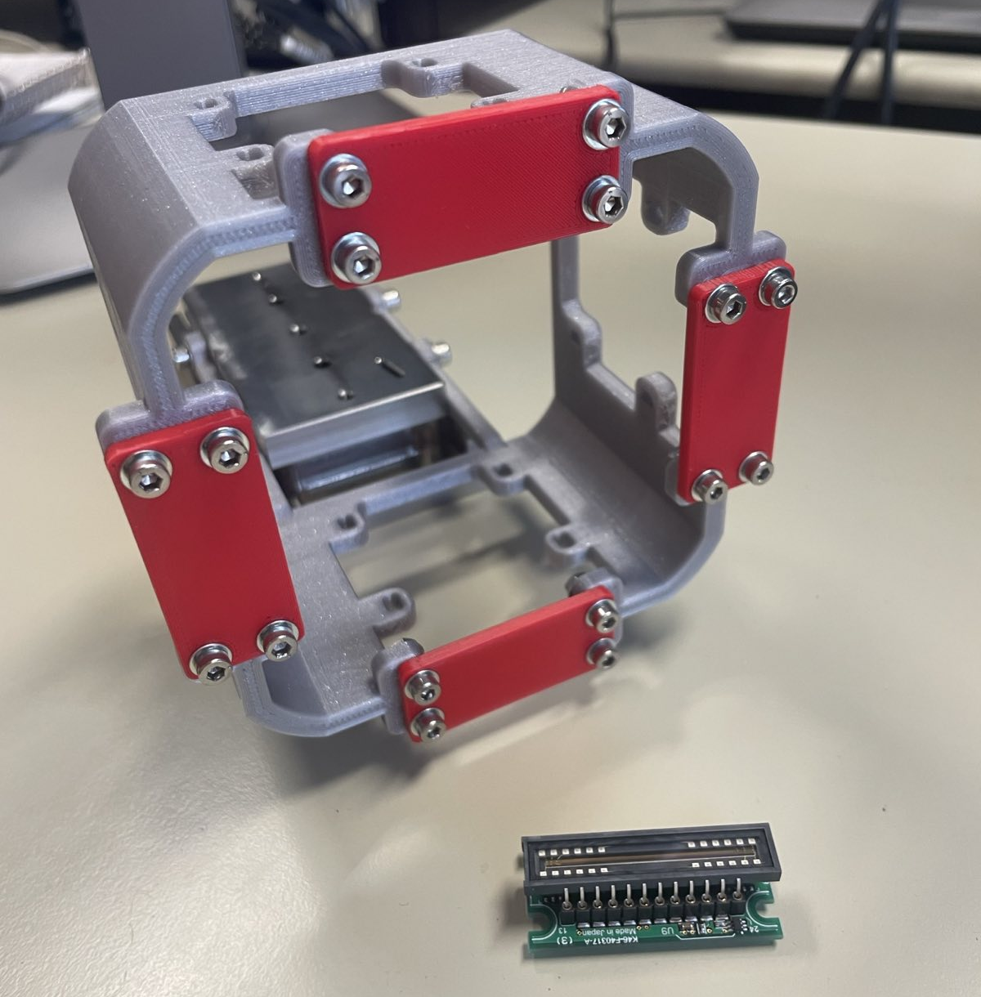
Alignment of CLEAR

