Slide 1
Laser Fast Abort Experiment for SuperKEKB
R. Zhang, H. Kaji, K. Uno, H. Nakayama (KEK)
K. Kitamura, H. Kakuno(Tokyo Metropolitan University)
S. Kitada, H. Murakami, T. Ijima (Nagoya University)
K. Yoshihara (University of Hawaii)
2024.12.03 @CERN
1 of 21

Slide 2
CONTENTS
Motivation and Background Review
  Motivation
  Feasibility analysis
  Experimental layout design for SuperKEKB ring
Status and Plan
  Achievements so far
  Plan
Acknowledgement
2 of 21

Slide 3
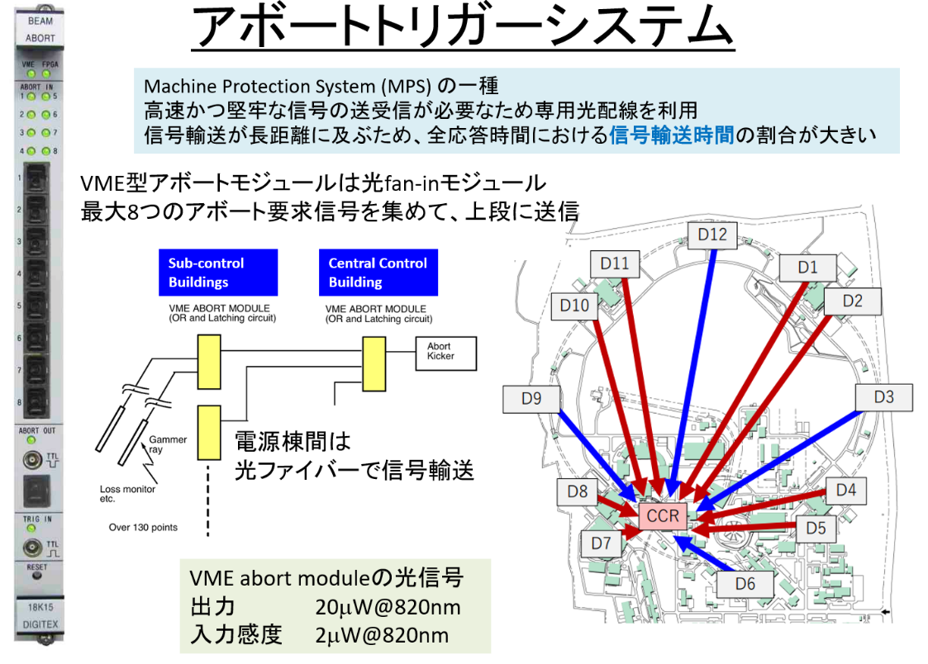
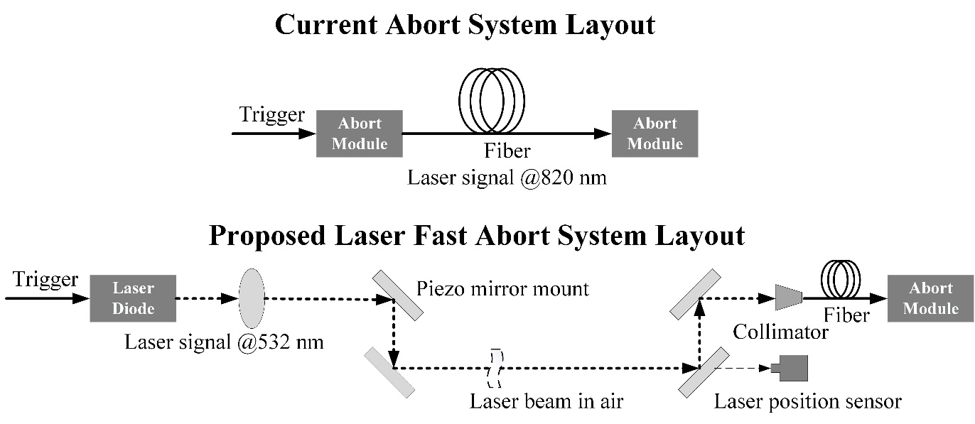
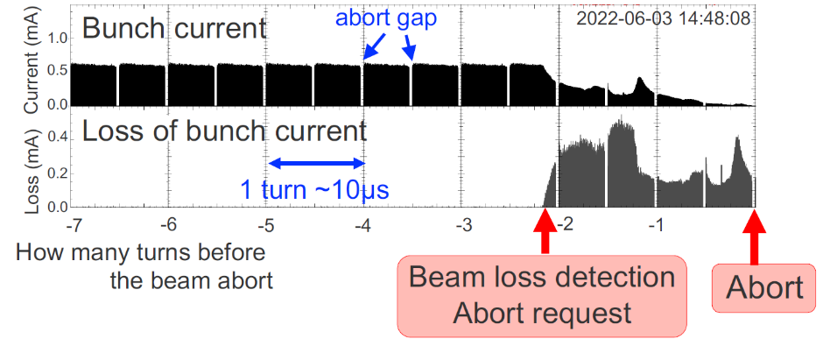
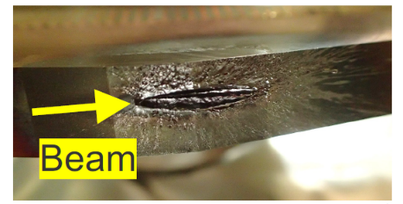
Motivation and Background Review
Motivation and Background
Current Abort System of SuperKEKB
Sudden beam loss of SuperKEKB (SBL issue)
  A phenomenon where an ampere-class beam is suddenly lost and aborted within a few cycles (tens of microseconds)
  Unknown cause
  Serious damage to accelerator hardware and Bella II detector
Current abort system can not realize machine protection effectively
Speed up the abort signal transmission for faster response
Novel design of laser fast abort system: the speed of the laser signal is faster than that in fiber medium (silica)
VME type abort module: optical fan-in board
Gather abort laser signal (8-ch)
Send signal to master abort module
Send signal power level @820nm: 20 μW
Action power for input power @820nm: 2 μW
Signal transmission between power stations
With input laser: abort module without action
Without input laser: abort module sends abort trigger
Collimator damage
H. Kaji, KEKB Weekly Meeting 2023.11.06
2 of 21

Slide 4
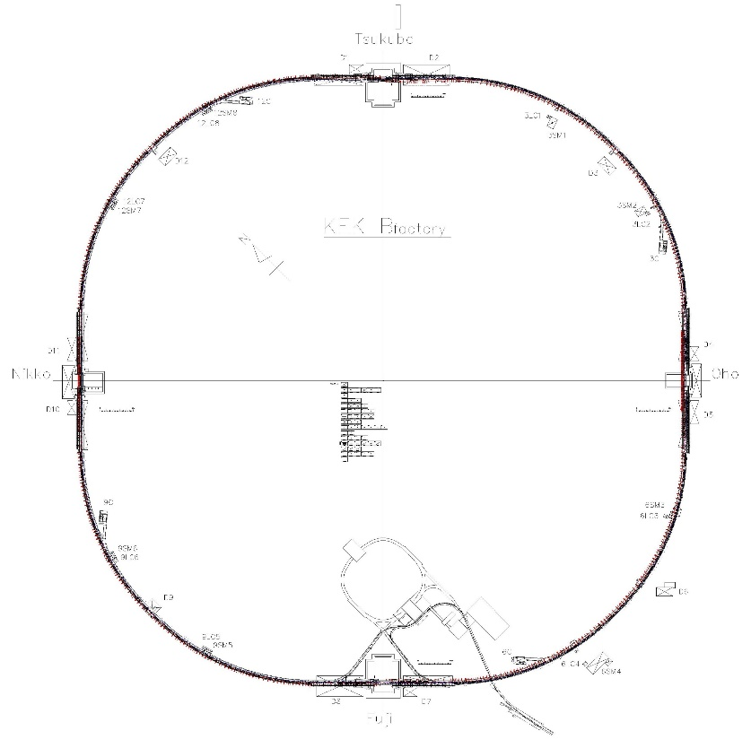
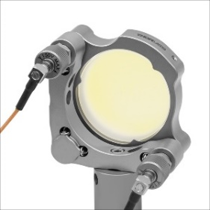
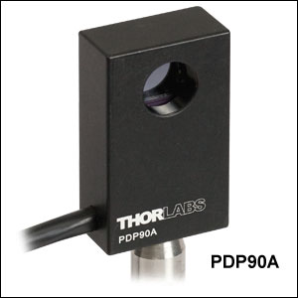
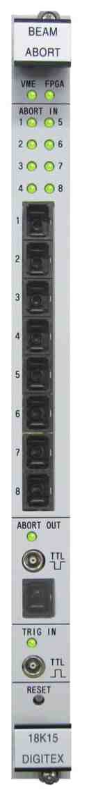
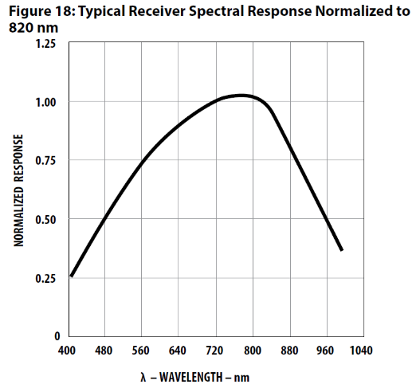
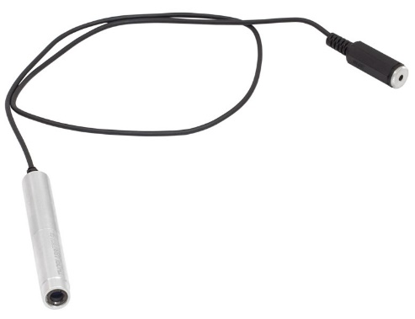
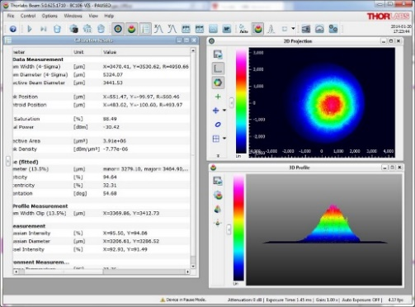

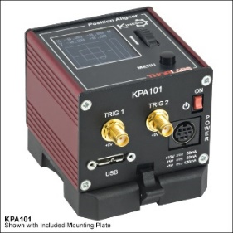
Motivation and Background Review
Feasibility Analysis
Transmission distance of about 400 m: adjustable optical telescope system and sufficient output power
Response threshold power for the abort module action: approximately 3 μW for a 532 nm laser, verified through experimentation
Piezo-mirror for cancelling spatial instability indued by environment factors, including ground vibrations and air disturbances
Simple and compact laser source for applications in the tunnel
  No need for water cooling or a complex optical cavity to maintain laser oscillation
  Simple power supply system: capable of receiving abort signals to switch on/off
  Visible light range: facilitates easy alignment
Sufficient and moderate output power for long-distance transmission
Replaceable easily and quickly
0.95 mW Class 2 @532 nm
R. Zhang, Linac Weekly Meeting 2023.04.04
4 of 21

Slide 5
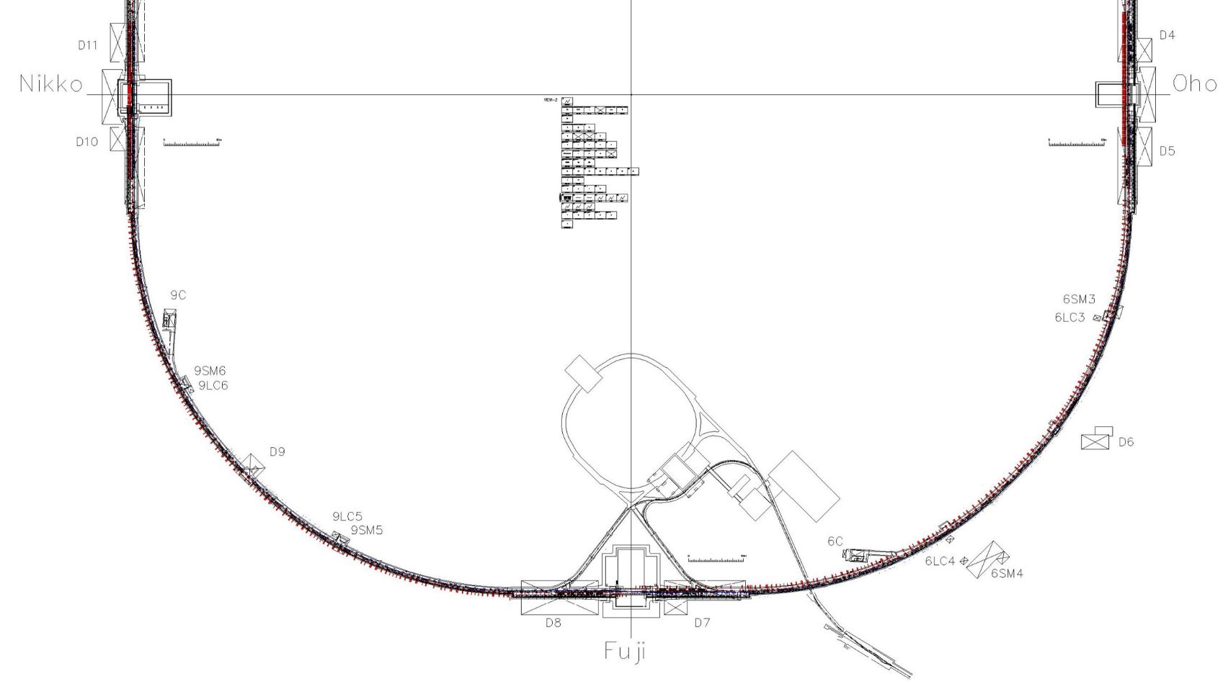
Motivation and Background Review
Experimental Layout Design for SuperKEKB Ring
Three parts of experiment setup:
  Laser source: laser diode, power supply with abort trigger module
  Transmission part: telescope system, HR flat mirrors, piezo mirror mount system and position sensor (tested two types of optical layout )
  Coupling part: telescope, fiber coupling collimator, fiber, laser power meter
Laser source location: near D06V1 or nonlinear collimator position
Coupling part location: around D07 (existed hole will be used for fiber from tunnel to ground *Approved)
5 of 21

Slide 6
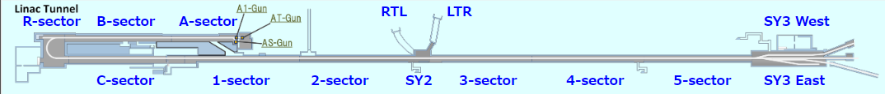
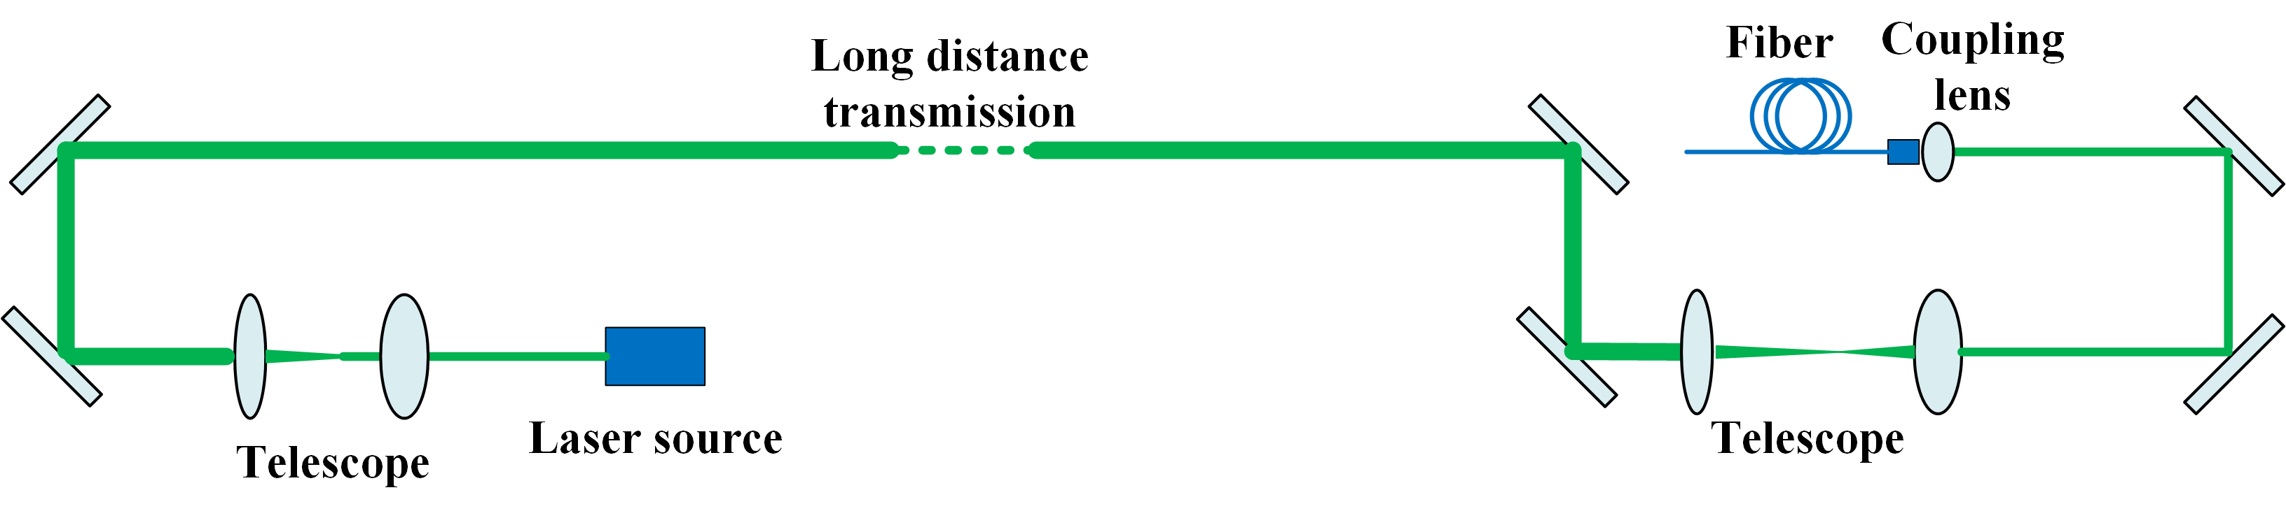
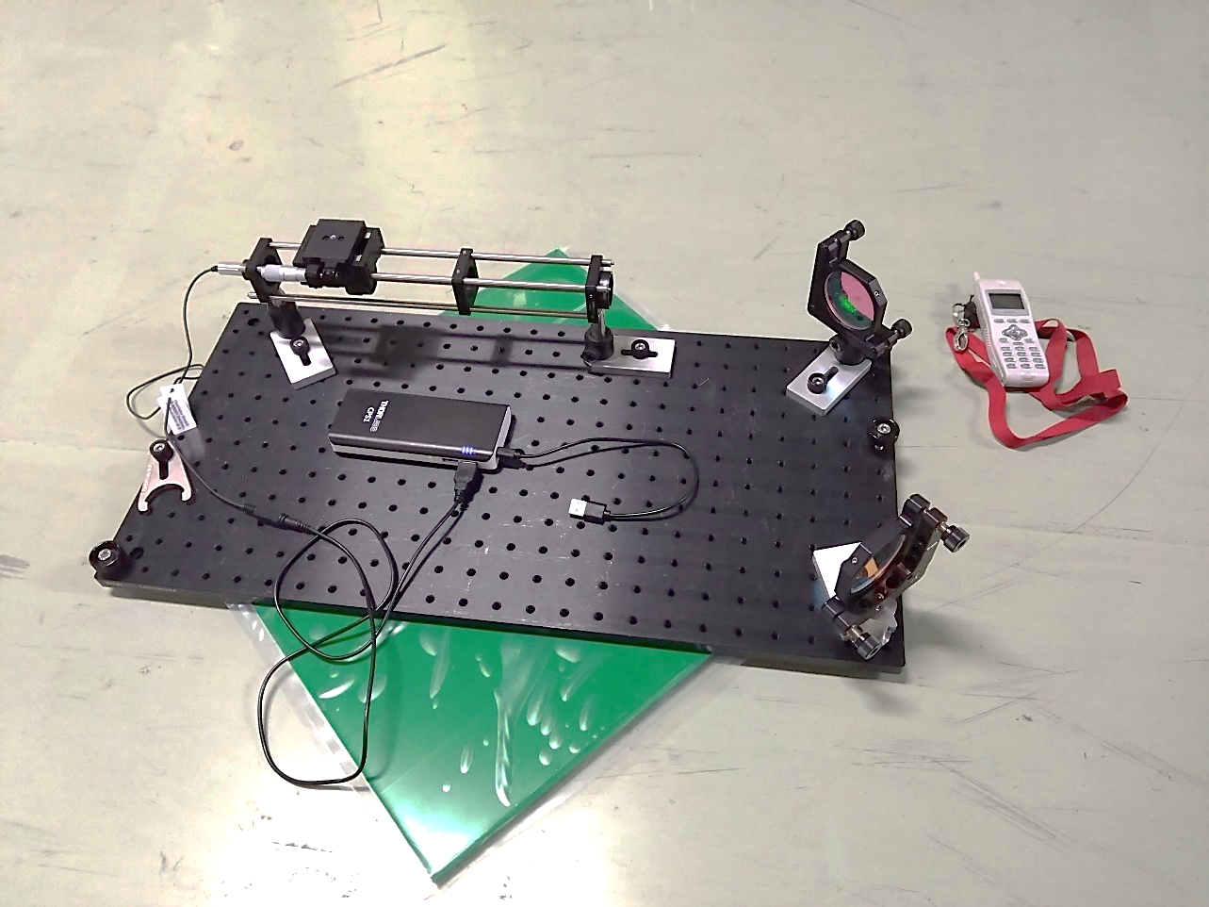
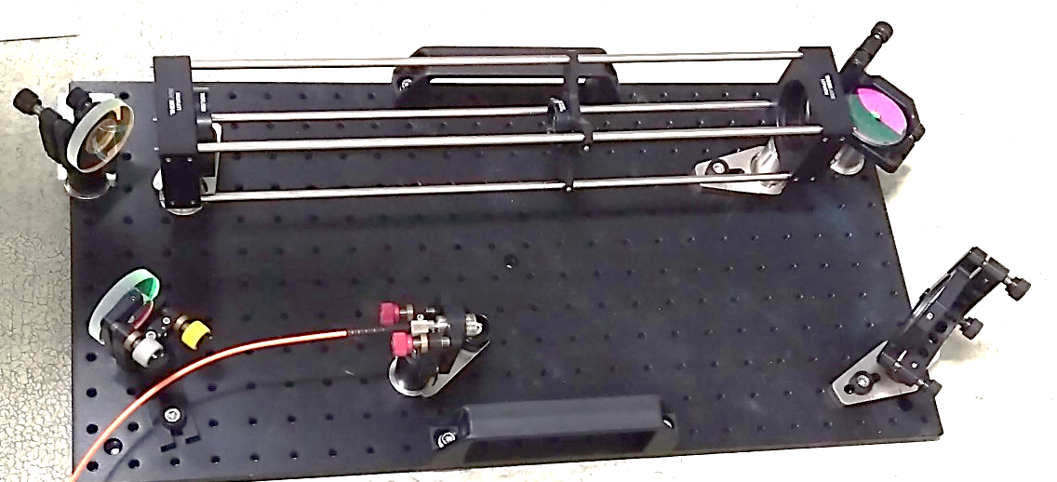
STUTAS & PLAN
Achievements so far: parallel laser beam transmission by telescope
~400 m
Telescope for 0.175x magnification (200-35mm)
Coupling lens with f 10.9mm for multimode fiber
Fiber: Φ400 μm, N.A.=0.5 (tested maximum coupling efficiency 96.6%)
532 nm 0.95 mW CW laser with 5 mm beam diameter (Gaussian distribution)
Telescope for 3x magnification (50-150mm)
3x magnification much better than 1.5x, 2x and 2.5x for good beam quality
Laser source
Coupling part
Tested additional telescope installation near 4-sector
The final laser beam profile became worse
Single telescope setup (3x one following the laser source) is adopted
7 of 21

Slide 7
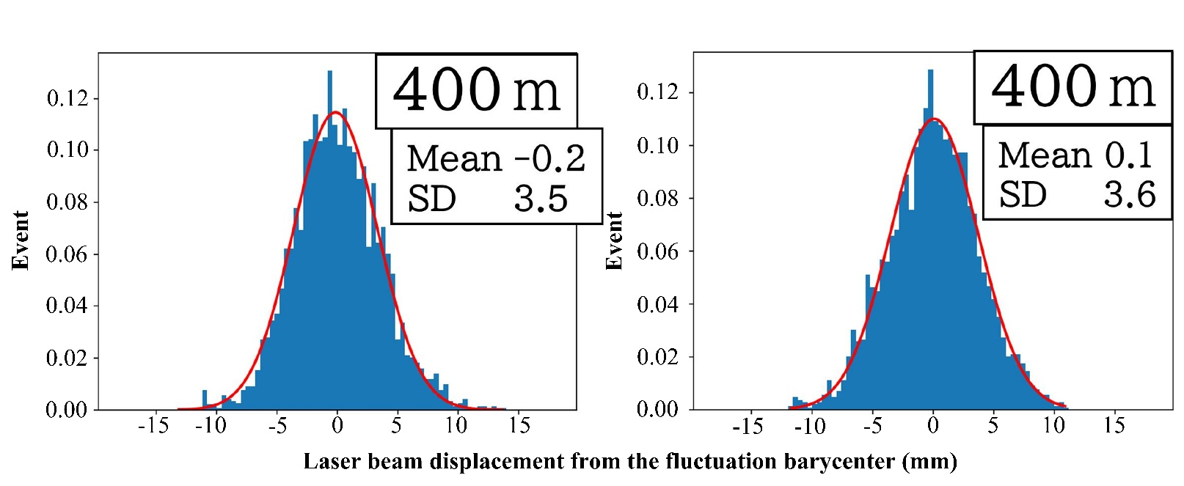
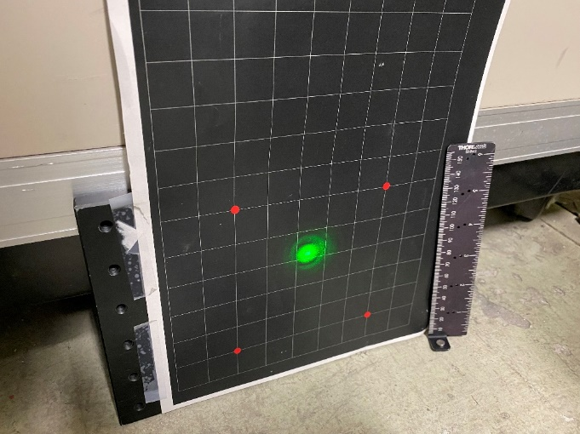
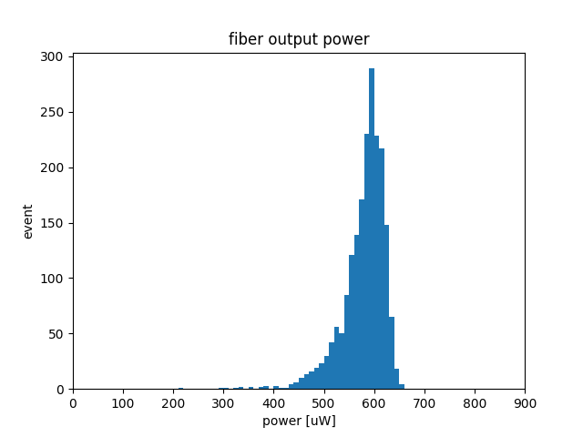
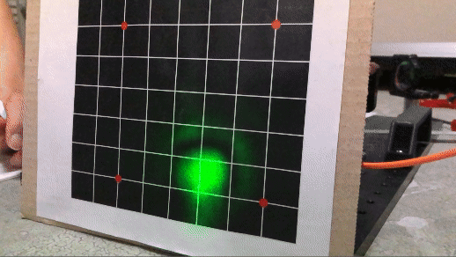
STUTAS & PLAN
Achievements so far: parallel laser beam transmission by telescope
Beam profile after 200 m transmission
Averaged coupled laser power over 10 mins: 581 ± 42 μW
Beam profile after 400 m transmission
Data analyzed by Kitamura from TMU
8 of 21

Slide 8


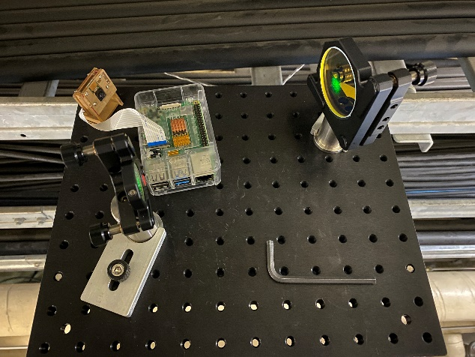
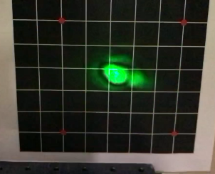
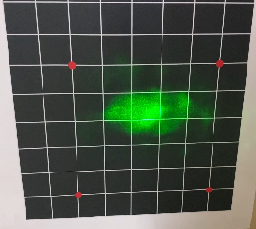
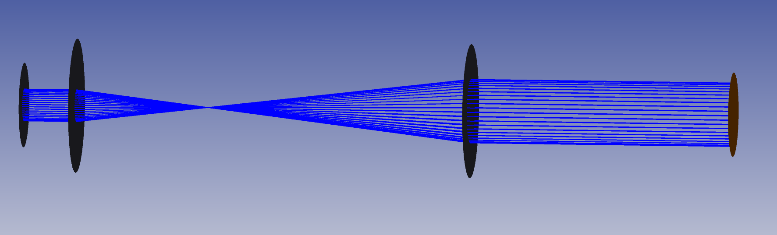
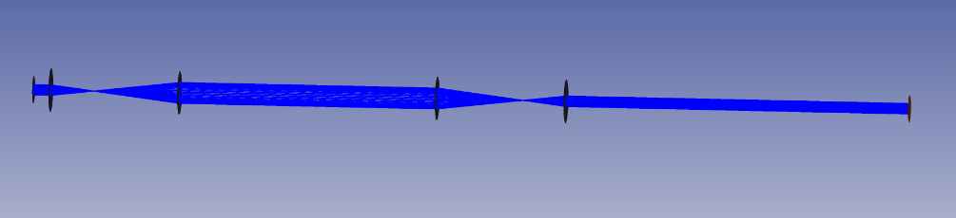
STUTAS & PLAN
From lens to spherical reflector (SR) mirror
f = R / 2
Plate reflector mirror
Spherical reflector mirror
f１
f 2
Concentric installation and adjustment of optical components
Difficult adjustment for telescope (distance between two lenses)
Few available types of 2-inch lenses
Two reflective mirrors are necessary for alignment
A spherical mirror focuses and reflects the laser beam for transmission
Simplify the optical layout and components
Relay optics becomes available (non-parallel transmission for laser beam)
Easy adjustment
1 SR mirror set
f１
f 2
f 2
f１
2 SR mirror sets
9 of 21

Slide 9
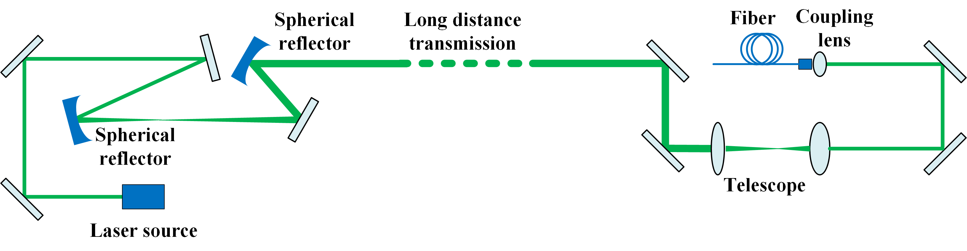
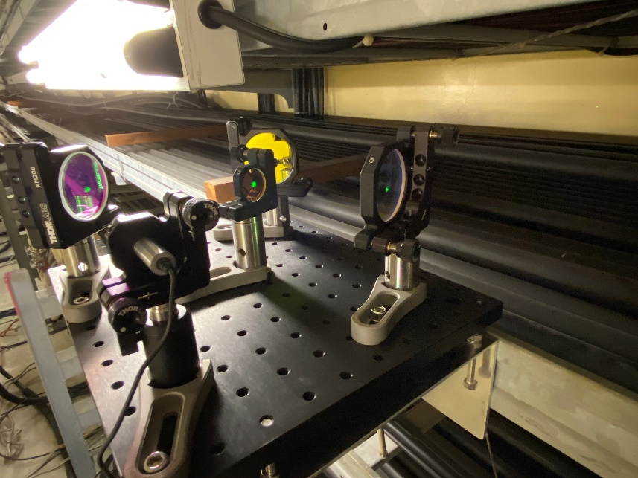

STUTAS & PLAN
Achievements so far: one set SR mirrors combination
~400 m
Telescope for 0.175x magnification (200-35mm)
Coupling lens with f10.9mm for multimode fiber
Fiber: Φ400 μm, N.A.=0.5 (tested maximum coupling efficiency: 96.6%)
532 nm 0.95 mW CW laser with 5 mm beam diameter (Gaussian distribution)
SR combination of R=50 m and R=100 m (1 inch diameter)
2x magnification
Coupling part
Laser source
Tested one set of SR combination case firstly
Most important work is to find the best position for the second SR mirror with R=100 m from the laser waist point
Best distance is about 40~45 m from the waist to the second SR mirror
SR mirror
10 of 21

Slide 10
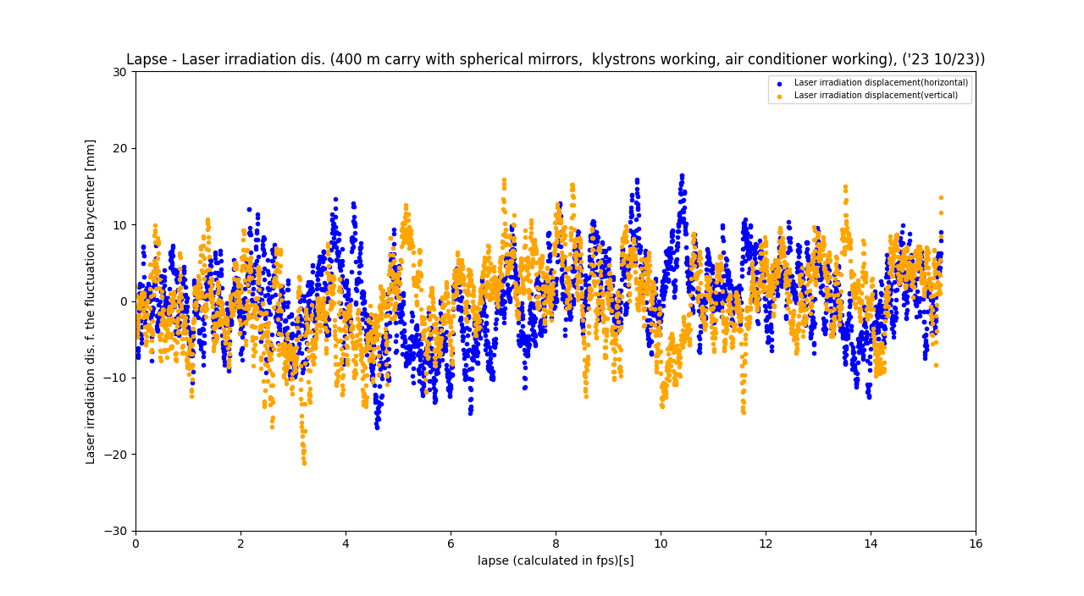
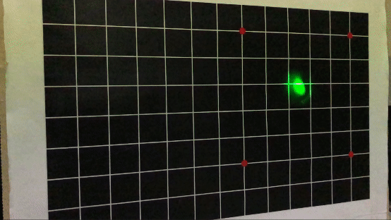
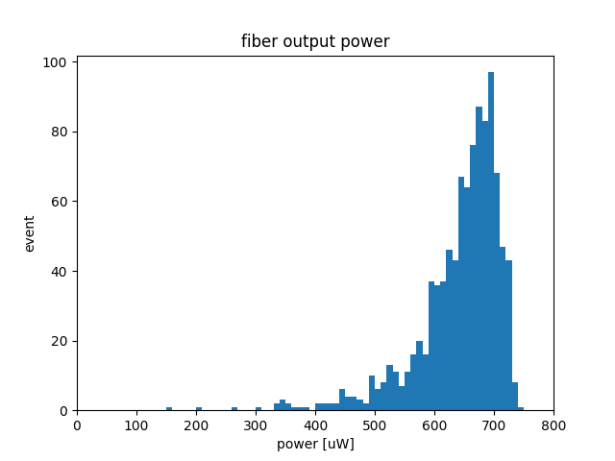
STUTAS & PLAN
Achievements so far: one set SR mirrors combination
11 of 21

Slide 11
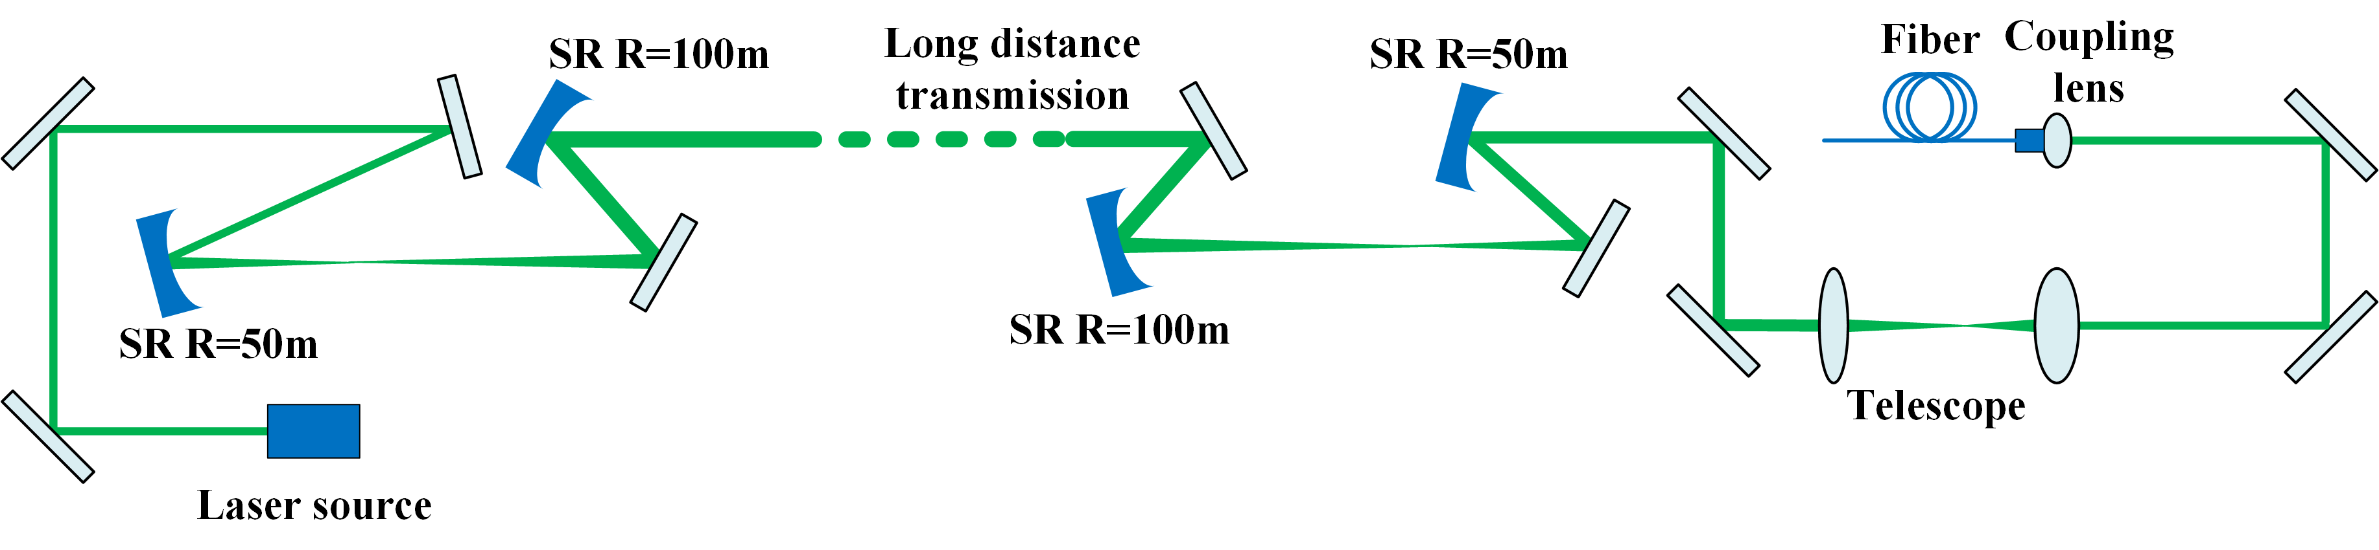
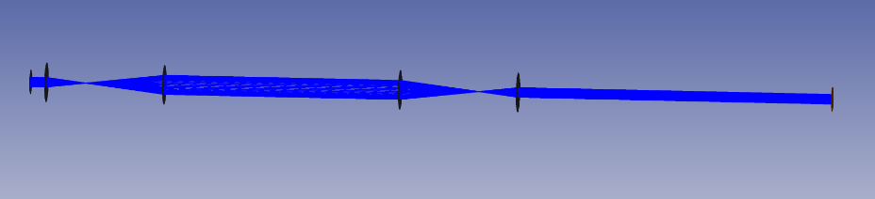

STUTAS & PLAN
Achievements so far: non-parallel laser beam transmission by spherical reflector mirrors
~250 m
Telescope for 0.175x magnification (200-35mm)
Coupling lens with f 10.9mm for multimode fiber
Fiber: Φ400 μm, N.A.=0.5 (tested maximum coupling efficiency: 96.6%)
532 nm 0.95 mW CW laser with 5 mm beam diameter (Gaussian distribution)
SR combination of R=50 m and R=100 m (1 inch diameter)
2x magnification
Laser source
Relay part
Coupling part
The 2nd SR combination set is used
Distance between the two SR commination sets is about 50 m (variable)
Decided configuration for SuperKEKB tunnel experiment
SR mirror
12 of 21

Slide 12
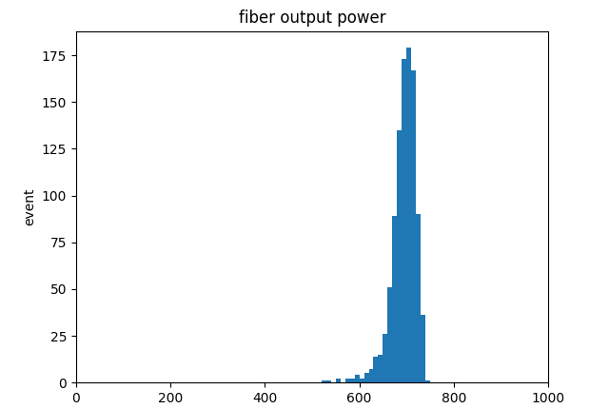
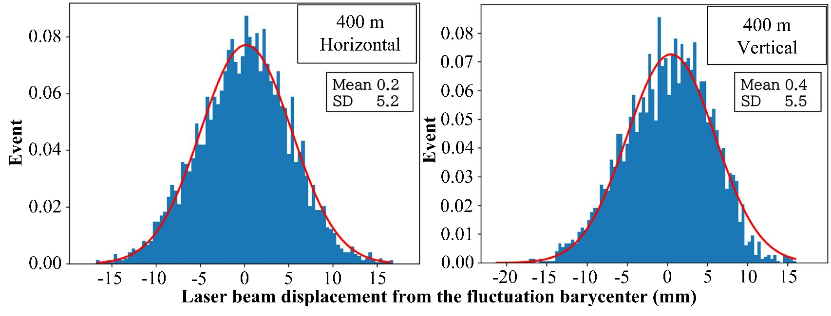
STUTAS & PLAN
Achievements so far: non-parallel laser beam transmission by spherical reflector mirrors
13 of 21

Slide 13
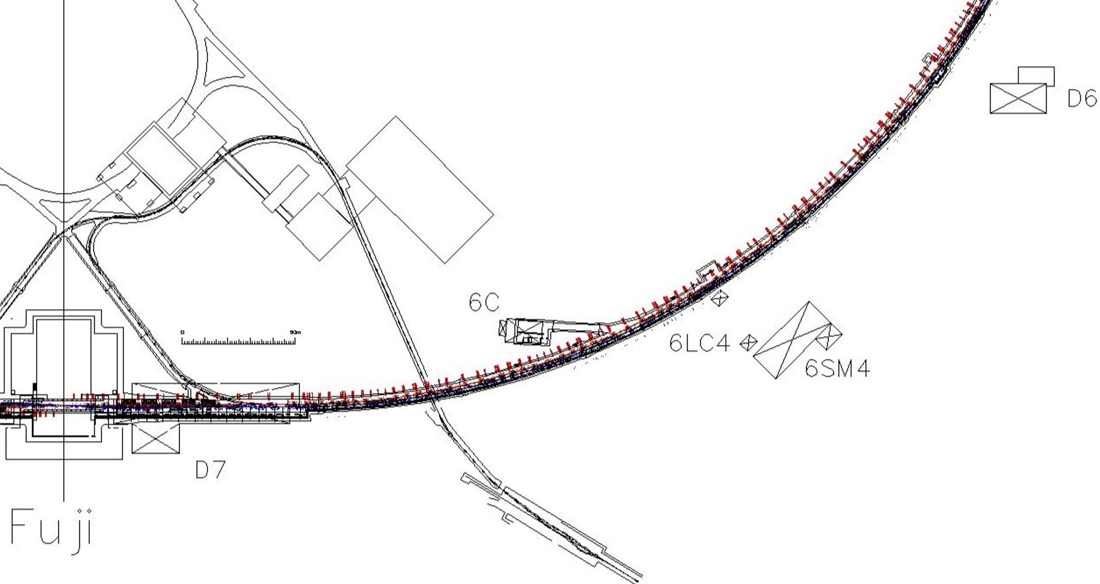
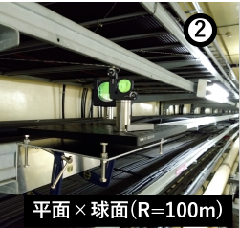
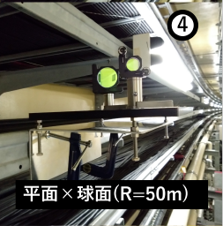
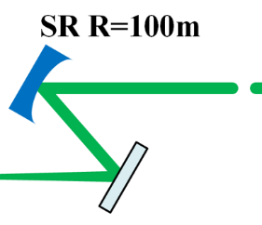
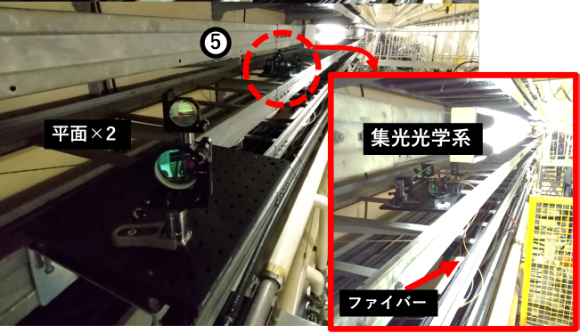
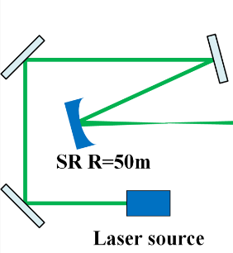
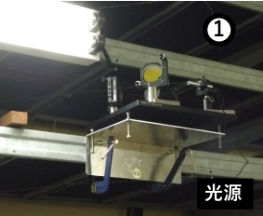
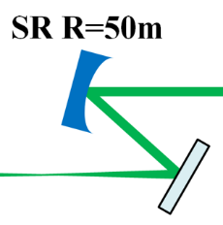
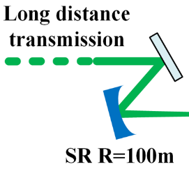
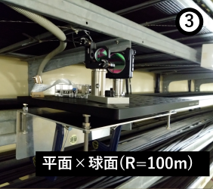
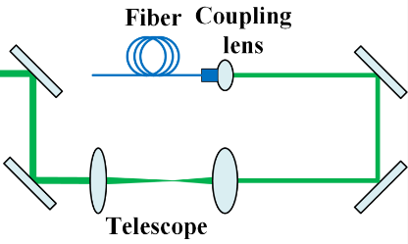
STUTAS & PLAN
Achievements so far: non-parallel laser beam transmission by SR in KEKB tunnel
plane mirrors + SR (R=100)
plane mirrors + SR (R=50)
2 plane mirrors
Coupling part
Fiber
Source part
plane mirrors + SR (R=100)
14 of 21

Slide 14
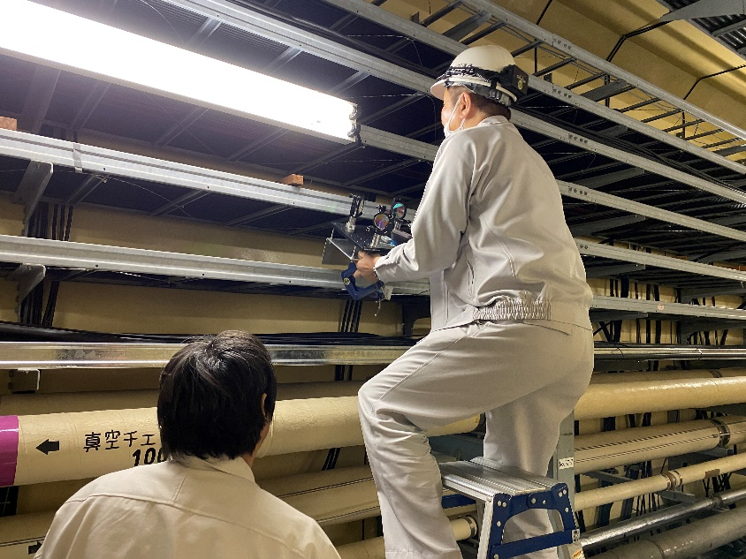
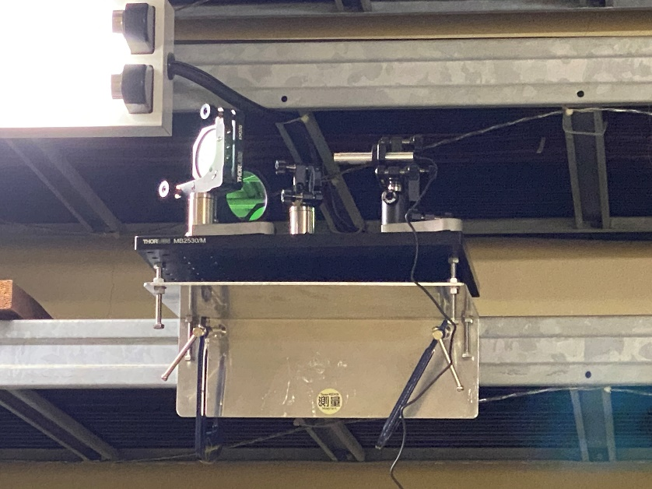
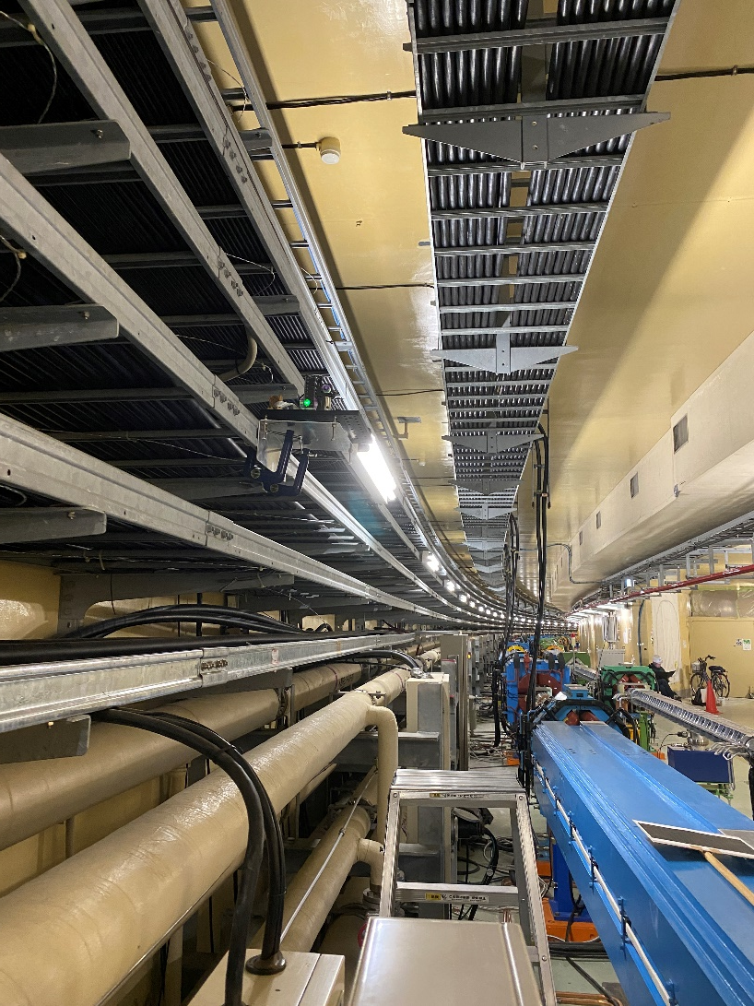
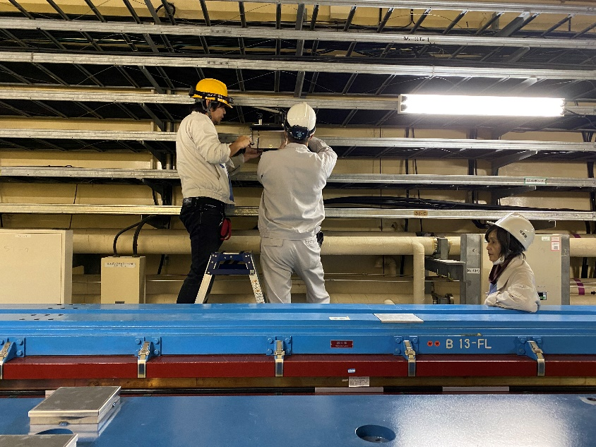

STUTAS & PLAN
Achievements so far: non-parallel laser beam transmission by SR in KEKB tunnel
15 of 21

Slide 15






STUTAS & PLAN
Achievements so far: non-parallel laser beam transmission by SR in KEKB tunnel
16 of 21

Slide 16



STUTAS & PLAN
Achievements so far: non-parallel laser beam transmission by SR in KEKB tunnel
17 of 21

Slide 17

STUTAS & PLAN
Achievements so far: non-parallel laser beam transmission by SR in KEKB tunnel
Long time measurement for stability check
Magnets power test in Oho section at the same time on 27th November 2023
Serious fluctuations started from the magnets power test finish (correlation? )
Averaged coupled laser power over 1 hour: 597.9 ± 112.1 μW
18 of 21

Slide 18
STUTAS & PLAN
Achievements so far: non-parallel laser beam transmission by SR in KEKB tunnel
2.5 hours stability check on 28th November 2023
Serious fluctuations started from the magnets power test finish (correlation?)
Coupled laser power can be adjusted to the original level
Adjustment
Magnets power test finish
19 of 21

Slide 19
STUTAS & PLAN
Achievements and Plan
Achievements
  Test of the designed optical setup
  Long distance experiment by use of the spherical mirrors at Linac and SuperKEKB ring tunnel
Short-term Plan
  New supporter design for stable installation
  Installation in SuperKEKB tunnel and application test during SuperKEKB 2024c commissioning
Long-term Plan
  Transmission distance from 400 m to 750 m
  → current optical design is impossible
  Structured laser beam design by CERN researchers
  → A spring of clear water in the desert
  Study SLB design and try to establish a setup at KEK for long-distance transmission testing and coupling experiment
  Verify whether the SLB is feasible for our laser fast abort experiment
  Long-term collaboration
20 of 21

Slide 20
ACCKNOWLEGEMENT
SuperKEKB Fast Beam Abort Study
Appreciate to
  JSPS KAKENHI (C) Grant Number JP24993974, MDI Budget, JSPS International Leading Research Budget
  Efforts from Mr. Kitada, Dr. Kaji, Dr. Murakami and Dr. Ijima
Heartfelt thanks to
  Mr. Witold and all the members of BE/GM/ESA
THANKS
21 of 21

Slide 22


STUTAS & PLAN
SuperKEKB Fast Beam Abort Study
R4 Fiscal Year |  |  |  |  |  | R5 Fiscal Year
10 | 11 | 12 | 1 | 2 | 3 | 4 | 5 | 6 | 7 | 8 | 9 | 10
Abort module reaction test by use of the selected laser source Spatial coupling measurement for different fiber and laser beam size: higher coupling efficiency by use of the fiber with larger core diameter and N.A.
Completed
In progress
Plan
Kitamura, JPS2023spring

Slide 23

方眼紙は1 目盛19*2/3 mm 、位置補正のため 5 マスを 1 辺とする正方形の 4 頂点に赤い丸が打ってある。各フレーム画像を Python ライブラリであるPIL の Image モジュール内、open メソッドを使って色の輝度ファイルに変換する画像のピクセル座標とその座標の輝度の値による加重平均から 4 つの赤い丸の画像内における位置をピクセル単位でフレーム画1328 像毎にこれらのピクセル位置から赤丸間距離が何ピクセルなのかを計算する
そして方眼ボードの1 目盛は19*2/3 mm 、5 マスで19*2/3* 5 = 98*1/3 mm である
この値と先程求めたピク1330 セル単位での赤丸間距離の対応から、ピクセルの校正を行った

Slide 24





Slide 25



