Slide 1
My Study
Shunya Kitada
First-year Master‘s student, Department of Physics, Graduate School of Science, Nagoya University, High Energy Particle Physics Laboratory (N-lab)
December 2, 2024 SLB Workshop
Co-experimenter
Rui Zhang, Hiroshi Kaji, Hikari Murakami

Slide 2
Outline
・Introduction
・SBL, Beam abort system, My study plan
・My study
・Optical fiber efficiency measurement
・24-hour measurement of 250m transmission
・67-hour measurement of 250m transmission
・Future study plan
・Summary

Slide 3
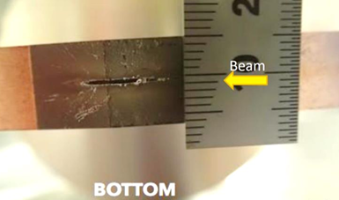
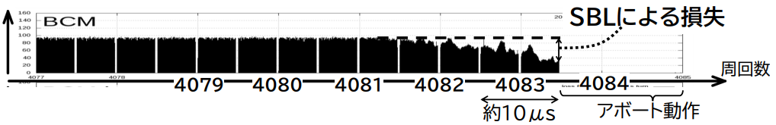
Introduction (SBL)
Collimator damaged by radiation from the SBL
SBL is one of the experimental challenges in the Belle II experiment
SBL is a mysterious phenomenon where most of the beam is lost after the beam circulates for several turns
→The lost beam scatters a large amount of radiation, causing serious damage to equipments such as detectors
and accelerator elements
Loss due to SBL
Number of cycles
Abort operation
An example of an SBL (Single Bunch Loss) event

Slide 4
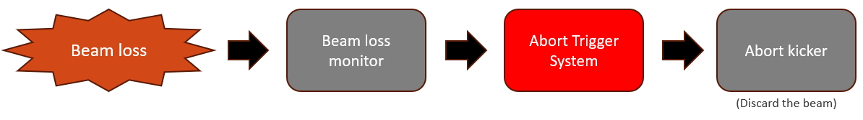
Introduction (Beam abort system)
The beam abort system is a system designed to protect the equipment by quickly discarding the beam when Beam loss occurs
Schematic diagram of the beam abort system (The process leading up to discarding the beam)

Slide 5
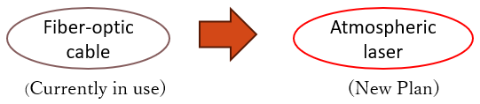
Introduction (My study plan)
The conventional beam abort system transmits the signal in this section using the optical fiber
To shorten the transmission time…
Refractive index
・Optical fiber : n (Refractive index)=1.5
・Atmospheric : n (Refractive index)=1.0
Optical fiber
Laser in the atmosphere
Laser signal transmission method is changed from signal transmission in optical fiber to a laser in the atmosphere
By reducing the refractive index from 1.5 to 1, the signal transmission speed is increased by 1.5 times!

Slide 6
Introduction (My study plan)
Logic of abort request signal
・Laser on : normal state
・Laser off : abort request
Optimize light collection efficiency
30μW is required for proper operation of the abort module
Laser used in the experiment→Class 2 laser：1mW
Stable laser transmission for long durations is required
In the atmosphere!
Signal from loss monitor
Laser Diode
Power：1mW
Laser
Coupling setup
Optical fiber
abort module
(At least 30 μW required)
My study
My study: Optimization of light collection efficiency in the coupling setup

Slide 7

My study(Optical fiber efficiency measurement)
Experimental Setup
Optical fiber (10 types)
telescope
Fib diameter(μm) | NA (Numerical Aperture)
400 | 0.5
400 | 0.39
200 | 0.5
200 | 0.39
200 | 0.22
105 | 0.22
105 | 0.1
50 | 0.22
600 | 0.5
1000 | 0.5
mirror
Laser source
1mW
Optical fiber
laser diameter:3.5mm
Power meter
Convex lens (focal length=35, 50, 100)
collimator

Slide 8
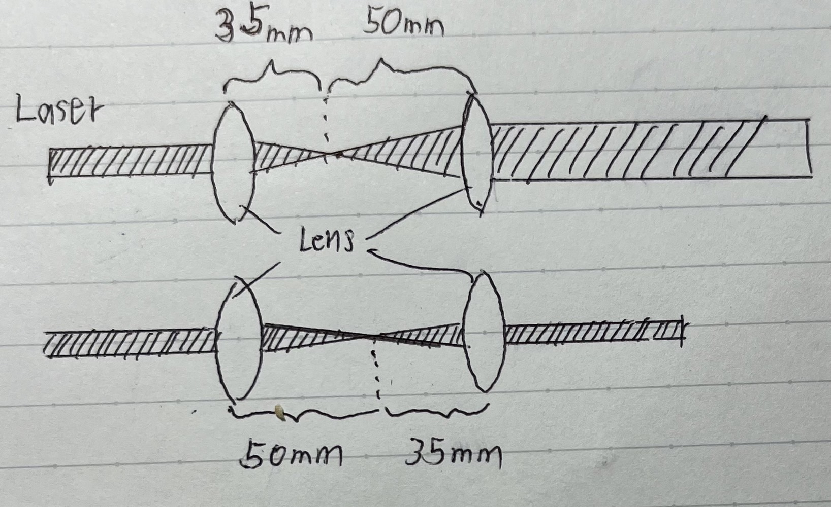
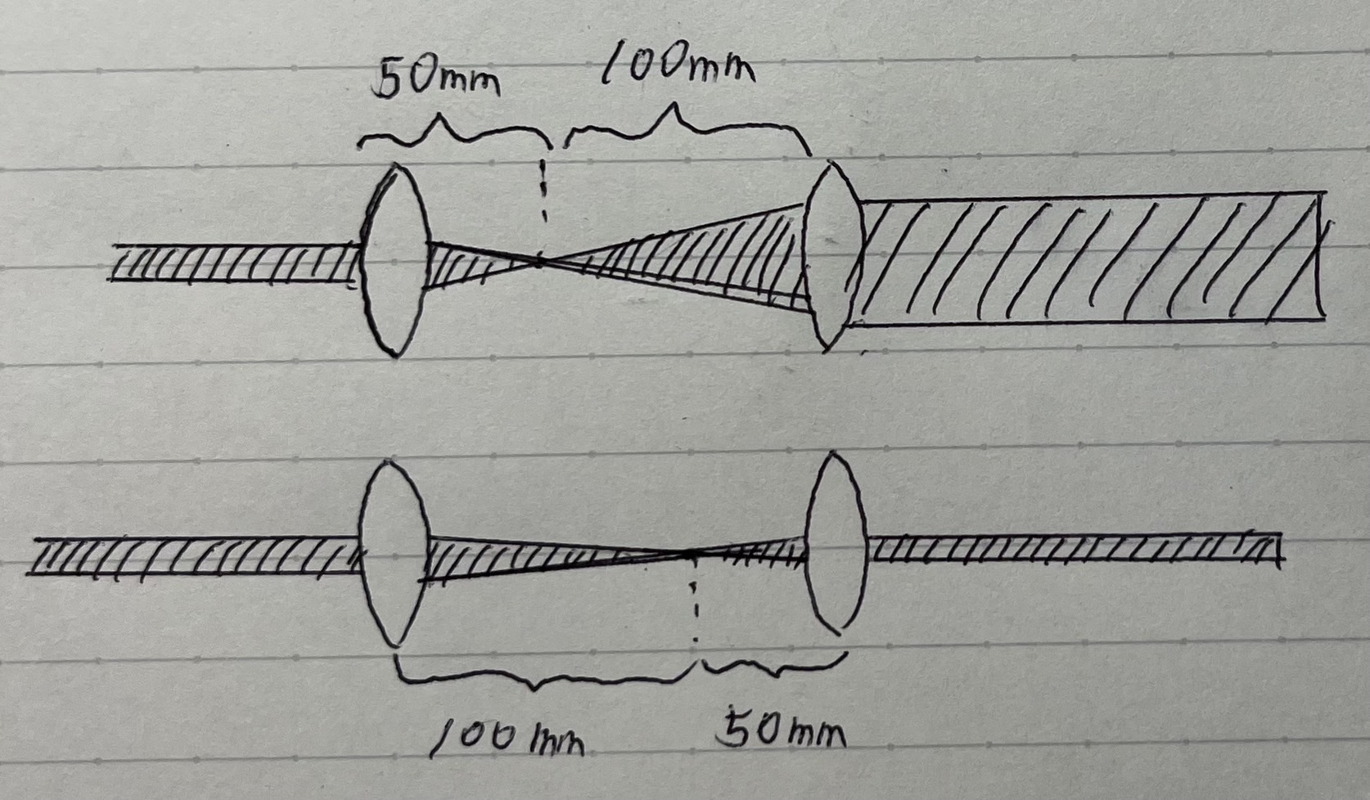
My study(Optical fiber efficiency measurement)
About telescope
Laser of four kinds of size
F35 and F50
F50 and F100

Slide 9
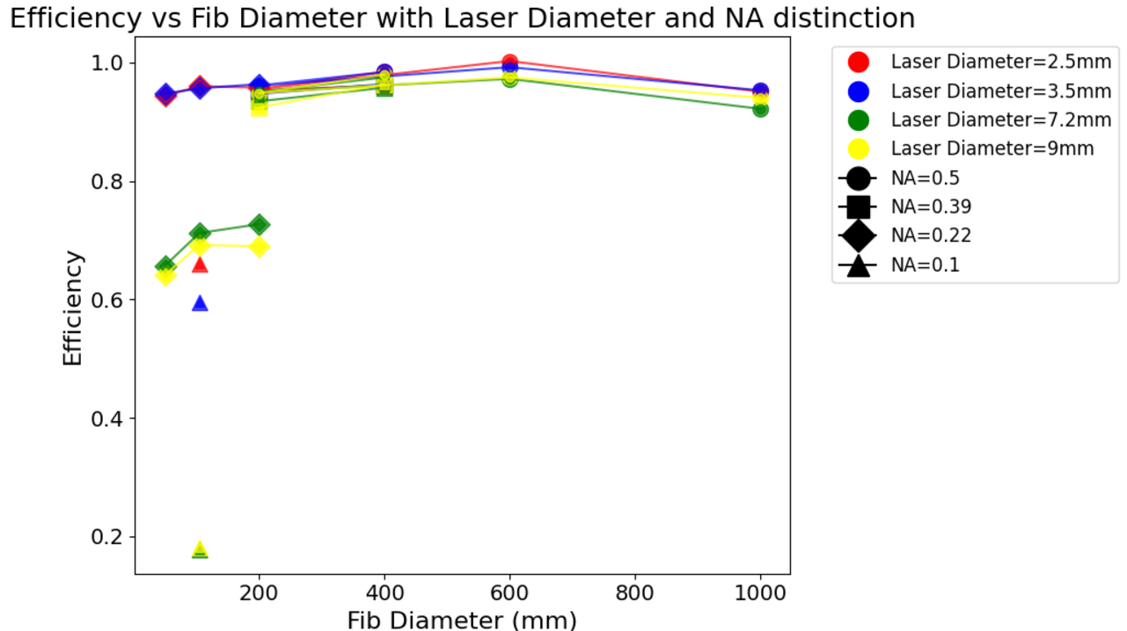

Result (Optical fiber efficiency measurement)
Efficiency = $\frac{\text{Light} \text{intensity} \text{after} \text{passing} \text{through} \text{the} \text{fiber}}{\text{Light} \text{intensity} \text{before} \text{entering} \text{the} \text{fiber}}$
・The smaller the diameter of the laser, the
better the efficiency
・The larger the fiber diameter and NA, the
better the efficiency
・The fiber with a diameter of 1000 showed a
slight decrease in efficiency
In future research, we will use the fiber with a diameter of 600μm and NA 0.5, or the fiber with a diameter of 600μm and NA 0.5

Slide 10
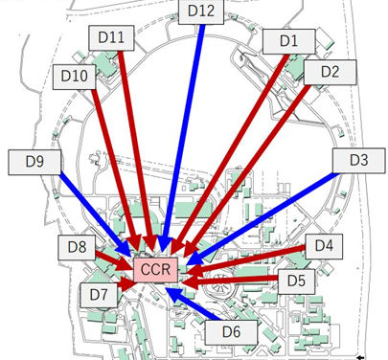
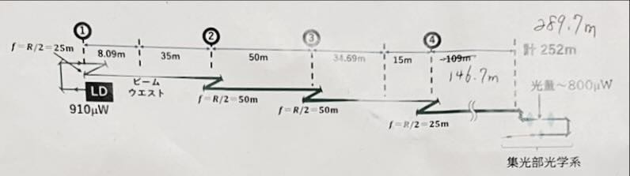
My study (24-hour measurement of 250m transmission)
Long-distance transmission
First, the goal is to achieve transmission over approximately
250 meters from around D06 to CCB (Central Control Building)
approximately 250 meters
250m
Beamwest
telescope
CCB
1000μW
focusing light
Overview diagram of the setup for 250m transmission
Diagram of the SuperKEKB accelerator ring

Slide 11
My study (24-hour measurement of 250m transmission)
Experimental setup
・Laser light source (power:1mW, Laser diameter:3.5mm)
・Reflective mirror (Reflection angle of 20 degrees, 2 inches)
・Spherical mirror (Focal length of 25m and 50m, 2 inches)
・Telescope
・Focusing lens
・Optical fiber (400μm, 0.5NA) → Because the focusing efficiency was better than that of the fiber with a
diameter of 600μm during the 250m transmission

Slide 12
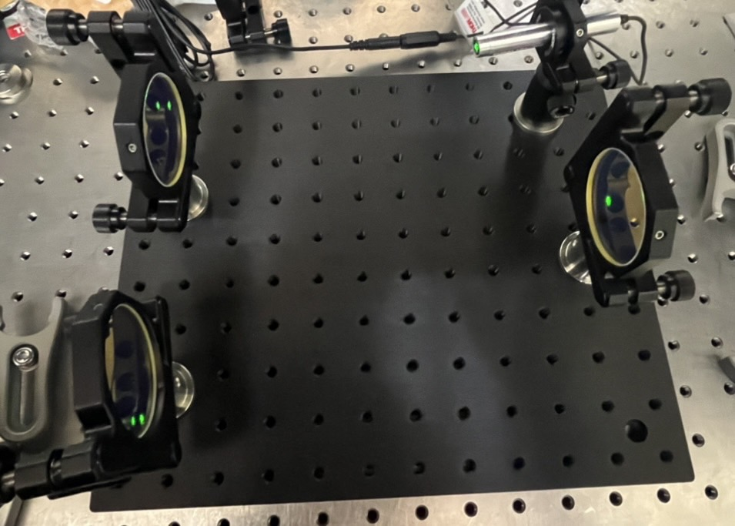
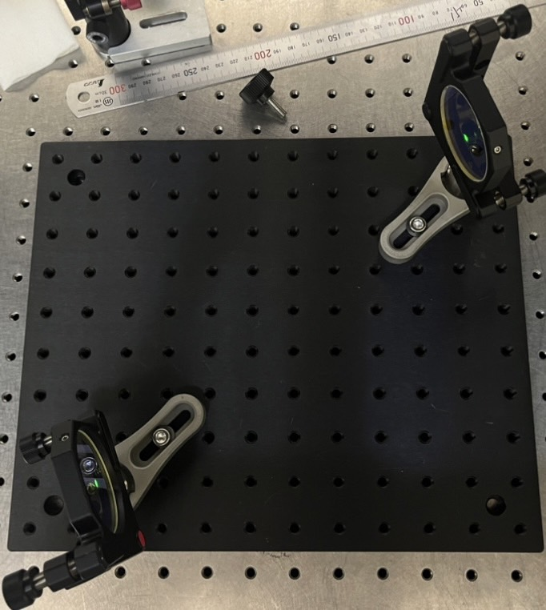
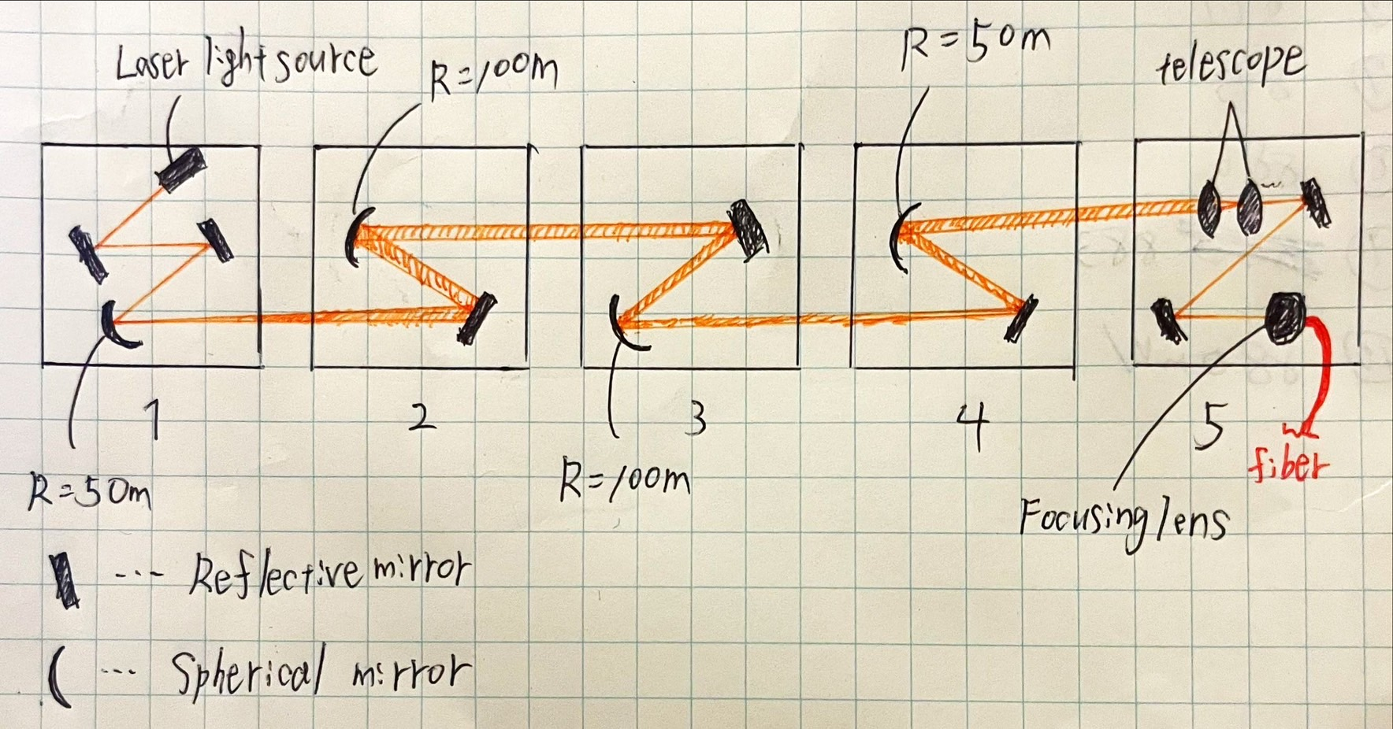
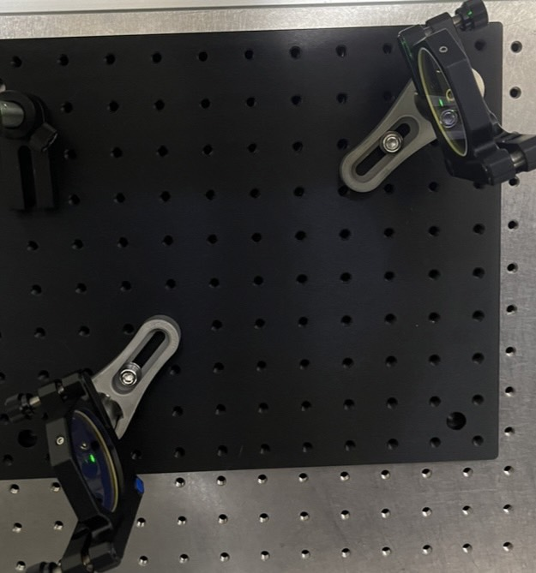
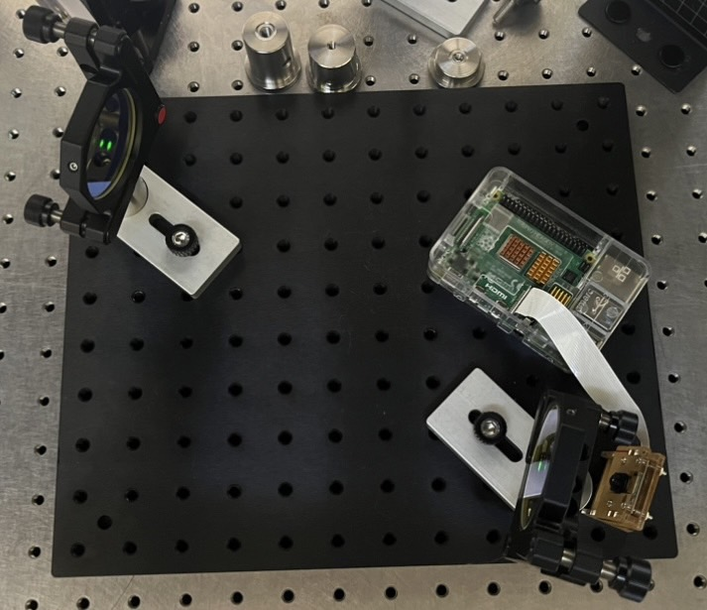
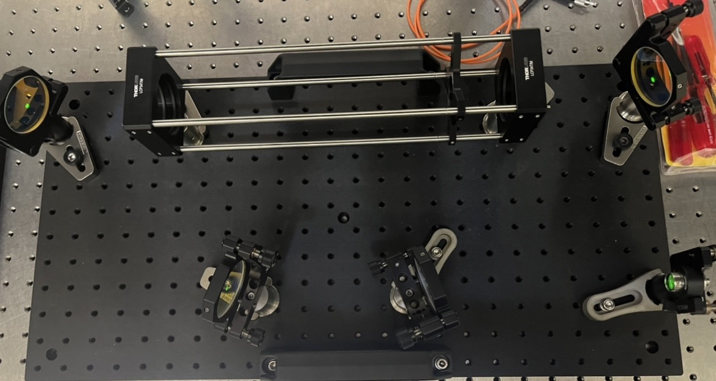
My study (24-hour measurement of 250m transmission)
Approximately 250 meters
Light source
telescope
fiber
Focusing lens
setup

Slide 13
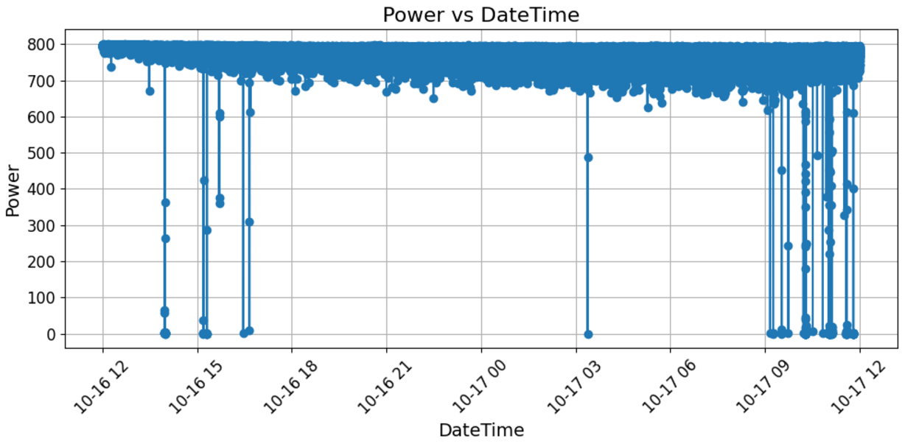
Result(24-hour measurement of 250m transmission)
Raw date
(μW)
Laser beam is blocked by person
(There is a lot of foot traffic on weekdays)

Slide 14
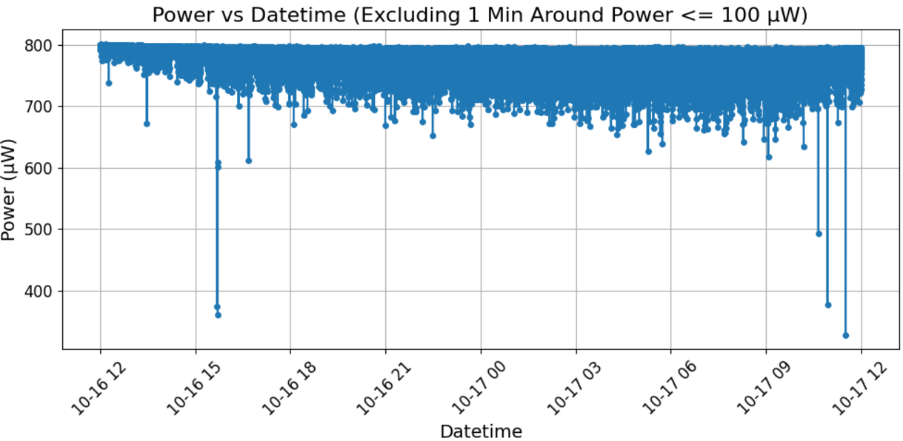

Result(24-hour measurement of 250m transmission)
Data organization
Consider the time during which the
laser was blocked by a person as
when the power is below 100 μW
→ Remove the data around values
below 100μW ( $±1$ min )

Slide 15
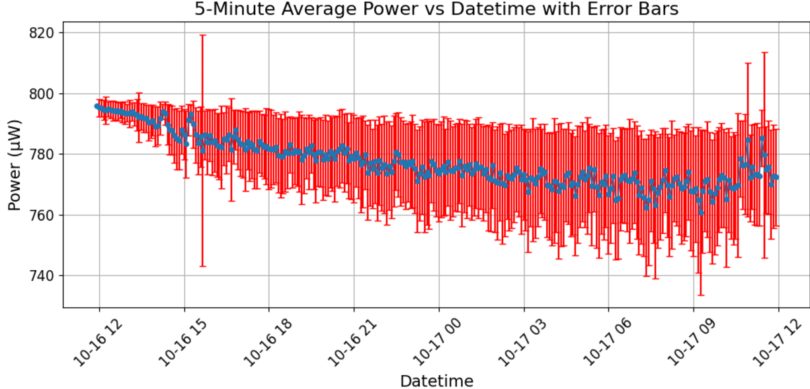
Result(24-hour measurement of 250m transmission)
The average and standard deviation of this data within 5-min
Over the 24-hour measurement, the average dropped significantly, and the variability of the data increased

Slide 16
Study (67-hour measurement of 250m transmission)
Improvement of the setup
・During the 24-hour measurement, the height of the center of the mirror was different
→The height of the centers of the mirrors was adjusted to be the same
・The size of the initial mirror was changed from 2 inches to 1 inch
→ By replacing the mirror with a smaller size, the center of the mirror became easier to identify

Slide 17
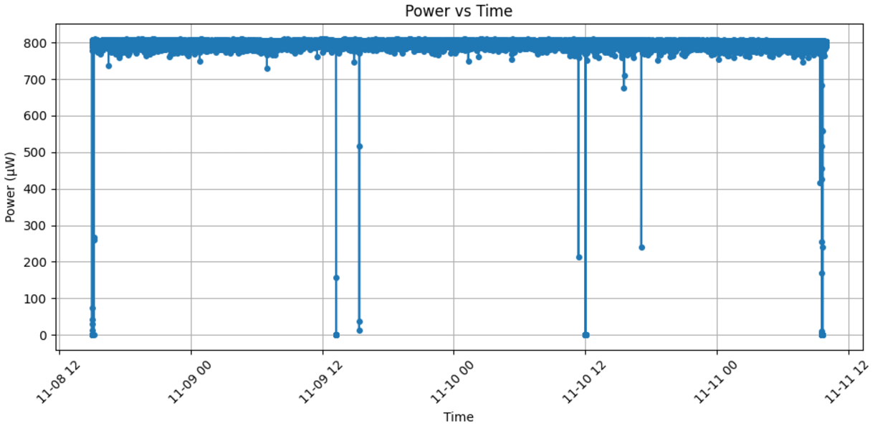
Result (67-hour measurement of 250m transmission)
Raw date

Slide 18
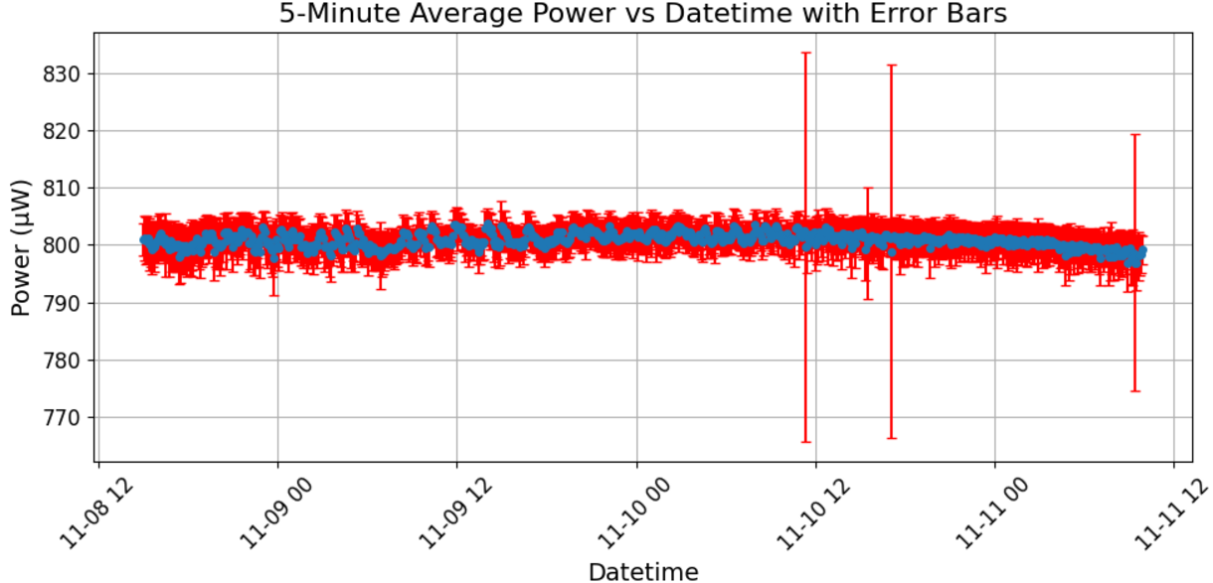
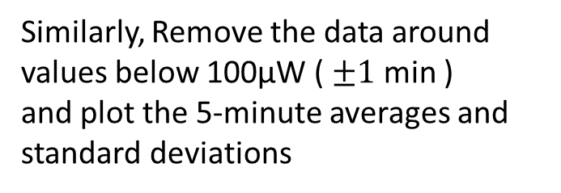
Result (67-hour measurement of 250m transmission)
Similarly, Remove the data around values below 100μW ( $±1$ min )
and plot the 5-minute averages and
standard deviations

Slide 19
Result (Comparison of both date)
Before the setup improvement
After the improvement
・There are outliers, but it is much more stable compared to the previous measurement
・The cause of the outliers here is unknown→We will research it in the future

Slide 20
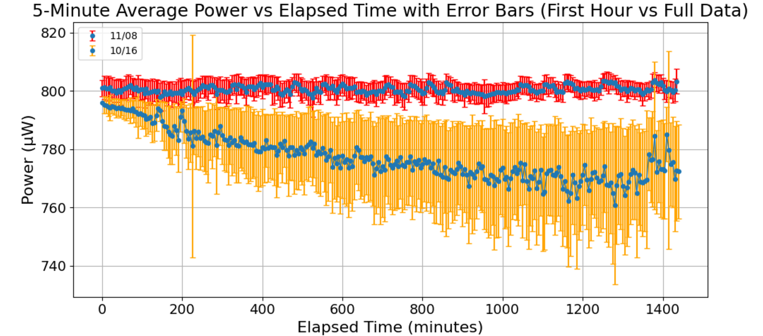
Result (Overlay two data)
Overlay 24 hours of data from both sets
By overlaying the data, it is clear that the stability has significantly improved. Additionally, the variability of the data has decreased

Slide 21
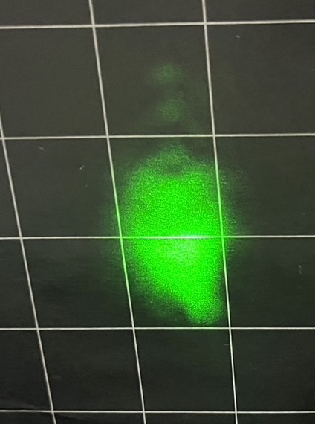
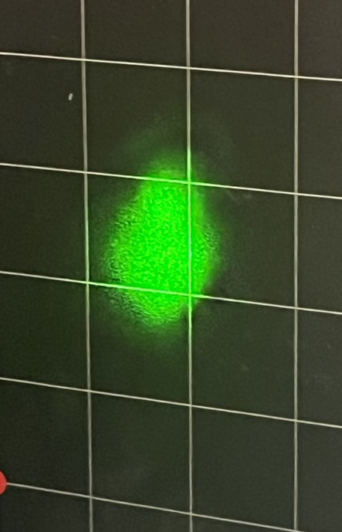
Result (Laser profile)
・The left figure shows the laser profile near
250m, before and after the improvement of
the mirror height
・After the improvement, the size of the laser
became smaller
・One tick mark is 2 cm
→The size of the laser decreased from about
4 cm to 3 cm
・Laser diameter of the light source: 3.5mm
→Even with focusing using a spherical lens, the
diameter has increased by about 10 times
Comparison of laser profiles(250m)
Before improvement
After improvement

Slide 22
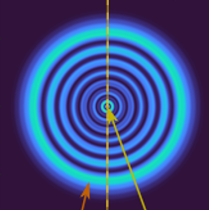
Future study plan
Currently, we are using a Gaussian beam
→ It is divergent and increases in size with distance
At CERN, research is being conducted on SLB (Structured Laser Beams)
→It is said that theoretically, it has the ability to
propagate over an infinitely long distance with low
divergence in the central part
Cross-sectional view of the SLB
This time, I came to study this SLB!

Slide 23
Summary
・Measurement of focusing efficiency for different fiber diameters, NA, and laser diameters
→The larger the NA and fiber diameter of the optical fiber, the better the efficiency (Except for
fiber diameters of 1000μm), the smaller the diameter of the laser, the better the efficiency.
・250-meter transmission experiment
→We were able to obtain a high value exceeding 700 μW
→By adjusting the height and size of the mirror, stability was improved
Future study plan
The transmission distance will increase even further from now on
→I want to learn about SLB and incorporate it into my future research!

Slide 24
Finally
Thank you for allowing me to participate in this workshop!
I would like to express my heartfelt gratitude to Elena and Witold for
preparing such an opportunity, as well as to the BE/GM group
members for including me in the SLB study, and to everyone involved.
Thank you very much!

