Slide 1
Recent Developments For A Photogrammetric System To Measure Offsets w.r.t. Stretched Wires
Dirk Mergelkuhl, Dominique Missiaen, Camille Vendeuvre - CERN, Geneva, Switzerland
Servet Lapardhaja - NTUA - Athens, Greece

Slide 2
Agenda
Introduction
Automatic wire detection and measurement
Target detection, decoding and measurement
Final calculation
Results
Outlook
Conclusion

Slide 3
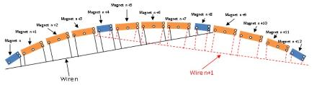
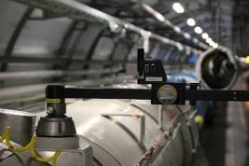
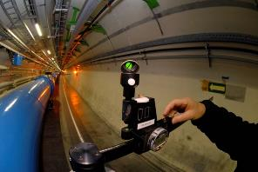
Introduction
«Ecartometry» is used at CERN for > 50 years
  In the LHC, the magnets are «smoothed» using this technology
  Different devices have been developed
  The accuracy is in the range of 0.05 mm at 1 σ
  There is a need for new techniques
    To limit the human impact on the measurement
    For automation of the measurement
  Photogrammetry seems to be promising

Slide 4
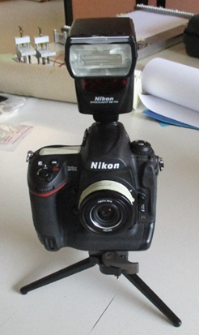

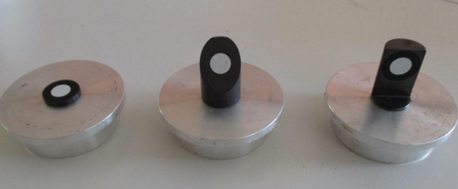
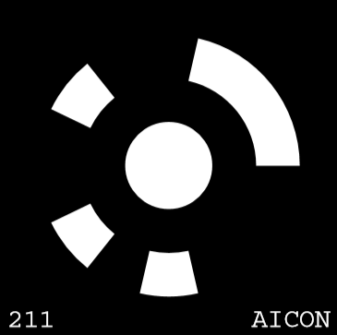
Equipment used for the test
Nikon D3X
Lens of 28 mm AICON metric
AICON 3D studio (DPA pro)
Nikon SB-700 flash
Carbon fiber scale bars
Fishing wire of 0.3 mm
Coded and non-coded targets
Structure | Matériau | Couleur | Diamètre | Résistance
Monofilament | Nylon | Noir | 0,30 mm | 7 kg
Tressé | Polyéthylène | Rouge | 0,35 mm | 30 kg
Torsadé | Vectran | Noir | 0,40 mm | 20 kg

Slide 5
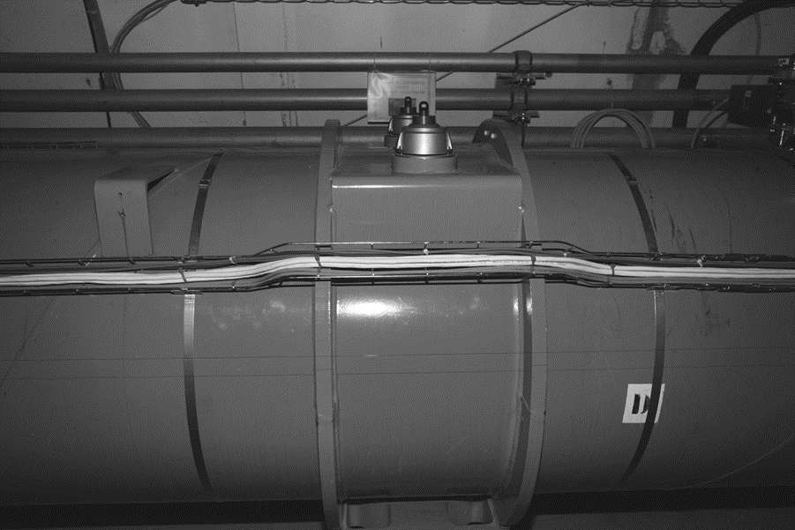
Automatic wire detection
  It is quite difficult to detect automatically the streched wire in an image
    Multiple services
  Wire is a straight line
    Sag of 6 microns
      neglected
targets
Cable trays
Tubes
Stretched wire
shadow

Slide 6
Automatic wire detection (2)
The typical properties of a thin wire in a photo are:
  Continuous line that traverses the entire image
  Straight line which corresponds to minimum curvature of edges
  Two parallel edges with a defined distance between them
  The wire is dark in the image and the background is lighter

Slide 7
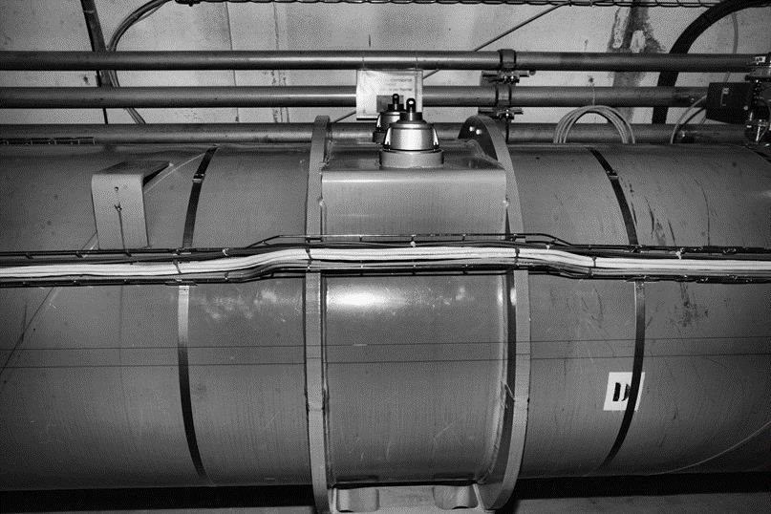
Automatic wire detection (2)
Pre-treatment by applying
  Adaptive image equalization
  Edge preserving filter
  (guided filter) to reduce the noise

Slide 8
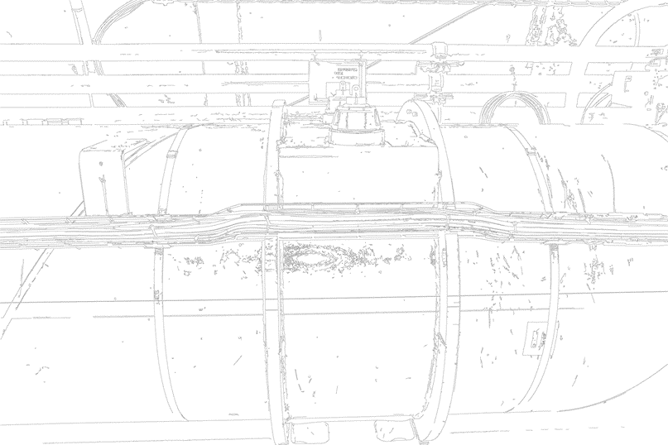




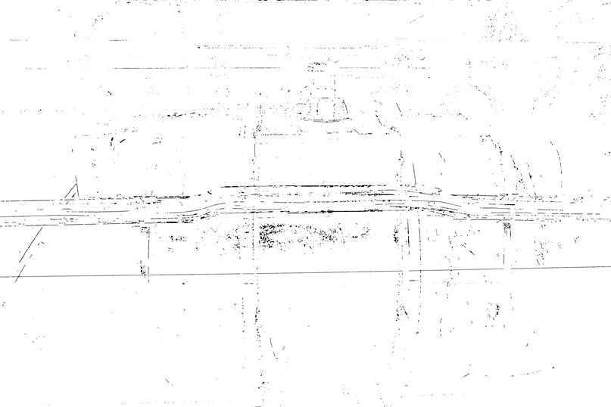
Automatic wire detection (3)
Canny edge detectors
Using morphological operators : dilatation and erosion
  Only edge with small distance are visible
Wire
Canny Edge detection
dilation
erosion
Wire
Wire

Slide 9
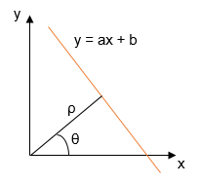
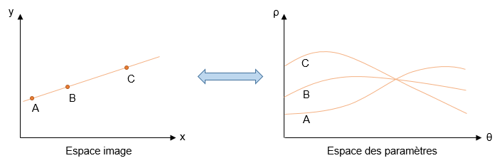
Automatic wire detection (4)
To identify the line in the binary image, the Hough transformation can be used
      Lines are represented by 2 parameters θ and ρ
      Each line is materialised by a point
      Lines passing at the same point is a curve
      The intersection of the curves is most probably the line we are looking for

Slide 10
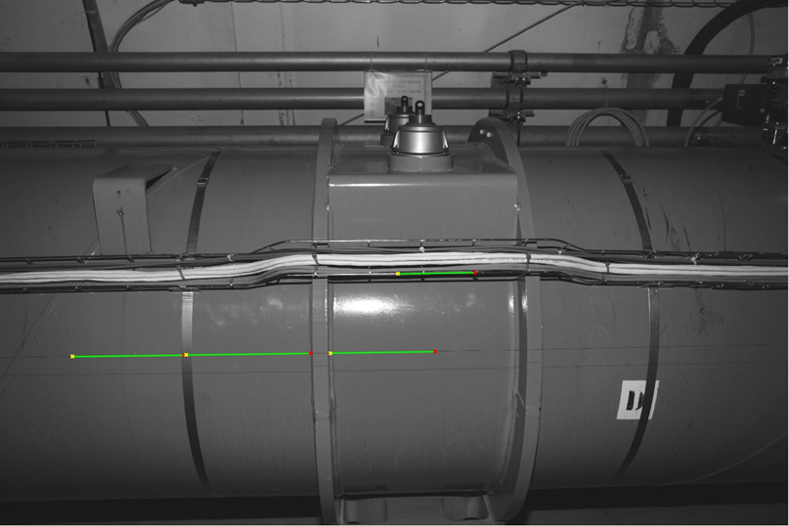
Automatic wire detection (5)
Calculation of length of each segment
Merge of the segments with the same θ and ρ
The longest segment is considered to be the best candidate for the wire position
Approximate position of the wire obtained with
  Length, X1, Y1, X2, Y2

Slide 11
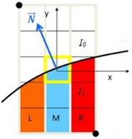
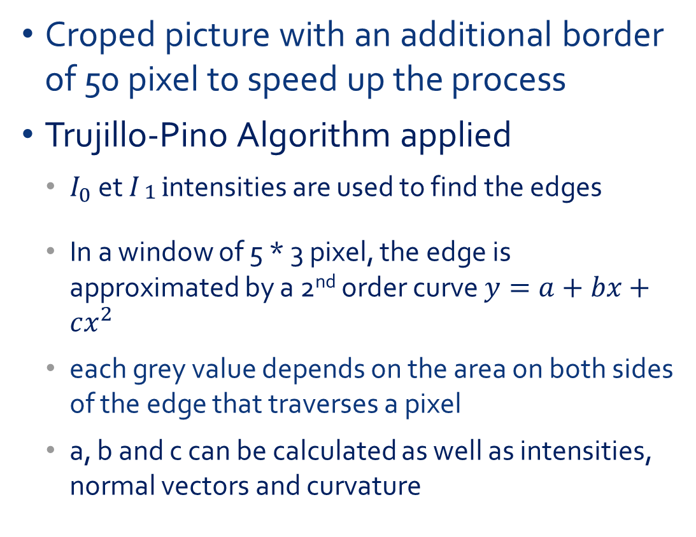
Wire position measurement
Croped picture with an additional border of 50 pixel to speed up the process
Trujillo-Pino Algorithm applied
  $I_{0}$ et $I_{\begin{aligned}1 \\ \end{aligned}}i$ntensities are used to find the edges
  In a window of 5 * 3 pixel, the edge is approximated by a 2nd order curve $y=a+bx+cx^{2}$
  each grey value depends on the area on both sides of the edge that traverses a pixel
  a, b and c can be calculated as well as intensities, normal vectors and curvature

Slide 12
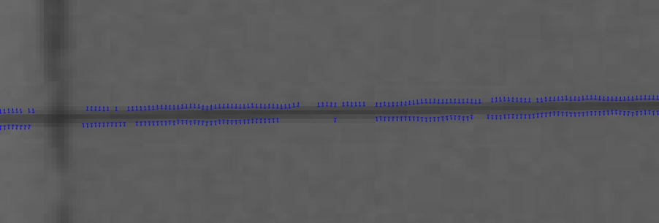
Wire position measurement (2)
Elimination of wrong points
  Distance to approximate determination < 35 μμ
  Curvature smaller than 0.2
  Normal vectors and approximate wire position are perpendicular within 10 deg.

Slide 13
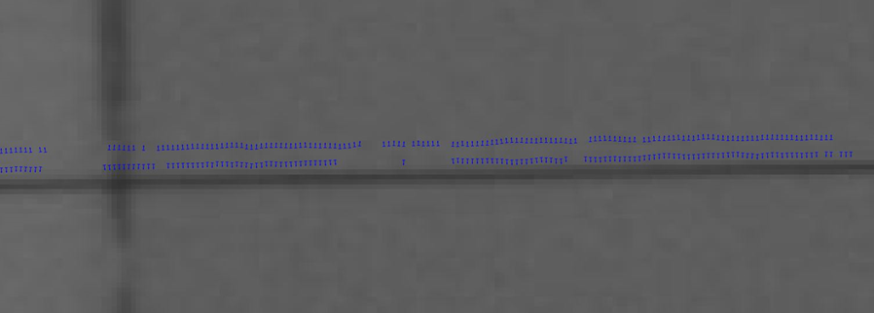
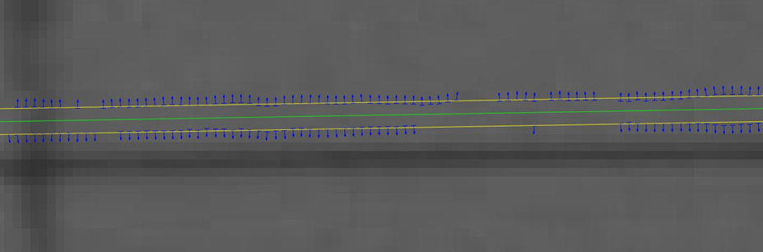
Wire position measurement (3)
Correction due to distortion using calibration parameters
Separation of the two edge lines using the normal vectors which have an opposite direction
Robust linear regression is calculated for each edge of the wire

Slide 14
Wire position measurement (4)
Validation of the two lines
  The parallelism of the two lines
  The distance between the lines has to correspond to an a priori information about line thickness in pixel
  The quality of the two individual lines defined by thresholds for sigma values of line parameters
  The wire has to be dark on light background
If one of the criteria is not fulfilled the candidate is rejected and the others are analyzed
  A maximum of 5 segments are analyzed

Slide 15
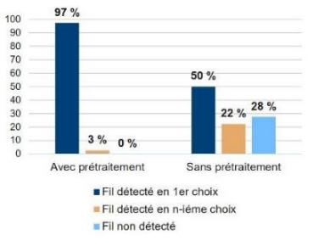
Wire detection and measurement
Relialibility of detection
  More than 150 photos taken in LHC
  pre-treatment is very important
  97% detected as 1st choice
  3% detected further
mean line calculation accuracy
  0.01 pixel for the position (b coefficient)
  the direction cosine 2*10⁻⁰⁶ (a coefficient)
  Typically several thousands of points with standard deviation of 0.16 pixel
Lucie Scandella

Slide 16
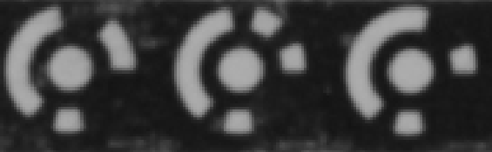


Automatic target detection
Original image
Pretreatment of the image
    Sharpening of the image (to accentuate the difference of black and white)
Binarization of the image
After sharpening
After binarization

Slide 17
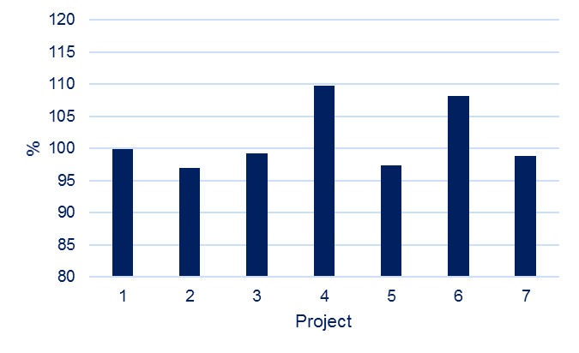
Automatic target detection (2)
For the detection, usage of the MATLAB regionprops function with conditions, which returns a set of properties for connected components (weighted centroid, area, major and minor axis, orientation)
  Connection of 8 components
  Ellipse are calculated for each detected region
  If ellipse surface - area surface/area surface < 1%
    It is a target
    For small targets (< 10pixels), thereshold is put to 3%
Comparison with the AICON software
  The percentage of targets detected
  by the new algorithm w.r.t. the AICON
  one is 101%
  Over 7 projects and 16000 images

Slide 18
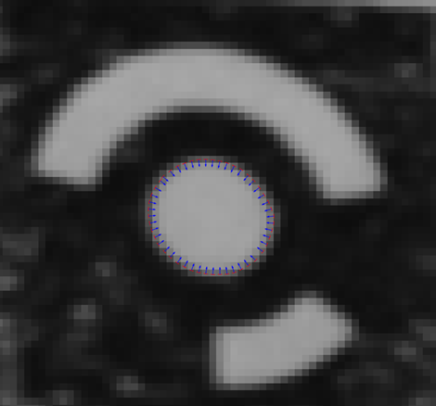
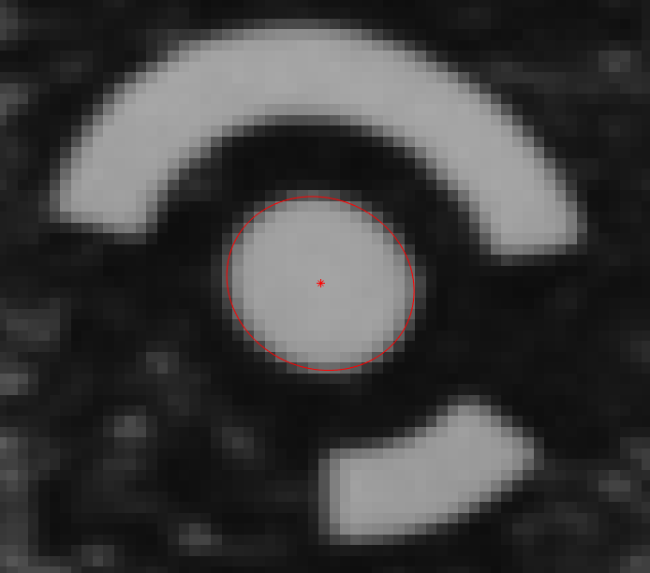
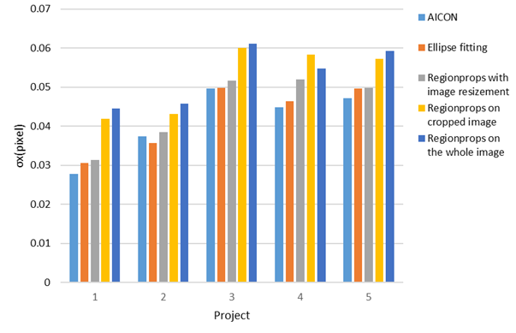
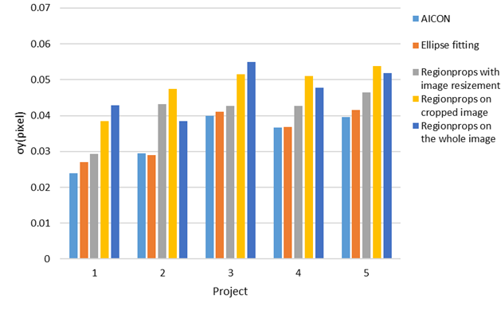
Target position determination
Several algorithms can be used
  Ellipse fitting (most reliable and precise)
  Crop each target from the whole image
  Sub-pixel edge detector from Trujillo Pino et al.
  Ellipse adjustment on the detected edge points using parametric equation of ellipse with least squares

Slide 19
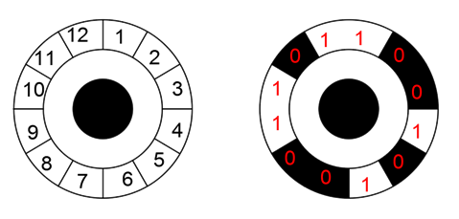
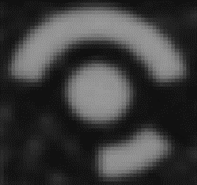

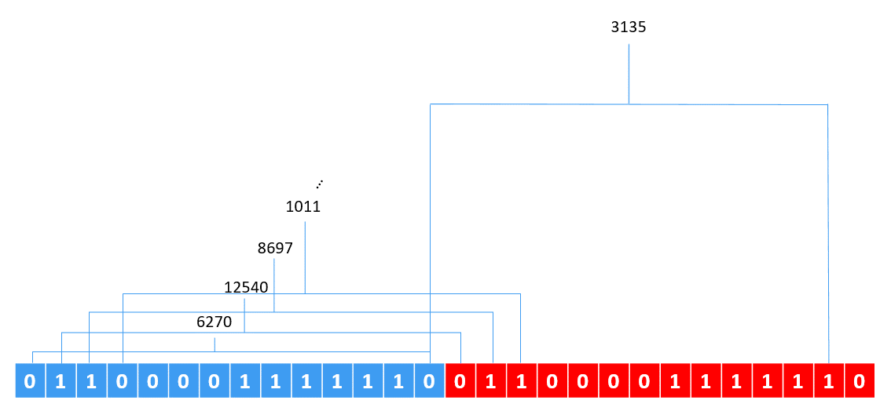
Target decoding
Crop each target from the whole image
Binarize each image
Spread points on the code segments (12, 14 or 20 points depending on the number of bits) 5 times with different rotations
  start with the position of the blue points and compare to the AICON look up table
  Then rotate 4 times to avoid ambiguity on the borders (red and green are positive rotations while cyan and magenta are negative) and compare to AICON table
Find the minimum value generated from binary sequence and check if it is generated more than once from the different rotations
Find correspondence of the number found with the AICON codes
AICON ID 170

Slide 20
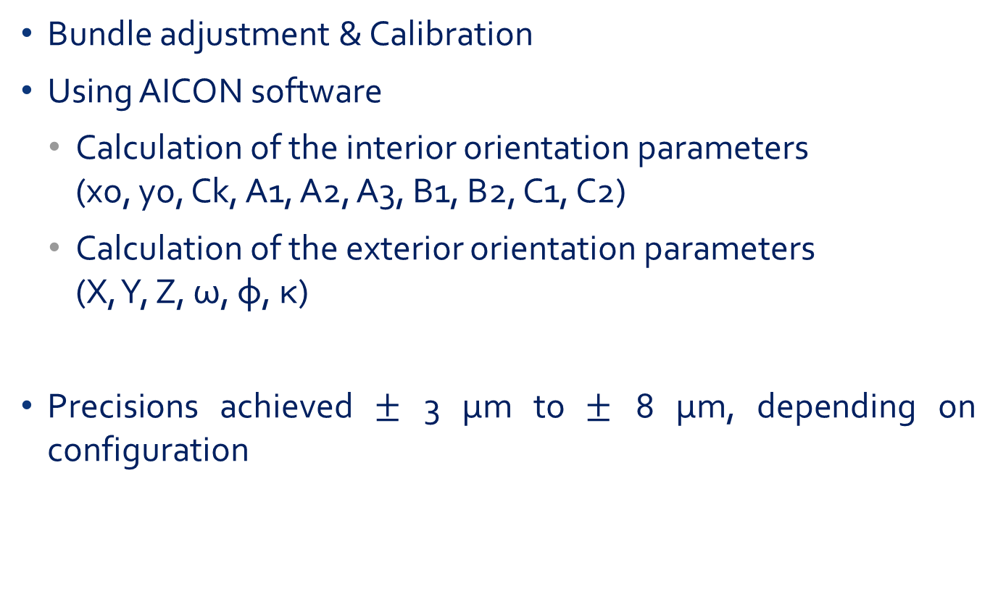
Bundle adjustment and calibration
Bundle adjustment & Calibration
Using AICON software
  Calculation of the interior orientation parameters
  (xo, yo, Ck, A1, A2, A3, B1, B2, C1, C2)
  Calculation of the exterior orientation parameters
  (X, Y, Z, ω, φ, κ)
Precisions achieved $±$ 3 μm to $±$ 8 μm, depending on configuration

Slide 21
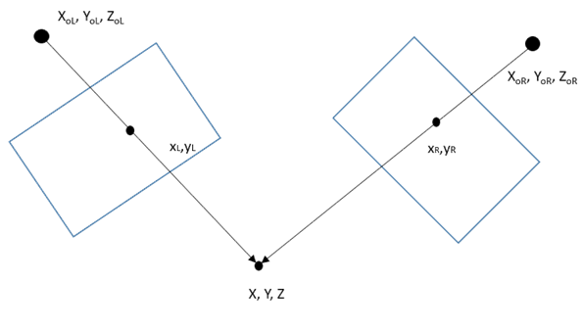
Homologous non-coded targets
Decoding can not be applied to find homologous points
Application of collinearity equations with least squares
Intersections among all combinations of uncoded targets are tried
Homologous points are found, if the intersection precision is higher than 50 μm on each component

Slide 22

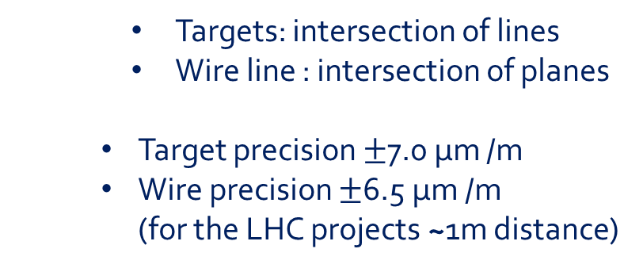
Final calculation
Use of LGC2 adjustment software
  Integration of the 2D wire and target measurements
  Correct image coordinates from distortion
  Camera observations entered into a simplified camera model as Unit vectors
    Targets: intersection of lines
    Wire line : intersection of planes
    Target precision $±$7.0 μm /m
    Wire precision $±$6.5 μm /m
    (for the LHC projects ~1m distance)
Ray 3
Ray 1
Ray 2
Ray 4
Intersection line -wire

Slide 23
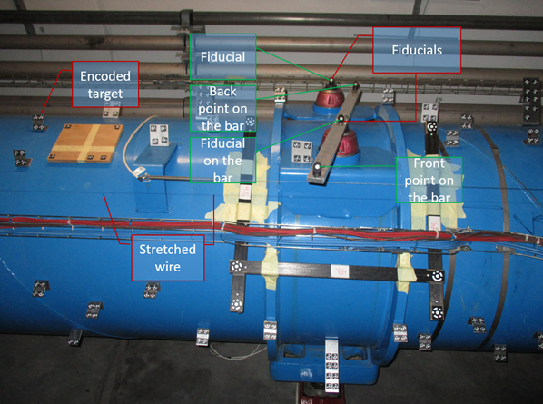
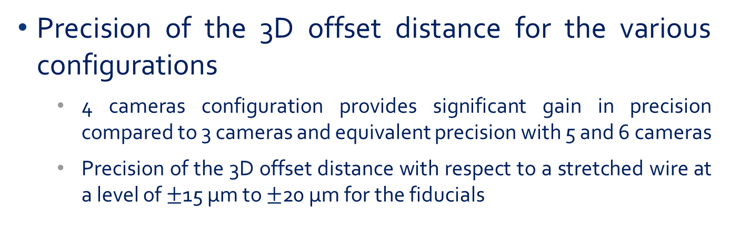
Offsets calculation
Precision of the 3D offset distance for the various configurations
  4 cameras configuration provides significant gain in precision compared to 3 cameras and equivalent precision with 5 and 6 cameras
  Precision of the 3D offset distance with respect to a stretched wire at a level of $±$15 μm to $±$20 μm for the fiducials

Slide 24
Outlook
Creation of a carbon frame which will include 4 cameras with a base of 0.75-1.00m
Installation of 2 precise bi-directional inclinometers for the link to the gravity
Development of a blunder detection inside the LGC2
Automation of all the chain of calculation
  Data transfer between AICON and MATLAB to be automated
  Development of a more sophisticated way of intersections to find homologous points for large number of non-coded targets
Integration of the carbon frame on the collimator Survey train

Slide 25
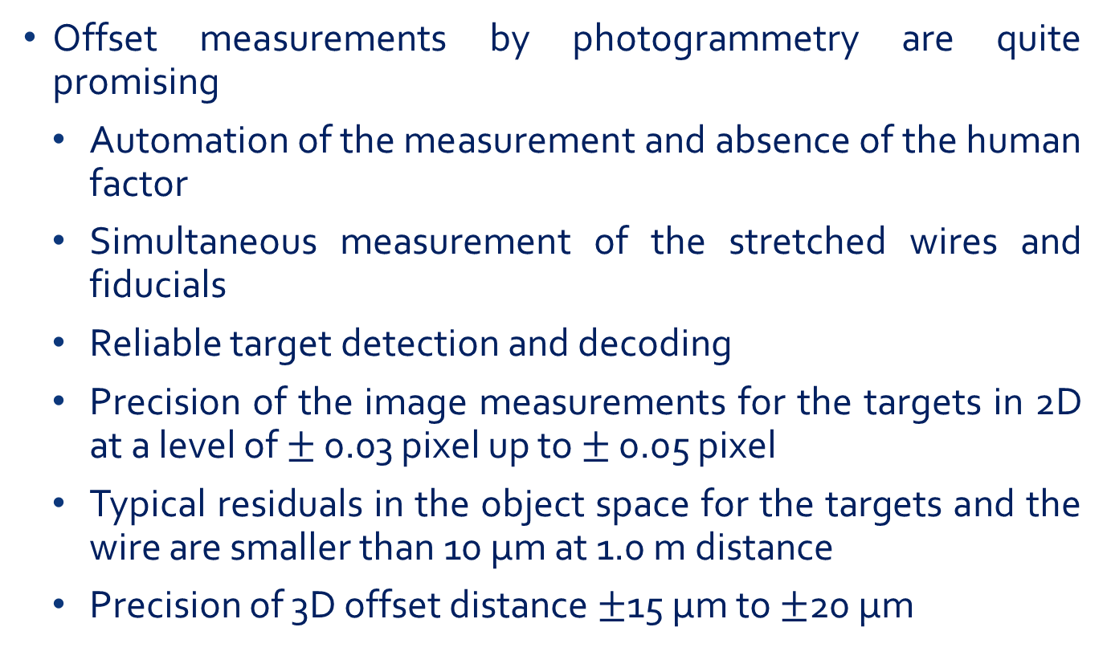
Conclusion
Offset measurements by photogrammetry are quite promising
Automation of the measurement and absence of the human factor
Simultaneous measurement of the stretched wires and fiducials
Reliable target detection and decoding
Precision of the image measurements for the targets in 2D at a level of $±$ 0.03 pixel up to $±$ 0.05 pixel
Typical residuals in the object space for the targets and the wire are smaller than 10 µm at 1.0 m distance
Precision of 3D offset distance $±$15 μm to $±$20 μm

Slide 26
Aknowlegments
Great thanks to Dirk Mergelkul who wrote the paper, helped fort the presentation and supervised the 3 students who made a master thesis on the topic : Camille Vendeuvre, Lucie Scandella and Servet Lapardhaja

Slide 27
Questions ?

