Slide 1

SLB KEK/CERN Collaboration Workshop Final Presentation
Rui Zhang (KEK ACCL-5, Injector Group)
2024.12.06. @CERN

Slide 2
Contents
Short summary for one week workshop
SLB section
  Local SLB test
  Issues with current SLB setup
  SLB application for the SuperKEKB fast abort laser system
Future and further collaboration
Summary and acknowledgement

Slide 3

Short Summary for 1 Week Workshop
Please accept my heartfelt gratitude for every members of Geodetic Metrology Group, CERN
I’m truly sorry for bothering you so much during your busiest time
The week-long experience has been immensely rewarding for me
Not only in scientific research but also in conducting experiments and fostering a productive working atmosphere, there is much to learn and draw inspiration from
One-week insightful conversation with all of you is more enlightening than ten years of study

Slide 4
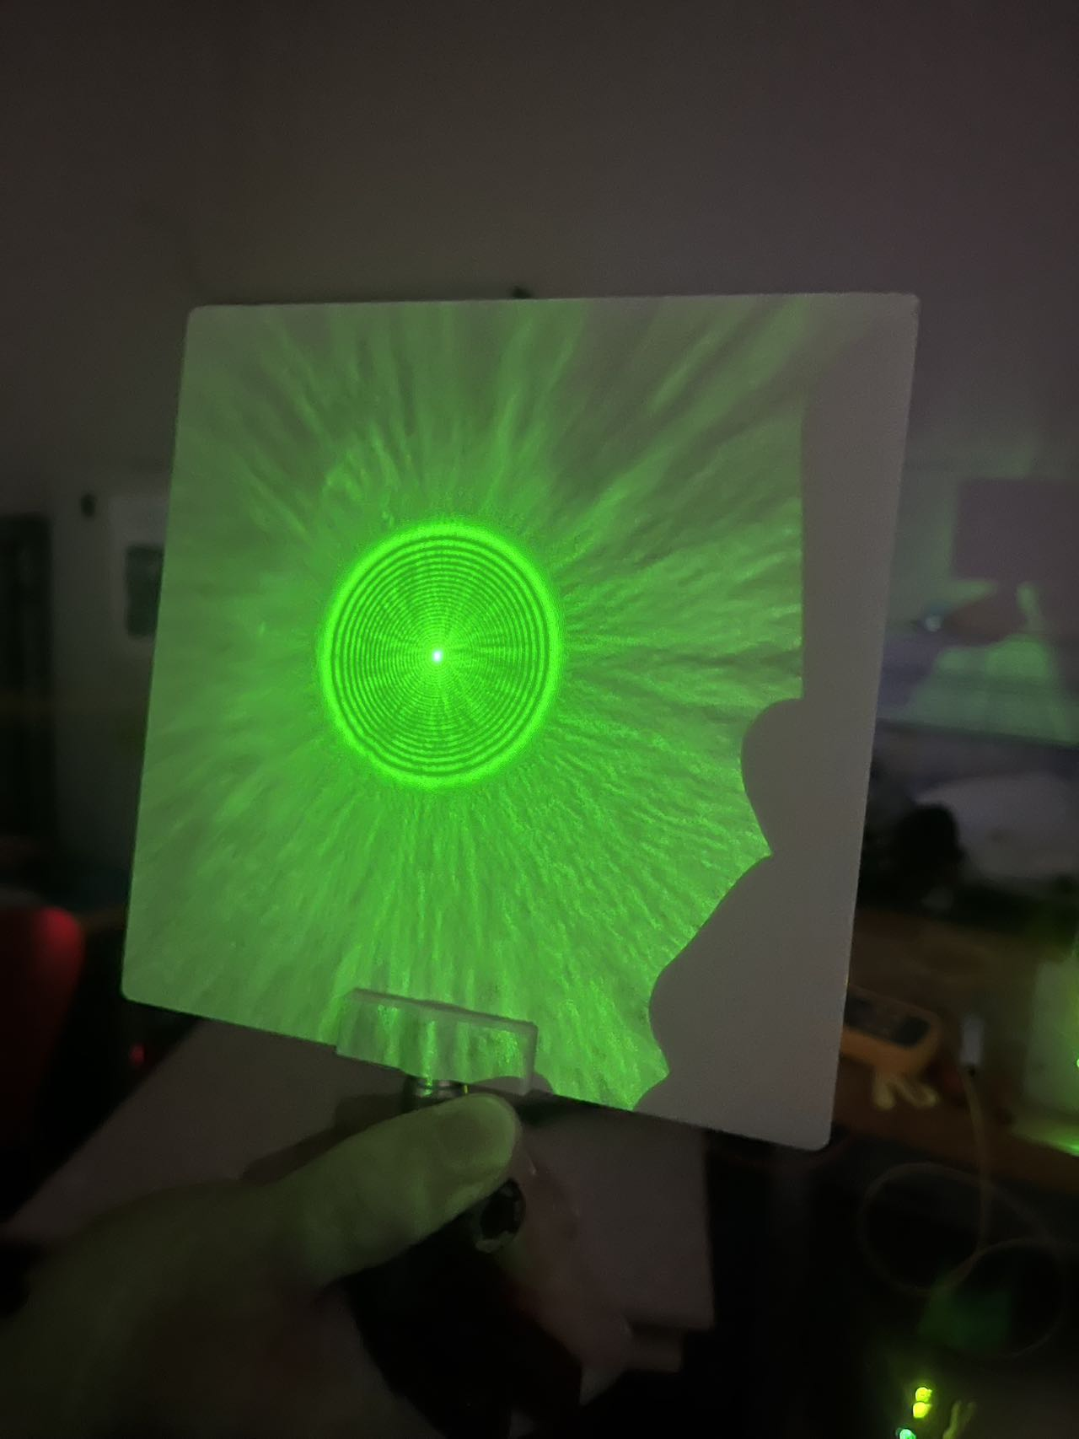
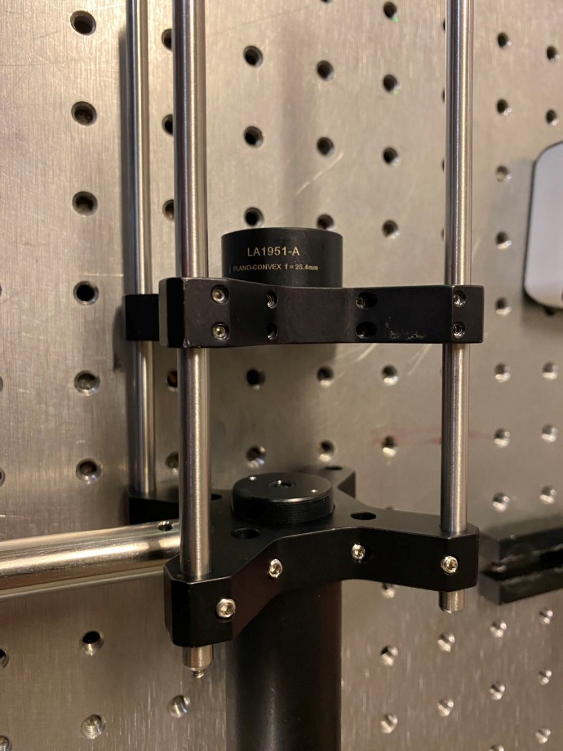
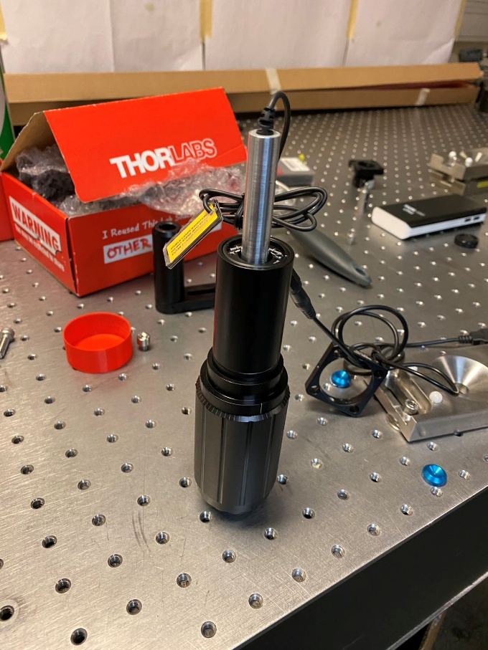
SLB Section: Local Test
We experienced the SLB experiment on 3rd December 2024
Impressed by the excellent features and compactness of SLB setup

Slide 5
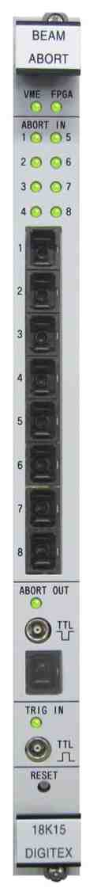
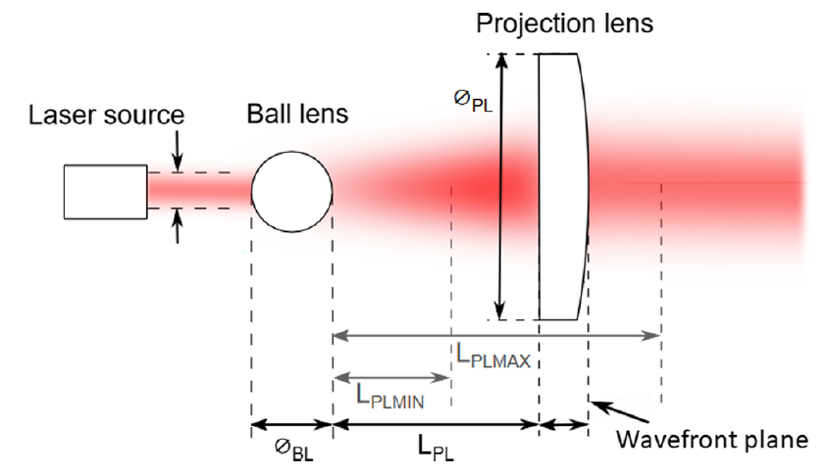
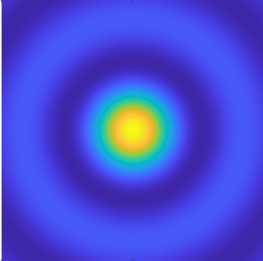
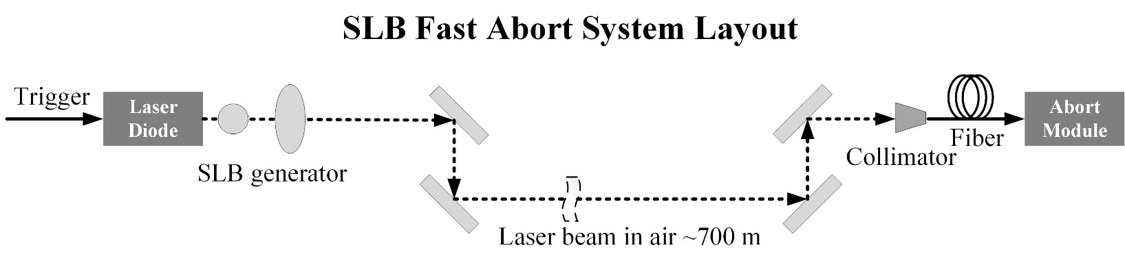
SLB Section: Issues
Issue with current SLB setup
  Low power of the central part of SLB (0.95 mW input; Diam. of ball lens :5 mm; Diam. of projection lens: 1 inch)
  Measured power of central part: ~29 μW (Best power level at end point: ~100 μW)
Action power for input power @820nm: 2 μW
Application in commissioning: 30 μW

Slide 6
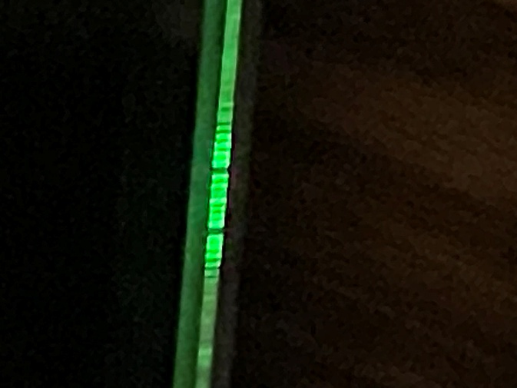
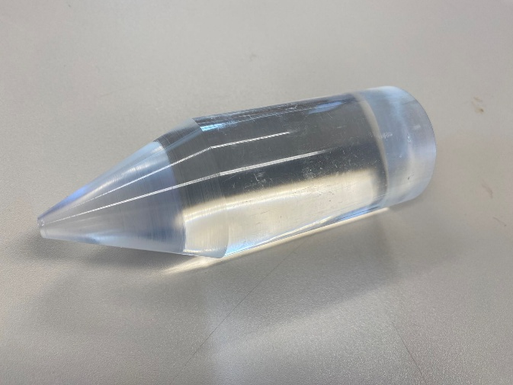
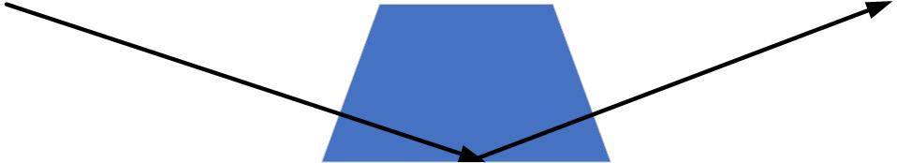
SLB Section: For SuperKEKB Abort System
Optimization
  Higher power input laser: 0.95 mW → 4.5 mW
  Projection lens with bigger size: 1 inch → 2 inch
  Optimized parameters for bigger central part and comparable low divergence (will be investigated by simulation )
  Fiber array coupling component for improving the coupling efficiency
  Wedge optical component to replace
  Light guide
  …

Slide 7
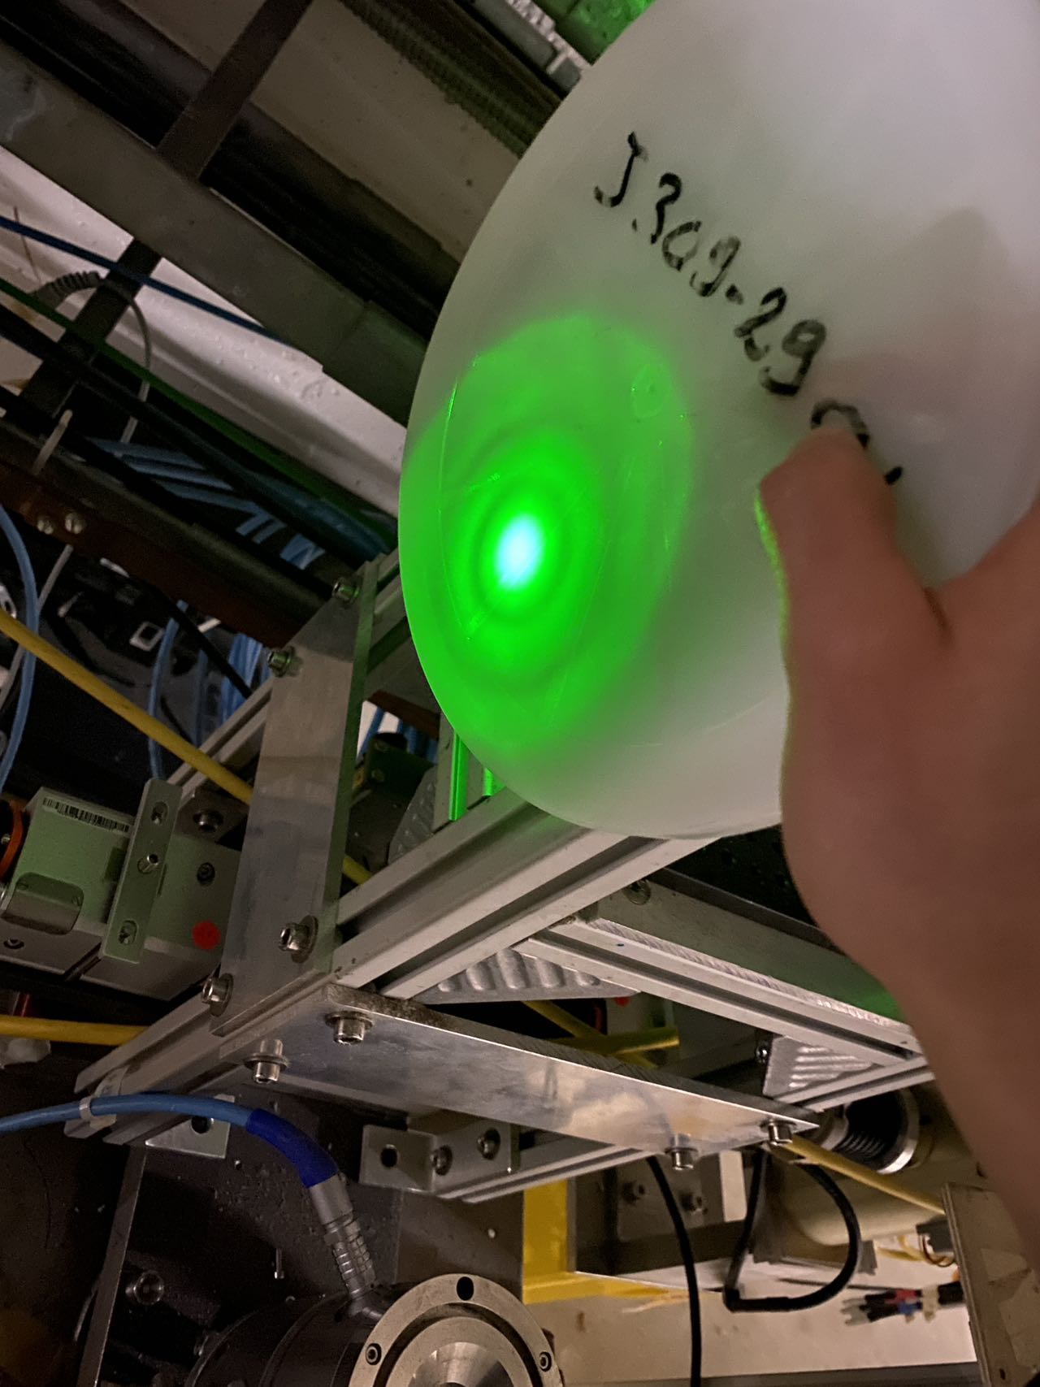
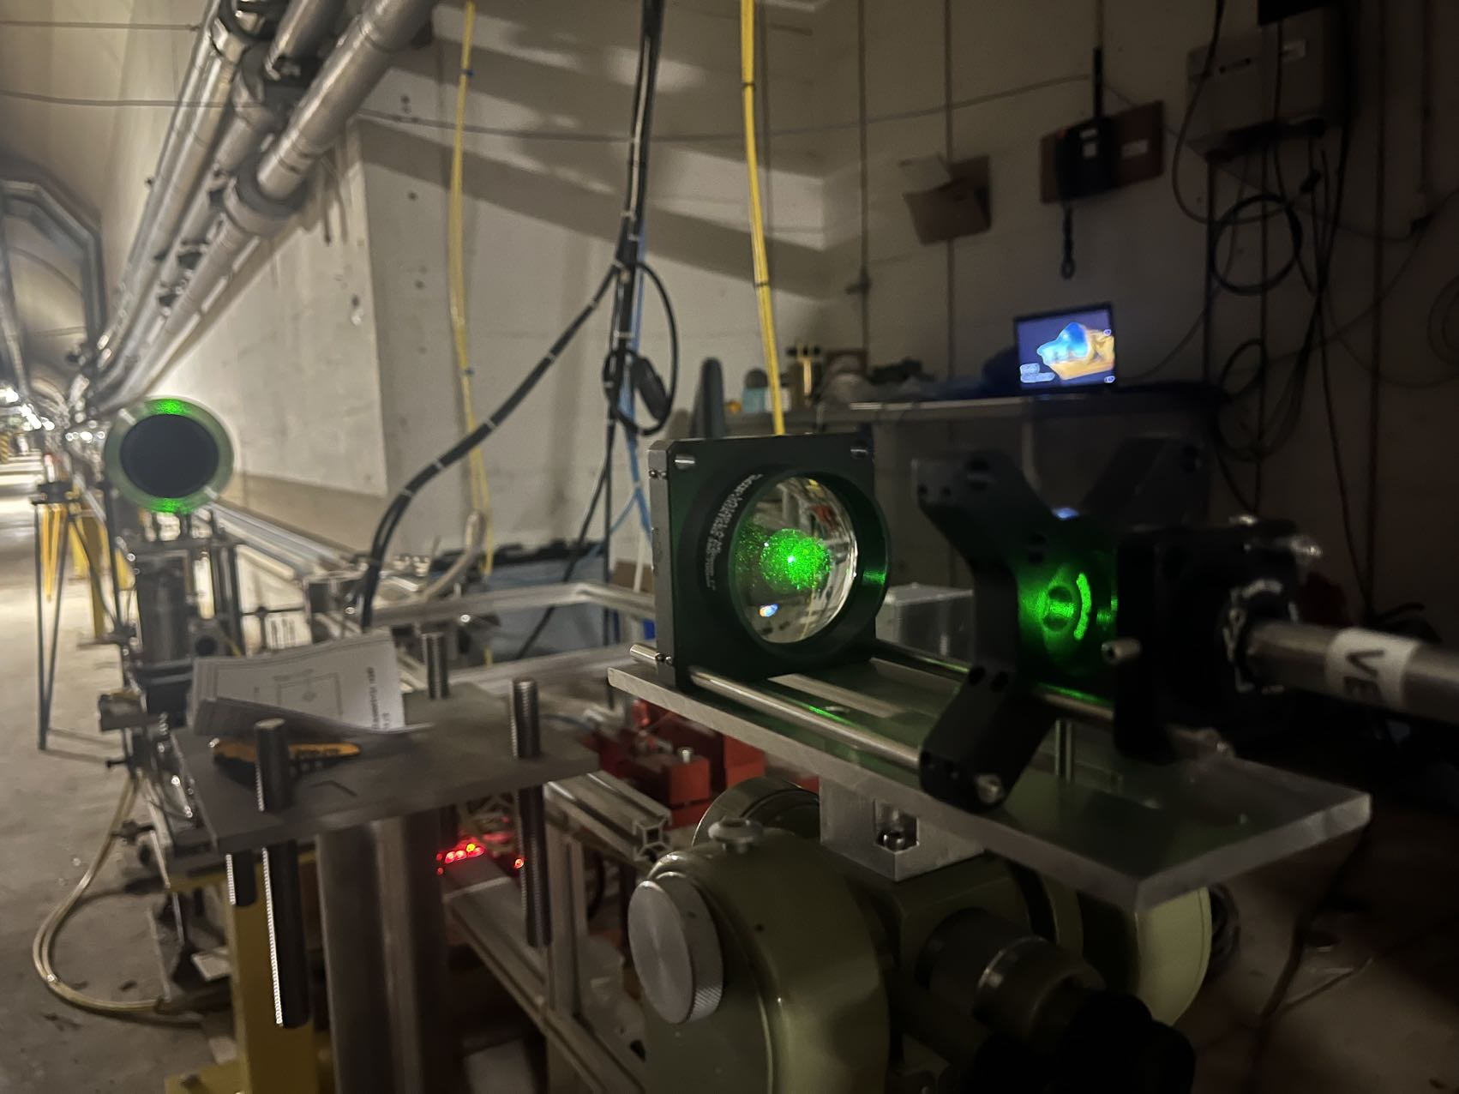
SLB Section: For SuperKEKB Abort System
Measurement at TT1 tunnel (140 m)
  Higher power input laser: 0.95 mW → 4.5 mW
  Projection lens with bigger size: 1 inch → 2 inch
  Bigger size convex lens: 5 mm → 9 mm (f=12 mm)

Slide 8
SLB Section: For SuperKEKB Abort System
Measurement at TT1 tunnel (140 m)
  Higher power input laser: 0.95 mW → 4.5 mW
  Projection lens with bigger size: 1 inch → 2 inch
0. 95 mW Input
10 mm ball lens and 2 inch projection lens
Bigger central part
Maximum power after 140 m transmission: 61 μW
4.5 mW Input
10 mm ball lens and 2 inch projection lens
Bigger central part
Maximum power after 140 m transmission: 330 μW
Measured power at 70 m: 900 μW

Slide 9
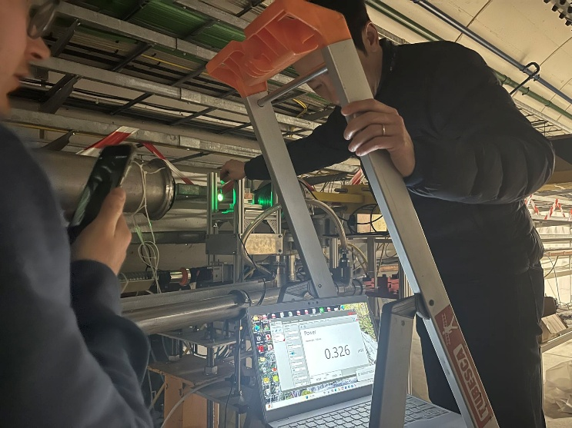
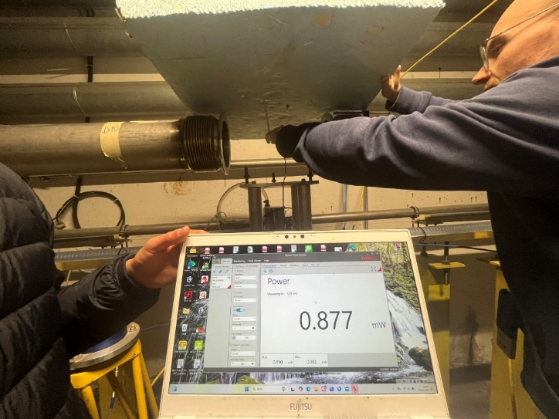
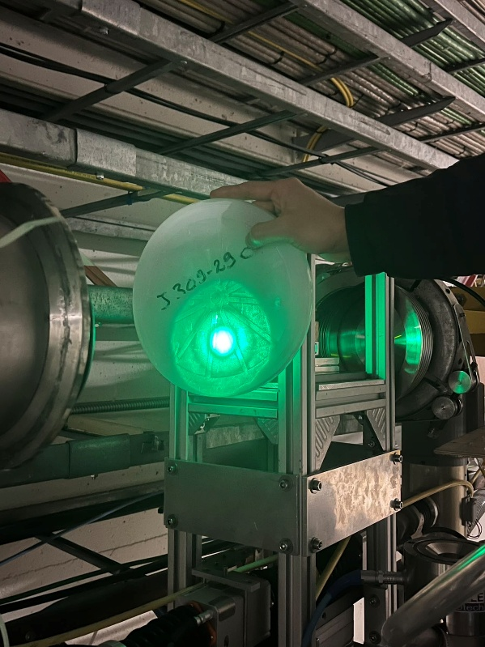
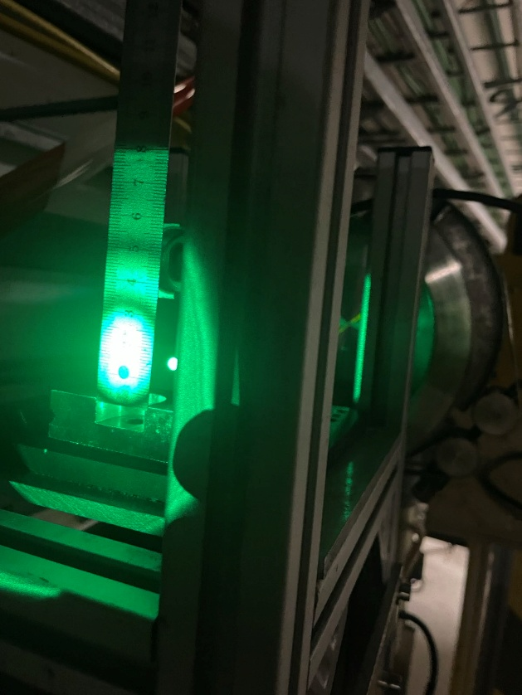
SLB Section: For SuperKEKB Abort System
Measurement at TT1 tunnel
  Higher power input laser: 0.95 mW → 4.5 mW
  Projection lens with bigger size: 1 inch → 2 inch

Slide 10
SLB Section: For SuperKEKB Abort System
To be improved
  Lower divergence for 700 m transmission
    Better balance should be considered: bigger central part for higher power v.s. smaller central part for lower divergence
    Simulation result for best condition (distance between two lenses, best ξ parameter, input laser beam size)
    Spherical mirror or optical plate
  Wavefront optimization
    Simulation code and design of BE/GM group knowledge
    Dedicated wavefront to realize long distance transmission at KEK
  Pipe installation

Slide 11
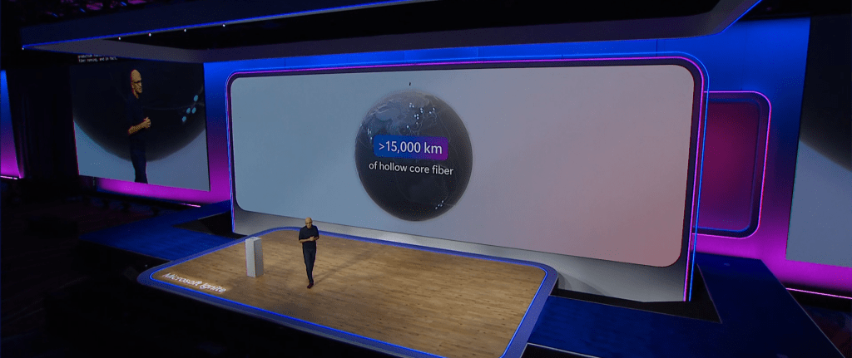
Future and further collaboration
As to SLB application at KEK
  After all the optimization and test, install as soon as possible at KEK
  Collaboration basing on intellectual property between CERN and KEK
Microsoft Ignite 2024 on 19th November
Hollow core fiber for ultrafast communication
https://news.microsoft.com/ignite-2024/

Slide 12

Future and further collaboration
While I was still captivated by the charm of the SLB for fast abort experiment…
After the presentations of Mr. Jean-Christophe, Mr. Witold and Mr. Martin

Slide 13
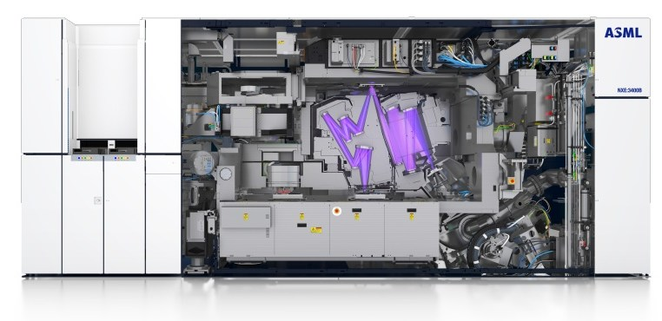

Future and further collaboration
A candidate for UV laser lithography
  Very small beam size in near filed
  A beam size that remains constant over a relatively long range
  With high power UV laser input
380 million dollars
150 ton
* From ASML homepage

Slide 14
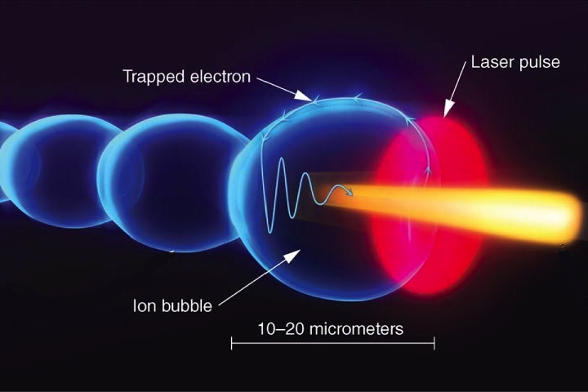
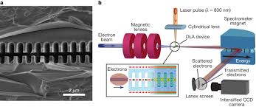
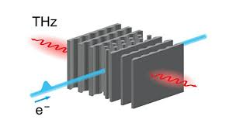
Future and further collaboration
Novel acceleration based SLB
  Laser plasma acceleration, THz accelerator, dielectric accelerator…
  Longitudinal varying electric field for acceleration
  A beam size that remains constant over a relatively long range along z direction

Slide 15
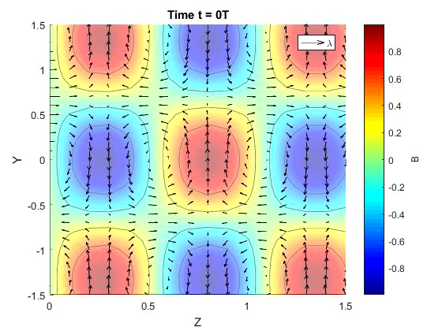

Future and further collaboration
Novel acceleration based SLB
  Longitudinal varying electric field for acceleration
  A beam size that remains constant over a relatively long range along z direction
1.0
0.5
0
-0.5
-1.0

Slide 16
Summary & Outlook
Practical experience of SLB at CERN
Optimization of SLB for SuperKEKB abort system application
Promising application of SLB and other technologies at KEK
Prospects of future collaboration with CERN
THANKS

