Slide 2

ActiWiz – notre couteau Suisse pour les calculs d’inventaires des radionuclides
C. Theis & H. Vincke
ARRAD WG1 - libération de matériaux et de bâtiments
17/10/2024, CERN

Slide 3



Contents
Introduction
Calculation methodologies for nuclide inventories
Overview of ActiWiz 3 & its application in practice

Slide 4
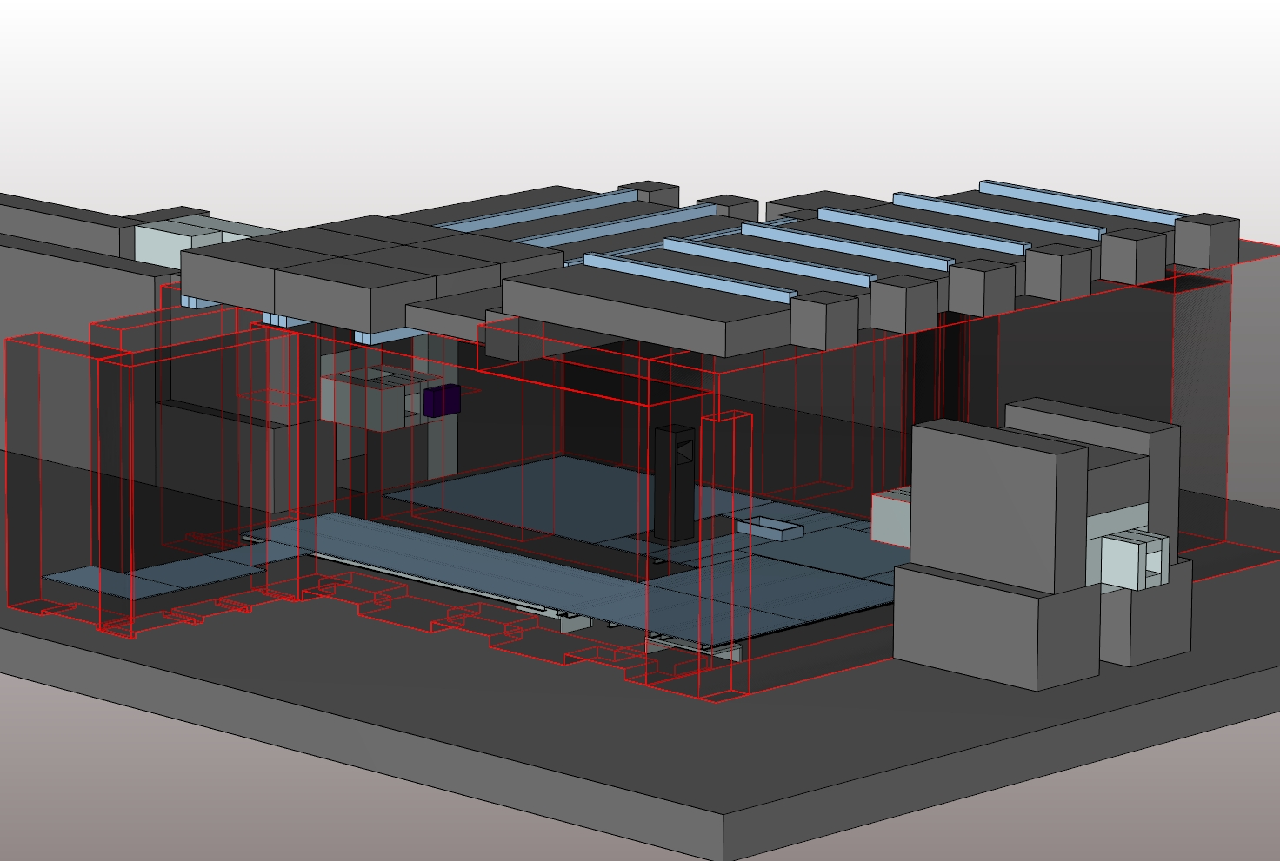
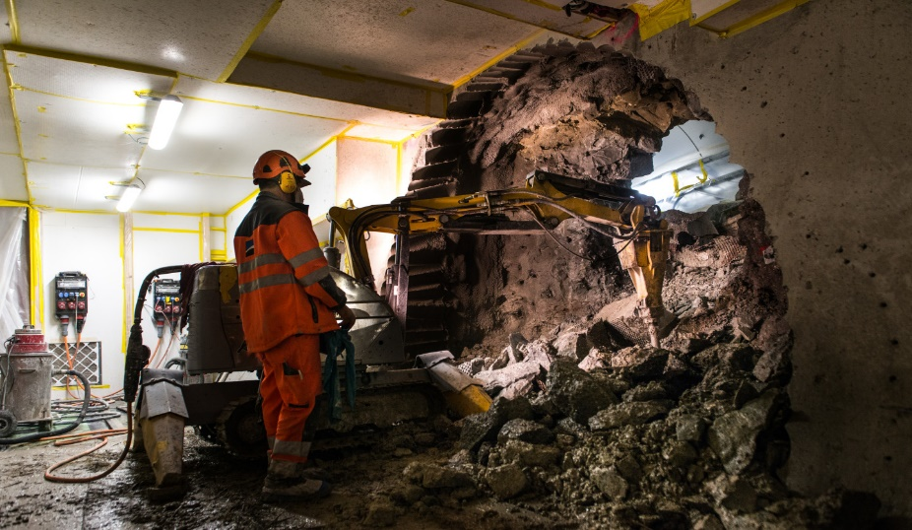
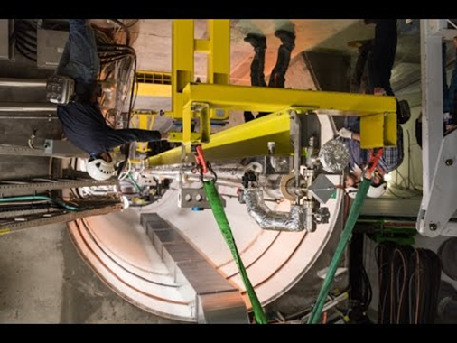
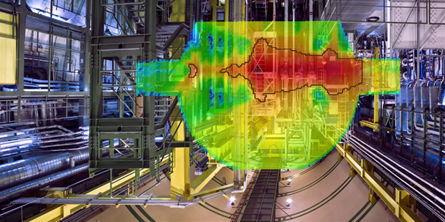

Construction
Design
Activated material
Operation
Maintenance &
Dismantling

Slide 5
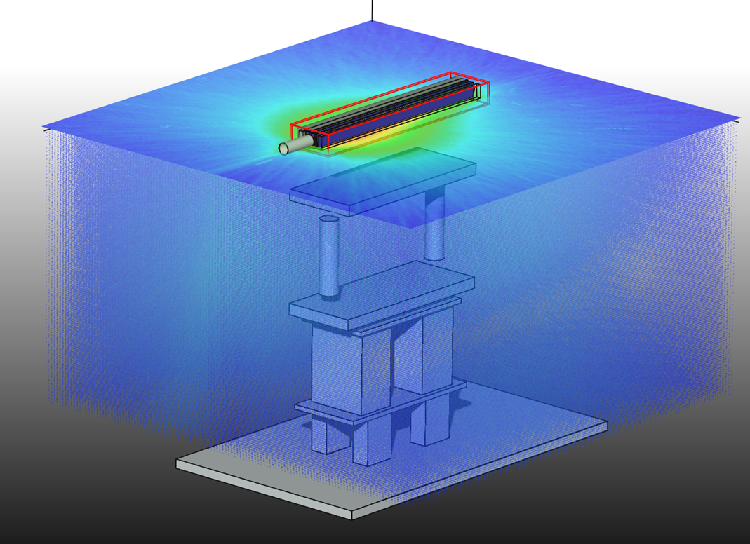
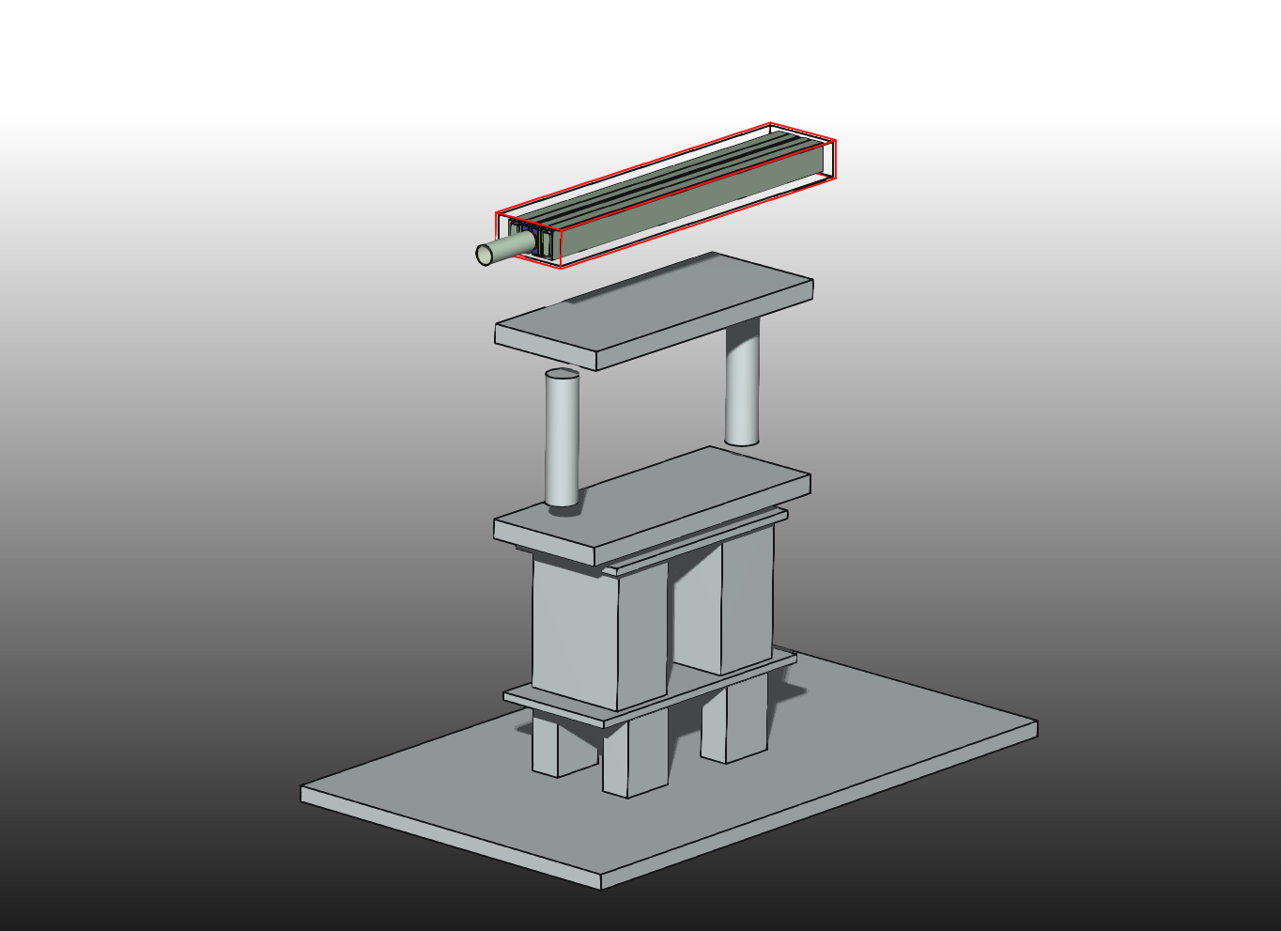
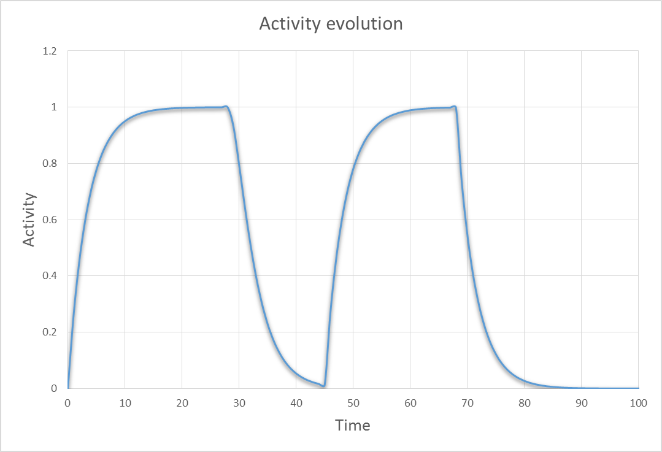
Material activation
secondary particles
beam
Decay
Isotope production &
build-up

Slide 6
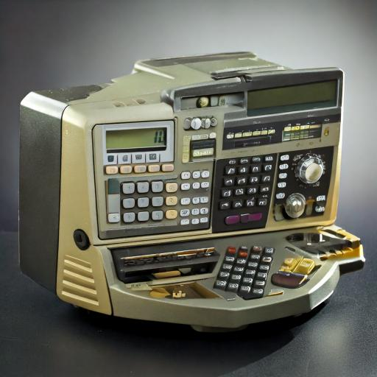
The challenge we faced….
Multitude of usually unknown parameters
material composition
irradiation & cooling period
radiation field
We need a tool that can calculate
all of this for us efficiently
Full laboratory analysis (γ-spec & radiochemical) is not a sustainable option due to huge material flow

Slide 7
Methods of computing nuclide inventories
Hybrid
(deterministic & MC)
Monte Carlo
State-of-the-art method for many problems in science
Combine the power of modern intranuclear-cascade models with analytical computation speed
Advantages
Advantages
Yields spatial distributions of nuclides & residual dose rate
Very high statistical significance & short computation times
Analysis & reporting tailored to characterization
Disadvantages
Disadvantages
Calculation times can be very long
Difficult to achieve sufficient statistics for thin layers
Requires fluence spectra as input
(→Monte Carlo)
Does not yield spatial information

Slide 8
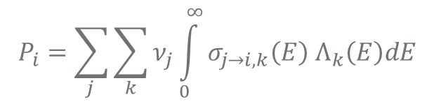
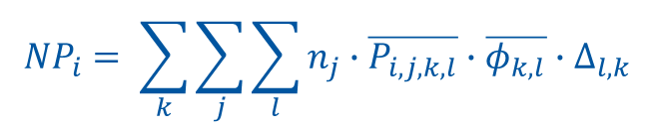

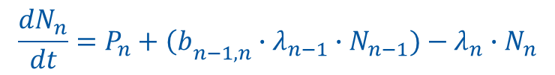
P_{i,j,k}(E) provides the amount of isotope i produced in a single element j, for a single radiation type k and a given energy (group) E
Foundation of ActiWiz: Basic nuclide production rates P_{i,j,k}(E)
neutrons < 20 MeV: JEFF 3.3
neutrons > 20 MeV, p, pi+, pi-, photons up to 100 TeV: 100 CPU years of generic CERN-FLUKA calculations
Data for 85 constituents (mainly elements of natural composition) and 5 particle types have been produced.
➔ in total 17 million basic isotope production data values

Slide 9
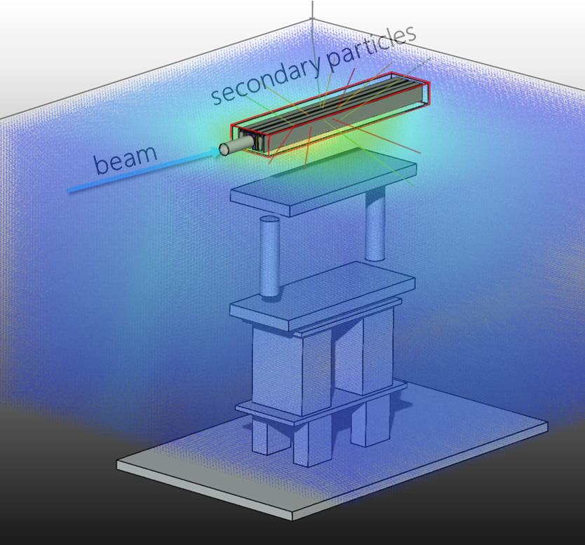
Nuclide inventory calculation in ActiWiz
Production rate P_{i} of each radio-nuclide i , based on particle fluences Φ_{k,} the material composition n_{j} and P_{i,j,k}(E)
Build-up & decay
(Bateman)
decay
build-up
Nuclide inventory for a given irradiation and cool down history within seconds for most cases

Slide 10
Nuclide inventory analysis
Radiotoxicity
(EU, CH, US, A, Japan, IAEA limits)
γ emission spectra
Radiological dominating isotopes
Isotope production sources
Alpha/beta
analysis
Shielding calculator
Evolution of rad. hazard with add. cooling time
Residual dose rate calculator

Slide 11
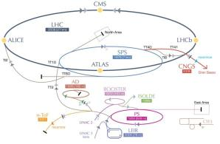
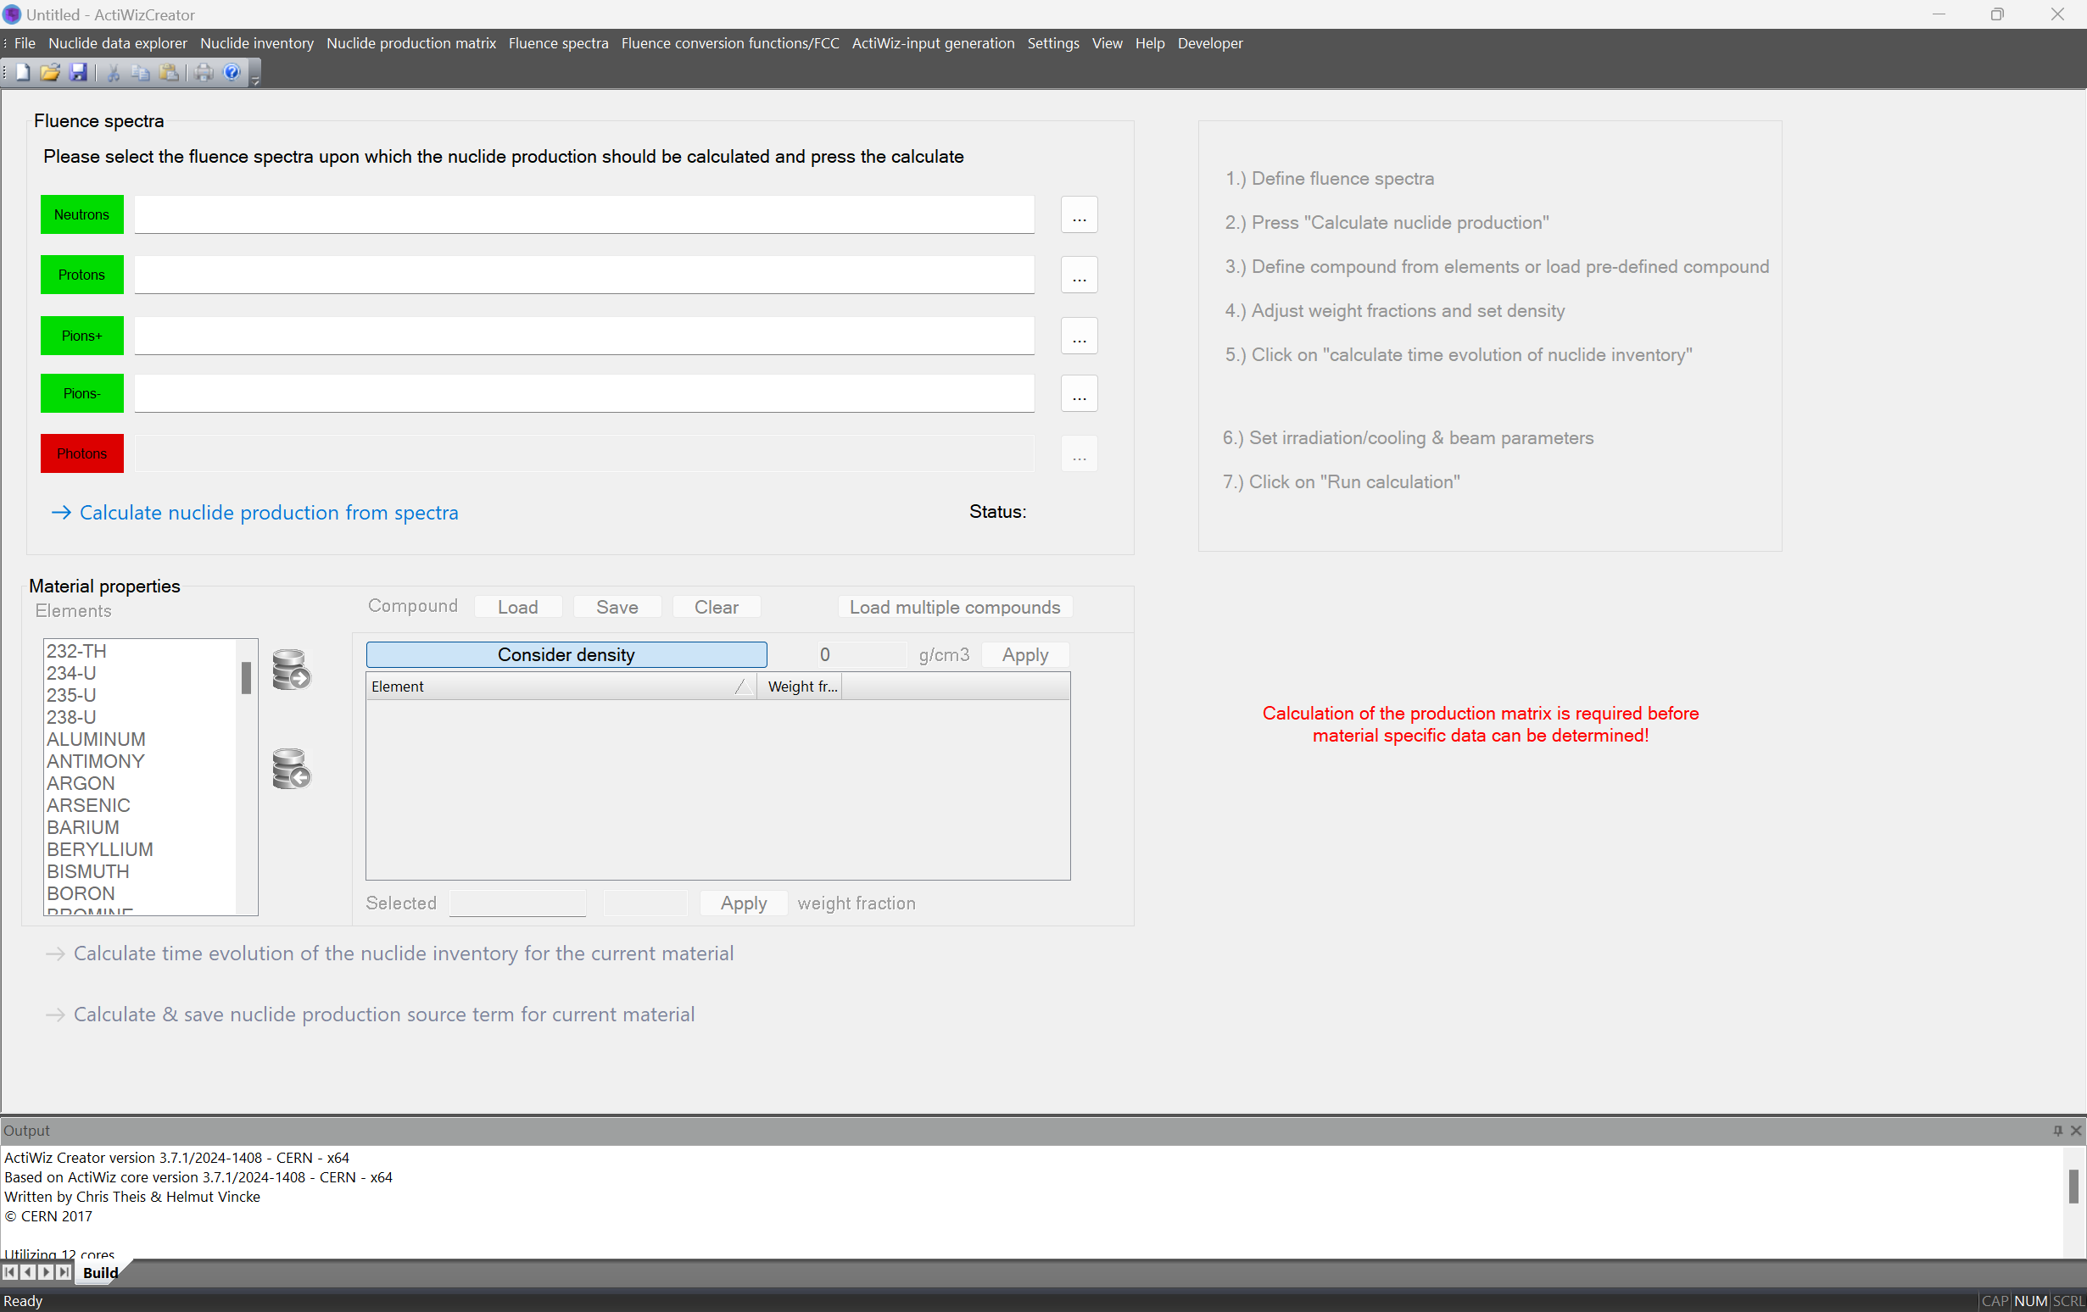
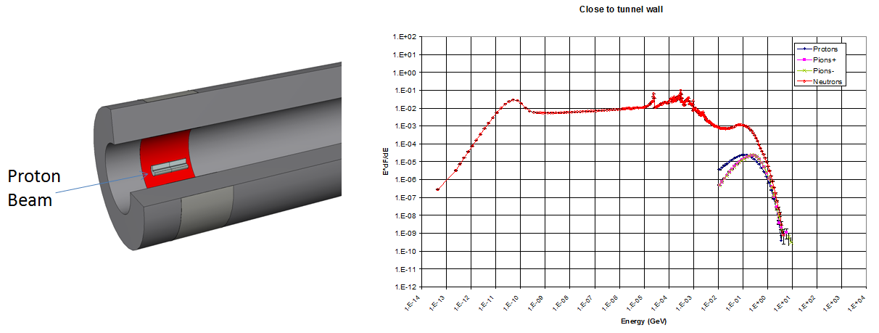

ActiWiz 3 overview
84 built-in radiation fields
CERN accelerators & LHC experiments
External radiation fields
Import via fluence spectra
Fully integrated GUI
+ python scripting
engine
Parameters
Arbitrary material compounds (85 chemical elements)
Arbitrary irradiation/cooling patterns (512 bits FP precision)

Slide 12

A short demo
Long term irradiation at the Super Proton Synchrotron (SPS)
1) key nuclides in materials
2) difficult to measure nuclides

Slide 13
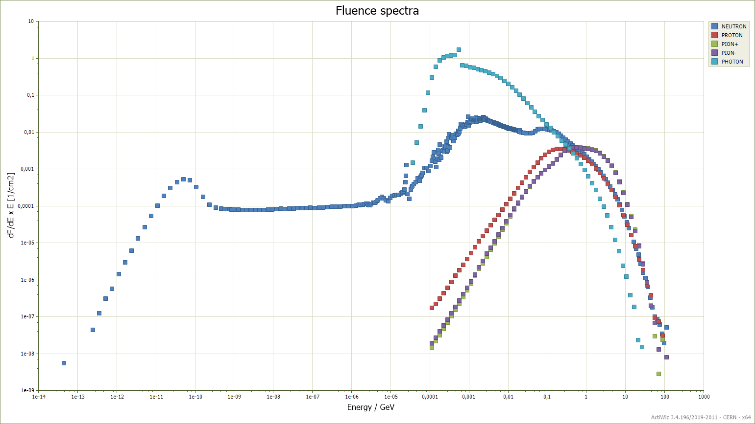
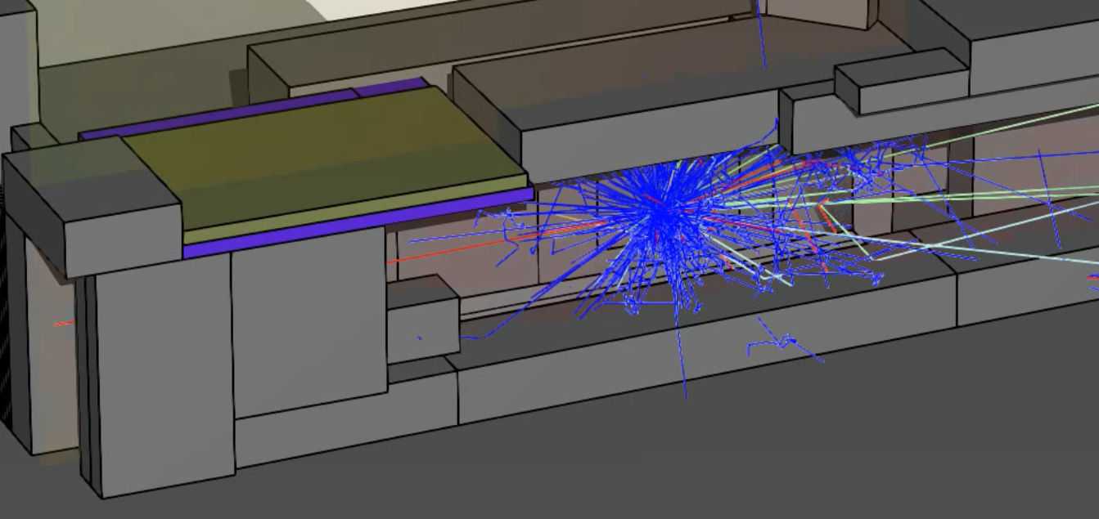
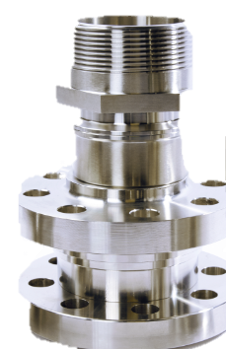
Nuclide inventory produced in steel (304L) located close to a target in the SPS (400 GeV)
Long term irradiation of 20 years, various cooling times
Steel equipment is located next to a target in the SPS and is irradiated by the secondary radiation field
Radiation field that is produced is used as input to calculate nuclide inventory produced in steel equipment
Which isotopes are dominant in the nuclide inventory?
How does this change for different cooling time?

Slide 14
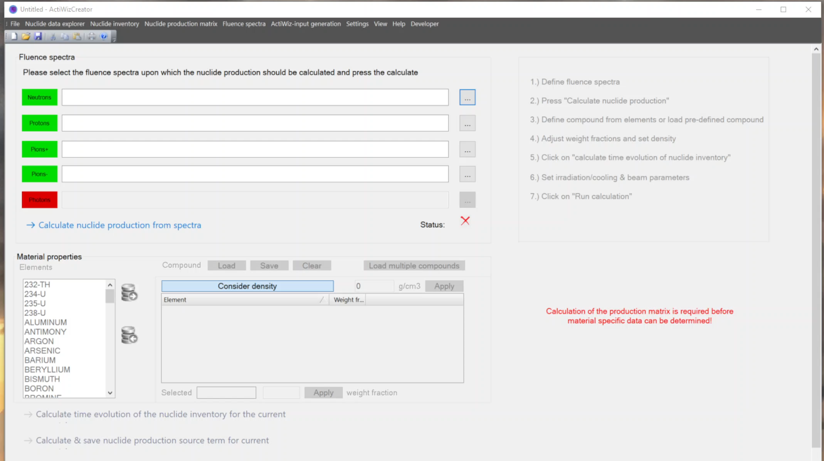

Slide 15
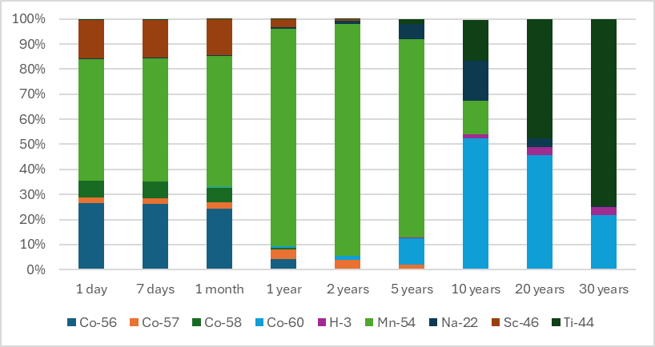
Analysis of radionuclides as a function of cooling times
Which isotopes are dominant at what cooling time?
Example: radiotoxicity (according to Swiss LL) of stainless steel in Super Proton Synchrotron (after 20 years of irradiation)
Allows for defining key nuclides for operational and waste characterization

Slide 16
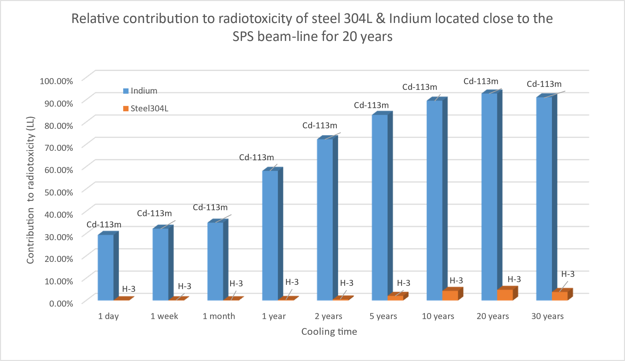
Analyzing difficult to measure isotopes in equipment
Steel 304L and Indium are irradiated next to the SPS (same radiation field as before) over 20 years.
Question:
What is the contribution of “pure” alpha/beta emitters to the total radiotoxicity in both materials?
How does this change with cooling time?

Slide 17
Summary & conclusion
ActiWiz is an inhouse development originating from the need to calculate nuclide inventories in a highly optimized way
Provides targeted reporting for characterization and removes the complexity of general purpose MC simulations
Continuous benchmarking against FLUKA & experiments

Slide 18
Thank you for your attention

Slide 19
Analysis & reporting
Component criticality analysis:
“which chemical element contributes in which proportion to clearance limits, H*(10), etc.”
***********************************************************************************************************
C O M P O N E N T C R I T I C A L I T Y A N A L Y S I S
***********************************************************************************************************
Compound: "inconel-0.25-Co", density 8.19 g/cm3
The following table shows how much each component of the compound material contributes
to the selected hazard quantity: H*(10) level
COBALT : 95.11% (weight fraction: 0.25%)
NICKEL : 3.45% (weight fraction: 53%)
TANTALUM : 0.59% (weight fraction: 0.01%)
IRON : 0.42% (weight fraction: 18.4%)
NIOBIUM : 0.21% (weight fraction: 5.2%)
CHROMIUM : 0.15% (weight fraction: 18.3%)

Slide 20
Analysis & reporting
**************************************************************************************************************
(Q U A S I) - P U R E A L P H A & B E T A E M I T T E R S
**************************************************************************************************************
Selected hazard factor: IAEA clearance limits - Safety Standards RS-G-1.7 (2004)
Id rel. contribution to hazard t1/2 [s] decay info
--------------------------------------------------------------------------------------------------------------
H-3 67.5% 3.89097e+08 [ 100% beta-, ]
C-14 2.3% 1.79874e+11 [ 100% beta-, ]
Cl-36 0.251% 9.49863e+12 [ 1.9% beta+, 98.1% beta]
Mn-53 0.00868% 1.16129e+14 [ 100% beta+, ]
Fe-55 3.63% 8.63082e+07 [ 100% beta+, ]
...
--------------------------------------------------------------------------------------------------------------
Total contribution to hazard = 73.7%, which equals = 1.198378E-06 Bq/unit (93.5% of total activity)
--------------------------------------------------------------------------------------------------------------
The following chemical elements contributed to the hazard with 73.7% via (quasi) pure alpha/beta emitters:
CARBON - 0.0117% (weight fraction: 0.0025%)
IRON - 73.5% (weight fraction: 99.7%)
MANGANESE - 0.202% (weight fraction: 0.235%)
PHOSPHORUS - 0.0139% (weight fraction: 0.0115%)
SILICON - 0.00366% (weight fraction: 0.0035%)
SULFUR - 0.0078% (weight fraction: 0.00901%)
Example: ARMCO iron used for yokes
20 y irradiation @ SPS
20 y of cool-down

Slide 21
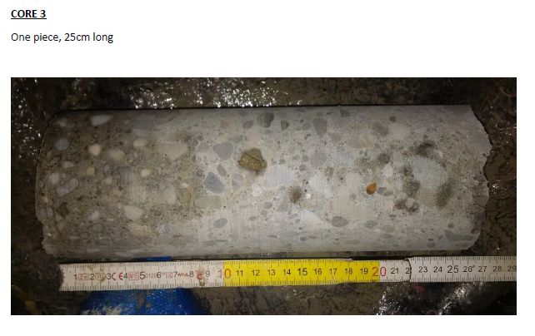

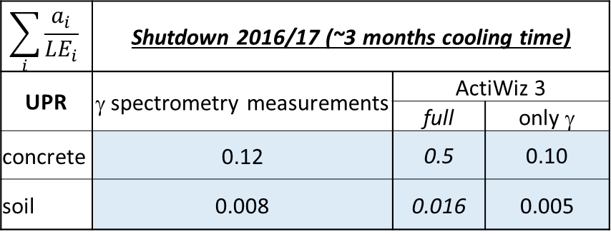
Spoil activation study
Spoil activation assessment for future civil engineering works at the HiLumi LHC:
quantity of interest is the radiotoxicity = sum of activity over clearance limit
in 2016 some concrete wall & soil samples were taken and analyzed
particle fluence spectra calculated with FLUKA (detailed tunnel geometry)
$$\sum_{i}{\frac{a_{i}}{{LE}_{i}}}$$ | Shutdown 2016/17 (~3 months cooling time)
UPR | γ spectrometry measurements | ActiWiz 3
 |  | full | only γ
concrete | 0.12 | 0.5 | 0.10
soil | 0.008 | 0.016 | 0.005
C. Adorisio, S. Roesler,
Induced activation studies for the LHC upgrade to High Luminosity LHC,
ARIA 2017 Workshop, Lund
Ca-45 | 80%
Na-22 | 7%
Zn-65 | 3%
Fe-55 | 3%
S-35 | 1%
Mn-54 | 1%
Ca-45 is a pure β emitter: cannot be seen with γ-spec
Ca-45 | 68%
Na-22 | 28%
S-35 | 2%

