Slide 1
A probabilistic approach for characterization studies
M. Magistris, A. Gomes, R. Neugebauer, E. Stamati
CERN
ARRAD GT1 - libération des matériaux au CERN

Slide 2






Outline
Clearance criteria
Challenges
Systematic approach
Probabilistic approach
Conclusions

Slide 3

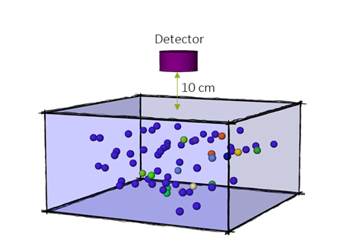
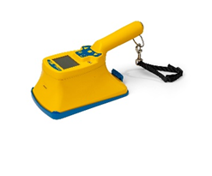
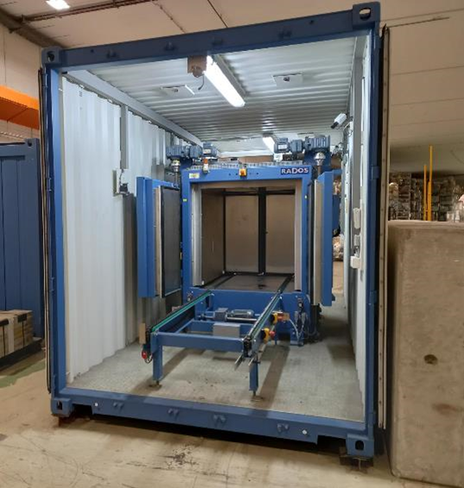



Clearance criteria
Dose-rate $<100 nSv/h$
Contamination $\sum_{i=1}^{n}{\frac{asi}{CSi}<1}$
Specific activity $\sum_{i=1}^{n}{\frac{Ai}{LLi}<1}$

Slide 4
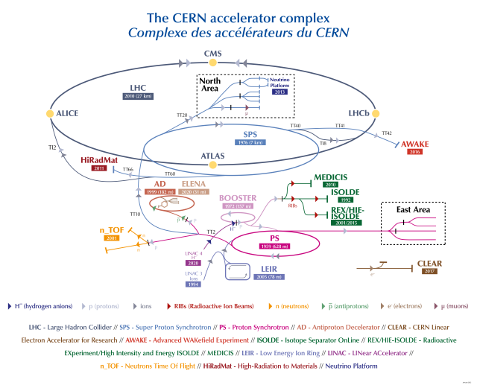
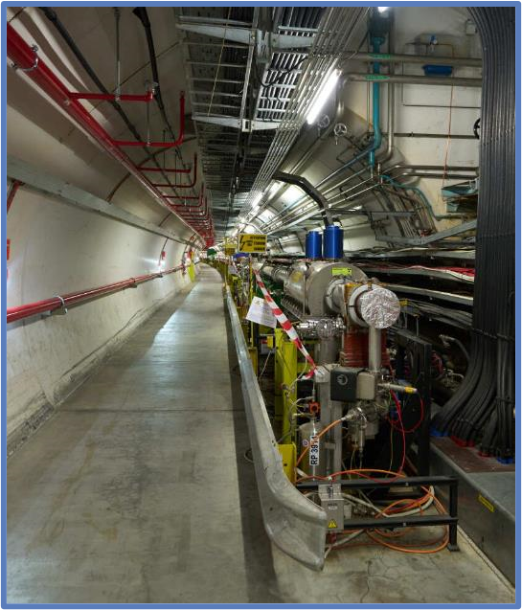
Challenges
Particles: protons, pions, neutrons, electrons….
Particle energy: eV to TeV
Timescale: months to decades

Slide 5
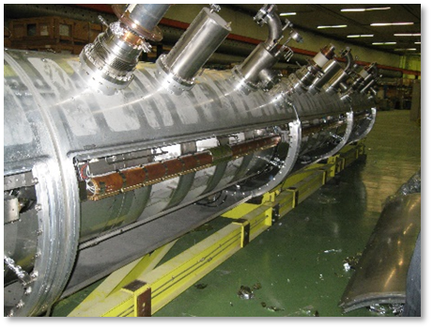
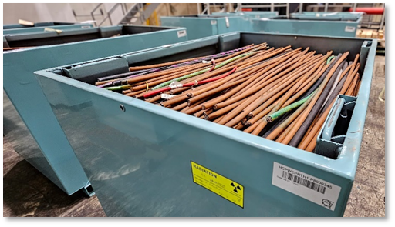


Challenges
Mixed items from multiple particle accelerators
Accelerator components with complex shapes, which can affect radiation measurements
Different materials, each with different activation properties

Slide 6
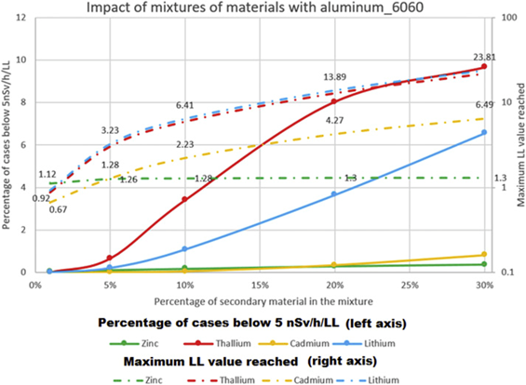




Systematic approach
Systematic study of all possible activation scenarios:
Geometry
Radiological history
Material composition
5,000,000 activation scenarios
Boundary scenario
$$\frac{DR}{{LL}_{sum}}=\frac{DR}{\sum_{i=1}^{n}{\frac{Ai}{LLi}}}≤5 nSv/h$$
Sensitivity study

Slide 7






Systematic approach
$$zxc∈A=πr^{2}$$
Total gamma counting: classification based on a reference fingerprint (or nuclide vector)
How can we choose the most penalizing fingerprint?...
... with a Figure Of Merit!
The most penalizing scenario was used for classification at the exit of accelerators.
FOM$=\frac{\sum{\frac{A_{i}}{{LL}_{i}}}}{\sum{A_{i}×{LNC}_{i}}}$
See presentation by Frederic Aberle!
T. Frosio and al., Classification of radiological objects at the exit of accelerators with a dose-rate constraint, Applied Radiation and Isotopes

Slide 8
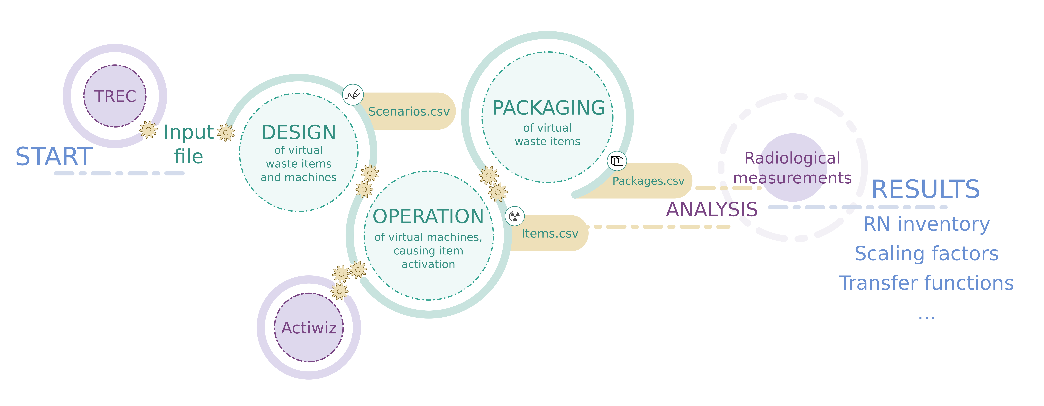


Probabilistic approach
In the systematic approach:
- every activation scenario has the same probability
- we classify based on the most penalizing scenario
In the probabilistic approach:
- every scenario has a given probability
- we classify based on a risk analysis
We extract the probability distributions from our database....
... and translate them into an input file, ready for computations.

Slide 9



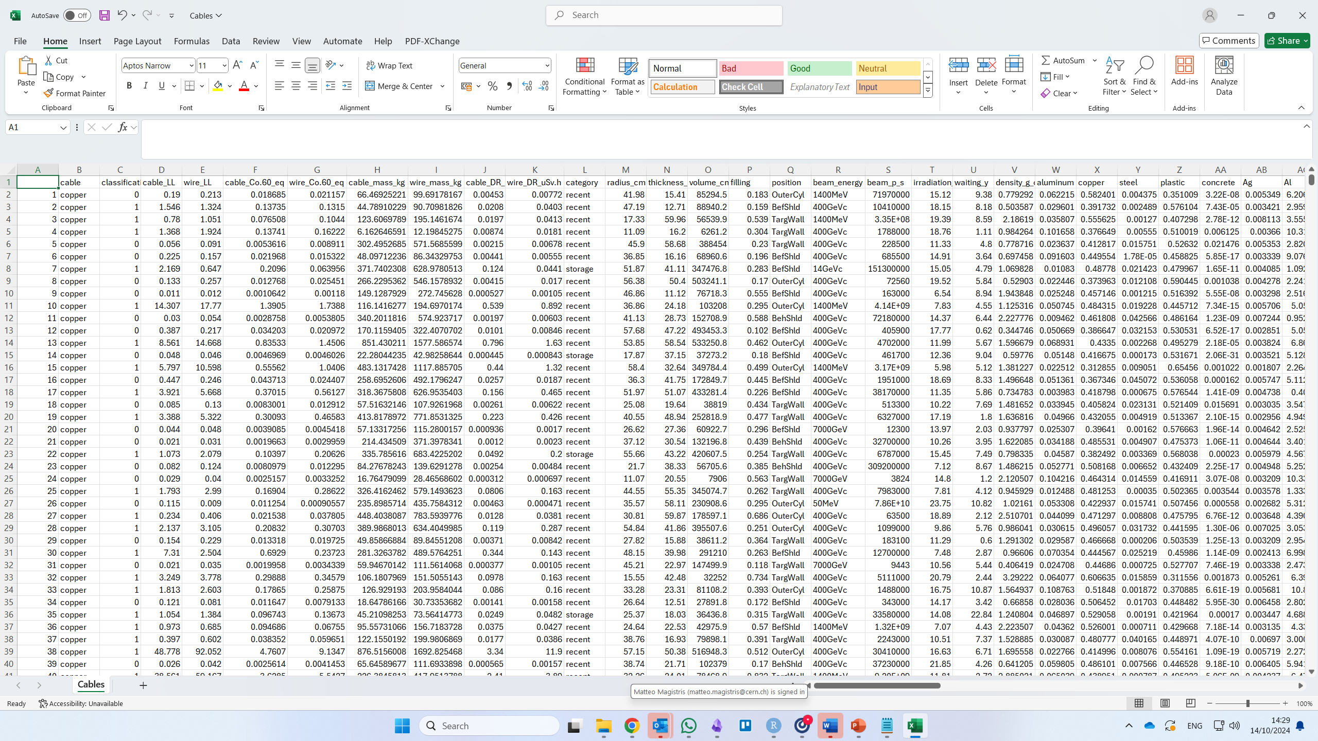

Probabilistic approach
Design:
We extract a population of virtual waste items based on the probability distributions
Operation:
ActiWiz computes the radiological properties of every virtual item

Slide 10


Probabilistic approach
Virtual items can be grouped together into packages
Analysis:
We define the TGC signal LL_eq, below which an item is conventional
$$If {Co60}_{eq}=\sum{A_{i}×{LNC}_{i}}<{LL}_{eq}⇒clearance$$

Slide 11
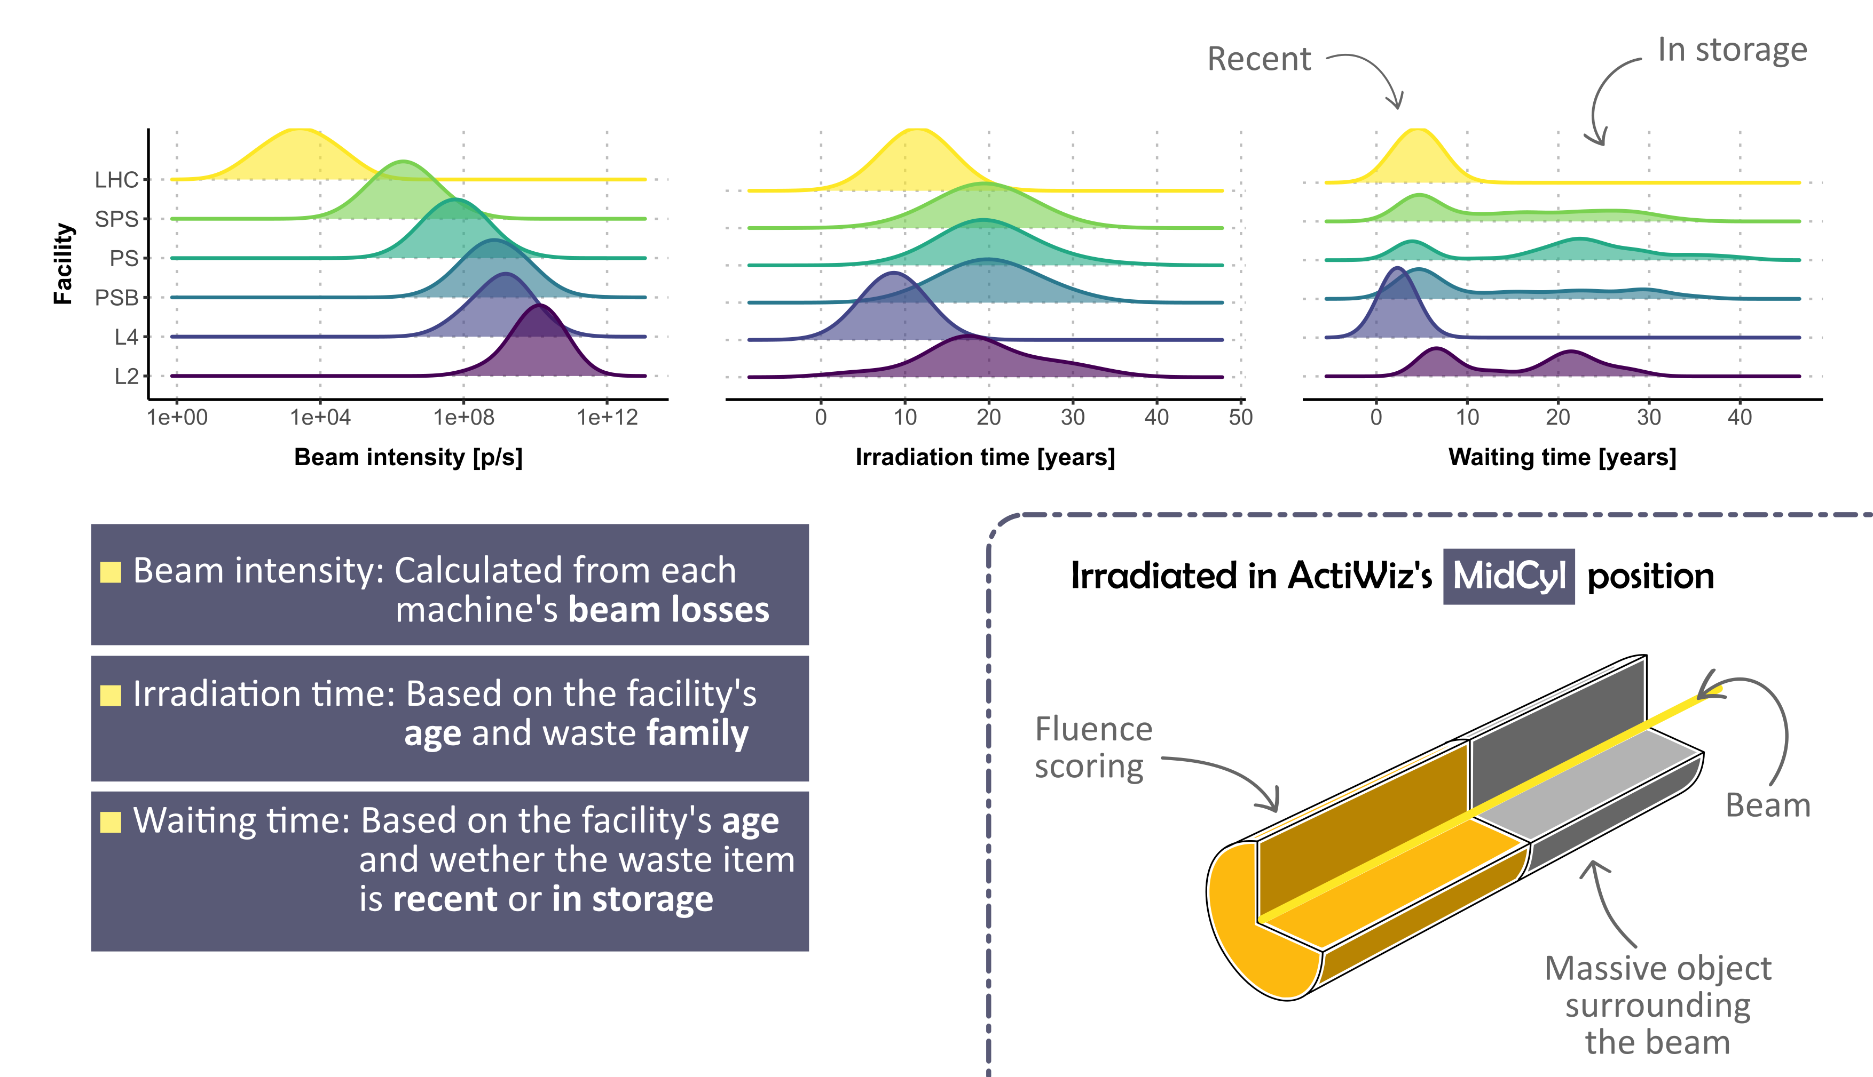
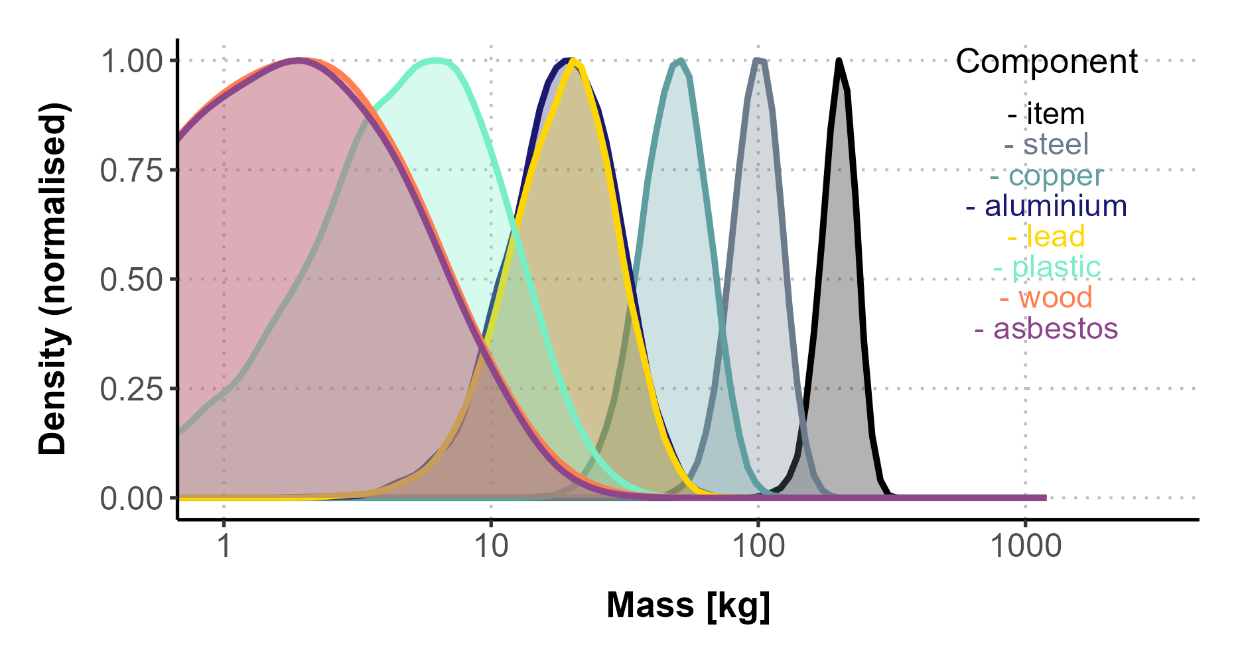
Probability distributions Example of massive pieces
Beam energy
Mass:
Entire waste item
Individual components making up the waste item

Slide 12
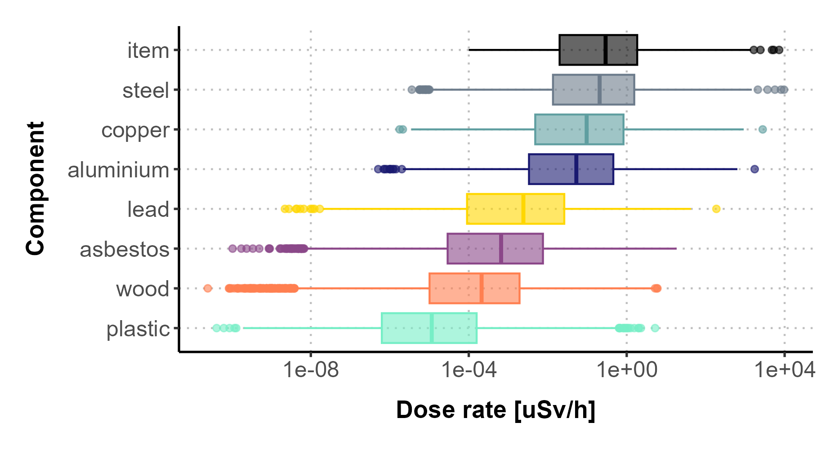

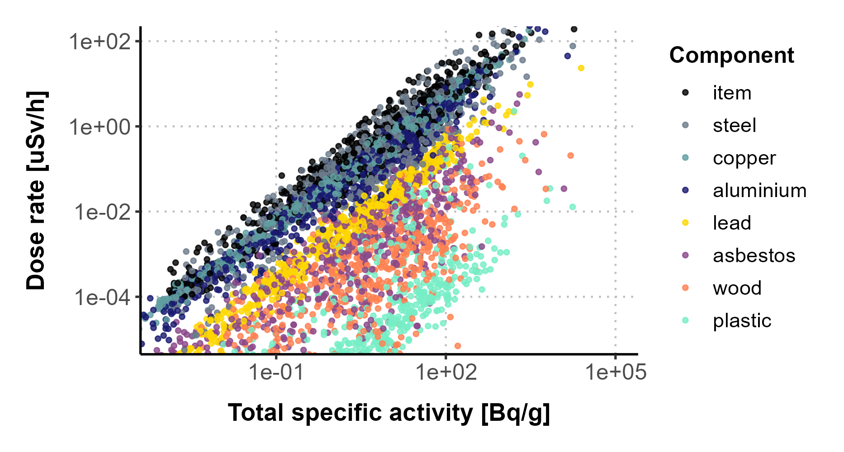


Radiological properties Example of metallic waste
1 nSv/h
Invisible
Dose-rate:
Near the entire waste item
Near individual components making up the waste item
Mass
See the invisible (< 1 nSv/h)
Analyze properties of components (e.g. plastic) based on DR of the entire item

Slide 13
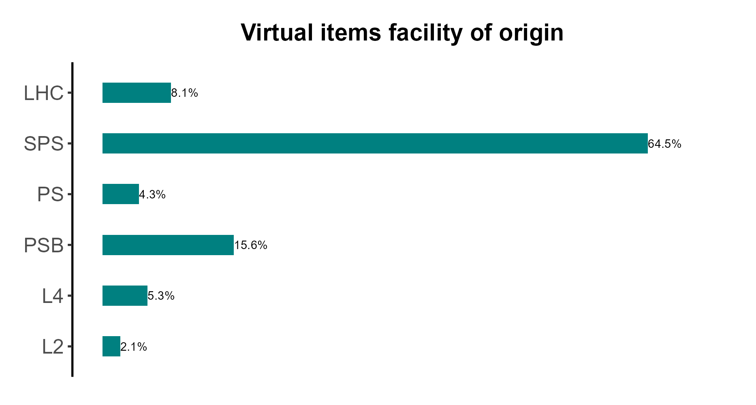

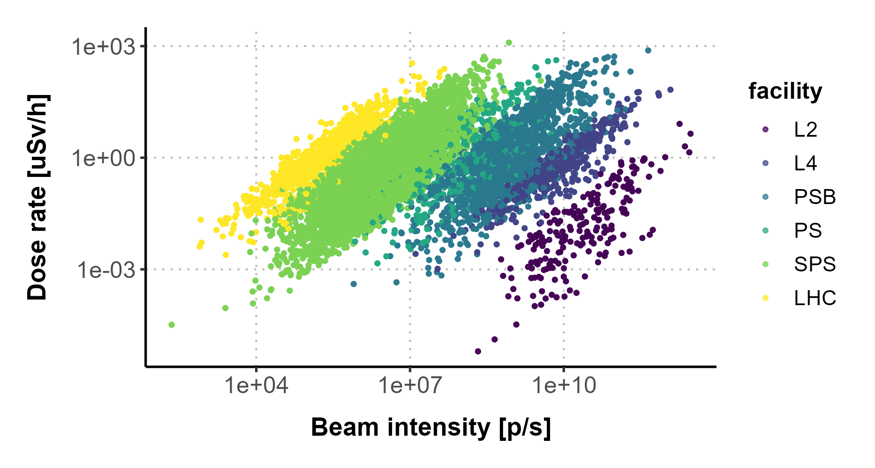
Radiological properties Example of massive pieces
Proton energy
Facility:
The probability depends on the age and size of the facility
The probability distribution ensures that likely scenarios are well represented

Slide 14
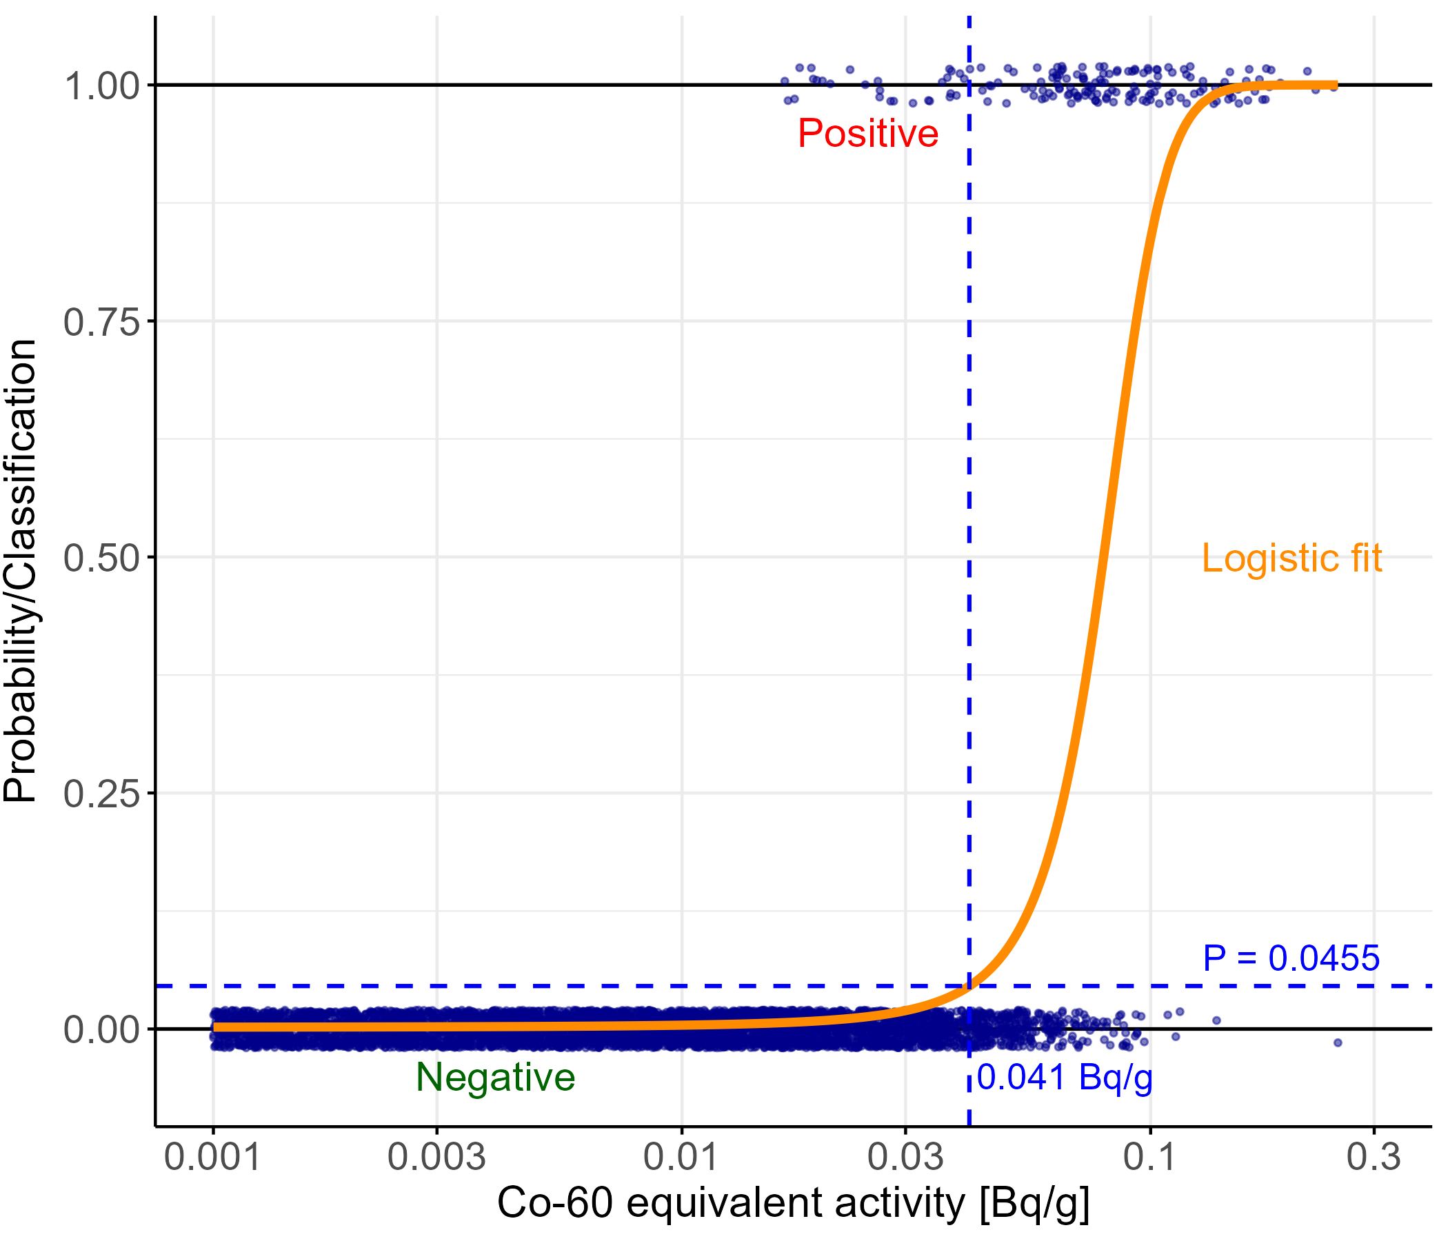


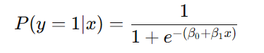
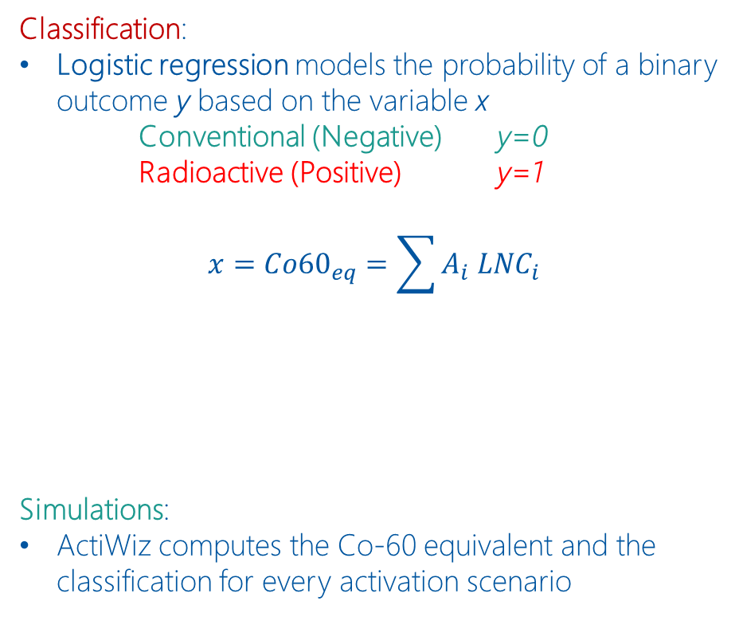
Machine learning Example of electric cables
Classification:
Logistic regression models the probability of a binary outcome y based on the variable x
Conventional (Negative) y=0
Radioactive (Positive) y=1
$$x={Co60}_{eq}=\sum{A_{i} {LNC}_{i}}$$
Simulations:
ActiWiz computes the Co-60 equivalent and the classification for every activation scenario
Confidence 95.45%
An item with Co-60_{eq} = 0.041 Bq/g is classified “negative” with 4.55% error.

Slide 15
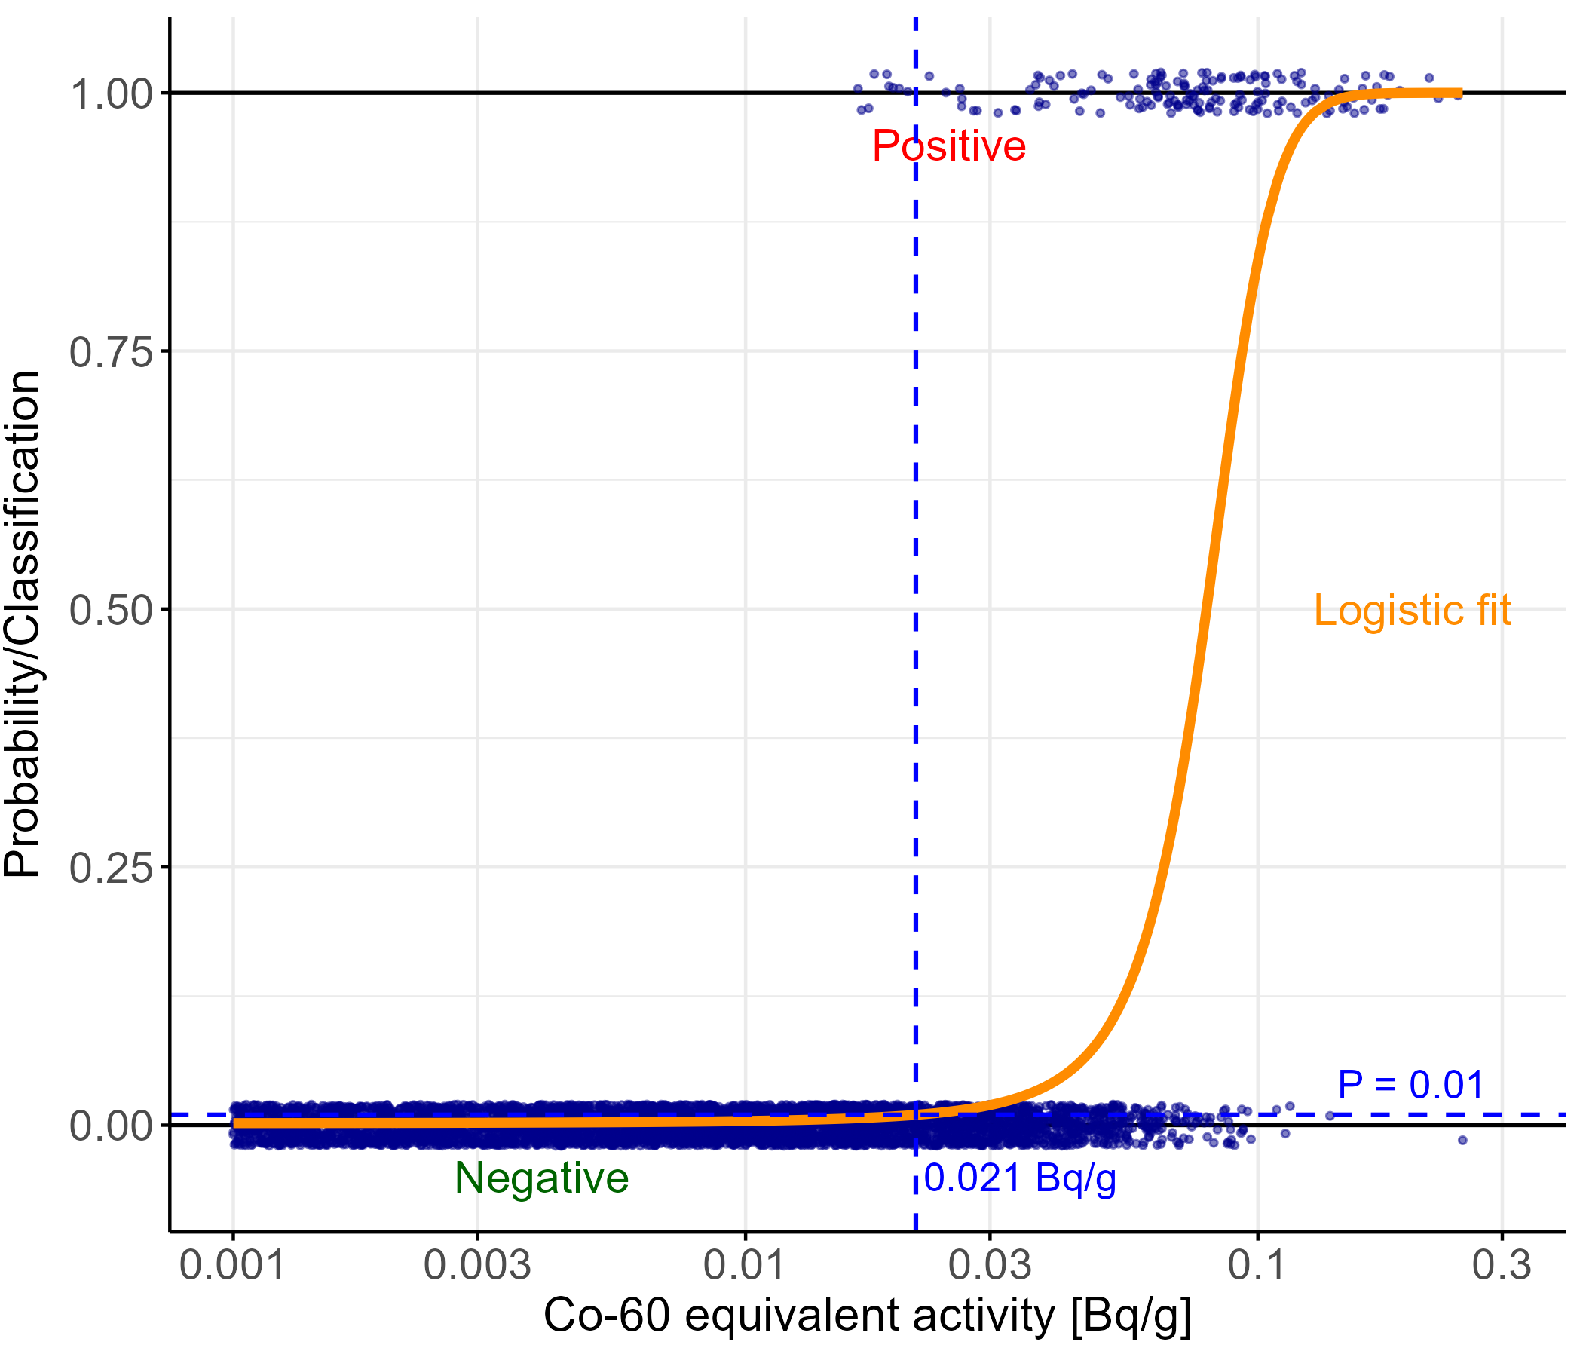

Machine learning Example of electric cables
Sensitivity:
We can quantify our level of confidence when performing clearance
Confidence 95.45%
Confidence 99%
If we wish our confidence to increase by <4% ...
... our threshold would decrease by 2x
See presentation by Andrea Gomes and Andrea Camerini!

Slide 16

Conclusions A probabilistic approach for clearance
Use available of data on material and waste
Select scenarios with 0.01 < LL < 100 and DR < 1 uS/h (i.e. discarding scenarios irrelevant for clearance)
Focus computational on the most relevant scenarios
Thanks to uncertainty propagation, and by using training vs testing sets, we can make a quantitative comparison of different models and evaluate their prediction accuracy.

Slide 17
Conclusions A probabilistic approach for clearance
As we move to continuous probability distribution and as we discard irrelevant scenarios, we can:
Concentrate our computational efforts on the cases with the highest impact, therefore:
Improve our computational "return of investment" (ROI), therefore:
Benefit from better accuracy, therefore:
Reach high confidence levels, because….
…we explore the phase space where it matters.

Slide 18
Thank you for your attention

