Slide 2

Radiological classification and clearance based on dose rate measurements and parametrical studies
F. Aberle
CERN
Acknowledgment
G. Dumont, R. Froeschl, T. Frosio, M. Magistris, S. Roesler, C. Theis
ARRAD GT1 Meeting – CERN – 17th of October 2024
https://indico.cern.ch/event/1460737/
Notes:
Focus on lowly activated materials

Slide 3
Challenges and objectives
Strategy and rules
Parametrical study
Practical implementation
Conclusion
Questions / answers
Notes:
Most important points: study and pratical implementation

Slide 4
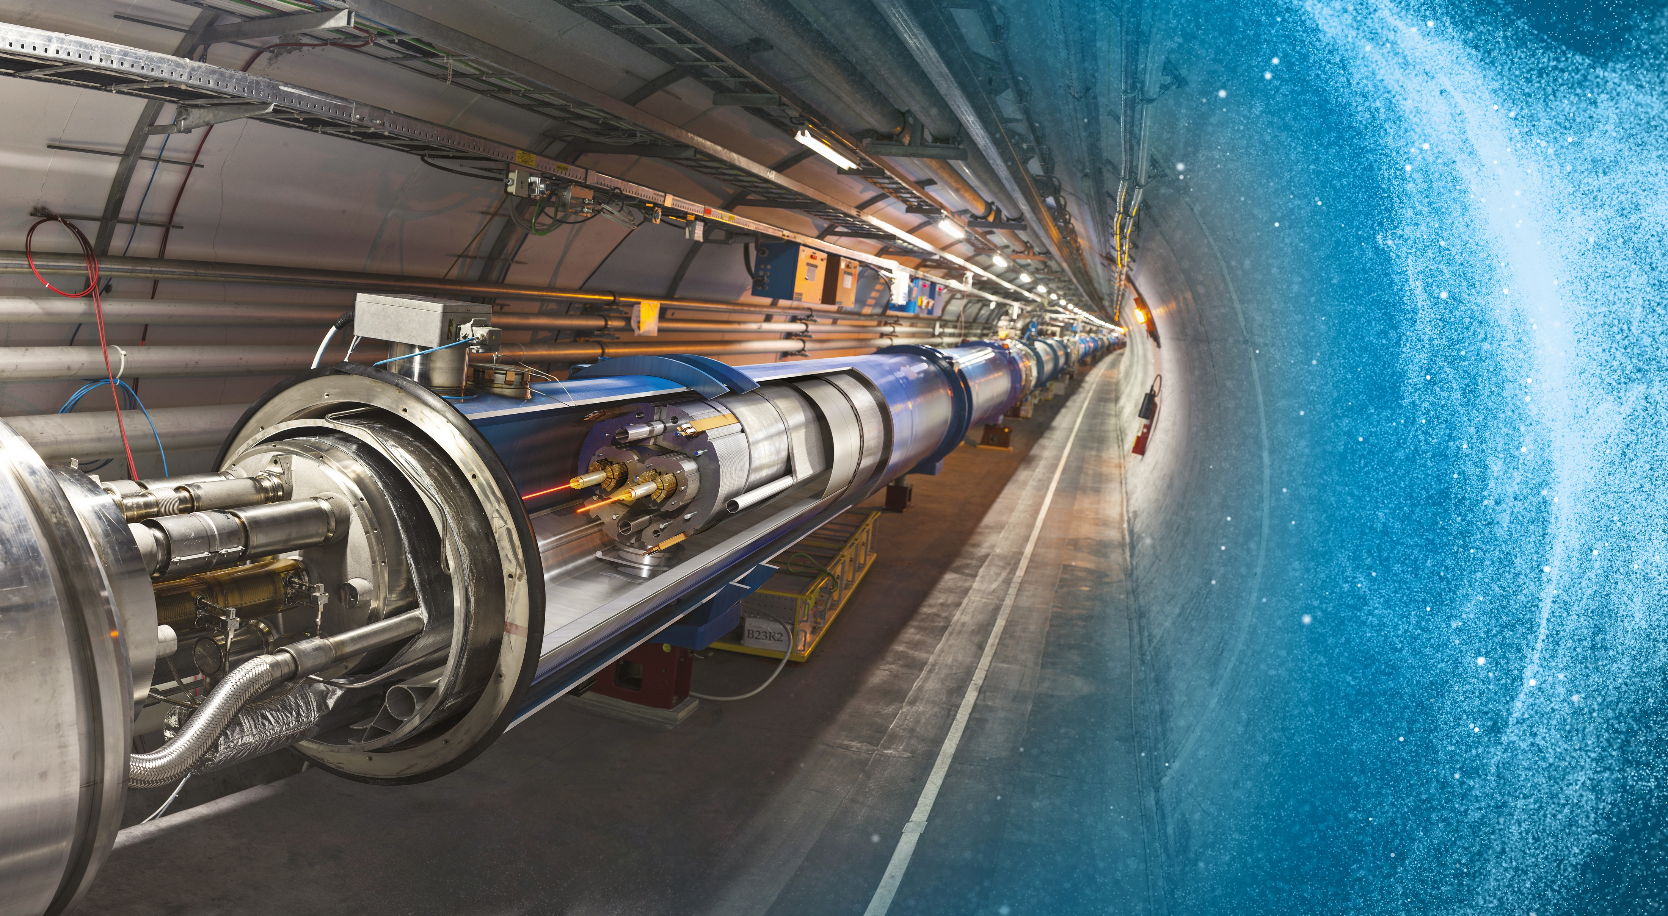
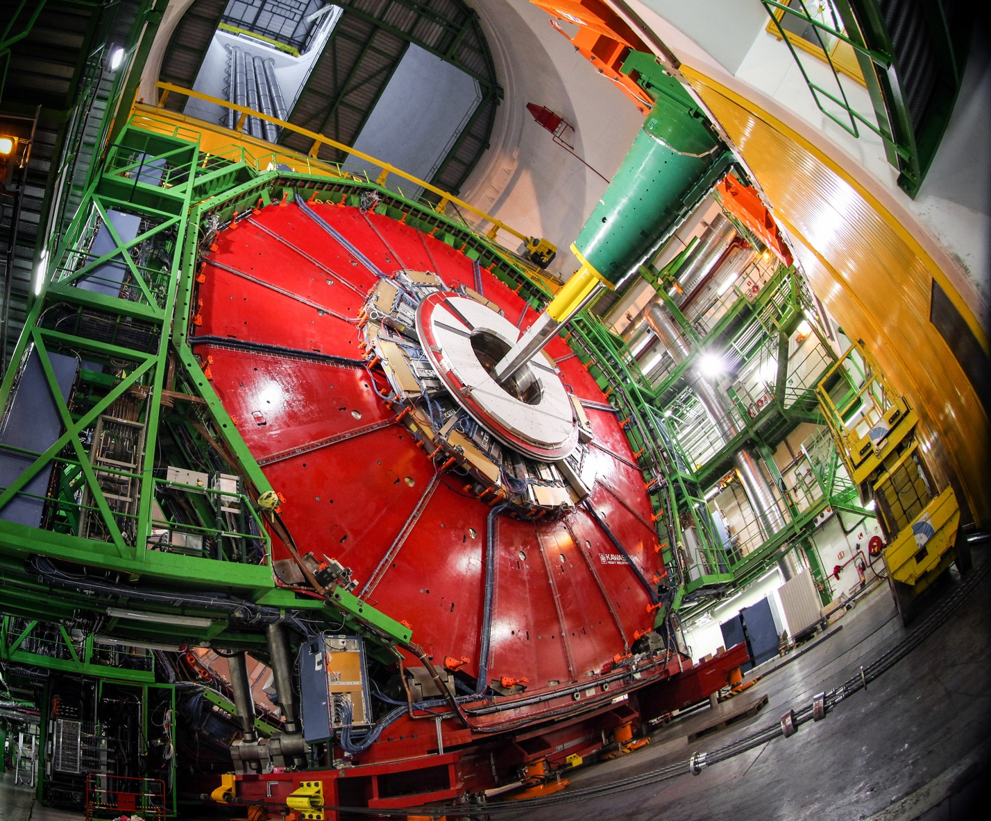
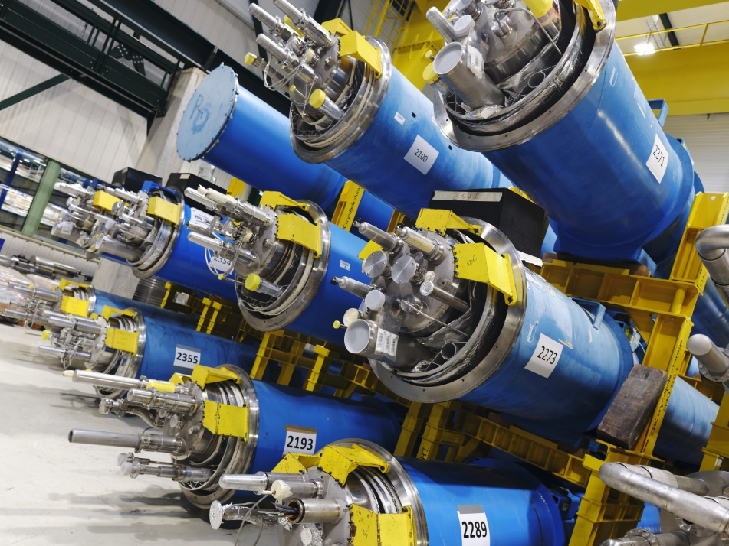
Key facts related to CERN
~400 buildings hosting radiation areas
7000 to 11000 persons accessing in radiation areas every year
More information: https://home.cern/resources/faqs
~50 km of accelerator tunnels
Over 160 physics experiments
20,000 to 50,000 activated components to be classified /year
Notes:
Lots of buildings and persons. Lots of components to be classified per year

Slide 5
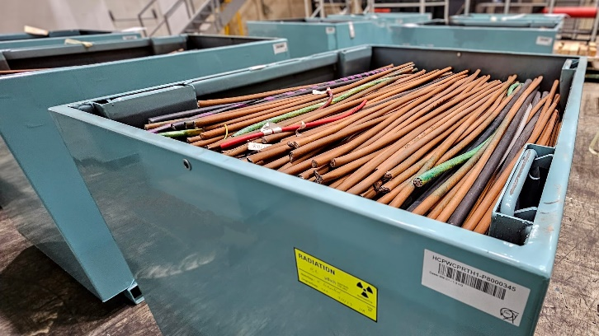
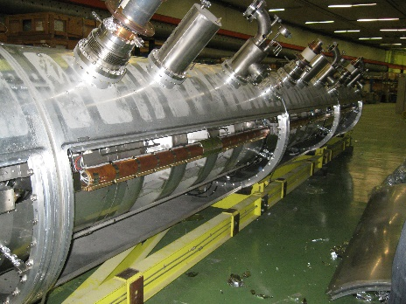
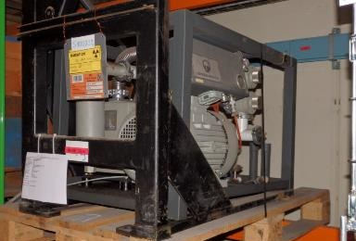
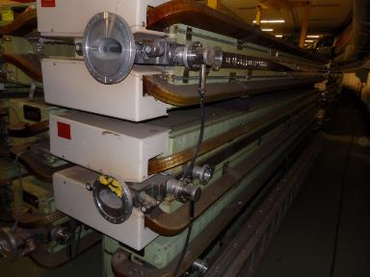
Typical CERN’s activated components
Activated by spallation, neutron capture, etc.
Mainly β-,γ- emitters.
Large variety of radionuclides (RN).
Very limited contamination.
Limited quantities of activated or contaminated liquids.
Cables
Accelerating cavities
Vacuum pumps
Magnets
Notes:
Usually spallation and neutron capture
Large RN inventory
Pictures

Slide 6

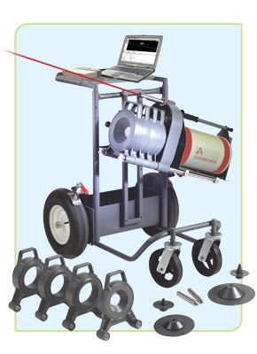
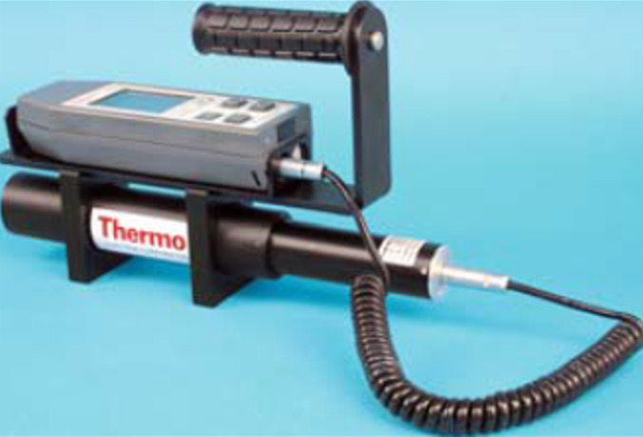
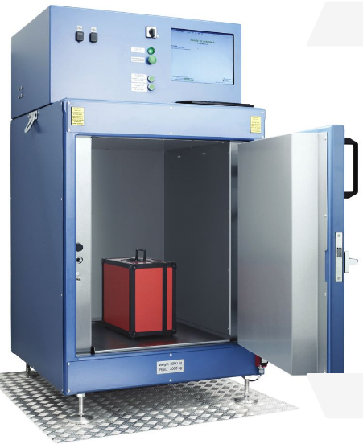
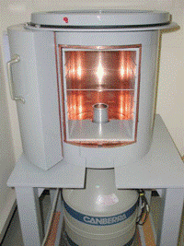

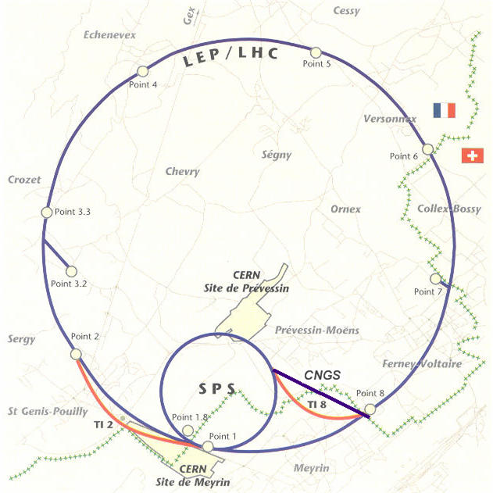
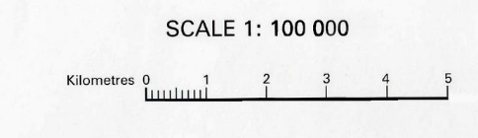
CERN’s Challenges and objectives
RAD
Environmental, RP and reputational risks in case of misclassification.
➔ Reliable classification required
Several thousands of cubic-meter of materials and waste leaving Radiation Areas every year.
➔ Effective classification required.
Limited storage space in each facility + spread of CERN facilities can impact physics schedule ← Fast decision needed.
➔ Fast classification required.
NON-RAD
Notes:
Ensure that classification is reliable, and misclassification is minimal
Needs to be effective as well
Needs to be fast

Slide 7
Strategy – zoning concept
Non-designated Area
Radiation Area
Safety Code F
No
control
Global
Control
Zone
Individual
Control
Zone
Clearance
limits rule
EDMS 942170
Verification measurements
Not systematic
A priori
Not Radioactive
Potentially Radioactive
Not Radioactive
Clearance measurements
Comprehensive (100% measured)
Successful
Unsuccessful
Delayed
NOT RADIOACTIVE
RADIOACTIVE
RP measurements
Notes:
We have a zoning concept, in which we separate the rad areas from the non designated
Non designated: non radioactive
Global: a priori non radioactive, we do global control with sampling
Individual: here we do comprehensive measurements of every item leaving area
Clearance measurement should be successful so that we clear material (so not too much restricitive)
Zoning concept with possible measurement

Slide 8
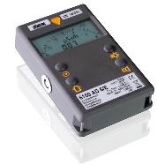
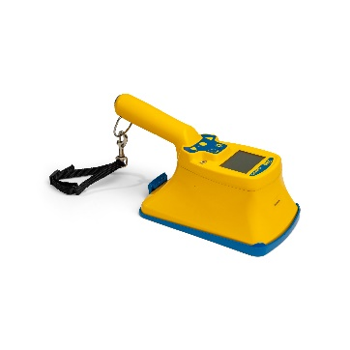
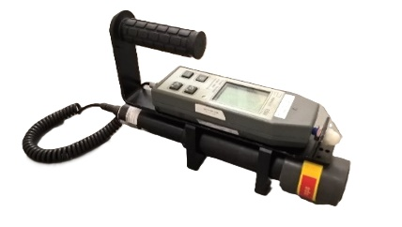
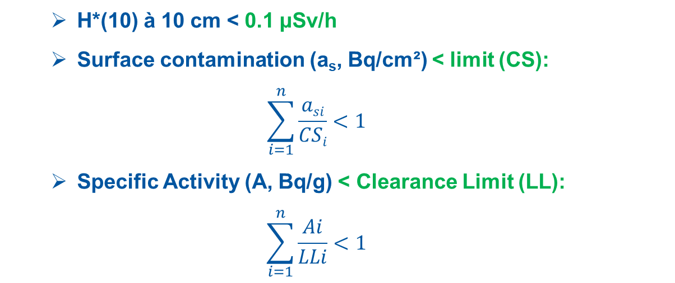
Clearance rules at CERN
Regulatory framework: Swiss Ordinance on Radiation Protection of 26 Avril 2017 (ORaP), RS 814.501 which is following the IAEA Safety Standard, Application of the Concepts of Exclusion, Exemption and Clearance, No. RS-G-1.7.
Transposed in CERN’s RP Rules: Clearance Limits for Radioactive Material at CERN, ref. EDMS 942170
Each of the following three criteria shall be respected before declaring material formerly Radioactive as Not Radioactive:
  H*(10) à 10 cm < 0.1 μSv/h
  Surface contamination (a_{s}, Bq/cm²) < limit (CS):
  $$\sum_{i=1}^{n}{\frac{asi}{CSi}<1}$$
  Specific Activity (A, Bq/g) < Clearance Limit (LL):
  $$\sum_{i=1}^{n}{\frac{Ai}{LLi}<1}$$
Dose rate measurements
Contamination measurements
Validation (binary) based on dose-rate measurements.
Notes:
Based on AIEA safety standard and swiss ordinance
3 limits transposed: dose rate, contamination, activity
To check this, we need to validate, on very low limits (0.1 Bq/g on Co-60)

Slide 9
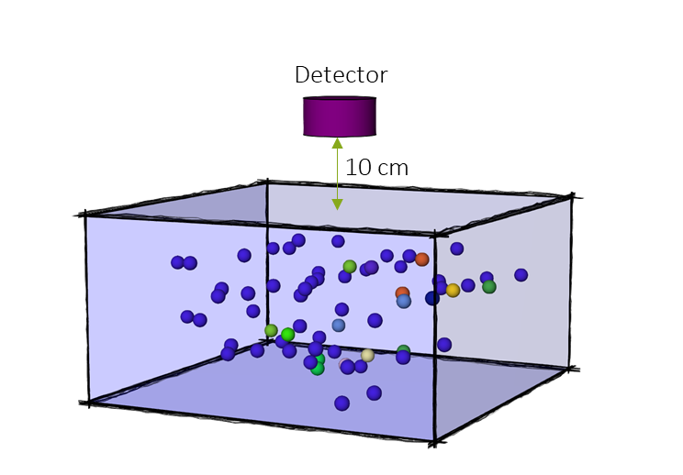
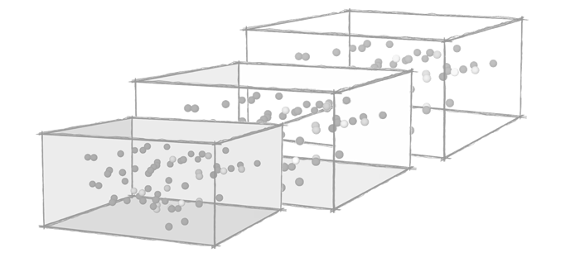

Parametrical study - methodology
Extensive activation study [1] to define under which conditions an object activated at CERN can be classified
as Not Radioactive by means of a dose rate measurement:
Vary geometry (dimensions, materials)
Vary activation conditions (irradiation, cooling times, radiation field)
Use of ActiWiz 3 and dedicated Python scripts to automatize
the calculations and the data compilation: more than 5,000,000
activation scenarios.
Determine boundary conditions, by Factor Analysis of Mixed Data methods (FAMD),
under which the minimum dose rate at 10 cm (DR) for 1·LL_{sum} is measurable with a hand-held detector.
$$\frac{DR}{{LL}_{sum}}=\frac{DR}{\sum_{i=1}^{n}{\frac{Ai}{LLi}}}≤5 nSv/h$$
[1] T. Frosio and al., Classification of radiological objects at the exit of accelerators with a dose-rate constraint, https://doi.org/10.1016/j.apradiso.2020.109303.
[2] Vincke, H. and Theis, C., ActiWiz 3 – an overview of the latest developments and their application, https://doi.org/10.1088/1742-6596/1046/1/012007.
Notes:
Define under wich conditions an object can be measured as non radioactive via dose rate measurements
You need boundaries (physical)
Irradiation conditions
Automatize calculations with actiwiz
Then you make sure that DR is below what is measurable with the device (and how)

Slide 10
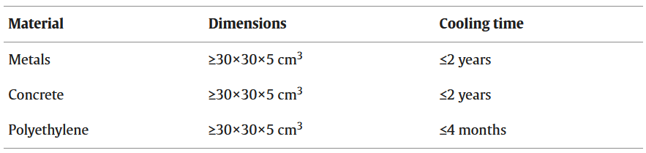
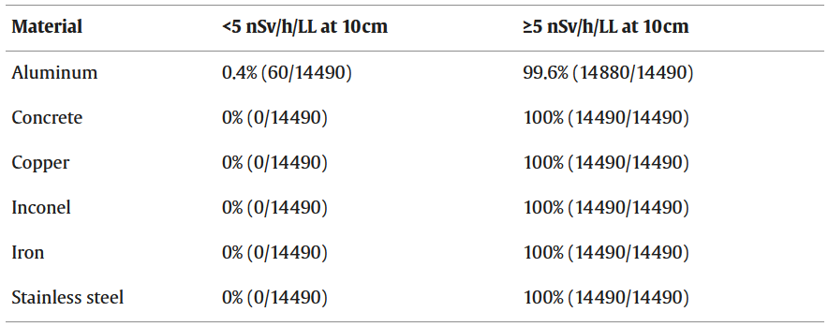
Parametrical study - results
Conditions under which a dose-rate measurement can be used for clearance
Minimum dimensions: 30x30x5cm³
Valid materials: aluminium, copper, concrete, iron, organics, steel.
Maximum decay:
  Metal and concrete: 2 years
  Organic material: 4 months
For the vast majority (>99.9%) of the scenario, LL_{sum}<1 when DR ≤ 5 nSv/h at 10cm.
LL_{sum}≤1.2 when DR ≤ 5 nSv/h at 10cm for the remaining scenario (0.07%).
(organic mat.)
% for which DR/LL can be < 5 nSv/h for the 86940 scenarios respecting the conditions
Notes:
Here are the conditions we found
We manage to be below the LL if dimensions and materials and decay is as shown
(for organics: Be-7 is the marker for DR)
Then you need to validate the study via statistical study

Slide 11
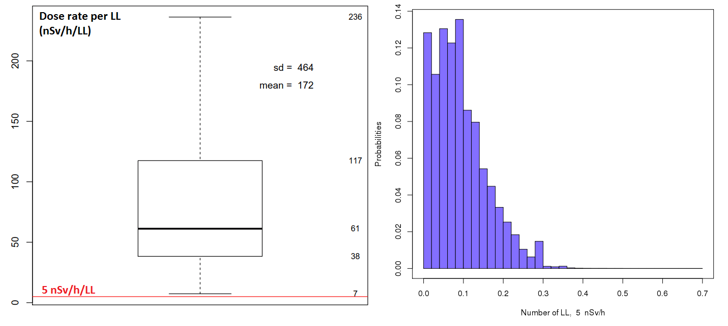
Parametrical study – statistical validation
Selection of ~2000 objects recorded in 2017 in the CERN’s traceability system (TREC), with very low dose rate and respecting the conditions.
New ActiWiz calculations for this set of objects representing statistically the DR/LL of objects found at the exit of the CERN’s accelerators:
  Known geometry (dimensions, materials’ distribution)
  Known facility of origin (beam energy)
  Vary positions in the machines
  Vary irradiation and cooling times
  More than 10,000,000
  activation scenarios.
Every objects correctly classified: LL_{sum}<1 whenever DR ≤ 5 nSv/h at 10cm.
  Mean DR at LL_{sum} =1: 61 nSv/h (IQR=38-118)
  Mean LL_{sum} at DR = 5 nSv/h at 10cm: 0.08 (IQR: 0.04-0.13)
  Min. DR at LL_{sum} =1: 7 nSv/h
  Max LL_{sum} at DR = 5 nSv/h at 10cm: 0.7
100% of the objects ≤ 1 x LL
Distributions of DR/LL (left) and LL fraction of for dose rate of 5 nSv/h at 10 cm (right).
Notes:
Here is the real response of dimensions, materials, beam energy, position in the machine, etc.
We redid the study with all these parameters for all these objects
Every object passed

Slide 12
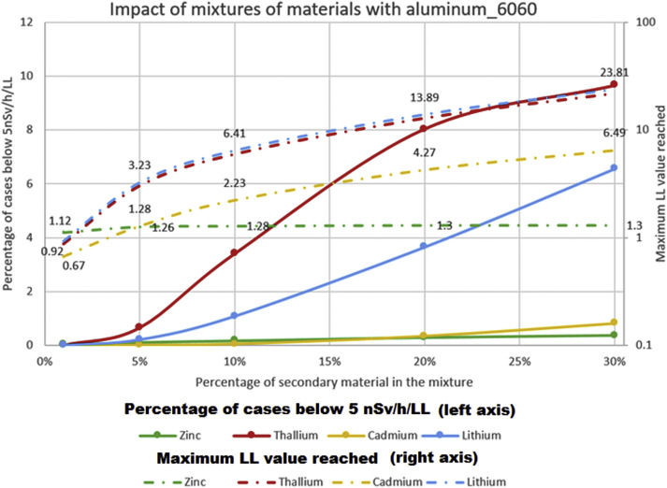
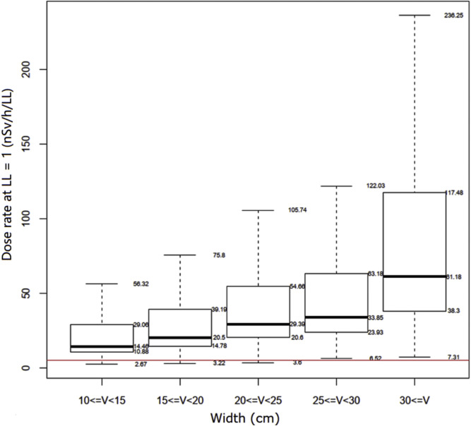
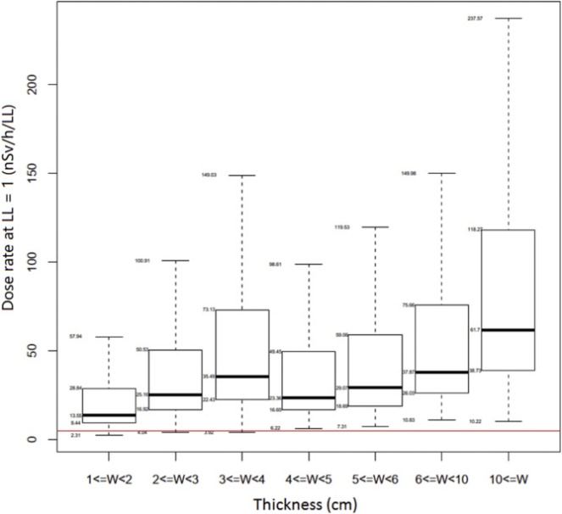
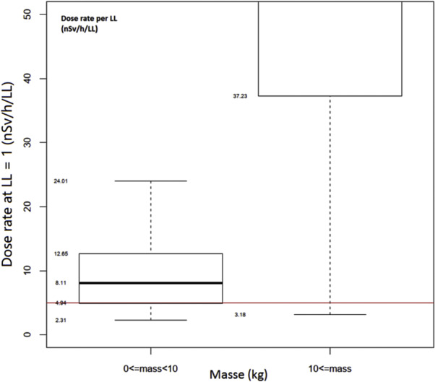
Parametrical study – risks analyses
Impact of non-compliance with the conditions was assessed and demonstrated a very low risk of misclassification in most of the cases (e.g., error in the dimensions).
Risk analyses also led to the definition of preventive measures to
mitigate the main risks of misclassification, such as: minimum mass of 10kg (metal/concrete) and 4kg (organic) and the exclusion of specific materials (e.g., batteries)
Notes:
We wondered about the risk we take with this approach
On top of the study, we did risk analysis to find the effect if we did not measure one parameter
Even if we are wrong by 2-5 cm, we are still fine
However, if we add additional material such as nickel, cadmium, it is more complicated
Hollow object is complex as well
This is why we need a minimum weight
We excluded batteries as well

Slide 13

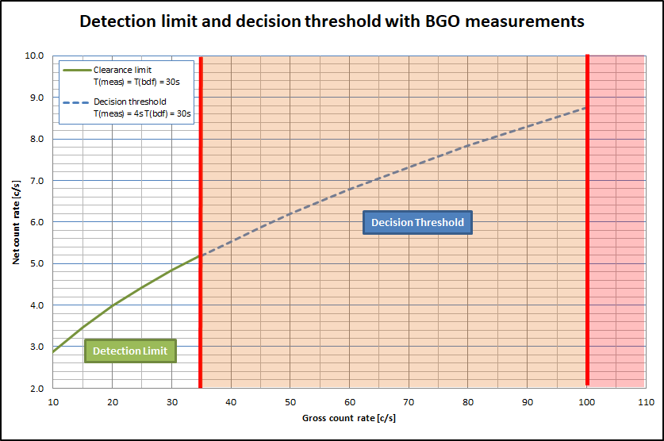
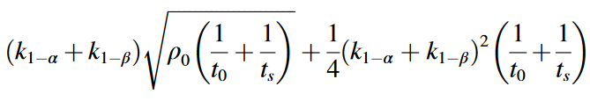
Minimum detectable dose rate – FHZ 152 BGO
FHZ 512 BGO scintillator probe with readout on a Thermo FH40
1 c/s <> 1 nSv/h for γ-emitters frequently found at CERN
Probe equipped with tungsten shielding to reduce the background below 35 c/s
Background measurement time ≥ 60s
– safety margin
Clearance measurement time ≥ 60s
– safety margin
Minimum detectable dose rate: 5 nSv/h
Study at 10cm, measurement at contact
– safety margin
ISO11929: DL=
Notes:
We have to make sure that we can measure 5 nSv/h
1ct = 1 nSv/h
Adding shielding
Extend counting time
Then we are able to measure less than 5 nSv/h
Also, contact vs 10cm in the study

Slide 14
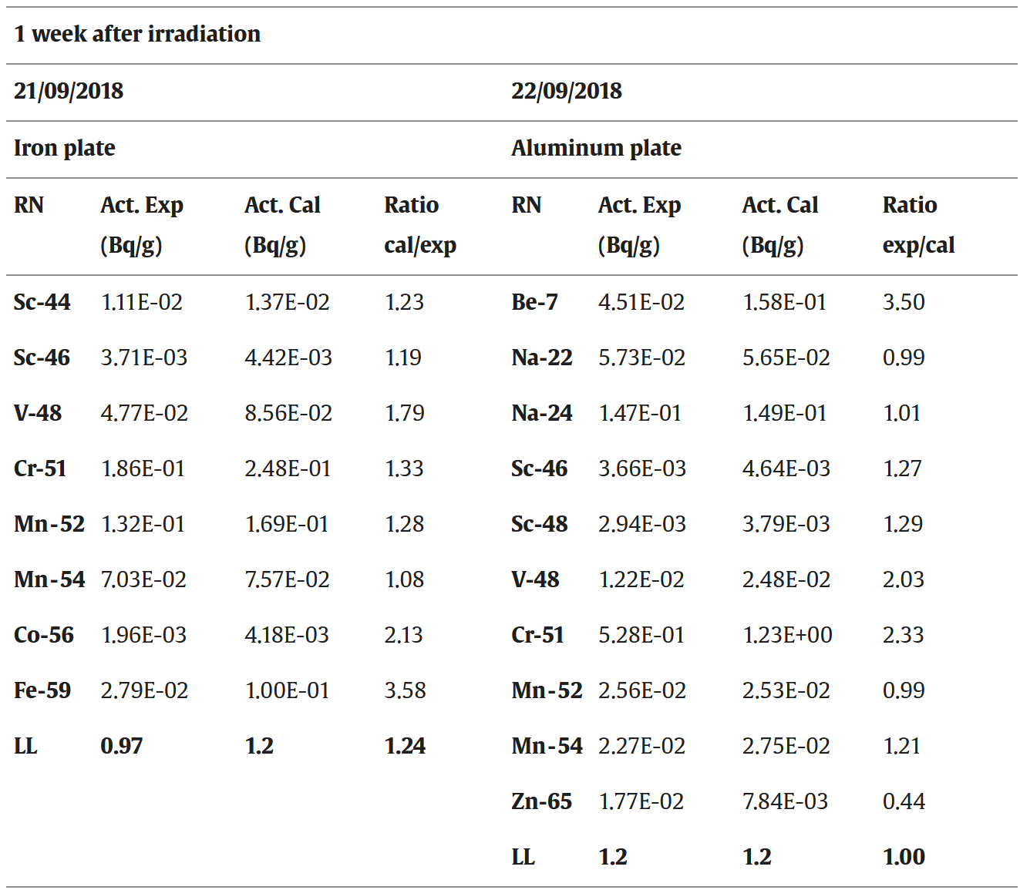
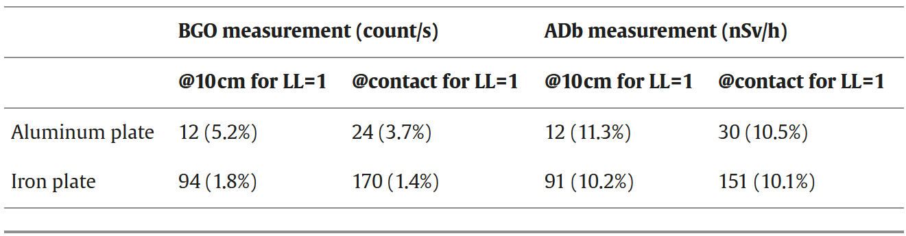
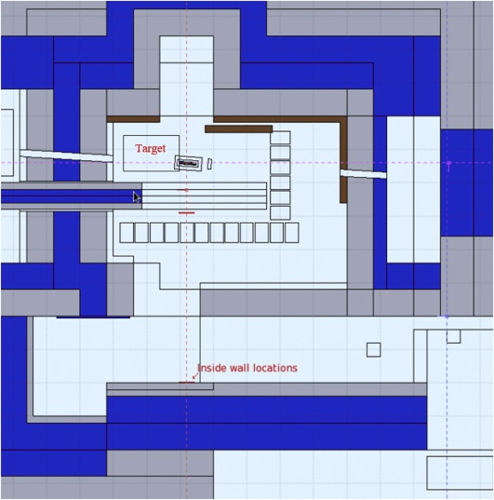
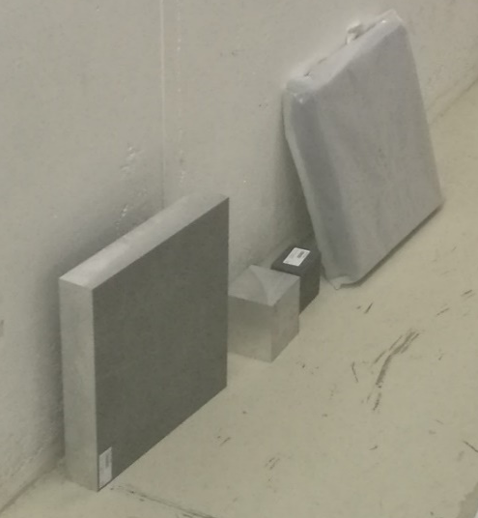
Experimental validation
Goal: verify the accuracy of the ActiWiz calculations
and verify the accuracy of the dose rate measurement
Experimental conditions:
Samples: 30x30x5cm3, aluminium and iron
Irradiation: 4.5h (iron) and 3d (aluminium)
24 GeV/c proton beam (~3.5E+10 proton/second)
Copper target
Irradiation location: 90° to target at ~6m
Comparison of ActiWiz calculations with gamma spectrometry measurements
→ Very good agreement
Comparison of dose rate measurement (Automess AD-b) with count rate measurements (FHZ 512 BGO)
Geometry of the irradiation facility (left) with the irradiation location and photo of the samples of aluminium and iron irradiated (right).
→ Very good agreement
Notes:
Experimental validation as well in irradiation in a target area
The activity calculated is in good agreement
The dose rate is well measurable

Slide 15
Clearance by dose rate measurements - procedure
Radioactive or potentially radioactive component
Pre-defined conditions respected
H*(10) < 0.1 µSv/h contact
FHZ512-BGO scan ≤ Decision Threshold
FHZ512-BGO measurement ≤ 5 c/s net
Contamination measurement ≤ Decision Threshold
NOT RADIOACTIVE
Direct measurement whenever possible.
Typically, 10 c/s net.
As defined by the parametrical study (slide 10 and 12): type of objects, excluded facilities, excluded materials, min. decay, min. mass and min. dimensions.
RADIOACTIVE
TRUE
FALSE
Notes:
If conditions are met
Measure
Scan with hot spot
Measure with shielding
Long measurement
Contamination
Then OK

Slide 16
Conclusion
Effective, fast and reliable classification of activated components achieved at CERN by coupling zoning and low-level dose rate measurements.
A general parametrical study [1], covering most of the CERN facilities (from Lin4 to LHC), defines the generic conditions (see slides 10 and 12) under which clearance of radioactive and potentially radioactive objects can be performed by low-level dose rate measurements, i.e., ≤ 5 nSv/h at contact.
FOPH approved the methodology and the principle of simplified clearance, i.e. without prior notification.
Quality control performed regularly by gamma spectrometry on randomly selected objects did not show any deviation, ie. LL_{sum}<1 always verified.
When the clearance cannot be performed by low-level dose rate measurements, a low-level total-gamma clearance monitor can be used with a similar parametrical study defining the boundary conditions and the fingerprints to be used [2].
Whenever needed, dedicated studies can cover specific cases (worksites, type of
material, geometry of components, etc.) to apply the same methodology, but with other
boundary conditions than the ones defined by the general studies [1], [2].
Similar study/approach is used for transport classification.
[1] T. Frosio and al., Classification of radiological objects at the exit of accelerators with a dose-rate constraint, doi: 10.1016/j.apradiso.2020.109303
[2] T. Frosio and al., New methodology for in-situ classification of radiological items with a clearance monitor system, doi: 10.1016/j.nima.2020.163847
Notes:
Mention that we have a different parametrical study for clearance monitors
We can do specific studies for specific facilities to be more precise
Same issue for transportation classification

Slide 17

Notes:
Questions: sample size: how about attenuation: too thick is problematic, (averaging if a big object or more than 100kg). Xou measure several sides, on top of the scans.
If too small: we dont measure with these, and we do with clearance monitors, or gamma spectroscopy
How about background control? Try to have low background, measure on 60s.

Slide 18
BACKUP SLIDES

Slide 19
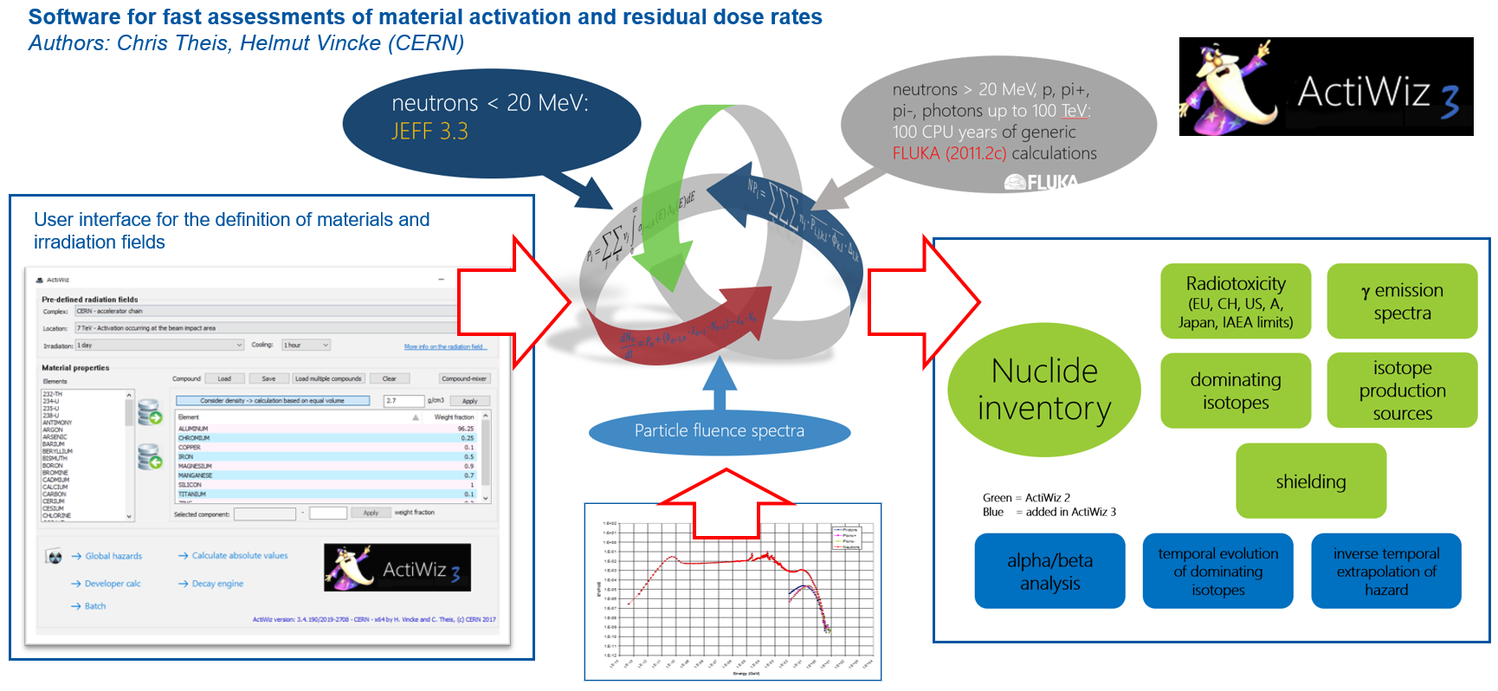
ActiWiz 3
Notes:
ADD REF

Slide 20
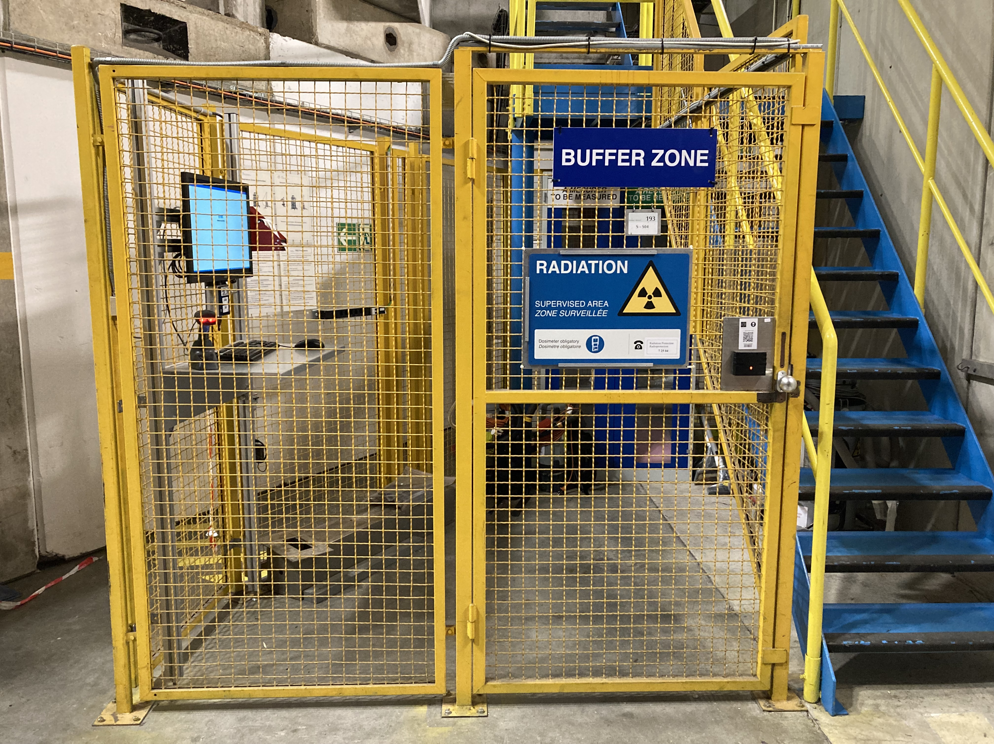
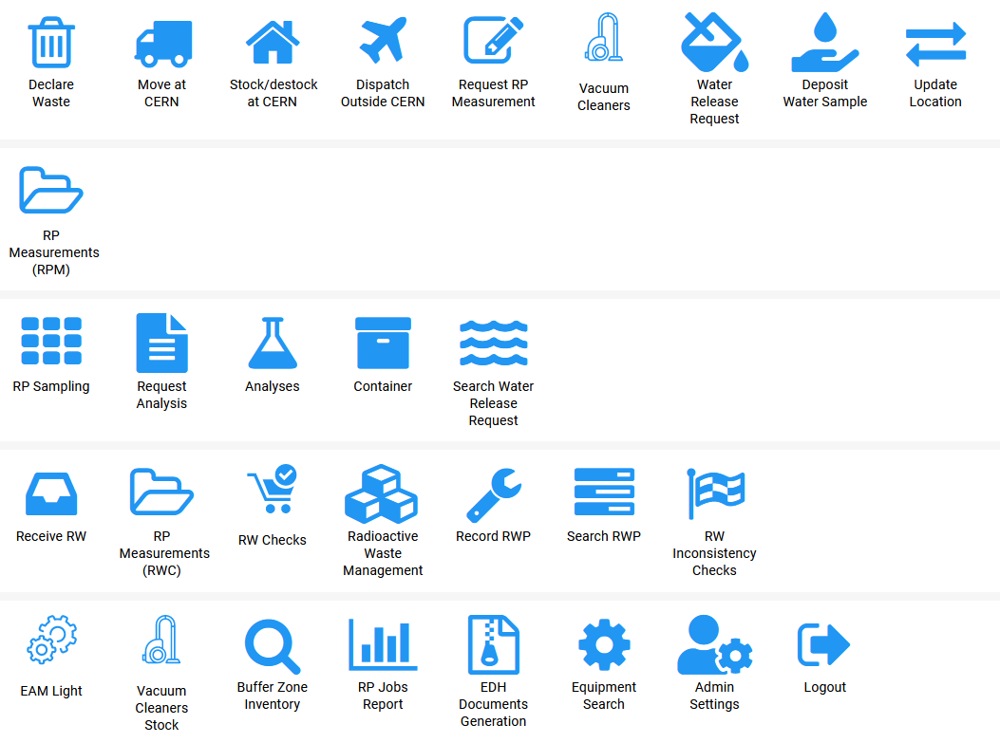



Traceability of radioactive equipment at CERN
Concept
Shipping outside CERN
Hardware
Software
Site perimeter equipped with exit radiation monitors (“Site Gate Monitors”).
Radiation portal truck monitor mandatory for waste truck leaving CERN
Transport/shipping in compliance with ADR regulations
Client requests
Inventory function
RP measurement
Radiation area
Buffer Zone
RP analysis
RW management
Identification function
CERN asset (equipment) database
General / admin
RP measurement func.
Single, centralised database
Capturing component properties
Integrated in CERN’s life-cycles
Recording all RP measurements and radiological analyses
Other radiation areas at CERN
HxGN EAM
CERN perimeter

