Slide 2
BDF/SHiP at the High Intensity ECN3 (HI-ECN3) Facility
M. Fraser & C. Ahdida
HI-ECN3 Study Project Leader & Deputy Project Leader
ESS - CERN Meeting, ESS, Lund, Sweden
20th September 2024

Slide 3
Content
Motivation
BDF/SHiP introduction
  Concept
  Layout
  Target design
  Target complex & service building
  Timeline

Slide 4
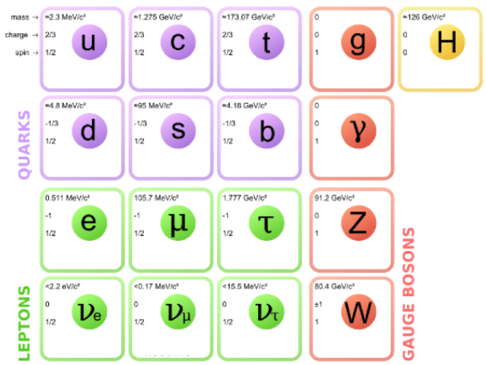
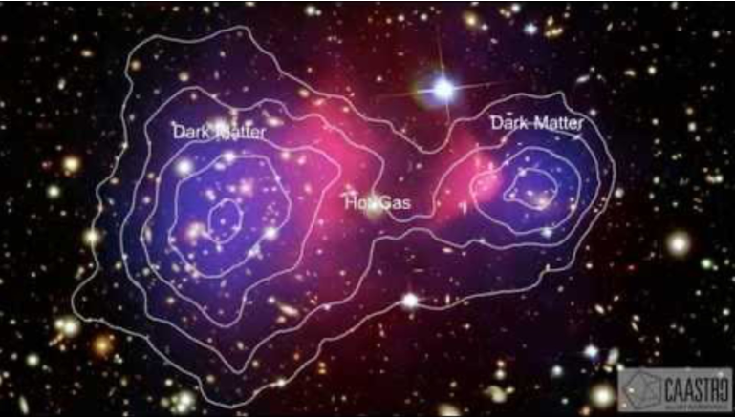
Motivation
High Intensity ECN3 (HI-ECN3) project for a new state-of-the-art high intensity experimental facility in ECN3
HI-ECN3 will house the Beam Dump Facility (BDF) and the Search for Hidden Particles (SHiP) experiment to probe Beyond the Standard Model and to directly search for Feebly Interacting Particles
Standard Model of Particle Physics
Evidence for Dark Matter
26% of universe!
Search for very weakly, long-lived interacting particles
Mass distribution from gravitational lensing
?
X-ray emission from hot plasma
SUSY,
sterile neutrinos,
etc.
Incomplete!
Galaxy clusters after collisions → 80-85% dark matter clouds

Slide 5

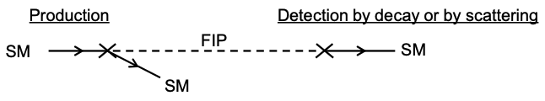
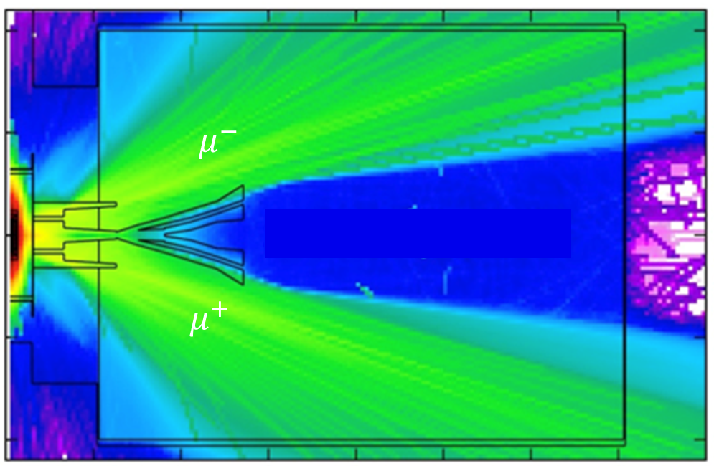

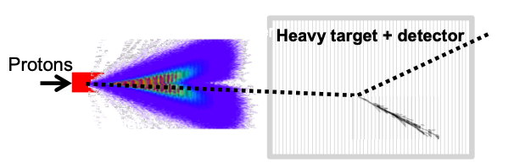
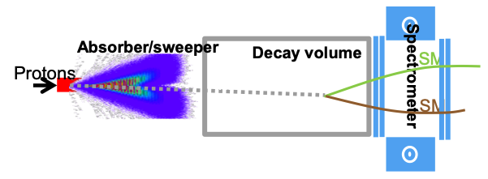
BDF/SHiP Concept
Physics
SPS beam intensity and energy is unique for exploring and directly searching for Feebly Interacting Particles at SPS complementary to collider physics
Concept of BDF/SHiP
Beam Dump Facility Concept
Beam
High energy → production of charmed + beauty mesons
High ppp & POT → overcome small prod cross-section of extra rare events of hidden particles
Target/dump
High ρ, Z & A → Maximize p+ interaction
Shortest λ → Force absorption of K & π to reduce muon & neutrino background
Muon shield
Active muon shield to sweep muons out of detector location
Not to scale!
Active muons shield
Decay volume
(vacuum)
em
p⁺
^{400 GeV}
π, K
µ
Detector
hadrons
scattering events
decay events

Slide 6
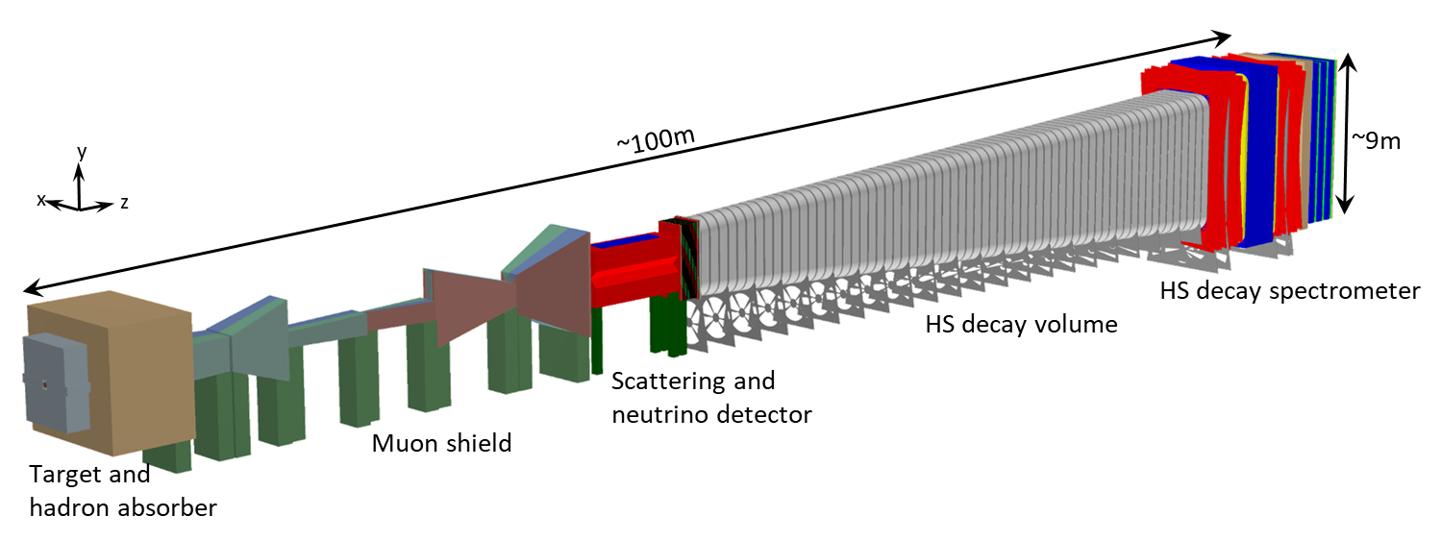
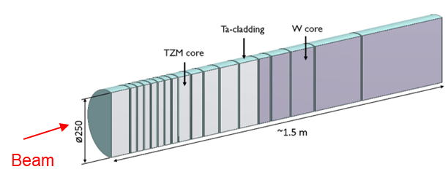
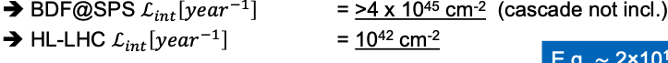
BDF/SHiP Layout and Beam Parameters
Key beam parameters of BDF/SHiP
p⁺
^{400 GeV}
 | BDF
Beam energy (GeV) | 400
Intensity (p/spill) | 4×10¹³
Spill duration (s) | 1
Cycle length (s) | 7.2
Avg. beam power (kW) | 356
Avg. beam power depos. in target (kW) | 305
Annual POT | 4×10¹⁹
Total POT (15 yrs) | 60×10¹⁹
Target
BDF luminosity with 4×10¹⁹ POT/y currently available at the SPS
TZM: 0.08% titanium – 0.05% zirconium – molybdenum alloy
e.g. ~2×10¹⁷ charmed hadrons (>10 times the yield at HL-LHC)

Slide 7
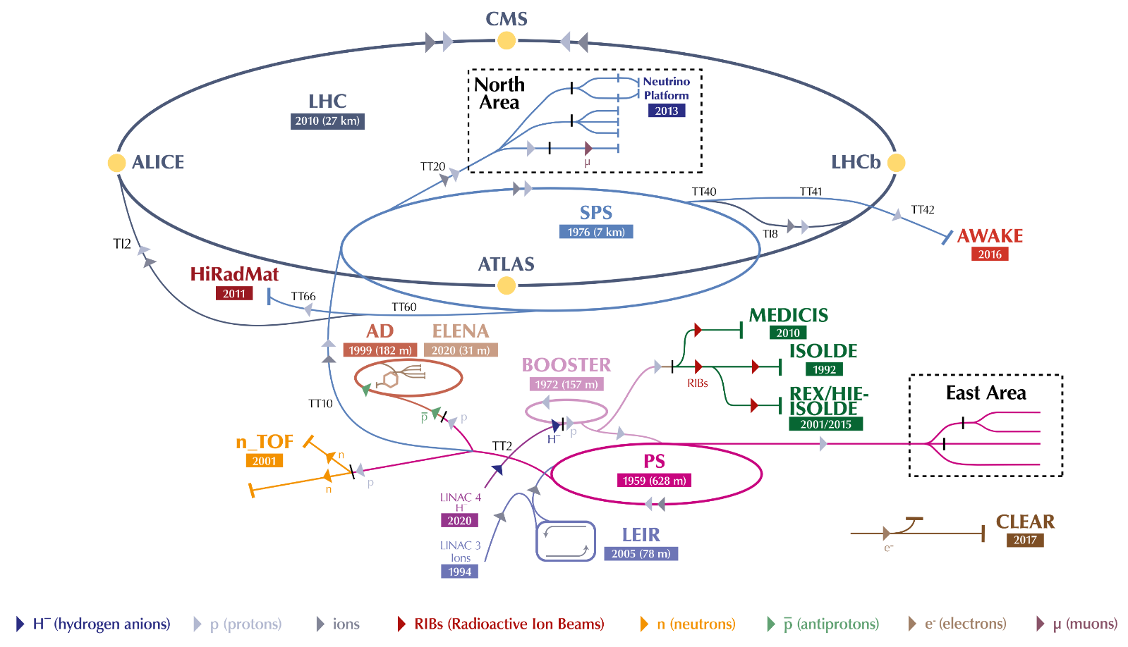
The CERN accelerator complex
Copyright CERN. Source CERN CDS

Slide 8
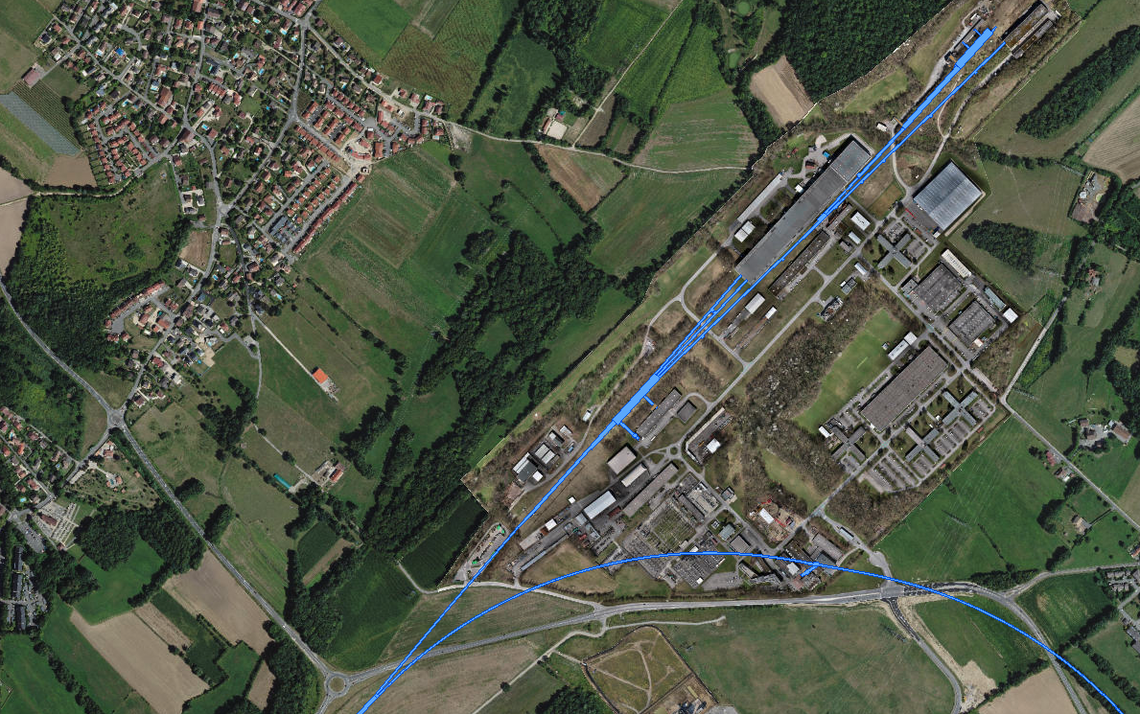
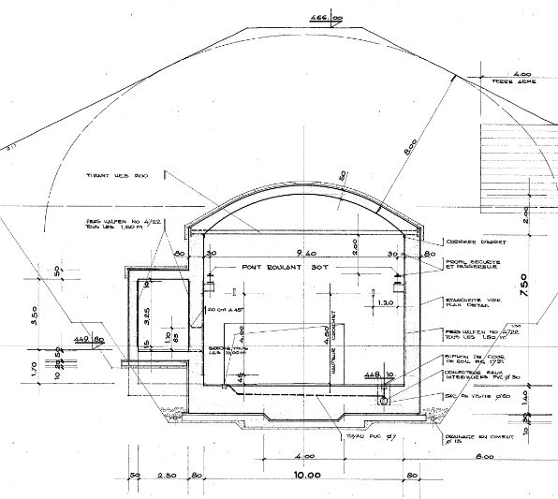
ECN3 – Experimental Cavern North 3
EHN2
TCC8 & ECN3
(SPS’s only underground experimental cavern!)
ECN3
TCC8
TCC8 cross-section
EHN1
Bypassing NA Production
Targets in TCC2
8m soil
~ 1.6 km
SPS LSS2 Extraction Straight
8

Slide 9
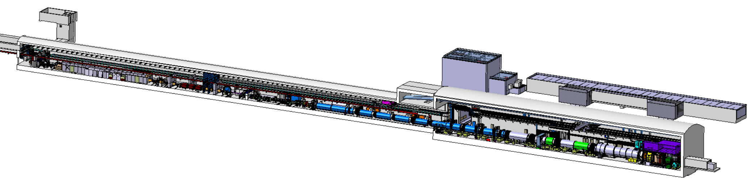
ECN3 today: NA62 experiment
Experiment | p⁺ [10¹² /spill] | p⁺ flux (avg.) [10¹¹ Hz] | POT [10¹⁸ /yr]
NA62 | ~ 3 | ~ 2 | 2.6
Beam from SPS
B911
B918
TCC8
T10 target generates a secondary beam of kaons
ECN3

Slide 10
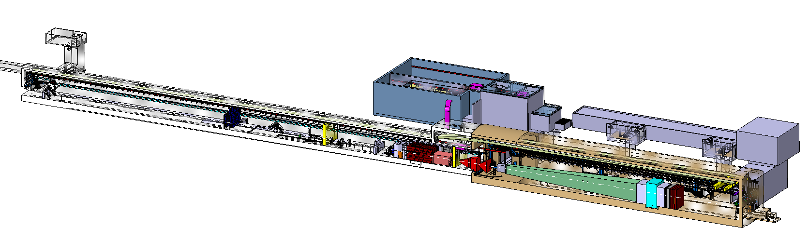
ECN3 in 2031: BDF / SHiP
An order of magnitude intensity upgrade
Experiment | p⁺ [10¹² /spill] | p⁺ flux (avg.) [10¹² Hz] | POT [10¹⁹ /yr] | SHiP POT request [10²⁰ /15 yr]
NA62 | ~ 3 | ~ 0.2 | 0.26 | -
SHiP (baseline) | 40 | ~ 2.5 | 4.00 | 6.0
Beam from SPS
B911
B918
Beam Dilution System
TCC8
BDF’s Target Complex:
containing a “thick” high-Z target (Mo/W)
ECN3

Slide 11
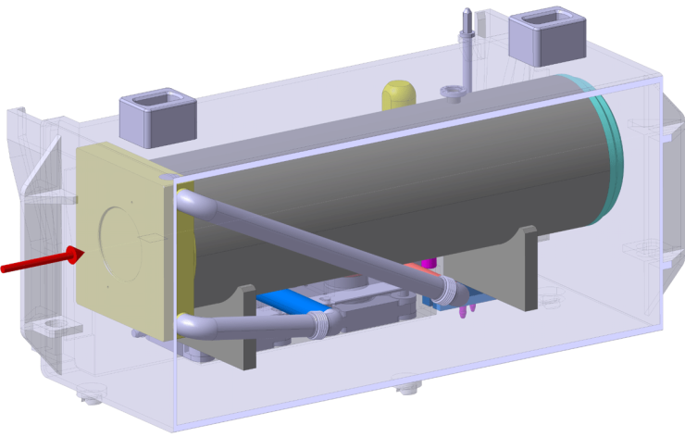
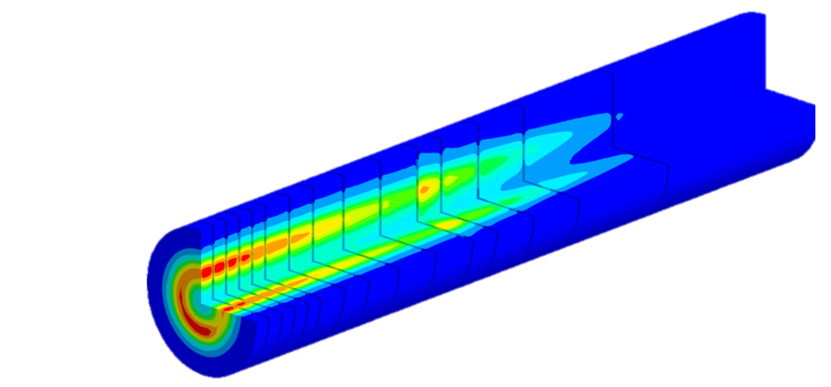
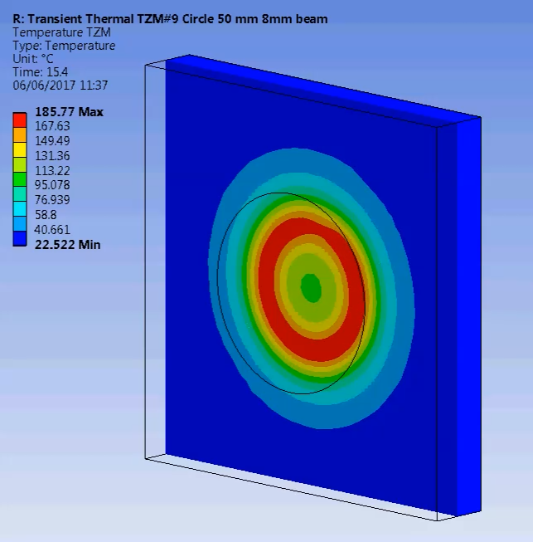
ECN3 in 2031: BDF / SHiP
~ 350 kW (avg.)
~ 2.3 MW (spill)
Beam from SPS
B911
B918
Beam Dilution System
TCC8
BDF’s Target Complex:
containing a “thick” high-Z target (Mo/W)
ECN3

Slide 12
ECN3 in 2031: BDF / SHiP
An order of magnitude intensity upgrade
Experiment | p⁺ [10¹² /spill] | p⁺ flux (avg.) [10¹² Hz] | POT [10¹⁹ /yr] | SHiP POT request [10²⁰ /15 yr]
NA62 | ~ 3 | ~ 0.2 | 0.26 | -
SHiP (baseline) | 40 | ~ 2.5 | 4.00 | 6.0
Beam from SPS
New Target
Service Building
New
Access
Shaft
Existing
Access Shaft
B911
B918
Beam Dilution System
TCC8
BDF’s Target Complex:
containing a “thick” high-Z target (Mo/W)
ECN3

Slide 13
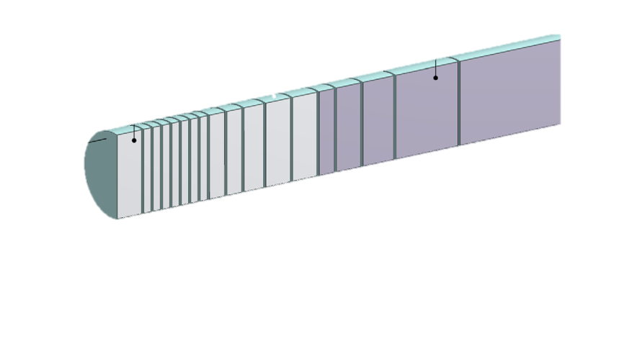
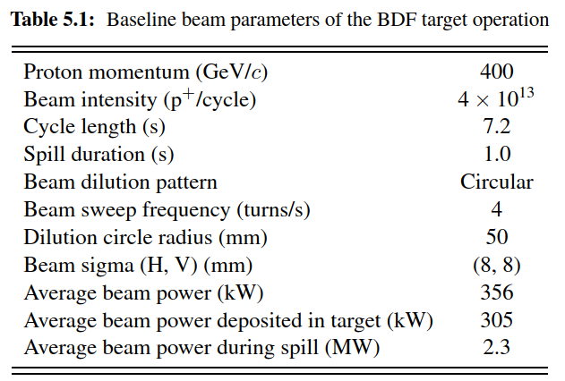
BDF Target Baseline Design
~ 1500 mm
Baseline beam parameters of the BDF Target operation. https://doi.org/10.23731/CYRM-2020-002
~ 4.0×10¹⁹ p⁺/y
D250 mm
5x W blocks (780 mm)
13 x TZM blocks (580 mm)
Baseline design:
Water-cooled, Mo & W blocks (cladded with Ta)
Tested with beam in 2018 & PIE
TDR phase needed to improve CDS design:
Alternatives to water-cooling to avoid cladding and the risk of development of free radicals (hydrogen)
See talks:
Status of the BDF Target Design (R. Ximenes)
Preliminary Considerations for the Target He Systems (F. Dragoni, N. Zaric)
Radiation Protection Considerations (C. Ahdida)

Slide 14
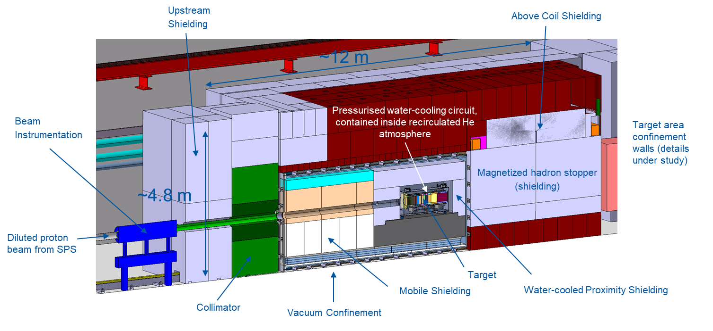
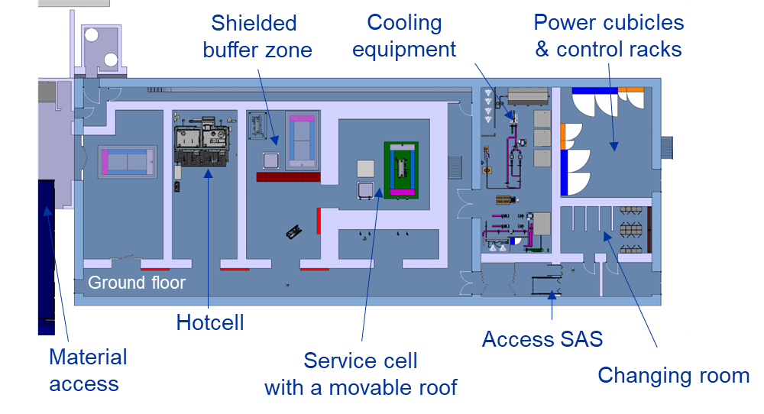
BDF Target Complex and Service Building
BDF target complex layout
Service building layout
See talks:
Considerations for the Design of the BDF Target Station and Annex Services (J.L. Grenard)
Radiation Protection Considerations (C. Ahdida)

Slide 15
Project Timeline
Beam on target for Facility Commissioning:
2030
~ 2 years operation for SHiP before LS4
Research Board Decision for SHiP: March 2024
Civil Engineering for ECN3 is the critical path: ~ 3 – 4 years
HI-ECN3 TDR deadline
SHiP TDR deadline

Slide 16
Summary
The HI-ECN3 project exploits the available SPS beam intensity and existing CERN infrastructures for a cost-effective, novel approach to explore the intensity frontier and launch a unique (worldwide), direct search for dark matter to be performed by the SHiP experiment
Detailed studies and optimization to be carried out in the Technical Design Phase until end of 2025, to achieve first beam on target in 2030
Safety is at the core of the Technical Design Phase
Very similar requirements to a neutron spallation target, wherefore synergies with ESS are being pursued

Slide 18
HI-ECN3 Study Project Team
Project Leader (PL):
Matthew FRASER
Deputy Project Leader (DPL):
Claudia AHDIDA
Project Safety Officer (PSO):
Melenia AVERNA
Project Budget Officer:
Sylvie PRODON
Project Planning Officer (PPO):
Fernando PEDROSA
Configuration & Quality Assurance Manager:
Giulia ROMAGNOLI
Integration Support via ICEA:
Michael LAZZARONI
North Area Operation & Experiment Liason:
Dipanwita BANERJEE
SHiP Experiment Contact Person:
Richard JACOBSSON
SHiP Experiment Safety Correspondent:
Letizia DI GIULIO
Project & Experiment Safety Support (PESS) Correspondant :
James CURRIE
Admin Support:
Katarina SIGERUD & Ane-Mona BRANZA
WP1 – Project Management
Matthew FRASER
Deputy: Claudia AHDIDA
WP2 – Beam Extraction, Transfer and Delivery
Francesco VELOTTI
Deputy: Laurie NEVAY
WP3 – Target & Beam Intercepting Devices
Rui XIMENES
WP4 – Target Complex
Jean-Louis GRENARD
WP5 – Exp. Area, Interface & Integration
Francois BUTIN
WP6 – Radiation Protection & Safety
Claudia AHDIDA
WP7 – Infrastructure, Services & Civil Eng.
Fernando PEDROSA
WP8 – Radiation field and R2E & R2M effects
Luigi ESPOSITO
M. Fraser BDF/SHiP at the HI-ECN3 Facility SY-TM – ECN3 18th June 2024

Slide 19
Project Work Breakdown Structure v 0.1
…to be finalised with revised cost & resources by the end of the TDR phase (end 2025)
WP8 – Radiation field and R2E & R2M effects
Luigi ESPOSITO
WP1 – Project Management
Matthew FRASER
Deputy: Claudia AHDIDA
WP2 – Beam Extraction, Transfer and Delivery
Francesco VELOTTI
Deputy: Laurie NEVAY
WP3 – Target & Beam Intercepting Devices
Rui XIMENES
WP4 – Target Complex
Jean-Louis GRENARD
WP5 – Exp. Area, Interface & Integration
Francois BUTIN
WP6 – Radiation Protection & Safety
Claudia AHDIDA
WP7 – Infrastructure, Services & Civil Eng.
Fernando PEDROSA
Planning, Scheduling & Coord.
Fernando PEDROSA
Extraction
Pablo ARRUTIA
Target Design & Engineering
Rui XIMENES
Target Complex Design & Engineering
Jean-Louis GRENARD
Expt Area Design & Engineering
Francois BUTIN
Safety Files
Melania AVERNA
NA-CONS Synergism
Fernando PEDROSA
Budget & Resources
Sylvie PRODON
Primary Beam Line
Laurie NEVAY / Francesco VELOTTI
BIDs Design & Engineering
Rui XIMENES
TC & Surface Building Integration
Jean-Louis GRENARD
Global Integration (inc. Exp. Area Integration)
Francois BUTIN
Radiation Protection
Claudia AHDIDA
Civil Engineering
John OSBORNE
Procurement
Magnets
Philip SCHWARTZ
XTAX Upgrade
Miguel SANTOS
Containment Systems
Jean-Louis GRENARD
TCC8/ECN3 Dismantling
Nicolas QUINQUIS / Francois BUTIN
Radioactive Waste Management & Transport
Philippe BERTREIX
Renaud CHAROUSSET
Gas Distribution
Davide JAILLET
Project Office
Matthew FRASER
Power Converters
Ivan JOSIFOVIC
Experiment Requirements
Richard JACOBSSON
Service Cell Systems
Jean-Louis GRENARD
Shielding Proecurement & Recovery
Michael LAZZARONI
Fire Safety
Oriol RIOS
Cooling & Ventilation
Roberto BOZZI
Technical Coordination
Matthew FRASER
Vacuum Upgrade
Miguel SANTOS
Energy Deposition & Radiation Effects
Luigi ESPOSITO
Robotic Systems
Luca BUONOCORE
Experiment Interfaces
Richard JACOBSSON
Access & Safety Systems
Tomasz LADZINSKI / Anna SUWALSKA
Electrical & Fiber Infrastucture
Eva CANO GONZALEZ
Configuration & Quality Management
Giulia ROMAGNOLI
Beam Instrumentation
David BELOHRAD
Detailled Design & Production
Luca GENTINI
Remote Handling Systems
Roberto RINALDESI
Accelerator Interfaces
Francois BUTIN
Occupational Safety
James CURRIE
Cryogenics
Installation
Machine Protection
Antoine COLINET
Target Instrumentation
Jerome LENDARO
Radioactive Components Storage & Disposal
Jean-Louis GRENARD
Experiment Installation
Francois BUTIN /
Richard JACOBSSON
Survey & Alignment
Camille VENDEUVRE
Commissioning
Operational Controls & Tools
Kevin LI
Material R&D
Stefano SGOBBA
Radiation to Electronics
Ruben ALIA
Experiment Requirements
Richard JACOBSSON
Handling Systems & Operational Support
Roberto RINALDESI
Beamline Shielding Improvements
Laurie NEVAY
Prototype Target Beam Test
Rui XIMENES
Accelerator Interfaces
Jean-Louis GRENARD
Telecom & Network
Experiment Requirements
Richard JACOBSSON
Magnetised Hadron Stopper
Philip SCHWARTZ
Work Package Descriptions to be drafted during TDR phase
M. Fraser BDF/SHiP at the HI-ECN3 Facility SY-TM – ECN3 18th June 2024

Slide 20
HI-ECN3 Project Master Schedule & Critical Path
LS3
TDR Phase
(BDF)
Critical path:
CE procurement & works
LS4

