Slide 1

Status of the BDF Target Design
ESS – CERN Meeting
Mike Parkin, Alvaro Romero Francia, Tina Griesemer, Damien Grenier, Christophe Yves Mucher, Steven S,, Jean-Louis Grenard, Marco Calviani, Giuseppe Mazzola, Luigi Esposito, Rui Franqueira Ximenes et al (SY-STI), Francesco Dragoni, Nikola Zaric, (EN-CV) Matthew Fraser (SY-ABT) on behalf HI-ECN3 Project
2024/09/20

Slide 2
Content
BDF Target requirements
Water cooled target (CDR concept)
He cooled target (new proposal)
Conclusions & prospects
Questions to ESS

Slide 3
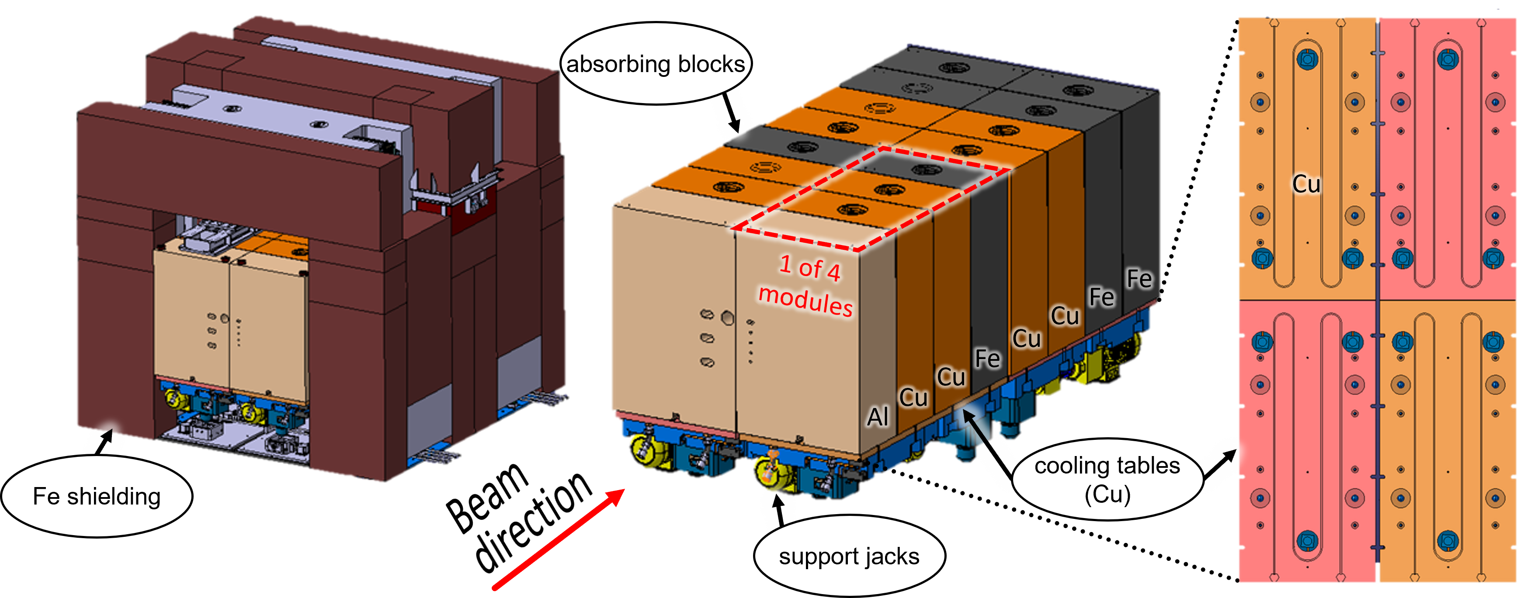
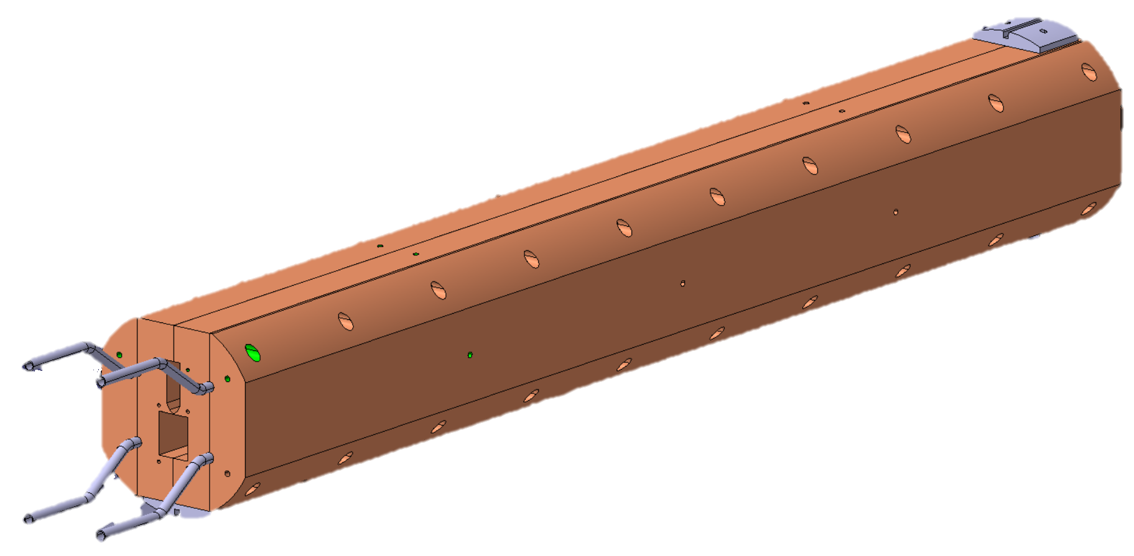
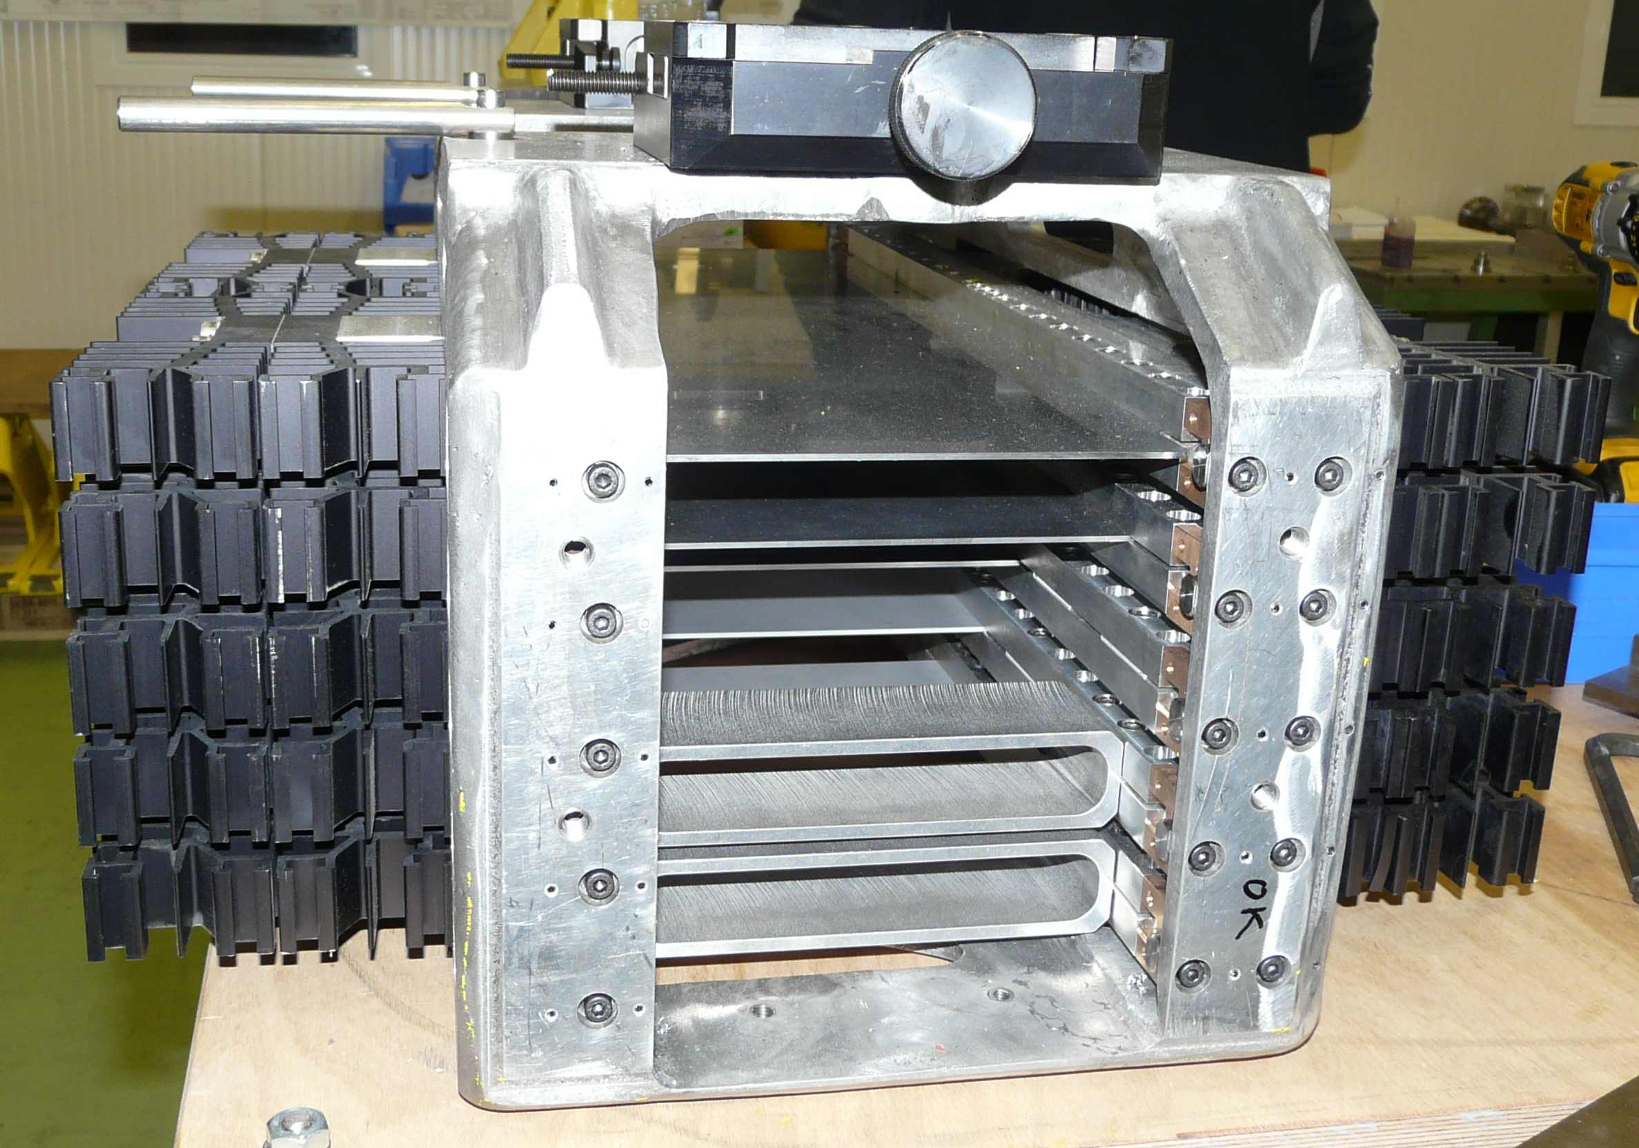
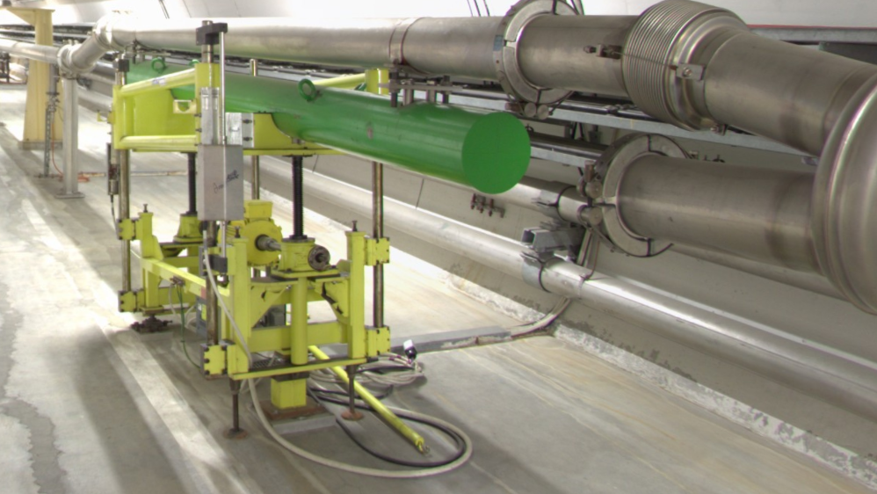
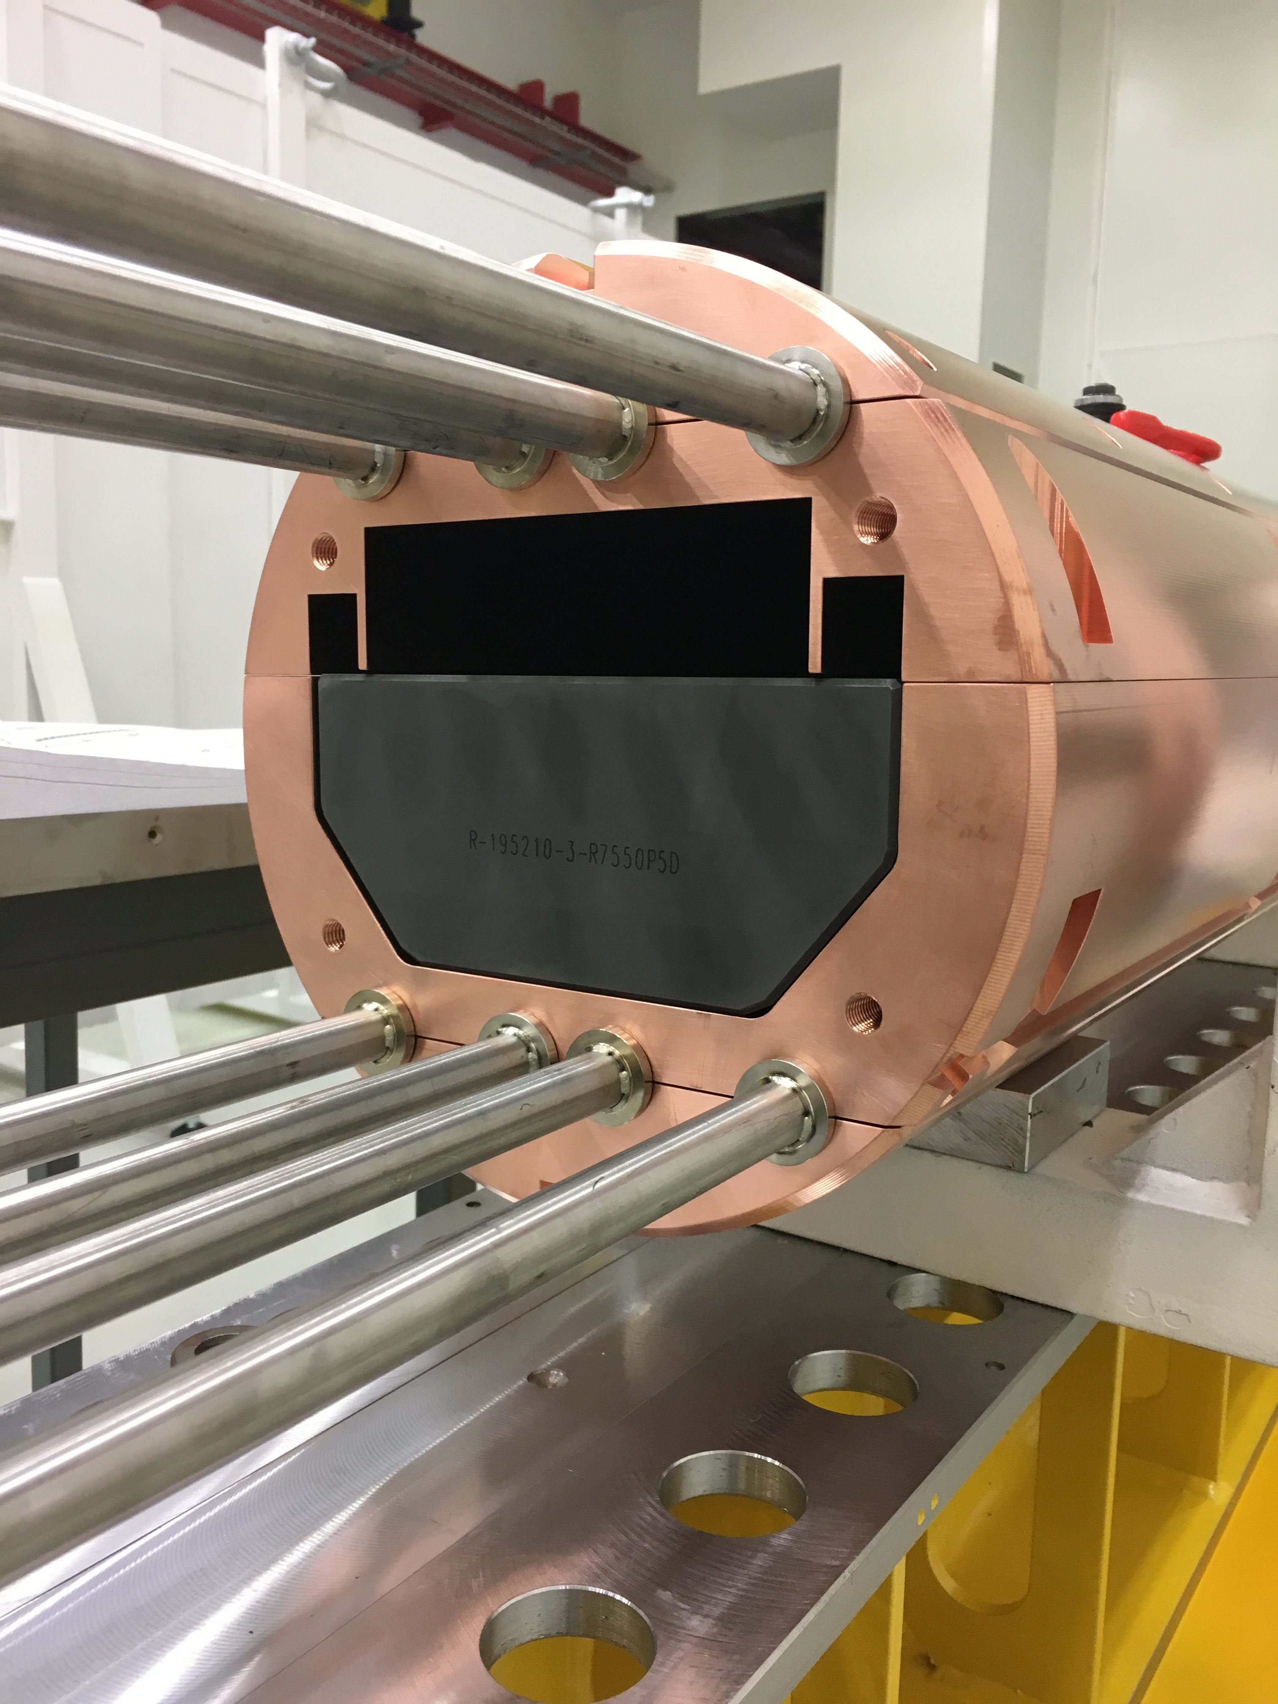
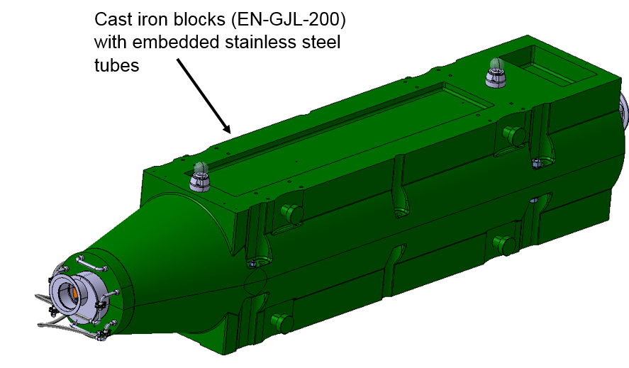
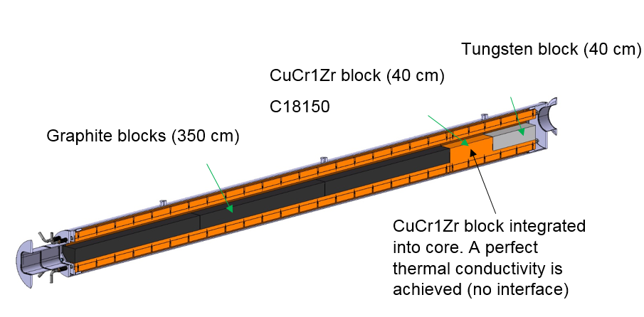
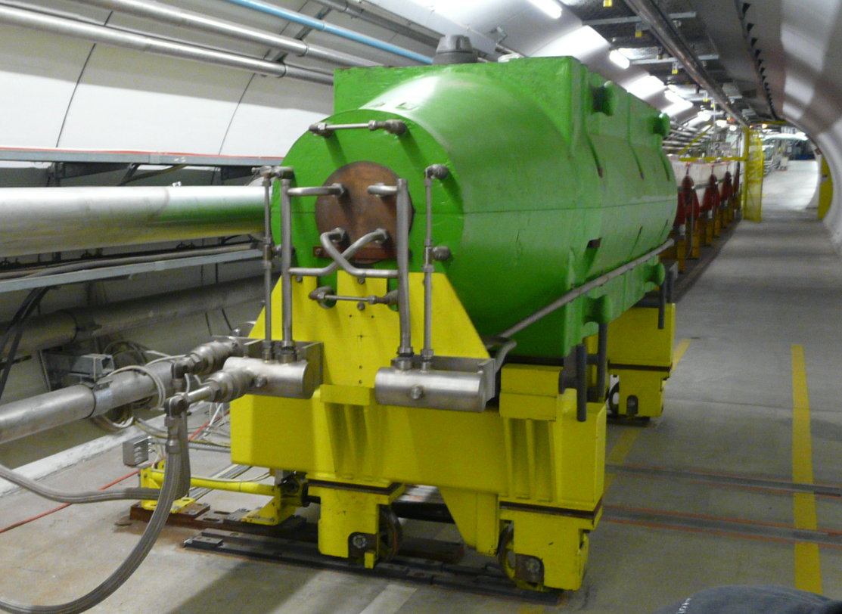
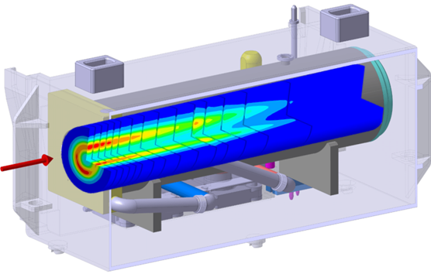
Beam Intercepting devices towards ECN3
T4 XTAX
T4 Target
TCSC
TBSE
P42 commissioning Dump (TIDVG4)
TT22
EHN1
LSS2
TT21
TT24
P4
P4:6
P42
Target + beam windows
TT20 TED
SPS
TCC8
ECN3
EHN2
NA-CONS
HI-ECN3
Other BIDS: Collimators, Masks, etc → To be defined

Slide 4
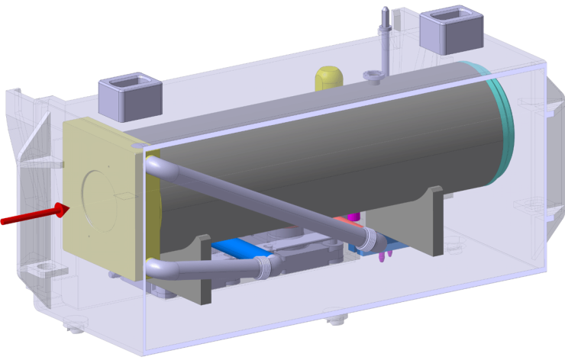
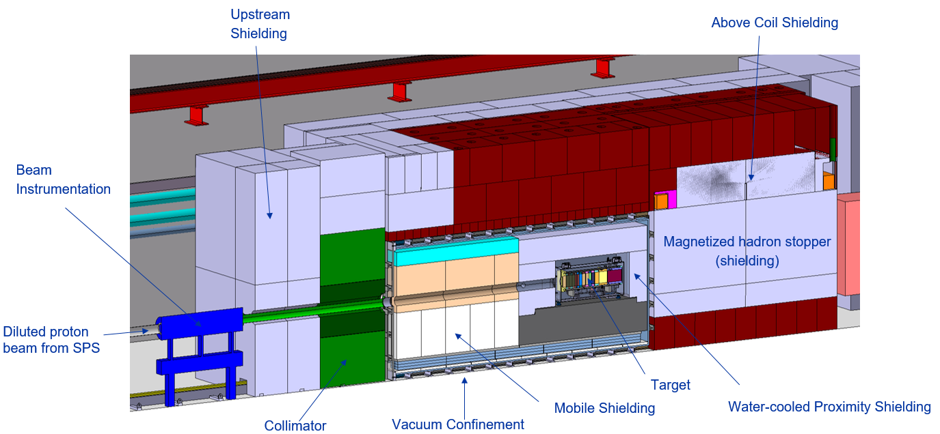
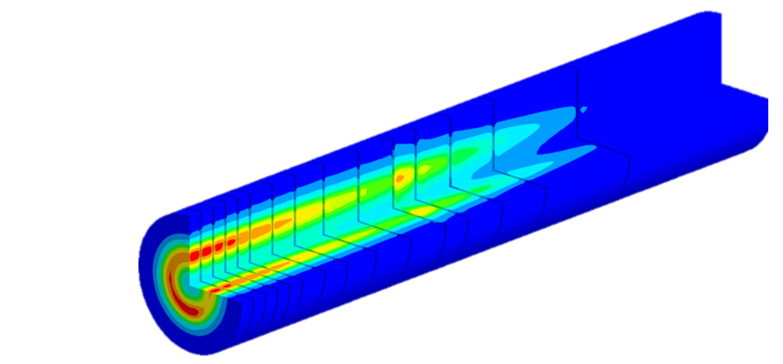
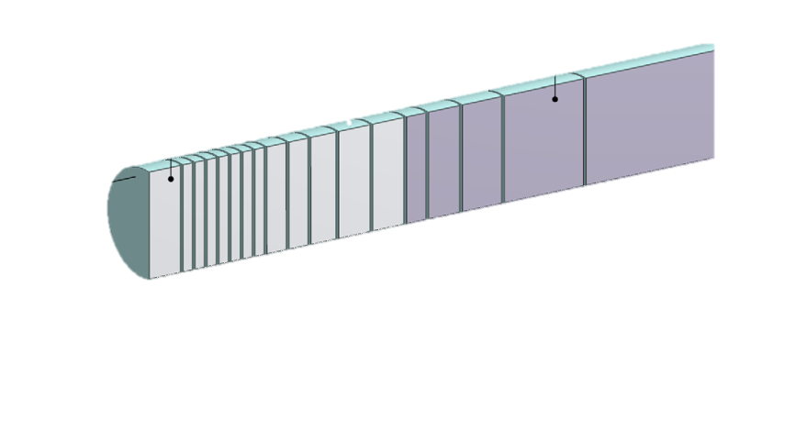
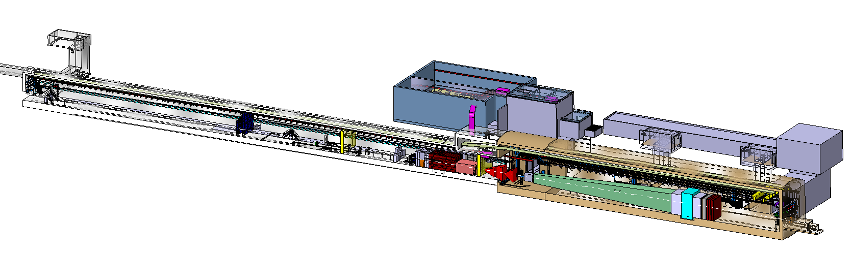
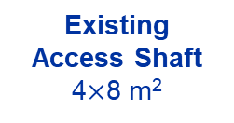
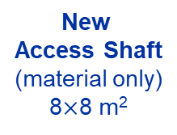
BDF/SHiP Target & Complex (Future ~ 2030)
Baseline Design → To be improved during TDR
WP4
350 kW-class Target
WP3
13 x TZM blocks (580 mm)
5x W blocks (780 mm)
New
Service Building
~ 500 – 700 m²
New
Access Shaft
(material only)
8$×$8 m²
Existing
Access Shaft
4$×$8 m²
B911
B918
Beam Dilution System
TCC8
WP2
WP4
ECN3
WP6,WP7 +al.
New Target Complex
containing the Beam Dump Target
WP5+SHiP

Slide 5
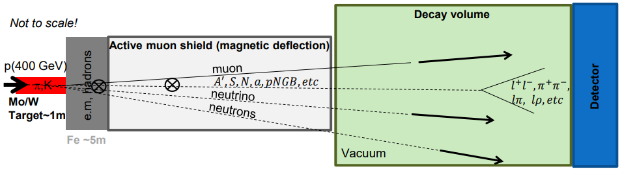
BDF/SHiP Target
Beam Dump Target / SHiP Target
  Fully absorbe all p+, maximize production of charm and beauty hadrons & re-absorption of pions, muons and kaons
High energy → production of charmed and beauty mesons
High ppp & POT → overcome small prod cross-section of extra rare events of hidden particles
High ρ, Z & A → Maximize p+ interaction
Shortest λ → Force absorption of K & π to reduce muon & neutrino background
SPS Beam Dump Facility: Comprehensive Design Study, https://doi.org/10.23731/CYRM-2020-002
SHiP Experiment - Comprehensive Design Study report, https://cds.cern.ch/record/2704147
R. Jacobsson

Slide 6
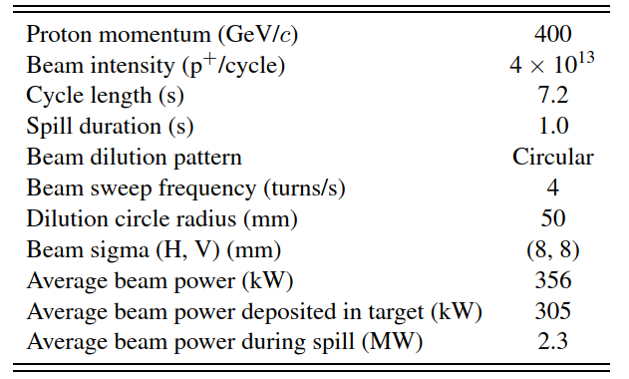
BDF Target
Target requirements
  Physics:
    high-Z material & with short interaction length
    Fully absorb SPS p+ beam
  Engineering:
    305kW power → cooling needs
    305kW power → temperature & thermal-induced stresses
  High nr of spills & POT → mechanical fatigue & radiation damage
Safety:
  High activation → Remote handling, waste disposal considerations, spallation/contamination products…
Baseline beam parameters of the BDF Target operation. https://doi.org/10.23731/CYRM-2020-002
~ 4.0×10¹⁹ p⁺/y
Very similar requirements to a neutron spallation target
Synergies with other labs are being pursued

Slide 7
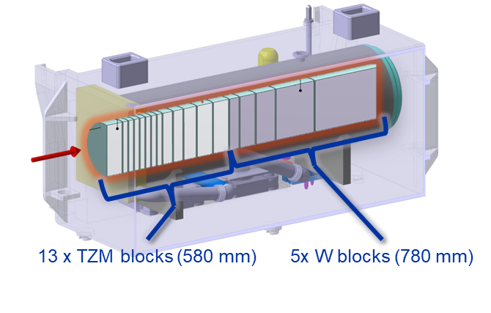
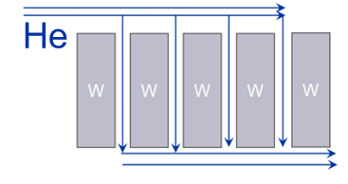
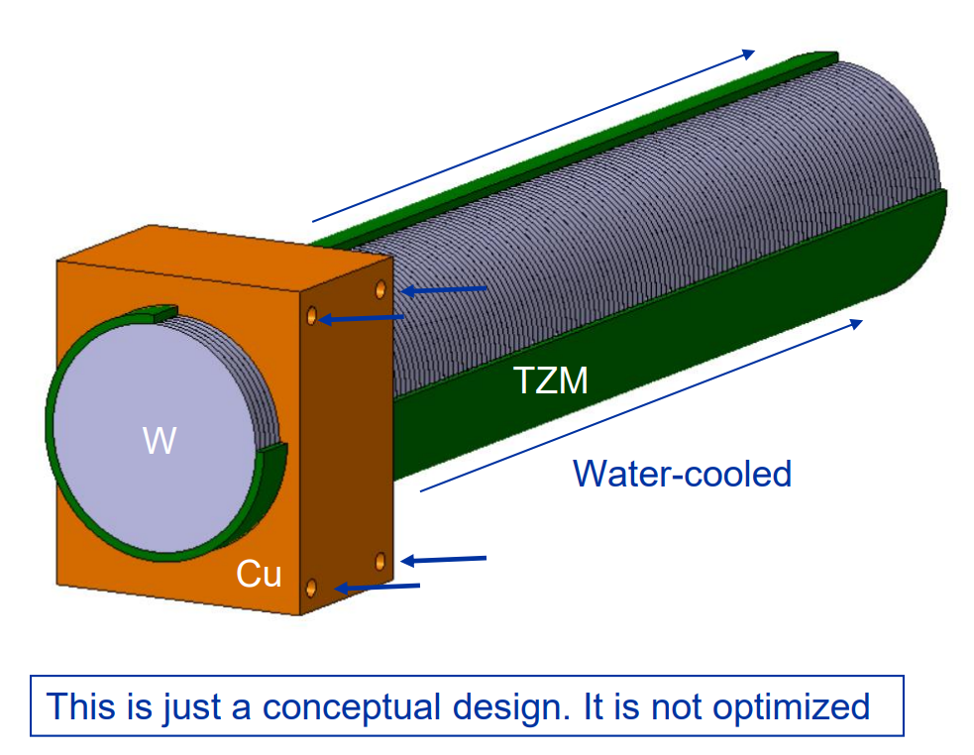
BDF Target baseline design
Baseline Design (CDR) – Water cooled, W + TZM cladded w/ Ta2.5W .
Pursued during the conceptual design phase
Prototype + test with beam + Post irradiation examination
Still some safety aspects to be addressed
Could be further optimized for physics
https://doi.org/10.1103/PhysRevAccelBeams.22.113001
Alternative designs currently being studied in the TDR
W Helium cooled Target
Removes water from beam
Better physics performance
Reduces decay heat & residual stresses
Conceptually different system!
Enclosed compact
Cu + W Target
Removes water from beam
Keeps physics performance
Reduces decay heat
Increases T and stress
Other concepts: Baseline with W rolled material, Nb-cladded Target,…

Slide 8
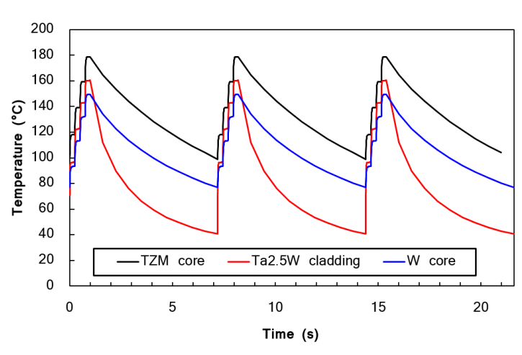
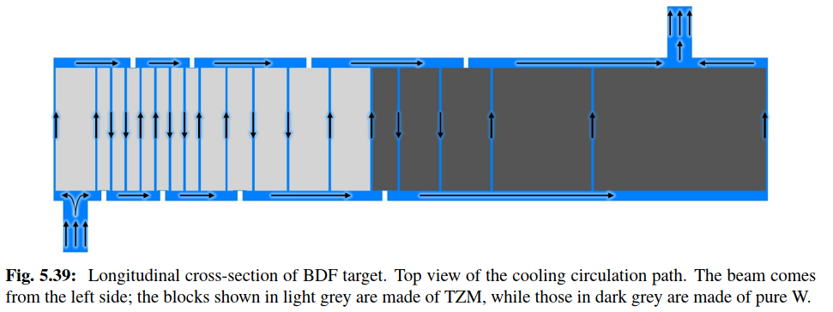
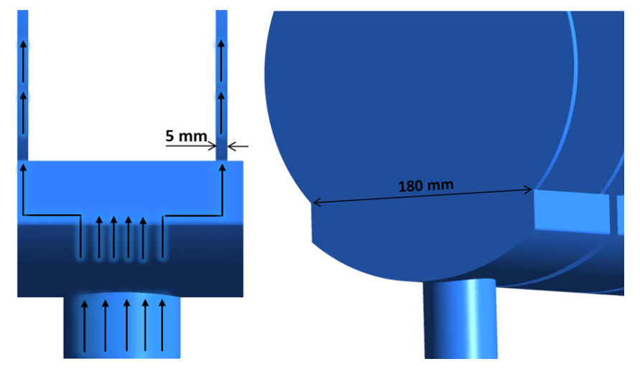
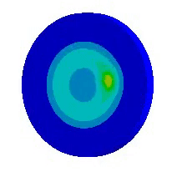
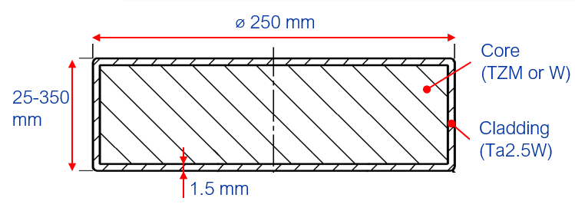
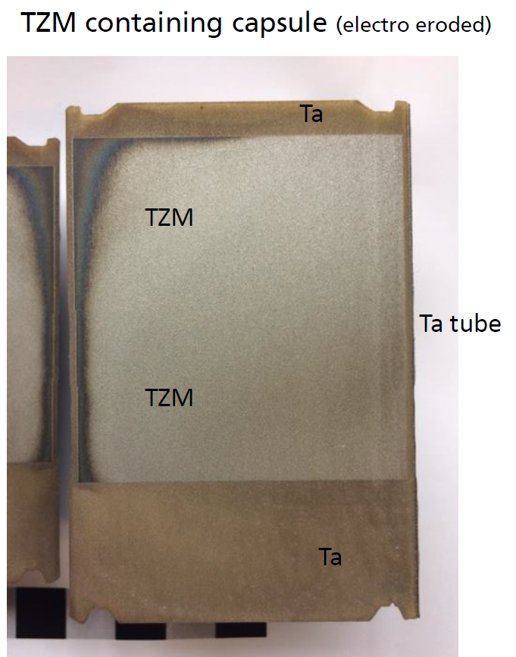
BDF Target baseline design
https://doi.org/10.1103/PhysRevAccelBeams.22.113001
BDF Baseline Target Design
Target Core with reasonable physics performance & that allows diluting (longitudinally) the energy deposition
Water-cooled, Ta-cladded TZM + W Core
  TZM: Absorbs most of the power. Higher strength, better creep resistance, higher recrystallisation temp wrt Mo.
  W: Good radiation damage resistance. Best for physics.
  Ta2.5W: To avoid corrosion-erosion of the core materials
  Cooling: 22 bar, 5 m/s, ~660l/min, ~305kW of heat.
Manufacturing
  Forged TZM and sintered W (single blocks)
  Diffusion bonding with cladding via Hot Isostatic Pressing
D250 mm
13 x TZM blocks (Z=42, ρ=10.2g/cm³)
(580 mm)
5x W blocks (Z=74, ρ=19.3g/cm³)
(780 mm)

Slide 9
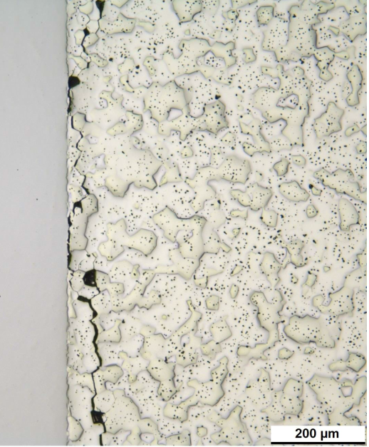
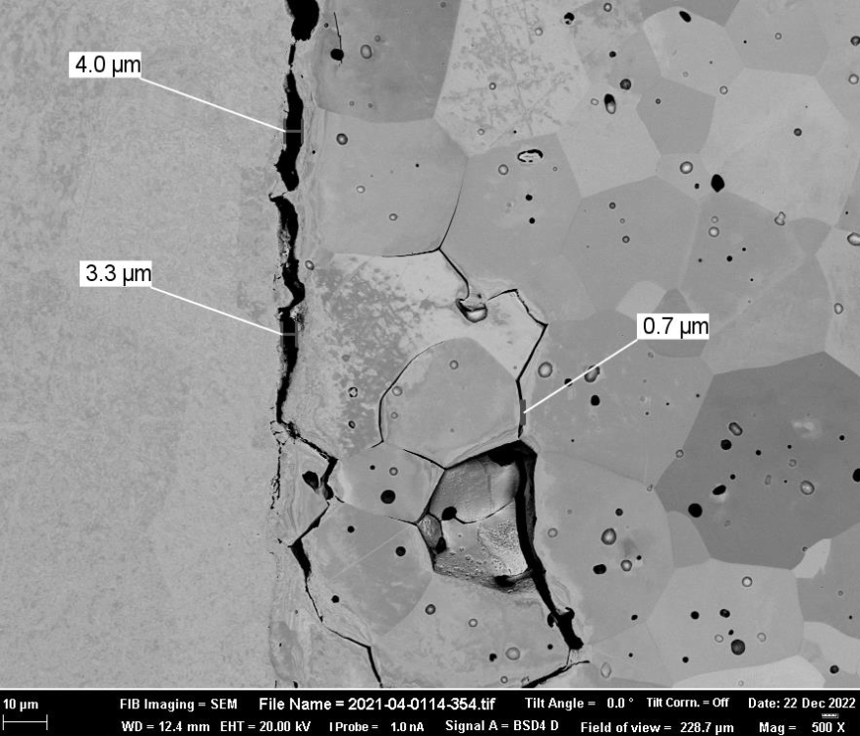
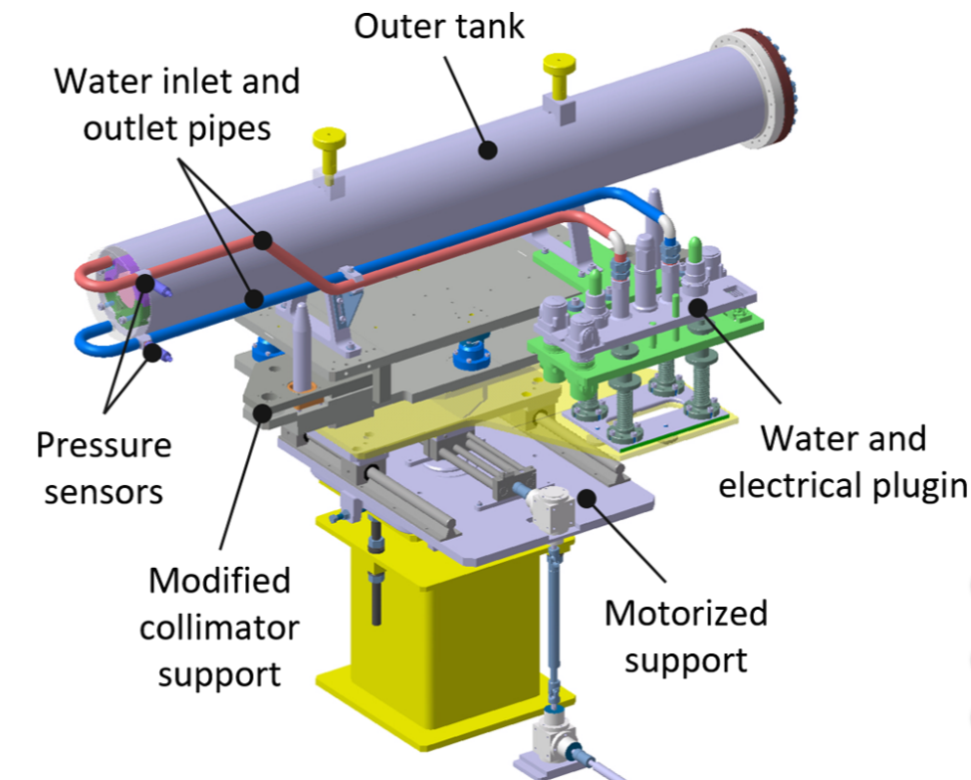
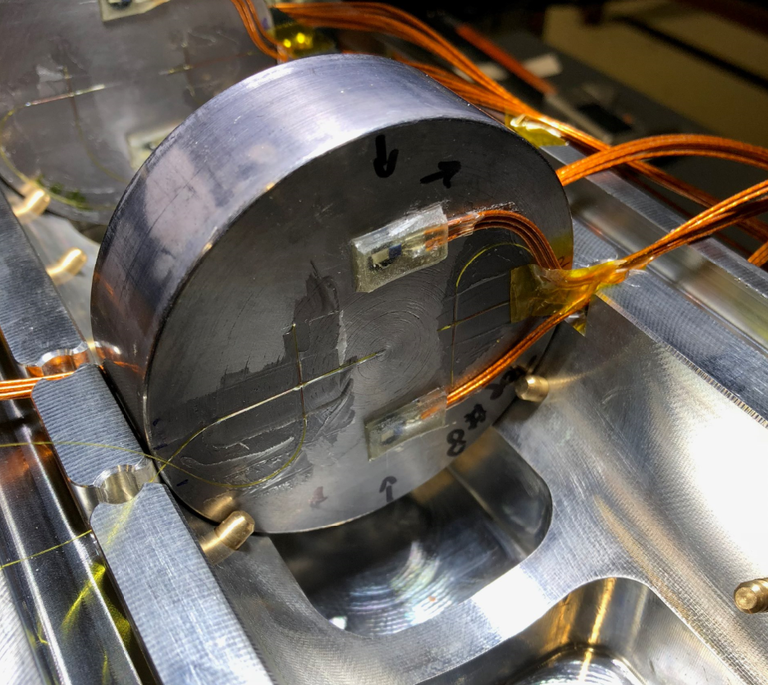
BDF Baseline Target Prototype + PIE
Prototype Beam tests
Validate manufacturing and test operation at identical temperatures & mechanical stresses.
Reduced diameter (80 mm) prototype.
Tested in 2018 on a dedicated slow extraction (SX) testbench in the T6 primary beam line in TCC2 at CERN. Total of 2.4 × 10¹⁶ p⁺
Post Irradiation Examination
Design mostly validated but with few caveats
I. Film Dosimetry
II. Metrology & Microscopy
III. Ultrasonic Testing
IV. Specimen Extraction
V. Microstructural Characterization
VI. Mechanical Characterization
VII. Thermal Characterization
Post-irradiation examination of a prototype tantalum-clad target for the Beam Dump Facility at CERN, T. Grisemer, R.F.Ximenes (to be published soon!)
https://doi.org/10.1103/PhysRevAccelBeams.22.123001
Notes:
Instrumentation (temperature and strain) of 4 most critical blocks
Total 14 hours of beam in 3 days → 2.4 × 10¹⁶ PoT

Slide 10
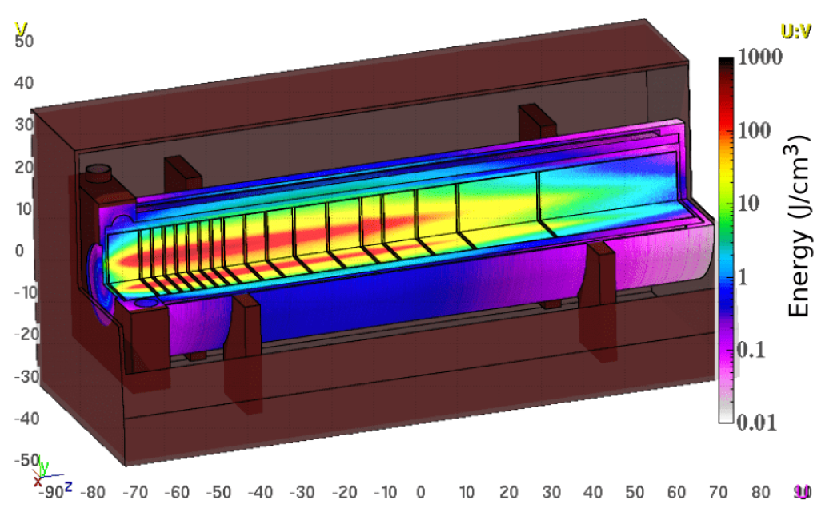
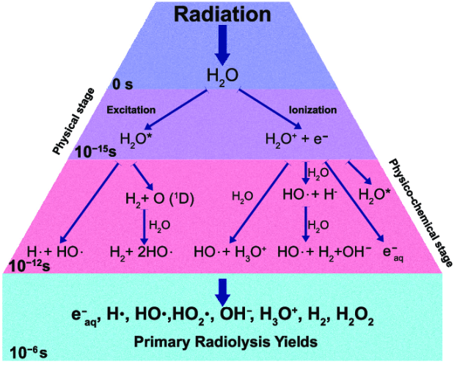
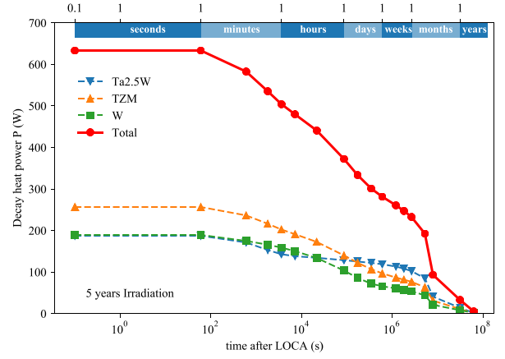
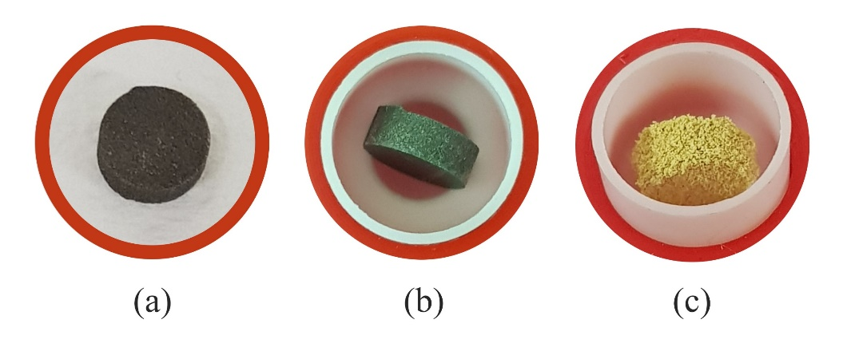
In search of an alternative design
Main motivations
Most of the shower develops on TZM and not on W → core could be further optimized for physics
Water in-beam promotes formation of radicals → safety concerns to be addressed or water removed
Decay heat on baseline target is considerable & driven by cladding. Possibility of LOCA (Loss Of Coolant Accident) poses a critical safety risk → Reduce Ta cladding
PIE revealed W quality to be poor → Look into more robust W supply
13 x TZM blocks
(580 mm)
5x W blocks
(780 mm)
400GeV/c p+ beam4x10¹⁹ POT
BDF Target water cooling layout (20bar, 5m/s)

Slide 11
Alternative designs: Nb-cladded
Baseline Design (CDR) – Water cooled, W + TZM cladded w/ Ta2.5W .
Pursued during the conceptual design phase
Prototype + test with beam + Post irradiation examination
Still some safety aspects to be addressed
Could be further optimized for physics
https://doi.org/10.1103/PhysRevAccelBeams.22.113001
Alternative designs currently being studied in the TDR
W Helium cooled Target
Removes water from beam
Better physics performance
Reduces decay heat & residual stresses
Conceptually different system!
Enclosed compact
Cu + W Target
Removes water from beam
Keeps physics performance
Reduces decay heat
Increases T and stress
Other concepts: Baseline with W rolled material, Nb-cladded Target,…

Slide 12
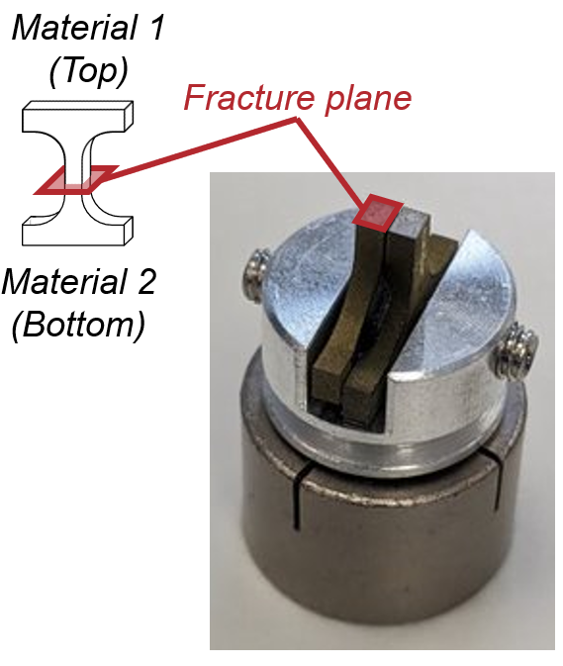
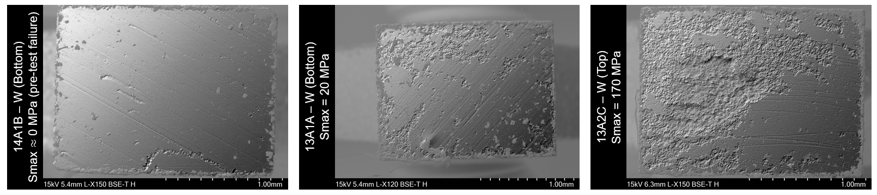
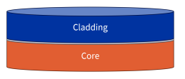
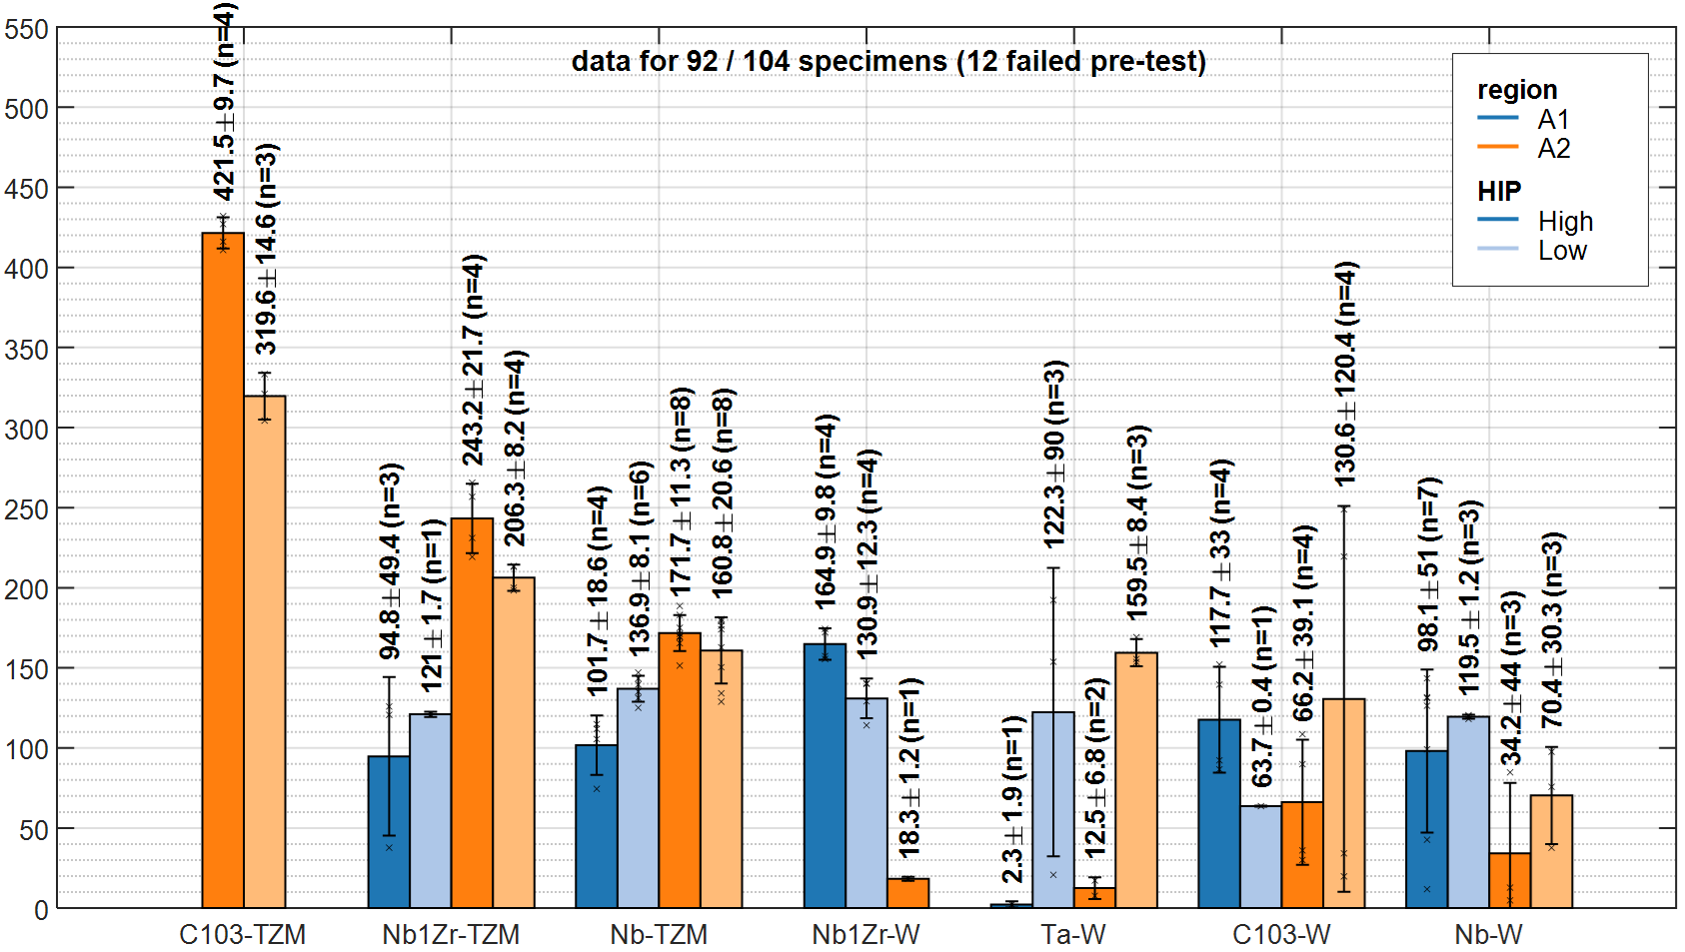

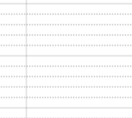
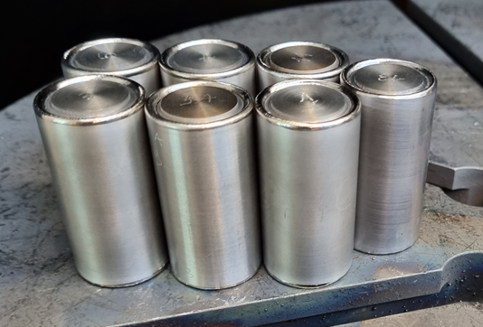
Nb-cladding R&D
Exploring diffusion bonding of niobium and its alloys with tungsten and a molybdenum alloy for high-energy particle target applications, T. Grisemer, R.F.Ximenes (to be published soon!)
Nb-cladding R&D
I. EBW of Capsules
II. Helium
Penetrant Test
III. 1st HIPing Cycle (1200 °C)
IV. 2nd HIPing Cycle (1400 °C)
V. Ultrasonic Testing
VI. Cutting & OM at interface
VII. Thermal Characterization
VIII. Mechanical Characterization
Thermal diffusivity specimens
  Excellent thermal contact has been confirmed for
  all Niobium alloys (Nb, Nb1Zr, C103)
Tensile specimens
  Interface strength for Nb alloys higher for TZM than W
  TZM core :
    Ta foil + HIP: High increased the strength
    C103 did not bond without the foil
  W core
    Higher variation, but it seems no foil increases interface strength
SEM: Increase of successful diffusion bonding / maximum stresses
TZM → C103 +
Ta foil + HIP:High
w/o foil + HIP:High
w/o foil + HIP:Low
Ta foil + HIP:High
Ta foil + HIP:Low
W → Nb1Zr +
no foil + HIP:High
UTS [MPa]
However, long-lived Nb isotopes pose challenges for waste disposal
TZM
W
*by courtesy of Bangor University

Slide 13
Alternative designs: W Helium cooled Target
Baseline Design (CDR) – Water cooled, W + TZM cladded w/ Ta2.5W .
Pursued during the conceptual design phase
Prototype + test with beam + Post irradiation examination
Still some safety aspects to be addressed
Could be further optimized for physics
https://doi.org/10.1103/PhysRevAccelBeams.22.113001
Alternative designs currently being studied in the TDR
W Helium cooled Target
Removes water from beam
Better physics performance
Reduces decay heat & residual stresses
Conceptually different system!
Enclosed compact
Cu + W Target
Removes water from beam
Keeps physics performance
Reduces decay heat
Increases T and stress
Other concepts: Baseline with W rolled material, Nb-cladded Target,…

Slide 14
BDF W Helium cooled Target
17 to 740 mm
Ø250mm
to
Ø362mm!
Helium cooled blocks (without cladding)
Removes the high stress regions of the baseline design (Ta cladding)
Allows higher surface block temperatures (no risk of boiling)
Removes radiological concerns with the water
All core material is W (good for physics)
- But HTC is lower
- New cooling system complexity and cost
Gaps 4mm
W
P+
BDF He system parameters
Thermal Power | 305 kW
Inlet Pressure | 16 bara
Pressure Drop | <2 bar (high estimate)
Mass flow | 345 – 400 g/s
Volume flow | 0.13 -0.15 m³/s
Inlet temperature | 30 °C
Outlet temperature | 200-170 °C
Heat transfer coefficient | 1000-2000 W/m²/K
BDF Target. Coolant by Gaseous helium, ~200m/s.
3 or 4 channels in parallel.
 | ESS at 2012CDR | BDF | LBNF at 2023
Inlet Pressure | 3 bar | 16 bara | 4.5 bar
Swept vol. flow rate | 4.6m³/s | 0.13-0.15m³/s | 0.076m³/s
Target deposited heat | 3MW | 305kW | 35kW
14

Slide 15
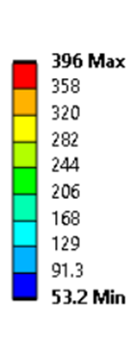
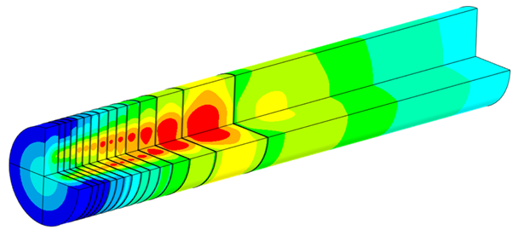
BDF W Helium cooled Target
Operational conditions
Temperature (°C)
BDF operational conditions
Target design lifetime | 5 years
Max dpa | 1.6 to 1.2
Max He implantation | 220 to 143 appm
Max stresses | 150MPa
Max bulk temperature | 400°C
Max W-to-He surface Temperature | 350°C
Beam parameters | Same as for Baseline, except beam size
P+
18 x W blocks (~1.5mm)
15

Slide 16
BDF W Helium cooled Target
Design approach
Cooling station & target have been considered together for system temperatures and pressures
Design approach has included Defining Design limits
  Stress
  Fatigue
  Block Temperature
  Surface temperature (e.g. limited oxidation)
  Irradiated properties
Applied these limits to target block position optimisation
Used safety margins >2 on irradiated (degraded) material properties at 2dpa. <2dpa expected)
Extrapolation and rule-of-thumb factor used to obtain irradiated fatigue limits due to lack of data
Limited by Stresses
Limited by Surface Temperature
Limited by Stresses
Whole target
16

Slide 17

BDF W Helium cooled Target
Target Options being Considered
Beam Sigma & sweep radius
16 mm vs 8 mm (baseline)
50 mm sweep radius
Core geometry
Full 360 ° disks
45° 1/8th target slices
Helium Pressure
Recently moved to 16 bar due to compressor availability, size, cost and complexity
Benefits for stress and fatigue
Requires slightly larger diameter core for physics
To be seen if compatible with beam dilution system
Full target
1/8th target
1/8th target requires diagonal cuts to prevent shine path (effective but adds complexity)
Or offset cuts (less effective)
Nominal gaps <0.5mm
Beneficial for target pressure drops
Lower than CDR design at 22bar
17

Slide 18
*“Application of hot isostatic pressing (HIP) technology to diffusion bond refractory metals for proton beam targets and absorbers at CERN, ” J. Descarrega et al.; Material Design and Processing Communications. 8 August 2019 https://doi.org/10.1002/mdp2.101
BDF W Helium cooled Target
The Core blocks
W sheets, HIPed together with interlayers of ~50um Ta foil (or other – to be explored)
  → Improved mechanical properties compared to Sintered blocks used for CDR.
Using W sheets thickness 10mm ±5mm
  → As thick as reasonably possible with the best mechanical properties.
Ta interlayer foil
  → builds on previous HIPing experience*
Options of joining being investigated:
  Hot Isostatic Pressing
  Vacuum Hot Press (used at SNS)
  Spark Plasma Sintering (used at SY)
  Tungsten Powder Injection Molding.
  Electron Beam Tungsten Rapid Prototyping
Ta capsule (or e.g. SS)
Capsule may be partially/fully machined away after HIPing.
W Sheets
50um Ta interfoil (or other)
Helium coolant
Full encapsulation
Circumferential encapsulation
No encapsulation
Drivers:
Must be clad for HIPing joining process
Don’t want cladding: high stresses at the cladding
Don’t want cladding: Ta produces lots of decay heat
Do want cladding at circumference: Compressive stresses beneficial to W sheets
Do want cladding : Protective layer against oxidation / corrosion-erosion

Slide 19
a
BDF W Helium cooled Target
Ongoing Material Studies
Exact tests and number of tests currently being defined
Testing will be performed on
  The raw W sheets
  The joined blocks (similar to the baseline prototype after HIPing tests)
  The joined blocks post-beam (similar to the baseline prototype tests)
  In depth testing from 1 supplier & basic characterization from 2 more suppliers
- Raw W sheets

Slide 20
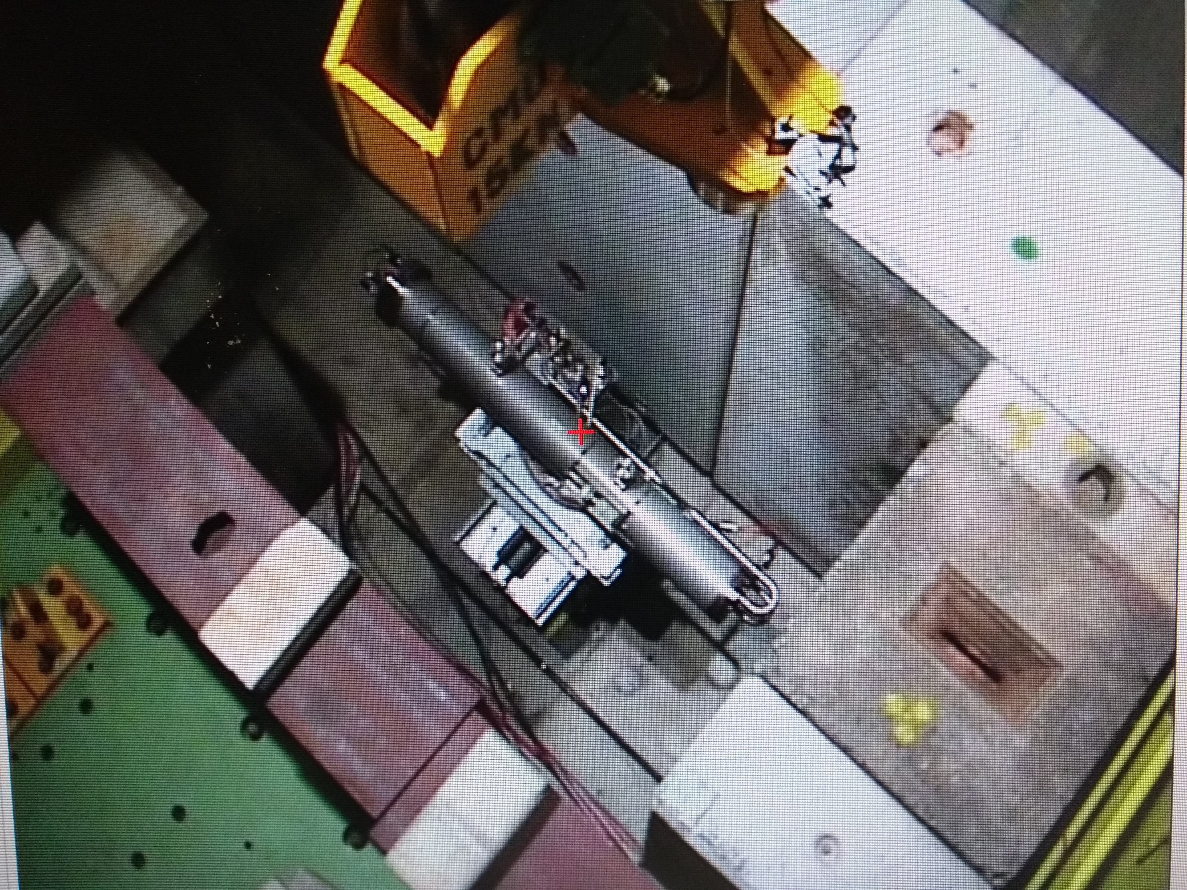
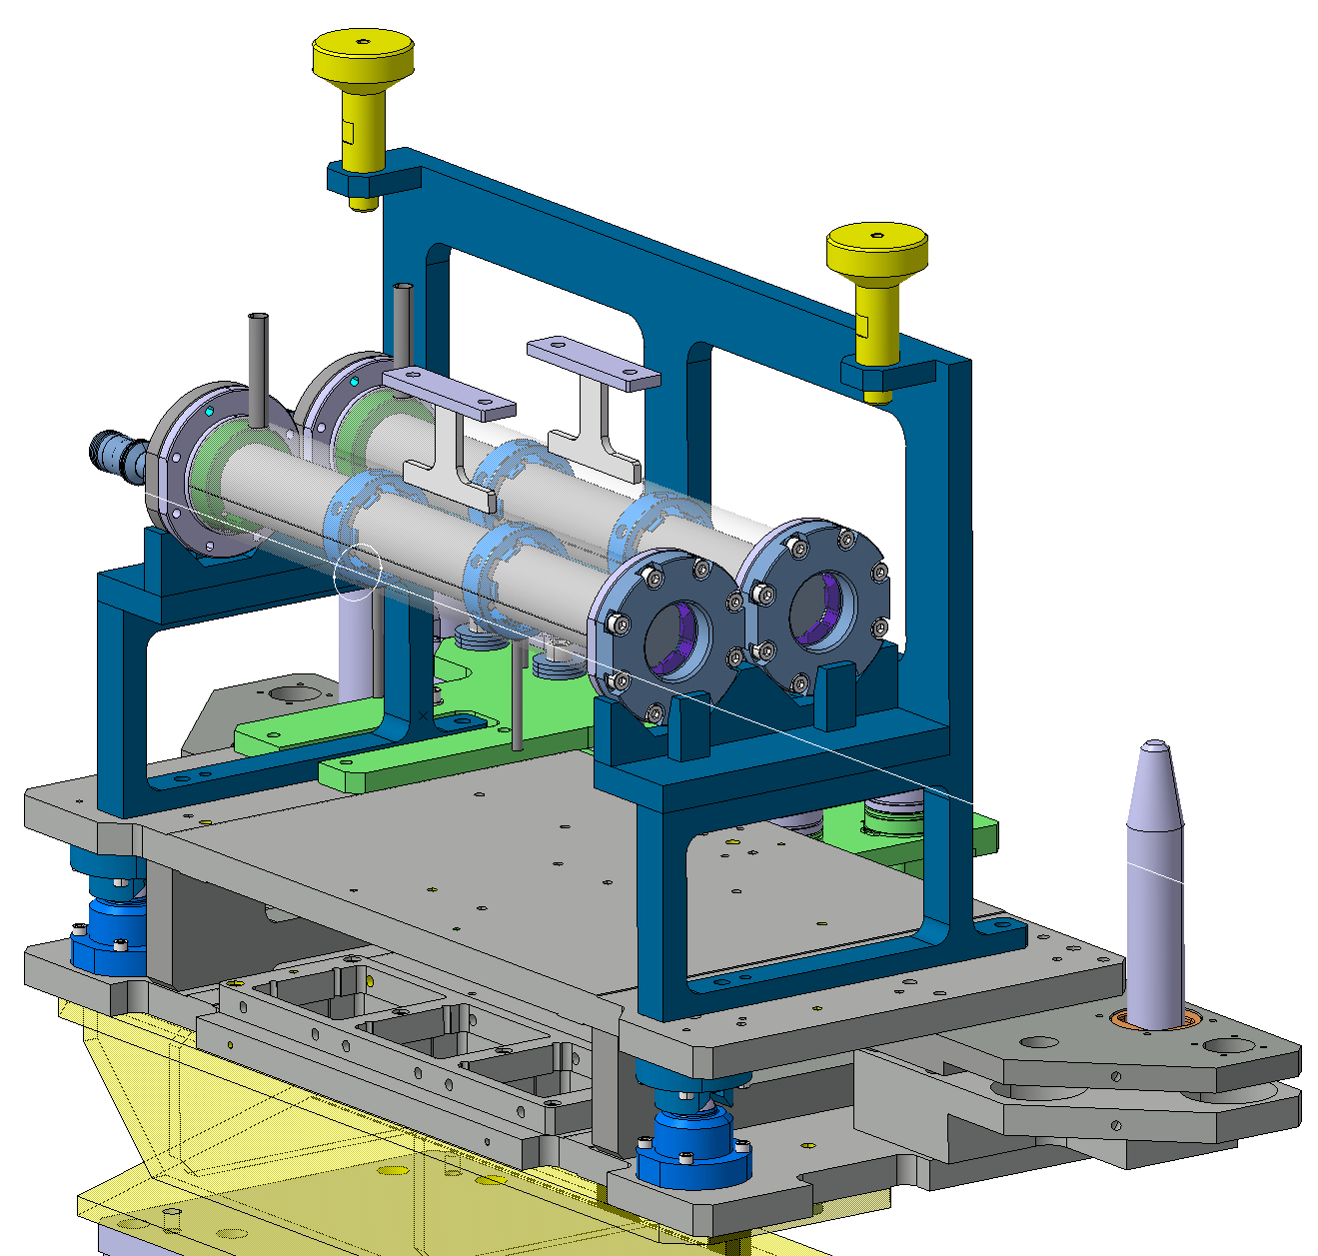
Prototype target design
BDF W Helium cooled Target
Prototype target
To be constructed and tested in North Area T6 on the existing test stand base
Reproduce temperatures and magnitude & type of thermal-induced stresses
Post-beam testing of mechanical properties and interfaces will be performed
Potential to cross-check simulations
Coolant efficiency could be tested on a separate non-beam mock-up
If time allows, two targets will be tested:
  Static Helium concept** & actively cooled He concept
  3rd option: Water cooled concept (niobium cladding, copper sheets, copper external… TBD)
**In the event of no delay to the North Area long shutdown, the timescale is not possible to have a flowing helium circuit installed and commissioned before the prototype tests…

Slide 21
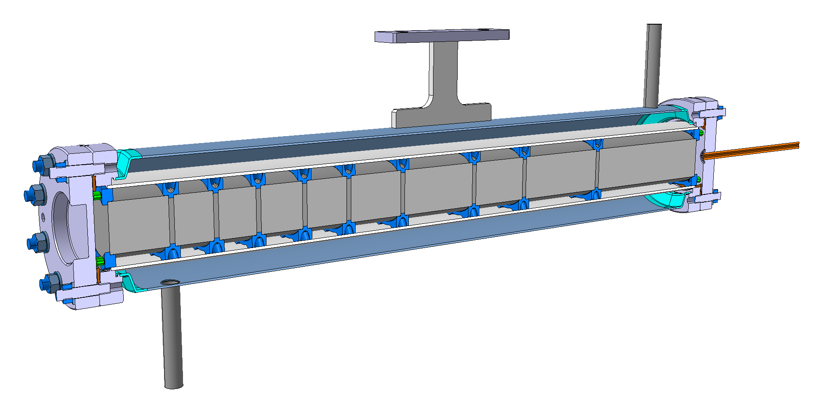
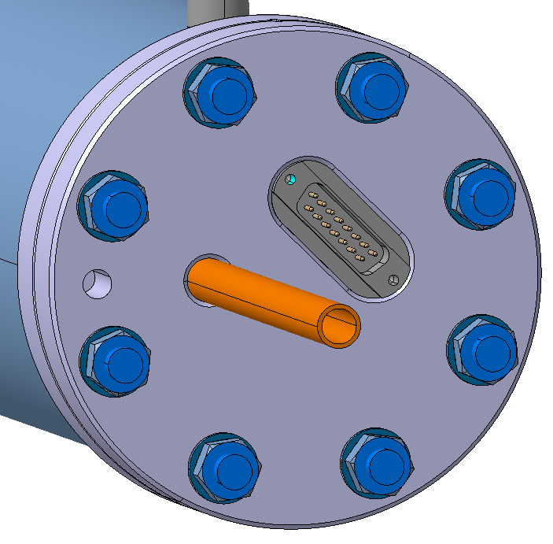
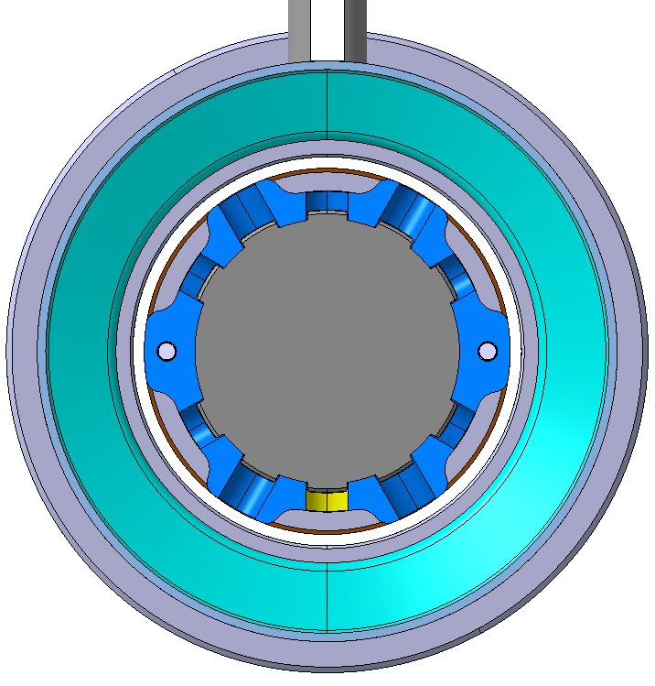
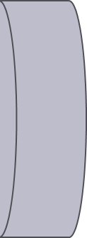
Prototype target design
BDF W Helium cooled Target
Prototype target
Static Helium concept (baseline for now)
W in static Helium. Cooled with a water jacket
Block spacing defined to match maximum stresses and temperatures and stress type.
  Challenge with static gas. Requires a LONG cycle time = 7.2 minutes, with intensity 1.5e12 ppp.
Beam parameters considered: Beam σ 1mm to 3mm, Intensity 5e11 to 2e13 ppp
Coolant: flowing water
Steel can
Static helium
Mix of semicircle and full circle blocks
Semi-circle blocks better reproduce stress state of 1/8th target slices.
Full circle blocks better reproduce the stress –state of the 360° target.
W
Core ø50mm
600mm

Slide 22
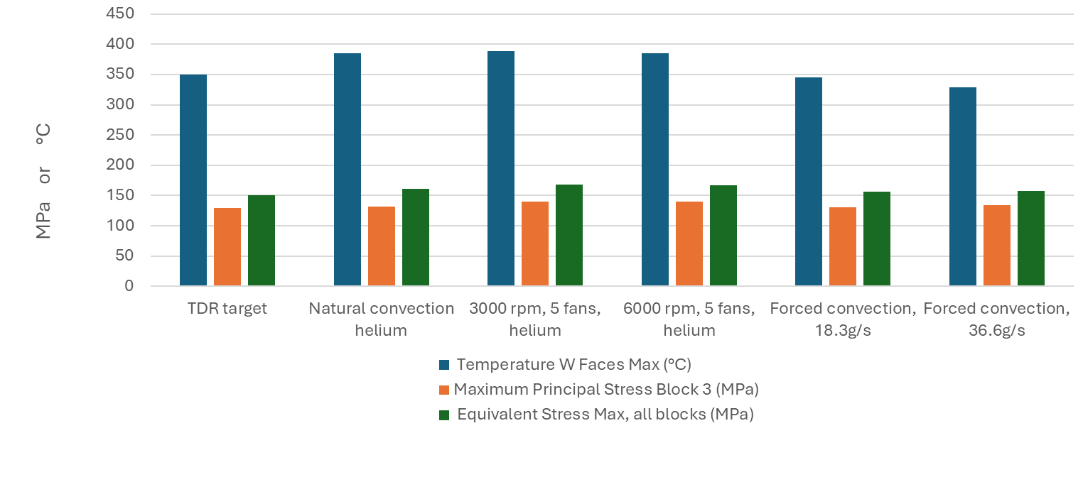





Prototype target design
BDF W Helium cooled Target
Prototype target
Static Helium concept (baseline for now)
P+
HTC 10
1.3e12ppp. 720s/c
Temperature (°C)
Max P stress (MPa)

Slide 23

Prototype target design
BDF W Helium cooled Target
Outgassing
One of the main concerns into moving to a W He-cooled target operating at high temperature is the outgassing of radioactive species.
Being studied:
Shortlisted highest contributors in terms of total activity, LL and LA as computed by RP
Assume radioactive isotope as volatile if it makes one chemical compound which is reported as volatile (due to boiling or sublimation) below 500 °C
  Usually containing O, N, H (oxides, nitrates, nitrides, hydrides and hydroxides)
Some conflicting data, e.g. on W trioxide.
Other species of concern such as iodine which can make volatile molecules with Cobalt, Hafnium and Tantalum. ?
→ Plan to execute offline oxidation tests
→ Plan to execute irradiation and out-diffusion measurements

Slide 24
Conclusions & outlook
A water-cooled baseline design exists with a core of TZM and W.
Sound design, yet with potential for physics optimization and with some radiation protection caveats
W material quality used in the 2018 prototype was not good
Following HI-ECN3 project approval and start of TDR phase
Multiple alternative designs explored in view of mitigating water radiolysis, decay heat and improve physics performance.
He-cooled target most promising option. Being explored in detail.
Presently tackling
  Definition of core segmentation taking key metrics and safety margins
  Material R&D for the W base material and bonding of the assembly
  Detail design of a prototype to be tested with beam in 2025/26
  Design of the cooling station (Francesco and Nikola’s talks)
  Addressing Radiation Protection aspects (Claudia’s talk)
  Many other points to be addressed in the coming months

Slide 25
Questions to ESS (1/2)
What safety factors (e.g. mechanical, thermal, cooling etc) have been chosen for the engineering studies of the target blocks?
What is the W material used at ESS and what quality assurance plan was adopted?
How has fatigue been assessed (both numerically and via testing)?
Are there erosion concerns?
Are there oxidation & spall concerns?
Is radiation damage and gas production a concern at ESS?
What radiochemistry is a concern (e.g. from volatile compounds from the irradiated W) and has been particularly addressed, and why?

Slide 26
Questions to ESS (2/2)
How significant is decay heat and LOCA for ESS Target?
What are the redundancy systems and measures put in place for LOCA?
What instrumentation is used to monitor the target and its core ?
What design & manufacturing specifications have been adopted for the target assembly and that were mostly driven by the presence of a He coolant ?
Considering today’s status of the He-cooled pure W target for BDF, what recommendations can you provide?
Many thanks!

Slide 28

WP3 – Target & BIDs: Planning (key dates)
TDR phase
Production phase
Commissioning & operation
TDR phase (main activities) – (2024-mid 2026)
Target (& BIDs) conceptual design followed by detailed design
Prototype(s) Target Design, construction and beam tests
Material studies, R&D and Procurement
Production phase – (2026 – 2030)
Detailed Design phase
Procurement & production of components and systems
Tests/dry-run, installation activities
Material tests/PIEs

Slide 29



Enclosed compact Cu + W Target
beam
Cu+W target :
Removes water from beam path (radiolysis)
Keeps physics performance
Reduces decay heat
Increases T and stress
Cu-SS HIP bonding for the SPS internal dump (TIDVG5)
29

Slide 30
Main Target developments in the coming months
Focus on W quality assurance
W via rolled products to ensure low porosity (low brittleness),and high mechanical properties
Material R&D on W to W bonding and characterization of interface strength
Further develop alternative target concepts, particularly He cooled option
Understand & design such He cooling system
Design Target core than can withstand higher temperatures and reduce mechanical stresses
Develop prototype Target(s) to be tested at CERN SX test-bench in 2025

Slide 31

BDF – New ideas to be explored in 2024

Slide 32

Ta2.5W cladding – LOCA
(Loss-of-Coolant Accident scenario) LOCA hypothetical scenario used as a criterion for assessing the safety of a nuclear installation during its design phase.
→ Strong implications on the classification of the facility.
Thermo-mechanical simulations to determine the temperature evolution of the target in a 2 years scenario after the accident.
Depending on the assumptions, T > 300 C may be reached for prolonged periods ((O)weeks)
Mena R., Ximenes R.F. and Calviani M. (2022), Loss-of-Coolant-Accident study for the Beam Dump Facility at CERN, NURETH-19 Conference

Slide 33





Ta2.5W cladding – LOCA
Visual inspection of the samples before and after oxidation for different temperatures.
Raw sample
800 °C at 2 °C/min
800 °C at 40 °C/min
Potentially degradation of the material through oxidation with LOCA.
→ Campaign to assess the onset for extensive oxidation and formation of volatile oxides
Thermogravimetric analyses (TGA) performed for Ta2.5W, TZM and W in the range of 400-800 C under active and inert atmospheres.
Inert
Atmosphere
(argon 6.0)
Ta2.5W
400 °C
500 °C
600 °C
700 °C
TZM
Active
Atmosphere
(50% argon: 50% air)
r1 = 10
r2 = 2
r3 = 40
[°C/min]
W
r1 = 10
r2 = 2
r3 = 40
[°C/min]
400 °C at 10°C/min x 7 days
800 °C at 2°C/min
Notes:
Small mass gain for Ta2.5W at 400C with inert argon (with some impurities)
Clear oxide layer at 500 C

Slide 34




Nb-alloys cladding R&D
Residual stress
Presence of residual stresses (RS) during the manufacturing of the target blocks via Hot Isostatic Pressing (HIPing).
RS defines the onset for plastic deformation and eventually material failure
Purpose: quantify the RS in the BDF target blocks
Contour method* employed to measure the RS in the BDF target blocks. Ongoing FE model calibration.
* Prime, M. B., 2001, Cross-sectional Mapping of Residual Stresses by Measuring the Surface Contour After a Cut, Journal of Engineering Materials and Technology 123(2):162–168
The contour method and its different steps to obtain the residual stresses. Adapted from [StressMap 2018]
Resulting left and right parts after EDM cutting (Top) Block 3 and (Bottom) Block 4
Average flatness measurements of the resulting surfaces
(Top) Block 3 and (Bottom) Block 4

Slide 35






BDF Target Prototype removal (2020)
Unplug-in  Transport to the bunker  Unscrew downstream flange  Instrumentation wire cut & flange removal  Extraction half-shells core assembly  Unscrew half-shells  Removal top half-shell & first glimpse of the target blocks
BDF target assembly

Slide 36




BDF Target Prototype removal (2020)
Identification of the blocks and angular orientation with respect to the beam with a marker  Removal of the target blocks for the post irradiation examination (PIE) campaign  Storage of the extracted blocks in a shielded container

Slide 37


NA62 in ECN3 (Today)
T10 target, K12 beamline and NA62 experiment to be dismantled in LS3
T10
Target
T10
XTAX
Existing
Access Shaft
4$×$8 m²
K12 beam line
B911
B918
TCC8
ECN3
Introduction to the BDF / HI-ECN3 Project - Discussion with JPARC T2K team

Slide 38
BDF/SHiP Target & Complex (Future ~ 2030)
Baseline Design → To be improved during TDR
WP4
350 kW-class Target
WP3
13 x TZM blocks (580 mm)
5x W blocks (780 mm)
New
Service Building
~ 500 – 700 m²
New
Access Shaft
(material only)
8$×$8 m²
Existing
Access Shaft
4$×$8 m²
B911
B918
Beam Dilution System
TCC8
WP2
WP4
ECN3
WP6,WP7 +al.
New Target Complex
containing the Beam Dump Target
WP5+SHiP

