Slide 2
HI-ECN3 Target complex
CERN – ESS exchange Lund 20th September 2024
Jean-Louis GRENARD - CERN - HI-ECN3 WP4 Target complex

Slide 3
What do we call Target Complex?
The target area
  Target station which contain the target
  Associated shielding
  The space to perform target maintenance activities (inspections, replacement, repair…)
  Remote handling equipment (crane, spreaders, mobile robots)
  Confinement(s)
The target service building
  Air handling units
  Cooling stations
  Controls systems
  The space to perform preparation for target (and other activated components) final disposal and possibly post irradiation examination

Slide 4
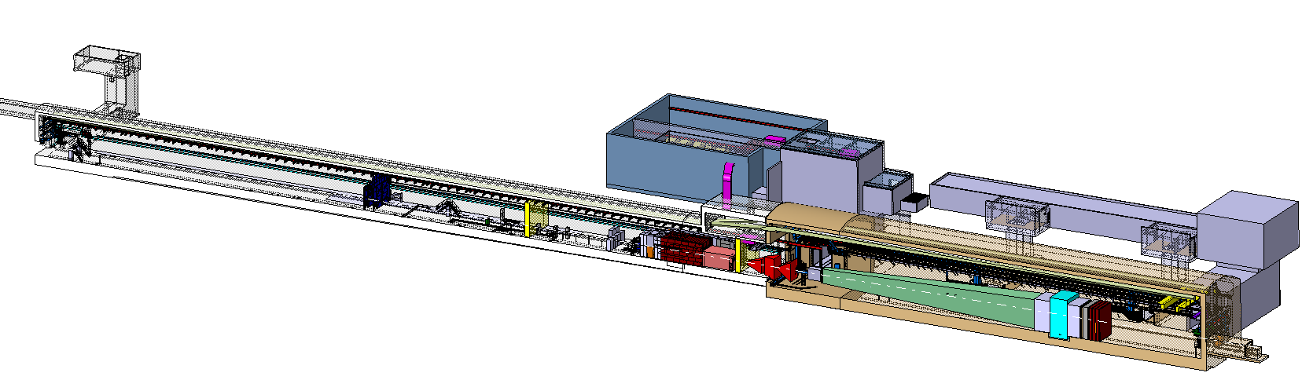
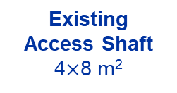
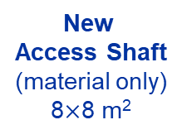
BDF/SHiP Target & Complex
New
Service Building
~ 1000 m²
New
Access Shaft
(material only)
8$×$8 m²
Existing
Access Shaft
4$×$8 m²
B911
B918
Beam Dilution System
TCC8
New Target Complex
containing the Beam Dump Target
ECN3

Slide 5
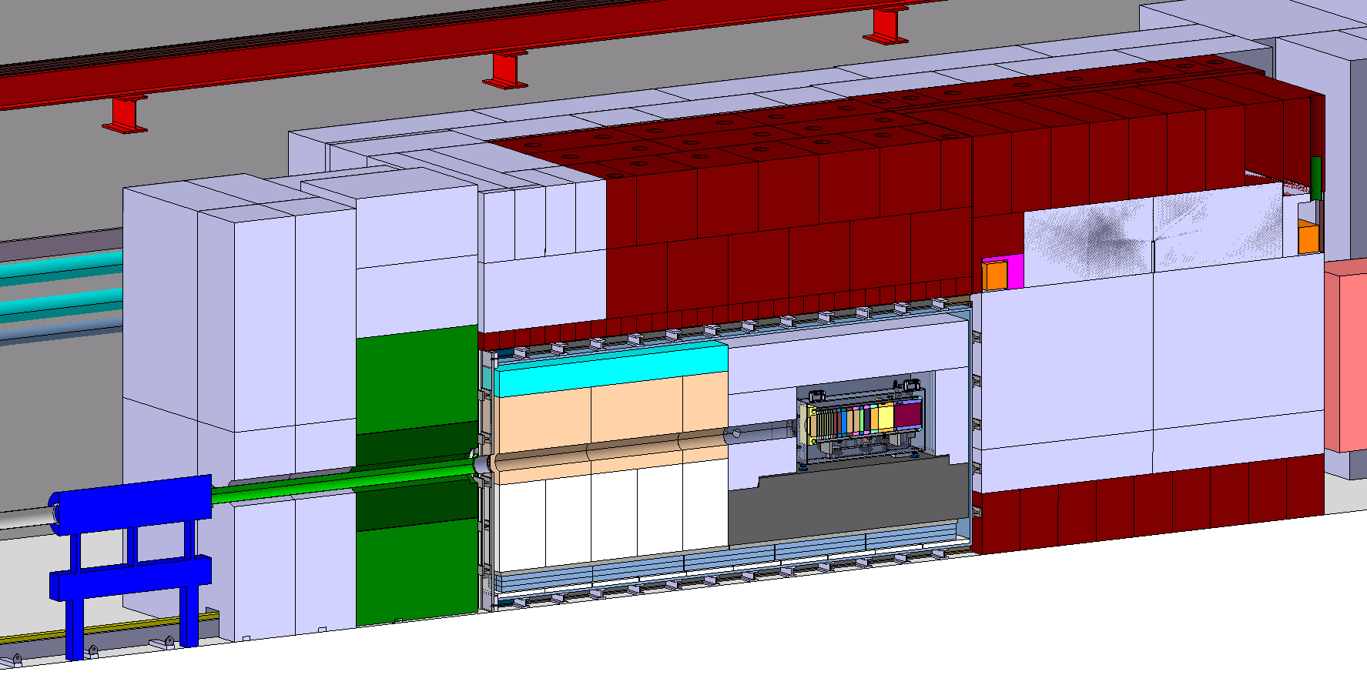
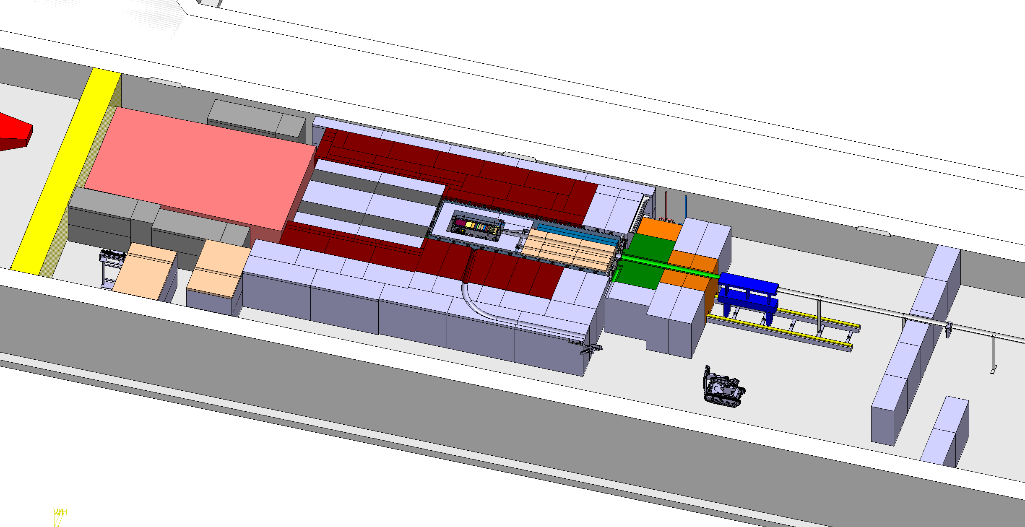
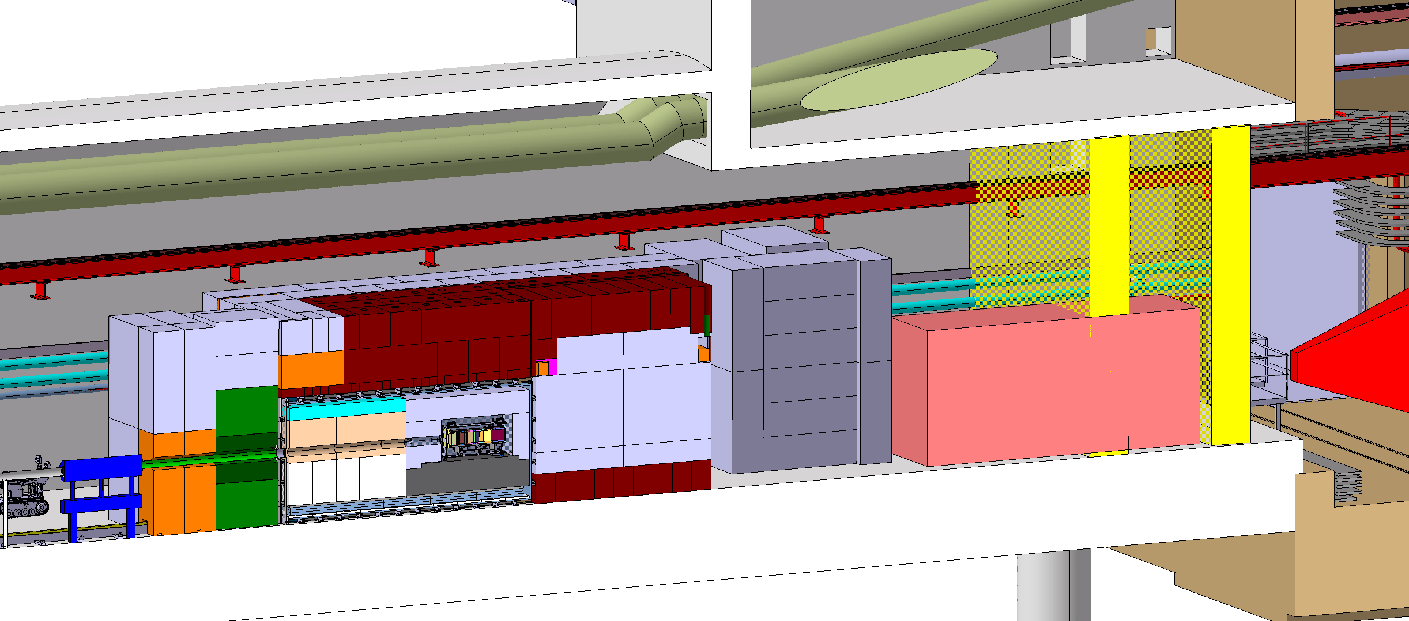
BDF Target complex integration
Upstream Shielding
Above Coil Shielding
Target area
Confinement wall
Magnetized
shielding
Beam instrumentation
Diluted Proton beam from SPS
Water cooled proximity shielding
Mobile Shielding
Vacuum confinement
Target
Collimator
Target station
SHIP experiment
Access chicane
Space for shielding temporary storage

Slide 6
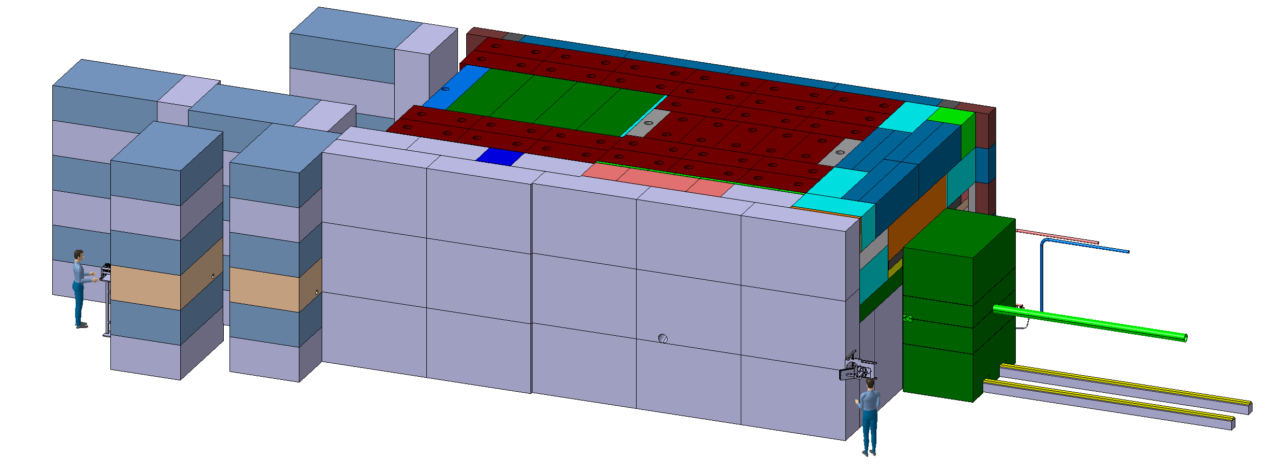
BDF Target complex integration - shielding
~4,8m
~8m
~ 180 m³ (~1400t) of cast iron + US1010
~ 360 m³ (~800t) of concrete / marble
~12m

Slide 7
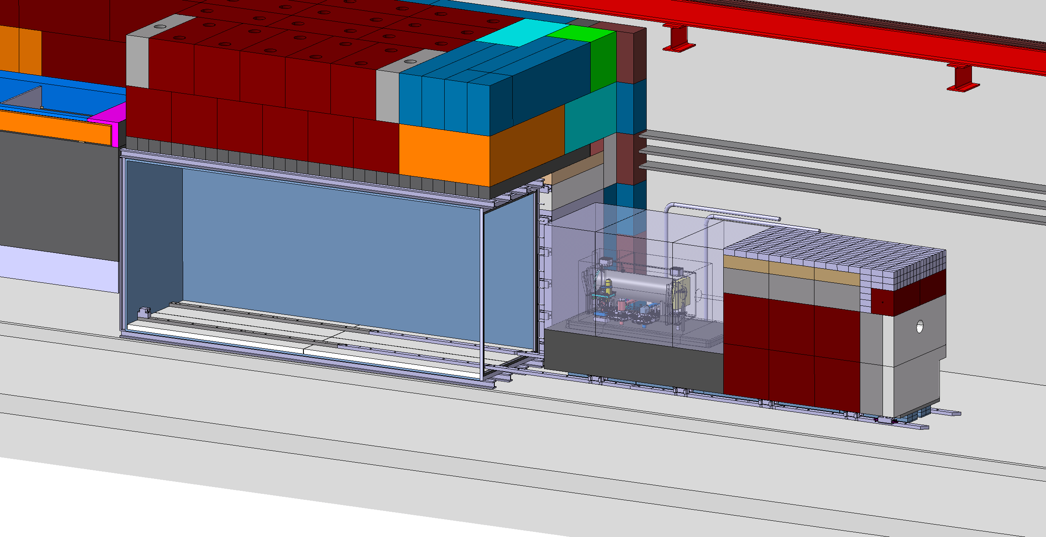
BDF Target complex integration extraction
Concept similar to the ISIS target station

Slide 8
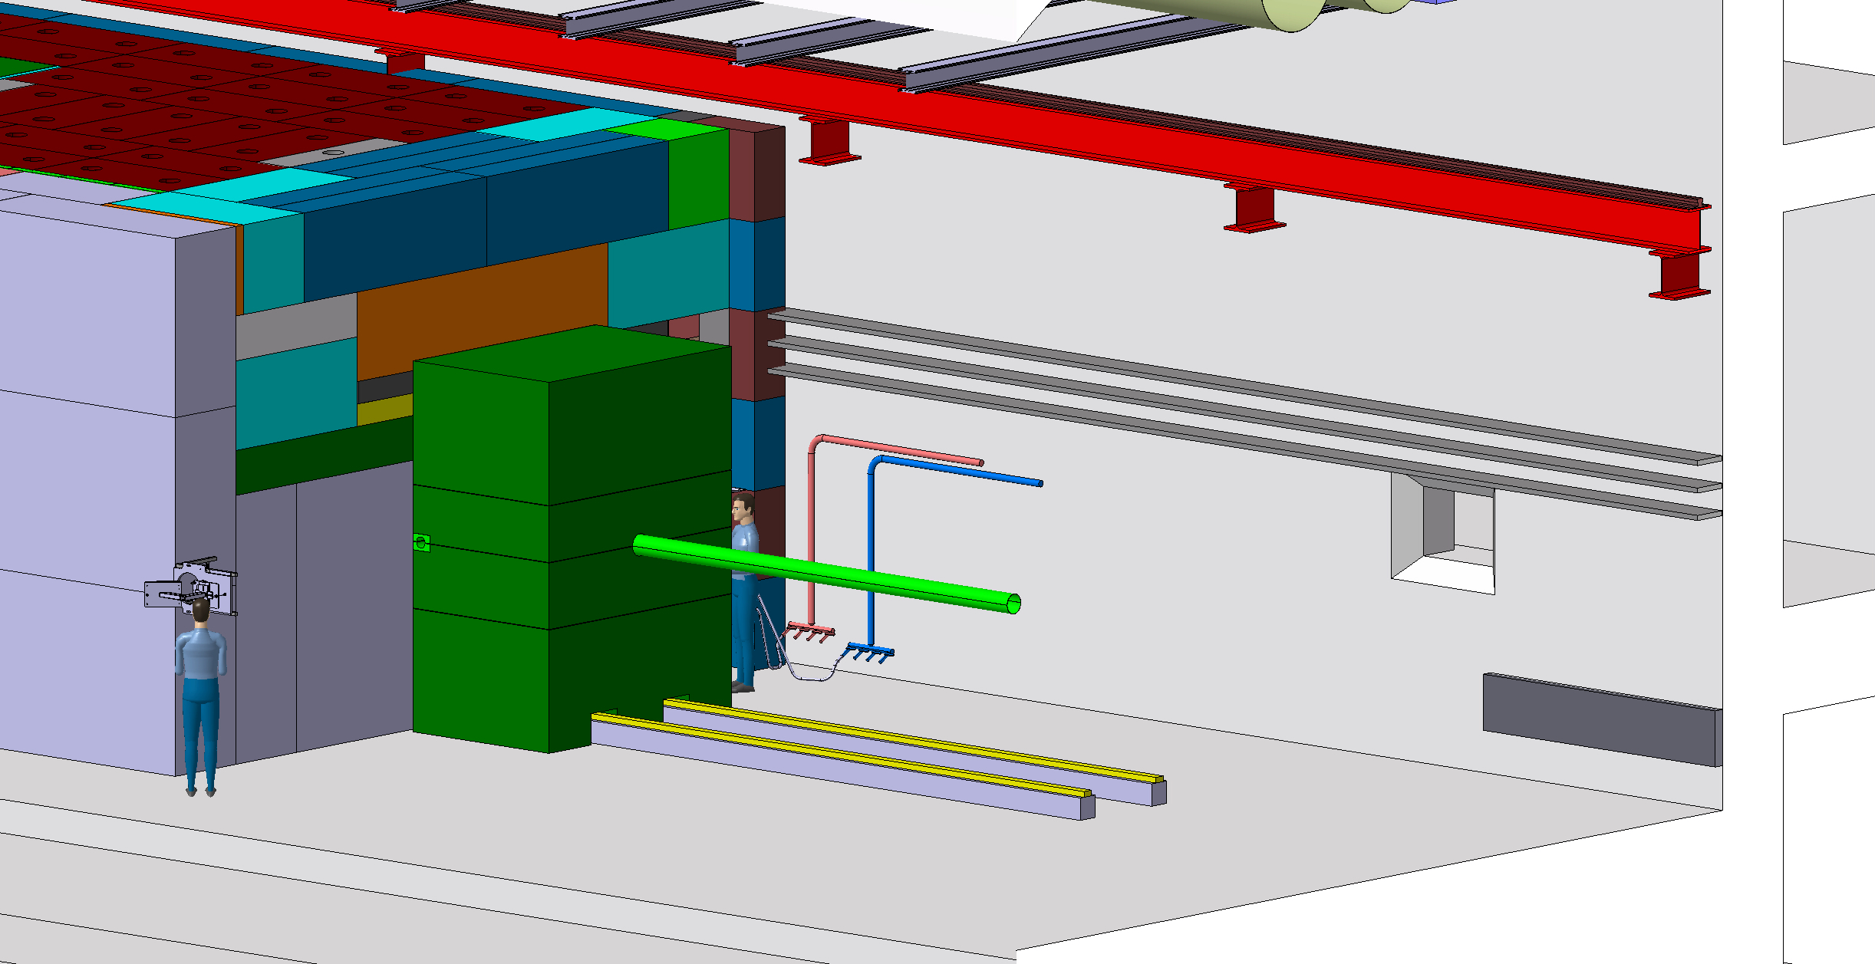

Slide 9
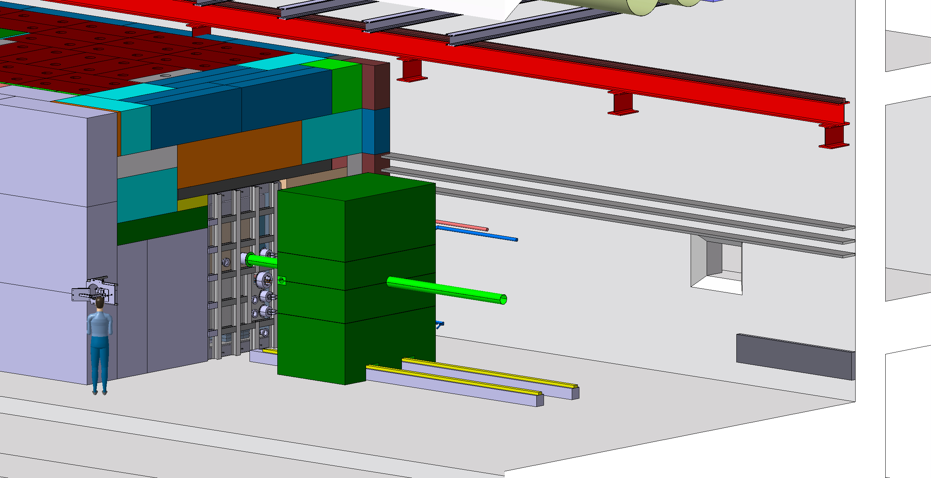

Slide 10
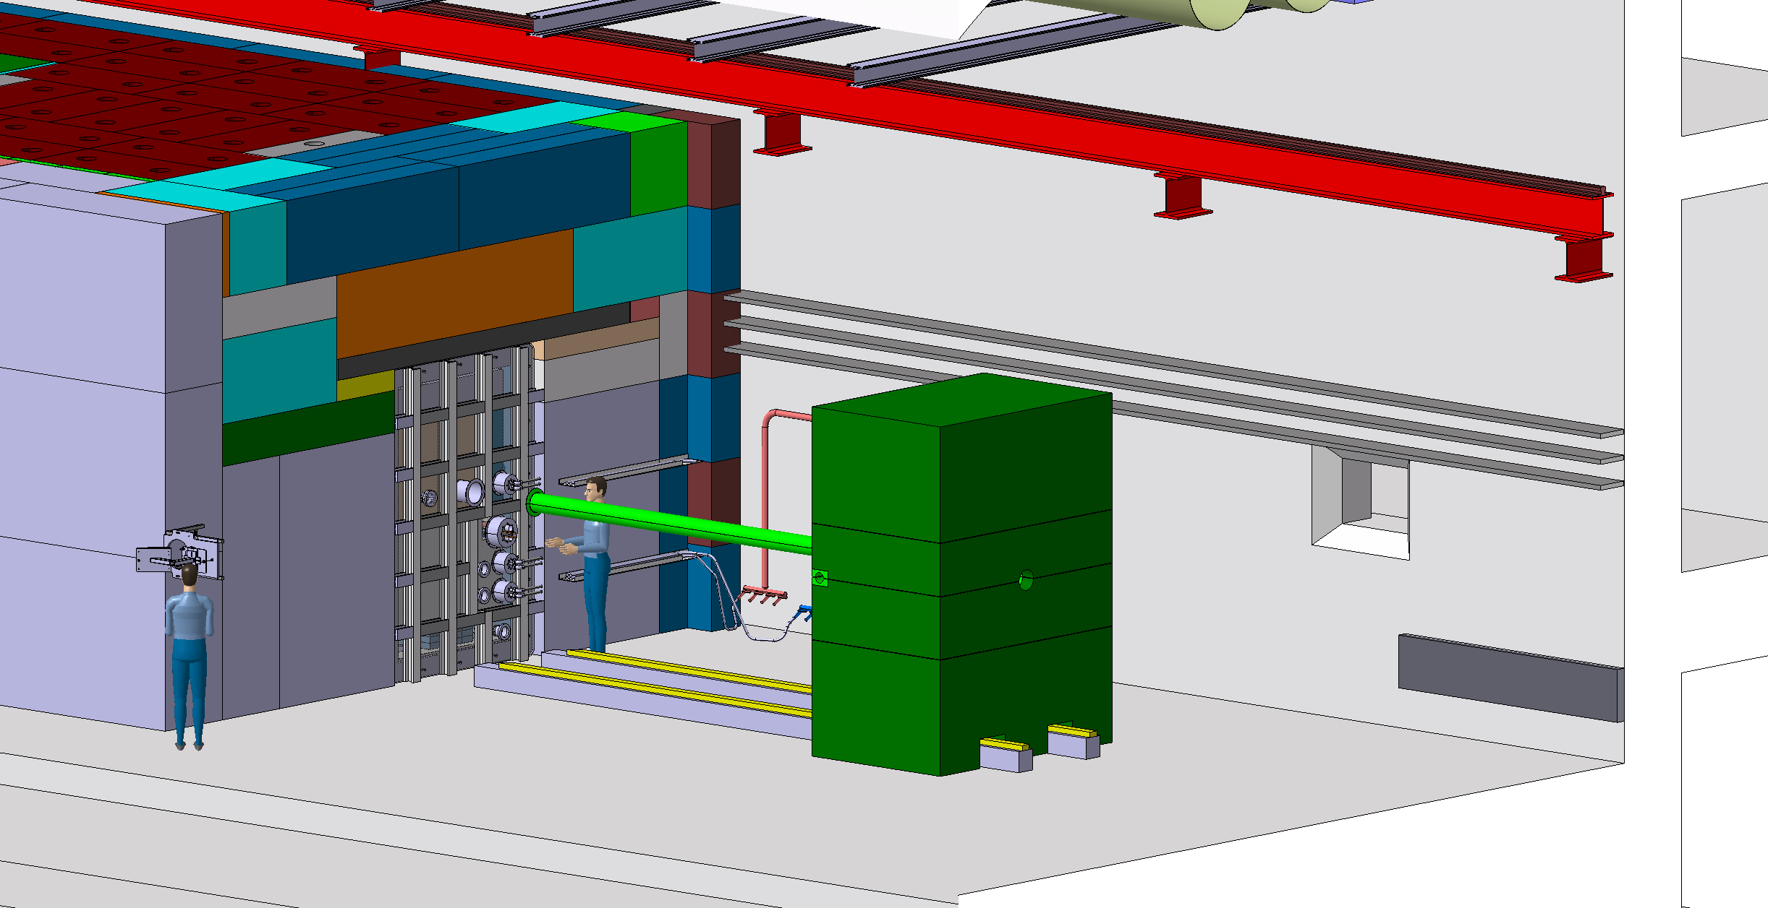

Slide 11
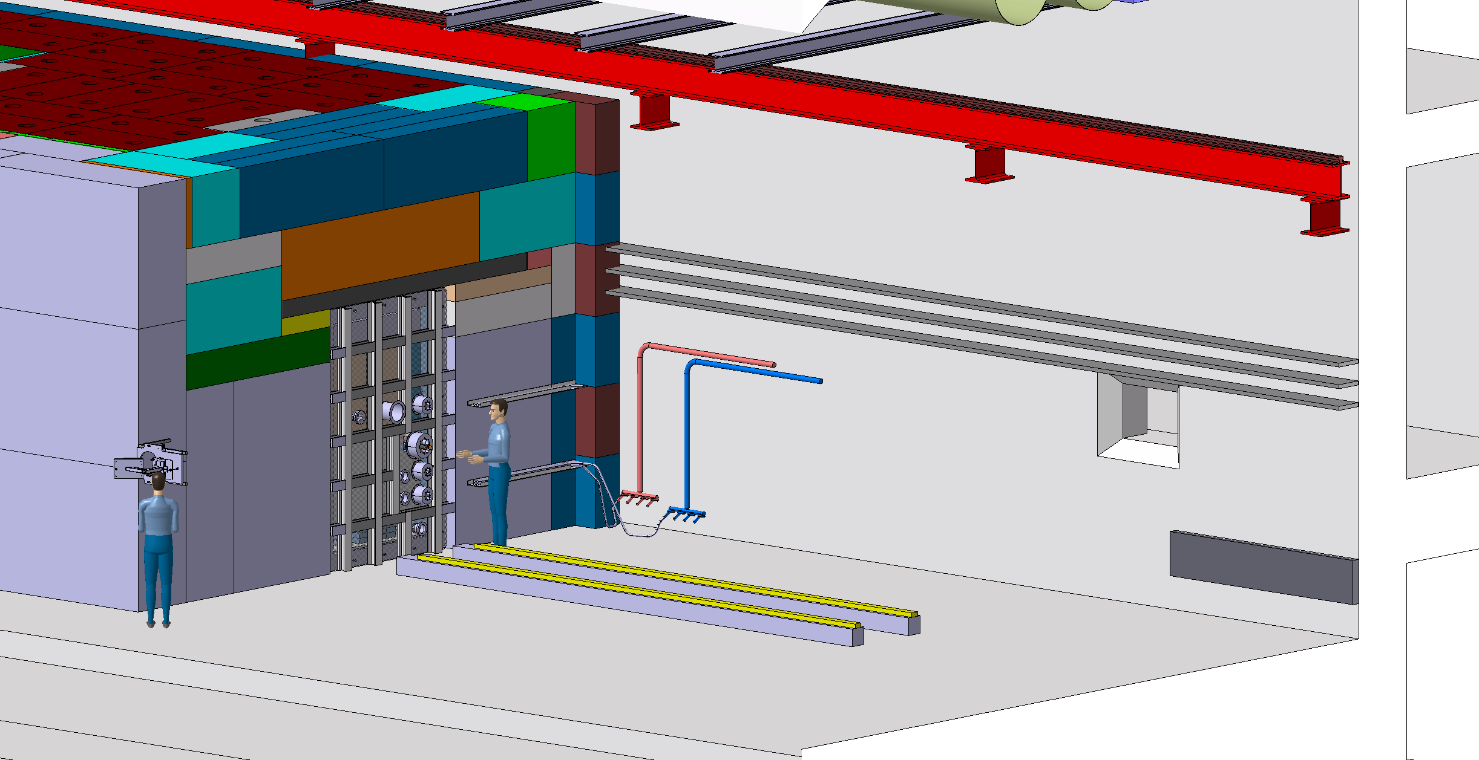

Slide 12
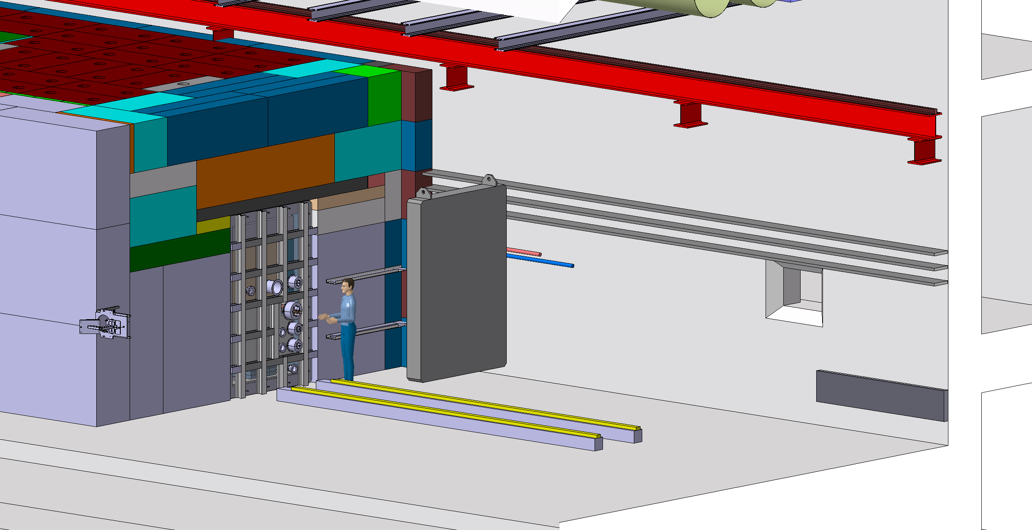
Installation of lifting tool
which include shielding

Slide 13
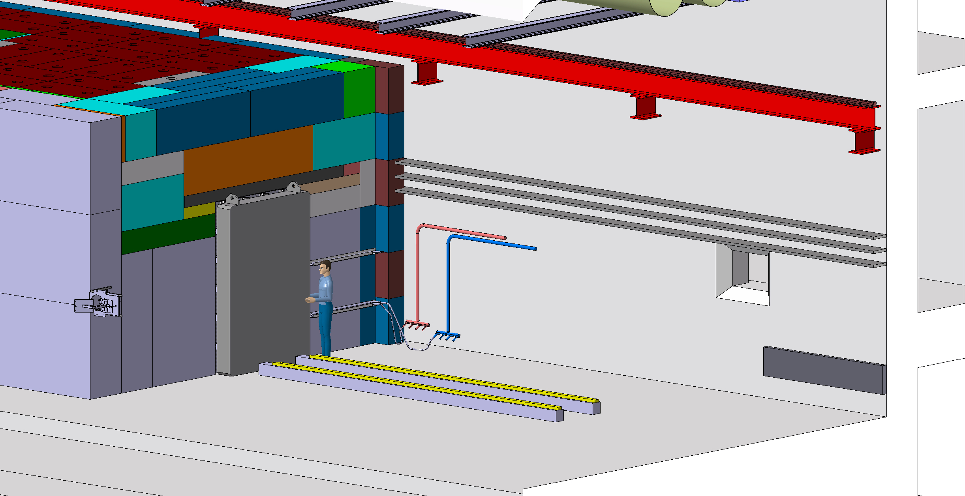

Slide 14


Slide 15
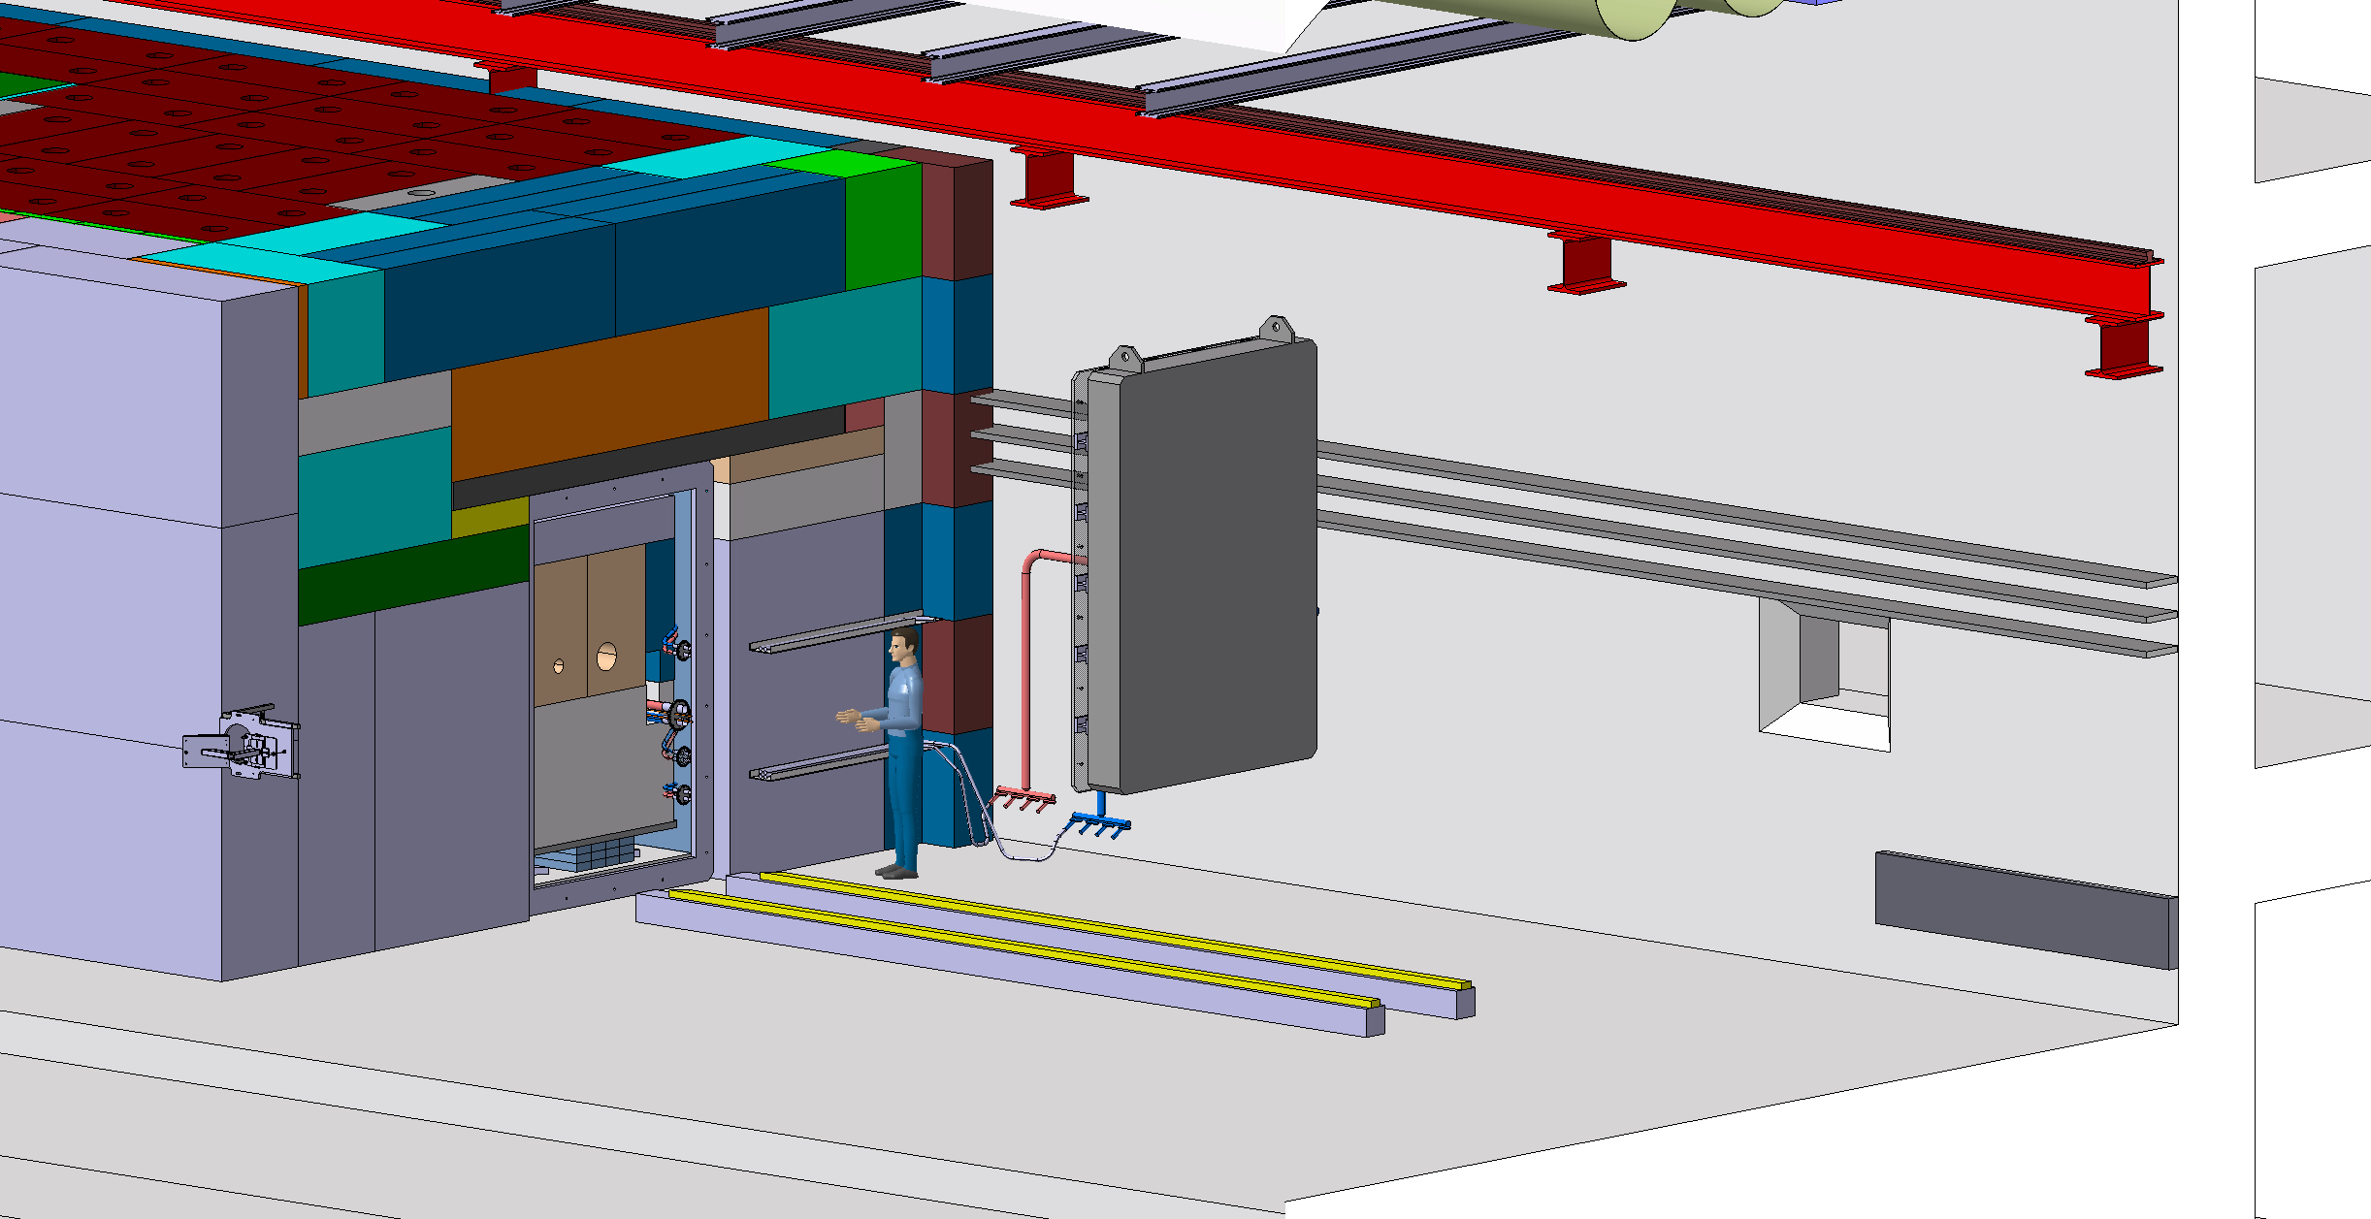

Slide 16
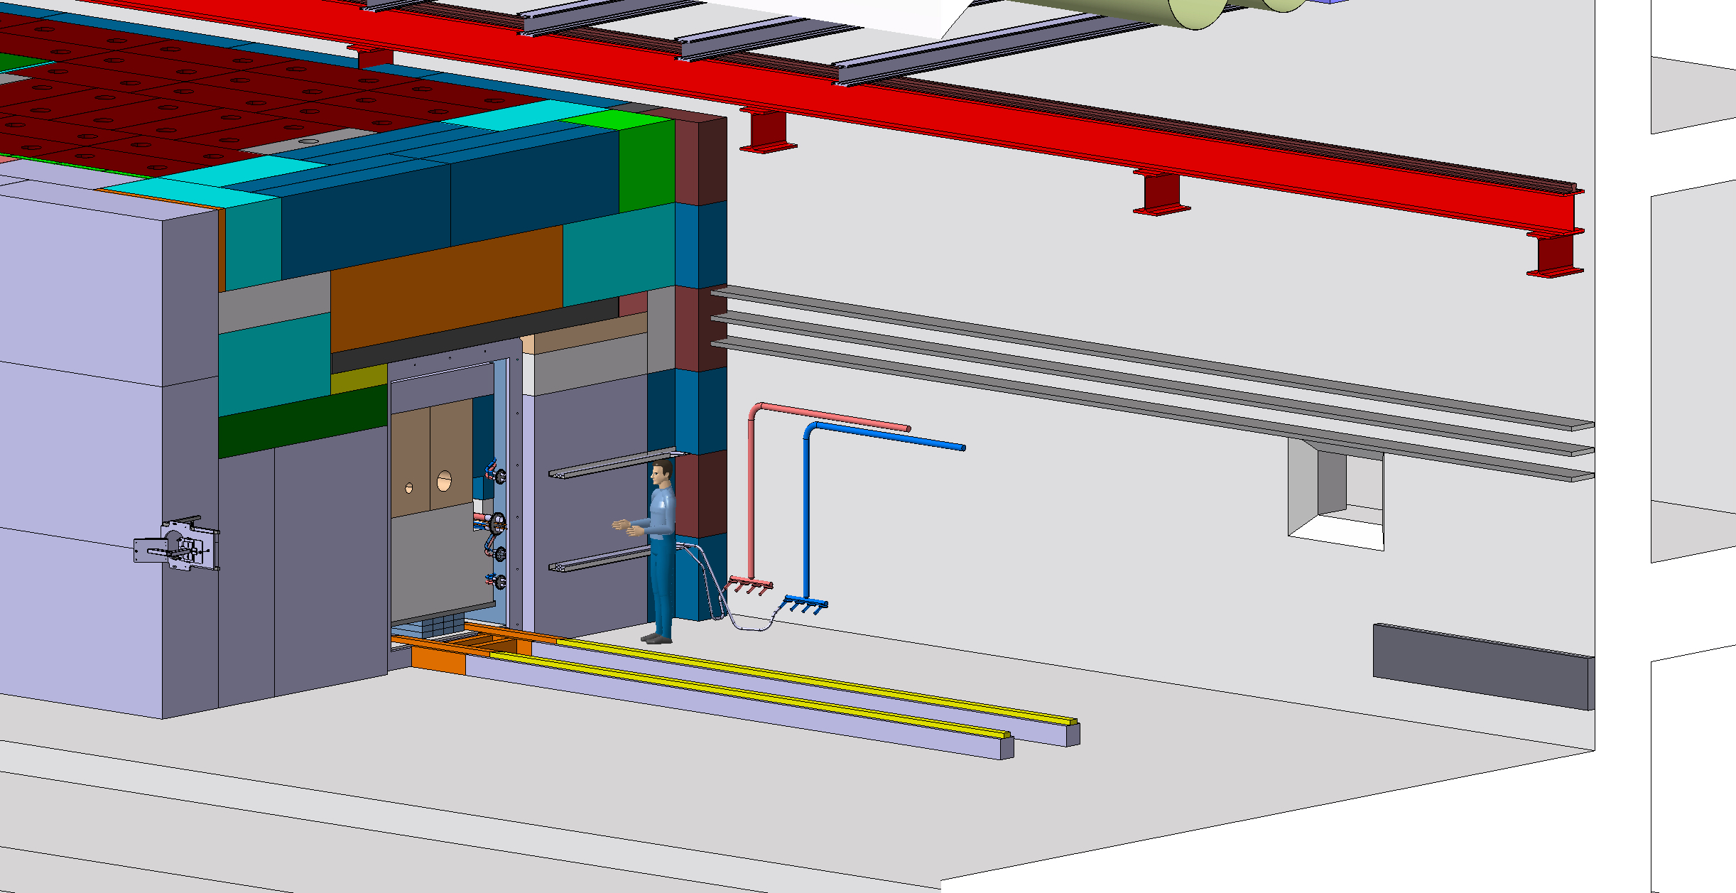

Slide 17
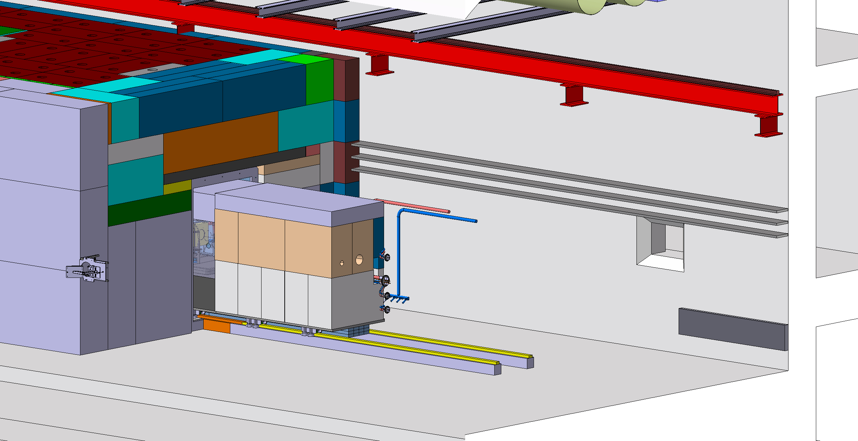

Slide 18
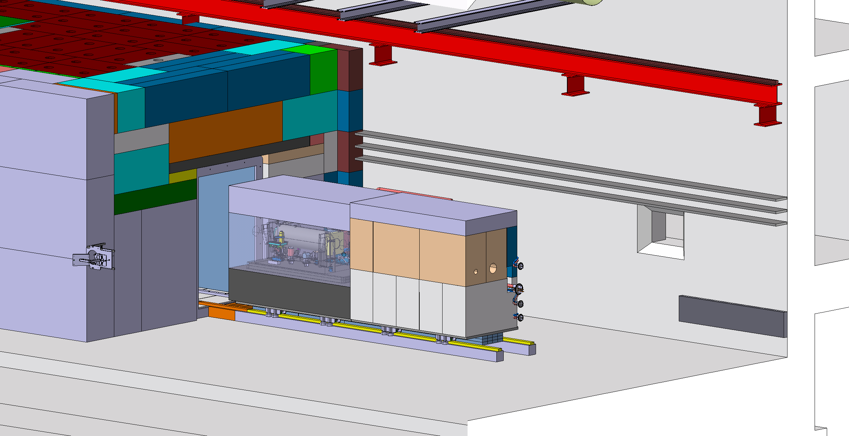

Slide 19


Slide 20
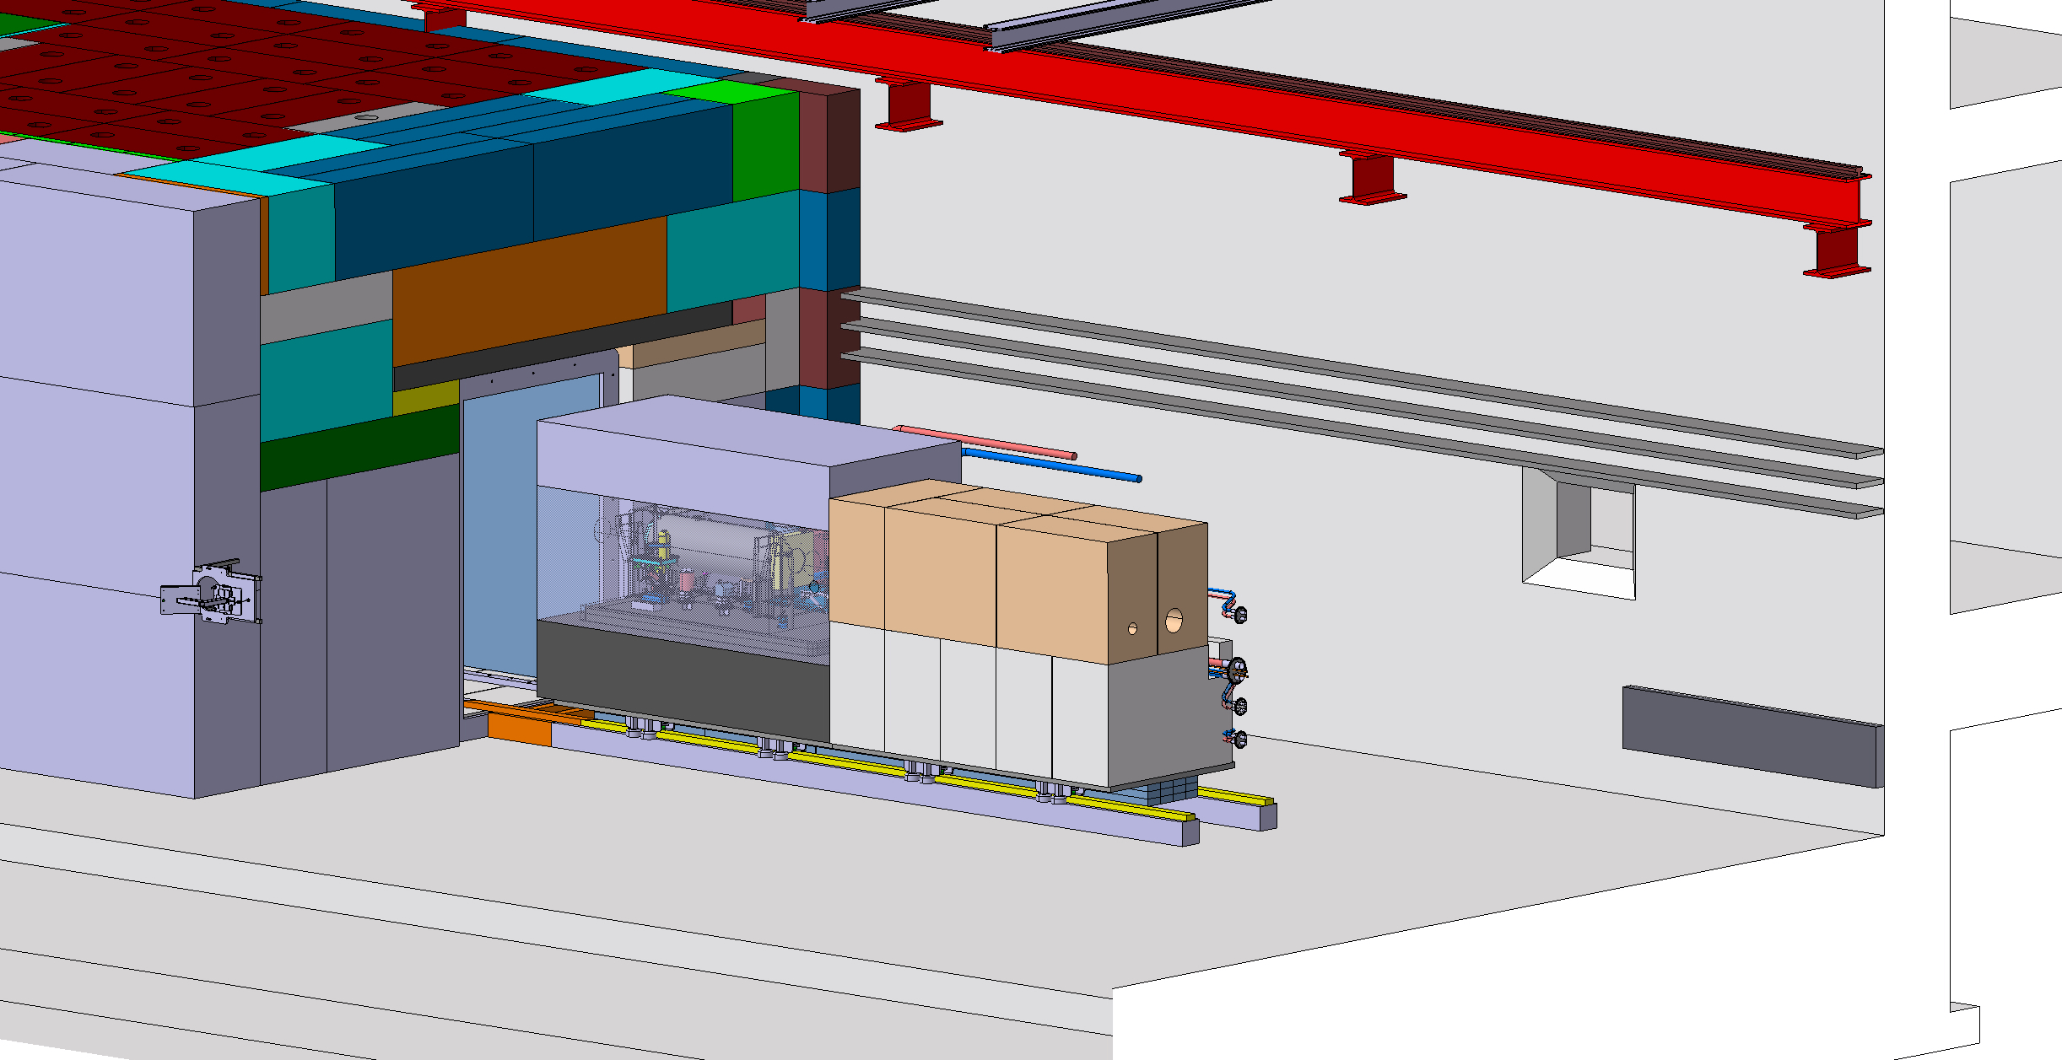

Slide 21
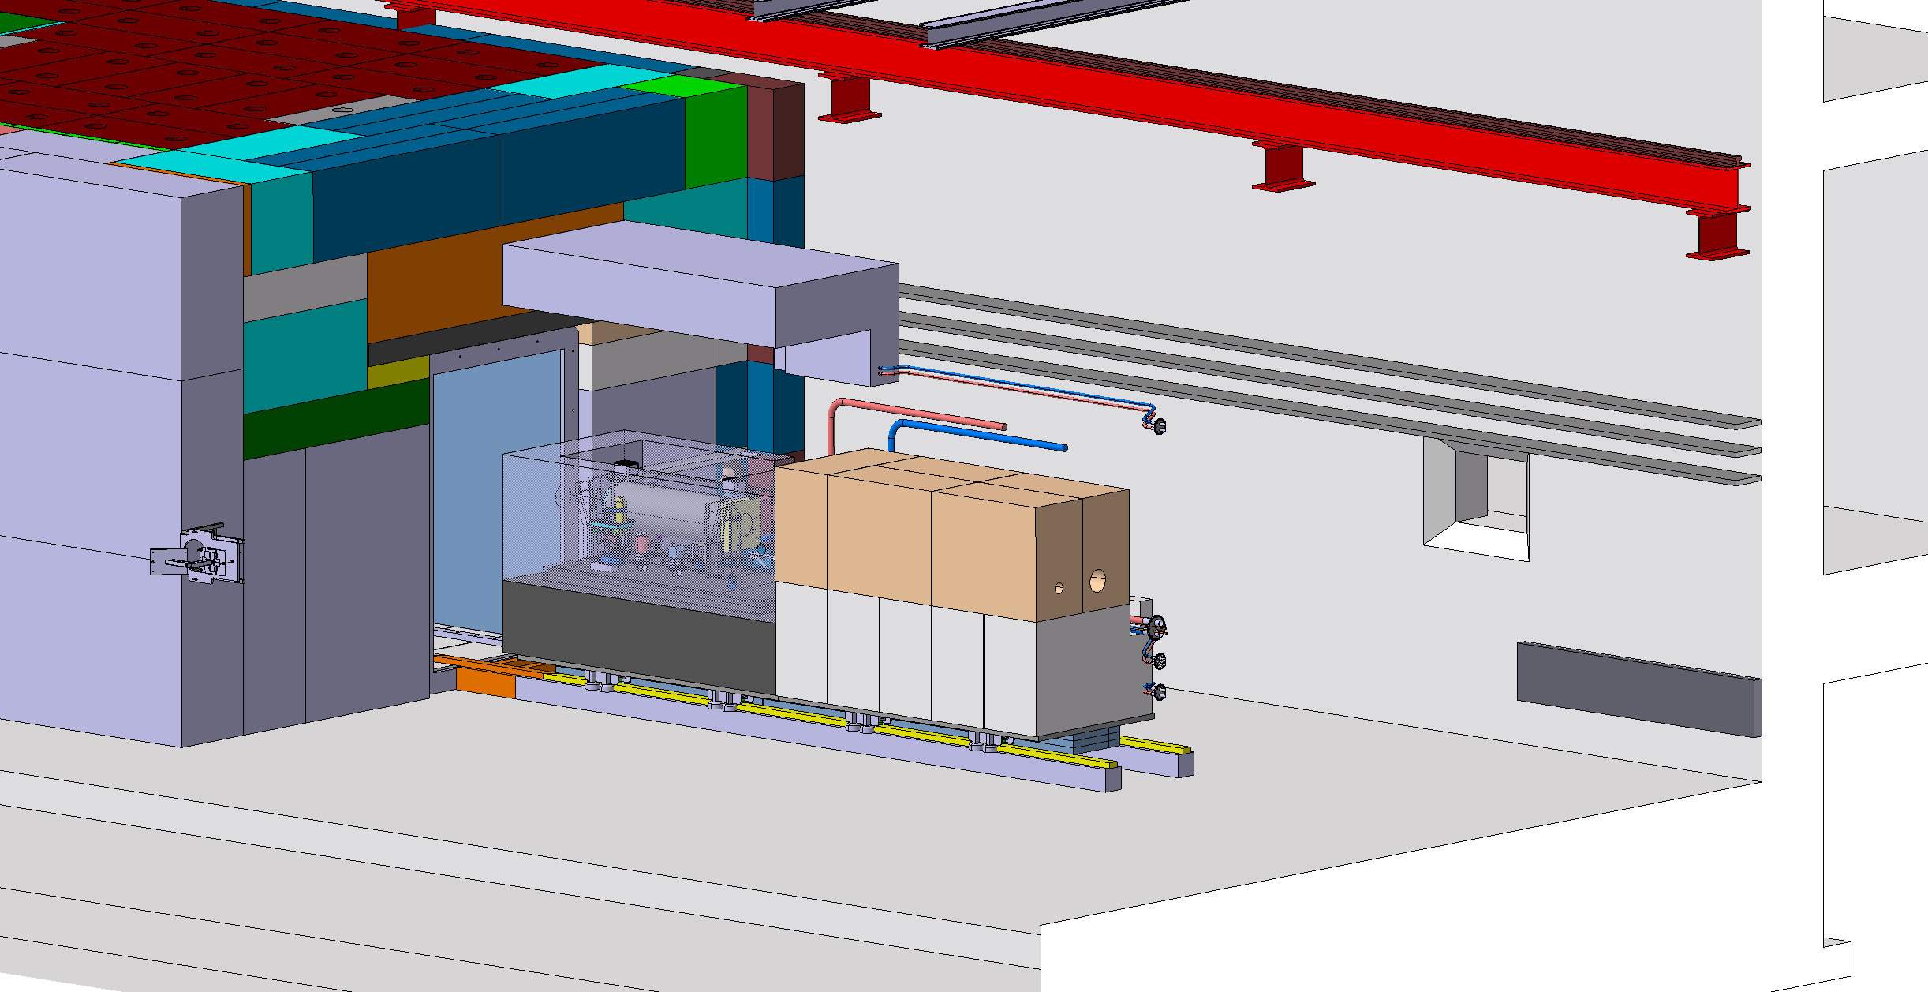

Slide 22
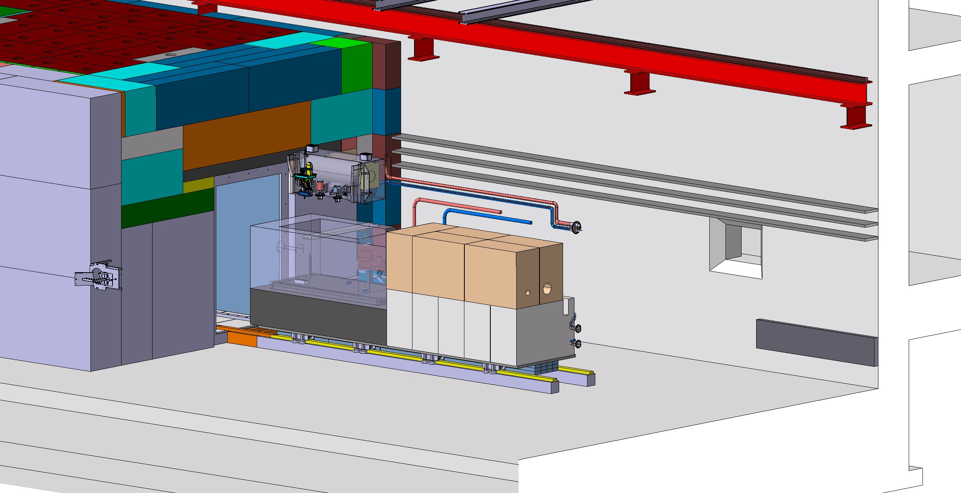

Slide 23
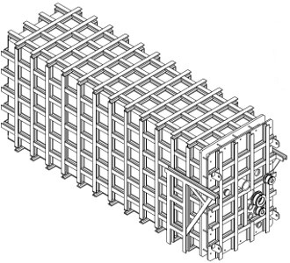
Target station vacuum confinement
Overall dimensions: ~6.36 x 2.05 x 2.95 m
Can be fully fabricated and tested at a contractor premisses
Primary vacuum to optimize air activation around target
(Water containment in case of water leak)

Slide 24
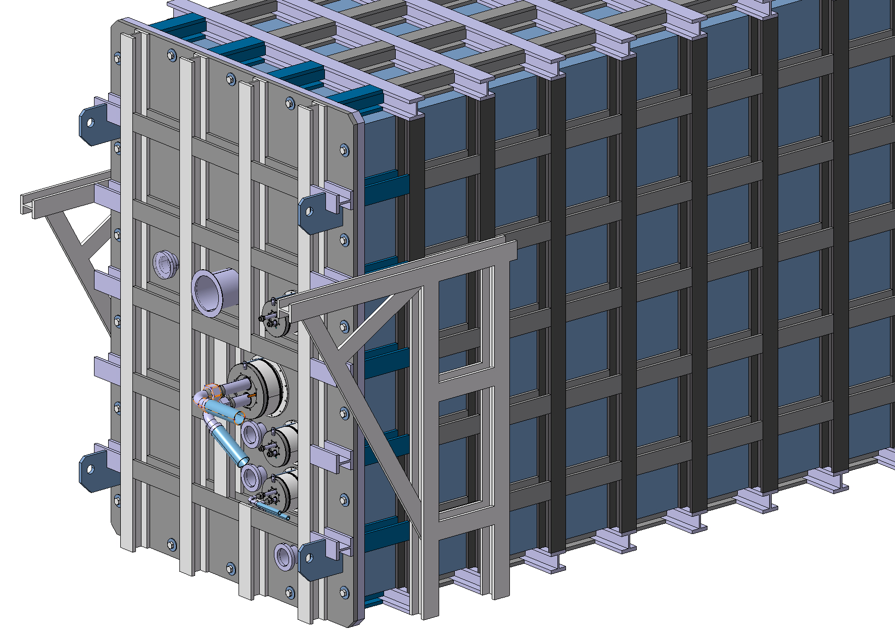
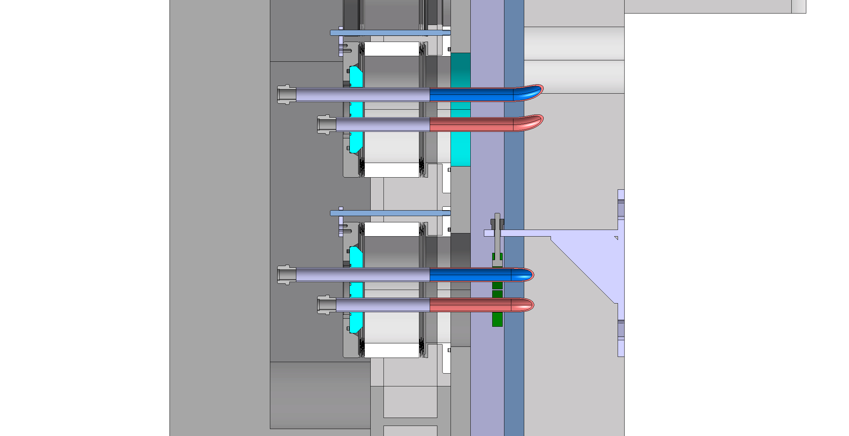
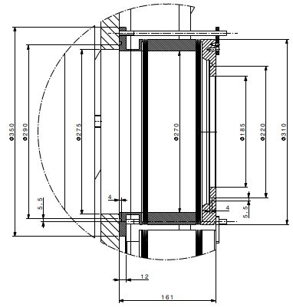
Target station vacuum confinement
Utilities feedthroughs
Mechanical design ready to build a prototype
Design of radiation tolerant gaskets
Decommissioning plan

Slide 25
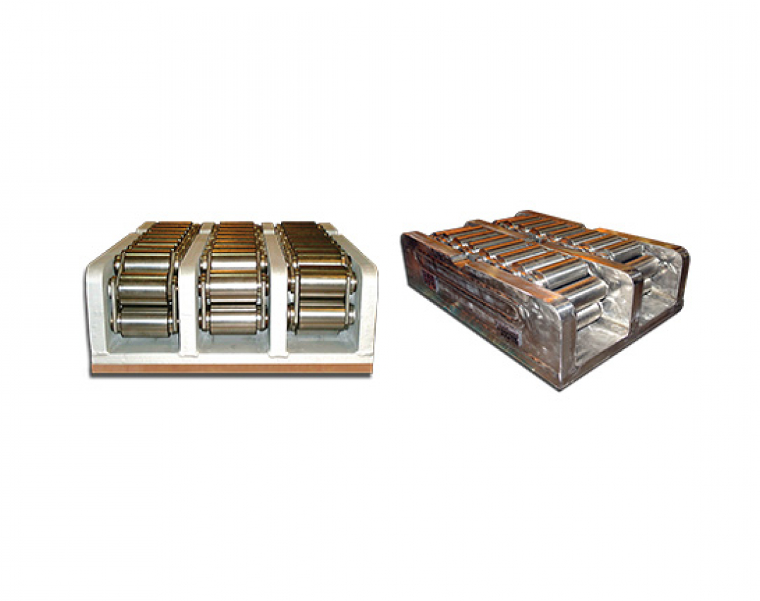
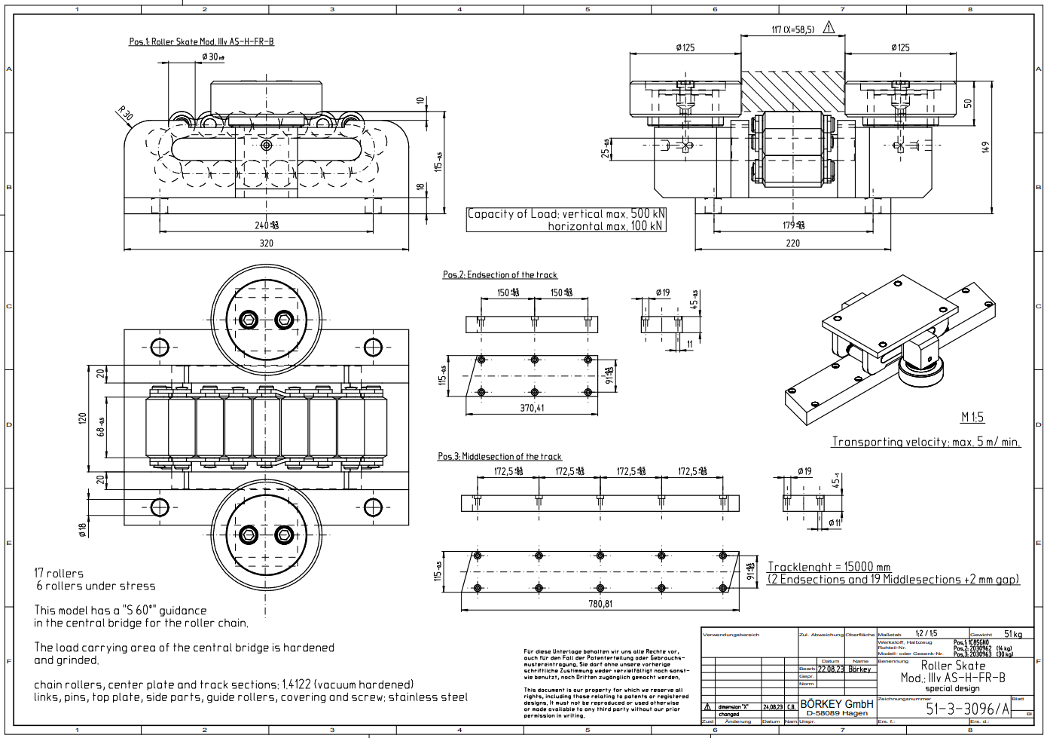
BDF Target complex integration extraction
Trolley mounted on full stainless steel chain action rollers

Slide 26
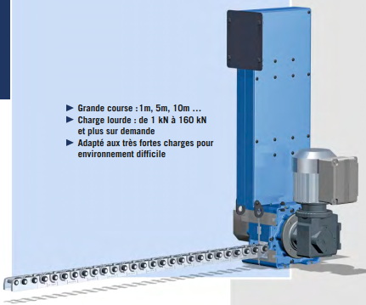
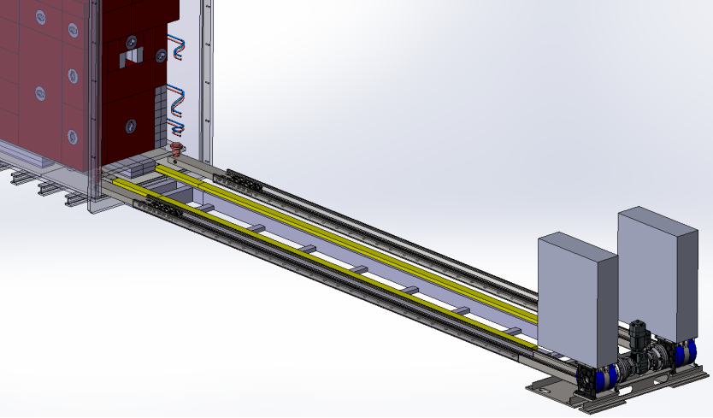
BDF Target complex integration extraction
Extraction / insertion mechanism based on a motorized rigid chain
This will be installed on purpose in case of target exchange

Slide 27
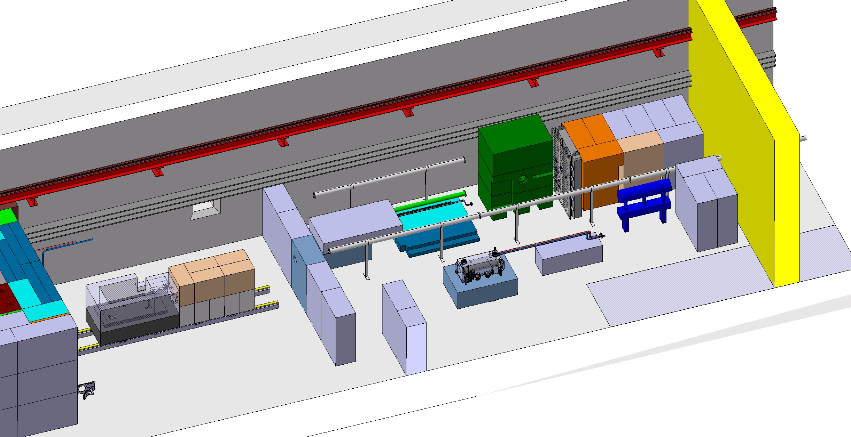
Space requirement for target exchange
~30m

Slide 28
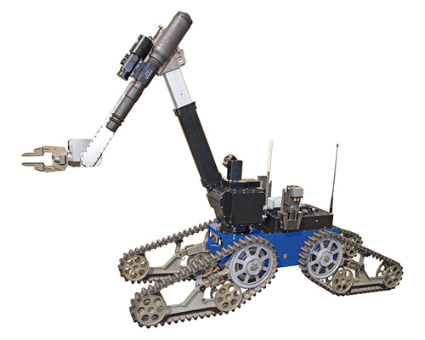
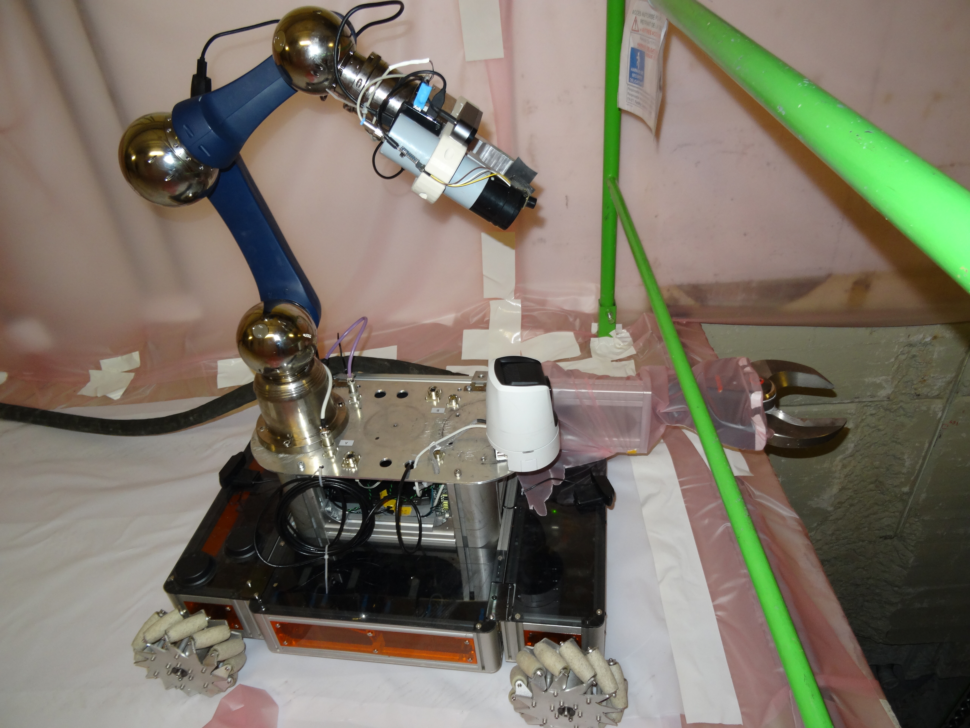
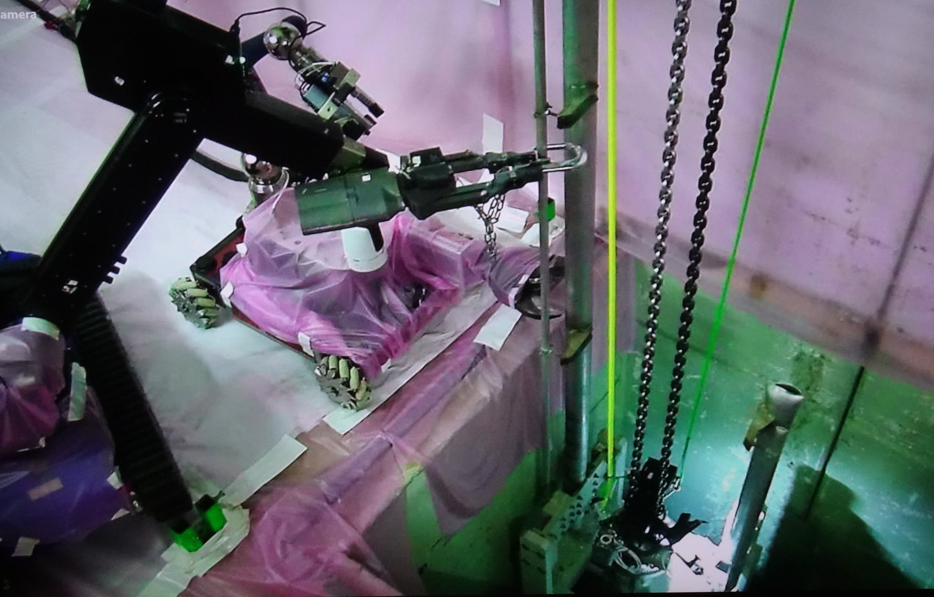
Maintenance of the target complex - few ideas
Target exchange
  Connections of utilities located in ‘’human’’ accessible environment
  Remote handling features for the connections
  Support of remotely controlled crane and ROVs
  Size reduction for final disposal by shearing
  Transfer from the underground to surface in shielded casks
n-TOF target#2 pipes reduction with ROVs

Slide 29
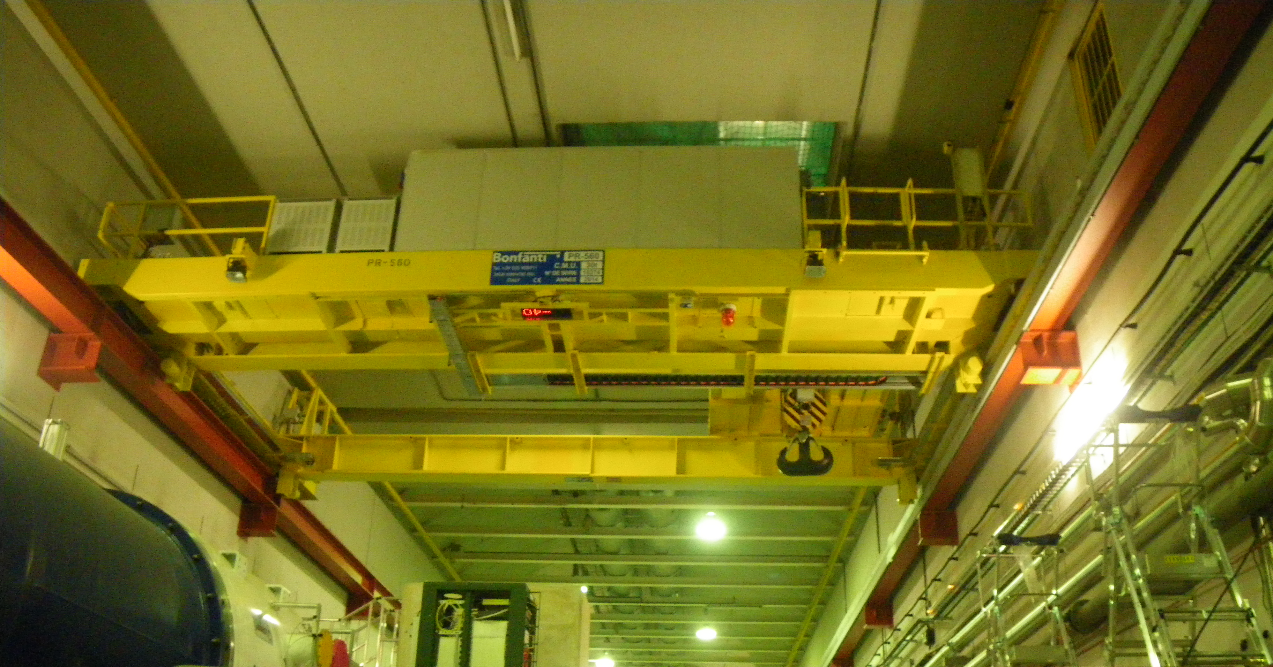
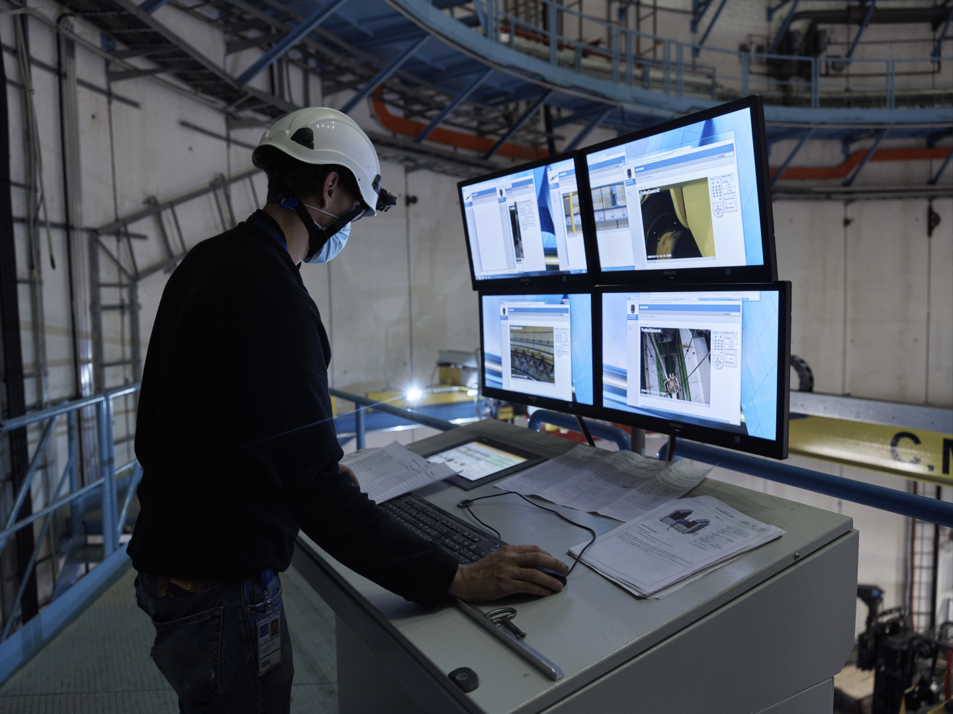
Target Complex handling
Existing overhead travelling crane 30t capacity replaced
  Redundancy on the 3 movements of the crane
  Integration of a video system
  Integration of a positioning system for the 3 movements
  Off-board control cubicles
  Cable festoon routing
  Remote tools connection on the hook
  Auxiliary hoist
  Investigation on possibility to optimize crane size
  Ongoing specification

Slide 30
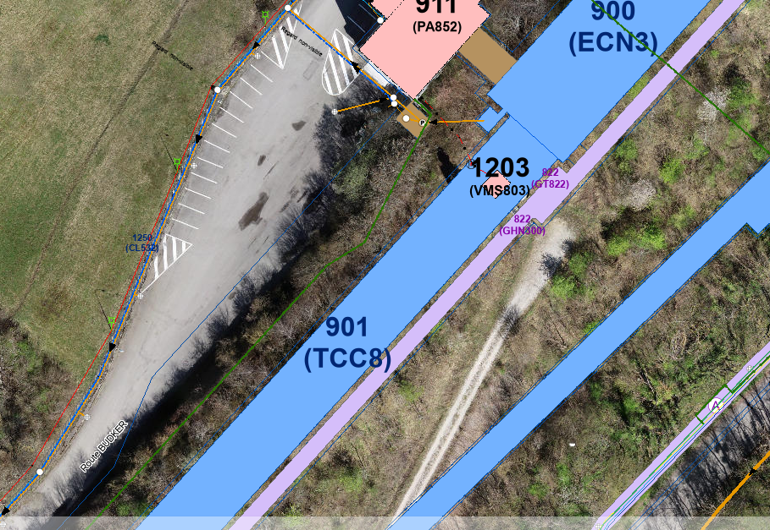
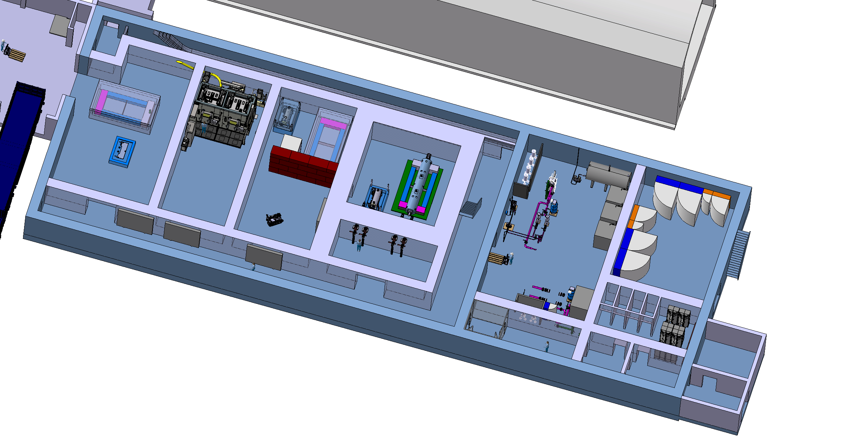
The target service building
Nuclear ventilation system of the target complex
  Air handling units, filters, dehumidifiers (outside)
Target cooling systems
  Pumps, Filters, Heat exchanger, Cooling instrumentation, He circulation system
  Target controls systems
  Target monitoring (sensors), Target control valves, vacuum vessel confinement
  Service cell / hot cell
  Buffer area
Safety systems
Electrical distribution system
Control and safety systems
(Evaporator)
~1000m²

Slide 31
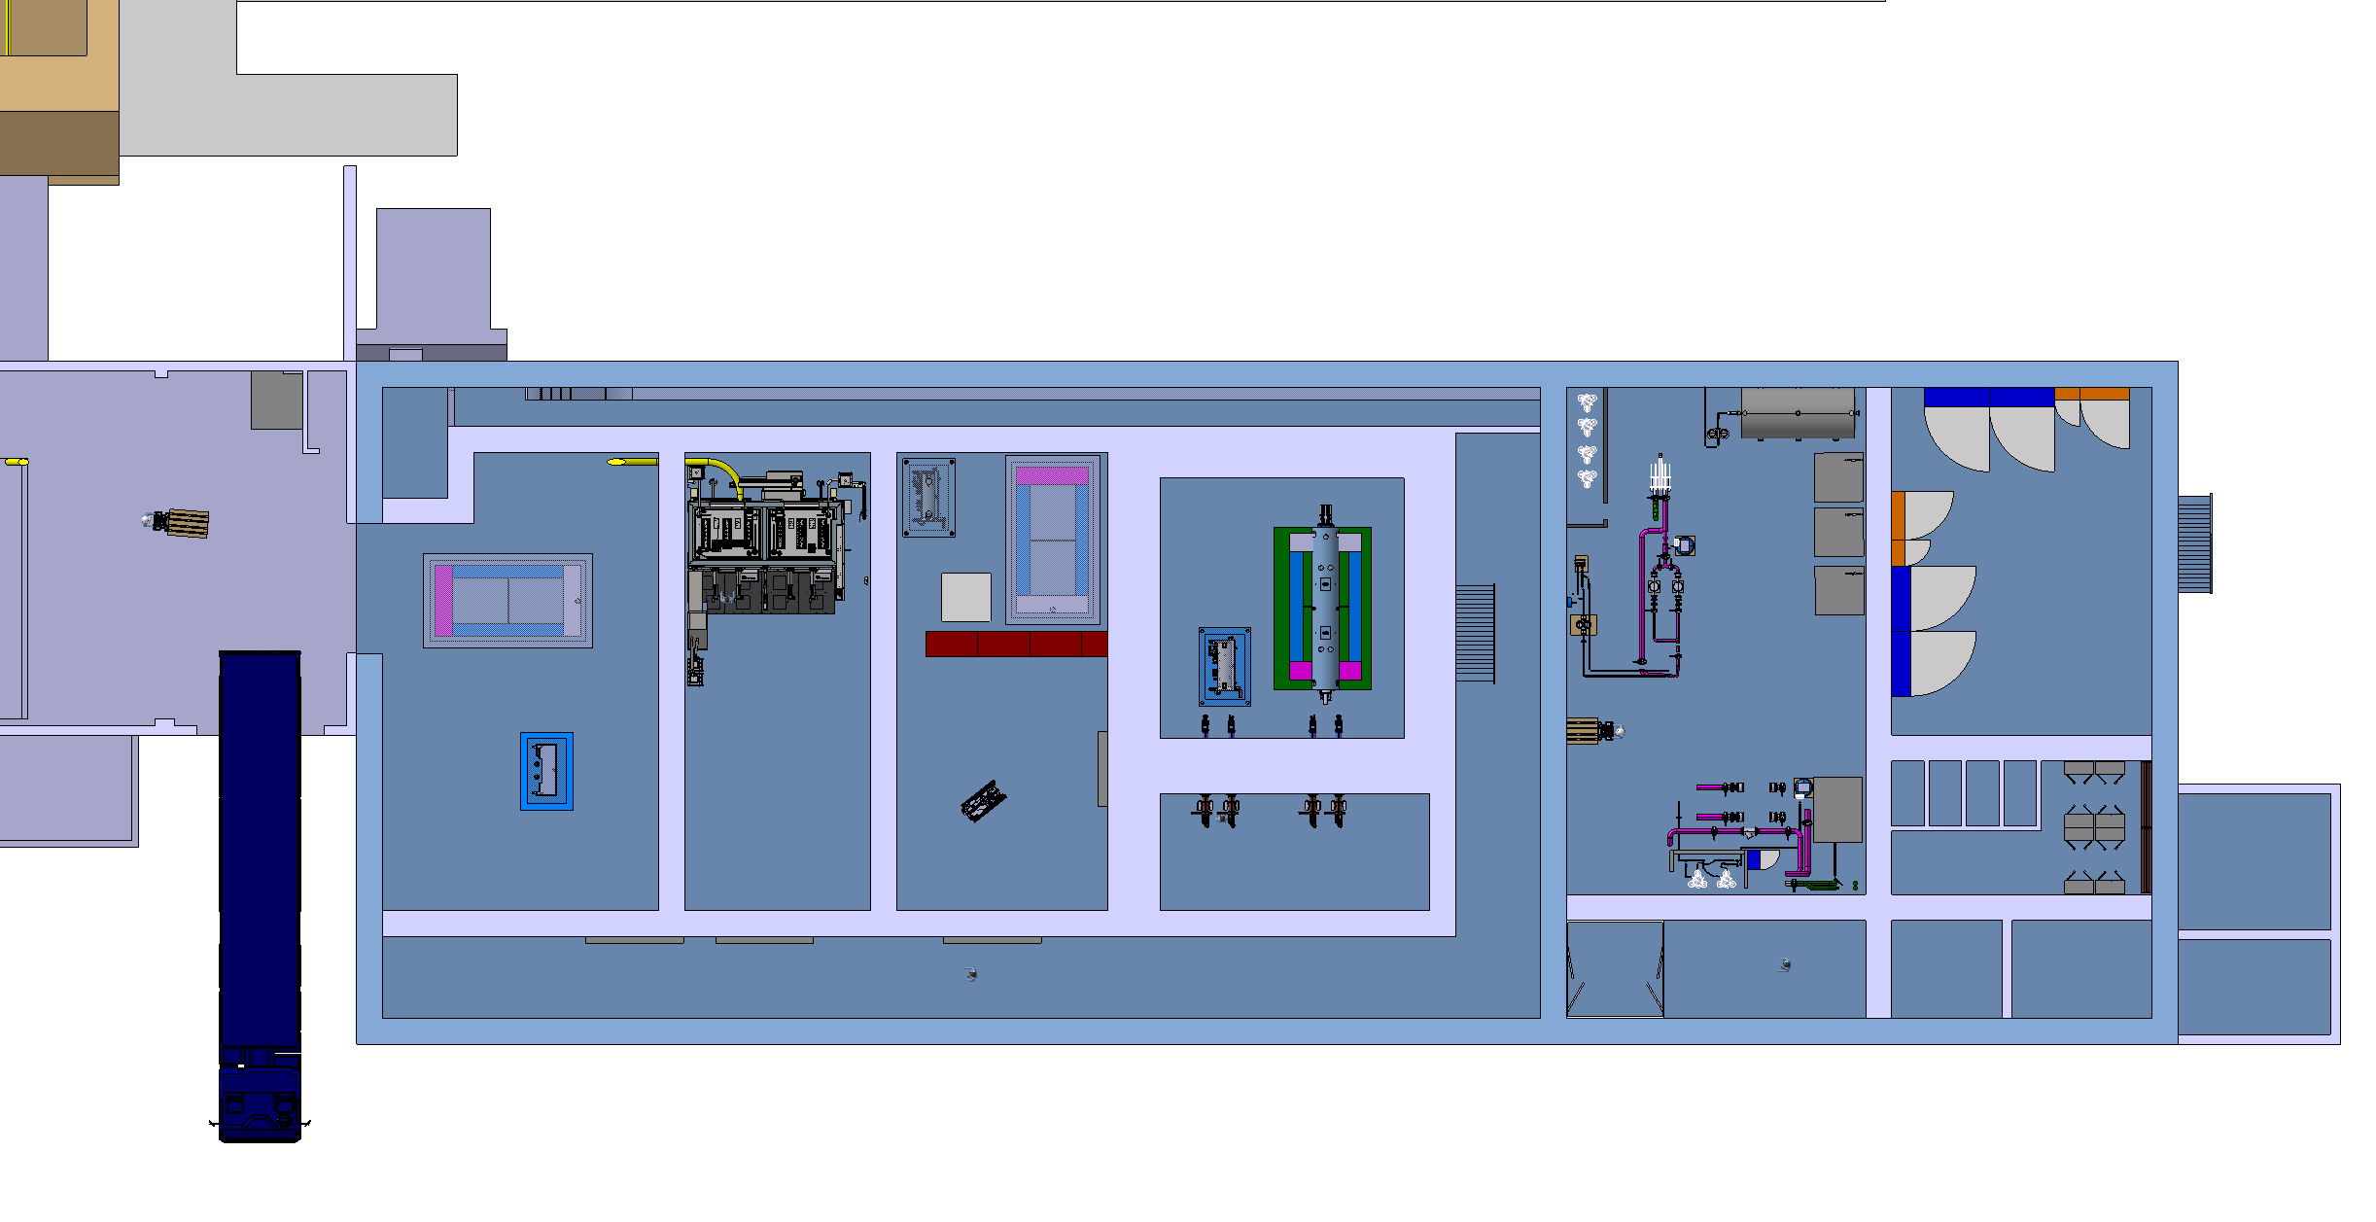
Service building – ground floor
Cooling equipment
Power room
Material access
New lorry access
Personnel access
HotCell
Service cell
with a movable roof
Shielded buffer zone

Slide 32
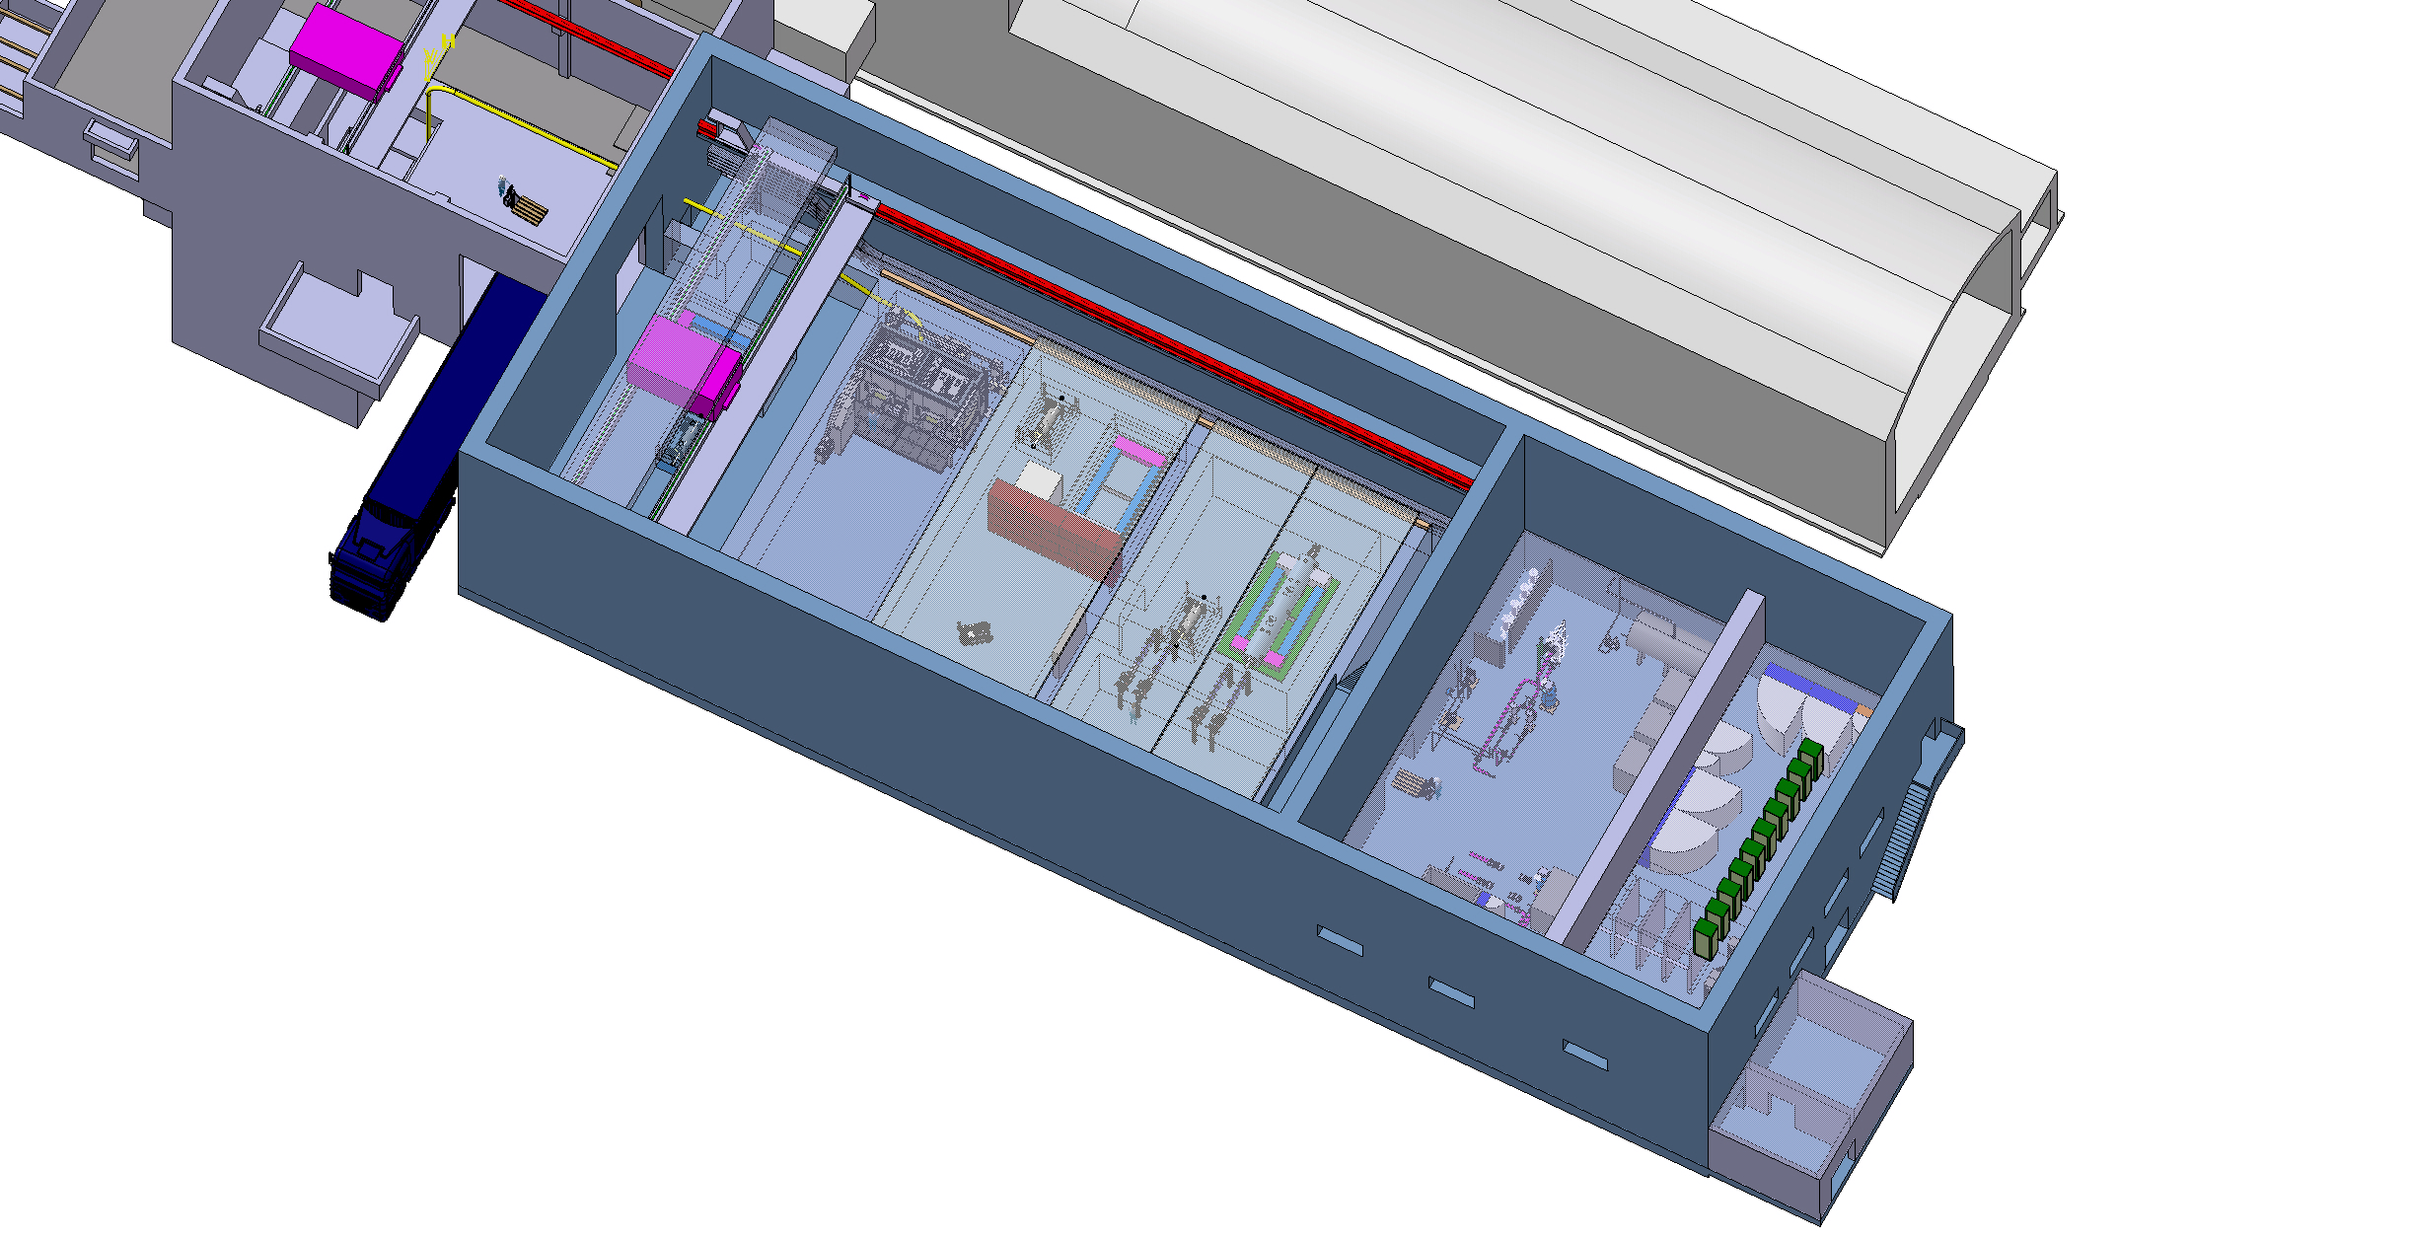
Service building – 1rst level
30t overhead traveling crane
Control racks
Mobile shielded hatches
Filter room

Slide 33
HI-ECN3 service cell - context
HI-ECN3 project need to have a facility to prepare objects for final disposal
  BDF target
  Proximity shielding
  Hadron stopper coil
  Why do we need a specific facility to prepare HI-ECN3 object for final disposal (waste packaging)?
  Level of radiation (~few Sv/h after 1year of cool down)
  Characteristics of materials (W)
  Presence of radiological critical spallation products
  Size and weight of the objects doesn’t fulfil elimination path requirement towards PSI (container size limitation)
  Understanding of failure modes to improve future designs
  Lessons learnt from waste packaging of highly radioactive objects (ISOLDE target, LHC TDE, n_TOF spallation targets)
  Currently such facility does not exist at CERN
Main justification

Slide 34
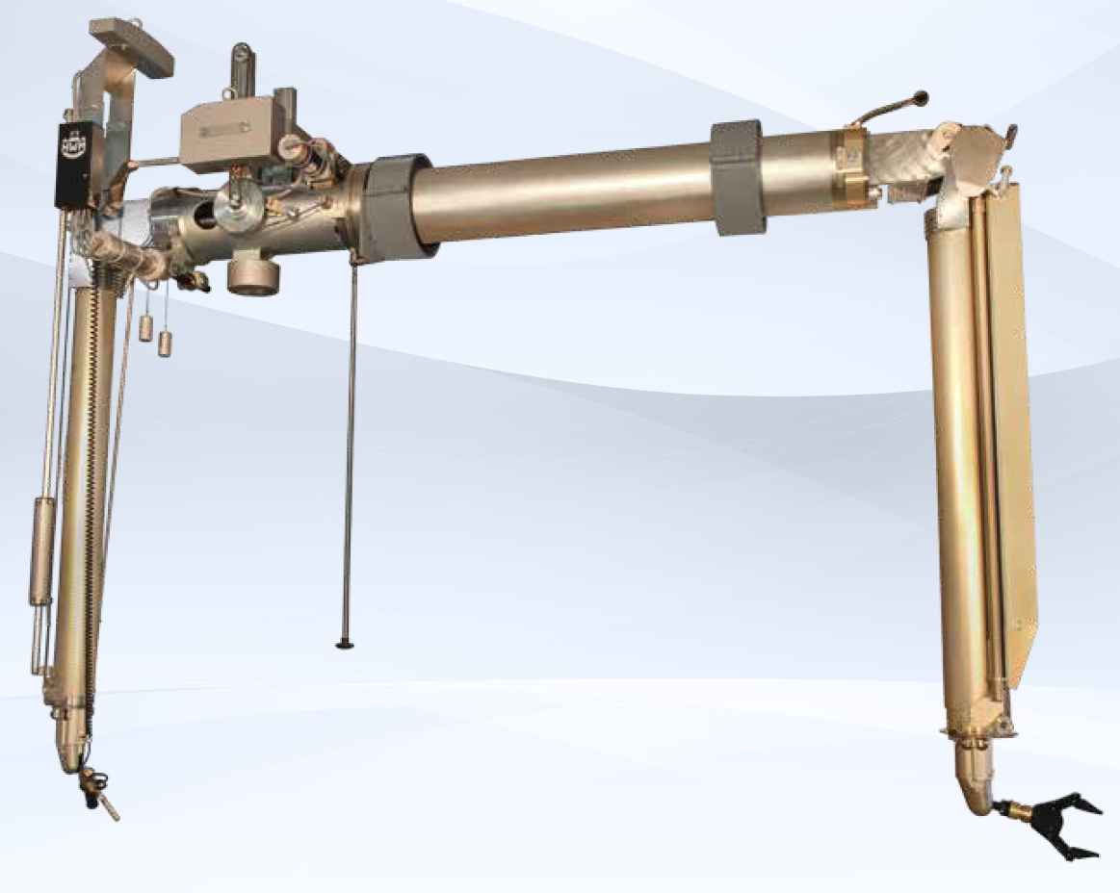
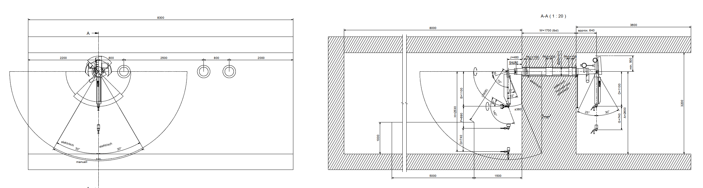
Service cell definition - design
Prelimiary discussion with master slave manipulator manufacturer
→Check of volumes in integration model

Slide 35
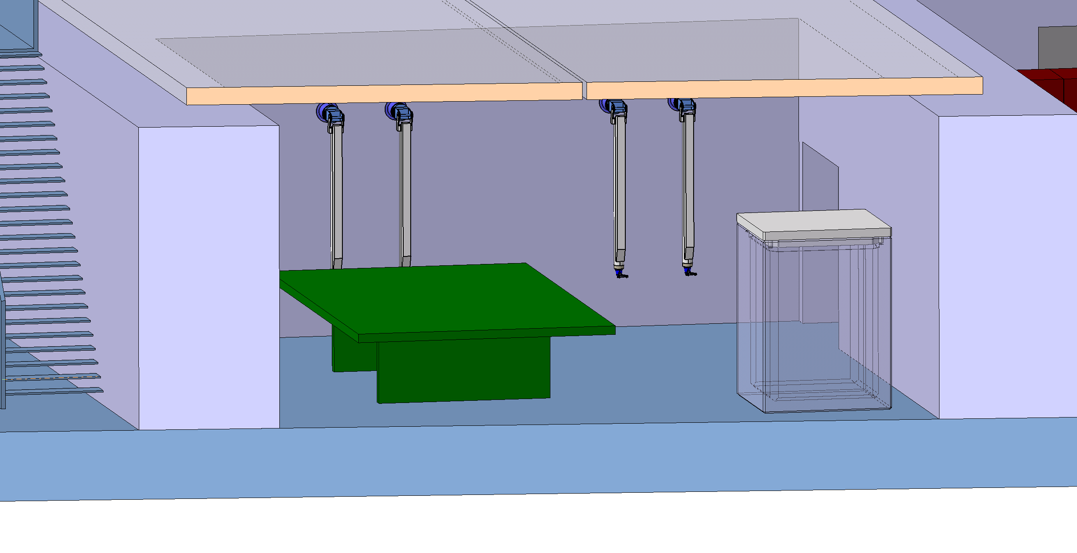
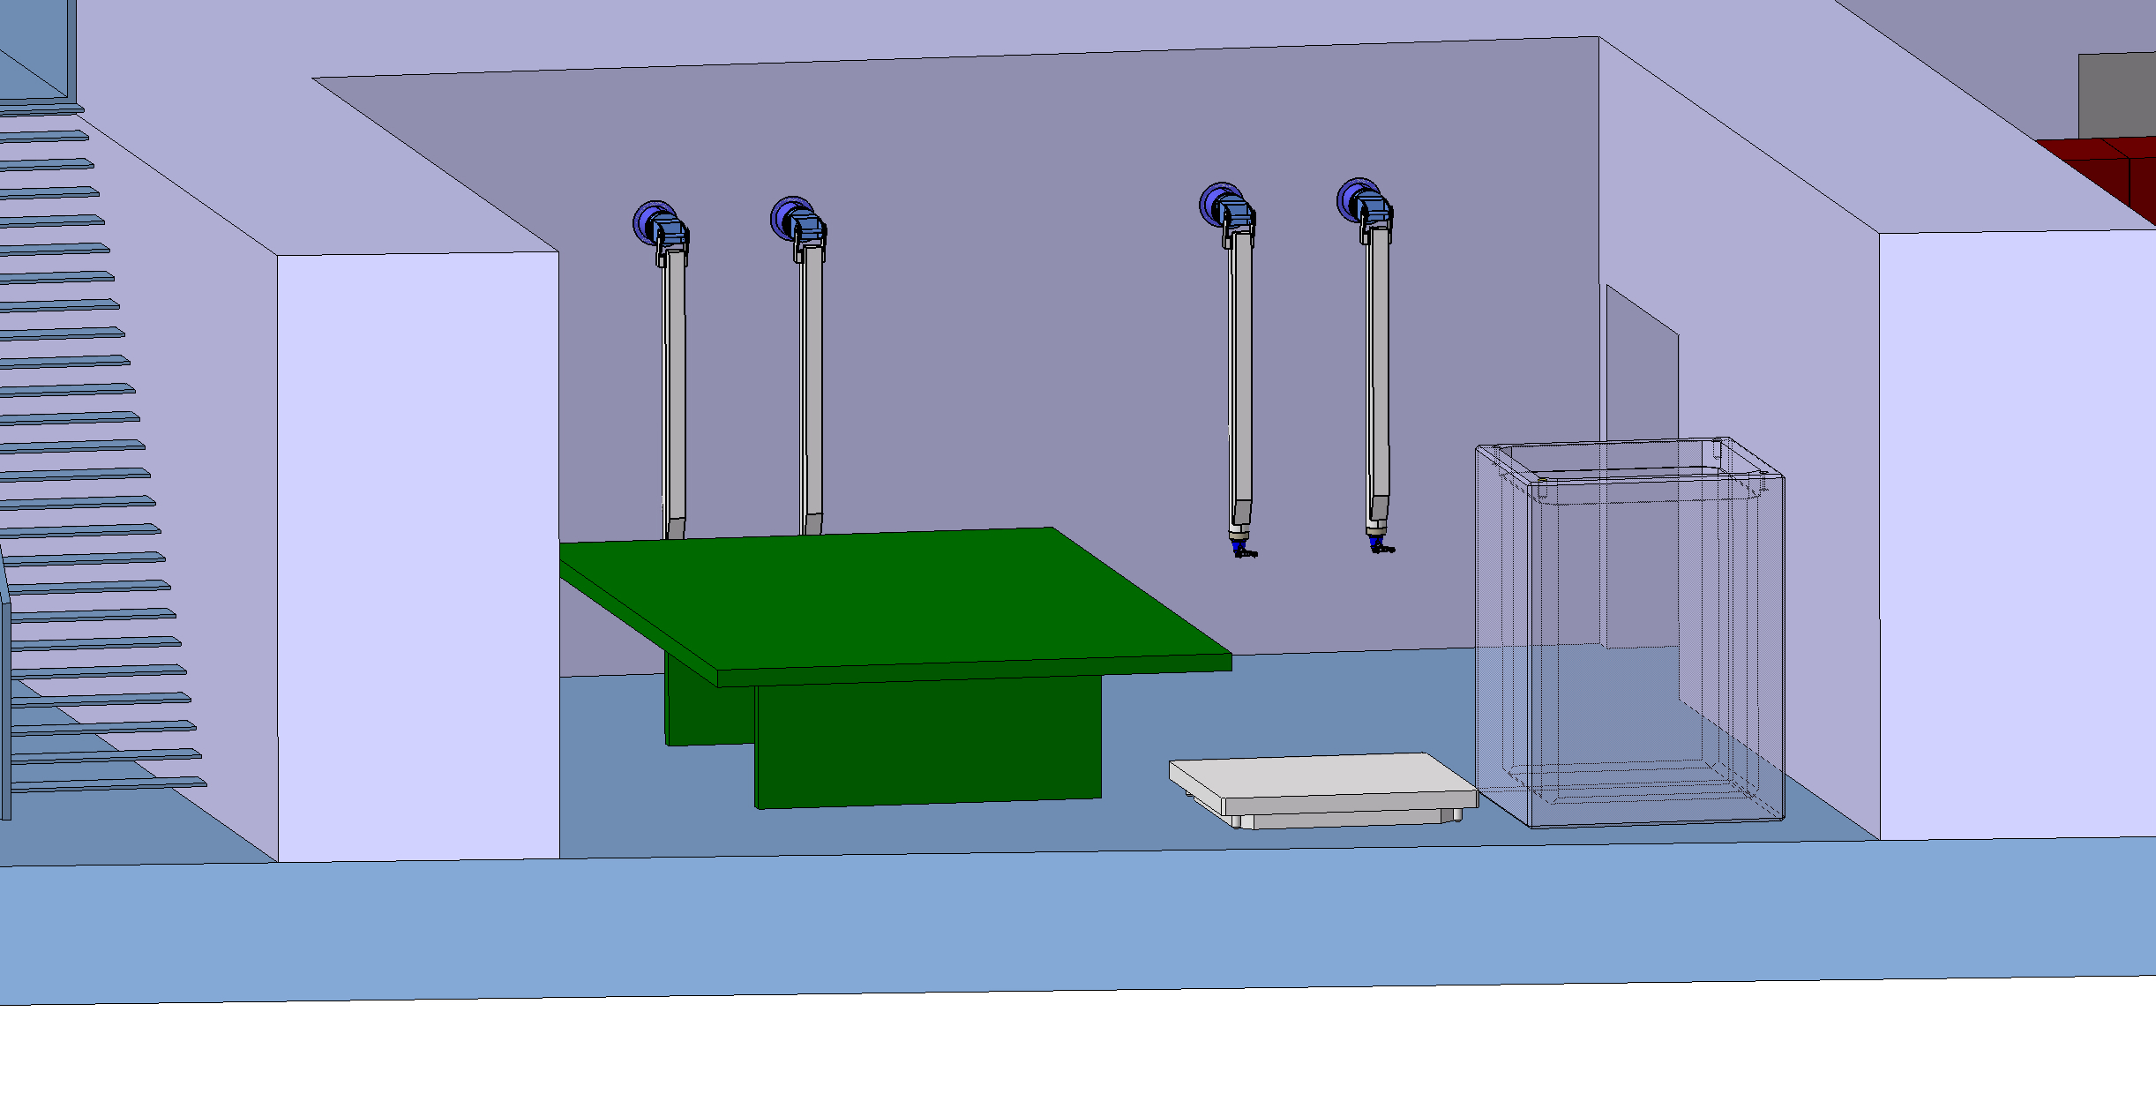
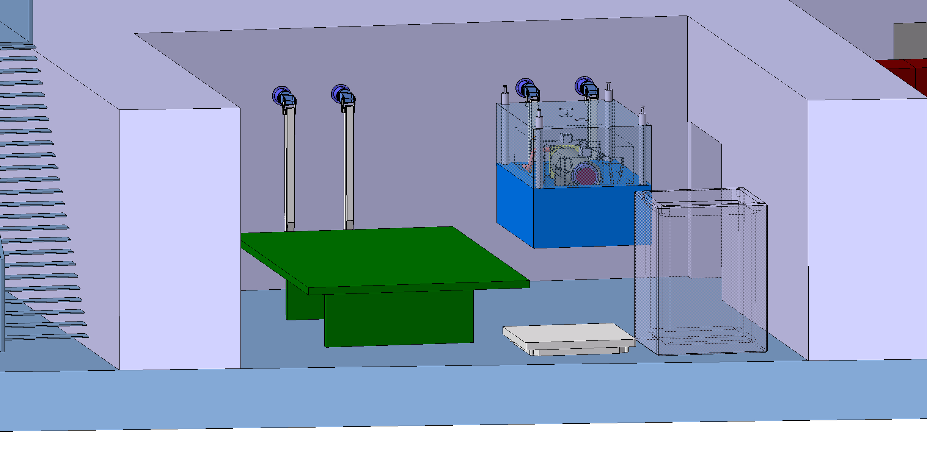
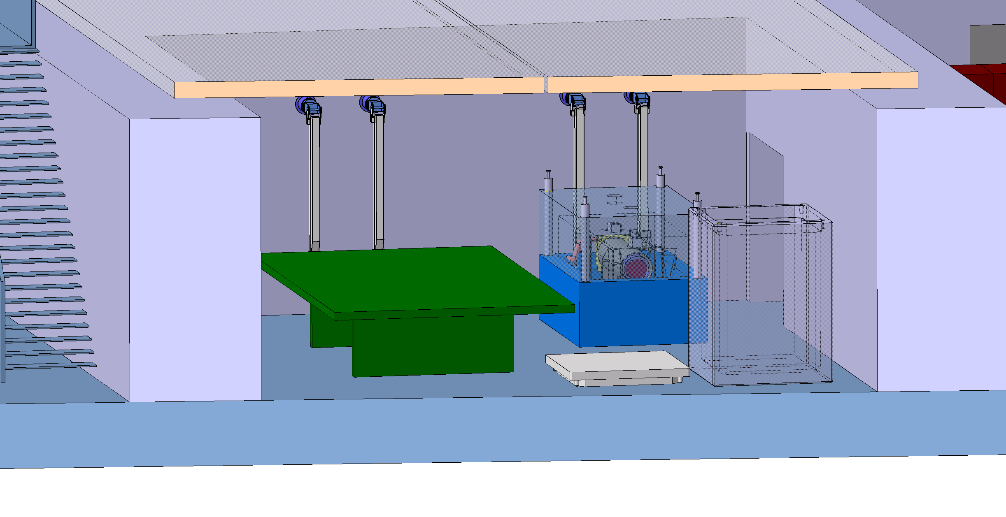
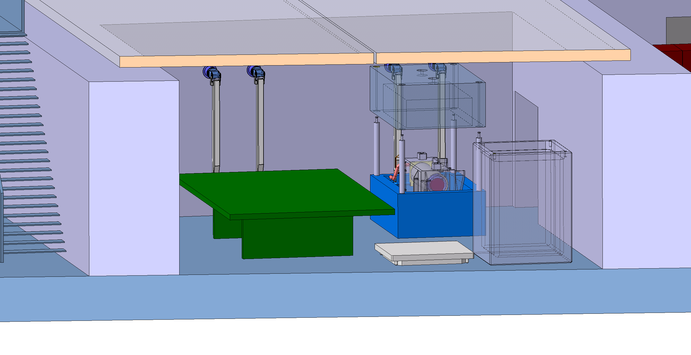
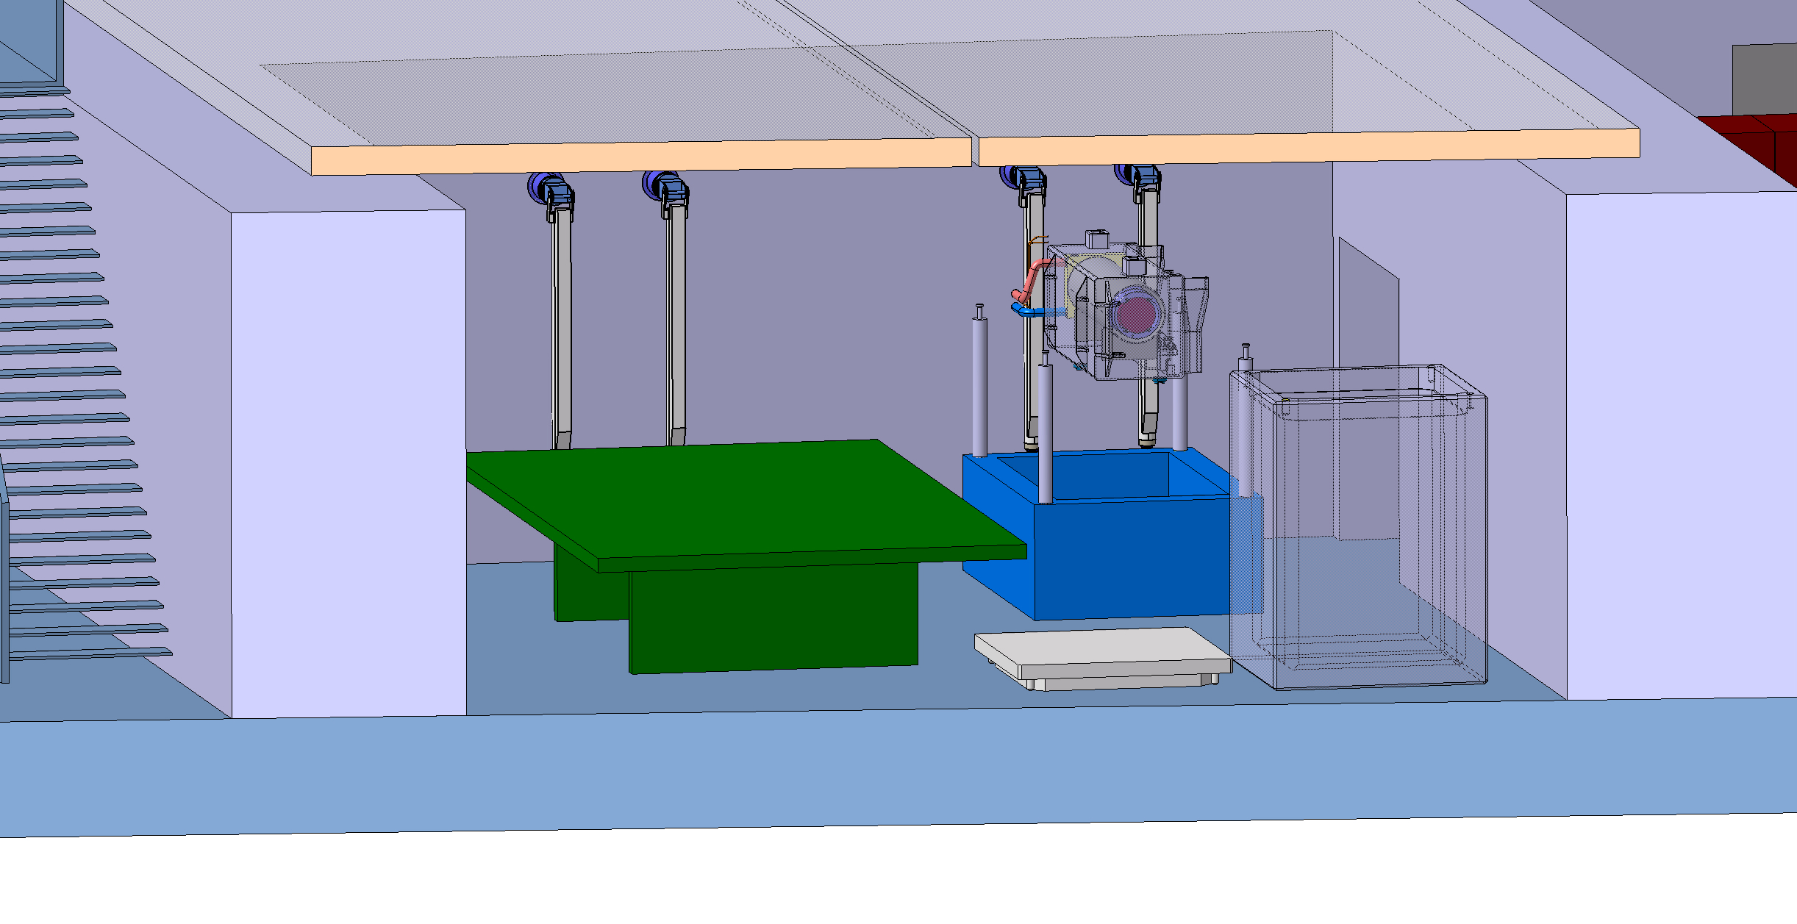
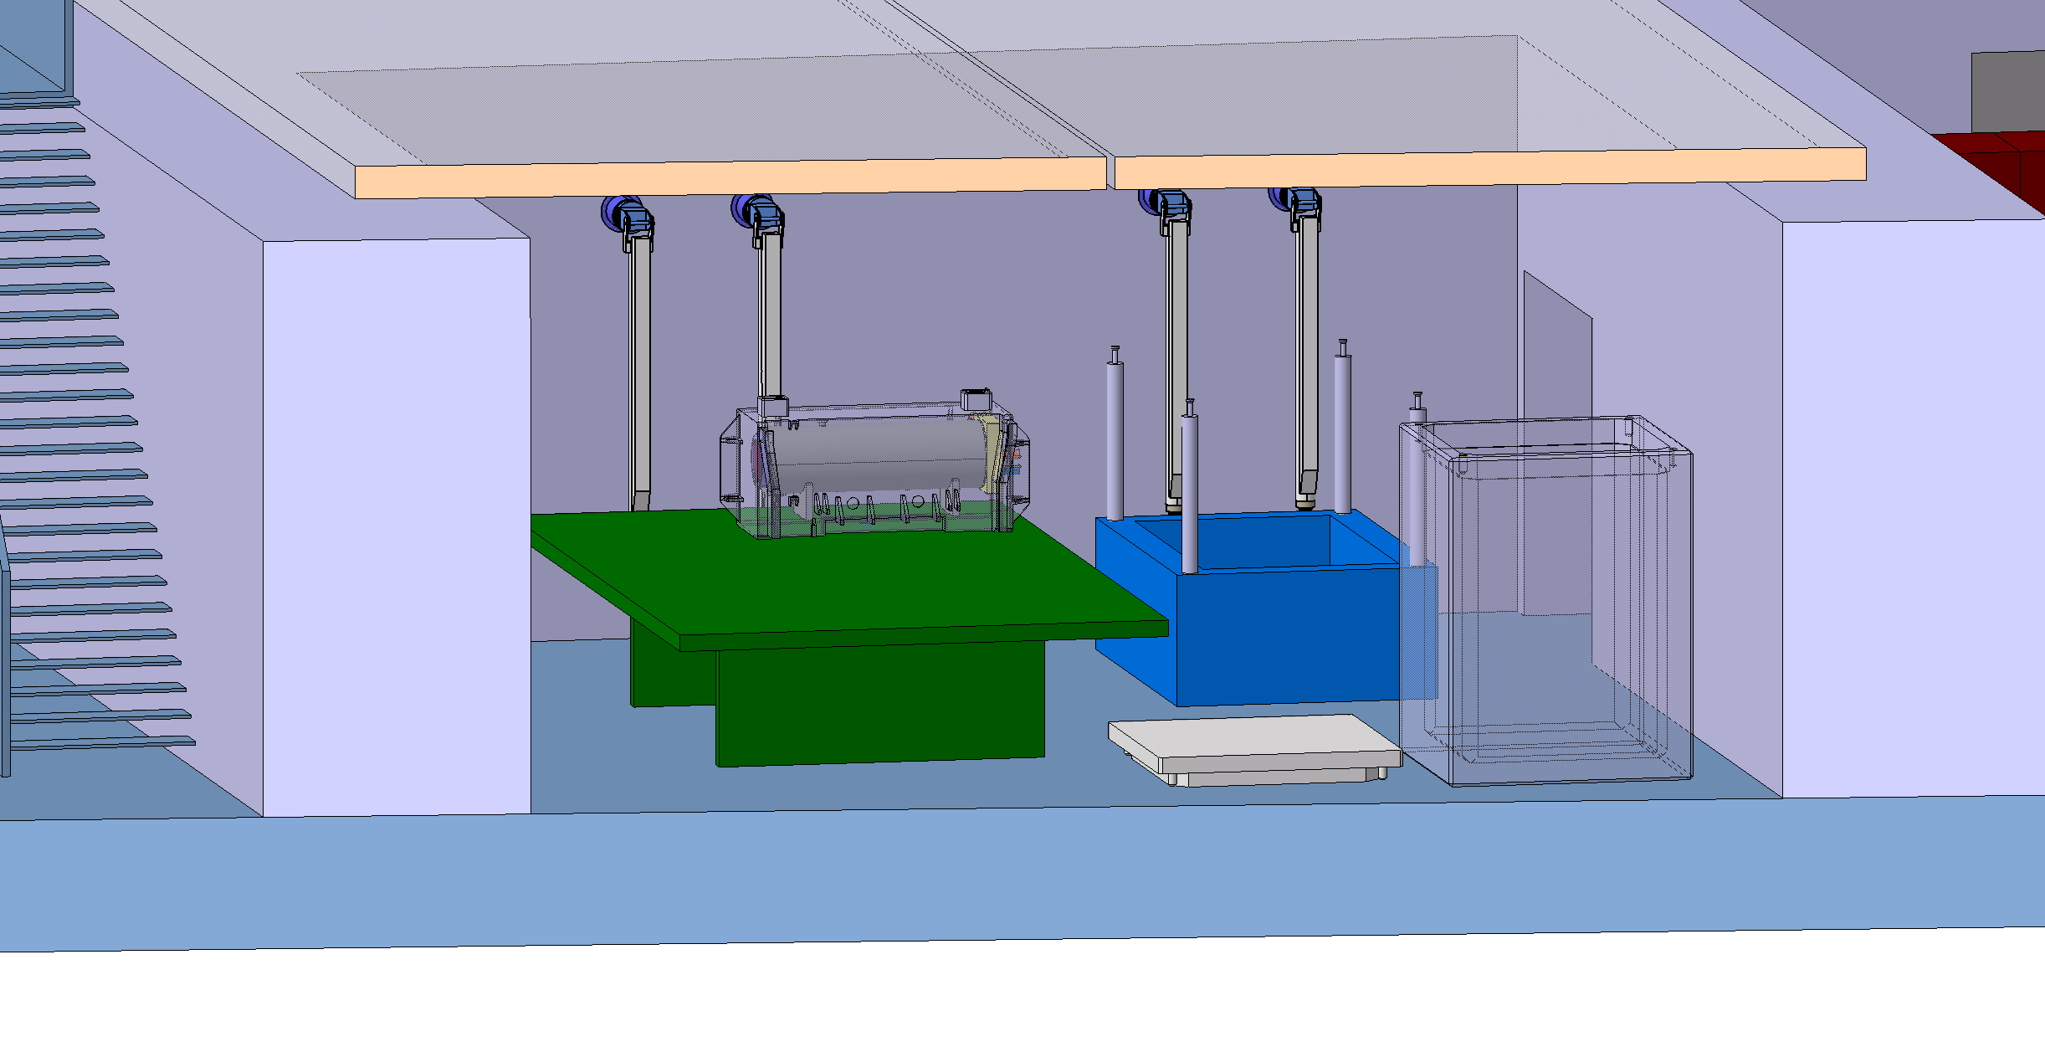
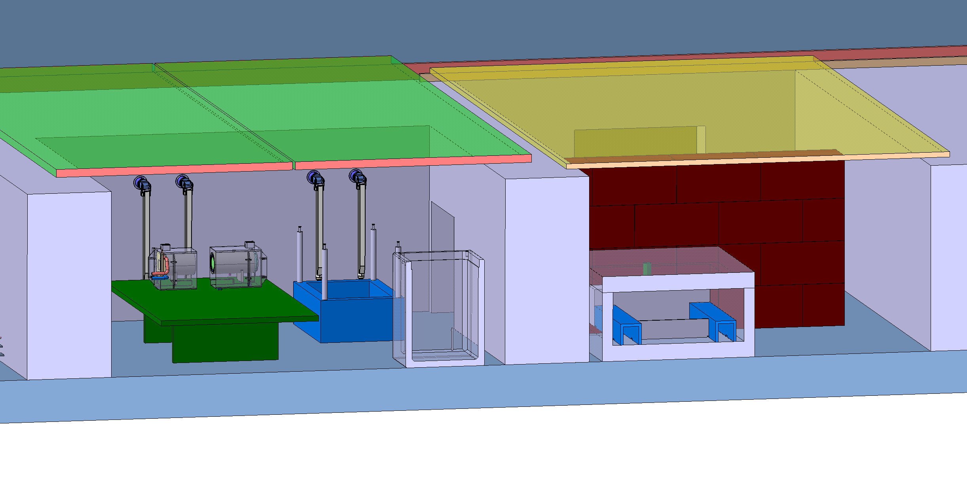
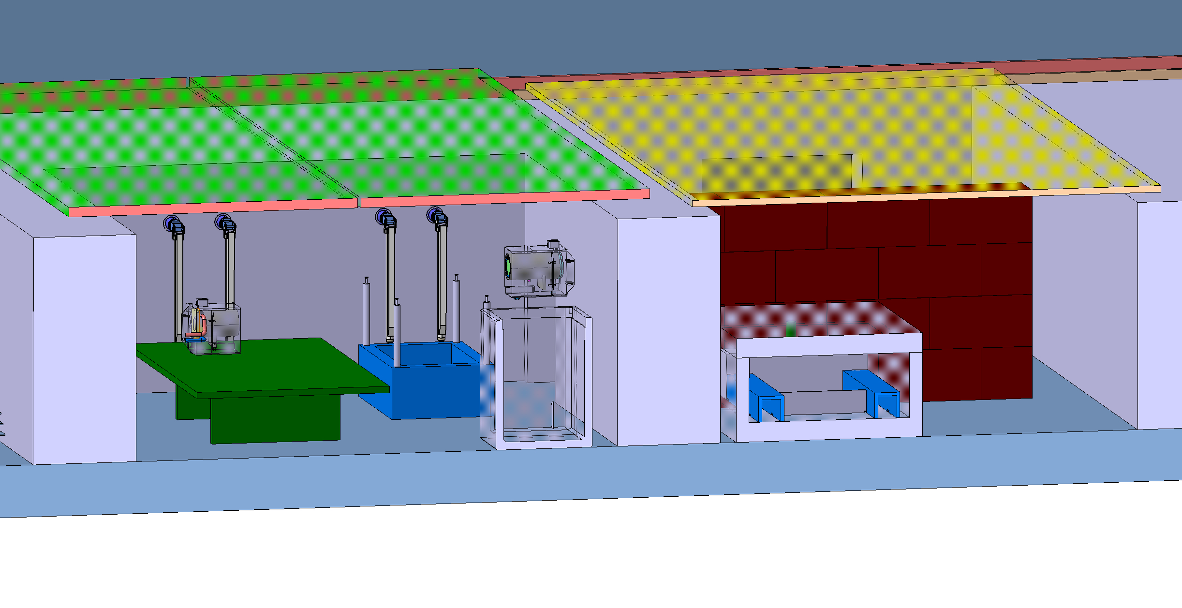



Service cell definition – BDF target waste packaging draft sequence

Slide 36


Service building within the BDF/SHiP complex

Slide 37
Systems failure scenarios
Evaluation required for operation and maintenance scenarios
  Water and/or He leak
  Vacuum leak
  Fire
  Ventilation
  Cooling
  Extraction system
  Handling tools

Slide 38
Subjects of concern – Target station
Did you have any elastomers (for gaskets?) in areas with (high) radiation dose?
Did you have any lubricant in areas with (high) radiation dose?
Did you have any place where you have implemented measure to prevent cold welding (typically on rolling elements)
How have you qualified sub systems? And to which extend have you over stressed your systems?
How have you prevented the pollution of the target vessel during installation? To which extend all your systems are sensitives to dust and corrosion?

Slide 39
Subjects of concern – Cooled shielding
What has made de decision for ESS to move towards a cooled shielding made out of stainless steel?
What is the chemical composition of the stainless steel shielding?
Did you encountered any difficulties during production?
What QA checks have you performed typically for the quality of the welds?
Have you identified several suppliers for those blocks? Could share the name of your suppliers?

Slide 40
Subjects of concern - Hotcell
How have you define the process and workflow for the hotcell?
What is the strategy for the final disposal of the target wheel?
Did you intend to separate each individual W block from the wheel?
How dose the design of the hot cell and associated process have defined the target?
What has made decision to built a hotcell without lead glass window (Just operating with cameras)
How did you guarantee the air tightness of the hotcell when you insert equipment?
What are your constrains in term of final packaging for waste disposal? (Package type, shielded container)
What are the standards you have used to design the hotcell?
Did you intend to use your hot cell else than for the target facility?

Slide 41
Subjects of concern – Support building
From which standards (as a nuclear facility) have you based your design?
Which systems are covered by secured network (UPS and/or diesels generators)?
What is the strategy in case of power outage?

Slide 42
Thank you

Slide 43
Spares slides

Slide 44


Target Complex in an existing facility
ECN3
Implementation in the SPS North Area ECN3 designed at construction in 70’s for a High Intensity (NAHIF)
Currently used by NA62 experiment
SPS North Area beam lines and associated infrastructure being currently consolidated
Would require the dismantling fraction of current beam line, target station, the experiment
Only one target station can be accommodated in the cavern
SPS extraction
towards North Area
CERN
Prevessin site
SPS
ring
CERN
Meyrin site

Slide 45

The TCC8 area
8m soil
~10m bellow ground
TCC8 cross section (length 170m)

Slide 46




Target station vacuum confinement
Grid of HE 100 M beams (each 120 mm tall) crossing each other at 90º, 500 mm separation
Skin thickness: 30 mm
Boundary condition: floor beams fixed to the floor in the vertical direction.
Max displacement 3 mm
Max VM stress in the sheet: ~200 MPa local peak, lower elsewhere
Max utilization factor of the beams:0.49
Buckling factor: 0.82
Simplified analysis using 1-d beams and 2-d shell elements
More detail vessel design
500 mm
120 mm
Skin thickness: 30 mm

