Slide 2
Radiation Protection Considerations for
HI-ECN3
C. Ahdida, G. Mazzola, G. Dumont
WP6 - Radiation Protection & Safety
ESS - CERN Meeting, ESS, Lund, Sweden
20th September 2024

Slide 3
Outline
Overview of RP Challenges at HI-ECN3
Target Complex Design Optimization
Target Studies

Slide 4
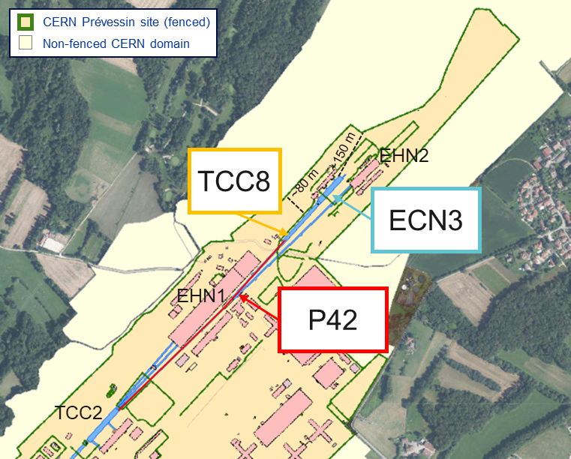
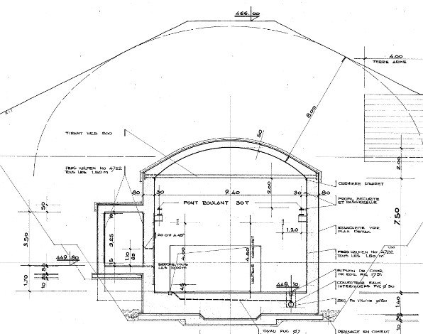
HI-ECN3 at ECN3
CERN’s SPS North Area
TCC8 cross-section
Key beam parameters of BDF/SHiP
 | BDF
Intensity (p/spill) | 4×10¹³
Spill duration (s) | ≥1
Cycle length (s) | ≥7.2
Avg. beam power (kW) | 356
Average intensity (p/s) | ≤5.6×10¹²
Annual POT | 4×10¹⁹
Duration (years) | 15
Total POT | 6×10²⁰
8m soil
High Intensity ECN3 (HI-ECN3) project for a new state-of-the-art high intensity experimental facility in ECN3
    exploiting the available high intensity SPS 400 GeV/c proton beam
    benefiting from an existing cavern of comfortable size incl. its infrastructure
    using the advantage of the shielding created by the soil
RP challenges
    High beam energy and intensity as well as high POT leading to high prompt radiation and activation levels
    Proximity to surface, experimental and public areas
    Losses during beam transfer (not covered here)

Slide 5
Target Complex Optimization

Slide 6


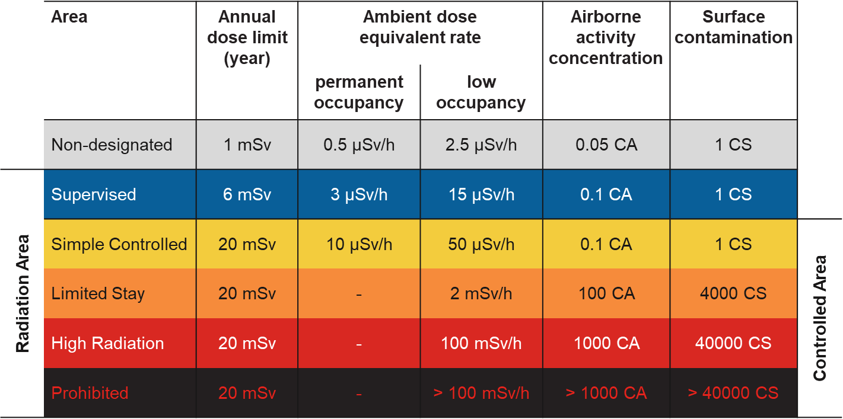
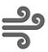

BDF/SHiP design optimization
RP studies based on FLUKA MC simulations were performed for a design optimization of BDF/SHiP@HI-ECN3
ALARA approach
Optimization required to ensure that exposure of personnel to radiation and radiological impact on environment are As Low As Reasonably Achievable
Prompt radiation
Reduce prompt radiation to comply with radiation area classification in the surrounding accessible areas as well as the 1 mSv limit at the CERN fence
Radiation area classification
residual radiation
Limit activation of target and experimental area to reduce residual dose rates to be compatible with an adequate area classification
Air and soil activation
Reduce activation of air and its releases into the environmental. Limit soil activation (³H<1000 Bq/kg, ²²Na<50 Bq/kg) and transfer to groundwater
Environmental impact
Reduce environmental impact from prompt radiation and releases of activated air to fulfill CERN’s dose objective for the public of <10 uSv/year

Slide 7
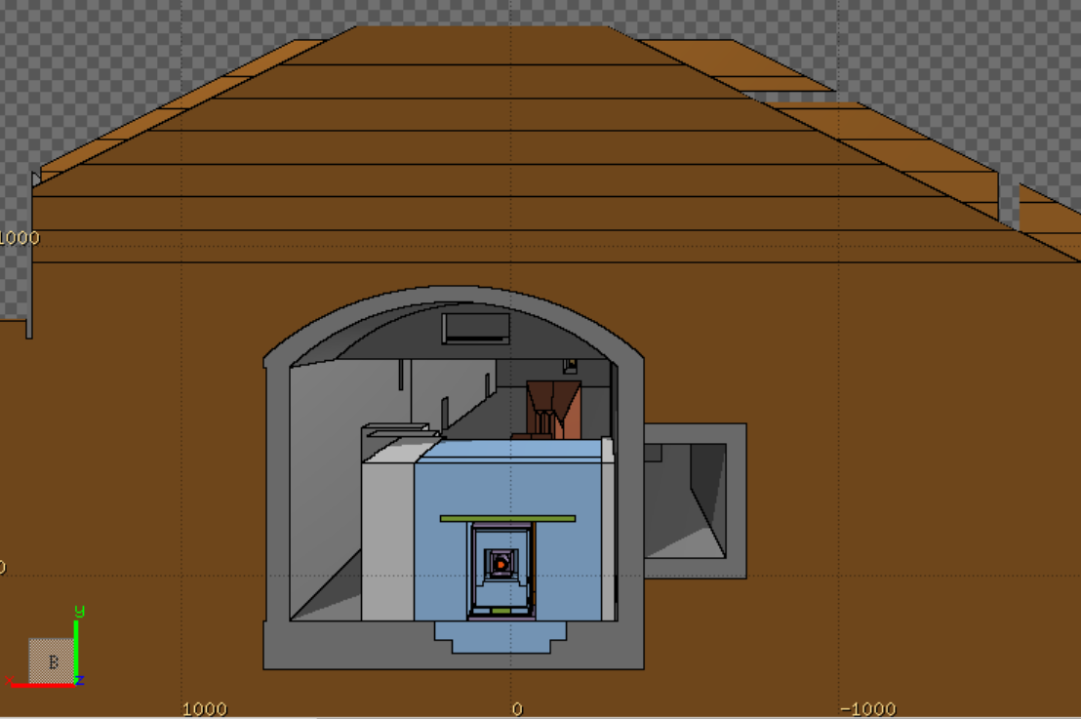
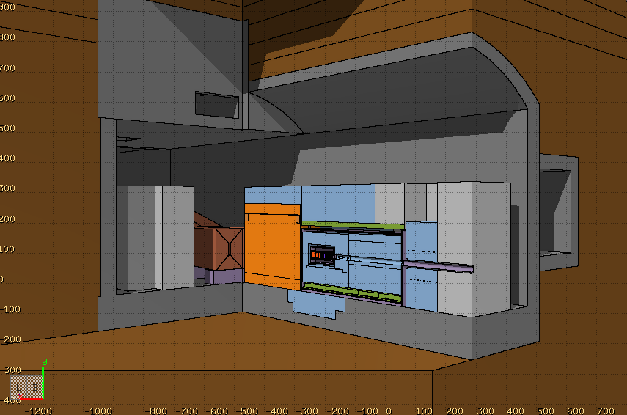
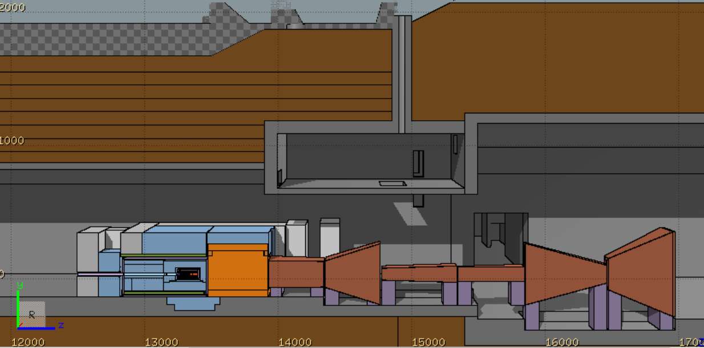
BDF/SHiP FLUKA model
FLUKA hosted by CERN [1-3]
Target complex & muon shield, Created using FLAIR [4]
A detailed BDF/SHiP target complex together with the muon shield was implemented in FLUKA
Optimized BDF dump with reduced shielding and re-use of existing, already activated TCC8/TT7 shielding blocks, while maintaining SHiP physics performance
Shielding embedded in vacuum vessel
FLUKA geometry includes the full underground TCC8/ECN3 cavern and surrounding galleries, tunnels, rooms, etc.
Ground profile data from CERN’s Geographic Information System and technical drawings were used to model the surrounding ground
Moraine
8 m
TCC8
Muon shield
1.7 T
1.6 m
Vacuum vessel
11 m
1.6 m
W-TZM target
4.8 m
Magnetic part of hadron stopper
1.6 T
1 m
Muon shield
ECN3
Floor shielding (13.3 m³)
Stainless steel
US1010
~180 m³ of cast iron + US1010
~360 m³ of concrete
Concrete
Moraine
Cast iron

Slide 8
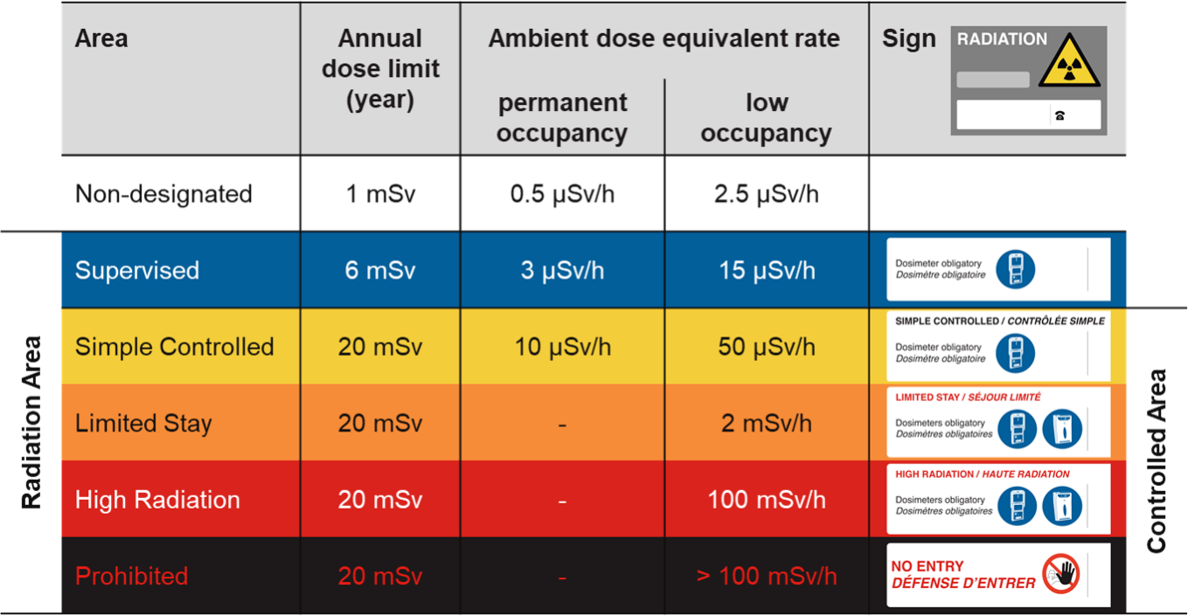
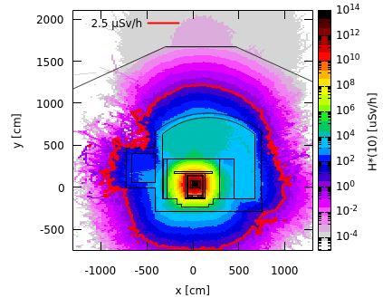
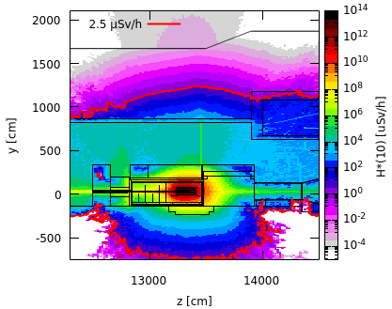
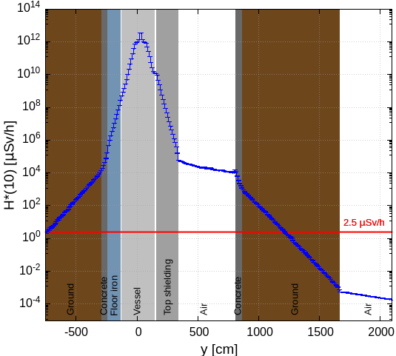
Prompt radiation in target area
Avg. intensity of 5.6×10¹² p/s
Cross-sectional view
Side view
Along y-axis
(-20 cm < x < 80 cm)
(13260 cm < z < 134380 cm)
(13260 cm < z < 13380 cm)
(-20 cm < x < 80 cm)
Shielding design is well optimized for the prompt radiation
Annual limit of Non-designated Area on CERN domain and at CERN fence (1 mSv/y) as well as dose objective for members of the public (10 uSv/y) is by far met

Slide 9
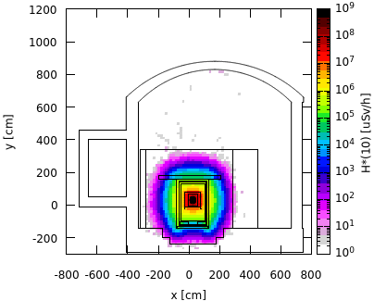
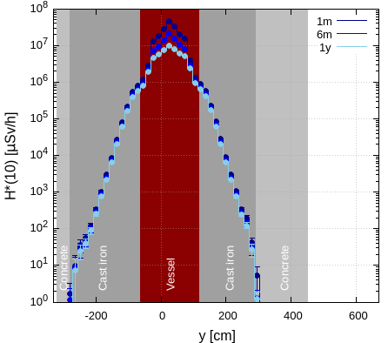
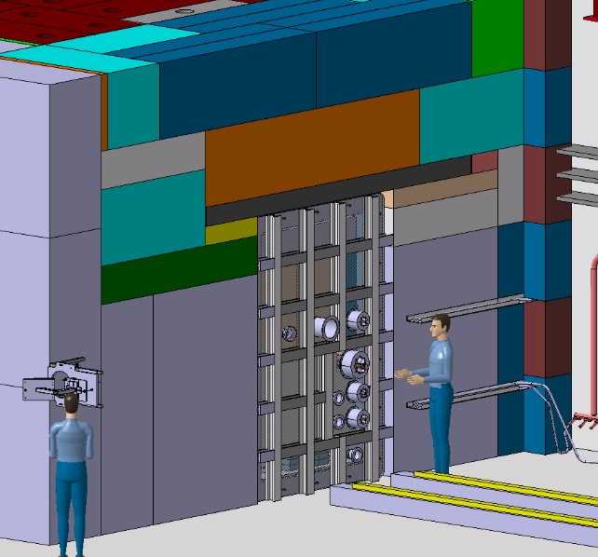
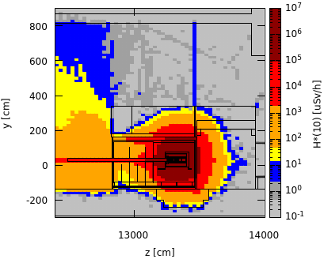
Residual radiation in target area
Total PoT 6×10²⁰
Cross-sectional view, target level
Along x-axis, working height
Upstream of vessel w/o upstream shielding
Preliminary worst case manual intervention scenario
1 month cool-down
1 month
(13240 cm < z < 13390 cm)
(15 cm < y < 45 cm)
(13240 cm < z < 13390 cm)
(-15 cm < x < 80 cm)
Shielding removed
x [0,40]
x_beam = 26 cm
After removal of the shielding upstream of the vessel, residual dose rates of several 100 µSv/h are expected
Supervised Radiation Area on the sides
Further optimization by movable shielding
The shielding design contains well the high residual dose rates reaching in the central target region several 10 Sv/h after 1 month of cool-down
The residual dose rates outside the shielding are < 1 µSv/h

Slide 10
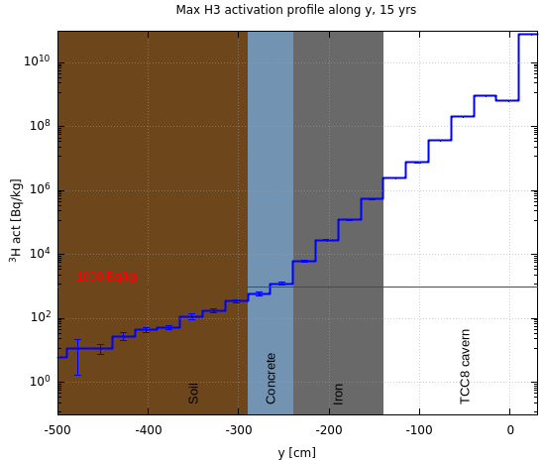
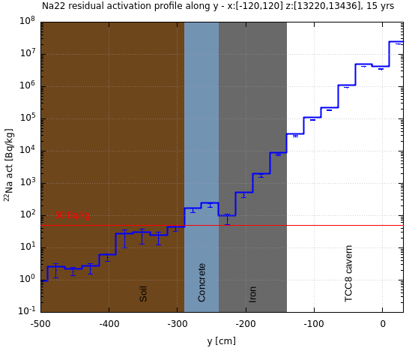
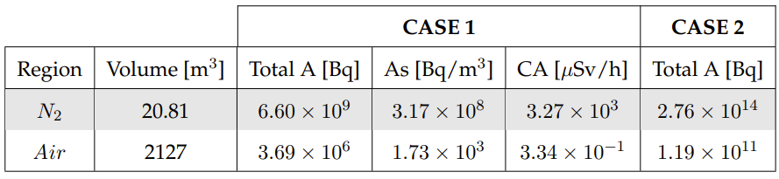
Air and soil activation
Total PoT 6×10²⁰
PoT 4×10¹⁹ per year
Specific activity of ³H and ²²Na in the soil below TCC8 (most critical area)
Air activation
Activation of air in target complex area were studied
Production of radionuclides evaluated with FLUKA in combination with ActiWiz [5]
³H
²²Na
¹
CASE 1: build-up of radionuclides during operation w/o air extraction and 30 min cooldown time before air release
CASE 2: constant immediate release of air (worst-case for upper limit of environmental impact)
Thanks to floor iron shielding, ³H and ²²Na activity concentrations in the soil are below respective design limits
A hydro-geological study is underway, which will allow to refine the design limits and possibly allow to reduce the required shielding
Flush of target complex with fresh air before any access to reduce specific airborne radioactivity to be compatible with 0.1 CA
Exposure of members of the public due to air releases is negligible
¹ Person working 40h/w, 50w/y with standard breathing rate in activated air with CA = 1 receives 20 mSv

Slide 11
BDF Target Studies

Slide 12
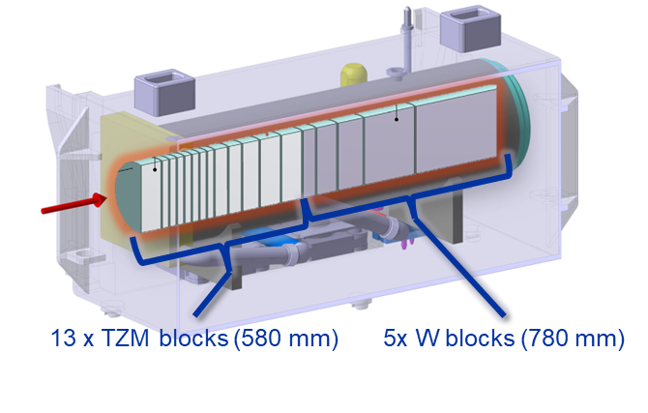
BDF Target baseline design
Baseline Design (CDS) – Water cooled, W + TZM cladded w/ Ta2.5W
Pursued during the comprehensive design phase → C. Ahdida et al., SPS Beam Dump Facility - Comprehensive Design Study, CERN-2020-002
Prototype + test with beam + Post irradiation examination

Slide 13
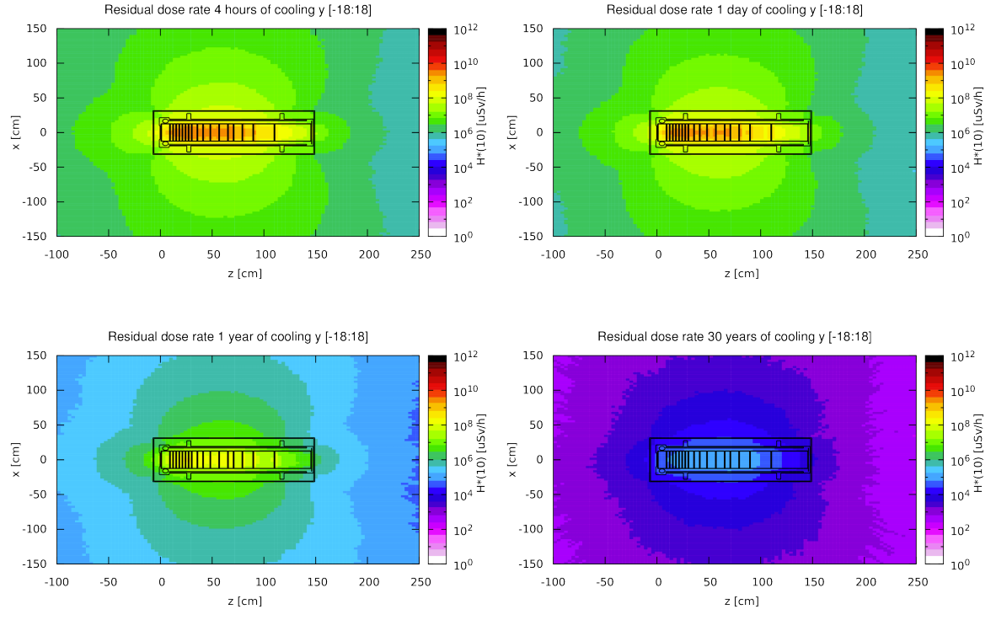
Residual Radiation – baseline CDS target
Total PoT 4×10¹⁹ (5 yrs)
Longitudinal cut along the target
The residual dose rates of the target were studied for 5 years of operation (now 15 yrs) and different cool-down times
The highest dose rates are in the order of 100 Sv/h after 4 hours of cooling and a few Sv/h after 1 year
Even after 30 years, dose rates at 40 cm still of the order of a few mSv/h → dedicated storage place in facility for irradiated target
For radioactive transport the max. dose rate level at any point on the external surface of a package shall not exceed 2 mSv/h
Thick iron cask (~30 cm thick) for transportation and storage as well as during handling
4 hours cool-down
1 day cool-down
1 year cool-down
30 years cool-down

Slide 14
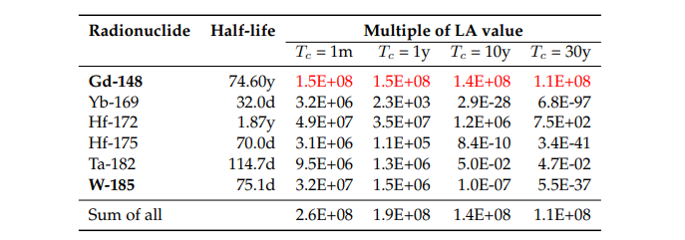
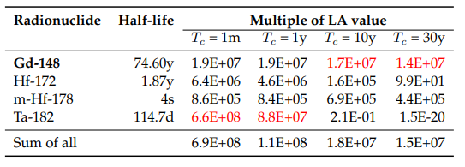
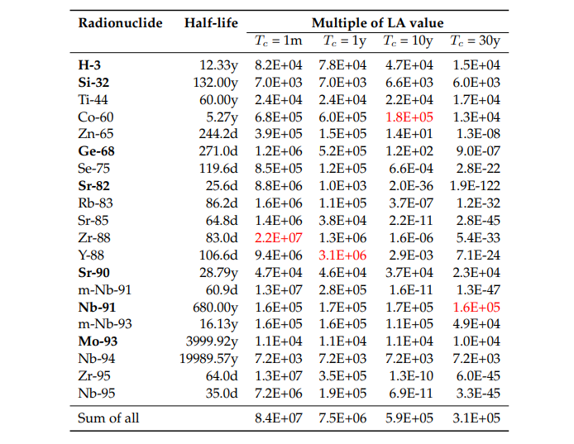
CDS target radionuclide inventories
Total PoT 2×10²⁰ (5 yrs)
LA multiples of BDF target materials
Main contributors (>1%), sum for all radionuclides
W
Ta
TZM
Pure alpha/beta emitters are shown in bold
Dominant radionuclide is shown in red
Total PoT 2×10²⁰ (5 yrs) + 1 month cool-down
Target | Material | Mass [kg] | Multiple LL | Multiple LA | A [Bq]
CDS | W | 695 | 1.9E+08 | 2.6E+08 | 9.2E+14
 | TZM | 271 | 1.1E+09 | 8.4E+07 | 1.8E+14
 | Ta | 28 | 1.7E+11* | 6.9E+08 | 9.8E+14
*Dominated (99.9%) by Ta-182 (115 d half-life)

Slide 15
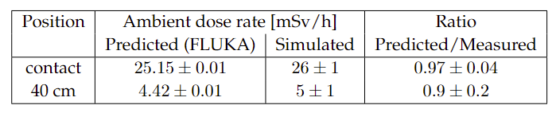
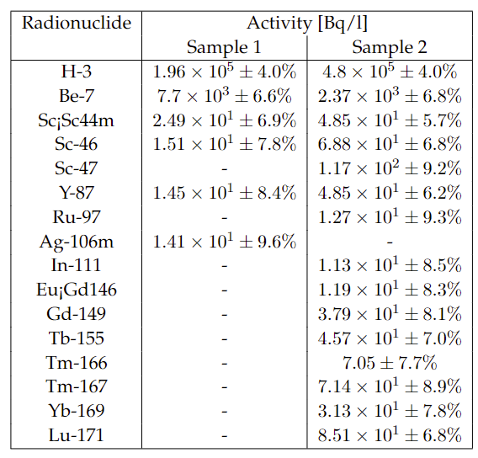
Prototype Target Tests
Benchmark of residual dose rates (mSv/h)
BDF target prototype w/ in total 14 h irradiation in TCC2, leading to 2.4E16 PoT
Target activation was measured and compared to FLUKA simulations showing excellent agreement
Cooling water activation was estimated w/ FLUKA
Estimated residual dose rate after 1h of cooling at 40 cm from the cartridge is 18.7 mSv/h, while the PMI monitor measured 16.9 mSv/h
Both samples showed the presence of high-Z spallation products some of them could have been produced in the target materials
Water-cooling filter with debris was analysed via EDX
  No peaks were found for Ta, W, Mo or Ti
  Metallic particle (Al, Ca, Fe, Cl, Fe, Cr)
Radionuclides in water samples
Water samples were analysed by liquid scintillation and gamma spectrometry

Slide 16
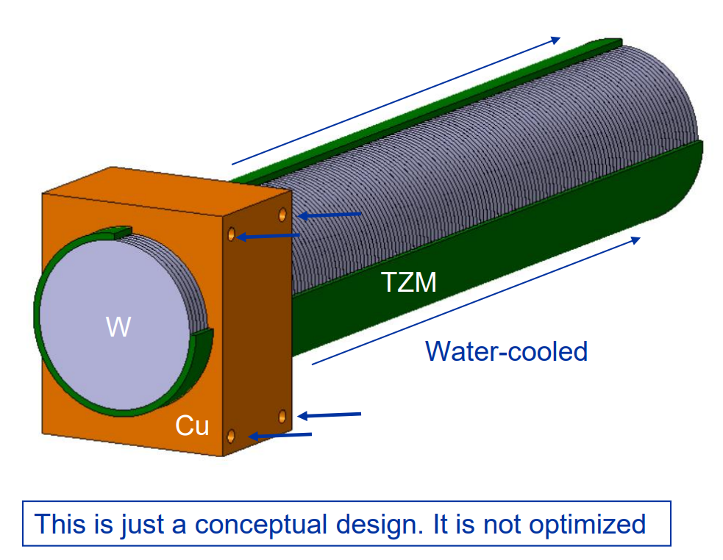
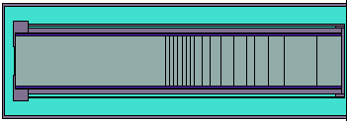
Alternative BDF target design studies
Baseline Design (CDS) – Water cooled, W + TZM cladded w/ Ta2.5W
Investigation of alternative claddings (Nb, Nb-1Zr, Nb-10Hf-1Ti)
Alternative designs currently being studied in the TDR
W Helium cooled Target
Enclosed compact
Cu + W Target
Investigation of radionuclide inventories
Expected to be less critical from a radiological point of view
D = 33 cm, L = 201 cm

Slide 17
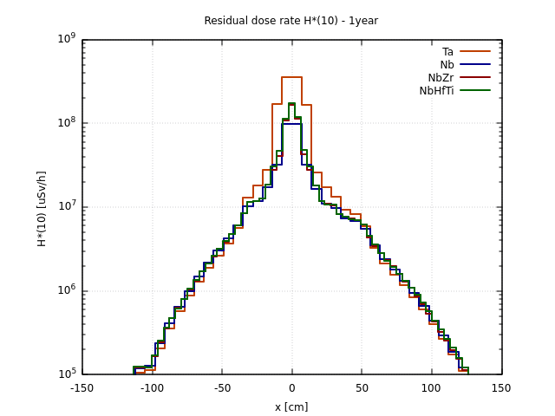
Alternative Claddings
Cladding materials:
  Tantalum –16.6 g/cm3
  Nb (ASTM R04210 – Type 2) – 8.6 g/cm3
  Nb-1Zr (ASTM R04261 – Type 4) – 8.6 g/cm3
  Nb-10Hf-1Ti (ASTM R04295) – 8.86 g/cm3
Total PoT 2×10²⁰ (5 yrs), 1y cool-down
Residual dose rates (uSv/h)
Total PoT 2×10²⁰ (5 yrs)
Includes residual dose rates from surrounding material
Nb-94 half-life of 20300 yrs
Waste classification as FA-MA waste to be disposed of in Switzerland (no open pathway so far for such activation of Ta/Nb)
No difference in the residual dose rates for the various Nb claddings
* LMA: Acceptance Activity Limits, if activity levels < LMA candidate for elimination in France

Slide 18
Alternative BDF target design studies
Baseline Design (CDS) – Water cooled, W + TZM cladded w/ Ta2.5W
Investigation of alternative claddings (Nb, Nb-1Zr, Nb-10Hf-1Ti)
Alternative designs currently being studied in the TDR
W Helium cooled Target
Enclosed compact
Cu + W Target
Investigation of radionuclide inventories
Expected to be less critical from a radiological point of view
D = 33 cm, L = 201 cm

Slide 19
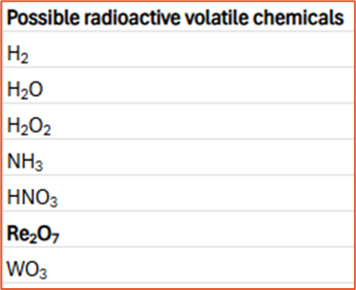
Radionuclide inventories comparison
Total PoT 2×10²⁰ (5 yrs) + 1 month cool-down
Target | Material | Mass [kg] | Multiple LL | Multiple LA | A [Bq]
Large W | W | 3178 | 1.3E+08 | 8.2E+08 | 3.7E+15
 | TZM¹ | 219 | 4.0E+07 | 1.8E+06 | 5.0E+12
CDS | W | 695 | 1.9E+08 | 2.6E+08 | 9.2E+14
 | TZM | 271 | 1.1E+09 | 8.4E+07 | 1.8E+14
 | Ta | 28 | 1.7E+11* | 6.9E+08 | 9.8E+14
LA for short-cool-down times:
For 1h (4h), Hf-178m (4s half-life) produced via Ta-178m (2.36h half-life) is dominant (48%)
For 1d, Gd-148 (74y half-life) becomes most important (38%) (as for 1 month)
*Dominated (99.9%) by Ta-182 (115 d half-life)
¹TZM cladding layer
See backup slides for list of radionuclides
When comparing the W parts of the two targets, the multiple of LA and total A are a factor 3-4 higher (mainly due to the higher mass) for the large W target than the CDS target
There are only few percent differences between the TZM quantities
The Ta cladding of the CDS target exhibits mostly the highest values
Also Iodine can make volatile molecules with Cobalt, Hafnium and Tantalum

Slide 20
Summary & Questions
Main radiological aspects regarding an implementation of BDF/SHiP in ECN3 were investigated
First shielding design for an optimization of exposure of personnel to radiation and radiological impact on environment
Further detailed studies and optimization in the Technical Design Phase until end of 2025 to achieve first beam on target in 2030
Questions
  What potential release of radionuclides from the target to the He loop do you expect? How do you plan to mitigate the contamination?
  How do you account for H-3 out-diffusion?
  What are your plans for radioactive waste management (characterization, conditioning, waste packaging, shielding, elimination)
  Do you foresee any destructive works on the activated target/surrounding elements?

Slide 22
Bibliography
[1] Website: https://fluka.cern
[2] C. Ahdida, D. Bozzato, D. Calzolari, F. Cerutti, N. Charitonidis, A. Cimmino, A. Coronetti, G. L. D’Alessandro, A. Donadon Servelle, L. S. Esposito, R. Froeschl, R. García Alía, A. Gerbershagen, S. Gilardoni, D. Horváth, G. Hugo, A. Infantino, V. Kouskoura, A. Lechner, B. Lefebvre, G. Lerner, M. Magistris, A. Manousos, G. Moryc, F. Ogallar Ruiz, F. Pozzi, D. Prelipcean, S. Roesler, R. Rossi, M. Sabaté Gilarte, F. Salvat Pujol, P. Schoofs, V. Stránský, C. Theis, A. Tsinganis, R. Versaci, V. Vlachoudis, A. Waets, M. Widorski, New Capabilities of the FLUKA Multi-Purpose Code, Frontiers in Physics 9, 788253 (2022)
[3] G. Battistoni, T. Boehlen, F. Cerutti, P.W. Chin, L.S. Esposito, A. Fassò, A. Ferrari, A. Lechner, A. Empl, A. Mairani, A. Mereghetti, P. Garcia Ortega, J. Ranft, S. Roesler, P.R. Sala, V. Vlachoudis, G. Smirnov, Overview of the FLUKA code, Annals of Nuclear Energy 82, 10-18 (2015)
[4] V. Vlachoudis, FLAIR: A Powerful But User Friendly Graphical Interface For FLUKA, in Proc. Int. Conf. on Mathematics, Computational Methods & Reactor Physics (M&C 2009), Saratoga Springs, New York (2009)
[5] H. Vincke, C. Theis, ActiWiz – optimizing your nuclide inventory at proton accelerators with a computer code, Progress in Nuclear Science and Technology (2014)
[6] P. Vojtyla, Models for assessing the dosimetric impact of releases of radioactive substances from CERN facilities to the environment – Air, CERN Internal report (2021)

Slide 23
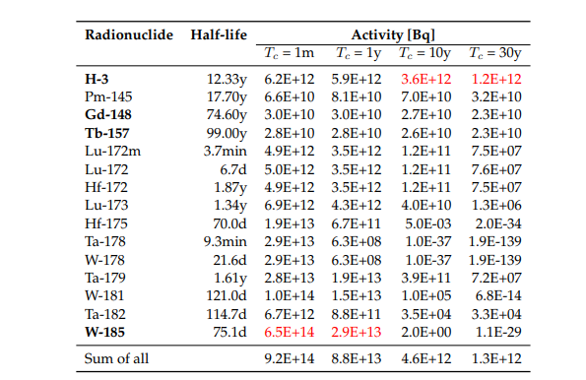
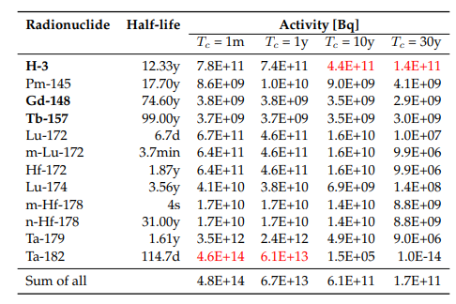
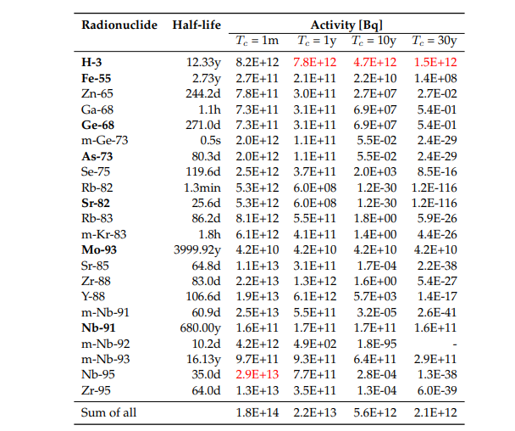
Activities multiples – CDS target
Total PoT 2×10²⁰ (5 yrs)
Activities of BDF target materials
W
Ta
TZM
Pure alpha/beta emitters are shown in bold
Dominant radionuclide is shown in red
Main contributors (>1%), sum for all radionuclides

Slide 24
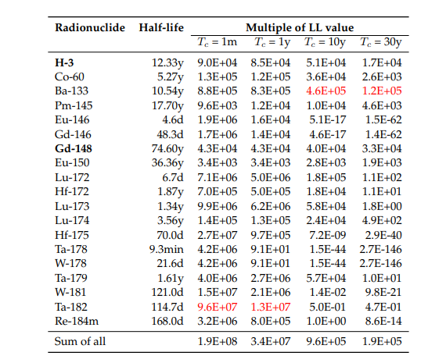
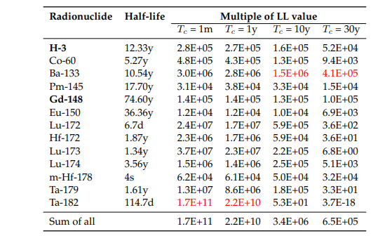
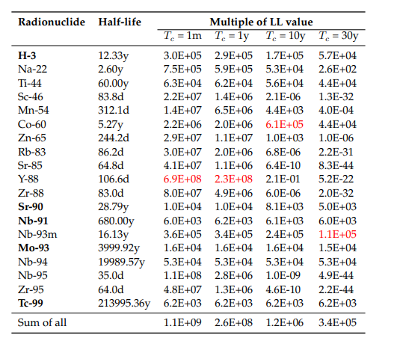
Multiples of Swiss Clearance Limits (LL)
CDS Target
Total PoT 2×10²⁰ (5 yrs)
LL multiples of BDF target materials
W
Ta
TZM
Pure alpha/beta emitters are shown in bold
Dominant radionuclide is shown in red
Main contributors (>1%), sum for all radionuclides

Slide 25
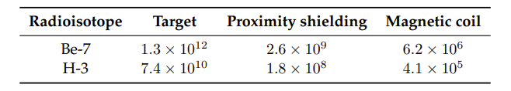
Water activation – CDS
Activation of water from cooling circuits was estimated
Shielding estimate around demineralization cartridges was performed assuming Be-7 to be stopped, but no target debris
  → 50 cm cylindrical concrete shielding was foreseen and for the roof of the area 165 cm concrete
Remaining water in circuit mostly contains H-3 with a concentration of around 0.5 GBq/l per year of operation
Due to the high H-3 production in the target (~18 TBq during 5 yrs operation), a significant contribution to the H-3 concentration in the water can come from H-3 out-diffusion from the target disks and subsequent trapping in the cooling water
In case of 1% of out-diffusion every 2 months (best guess, no data available) and 100% trapping, the H-3 concentration from out-diffusion amounts to ~60 MBq/l every 2 months
The exchange of cooling water (1 m³) in one year would result in ~220 GBq of H-3 activity
PoT 1×10¹⁹ (1 yr)
Total Activity (Bq) for H-3 and Be-7
Results above do not take out-diffusion from target into account

Slide 26
Alternative cladding materials
Material: |  | Niobium | Nb-1Zr | Nb-10Hf-1Ti
 |  | (ASTM R04210 | (ASTM R04261 | "C103"
 |  | Type 2) | Type 4) | (ASTM R04295)
Density (g/cm3): |  | 8.6 | 8.6 | 8.86
Composition: | C | 0.01 | 0.01 | 0.015
Max Weight % | N | 0.01 | 0.01 | 0.01
 | O | 0.025 | 0.025 | 0.025
 | H | 0.0015 | 0.0015 | 0.0015
 | Zr | 0.02 | 0.8-12 | 0.7
 | Ta | 0.3 | 0.5 | 0.5
 | Fe | 0.01 | 0.01 | -
 | Si | 0.005 | 0.005 | -
 | W | 0.05 | 0.05 | 0.5
 | Ni | 0.005 | 0.005 | by difference
 | Mo | 0.02 | 0.05 | -
 | Hf | 0.02 | 0.02 | 9-11"
 | Ti | 0.03 | 0.03 | 0.7-1.3"
Reference: |  | [1] | [2] | [3]
[1] | https://www.navstarsteel.com/niobium-sheet.html
[2] | https://www.tantalum-niobium.com/niobium/nb-1zr-wire-rod.html
[3] | Ximenes Franqueira R., Internal communication, (2021)

Slide 27
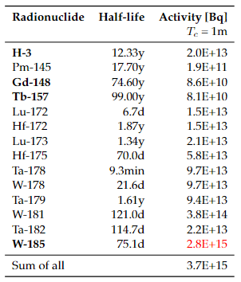
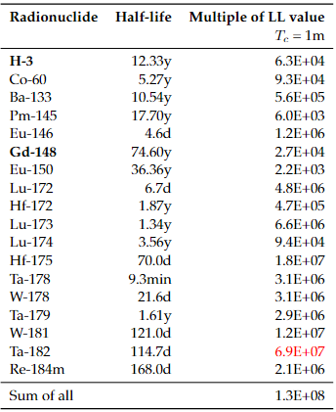
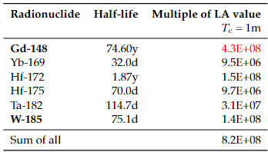
Radionuclide inventory of large W target
Tungsten part
Total PoT 2×10²⁰ (5 yrs) + 1 month cool-down
Tungsten – Total Activity (Bq)
Tungsten – Multiple of LL
Tungsten – Multiple of LA
Pure alpha/beta emitters are shown in bold
Dominant radionuclide is shown in red
Main contributors (>1%), sum for all radionuclides

Slide 28
Large W target – LA for short cool-down
Tungsten part
Total PoT 2×10²⁰ (5 yrs)
Tungsten – Multiple of LA
1 hour
1 day
Radionuclide | Halflife | 1h
Hf-178m | 4s | 1.2E+09
Gd-148 | 74.60y | 4.3E+08
W-187 | 23.9h | 3.2E+08
W-185 | 75.1d | 1.9E+08
Hf-172 | 1.87y | 1.5E+08
Ta-182 | 114.7d | 3.8E+07
Sum of all |  | 2.52E+09
Radionuclide | Halflife | 1d
Gd-148 | 74.60y | 4.3E+08
W-185 | 75.1d | 1.9E+08
W-187 | 23.9h | 3.2E+08
Hf-172 | 1.87y | 1.5E+08
Ta-182 | 114.7d | 3.8E+07
Yb-169 | 32.0d | 1.7E+07
Ta-183 | 5.1d | 1.7E+07
Hf-175 | 70.0d | 1.3E+07
Sum of all |  | 1.13E+09
Pure alpha/beta emitters are shown in bold
Dominant radionuclide is shown in red
Main contributors (>1%), sum for all radionuclides
For 1 h of cool-down, Hf-178m is dominant (48%) and wrt. to 1 month of cool-down also W-187 and W185 are relevant (Hf-178m comes from the decay of Ta-178m (2.36h half-life)
For 4 hours of cool-down, the important radionuclides are as for 1 hour
For 1 day of cool-down, Gd-148 becomes most important (38%)

Slide 29
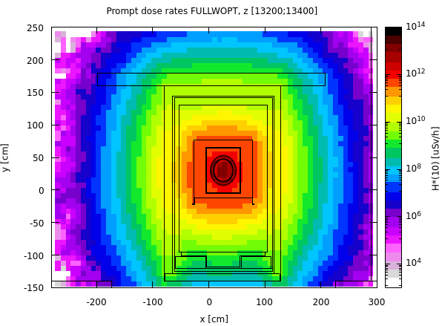
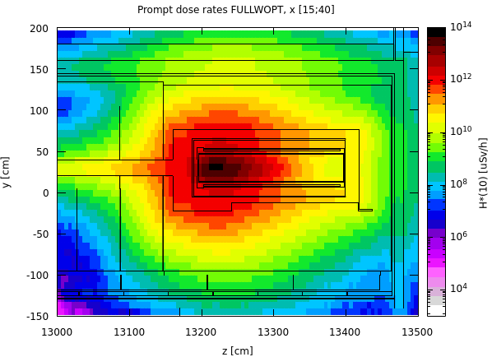
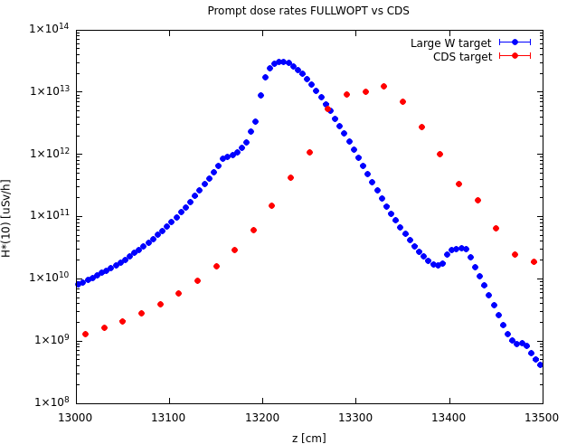
Prompt radiation for large W target
4×10¹³ p / 7.2 s
Cross-sectional cut at the target
Longitudinal cut at the target
Along z – Large W target vs. CDS target
2 m
1.4 m
The highest dose rate are observed in the upstream part of the large W target with a sharp decrease towards its downstream end, which will lead to a significantly higher activation in the upstream than the downstream part of the target
The max. dose rate reached in the large W target is with ~3.2e13 uSv/h about a factor 2.6 higher than what is reached at maximum in the CDS target

Slide 30
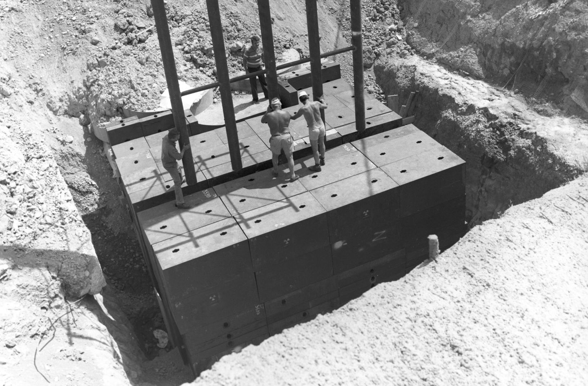
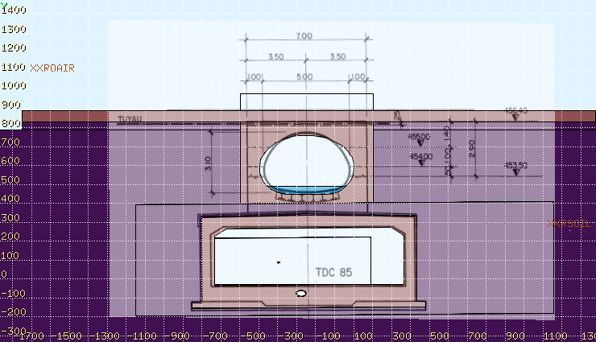
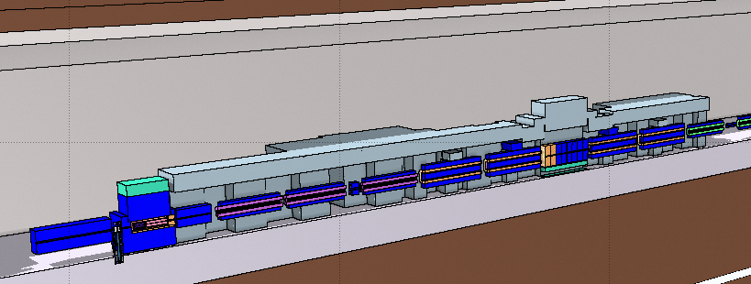
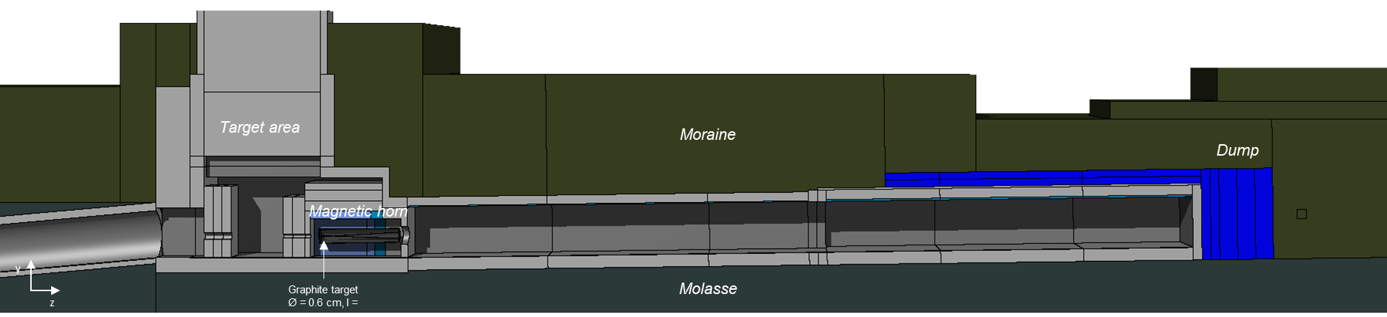
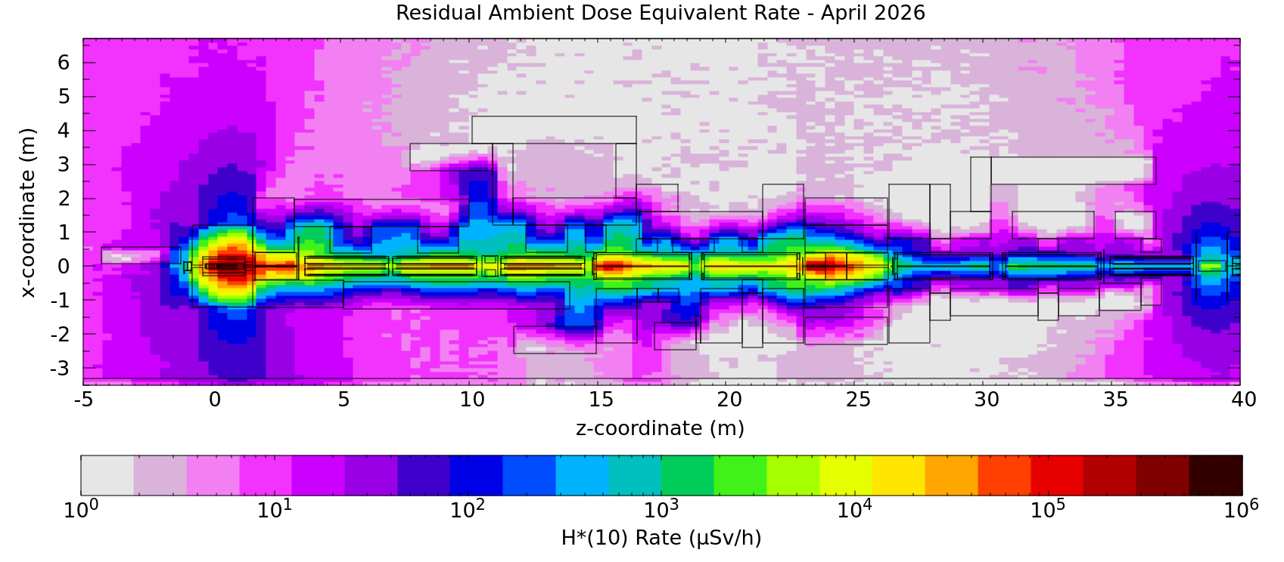
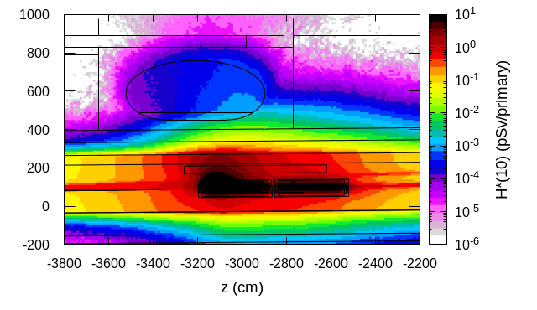
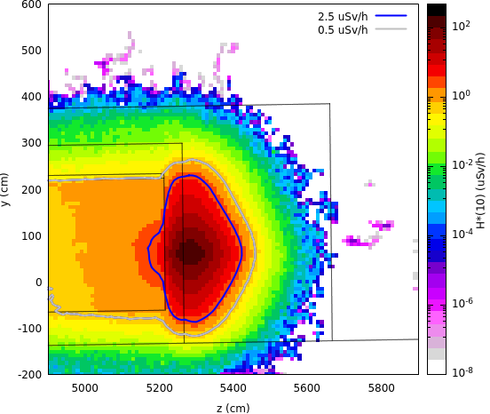
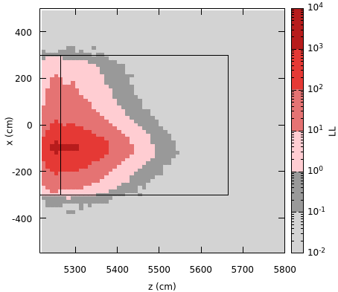
Some additional studies
Beam transfer
TT7 shielding recovery
TCC8 dismantling
Several RP studies for the high intensity SPS-ECN3 beam transfer were performed
This includes studies for a bridge above the TDC85 transfer tunnel near ECN3
Shielding recovery from discontinued CERN PS Neutrino Facility (PSNF)
Dismantling of the highly radioactive TCC8 target area in 2026
Evaluation of residual dose rates and radio-nuclide inventories for operational RP as well as radioactive transport and waste studies
~100 m³ std. cast iron blocks
~50 m³ non-std cast iron blocks
~3 MCHF, investment <1/3
TCC8
Residual H*(10)
Prompt H*(10)
Residual H*(10)
Radioactive waste zoning
Various beamline and shielding configurations were investigated

Slide 31




Environmental impact
PoT 4×10¹⁹ per year
Dose from air releases
Dose from stray radiation
Used max. dose coefficients from different age groups [6]
Annual effective dose from muons
Positions of nearby population groups
Effective dose estimates
CERN fence
Release point
Muon prompt radiation aboveground downstream ECN3
H-3 release due to air activation of ~80 kBq
Worst-case immediate air release (CASE 2) yields 3 nSv/year (main contributors: N-13, Ar-41, C-11, O-15) and is thus well below the annual dose objective of CERN
Exposure of members of the public due to air releases is negligible
Annual limit of Non-designated Area on CERN domain and at CERN fence (1 mSv/y) as well as dose objective for members of the public (10 uSv/y) is by far met

