Slide 1


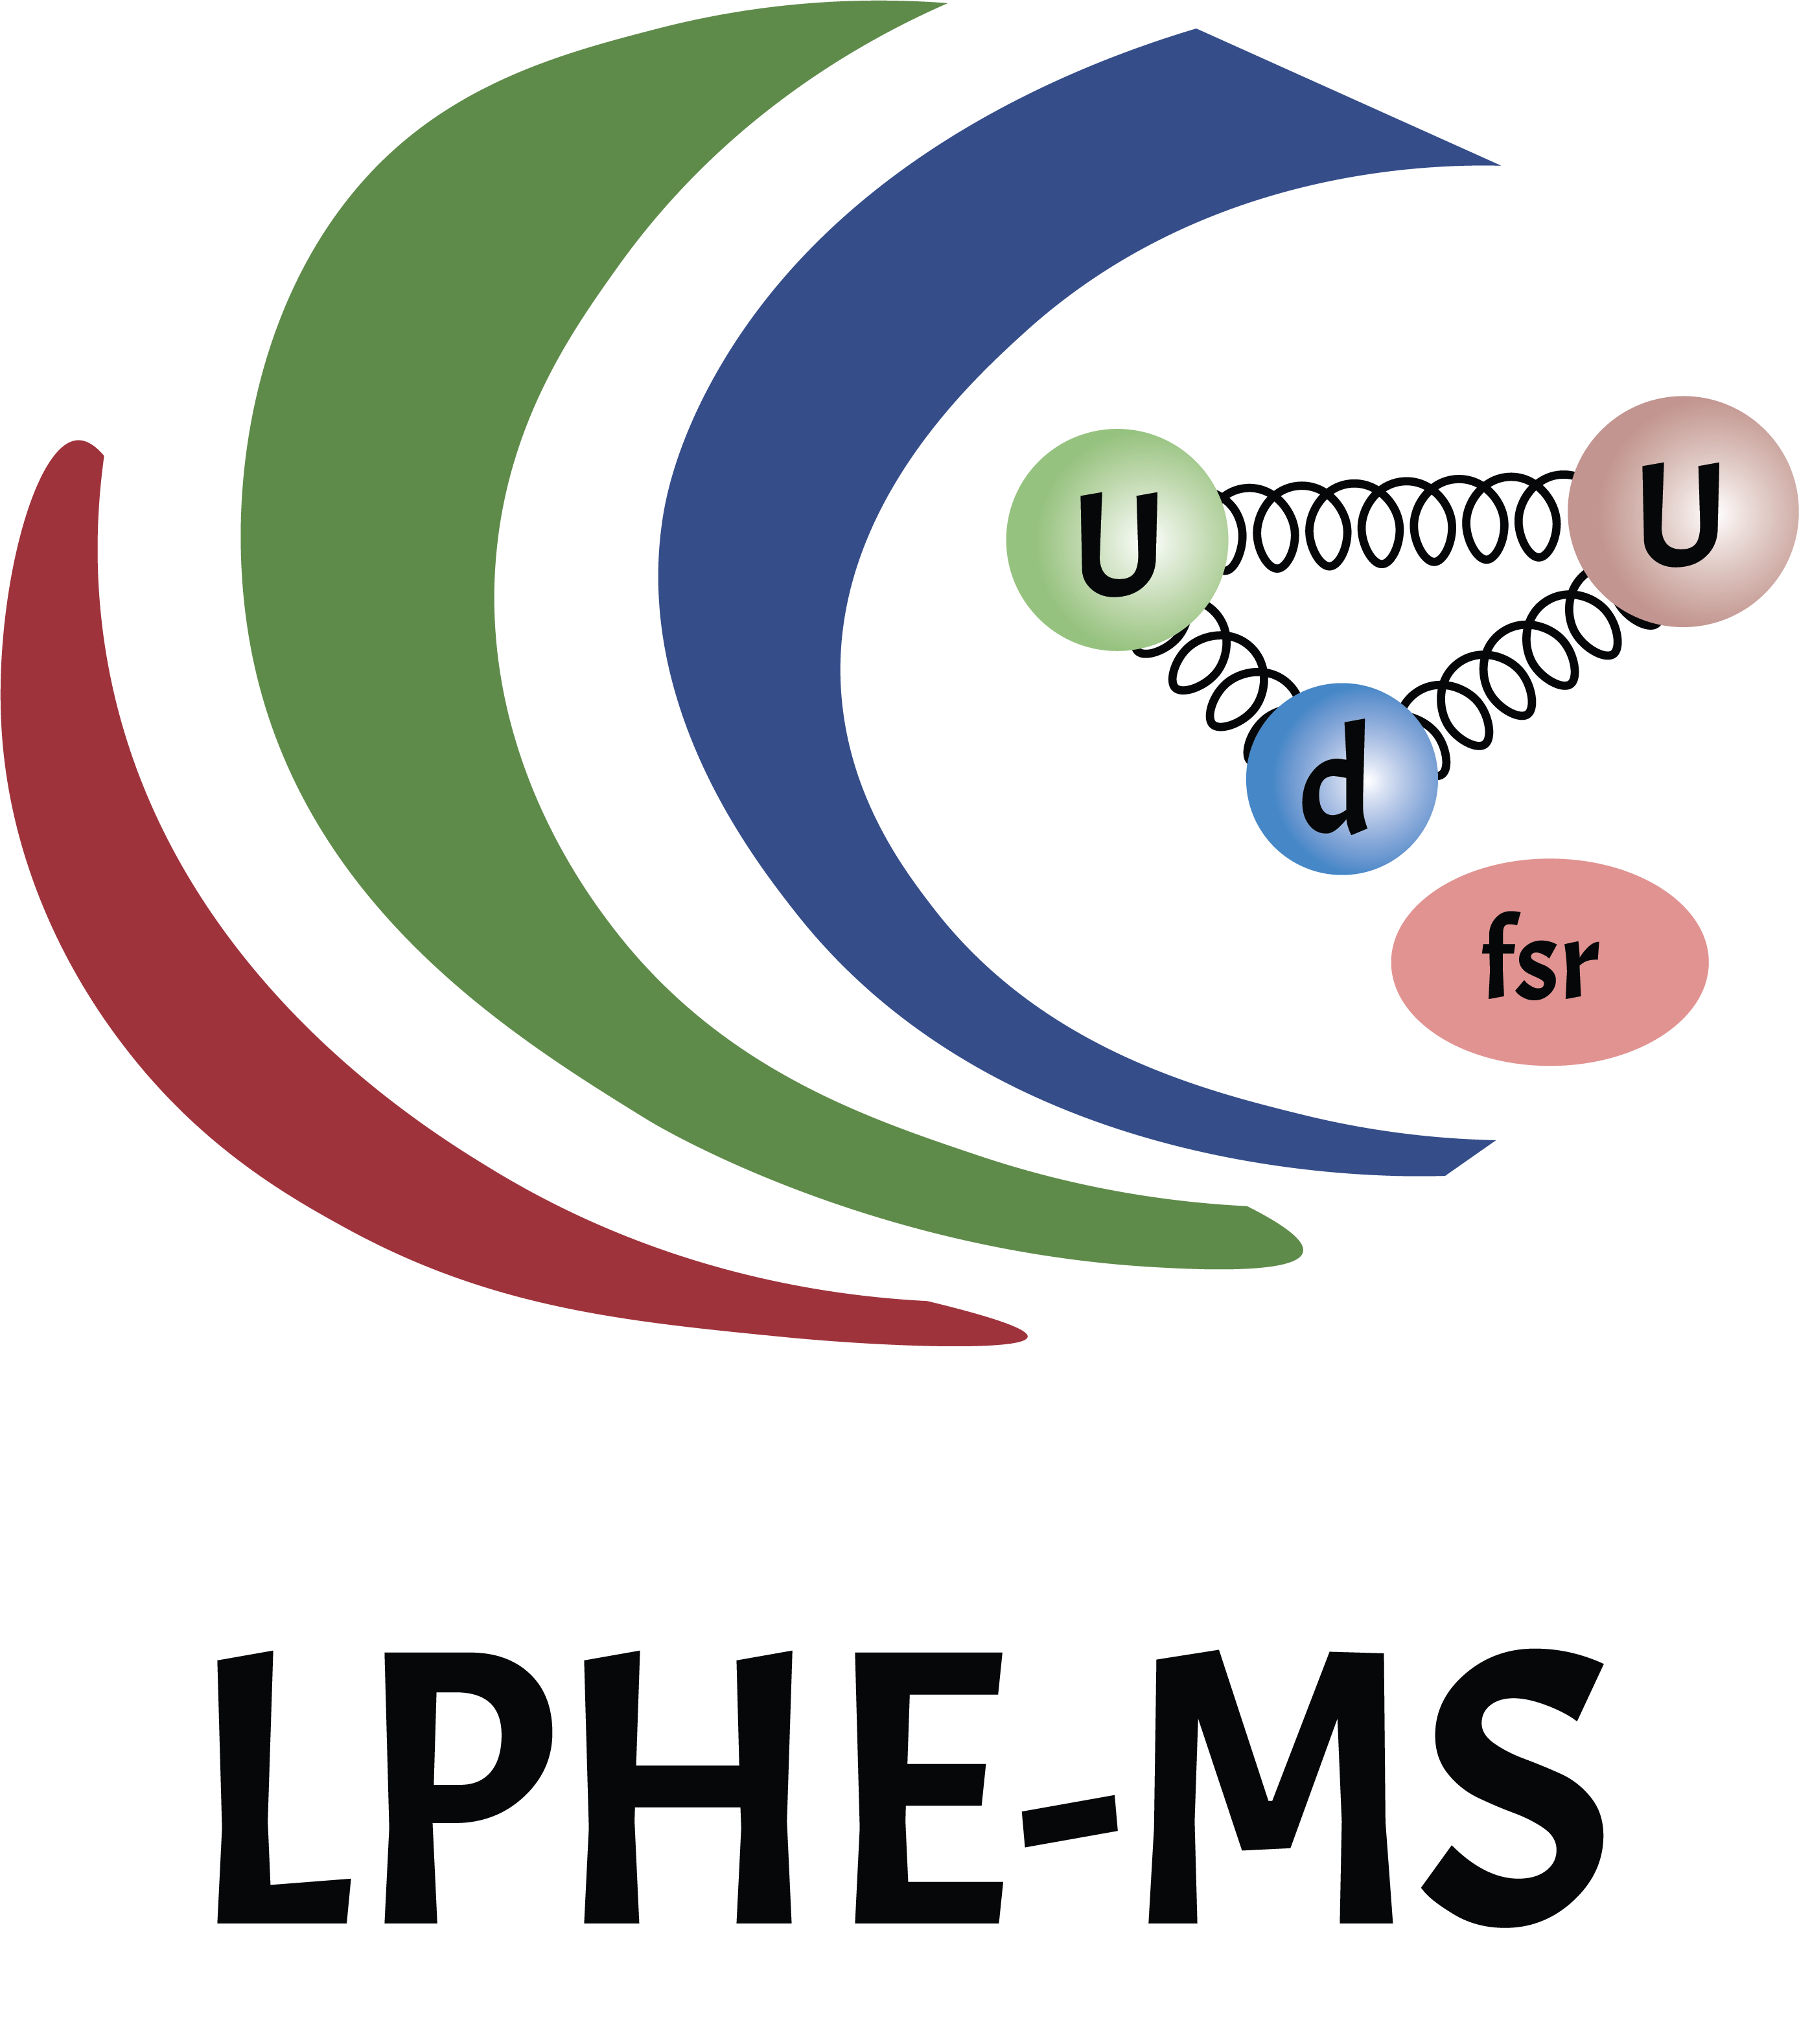

Weak/strong gauge duality in M-Theory on K3xK3
M. Charkaoui, R. Sammani, E. H. Saidi, R. Ahl Laamara

Slide 2
Plan
Introduction
  The Swampland Program
The Weak Gravity Conjecture (WGC).
M-theory on Calabi-Yau fourfold
  3D Effective field theory
  Fibration structure
Weak/strong gauge duality
Conclusion and future directions

Slide 3
Introduction

Slide 4
The Swampland Program
Introduction
11d M-Theory
10d IIA-IIB
…
Energy
Compactification (circles, Calabi-Yau manifolds…)
d-dim EFT
d<11

Slide 5
Introduction
Using different geometries for compactification we get a large spectrum of low energy EFT
Question:
If we start from a low energy EFT can we always get to a theory in the UV compatible with quantum gravity?

Slide 6
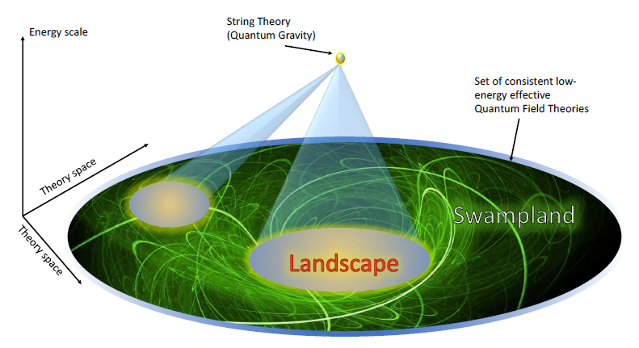
Introduction

Slide 7
Introduction
This is done via conjectures, not yet all proven, but tested in many setups.
Weak Gravity Conjecture
Distance Conjecture
No global symmetries Conjecture…
The asymptotic WGC relates many of the conjectures.

Slide 8
The Weak Gravity Conjecture

Slide 9

The Weak Gravity Conjecture
The Weak Gravity Conjecture
Consider a theory coupled to gravity, with a U(1) gauge symmetry with gauge coupling g
$$S=\int{d^{d}X\sqrt{−G}}[{\left(M_{d}\right)}^{d−2}\frac{R_{d}}{2}−\frac{1}{4g^{2}}F^{2}+…]$$
  Electric WGC: there exists a particle in the theory with mass m and charge q such that:
  $m≤\sqrt{\frac{d−2}{d−3}}gq{\left(M_{d}\right)}^{\frac{d−2}{2}}$; d>3, q=1,2…
  Magnetic WGC: the cutoff scale $Ʌ$ of the effective field theory is bounded from above by the gauge coupling
  $$Ʌ_{WGC}≤g{\left(M_{d}\right)}^{\frac{d−2}{2}};d>3$$

Slide 10
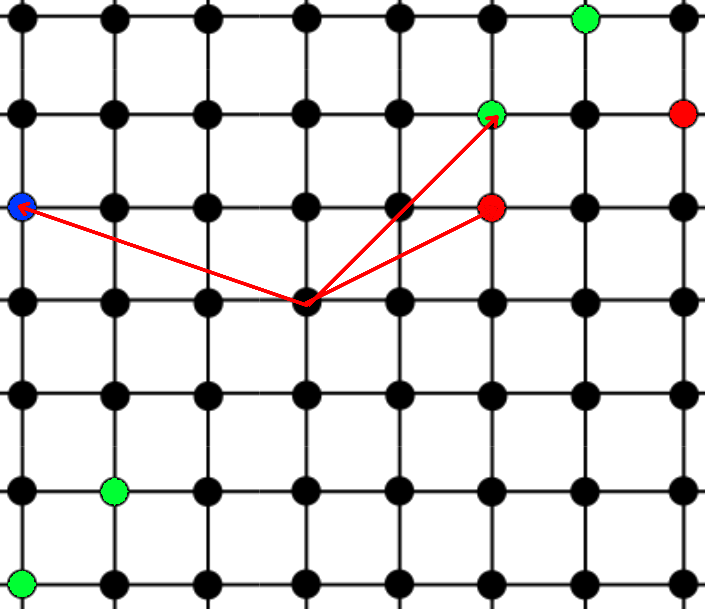
Refinements of the WGC
The Weak Gravity Conjecture
The tower WGC states that there should exist an infinite tower of superextremal states:

Slide 11
M-theory on Calabi-Yau fourfolds

Slide 12
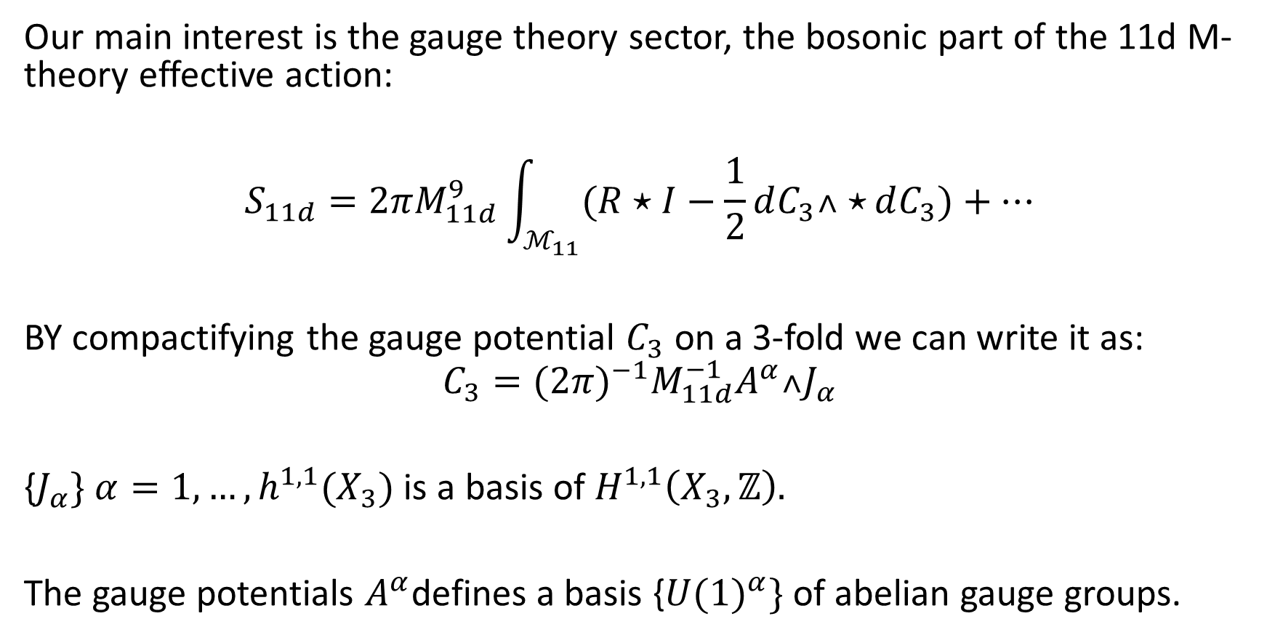
3D EFT
Our main interest is the gauge theory sector, the bosonic part of the 11d M-theory effective action:
$$S_{11d}=2πM_{11d}^{9}\int_{ℳ_{11}}{(R⋆I−\frac{1}{2}dC_{3}˄⋆}dC_{3})+…$$
BY compactifying the gauge potential $C_{3}$ on a 3-fold we can write it as:
$$C_{3}=({2π)}^{−1}M_{11d}^{−1}A^{α}˄J_{α}$$
{$J_{α}\}$ $α=1,…, h^{1,1}(X_{3})$ is a basis of $H^{1,1}\left(X_{3},ℤ\right).$
The gauge potentials $A^{α}$defines a basis {${U(1)}^{α}\}$ of abelian gauge groups.

Slide 13

3D EFT
The duality between the 2-forms space and the 2-cycles space implies:
$$J_{α}C^{β}=δ_{α}^{β}$$
Thus we can define the linear combination:
$${U(1)}_{C}=c_{α}{U(1)}^{α} , C=c_{α}C^{α}∈H_{2}\left(X_{3}\right)$$
The fluctuations of the Kahler form:
$$J=λv^{0}J_{0}+λ^{α}v^{i}J_{i}$$
With $λ$ a positive parameter controlling the volume of the cycles

Slide 14

3D EFT
The action in 3d is given by:
$$S_{3d}=\frac{M_{Pl}}{2}\int_{ℳ_{3d}}{(R⋆I−g_{AB}dΦ^{A}˄⋆dΦ^{B}})−\frac{1}{2g_{3}^{2}}\int_{ℳ_{3d}}{f_{αβ}F^{α}˄⋆F^{β}}$$
With the volume of the manifold given by:
$$𝒱_{X_{4}}=\frac{1}{4!}\int_{X_{4}}{J^{4}}$$
For gravity to remain dynamical we need $𝒱_{X_{4}}<∞.$

Slide 15

Fibration structure
This implies that the manifold must be fibered as:
$$X_{4}=F_{1}×B_{3}$$
Or
$$X_{4}=F_{2}×B_{2}$$
Or
$$X_{4}=F_{3}×B_{1}$$
With the fiber shrinking while the base expanding to keep the voume finite, more precisely the fibers are given by:

Slide 16

Fibration structure
Limits of type T²:$J_{0}^{4}=0, J_{0}^{3}≠0$
$$π:X_{4}→B_{3}$$
$$𝒱_{T²}\sim \frac{1}{λ^{3}},{ 𝒱}_{B_{3}}\sim λ^{3}, λ→∞$$
Limits of type S (K3/$T^{4}):$ $J_{0}^{4}=0, J_{0}^{3}=0, J_{0}^{2}≠0$
$$ρ:X_{4}→B_{2}$$
$$𝒱_{{K3/T}^{4}}\sim \frac{1}{λ²},{ 𝒱}_{B_{2}}\sim λ², λ→∞$$
Limits of type V: $J_{0}^{4}=0, J_{0}^{3}=0, J_{0}^{2}=0$
$$σ:X_{4}→B_{1}$$
$$𝒱_{CY3}\sim \frac{1}{λ},{ 𝒱}_{B_{1}}\sim λ, λ→∞$$

Slide 17
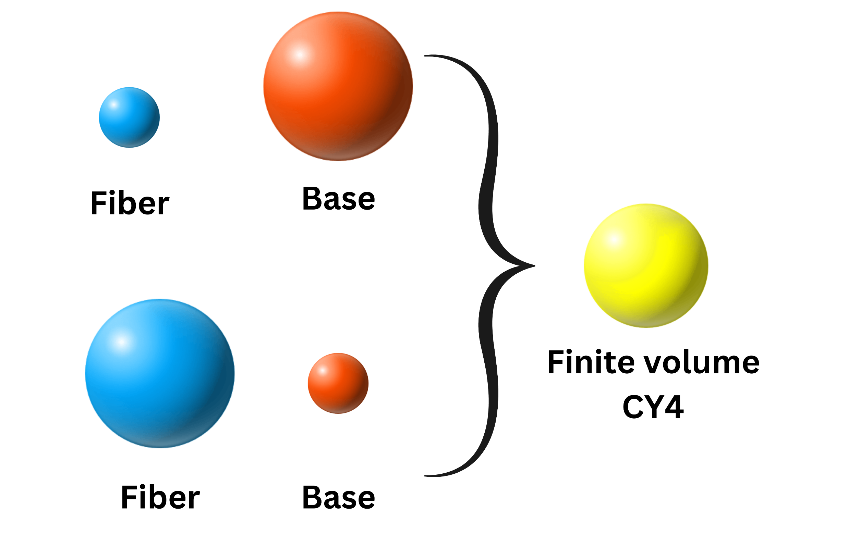

Fibration structure
We focus on the case of type S:
$$X_{4}=S_{∥}×S_{⊥}$$
More precisely we take S=K3.
We find a duality exchanging the fiber and the base, given by the mapping:
$$λ→1/λ$$

Slide 18
Weak/Strong gauge duality

Slide 19

Weak/Strong gauge duality
Given a curve $C=c_{α}C^{α}∈H_{2}\left(X_{3}\right)$:
The gauge coupling in that direction arising from reducing the three-form $C_{3}$is given by:
$${g²}_{YM,C}=g_{3}^{2}(c_{α}f^{αβ}c_{β})$$
If we take curves in the shrinking fiber ${K3}_{||}$ the shrinking of the curves $C_{||}$ gives a weak coupling limit:
$${g²}_{YM,C_{||}}\sim \frac{1}{λ²}$$
Similarly, we get the strong coupling limit from the expanding curves in the surface ${K3}_{⊥}$:
$${g²}_{YM,C_{⊥}}\sim λ²$$

Slide 20
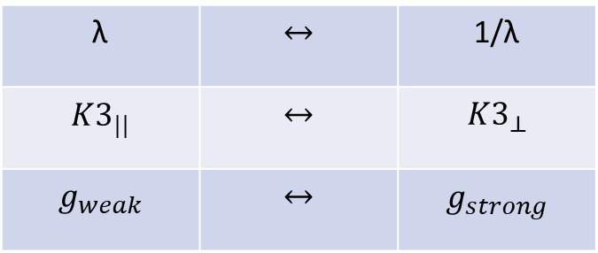

Weak/Strong gauge duality
The duality exchanging the fiber and the base , links also weak and strong gauge couplings:
$$g_{weak}\sim \frac{1}{g_{strong}}$$
We then show the existence of towers of states satisfying the WGC both in weak and strong couplings which is in line with the minimal WGC.
These towers of states are given by the BPS states: M2/$C_{2}$, or non-BPS excitations of M5/K3.
λ | $$↔$$ | 1/λ
${K3}_{||}$ | $$↔$$ | $${K3}_{⊥}$$
$$g_{weak}$$ | $$↔$$ | $$g_{strong}$$

Slide 21
Conclusion
We generalized mathematical results on the fibration of Calabi-Yau manifolds.
We found a duality relating gauge coupling regimes, as well as the fiber and the base of the manifold
We generalized the scope of validity of the Asymptotic WGC to probe weak and strong gauge coupling limits, this is in line with a new refined version of the WGC labeled the minimal WGC and tested it for the case of S=K3

Slide 22
Future directions
Can we extend the Weak/strong gauge duality to an S-duality, or possibly S-Selfduality.
Test the conjecture for type T² and type V, and find a duality relating them as well.

Slide 23
Thank you for your attention

