Slide 1
Investigating Gas Adsorption and Diffusion Dynamics in Zeolite-Based Membranes for Post-Combustion CO₂ Capture
Presenter: Timothy Manda
Jaramogi Oginga Odinga University of Science and Technology
S261/P/9776/24
Supervisors
Dr. Livingstone Ochilo
Dr. Solomon Omwoma

Slide 2
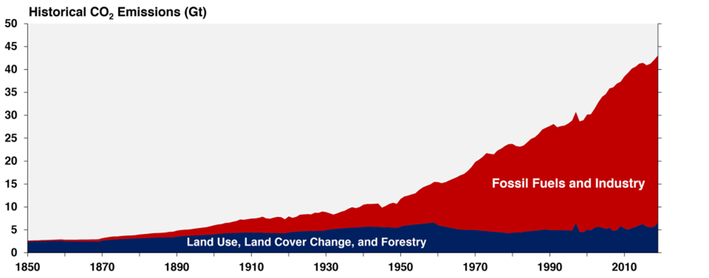
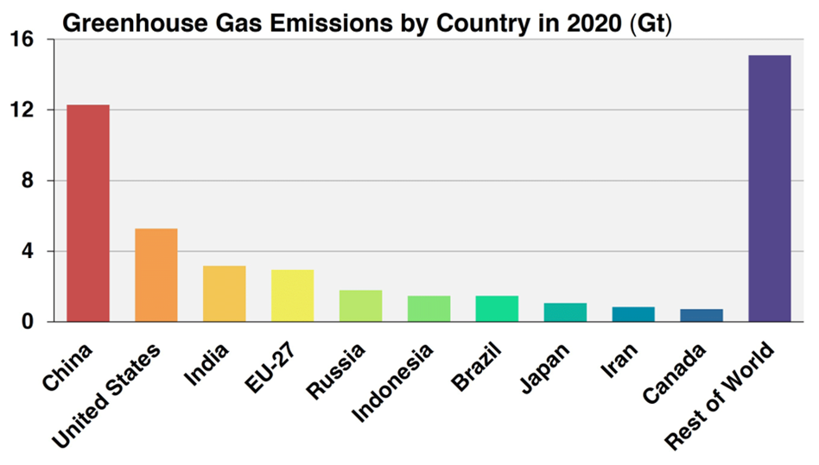
Introduction
Global CO₂ Emission
- CO₂ is the primary greenhouse gas contributing to global warming
Power plants and industrial processes are significant sources of emissions
Importance of CCS
- CCS as a vital strategy for reducing greenhouse gases.
- Focus on post-combustion CO₂ capture, which captures CO₂ from flue gases.

Slide 3
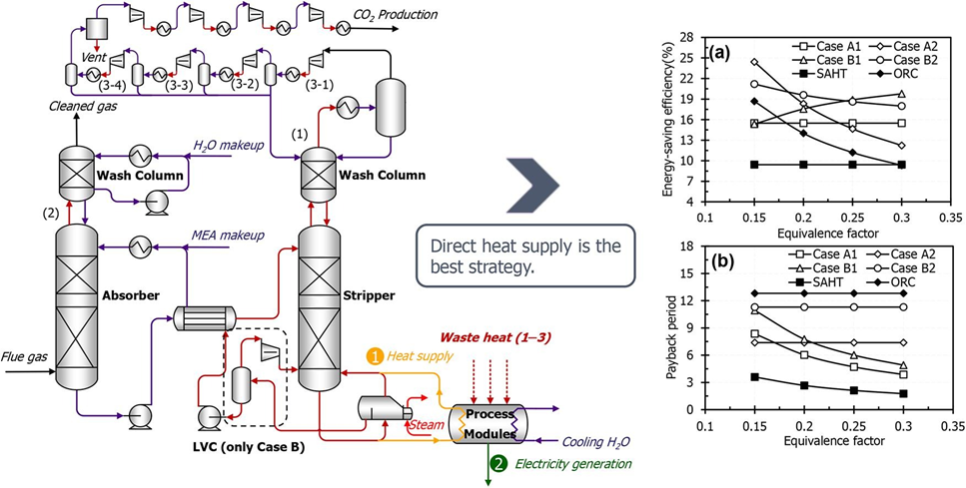
Background:
Post-Combustion Carbon Capture
- Used in power plants to capture CO₂ after fuel combustion.
- Conventional techniques like amine scrubbing: limitations in large-scale use (high energy consumption, solvent degradation).
Savings-to-investment ratio (SIR) and payback period (PBP) depended on EF and electricity prices
Need for Advanced Solutions
- Current technologies are not energy-efficient or economically viable for long-term

Slide 4
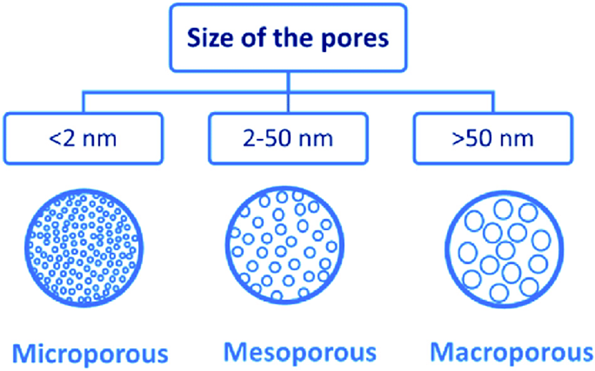
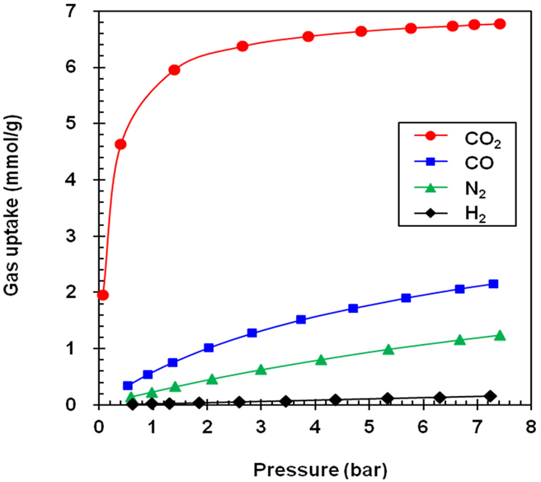
Zeolites in CCS:
Advantages over conventional techniques (lower energy consumption, material stability).
tunable pore sizes, high adsorption capacity selective CO₂ separation
Molecular sieving and diffusion studies in gas separation by zeolites

Slide 5
Problem Statement
Challenges in Current CO₂ Capture Technologies leading to increase in atmospheric CO2 concentration
Need for Efficient Solutions
High energy consumption and operating costs in solvent-based systems.
Limitations in scalability for industrial applications.
There’s a pressing need to improve the efficiency and cost-effectiveness of CCS systems
Key Question: How can zeolite-based membranes enhance post-combustion CO₂ capture while minimizing energy and operational costs?

Slide 6
Research objectives
Primary objective
Specific Objectives
To Investigate the gas adsorption and diffusion dynamics in zeolite-based membranes for enhanced post-combustion CO₂ capture
To optimize CO₂ selectivity and separation efficiency in zeolite-based membranes.
To reduce energy consumption during the CO₂ capture and regeneration process.
To evaluate the economic and environmental feasibility of using zeolite membranes in large-scale CCS applications

Slide 7
Hypothesis
Working Hypothesis
Zeolite-based membranes can outperform conventional CO₂ capture techniques by providing higher selectivity, efficiency, and lower energy demands for CO₂ separation and regeneration

Slide 8
Methodology
1. Experimental Setup
2. Modeling and Simulation
Zeolite Membrane Selection
Select zeolite membranes based on pore size, surface area, and adsorption characteristics.
Measure CO₂ adsorption capacity using gas chromatography and breakthrough experiments.
Evaluate diffusion rates through zeolite membranes using Fick's law.
Analyze selectivity of CO₂ vs other gases (N₂, O₂) under various temperatures and pressures.
Computational models to predict gas diffusion dynamics within zeolite pores.
Simulate adsorption and regeneration cycles to assess energy efficiency

Slide 9
Theoretical Framework
Adsorption Theory
Diffusion Dynamics
Langmuir and BET isotherms for describing gas adsorption on zeolite surfaces
Fick's laws of diffusion to model gas transport through the zeolite membrane.
The impact of pore size and structure on diffusion rates and selectivity

Slide 10
Expected Results
Efficiency Gains
- Zeolite membranes will show higher CO₂ selectivity and lower energy use for regeneration.
Economic Benefits
- The cost per ton of CO₂ captured will be reduced compared to conventional techniques.
Scalability
- Zeolite-based membranes will demonstrate potential for large-scale applications in industrial settings.

Slide 11
Significance of the Study
Contribution to CO₂ Capture Technologies
- This study will advance the development of more efficient and cost-effective CO₂ capture systems.
Environmental Impact
- Successful implementation could significantly reduce greenhouse gas emissions.
Industry Relevance
- Findings can be applied to power plants, cement production, and other industries with high CO₂ output.

Slide 12
Conclusion
Zeolite-based membranes offer a promising alternative to traditional CO₂ capture methods.
They enhance selectivity, reduce energy demands, and present a sustainable solution for long-term CO₂ capture

Slide 13
​ Backup

Slide 14
High-Throughput Evaluation of Earth abundant metal Catalysts for CO2 conversion to methane Using Machine Learning and Molecular Simulations

Slide 15

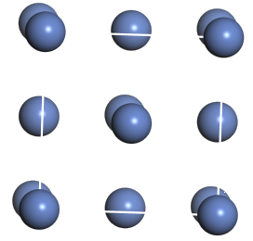
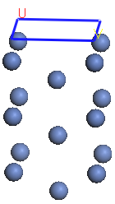
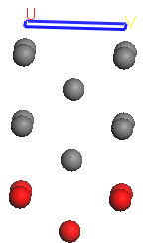
CO2 molecule (O-O bond
length = 2.320 Ang)
b) Ni catalyst
Cleave surface
Constrained atoms
c) Ni catalyst with the
cleaved surface
d) Constrained atoms are shown in red

Slide 16
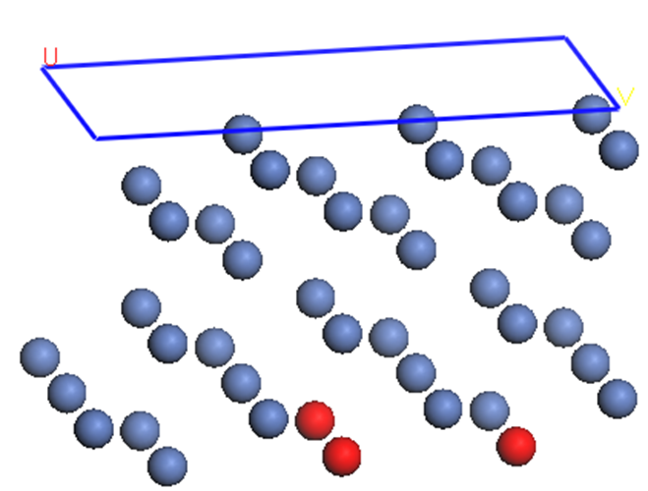
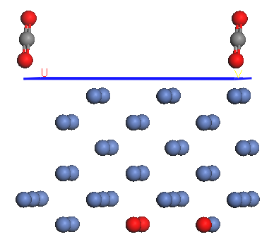
a) Optimized 3x2 Ni structure
b) Perpendicular orientation on the surface

Slide 17
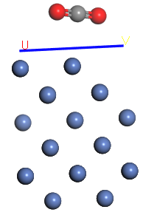
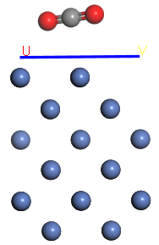
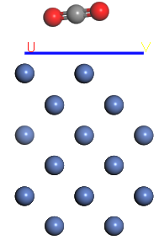
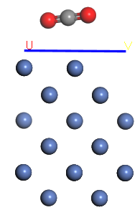
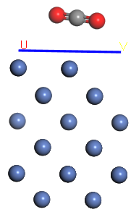
a) BE = -9.75490171eV
b) BE = -9.74915627eV
c) BE = -9.75611590eV
d) BE = -9.75088002eV
e) BE = -9.74872344eV

Slide 18
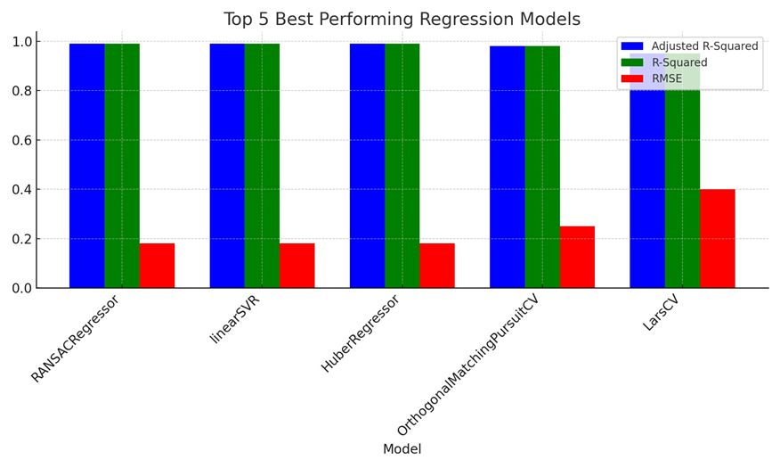
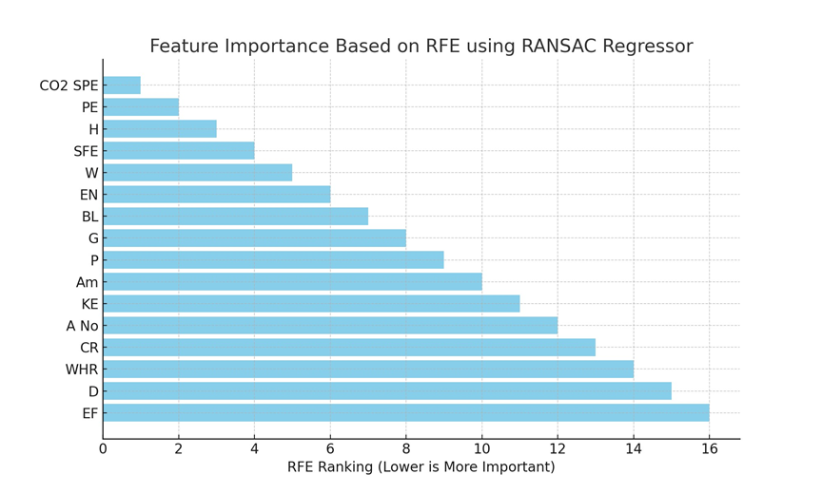

Slide 19
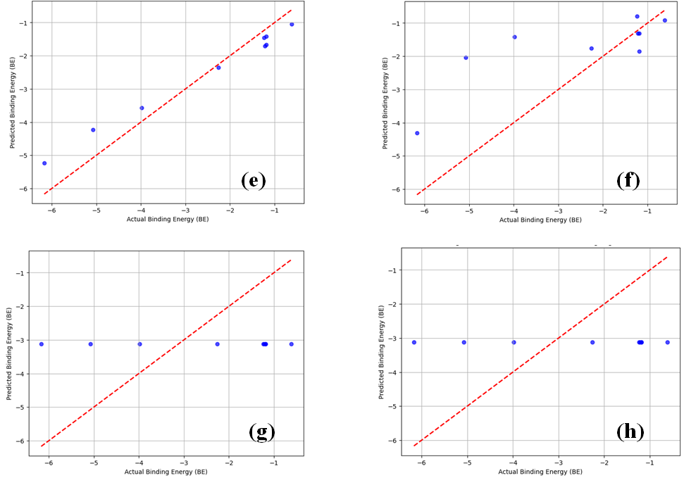

Slide 20
