Slide 1
Overview of CERN planning, budgeting and controlling principles, process and its supporting information systems
Presentation to FAIR GSI
Kasia Pokorska, 26 November 2024

Slide 2
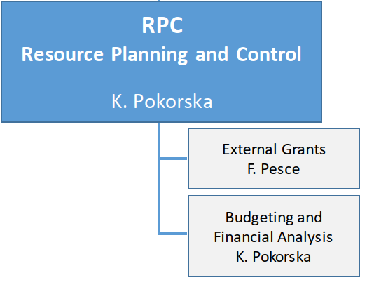

Presentation of the central planning unit
Group Resources Planning and Control in the Finance and Administrative Processes department: FAP-RPC

Slide 3
General Context and Constraints (1)
AIM:
to optimize the resources allocation
to BEST fulfil the Organization’s mission.
MAXIMUM OUTPUT with MINIMUM INPUT
Constraints:
  Limited resources
  Construction of HL-LHC within constant budget (no additional MS contributions)
  Aging infrastructure
  Compliance with Financial Rules & internal financial regulations

Slide 4
General Context and Constraints (2) - Resources challenges CERN is facing today
Recent economic context:
    Difficulty for Member States to settle their contributions on time (strong CHF)
    Difficulty for research institutes to fulfil their contractual obligations towards various facilities / experiments at CERN
    COVID-19 and the Russian invasion of Ukraine
      Two-digit inflation in most Member States, energy prices rising dramatically in 2022
      Waiving of the Ukrainian contribution as an Associate Member States
      Termination of the collaboration with Russian and Belorussian institutes
        Translated in financial obligations taken over by CERN (HL-LHC project) and experiments (detectors upgrades)
    Almost “continuous” planning and forecasting exercise since 2020
CERN budget under pressure:
    Negative materials indexation 2016-2017, 2021, 2025 (CHF appreciation, slower economic growth)
    Extremely high materials indexation 2023-2024, not compensated by the increase of the Member States contribution
      The corridor principle limit the indexation to 2%, significant loss of the purchasing power for CERN despite one-of of additional contribution for 2023
      CERN’s duty to identify and propose various savings (e.g. reducing the operation time of accelerators, crisis levy by staff members, delaying consolidation of infrastructure, postponing projects)

Slide 5
General Context and Constraints (3) - Resources challenges CERN is facing today
Limited staff resources in departments
    2666 “heads” at the end of 2023 (2615 FTEs in 2023)
  Distribution (and constant re-allocation) of available and limited resources between
    Operation and consolidation of the existing accelerator complex
    High-Luminosity upgrade of the LHC machine and detectors
    Preparation for the future
      Studies for future circular colliders, physics beyond colliders

Slide 6
Overview of the CERN planning cycle (1) – core planning documents: MTP and Final Budget
Medium Term Plan (MTP) including Draft Budget
    Overall underlining strategy (objectives) for the next 5 years
      10-year projection for revenues and expenses
    Draft Budget for the next year in the current prices
    Targets for next budget year (to be measured against these)
    Submitted to the approval by the Council
    E.g. MTP 2024: covers planning period 2025-2029 and introduces Draft Budget for the year 2025
Final Budget
    Implements
      The approved indexation to the expenses and revenues budget
      The allowed transfers of unspent budget between years (carry forward, carry back, reprofilings)
    Includes the information on the Probable Revenues and Expenses for the current year
    For information only, no formal vote required from the Council

Slide 7
Overview of the CERN planning cycle (2) – core reporting document: APR
Annual Progress Report (APR)
    Quantitative aspect:
      Compares the actual amounts (budget out-turn) with the budgeted values by activity, showing the achievements
      Dedicated section on KPIs
        measuring various outputs: scientific, administrative (human resources, procurement), outreach, safety, environement
    Qualitative aspect:
      Explains the numerical variations
      “Narrative” reporting on the targets / objectives set in the Final Budget
    Joint effort of multiple actors
      Accounting for the actual amounts
      DHs, DPOs, Project Leaders for explanations
Revised Budget
    Part of the MTP
      Eg. MTP 2024 contains Revised 2024 Budget
    Published as a separate document occasionally (e.g. in 2009 as a result of the LHC incident in September 2008)

Slide 8
Overview of the CERN planning cycle (3) – auxiliary documents: CVI and “Scale”
Cost Variation Index (CVI)
    Voted in December
    Personnel part: to protect basic salaries and stipends from the erosion of purchasing power resulting from the increase in the cost of living
      No “negative” indexation but keep the memory
    Materials part: to align the expenses budget to the inflation / deflation tendency, corrected by the variation in exchange rate between national currencies and Swiss franc
    Revenue part, only Member States’ and Associate Member States’ contributions are indexed, the “corridor” principle
Scale of Member States’ Contributions
    Voted in June
      The contributions are expressed in the current year prices
    Indexation applied in December
      Corridor principle: Member States’ contribution are indexed in between 0% and 2%

Slide 9
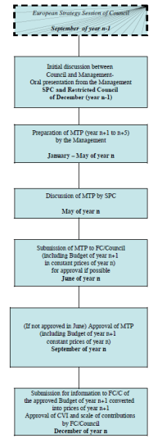
Overview of the CERN planning cycle (4) – planning milestones
Using APT bottom-up
White Paper MTP N+1 -> N+5
MTP for approval N+1 -> N+5
Draft Budget N+1
If no approval in June, MTP with changes for approval
Final Budget N+1

Slide 10
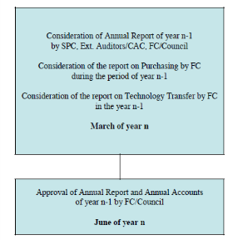
Overview of the CERN planning cycle (5) – controlling milestones
Annual Progress Report N-1

Slide 11
Overview of the CERN planning cycle (6) - timeline
Scale of contribution N+1
CVI N+1
N
N-1
N+1
N+2
N+3
N+4
N+5
June N
Dec. N
Medium Term Plan N+1 -> N+5
Annual Progress Report N-1
Revised Budget N
Draft Budget N+1
Planning
Reporting
Probable Revenues and Expenses N
Final Budget N+1

Slide 12
Resources planning @CERN (1) – actions of different governing bodies
Council approves guidelines on OBJECTIVES and TARGETS for each scientific programme and project
    Not driven by internal CERN organisation or type of resources
Feedback by the Scientific Policy Committee on the scientific programs
    First physics potential
    Financial affordability considered as well
Approval of experiments/new initiatives via the Research Board
Vision of the Director General translated in the Mid/Long Term Plan
    Balance between scientific interest and available resources
    Resources allocation is based on a Personnel + Materials policy

Slide 13
Resources planning @CERN (2) - Principles
Financial Rules and Regulations
    Document approved by Council
    Last revision to accommodate latest practices in June 2024: CERN/FC/6786/RA/Rev.
    Stipulate (Article 16):
  CERN’s accounts shall be drawn up in accordance with the International Public Sector Accounting Standards (IPSAS).
  These standards and the way in which they are implemented shall be explained in the notes attached to the annual Financial Statements.
    Planning and budget: Section 2 - Article 5 to 9
IPSAS implementation
    Since 2007 in the financial statements
    Budget follows the “modified” cash principle (accruals based) with some non-cash elements (e.g. variation of the paid leave)

Slide 14
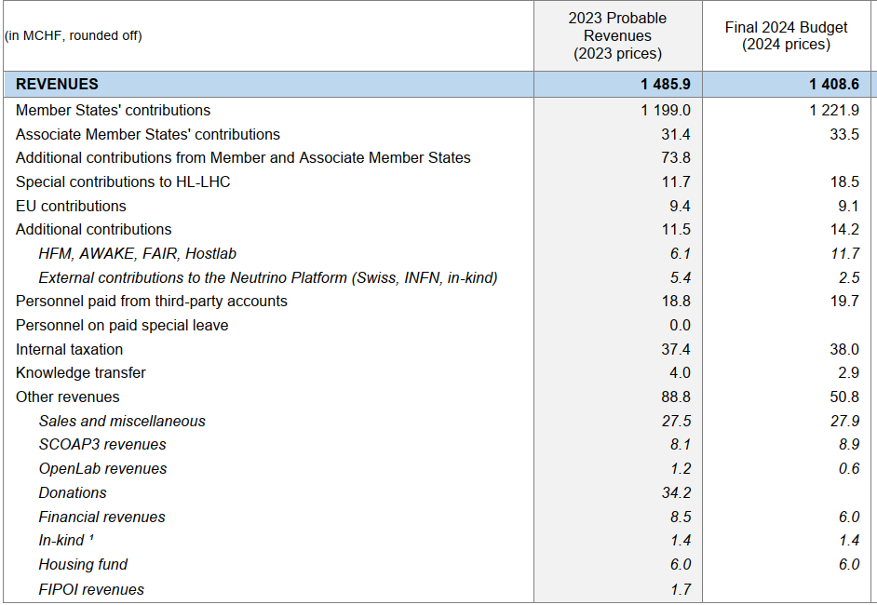
Resources planning @CERN (3) - Revenues
Member States’ contribution
    ~90% of the whole revenues
Contributions from Associate Member States
    Transition phase, a percentage of the full amount, minimum 1 MCHF
    Ramping up to 100% over a few years
Participation in EU projects
In-kind and cash contributions to specific projects and facilities, from
    Countries (e.g. US for HL-LHC)
    Institutes (e.g. ITER, FAIR)
    Private Industry (e.g. Siemens, Oracle, Micron for OpenLab initiative)
    Private Donors (e.g. for Science Gateway, Artificial Intelligence and Quantum Computing technics for detectors)

Slide 15
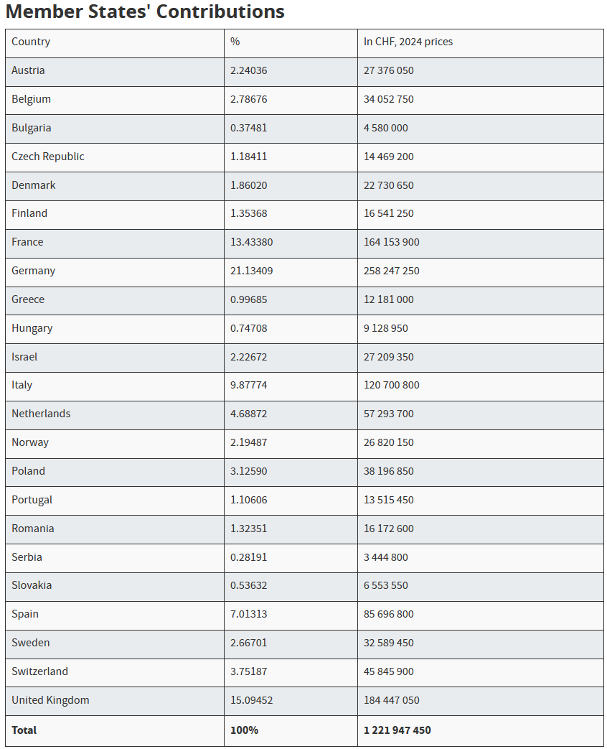
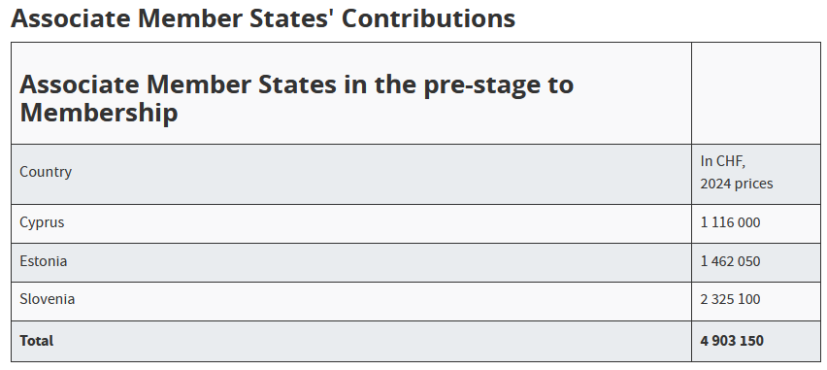
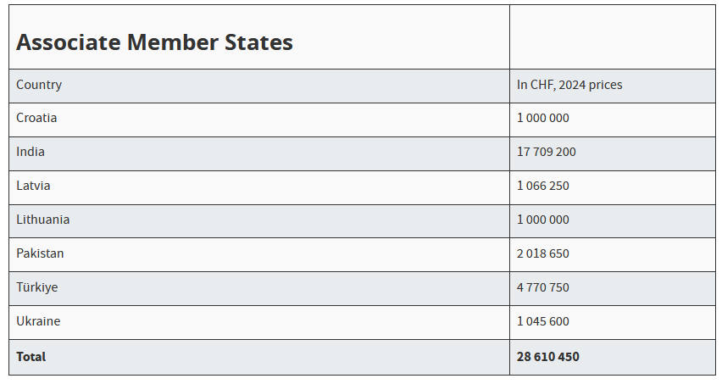
Resources planning @CERN (4) – Member States’ contributions in 2024
Member States pay as a function of their economy size expressed in CHF
  Net National Income at factor cost (not GDP)
Indexation of contributions decided annually according to the defined principle

Slide 16
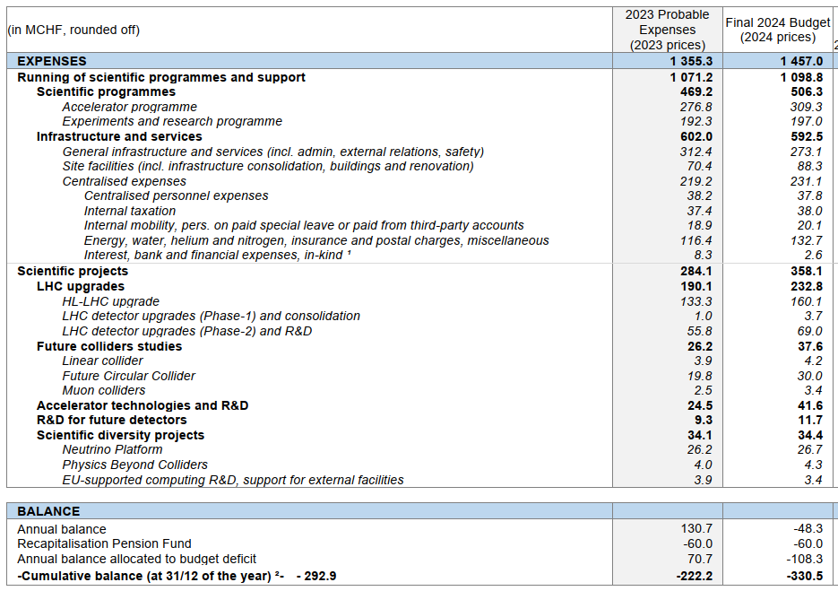
Resources planning @CERN (4) – Expenses in general
Expenses are broken down by
    Activity / Project
    Organic Unit (Department)
    Funding
    Nature / Account
=> Impact IPSAS
    Accrual accounting
    The expenses are recognized when
    an actual / physical delivery takes place
    and not the payment!

Slide 17
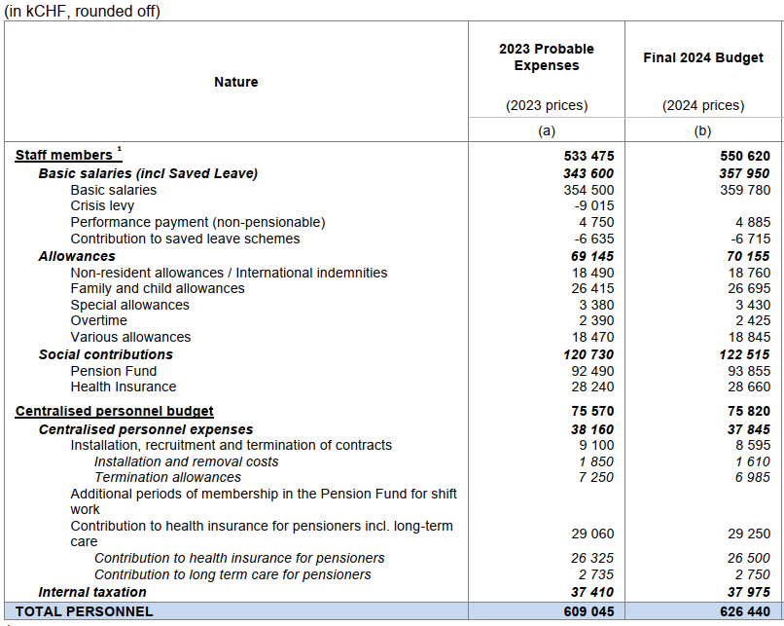
Resources planning @CERN (5) – Personnel
Employed Member of Personnel – staff category
  Budgeted at standard cost
      An overhead factor calculated at the beginning of each year
Carry-forward
    Unspent budget can be carried to the next year only to cover the existing commitments
Conversion from Limited Duration contract to Indefinite Contract (LD->IC)
    Impact on the budget
Advancement exercise
    Current career structure limits the increase of personnel cost (salary increase + performance payment)
    Built in the budget, around 1.6% per year
    Compensated by expensive departures

Slide 18
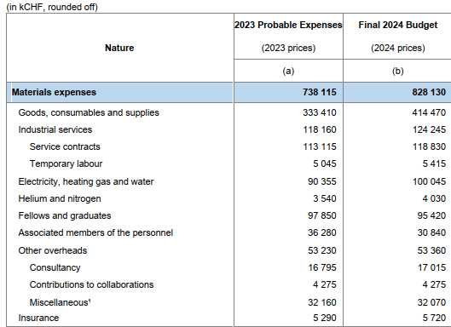
Resources planning @CERN (6) – Materials
Various categories, including
  Workforce:
      Employed Members of Personnel – GRADuate category, “soft” ceiling 95 MCHF
      Associated Members of Personnel (MPA)
    Industrial services
    Utilities: energy, helium & nitrogen (~10% of the budget)
Carry forward of unspent budget
    Recurrent yearly activities – none, only in the limit of committed amounts
    Multi-annual activities with earmarked funding
      Unspent budget can be carried forward to the next year without limits
      If project is advancing faster, funds can be also carried back from future years without limits.

Slide 19
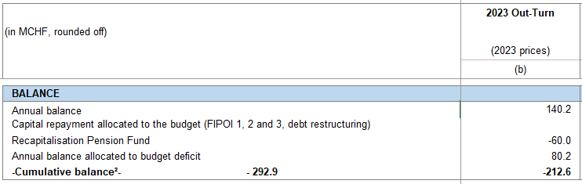
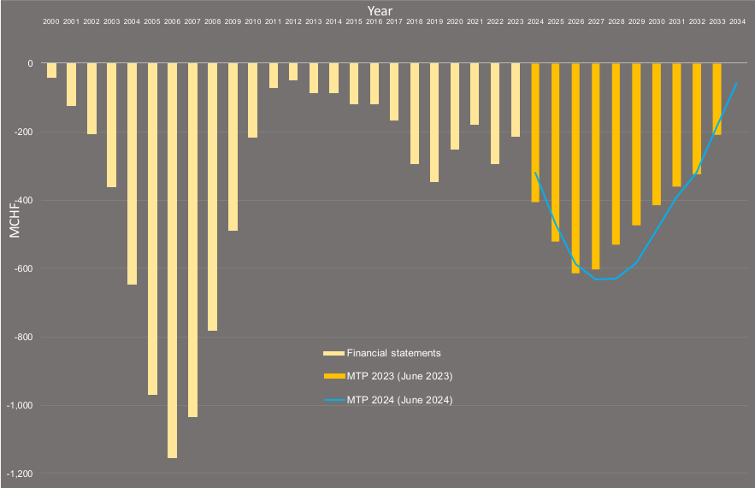
Resources planning @CERN (7) – deficit, debts, and financial costs
No short-term debts
Long-term debts
    FIPOI: 0% interest loan for buildings
Cumulative budget deficit
    -212.6 MCHF at the end of 2023
    Regularly reported to the Council

Slide 20
Resources controlling/monitoring @CERN (1) – staff and graduates
Staff
    For each post opening for limited duration contract
      Verification whether within FTEs limit
      Check the implication on cost
    LD to IC exercise
      Budgetary consequences
    Advancement exercise
      Monitor the cost
  Real cost versus standard
      Follow-up on quarterly basis
      Readjustment if needed
Graduates
    Follow up of the commitments (in CHF) versus budget
    Regular reporting on the actual spending

Slide 21
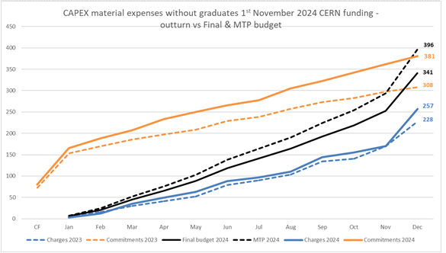
Resources controlling/monitoring @CERN (2) - Materials
Sophisticated budget control structure set up in Cegid
    Different criteria
      Per department / project / recurrent activity
    All extra commitments / expenses exceeding allocated budget are coming to FAP-RPC for approval
Projects of significant size use EVM
Internal monthly reports forecasting
expenses and comparing to the budget

Slide 22
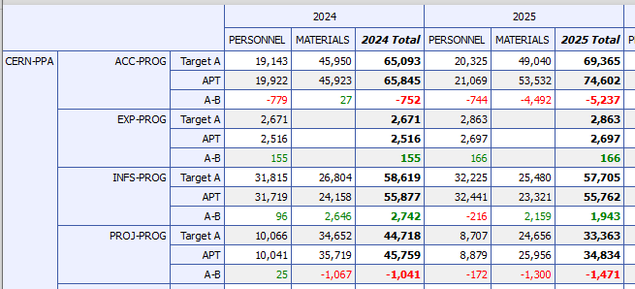
Tools (1) – planning: Activity Planning Tool APT
Top-down approach:
    Management decision
    Implemented in budget / target figures
Bottom-up approach
    Group / Project leader requests (“APT”)
    Consolidated into departmental proposals
Arbitration and approval during the MTP preparation

Slide 23
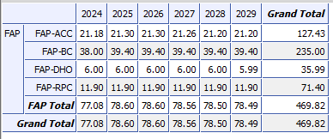
Tools (2) – staff forecast: Staff Monitoring Tool SMT
SMT allows to
    Simulate number of FTEs
    Calculate the corresponding cost
Deterministic tool
    All events are expressed with a probability
Using different scenarios and hypothesis
    All Limited Duration (LD) leave
    All LD stay
    Various retirements / advancement / replacement models
    Different LD to Indefinite Contract ratio
    Etc.

Slide 24
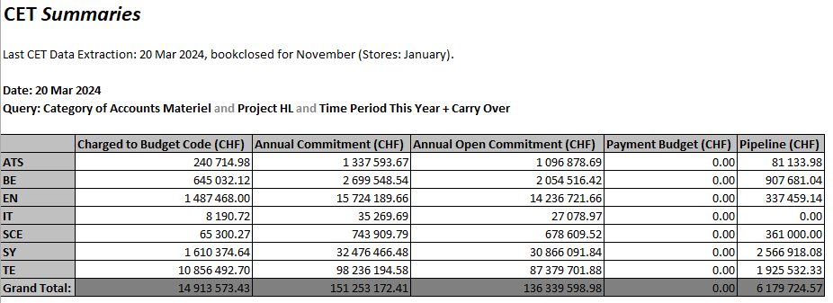
Tools (3) – controlling and reporting: CERN Expenses Tracking CET (Cegid)

Slide 25
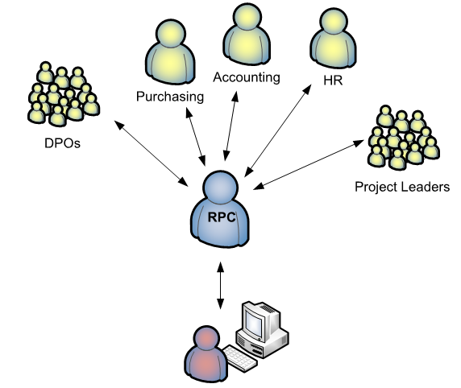
Interactions with other services
Departmental planning officers and Project Leaders
  Consolidation of bottom-up budgetary requests
  Implementation of top-down budget decision
General and Personnel Accounting
  Close collaboration on the Annual Progress Report
  Establishing of the common processes, understanding, interpretation of accounting rules and standards
Procurement
  Contract adjudications
  Estimation of Industrial Services
Human Resources
  Openings and extensions of posts within FTE limit
  Budgetary impact of the LD to IC exercise
  Advancement exercise
Business computing group
  Interface to administrative tools: APT, SMT, CET / Cegid, HRT, EDH
  Working groups on possible enhancements to the existing applications
BC

