Slide 1
Business Computing @ CERN
Visit of GSI / FAIR
November 26th 2024
Jan Janke (CERN / FAP-BC)

Slide 2
In Short
Provide IT solutions to support CERN’s administrative business processes
5 products, 12 delivery teams
Heterogeneous IT landscape: mix of bespoke and standard solutions
75 CERN personnel members + ca. 50 people from near- and off-shore partners
Central budget
No scientific or research computing

Slide 3
Internal Organisation
GL
Jan Janke
DGL
Juan Lopez Gonzalez
Product Management
Eloy Reguero Fuentes
Design
Sophie Gobert
Agile Practices
Eveline Sintnicolaas
Engineering
Lino Vazquez Tenorio
Dev Team (e.g. HR1)
Team Supervisor
Dev Team (e.g. FIN2)
Team Supervisor
...
Team Supervisor
Dev Team X
Team Supervisor

Slide 4
Group Size
Group size: ca. 75 members of personnel (50% staff, 50% graduates/students)
High personnel turnover: ca. 20 arrivals and departures per year
  Consequence of CERN’s education mandate and contract policy (short term contracts)
  Half-life time of the group: ca. 2.5 years
Additional external workforce: ca. 50 people at the moment (not all full-time)
  Increasing reliance on near-/off-shore contracts in the future
  Access to more experienced workforce at about the same cost as for graduates
  Move part of the knowledge retention responsibility to external partners
Material budget: 4.5 MCHF for recurrent operations + variable project specific budget
  Solution delivery related costs (licenses, subscriptions, maintenance, consultancy, etc.)
  Personnel costs for non-staff members (i.e. graduates, students, external workforce)
  Training, travel, other expenses

Slide 5
Scope
Support
Human Resources
Finance
Materials
Payments
Accounting
Stores
Processes
Records
Treasury
Contracts
Services
Leave
Suppliers
Inventory
Rentals
Reporting
Career
Roles
Planning
Contracts
Claims &
Payroll
Logistics
User Support
Training
Recruitment
Budget
CERN Hotel
Purchasing
Admin Support
EU Reporting
Team Codes
Safety
Equip.
Projects & Experiment Support
Infrastructure
Safety
Buildings
Access
Project
Management
Medical data
Phonebook
Mail
Safety Roles
Public Outreach
Intervention Management

Slide 6
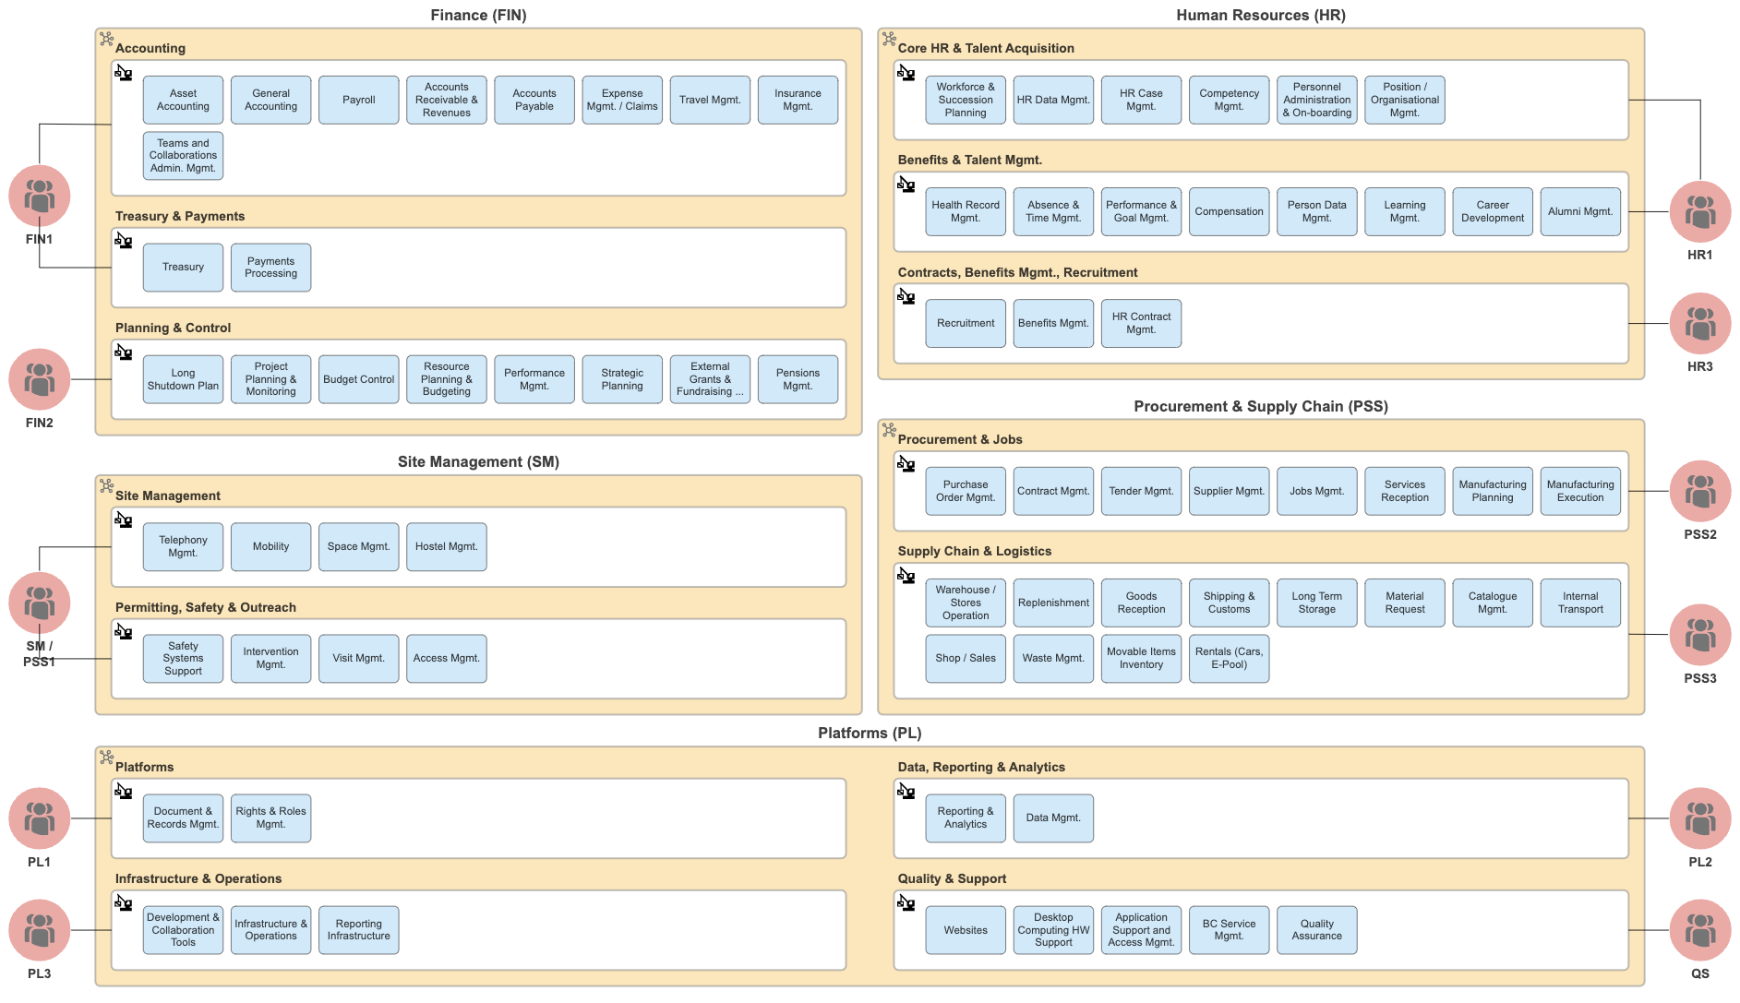
Product Map

Slide 7



Application Landscape
266 active applications of varying size and complexity
Around 25 external vendors
  Principal commercial system providers: Oracle (EBS), Cegid (XRP), Infor (LN)
Bespoke application development
  Main technologies: Java (Spring Boot), HTML/JavaScript (React), Oracle DB

Slide 8

Separation of Concerns

Slide 9
What Do We Do?
Defined together by business partners and BC Product Managers
Driven by common multi-year vision and strategy
Executed through commonly and quarterly updated agreed roadmap
Product Manager / Business Relationship Manager
  Full time role
  No people management (different skill, no distraction from core tasks)
  Management by influence

Slide 10
How Do We Deliver?
Agile solution delivery teams
Concrete work defined by Product Owner who owns the backlog
Each team has a people supervisor and technical lead

Slide 11




Operating Model
very closely collaborates with PM for feature preparation
Product Strategy
Dev Teams
Designers
support teams
when needed
Finance
Dev Team
Human Resources
Supervisor
Procurement,
Supply Chain, Logistics
Product Owner
Developers and ERP Specialists
Site Management
Platforms
Available for teams,
PMs, Group Mgmt.
Agile Coaches
Notes:
Mention architects

Slide 12
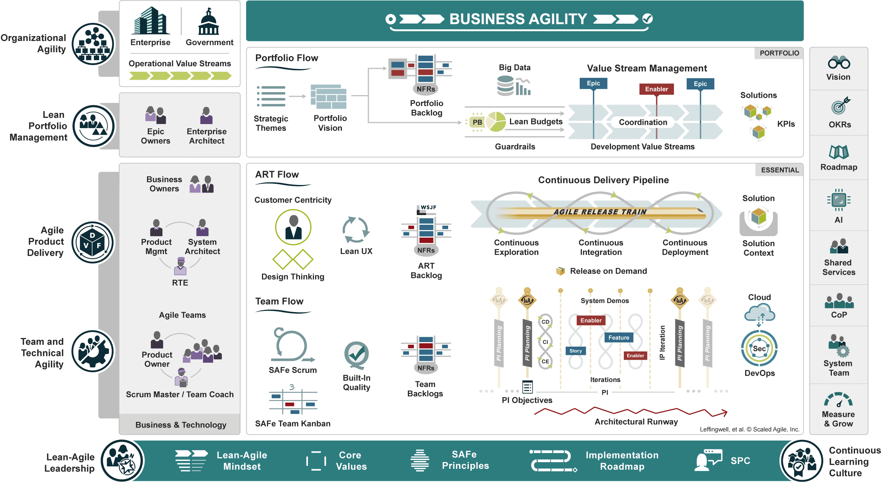
Bringing Everything Together: SAFe

Slide 13
Delivery Cadence
Value delivered throughout programme increments (quarters)
Quarters divided into 2-week long sprints
PMs provide features for the teams to work on during the next quarter
Teams reserve capacity for ad-hoc work and support
Product Owner manages the operational backlog
Flexibility to adjust work programme if needed
Deploy new solutions as early as possible, improve iteratively

Slide 14
Active Architecture Management
Lead Architect is a member of the extended group management
Team of System Architects define policies and advice PMs, Designers, Teams
Use of an EA Tool to describe products, processes, applications, and dependencies
Explicit business process documentation
Defined architectural guardrails for dev teams to follow
Active management of technical debt (awareness, evaluation, reduction)

Slide 15
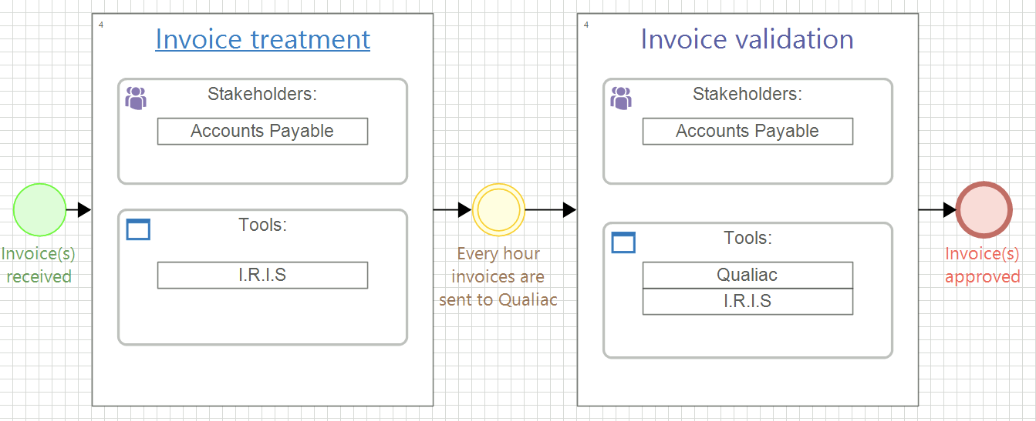
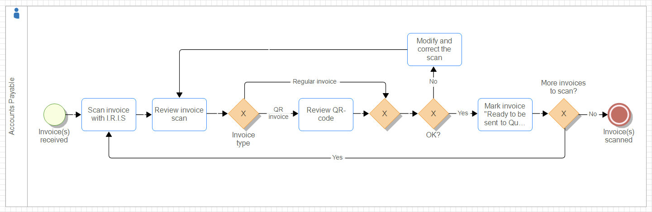
Business Process Modelling
Notes:
Tool for communication with business, starting point for AS-IS and TO-BE analysis

Slide 16
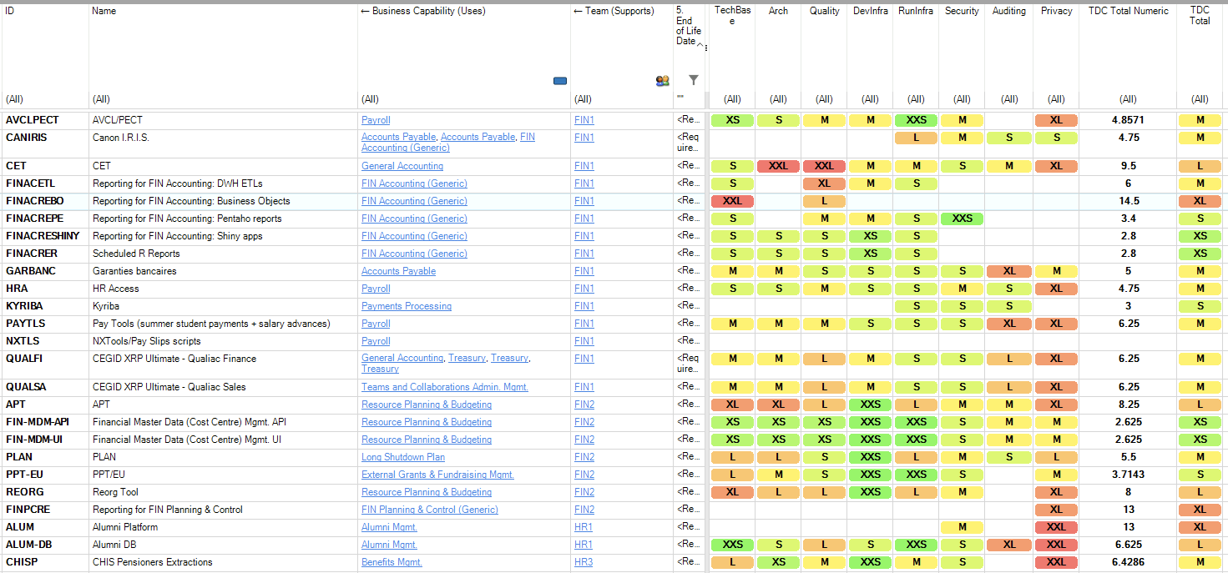
Technical Debt Exposure

Slide 17
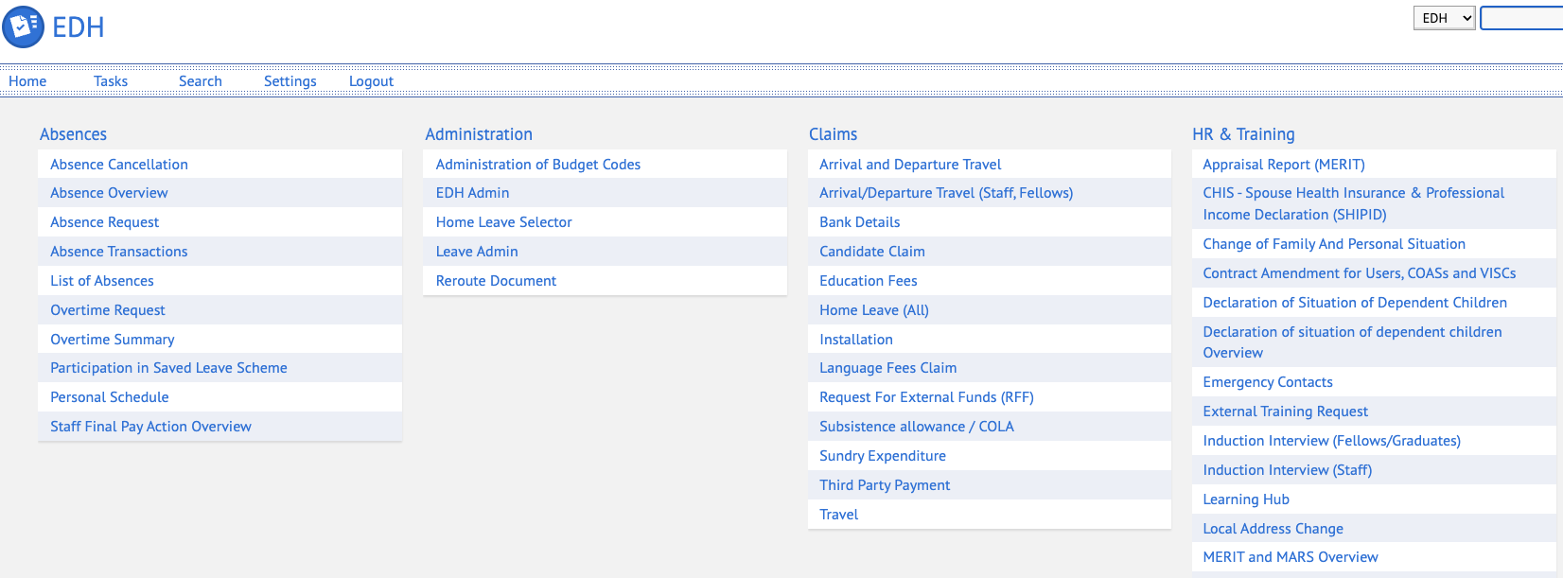
Integrating Everything
Centralised ”Foundation” database
In-house developed workflow management system “EDH”

Slide 18
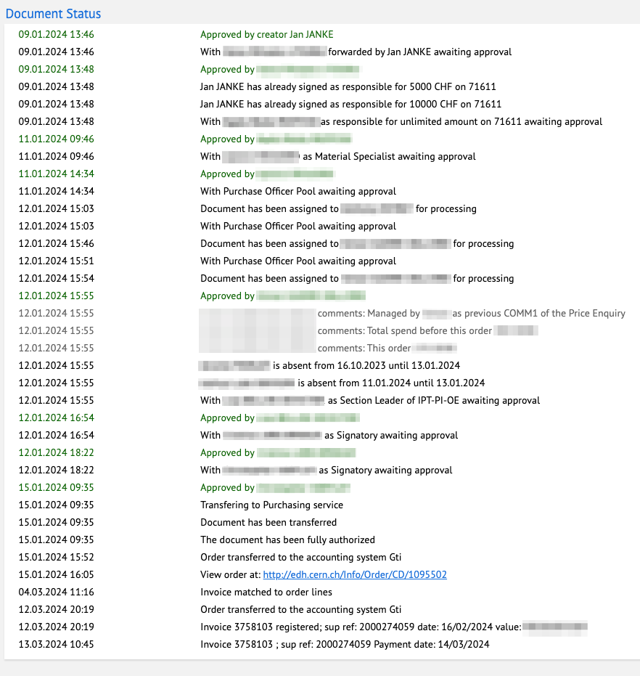
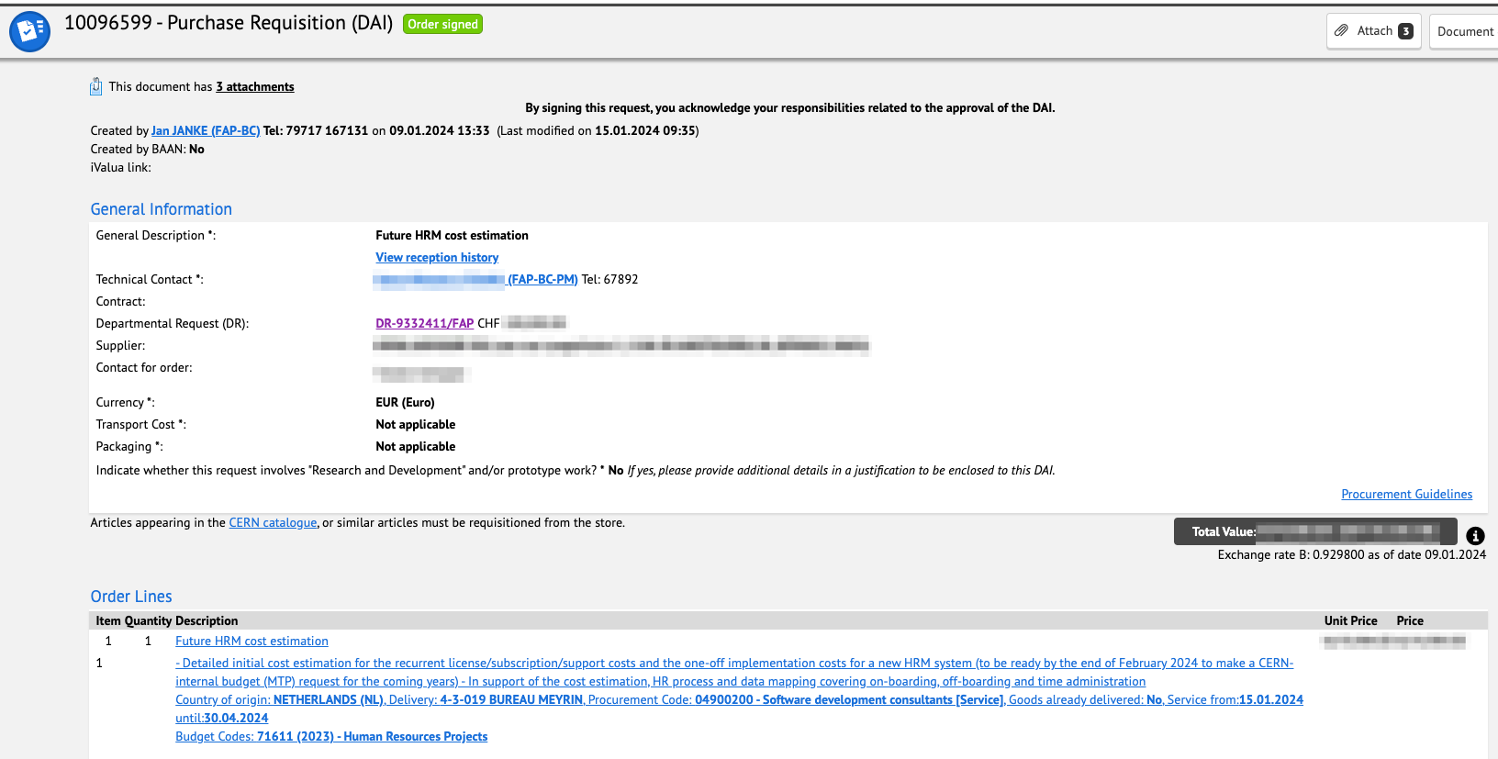
Example: Purchase Requisition

Slide 19
We Are Starting a Transformation Phase
Notes:
Did any issues exceed the threshold?

Slide 20
Where Is BC Today (Nov 2024)?
Heterogenous mix of standard and bespoke software
Many applications based on a wide technology landscape
ERPs selected 20-30 years ago as part of a best-of-breed strategy
EDH provides access to 80+ electronified business processes
Highly diverse reporting landscape : HRT, CET, Pentaho, R, Power BI
Maintenance is difficult due to a high degree of customisation
Hard to benefit from new features and innovations in standard software
Talent management challenging (turnover, unattractive tech stack, complexity)
Notes:
Main issues of today

Slide 21
BC Recognizes That …
Vision can only be achieved in a partnership with CERN’s business units
Business processes require standardisation to embrace market solutions
Cost reduction within BC is not a goal (BC’s budget corresponds to ca. 1% of CERN)
“Best-of-breed” results in managing a complex integration landscape
BC cannot compete with external vendors in most cases
BC builds solutions for the entire CERN community and not only for the FHR sector

Slide 22
Vision for the Future
Highly integrated cloud-based standard solutions
One integrated Enterprise system covering CERN's business processes
Two-fold reporting strategy (advanced and general-purpose)
Inhouse development for CERN specific processes and integrations
HCM/ERP system integrated workflows and EDH co-exist

Slide 23
Why 1 Single HCM/ERP?
Benefits for Business Partners and End Users
  Uniform user experience across business domains
  Shared set of master data not subject to error-prone in-house developed integration pipelines
  Use of a widely proven standard solution / possibility to exchange experiences w. outside users
  Closely follow the vendor’s update cadence and quick access to the latest innovations (e.g. AI)
  More powerful out-of-the-box reporting available by default
Efficiency Gains within BC
  Less custom in-house developed system integrations
  Strongly simplified technical stack (one core tech, Low/No Code for configuration/extension)
  Easier access to needed skills/competencies on the job and professional services markets
  Easier to reassign people to a different solution delivery team within BC (due to uniform tech stack)
  Move responsibility for hardware maintenance and linked technical debt to external vendor

Slide 24
Transformation Starts with CERN’s HR Processes
Notes:
Did any issues exceed the threshold?

Slide 25
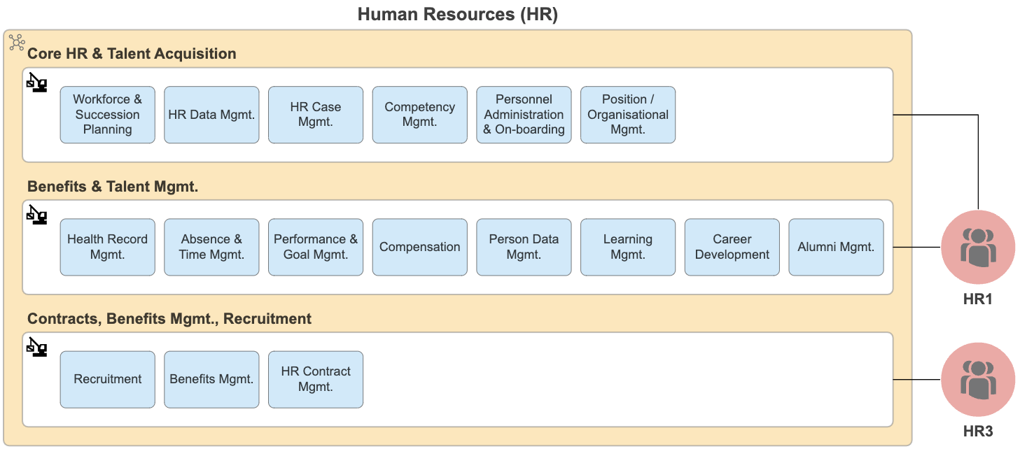
Principal Processing Service for HR Data

Slide 26
Hire To Retire
Talent Acquisition – Onboarding – Talent Management – Offboarding
Different solutions for Recruitment, Learning, Core HR, Payroll
Principal system’s EOL reached, support ends 2032
Opportunity to simplify, integrate more and standardise

Slide 27
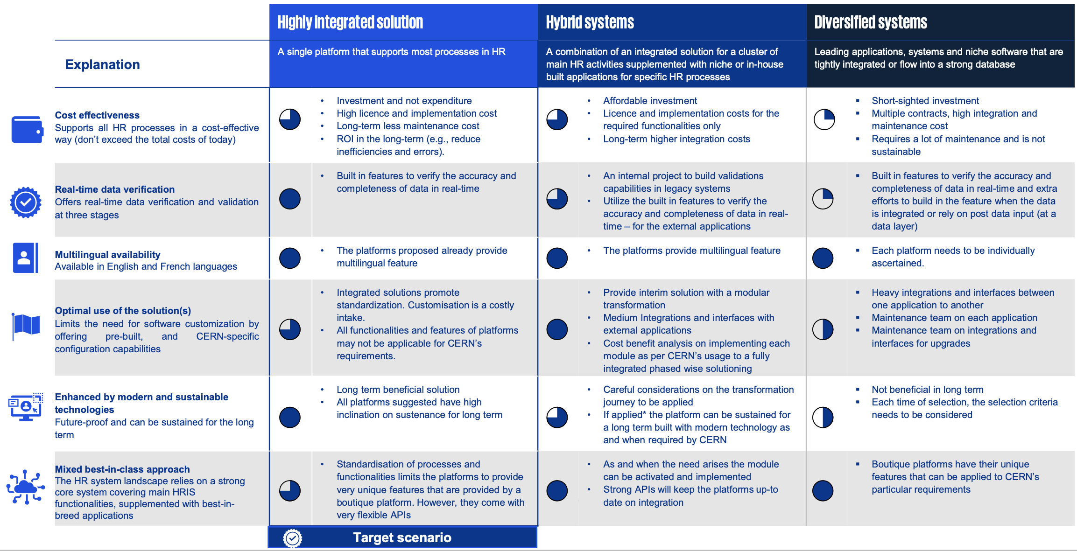
Future HR Information System Scenarios

Slide 28
Challenges
High degree of customisation in CERN systems
  Reduces benefit of relying on a standard market solution
Successfully decustomised Logistics/Supply Chain solution (infor LN 10.7)
Finance processes relatively standard (IPSAS compliant)
HR processes partially harder to standardise
  CERN has three roles: employer, state, university
  Processes encompass
    health ensurance, pension fund, family benefits, host state legitimation documents mgmt.
    external partner institute scientists mgmt. etc.
Notes:
IPSAS: Int. Public Sector Accounting Standards -> https://www.ipsasb.org/

Slide 29
Opportunities
HR system landscape shaped during the 1990s, a lot has changed since then
Review our internal processes
Distinguish between areas where CERN needs to be different and where not
Standard solutions imply availability of external expertise and resources
Less integration points between systems
Much improved reporting out-of-the-box
Iterative process: start with HR, consider further integration of FI, Procurement, etc.

