Slide 1
Mechanical Engineering of Accelerator Components and Peripherals
Antti Kolehmainen, Tommi Mikkola and Tuukka Lehtinen
on behalf of CERN EN-MME

Slide 2
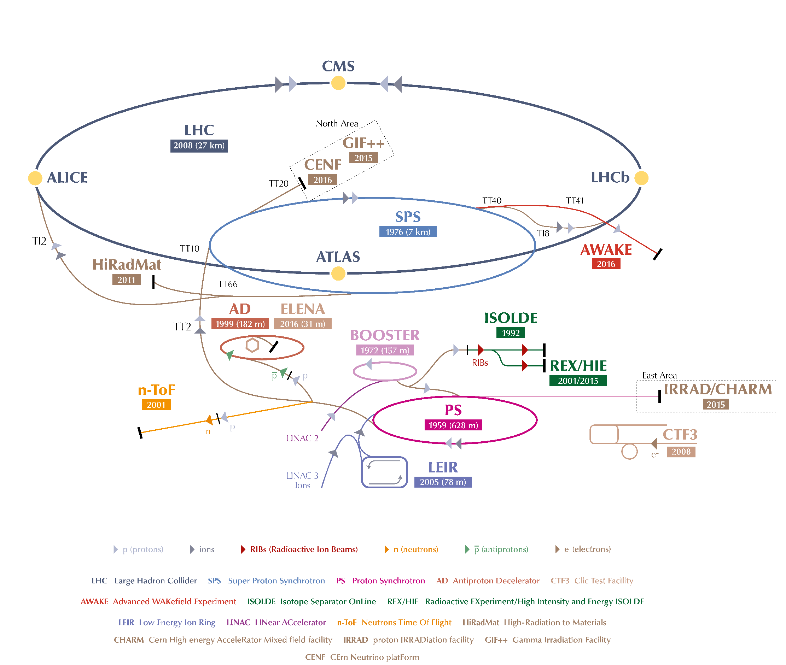
CERN EN-MME Group
“The mandate of the MME group is to provide to the CERN community specific engineering solutions combining mechanical design, fabrication and material sciences.”
EN-MME group size roughly 180 people
Our main activities are:
  Mechanical design
  Engineering calculations and simulations
  Production and sourcing
  Material development
  Mechanical and geometrical measurements
We work on all the machines and experiments!
EN-MME = Engineering Department – Mechanical and Materials Engineering

Slide 3
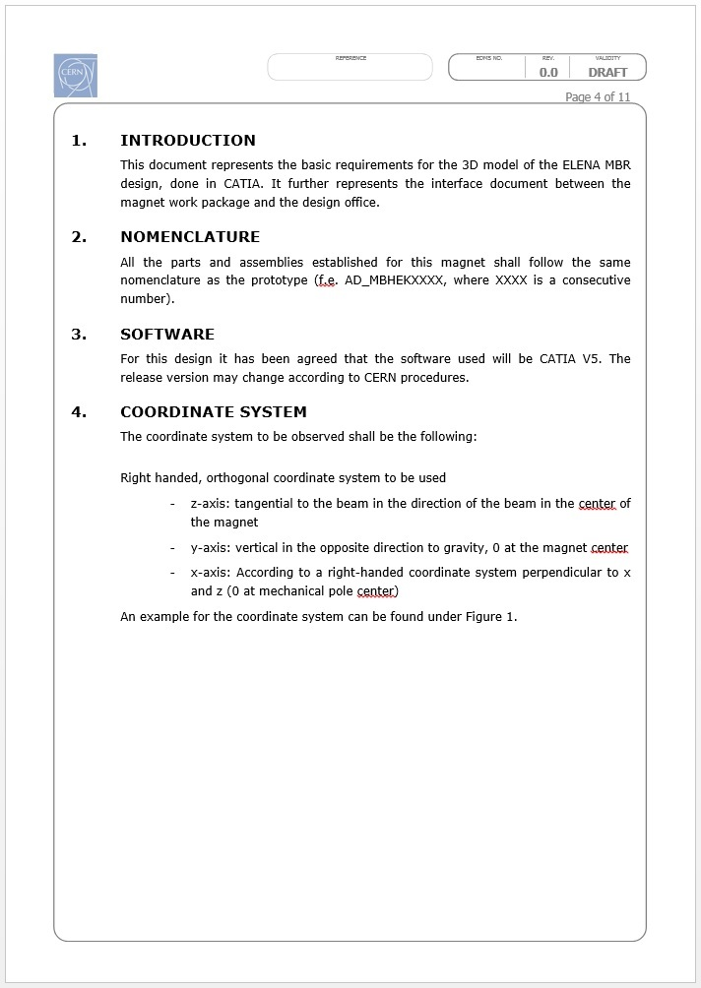
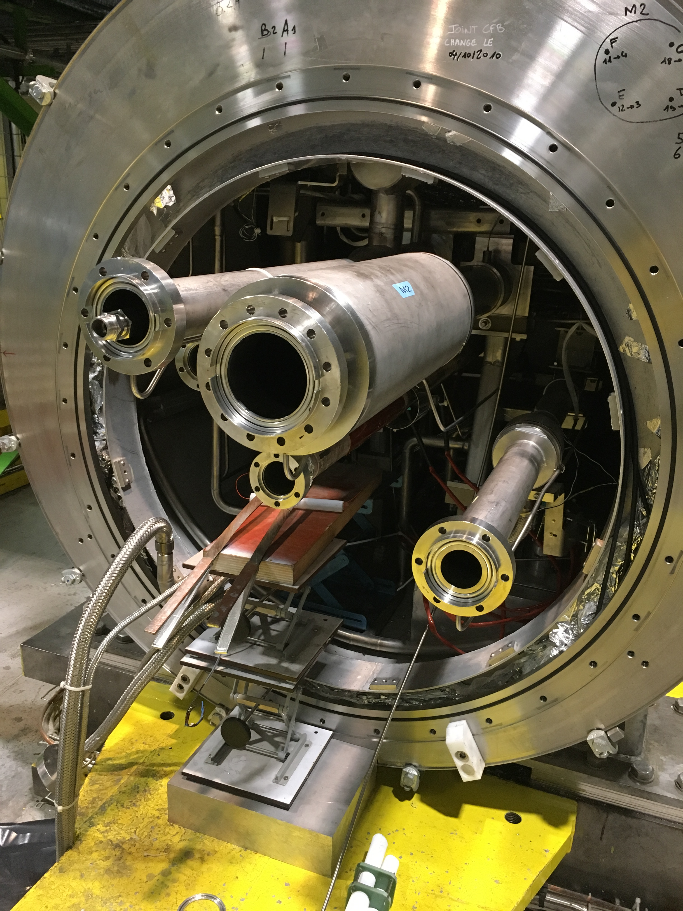
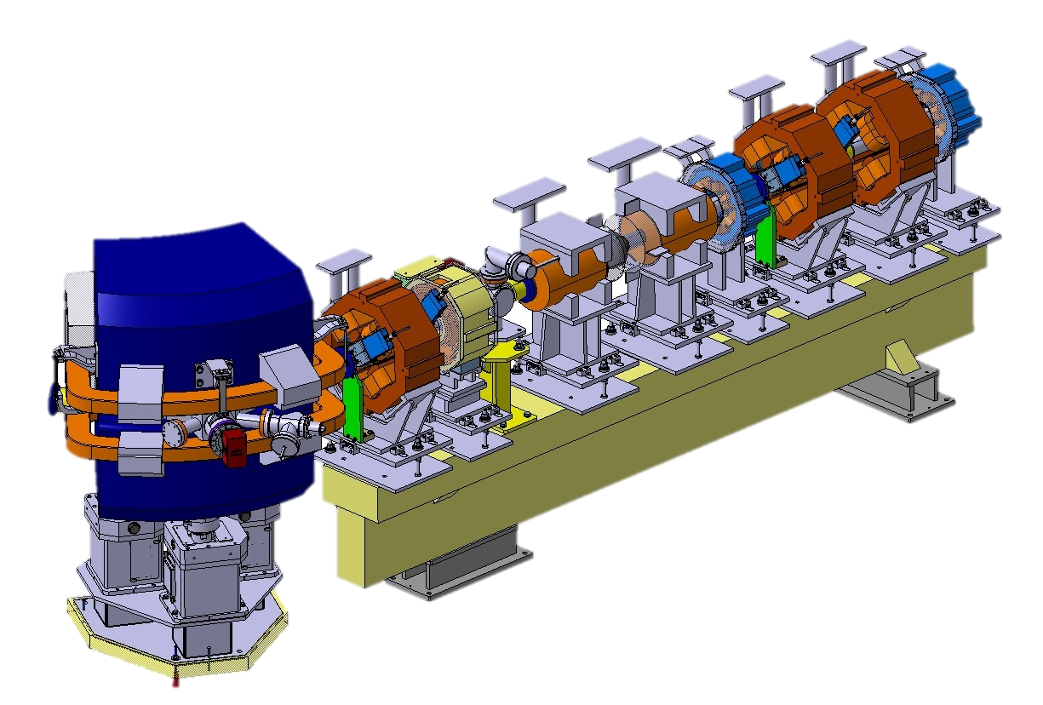
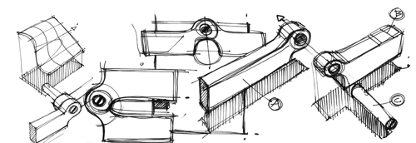
Mechanical Design – Design Inputs
Client specification Space limitations and interfaces
All project parties participate in defining design inputs!

Slide 4
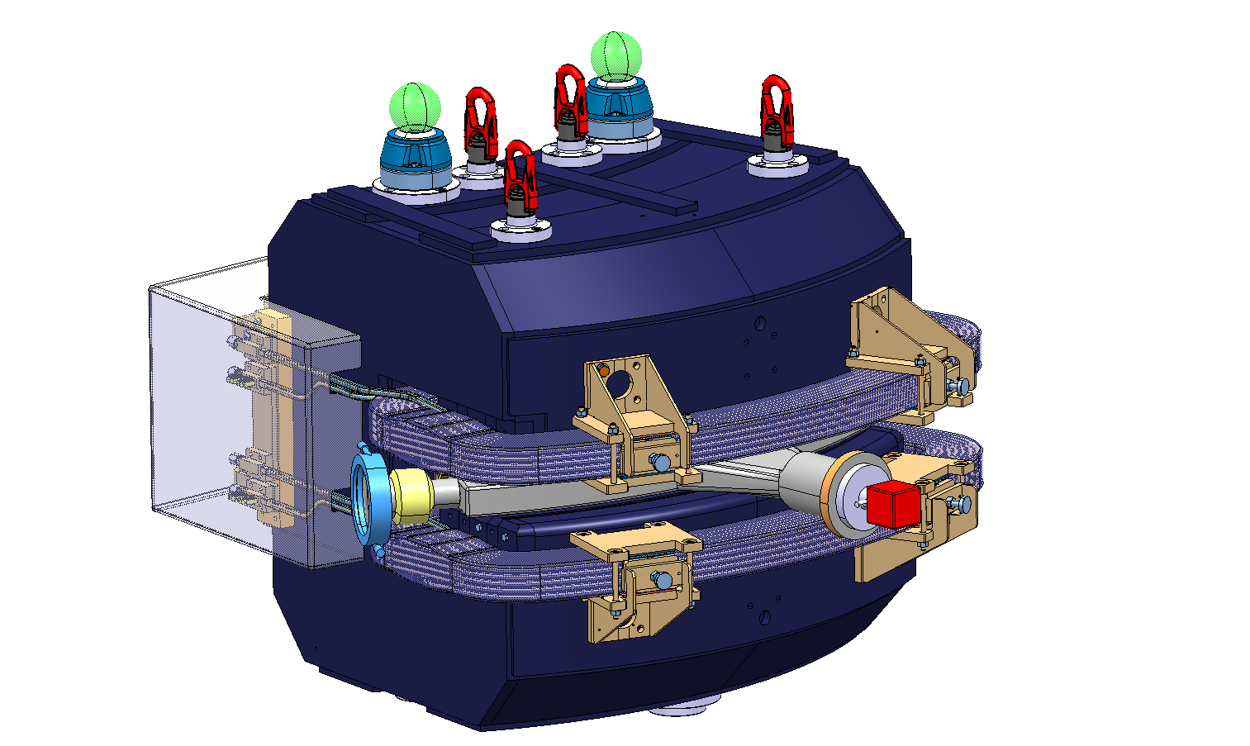
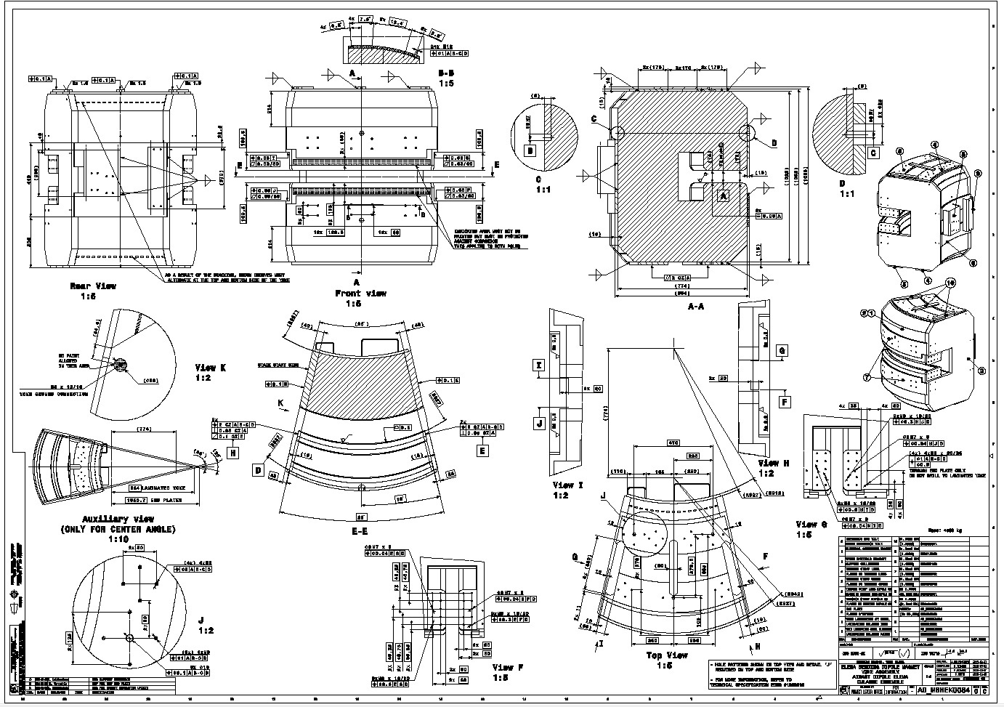
Mechanical Design – Process
Iteration:
Designer – Client
Analysis, simulation
Integration
Manufacturing
Deliverables:
2D drawings
3D models
Supporting documents, such as analysis or measurement reports

Slide 5
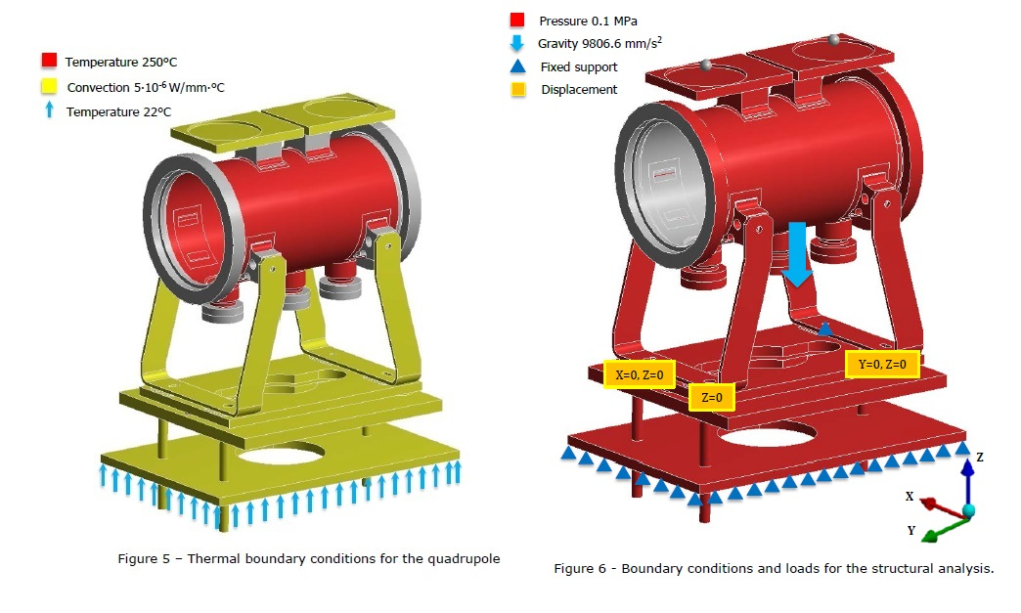
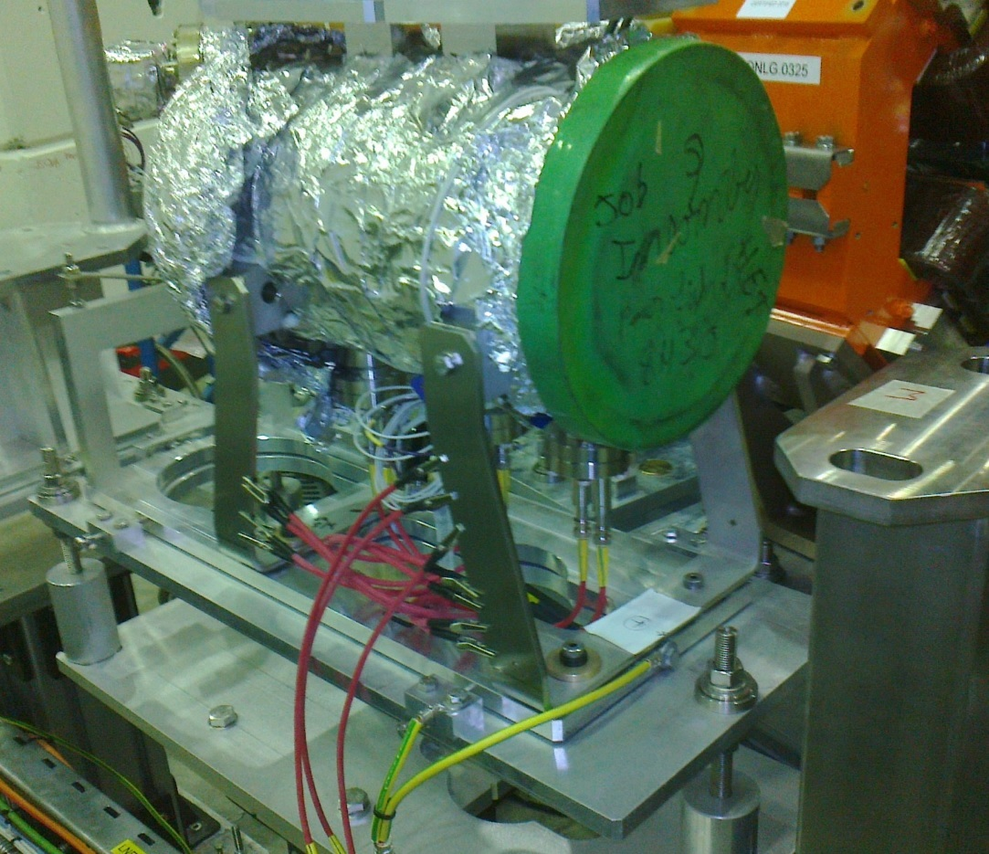
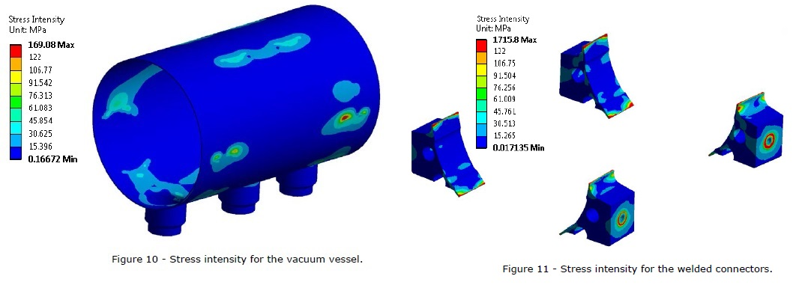
Engineering Calculations and Simulations
Why: To guide design work, to meet requirements, and to assess safety
Boundary conditions
Functional device
Analysis results

Slide 6
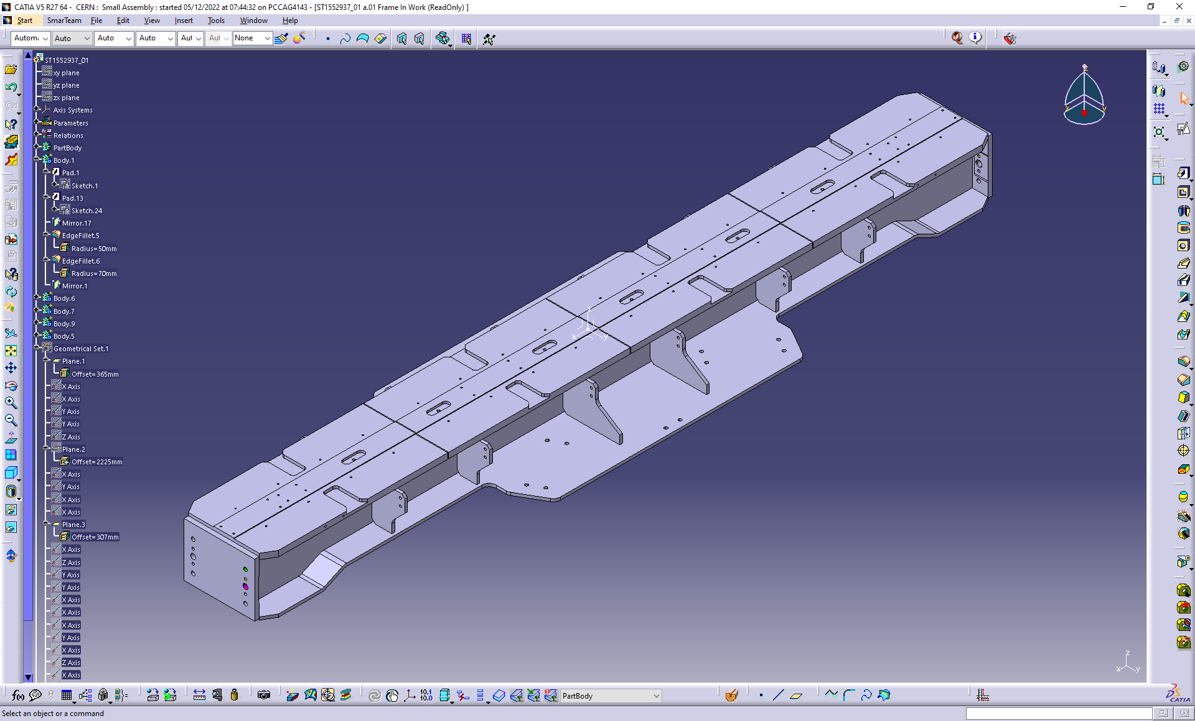
CAE Tools - CATIA

Slide 7
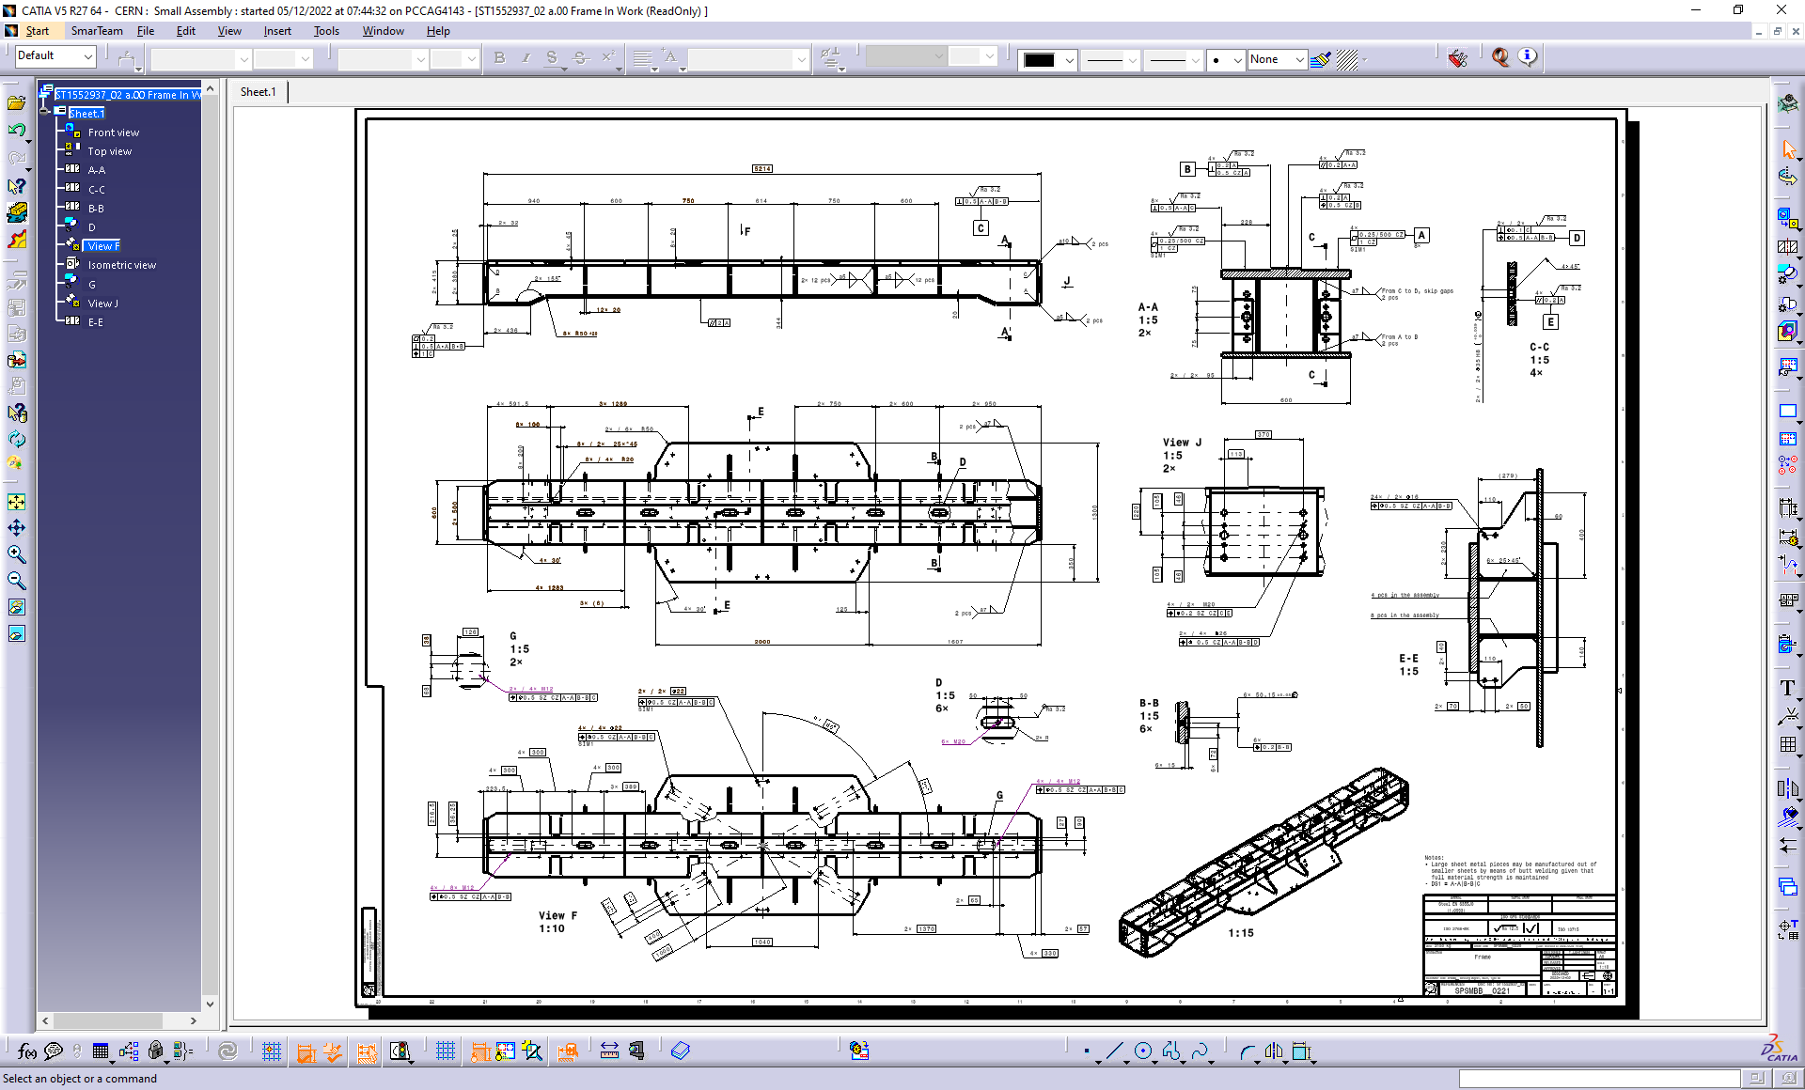
CAE Tools - CATIA

Slide 8
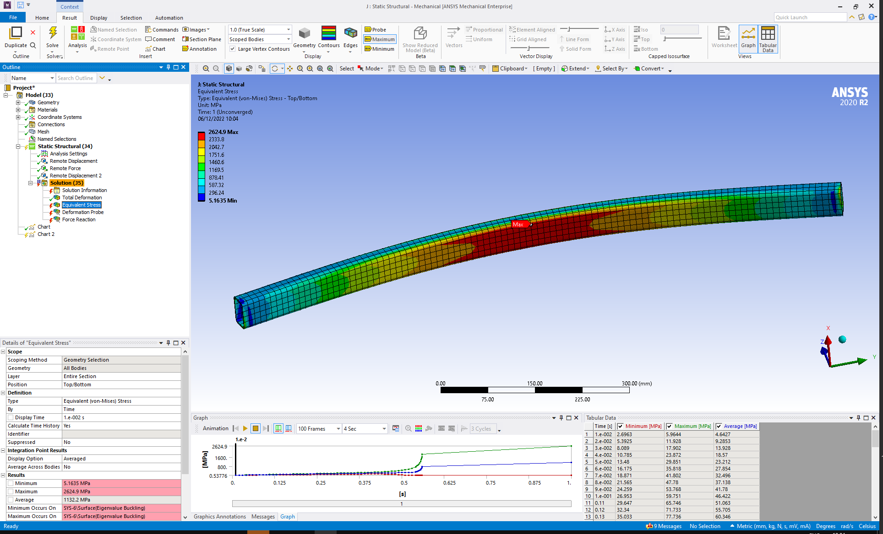
CAE Tools - ANSYS

Slide 9
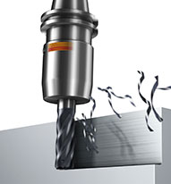
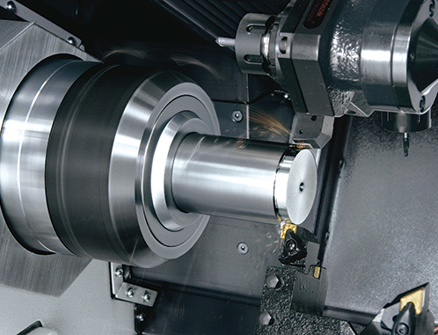
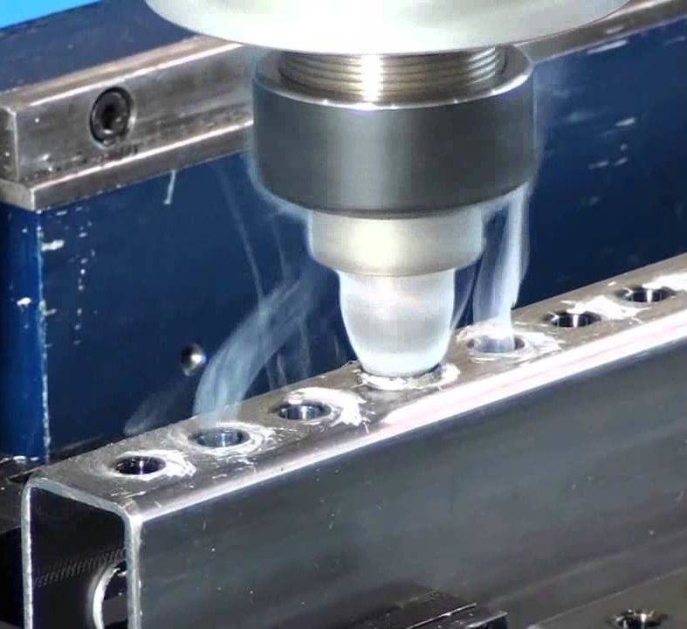
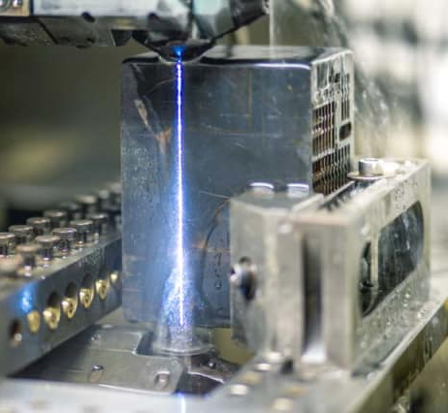
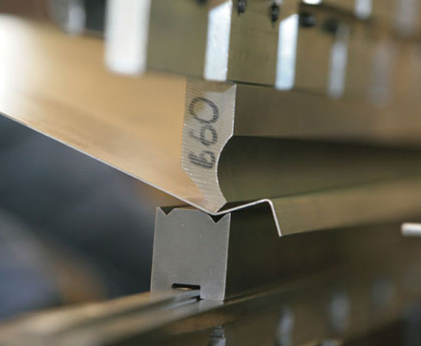
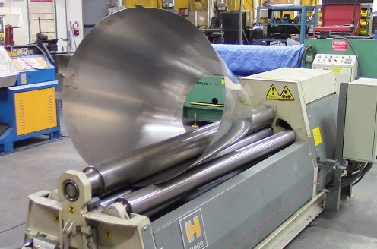


Manufacturing and Production
EN-MME operates three machine shops mostly for prototype and small series production
Capabilities:
  Machining: Milling, turning, drilling, cutting, grinding, electrical discharge machining, etc.
  Forming: Sheet metal bending, rolling, punching, pressing, extrusion, etc.
  Joining: Welding, brazing, soldering, etc.

Slide 10
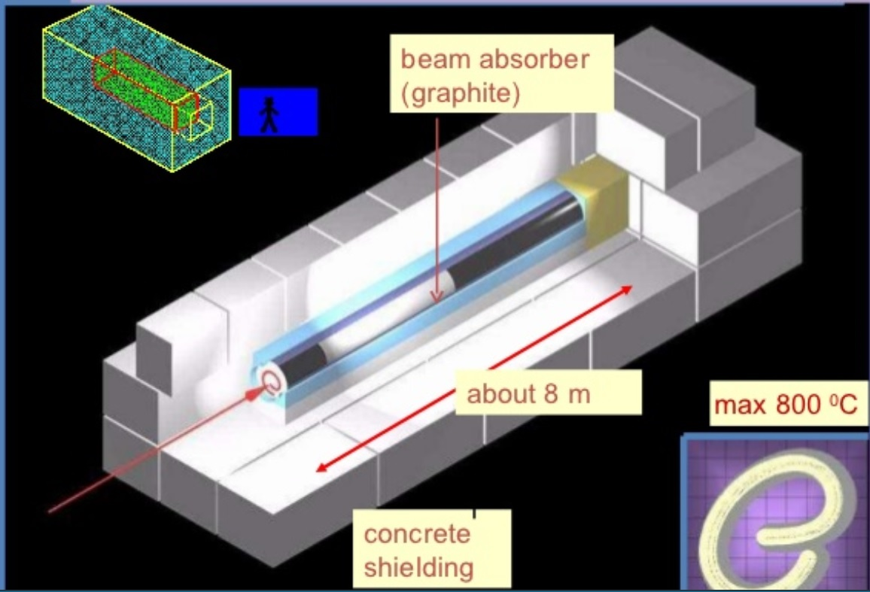
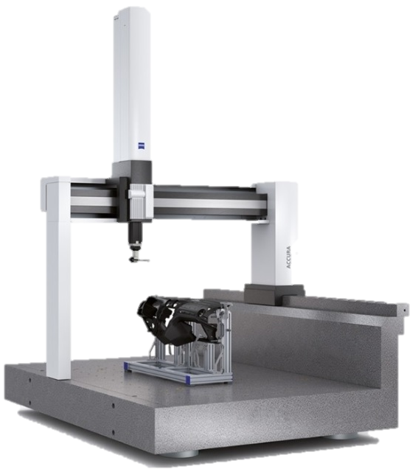
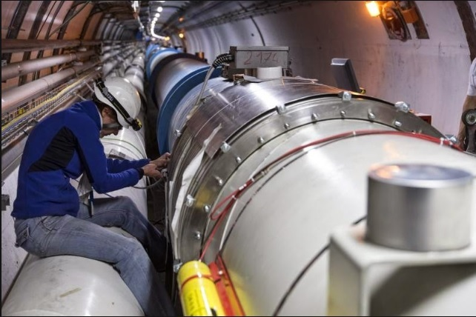
Material Development and Measurements
Material development examples:
Graphites for beam impacts
Stainless steel alloys for permeability
Mechanical measurement examples:
Non-destructive testing: X-ray for LHC dipole magnets
Destructive testing: Material tensile strength testing
Geometrical measurements: Verification of component compliance to specification (drawings and/or model)

Slide 11



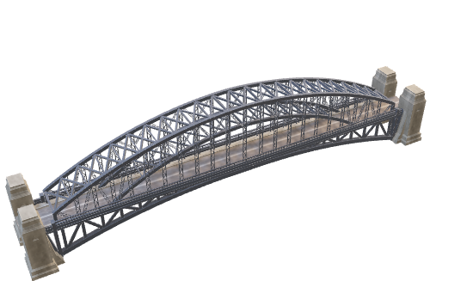
Challenges
Note! Bridge length varies between some micrometers to some parsecs...

Slide 12
Questions!

