Slide 1
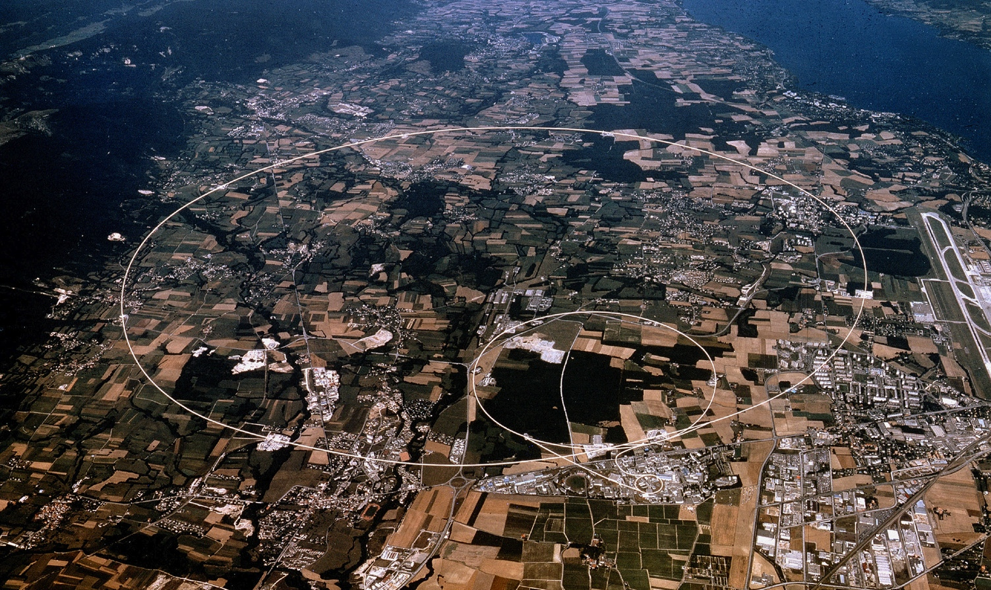

Introduction to Experiments
At CERN with Focus on LHC
H. Danielsson, CERN 2/12/2024

Slide 2
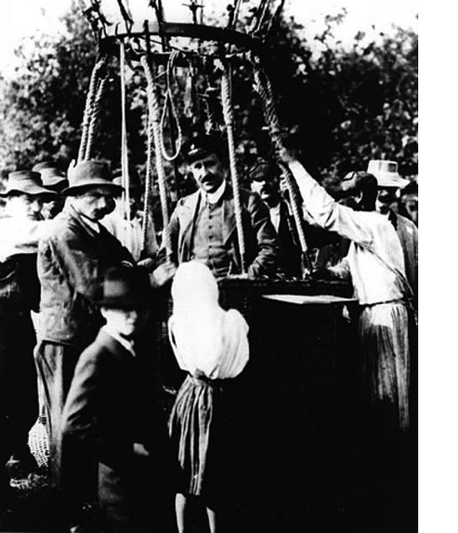
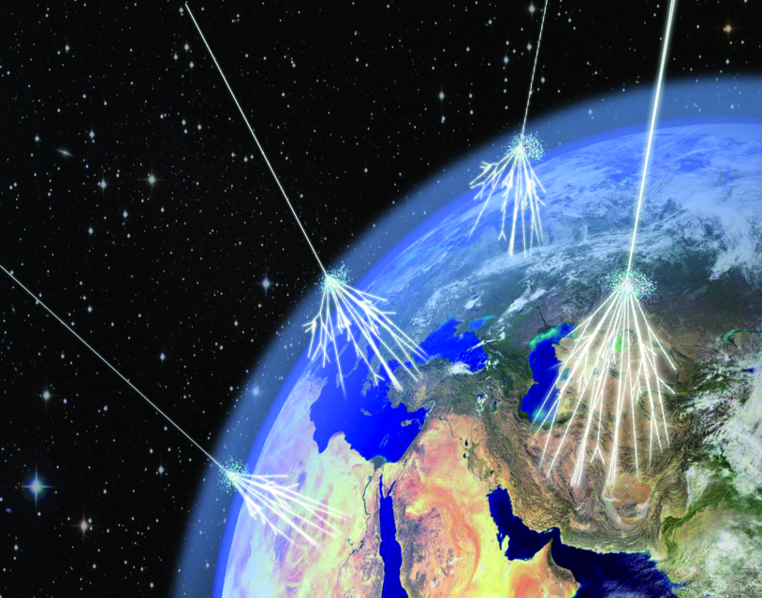
Cosmic rays are used to study the performance of the detector. Free of charge! ☺
Hess received the Nobel Prize in Physics in 1936 for his discovery (1912)

Slide 3
2017: AMS
AMS-02 is a particle-physics detector that looks for dark matter, antimatter and missing matter from a module attached to the outside of the International Space Station (ISS). It also performs precision measurements of cosmic rays.

Slide 4
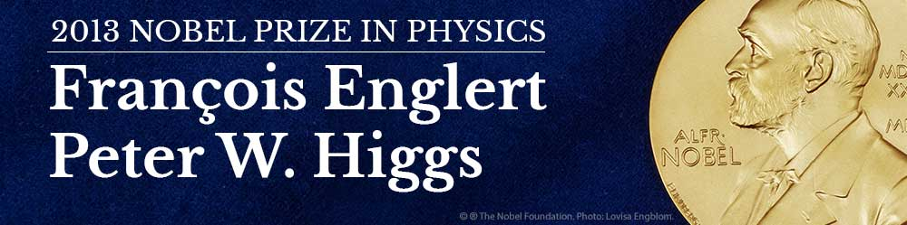
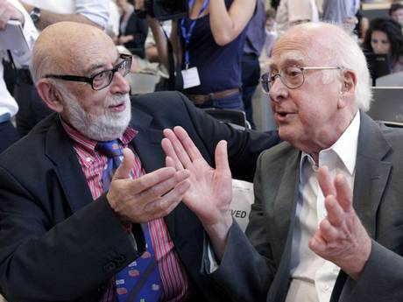
8 October 2013
The Royal Swedish Academy of Sciences has decided to award the Nobel Prize in Physics for 2013 to
François Englert and Peter Higgs
“for the theoretical discovery of a mechanism that contributes to our understanding of the origin of mass of subatomic particles, and which recently was confirmed through the discovery of the predicted fundamental particle, by the ATLAS and CMS experiments at CERN’s Large Hadron Collider”

Slide 5
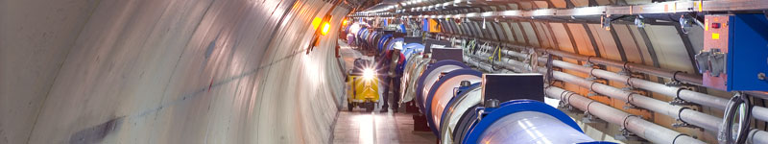
Outline
Introduction
  SM
CERN and the Large Hadron Collider (LHC)
  The accelerator
  How detectors work and examples
The Higgs discovery
What’s next?

Slide 6
Scale
Life
Earth
Size of the universe
quark
“Weak scale”
~10⁻¹⁷ cm
~10⁻¹⁵ cm
~10² cm
~10²⁸ cm
LHC at CERN
Cosmology

Slide 7

A few examples from last century:
The theory has a problem/make predictions and the search can start:
  In 1928, Paul Dirac published a paper proposing that electrons can have both a positive and negative charge.
    Carl David Anderson discovered the positron on 2 August 1932,^{[25]} for which he won the Nobel Prize for Physics in 1936
  The quarks:
    At the time of the quark theory's inception, the "particle zoo" included a multitude of hadrons, among other particles. Gell-Mann and Zweig posited that they were not elementary particles, but were instead composed of combinations of quarks and antiquarks.
  The neutrino:
    The neutrino^{[a]} was postulated first by Wolfgang Pauli in 1930 to explain how beta decay could conserve energy, momentum, and angular momentum (spin).
  The Higgs Boson
    Higgs, Brout, Englert . Problem : without the Higgs mechanism the bosons (force carriers) have no mass which is clearely not the case for Z and W.

Slide 8
The Standard Model
Is a very successful theory and describes the world around us
The Standard Model is a discovery in itself
However, it explains only a fraction of the universe (~5%)
  95% is dark energy and dark matter. What is made of? The search is ongoing for particles(?)…
  Or do we have an issue with our understanding of gravity?
And, the gravity is not part of the standard model !

Slide 9
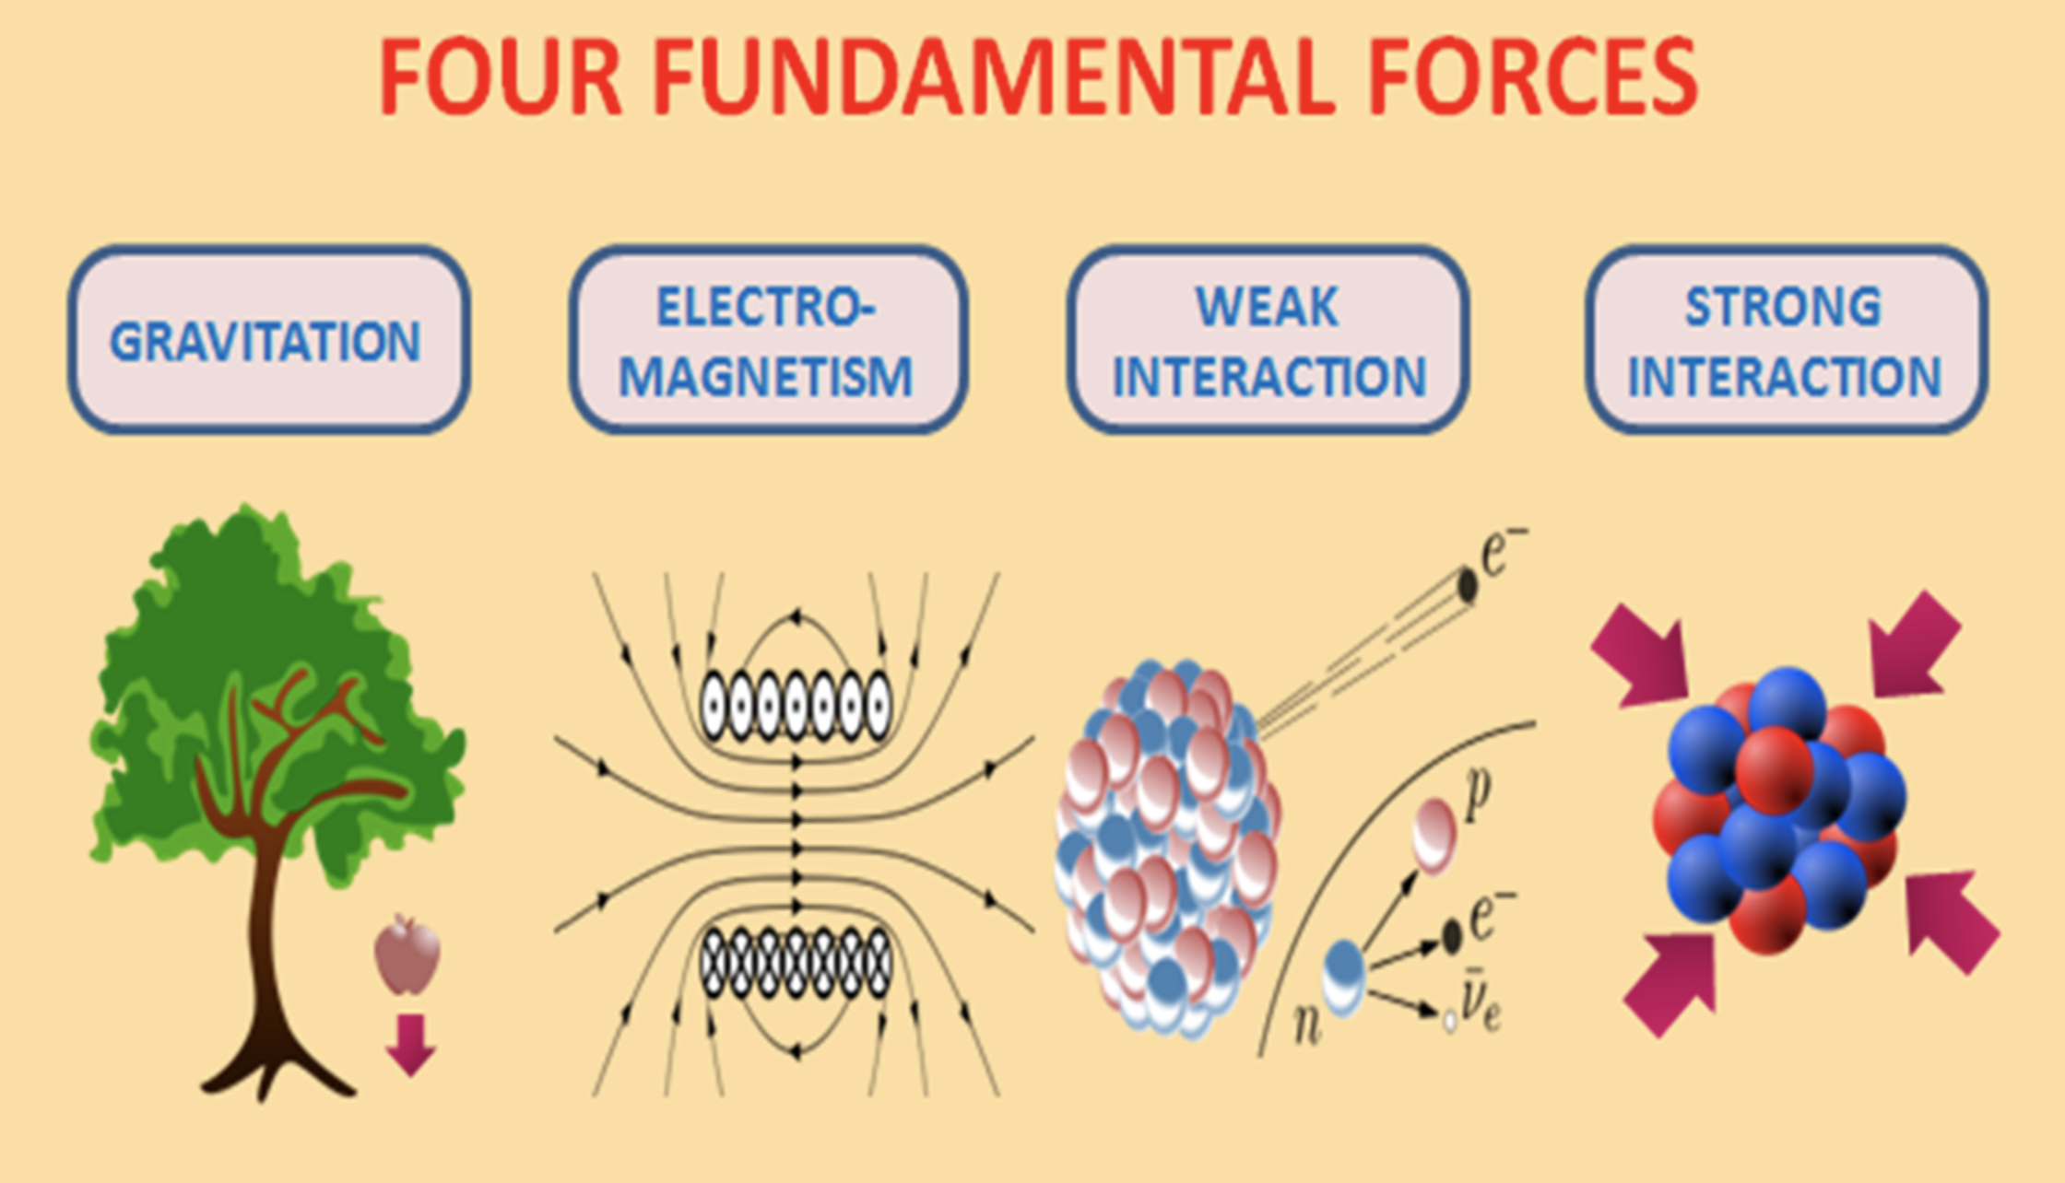
Unification
Einstein
Maxwell
Quantum Mechanics
Image credit: Wikimedia Commons user Kvr.lohith
16/5/2019

Slide 10
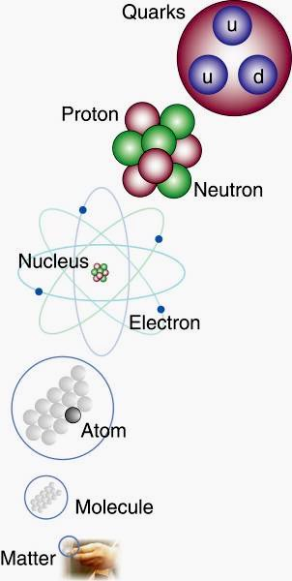
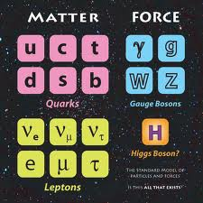
The Standard Model (1970-90s)
Matter particles: fermions (1/2 integer spin)
‘Force’ particles: bosons (integer spin)
Higgs field causes electro weak symmetry breaking and gives particles their masses
→ Nucleon level (partons) : binding energy ~98% of the mass
→ Most of the (luminous) mass in the universe comes from QCD confinement energy. E=mc²

Slide 11
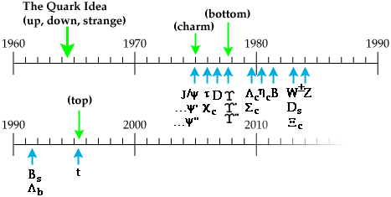
A bit of history
1964 The BEH
mechanism
The Standard Model completed
n_{t}
2012 The Higgs boson
discovered at CERN
LHC approved on
16 December 1994

Slide 12
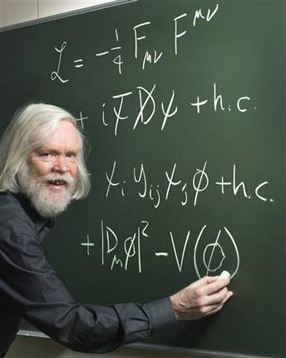
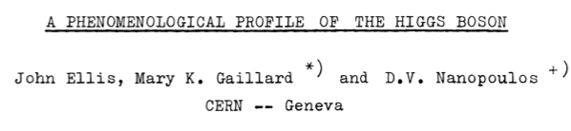
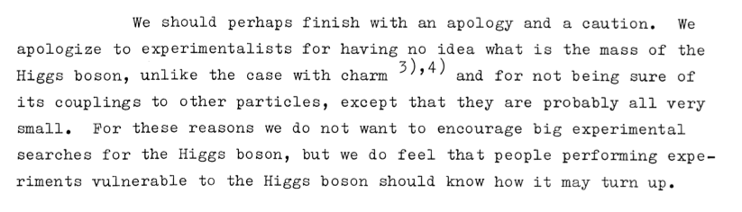
In 1976:
The Roadmap:

Slide 13
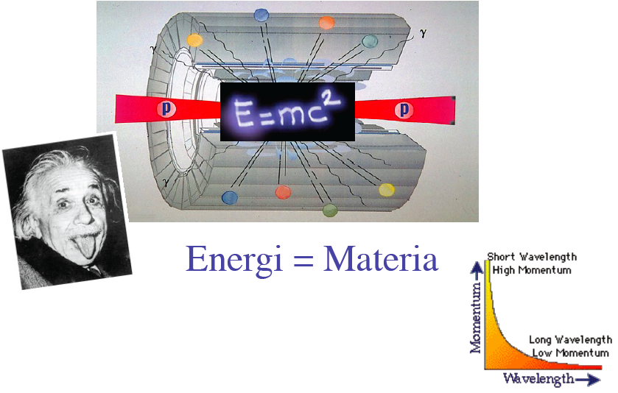
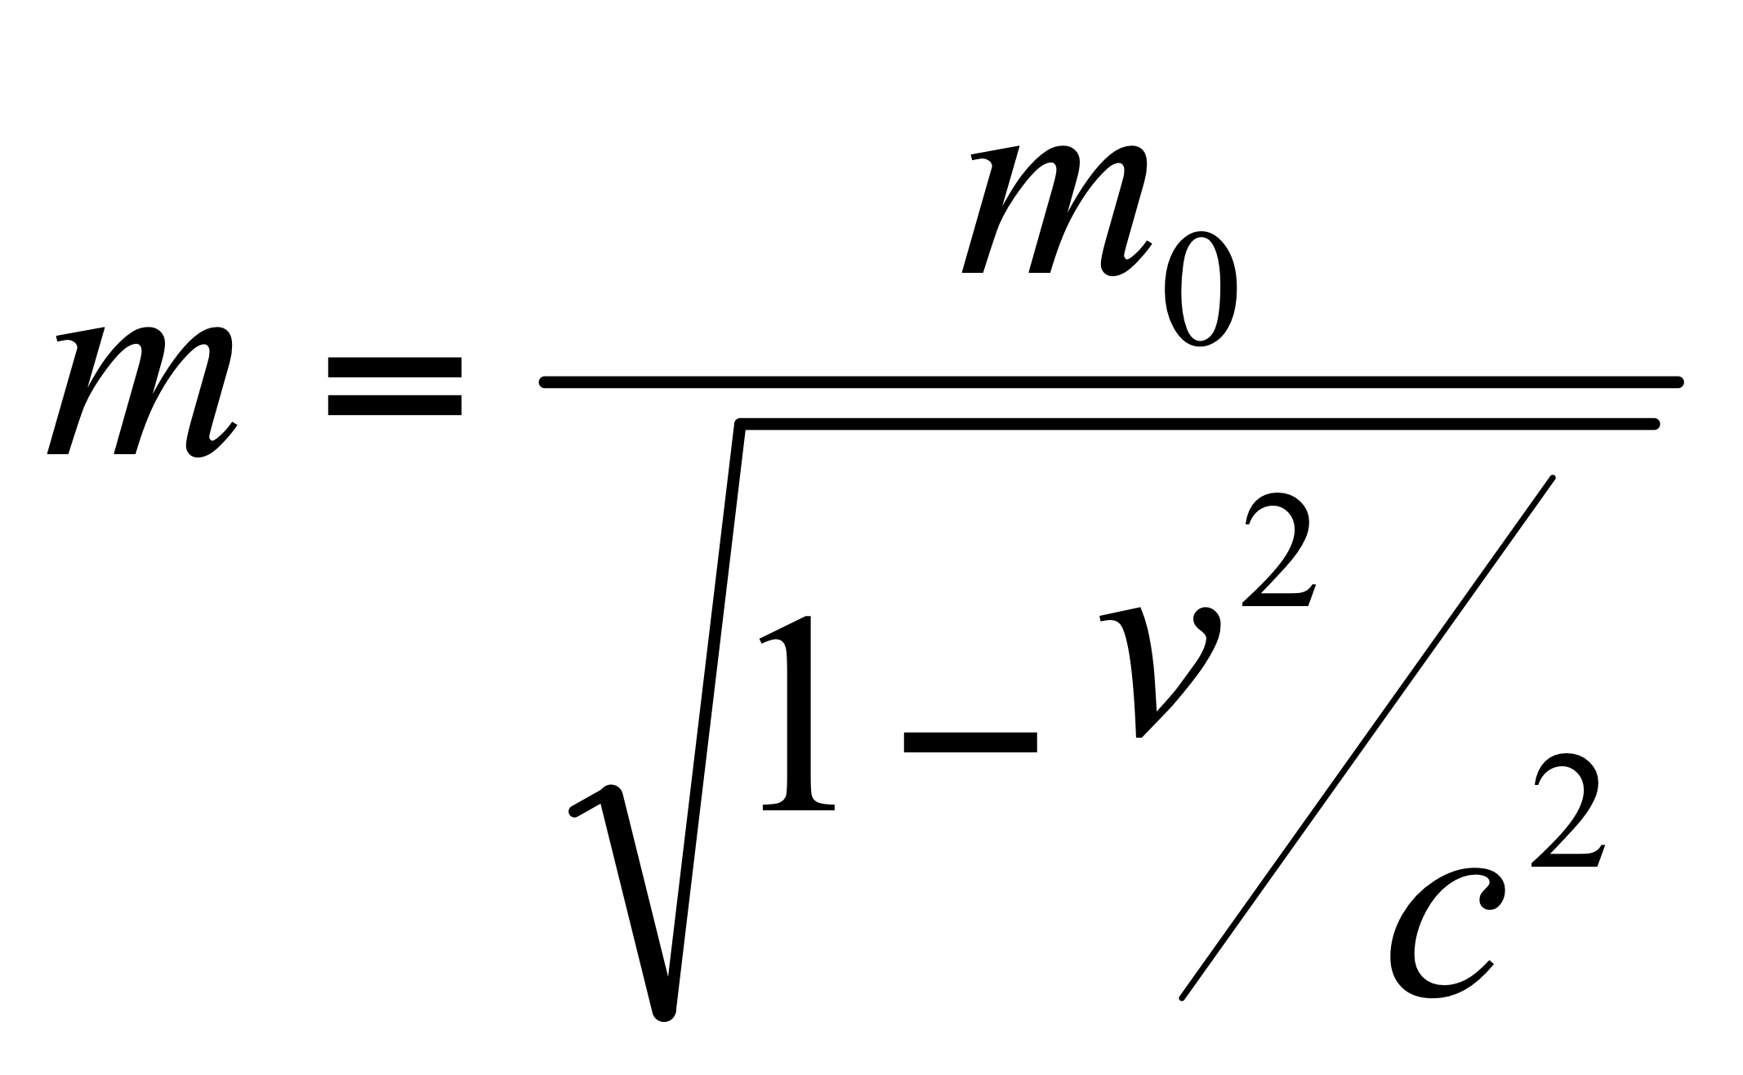
How ?
E=3.5TeV ➔
V=99.999996% of c
Energy = Matter
E²= (m₀c²)² + (pc)²

Slide 14
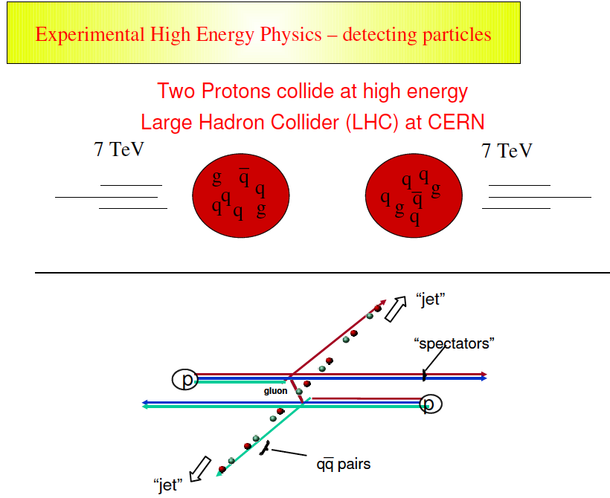
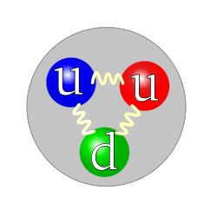
4
4
16/5/2019

Slide 15
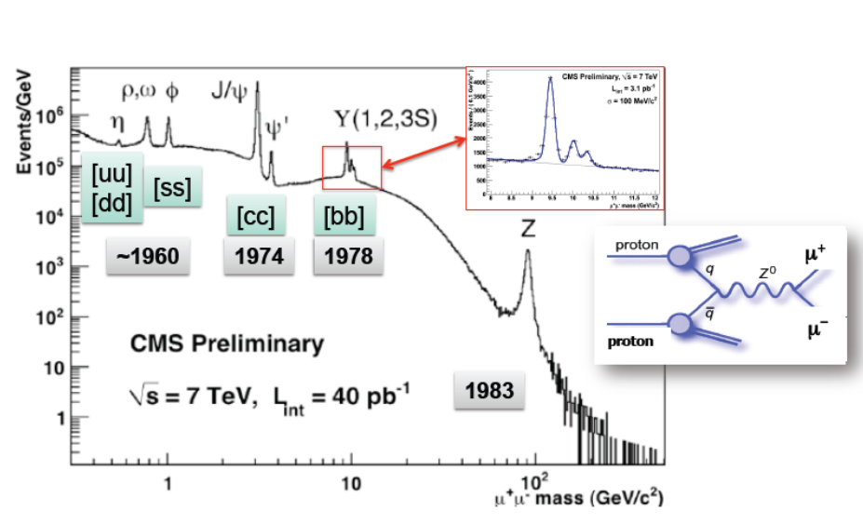
After 10 min of LHC running: full history of SM

Slide 16
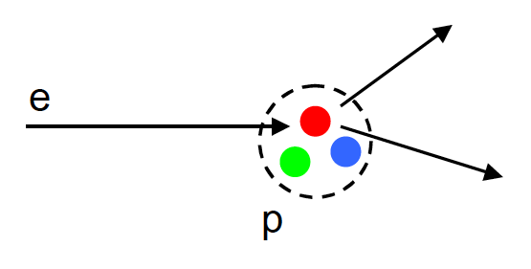
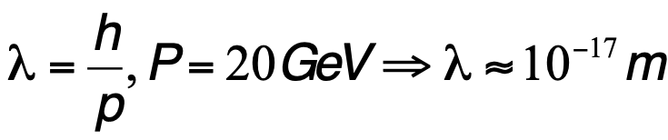
On example: the discovery of the quarks at SLAC in 1968
l
The quark model was independently proposed by physicists Murray Gell-Mann and George Zweig in 1964.
Gell-Mann found the quarks in:
“Three quarks for Muster Mark!
Sure he has not got much of a bark
And sure any he has it's all beside the mark.”
—James Joyce, Finnegans Wake

Slide 17
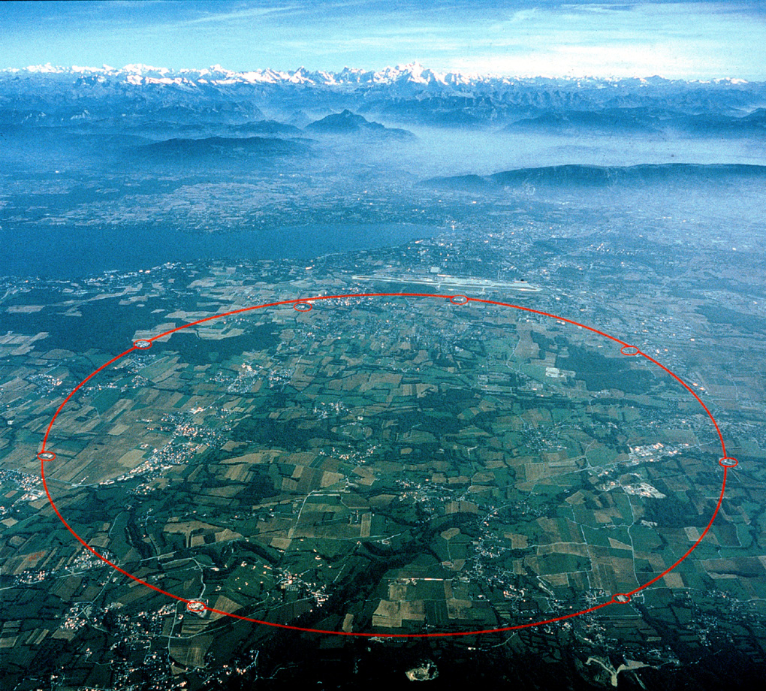
Center-of-Mass Energy (Nominal)
14 TeV
Center-of-Mass Energy (close to nominal)
13TeV
5/2017. No change in 2018
Restart in 2015
LHCb
ATLAS
Center-of-Mass Energy (2012)
8 TeV
CMS
ALICE
Center-of-Mass Energy (2010-2011)
7 TeV

Slide 18
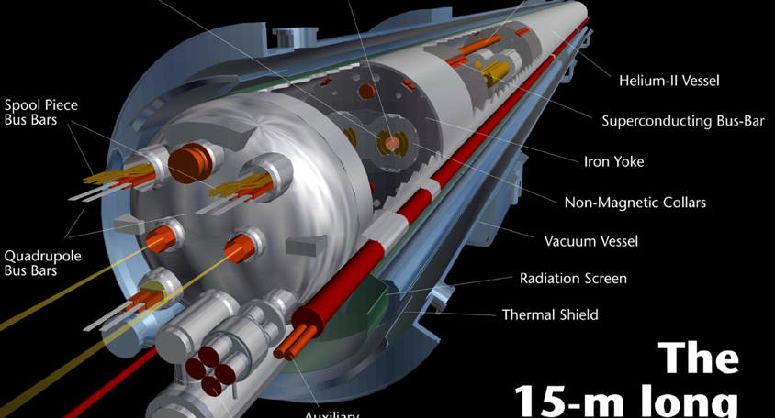
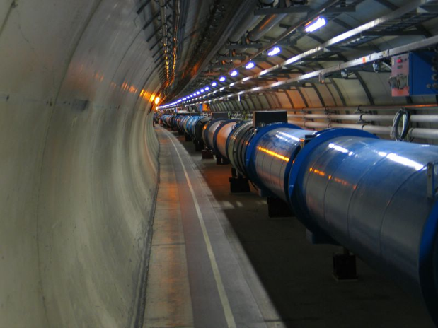
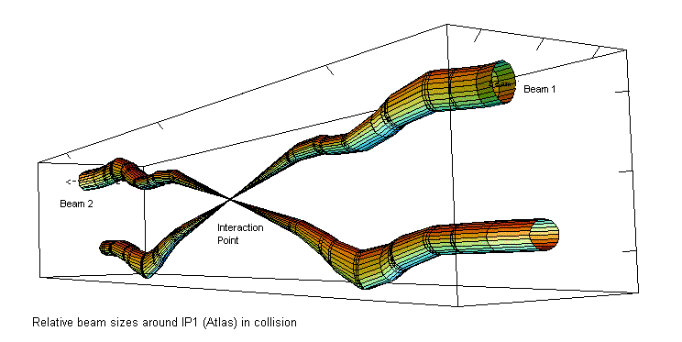
Large Hadron Collider (LHC)
  The Accelerator
    100 - 150 m below surface at 1.9 Kelvin in a tunnel 27 km long.
    The protons circulate at a speed of ~ 11000 turns/sec
    There are 2808 bunches
    Collisions at 40 MHz (every 25 ns)
    600 000 000 collisions per second !

Slide 19
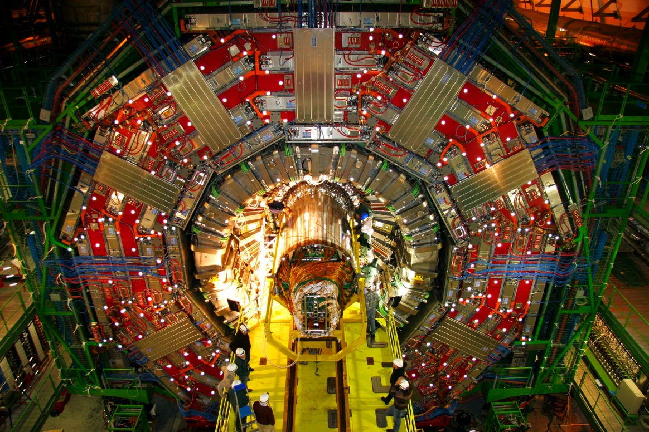
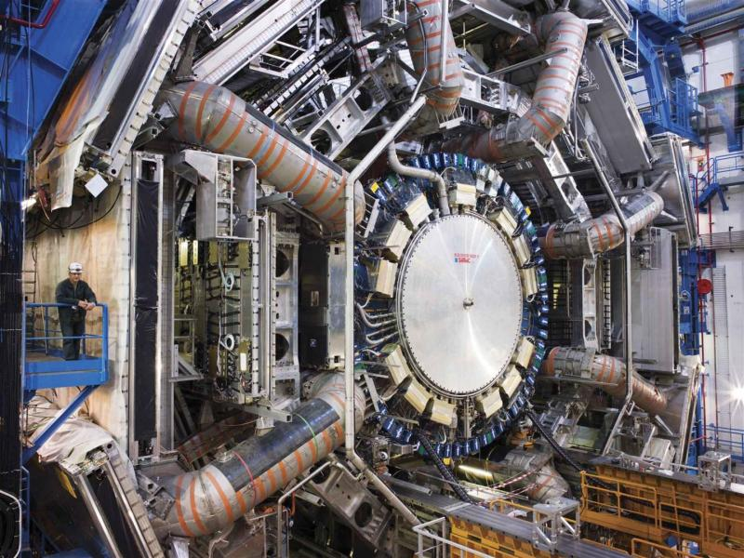
The experiments
CMS: heavier than
the Eiffel Tower
ATLAS: as big as a
5 storey building

Slide 20
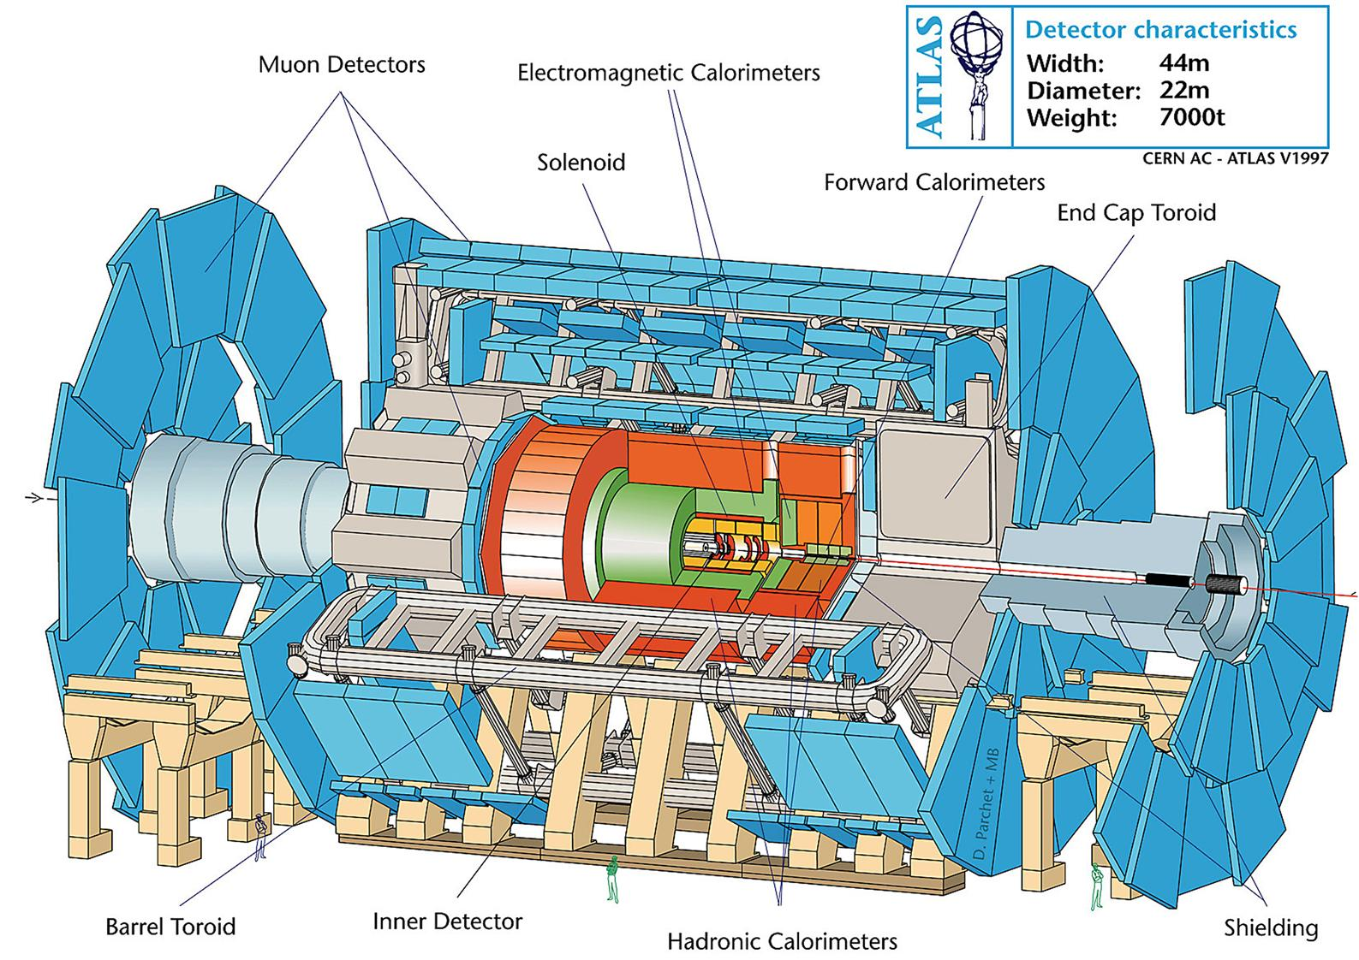
Största och mest sofistikerade detektorer
Thisis
To hide
The legend
Thisis
To hide
The legend

Slide 21
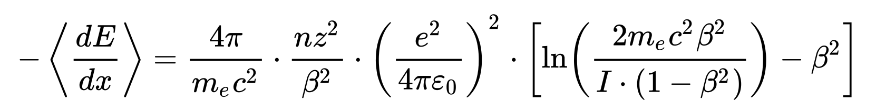
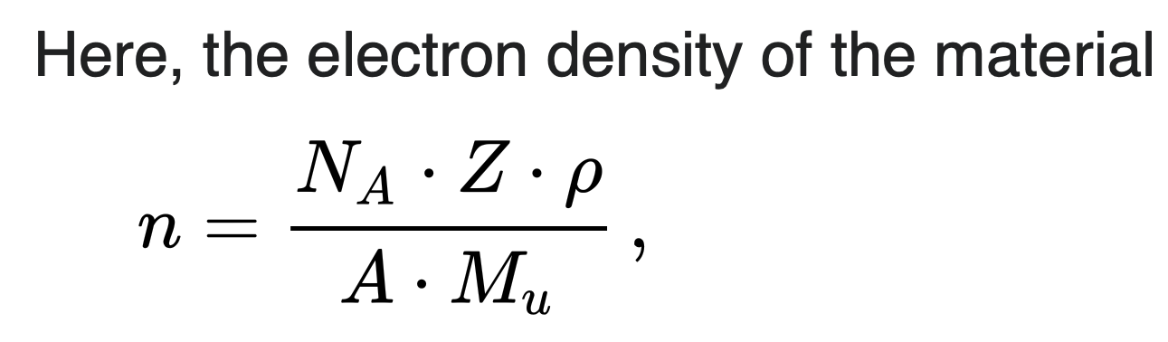
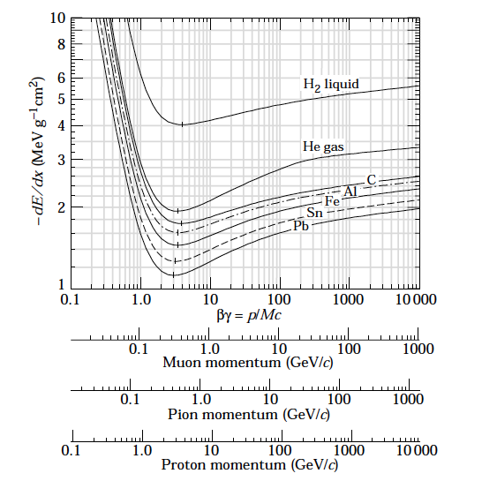
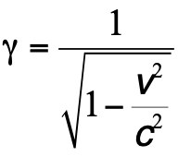
Bethe-Bloch Energy Loss
PDG plots:
http://pdg.lbl.gov/index.html
Calculated
For charged particles but not for electrons !

Slide 22
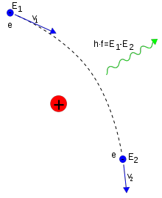
Bremsstrahlung
(braking radiation)
A fast moving particle is decelerated in the electrical field of the nuclei.
Above a few tens MeV, bremsstrahlung is the most dominated process for electrons and positrons
It becomes important to muons (and pions) at a few hundred GeV
What about the atomic electrons? Yes, the electron cloud gives and additional contribution to the bremsstrahlung
Let’s see how this is used in the detector layout later
e⁻
e⁻
e⁻
e⁻
e⁻

Slide 23
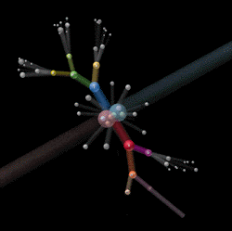

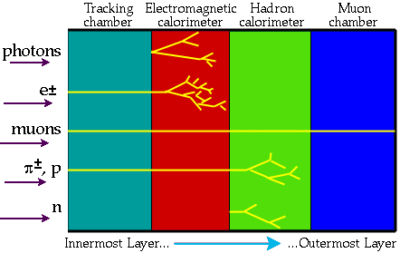
Principles of Detection
The collision energy condenses into particles (e, p, π, μ,γ Κ…)
Detectors surrounding the collision point (or after in case of fixed target) are sensitive to the passage of energetic particles.

Slide 24
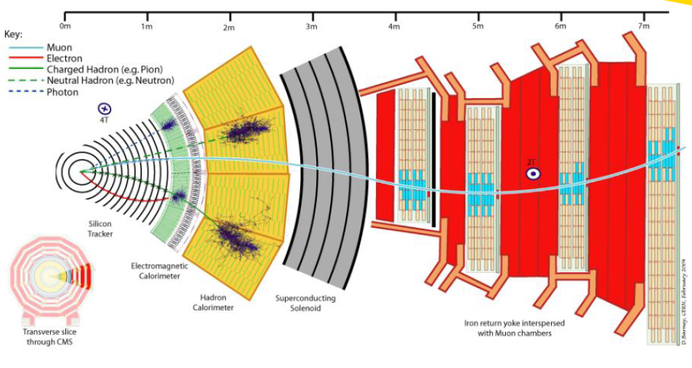
Partikeldetektorer

Slide 25
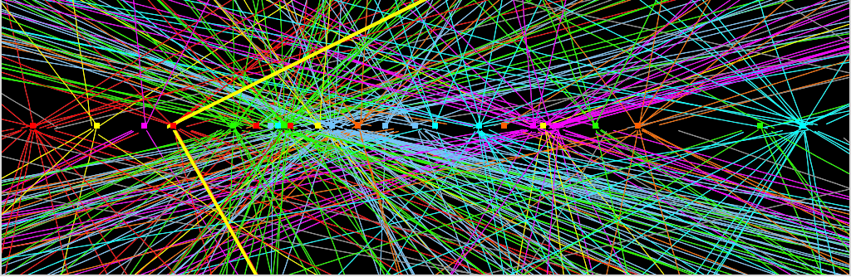
Detector Challenges (Highlights)
10 cm
- Trigger Challenge : How to select 400 out of 20x10⁶ events per second while keeping the interesting (including unknown) physics
- Computing Challenge : How to reconstruct, store and distribute 400 increasingly complex events per second (over 100 Petabite per experiment)

Slide 26
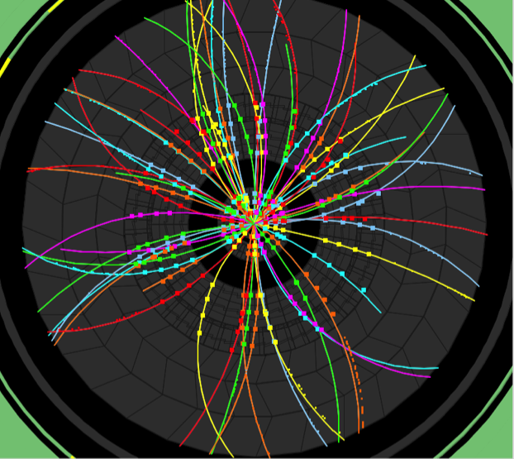
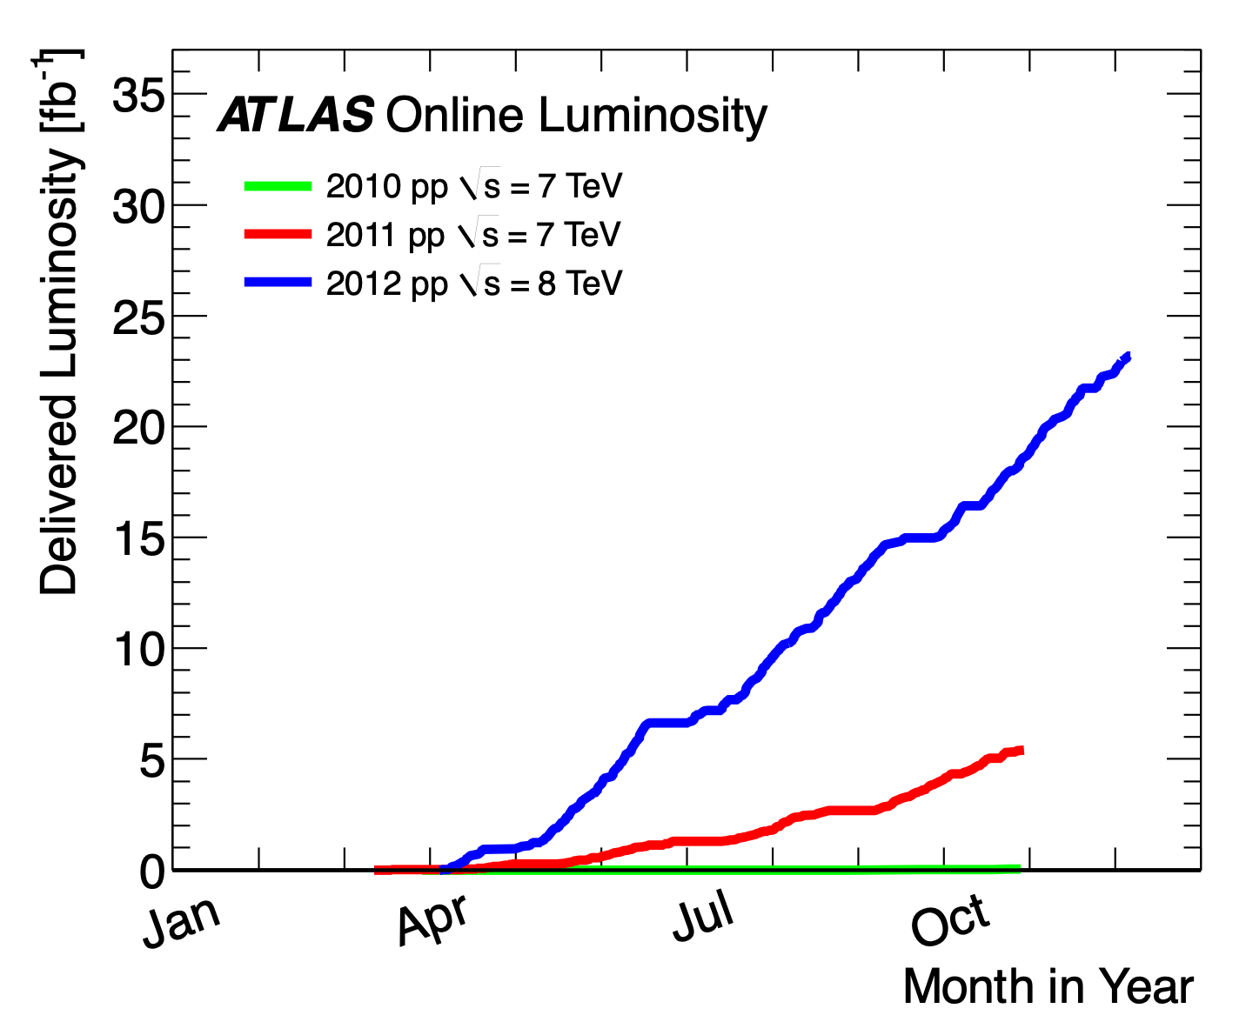
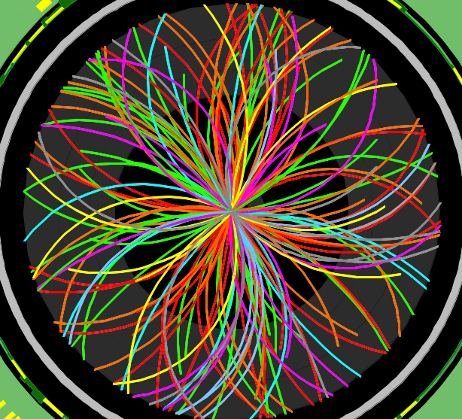

The first LHC run
2010
Event rate = luminosity x cross-sections
2011
O(2) Pile-up events
Event taken at random (filled) bunch crossings
150 ns inter-bunch spacing
2012
23 fb⁻¹
at 8 TeV
2010
0.05 fb⁻¹
at 7 TeV
2011
2011
5.6 fb⁻¹
at 7 TeV
O(10) Pile-up events
Event taken at random (filled) bunch crossings
50 ns inter-bunch spacing
Design value
(expected to be
reached at L=10³⁴ !)
2012
O(20) Pile-up events
50 ns inter-bunch spacing

Slide 27
The detection of the Higgs boson

Slide 28
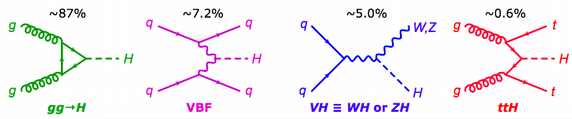
Higgs production
Vector boson fusion
VBF
Top-antitop fusion
ttH
Higgs strahlung
VH
Gluon-gluon fusion
gg→H

Slide 29
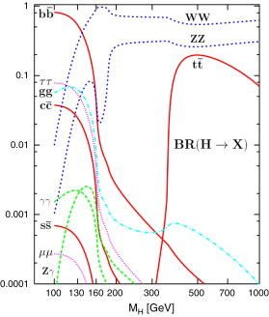
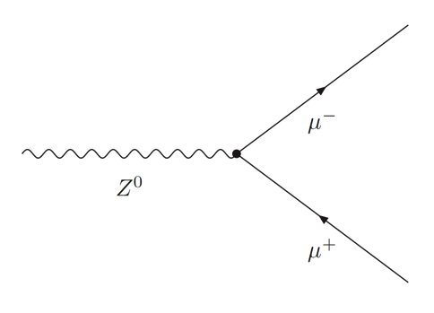
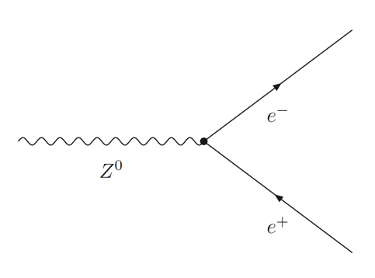
Detect Higgs by decay products
Variety of decay channels
Massive particles more likely
Difficult to detect from background
Life time is 1.56×10−22 s (!)
(predicted in the Standard Model)
gg is clean, but rare
Ref: hep-ph/0208209

Slide 30
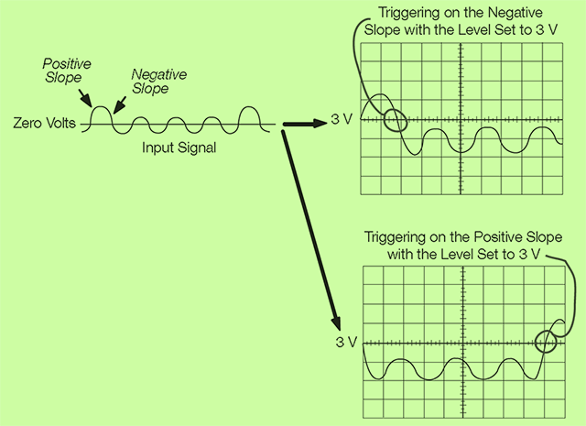
Online, Offline Trigger

Slide 31
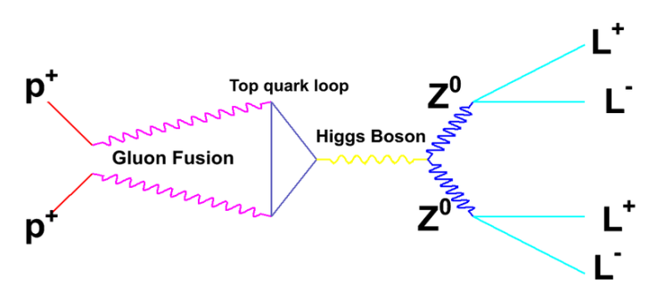
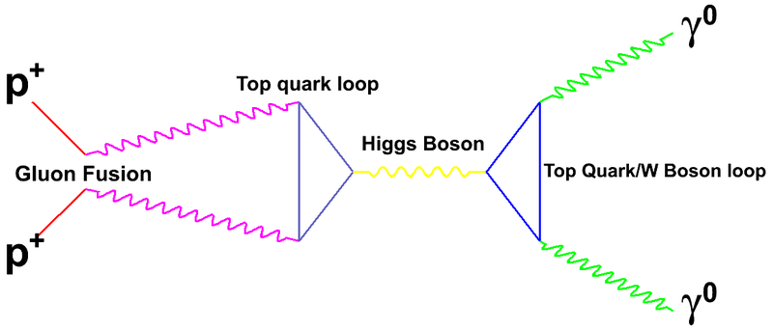
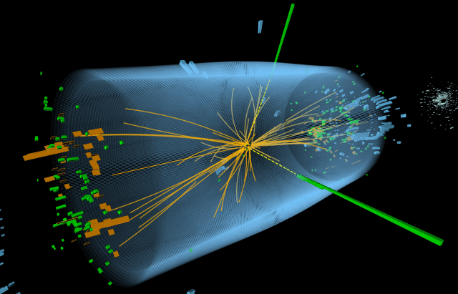
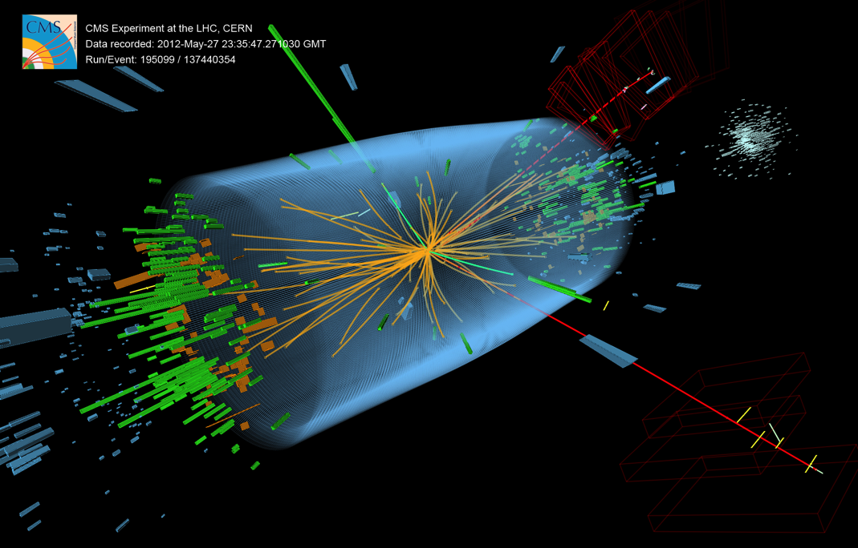
April-July 2012: 8 TeV, 5.8 fb⁻¹
ONLINE
Event visualization
Measure energy of photons emitted
Measure decay products of Z bosons

Slide 32

H→ 4 leptons
OFFLINE
Full analysis

Slide 33
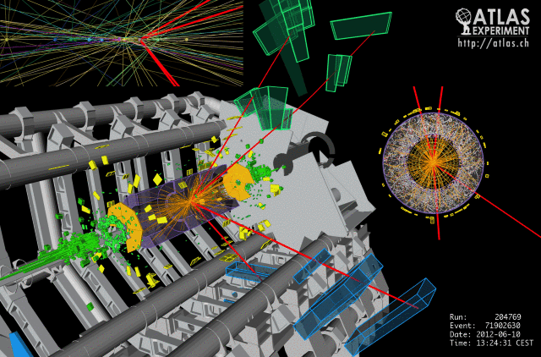
Higgs events H→4l (muons)

Slide 34
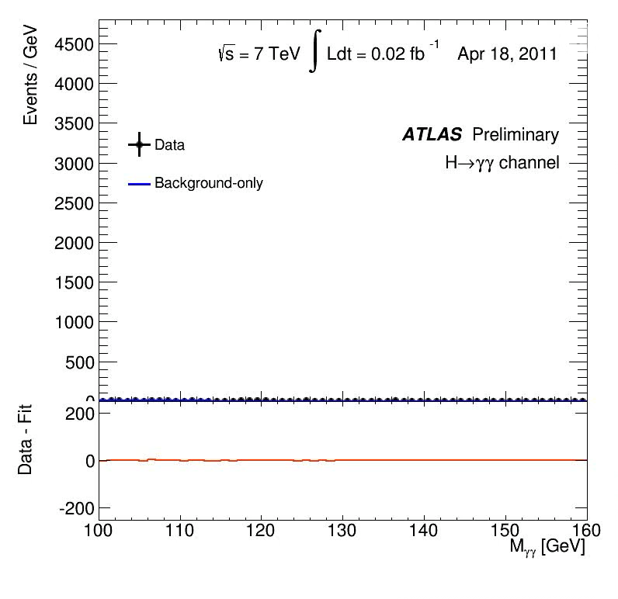
H → γγ

Slide 35


From CMS Higgs→γγ
16/5/2019

Slide 36
But
There is a problem (at least)…….

Slide 37

Dark Matter? Dark Energy?
Dark Matter is invisible matter, it does not emit light. Its evidence comes from the study of the motion of galaxies and groups of galaxies
Dark Energy is the term introduced to justify the acceleration of the Universe expansion (is it equivalent to Einstein’s cosmological constant)

Slide 39

Nima Arkani-Hamed

Slide 40

Breaking News ! ?
https://www.cosmos.esa.int/web/gaia/iow_20230927
Youyoutube

Slide 41
What about future experiments ?
SHiP and the associated SPS Beam Dump Facility is a new general-purpose experiment proposed at the SPS to search for "hidden" particles as predicted by a very large number of recently elaborated models of Hidden Sectors which are capable of accommodating dark matter, neutrino oscillations, and the origin of the full baryon asymmetry in the Universe. The experiment is design to search for any type of very weakly interacting long-lived particles, among which are found e.g. heavy neutral leptons, dark photons , dark scalars, axion-like particles, and light supersymmetric particles - sgoldstinos, etc, as well as different types of Light Dark Matter.
Hike (future of NA62) Measure branching ratios of rare Kaon decays for direct comparison with standard model predictions

Slide 42
Modified Newtonian Dynamics (MOND) as an alternative to dark matter !
Who is right ?
>A new theory of gravity
>Experiments:
In space or on the ground
Accelerators (CERN)

Slide 43

An electron-positron Higgs factory is the highest-priority next collider. For the longer term, the European particle physics community has the ambition to operate a proton-proton collider at the highest achievable energy
Large-scale data-intensive software and computing infrastructures are an essential ingredient to particle physics research programmes

Slide 44


Slide 45


Slide 46

HL-LHC and HE- LHC
Development of high field superconducting magnets
High-Energy LHC with 10-13 T magnets
HE-LHC with ~30 TeV center-of-mass energy for proton collisions and 16-20 T magnets

Slide 47

FCC , the future?

Slide 48

FCC-ee

Slide 49


Slide 50


Slide 51
Literature
CERN Academic Training
  http://indico.cern.ch/conferenceDisplay.py?confId=266737
CERN ATLAS
  http://atlas.cern/resources
European Strategy (2019):
  https://europeanstrategy.cern/european-strategy-for-particle-physics
  https://indico.cern.ch/event/808335/timetable/ - 20190513.detailed

Slide 52
Spares
16/5/2019

Slide 53


Slide 54
What are these theories she talks about
SUSY
  In particle physics, a supersymmetric extension of the Standard Model is a possible candidate for undiscovered particle physics, and seen by some physicists as an elegant solution to many current problems in particle physics if confirmed correct, which could resolve various areas where current theories are believed to be incomplete and where limitations of current theories are well established.
GUT: A Grand Unified Theory (GUT) is a model in particle physics in which, at high energies, the three gauge interactions of the Standard Model comprising the electromagnetic, weak, and strong forces are merged into a single force.
Dark matter:
  To solve the problem of rotating galaxies and other problems in the universe
Hierarchy problem

Slide 55
Question: Higgs production?
Ref (link) : Higgs production
Gluon fusion. If the collided particles are hadrons such as the proton or antiproton – as is the case in the LHC and Tevatron – then it is most likely that two of the gluons binding the hadron together collide. The easiest way to produce a Higgs particle is if the two gluons combine to form a loop of virtual quarks. Since the coupling of particles to the Higgs boson is proportional to their mass, this process is more likely for heavy particles. In practice it is enough to consider the contributions of virtual top and bottom quarks (the heaviest quarks). This process is the dominant contribution at the LHC and Tevatron being about ten times more likely than any of the other processes.^{[86][159]}
Higgs Strahlung. If an elementary fermion collides with an anti-fermion – e.g., a quark with an anti-quark or an electron with a positron – the two can merge to form a virtual W or Z boson which, if it carries sufficient energy, can then emit a Higgs boson. This process was the dominant production mode at the LEP, where an electron and a positron collided to form a virtual Z boson, and it was the second largest contribution for Higgs production at the Tevatron. At the LHC this process is only the third largest, because the LHC collides protons with protons, making a quark-antiquark collision less likely than at the Tevatron. Higgs Strahlung is also known as associated production.^{[86][159][160]}
Weak boson fusion. Another possibility when two (anti-)fermions collide is that the two exchange a virtual W or Z boson, which emits a Higgs boson. The colliding fermions do not need to be the same type. So, for example, an up quark may exchange a Z boson with an anti-down quark. This process is the second most important for the production of Higgs particle at the LHC and LEP.^{[86][160]}
Top fusion. The final process that is commonly considered is by far the least likely (by two orders of magnitude). This process involves two colliding gluons, which each decay into a heavy quark–antiquark pair. A quark and antiquark from each pair can then combine to form a Higgs particle.^{[86][159]}

Slide 56
Higgs production
Vector boson fusion
VBF
Top-antitop fusion
ttH
Higgs strahlung
VH
Gluon-gluon fusion
gg→H

Slide 57



Cherenkov light
Named after the Russian scientist P. Cherenkov who was the first to study the effect in depth (he won the Nobel Prize for it in 1958)
From Relativity, nothing can go faster than the speed of light c (in vacuum)
However, due to the refractive index n of a material, a particle can go faster than the local speed of light in the medium c_{p} = c/n
Fast electrons in a reactor emitting blue light (Cherenkov radiation)
This is analogous to the bow wave of a boat travelling over water
or the sonic boom of an aeroplane travelling faster than the speed of sound

Slide 58


Cherenkov radiation
The left corner of the triangle represents the location of the superluminal particle at some initial moment (t=0). The right corner of the triangle is the location of the particle at some later time t. In the given time t, the particle travels the distance
$$=\frac{{\text{ν}}_{em}}{{\text{ν}}_{p}}$$

Slide 59


Cherenkov Detector NA62

Slide 60
Higgs to Fermions
Recent analysis shows evidence of Higgs boson decaying to fermions (leptons or quarks). Not previously observed!
It is important to measure this decay but no surprise is expected
Difficult due to high background
BR related to mass. High mass fermions preferred (τ,b)
Both ATLAS and CMS has “evidence” in the channel H→ ττ ….but not yet the famous “5 σ” needed to claim discovery

Slide 61


Higgs decays to fermions (ττ) in ATLAS (26 Nov 2013)
The taus decay into an electron (blue line) and a muon (red line)

Slide 62


Higgs decays to fermions (ττ) in CMS (3 Dec. 2013)
One tau decays to neutrinos and a muon (red lines on the right), while the other decays into a charged hadron (blue towers) and a neutrino

Slide 63

Higgs
“exclusion plots”

Slide 64

The ATLAS experiment
16/5/2019

Slide 65


LHC
20 Years, projecting, constructing and Simulating…
Accelerators:
Powerful machines capable of accelerating particles to very high energies before being collided with other particles
2. Detectors:
Gigantic instruments that record particle collisions
3. Computers:
To collect, store, distribute and analyze enormous quantities of data generated by detectors
The biggest scientific instrument ever built

Slide 66

The Higgs search as of 18/11/2011 ☺
To be continued……..

Slide 67
After 10 min of LHC running: full history of SM

Slide 68


What LEP (CERN) and
Tevatron (Fermilab)
Until year 2000
Until year 2011

Slide 69

16/5/2019

Slide 70
Interaction of Particles with Matter
In order to detect a particle it must interact with matter!
The most important interaction processes are electromagnetic:
Charged Particles:
Energy loss due to ionization (e.g. charged track in straw detector) heavy particles (not electrons/positrons!)
Energy loss due to photon emission (electrons, positrons) bremsstrahlung
Photons:
Interaction of photons with matter (e.g. EM calorimetry)
Photoelectric effect
Compton effect
Pair production
Other important electromagnetic processes:
Multiple Scattering (Coulomb scattering)
scintillation light (e.g. TOF systems)
Cherenkov radiation
Transition Radiation (e.g. particle id normally electrons)
Can calculate the above effects with a combo of classical E&M and QED.
In most cases calculate approximate results, exact calculations very difficult.

Slide 71



Bethe-Bloch Formula for Energy Loss
Average energy loss for heavy charged particles
Energy loss due to ionization and excitation
Valid for energies <100’s GeV and β >>zα (≈z/137)
heavy= m_{incident}>>m_{e}
proton, k, π, μ
Fundamental constants
r_{e}=classical radius of electron
m_{e}=mass of electron
N_{a}=Avogadro’s number
c=speed of light
=0.1535MeV-cm²/g
Absorber medium
I=mean ionization potential
Z= atomic number of absorber
A=atomic weight of absorber
r=density of absorber
d=density correction
C=shell correction
Incident particle
z=charge of incident particle
b=v/c of incident particle
g=(1-b²)^{-1/2}
W_{max}=max. energy transfer
in one collision
Note: the classical dE/dx formula contains
many of the same features as the QM version: (z/β)², & ln[]

Slide 72




Multiple Scattering
A charged particle traversing a medium is deflected by many small angle scatterings.
These scattering are due to the coulomb field of atoms and are assumed to be elastic.
In each scattering the energy of the particle is constant but the particle direction changes.
In the simplest model of multiple scattering we ignore large angle scatters.
In this approximation, the distribution of scattering angle θ_{plane} after traveling a distance x
through a material with radiation length =L_{r} is approximately gaussian:
with
In the above equation β=v/c, and p=momentum of incident particle
This is not good for tracking!

Slide 73

Photons interacting with matter
Photoelectric effect
Compton scattering
Pair production
Mass Attenuation Coefficient = Interaction probability/density

Slide 74



Photons - 3 interactions

Slide 75

Transition Radiation (Particle ID)
Transition Radiation: photon emitted by a charged particle when traversing the boundary between materials with different dielectrical constants (ε₁ε₂)
g > 1000
Intensity: I ~ γ = E/m, θ ~ 1/ γ
  Identification of transition radiation
  photons used for
  particle identification (mostly electrons)
  of particles with momenta between
  1 and few 100 GeV
q
charged
particle

Slide 76



Cherenkov Detector
LHCb
AMS

Slide 77

Transition radiation
(particle identification)

Slide 78

TRT (ATLAS): 3 straws and radiators
Cross section view
TR photon
electrons
High threshold
Low threshold

