Slide 1
I.FAST
2025 Annual Meeting
Valérie BRUNNER
Steering Committee – 21 October 2024

Slide 2
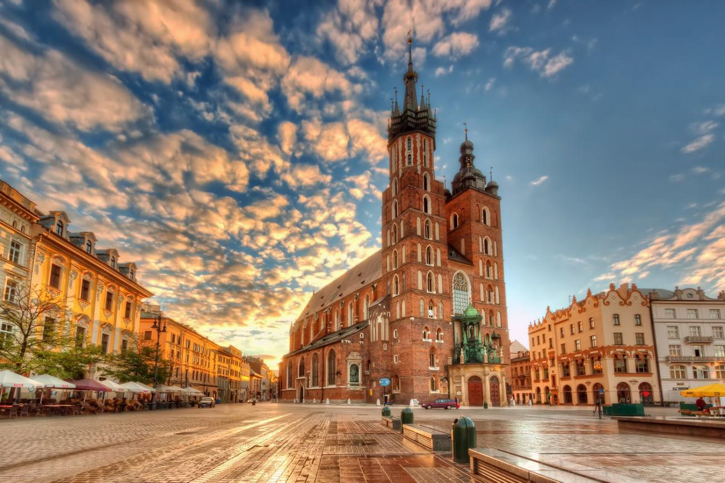
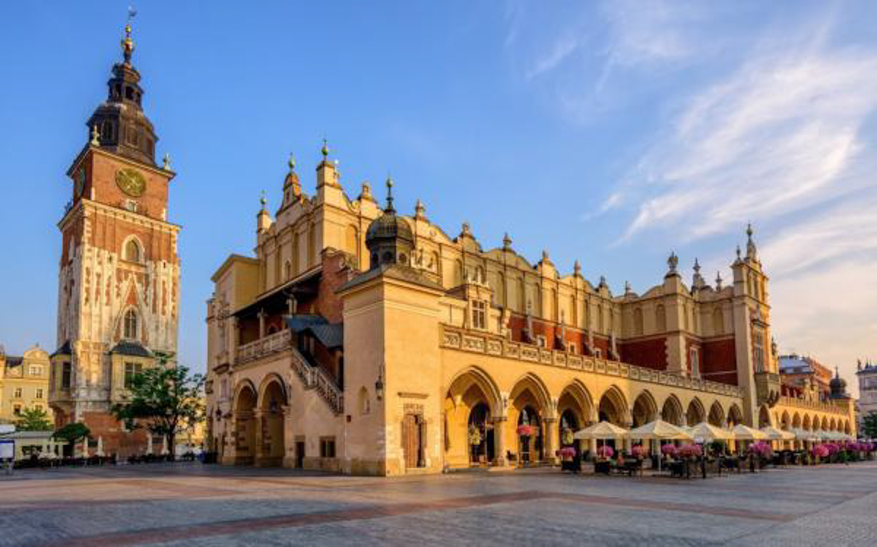
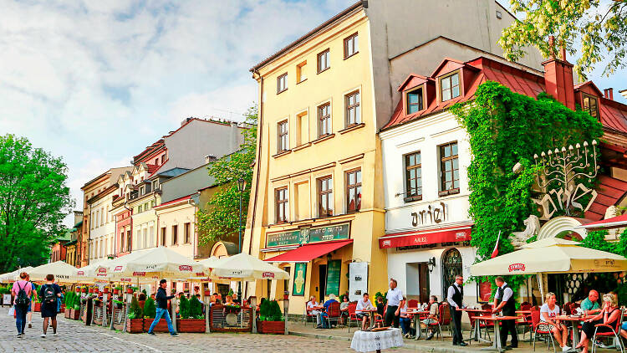
Location: Krakow, Poland
7-11 April 2025

Slide 3

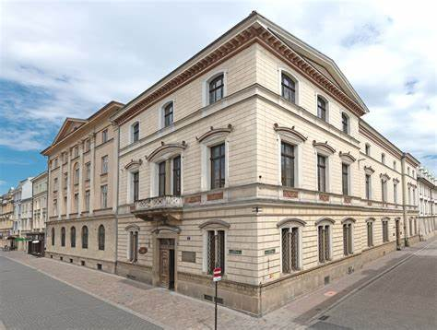
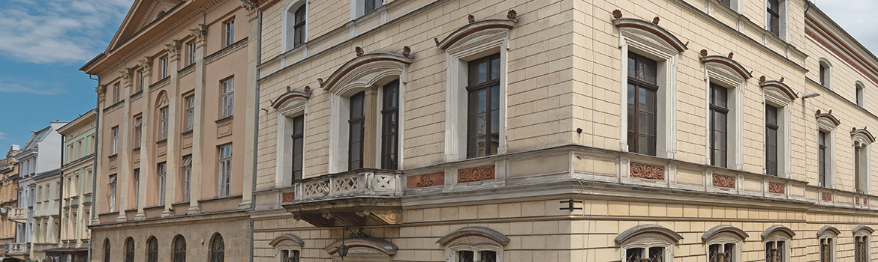
Meeting venue
Polish Academy of Science (PAU)
Slawkowska 17, Krakow, Poland
Located next to the historical center of the city

Slide 4
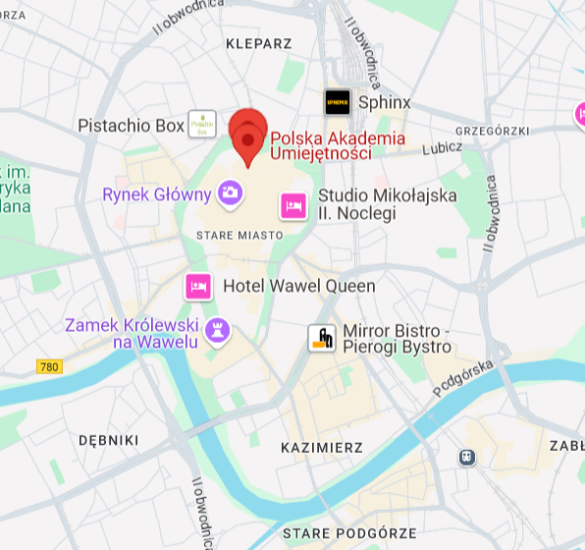
Meeting venue
From International Airport Jean-Paul II
35mn by car
40mn by bus
20mn by train shuttle (every 30mn)
or from Krakow main Train Station
- 20mn by public transport

Slide 5
Preliminary Agenda – Krakow 2025
Day | Date | Sessions | Events
1 2 | Monday 7 April Tuesday 8 April | EA Jade/I.FAST workshop WP Parallel Meetings
3 | Wednesday 9 April | WP Parallel Meetings 14:00 Plenary meeting | Welcome drink
4 | Thursday 10 April | Plenary meeting (all day) | Banquet dinner
5 | Friday 11 April | 9:00 Plenary meeting, Highlight talks, SAC report, discussion 14:00 Governing Board/Steering Committee

Slide 6
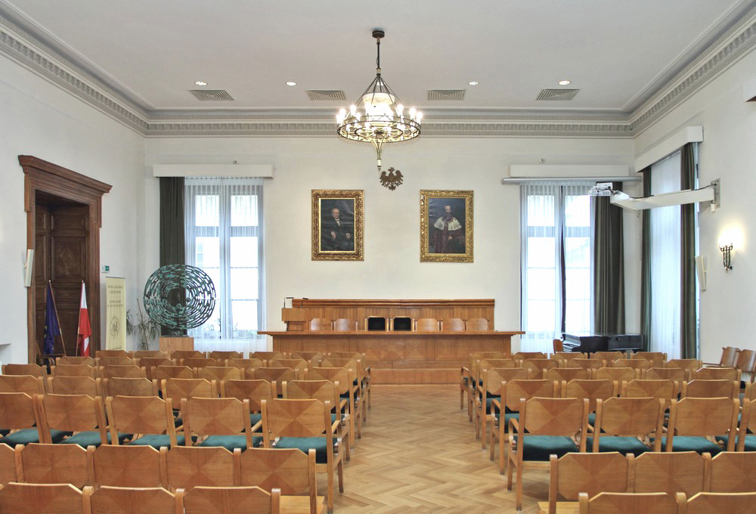
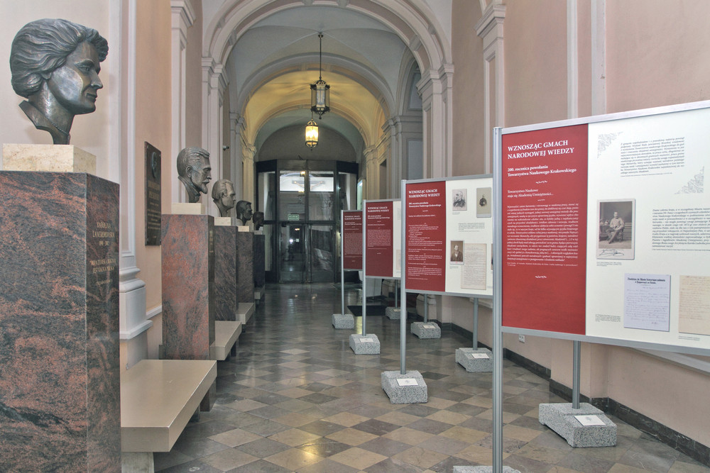
Meeting rooms
- Grand Hall - Duza Aula: capacity 180 seats
Exhibition space
Hall - entrance

Slide 7
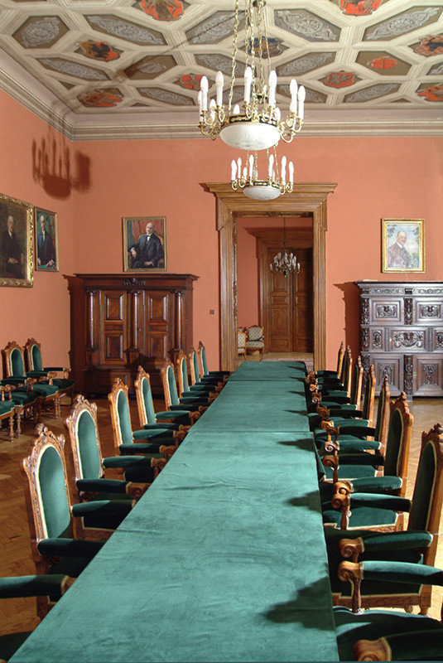
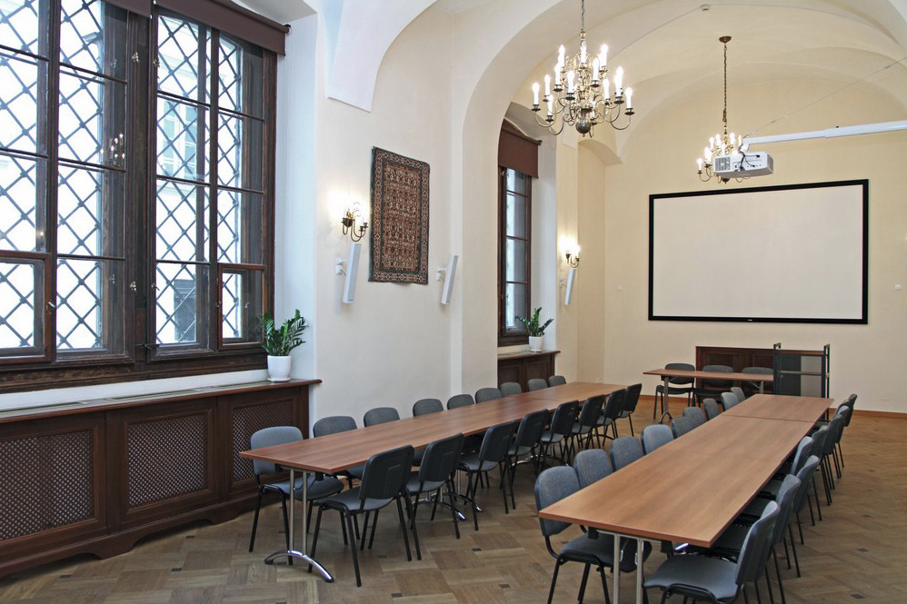
Meeting rooms
Small Hall – Mala Aula:
capacity 35 seats
Karolina Aula
capacity 50 seats

Slide 8
Practical details
Indico site: https://indico.cern.ch/event/1464979/
Plenary sessions beging on Wedn. at 14:00
Catering in exhibition space
- Coffee breaks during workshop and plenary sessions
Buffet lunch organized on Thursday
A lot of restaurants available around the venue

Slide 9
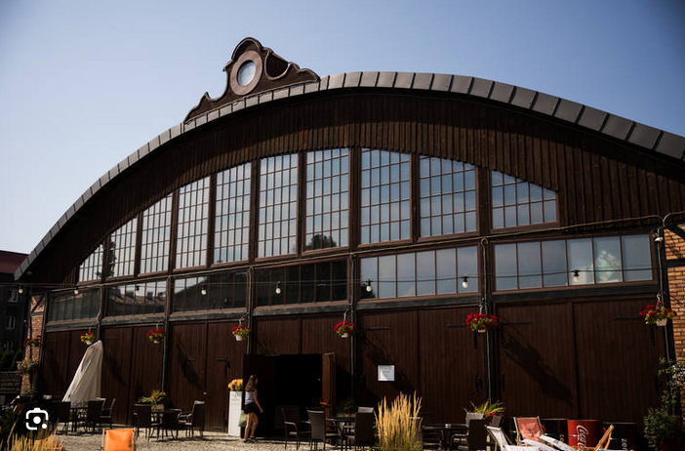
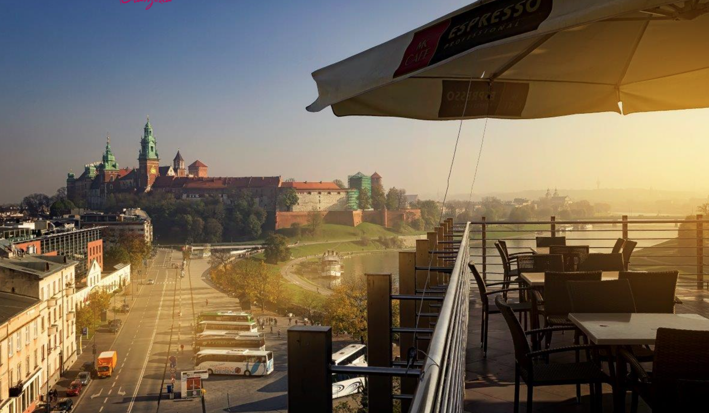
Practical details
Thanks to the local organising Committee IFJ-PAN, a list of hotels will be available from the Indico site soon and a few nice places for the social events have been identified, still need to be confirmed.
Welcome drink on Wednesday evening
Banquet dinner on Thursday evening

Slide 10
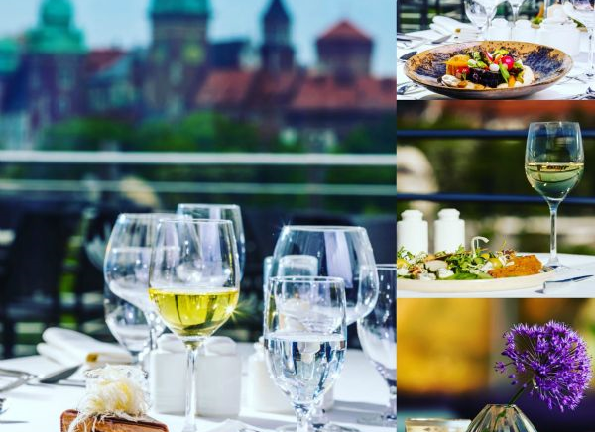
Registration
Registration will be open soon for attendance/participation to:
- Plenary meetings
- Professional visit (To be confirmed)
- Social events

Slide 11


