Slide 1

Task 11.3 Permanent Magnet Quadrupoles & Combined Function Magnets for Ultra Low-Emittance Rings
Ben Shepherd, Alex Hinton (ASTeC, STFC Daresbury Laboratory)
Dušan Topalović, Jure Počkar, Tadej Milharcic and Mirko Kokole (Kyma)
Alfie Shahveh (Diamond Light Source)
I.FAST Period 2 Review
21/10/2024

Slide 2
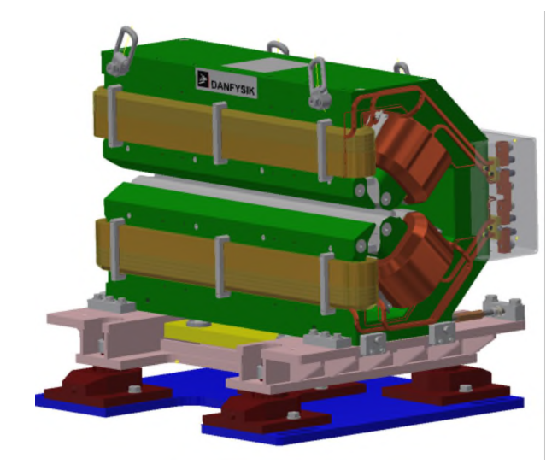
Introduction
Fourth generation synchrotron light sources make use of multi-bend achromat lattices to reduce beam emittance and increase radiation brightness.
Lattices require combined function dipole-quadrupole (DQ) magnets.
Diamond-II upgrade will require 48 DQ magnets drawing 2.3 kW each.
Goal of WP11.3 – test if equivalent field requirements can be met by a permanent magnet based solution.
Notes:
Focus of WP11 is on sustainable technologies for accelerators.
Goal is to build a prototype permanent magnet that provides equivalent field strength and quality to existing electromagnet design. Permanent magnet could provide equivalent use for negligible power consumption.

Slide 3
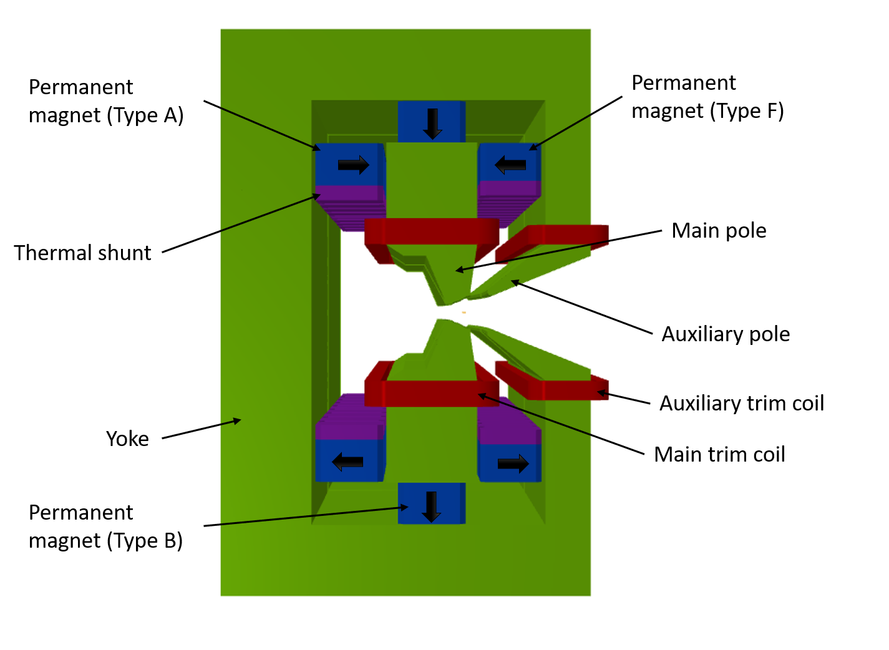
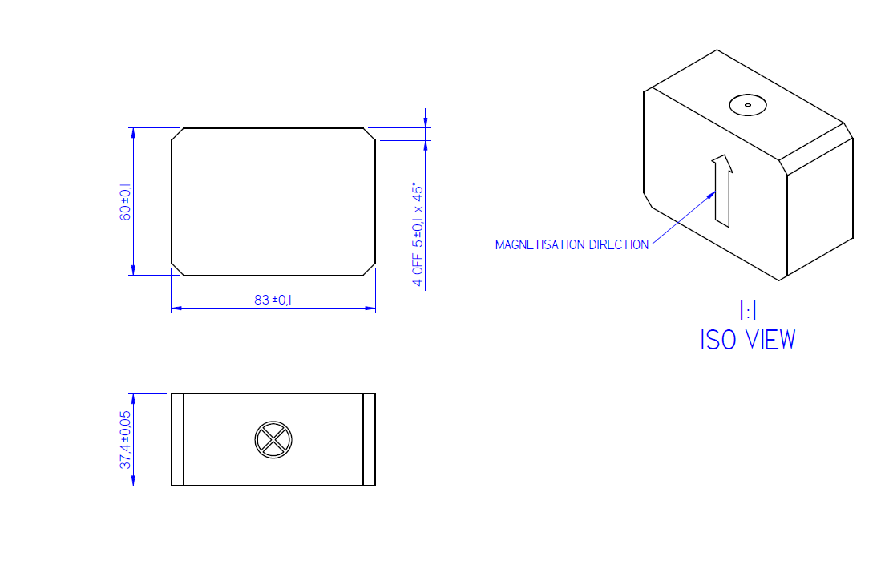
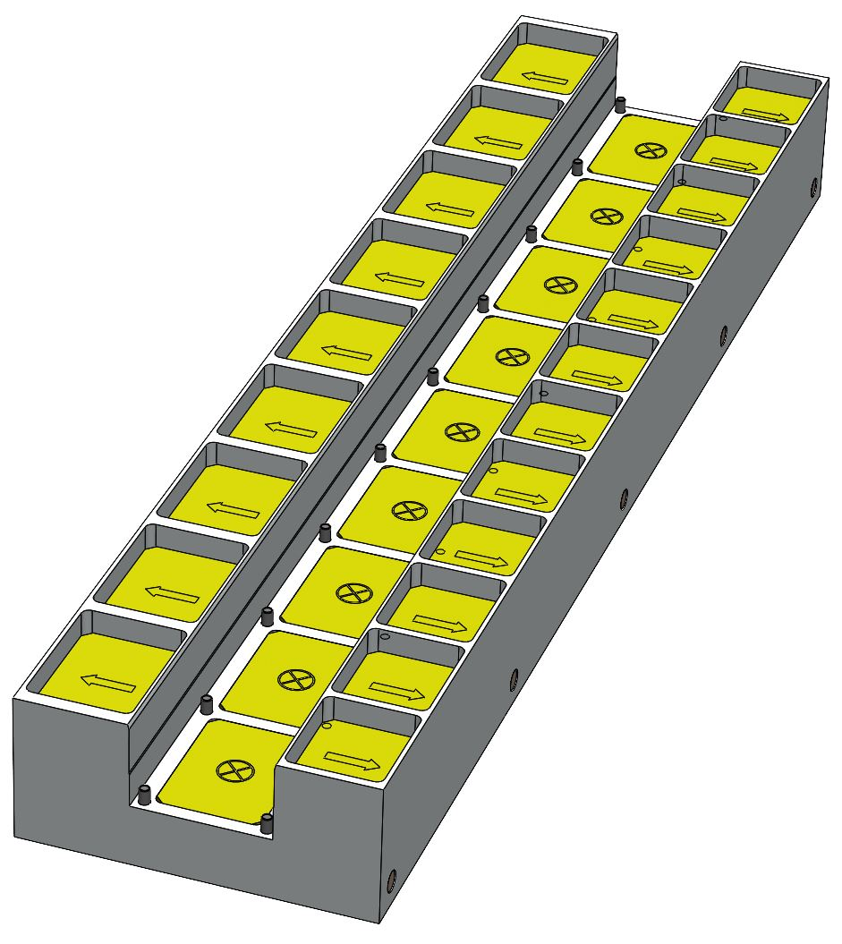
HEPTO Magnet Prototype
Hybrid Electromagnet-Permanent Magnet Tuneable Optics (HEPTO) to meet same field requirements as DQ electromagnets for Diamond-II.
Dipole = 0.7 T, Gradient = 33 T/m.
Effective length = 0.870 m.
Main source of field = NdFeB permanent magnet blocks (originally purchased for an undulator).
Dipole and gradient fields require independent tuning of ±2.5% for commissioning purposes.
Field tuning achieved by air-cooled trim coils.
Yoke and poles made from XC06 low-carbon steel.
Notes:
Image of Opera model of HEPTO magnet.
Field produced by NdFeB undulator blocks arranged in tray structure.
Field provided by asymmetric quadrupole style low carbon steel yoke.

Slide 4
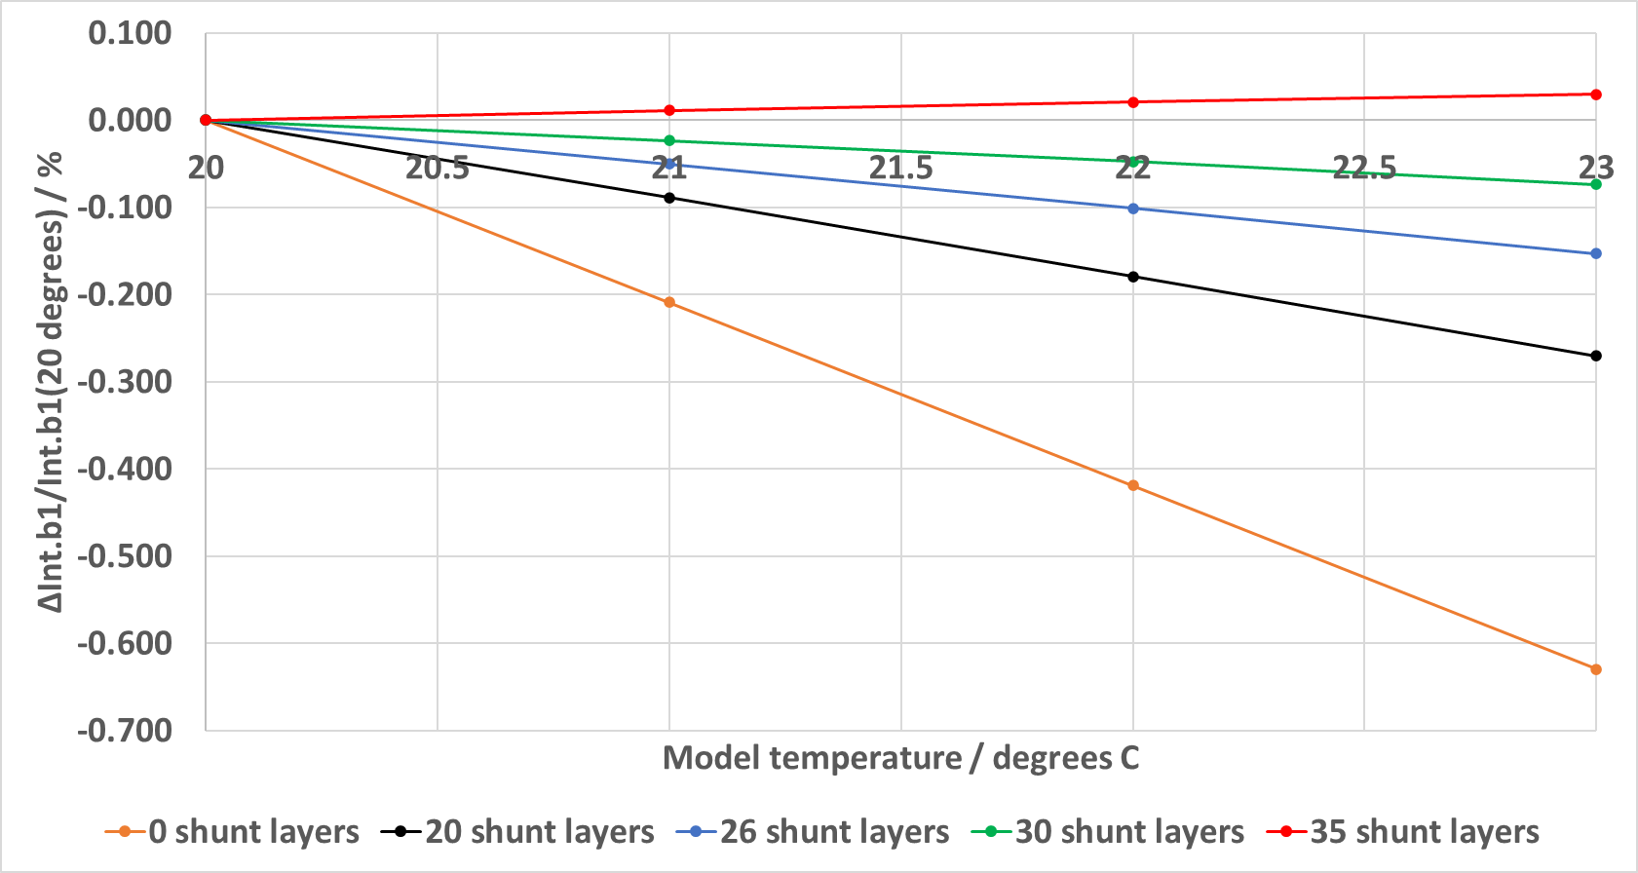
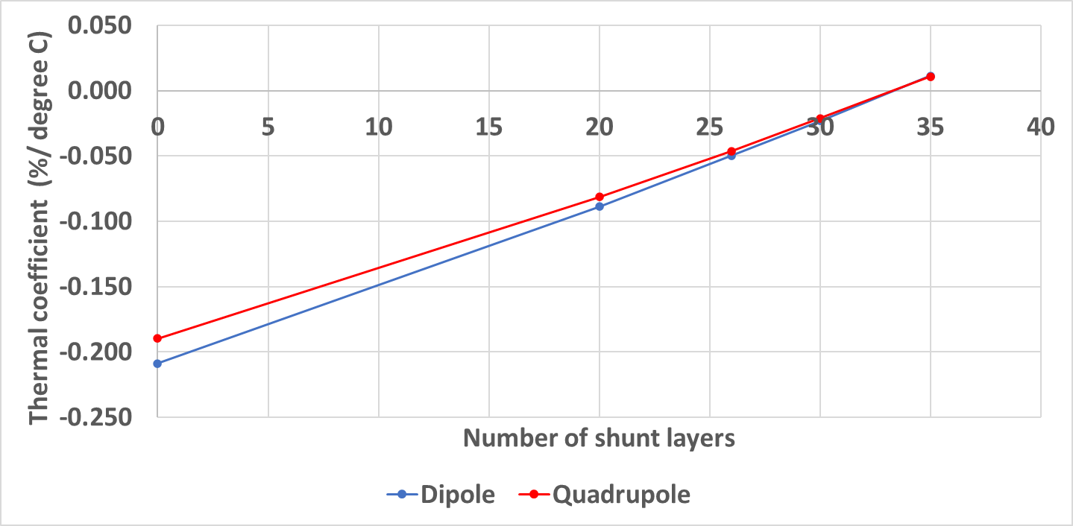
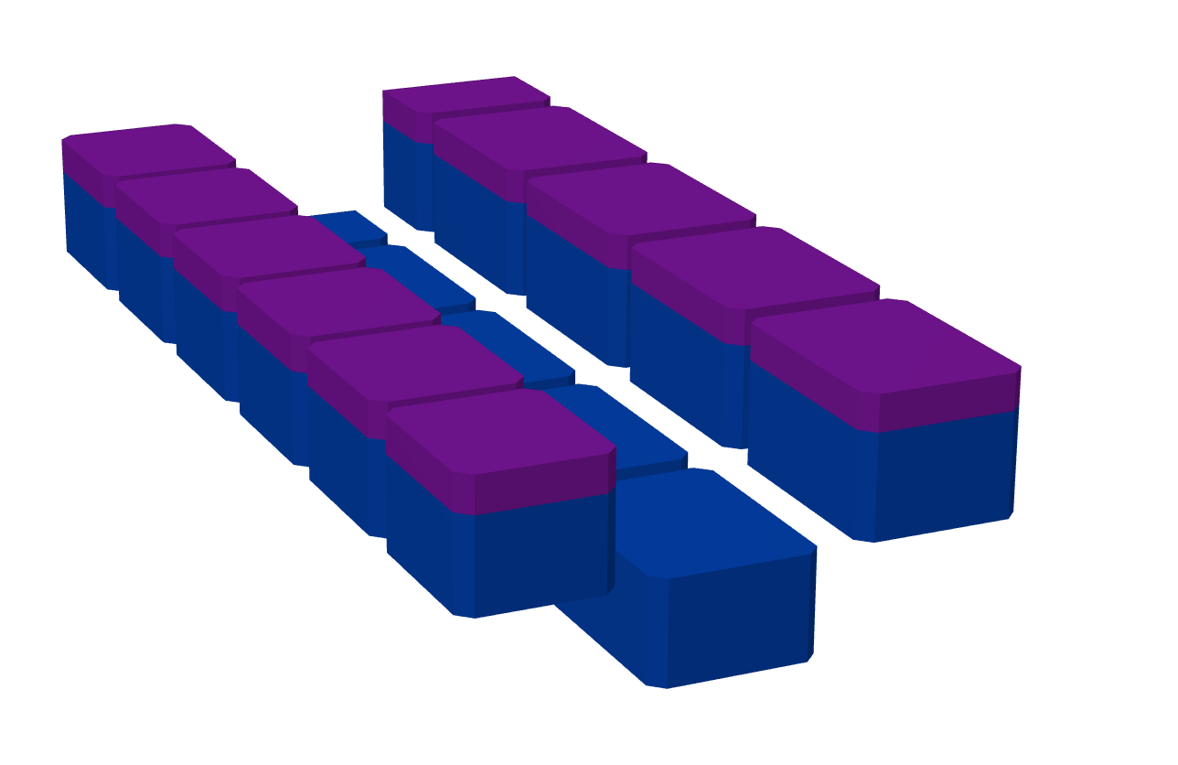
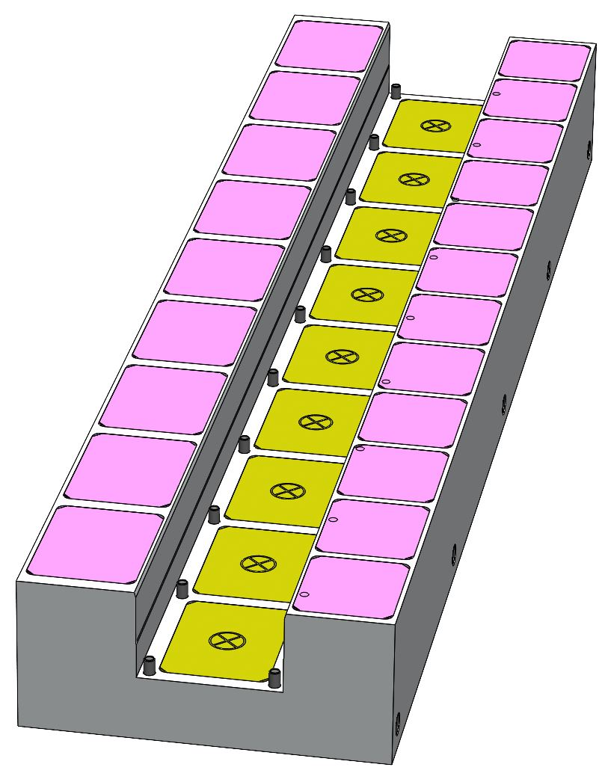
Thermal Shunts
Thermal shunt material can only be purchased from suppliers in large batches.
Spare FeNi thermal shunt material purchased from Soleil (42 sheets for €1600).
Material cut and glued to type A and F magnet blocks.
Enough material to produce 26 layers of
0.5 mm thick sheets.
Predicted thermal stability -0.050 % / degree Celsius. 0.01% variation typical due to power supply fluctuation in electromagnets.
Notes:
Thermal shunts reduce variation of field strength with fluctuations in ambient temperature – make magnet more stable.
Amount of material purchased from Soleil is less than predicted optimum amount to minimise fluctuations; will still be sufficient to try to measure fluctuations in field strength with temperature.

Slide 5
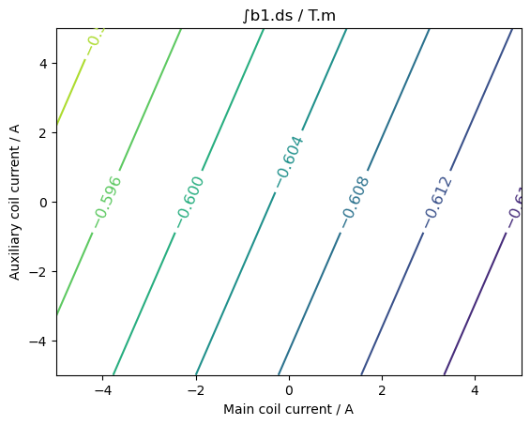
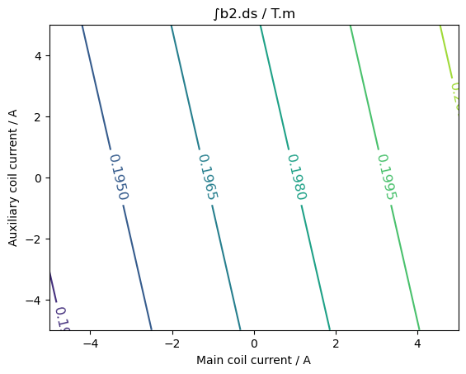
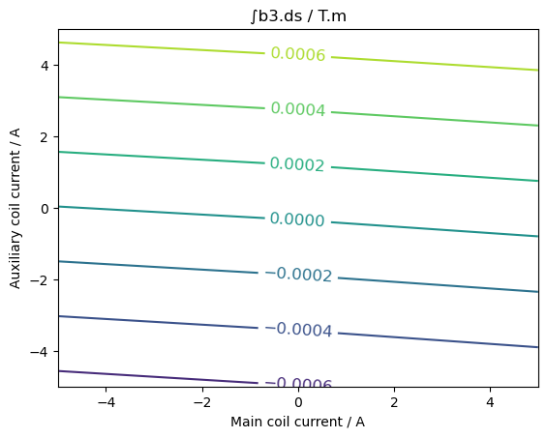
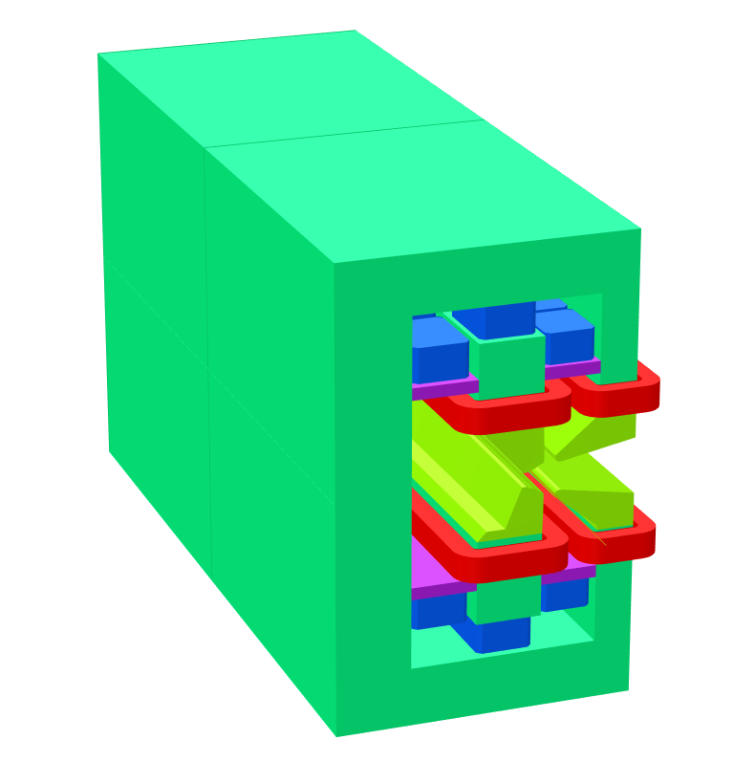
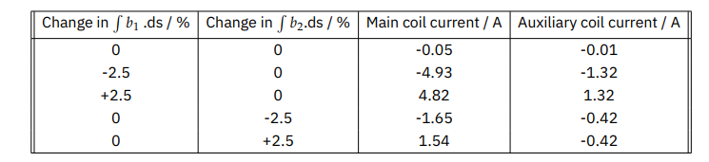
Field Tuning
Main coil
Auxiliary coil
Main coil turns | 64
Main coil pair maximum power / W | 30.6
Auxiliary coil turns | 36
Auxiliary coil pair maximum power / W | 16.4
Electromagnet DQ power dissipation / W | 2300
Notes:
Trim coils provide ability to tune integrated dipole and quadrupole fields independently by +/- 2.5%.
Tuning can be achieved with coil currents < 5A i.e. coils can be air cooled – no need for water cooling infrastructure and cooling power.
Absolute maximum power consumption of trim coils is ~ 50 W. Power dissipation from electrical resistance in equivalent EM DQ is 2.3 kW. ~2 orders of magnitude power saving. Nominally negligible power in trim coils.

Slide 6
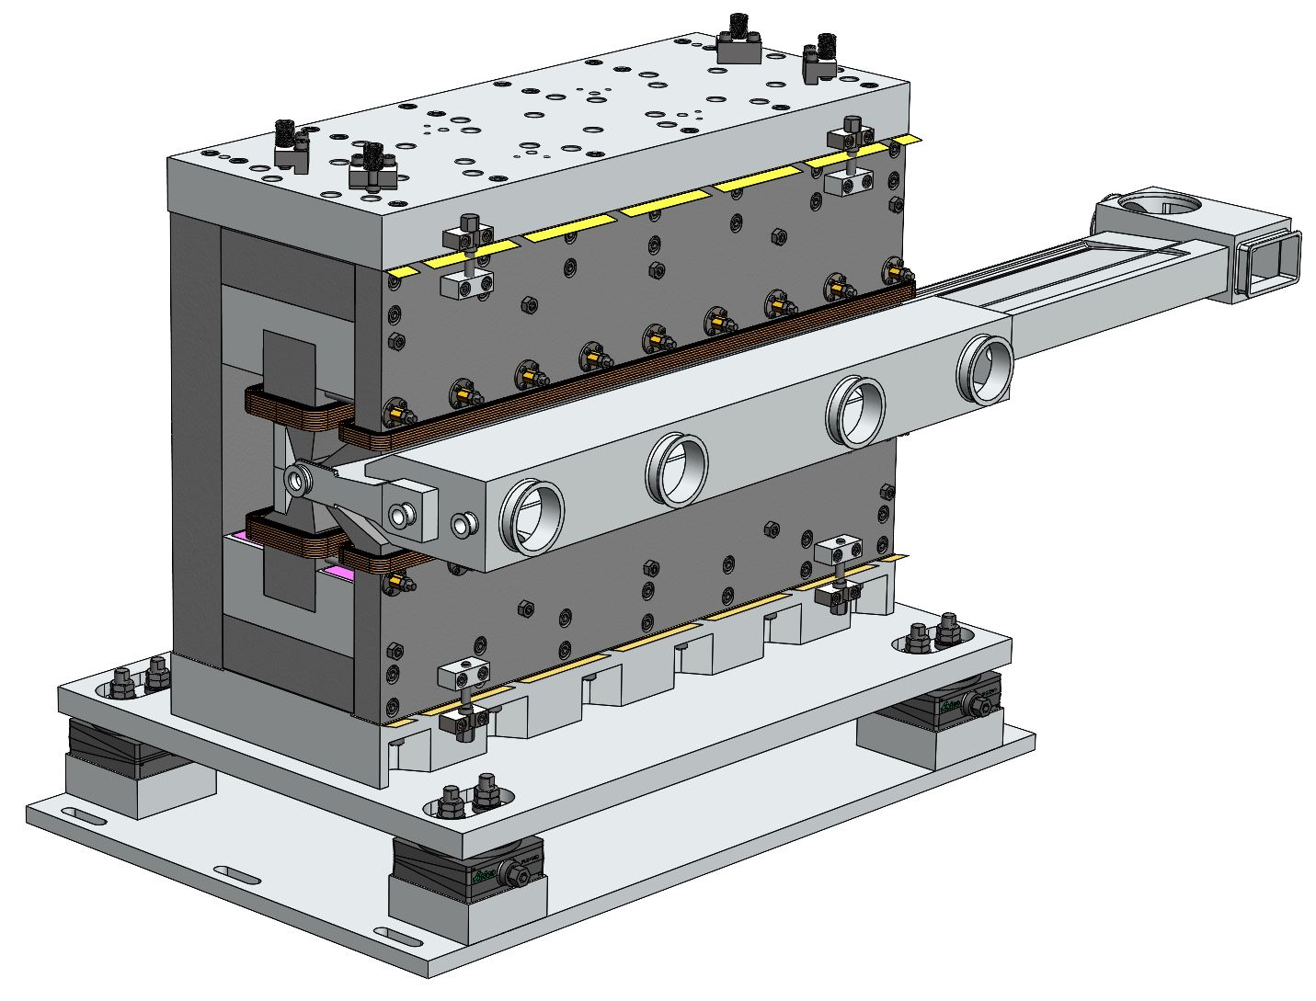
Full Mechanical Design
Mechanical design of the prototype magnet has been completed.
Design allows mechanical shimming of built prototype to shim field strength and quality.
Engineering drawings have been completed.
Procurement of mechanical components is ongoing.
Notes:
Mechanical design for prototype HEPTO magnet has been completed at Kyma.
Design includes mechanical shimming scheme. Can trim field strength and quality without use of trim coils to minimise power dissipation in nominal use and to maximise tuning range provided by coils.
Currently out for quotes for procurement of mechanical components.

Slide 7
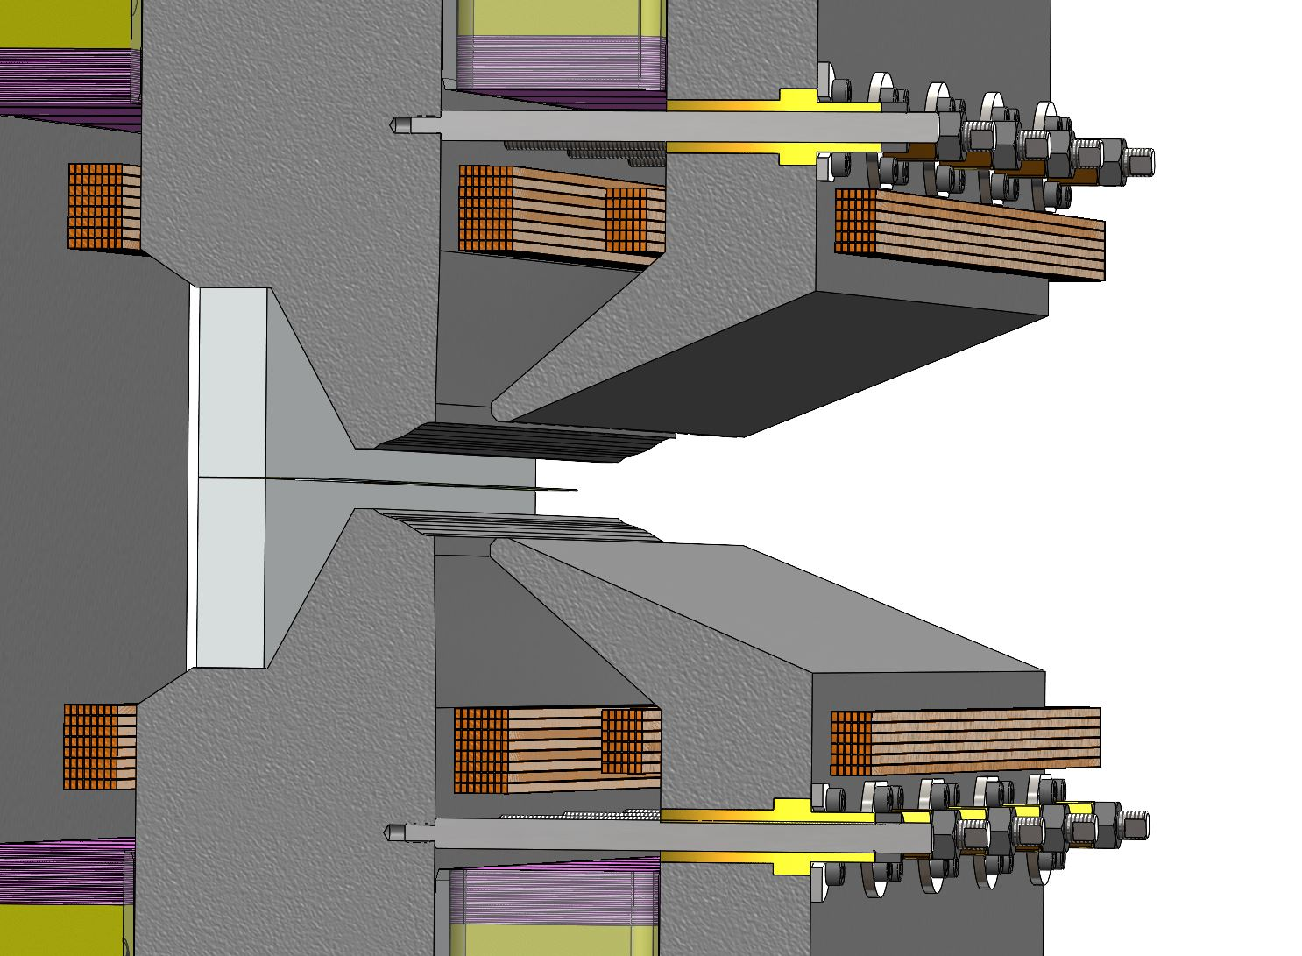
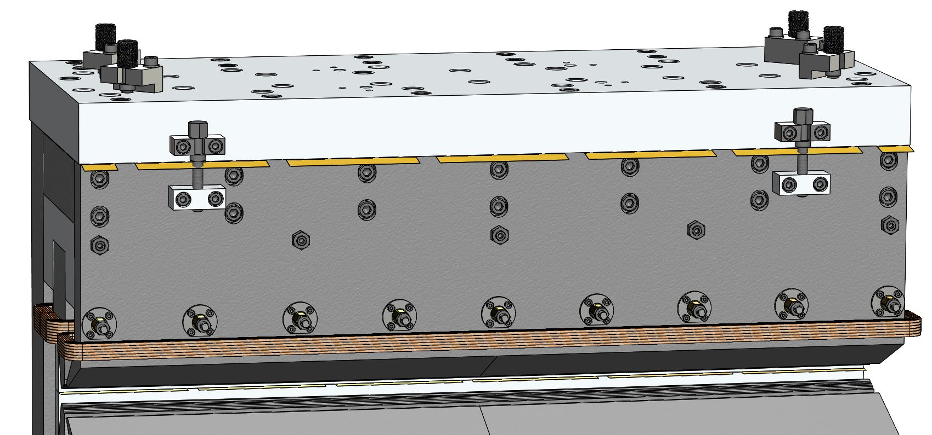
Mechanical Shimming
Note: vertical adjustment for main and auxiliary poles are pre-shimmed (300 µm thickness) to allow gaps to be increased or decreased.
Shim thicknesses in range 10-50 µm.
1. Threaded rods used to deform auxiliary poles for horizontal adjustment of auxiliary pole tips. Range of adjustment will be confirmed by FEM.
2. Two screws for opening gap between auxiliary pole and aluminium plate. Brass shims can be added/removed to adjust vertical position of auxiliary pole.

Slide 8
Current Status
Magnetic design of HEPTO prototype magnet using spare undulator magnet blocks is complete.
Maximum power requirement per magnet (5 A per coil) = 50 W.
Equivalent electromagnet requires 2.3 kW + water cooling.
Mechanical design and drawings are complete.
Permanent magnet blocks delivered to Kyma.
Thermal shunt material delivered to Kyma and has been sent for water jet cutting.
Armco steel for yoke and poles has been purchased and machining of parts is ongoing.

Slide 9
Expected Delivery Dates
Delivery of manufactured steel parts to Kyma – 30/11/2024.
Completion of assembly of prototype PM combined function magnet – 20/12/2024.
Delivery of prototype to Daresbury Laboratory for magnetic testing – 10/01/2024.
MS56 - Magnets constructed and tested – 31/01/2025
D11.3 - Prototype adjustable PM combined function magnet – 01/03/2025

Slide 10

Thank you
Acknowledgements:
Dušan Topalović, Jure Počkar, Tadej Milharcic and Mirko Kokole (Kyma)
Alfie Shahveh (Diamond Light Source)
Facebook: Science and Technology Facilities Council
Twitter:@STFC_matters
YouTube: Science and Technology Facilities Council

