Slide 1
Status of efficient klystron D11.2
I.FAST Steering Committee meeting. 21.10.2024
N. Catalan Lasheras, P. Alonso. Arias, O. Brunner, D.Soriano Guillen, C. Marrelli, P. Martinez Yanez, C. Nicou, Z. U. Nisa, I. Syratchev (CERN)
J. Cai (UESTC)
A. Baig (STFC)
G. Batto, A. Beunas, K. Haj Khlifa (Thales)
Notes:
14:55 Mike, 15:00 Olivier, 15:10 Ben

Slide 2
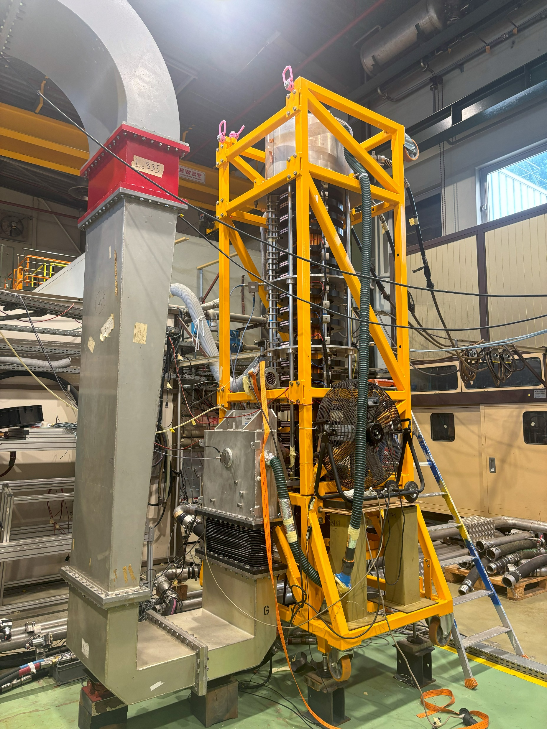
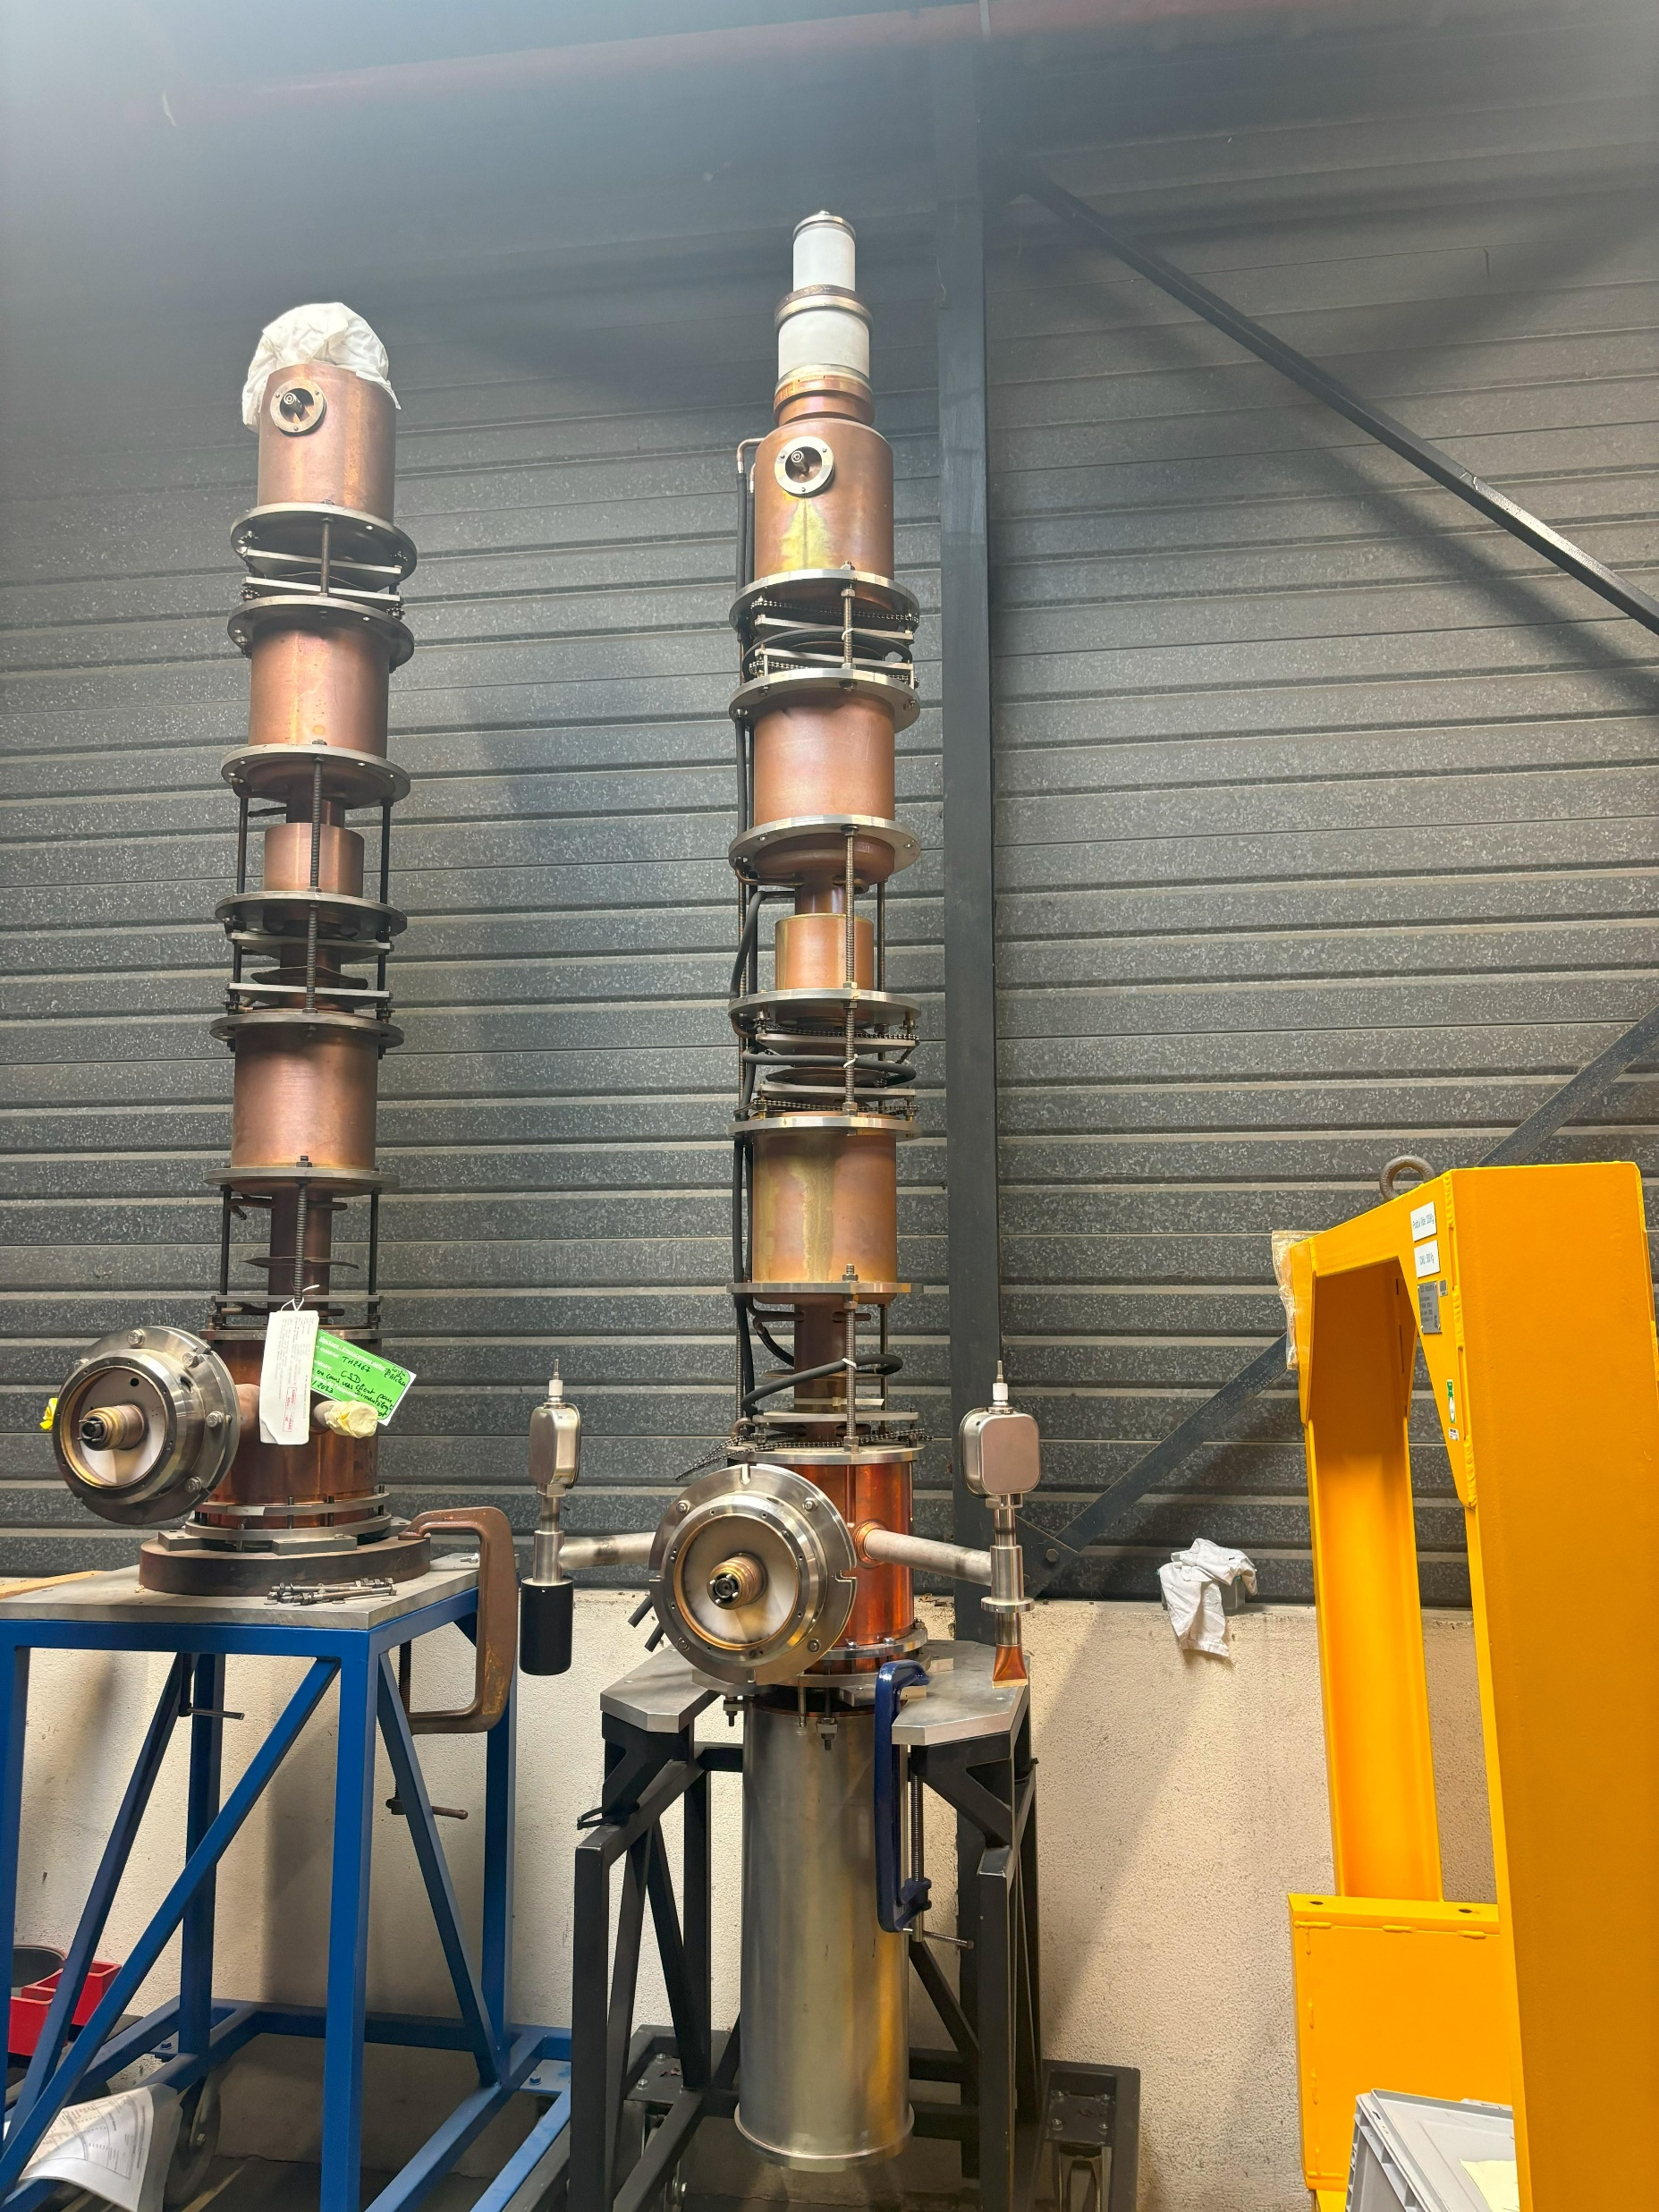
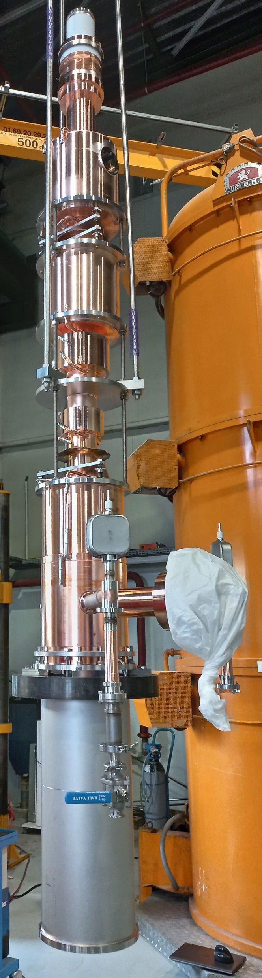
Klystron assembly finished!
Conditioning took place in July before factory closure
First measurements after conditioning end of August
CERN visit beginning of September
FAT beginning October
TH2167
TH2167HE

Slide 3
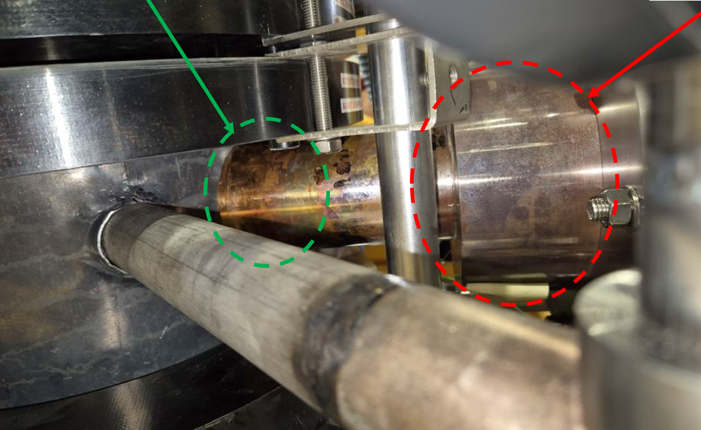
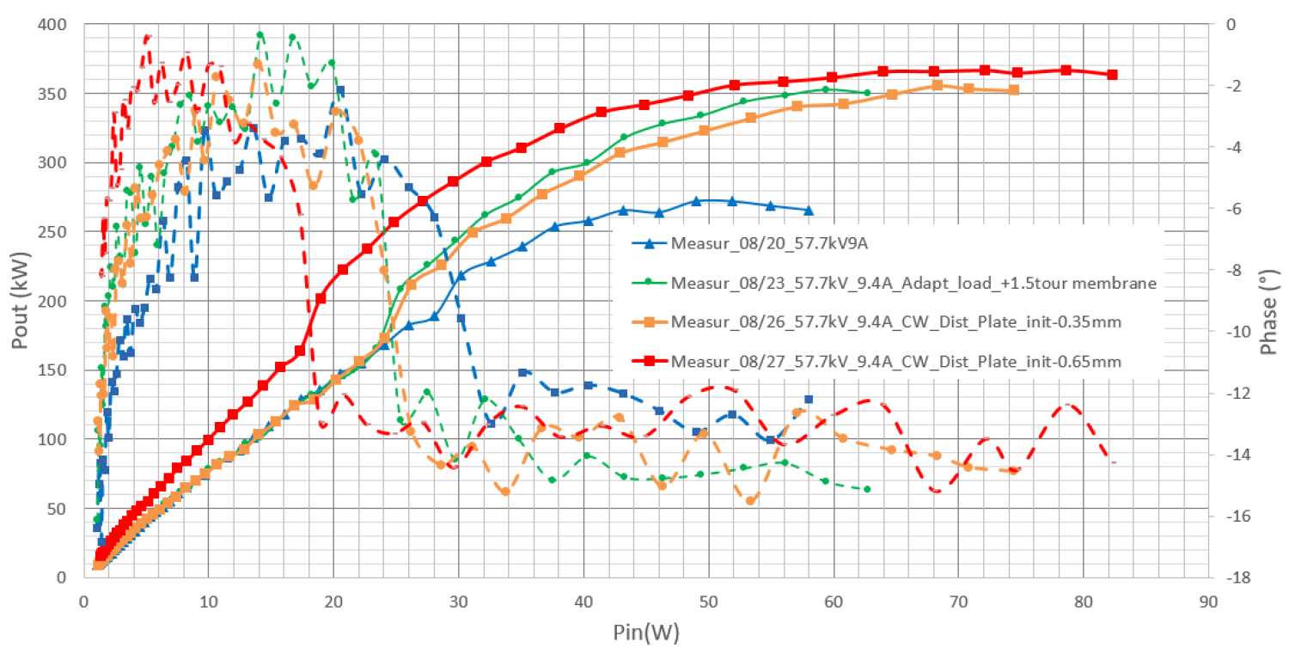
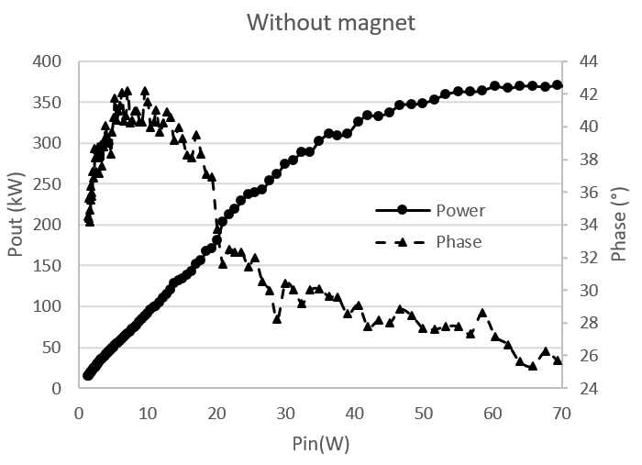
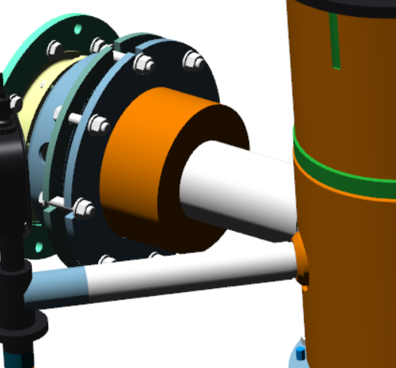
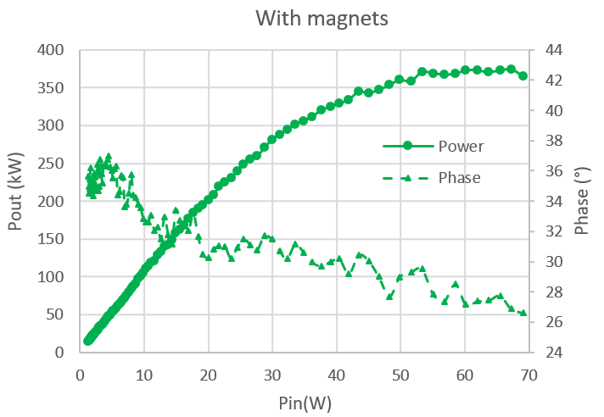
Multipacting on output cavity
Multipacting observed; heating and power loss above 200 kW
Simulations suggested the application of a static magnetic field
Power and phase back to nominal and heating under control
For following klystrons will be coated to reduce SEY
N

Slide 4
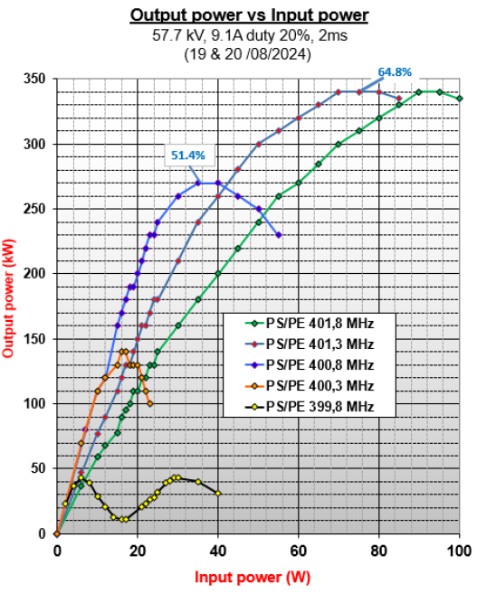
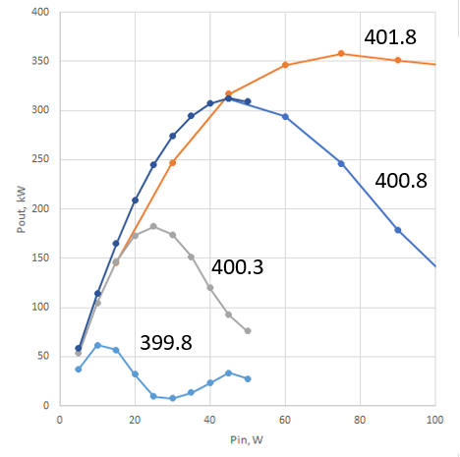
First measurements and missing power
Power and efficiency bellow expected values
Frequency scan to verify tuning of cavities
Simulations showed that 2nd harmonic cavity was detuned
Cavity re-tuned by membrane plus compression

Slide 5
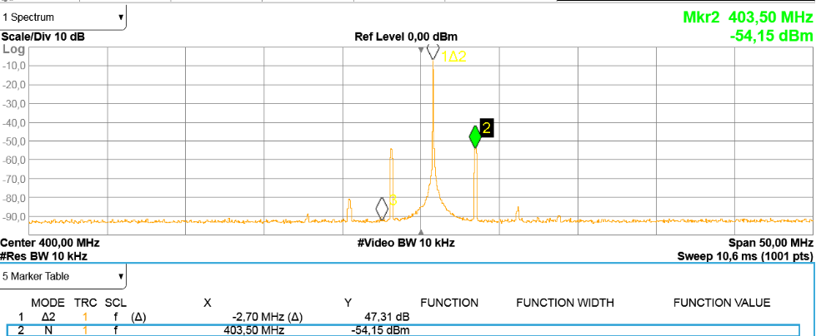
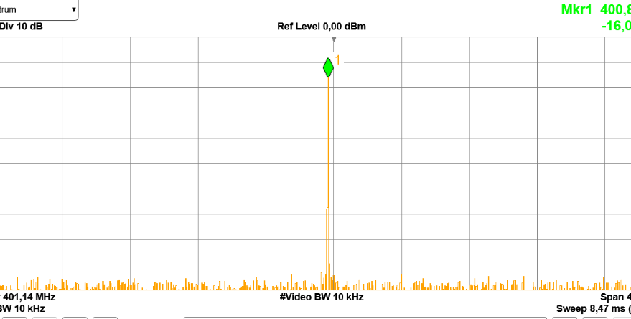

Sidebands caused by reflected electrons
  Sidebands appeared at 403.5 MHz before saturation.
  Attenuated and pushed after saturation by adjusting cavity 5
  Eliminated by adjusting the current of the main coils.

Slide 6
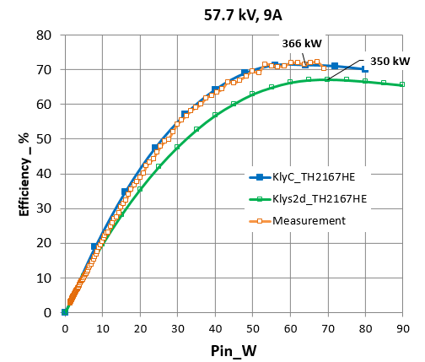
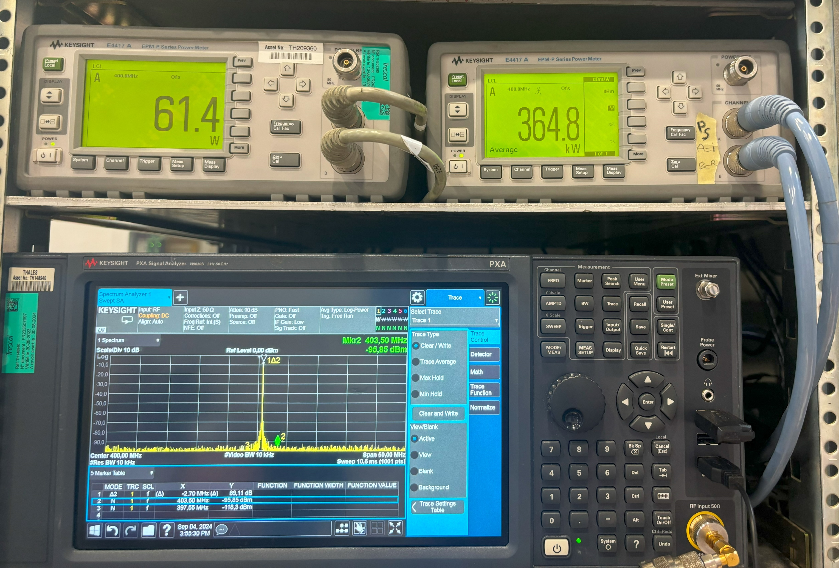
After all tuning and displacing sidebands
70 % efficiency measured @ 57.7 kV
Excellent agreement with simulations!

Slide 7
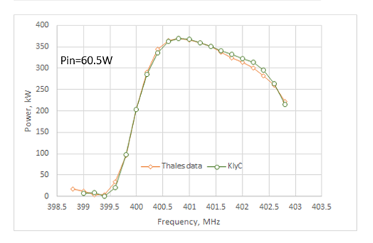
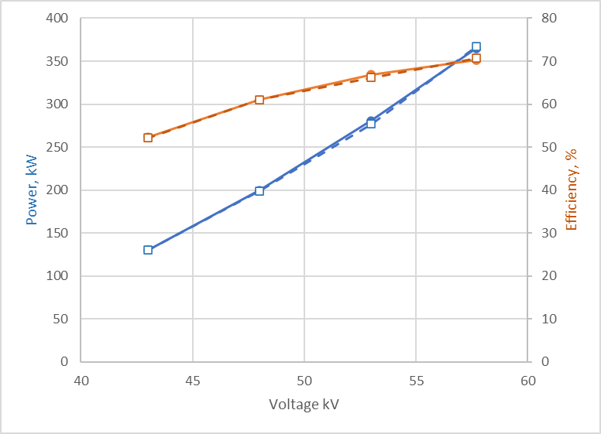
Digital twin!
Bandwith @ +/- 0.7 MHz = 0.6 dB
@ Pin=60W_57.7 kV, 9A
Measurements at saturation for different cathode voltage and fixed perveance
Measurements
klyC
Good agreement between Measurement and KlyC calculations
High efficiency (61%) maintained at 200 kW (mode I); 6 points higher than the TH2167
Simulation agreement obtain by retro-simulation of re-tuned parameters.

Slide 8
Current status
Adding and reconfiguring lead shielding to meet current demands
Preparation for transport next Thursday
Arrival at CERN beginning of November
Tests in 112 to confirm THALES results
IFAST deliverable (report) by end of the year

Slide 9
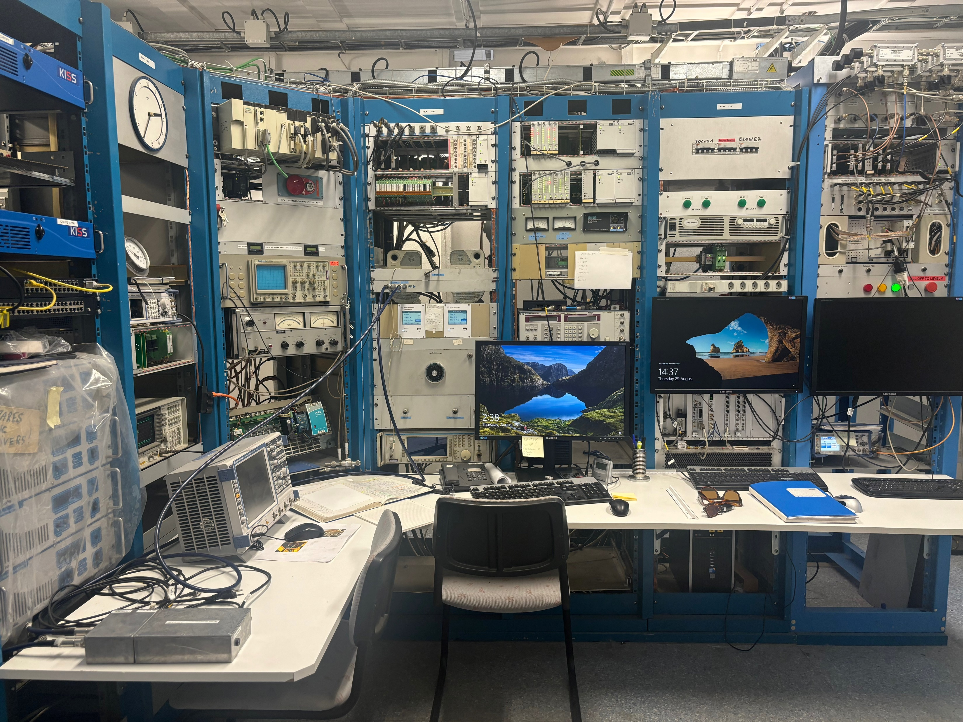
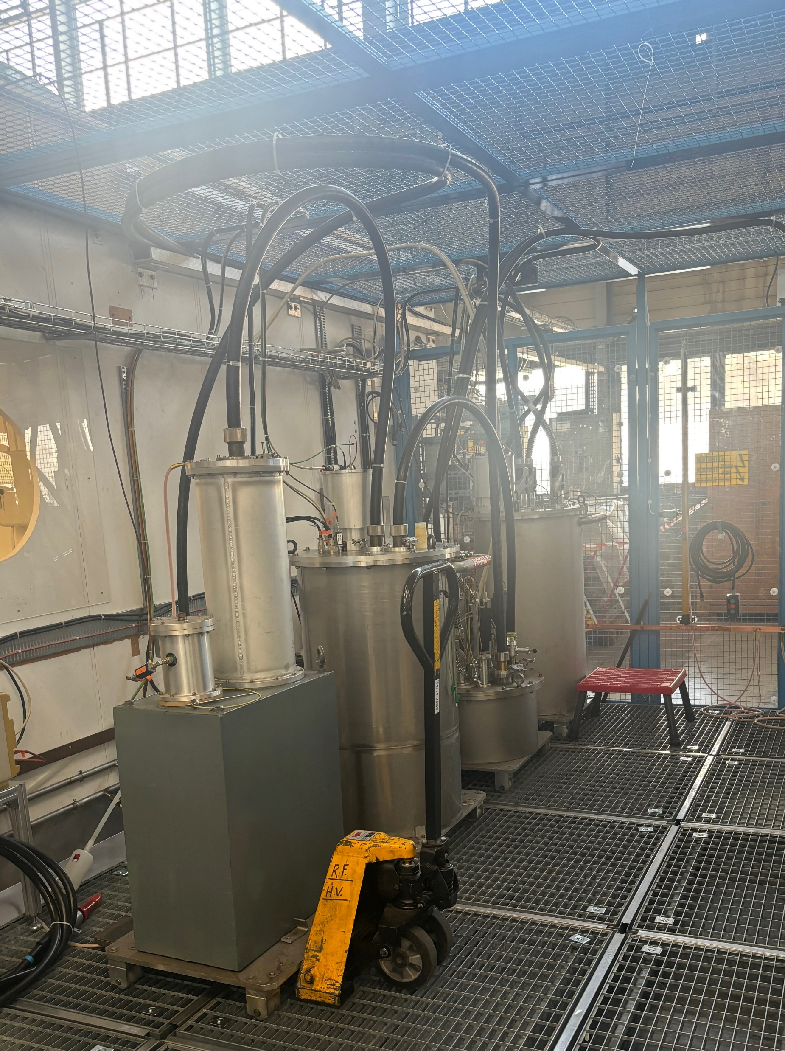
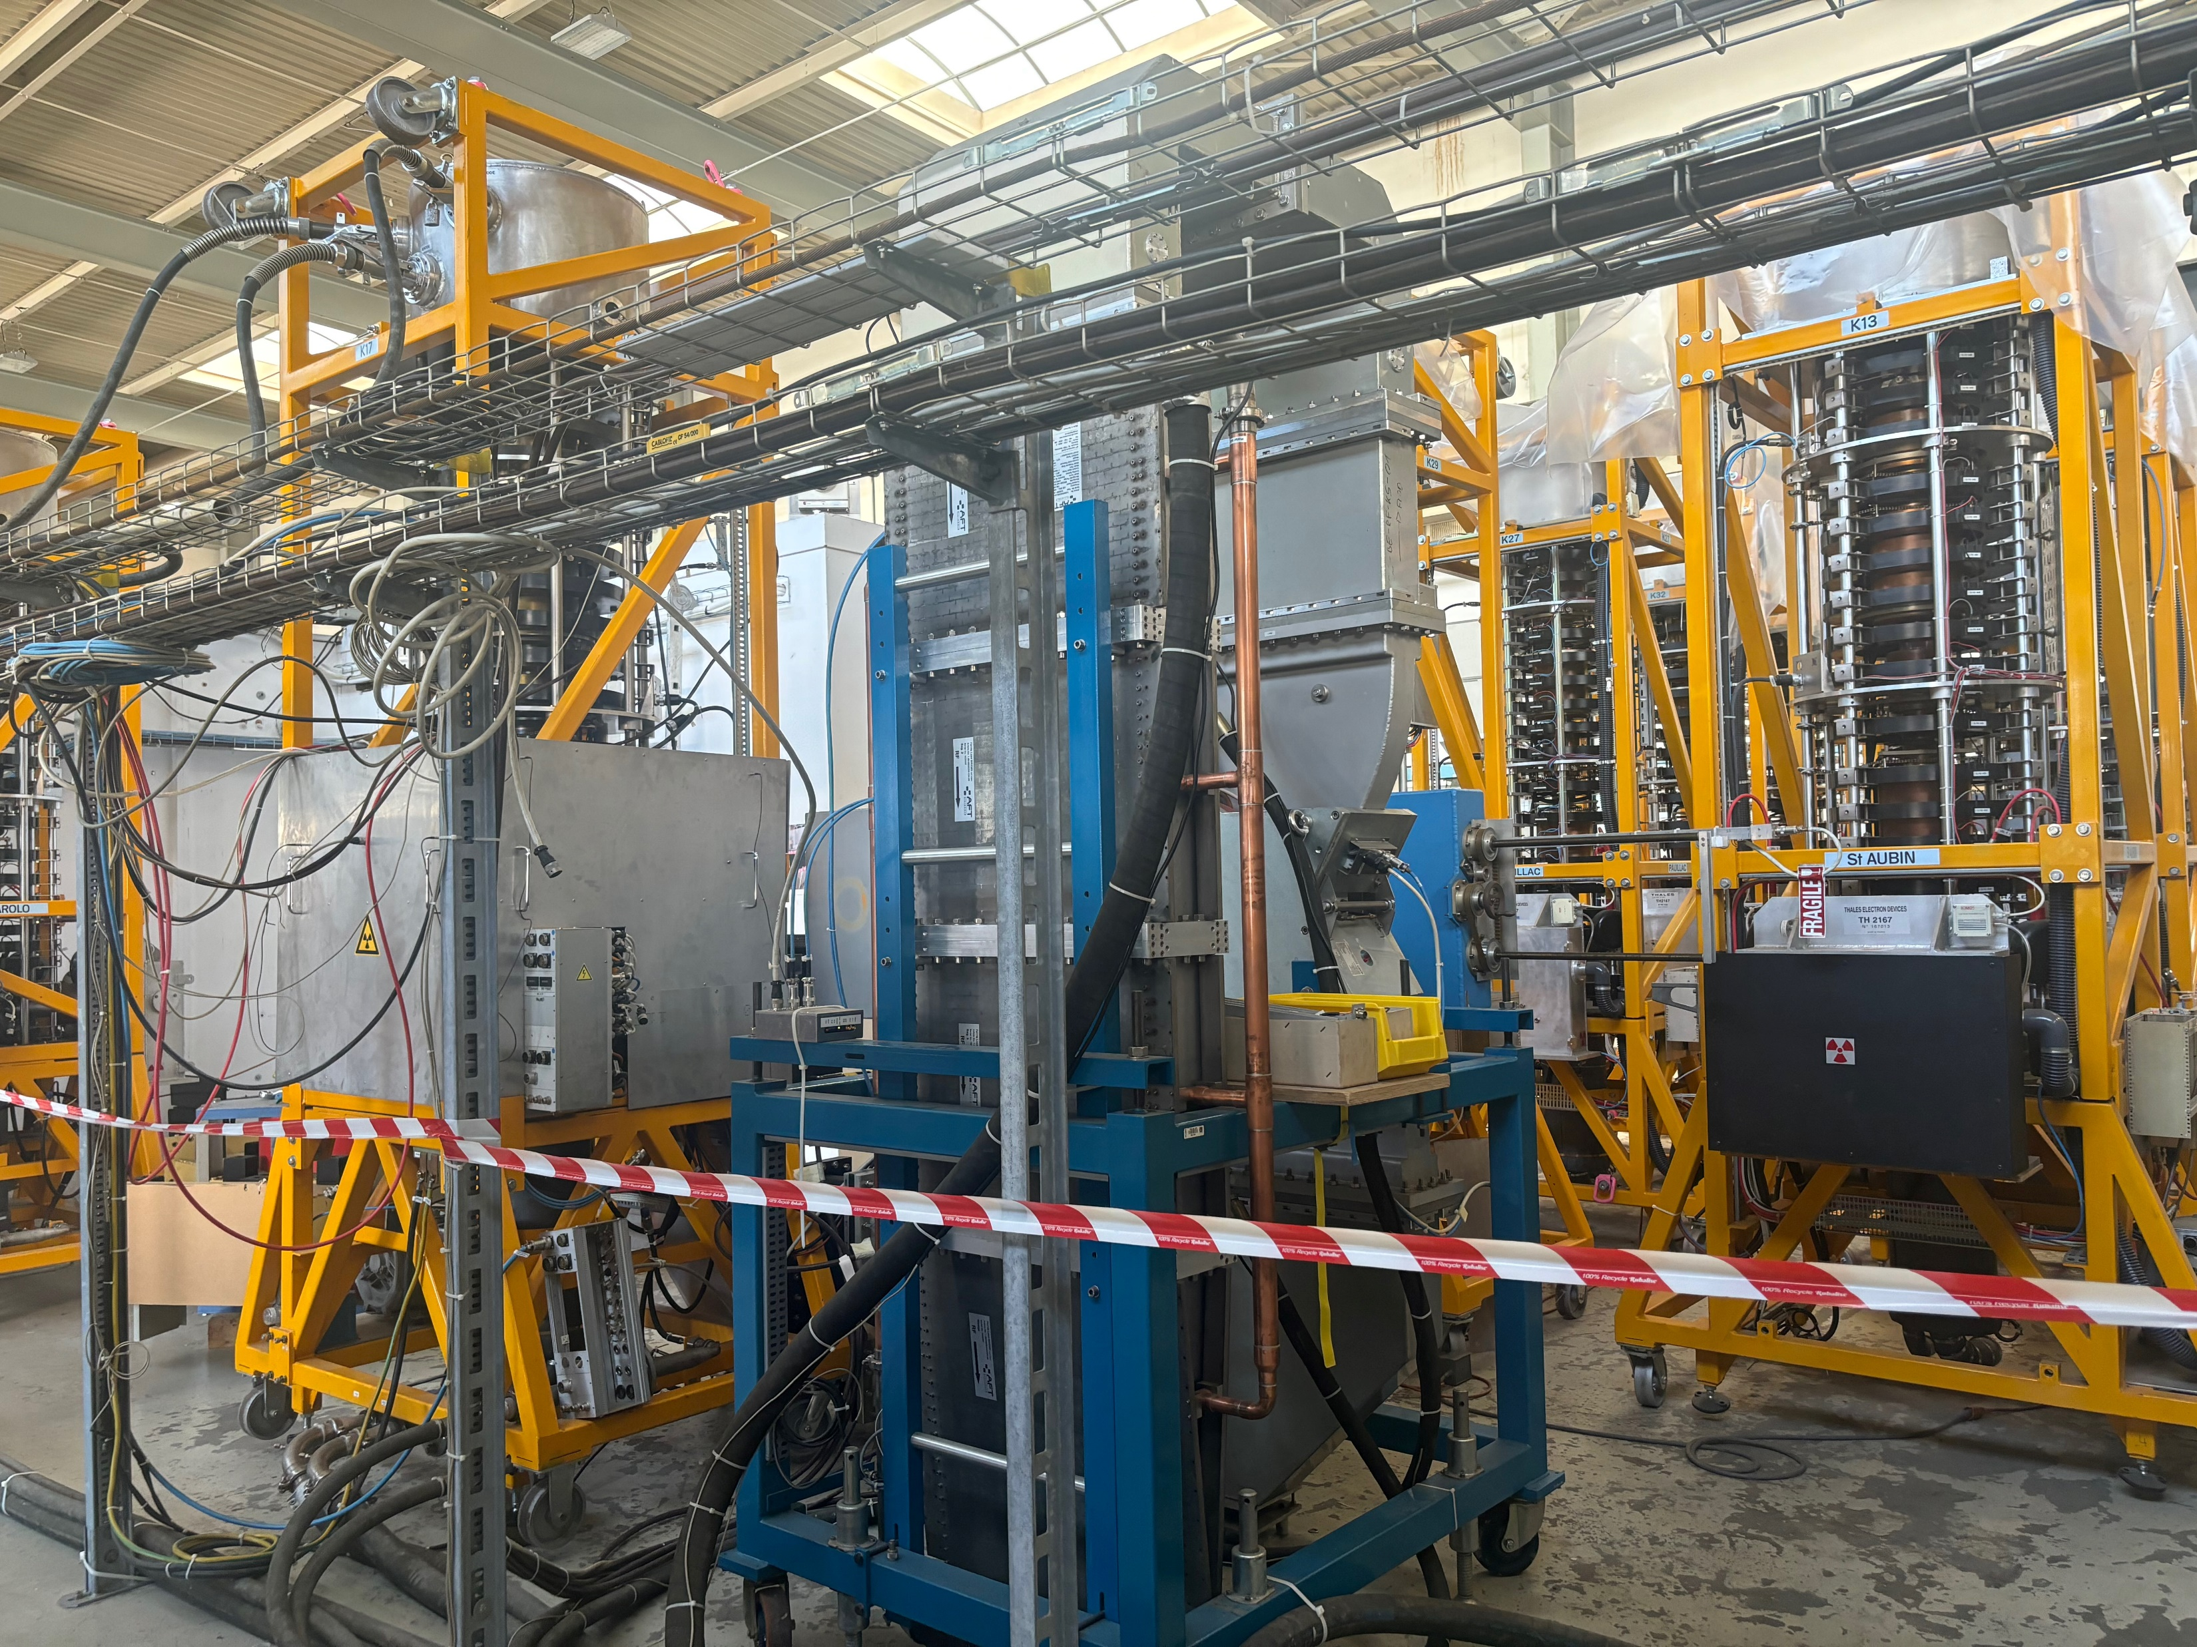
Next Steps
FAT at Thales in October 2024
01
Delivery to CERN and installation in the TH2167 test stand
02
Phase 1: test on present test stand to confirm factory performances and compare with TH2167
03
Renovation of the test stand
04
Phase 2: testing on renovated test stand: focus on efficiency measurements and soak test
05
Production of series klystrons and installation during LS3
06

Slide 10
Thank you for your attention!

