Slide 1
Task 7.3: VAriable Dipole for the Elettra Ring (VADER)
I.FAST - Steering Committee Meeting #13 – 21/10/2024
Y. Papaphilippou for the Task 7.3 collaborators

Slide 2
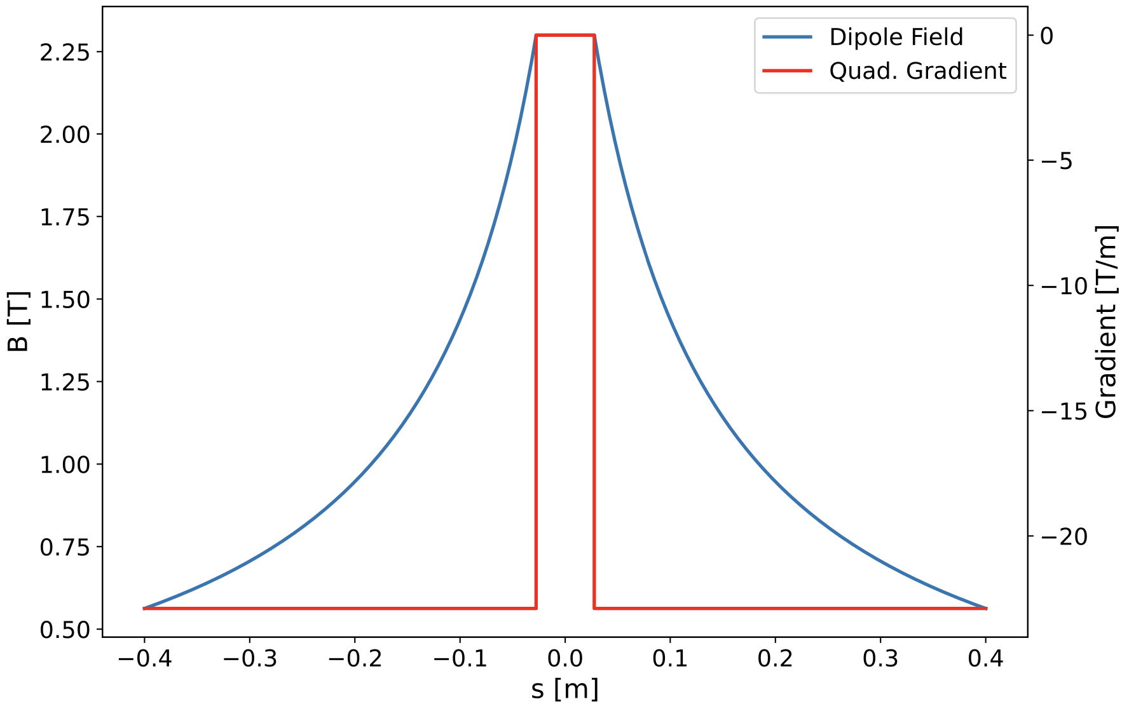
Profile Design and Magnet Specifications
Finalised in December 2022 (8 months delay, hiring issue during COVID)
Similar parameters as CLIC DR but…
  Higher transverse gradient (> factor of 2)
  Higher magnetic gap (~40%)
  Longer magnet (~40%)
Specifications | CLIC DR | VADER
Magnet Gap (mm) | 13 | 18
Max Field (T) | 2.3 | 2.3
Transverse G (T/m) | 11 | 23
Field Quality (Units 1E-4) | ≈ 1 | ≈ 1
Magnet Length (cm) | 56 | 80

Slide 3
Magnetic design challenges
Needed to satisfy field requirements for curved trajectory.
Curved trajectory combined with higher gap and low multipole content for iron dominated magnet that works under saturation, extremely difficult objective
Sagitta much higher than expected
Opera software bugs not present in previous versions, impossible to perform required calculations with curved trajectory
This forced to manually develop in-house code (CIEMAT) to analyse field quality (in both Opera & Matlab)

Slide 4
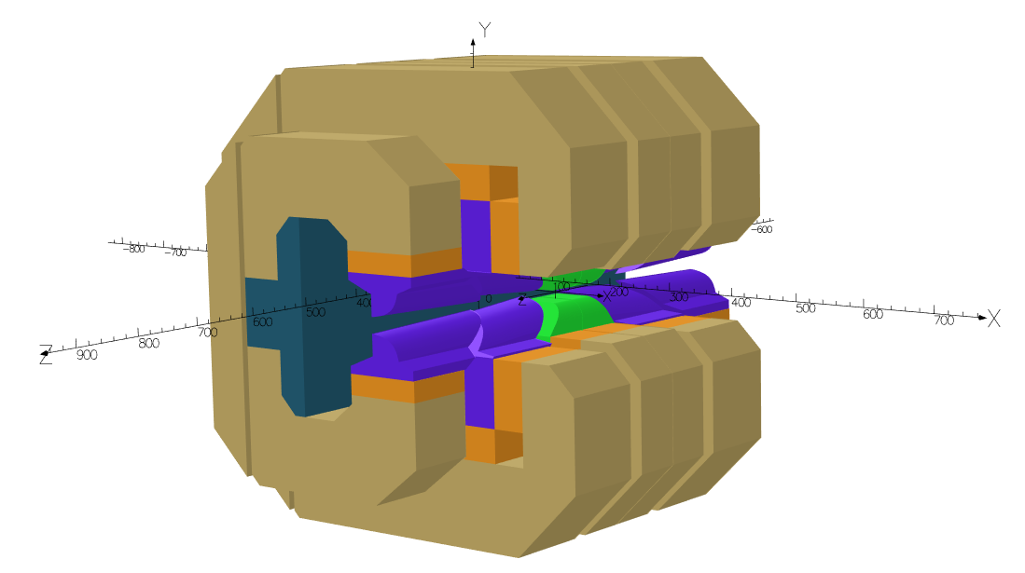
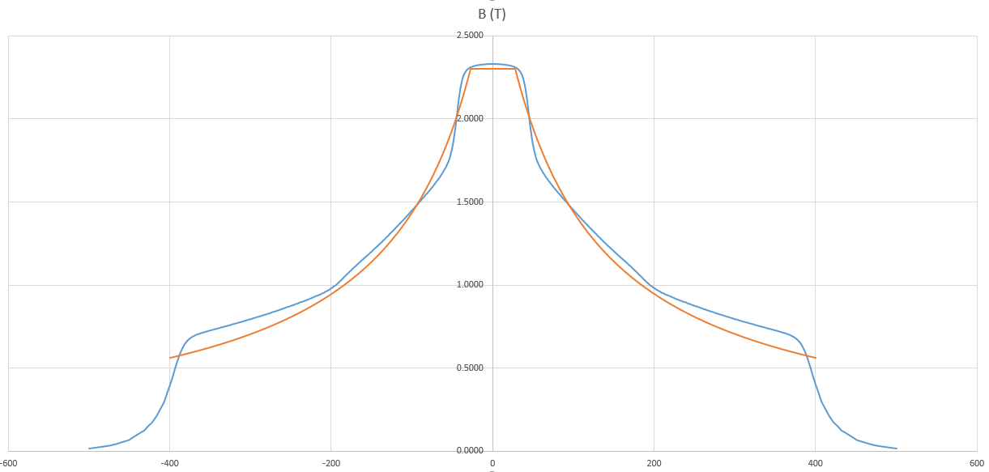
Magnetic Design @ CIEMAT
M. Dominguez,
F. Toral
New field regulation design
Hyperbolic pole tips profile
New poles
Longitudinal gradient profile achieved
Integrated transverse gradient exceeds specs
Field quality looks reasonable
Fabrication drawings in progress
New PM blocks dimensions
B1 | B2 | B3 | B4 | B5 | B6 | B7 | B8 | B9 | B10
10000 | -807.79 | 4.65 | 6.74 | -1.09 | 0.21 | -0.07 | 2.55E-05 | -0.01 | -0.03

Slide 5
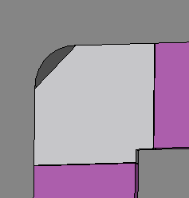
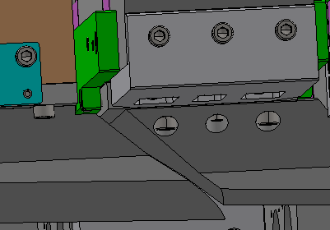
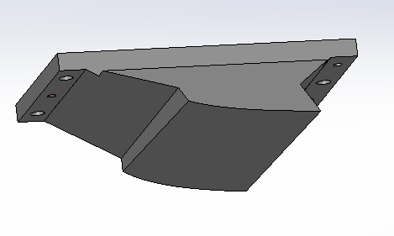
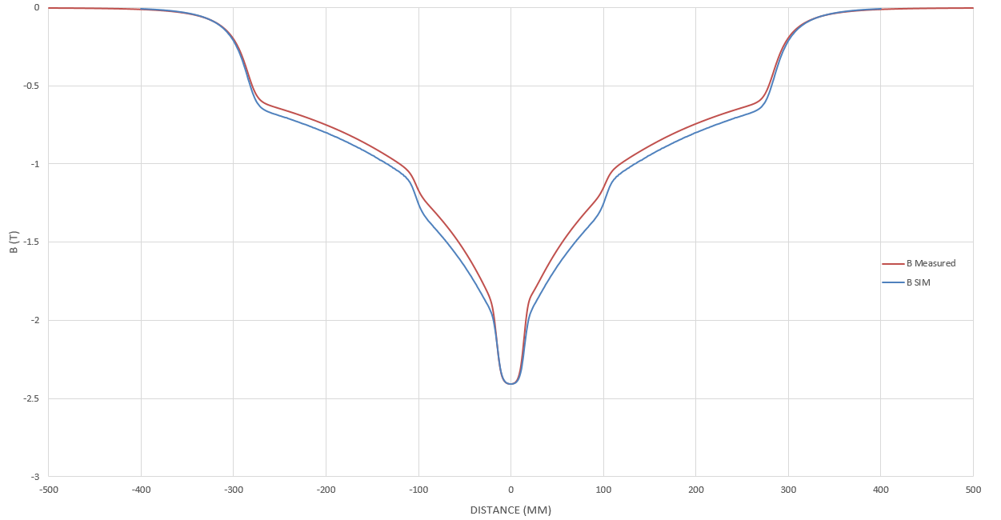

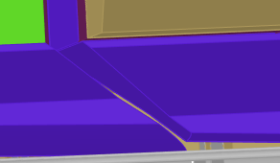

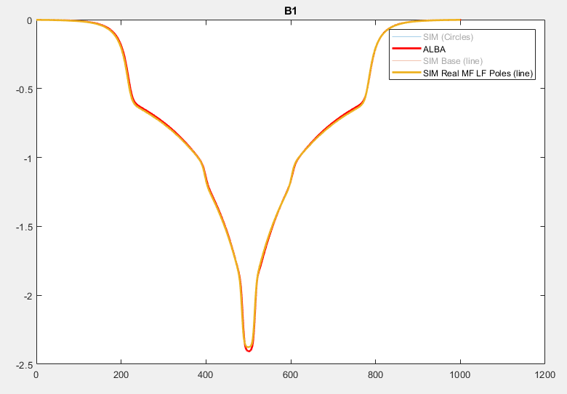
Resolving CLIC prototype issues for VADER
LF pole extrusion
6 mm HF & MF pole base expansion
MF pole extrusion
Discrepancy in CLIC prototype between simulations vs magnetic measurements with integrated dipolar field 4% lower
Various investigations: missing Armco heat treatment, misalignment, hysteresis, simulation error, etc.
Traced back to Opera simplifications required not reflected in real 3D mechanical model
Any of them alone not capable to explain difference
All three simulated allow model matching almost perfectly magnetic measurements!
Simulated integrated field is now 0.641T vs 0.638 measured

Slide 6
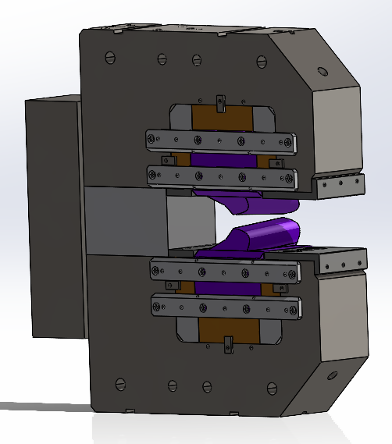
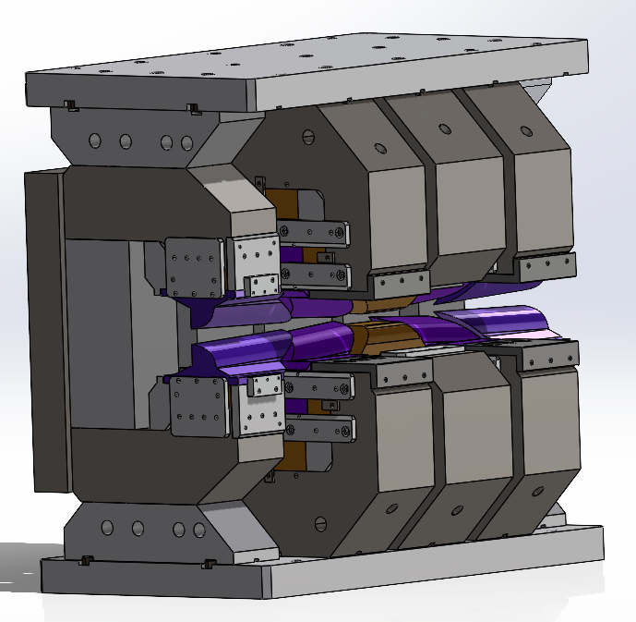
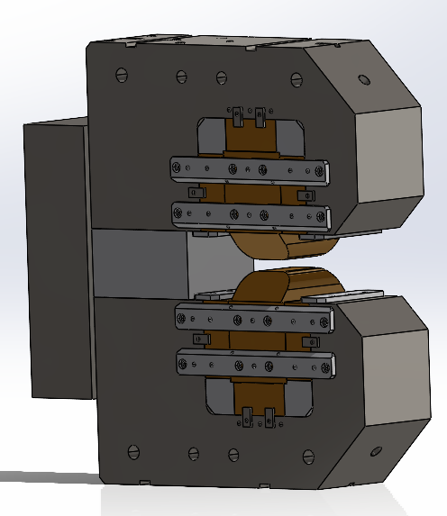
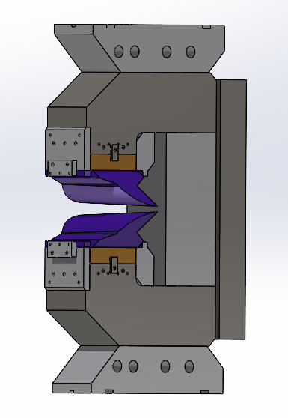
VADER: Mechanical Design
Mechanical design started in September. Now is finished and production drawings ready for KYMA
From this…
…to this:

Slide 7
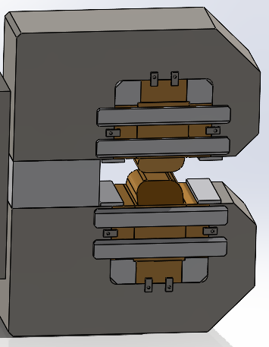
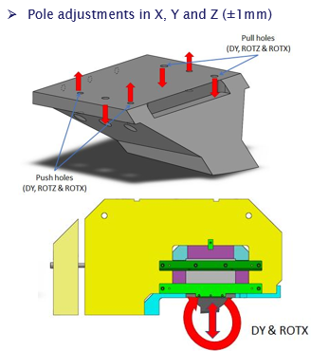
VADER vs CLIC Prototype: Main differences
Iron yokes formed by 3 main pieces instead of one, screwed from iron to iron across aluminium support block (before first assembly step)
In VADER, same pole adjustments in MF and LF modules present in CLIC except DY (vertical adjustment)

Slide 8
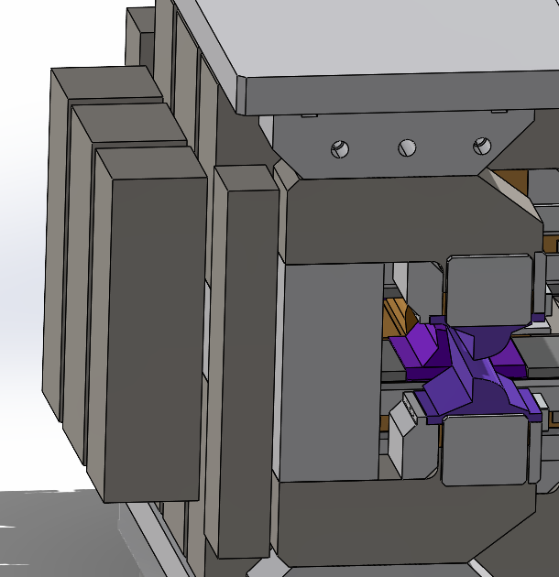
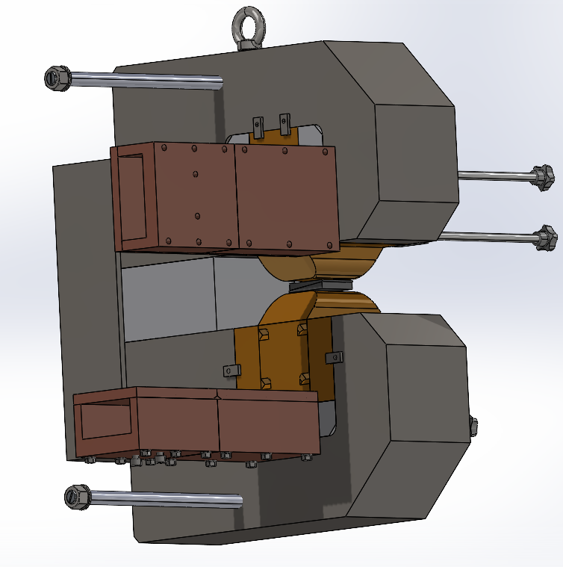
VADER vs CLIC Prototype: Main differences
PM blocks bigger, meaning higher forces. POM boxes redesigned (longer) and second one to carry block added
Moving parts of field regulation under much higher forces, guides reinforced and regulating screws include bronze ending to avoid fluency with time (instead of plastic in CLIC)

Slide 9
VADER: Timeline
Material List - by October 2024
  CIEMAT sent list of materials used to expedite procurement and Kyma pre-ordered bulk material with longest delivery times
Final manufacturing drawings - by beginning of November 2024
From mid-November 2024, Kyma proceeds with procurement of all components.
Initial estimates indicate that materials ready and delivered by March-April 2025
Assembly process estimated as follows:
  1 week for mechanical assembly of the modules.
  2 weeks for final assembly.
  1 week contingency.
Latest date for deliverable May 2025

Slide 10
VADER timeline
Milestone MS 26
Deliverable D7.3
Milestone MS 27
Optics work including magnet specifications completed (CERN/Elettra) since end of 2022
  8 months delay in hiring fellow
Magnetic and mechanical design from CIEMAT completed with input from KYMA for fabrication, ready by September 2024
  16 month delay due to early departure of fellow and challenges with magnetic design
Fabrication of the prototype by KYMA started on October 2024 (drawings transmitted)
Prototype ready for acceptance tests by May 2025 (7 months delay in deliverable 7.3)
Acceptance tests will be finalised by June 2025

Slide 11

Thank you for your attention!

Slide 12


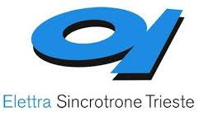

VAriable Dipole for the Elettra Ring - VADER
Task 7.3 within I.FAST WP7: High Brightness Accelerators for Light Sources
Partners and collaborators:
Y. Papaphilippou
(A. Poyet)
M. Dominguez
F. Toral
E. Karantzoulis
D. Castronovo
R. Geometrante

Slide 13
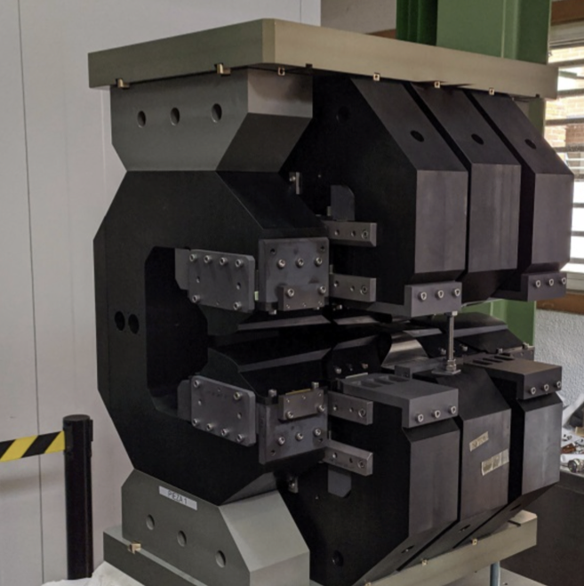
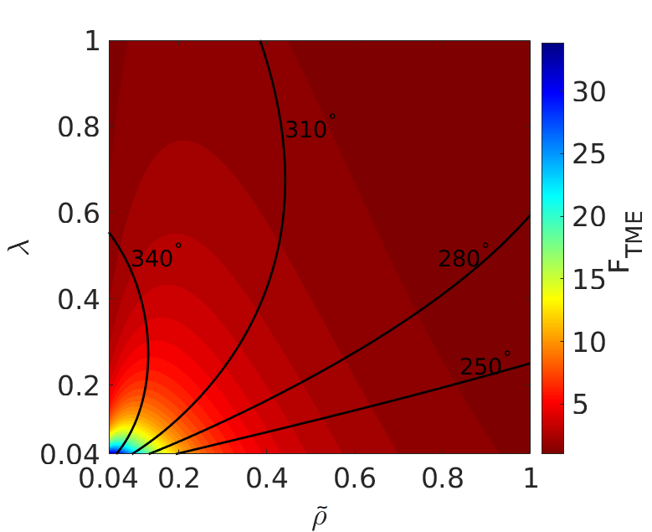
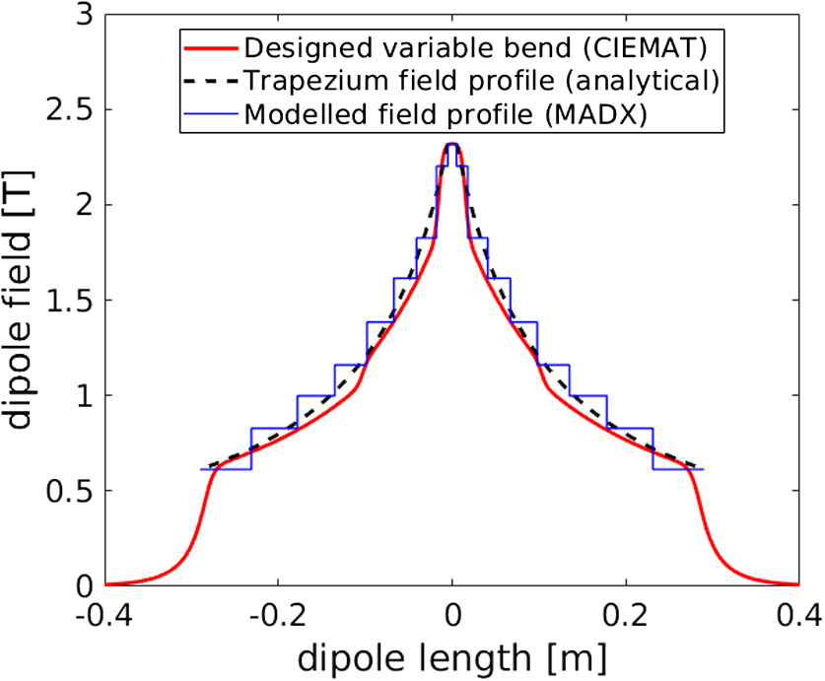
VADER objectives
Fabricate an innovative dipole magnet prototype with longitudinal varying dipole field, including a transverse gradient for the ELETTRA upgrade
Permanent magnet concept with trapezoidal bending radius, 2.3 T peak field and ~10 T/m gradient, already established (CERN/CIEMAT)
Proved the horizontal emittance reduction to ultra-low levels of i.e. ~60 pm @ 2.86 GeV, for the CLIC DR (M. A. Domínguez Martinez et al., IEEE Trans. Appl. Supercond. 28, 1, 2018; S. Papadopoulou et al, PRAB 22, 091601, 2019)
First demonstrator constructed/qualified by CIEMAT

Slide 14
VADER objectives
Keep the same S6BA-E lattice for Elettra and replace the LG dipoles by VADER ones.
  Implement a trapezoidal profile in bending radius
  Observe a clear emittance reduction
Some constraints:
  Same geometrical layout
  Same total bending angle for each dipole
  Same dipole length
But also some freedoms:
  We set the dipole peak field at 2.3 T (as for the CLIC magnet) instead of the current 1.8 T

Slide 15
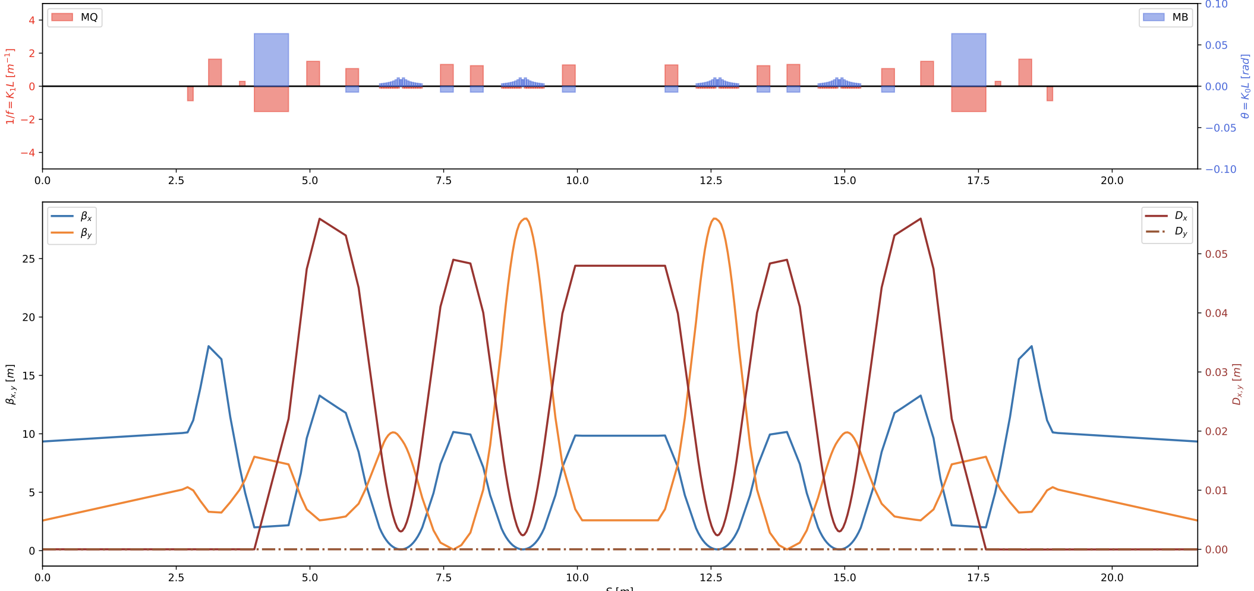
Lattice and optics design
A. Poyet
Optics constraints at the ID are matched
Horizontal emittance reduction from 212 to 100 pm (more than factor of 2!)
Tunes: 34.706 / 22.852
Chromaticities: -157/-125
Non-linear optimization: already good on-momentum DA

Slide 16
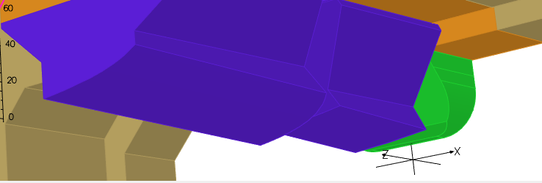
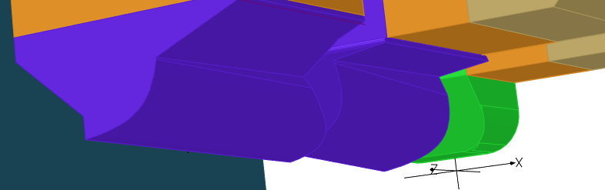
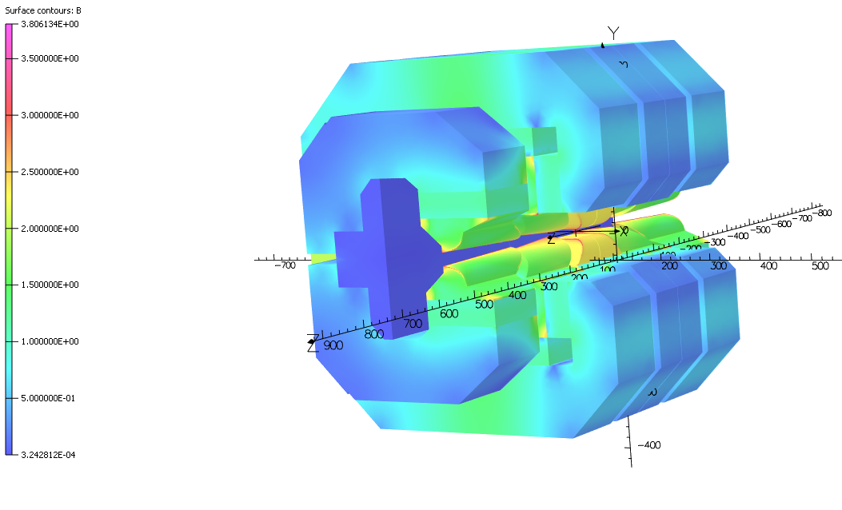
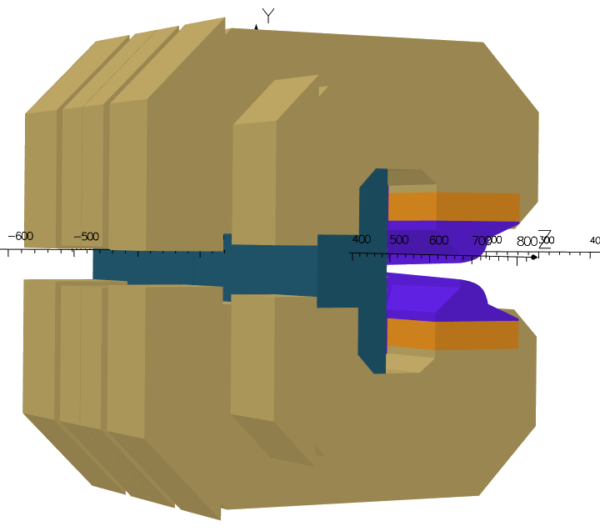
Magnetic Design @ CIEMAT
M. Dominguez,
F. Toral
No changes in philosophy, major changes in poles (90% of the design time)
All NdFeB permanent magnet blocks, including low-field modules
Permanent magnet volume increased around 40% reaching demanded field peak of 2.3 T with magnet gap of 18mm (17+1mm)
New field trimming design implemented
    Yoke completely split in two parts
    supported by aluminium block
    Sliding parts achieve higher/better regulation than CLIC DR prototype
CLIC DR poles
VADER poles

Slide 17
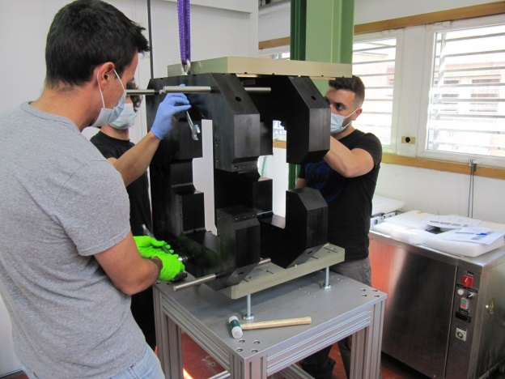
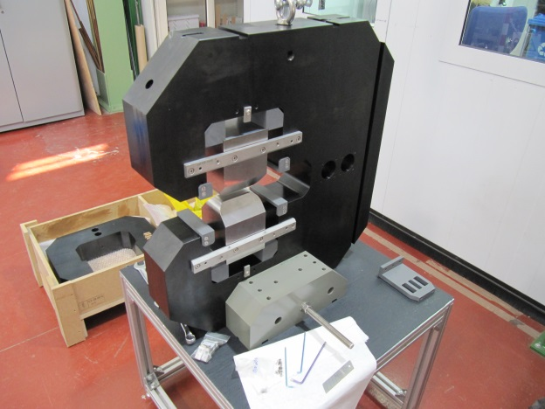
CLIC: Preliminary Assembly
A preliminary assembly without permanent magnets (PM) should be done to assure the correct manufacturing and adjustment of all the parts.
Testing the modules’ approach system
Each module is mounted separately, with all the parts except the PM

Slide 18
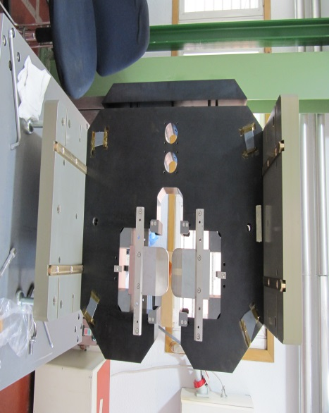
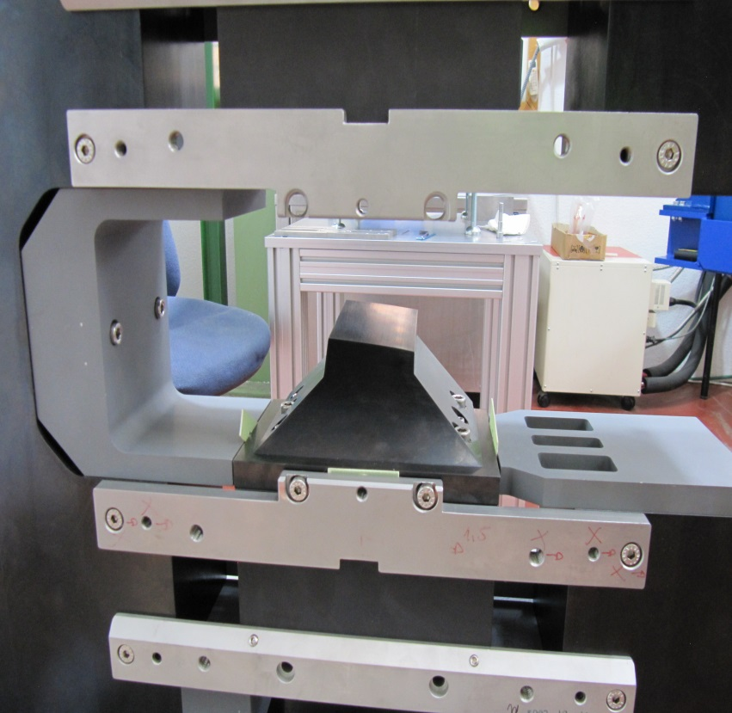
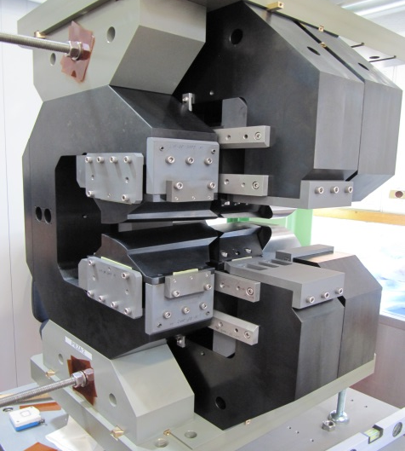
CLIC: Preliminary Assembly
HF module is mounted first, with the top and bottom aluminium plates
Then each module is introduced following the bronze guides fixed to the plates
Detail of one pole and how they are fixed in their nominal position using fibre gauges
Full assembly without PM

Slide 19
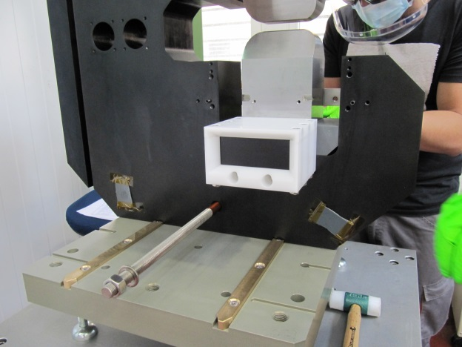
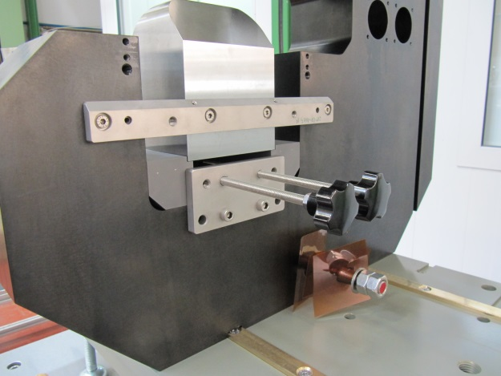
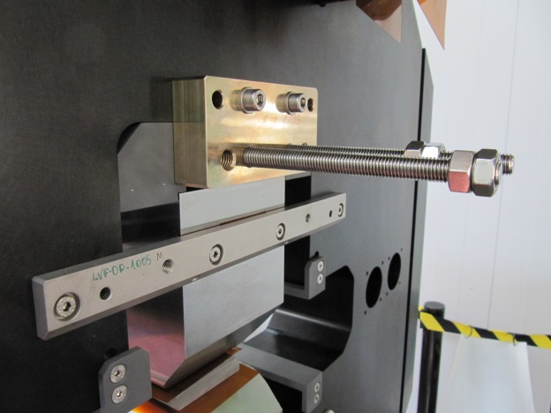
CLIC: Assembly with PM
The PM blocks are introduced using a POM box attached to the yoke
The insertion was controlled using these rods and plate…
…that have to be redesigned due to the huge forces involved
This is already implemented for VADER

Slide 20
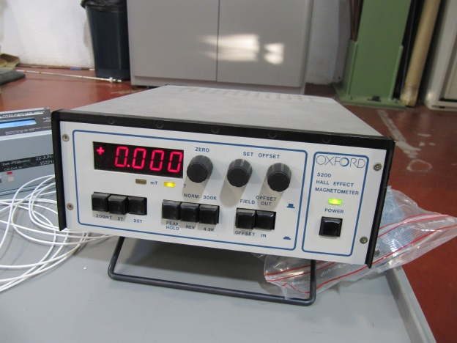
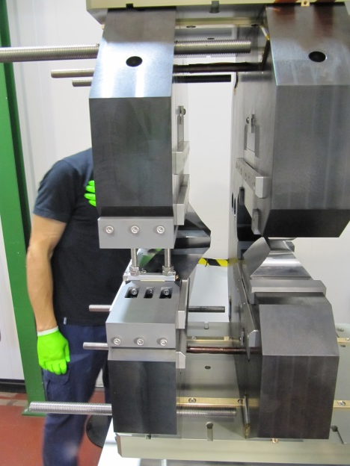
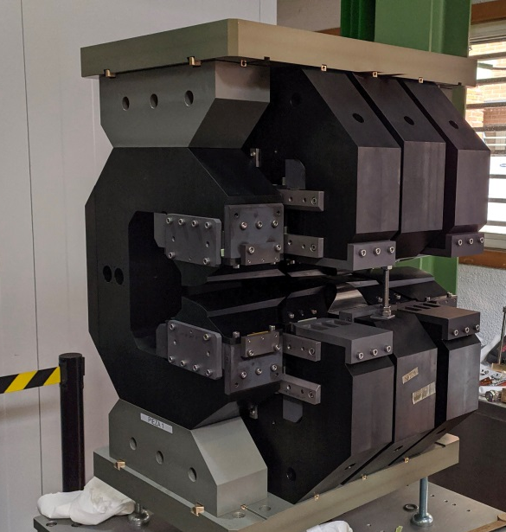
CLIC: Assembly with PM
Magnetic measurements are done after each PM is inserted.
Low precision but necessary to assure the correct PM assembly
Once each module has all the magnets in, the controlled approach starts
The process is repeated with each module until the assembly is completed

