Slide 1


Quench Heaters resistance
M. Baldini - FNAL

Slide 2
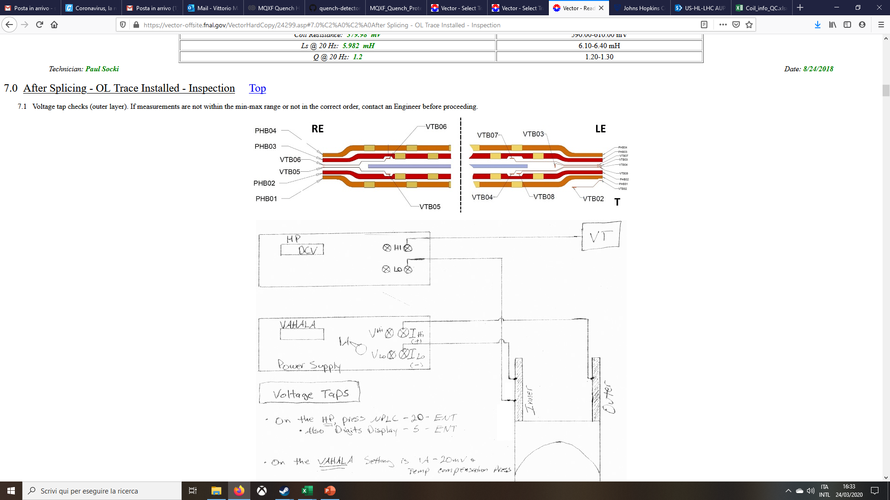
MQXFA quench heaters
MQXFA Pre-series and series magnets QH: 26 stations each strip

Slide 3
AUP QH resistance measurements
Resistance is measured on each QH strip before coil fabrication at FNAL and BNL
  This is part of the QC and those are 4W measurements
Resistance is measured on each QH circuit at several stage at BNL (Circuits consist of two QH strips connected in series):
    Magnet horizontal
    Wire stand
    Magnet at 4.5 K
    Magnet in the dewar at 300 K
    Magnet after cold test before shipment

Slide 4
Nominal Values
 |  |  | MQXFA | MQXFB
Geometry | Magnet length | (m) | 4.2 | 7.15
 | Heater SS width | (mm) | 20 | 20
 | Heater Cu width | (mm) | 20 | 20
 | Heater SS thickness | (mm) | 0.025 | 0.025
 | Heater Cu thickness | (mm) | 0.01 | 0.01
 | Station length | (mm) | 40 | 40
 | Station period | (mm) | 160 | 160
 | Number of stations |  | 25 | 44
Room temperature strip resistance | SS resistivity at RT | (Ω m) | 7.30E-07 | 7.30E-07
 | Cu resistivity at RT | (Ω m) | 1.80E-08 | 1.80E-08
 | SS station resistance at RT | (Ω) | 5.84E-02 | 5.84E-02
 | Cu station resistance at RT | (Ω) | 1.08E-02 | 1.08E-02
 | Total strip resistance at RT | (Ω) | 1.73E+00 | 3.05E+00
Cold strip resistance | SS resistivity at 10 K | (Ω m) | 5.45E-07 | 5.45E-07
 | Cu resistivity at 10 K | (Ω m) | 6.00E-10 | 6.00E-10
 | SS station resistance at 10 K | (Ω) | 4.36E-02 | 4.36E-02
 | Cu station resistance at 10 K | (Ω) | 3.60E-04 | 3.60E-04
 | Total strip resistance at 10 K | (Ω) | 1.10E+00 | 1.93E+00
Circuit resistance (nominal) | Number of strips in series |  | 2 | 2
 | Resistance of the warm leads | (Ω) | 2.3 | 0.6
 | Total resistance | (Ω) | 4.5 | 4.5
Powering parameters (nominal) | Voltage | (V) | 900 | 900
 | Capacitance | (mF) | 7.1 | 7.1
 | Peak current | (A) | 200 | 200
 | RC | (ms) | 32 | 32
 | Peak power density | (W/cm²) | 218 | 218
 | Energy density in the heater stations | (J/cm²) | 3.46 | 3.46

Slide 5
QH strip resistance data @300K
Data collected at FNAL with 4W measurements
Average
Nominal value
R [Ω]
 | Warm
Avg. strip | 1.88678
St. Dev | 0.13109
Max | 2.33
Min | 1.57
Range | 0.76
Range (%) | 39%
532 stripes measured
*percentage over the average strip value
MQXFB Prod. average @ RT = 3.12 ± 0.19 Ω

Slide 6
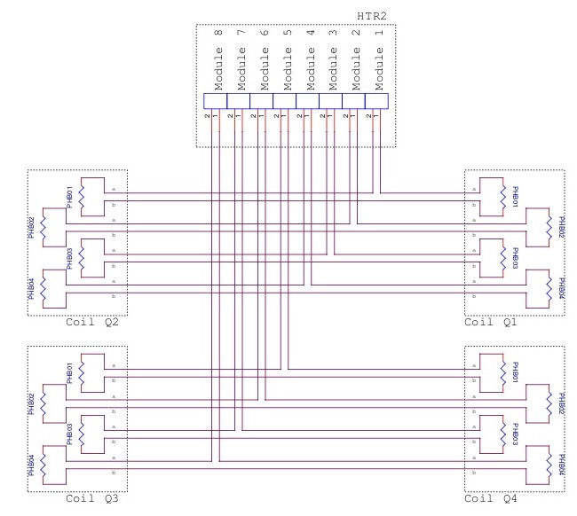
MQXFAP2 and MQXFA pre-series
Quadrants | Heaters circuit
Q1-Q2 | PHB01
Q1-Q2 | PHB02
Q1-Q2 | PHB03
Q1-Q2 | PHB04
Q4-Q3 | PHB01
Q4-Q3 | PHB02
Q4-Q3 | PHB03
Q4-Q3 | PHB04
EACH QH CIRCUIT CONSIST OF 2 STRIPS

Slide 7
Resistance measurement at BNL
 | Measurement location: | Horizontal | Wiring Stand | Dewar
HORIZONTAL: magnet is in horizontal position and the measurement are taken from the magnet connectors
WIRING STAND: magnet is vertical attached to the top head. Measurements are taken from the top head connectors
DEWAR: measurements at cold taken from the top head connectors

Slide 8
QH circuit resistance data @300K
QH resistances were measured and then averaged. Results were compared with circuit resistance calculated using single strip 4W measurements
Here the difference between the measured R vs calculated R is reported
Can we use this difference to estimate the warm wire contribution?
Q1-Q2 circuit
Q3-Q4 circuit

Slide 9
QH circuit resistance data at 4.5 K
2 wire data taken at BNL
MQXFA05 data are higher than the rest of the magnets

Slide 10
Summary
R [Ω] MQXFA
 | Warm | 1.9 K
Avg. circuit | 4.12195 | 2.24543
St. Dev | 0.25637 | 0.21566
Max | 5.145 | 2.98
Min | 3.38 | 1.642
Range | 1.765 | 1.338
The average was calculated using all the measured data

