Slide 1

Scientific Python
I. Osborne (Princeton)
G. Watts (UW/Seattle)

Slide 2
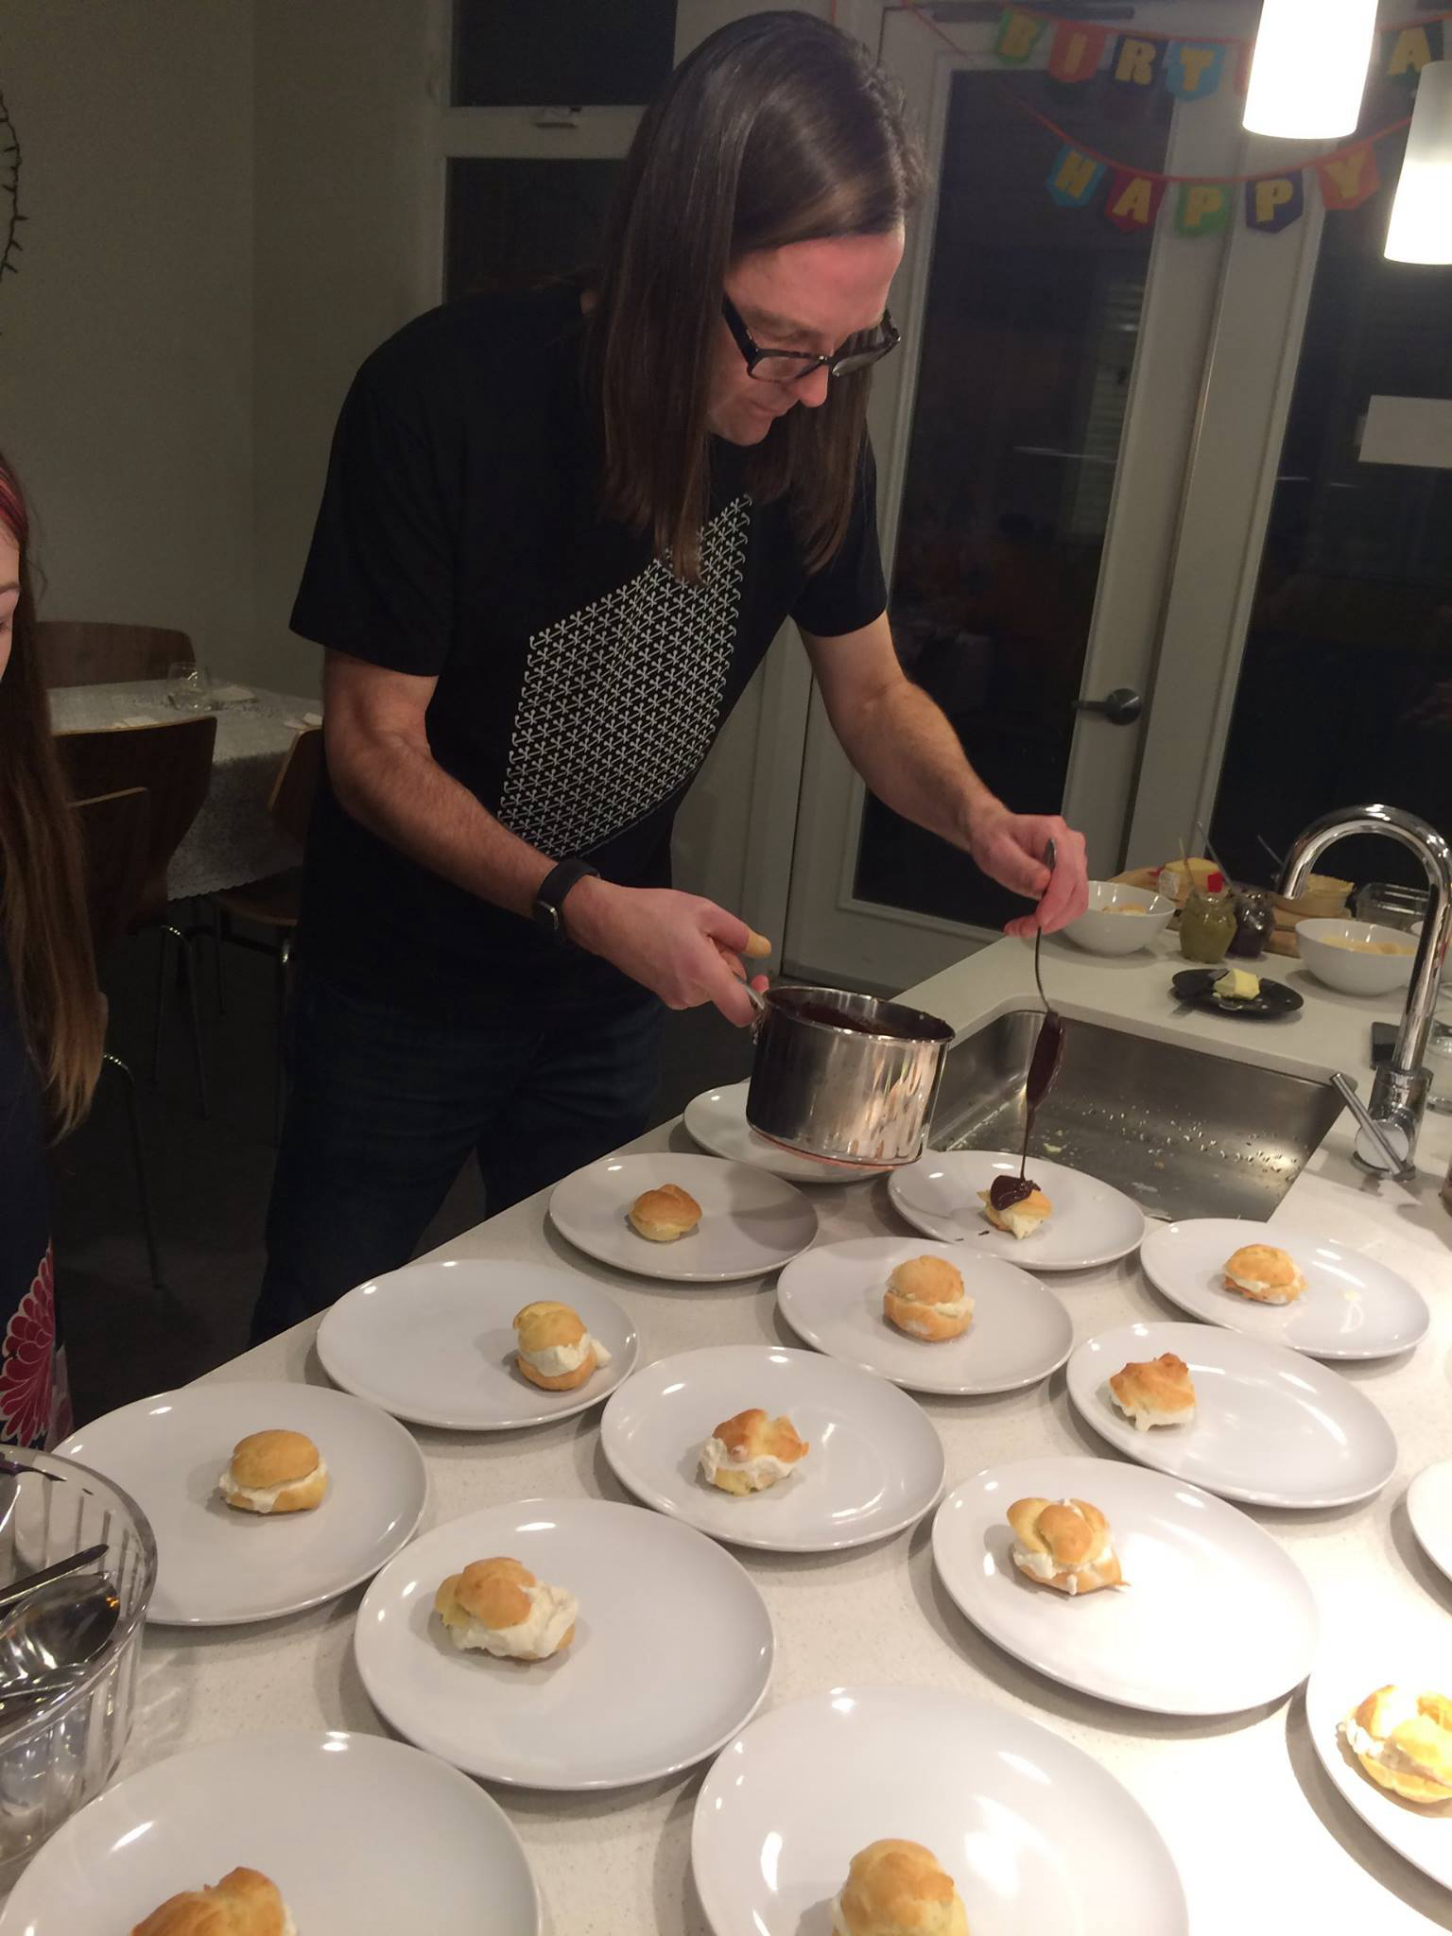


Who Am I?
Professor at the University of Washington in Seattle
gwatts@uw.edu
UW Info
@gordonwatts (github)
I got into particle physics because I loved the intersection of physics, hardware and computer science.
I got involved with IRIS-HEP 7 years ago working towards software for the HL-LHC
Ianna will introduce herself in the next lecture!

Slide 3
Scientific Python
How many of you have had some experience with the Python Programming Language?

Slide 4
Scientific Python
What is the largest program you’ve written or worked on (lines of code)?

Slide 5
Scientific Python
Who has heard of array programming?

Slide 6
Scientific Python
Large Language Models?

Slide 7
Scientific Python
How many people here do you know?

Slide 8
What We’ll Cover
Lecture 1 | Python Refresher! (we’ll go fast!) | Gordon
Lecture 2 | Array Oriented Programming | Gordon
Lecture 3 | Using Jagged Or Awkward Arrays and Data | Gordon
Lecture 4 | Making Python Scream (e.g. go fast)! | Gordon

Slide 9
Why Python?

Slide 10
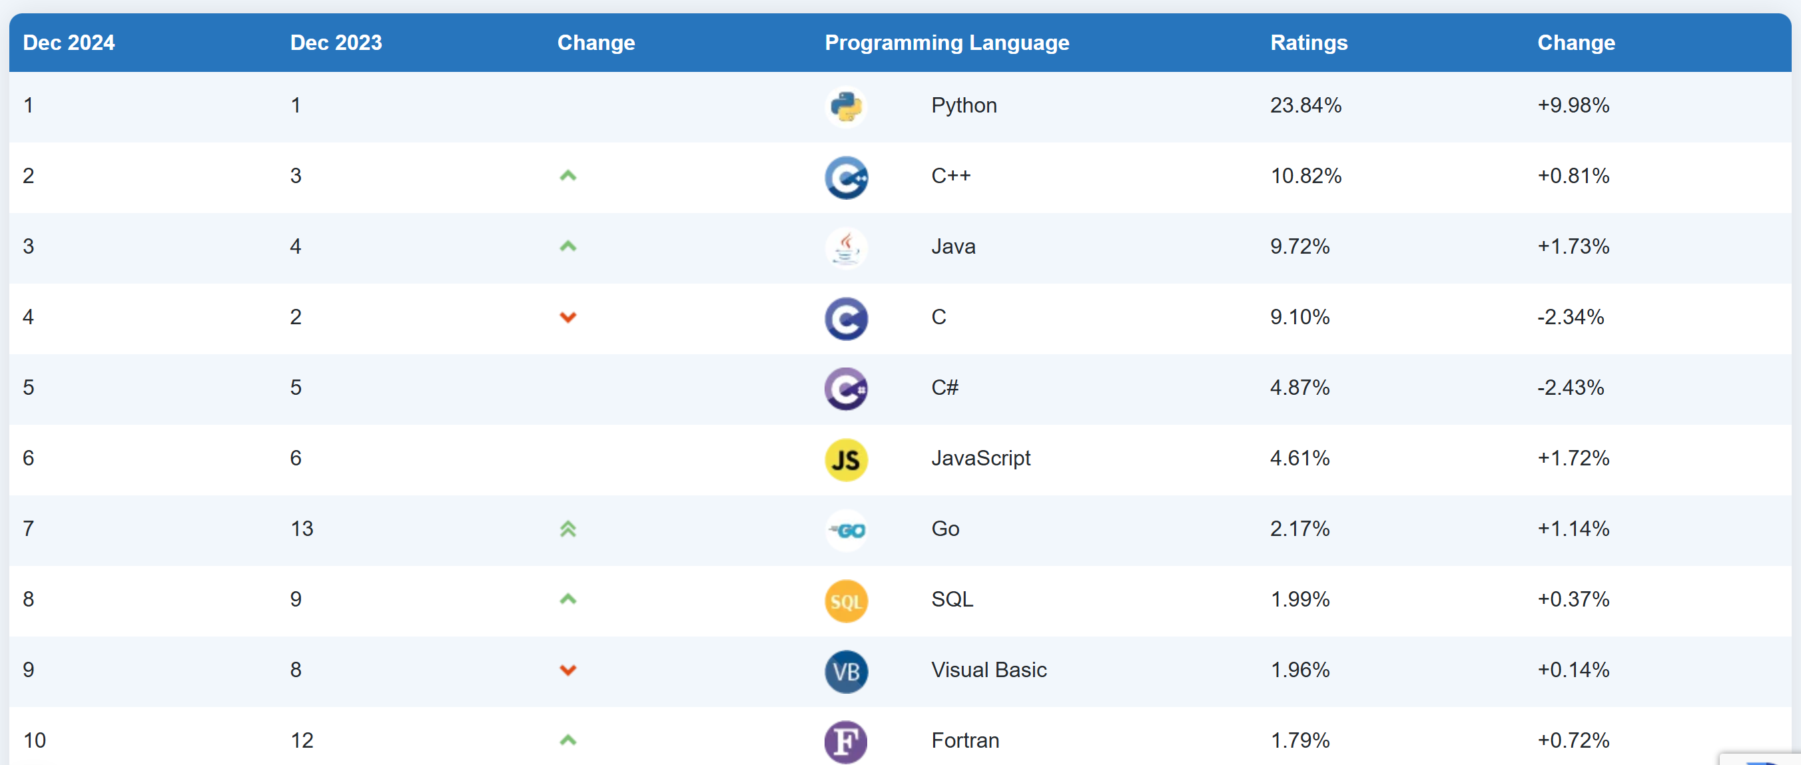
“About to become the language of the year…”

Slide 11
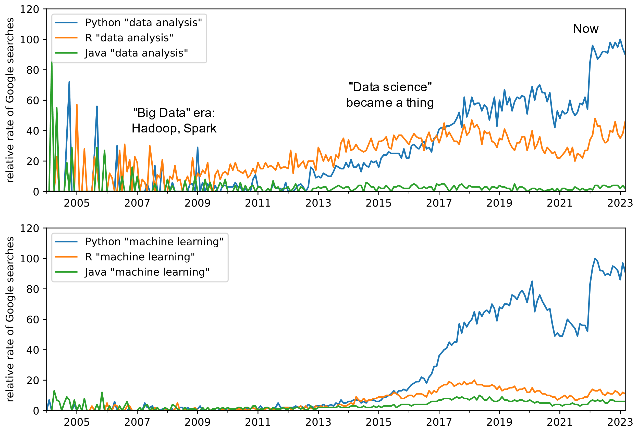
Data Analysis Too!

Slide 12
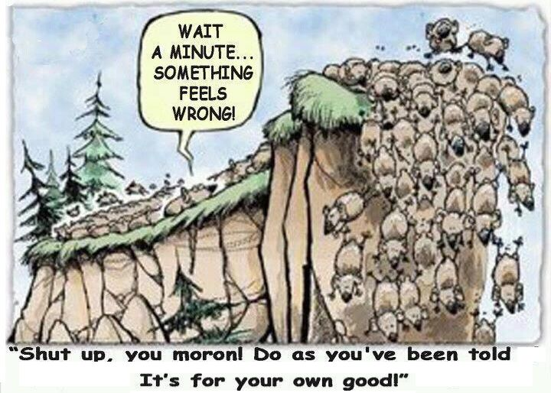

Slide 13
It is popular for a reason!
All the standards: flow control, functional, classes
Efficient high-speed extensibility
Popularity means large eco-system!
Also… it’s fun!
Why it is so popular for data science!
You can concentrate on what is unique about your problem, and grab someone else’s package for everything else!

Slide 14
What about speed?
We will explore this…
But…
Python can operate efficiently – but you must be aware of what you are doing!

Slide 15
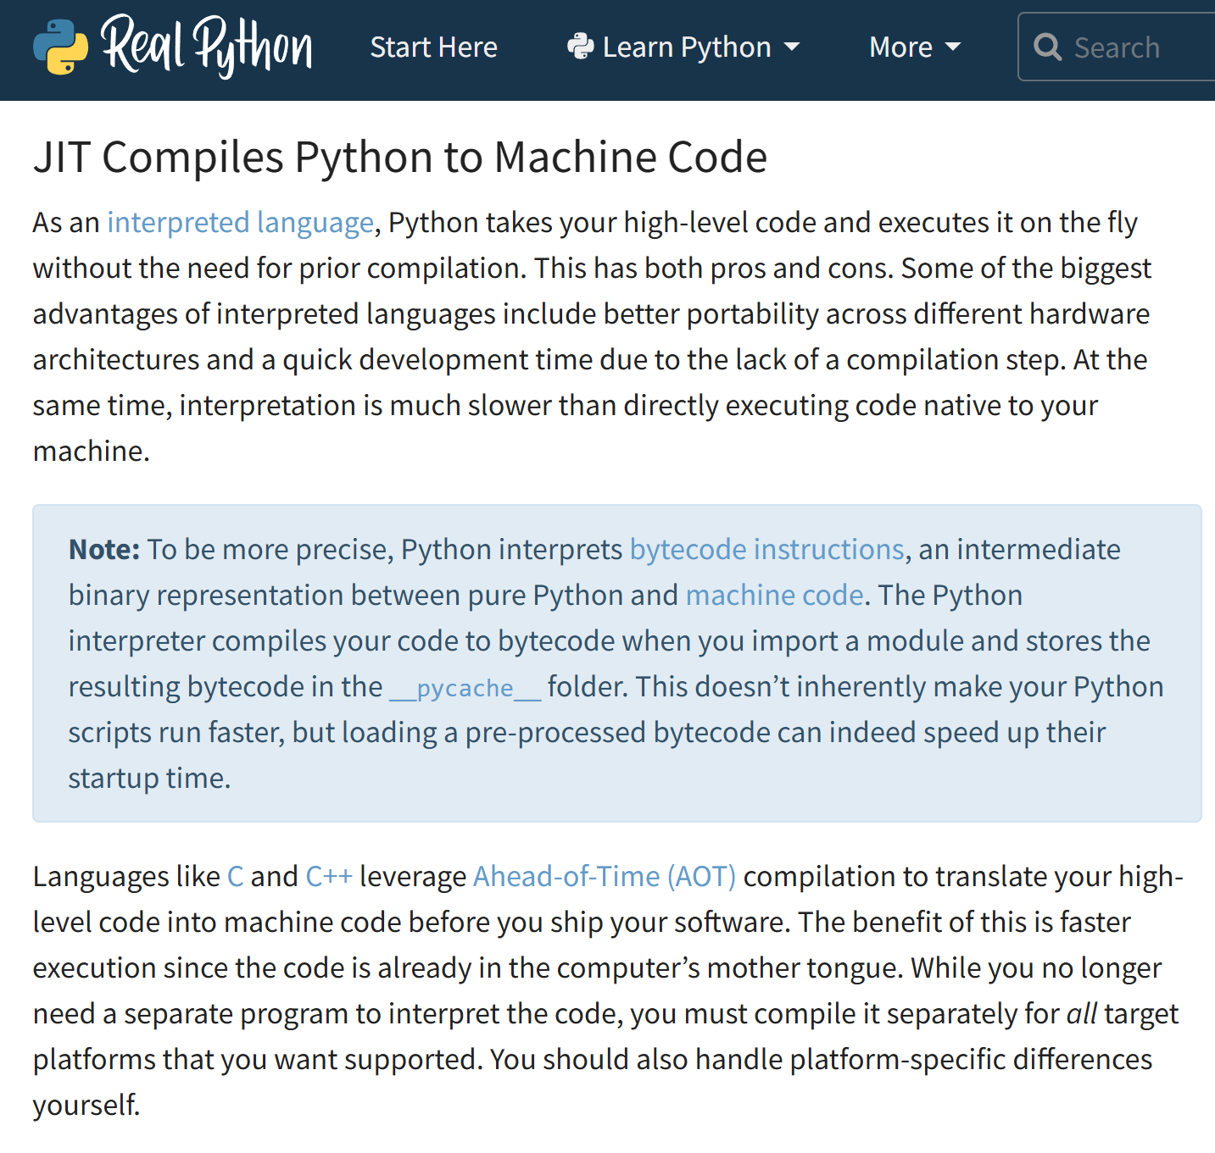
Experimental in 3.13

Slide 16
Learn by doing…

Slide 17
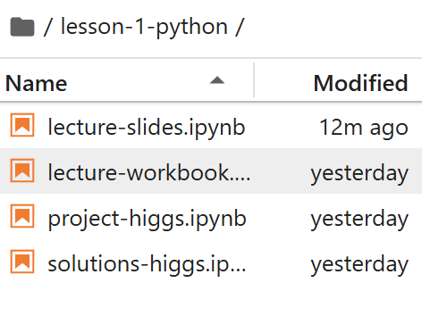
How to follow the lectures…
I do….
During Lecture
You do….
Post lecture projects…

Slide 18
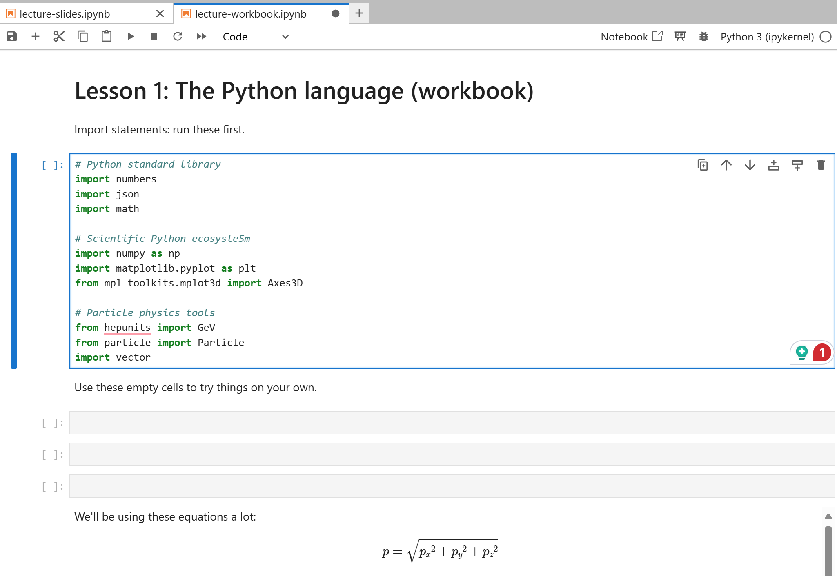
Notebook Navagation
When you see the notebook,
Click on a code cell to edit it.
Control-enter to run it.
Shift-enter to run it and move on to the next cell.
But be sure to evaluate all code cells so that you're not missing any data.
If you need to refresh your notebook's state, use the Kernel → Restart Kernel and Run up to Selected Cell menu item.
Click on a cell to edit it
Blue outline will appear
Edit it as you wish!
Shift-Enter or cntrl-Enter to execute the cell’s code
It’s a mess!
Restart and re-run the cells quickly (shift-enter one after the other, or “run all above”).

