Slide 1
Introduction to using Containers and Virtual Environments
G. Watts (University of Washington/Seattle)

Slide 2

Analysis Group
Established analysis group!
Just arrived New Member with some great new ideas to improve the analysis

Slide 3
How do they even make the first plot!?!
How do you log in?
How do you access the data?
How do you setup your software environment?
How do you access the group’s common software?
How do you make a plot?
Q: what if you are working on two projects with conflicting requirements?

Slide 4
How do they even make the first plot!?!
How do you log in?
How do you access the data?
How do you setup your software environment?
How do you access the group’s common software?
How do you make a plot?
Containers
Virtual Environments

Slide 5
Containers & Virtual Environment
Taken a piece of software from one computer to another and found that it doesn’t work?
Had to install a bunch of dependencies to run a piece of software written by a colleague?
What about saying “it works on my machine” when someone else is having trouble running your code?
Containers and Virtual Environments answer these questions!

Slide 6
These Are Another Tool to get Science Done
These are tools
They do take some time to use
They do take resources (disk/networking)
But they enable
  Collaboration on software
  Community building around software
  Publishing of software
  Reuse of software

Slide 7
Use UChicago’s Especially Setup Environment

Slide 8
Use UChicago’s Especially Setup Environment
Something for your analysis
Containers at a Analysis Facility website
Codespaces (MS/vscode)
UChicago is based on binder hub which is based on containers
“the open-source ecosystem!”

Slide 9
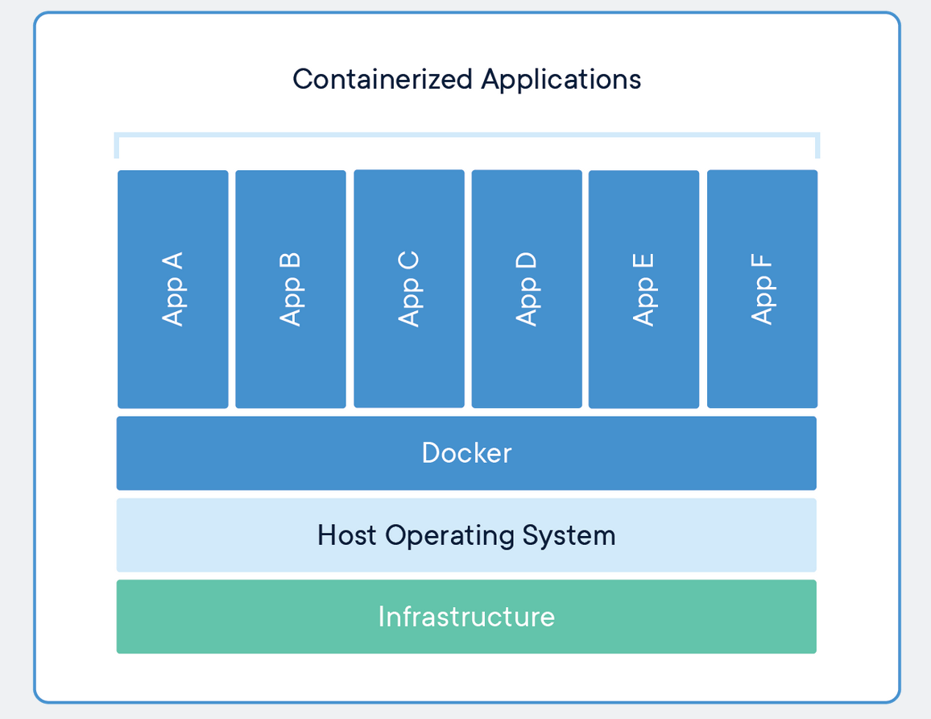
Containers
Imagine if we’d tried to install all of the necessary packages for this tutorialon your laptops?
Would have taken hours
But…
  Most of you would have been just fine, but one or two…
  And some of you probably have other versions of the package installed – that you needed…
Binder is software built on containers!
Tutorial from HSF!!

Slide 10
Containers
podman!
Built to emulate a computer/OS configuration!
You or your collaborators provide
Windows, Linux, Mac
Docker
Podman
Sinularity
Etc.
Provided…

Slide 11
How Powerful Are they?
This is a windows laptop…
docker run --rm -it -v C:\\Users\\gordo\Code:/userhome rootproject/root
The name of the container stored up on docker’s hub

Slide 12
What is the downside?

Slide 13
Working With Containers
Images
On a repository on the net (e.g. hub.docker.com).
Cached locally on your machine
Built locally
Once built or cached, can be re-used.
No state information.
docker run <image-name>
Containers
Two states: Running and Paused
Running: running, you can interact with it
Paused: cached state (files, etc.).

Slide 14
Working With Containers
Images
docker images
Containers
docker ps -a

Slide 15
Working With Containers
Images
DockerFile
docker build .
Containers

Slide 16
Let's Build A Hello World
hello.py
# Print hello
print(“hello world from a container!”)
Dockerfile
FROM python:3.11
Build & Run
docker build -t hello:0.1 .
docker run --rm –it hello:0.1

Slide 17
Getting the file on there…
Dockerfile
FROM python:3.11
WORKDIR /app
COPY hello.py hello.py
Build & Run
docker build -t hello:0.1 .
docker run --rm –it hello:0.2
docker run --rm -it hello:0.2 python /app/hello.py
Where is vim?
What about keeping the OS up to date?

Slide 18
Adding our own packages…
Dockerfile
FROM python:3.11
# Update the security
RUN apt-get update
RUN apt-get upgrade -y
RUN apt-get install -y vim
# Load in the main file.
WORKDIR /app
COPY hello.py hello.py
docker build -t hello:0.3 .
docker run --rm -it hello:0.3 bash
Or
docker run --rm -it hello:0.3 python /app/hello.py

Slide 19
Starting and Stopping
This is valuable when you are using the docker container as a development environment.
`docker run`
Edit the `hello.py` file
Exit
`docker start`
`docker attach`
The container, once up and running, will maintain state!

Slide 20
Making it “stand-alone”
Note when we run this command:
docker run --rm -it hello:0.3
You were dropped into Python?
Dockerfile
FROM python:3.11
# Update the security
RUN apt-get update
RUN apt-get upgrade -y
RUN apt-get install -y vim
# Load in the main file.
WORKDIR /app
COPY hello.py hello.py
CMD ["python", "/app/hello.py"]
Can we make `hello.py` just run?

Slide 21
Dockerfile you’ve been using…
FROM condaforge/mambaforge
COPY binder/environment.yml .
# Fix enter timezone issue -
ENV TZ=Asia/Kolkata
RUN ln -snf /usr/share/zoneinfo/$TZ /etc/localtime && echo $TZ > /etc/timezone
RUN apt-get update
RUN apt-get upgrade -y
RUN apt-get install build-essential cmake -y
RUN mamba env create -f environment.yml && mamba init bash
# Make RUN commands use the new environment:
RUN echo "mamba activate hsf-india" >> ~/.bashrc
SHELL ["/bin/bash", "--login", "-c"]

Slide 22
Virtual Environments
Built to solve the same problem in python
Much more light weight than containers…
Install only the packages that you need.

Slide 23

Virtual Environments
1
Install Python On Your Laptop!
2
Install Packages to work on Project 1
Virtual Environments to the rescue…
3
Install Packages to work on Project 2
Project 1 needs awkward < 1.0, and project 2 needs awkward >= 2.0!!!

Slide 24
Virtual Environments are like having multiple (separate) python installations!

Slide 25
What do you need?
The python interpreter and all libraries…
Python installed on your computer
Pip installed on your computer
List of packages you want installed!
The package installer – pulls packages down from pypi!
A straight text file – “requirements.txt”

Slide 26
Let’s build an example
I want to run this code in a local notebook server:
import uproot
from hist.dask import Hist
f = uproot.dask({
r"C:\Users\gordo\Downloads\dataWW_d1_split_removed.root": "tree_event;1;1"
})
h = Hist.new.Reg(50, 0.0, 100).Double()
filled_dask = h.fill(f.lep_pt_0)

Slide 27
Create the virtual environment
1
C:\Users\gordo\AppData\Local\Programs\Python\Python312\python.exe -m venv .venv
(customize for your OS, of course!)
Command to Create A Virtual Environment
In this directory
2
.\.venv\Scripts\Activate.ps1
python.exe -m pip install --upgrade pip

Slide 28
Install first packages
Create `requirements.txt`, and add `jupyterlab` to it.
pip install -r .\requirements.txt
jupyter-lab
Now – iterate until we have that code running!

Slide 29
Final requirements.txt
jupyterlab
uproot
dask[complete]
dask-awkward
hist[dask]
You can check this into your github repository along with the notebook file
Now anyone can run your file!
Wait! I want to preserve this forever!!
Run `pip freeze`.
Use the output to create a new requirements.txt file

Slide 30
Keeping the mess under control…
1
Start with virtual environments
And put everything in github or some other source control!
2
Containers later
Useful tools to make the code you develop more sustainable…
(next steps – create a generally useful library that you submit to pypi.org!!)

