Slide 1
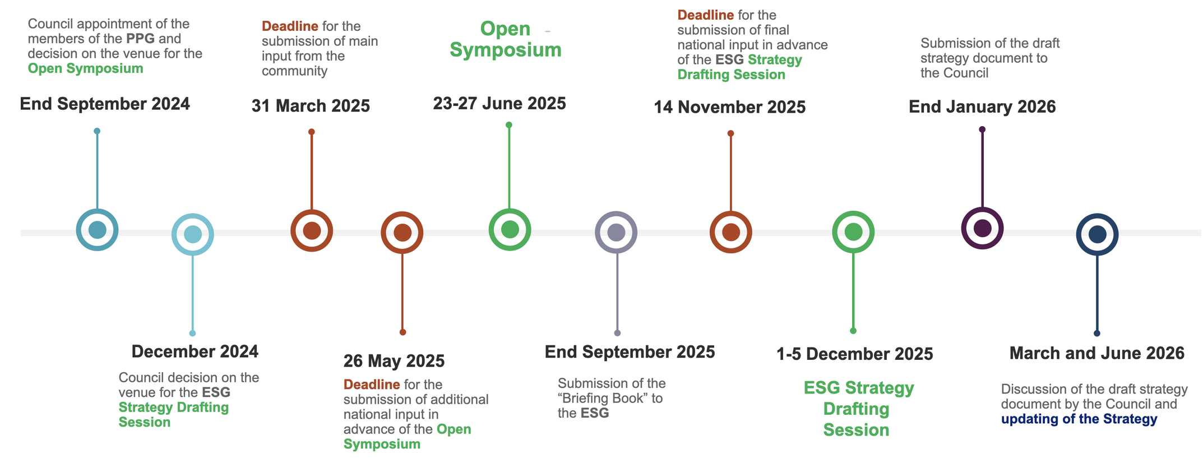
ESPPU
European Strategy Group
Represents member states, large laboratories, CERN management and invitees, e.g. Prof. Michael Tuts for the US
Preparatory Group
Prepares Briefing Book
To be appointed by CERN Council
Two members from the Americas
Strategy Secretariat
Karl Jakobs (Strategy Secretary)
Hugh Montgomery (SPC Chair)
Dave Newbold (LDG Chair)
Paris Sphicas (ECFA Chair)
Find more at: https://europeanstrategyupdate.web.cern.ch/welcome
1

Slide 2
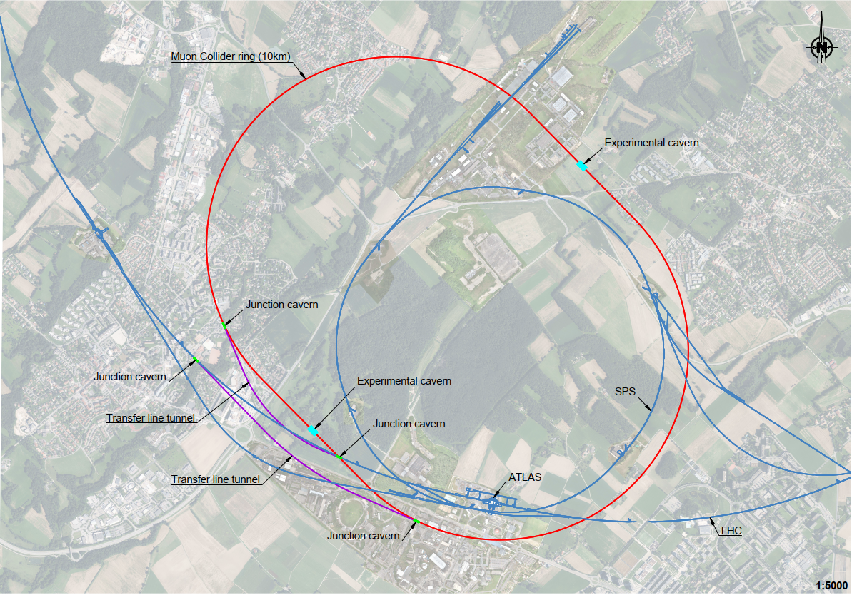
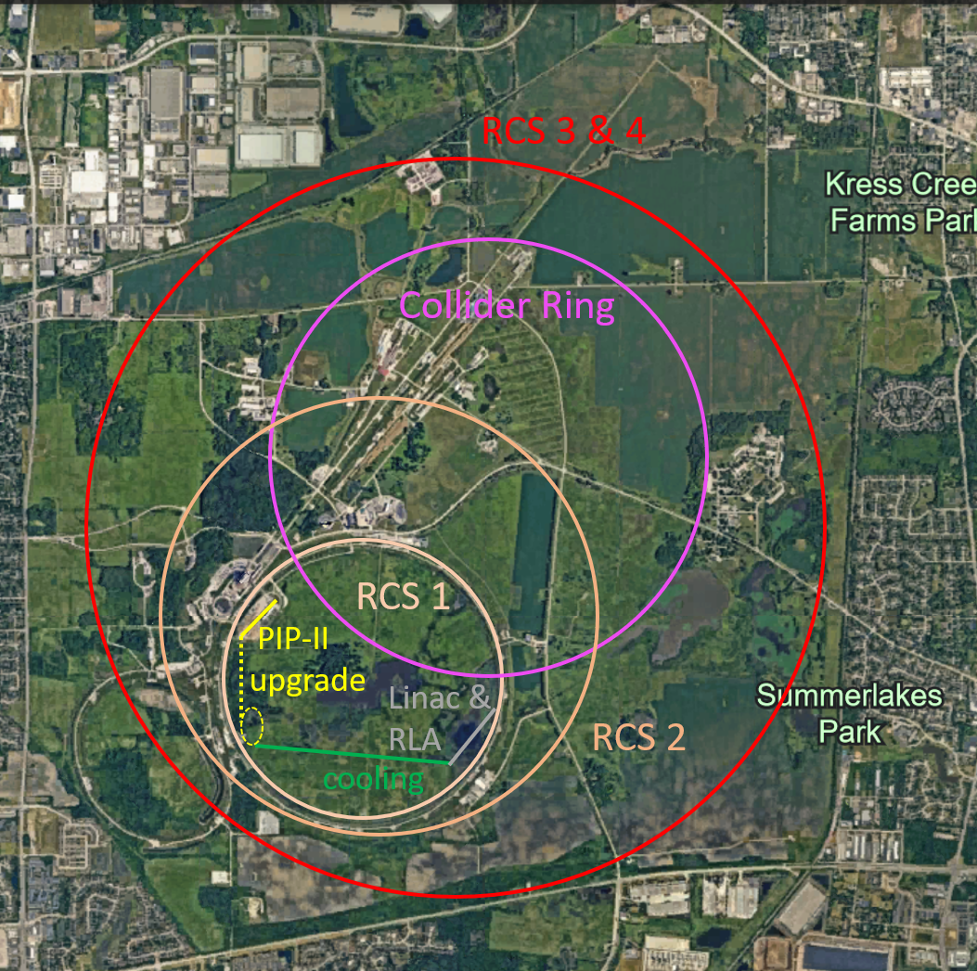
Plan for ESPPU
March 2025 deliver promised ESPPU reports
Evaluation report, including tentative cost and power consumption scale
R&D plan, including scenarios and timelines
This requires to push as hard as possible with existing resources
Present green field designs and continue to work on them
International collaboration
Parameters, lattice designs, component designs, beam dynamics, cost, …
Perform example civil engineering studies
CERN (collider and demonstrator)
FNAL, the US started doing similar studies
Provide dedicated parameter tables for the implementation at existing sites (FNAL, CERN, …)
Scaled from green field design using existing infrastructure
Do not have the resources and time to make detailed designs for CERN and FNAL for ESPPU
2

Slide 3
Note: LDG
LDG will also submit a document to the European Strategy
Chair of the LDG will change in January 2025:
Mike Seidel will take over from Dave Newbold
Review of all five activities planned
HFM, RF, plasma, energy recoveryy linacs and muon collider
Initially planned for end of Novembber but delayed
Exact scope of review is being defined

Slide 4
Report Plan
Discussions with Karl Jakobs
Concise reports should have 10 pages
Could be one ore two reports
Maybe one overall report and one focused on the R&D plan and implementation
Need to coordinate with other reports
E.g. one for the general magnet development
But some overlap is probably fine
  The same message more than once
Long supporting reports should also be available March 31rst 2025
Evaluation report
R&D Plan
Idea is to combine into one document with different sections

Slide 5
Tentative Timeline
Long report(s)
April 2024: Parameter revision is starting
End of June 2024: Parameters updated (to EU October)
September 2024: Overleaf in place for authors to start
End of October 2024: Report ready for content editing
End of December 2024: Draft ready for collaboration and the IAC
End of January 2025: Report ready for copy editing (language)
End of February 2025: Start of signature process
End of March 2025: Report ready
Concise report(s)
End of September 2024: Overleaf in place
End of October 2024: Start of editing to integrate long report
End of December 2024: Draft ready for editing and IAC
February 2025: Start of copy (language) editing
End of March 2025: Report submission

Slide 6
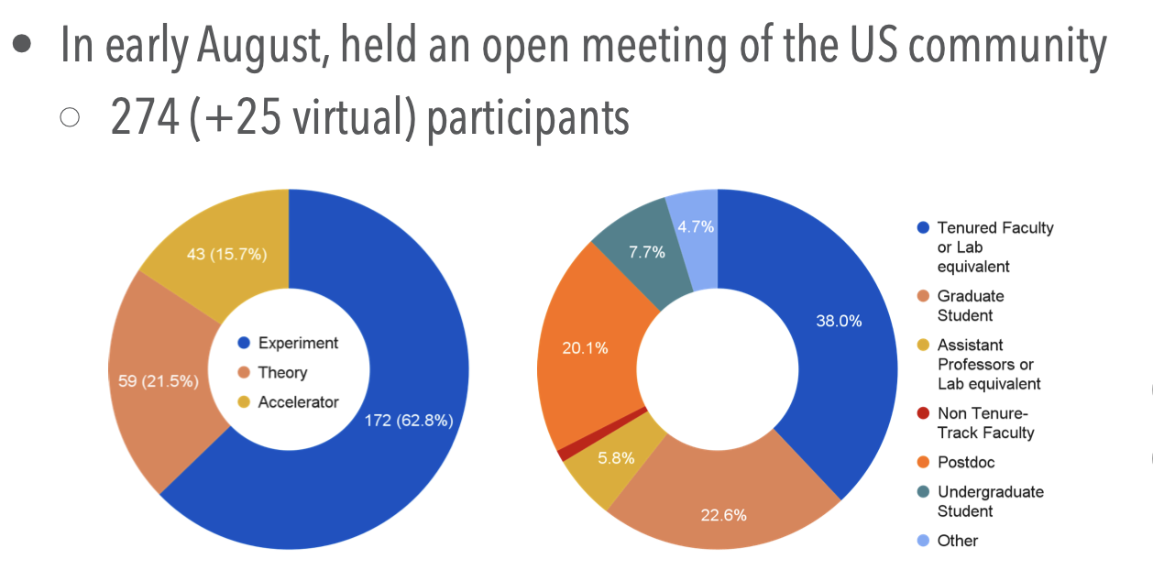
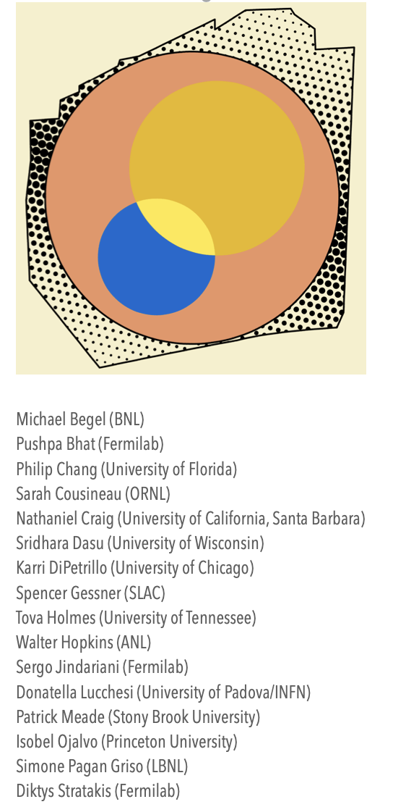
US Progress
US Muon Collider Inauguration Meeting beginning of August at FNAL showed strong interest
Full integration with US planned
Need to move forward while waiting for US to get organised
In particular, R&D plan has to be common plan
Used Organzation Committee of FNAL with some additional members as de facto US organisation
Providing members for
  Editorial Board
  Authors of ESPPU report
  Cost estimate
  Next annual meeting programme committee
And Mark Plamer, Steve Gourley, Kevin Black, Lawrence Lee
Last years publications rules are now very important during the transition

Slide 7
Report Organisation
Editorial Board
Will drive the writing and editing
For Interim Report relied on authors to implement proposed changes
For ESPPU report, editors will at the end of the process write text directly and allow authors to comment
Will contain five experts chosen by the US partners
Informal contacts in the US organization ongoing
Reviewers
A number of people can provide important overall input but might not have the time to edit the report
Plan to invite them specifically to read the documents to give comments

Slide 8
Report Organisation
Evaluation Report
Will be based on the Interim Report
Reuse the same structure but
Add some more detail, where beneficial
Add progress over last year as appropriate
Move unfunded R&D sections to R&D Plan
The same authors as for the Interim Report
US authors welcome to help
Already helped during the Interim Report
In some cases important activity in the US
  E.g. physics, MAIA, …

Slide 9
Core Editorial Team
Federico Meloni (chair), Chris Rogers (deputy chair), Kevin Black, Christian Carli, Steve Gourlay, Sergo Jindariani, Roberto Losito, Donatella Lucchesi, Patrick Meade, Elias Metral, Simone Pagan Griso, Nadia Pastrone, Daniel Schulte, Diktys Stratakis, Taylor, Andrea Wulzer

Slide 10
Assessment, Part I
Introduction and Motivation
Daniel, Kevin Black, Sergo Jindariani, Mark Palmer, Nadia Pastrone, Steinar Stapnes, …
Physics
Andrea Wulzer, Fabio Maltoni (tbc), Patrick Meade, Nathaniel Craig, Andre de Gouvea , Roberto Francescini, David Marzocca, Jorge De Blas Mateo
Interfaces
Physics and Detector Needs (P. Meade, Simone Pagan-Griso, F. Meloni, N. Pastrone)
MDI (Anton Lechner)
Detector (Donatella Lucchesi, Federico Meloni, Simone Pagan-Griso, Sergo Jindariani)
MUSIC (Donatella Lucchesi, Davide Zuliani)
MAIA (Karri diPetrillo, Tova Holmes)
Performance (Lorenzo Sestini, Massimo Casarsa, Karri diPetrillo, Tova Holmes)
Technology Timon Heim, Artur Apresyan (tbc), Nazar Bartosik, Luigi Longo
Software and Computing: Kevin Pedro, NN

Slide 11
Assessment, Part II
Accelerator concept (Christian Carli)
Proton Complex (Natalia Milas)
Muon Production and Cooling (Chris Rogers)
Acceleration (Antoine Chance, Heiko Damerau, Scott Berg)
Collider Ring (Christian Carli)
Collective Effects and Integration (Elias Metra)
Accelerator technology (Roberto Losito)
Magnets (Soren Prestemon, Steve Gourlay, Luca Bottura, Bernhard Auchmann, Marco Stratera, Bernardo Bordini, NN Japan, NN Florida)
Power converter (F. Boattini)
RF (Dario GIove, Alexej Grudiev)
Target (R. Franqueira Ximenes, A. Lechner)
Radiation shielding (R. Franqueira Ximenes, A. Lechner)
Muon cooling cell (L. Rossi, R. Losito)
Cryogenics (P. Borges de Sus, R. van Weelderen)
Vacuum (J. Ferreira Somoza)
Instrumentation (T. Lefevre)
Radiation protection (C. Ahdida, Jerzy Mikolaj Mancza)
Movers (A. Kohlmainen, C. Accettura)
Infrastructure (R. Losito)
General Safety (S. Marsh)

Slide 12
R&D Plan, Part I
R&D Objective, Timeline, Plan and Cost
Steinar, Daniel, Taylor, Roberto, Sergo
Physics R&D
Andrea Wulzer, Fabio Maltoni, Patrick Meade, Nathaniel Craig, Andre de Gouvea, Roberto Francescini, David Marzocca, Jorge De Blas Mateo
Detector R&D (Nadia Pastrone, Federico Meloni, Simone Pagan-Griso, Sergo Jindariani)
Concepts and performance: Karri diPetrillo, Tova Holmes, ..
Technology R&D: Timon Heim, Artur Apresyan (tbc), Nadia Pastrone + NN
Software and Computing: Kevin Pedro, Walter Hopkins (tbc) + NN
Magnet R&D
Soren Prestemon, Steve Gourlay, Luca Bottura, Bernhard Auchmann, Marco Stratera, Bernardo Bordini, NN Japan, NN Florida
Accelerator R&D (Roberto Losito, Christian Carli …)
Accelerator design (Christian Carli, Scott Berg, Pavel Snopok, David Neuffer, Natalia Milas, Chris Rogers, Antoine Chance, Heiko Damerau, Elias Metral, Vasily Morozov)
Power converter (F. Boattini)
Machine-detector interface (A. Lechner)
Neutrino flux mitigation system (A. Kohlmainen, C. Accettura)
RF Systems: (Dario GIove, Alexej Grudiev, Emilio Nanni, Sergey Belomestnykh, Tianhuan Luo, Grahame Burt (tbc), Ulla van Rienen, Juliette Plouin (tbc))
Target system (R.F. Ximenes, A. Lechner, Katsuya Yonehera)
Instrumentation (T. Lefevre)
Radiation shielding (A Lechner, R. Franqueira Ximenes, Jose Ferreira Samoza, Patricia Borges de Sousa)
Cryogenics (P. Borges de Sousa, R. van Weelderen)
Vacuum (J Ferreira Samoza)
Radiation protection (C. Ahdida, Jerzy Mikolaj Mancza)

Slide 13
R&D Plan, Part II
Accelerator R&D, cont (Roberto Losito, Christian Carli …)
Infrastructure (R. Losito)
General Safety (S. Marsh)
Other technologies (R. Losito)
Software for the accelerator (NN)
Other Test Infrastructure (Roberto Losito)
R&D Programme Synergies (Chris Rogers, Luca Bottura, NN)
Sustainability (Carlo Rossi, Giorgio Apollinari (tbc))
Cost drivers and cost scale
Power driver and power scale
Collider Implementation
Overview
Implementation at CERN (Roberto Losito, John Osborn, Youri Roberts, Claudia Ahdida, Christian Carli,…)
Implementation at FNAL (Diktys Stratakis, Frederique Pellemoine (tbc), Scott Berg, Jeff Eldred (tbc), Katsuya Yonehara, Eliana Gianfelice, Sergei Nagaitsev (tbc))
Timeline (Sergo Jindariany, Chris Rogers, Roberto, Luca, DS, +)
Muon Cooling technology development and demonstration
Chris Rogers, Roberto Losito, Diktys Stratakis,
Cooling demonstrator programme
Scope, test stands, cooling cells, magnets, …
RF test stands (L. Rossi, R. Losito, Dario Giove, Emilio Nanni, Spencer Gessner)
Muon cooling module concept and tests (L. Rossi, R. Losito, Emilio Nanni)
Demonstrator Implementation at CERN (Roberto Losito, Chris Rogers, John Osborn, Lucio Rossi, NN)
Implementation at FNAL (Diktys Stratakis, Frederique Pellemoine (tbc), Scott Berg, Jeff Eldred (tbc), Katsuya Yonehara, Eliana Gianfelice, Sergei Nagaitsev (tbc)

Slide 14
Template: Objectives, Deliverables and Resources
Name | Unique name, e.g. “Cool.P1”
Objectives
Short description of the objectives of the workpackage
e.g. Identify the optimum choice of absorber windows for the final cooling
High-level Deliverables
A choice of the engineering design of the prototype muon cooling cell and the components
2) A prototype muon cooling cell
3) A test of the module with magnetic field and RF power
Resources | 2026 | 2027 | 2028 | 2029 | 2030 | 2031 | 2032 | 2033 | 2034 | 2035
Staff
Postdoc
Student
Material
Interested partners
Institutes that might be interested to contribute to the work
Resources are given in total number of FTE-years for the whole duration and in kEuro for material

Slide 15
Tasks and Resources
1 | Task description | Resource estimate staff postdoc PhD material [FTEy] [FTEy] [FTEy] [kEuro]
 | Coordination, scope and costing | 0.6 |  |  | 400
 | Civil Engineering, including freeing TT7 for RP survey and inspection | 0.6 | 3 |  | 300
 | Collimation Optics Design | 0.1 | 0.5
 | Collimation magnet conceptual design | 0.4 | 2
 | Cooling beam physics concept | 0.1 | 0.5
 | RF concept (parameters, technology choice, power optimisation) | 0.2 | 1
 | RF system design for the cooling cell (RF + mechanical) | 0.4 | 2
 | magnet concept (technology choice, parameters, interfaces) | 0.2 | 1
 | magnet system design for the cooling cell (magnet, cryo, power converter) | 0.4 | 2
 | Engineering integration concept | 0.2 | 1 |  | 150
 | Engineering integration conceptual design | 0.4 | 2
Old example

Slide 16
Workpackage Description
Workpackage Description
Chose the components for the muon cooling cell protoype in collaboration with the magnet, RF, vacuum and instrumentation workpackages. Integrate the components into a module. Test the module with RF power and magnetic field.
Old example

Slide 17
Comment: Design and Technologies
Do not have a full conceptual design at this moment
Roadmap planned to justify investment into CDR
The progress justifies to ramp up the programme
Progress in the different accelerator areas
But did not yet address all areas
Do not yet reach target performance in some areas
Progress with different technologies
Magnets, power converter etc.
But some need more work, e.g. RF beamloading compensation, cooling absorbers etc.
Plan is to stick with current target parameters and discuss on a case-by-case basis the impact of failure to further improve

Slide 18
Cost
Cost scale estimate has started (led by Carlo Rossi)
Some models exist
Magnets, RF, power converter, …
Some areas are similar to known accelerators
E.g. proton complex
However some areas need more work
E.g. cooling module design
Did not have time to iterate to reduce cost
More likely than in conventional designs
Need to understand scaling to large numbers

Slide 19
R&D Strategy
Assume that material budget will mainly be available in Europe in the next few years
While personnel is already ramping up in the US
In particular on the detector and physics side
Will try to adjust some existing US programmes to make them more relevant for the muon collider
After 2030, the US can ramp up the material significantly
Can share the cost
Need to work out the other regions

Slide 20
Demonstrator Strategy
Workshop at the end of October/early November at FNAL
Tentative strategy:
RF test stand is urgent
Cooling cell prototypes and test infrastructure
Low-cost, fast-track infrastructure at CERN in TT7
Longer-term, more substantial demonstrator infrastructure at FNAL, CERN or elsewhere

Slide 21
Outreach
Need your support
National events
  Attend to represent the muon collider
  Help to convince organisors to invite IMCC experts
  Inform us so that we can identify suitable experts
Early career events
First event has been successful (see Taylor)
They will actually have to build and operate the machine
Please help

Slide 22
Reserve

Slide 23
Report Structure (Executive Summary)
Executive Summary
Overview
1.1 Motivation
1.2 The accelerator concept
1.3 Muon collider challenges
1.4 Developing the muon collider study
1.5 R&D programme
1.6 Timeline and staging
1.7 Site considerations
1.8 Synergies and outreach
Draft

Slide 24
Report Structure (Status and Progress)
1 Physic opportunities
(staging, synergies, …)
2 Interface
2.1 Phenomenology
2.2 MDI
3 Detector
3.1 Overview
3.2 MUSIC
3.3 MAIA
3.4 Performance
3.5 Technologies
3.6 Software and computing
4 Accelerator complex concepts
4.1 Proton driver
4.2 Target & front-end
4.3 Cooling
4.4 Acceleration
4.5 Collider
4.6 Collective effects and integration
5 Technologies
5.1 Magnets
5.2 Power converter
5.3 RF
5.4 Target
5.5 Radiation shielding
5.6 Muon cooling cell
5.7 Cryogenics
5.8 Vacuum
5.9 Instrumentation
5.10 Radiation protection
5.11 Movers
5.12 Infrastructure
5.13 General Safety
Draft
Note: Civil engineering moved to second part

Slide 25
Reminder: Interim Report Structure
Executive Summary
Implementation Considerations
Physics Potential
Physics, Detector and Accelerator Interface
Detector
Accelerator design
Accelerator technologies
Synergies
R&D programme development
Collaboration Development
Note: slightly older layout but authors are idenfied

Slide 26
R&D Programme
Do not need to again explain the challenges or the status
Strongly linked to timeline
Similar to LDG Roadmap exercise
Did not get the resources planned, so have to still implement part of the last Roadmap
Relevant experts to submit proposals for workpackages
Area leaders
US experts
Other authors and volunteers
Will then iterate to harmonise
Defining priorities

Slide 27
Report Structure (R&D, Implementation)
1 R&D, Objectives, Timeline, Plan and Cost
Overview, introduction, focus 2025-2035
2 Physics R&D ()
3 Detector R&D ()
3.1 Detector concepts
3.2 Detector technologies
3.3 Software and computing for detectors
4 Magnet R&D ()
Including integration with HFM
5 Accelerator R&D ()
5.1 Accelerator design
5.2 Machine-detector interface
5.3 Neutrino flux mitigation system
5.4 RF Systems
5.5 Target system
5.6 Instrumentation
5.7 Radiation shielding
5.8 Cryogenics
5.9 Vacuum
5.10 Radiation protection
5.11 Infrastructure
5.12 General Safety
5.13 Other technologies
5.14 Software for the accelerator
Draft

Slide 28
Report Structure (R&D, Implementation)
6 Muon cooling technology development and demonstration ()
6.1 Cooling demonstrator programme
Scope, test stands, cooling cells, magnets, …
6.2 Muon cooling test module
6.3 Demonstrator Implementation at CERN
6.3.1 Demonstrator system description
6.3.2 Civil engineering
6.3.3 Infrastructure
6.3.4 Cost and timeline
6.4 Implementation at FNAL
6.4.1 Demonstrator system description
6.4.2 Civil engineering
6.4.3 Infrastructure
6.4.4 Cost and timeline
7 Other Test Infrastructure ()
Mention also existing infrastructure (e.g HiRadMat)
8 R&D Programme Synergies ()
9 Sustainability ()
9.4 Cost drivers and cost scale
9.5 Power driver and power scale
10 Collider Implementation (after 2035-2050) ()
9.1 Overview
9.2 Implementation at CERN
9.3 Implementation at FNAL
9.6 Timeline
Draft

Slide 29
Tentative Timeline (Fast-track 10 TeV)
Only a basis to start the discussion, will review this year
Need at least two years of demonstrator operation (better more)
Need RF test stand before
Decision starting in 2036
Estimated10 TeV construction/installation
Different initial estimates for detector
seem to be fast enough
Buit need to develop robust timeline

