Slide 1
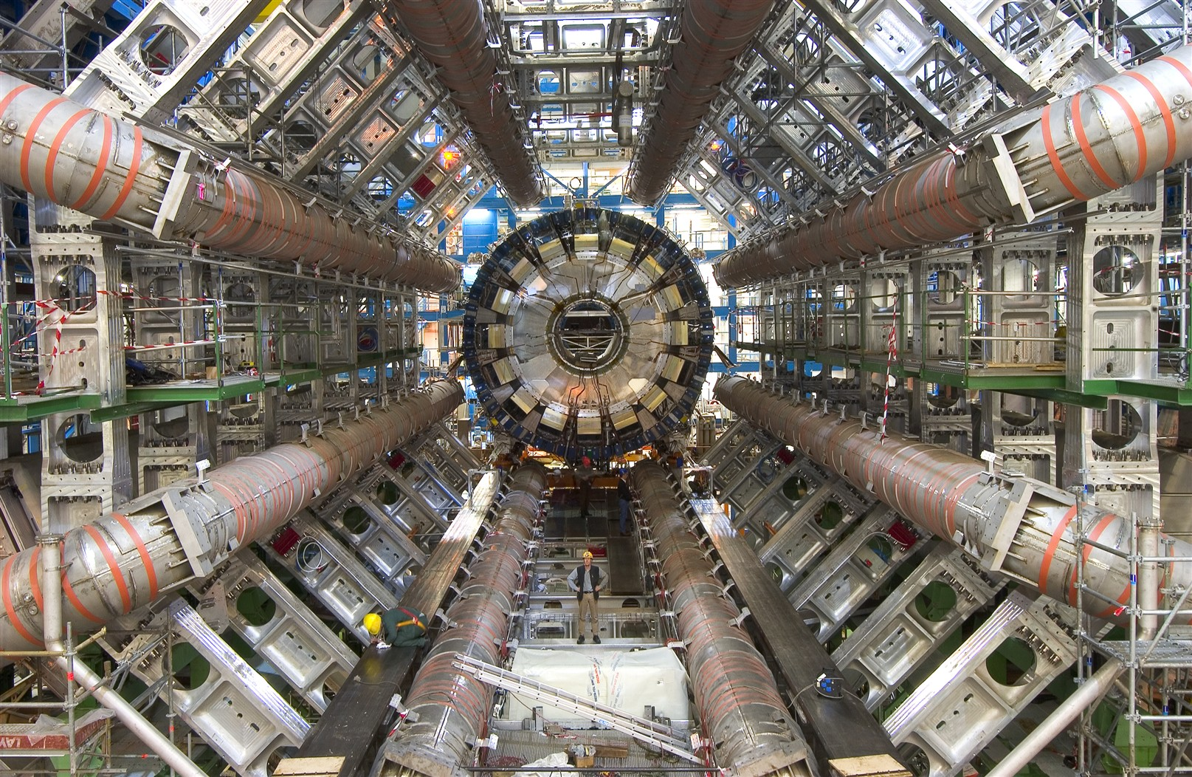
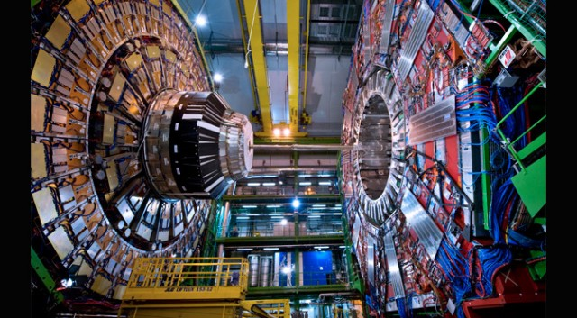

EFT measurements and interpretations for Higgs & EWK processes at ATLAS and CMS
Darien Wood*
Northeastern University
for the ATLAS and CMS Collaborations
* Speaker supported by NSF PHY-2309945

Slide 2
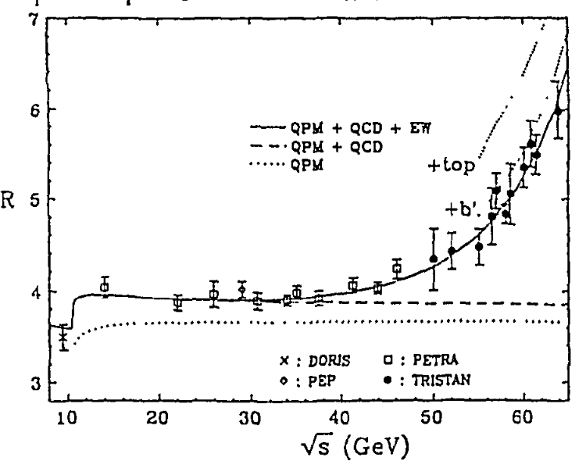
Talk Outline
Effective Field Theory introduction
Experimental probes of EFT
Dimension-5 operator studies
  Majorana neutrino search
Dimension-6 operator studies
  Higgs EFT combinations
  Higgs + EW combinations
Dimension-8 operator studies
Progress and challenges
TRISTAN expt.
The main highlights of this talk are the combined EFT fits to multiple processes

Slide 3

EFT results shown earlier in this session (Jonny Allen)
ATLAS:
Inclusive and VBS $ZZ$
$WWγ$ observation paper
CMS
VBS $ZV$ semi-leptonic final state

Slide 4
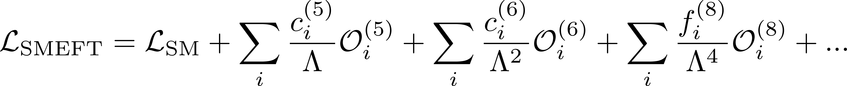
Standard Model Effective Field Theory Expansion
Dimension 5: odd-dimensional operators violate lepton and/or baryon number conservation, so not used in most analyses
Exception: Weinberg operator for generating Majorana neutrino mass
Dimension 6: Dominant EFT term for many processes, particularly anomalous trilinear gauge couplings (aTGCs)
Dimension 8: particularly important for quartic gauge couplings (QGCs) and Vector Boson Scattering (VBS) processes (although dim-6 can contribute as well)
All SMEFT operators respect ${SU(2)}_{L}×{U(1)}_{Y}$symmetry and treat the Higgs field as a single ${SU(2)}_{L}$doublet

Slide 5
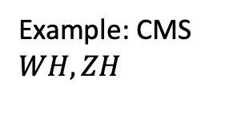
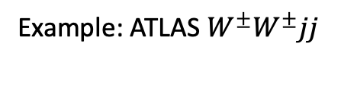
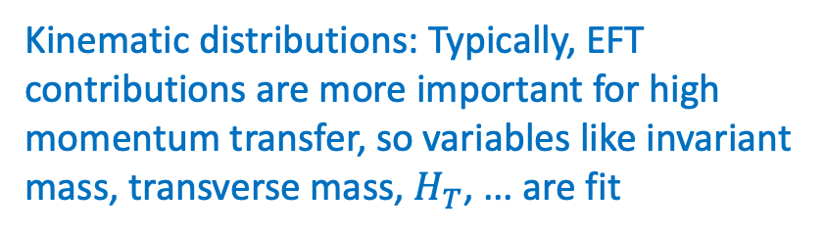
Experimental Probes of EFT
Cross section: EFT operators can alter cross section through interference with SM (linear in coupling) or pure BSM (quadratic in coupling) contributions:
Kinematic distributions: Typically, EFT contributions are more important for high momentum transfer, so variables like invariant mass, transverse mass, $H_{T}$, ... are fit
Example: ATLAS $W^{±}W^{±}jj$
JHEP 04 (2024) 026
Matrix element: Matrix Element Likelihood Analysis (MELA): likelihood ration formed for BSM matrix element divided by SM matrix element using final state kinematic and angular variables. Similarly, the event momenta and angles can be used to train ML. Note: this can be important for untangling CP-even and CP-odd operators
Example: CMS $WH, ZH$
JHEP 03 (2025) 114

Slide 6
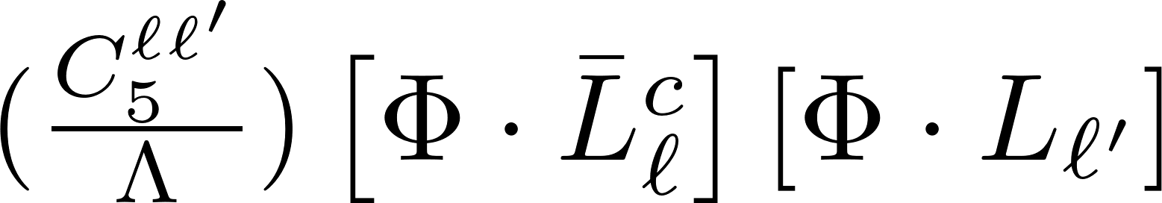
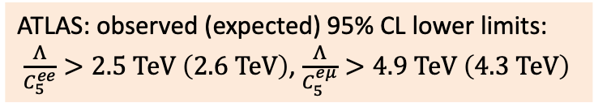
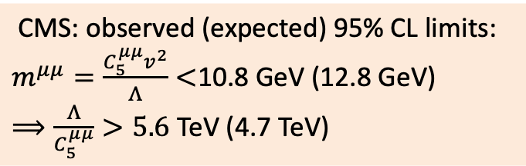

Dimension 5 – Majorana neutrino searches
Phys. Lett. B 856 (2024) 138865
Same sign $WWjj$
Weinberg operator:
CMS: observed (expected) 95% CL limits:
$m^{μμ}=\frac{C_{5}^{μμ}v^{2}}{Λ}<$10.8 GeV (12.8 GeV)
$⟹\frac{Λ}{C_{5}^{μμ}}>5.6$ TeV (4.7 TeV)
Phys. Rev. Lett. 131 (2023) 011803
ATLAS: observed (expected) 95% CL lower limits:
$\frac{Λ}{C_{5}^{ee}}>2.5 \text{TeV} \left(2.6 \text{TeV}\right)$, $\frac{Λ}{C_{5}^{eμ}}>4.9 \text{TeV} \left(4.3 \text{TeV}\right)$

Slide 7
Dimension-6 SMEFT
Example: table of some of dim-6 operators considered in ATLAS EFT combination
Dimension 6 operators in Warsaw basis (mostly commonly used)
2499 individual operators
Reduced sets obtained by
requiring flavor symmetry in quark and/or lepton sectors
  MVF – minimum flavor violation (Yukawa’s only)
  TopU3l – 3rd generate left as singlet
removing CP-odd operators
purely bosonic
3 Higgs fields
2 Higgs fields
one Higgs field
4 lepton

Slide 8
CMS Higgs SMEFT combination
CMS-HIG-23-013
arxiv.org:2504.13081
2d scans of Wilson coefficients based on $p_{T}^{H}$ distributions

Slide 9
CMS Higgs SMEFT combination (cont.)
Most constrained linear combinations
Principal Component Analysis
strongest deviation from SM – Prob 3.6%
10 eigenvectors from 31 WCs
CMS-HIG-23-013
arxiv.org:2504.13081

Slide 10
ATLAS SMEFT Higgs combination
JHEP 11 (2024) 097
Starting point: measurement of Simplified Template Cross Sections (STXS) for many processes
Expected impact WCs on STXS measurements

Slide 11
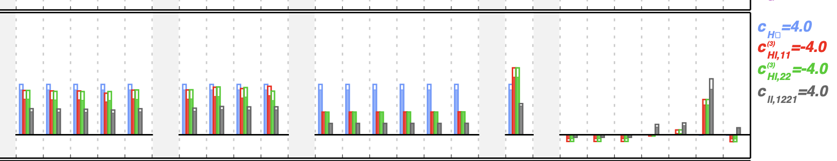
ATLAS SMEFT Higgs combination
JHEP 11 (2024) 097
Note that some STXS components receive comparable contributions from several EFT operators → Principal Component Analysis
shaded/open = linearized/quadratic
Starting point: measurement of Simplified Template Cross Sections (STXS) for many processes
Expected impact WCs on STXS measurements

Slide 12
ATLAS Higgs combination (cont.)
JHEP 11 (2024) 097
Where there are tighter constraints in quadratic model → relatively weak impact from BSM-SM interference terms
WC basis is rotated to measure the most sensitive linear combinations

Slide 13
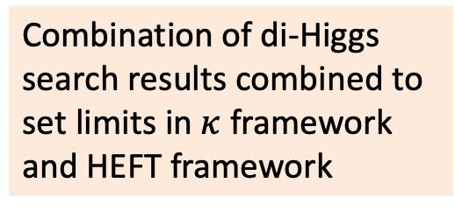
di-Higgs: HEFT combination
Phys. Rev. Lett. 133 (2024) 101801
Combination of di-Higgs search results combined to set limits in $κ$ framework and HEFT framework
Note: Assumptions in HEFT differs from SMEFT. Higgs is treated as an SU(2) singlet scalar field.

Slide 14

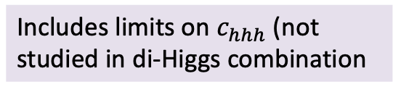
ATLAS di-Higgs 308 fb⁻¹ (new result)
$HH→b\overline{b}γγ$ only (13 TeV and 13.6 TeV)
ATL-COM-PHYS-2025-585
Interpreted in both SMEFT and HEFT
Includes limits on $c_{hhh}$ (not studied in di-Higgs combination
hEFT
SMEFT

Slide 15
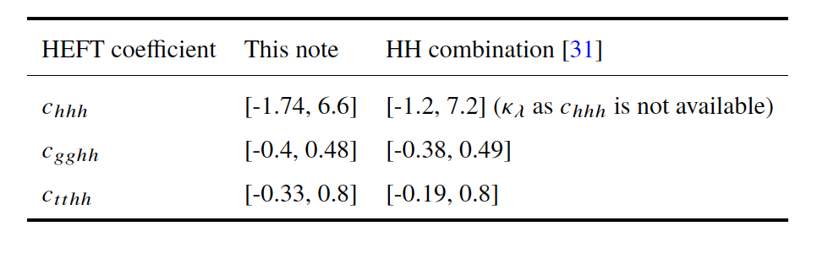
ATLAS di-Higgs 308 fb⁻¹ (new result)
$HH→b\overline{b}γγ$ only (13 TeV and 13.6 TeV)
ATL-COM-PHYS-2025-585
Interpreted in both SMEFT and HEFT
Includes limits on $c_{hhh}$ (not studied in di-Higgs combination
hEFT
SMEFT

Slide 16

CMS dim-6 SMEFT combination (EW, Higgs, top, jets)
arxiv.org:2504.02958
examples where $c_{W}$could contribute

Slide 17

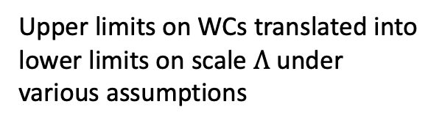
CMS dim-6 SMEFT combination (cont.)
arxiv.org:2504.02958
Results of one-by-one fits to WCs in original Warsaw basis
  (note factors of 10 scaling)
Low panel shows how individual processes contribute to the constraints
Consistency with SM: 26% (excluding multijet)
$c_{W}$highlighted for reference
Upper limits on WCs translated into lower limits on scale $Λ$ under various assumptions
Simultaneous fit to 42 WCs carried out (largest number to date)
Linear combinations of WCs with the tightest constraints (for a subset of inputs)

Slide 18
CMS dim-6 SMEFT combination (cont.)
arxiv.org:2504.02958
Results of one-by-one fits to WCs in original Warsaw basis
  (note factors of 10 scaling)
Low panel shows how individual processes contribute to the constraints
Consistency with SM: 26% (excluding multijet)
$c_{W}$highlighted for reference
Upper limits on WCs translated into lower limits on scale $Λ$ under various assumptions
Simultaneous fit to 42 WCs carried out (largest number to date)
Linear combinations of WCs with the tightest constraints (for a subset of inputs)

Slide 19
ATLAS dim-6 SMEFT combination
After principal component analysis
ATLAS-PHYS-PUB-2022-037
Results derived from the full likelihood fit
Expected fractional contributions are derived from the simplified multivariate gaussian model (as in CMS)
Deviation from SM is driven by known discrepancy in FB asymmetry.
Higgs + EW ATLAS inputs
Higgs + EW ATLAS plus EW precision observables (LEP/SLD)

Slide 20

Dimension-8 EFT
Dim-8 operators are important in Quartic Gauge Couplings and are usually examined in Vector Boson Scatter (VBS) modes.
Exampe: $f_{T0}$ sensitivity in VBS production of $ZV$
Without assuming additional symmetries, there are 44807 independent operators at dim-8
Recent ATLAS and CMS use the Éboli basis operators (bosonic operators) with a reduced set the contributes to QGCs but not to TGCs
CMS-PAS-SMP-22-011

Slide 21




More examples of dim-8 VBS results
ATLAS: VBS $WZ$
JHEP06(2024)192
ATLAS: VBS $W^{±}W^{±}$
JHEP04(2024)026
Typical observations:
EFT fits consistent with SM
Quadratic term (BSM only) dominant constraints on dim-8 operators
shown: $f_{T0} , f_{T1}$
shown: $f_{M0}$

Slide 22
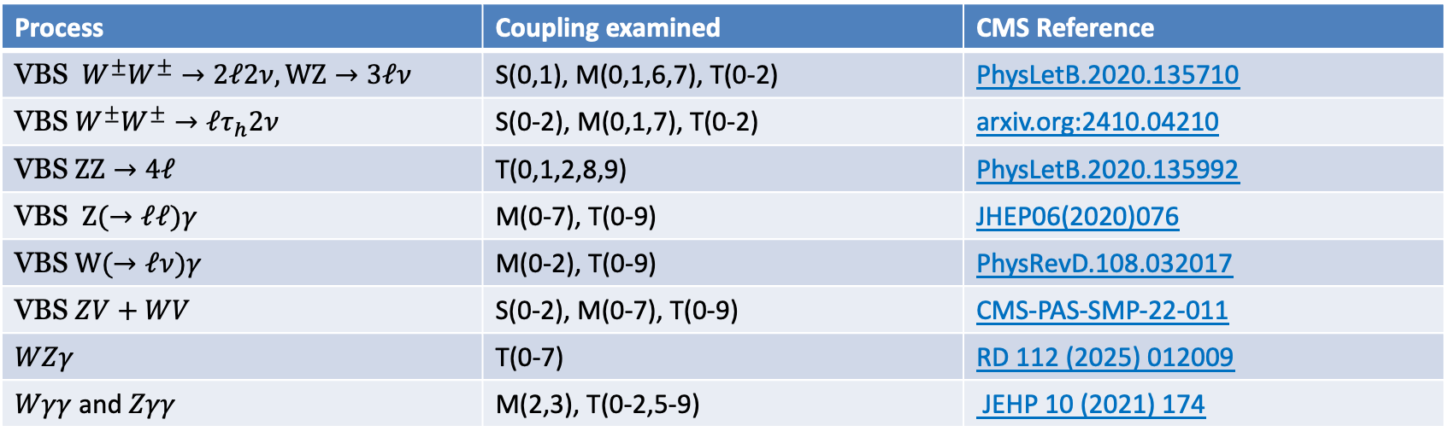
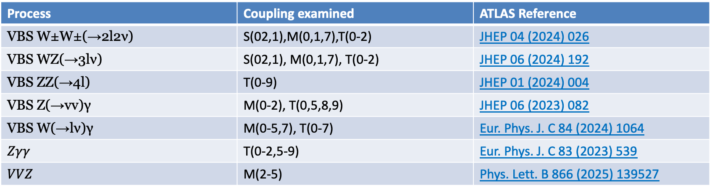
CMS and ATLAS results with dim-8 limits
Process | Coupling examined | CMS Reference
VBS $W^{±}W^{±}→2ℓ2ν, WZ→3ℓν$ | S(0,1), M(0,1,6,7), T(0-2) | PhysLetB.2020.135710
VBS $W^{±}W^{±}→ℓτ_{h}2ν$ | S(0-2), M(0,1,7), T(0-2) | arxiv.org:2410.04210
VBS $ZZ→4ℓ$ | T(0,1,2,8,9) | PhysLetB.2020.135992
VBS $Z(→ℓℓ)γ$ | M(0-7), T(0-9) | JHEP06(2020)076
VBS $W(→ℓν)γ$ | M(0-2), T(0-9) | PhysRevD.108.032017
VBS $ZV+WV$ | S(0-2), M(0-7), T(0-9) | CMS-PAS-SMP-22-011
$$WZγ$$ | T(0-7) | RD 112 (2025) 012009
$Wγγ$ and $Zγγ$ | M(2,3), T(0-2,5-9) | JEHP 10 (2021) 174
Process | Coupling examined | ATLAS Reference
VBS W±W±(→2l2ν) | S(02,1),M(0,1,7),T(0-2) | JHEP 04 (2024) 026
VBS WZ(→3lν) | S(02,1), M(0,1,7), T(0-2) | JHEP 06 (2024) 192
VBS ZZ(→4l) | T(0-9) | JHEP 01 (2024) 004
VBS Z(→vv)γ | M(0-2), T(0,5,8,9) | JHEP 06 (2023) 082
VBS W(→lν)γ | M(0-5,7), T(0-7) | Eur. Phys. J. C 84 (2024) 1064
$$Zγγ$$ | T(0-2,5-9) | Eur. Phys. J. C 83 (2023) 539
$$VVZ$$ | M(2-5) | Phys. Lett. B 866 (2025) 139527

Slide 23
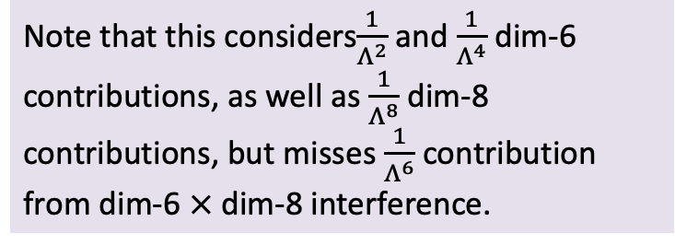

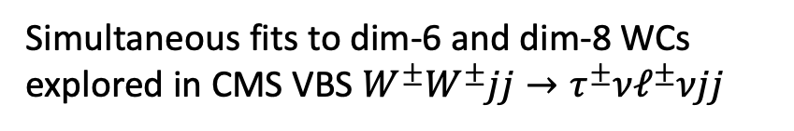

Challenge: interplay between dim-6 and dim-8
CMS arxiv.org:2410.04210
Although VBS processes are used to explore dim-8 couplings, the same processes receive contributions from dim-6 operators
Simultaneous fits to dim-6 and dim-8 WCs explored in CMS VBS $W^{±}W^{±}jj→τ^{±}νℓ^{±}νjj$
dim-8 WCs $→$
Note that this considers$\frac{1}{Λ^{2}}$ and $\frac{1}{Λ^{4}}$ dim-6 contributions, as well as $\frac{1}{Λ^{8}}$ dim-8 contributions, but misses $\frac{1}{Λ^{6}}$ contribution from dim-6 $×$ dim-8 interference.
dim-6 WCs $→$

Slide 24
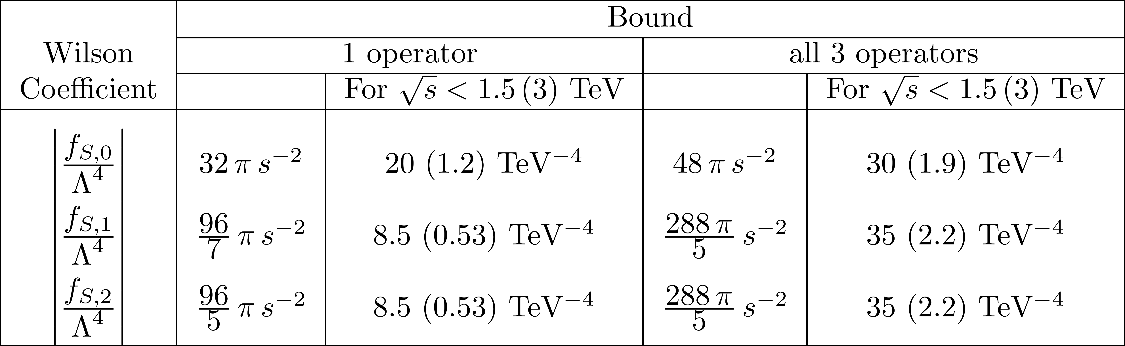
Challenge: unitarity violation
Recall: EFT operators are just a low-energy approximation of unknown UV physics. When EFT operators are extrapolated to high energy, the scatting amplitudes can violate unitary. At LHC energies, unitarity constraints can limit the range of validity of experimental constraints on WCs
Typical methods:
”Clipping” – zero out EFT contributions when a chosen kinematic variable exceeds a value
partial wave unitarity constraints
Example of effects of unitarity constraints on dim-8 WCs
Example of S operator bounds from J=0, J=1 partial wave unitarity: Phys. Rev. D 101, 113003 (2020)
ATLAS: JHEP04(2024)026

Slide 25
Closing remarks
Other related talks at this conference: (list may be incomplete)
Measurements of multi-boson and rare electroweak processes at ATLAS and CMS (incl. VBS and polarization measurements) (Jonny Allen)
Polarized boson pairs at NLO in the SMEFT (Jakob Linder)
SMEFT at EIC and LHC (Anke Biekoetter)
Main takeaways:
EFT formalism is being used broadly and is providing a way to combine results across channels and experiments to quantify constraints on BSM physics
Good ongoing collaboration among ATLAS, CMS, and theory community to refine and organize future analyses of EFT

Slide 26
backups

Slide 27
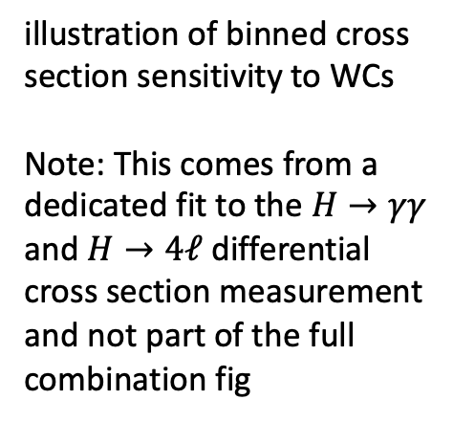
ATLAS Higgs combination
illustration of binned cross section sensitivity to WCs
Note: This comes from a dedicated fit to the $H→γγ$ and $H→4ℓ$ differential cross section measurement and not part of the full combination fig

Slide 28
Principal component analysis
Information matrix is the Hessian of the combined measurements with respect the WCs
decomposed in eigenvalues and eigenvectors
linear-only fit, as quadratic terms would ruin the orthogonality

