Slide 2

Copyright statement and speaker’s release for video publishing
The author consents to the photographic, audio and video recording of this lecture at the CERN Accelerator School. The term “lecture” includes any material incorporated therein including but not limited to text, images and references.
The author hereby grants CERN a royalty-free license to use his image and name as well as the recordings mentioned above, in order to broadcast them online to all registered students and to post them without any further processing on the CAS website.
The author hereby confirms that the content of the lecture does not infringe the copyright, intellectual property or privacy rights of any third party. The author has cited and credited any third-party contribution in accordance with applicable professional standards and legislation in matters of attribution.

Slide 3

Basic Mathematics and Units
Rende Steerenberg – CERN BE/OP

Slide 4
Contents
Vectors & Matrices
Differential Equations
A word on the units we use

Slide 5
Vectors & Matrices
Differential Equations
A word on the units we use

Slide 6
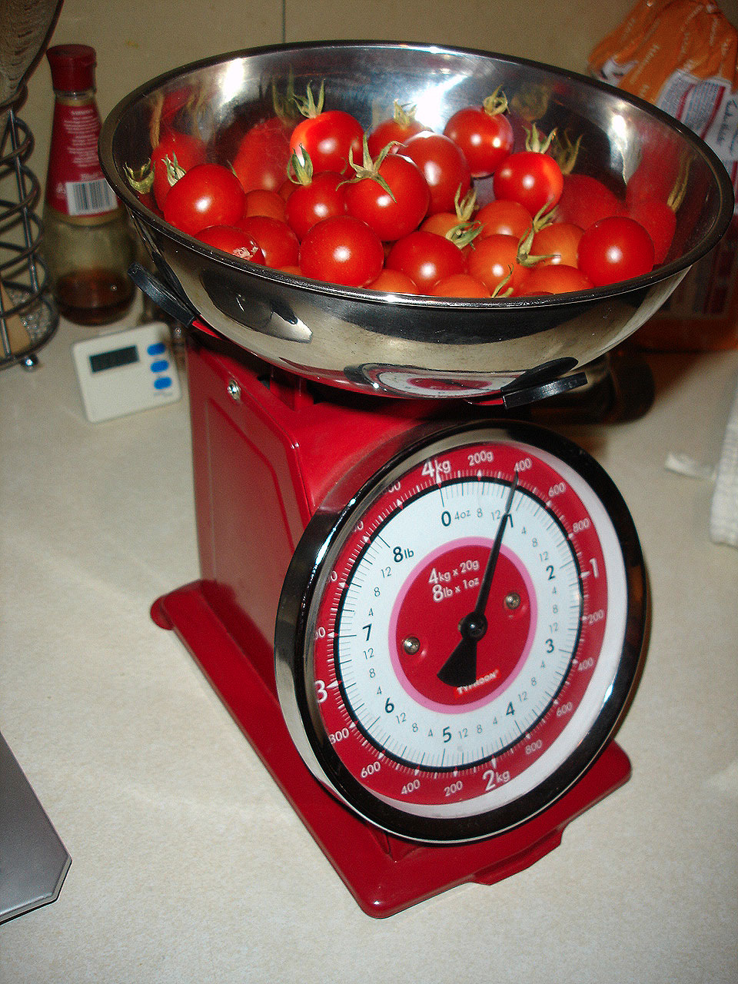

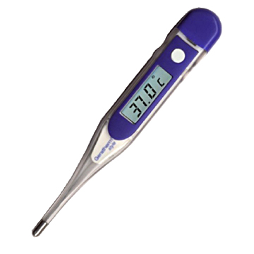


Scalars & Vectors
Scalar, a single quantity or value
Vector, (origin,) length, direction

Slide 7
Coordinate systems
A vector has 2 or more quantities associated with it
(x,y) Cartesian coordinates
(r, θ) Polar coordinates
r
y
r
θ
x
r is the length of the vector
θ gives the direction of the vector

Slide 8
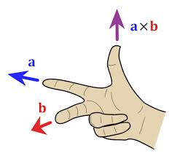
Vector Cross Product
a and b are two vectors in a plane separated by angle θ
a × b
a
θ
b
The cross product a × b is defined by:
Direction: a × b is perpendicular (normal) on the plane through a and b
The length of a × b is the surface of the parallelogram formed by a and b

Slide 9
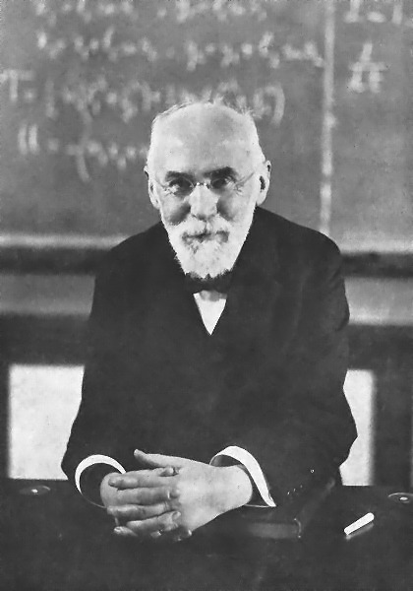
Cross Product & Magnetic Field
The Lorentz force in a pure magnetic field expression
Force
B field
Direction of current
The reason why our particles move around our “circular” machines under the influence of the magnetic fields
Today
“Normal conducting & perm. magnets” by Jeremie Bauche
“Transverse Beam Dynamics” by Bernhard Holzer
Today & Tue.

Slide 10
Lorentz Force in Action
Velocity ‘v’
Magnetic Field
charge = -e
Particle with
mass ‘m’
charge = e
charge = 2e
The higher the energy of the beam the larger the radius of curvature

Slide 11
A Rotating Coordinate System
It travels on the central orbit
Vertical
Horizontal
Longitudinal
y
θ
s or z
x

Slide 12
Magnetic Rigidity
As a formula this is:
=
=
mv
2
Radius of curvature
F
evB
Like for a stone attached to a rotating rope
ρ
Which can be written as:
ρ
=
mv
=
p
B
Momentum
p=mv
e
e
Bρ is called the magnetic rigidity, and if we put in all the correct units we get:
Bρ = 33.356·p [kG·m] = 3.3356·p [T·m] (if p is in [GeV/c])

Slide 13
Moving a Point in a Coordinate System
To move from one point (A) to any other point (B) one needs control of both Length and Direction.
Rather clumsy !
Is there a more efficient way of doing this ?
y
A
B
x
2 equations needed !!!

Slide 14
Matrices & Vectors
So, we have:
Let’s write this as one equation:
Rows
A and B are Vectors or Matrices
A and B have 2 rows and 1 column
M is a Matrix and has 2 rows and 2 columns
Columns

Slide 15
Matrix Multiplications
This implies:
Equals
Is this really simpler ?
This defines the rules for matrix multiplication
This matrix multiplication results in:

Slide 16
Moving a Point & Matrices
Lets apply what we just learned and move a point around:
y
1
y1
2
y2
x3
x2
x1
x
y3
3
M1 transforms 1 to 2
M2 transforms 2 to 3
This defines M3=M2M1

Slide 17
Matrices & Accelerators
We use matrices to describe the various magnetic elements in our accelerator.
  The x and y co-ordinates are the position and angle of each individual particle.
  If we know the position and angle of any particle at one point, then to calculate its position and angle at another point we multiply all the matrices describing the magnetic elements between the two points to give a single matrix
Now we are able to calculate the final co-ordinates for any initial pair of particle co-ordinates, provided all the element matrices are known.

Slide 18
The Unit Matrix
There is a special matrix that when multiplied with an initial point will result in the same final point.
X_{new} = X_{old}
Y_{new} = Y_{old}
The result is :
The Unit matrix has no effect on x and y

Slide 19
Going Backwards
What about going back from a final point to the corresponding initial point ?
or
For the reverse we need another matrix M⁻¹
such that
The combination of M and M⁻¹ does have no effect
M⁻¹ is the “inverse” or “reciprocal” matrix of M.

Slide 20
Calculating the Inverse Matrix
If we have a 2 x 2 matrix:
Then the inverse matrix is calculated by:
The term (ad – bc) is called the determinate, which is just a number (scalar).

Slide 21
Example: Drift Space Matrix
A drift space contains no magnetic field.
A drift space has length L.
x₂ = x₁ + L.x₁’
x₁’
x₁
L
x₁’ small
}

Slide 22
A Practical Example
Changing the current in two sets of quadrupole magnets (F & D) changes the horizontal and vertical tunes (Q_{h} & Q_{v}).
This can be expressed by the following matrix relationship:
or
Change I_{F} then I_{D} and measure the changes in Q_{h} and Q_{v}
Calculate the matrix M
Calculate the inverse matrix M⁻¹
Use now M⁻¹ to calculate the current changes (ΔI_{F} and ΔI_{D}) needed for any required change in tune (ΔQ_{h} and ΔQ_{v}).

Slide 23
Vectors & Matrices
Differential Equations
A word on the units we use

Slide 24
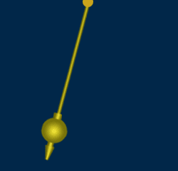
The Pendulum
Lets use a pendulum as example
The length of the pendulum is L
It has a mass m attached to it
It moves back and forth under the influence of gravity
L
M
Lets try to find an equation that describes the motion of the mass m makes.
This will result in a Differential Equation

Slide 25
Differential Equation
The distance from the centre = Lθ (since θ is small)
θ
The velocity of mass M is:
L
The acceleration of mass M is:
M
Newton: Force = mass x acceleration
Mg
Restoring force due to gravity is
-M g sinθ
θ is small
L is constant
(force opposes motion)

Slide 26
Solving a Differential Equation
Differential equation describing the motion of a pendulum at small amplitudes.
Find a solution……Try a good “guess”……
Differentiate our guess (twice)
and
Put this and our “guess” back in the original Differential equation.

Slide 27
Solving a Differential Equation
Now we have to find the solution for the following equation:
Solving this equation gives:
The final solution of our differential equation, describing the motion of a pendulum is as we expected :
Oscillation amplitude
Oscillation frequency

Slide 28
Position & Velocity
The differential equation that describes the transverse motion of the particles as they move around our accelerator.
The solution of this second order describes oscillatory motion
For any system, where the restoring force is proportional to the displacement, the solution for the displacement will be of the form:

Slide 29
Phase Space Plot
Plot the velocity as a function of displacement:
ωx₀
x
x₀
It is an ellipse.
As ωt advances by 2 π it repeats itself.
This continues for (ω t + k 2π), with k=0,±1, ±2,..,..etc

Slide 30
Oscillations in Accelerators
Under the influence of the magnetic fields the particle oscillate
x’
x
x
ds
s
dx
x = displacement
x’ = angle = dx/ds

Slide 31
Transverse Phase Space Plot
This changes slightly the Phase Space plot
X’
Position
φ
x
Angle
φ = ωt is called the phase angle
X-axis is the horizontal or vertical position (or time).
Y-axis is the horizontal or vertical phase angle (or energy).

Slide 32
Transverse Phase Space Plot
We distinguish motion in the Horizontal & Vertical Plane
x’
y’
φ
x
φ
y
Horizontal Phase Space
Vertical Phase Space

Slide 33
Transverse Emittance
To be rigorous we should define the emittance slightly differently.
Observe all the particles at a single position on one turn and measure both their position and angle.
This will give a large number of points in our phase space plot, each point representing a particle with its co-ordinates x, x’.
x’
emittance
beam
Symbol: ε
Expressed in 1σ, 2σ,..
Units: mm mrad
x
acceptance
The emittance is the area of the ellipse, which contains all, or a defined percentage, of the particles.
The acceptance is the maximum area of the ellipse, which the emittance can attain without losing particles

Slide 34
Vectors & Matrices
Differential Equations
A word on the units we use

Slide 35
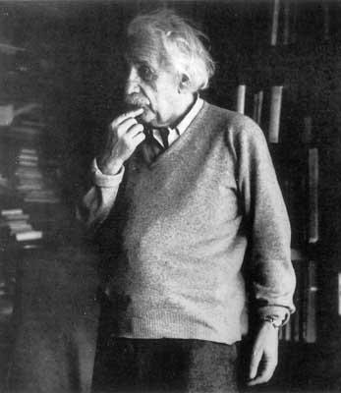
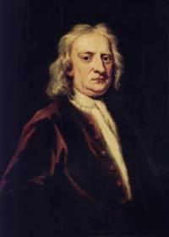
Relativity
velocity
CPS
c
SPS / LHC
}
Einstein:
energy increases
not velocity
PSB
energy
Newton:

Slide 36
The Units we use for Energy
The energy acquired by an electron in a potential of 1 Volts is defined as being 1 eV
The unit eV is too small to be used today, we use:
  1 KeV = 10³, MeV = 10⁶, GeV = 10⁹, TeV = 10¹²

Slide 37
Energy: eV versus Joules
The unit most commonly used for Energy is Joules [J]
In accelerator and particle physics we talk about eV…!?
The energy acquired by an electron in a potential of 1 Volt is defined as being 1 eV
1 eV is 1 elementary charge ‘pushed’ by 1 Volt.
1 eV = 1.6 x 10⁻¹⁹ Joules

Slide 38
The Energy in the LHC beam
The energy in one LHC beam at high energy is about 400 Million Joules
This corresponds to the energy of a TGV engine going at 160 km/h
...... but then concentrated in the size of a needle

Slide 39
Energy versus Momentum
Einstein’s formula:
which for a mass at rest is:
The ratio between the total energy and the rest energy is
The ratio between the real velocity and the velocity of light is
Then the mass of a moving particle is:
We can write:
Momentum is:

Slide 40
Energy versus Momentum
Energy
Momentum
Therefore the units for
  momentum are: MeV/c, GeV/c, …etc.
  Energy are: MeV, GeV, …etc.
Attention:
  when β=1 energy and momentum are equal
  when β<1 the energy and momentum are not equal

Slide 41
A Practical Example (PSB-ISOLDE)
Kinetic energy at injection E_{kinetic} = 1.4 GeV
Proton rest energy E₀=938.27 MeV
The total energy is then: E = E_{kinetic} + E₀ = 2.34 GeV
We know that
, which gives γ = 2.4921
We can derive
, which gives β = 0.91597
Using
we get p = 2.14 GeV/c
In this case: Energy ≠ Momentum

Slide 42
A Practical Example (PSB-PS)
Kinetic energy at extraction E_{kinetic} = 2 GeV
Proton rest energy E₀=938.27 MeV
The total energy is then: E = E_{kinetic} + E₀ = 2.94 GeV
We know that
, which gives γ = 3.128
We can derive
, which gives β = 0.948
Using
we get p = 2.79 GeV/c
In this case: Energy ≠ Momentum

Slide 43
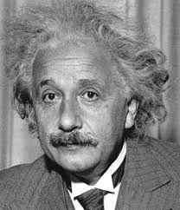
Pure mathematics is, in its way, the poetry of logical ideas.
Albert Einstein

