Slide 2

Copyright statement and speaker’s release for video publishing
The author consents to the photographic, audio and video recording of this lecture at the CERN Accelerator School. The term “lecture” includes any material incorporated therein including but not limited to text, images and references.
The author hereby grants CERN a royalty-free license to use his image and name as well as the recordings mentioned above, in order to broadcast them online to all registered students and to post them without any further processing on the CAS website.
The author hereby confirms that the content of the lecture does not infringe the copyright, intellectual property or privacy rights of any third party. The author has cited and credited any third-party contribution in accordance with applicable professional standards and legislation in matters of attribution.

Slide 3

Accelerators for Beginners and the CERN Complex
Rende Steerenberg – CERN BE/OP
10 March 2025

Slide 4

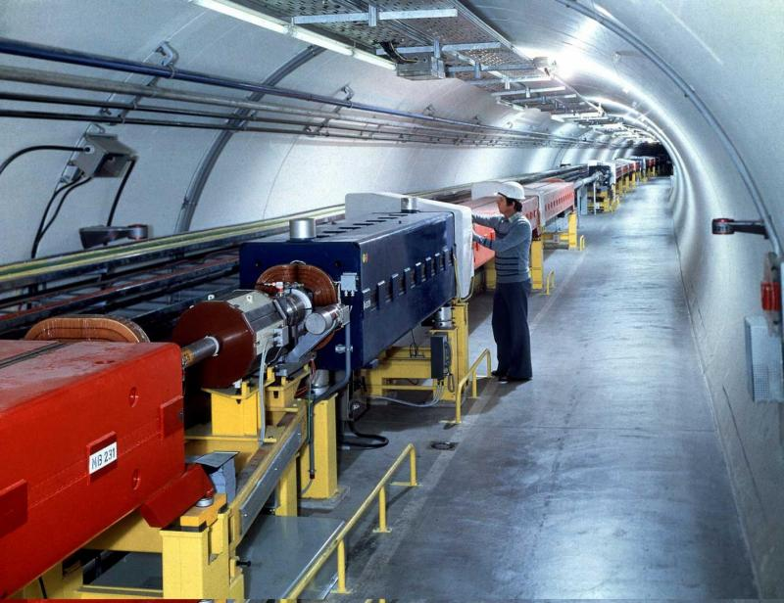
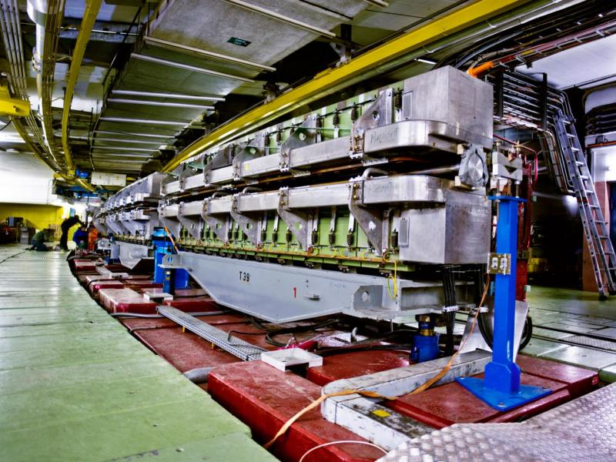
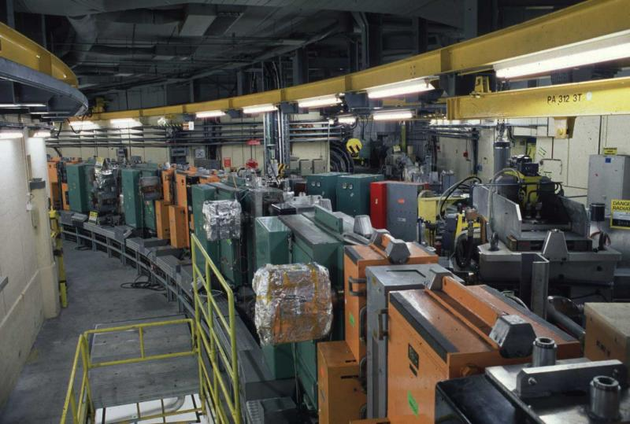
Content
Why Accelerators and Colliders ?
The CERN Accelerator Complex
Cycling the Accelerators & Satisfying Users
The Main Ingredients of an Accelerator

Slide 5
Content
Why Accelerators and Colliders ?
The CERN Accelerator Complex
Cycling the Accelerators & Satisfying Users
The Main Ingredients of an Accelerator

Slide 6
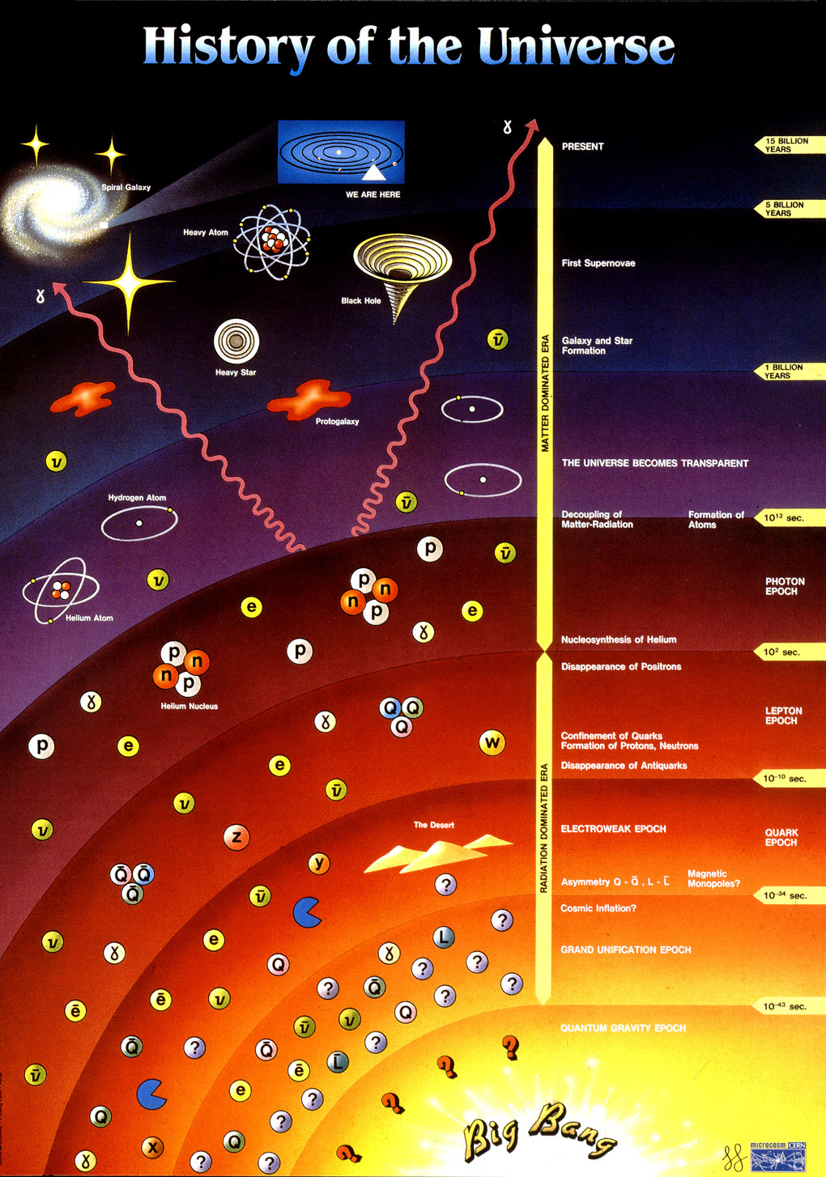
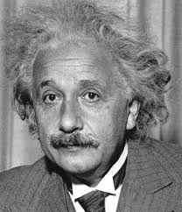
Creating Matter from Energy
During the Big Bang Energy was transformed in matter
E = m・c²
In our accelerators we provide energy to the particles we accelerate.
In the detectors we observe the matter created

Slide 7
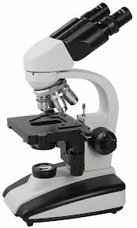
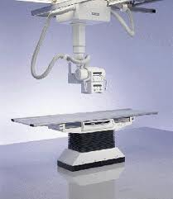
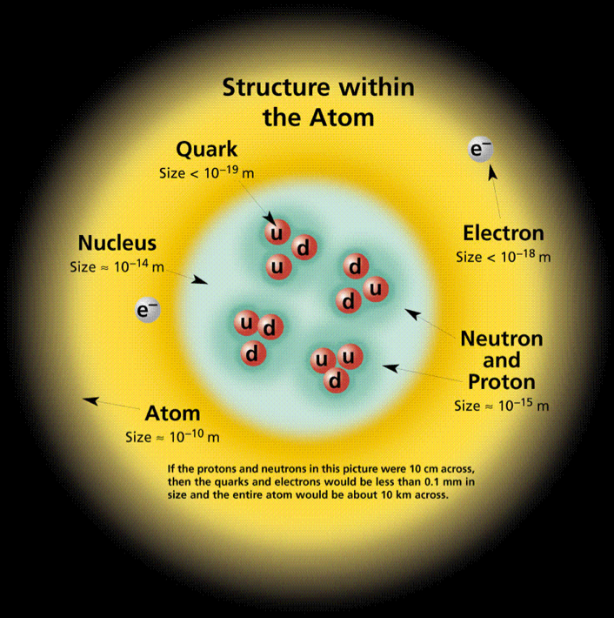
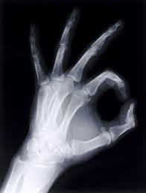
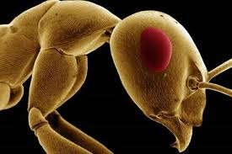
Looking to smaller dimensions
Visible light
λ = 400 ➔ 700 nm
X-ray
λ = 0.01 ➔ 10 nm
Particle accelerators
λ < 0.01 nm
λ =
h c
Increasing the energy will reduce the wavelength
E

Slide 8
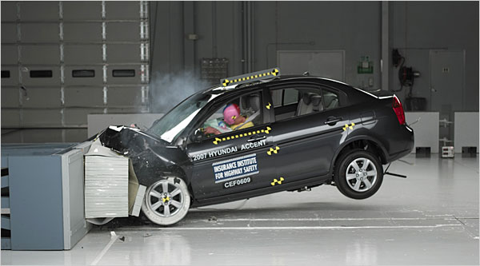
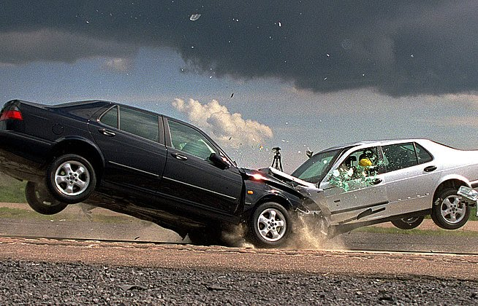
Fixed Target vs. Colliders
Fixed Target
Collider
Much of the energy is lost in the target and only part is used to produce secondary particles
All energy will be available for particle production

Slide 9
Content
Why Accelerators and Colliders ?
The CERN Accelerator Complex
Cycling the Accelerators & Satisfying Users
The Main Ingredients of an Accelerator

Slide 10
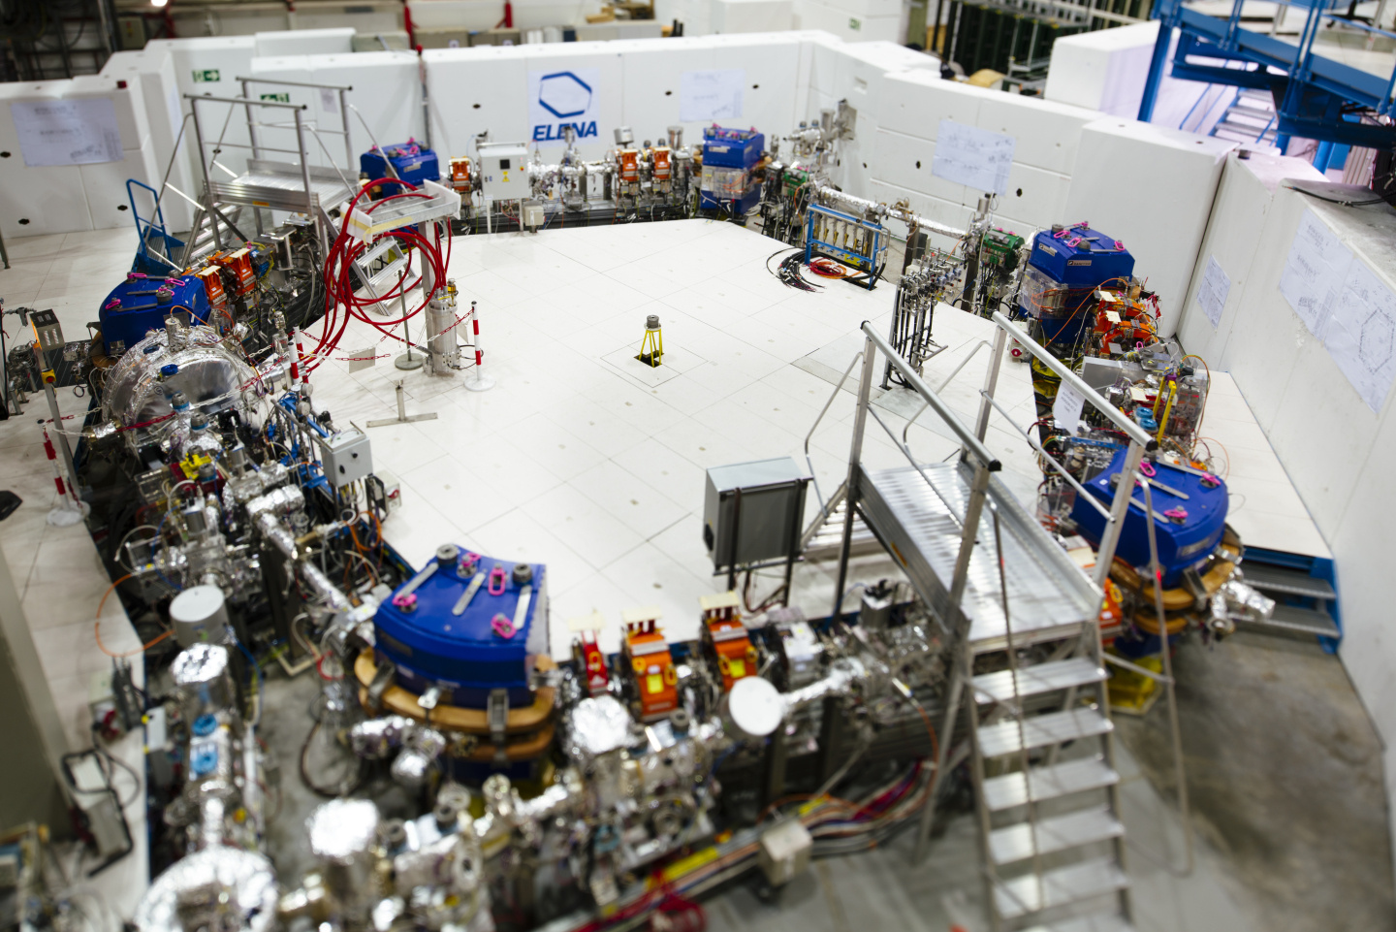
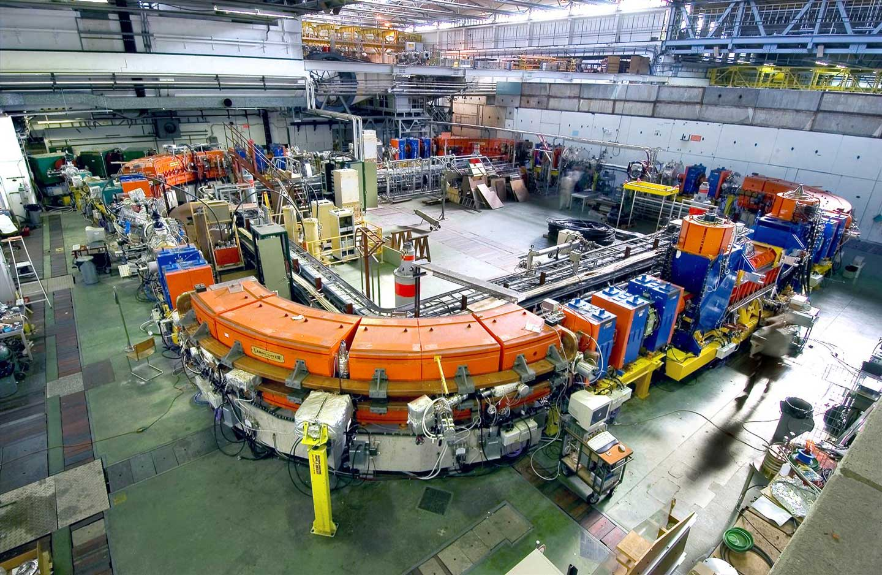
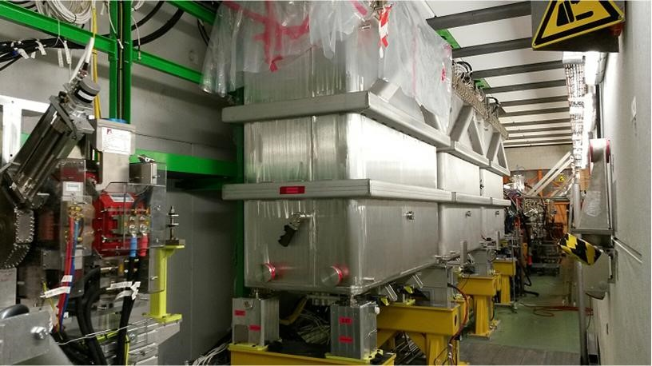
The CERN Accelerator Complex

Slide 11
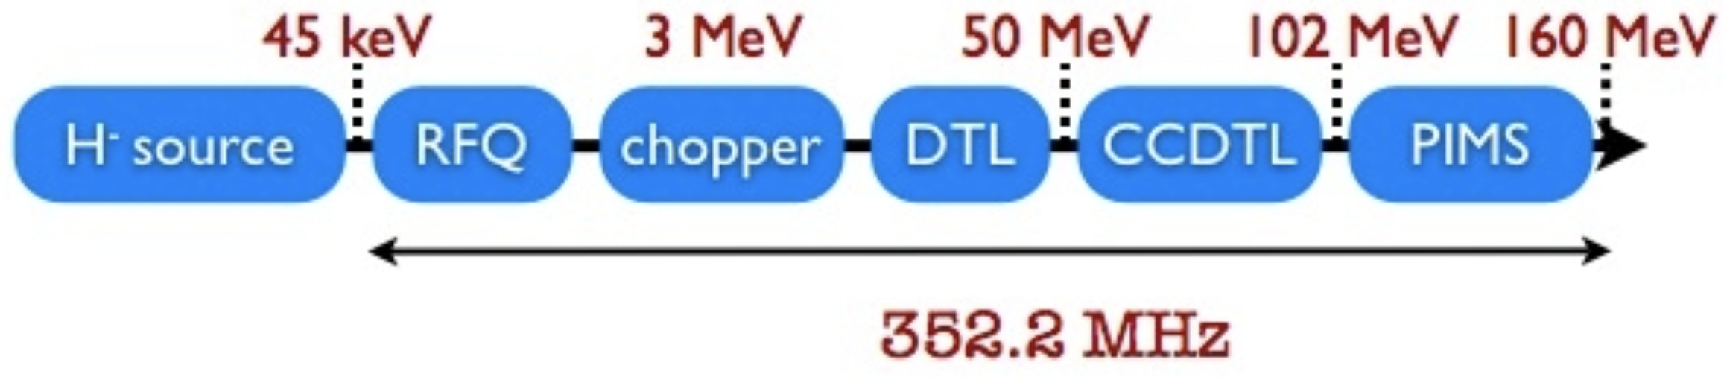
Linac 4
H⁻ ion source at 45 keV
Accelerates beam up to 160 MeV
The chopping scheme allows removing some of the Linac bunches to make the beam fit into the PS Booster RF buckets
Pulse rate 1.2 s

Slide 12
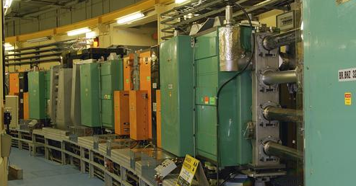
PS Booster
1st Synchrotron with 4 superposed rings
Circumference of 157 m
Proton energy from 160 MeV to 2 GeV
Can cycle every 1.2 s
Each ring will inject over multi-turns, using charge exchange injection
Before stripping foil
Behind stripping foil
x’
x’
+
+
-
+
+
+
+
+
-
-
-
+
+
+
+
-
+
+
-
+
+
+
+
+
+
-
+
-
+
x
+
+
+
+
+
x
+
-
+
+
+
+
-
+
+
+
+
+
-
+
+
+

Slide 13
The CERN Accelerator Complex

Slide 14
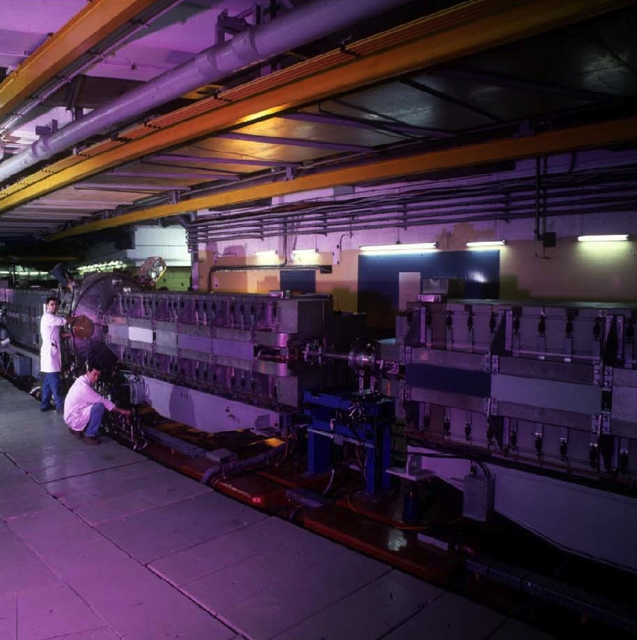
PS
The oldest operating synchrotron at CERN
Circumference of 628m
  4 x PSB circumference
Increases proton energy from 2 GeV to max. 26 GeV
Cycle length ranges from 1.2s to 3.6s
Many RF systems allow for complex RF gymnastics
Various types of extractions:
  Fast extraction
  Multi-turn extraction (MTE)
  Slow extraction

Slide 15
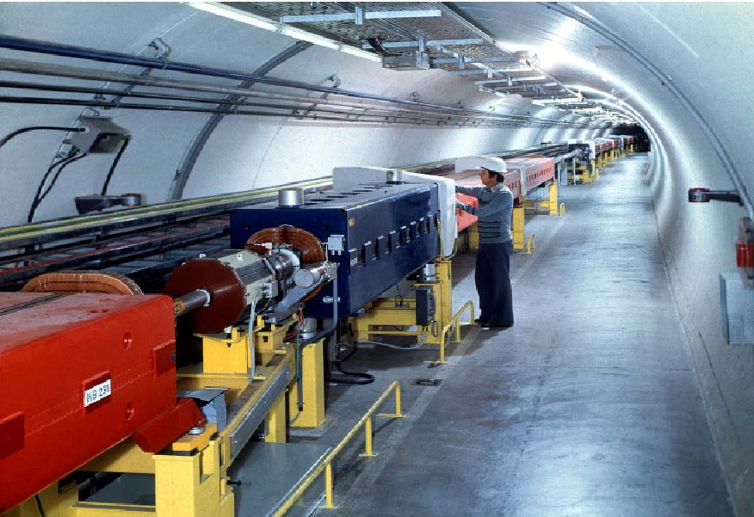
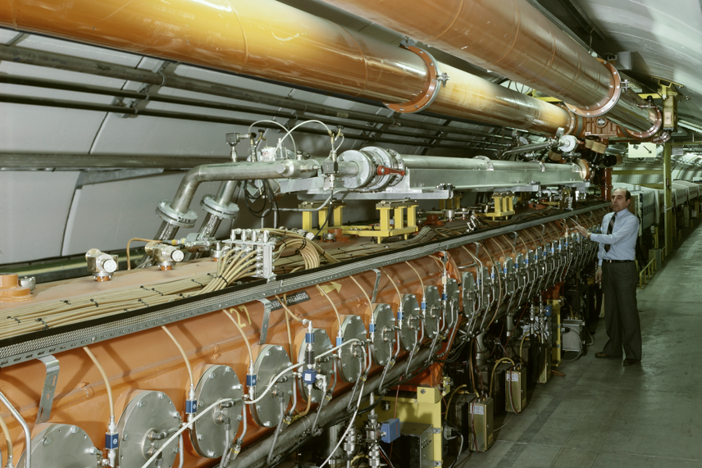
SPS
The first synchrotron in the chain at ~30m under ground
Circumference of 6.9 km
  11 x PS circumference
Increases proton beam energy up to 450 GeV with up to ~5x10¹³ protons per cycle
Provides slow extracted beam to the North Area
Provides fast extracted beam to LHC, AWAKE and HiRadMat

Slide 16
The CERN Accelerator Complex

Slide 17
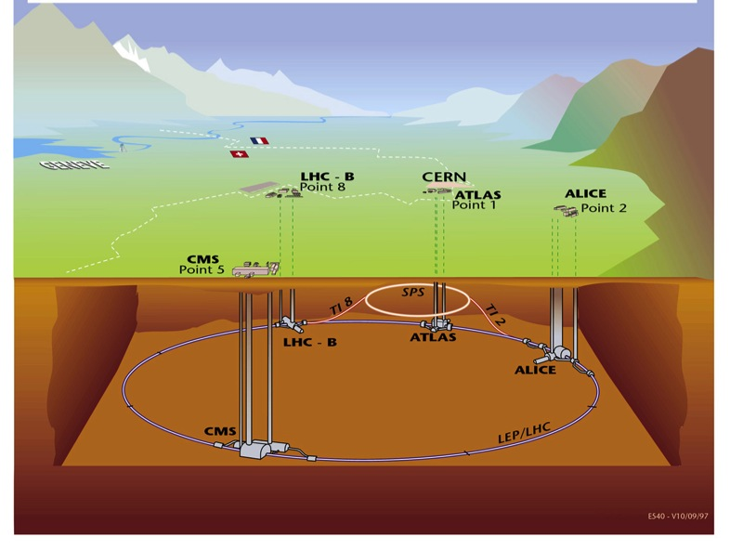
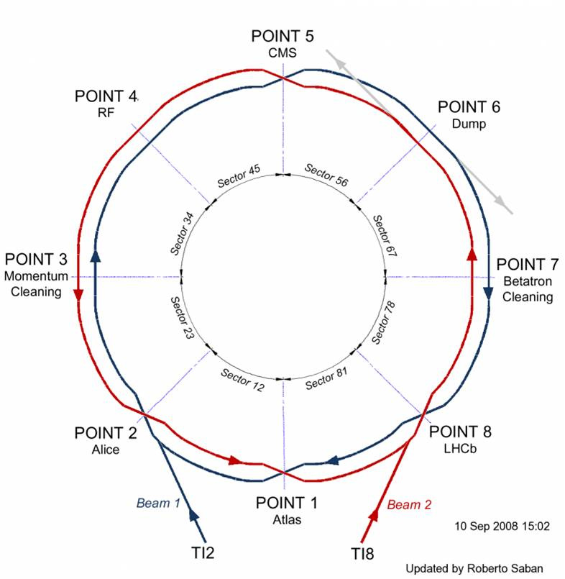
LHC
Situated on average ~100 m under ground
Four major experiments
Circumference 26.7 km
Two separate beam pipes going through the same cold mass 19.4 cm apart
150 tons of liquid helium to keep the magnets cold and superconducting

Slide 18
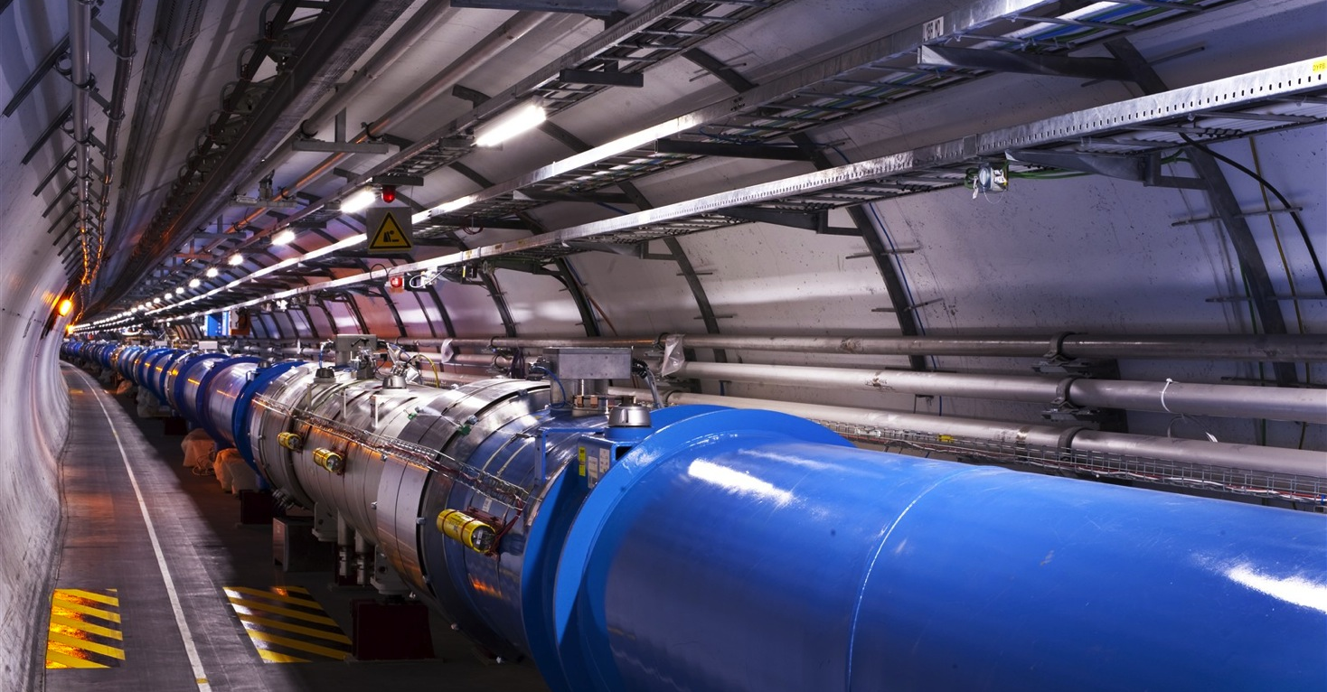
LHC
1232 main dipoles of 15 m each that deviate the beams around the 27 km circumference
392 main quadrupoles that keep the beam focused
6000 corrector magnets to preserve the beam quality
Main magnets use superconducting cables (Cu-clad Nb-Ti)
12’000 A provides a nominal field of 8.33 Tesla
Operating in superfluid helium at 1.9K

Slide 19
LHC: Luminosity the Figure of Merit
Number of bunches
Intensity per bunch
Geometrical
Correction
factors
Beam dimensions
Maximise Luminosity:
Bunch intensity
Transverse beam size
Beam size at collision points (optics functions)
Crossing angle
Machine availability

Slide 20
Content
Why Accelerators and Colliders ?
The CERN Accelerator Complex
Cycling the Accelerators & Satisfying Users
The Main Ingredients of an Accelerator

Slide 21
The LHC Cycle
= Field in main magnets
= Beam 1 intensity (current)
= Beam 2 intensity (current)
Time
6.8 TeV
450 GeV
Injection
Ramp
Squeeze
&
Adjust
Stable beams for physics
Dump
&
Ramp down

Slide 23
Filling the LHC & Satisfying Fixed Target users
To LHC clock-wise or counter clock-wise
= Field in main magnets
= Proton beam intensity (current)
450 GeV
= Beam transfer
SPS
26 GeV
PS
1.4 GeV
PSB
1.2 seconds
Time

Slide 24
Content
Why Accelerators and Colliders ?
The CERN Accelerator Complex
Cycling the Accelerators & Satisfying Users
The Main Ingredients of an Accelerator

Slide 25

The LEIR Accelerator as Example
Building 150

Slide 26
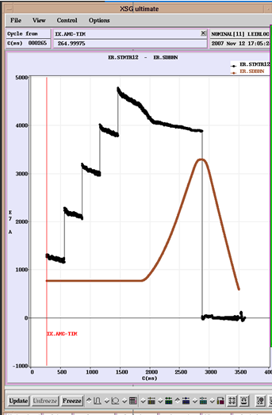
Vacuum Chamber
The particle beam:
arrives through a transfer line
is injected
is accelerated over many turns in a “circular” machine
is extracted
leaves through a transfer line
Extraction
Injection(s)
Acceleration
&
Increase of magnetic field

Slide 27
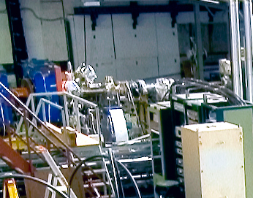
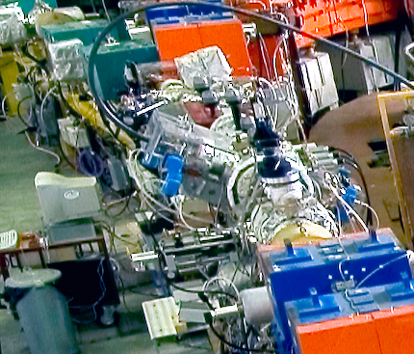
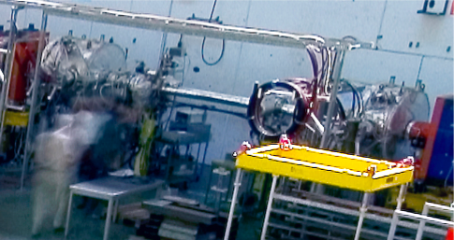
Injecting & Extracting Particles
Injection
Extraction
Extraction
Extraction
Injection

Slide 28
Injecting & Extracting Particles
Incoming beam
Magnetic field
No magnetic field
Circulating beam
Injected beam
Septum Magnet
Kicker Magnet

Slide 29
Injecting & Extracting Particles
Extracted beam
Magnetic field
No magnetic field
Circulating beam
Beam to be extracted
Septum Magnet
Kicker Magnet

Slide 30
Make Particles Circulate
Main Dipoles
Main Dipoles
Main Dipoles
Main Dipoles

Slide 31
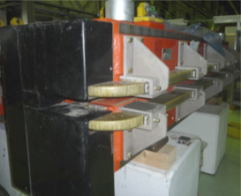
Deviating Charged Particles
Moving charged particles are deviated
in a magnetic field
Magnetic Lorentz Force:

Slide 32
Oscillatory Motion in the Horizontal Plane
Two charged Particles in a homogeneous magnetic field
Horizontal motion
Particle B
Particle A
Horizontal
displacement
0
Machine circumference
2π
Particle B
Particle A
Different particles with different initial conditions in a homogeneous magnetic field will cause oscillatory motion in the horizontal plane → Betatron Oscillations

Slide 33
Oscillatory Motion in the Vertical Plane
The horizontal motion seems to be “stable”…. What about the vertical plane ?
Many particles many initial conditions
Vertical
displacement
→ s
Many different angles

Slide 34
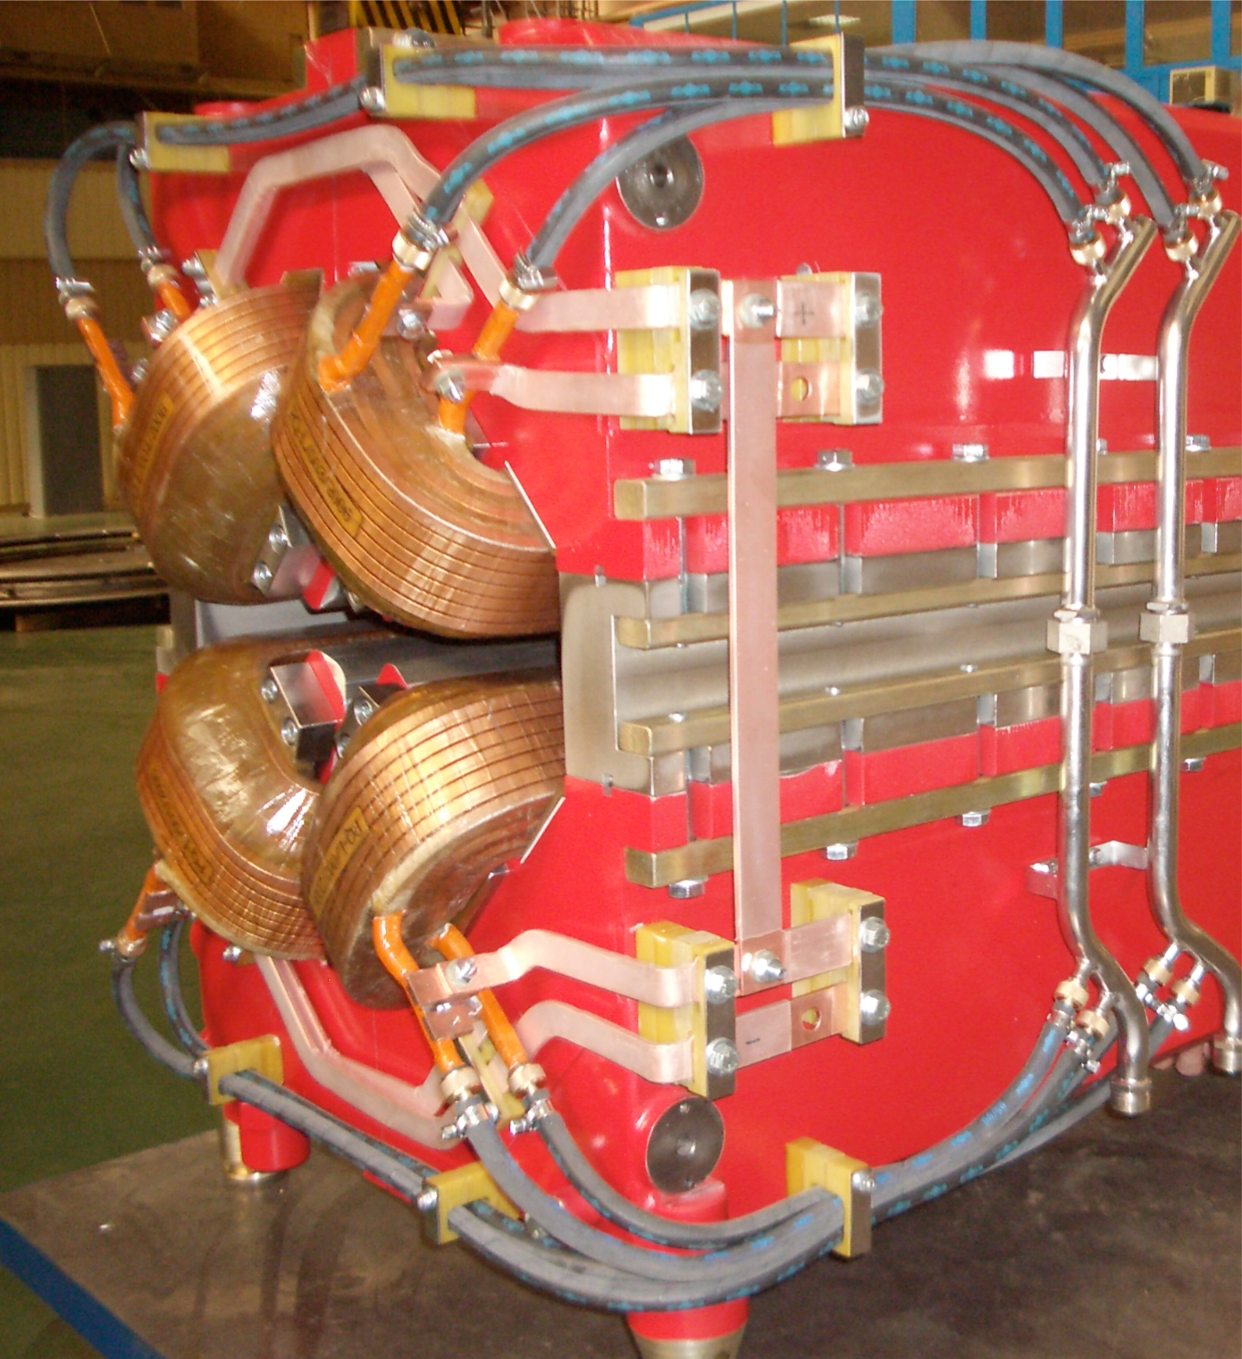
Focusing Particle Beams, a bit like a lens
Force on particles
Focusing Quadrupole
Rotated by 90º
De-focusing Quadrupole
QF
QD
QF

Slide 35
Focusing Particle Beams in LEIR
Main Dipoles
Main Dipoles
Main Dipoles
Quadrupoles

Slide 36
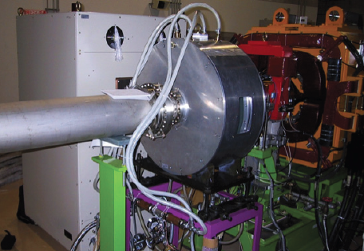
Accelerating Particles, Using Electrical Fields
Accelerating
Cavity

Slide 37
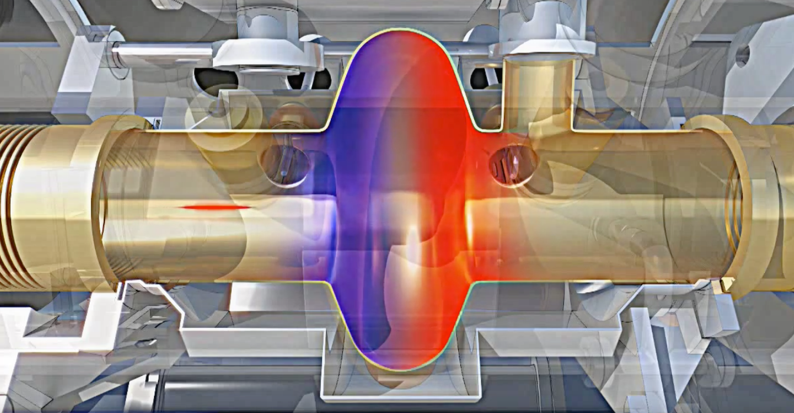
Radio Frequency Cavity
Charged particles are accelerated by a longitudinal electric field
The electric field needs to alternate with a harmonic of the revolution frequency

Slide 38
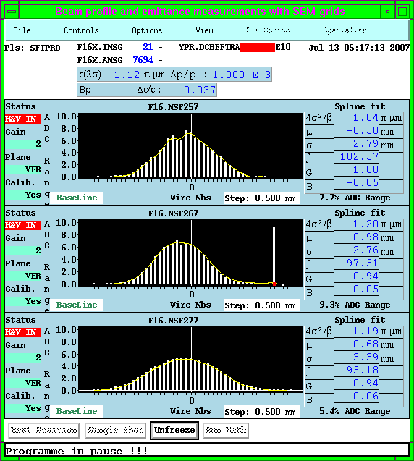
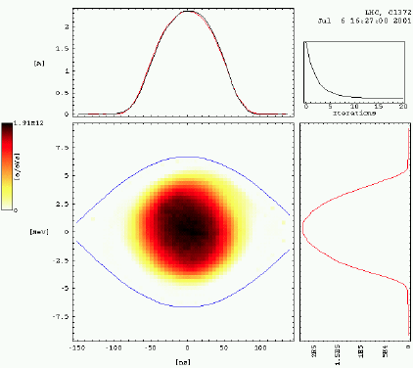
The Eyes of Operations
Beam intensity or current measurement
Transverse beam profile/size measurement
Longitudinal beam profile measurements
Measure the LHC luminosity, number of events per surface and time unit.
Any many more beam properties…..

Slide 39
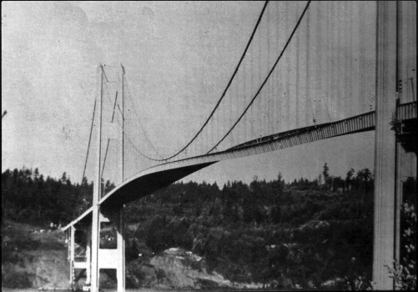
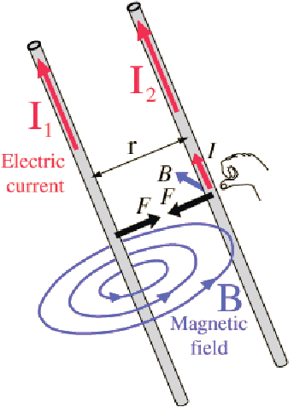
Possible Limitations
Machines and elements cannot be built with infinite perfection
Same phase and frequency for driving force and the system can cause resonances and be destructive
+
+
Neighbouring charges with the same polarity experience repelling forces
Moving particles create currents, These currents result in attracting or repelling magnetic fields

Slide 41
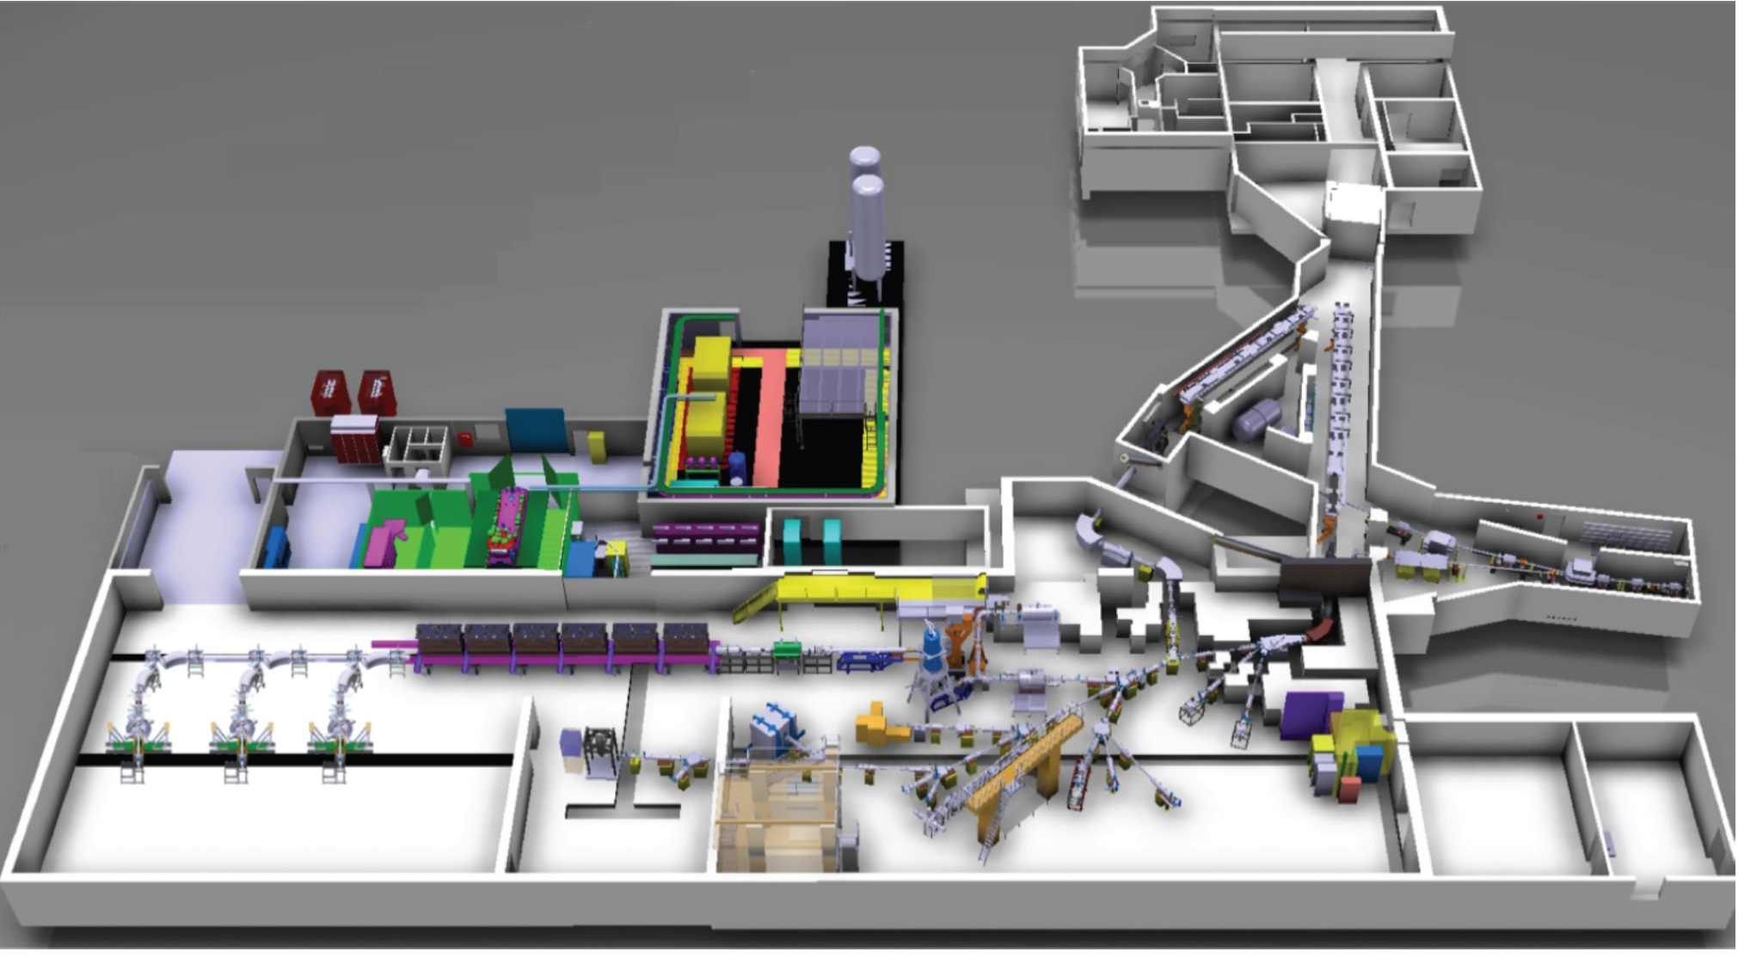
ISOLDE / HIE-ISOLDE
The PSB proton beam impinges on a target producing a range of isotopes
Two mass separators (GPS & HRS) allow selection of isotopes
The post acceleration of isotopes is being extended
  REX, normal conducting accelerating structures
  HIE-ISOLDE, super conducting LINAC

Slide 42
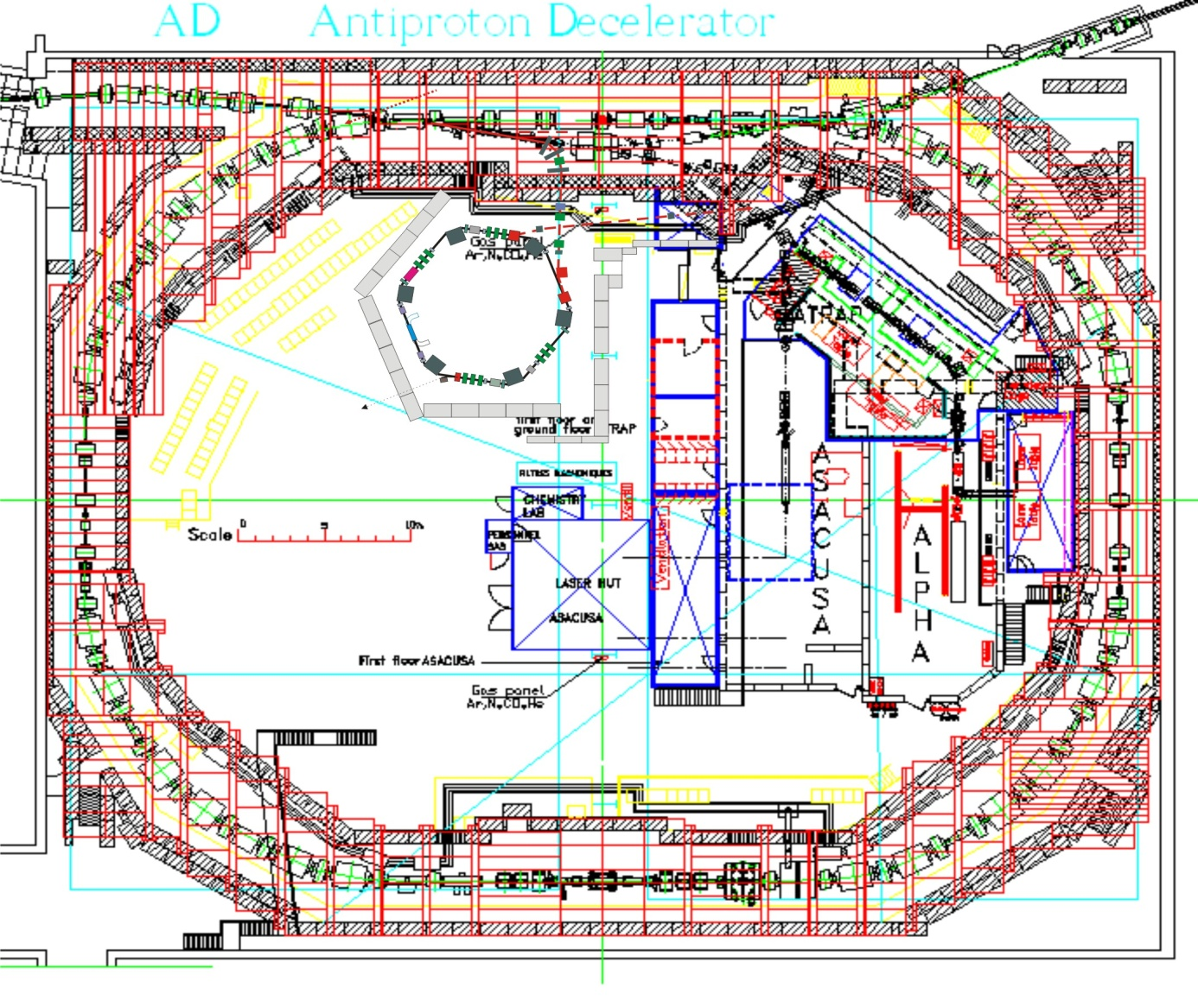
AD-ELENA
Receives fast extracted proton beam from PS at 26 GeV/c on a target
Every million protons yields about one usable antiproton at 3.5 GeV/c.
AD decelerates beam in stages down to 5.3 MeV
ELENA will further decelerate down to 100 keV
Experiments:
  ASACUSA, ALPHA, AEGIS, BASE, GBAR

Slide 43
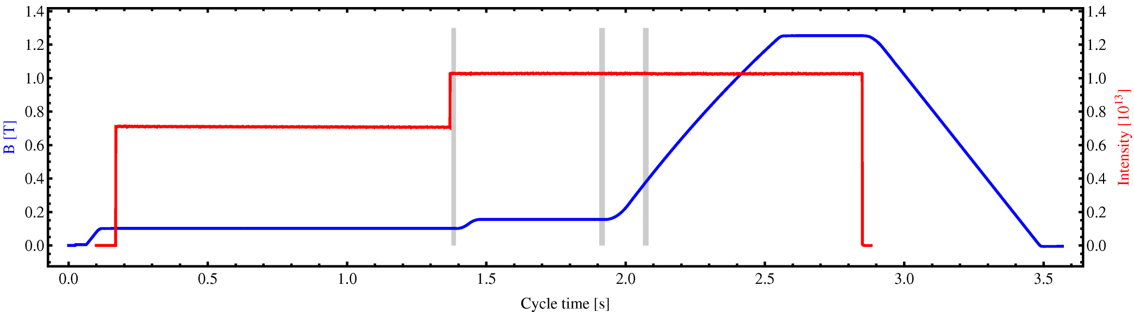
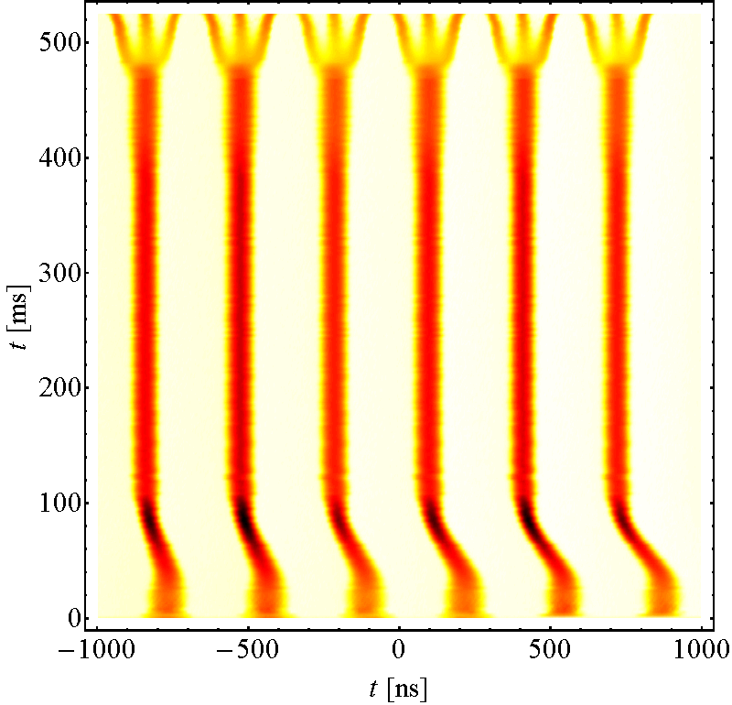
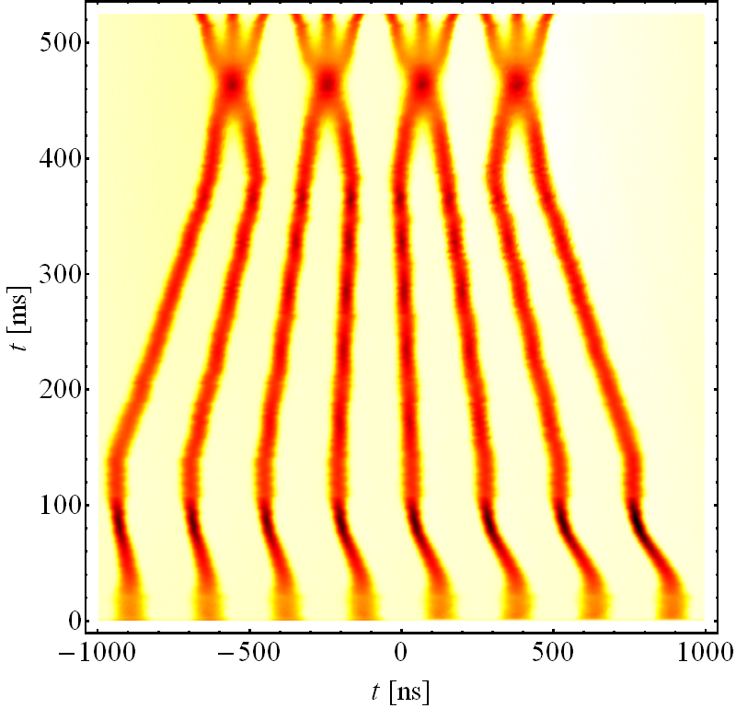
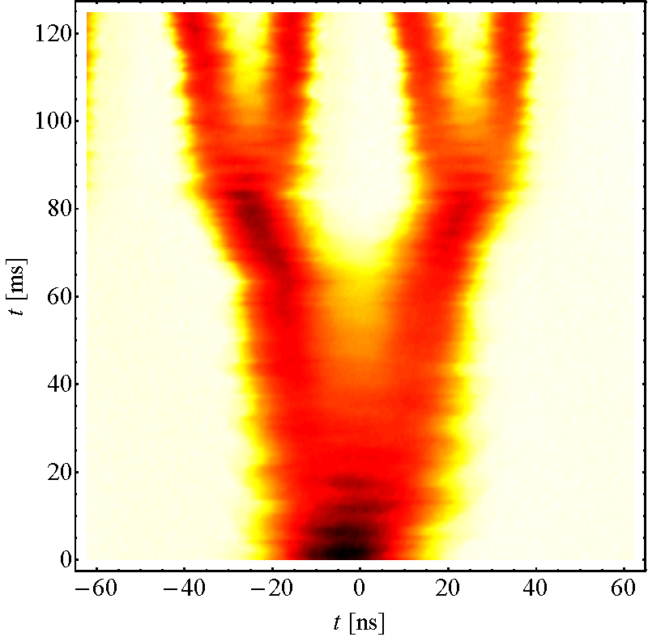
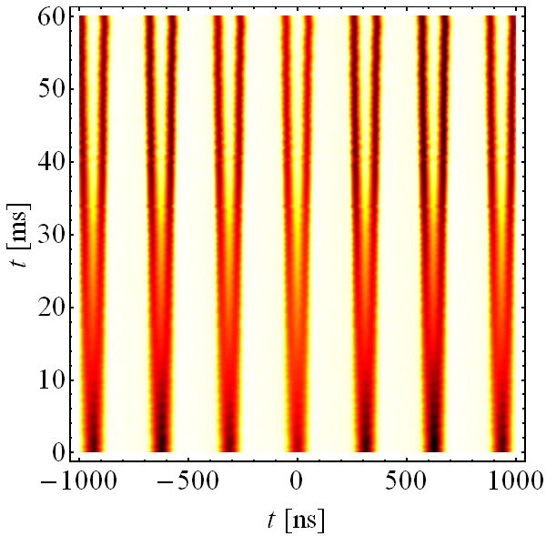
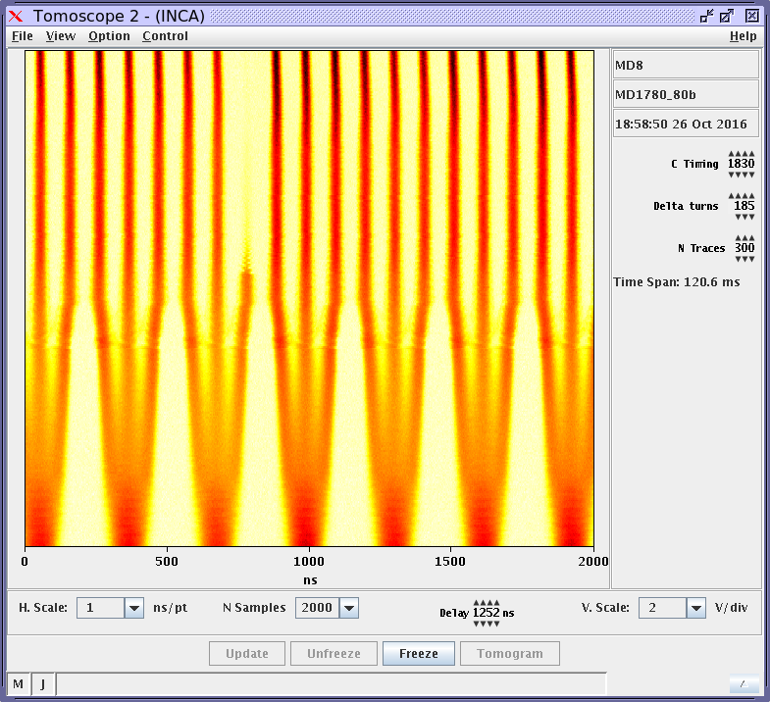
PS for LHC
Controlled blow-ups
Eject 36 or
Eject 24 or
48 bunches
h = 21
h = 7 or 9
γ_{tr}
72 bunches
h = 84
Standard (6 PSB b.)
BCMS (8 PSB b.)
Split in four at flat top
25 ns
26 GeV/c
8b4e (7 PSB b.)
80 bunches (7 PSB b.)
Standard: 72 bunches @ 25 ns
BCMS: 48 bunches @ 25 ns
The PS defines the longitudinal beam characteristics

Slide 44
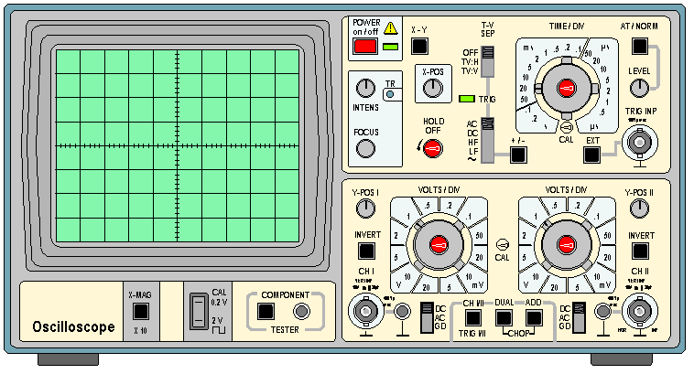
Example: Wall Current Monitor
A circulating bunch creates an image current in vacuum chamber.
+
Wall Current Monitor (WCM)
+
+
+
+
-
-
-
Insulator
(ceramic)
bunch
-
-
-
vacuum chamber
+
+
+
+
resistor
+
induced charge
The induced image current is the same size but has the opposite sign to the bunch current.

