Slide 1
Normal-Conducting and Permanent Accelerator Magnets
CERN Accelerator School
BASIC CAS, 10th March 2025
Jérémie Bauche
CERN

Slide 2
Acknowledgements
The first part of these slides, dedicated to the magnetic fields theory and electromagnets, is mostly from previous lectures from Thomas Zickler and Davide Tommasini, with some additions.
The second part, on permanent magnets, has been prepared based on material from Pierre Thonet (CERN), Gael Le Bec (ESRF), Johannes Bahrdt (Helmholtz Zentrum Berlin), and Ben Shepherd (STFC Daresbury Laboratory).
A big THANK YOU to all of them!

Slide 3
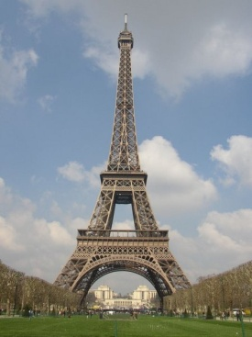
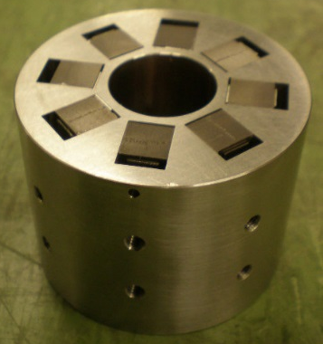
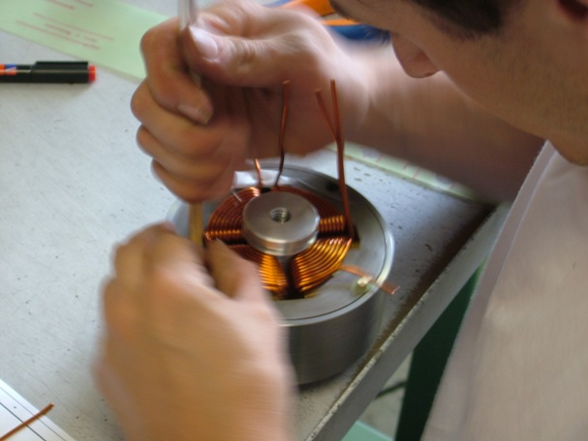
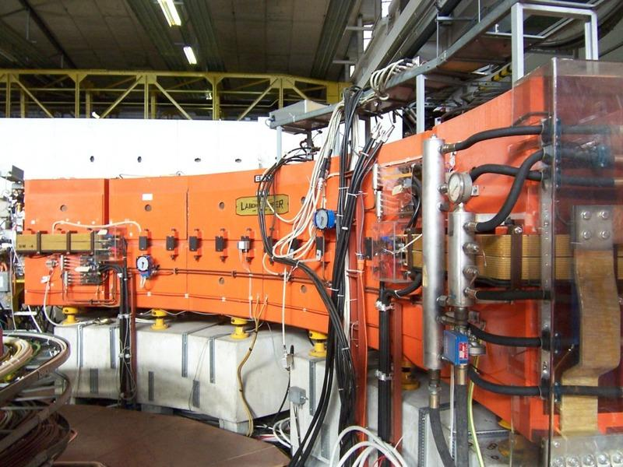
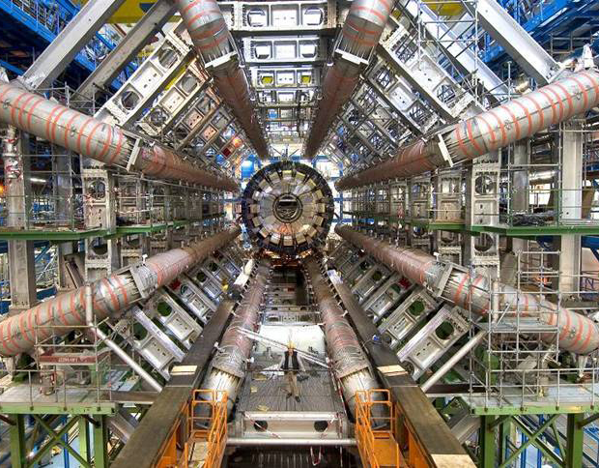
Scope of this lecture
  About 5000 ‘room temperature’ magnets (50 000 tonnes) are installed in the CERN accelerator complex, in about 20 km of beam lines
  There is a large variety (about 500 different types), with different technologies to address different needs
  Today, we will mainly focus on ‘room temperature’ magnets i.e., normal-conducting (iron-dominated) electro-magnets, and on permanent magnets

Slide 4
Outline
    Producing magnetic fields
      Why and how?
      Analogies with other domains
    Magnet technologies
      Technology classifications
      Electro-magnets (EM)
        EM components
        Magnet topologies and use in accelerators
      Permanent magnets (PM)
        Materials
        PM types in accelerators
        Comparison PM vs. EM
        Tuneable PM
    Spare slides

Slide 5
Outline
    Producing magnetic fields
      Why and how?
      Analogies with other domains
    Magnet technologies
      Technology classifications
      Electro-magnets (EM)
        EM components
        Magnet topologies and use in accelerators
      Permanent magnets (PM)
        Materials
        PM types in accelerators
        Comparison PM vs. EM
        Tuneable PM
    Spare slides

Slide 6

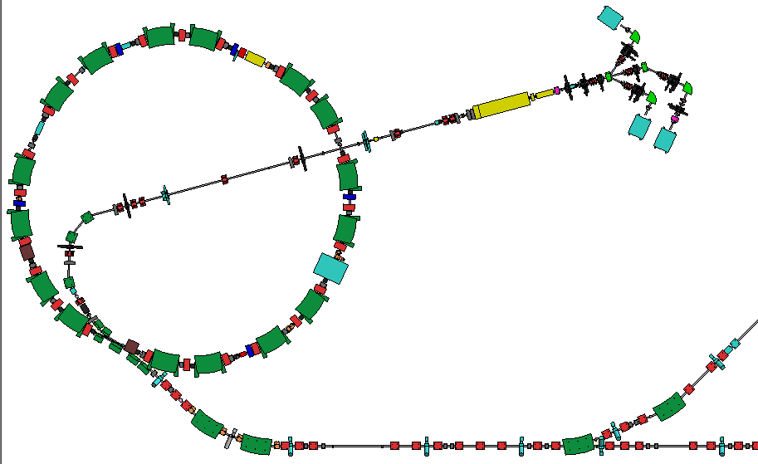
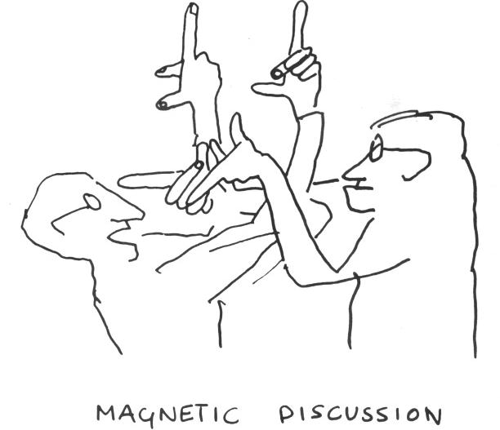







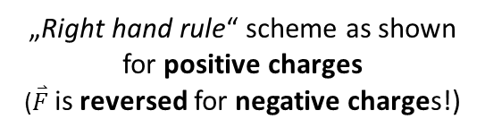



Why do we need magnets?
$$\vec{v}$$
Interaction with the beam
  guide the beam to keep it on the orbit
  focus and shape the beam
Lorentz‘s force:
  for relativistic particles, B and E effects are equivalent if
  to produce effect of B = 1 T you need E = 3∙10⁸ V/m = 300 MV/m !
  … practical limitation of E is only a few MV/m → use magnetic fields!
$$\vec{B}$$
$$\overset{⃑}{F}=q(\overset{⃑}{E}+\overset{⃑}{v}×\overset{⃑}{B})$$
$$\vec{F}$$
„Right hand rule“ scheme as shown for positive charges
($\overset{⃑}{F}$ is reversed for negative charges!)
$$\overset{⃑}{E}=c\overset{⃑}{B}$$
$$\vec{F}$$
Cartoon by B.Touschek
$$\vec{B}$$
$$\vec{v}$$
„Left hand rule“ with this scheme also works!
My mnemonic is “F.B.I.” where I replace $\overset{⃑}{v}$ by $\overset{⃑}{I}$ which stands as a flow (current) of positive charges

Slide 7
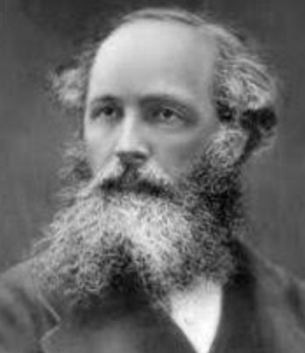
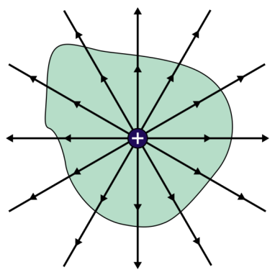
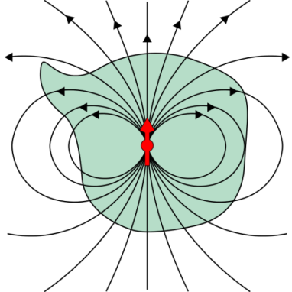
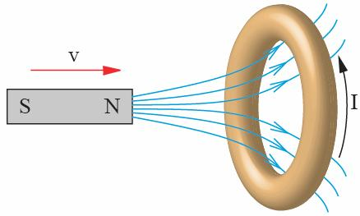
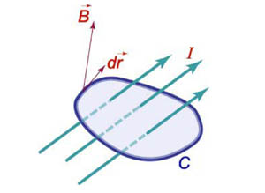


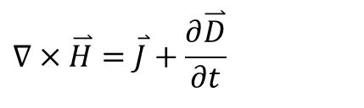


Maxwell‘s equations
In 1873, Maxwell published "Treatise on Electricity and Magnetism" where he summarized discoveries of Coulomb, Øersted, Ampere, Faraday, Gauss et. al. in 4 mathematical equations:
Gauss‘ law for electricity:
Gauss‘ law of flux conservation:
Faraday‘s law of induction:
Ampere‘s law:
$∇⋅\overset{⃑}{D}=$ $ρ$
$$\overset{⃑}{D}=ε\overset{⃑}{E}$$
James C. Maxwell
$$∇⋅\overset{⃑}{B}=0$$
$$∇×\overset{⃑}{E}=−\frac{∂\overset{⃑}{B}}{∂t}$$
$$∇×\overset{⃑}{H}=\overset{⃑}{J}+\frac{∂\overset{⃑}{D}}{∂t}$$
Notes:
D = electric displacement
E = electric field
ε0 = dielectric constant of free space
J = current density
$ρ$ = electric charge density

Slide 8
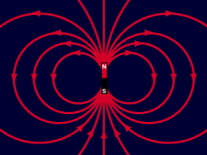
Magnet vocabulary
IEEE defines the following terms and units:
Magnetic field:
  H (vector) [A/m] (1 Oersted = 79.58 A/m)
  magnetizing force produced by electric currents
Magnetic flux density or magnetic induction:
  B (vector) [T or kg/(A·s²)] (1 Gauss = 10⁻⁴ T)
  density of magnetic flux driven through a medium by the magnetic field
  Note: flux or induction is frequently referred to as "Magnetic Field“
Permeability:
  H and B relate by the constitutive law for materials: B = µH
  µ = µ₀ µ_{r}
  permeability of free space µ₀ = 4·π·10⁻⁷ [(V·s)/(A·m) or (kg·m)/(A·s²)]
  relative permeability µ_{r} (dimensionless): µ_{air} = 1; µ_{iron} > 1000 (not saturated)

Slide 9
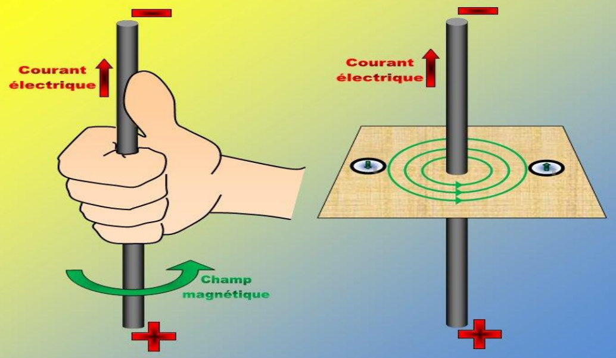
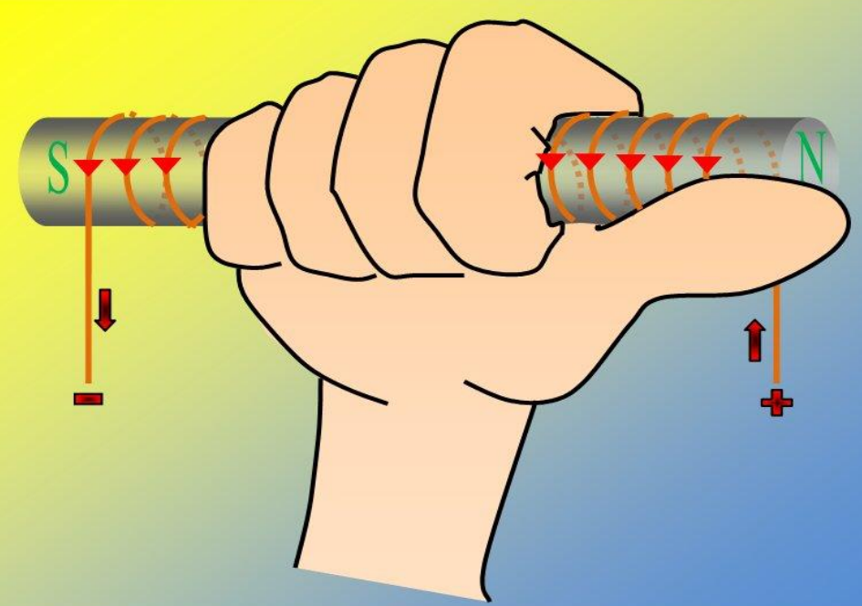
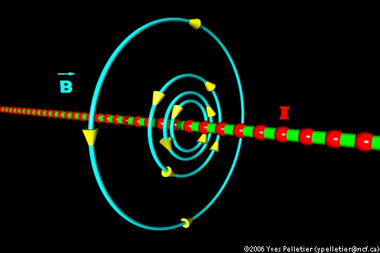
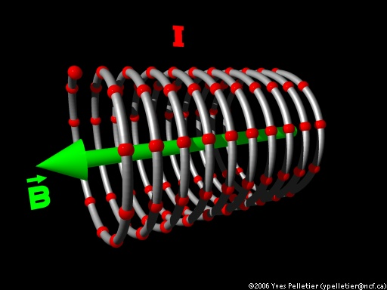


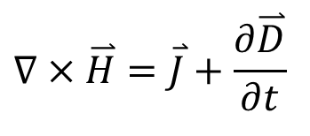
Producing the magnetic field
Maxwell & Ampere:
„An electrical current is surrounded by a magnetic field“
$$∇×\overset{⃑}{H}=\overset{⃑}{J}+\frac{∂\overset{⃑}{D}}{∂t}$$
$$\overset{⃑}{B}=μ\overset{⃑}{H}$$
$$∇×\overset{⃑}{B}=μ\overset{⃑}{J}$$
„Corkscrew “ (or „Right hand”) rule applies…
And this time, no “left” alternative!
https://lewebpedagogique.com/
https://lewebpedagogique.com/

Slide 10
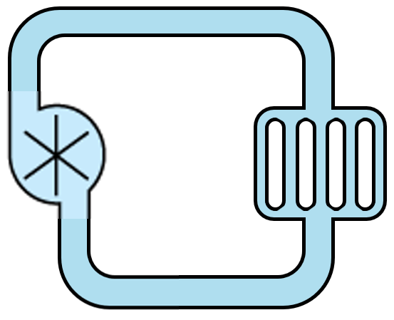
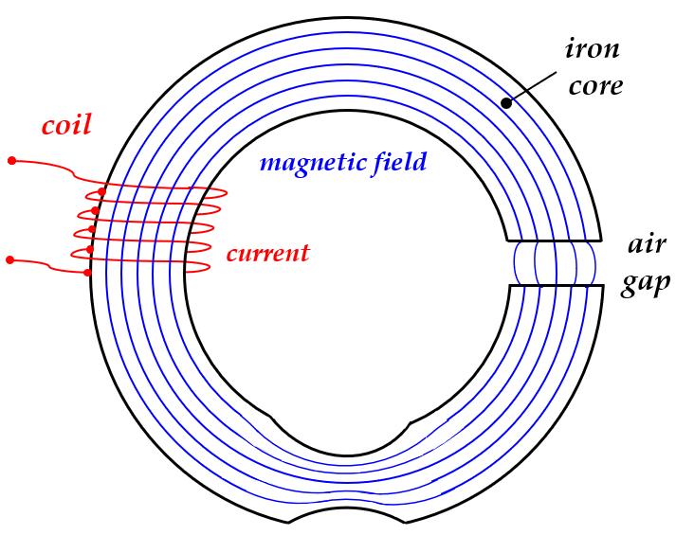
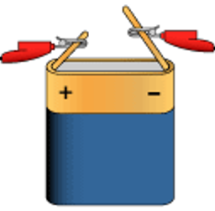
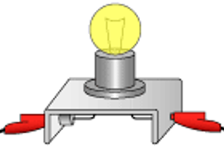
Analogy of electromagnetism with other domains
Hydraulic circuit
Electrical circuit
Magnetic circuit
Generator
Flow
current
water flow
voltage supply
air gap
pump
hydraulic resistor
lamp (resistor)
pipes
wires
Transmission line
Load

Slide 11
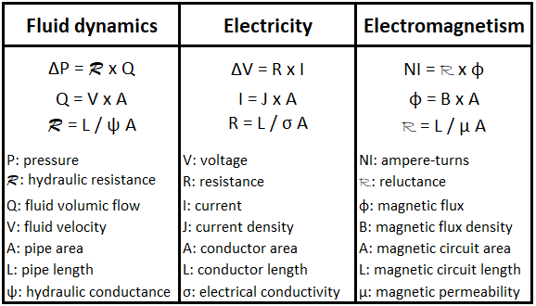
Analogy of electromagnetism with other domains
Similar analogies exist with mechanics, electrostatics…

Slide 12
Outline
    Producing magnetic fields
      Why and how?
      Analogies with other domains
    Magnet technologies
      Technology classifications
      Electro-magnets (EM)
        EM components
        Magnet topologies and use in accelerators
      Permanent magnets (PM)
        Materials
        PM types in accelerators
        Comparison PM vs. EM
        Tuneable PM
    Spare slides

Slide 13
Magnet technologies
Magnets
Permanent magnets
Superconducting
Normal-conducting
Electro-magnets
adjustable field amplitude
zero electrical resistance
no ohmic losses
very high current densities
require cryogenic cooling
adjustable field amplitude
limited by the ohmic losses
dissipated power to be removed
only moderate current densities
require air or water cooling
fixed field amplitude
do not require powering
do not require cooling

Slide 14
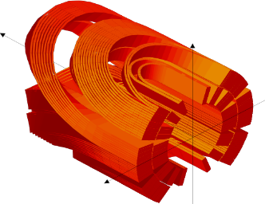
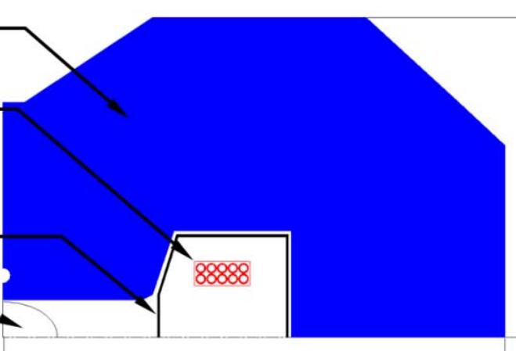
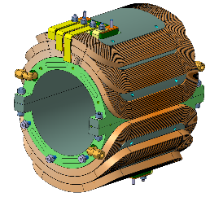
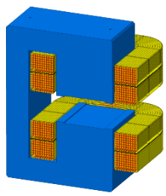
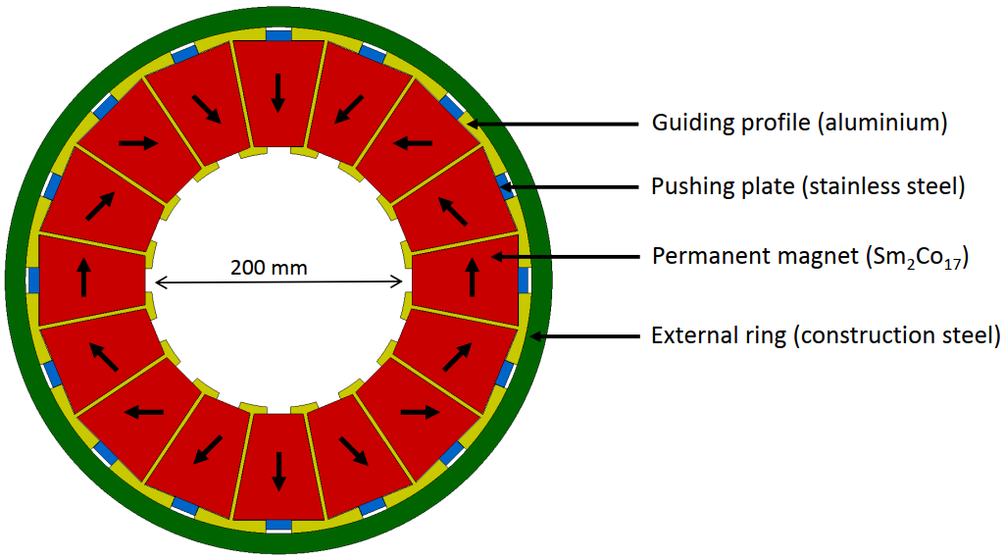
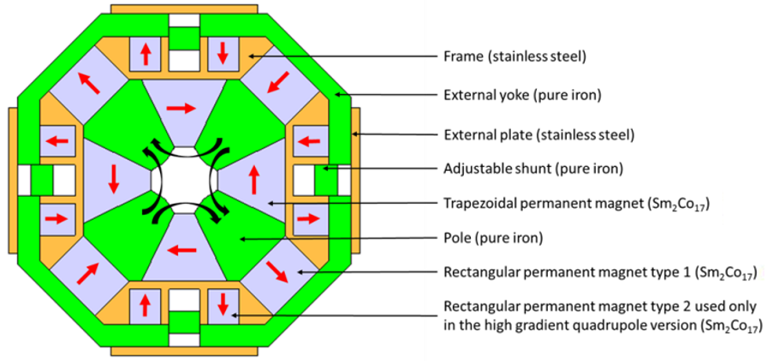
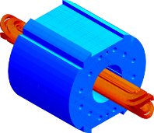
Magnet technologies
Magnets
Permanent magnets
Superconducting
Coil dominated
Normal-conducting
Iron dominated
Coil dominated
Iron dominated
Electromagnets
PM dominated
Iron dominated
SC cos theta dipole
Superferric dipole
NC cos theta dipole
NC dipole
PM Halbach dipole
PM quadrupole

Slide 15
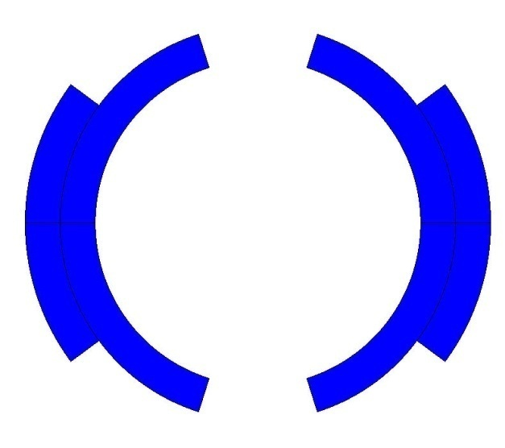
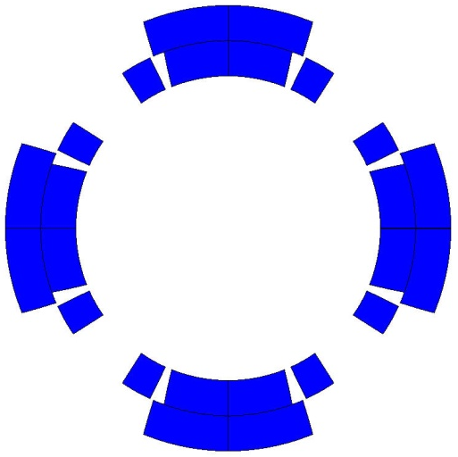
Coil dominated – Iron dominated
In coil-dominated magnets, the magnetic field in the aperture is shaped by the position of the conductors respectively the current distribution around the aperture
-> often superconducting
In iron-dominated magnets, the magnetic field is shaped by the geometry of the poles, which are surfaces of constant scalar potential
-> often normal-conducting
B₁: normal dipole
B₂: normal quadrupole
B₁: normal dipole
B₂: normal quadrupole
×
×
×

Slide 16
Outline
    Producing magnetic fields
      Why and how?
      Analogies with other domains
    Magnet technologies
      Technology classifications
      Electro-magnets (EM)
        EM components
        Magnet topologies and use in accelerators
      Permanent magnets (PM)
        Materials
        PM types in accelerators
        Comparison PM vs. EM
        Tuneable PM
    Spare slides

Slide 17

Iron dominated electromagnets
They represent the large majority of magnets in accelerators
They are mainly composed of
An electric circuit (coils) which produces the magnetic field
A magnetic circuit (yoke) which:
  confines the magnetic flux in the circuit to avoid stray flux
  shapes the magnetic field distribution in the region of interest
  enhances the magnetic effect induced by currents in the coils

Slide 18
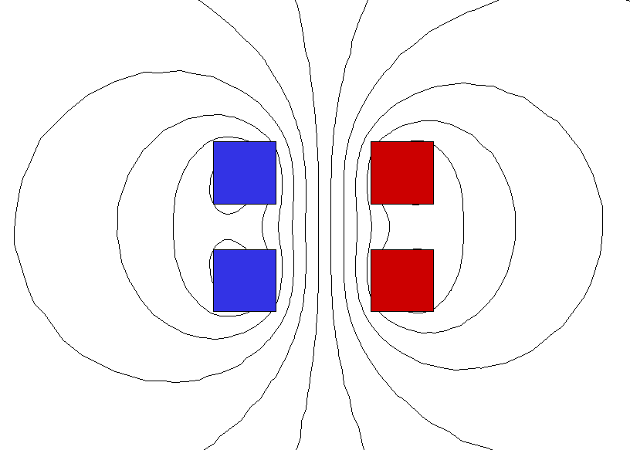
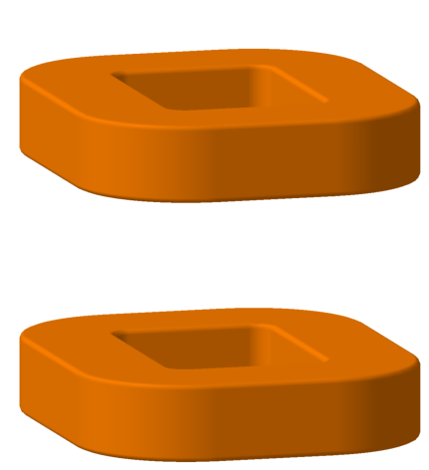
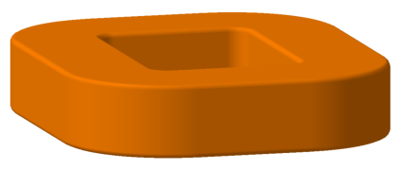
Creating the magnetic field
Flux lines represent the magnetic field
Coil colors indicate the current direction

Slide 19

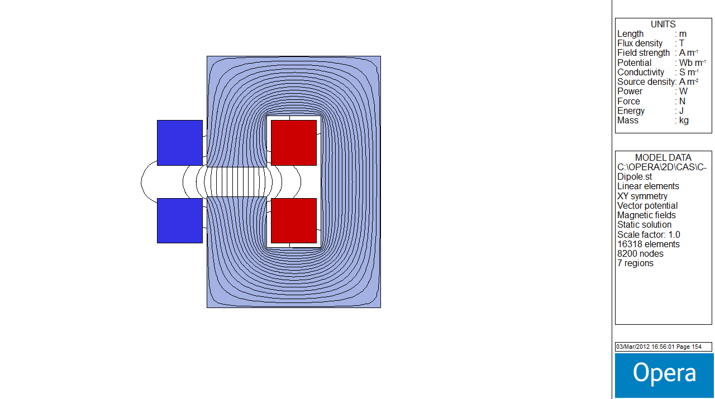
Confining the magnetic field
Coils hold the electrical current
Iron holds the magnetic flux

Slide 20

Shaping the magnetic field
From Gauss’ law, Ampere’s law and the constitutive relation, we can derive that the flux lines in free space always meet a material with infinite permeability perpendicular to the surface (“surface of constant scalar potential”)
Conversely: If we can shape a material with infinite permeability such that its surface is everywhere perpendicular to our desired field configuration, then the only field that can exist around the material will be this desired field!

Slide 21
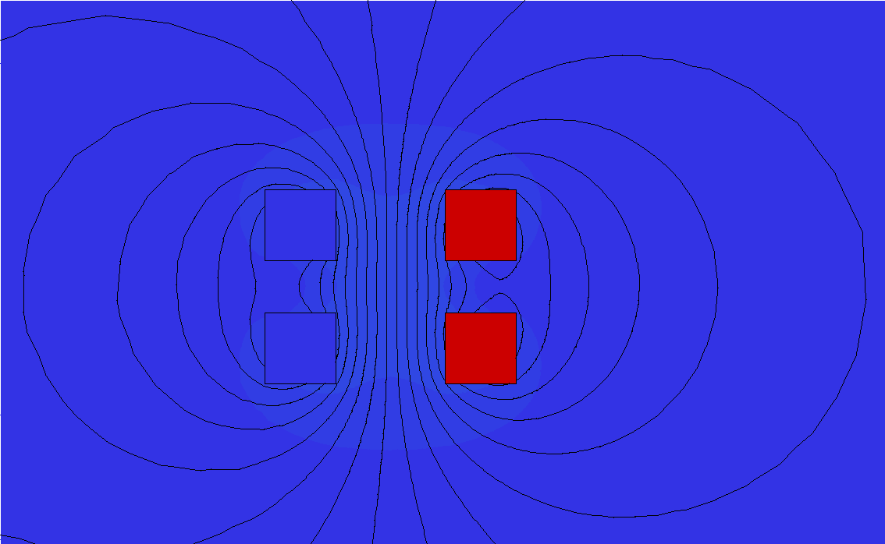
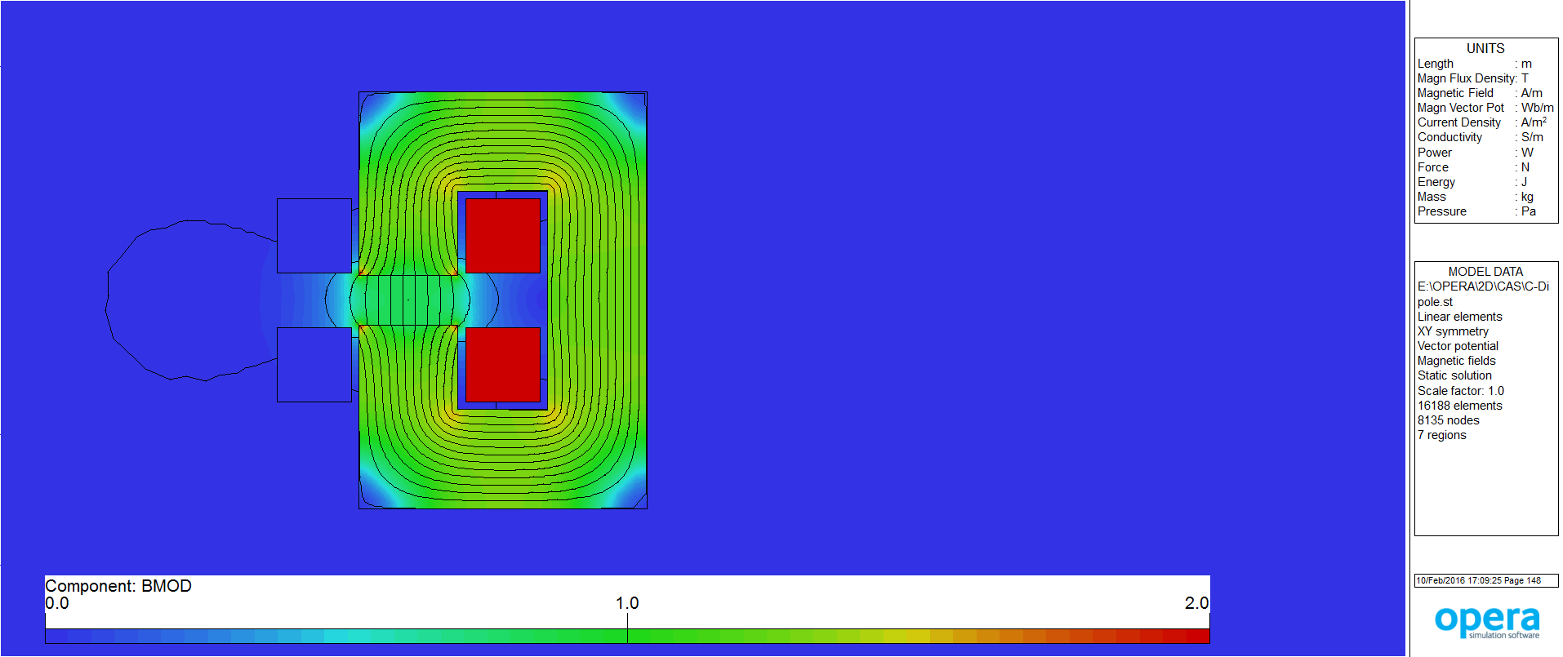
Enhancing the magnetic field
I = 32 kA
B_{centre} = 0.09 T
I = 32 kA
B_{centre} = 0.80 T (for 50 mm of aperture)
The presence of a magnetic circuit can increase the flux density in the magnet aperture by factors!

Slide 22

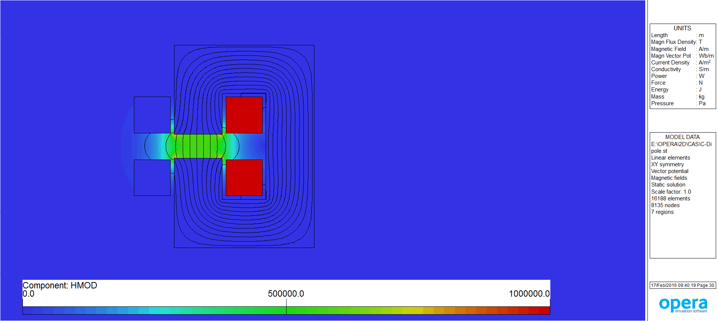






Excitation current in a dipole
$$\oint{\overset{⃑}{H}⋅d\overset{⃑}{l}=NI}$$
$$\overset{⃑}{B}=μ\overset{⃑}{H}$$
$$μ=μ_{0}μ_{r}$$
Ampere’s law and with
leads to
assuming, that B is constant along the path
If ${ μ}_{iron}→∞$ then
then:
$$NI=\oint{\frac{\overset{⃑}{B}}{μ}⋅d\overset{⃑}{l}=\int_{gap}{\frac{\overset{⃑}{B}}{μ_{air}}⋅d\overset{⃑}{l}+\int_{yoke}{\frac{\overset{⃑}{B}}{μ_{iron}}⋅d\overset{⃑}{l}=\frac{Bh}{μ_{air}}+\frac{Bλ}{μ_{iron}}}}}$$
$$\frac{λ}{μ_{iron}}→0$$
$$NI=\frac{Bh}{μ_{0}}$$

Slide 23
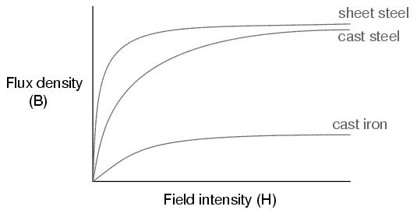
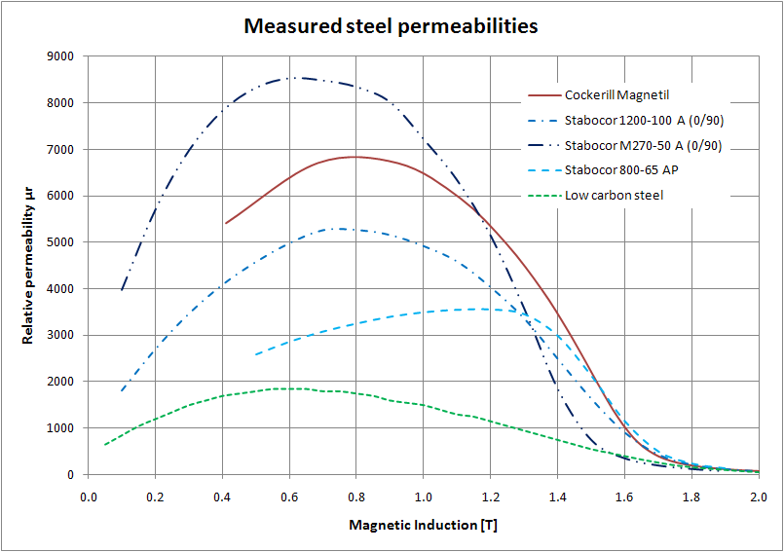
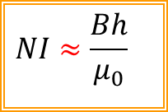
Permeability
Permeability: correlation between magnetic field strength H and magnetic flux density B
Ferro-magnetic materials: high relative permeability (µ_{r} >>1), but not constant
Saturation: Increase of B above 1.5 T in iron requires non-proportional increase of H
Consequence 1:
The path in the iron can no longer be fully neglected
Consequence 2:
The flux lines will no longer meet the iron perpendicularly, creating field imperfections
$$NI≈\frac{Bh}{μ_{0}}$$

Slide 24



Ideal vs. real magnets
Ideal magnets have infinite permeability, and the poles are extended to infinity in all directions
Real magnets have high, but finite and non-linear permeability, and the poles are truncated to provide space for the coils

Slide 25


Dipole
Purpose: bend or steer the particle beam
Applications: synchrotrons, transfer lines, spectrometry, beam scanning
Equation for normal (non-skew) ideal (infinite) poles: y = $±h/2$
→ straight line with h = gap height
Magnetic flux density in aperture: B $=\frac{\text{η} \text{µ}\text{0} \text{NI}}{h}$
→ η ≈ 0.98 for non-saturated yoke
Magnetic flux density components: B_{x} = 0; B_{y} = B₁ = const. (for “normal” dipole, i.e. H)
S
N

Slide 26


Quadrupole
Purpose: focusing the beam (horizontally focused beam is vertically defocused)
Equation for normal (non-skew) ideal (infinite) poles: $2xy$ = $±r^{2}$
→ hyperbola with r = aperture radius
Magnetic flux density in aperture: B $=\frac{\text{2 }\text{η} \text{µ}\text{0} \text{NI}\text{per} \text{pole}}{r2}$
(η ≈ 0.98 for non-saturated yoke)
Magnetic flux density components:${ B}_{x}=\frac{B_{2}}{R_{ref}}$ y ; ${ B}_{y}=\frac{B_{2}}{R_{ref}}$ x (for “normal” quadrupole)
S
N
N
S

Slide 27


Sextupole
Purpose: correct chromatic aberrations of ‘off-momentum’ particles
Equation for normal (non-skew) ideal (infinite) poles: $3x^{2}y−y^{3}=±r^{3}$
(r = aperture radius)
Magnetic flux density in aperture: B $=\frac{\text{3 }\text{η} \text{µ}\text{0} \text{NI}\text{per} \text{pole}}{r3}$
(η ≈ 0.98 for non-saturated yoke)
Magnetic flux density components: ${ B}_{x}=\frac{B_{3}}{R_{ref}^{2}}$ xy ; ${ B}_{y}=\frac{B_{3}}{R_{ref}^{2}}(x^{2}−y^{2})$ (“normal” sextupole)
N
S
S
N
N
S

Slide 28




Summary of magnet types
Pole shape | Field distribution | Pole equation | B | B_{x} , B_{y}
 |  | y = ± r = ± h/2 | B $=\frac{\text{η} \text{µ}\text{0} \text{NI}}{h}$ = $\frac{\text{η} \text{µ}\text{0} \text{NI}\text{per} \text{pole}}{r}$ | B_{x} = 0 B_{y} = B₁ = const.
 |  | 2xy = ± r ² | B $=\frac{\text{2 }\text{η} \text{µ}\text{0} \text{NI}\text{per} \text{pole}}{r2}$ | $B_{x}=\frac{B_{2}}{R_{ref}}$ y $B_{y}=\frac{B_{2}}{R_{ref}}$ x
 |  | 3x ²y –y ³ = ± r ³ | B $=\frac{\text{3 }\text{η} \text{µ}\text{0} \text{NI}\text{per} \text{pole}}{r3}$ | $B_{x}=\frac{B_{3}}{R_{ref}^{2}}$ xy $B_{y}=\frac{B_{3}}{R_{ref}^{2}}(x^{2}−y^{2})$/
 |  | 4(x ³y – xy ³) = ± r⁴ | B $=\frac{\text{4 }\text{η} \text{µ}\text{0} \text{NI}\text{per} \text{pole}}{r4}$ | $B_{x}=\frac{B_{4}}{R_{ref}^{3}}$ $({3x}^{2}y−y^{3})$ $B_{y}=\frac{B_{4}}{6R_{ref}^{3}}(x^{3}−{3xy}^{2})$/

Slide 29







Conventional NC magnet layouts
Excitation coils carry the electrical current creating H
Iron yoke guide, enhance and shape magnetic flux
Auxiliaries for cooling, interlock, safety, alignment, ...
H-type
Tapered poles
O-type
or
Window frame
Straight poles
Figure-of-eight
or
Collins
C-type

Slide 30
Outline
    Producing magnetic fields
      Why and how?
      Analogies with other domains
    Magnet technologies
      Technology classifications
      Electro-magnets (EM)
        EM components
        Magnet topologies and use in accelerators
      Permanent magnets (PM)
        Materials
        PM types in accelerators
        Comparison PM vs. EM
        Tuneable PM
    Spare slides

Slide 31


Permanent magnet materials
In 600 b.C., stones of “magnetite” (iron oxide) found in Magnesia area, in Greece.
Most popular PM materials:
AlNiCo: alloy of Al, Ni, Co
Ferrites: ceramic compound mixing iron oxide and one (or more) of Sr, Ba, Mn, Ni, Zn
Rare earths: Lanthanides group (elements 57 to 71 in periodic table)
For accelerator magnets:
Samarium-Cobalt: SmCo₅ and Sm₂Co₁₇ (Variants exist with Cu, Fe or Zr instead of Co)
Neodymium-Iron-Boron: Nd₂Fe₁₄B
Courtesy: Vacuumschmelze GmbH
Notes:
AlNiCo is capable to produce up to 1.2 T in a closed magnetic circuit, but the flux density drops drastically when the magnetic circuit is open, what makes it impractical for accelerator magnets.

Slide 32

PM characteristics
Distinction “soft” and “hard” (i.e. PM) magnetic materials: H_{c} soft < 200 Oe < H_{c} hard
BH_{max} is the maximum possible energy product, i.e. the capacity to produce magnetic field
B_{r} is the maximum flux density that the PM can achieve in a closed magnetic circuit
H_{cb} is the coercivity which tells how much opposite H field is needed to cancel the B_{r}
H_{cj} is the intrinsic coercivity which tells how much opposite H field is needed to fully demagnetize the magnet
For accelerator magnets:
Samarium-Cobalt:
  B_{r} ≈ 1.1 T ; H_{cb} ≈ 10 kOe ; BH_{max} ≈ 32 MGOe (Sm₂Co₁₇)
  Good radiation and corrosion resistance
  Small temperature coefficient: -0,03 to -0,05 %/°C
Neodymium-Iron-Boron:
  B_{r} ≈ 1.5 T ; H_{cb} ≈ 12 kOe ; BH_{max} ≈ 52 MGOe
  Strong magnetic field
  Larger temperature coefficient: -0,09 to -0,12 %/°C
.
.
.
BH_{max}
_{b}

Slide 33
Magnet technologies
Magnets
Coil dominated
Iron dominated
Electro-magnets
PM dominated
Iron dominated
Permanent magnets
The position of the conductors define the field pattern
The position of the iron poles define the field pattern
The position of the permanent magnet blocks define the field pattern (Halbach)
The position of the iron poles define the field pattern

Slide 34




PM-dominated magnets
Halbach: field pattern defined by position and orientation of PM blocks
Magnets are placed around aperture with magnetization axis oriented along the flux line path (low ext. stray field)
→ Very compact designs
→ Sensitive to magnetization orientation of PM blocks
Klaus Halbach
Halbach designs: dipole (left), quadrupole (centre), sextupole (right)
Evaluation of dipole field:
B ≈ B_{r} . cos(π/M) . ln(R/r)
B_{r}: remanent field
M: number of segments
R: external radius
r: internal radius
PM dipole design of FASER experiment – P. Thonet
LINAC 4 PM quadrupole

Slide 35

Iron-dominated PM
The field pattern is defined by the iron pole geometry (like in an iron-dominated EM)
The PM blocks only provide the magnetization of the magnetic circuit
Field quality is independent of errors of magnetization orientation of the PM blocks
Field amplitude can be increased w.r.t. Br of PM block with tapered poles
N-tof separation dipole – P. Thonet
AD target quadrupole – P. Thonet

Slide 36

Comparison EM vs. PM
PM have significant advantages over EM, but also some limitations for their use in accelerator magnets
Main advantages of PM:
  No power consumption
  No powering and cooling infrastructure
  Fail safe and maintenance free
  Relatively compact and cheap
Main limitations of PM:
  Fixed field
  Field stability (T° dependence)
  Safety (magnetic hazards)

Slide 37
Tuneable PM
Magnets
Electro-magnets
Fixed field
Permanent magnets
Hybrid magnets
Tuneable field
the magnetic circuit geometry is static
the field amplitude is tuned by powering auxiliary coils
the magnetic circuit geometry is variable
the field amplitude is tuned by modifying the magnetic circuit (with controllers, motors and mechanical linkage)

Slide 38



Mechanically tuneable PM
Mechanical modification of the magnetic circuit to tune the field amplitude
Can be made in two ways:
→ Changing the reluctance of the magnetic circuit:
  Moving yoke pieces (1)
→ Deriving the magnetic flux to a parallel circuit:
  Moving yoke pieces (2)
  Moving the PM blocks (3)
Main limitations:
  Management of the forces and tolerances
  Reliability and time response of motors
  Cost (magnet and control system)
(1) AD target quad. – P. Thonet
(2) SPring-8-II dipole T. Watanabe, et al.
(3) ZEPTO quad. B. Shepherd

Slide 39


Hybrid EM - PM
Combining coils with PM blocks in the same magnetic circuit to create a hybrid magnet
Main advantages:
  Main field can be tuned to a significant part of the nominal (up to ± 20 - 30 %)
  PM temperature dependence can be compensated by the coils
Main limitations:
  Risk of demagnetizing the PM blocks
  In designs where the PM and coils are in series in the magnetic circuit, the coil ampere-turns scale with the gap for the PM
CLIC final focusing quadrupole – A. Vorozhtsov, M. Modena

Slide 40
Literature
CAS proceedings, Fifth General Accelerator Physics Course, University of Jyväskylä, Finland, September 1992, CERN Yellow Report 94-01
International Conference on Magnet Technology, Conference proceedings
Iron Dominated Electromagnets, J. T. Tanabe, World Scientific Publishing, 2005
Magnetic Field for Transporting Charged Beams, G. Parzen, BNL publication, 1976
Magnete, G. Schnell, Thiemig Verlag, 1973 (German)
Field Computation for Accelerator Magnets: Analytical and Numerical Methods for Electromagnetic Design and Optimization, S. Russenschuck, Wiley-VCH, 2010
Practical Definitions & Formulae for Normal Conducting Magnets, D. Tommasini, Sept. 2011
CAS proceedings, Magnetic measurements and alignment, Montreux, Switzerland, March 1992, CERN Yellow Report 92-05
CAS proceedings, Measurement and alignment of accelerator and detector magnets, Anacapri, Italy, April 1997, CERN Yellow Report 98-05
The Physics of Particle Accelerators: An Introduction, K. Wille, Oxford University Press, 2000
CAS proceedings, Magnets, Bruges, Belgium, June 2009, CERN Yellow Report 2010-004
CAS on Magnets, Sankt Polten, Austria, November 2023
Design and manufacturing of three permanent magnet dipoles for FASER experiment, Pierre Thonet, TE-MSC seminar, https://indico.cern.ch/event/1010394/

Slide 41
Many thanks for your attention!
… more information is available in the spare slides!

Slide 42
Spare slides

Slide 43

Hysteresis cycle
Hysteresis loop of (ferro-)magnetic materials:
First magnetisation (“virgin curve”):
  Dotted line
Saturation
  No more amplification of B by the material
Remanence:
  Residual magnetic flux density when H = 0
Coercive force
  Necessary opposite H to cancel remanence
Hysteresis loop
  Relation of B to H when the material is excited sequentially to +H and –H. The surface corresponds to the dissipated power of the hysteresis losses

Slide 44
Design process
Electro-magnetic design is an iterative process:
Collect input data
Analytical design
Numerical 2D/3D simulations
Mechanical design
Drawings & specifications
Field strength (gradient) and magnetic length
Integrated field strength (gradient)
Aperture and ‚good field region‘
Field quality:
    field homogeneity
    maximum allowed multi-pole errors
    settling time (time constant)
Operation mode: continous, cycled
Electrical parameters
Mechanical dimensions
Cooling requirements
Magnet
Beam Optics
Power
Cooling
Vacuum
Survey
Integration
Safety
Certification
Transport
A magnet is not a stand-alone device!

Slide 45

Costs and optimization
Focus on economic design!
Design goal: Minimum total costs over projected magnet lifetime by optimization of capital (investment) costs against running costs (power consumption)
Total costs include:
capital costs of magnets
capital costs of power converters
capital costs of power distribution
capital costs of cooling system
operation costs of power converters
operation costs of cooling system
Attention:
$$Power∝current density$$
Decreasing current density means:
increasing coil cross section
increasing material (coil & yoke) cost
increasing manufacturing cost
But:
decreasing capital costs for power converter and cooling system
decreasing operation costs

Slide 46



Massive vs. laminated yokes
Historically, the primary choice was whether the magnet is operated in persistent mode or cycled (eddy currents)
+ no stamping, no stacking
- time consuming machining, in particular for complicated pole shapes
- difficult to reach similar magnetic performance between magnets
+ less expensive for prototypes and small series
+ steel sheets less expensive than massive blocks
+ steel properties can be easily tailored
+ uniform magnetic properties over large series
- expensive tooling
+ less expensive for larger series

Slide 47






Yoke manufacturing
Stamping laminations
Stacking laminations into yokes
Gluing and/or welding
Assembling the yoke parts

Slide 48






Excitation coils manufacturing
Conductor insulation
Coil winding
Ground insulation
Epoxy impregnation
Testing
Conductor selection
Notes:
[]

Slide 49


Coil cooling
Cooling is required to remove the dissipated electrical power from the coils
(Temperature acceptance of typical insulating materials is ~60°C)
Air cooling by natural convection:
  Only for low densities: j < 1 to 2 A/mm², depending on coil size
  Cooling enhancement
    Heat sink with enlarged radiation surface
    Forced air flow (cooling fan)
  Only for magnets with limited strength (e.g. correctors)
Direct water cooling:
  Typical current density j ≤ 10 A/mm²
  Requires demineralized water
  (low conductivity) and hollow
  conductor profiles

Slide 50



NC-magnets in the 1950-60s
CERN PS (1959), 25 GeV, 628 m
Combined function magnet: dipole + quadrupole + higher order multi-poles
Water cooled main coils + Figure-of-Eight windings + Pole-face windings
Magnetic field B: 0.014 T – 1.4 T
100 + 1 magnets in series
Notes:
Let’s have a look back in the history of normal-conducting accelerator magnets:
Certainly, a milestone in the construction of synchrotrons is the CERN Proton-Synchrotron (PS), which is still in operation after more than 60 years!
The PS is a combined function machine, built in the late 50s, consists 100 + 1 magnet connected in series. A PS main magnet unit was built from 10 laminated blocks sitting on a common girder, water cooled main coils made of hollow aluminium conductor, which power the dipole and the quadrupole field simultaneously and can produce a magnetic field between 0.014 T and 1.4 T.
In addition, there are so called “Figure of Eight” windings which can adjust the quadrupole field gradient in a small range around the working point without changing the integrated bending field.
On top of the poles are additional actively powered windings, called “Pole Face Windings” (PFW) for sextupole correction. These PFW provide also compensation for a non-uniform field attenuation due to eddy currents in the vacuum chambers with a set of passive windings which are connected to a resistor network.

Slide 51



NC-magnets in the 1970s
CERN SPS (1976), 7 km, 450 GeV
744 H-type bending magnets with B = 2.05 T

Slide 52




NC-magnets in the 1980s
LEP (1989), 27 km
Cycled field: 22 mT (20 GeV injection) to 108 mT (100 GeV)
5.75 m long ‘diluted’ magnet cores: 30% Fe / 70% concrete
Four water cooled aluminium excitation bars
Max. current: 4.5 kA

Slide 53


NC-magnets even in the LHC …
LHC Main Dipole
Double-aperture LHC quadrupole
What about the future…?

Slide 54

Circular Colliders
$$B=\frac{(Bρ)}{r_{M}}$$

Slide 55




Future challenges
Future accelerator projects bear a number of financial and technological challenges in general, but also in particular for magnets …
Large scale machines:
  Investment cost: material, production, transport, installation
  Operation costs: power consumption & cooling
  Reliability & availability
High energy beams and intensities:
  Ionizing radiation impact on materials and electronics
Hadron colliders:
  High magnetic fields
Lepton colliders (circular & linear):
  Alignment & stabilization
  Compact design & small apertures
Machine-Detector Interface (MDI) with the FF system
“2-Beams Modules” with 41848 DBQ and 4274 MBQ magnets

Slide 56





FCC energy efficient magnets
About 24000 magnets will be needed for the booster and collider of FCC-ee!
Energy saving: Ampere-turns recycled → 50% less power consumption
Cost saving: 50% less units to manufacture, transport, install, align
  Simple and reliable: few components
  Simple yoke design and coil layout → low manufacturing costs
  No coil inter-turn insulation (dipoles)
Compact: small dimensions, less material
Twin-aperture dipole
Twin-aperture quadrupole

Slide 57

Production of sintered PM blocks
The crystals of the base materials have an “easy axis” of magnetic orientation
Final magnetization direction will follow the one defined by initial orientation!

Slide 58





Assembly of PM
The assembly of a PM based accelerator magnet is generally not straight forward
It requires:
Measurement of the PM blocks properties
  Field amplitude and direction (Helmholtz coils)
Possibly, a sorting of the PM blocks
  Compensating field errors in PM dominated magnets
Specific tooling
  To deal with the magnetic forces
  The magnet is always on!
Magnetic measurements
  Polarity checks during assembly
Packaging
  Safety during transport
Helmholtz coils
PM dipole design of FASER experiment – P. Thonet

