Slide 1
WELCOME!
Basics of Accelerator Physics and Technology
10-14 March 2025
Appart’City, Ferney Voltaire, France

Slide 2
The CERN Accelerator School - CAS
Established at the beginning of 1983 – 42 years of CAS!
  To preserve and transmit knowledge accumulated, at CERN and elsewhere, on particle accelerators and colliders of all kinds
This provided a framework for a series of courses
  General accelerator physics
    Introduction to Accelerator Physics
    Advanced Accelerator Physics
  Specialized topics in the field (RF, BI, magnets, vacuum, colliders, beam dynamics, plasma,…)
  50 to 70 hours teaching in ~2-week intensive residential courses
About 90 courses held so far
Occasional courses in the framework of the US-CERN-Japan-Russia Joint Accelerator School (JAS), from 2022: IAS (International Accelerator School)
  16 schools held so far (since 1985), Superconductivity course in July 2023

Slide 3
Basics of Accelerator Physics and Technology
Course established in 2013
Entry-level training in General Accelerator Physics
  reviews the core topics of accelerator physics
  special emphasis on CERN machines
mainly for engineers and technical engineers, who have not yet attended one of the regular CERN Accelerator School Introductory courses
more conceptual and easier level than the Introductory Course
  subset of topics (five days only)
  no hands-on exercises
Originally this course was for CERN participation only, but since 2018 it is also available for anyone not working for CERN

Slide 4
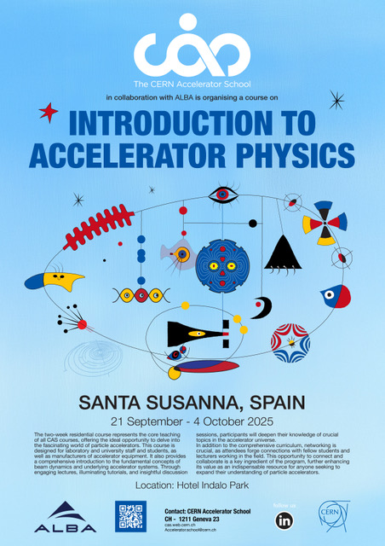
Upcoming Residential CAS Courses
Introduction to Accelerator Physics (yearly – in September)
  21 Sep – 4 Oct 2025 (Santa Susanna, Spain)
  Hands-on in transverse and longitudinal beam dynamics
Advanced Accelerator Physics (about every two years)
  10 – 22 Nov 2024 in Spa, Belgium, next in 2027
  Hands-on in RF, Beam Instrumentation and Beam Dynamics
Topical courses 2025+: Intensity Limitations in Hadron Beams, Beam Instrumentation, Medical Accelerators, FCC-ee and electron rings, …
Networking is an essential part of each CAS course!

Slide 5
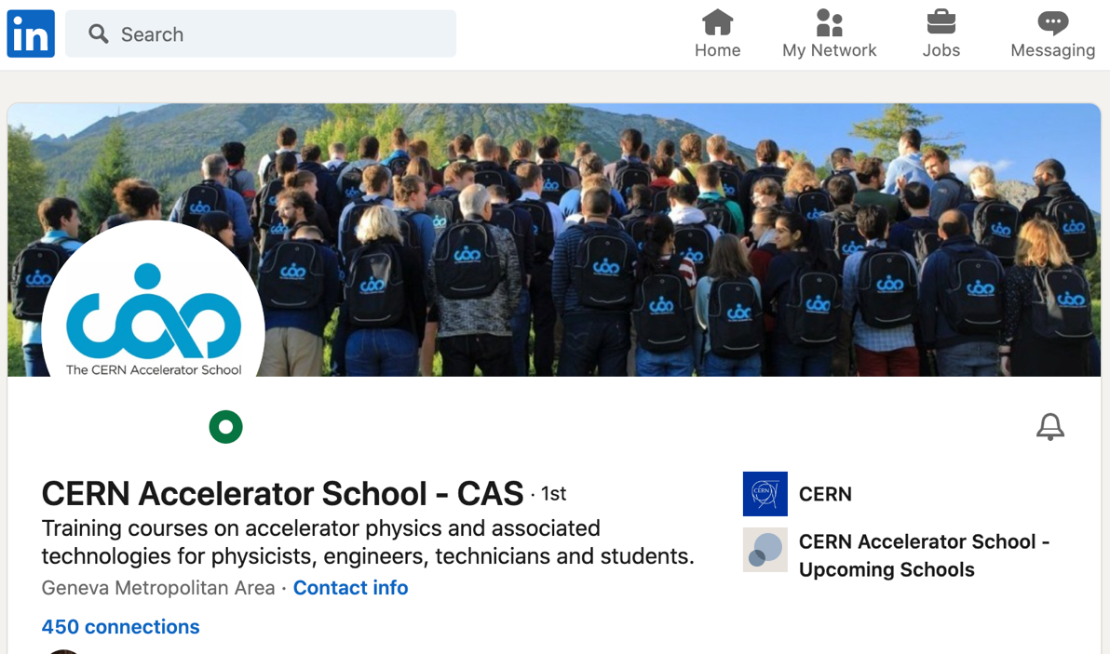
Networking
Next to the course teaching the most important aspect of the school
“digital training cannot replace CAS courses”
At residential courses:
- people socialising (and even working)
up to late in the evenings
- lots of interactions students <-> teachers
- cinema evening, karaoke CASaoke
- excursion
LinkedIn (about 9000 followers)
  From the CAS web page https://cas.web.cern.ch/
  CAS profile: https://www.linkedin.com/in/cern-cas/

Slide 6
This course
103 participants
  75 male / 28 female
  93 CERN / 10 extern
  Impressive 23 nationalities!!!
Lectures 45-50 minutes + discussion
Discussion sessions with lecturers
Lunch and coffee breaks on the other side of reception (left from coming in)
use them for networking
Welcome drink tonight!

Slide 7
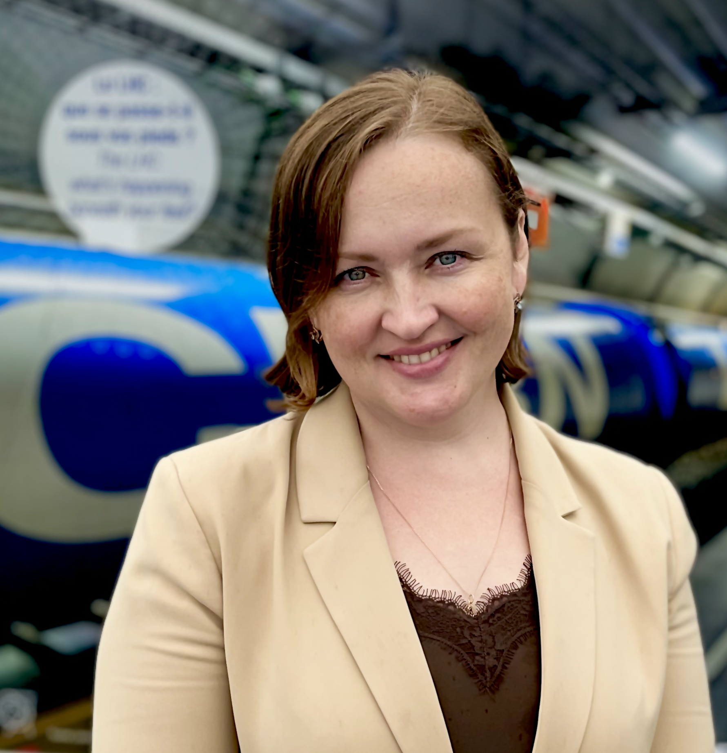
The CAS Team
  Please come and talk to any of us if you have any question / comment / request / complaint
Noemi Caraban Gonzalez
CASopedia, Social media
Christine Völlinger
Deputy Director
Maria Filippova
Administrative Assistant
Frank Tecker
Director
Delphine Rivoiron
Administrative Manager
Ron Suykerbuyk
Filming setup

Slide 8
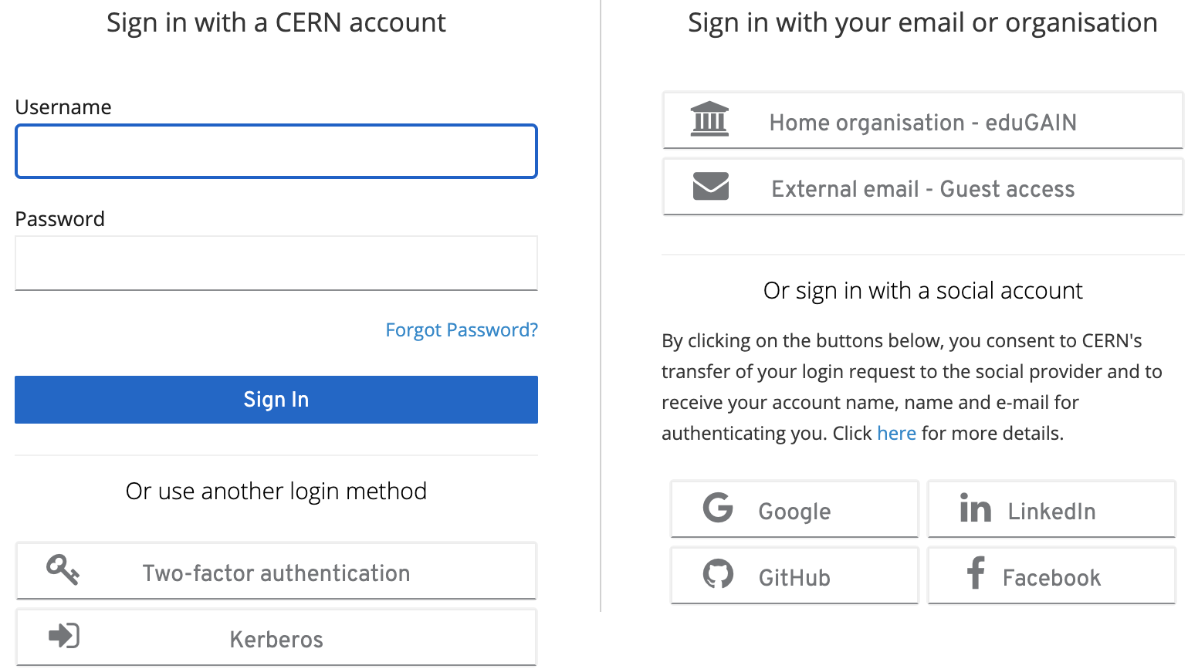
Online Evaluation Form
Important to maintain / improve the high quality of teaching
https://cas.web.cern.ch/evaluation/ferney-voltaire-2025
Log in with CERN account
or many other ways
(Google, LinkedIn, …)

Slide 9
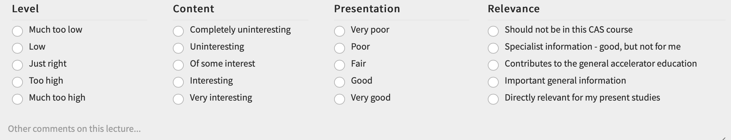

Online Evaluation Form
Please fill it in ideally daily during the course, when your memory is fresh
You can save it and come back to it later at any time
Just DON’T submit it until you have completed your evaluation at the end

Slide 10
Enjoy the course!
Basics of Accelerator Physics and Technology

