Slide 1


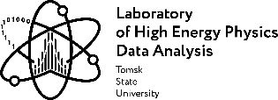
CAS SCHOOL, MARCH 2025
INTRODUCTION
TO
SPECIAL RELATIVITY
Dr. Irina Shreyber, PhD

Slide 2

Every day example:
plane, airport, bad weather
Dr. Irina Shreyber, PhD
2

Slide 3
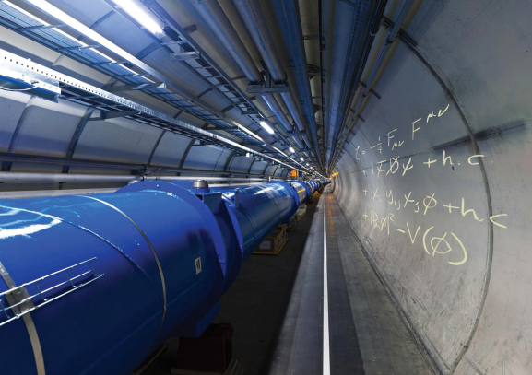
Why should engineers and technicians care about
Special Relativity?
Dr. Irina Shreyber, PhD
3

Slide 4
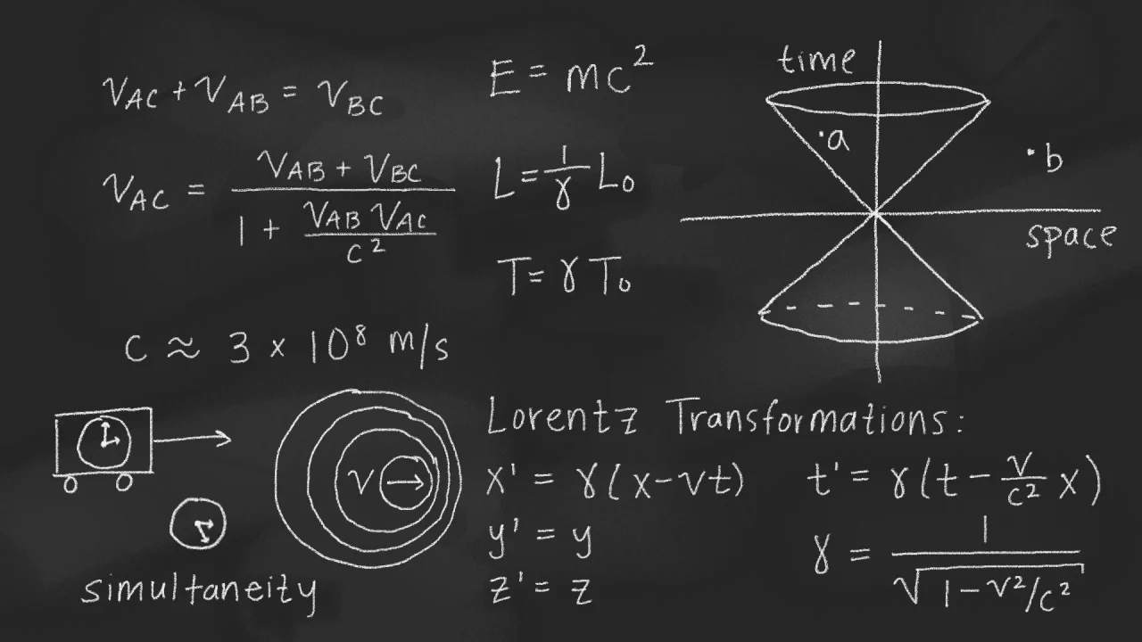
Einstein's theory from 1905 that changed how we see space and time.
Combines Newtonian mechanics with Maxwell's equations.
It shows that distance and time depend on the observer
Challenging old ideas of absolute space and time.
Motion affects how observers see space and time.
Special Relativity:
A Deeper Look at Space and Time
4
Dr. Irina Shreyber, PhD

Slide 5
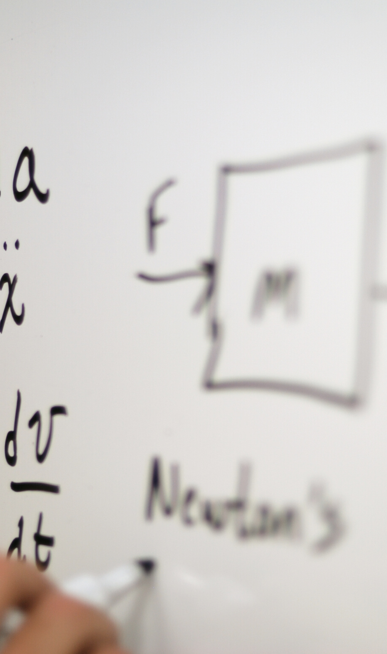
NEWTON’S PRINCIPLE OF RELATIVITY
GALILEO GALILEI IN 1632, AND LATER BY NEWTON
“The motions of bodies included in a given space are the same among themselves, whether that space is at rest or moves uniformly forward in a straight line.”
5
Dr. Irina Shreyber, PhD

Slide 6
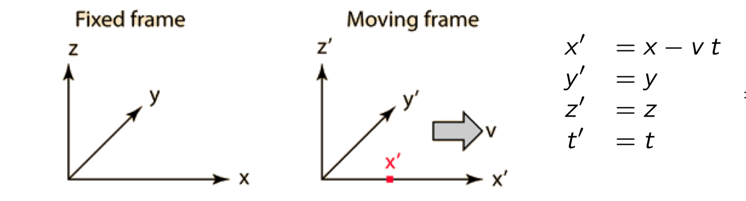

GALILEAN TRANSFORMATION
At the time of Newton the relation of the coordinates between two systems in motion with relative velocity v, was deﬁned by the Galilean transformation of motion
6
Dr. Irina Shreyber, PhD

Slide 7
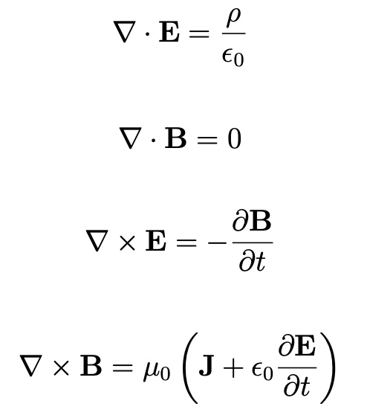

DIFFERENTIAL FORM
GAUSS’S LAW FOR E
MAXWELL EQUATIONS
GAUSS’S LAW FOR B
FARADAY’S LAW
for time-varying magnetic fields
AMPERE(-MAXWELL) LAW
for time-varying electric fields
7
Dr. Irina Shreyber, PhD

Slide 8
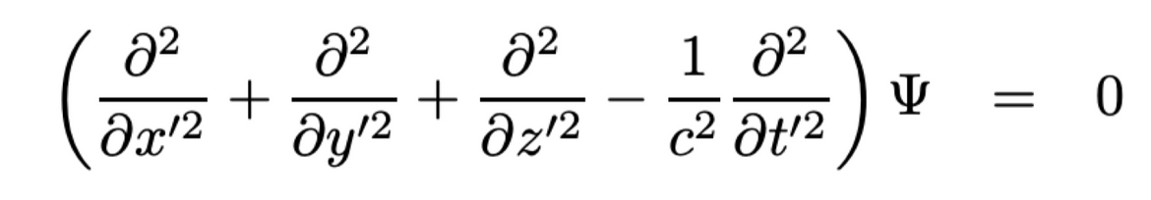
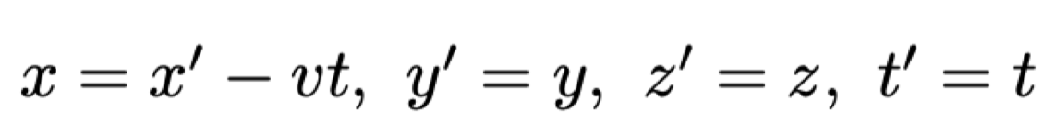
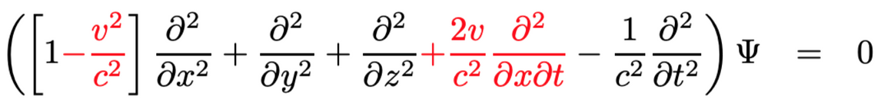
THE PROBLEM WITH GALILEAN TRANSFORMATION
Maxwell wave equation
Galilean
transformation
Maxwell wave equation
8
Dr. Irina Shreyber, PhD

Slide 9
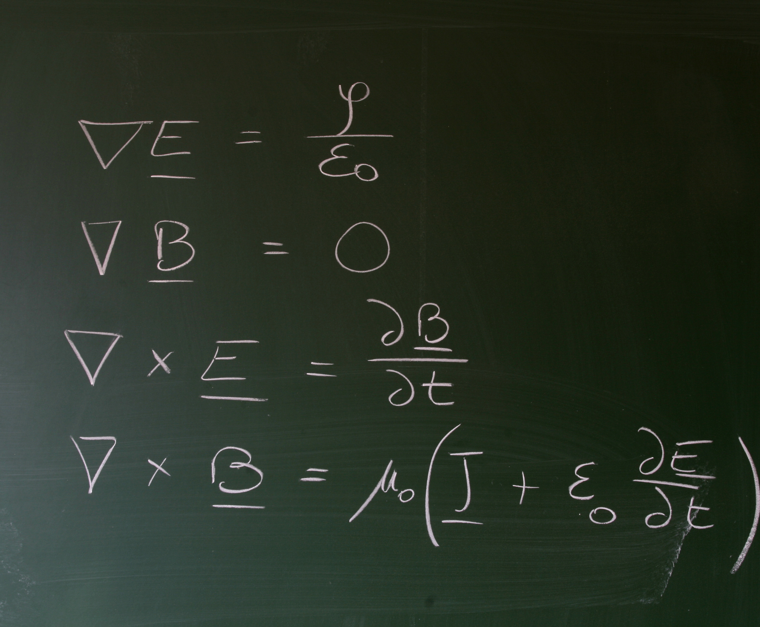
MAXWELL EQUATIONS: CONSEQUENCES
IF THERE IS A DISTURBANCE IN THE FIELD SUCH THAT LIGHT IS GENERATED, THESE ELECTROMAGNETIC WAVES GO OUT IN ALL DIRECTIONS EQUALLY AND AT THE SAME SPEED:
c = 299 792 458 m/s in vacuum ("celeritas" = speed)
IF THE SOURCE OF THE DISTURBANCE IS MOVING, THE LIGHT EMITTED GOES THROUGH SPACE AT THE SAME SPEED C.
This is analogous to the case of sound, the speed of sound waves being likewise independent of the motion of the source.
9
Dr. Irina Shreyber, PhD

Slide 10
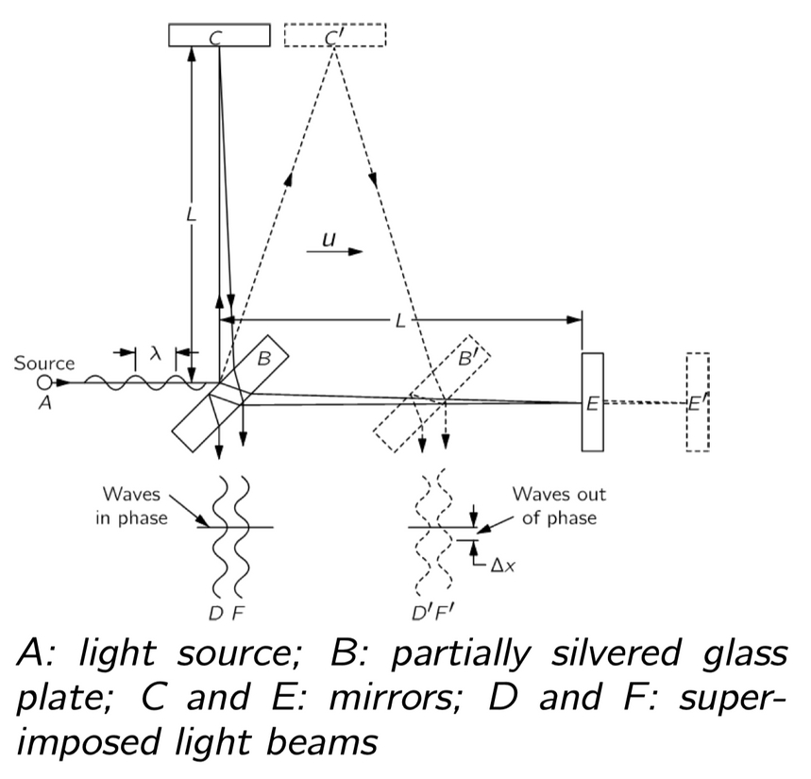
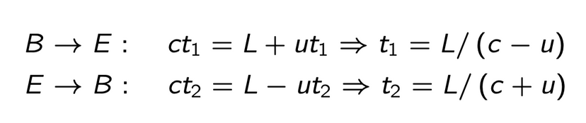
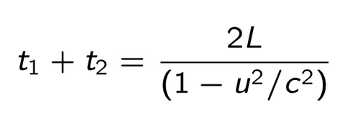
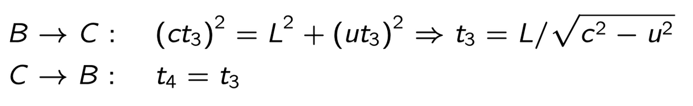
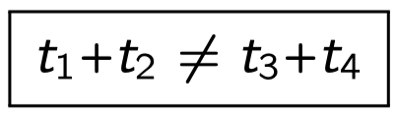
MICHELSON-MORLEY EXPERIMENT (1887)
The goal was to determine the absolute velocity of the earth through this hypothetical “ether”:
If there is an “ether drift” then
The apparatus was amply sensitive to observe such an eﬀect, but no time diﬀerence was found — the velocity of the earth through the aether could not be detected. The result of the experiment was null.
10
Dr. Irina Shreyber, PhD

Slide 11
The goal was to determine the absolute velocity of the earth through this hypothetical “ether”:
Light travels at a fixed and constant speed in any medium, regardless of the relative velocity of the light-source and the light-observer →
THIS IS UNLIKE ANY OTHER PHENOMENON DESCRIBED IN MECHANICS, AND IMPLIES THAT NEWTON'S MECHANICS IS INCOMPLETE.
THE LESSONS OF THE MICHELSON-MORLEY EXPERIMENT
Curl
Gradient
11
Dr. Irina Shreyber, PhD

Slide 12
The goal was to determine the absolute velocity of the earth through this hypothetical “ether”:
No medium is required for light to propagate; unlike a mechanical oscillatory phenomenon (wave), to exist light requires no medium to be distorted →
THIS IMPLIES MAXWELL'S EQUATIONS ARE COMPLETE
THE LESSONS OF THE MICHELSON-MORLEY EXPERIMENT
Curl
Gradient
12
Dr. Irina Shreyber, PhD

Slide 13
These lessons would not be absorbed fully until 1905, when Albert Einstein published the definitive papers explaining how to reconcile mechanics, electricity and magnetism, and the Michelson-Morley experiment
THE LESSONS OF THE MICHELSON-MORLEY EXPERIMENT
"If the Michelson–Morley experiment had not brought us into serious embarrassment, no one would have regarded the relativity theory as a (halfway) redemption."
Einstein
Curl
Gradient
13
Dr. Irina Shreyber, PhD

Slide 14
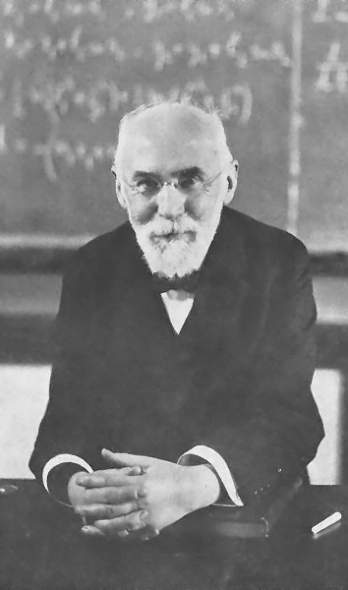
"COMPRESSION OF BODIES IN THE ETHER"
HENDRIK LORENTZ
replacement for the Galilean Relativity equations
THE EFFECTS OF THE AETHER ON BODIES IN MOTION
  ·Mechanical bodies would compress along the direction of motion in the ether, with a precise mathematical description for the process
  In transforming observations from the ether frame to other frames of reference, he would conceive of an alteration of time that also had a mathematical description
14
Dr. Irina Shreyber, PhD

Slide 15
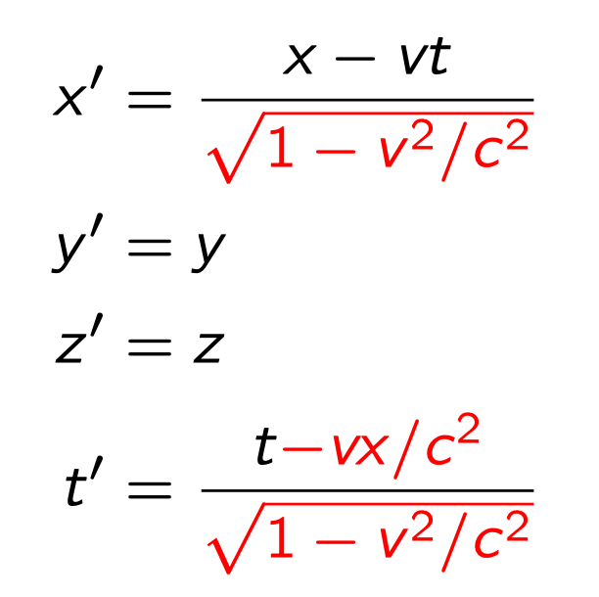
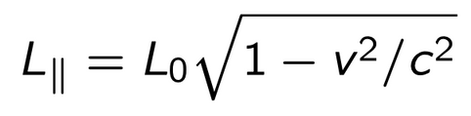
LORENTZ TRANSFORMATION
15
Dr. Irina Shreyber, PhD

Slide 16
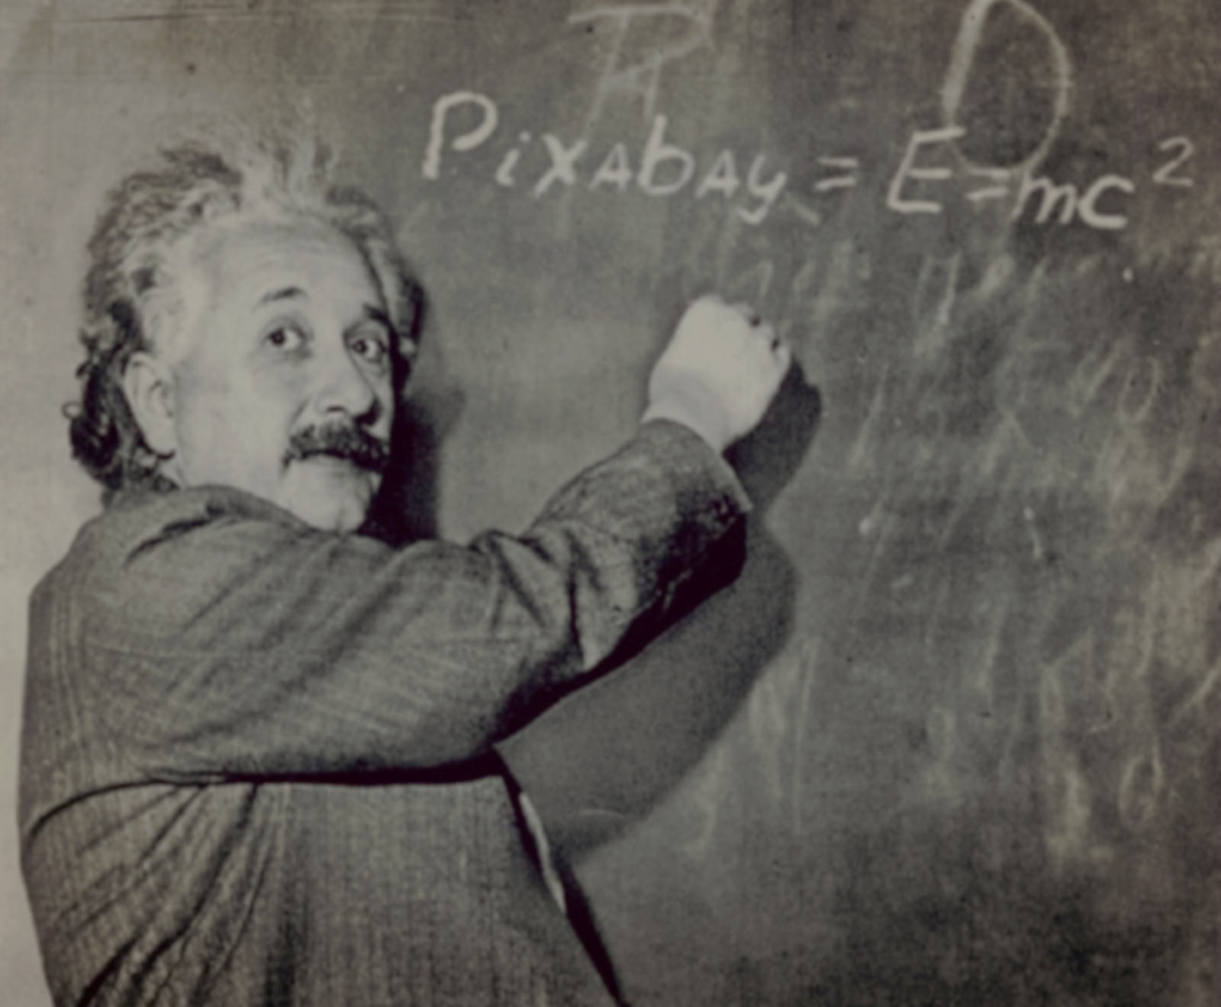
IN ALBERT EINSTEIN’S ORIGINAL TREATMENT, IN 1905, THE PRINCIPLE OF RELATIVITY IS BASED ON
TWO POSTULATES:
1. SPECIAL PRINCIPLE OF RELATIVITY:
The laws of physics are invariant (i.e. identical) in all inertial frames of reference (i.e. non-accelerating frames of reference).
EINSTEIN’S PRINCIPLE OF RELATIVITY
2. INVARIANCE OF C:
The speed of light in a vacuum is the same for all observers, regardless of the motion of the light source or observer.
16
1905, Albert Einstein, "On the Electrodynamics of Moving Bodies".

Slide 17

  "EVENT"
  "FRAME OF REFERENCE"
  "SIMULTANEITY"
  "SPEED OF LIGHT"
BREAKDOWN
THE POSTULATES
17
Dr. Irina Shreyber, PhD

Slide 18


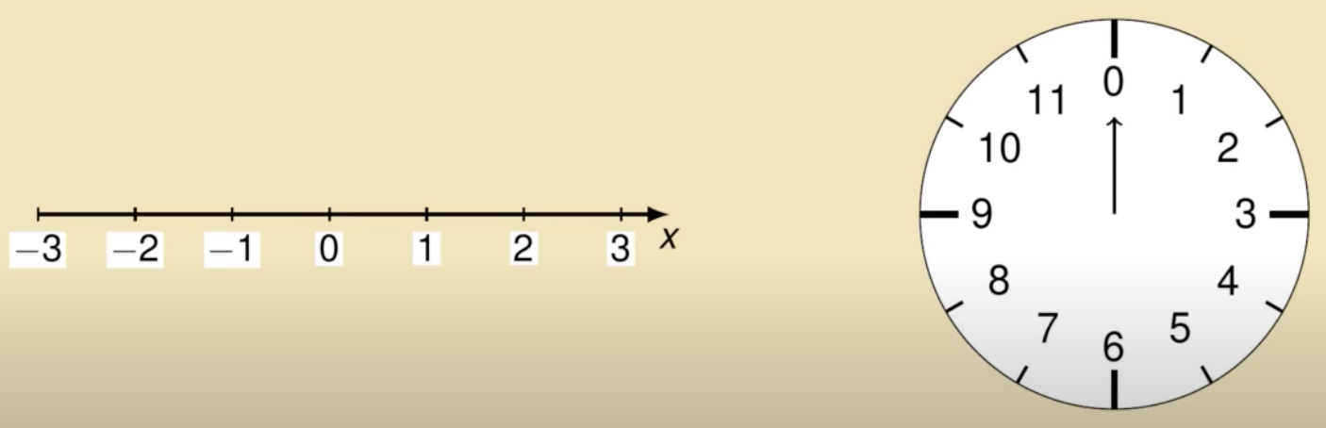
"EVENT"
IS ANYTHING WITH A LOCATION IN SPACE AND TIME
18
Dr. Irina Shreyber, PhD

Slide 19
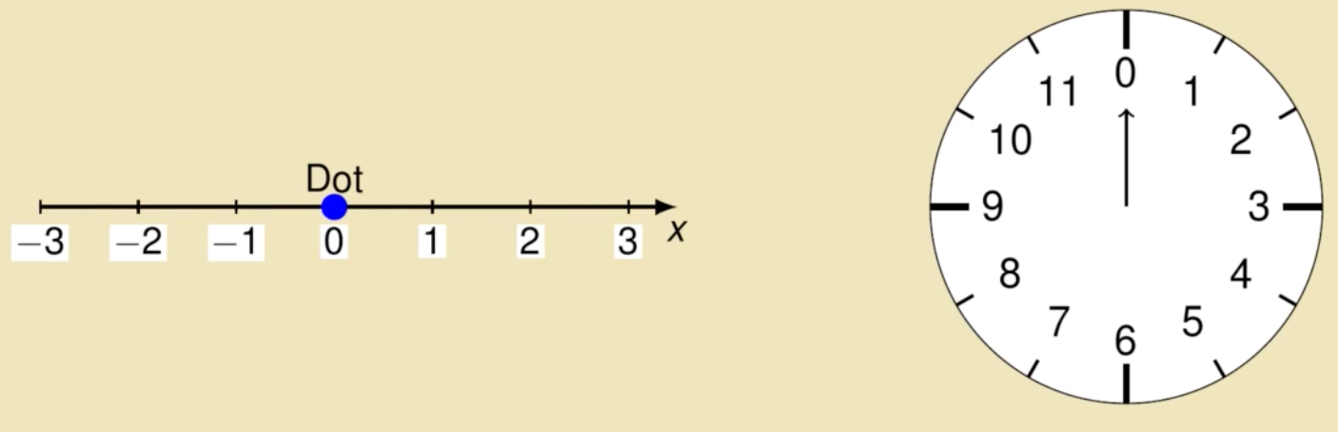
"EVENT"
IS ANYTHING WITH A LOCATION IN SPACE AND TIME
19
Dr. Irina Shreyber, PhD

Slide 20
"EVENT"
IS ANYTHING WITH A LOCATION IN SPACE AND TIME
The dot is at position x=0 m ath time t=0 s
20
Dr. Irina Shreyber, PhD

Slide 21
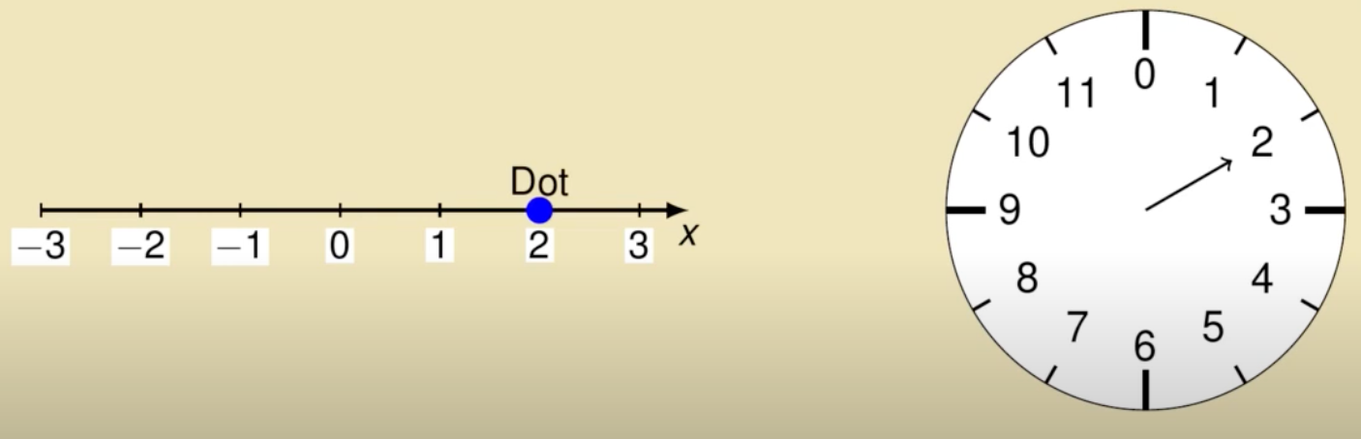
"EVENT"
IS ANYTHING WITH A LOCATION IN SPACE AND TIME
21
Dr. Irina Shreyber, PhD

Slide 22
"EVENT"
IS ANYTHING WITH A LOCATION IN SPACE AND TIME
The dot is at position x=2m ath time t=2s
22
Dr. Irina Shreyber, PhD

Slide 23



"FRAME OF REFERENCE"
IS ANY OBJECT OR SYSTEM ALL OF WHOSE PARTS MOVE AT THE SAME VELOCITY WITH RESPECT TO AN AGREED-UPON REFERENCE POINT IN SPACE.
Do the red dot and blue dot share the same or different frames of reference?
23
Dr. Irina Shreyber, PhD

Slide 24

"FRAME OF REFERENCE"
IS ANY OBJECT OR SYSTEM ALL OF WHOSE PARTS MOVE AT THE SAME VELOCITY WITH RESPECT TO AN AGREED-UPON REFERENCE POINT IN SPACE.
Do the red dot and blue dot share the same or different frames of reference NOW?
24
Dr. Irina Shreyber, PhD

Slide 25


"SIMULTANEITY"
TWO EVENTS (OR MORE) ARE SAID TO BE SIMULTANEOUS (THAT IS, TO POSSESS OF SIMULTANEITY), IF THEY ARE OBSERVED TO OCCUR AT THE SAME MOMENT IN TIME
Think really hard about
whether events are simultaneous,
and for whom
(which observers in which frames of reference) they are simultaneous.
25
Dr. Irina Shreyber, PhD

Slide 26

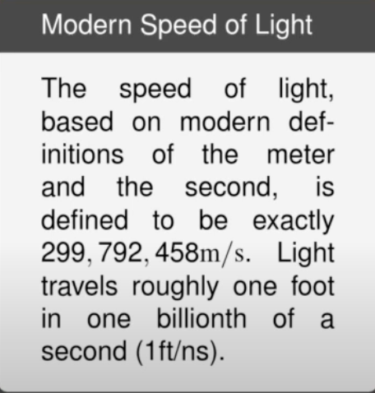
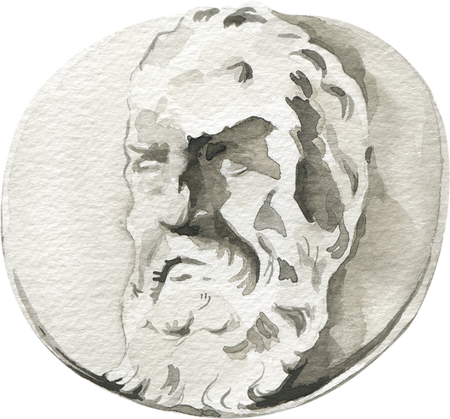
"THE SPEED OF LIGHT"
IT IS THE NUMBER OF METERS LIGHT CAN TRAVEL, ONCE EMITTED BY A SOURCE, IN A CERTAIN AMOUNT OF TIME.
Galileo Galilei: attempted to measure this by uncovering a lantern, having an assistant on a distant hill who uncovers their lantern upon seeing his, and upon seeing the assistant's lantern light he recorded the time for the round trip, taking into account human reaction time
26
Dr. Irina Shreyber, PhD

Slide 27

-21-
PROPER MASS:
mass of a body at rest
PROPER TIME:
PROPER DEFINITIONS
time as measured
in its own frame
PROPER LENGHT:
length as measured in its own frame
27
Dr. Irina Shreyber, PhD

Slide 28
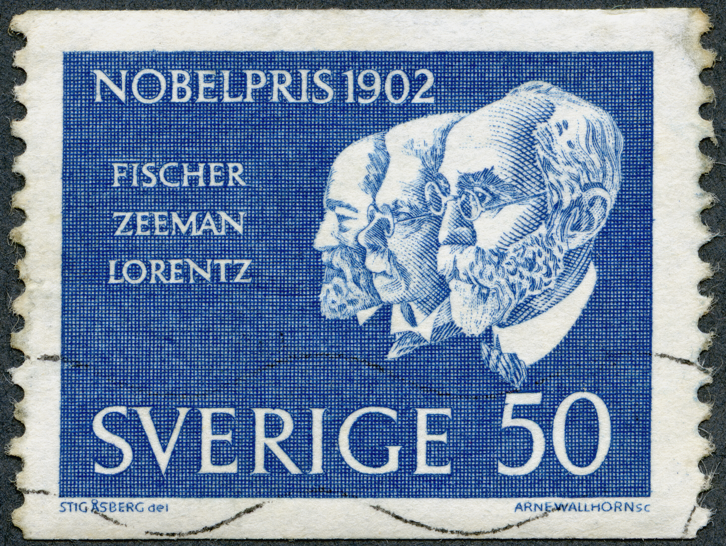
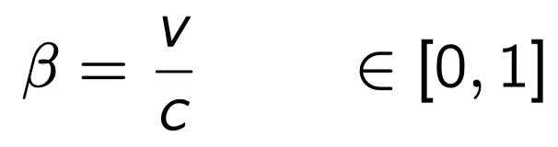
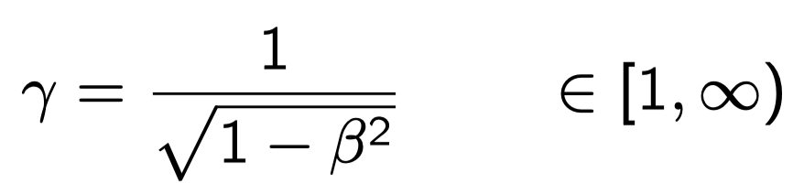
LORENTZ TRANSFORMATION
VELOCITY:
LORENTZ FACTOR:
28
Dr. Irina Shreyber, PhD

Slide 29
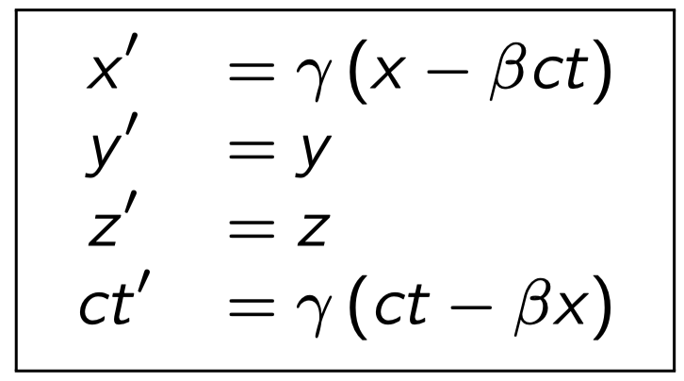
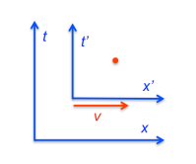
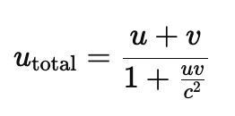
LORENTZ TRANSFORMATION
29
Dr. Irina Shreyber, PhD

Slide 30
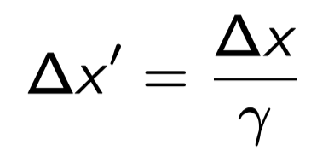
Lorentz contraction, is the solution that Lorentz proposed to solve the Michelson-Morley experiment:
is the phenomenon that a moving object’s length is measured to be shorter than its proper length, which is the length as measured in the object’s own rest frame
LENGTH CONTRACTION
30
Dr. Irina Shreyber, PhD

Slide 31
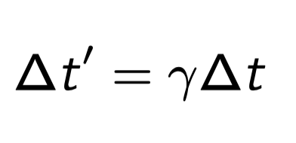
is a diﬀerence in the elapsed time measured by two clocks, due to them having a velocity relative to each other
TIME DILATION
Moving clocks appear to run slow
31
Dr. Irina Shreyber, PhD

Slide 32

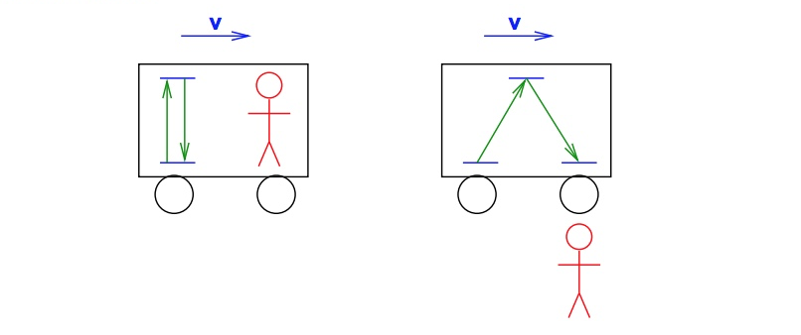
Reflection of light between 2 mirrors seen inside moving frame and from outside
TIME DILATION
Frame moving with velocity v
Seen from outside the path is longer, but c must be the same…
32
32
Dr. Irina Shreyber, PhD

Slide 33
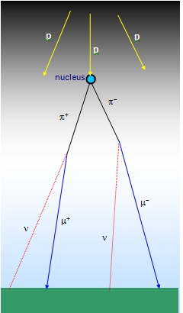
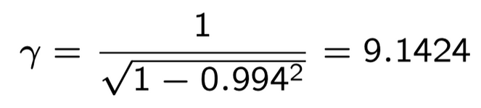
MUONS ARE FORMED IN COLLISIONS OF COSMIC RAYS WITH NUCLEI OF ATMOSPHERE’S ATOMS, AT HEIGHTS OF ABOUT 12000
  The half-life of a muon is 2.2 microseconds and so even moving at 0.994 c they would only expect to travel about 660 m before half of them decayed.
  As they are formed at 12000 m altitude it would take 40 µs, or about 20 half lives, to reach the ground.. So, they almost would not reach the ground
  But they do! This means that the muons are living longer???
  Their relativistic factor is:
Their time slows down, and 2.2 µs become about γ times longer, or Lengths contract and the 12000m become 12000/γ m.
MUON DECAY IN THE ATMOSPHERE
33
Dr. Irina Shreyber, PhD

Slide 34
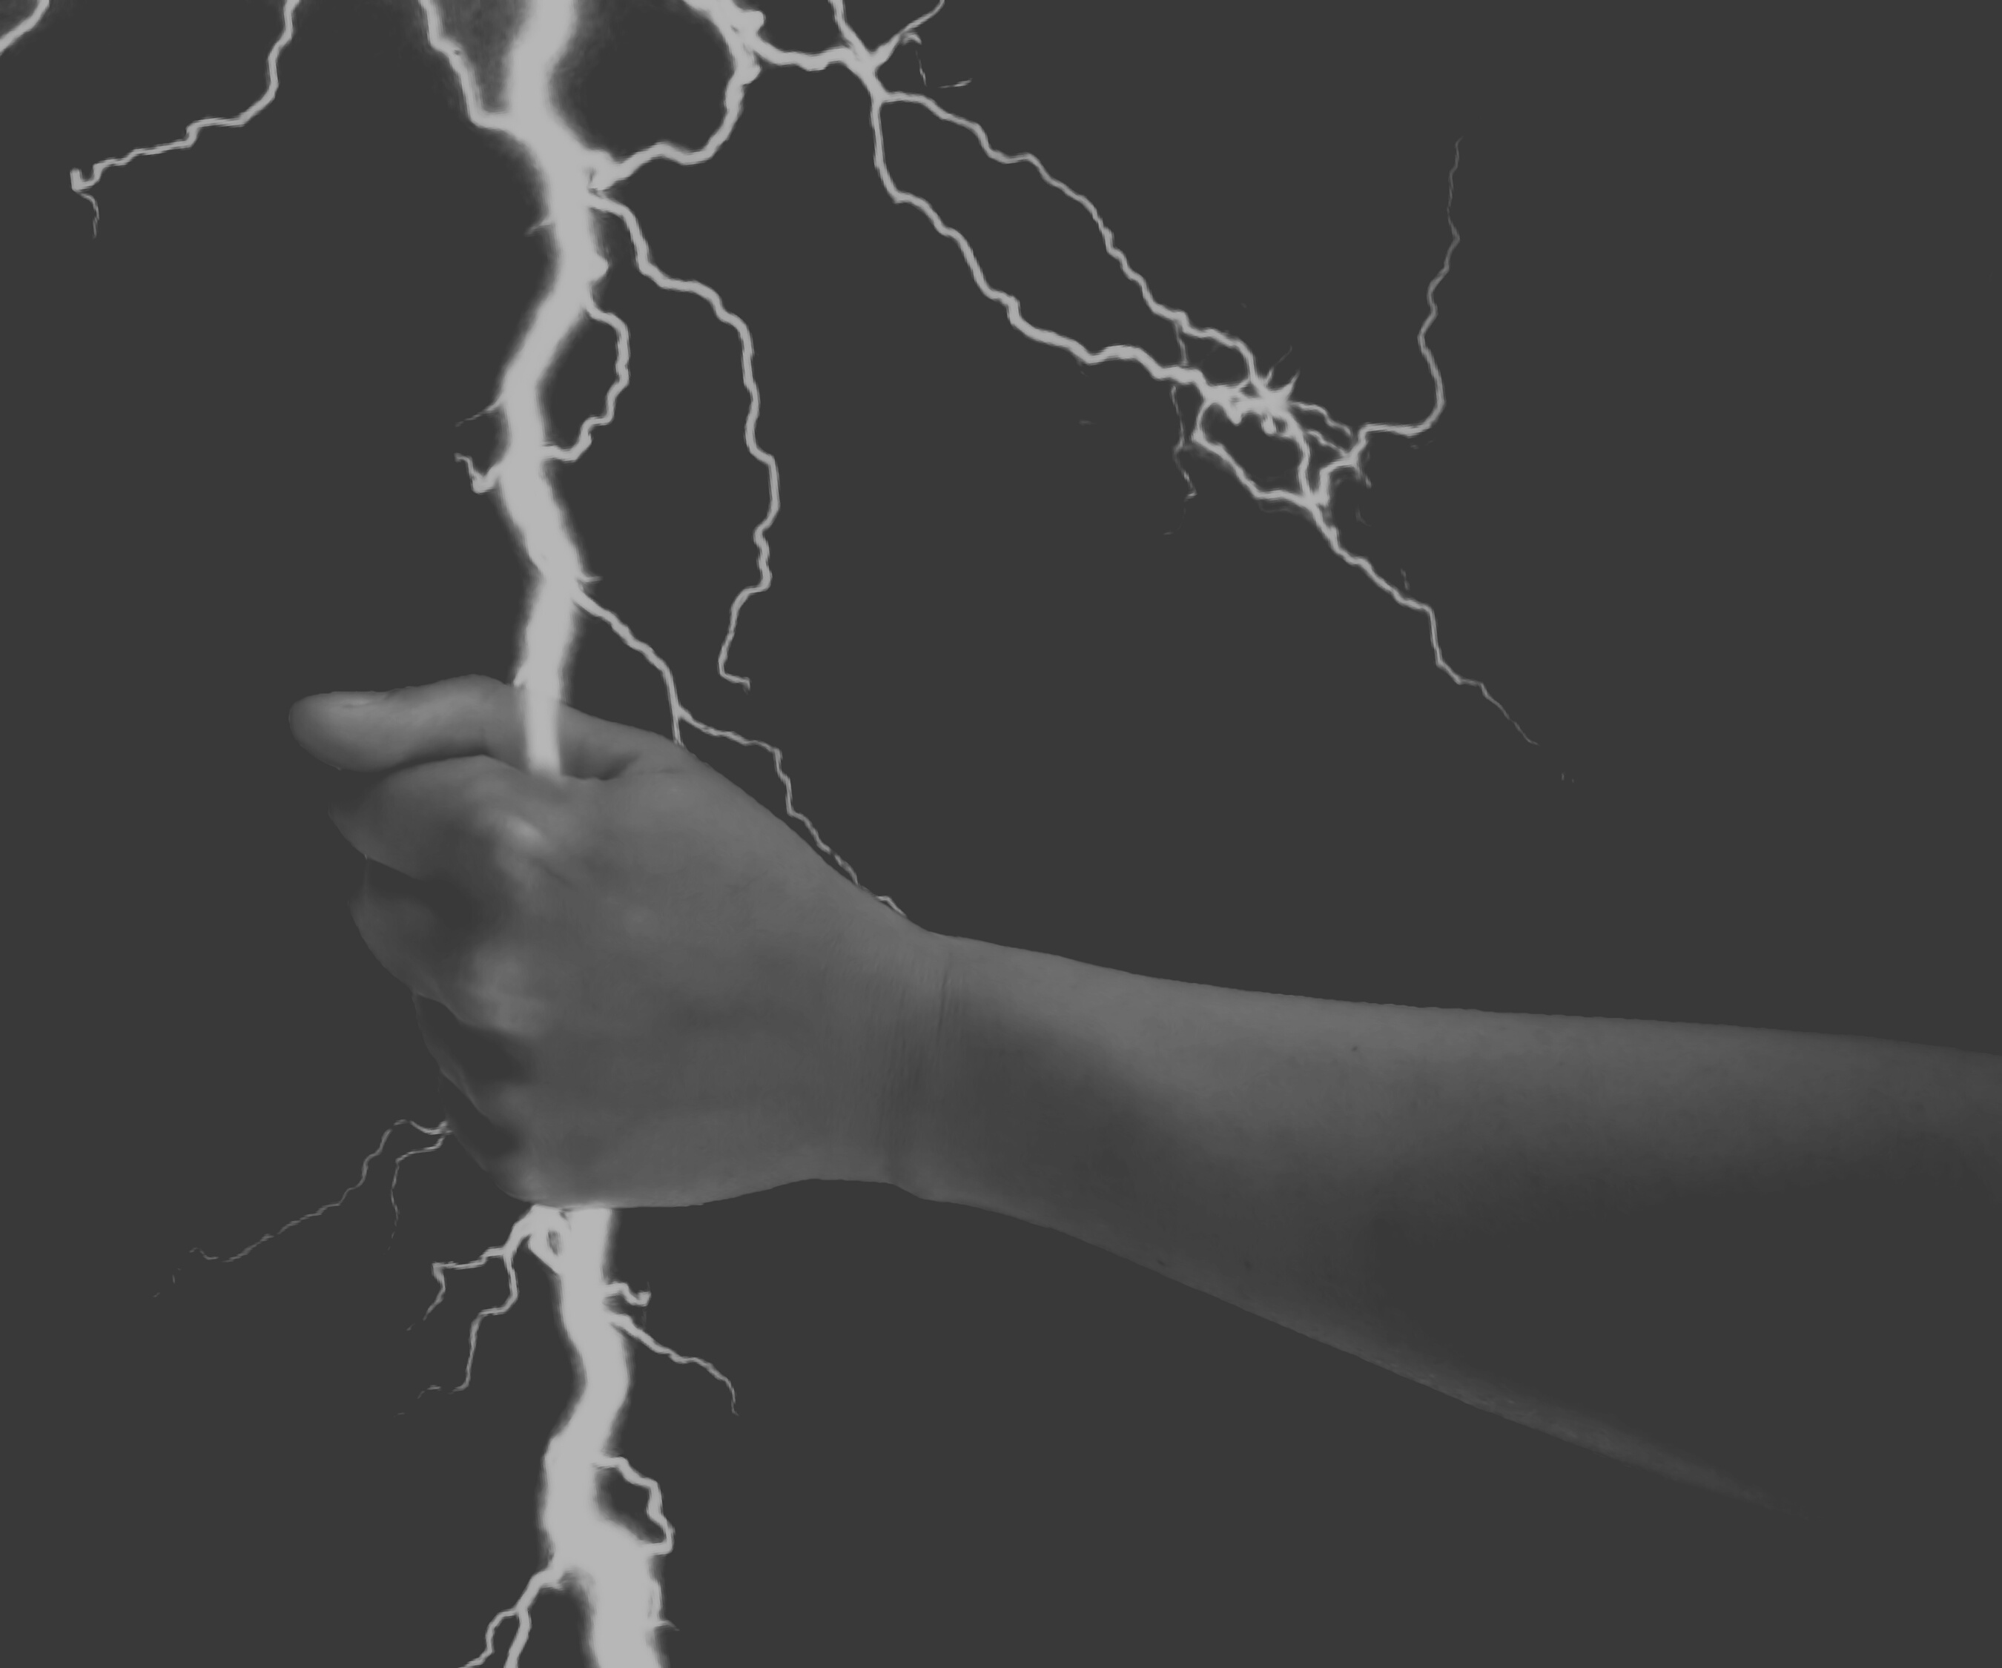
SOME CLARIFICATION
  Lorentz Contraction:
    It is not the matter that is compressed (what Lorentz thought)
    It is the space that is modified (Einstein)
  Time Dilation
    It is not the clock that is changed (what Lorentz and others thought
    It is the time that is modified (Einstein)
  EINSTEIN'S MAIN CONTRIBUTION: TO BELIEVE IT!
34
Dr. Irina Shreyber, PhD

Slide 35
EM is our first example of a field theory
IN ALBERT EINSTEIN’S ORIGINAL TREATMENT, IN 1905, THE PRINCIPLE OF RELATIVITY IS BASED ON
TWO POSTULATES:
1. SPECIAL PRINCIPLE OF RELATIVITY:
The laws of physics are invariant (i.e. identical) in all inertial frames of reference (i.e. non-accelerating frames of reference).
EINSTEIN’S PRINCIPLE OF RELATIVITY
2. INVARIANCE OF C:
The speed of light in a vacuum is the same for all observers, regardless of the motion of the light source or observer.
35
1905, Albert Einstein , "On the Electrodynamics of Moving Bodies".

Slide 36

EINSTEIN POSTULATES CONSEQUENCES:
SPECIAL PRINCIPLE OF RELATIVITY
  All physical laws (e.g. Newton's Laws or Maxwell's Equations) all have the same observed form in all inertial reference frames. This is "helpful" in that the basic laws of physics are not dependent on your state of motion.
  But as a consequence of this, it is impossible to tell from the laws of physics in your frame whether you are in motion or not.
There is no such thing as an absolute state of rest or motion - all motion is relative.
36
Dr. Irina Shreyber, PhD

Slide 37
EINSTEIN POSTULATES CONSEQUENCES:
INVARIANCE OF C
  All observers agree that light moves at a fixed speed - this is the singular invariant independent of states of relative motion;
  But as a consequence of this, the belief that time or space or both are experienced in the same way by observers in different states of motion must be abandoned.
There is no such thing as an absolute measure of time or space; measurements in one frame of reference need not agree with those in another, but all observers will agree that light signals travel at a fixed speed.
37
Dr. Irina Shreyber, PhD

Slide 38
EINSTEIN POSTULATES CONSEQUENCES
  Space and time are NOT independent quantities
  Relativistic phenomena (with relevance for accelerators):
    No speed of moving objects can exceed speed of light
    (Non-) Simultaneity of events in independent frames
    Lorentz Contraction and Time Dilation
    Relativistic Doppler effect – change in frequency (and wavelength) of light, caused by the relative motion of the source and the observer
  There are no absolute time and space, no absolute motion
Inertial system: It is not possible to know whether one is moving or not
38
Dr. Irina Shreyber, PhD

Slide 39
APPLICATION IN ACCELERATOR PHYSICS
  TIME DILATION
Relativistic Effect: Particles moving at speeds near speed of light experience slower internal clocks.
Impact:
Extended Particle Lifetimes: Unstable particles like muons, mesons live longer when accelerated, allowing for detailed study.
Design Consideration: Extended particle lifetimes improve beam stability in accelerators like the LHC.
  TIME DILATION: PROLONGED PARTICLE LIFETIMES
39
Dr. Irina Shreyber, PhD

Slide 40
APPLICATION IN ACCELERATOR PHYSICS
  LENGTH CONTRACTION
Relativistic Effect: Moving objects appear contracted along the direction of motion.
Impact:
Compressed Paths: Particles experience shorter distances inside accelerators.
Example: Particles moving near cc see the circumference of the LHC ring contracted in their frame.
Beam Compression: Bunches of particles contract, leading to better control over particle collisions.
  LENGTH CONTRACTION: SHORTENED PATH LENGTHS
40
Dr. Irina Shreyber, PhD

Slide 41
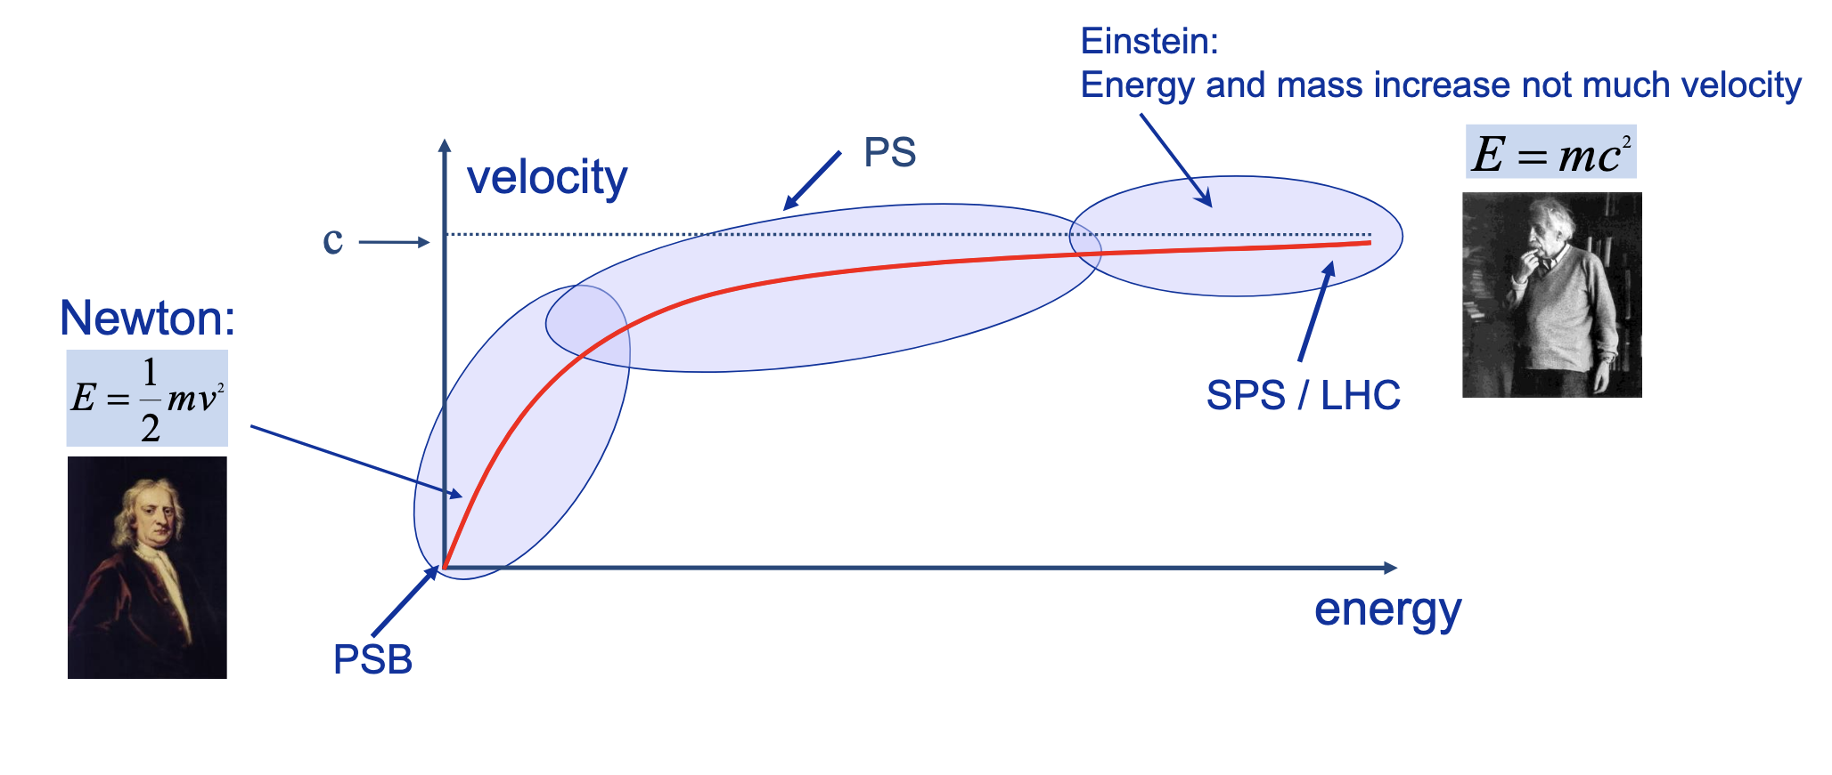
APPLICATION IN ACCELERATOR PHYSICS
  TRANSITON ENERGY
Source: Rende Steerenberg
TRANSITION ENERGY IS A DIRECT CONSEQUENCE OF RELATIVITY
41
Dr. Irina Shreyber, PhD

Slide 42
APPLICATION IN ACCELERATOR PHYSICS
Effect | Newtonian Prediction | Relativistic Reality
Particle Velocity | Increases proportionally with energy | Near cc, velocity barely changes—mass increases instead
RF Synchronization | RF timing stays the same | RF phase shift corrections required
Time Dilation | No time differences | Moving particles experience slower clocks
Beam Path & Length | Beam follows simple circular path | Beam orbit contracts in its own frame
Muon Lifetimes | Decay too fast to reach detectors | Relativity extends lifetime, allowing detection
42
Dr. Irina Shreyber, PhD

Slide 43

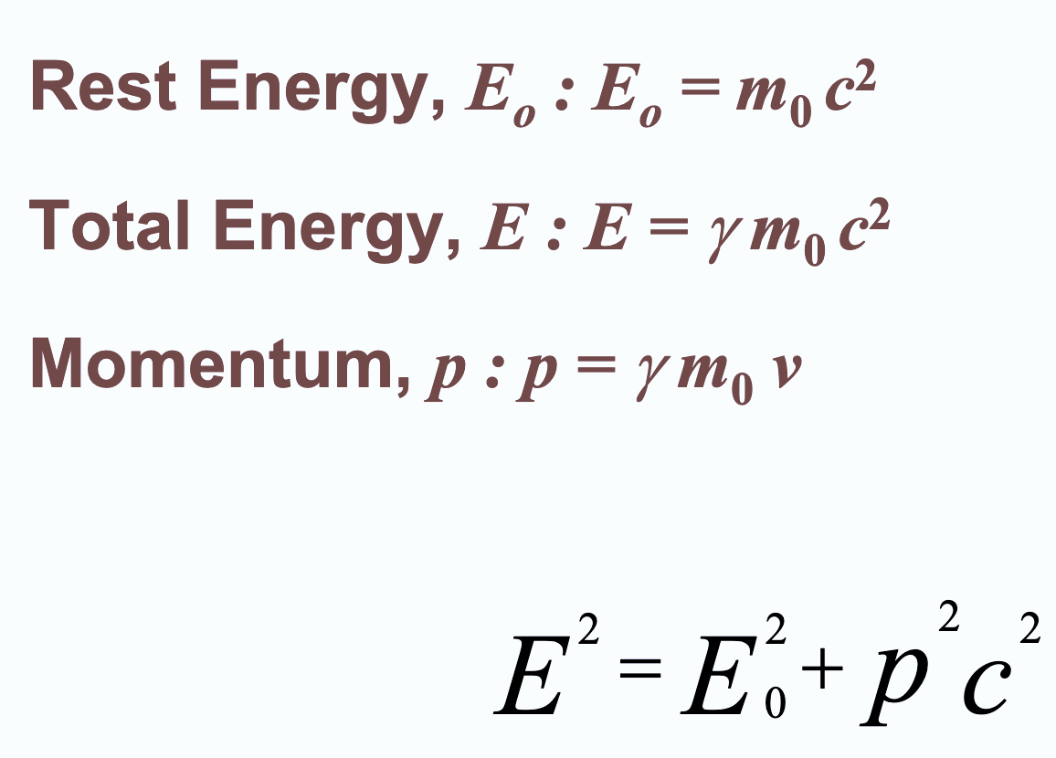
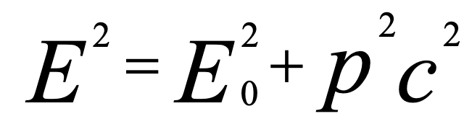
ENERGY AND MOMENTUM
Dr. Irina Shreyber, PhD
43

Slide 44
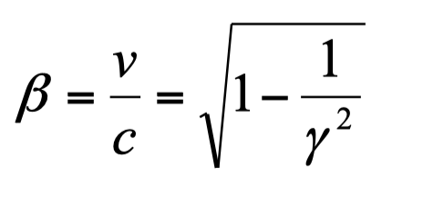
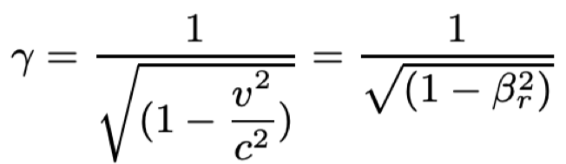
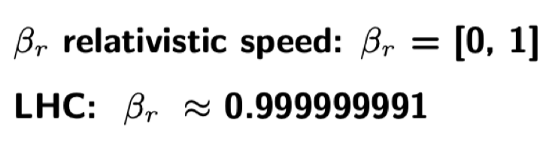
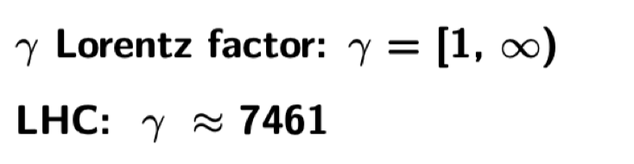
DEFINITIONS AND
PRACTICAL UNITS
44
Dr. Irina Shreyber, PhD

Slide 45
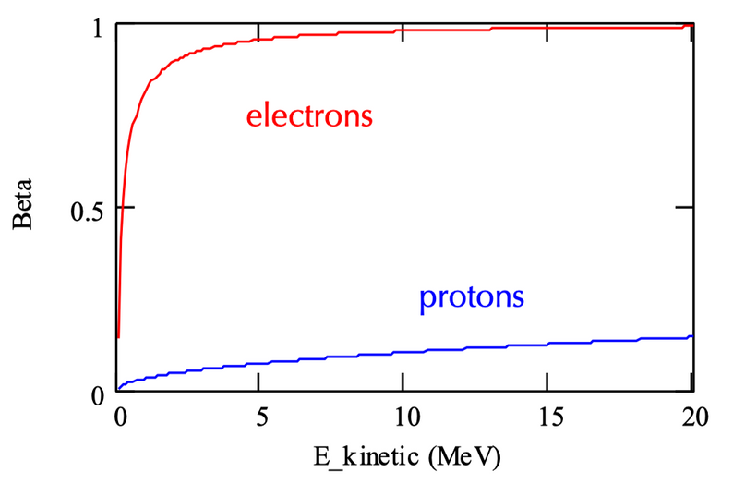
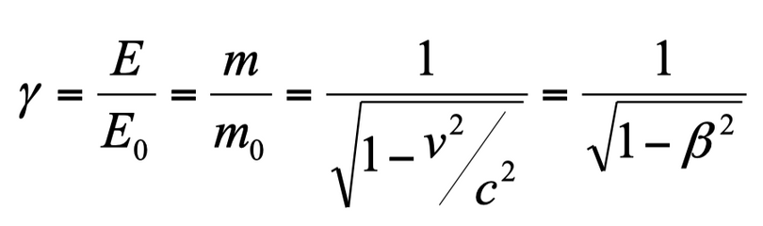
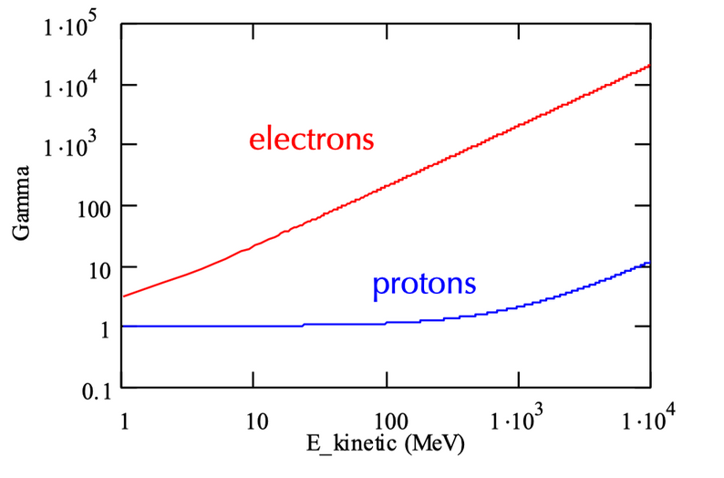
EXAMPLES
total energy
rest energy
Normalized velocity
45
Dr. Irina Shreyber, PhD

Slide 46
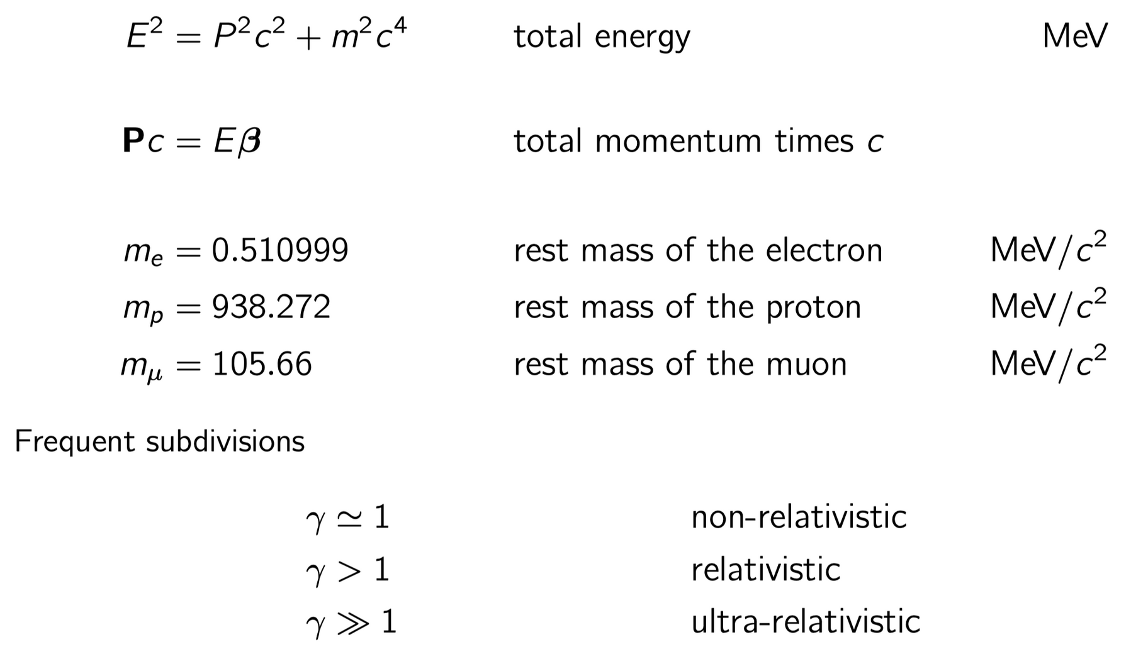
m₀²c⁴
USEFUL RELATIONS AND QUANTITIES
46
Dr. Irina Shreyber, PhD

Slide 47
EVERY DAY EXAMPLE: GPS SATELLITE
Orbital speed 14000 km/h ≈3.9 km/s
-> β ≈ 1.3x10⁻⁵, γ ≈ 1.000000000084
Small, but accumulates 7 μs during one day compared to reference time on earth!
After one day: your position wrong by ≈2 km !! (including general relativity error is 10 km per day)
Special relativity: 7μs slower, general relativity: 45 μs faster
Countermeasures:
(1) Minimum 4 satellites (avoid reference time on earth)
(2) Detune data transmission frequency from
1.023 MHz to 1.022999999543 MHz prior to launch
47
Dr. Irina Shreyber, PhD

Slide 48
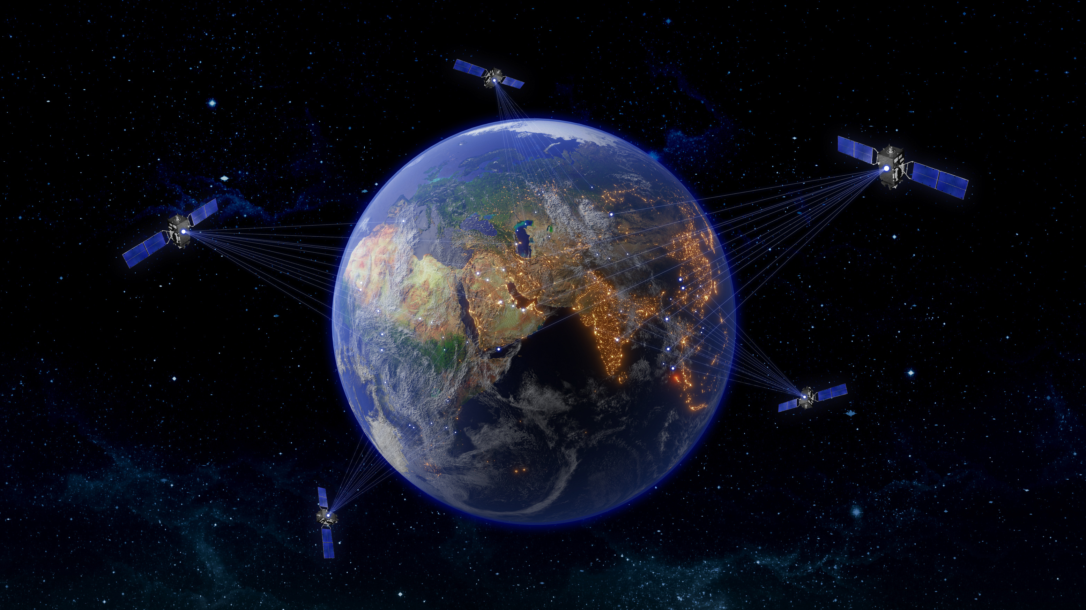
EVERY DAY EXAMPLE: GPS SATELLITE
  20’000 km above ground, (unlike popular believe: not on geostationary orbits)
  Orbital speed 14’000 km/h (i.e. relative to observer on earth)
  On-board clock accuracy 50 ns
  Navigation accuracy 15 meters
Do we correct for relativistic eﬀects ?
48
Dr. Irina Shreyber, PhD

Slide 49



THE END
Thank you for your attention!
CONTACT INFORMATION
irina.shreyber@cern.ch
https://www.linkedin.com/in/ishreyber/

